Slide 1
Biomedical Data Science:
Mining and Modeling
Deep Learning II:
Deep Supervised Learning,
Feed-forward Neural Networks, Convolutional Neural Networks, and Recurrent Neural Networks
Dr. Martin Renqiang Min
NEC Laboratories America

Slide 2
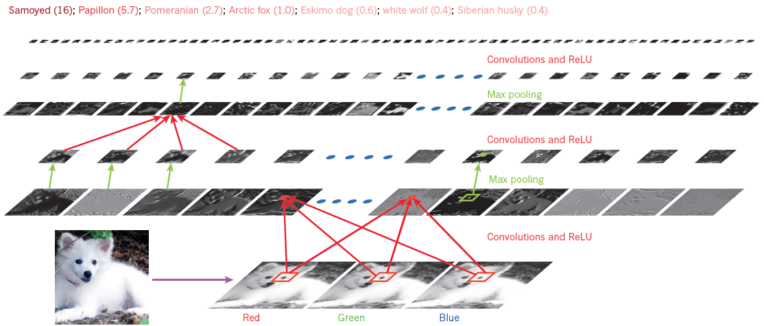
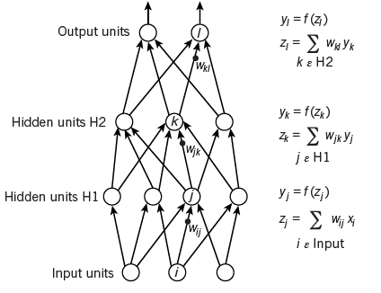
Supervised Deep Learning
LeCun, Bengio, and Hinton, Deep Learning. Nature 2015

Slide 3
Supervised Deep Learning
Supervised Machine Learning:
Feature Representation + Classification/Regression Loss + Optimization (on training data)
🡪 Prediction (on test data)
(hyper-parameter tuning with n-fold CV, n=5)
Supervised Deep Learning:
Input features and adaptively learned features by hidden layers + Mean Squared Error/Hinge Loss/Cross-Entropy Loss + SGD with Momentum (on large-scale training data) 🡪 Good Prediction Performance (on test data)
(hyper-parameter tuning on a validation set)
Test Data
Training
Validation
Training Data
Test Data
Training
Validation

Slide 4
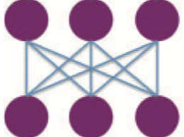
Fully Connected Layer
y
W
x
y = W x

Slide 5
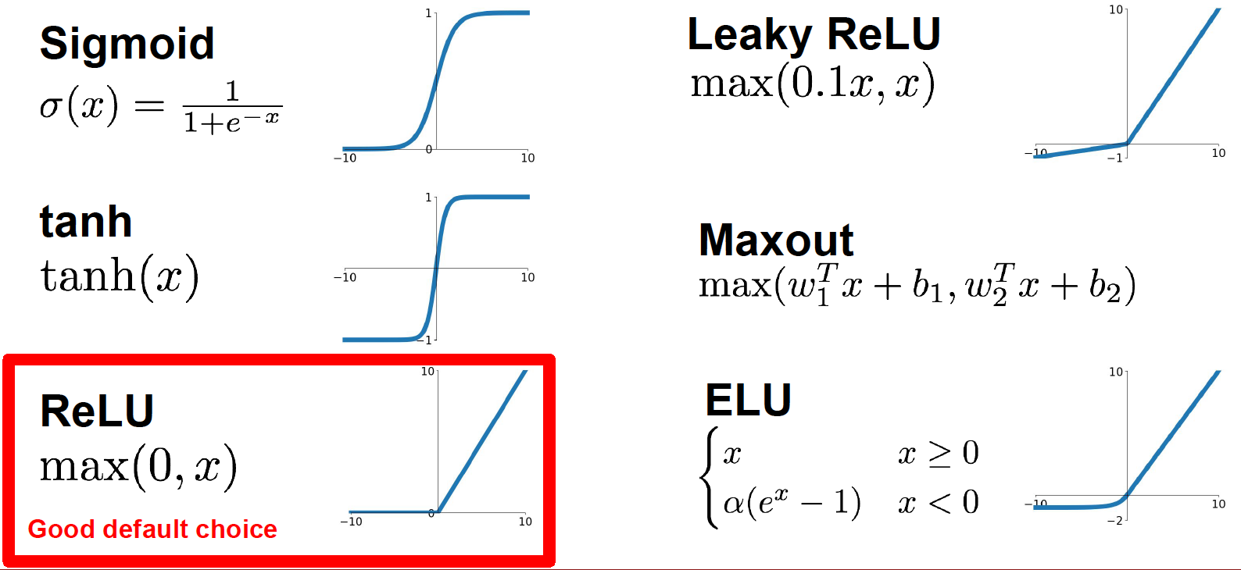
Activation Functions

Slide 6
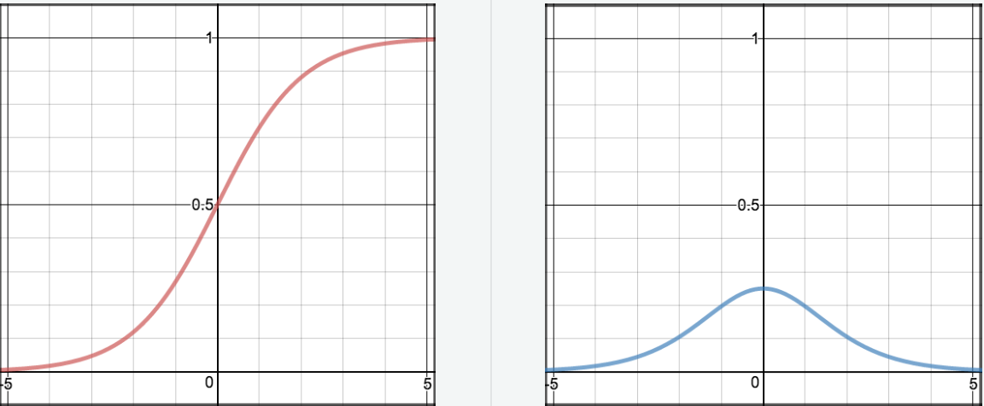
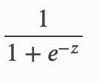
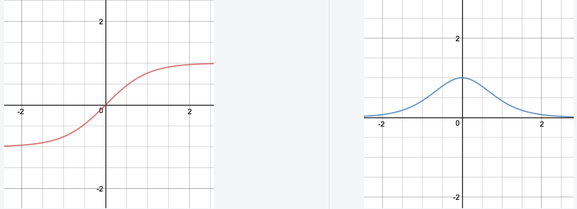
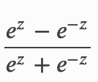
DNN with sigmoid and tanh activation functions has serious vanishing gradient and saturation issue
y
Grad = y(1-y)
y =
z
y
Grad = 1-y²
y =
z

Slide 7
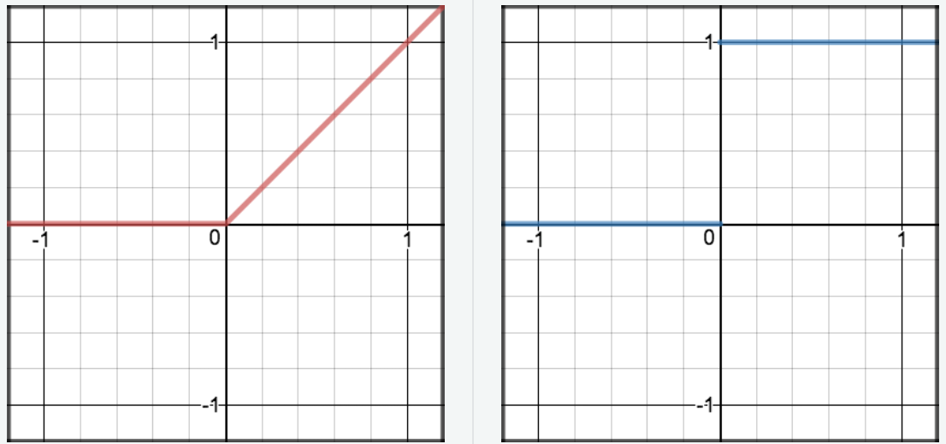
ReLU Activation Function
Avoid vanishing gradient and less computationally expensive than sigmoid and tanh
But it might cause dead neuron and the activity is not bounded above

Slide 8
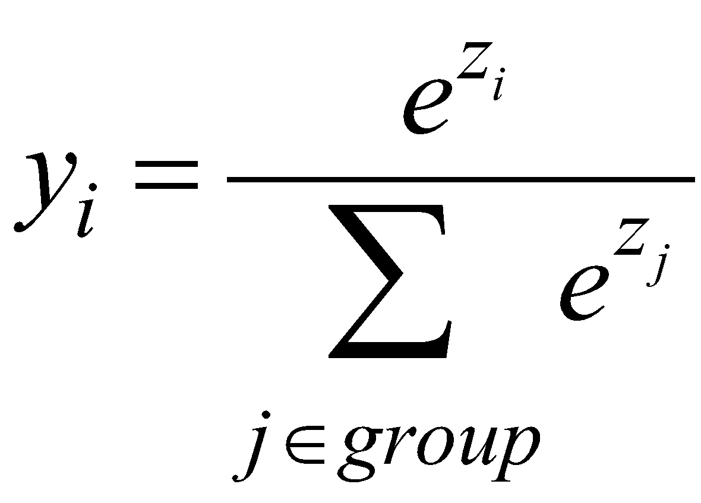
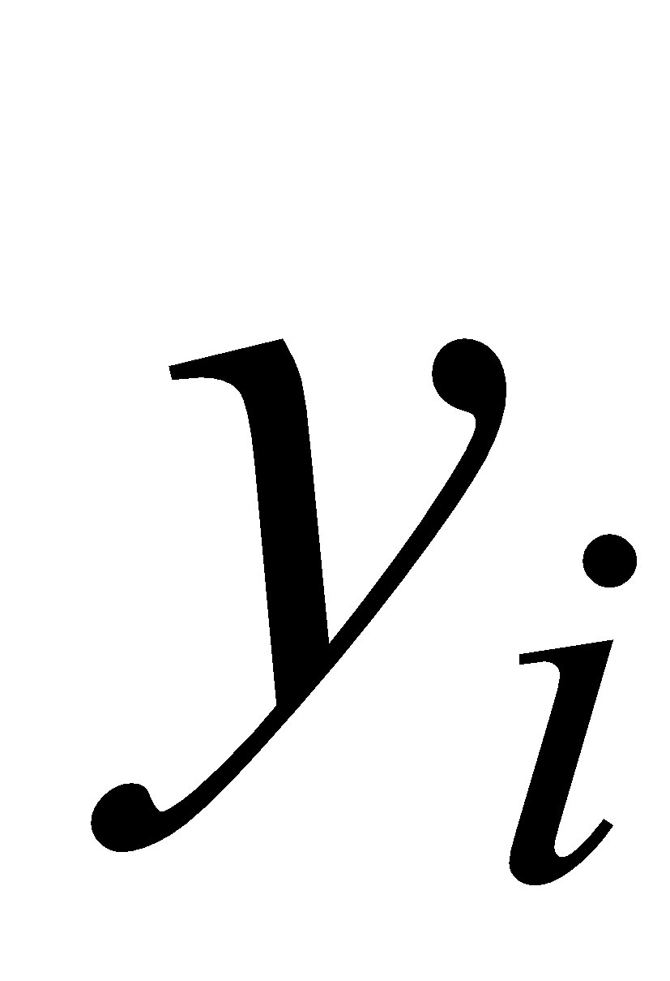
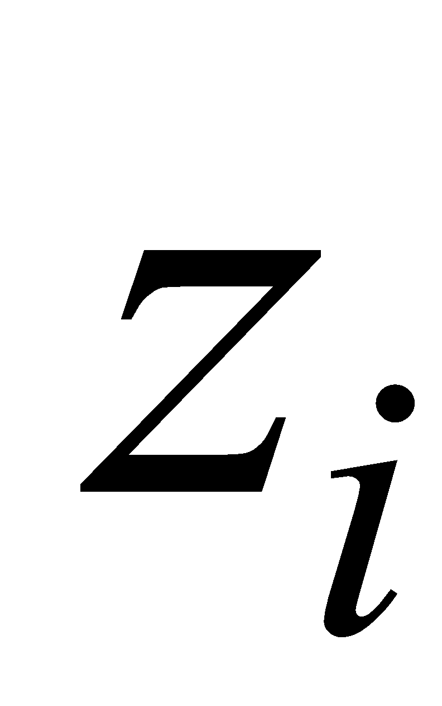
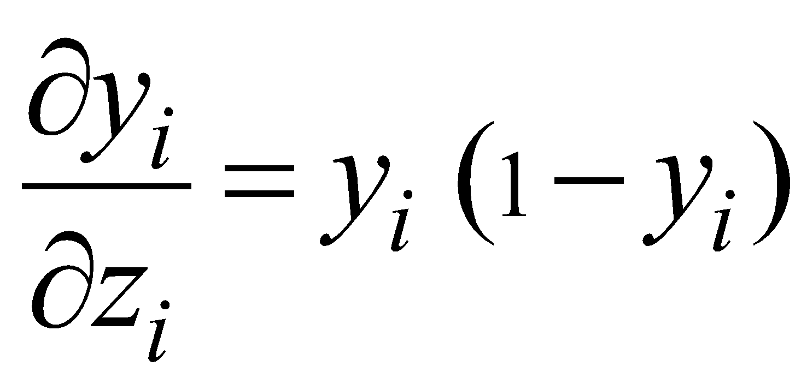
Softmax Activation Function
The output units in a softmax group use a non-local non-linearity:
softmax group
this is called the “logit”
Often used on top of a fully connected layer, which transforms an activity vector z into probabilities of classifying x into K classes

Slide 9
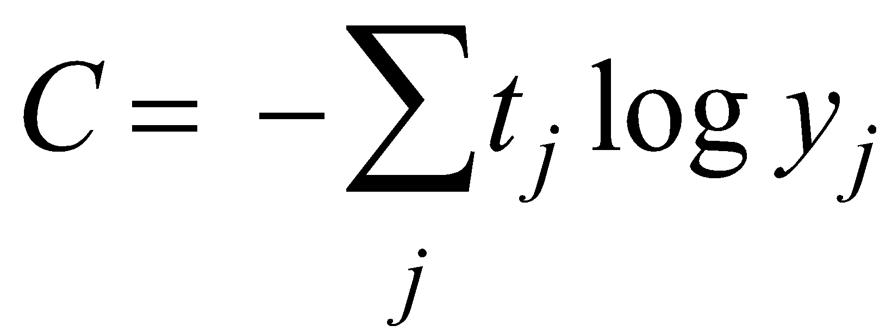
Loss Function: Cross-Entropy Loss
The right cost function is the negative log probability of the target class.
C has a very big gradient when the target value is 1 and the output is almost zero.
A value of 0.001 is much better than 0.0000001
The steepness of dC/dy exactly balances the flatness of dy/dz
Target Class
p is the positive class of i. For categorical classification, using the cross-entropy loss on top of a Softmax layer is the same as maximizing the log-probability of the correct class based on multinomial logistic regression

Slide 10
Loss Function: Mean Squared Error
MSE is a very bad cost function for softmax output units. Why?

Slide 11
Loss Function: Hinge Loss
The score for the wrong class must be at least 1 margin smaller than the score for the ground-truth class;
Otherwise, there is a loss incurred

Slide 12
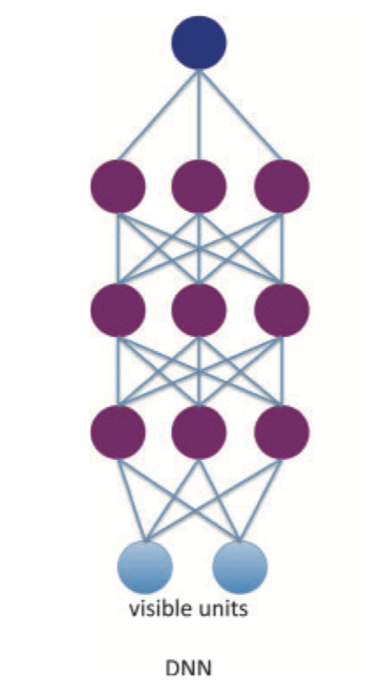
Deep Feedforward Neural Network with Sigmoid Hidden Units
y
h3
w3
h2
w2
h1
w1
x

Slide 13
Backpropagation with a Computational Graph
Loss = Squared Error
y
1.0
*
2 * (y – t)
w4
h3
σ
w3
z3
*
h2
σ
w2
z2
*
h1
σ
w1
z1
*
x

Slide 14
Train a Deep Neural Network with SGD
Split our training dataset into N mini-batches with batch size b
For Iteration = 1, …, Num_Max_Iterations
randomly choose a mini-batch D_{i}
(you can also have two loops: outer loop over epochs, inner loop over mini-batches)

Slide 15
DNN works much worse than a shallow CNN even on MNIST! ~1.0% vs. ~0.60% Why?

Slide 16
Hubel and Wiesel Experiment
https://www.youtube.com/watch?v=OGxVfKJqX5E

Slide 17
Message from Last Lecture
Deep learners should combine their knowledge with large-scale data to grow programs, encode essential knowledge into network structures, and let backpropagation and stochastic gradient descent do the heavy lifting.

Slide 18
Convolutional Neural Network: LeNet (1998)
LeCun et al., 1998

Slide 19
1D Convolution with W =5, F = 3, Stride = 2, Padding = 1
Output Size =
http://cs231n.github.io/convolutional-networks/

Slide 20
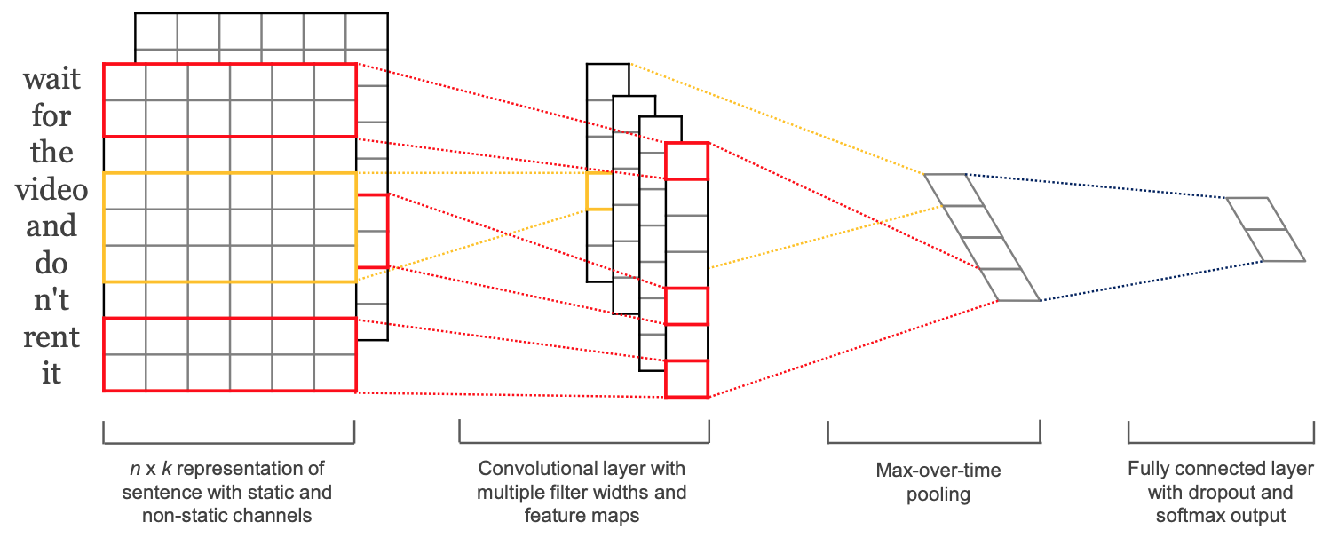
1D Convolution over Sentences
Yoon Kim, Convolutional Neural Networks for Sentence Classification. EMNLP 2014

Slide 21
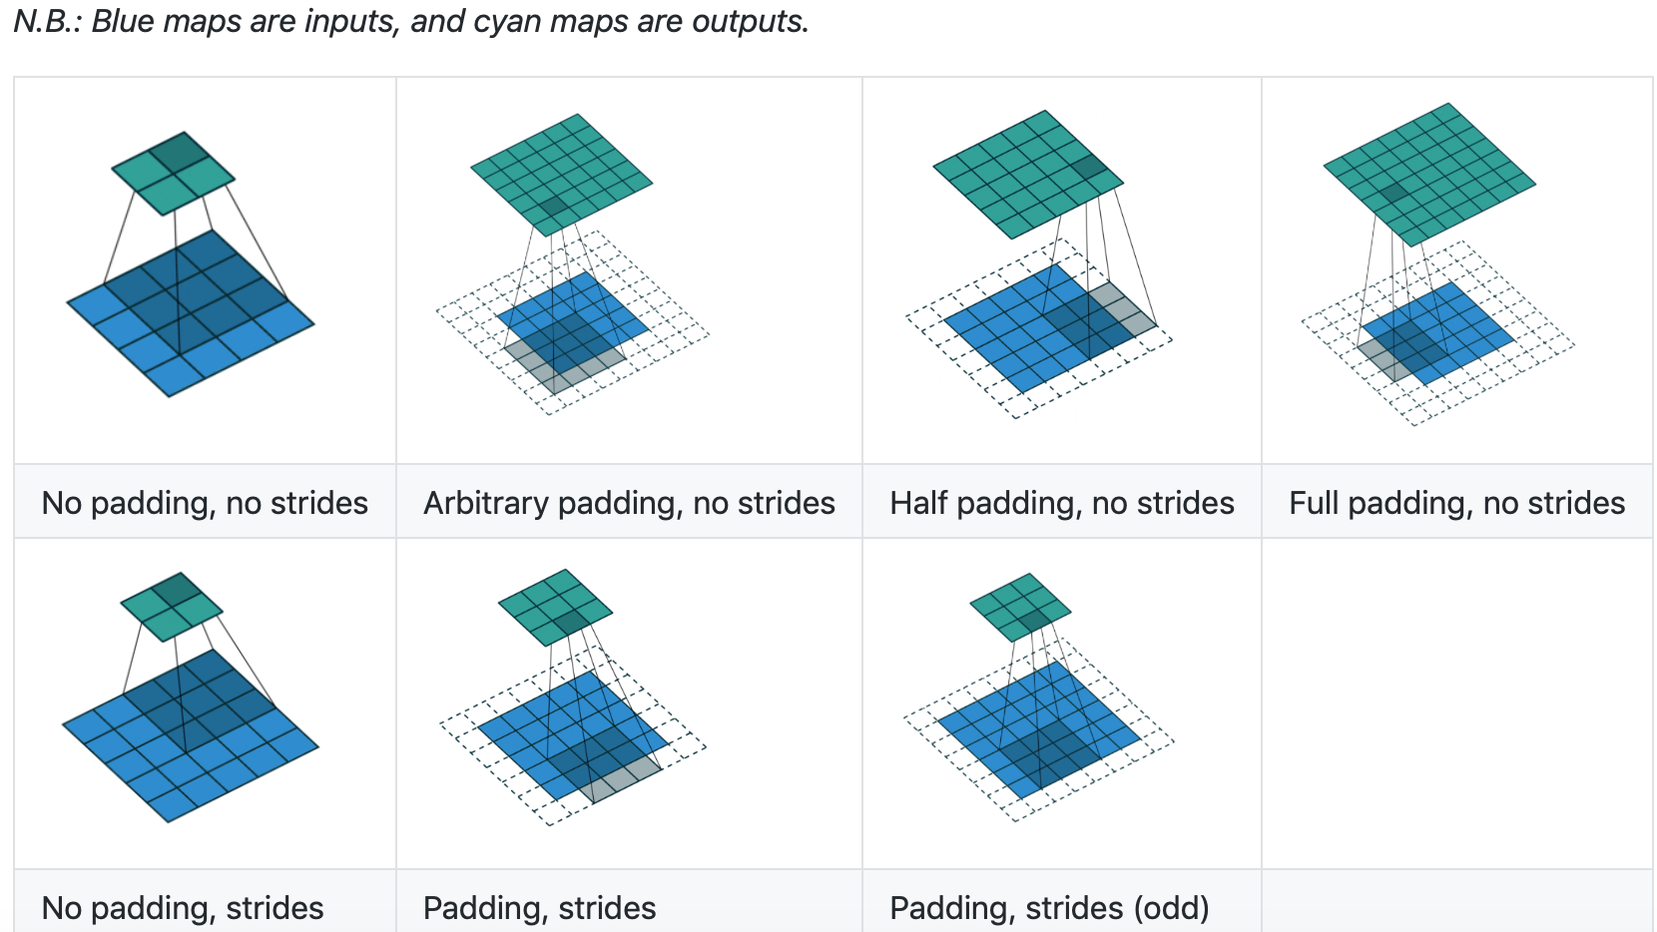
2D Convolutions
https://github.com/vdumoulin/conv_arithmetic

Slide 22
2D Convolution Animations
See the animation at
https://github.com/vdumoulin/conv_arithmetic

Slide 23
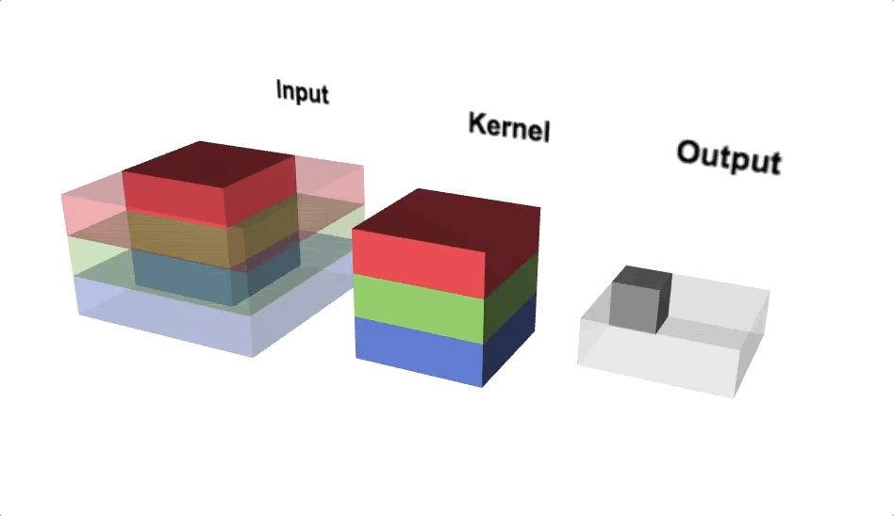
2D 3x3 Convolution Applied to RGB Input of Size 5x5
Picture credit: https://thomelane.github.io/convolutions/2DConvRGB.html

Slide 24
2D Convolutions in Numbers
http://cs231n.github.io/convolutional-networks/

Slide 25
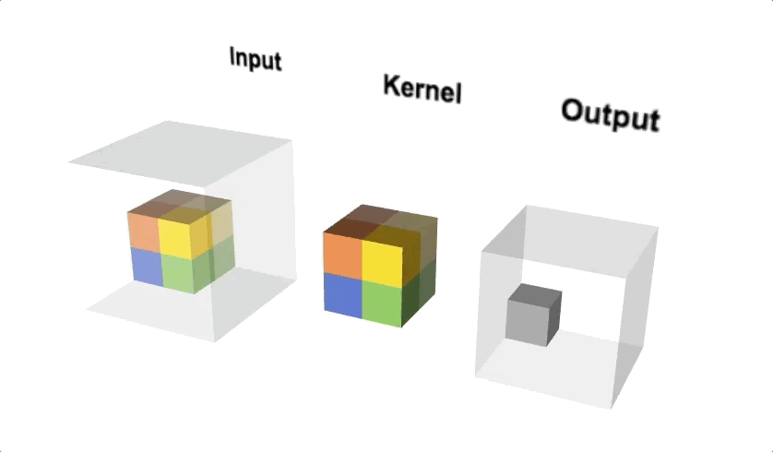
3D Convolution
Picture credit: https://thomelane.github.io/convolutions/3DConv.html

Slide 26
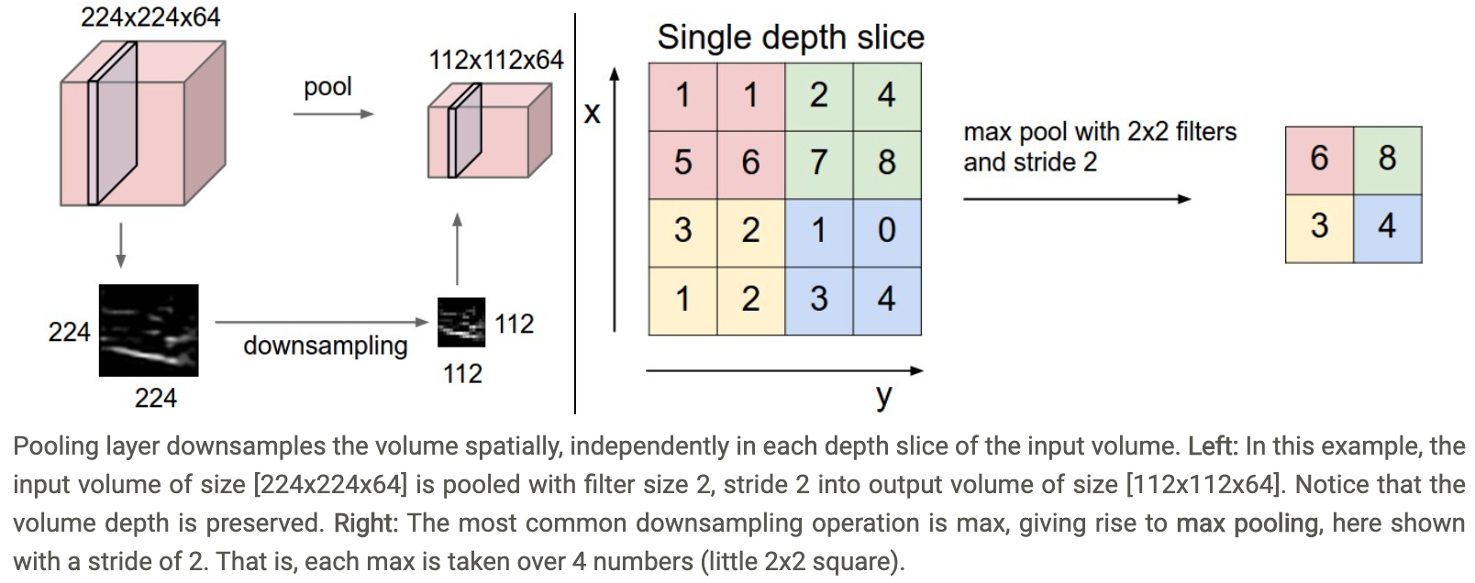
Max Pooling
http://cs231n.github.io/convolutional-networks/
Average Pooling is also widely used, especially in NLP

Slide 27
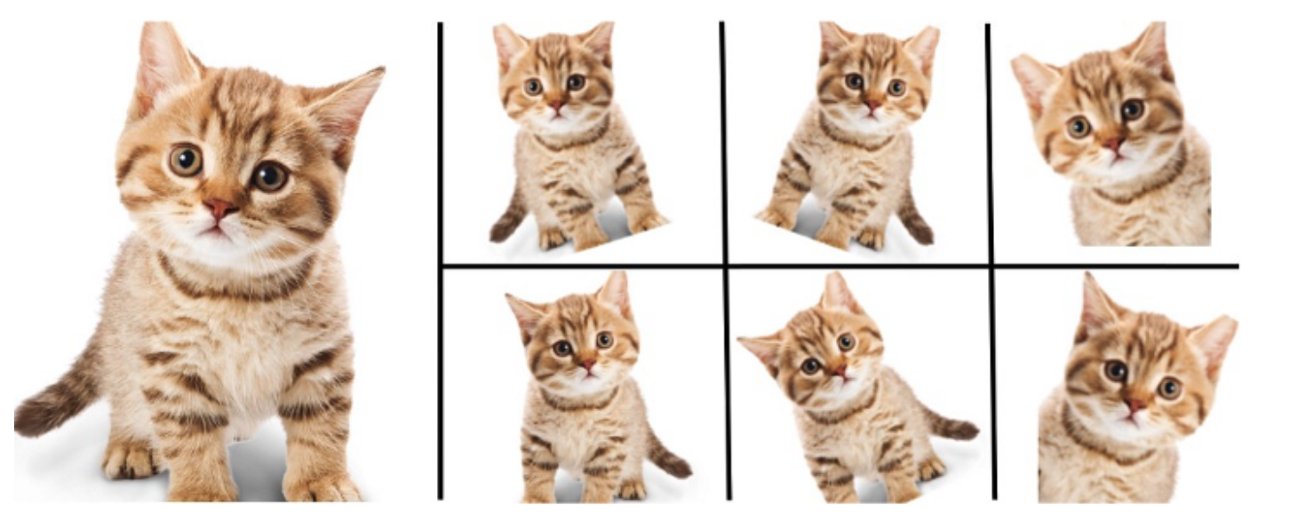
Data Augmentation
Random erasing, horizontal flipping, rotation, scaling (with cropping), cropping, contrast, color
Picture credit: https://nanonets.com/blog/data-augmentation-how-to-use-deep-learning-when-you-have-limited-data-part-2/

Slide 28
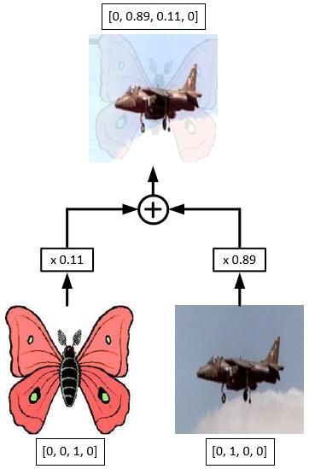
Mixup
Zhang et al., Mixup: beyond empirical risk minimization.
ICLR 2018.
Picture credit: https://www.dlology.com/blog/how-to-do-mixup-training-from-image-files-in-keras/

Slide 29
Case Study: AlexNet
NIPS 2012

Slide 30
AlexNet Network Structure
Pay attention to the output Size and the number of parameters

Slide 31
Training AlexNet using SGD with Momentum and Weight Decay

Slide 32
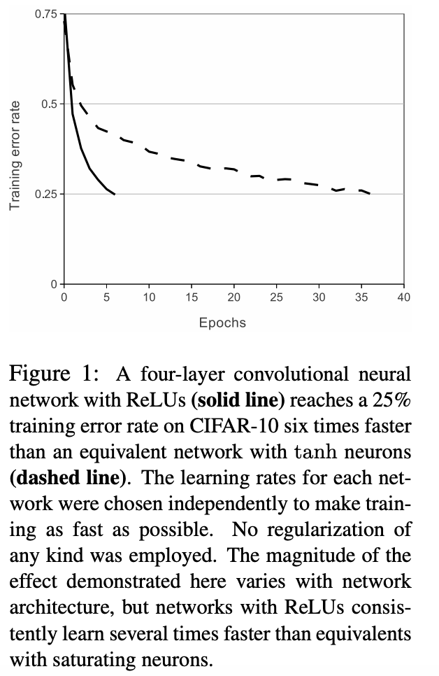
AlexNet with ReLU Converges Much Faster

Slide 33
AlexNet vs. VGG
Picture Credit: Fei-Fei, Johnson, and Yeung, Stanford cs231n, 2019

Slide 34
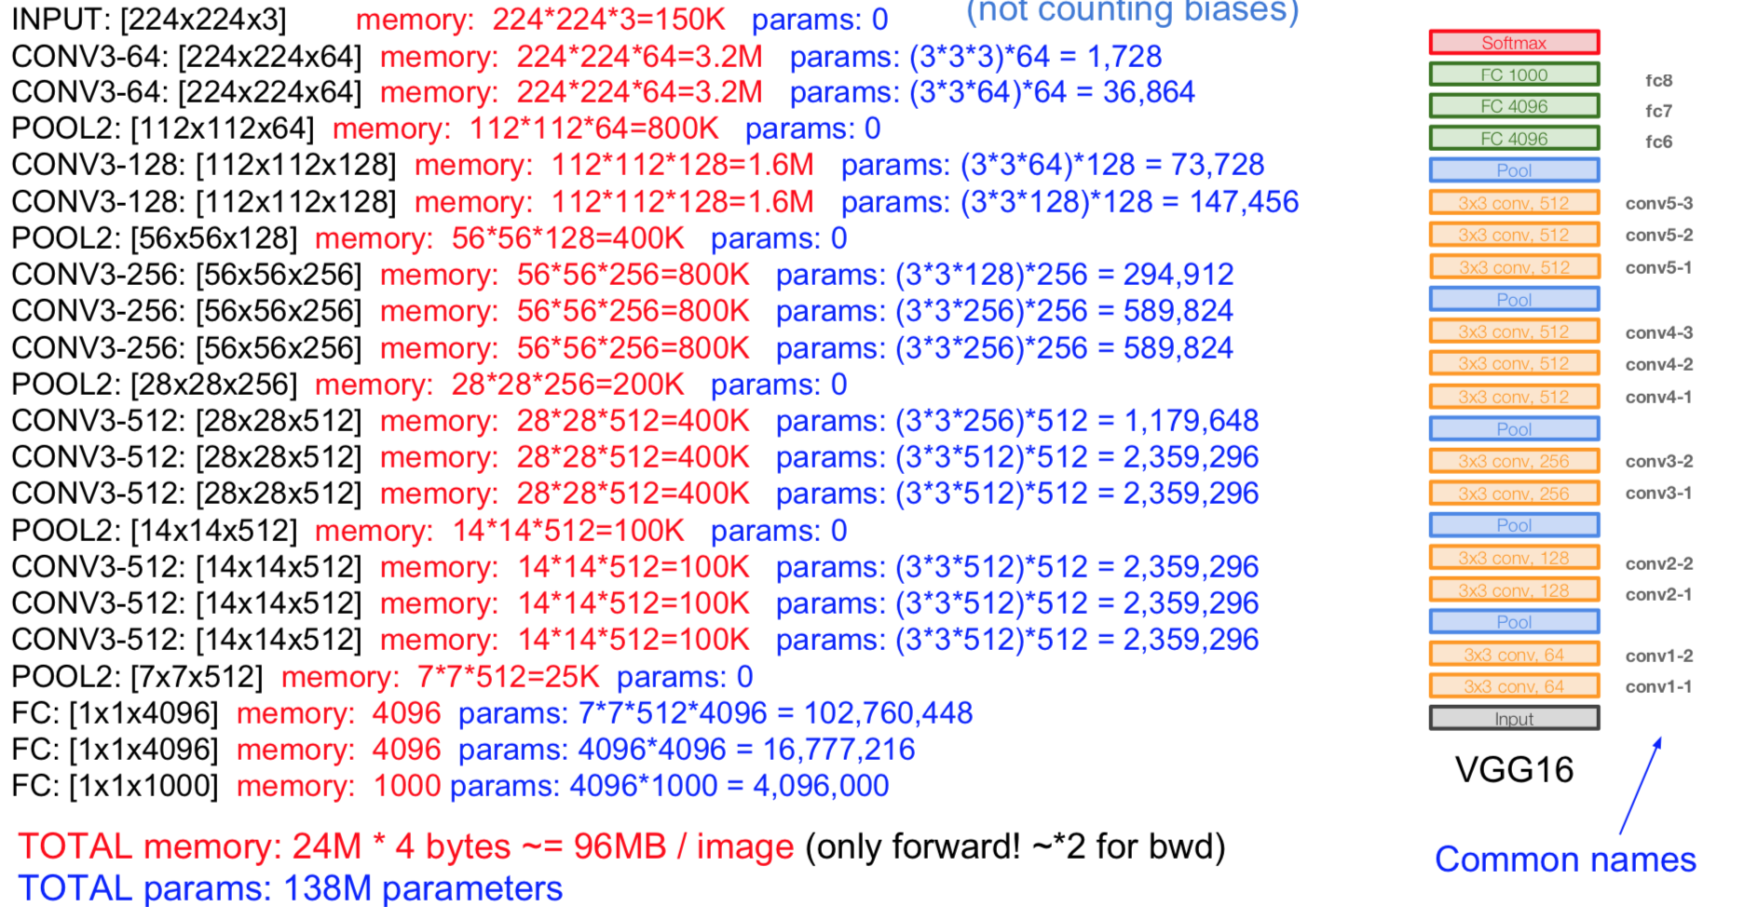
VGG
Fei-Fei, Johnson, and Yeung, Stanford cs231n, 2017

Slide 35
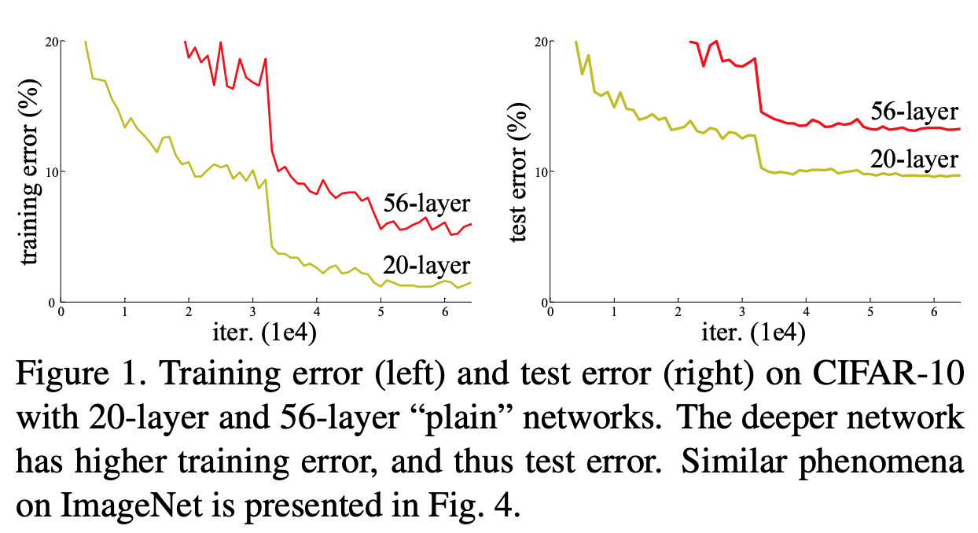
The deeper, the better?
He et al., CVPR 2015

Slide 36
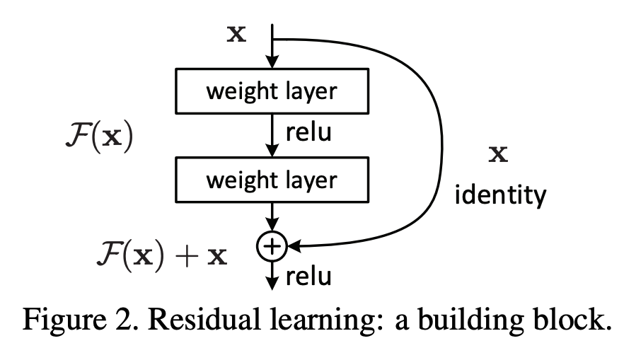
Learning Residual Feature Maps is Easier
He et al., Deep Residual Learning for Image Recognition. CVPR 2015

Slide 37
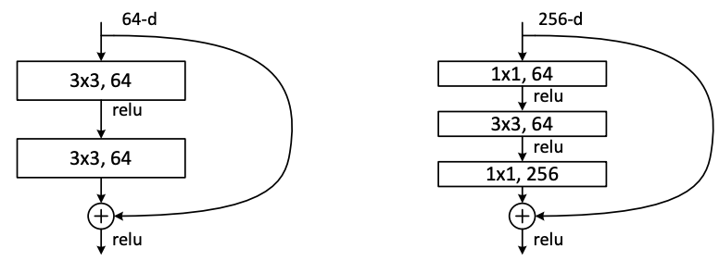
Learning Residual is Easier
He et al., Deep Residual Learning for Image Recognition. CVPR 2015

Slide 38
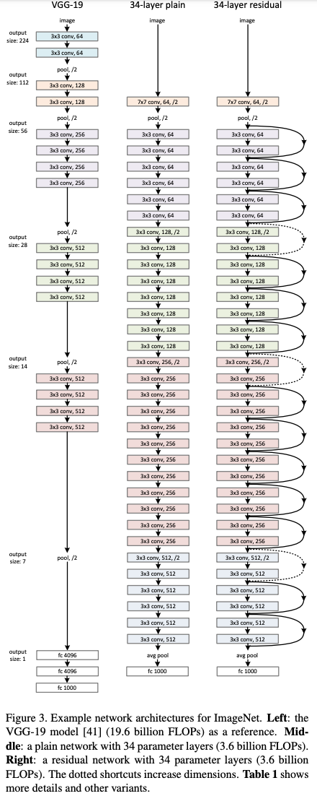
VGG vs. ResNet
He et al., CVPR 2015

Slide 39
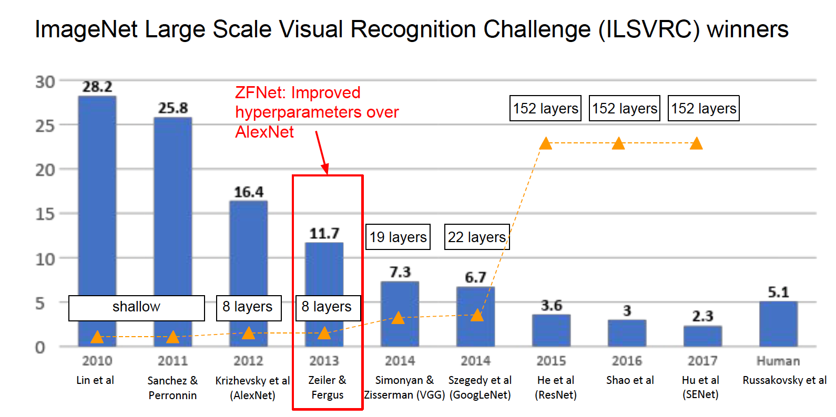
NEC Labs America Model
Picture Credit: Fei-Fei, Johnson, and Yeung, Stanford cs231n, 2019

Slide 40
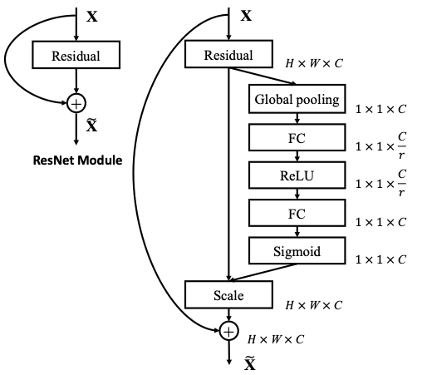
Squeeze-and-Excitation Blocks
conv
Hu et al., CVPR 2018.

Slide 41
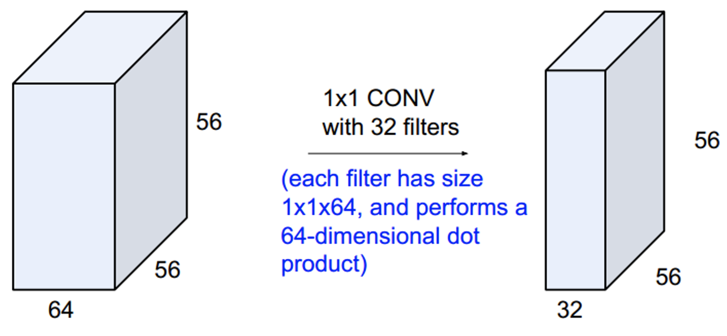
In Comparison to 1x1 Convolution
Picture credit: https://thomelane.github.io/convolutions/2DConvRGB.html
Notes:
https://pxhere.com/en/photo/941424
https://pixabay.com/photos/movement-driving-walking-streetlife-420399/

Slide 42
Double Descent Phenomena
Mikhail Belkin, Daniel Hsu, Siyuan Ma, and Soumik Mandal. Reconciling modern machine learning and the bias-variance trade-off. arXiv preprint arXiv:1812.11118, 2018.

Slide 43
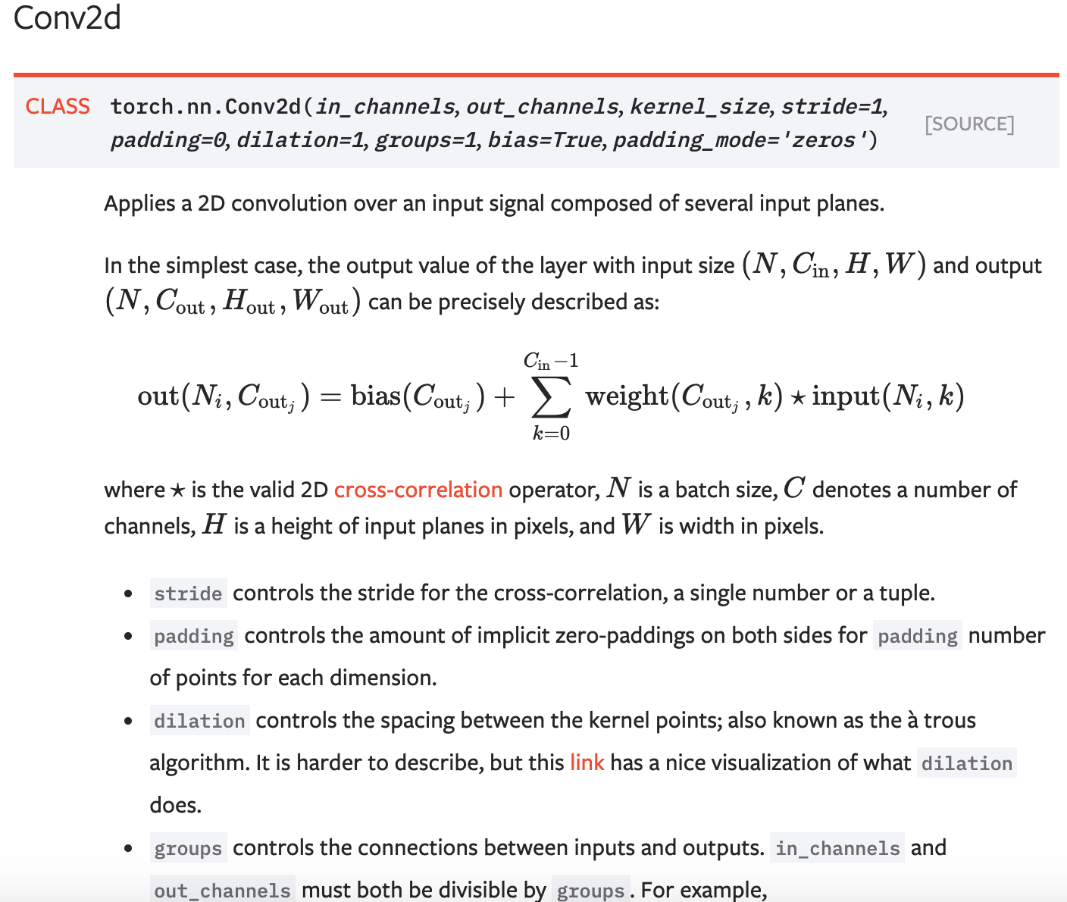
Conv2d in PyTorch

Slide 44
Demonstration of training a simple CNN Classifier on CIFAR10 using PyTorch in Jupyter Notebook

Slide 45
Implement Your Own Forward and Backforward in PyTorch

Slide 46
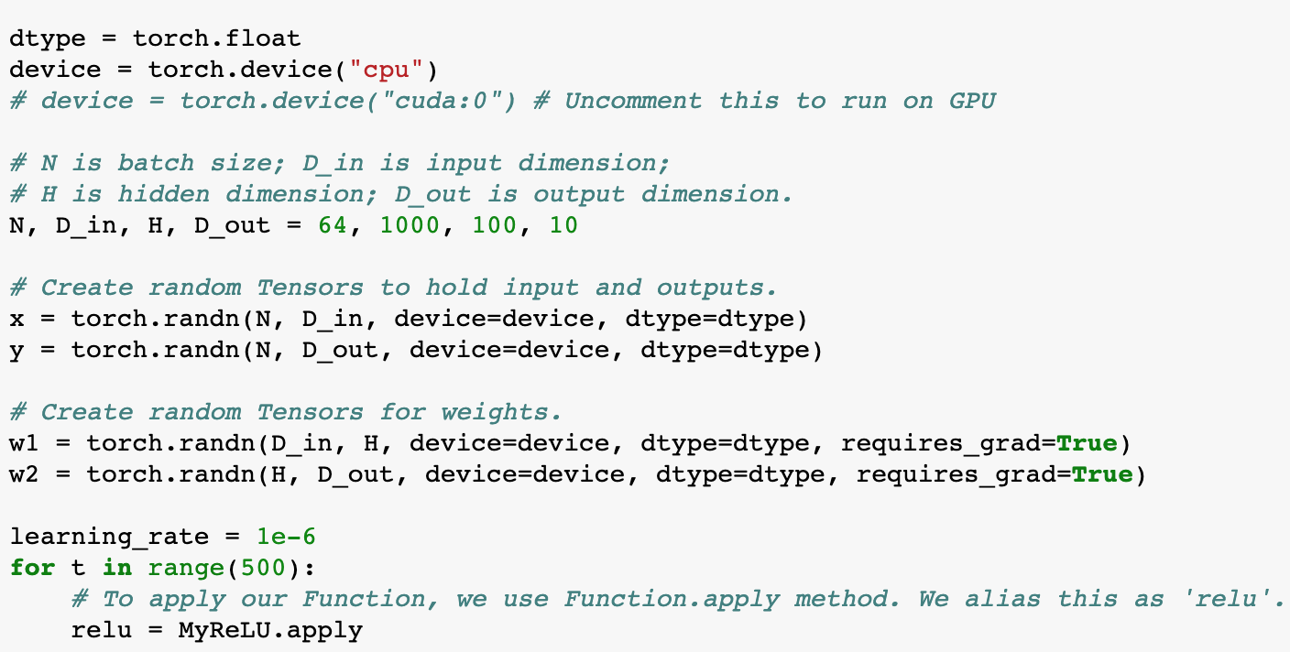
Implement Your Own Forward and Backforward in PyTorch

Slide 47
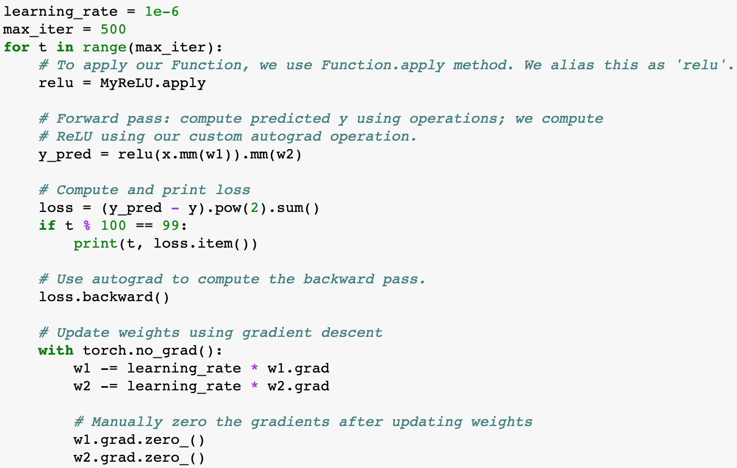
Implement Your Own Forward and Backforward in PyTorch

Slide 48
What can we do with a pre-trained Deep CNN on ImageNet?
Simple Transfer learning
We transfer our learned model on the ImageNet to a different domain, for e.g., fine-grained flower category classification
It only works when the transferred domain is closely related to the source domain of ImageNet
Few-shot learning
In this task, for each class, we only have a few labeled training examples
We can use the learned feature embeddings or their (weighted) mean as prototype(s)
Zero-shot learning
In this task, we don’t have any training example for some classes, but we have semantic descriptions about them
A simple idea: Output a 1000-class probabilities of a test image and use a convex combination of the semantic descriptions of the top k known classes to construct semantic features of the test image

Slide 49
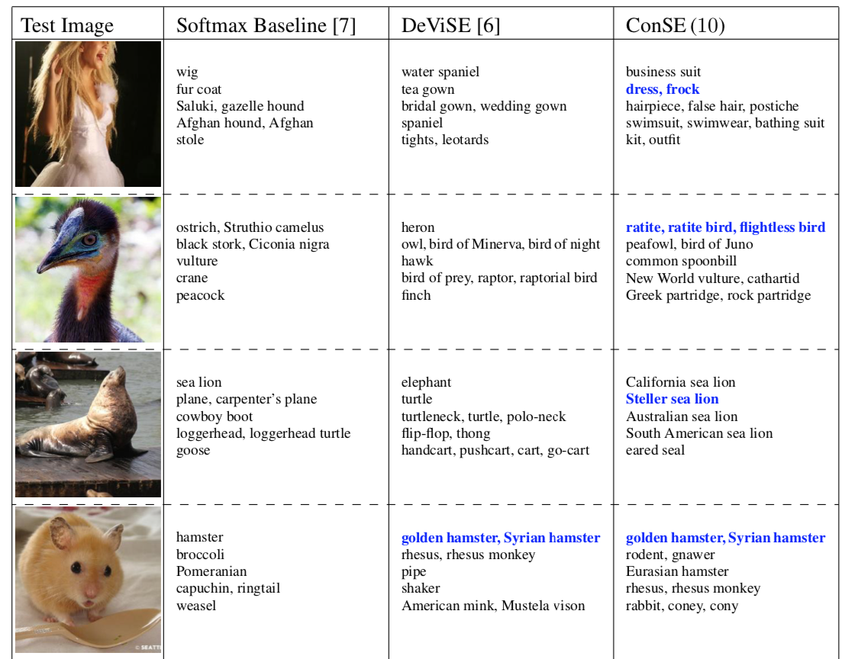
Zero-shot Learning Example
https://arxiv.org/pdf/1312.5650.pdf

Slide 50
What do CNN (AlexNet-like) filters look like?
Zeiler and Fergus, 2013:
Visualizing and Understanding Convolutional Networks
An important convolutional operation called Transposed Convolution was invented in this paper, which will be discussed in Lec 5.

Slide 51
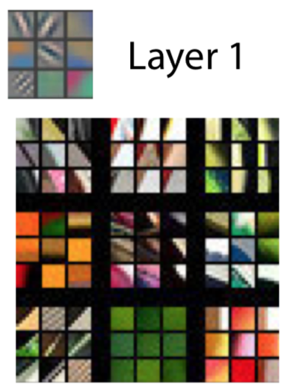
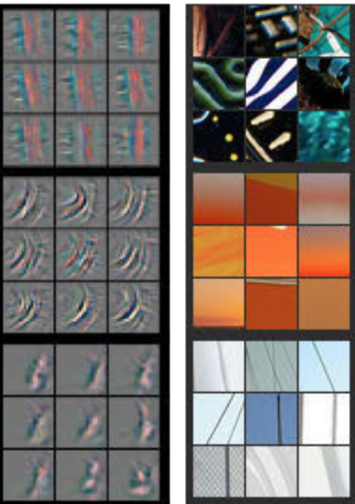
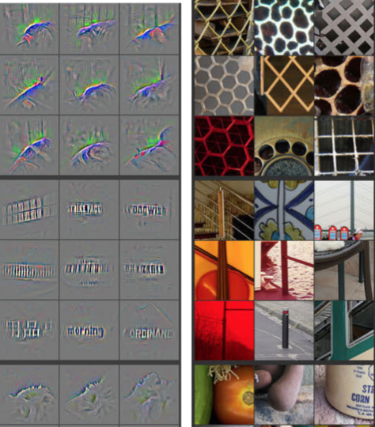
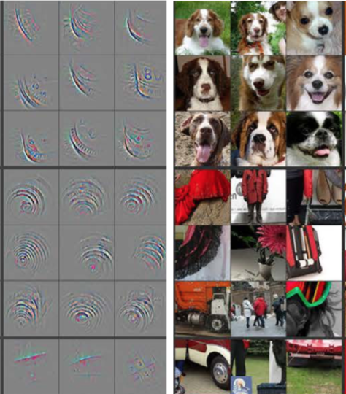
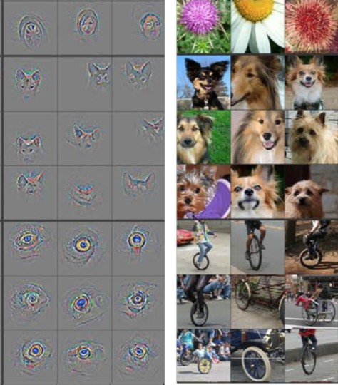
Layer 2
Layer 3
Layer 4
Layer 5

Slide 52
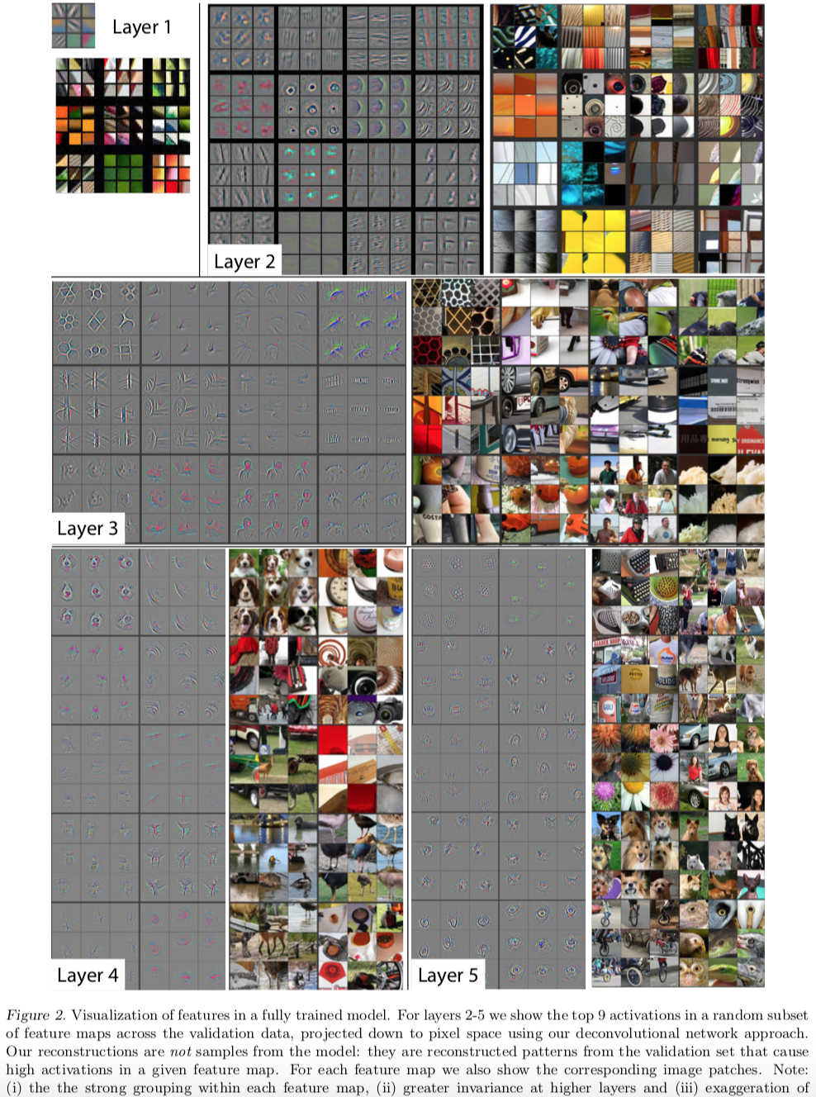

Slide 53
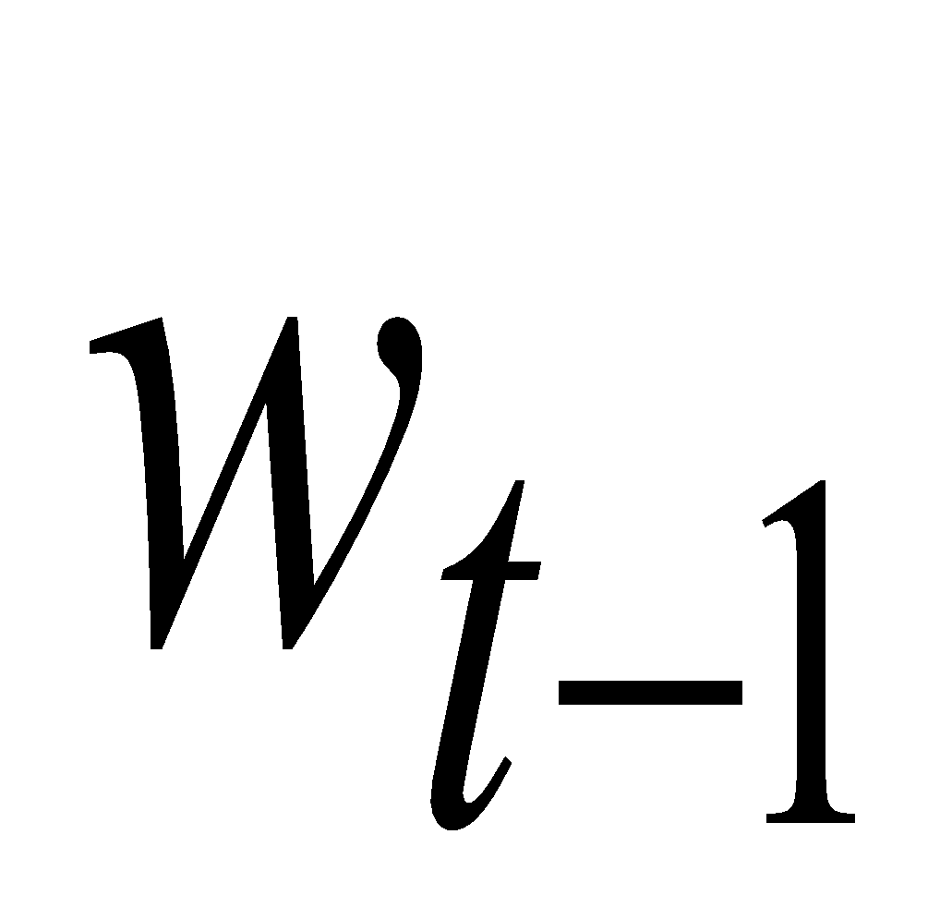
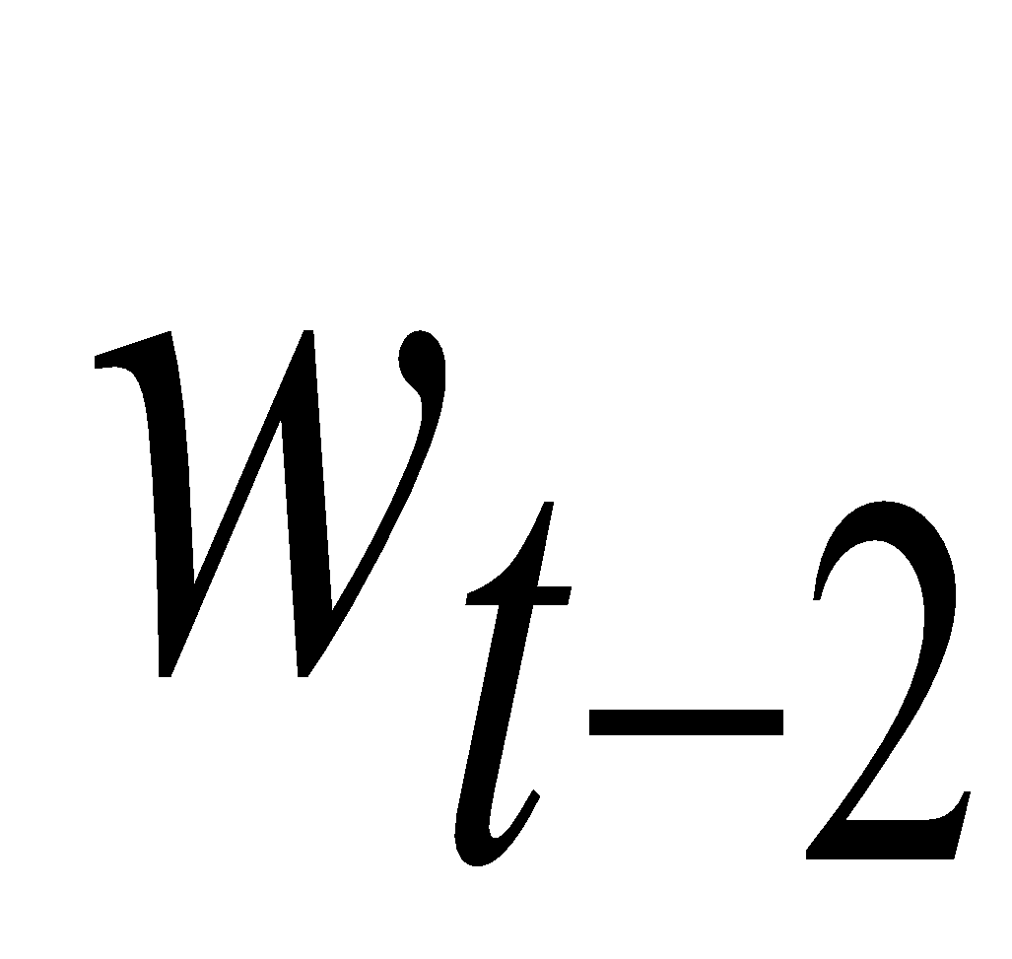
Memoryless models for sequences (Hinton’s Slide)
Autoregressive models Predict the next term in a sequence from a fixed number of previous terms using “delay taps”.
Feed-forward neural nets These generalize autoregressive models by using one or more layers of non-linear hidden units. e.g. Bengio’s first language model.
input(t-2)
input(t-1)
input(t)
hidden
input(t-2)
input(t-1)
input(t)

Slide 54
Beyond memoryless models (Hinton)
If we give our generative model some hidden state, and if we give this hidden state its own internal dynamics, we get a much more interesting kind of model.
It can store information in its hidden state for a long time.
If the dynamics is noisy and the way it generates outputs from its hidden state is noisy, we can never know its exact hidden state.
The best we can do is to infer a probability distribution over the space of hidden state vectors.
This inference is only tractable for two types of hidden state model.
The next three slides are mainly intended for people who already know about these two types of hidden state model. They show how RNNs differ.
Do not worry if you cannot follow the details.

Slide 55
Linear Dynamical Systems (engineers love them!) (Hinton)
These are generative models. They have a real-valued hidden state that cannot be observed directly.
The hidden state has linear dynamics with Gaussian noise and produces the observations using a linear model with Gaussian noise.
There may also be driving inputs.
To predict the next output (so that we can shoot down the missile) we need to infer the hidden state.
A linearly transformed Gaussian is a Gaussian. So the distribution over the hidden state given the data so far is Gaussian. It can be computed using “Kalman filtering”.
time →
output
output
output
hidden
hidden
hidden
driving input
driving input
driving input

Slide 56
Hidden Markov Models (computer scientists love them!) (Hinton)
Hidden Markov Models have a discrete one-of-N hidden state. Transitions between states are stochastic and controlled by a transition matrix. The outputs produced by a state are stochastic.
We cannot be sure which state produced a given output. So the state is “hidden”.
It is easy to represent a probability distribution across N states with N numbers.
To predict the next output we need to infer the probability distribution over hidden states.
HMMs have efficient algorithms for inference and learning.
output
output
output
time →

Slide 57
A fundamental limitation of HMMs (Hinton)
Consider what happens when a hidden Markov model generates data.
At each time step it must select one of its hidden states. So with N hidden states it can only remember log(N) bits about what it generated so far.
Consider the information that the first half of an utterance contains about the second half:
The syntax needs to fit (e.g. number and tense agreement).
The semantics needs to fit. The intonation needs to fit.
The accent, rate, volume, and vocal tract characteristics must all fit.
All these aspects combined could be 100 bits of information that the first half of an utterance needs to convey to the second half. 2^100 is big!

Slide 58
Recurrent neural networks (Hinton)
RNNs are very powerful, because they combine two properties:
Distributed hidden state that allows them to store a lot of information about the past efficiently.
Non-linear dynamics that allows them to update their hidden state in complicated ways.
With enough neurons and time, RNNs can compute anything that can be computed by your computer.
time →
output
output
output
hidden
hidden
hidden
input
input
input

Slide 59
Do generative models need to be stochastic? (Hinton)
Linear dynamical systems and hidden Markov models are stochastic models.
But the posterior probability distribution over their hidden states given the observed data so far is a deterministic function of the data.
Recurrent neural networks are deterministic.
So think of the hidden state of an RNN as the equivalent of the deterministic probability distribution over hidden states in a linear dynamical system or hidden Markov model.

Slide 60
From Standard Neural Networks to Recurrent Neural Networks
Let’s make the model easily extendable to model sequences with arbitrary lengths by weight sharing
y
h
h₀
...
h₁
h₂
h₃
y
h
h
h
y
h
W
W
W
W
h
x₁
x₂
x₃
...
x_{T}
x
x
x
x

Slide 61
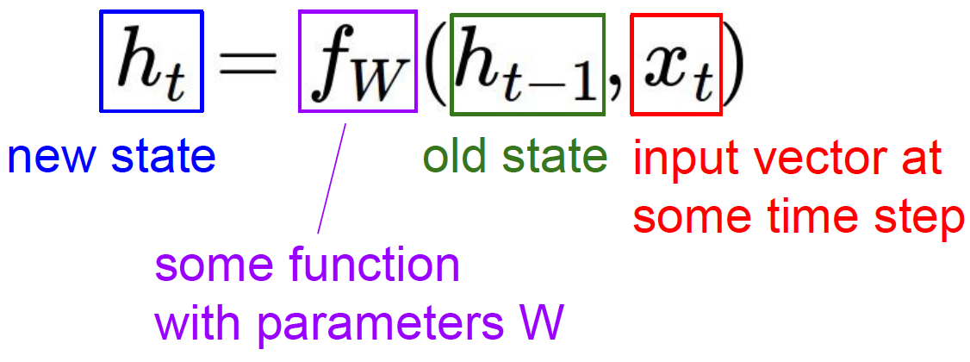
Recurrent Neural Networks (RNN)
At time step t, the hidden units accumulate past information about the
input sequence. Hidden activity vector h_{t} only depend on current
input x_{t} and previous hidden activity vector h_{t-1}
y
RNN
h₀
...
h₁
h₂
h₃
y
h₀
W
W
W
W
W
x₁
x₂
x₃
...
x_{T}
x_{t}

Slide 62
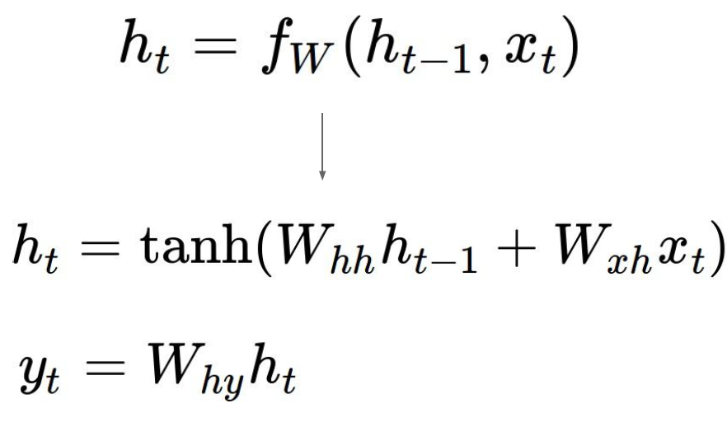
Vanilla Recurrent Neural Networks
y
_{RNN}
h₀
W
x_{t}

Slide 63
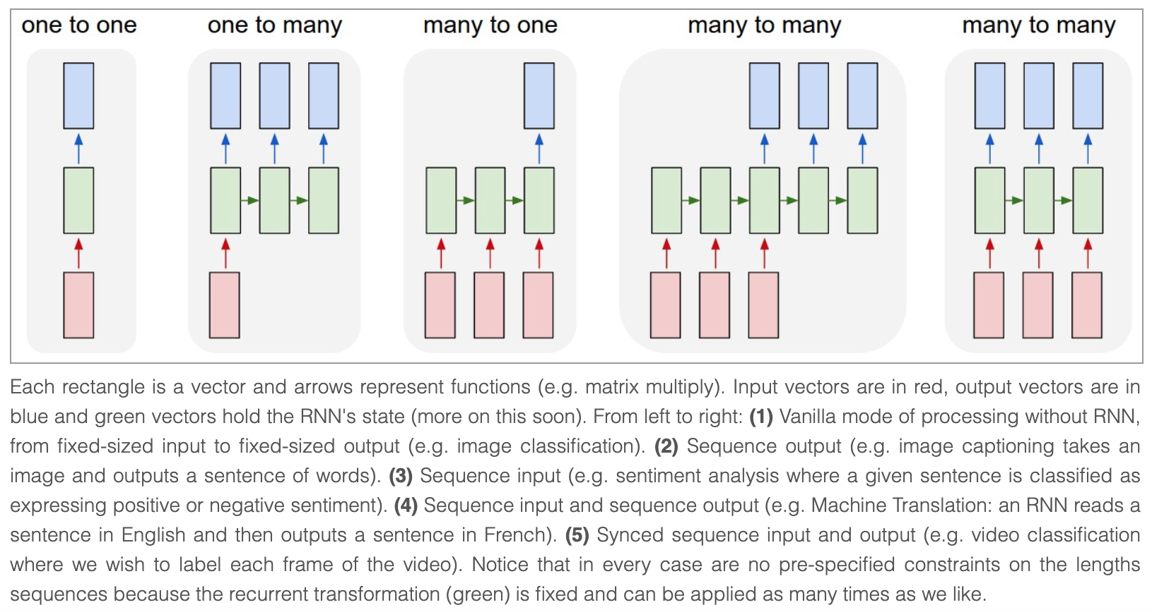
Different Architectures of RNN
Picture Credit: http://karpathy.github.io/2015/05/21/rnn-effectiveness/

Slide 64
Many-to-Many Vanilla RNN
y₁
y₂
y₃
...
y_{T}
h₀
...
h₁
h₂
h₃
h_{T}
W
W
W
W
x₁
x₂
x₃
...
x_{T}

Slide 65
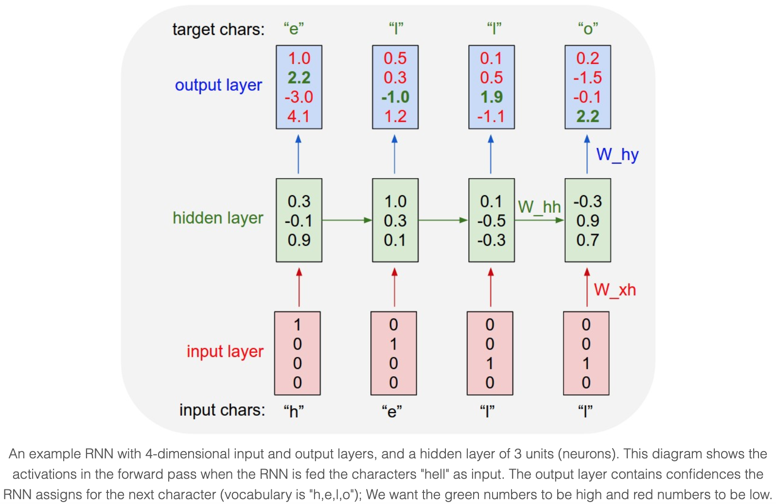
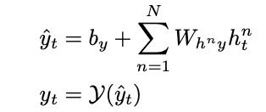
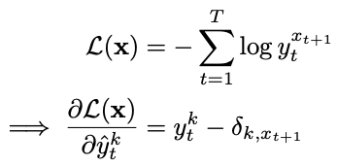
Training of Char-RNN (Teacher Forcing)
Picture Credit: http://karpathy.github.io/2015/05/21/rnn-effectiveness/

Slide 66
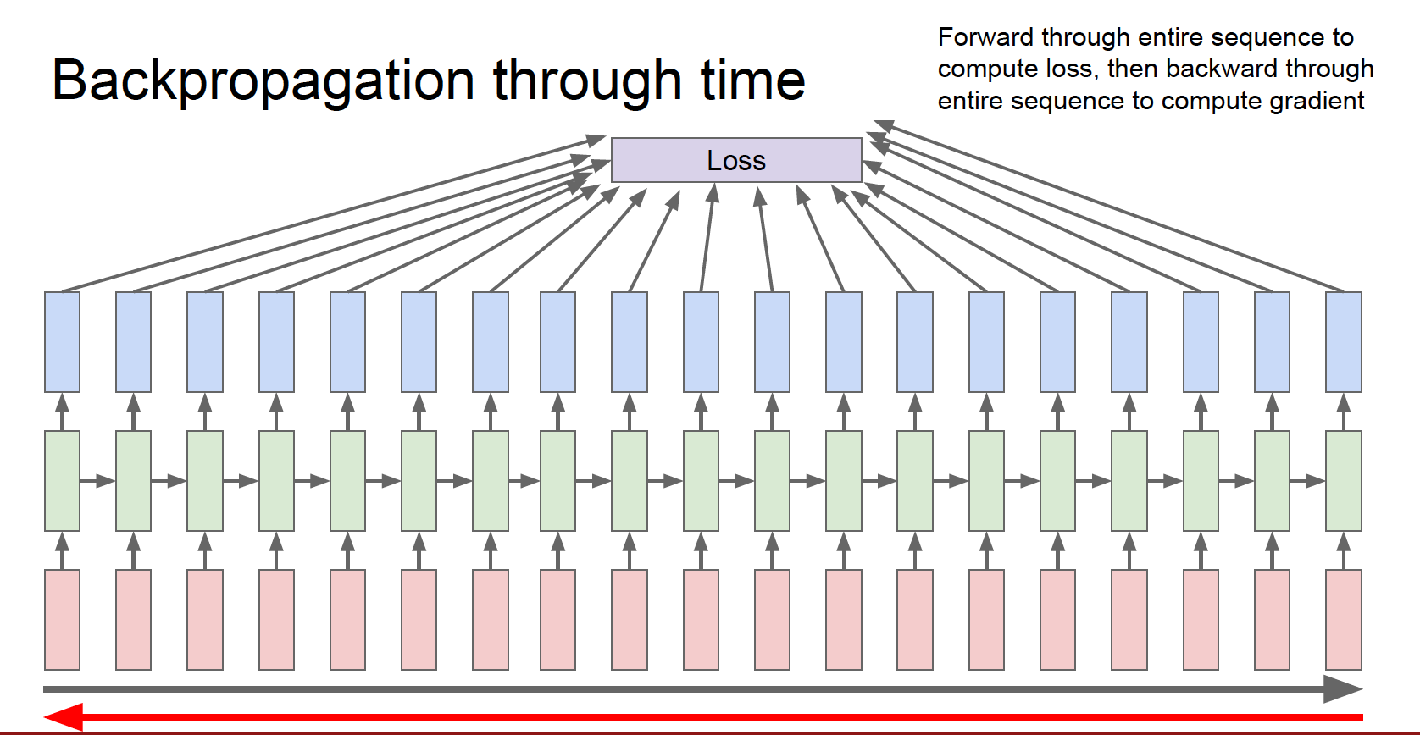

Slide 70
Inference of Char-RNN (Exposure Bias)
At test time, sample a character from the current model at each step, feed the current sampled character as input to the next time step

Slide 71
Karpathy’s Char-RNN on Shakespeare Articles
Source: http://karpathy.github.io/2015/05/21/rnn-effectiveness/

Slide 72
Source: http://karpathy.github.io/2015/05/21/rnn-effectiveness/

Slide 73
Source: http://karpathy.github.io/2015/05/21/rnn-effectiveness/

Slide 74
https://gist.github.com/karpathy/d4dee566867f8291f086

Slide 75
Why Vanishing and Exploding Gradient of Vanilla RNN Happens
Suppose we are using a many-to-many RNN for sequence labeling
is the immediate partial derivative of hidden activity vector with respect to
network weights
Pascanu et al., On the difficulty of training recurrent neural networks. ICML 2013
Notes:
\mathcal{E}_t = \mathcal{L}(\mathbf{h}_t) \\
\frac{\partial \mathcal{E}_t}{\partial \mathbf {\theta}} = \sum_{1\leq k \leq t} (\frac{\partial \mathcal{E}_t}{\partial \mathbf{h}_t}\frac{\partial \mathbf{h}_t}{\partial \mathbf{h}_k} \frac{\partial \mathbf{h}_k^+}{\partial \theta}) \\
\frac{\partial \mathbf{h}_t}{\partial \mathbf{h}_k} = \Pi_{t\geq i >k}\frac{\partial \mathbf{h}_t}{\partial \mathbf{h}_{t-1}} = \Pi_{t\geq i >k} W_{hh}^Tdiag(tanh^\prime(W_{hh}h_{t-1}+W_{xh}x_t))
\

Slide 76
Gradient norm Clipping
Design a better architecture

Slide 77
Long Short-Term Memory
Picture Credit: https://www.cs.toronto.edu/~graves/asru_2013.pdf

Slide 78
Long Short-Term Memory
H
c_{t-1}
c_{t}
h_{t-1}
h_{t}
Picture Credit: https://colah.github.io/posts/2015-08-Understanding-LSTMs/

Slide 80
Bidirectional LSTM
Picture Credit: https://www.cs.toronto.edu/~graves/asru_2013.pdf

Slide 81
Bidirectional LSTM
…
LSTM
LSTM
LSTM
…
LSTM
LSTM
LSTM
Peptide Pos. 1:
Amino
Acid
Embedding
Peptide Pos. 2:
Amino
Acid
Embedding
Peptide Pos. 9:
Amino
Acid
Embedding

Slide 82
Deep LSTM
Picture Credit: https://www.cs.toronto.edu/~graves/asru_2013.pdf

Slide 83
Deep LSTM for Generating Complex Sequences
Generating text with characters or words as symbols
Generating handwriting with sequences of pen coordinates (x, y) and pen on/off whiteboard as input
Alex Graves, Generating Sequences With Recurrent Neural Networks. 2015
https://arxiv.org/pdf/1308.0850.pdf

Slide 84
Deep Encoder-Decoder Networks:
Sequence-to-Sequence (Seq2Seq) Models

Slide 85
Data Augmentation in Sequence-to-Sequence (Seq2Seq) Models for Machine Translation
`

Slide 86
Summary of Topics Discussed
Activation Functions
Loss Functions
Training deep feedforward neural networks with backpropagation and mini-batch SGD
Convolution and pooling operations in CNN
Network architectures such as AlexNet, VGG, ResNet
Applications of supervised pre-trained CNNs
Visualization of pre-trained CNN filters and receptive fields
Recurrent Neural Networks, Sequence-to-Sequence Models
Geoff Hinton, “Never stop coding.” Great discoveries are from practice.

Slide 87
The End
Next lecture:
Deep Learning III:
Deep Generative Models, VAE, and GAN

