Slide 1
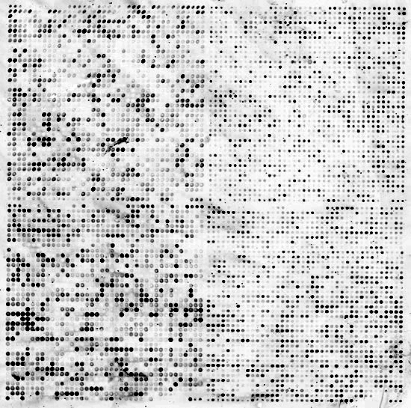
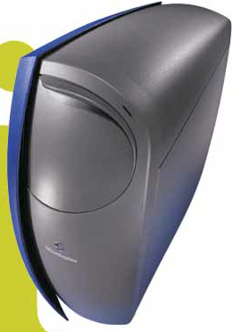

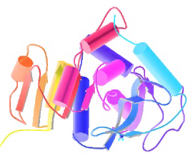
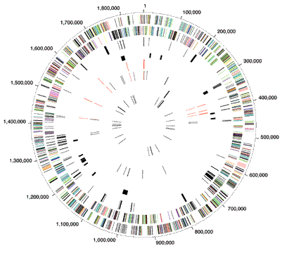


Biomed. Data Science:
Basic Multi-omic Analyses
Mark Gerstein, Yale University
gersteinlab.org/courses/452
(last edit in spring ’20)

Slide 2
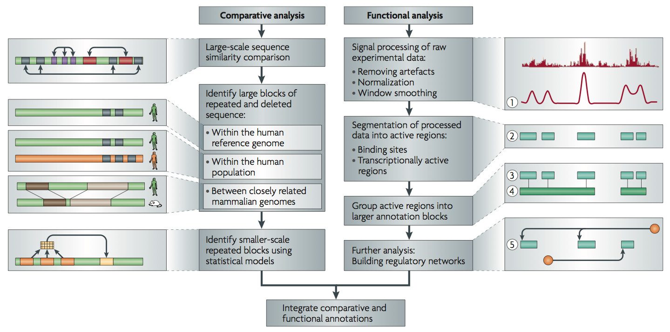
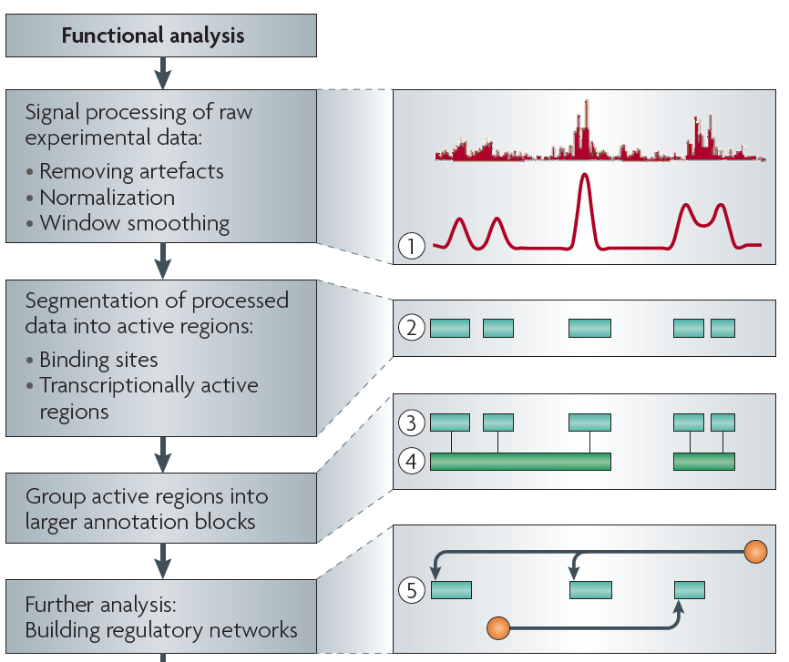
Non-coding Annotations: Overview
Features are often present on multiple ”scale” (eg elements and connected networks)
Sequence features, incl. Conservation
Functional Genomics
Chip-seq (Epigenome & seq. specific TF) and ncRNA & un-annotated transcription
[Nat. Rev. Genet. (2010) 11: 559]

Slide 3
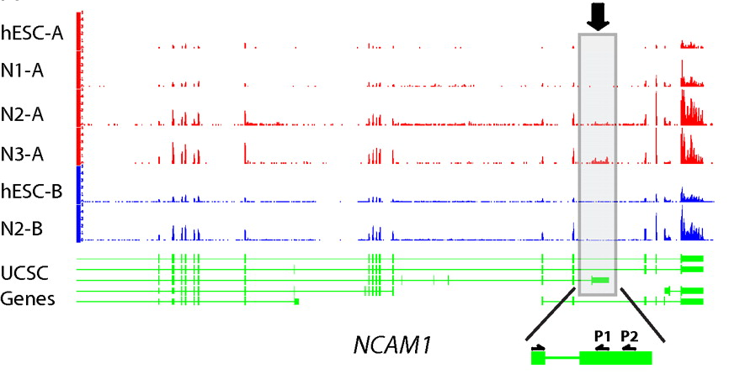
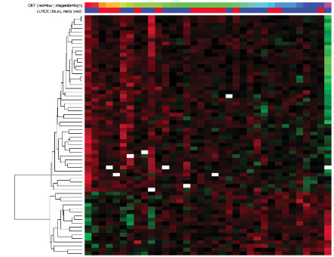
Information from
RNA-seq:
Avg. signal at exons & TARs (RPKMs)
[PNAS 4:107: 5254 ; IJC 123:569]
Signal tracks for two genes are shown. Figure made using UCSC genome browser.
RNA-Seq experiments one would keep: the expression levels (i.e. RPKMs) of ~20,000 genes, ~70,000 transcripts, ~200,000 exons, and ~2 million splices. Also, we would store information on ~15,000 novel Transcriptionally Active Regions (TARs), ~2,000 allele-specific expressed genes, ~50 chimeric transcripts as well as lists of differentially expressed elements between conditions.
Mertz, Kirsten D., Francesca Demichelis, Andrea Sboner, Michelle S. Hirsch, Paola Dal Cin, Kirsten Struckmann, Martina Storz, et al. “Association of cytokeratin 7 and 19 expression with genomic stability and favorable prognosis in clear cell renal cell cancer.” International Journal of Cancer 123, no. 3 (2008): 569-576.
Mapped reads show isoform composition in two different stages.
Du et al (in revision).

Slide 4
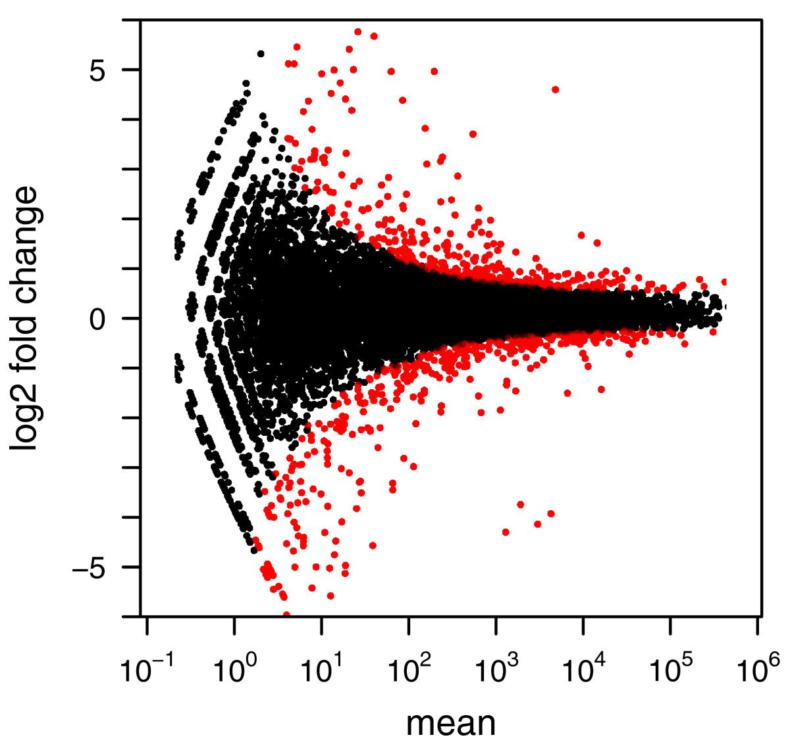
Differential expression analysis
Genome Biology, 2010 11:R106

Slide 5
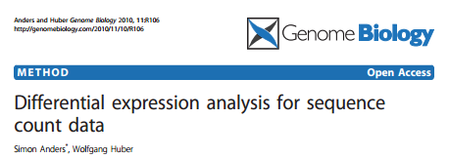
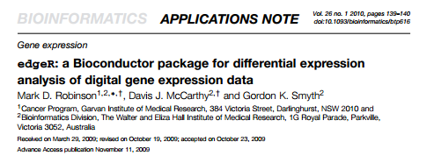
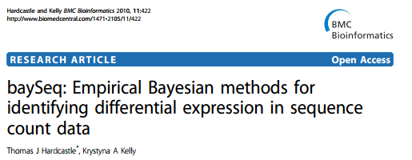
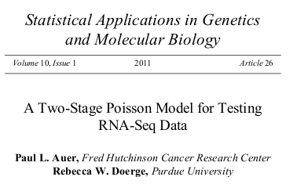
Differential expression analysis: Count-based
DESeq -- based on negative binomial distribution
edgeR -- use an overdispersed Poisson model
baySeq -- use an empirical Bayes approach
TSPM -- use a two-stage poisson model

Slide 6
chip-seq

Slide 7
Information from Chip-seq
TFs with Peaks
Control
His. Marks
(broad)
[Science 330: 1775
+ ENCODE Data Sources
TFs & Control: Yale
HMs: UW & Broad ]

Slide 8
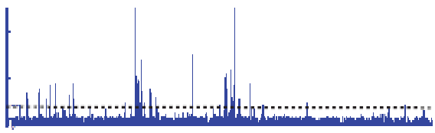

Summarizing the Signal:
"Traditional" ChipSeq Peak Calling
ChIP
Generate & threshold the signal profile to identify candidate target regions
  Simulation (PeakSeq),
  Local window based Poisson (MACS),
  Fold change statistics (SPP)
Threshold
Potential Targets
Normalized Control
Score against the control
Significantly Enriched targets
[Rozowsky et al. ('09) Nat Biotech]

Slide 9
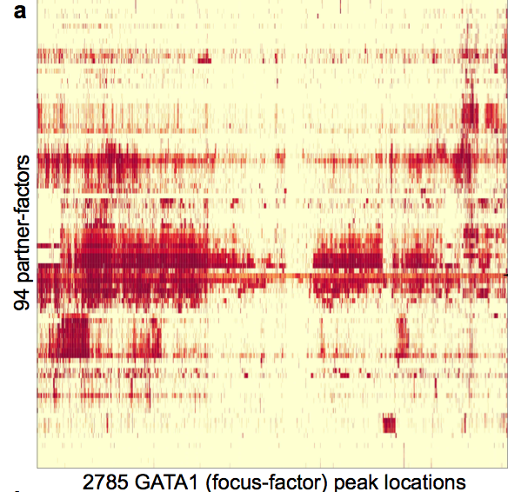
Data Flow: Chip-seq expts. to co-associating peaks
119 TFs from 458 ChIP-Seq experiments (2 Tb tot.)
Signal Tracks
7M Peaks from Uniform Peak Calling
Mostly in Tier 1 cell lines
  K562, GM12878, H1h-ESC…
Matching RNA-Seq data in all cell-lines
SPP & PeakSeq
thresholding w. IDR (replicas)
TF1
TF2
TF119
[ Gerstein et al. Nature (in press, '12) ]

Slide 10
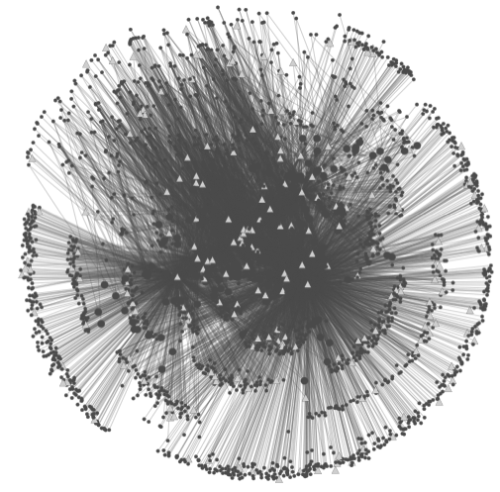
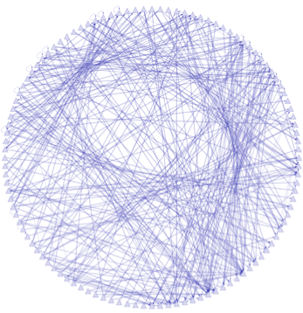
Data Flow: peaks to proximal & distal networks
Peak Calling
Assigning TF binding sites to targets
Filtering high confidence edges & distal regulation
[ Cheng et al., Bioinfo. ('11);
Gerstein et al. Nature (in press, '12) ;
Yip et al., GenomeBiology (in press, '12)]
~500K Edges
Based on stat. model combining
signal strength & location relative to typical binding
~26K Edges
TF
TF
Potential
Distal
Edge
Strong
Proximal
Edge

Slide 11
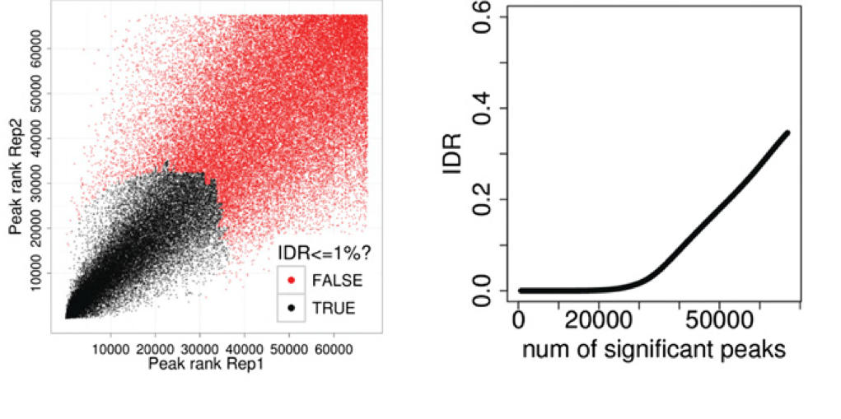
The irreproducible discovery rate (IDR)
Unified approach to measure the reproducibility of findings identified from replicate high-throughput experiments.
Idea : call peaks with low cutoff and classify peaks as reproducible or not (bivariate rank distributions) based on overlap of ranked peaks (consistency)
Genome Research 2012, 22:1813-1831

Slide 12
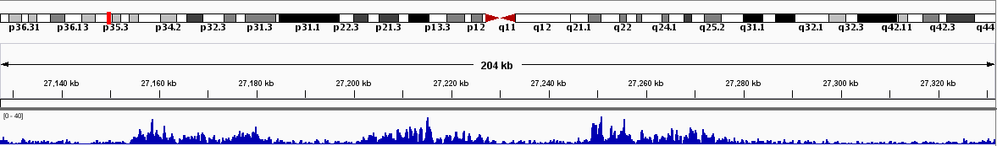
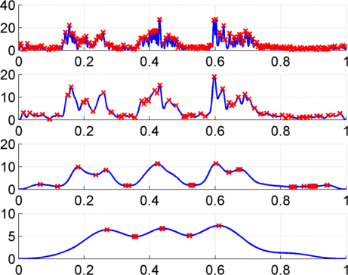
Multiscale Analysis, Minima/Maxima based Coarse Segmentation
Multiscale analysis is a natural way to analyze the ChIP-Seq data
Window Length
1kb
4kb
Harmanci et al, Genome Biology 2014, MUSIC.gersteinlab.org
16kb
Maxima
64kb
Minima
Notes:
Shown is the H3K36me3 track over 200kb regions with 3 active genes, indicated by green lines. The signal increases on the 3 genes. Our problem is to identify 3 enriched regions corresponding to these 3 genes. Thresholding usually overfragments these regions. To get around this issue, we apply a a multiscale filtering that smooths the signal with a sliding window using different window lengths, or scale lengths. At the top scale one can see that 3 peaks are identified.

Slide 13
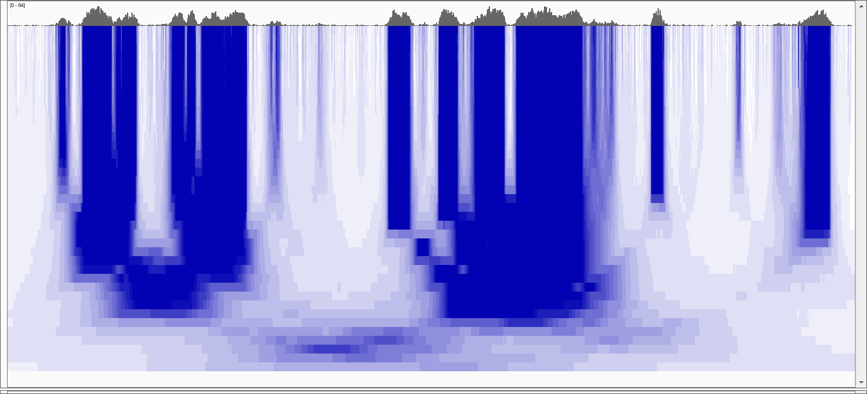
Multiscale Decomposition
20kb
100 b
Increasing Scale
100 kb
[Harmanci et al, Genome Biol. ('14)]
Notes:
To address the first issue, we use median based decomposition, which is median filtering the RD signal with increasing window lengths.
In order to perform median filtering with a window length, you take the signal and replace signal value at each point with the median of the values within the vicinity of that point.
In the figure, the RD signal is shown at the very top. In the bottom heatmap, each row is a filtered signal track in the decomposition.
White-> low, blue->high
Notice that the peaks in the signal get merged over the increasing scales.
Notice the “blocky” behavior of the decomposition where the edges are conserved over several scales before they die off rather quickly at a certain scale.

Slide 14
Multiscale Decomposition
Very
Punctate
ER
20kb
Broader
ER
Punctate
ER
Broad
ER
100 b
Increasing Scale
Very Broad
ER
100 kb
[Harmanci et al, Genome Biol. ('14)]
Notes:
In comparison with Gaussian decomp, median based decomp conserves the enriched regions upto a certain scale then removes them completely. Unlike
Gaussian, where all the signal features are transferred till the highest scale in the decomposition. This property makes median filtering a better candidate
For analysing the which scales levels are enriched in the signal

Slide 15
ASB/ASE & eQTL

Slide 16
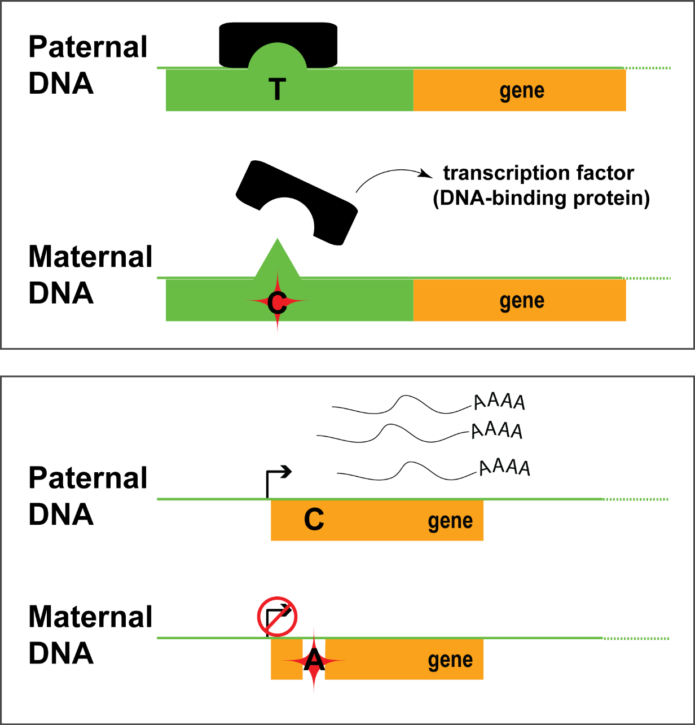
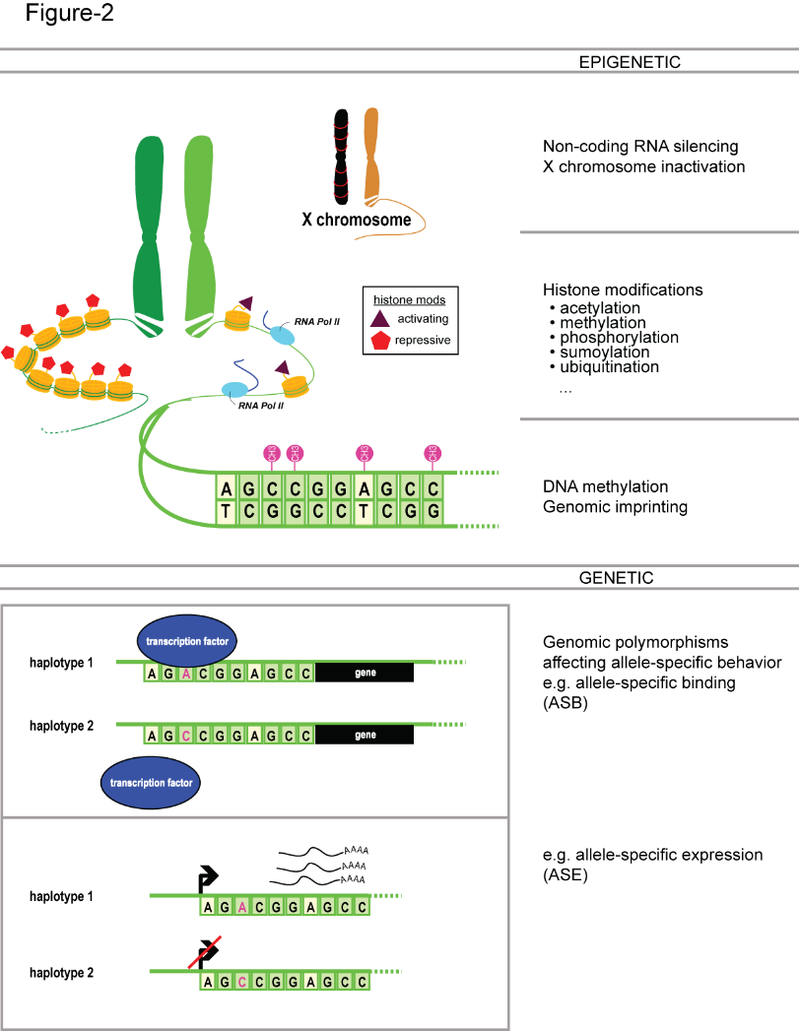
Allele-specific binding and expression
variants

Slide 17



Inferring Allele Specific Binding/Expression using Sequence Reads
RNA/ChIP-Seq Reads
ACTTTGATAGCGTCAATG
CTTTGATAGCGTCAATGC
CTTTGATAGCGTCAACGC
TTGACAGCGTCAATGCAC
TGATAGCGTCAATGCACG
ATAGCGTCAATGCACGTC
TAGCGTCAATGCACGTCG
CGTCAACGCACGTCGGGA
GTCAATGCACGTCGAGAG
CAATGCACGTCGGGAGTT
AATGCACGTCGGGAGTTG
TGCACGTTGGGAGTTGGC
10 x T
2 x C
…AACGC…
TF
…AATGC…
Haplotypes with a
Heterozygous Polymorphism
Interplay of the annotation and individual sequence variants
Does not format to std. theme

Slide 18
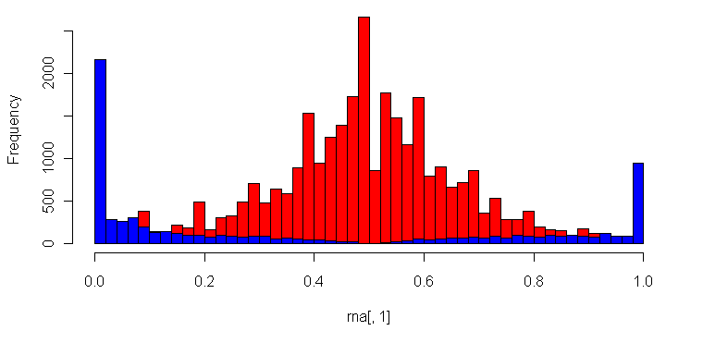
Many Technical Issues in Determining ASE/ASB:
Reference Bias
(naïve alignment against reference)
ASE/ASB Example:
…GTCAATGCAC
…GTCAATGCACG
…GTCAATGCACGTC
…GTCAATGCACGTCG
…GTCAACGCACGTCGGGA
GTCAATGCACGTCGAGAG
CAATGCACGTCGGGAGTT
AATGCACGTCGGGAGTTG
Null Example:
ACTTTGATAGCGTCAATG
CTTTGATAGCGTCAACGC
TTGACAGCGTCAATGCAC
ATAGCGTCAATGCACGT…
TAGCGTCAACGCACGT…
CGTCAACGCACGT…
CAATGCACGT…
AATGCACGT…
Allele-Specific SNPs
Binomial Null Distribution
(no allele-specific behavior)
Reference Allele
Alternate Allele
Fraction of Reads Mapping to Alternative Allele
[Rozowsky et al., MSB (‘11)]
Notes:
Alternative allele/Reference allele

Slide 19
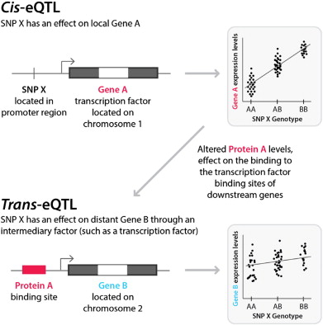
Expression quantitative trait locus (eQTL)
Biochimica et Biophysica Acta (BBA)-Molecular Basis of Disease 2014, 10:1896-1902

Slide 20


eQTL Mapping Using RNA-Seq Data
eQTLs are genomic loci that contribute to variation in mRNA expression levels
eQTLs provide insights on transcription regulation, and the molecular basis of phenotypic outcomes
eQTL mapping can be done with RNA-Seq data
[Biometrics 68(1) 1–11]
Notes:
A diagram to illustrate the RNA‐seq count variation of one gene due to an cis‐eQTL. (a) RNA‐seq measurements of a hypothetic gene with two exons in three diploid individuals. The target SNP which we test for association has the genotype CT, CC, and TT for the three individuals. There is an SNP on the first exon, which has genotype AT, AT, and AA for the three individuals. ASE can be measured by those sequence reads that overlap with a heterozygous exonic SNP. Therefore we can measure ASE for individuals (i) and (ii). However, association testing by ASE is only possible if the target SNP is heterozygous, thus only individual (i) can be used to test for eQTL by ASE (b) ASE measurements for individual (i). (c) TReC measured for the three individuals across the two exons of this gene.
© IF THIS IMAGE HAS BEEN PROVIDED BY OR IS OWNED BY A THIRD PARTY, AS INDICATED IN THE CAPTION LINE, THEN FURTHER PERMISSION MAY BE NEEDED BEFORE ANY FURTHER USE. PLEASE CONTACT WILEY'S PERMISSIONS DEPARTMENT ON PERMISSIONS@WILEY.COM OR USE THE RIGHTSLINK SERVICE BY CLICKING ON THE 'REQUEST PERMISSION' LINK ACCOMPANYING THIS ARTICLE. WILEY OR AUTHOR OWNED IMAGES MAY BE USED FOR NON-COMMERCIAL PURPOSES, SUBJECT TO PROPER CITATION OF THE ARTICLE, AUTHOR, AND PUBLISHER.

Slide 21
Hi-C

Slide 22
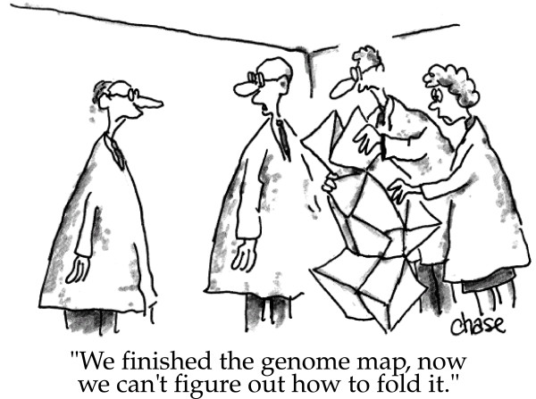
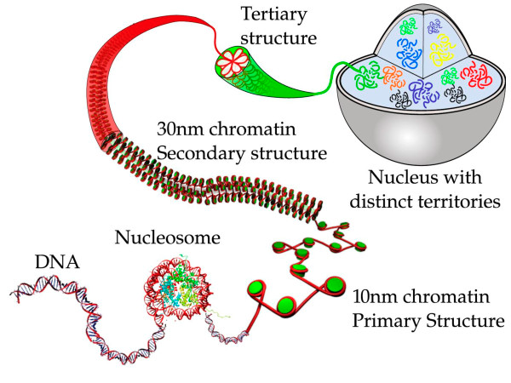
3D organization of genome
image credit: Iyer et al. BMC Biophysics 2011,
cartoonist John Chase
image credit: Iyer et al. BMC Biophysics 2011

Slide 23
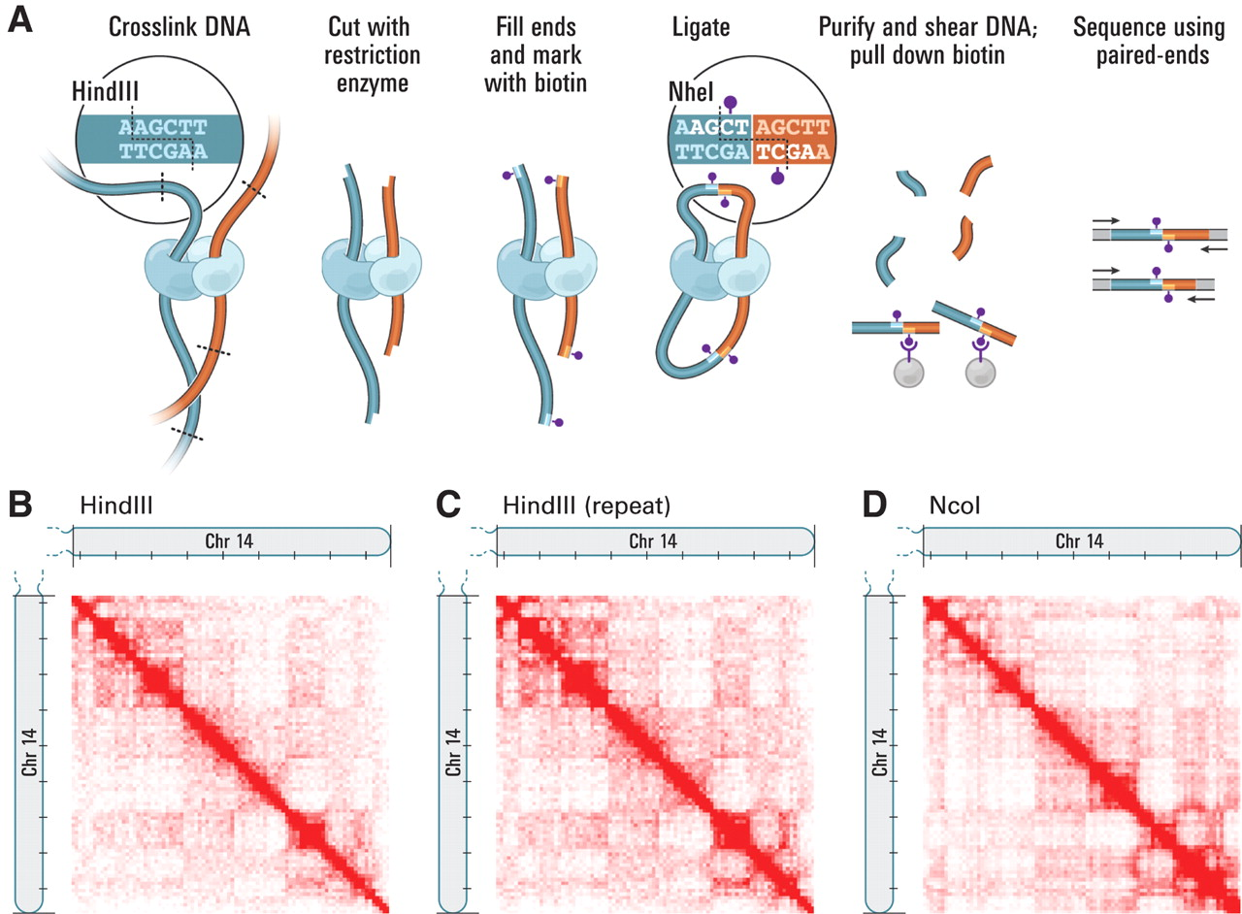
Hi-C contact map
Science 2009, 5950: 289-293

Slide 24
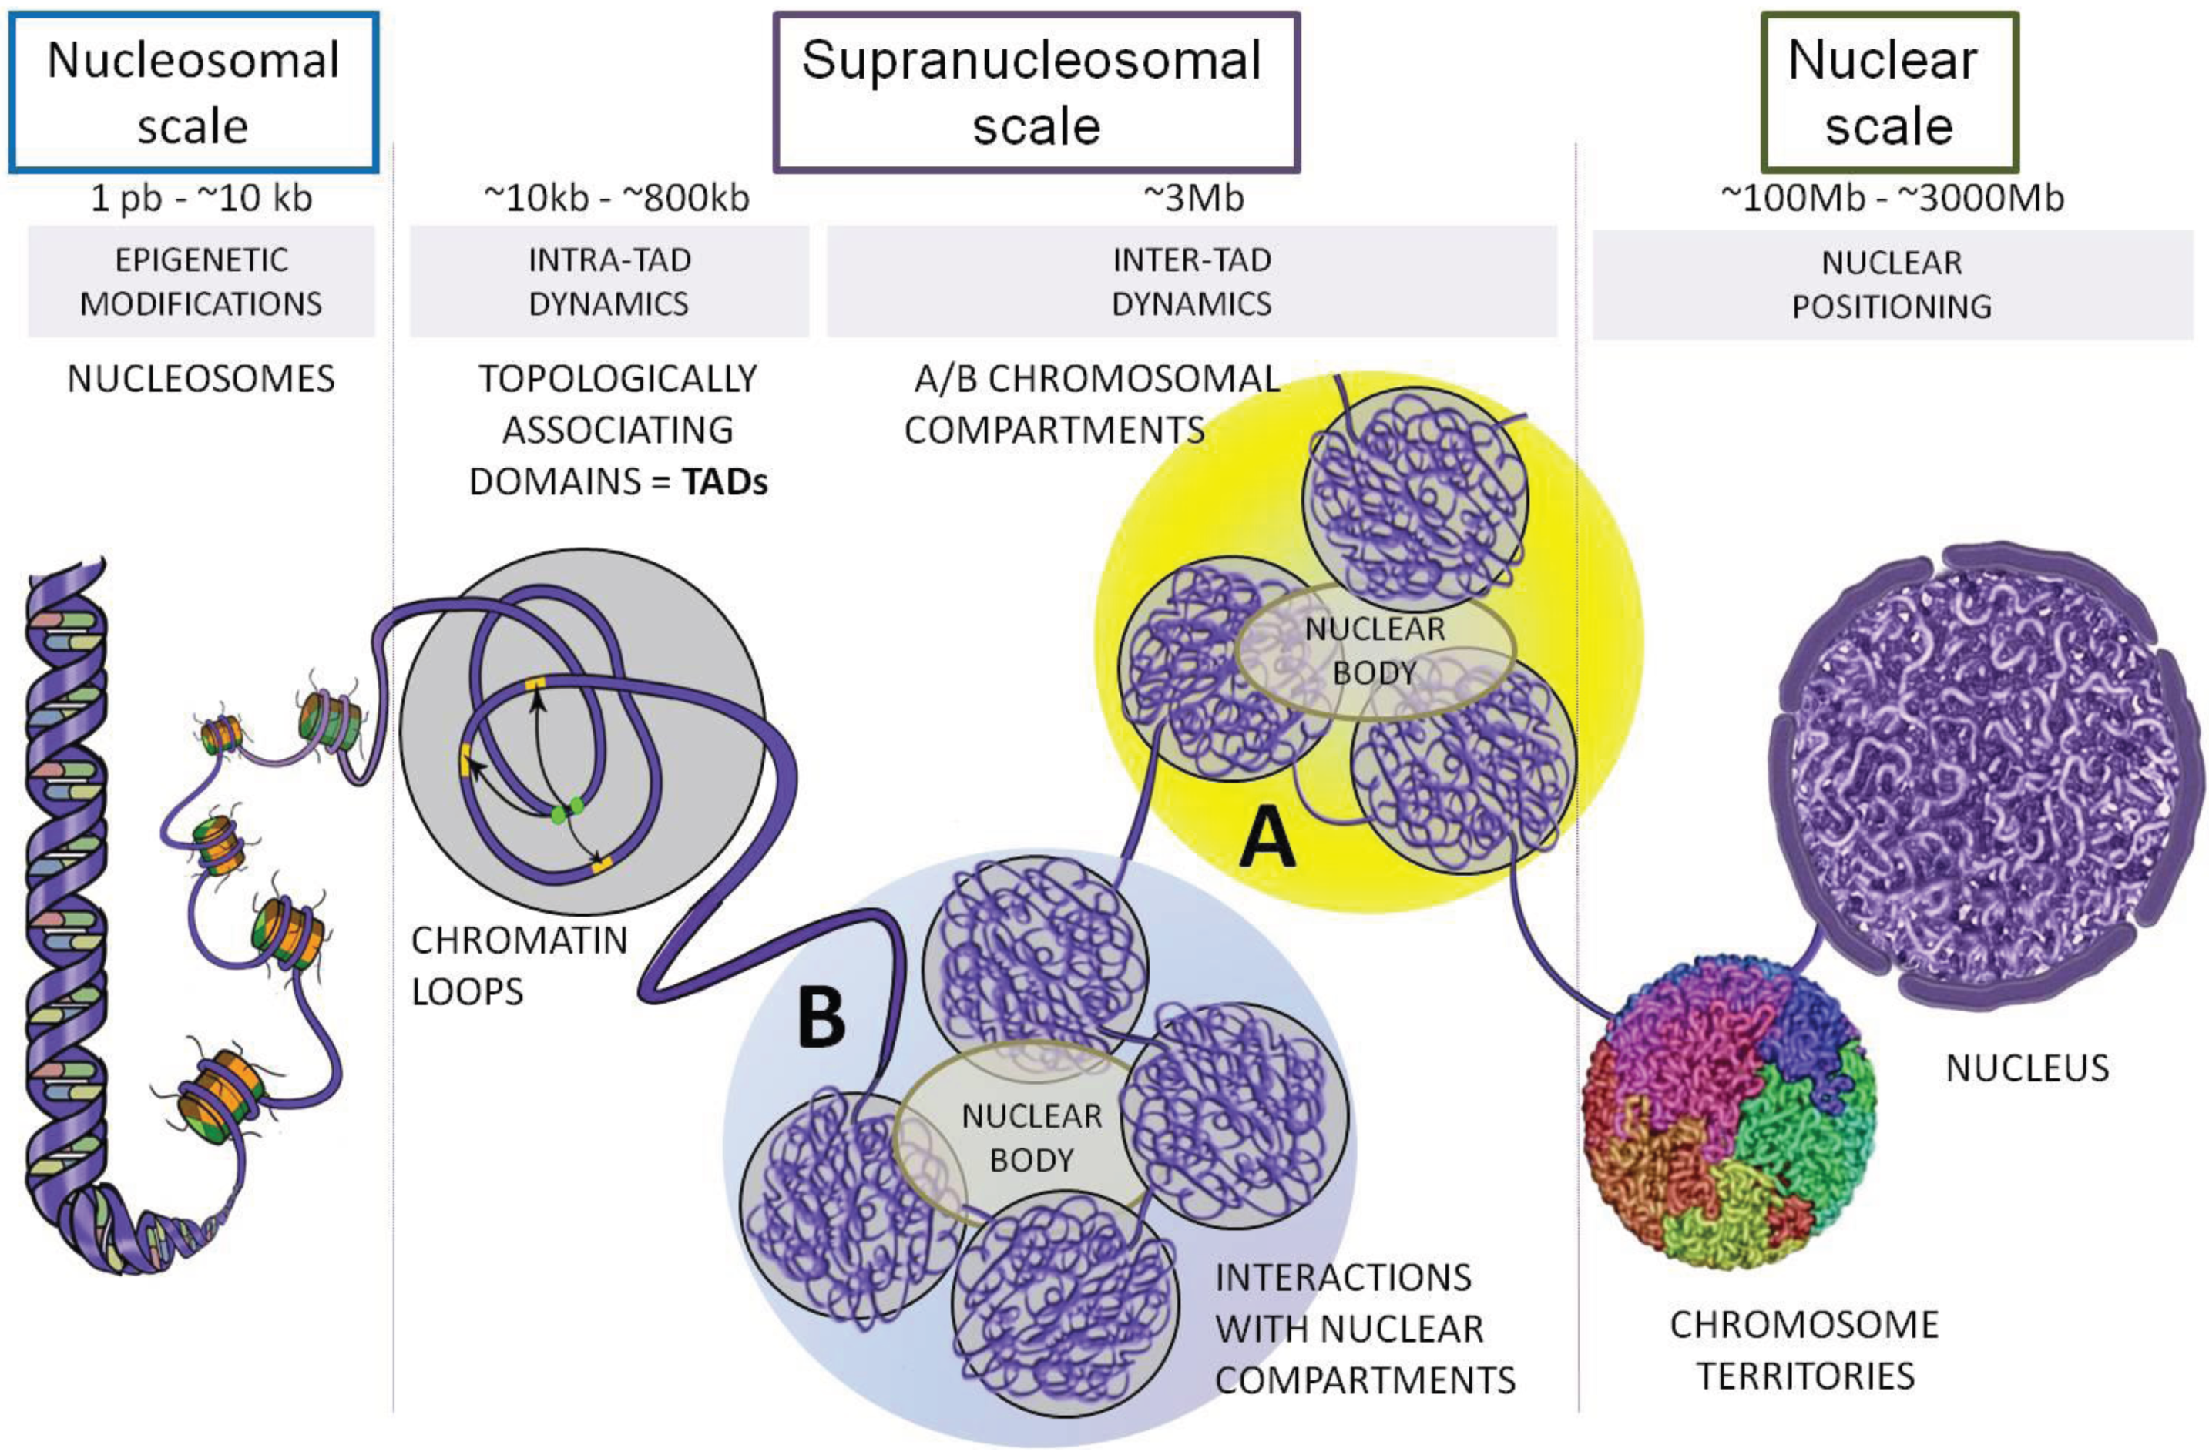
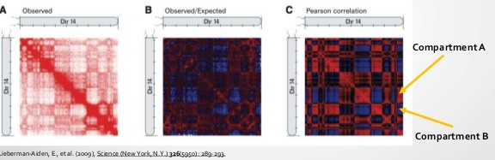
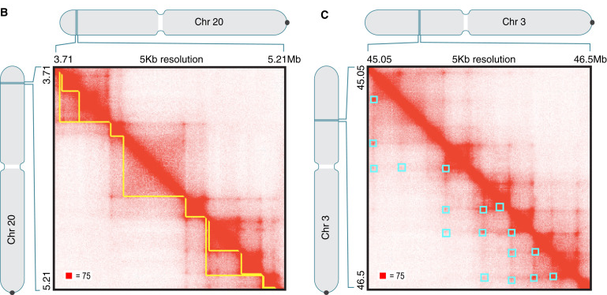
Hi-C contact map and Genome architecture
Cell 2014, 159(7):1665-1680
Genes 2015, 6(3), 734-750

Slide 25
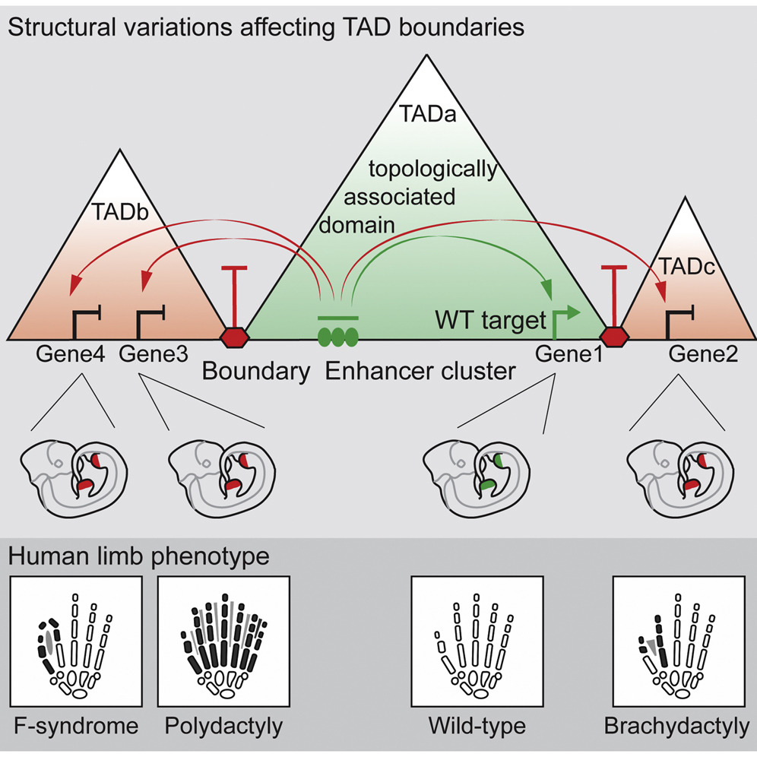
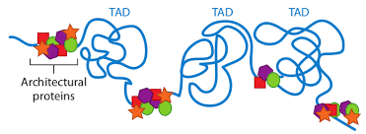
Topologically Associating Domain
Cell 2015, 161:1012-1025

Slide 26
Modularity

Slide 27
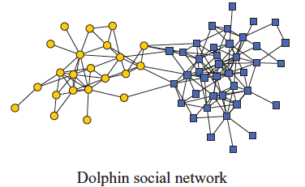
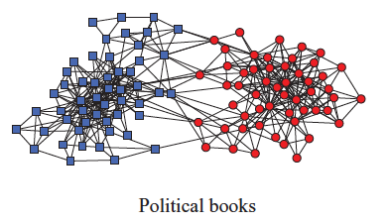
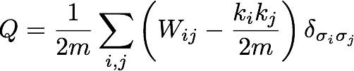
Network modularity
degree of node i
Newman Phy. Rev. E 2013
adjacency matrix
whether or not
i, j are in the
same module
number of edges
expected number of
edges between i and j

Slide 28

Network modularity
degree of node i
adjacency matrix
whether or not
i, j are in the
same module
number of edges
expected number of
edges between i and j

Slide 29

Network modularity
Optimization problem
for sim. annealing
degree of node i
adjacency matrix
whether or not
i, j are in the
same module
number of edges
expected number of
edges between i and j

Slide 30
TAD Finding

Slide 31
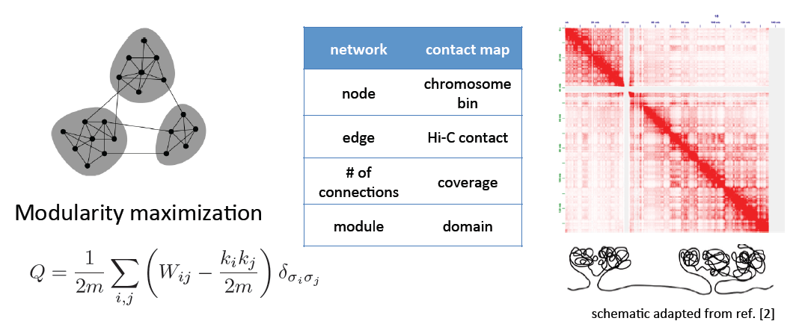
Identifying TADs in multiple resolutions
[Yan et al., PLOS Comp. Bio. (in revision, ‘17); bioRxiv 097345]

Slide 32
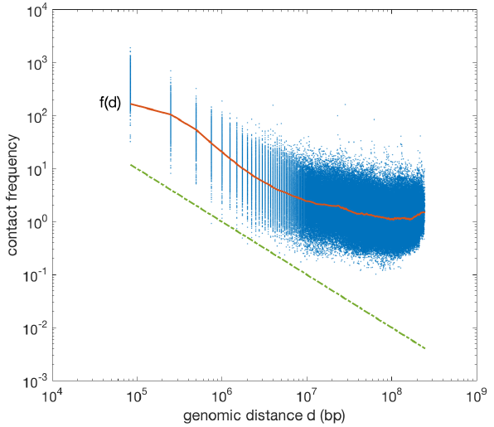


Identifying TADs in multiple resolutions
[Yan et al., PLOS Comp. Bio. (in revision, ‘17); bioRxiv 097345]

Slide 33
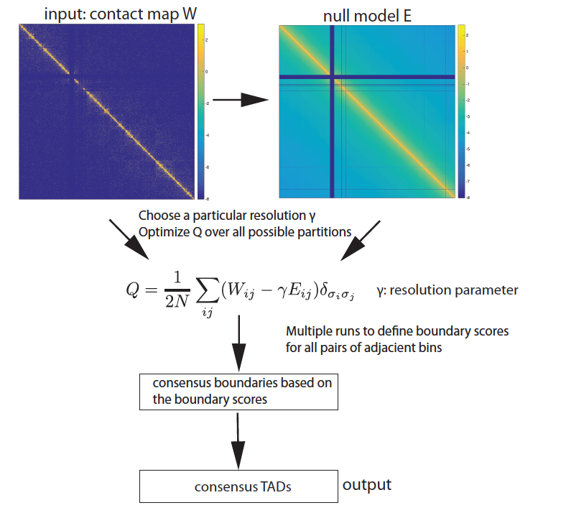

Identifying TADs in multiple resolutions
[Yan et al., PLOS Comp. Bio. (in revision, ‘17); bioRxiv 097345]
Numerically solve for
in equations

