Slide 1
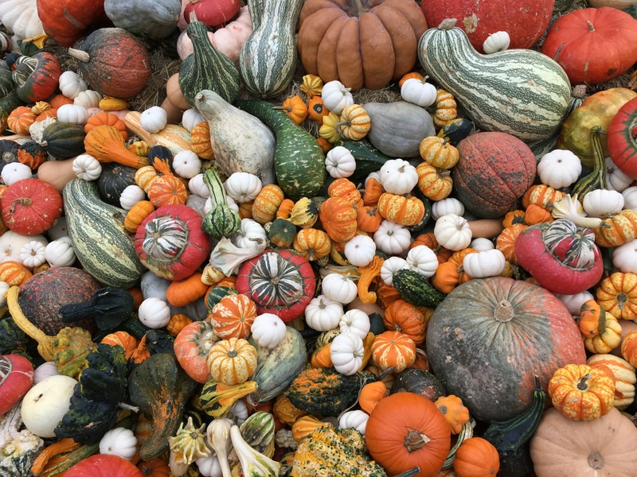
Thoughts on Genome Annotation, Prioritizing Variants & the Application of these
Concepts in a Disease Context
Mark Gerstein
Yale
Slides freely downloadable from Lectures.GersteinLab.org & “tweetable” (via @MarkGerstein).
No Conflicts for this Talk. See last slide for more info.

Slide 2

Overall Problem:
Finding Key Variants in
Personal Genomes
CAN YOU FIND THE PANDA?
  Millions of variants in a personal genome
  Thousands, in a cancer genome
  Different contexts for prioritization
  In rare disease, only a few
  high-impact variants are associated with disease
  In cancer, a few positively selected drivers amongst many passengers
  In common disease, more variants associated & each has weaker effect,
  But one wants to find key ”functional” variant amongst many in LD
Notes:
2

Slide 3
Overall Problem:
Finding Key Variants in
Personal Genomes
CAN YOU FIND THE PANDA?
  Millions of variants in a personal genome
  Thousands, in a cancer genome
  Different contexts for prioritization
  In rare disease, only a few
  high-impact variants are associated with disease
  In cancer, a few positively selected drivers amongst many passengers
  In common disease, more variants associated & each has weaker effect,
  But one wants to find key ”functional” variant amongst many in LD
  Thus: Need to find & prioritize high impact variants.
  Particularly hard for non-coding regions.
Notes:
3

Slide 4
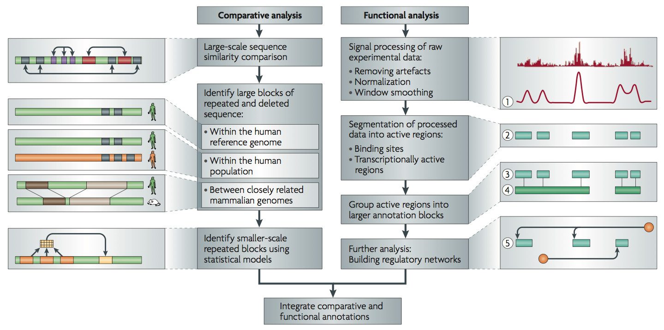
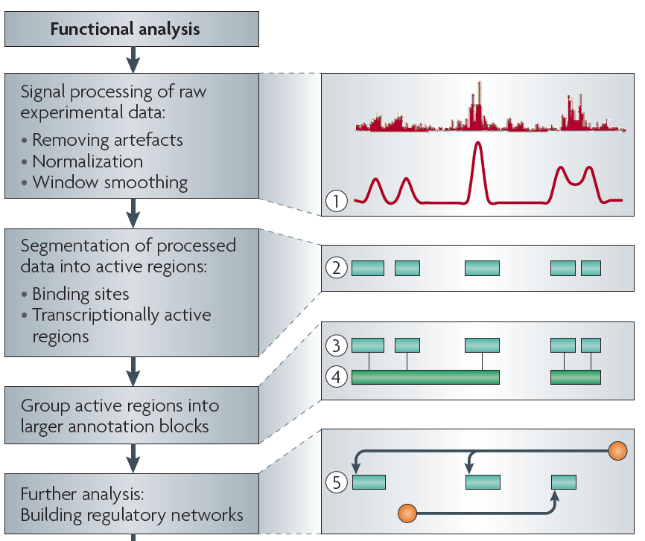
Non-coding Annotations: Overview
Features are often present on multiple ”scale” (eg elements and connected networks)
Sequence features, incl. Conservation
Functional Genomics
Chip-seq (Epigenome & seq. specific TF) and ncRNA & un-annotated transcription

Slide 5

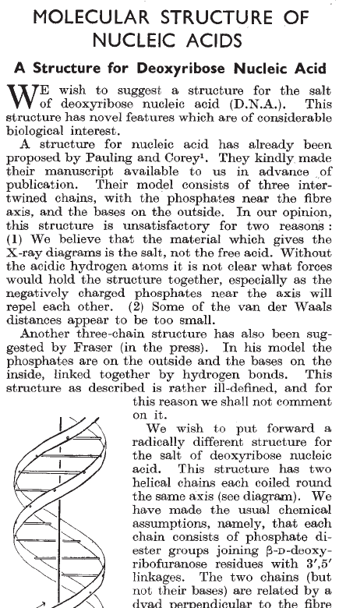
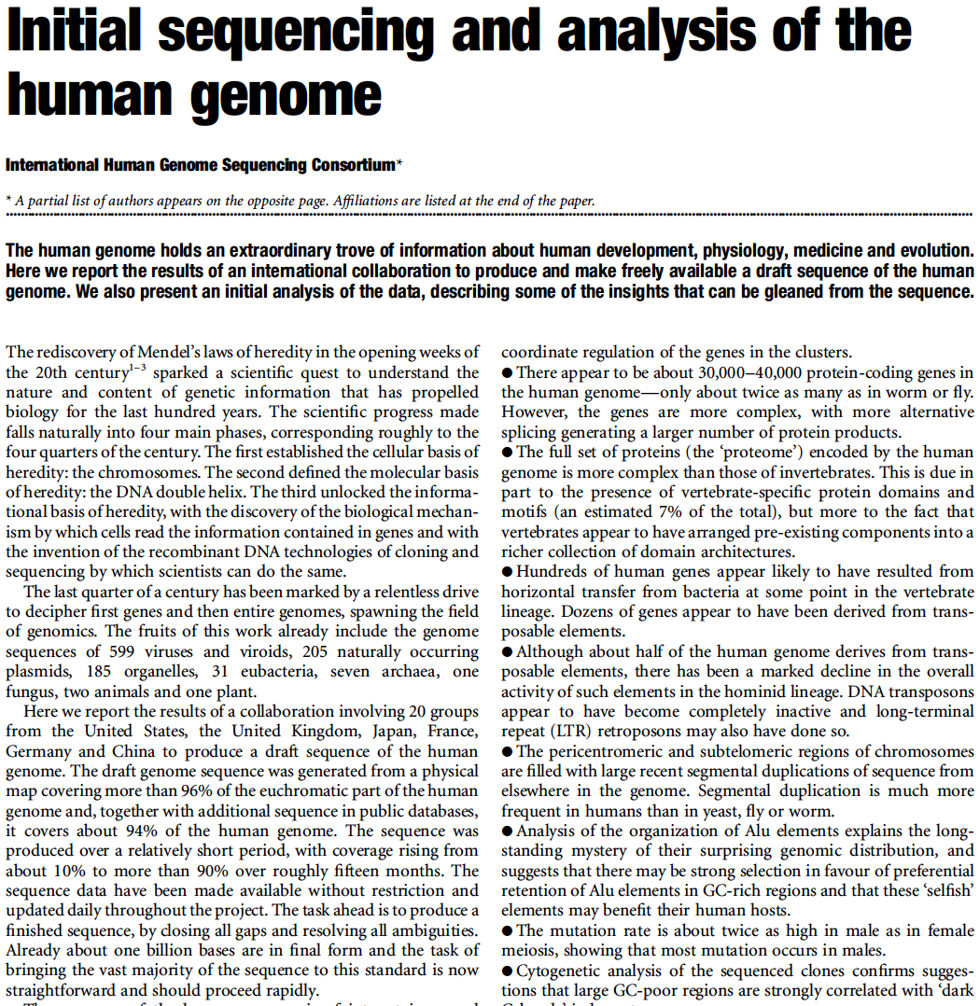
What is Annotation? (For Written Texts?)

Slide 6



Mutation recurrence
Cancer Type 1
Cancer Type 2
Cancer Type 3

Slide 7
Mutation recurrence
Cancer Type 1
Cancer Type 2
Cancer Type 3
Early replicated regions
Late replicated regions

Slide 8
Noncoding annotations
Cancer Type 1
Cancer Type 2
Cancer Type 3
Early replicated regions
Late replicated regions

Slide 9
Noncoding annotations
Cancer Type 1
Cancer Type 2
Cancer Type 3
Early replicated regions
Late replicated regions

Slide 10
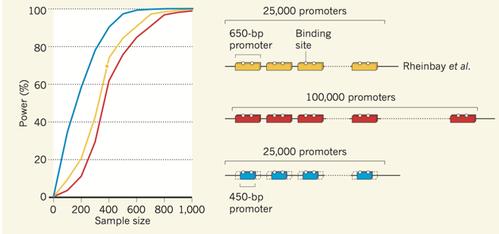
Power, as an issue in driver discovery
[Kumar & Gerstein, Nature ('17)]
Better annotation or large number of samples could help.

Slide 11
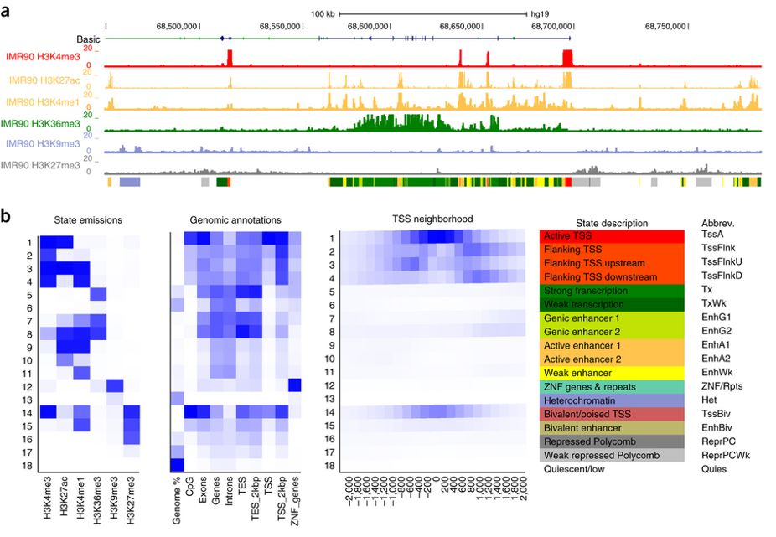
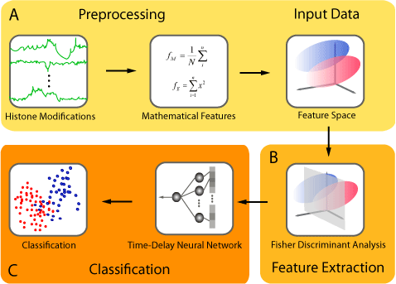
Background on computationally annotation
Peak calling:
  PeakSeq, SPP, MACS2, Hotspot …
  ENCODE Encyclopedia
Genome segmentation: partition the genome into regions (states) with distinct epigenomic profiles, then assign each state a functional label.
  ChromHMM: Multivariate Hidden Markov Model
  Segway: Dynamic Bayesian Network Model
Supervised regulatory prediction: learn predictive models from labeled dataset of regulatory elements.
  CSI-ANN: Time-Delay Neural Network
  RFECS: Random Forest
  DEEP: Ensemble SVM + Artificial Neural Network
  REPTILE: Random Forest
  gkm-SVM: Gapped k-mer
Target finding
  Ripple, TargetFinder, JEME, PreSTIGE, IM-PET
ChromHMM
J. Ernst, M. Kellis. Nat. Protoc., 2017
CSI-ANN
H.A. Firpi, D. Ucar, K. Tian. Bioinformatics, 2010

Slide 12
High-throughput approaches to dissect enhancer function
MPRA
Patwardhan RP, et al., Nat Biotech, 2009
Melnikov A, et al., Nat Biotech, 2012
Kheradpour P, et al, Genome Res, 2013
Birnbaum RY, et al, PLoS Genet, 2014
CRE-Seq
Kwasnieski JC, et al, PNAS, 2012
White MA, et al, PNAS, 2013
Kwasnieski JC, et al, Genome Res, 2014
MPFD
Patwardhan RP, et al., Nat Biotech, 2012
STARR-Seq
Arnold, CD, et al., Science, 2013
Arnold, CD, et al., Nat Genet, 2014
Shlyueva, D, et al, Mol Cell, 2014
Fumitaka and Ahituv, Genomics, 2015
TRIP
FIREWACh
SIF-Seq
Akhtar, W, et al., Cell, 2013
Murtha, M, et al., Nat Methods, 2014
Dickel, DE, et al., Nat Methods, 2014

Slide 13
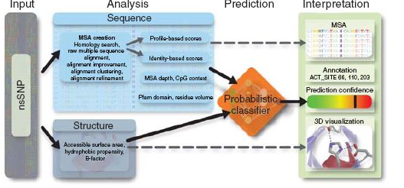
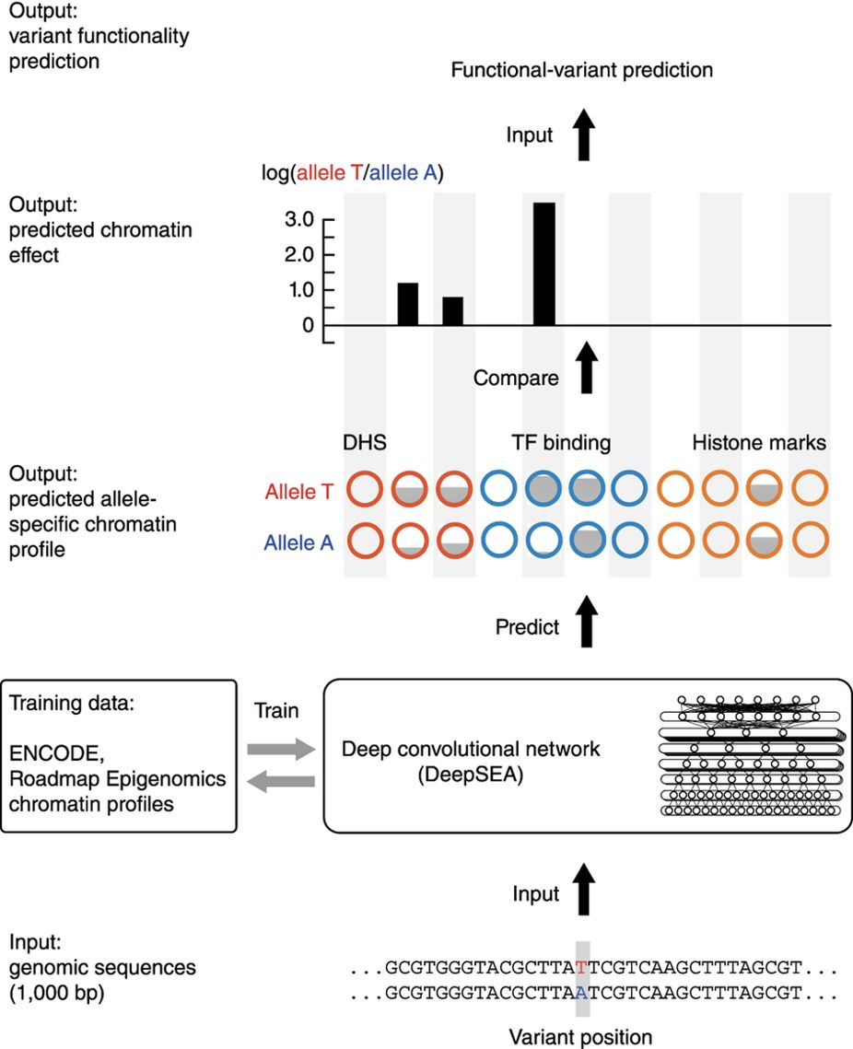
Genetic variant annotation: coding and noncoding
Tools developed specifically for coding variants:
  PolyPhen-2
  SnpEff
  SIFT
  ...
Tools developed specifically for noncoding variants:
  RegulomeDB
  HaploReg
  DeepSEA
  GWAVA
  ...
Tools for both coding and noncoding variants:
  CADD
  ANNOVAR
  VEP
  FATHMM-MKL
  ….
Polyphen-2
I.A. Adzhubei, et al. Nat. Methods, 2010
DeepSEA
J. Zhou, O.G. Troyanskaya, Nat. Methods, 2015

Slide 14
Thoughts on Genome Annotation, Prioritizing Variants &
Application of these concepts in a disease context
Background
  Types of variants: Germline, Somatic, &c
  Types of annotations: peaks, segmentations, model predictions
  Genomic covariates
Music
  Multi-scale peak calling
Matched Filter
  Integrating cross-assay signal-track patterns associated with enhancer
  Trained on high throughput STARR-seq experiments
  Validation in many different contexts
FunSeq
  Integrates evidence, with a “surprisal” based weighting scheme.
  Prioritizing variants within “sensitive sites” (human conserved)
RADAR
  Adapts FunSeq approach to RNA
  Prioritizes variants based on post-transcriptional regulome using ENCODE eCLIP
  Incorporates new features related to RNA sec. struc & tissue specific effects
uORFs
  Feature integration to find small subset of upstream mutations that potentially alter translation
LARVA & MOAT
  Uses parametric beta-binomial model, explicitly modeling covariates
  Non-parametric shuffles. Useful when explicit covariates not available.
PsychENCODE (Application)
    Population-level analysis of functional genomics data related to mental disease
    Single-cell deconvolution explaining across-population variation
    Large QTL resource (~2.5M eQTLs)
    Regulatory network construction using QTLs, Hi-C, & activity relationships. Used to link GWAS SNPs to genes.
    Embedding the reg. network in a deep-learning model (DSPN) to predict psychiatric disease phenotype from genotype and transcriptome data.

Slide 15
Thoughts on Genome Annotation, Prioritizing Variants &
Application of these concepts in a disease context
Background
  Types of variants: Germline, Somatic, &c
  Types of annotations: peaks, segmentations, model predictions
  Genomic covariates
Music
  Multi-scale peak calling
Matched Filter
  Integrating cross-assay signal-track patterns associated with enhancer
  Trained on high throughput STARR-seq experiments
  Validation in many different contexts
FunSeq
  Integrates evidence, with a “surprisal” based weighting scheme.
  Prioritizing variants within “sensitive sites” (human conserved)
RADAR
  Adapts FunSeq approach to RNA
  Prioritizes variants based on post-transcriptional regulome using ENCODE eCLIP
  Incorporates new features related to RNA sec. struc & tissue specific effects
uORFs
  Feature integration to find small subset of upstream mutations that potentially alter translation
LARVA & MOAT
  Uses parametric beta-binomial model, explicitly modeling covariates
  Non-parametric shuffles. Useful when explicit covariates not available.
PsychENCODE (Application)
    Population-level analysis of functional genomics data related to mental disease
    Single-cell deconvolution explaining across-population variation
    Large QTL resource (~2.5M eQTLs)
    Regulatory network construction using QTLs, Hi-C, & activity relationships. Used to link GWAS SNPs to genes.
    Embedding the reg. network in a deep-learning model (DSPN) to predict psychiatric disease phenotype from genotype and transcriptome data.

Slide 16
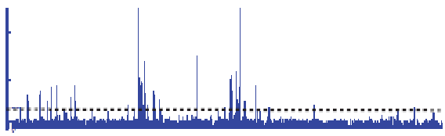

Summarizing the Signal:
"Traditional" ChipSeq Peak Calling
ChIP
Generate & threshold the signal profile to identify candidate target regions
  Simulation (PeakSeq),
  Local window based Poisson (MACS),
  Fold change statistics (SPP)
Threshold
Potential Targets
Normalized Control
Score against the control
Significantly Enriched targets
Now an update: "PeakSeq 2" => MUSIC
[Rozowsky et al. ('09) Nat Biotech]

Slide 17
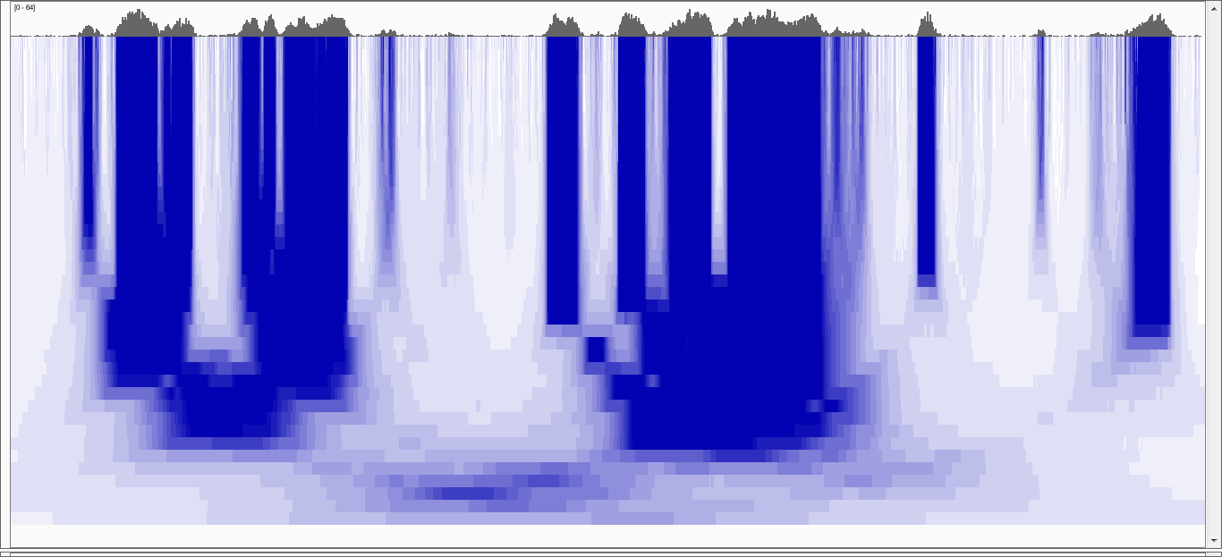
Multiscale Decomposition
20kb
100 b
Increasing Scale
100 kb
[Harmanci et al, Genome Biol. ('14)]
Notes:
To address the first issue, we use median based decomposition, which is median filtering the RD signal with increasing window lengths.
In order to perform median filtering with a window length, you take the signal and replace signal value at each point with the median of the values within the vicinity of that point.
In the figure, the RD signal is shown at the very top. In the bottom heatmap, each row is a filtered signal track in the decomposition.
White-> low, blue->high
Notice that the peaks in the signal get merged over the increasing scales.
Notice the “blocky” behavior of the decomposition where the edges are conserved over several scales before they die off rather quickly at a certain scale.

Slide 18
Multiscale Decomposition
Very
Punctate
ER
20kb
Broader
ER
Punctate
ER
Broad
ER
100 b
Increasing Scale
Very Broad
ER
100 kb
[Harmanci et al, Genome Biol. ('14)]
Notes:
In comparison with Gaussian decomp, median based decomp conserves the enriched regions upto a certain scale then removes them completely. Unlike
Gaussian, where all the signal features are transferred till the highest scale in the decomposition. This property makes median filtering a better candidate
For analysing the which scales levels are enriched in the signal

Slide 19
Thoughts on Genome Annotation, Prioritizing Variants &
Application of these concepts in a disease context
Background
  Types of variants: Germline, Somatic, &c
  Types of annotations: peaks, segmentations, model predictions
  Genomic covariates
Music
  Multi-scale peak calling
Matched Filter
  Integrating cross-assay signal-track patterns associated with enhancer
  Trained on high throughput STARR-seq experiments
  Validation in many different contexts
FunSeq
  Integrates evidence, with a “surprisal” based weighting scheme.
  Prioritizing variants within “sensitive sites” (human conserved)
RADAR
  Adapts FunSeq approach to RNA
  Prioritizes variants based on post-transcriptional regulome using ENCODE eCLIP
  Incorporates new features related to RNA sec. struc & tissue specific effects
uORFs
  Feature integration to find small subset of upstream mutations that potentially alter translation
LARVA & MOAT
  Uses parametric beta-binomial model, explicitly modeling covariates
  Non-parametric shuffles. Useful when explicit covariates not available.
PsychENCODE (Application)
    Population-level analysis of functional genomics data related to mental disease
    Single-cell deconvolution explaining across-population variation
    Large QTL resource (~2.5M eQTLs)
    Regulatory network construction using QTLs, Hi-C, & activity relationships. Used to link GWAS SNPs to genes.
    Embedding the reg. network in a deep-learning model (DSPN) to predict psychiatric disease phenotype from genotype and transcriptome data.

Slide 20
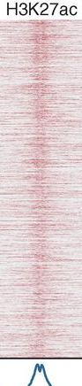
Unique shape associated histone signals flanking active enhancers identified through STARR-seq
Arnold, et al., Science
Shlyueva, et al., Nat Rev Genet
Nie, et al., PloS one

Slide 21
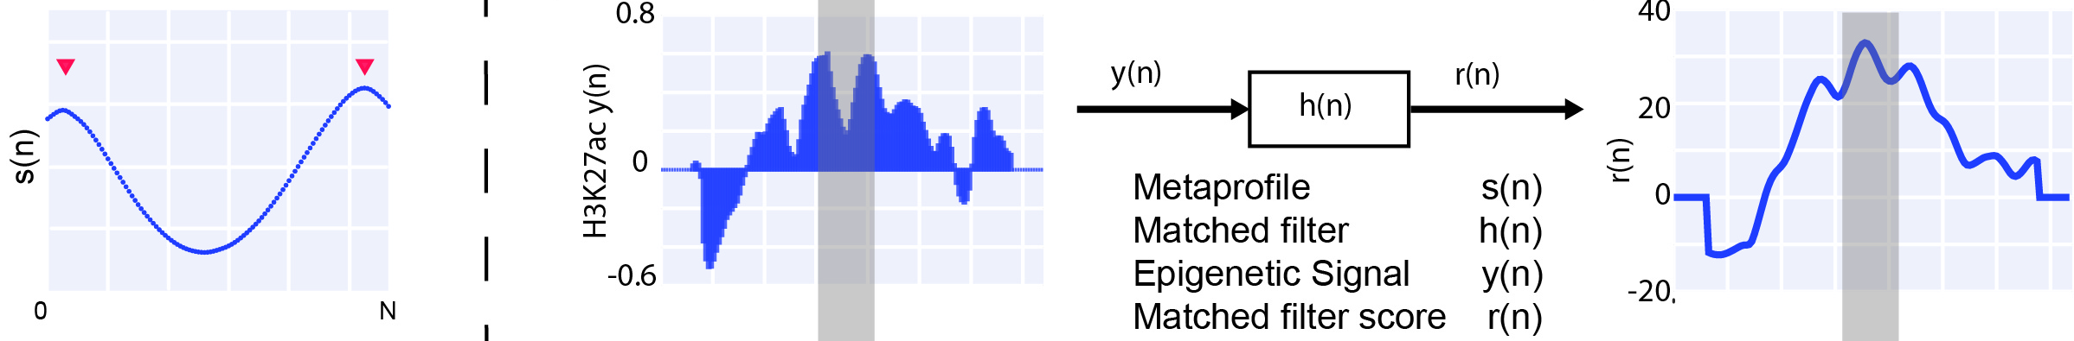
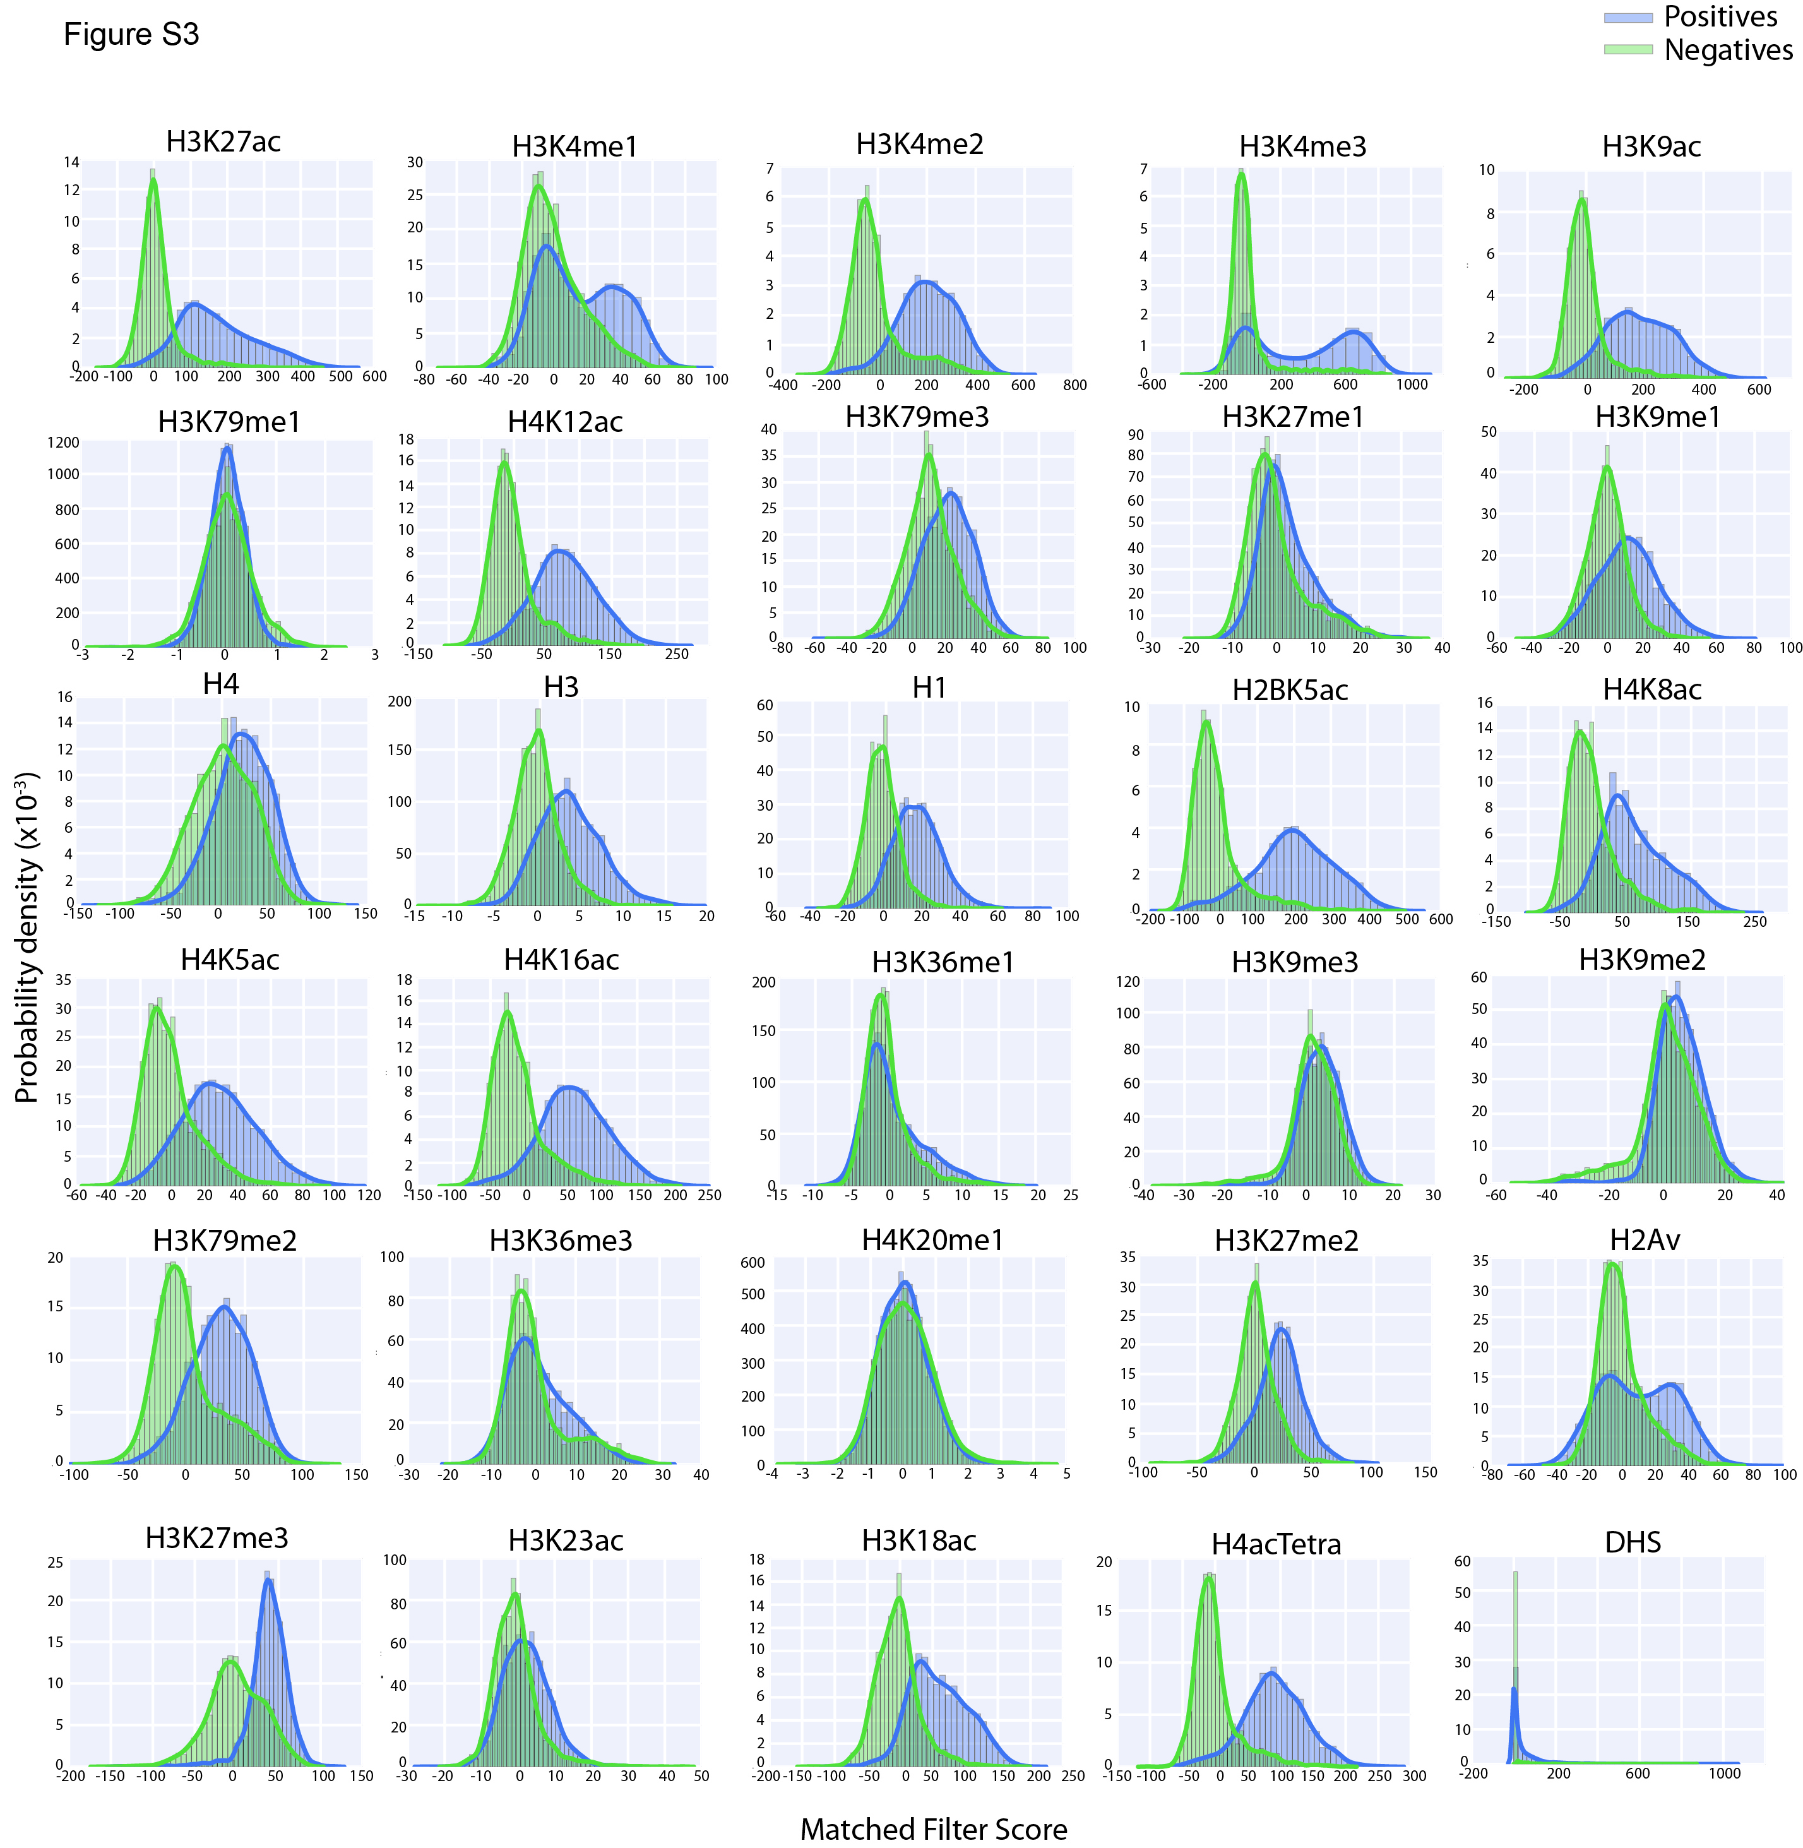
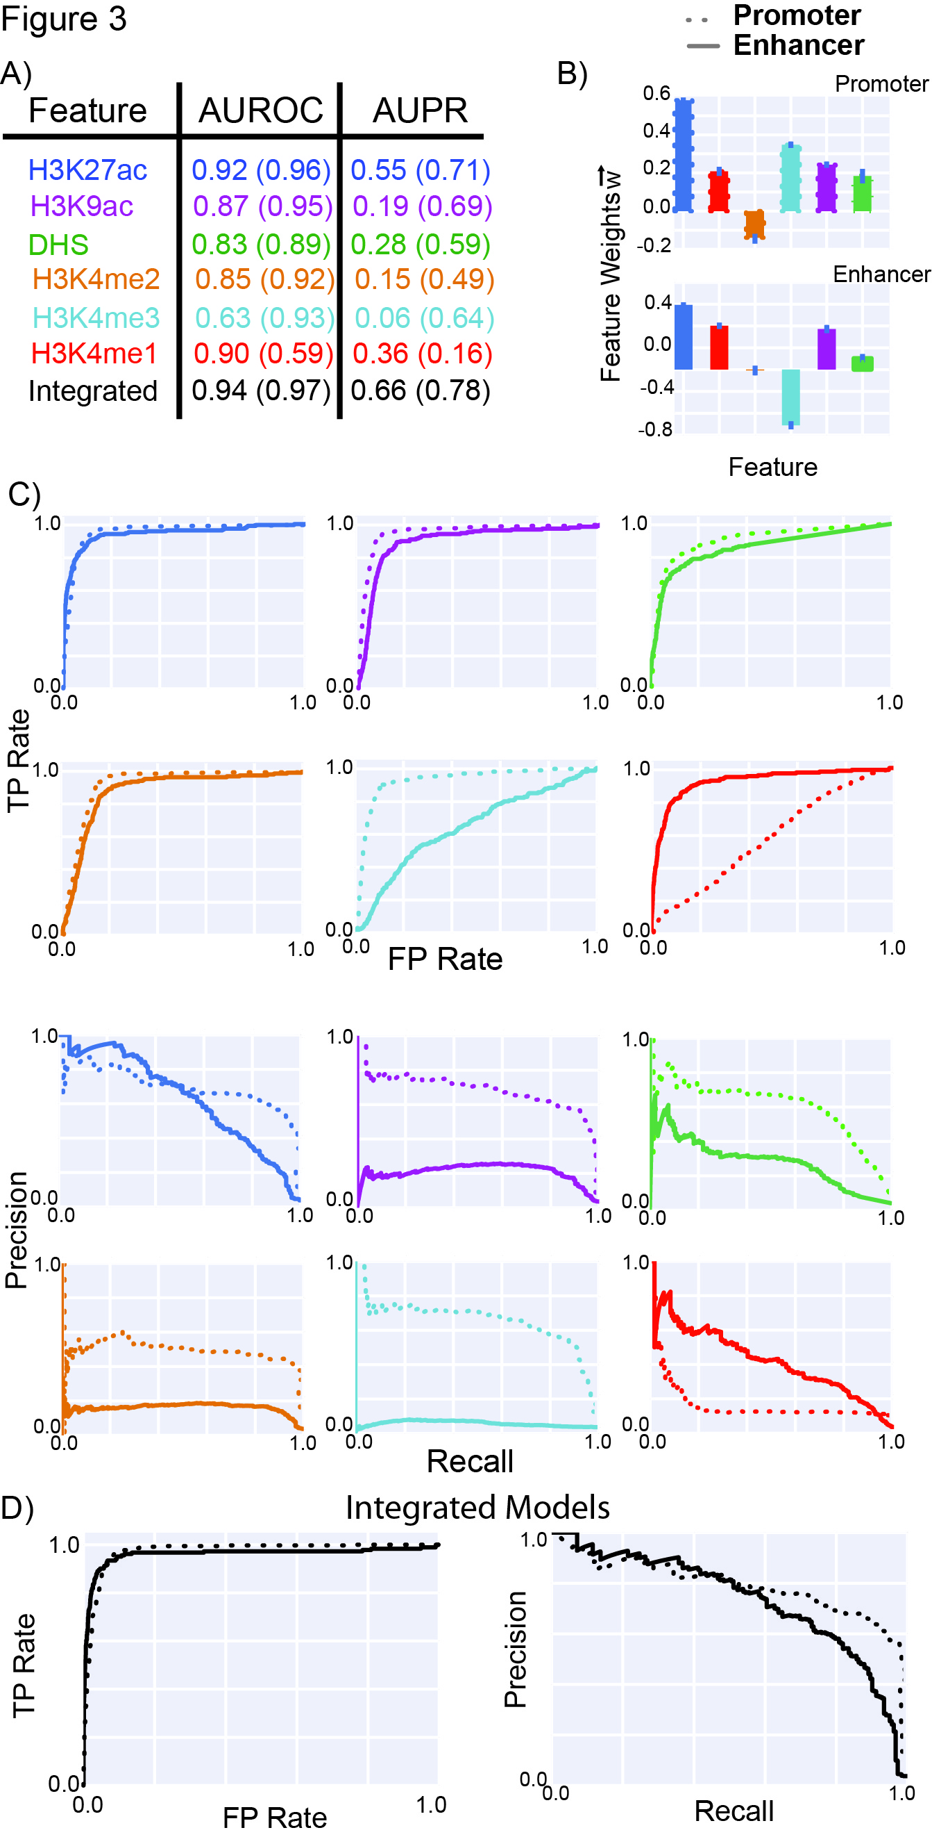
Matched Filter recognize shape patterns
Matched Filter
Score STARR-seq regulatory regions VS random negatives
Evaluate using ROC curve
H3K4me3
H3K4me1
[ biorxiv.org/content/early/2018/08/05/385237 ]

Slide 22
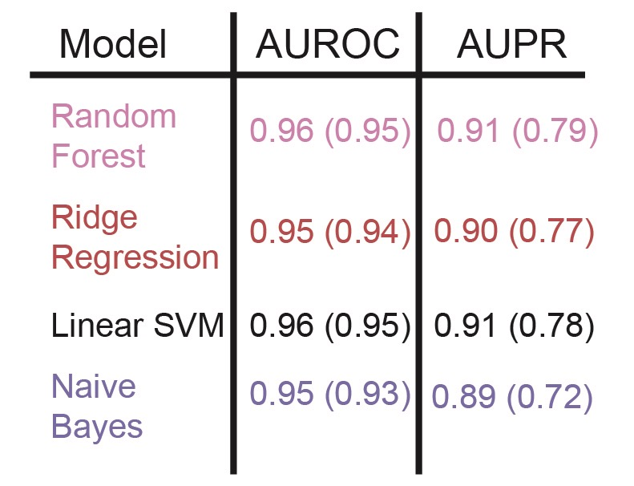
Integrate matched filter scores of multiple features
Large scale STARR-seq experiment data helps to improve the performance of integrated model
Cross validation
[ biorxiv.org/content/early/2018/08/05/385237 ]

Slide 23
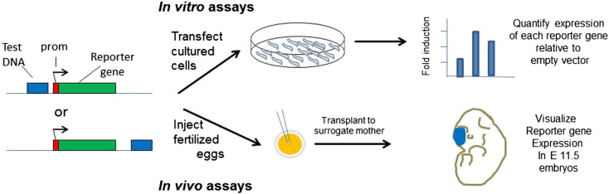
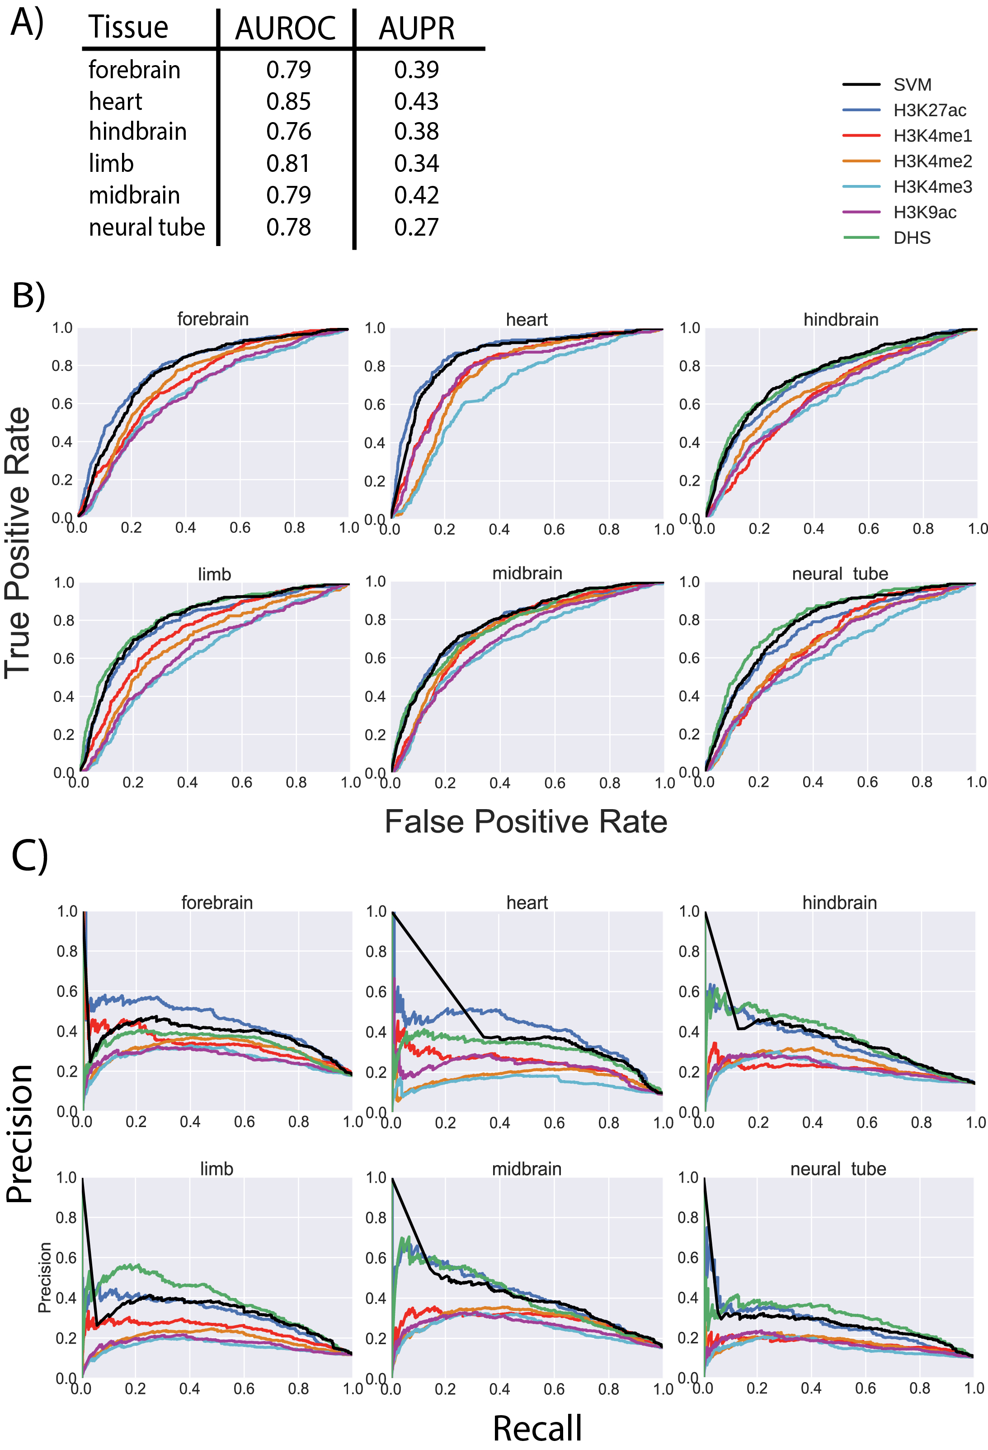
Validation with transgenic mouse enhancer assay
Inject fertilized eggs
False Positive Rate
[ biorxiv.org/content/early/2018/08/05/385237 ]

Slide 24
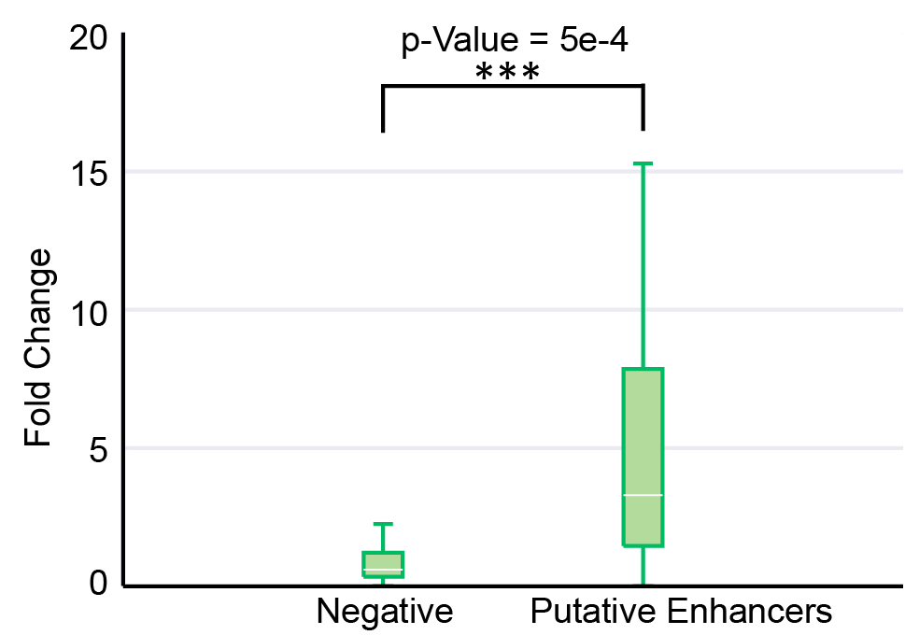
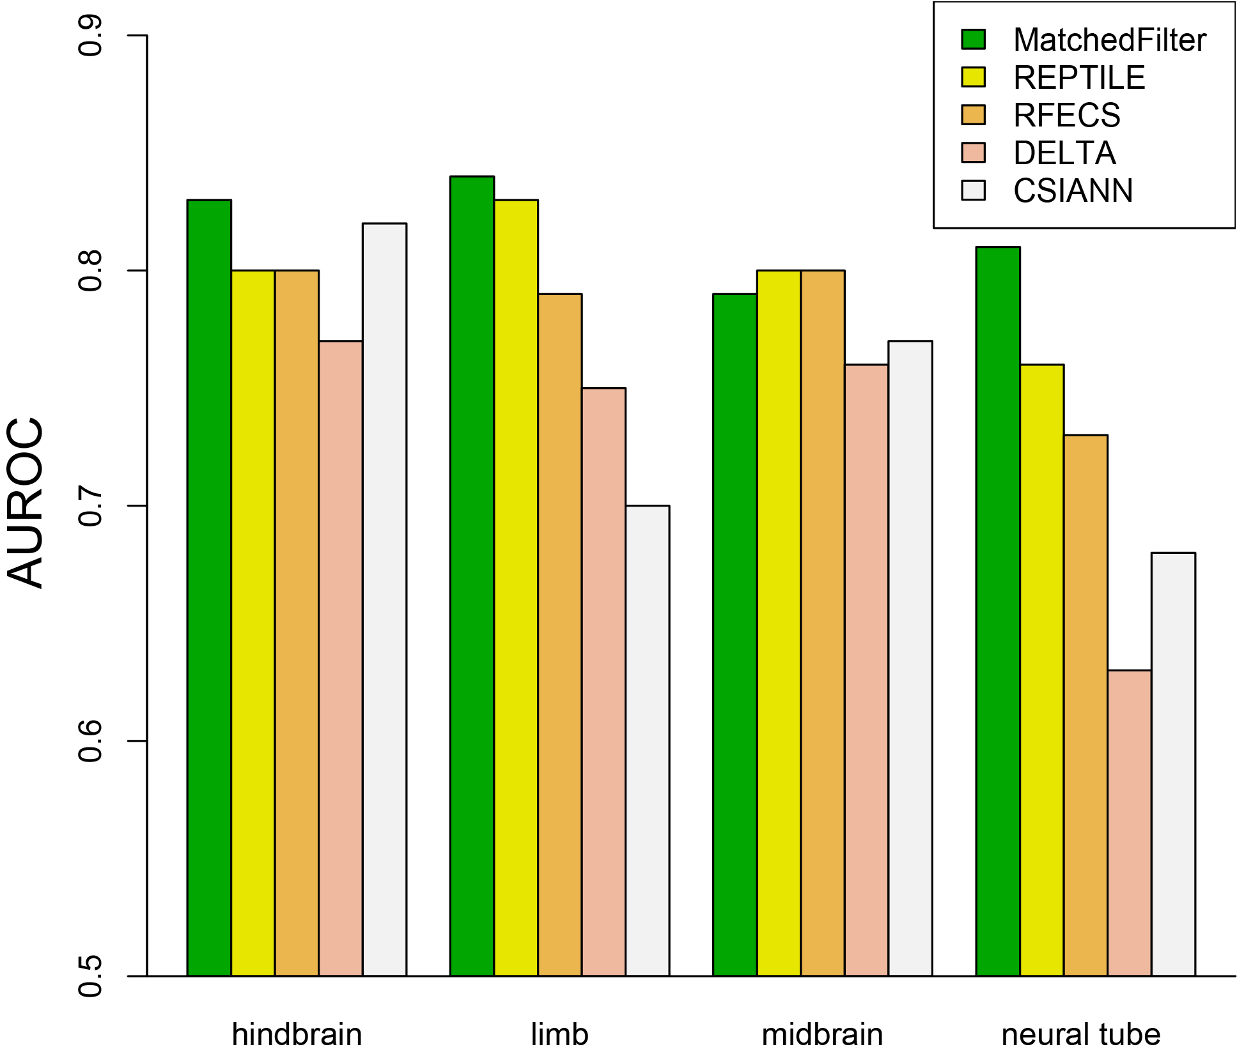
Matched-Filter can be applied across different organisms
Validation using transduction-based reporter assay (H1-hESC, HOS, A549 and TZMBL)
Compare overlap with FANTOM5 enhancers
Compare Matched-Filter performance with other state-of-the-art methods
[ biorxiv.org/content/early/2018/08/05/385237 ]

Slide 25
Constructing a high-confidence set of cell-specific enhancers

Slide 26
Thoughts on Genome Annotation, Prioritizing Variants &
Application of these concepts in a disease context
Background
  Types of variants: Germline, Somatic, &c
  Types of annotations: peaks, segmentations, model predictions
  Genomic covariates
Music
  Multi-scale peak calling
Matched Filter
  Integrating cross-assay signal-track patterns associated with enhancer
  Trained on high throughput STARR-seq experiments
  Validation in many different contexts
FunSeq
  Integrates evidence, with a “surprisal” based weighting scheme.
  Prioritizing variants within “sensitive sites” (human conserved)
RADAR
  Adapts FunSeq approach to RNA
  Prioritizes variants based on post-transcriptional regulome using ENCODE eCLIP
  Incorporates new features related to RNA sec. struc & tissue specific effects
uORFs
  Feature integration to find small subset of upstream mutations that potentially alter translation
LARVA & MOAT
  Uses parametric beta-binomial model, explicitly modeling covariates
  Non-parametric shuffles. Useful when explicit covariates not available.
PsychENCODE (Application)
    Population-level analysis of functional genomics data related to mental disease
    Single-cell deconvolution explaining across-population variation
    Large QTL resource (~2.5M eQTLs)
    Regulatory network construction using QTLs, Hi-C, & activity relationships. Used to link GWAS SNPs to genes.
    Embedding the reg. network in a deep-learning model (DSPN) to predict psychiatric disease phenotype from genotype and transcriptome data.

Slide 27
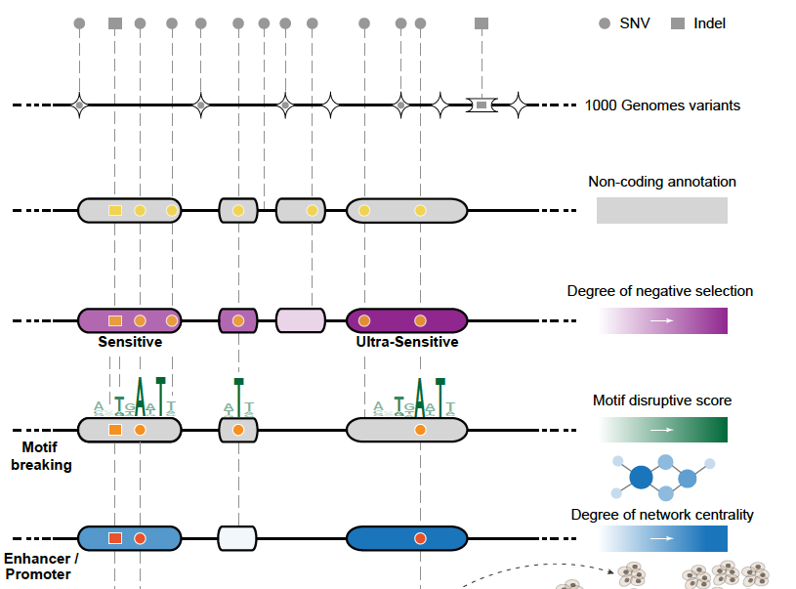
Funseq: a flexible framework to determine
functional impact & use this to prioritize variants
Annotation (tf binding sites open chromatin, ncRNAs) & Chromatin Dynamics
Conservation
(GERP, allele freq.)
Mutational impact (motif breaking, Lof)
Network (centrality position)
[Fu et al., GenomeBiology ('14), , Khurana et al., Science ('13)]

Slide 28
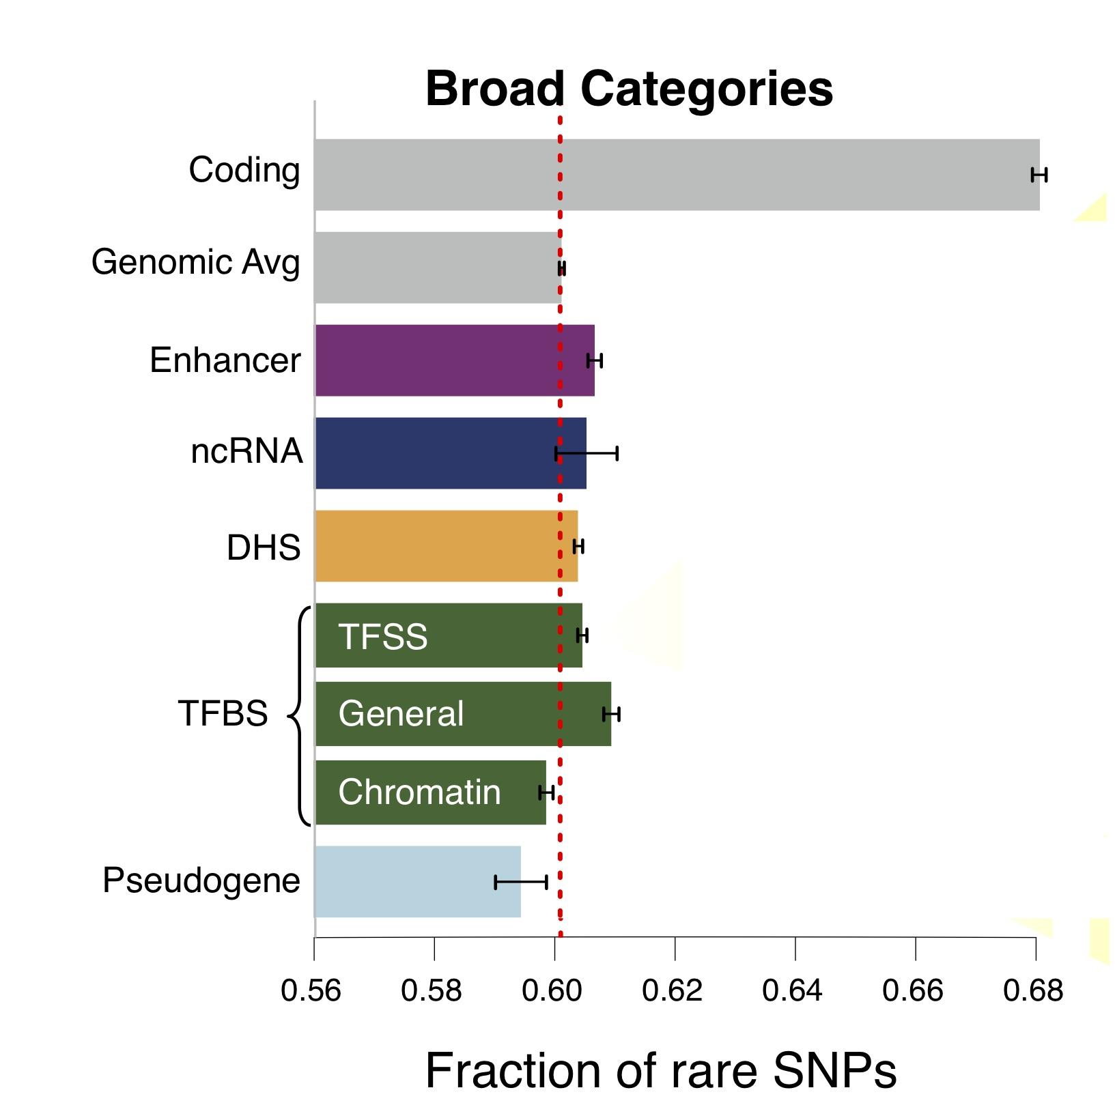
Finding "Conserved” Sites in the Human Population:
Negative selection in non-coding elements based on
Production ENCODE & 1000G Phase 1
Broad categories of regulatory regions under negative selection
Related to:
ENCODE, Nature, 2012
Ward & Kellis, Science, 2012
Mu et al, NAR, 2011
(Non-coding RNA)
(DNase I hypersensitive sites)
(TFSS: Sequence-specific TFs)
(Transcription factor binding sites)
Depletion of Common Variants
in the Human Population

Slide 29
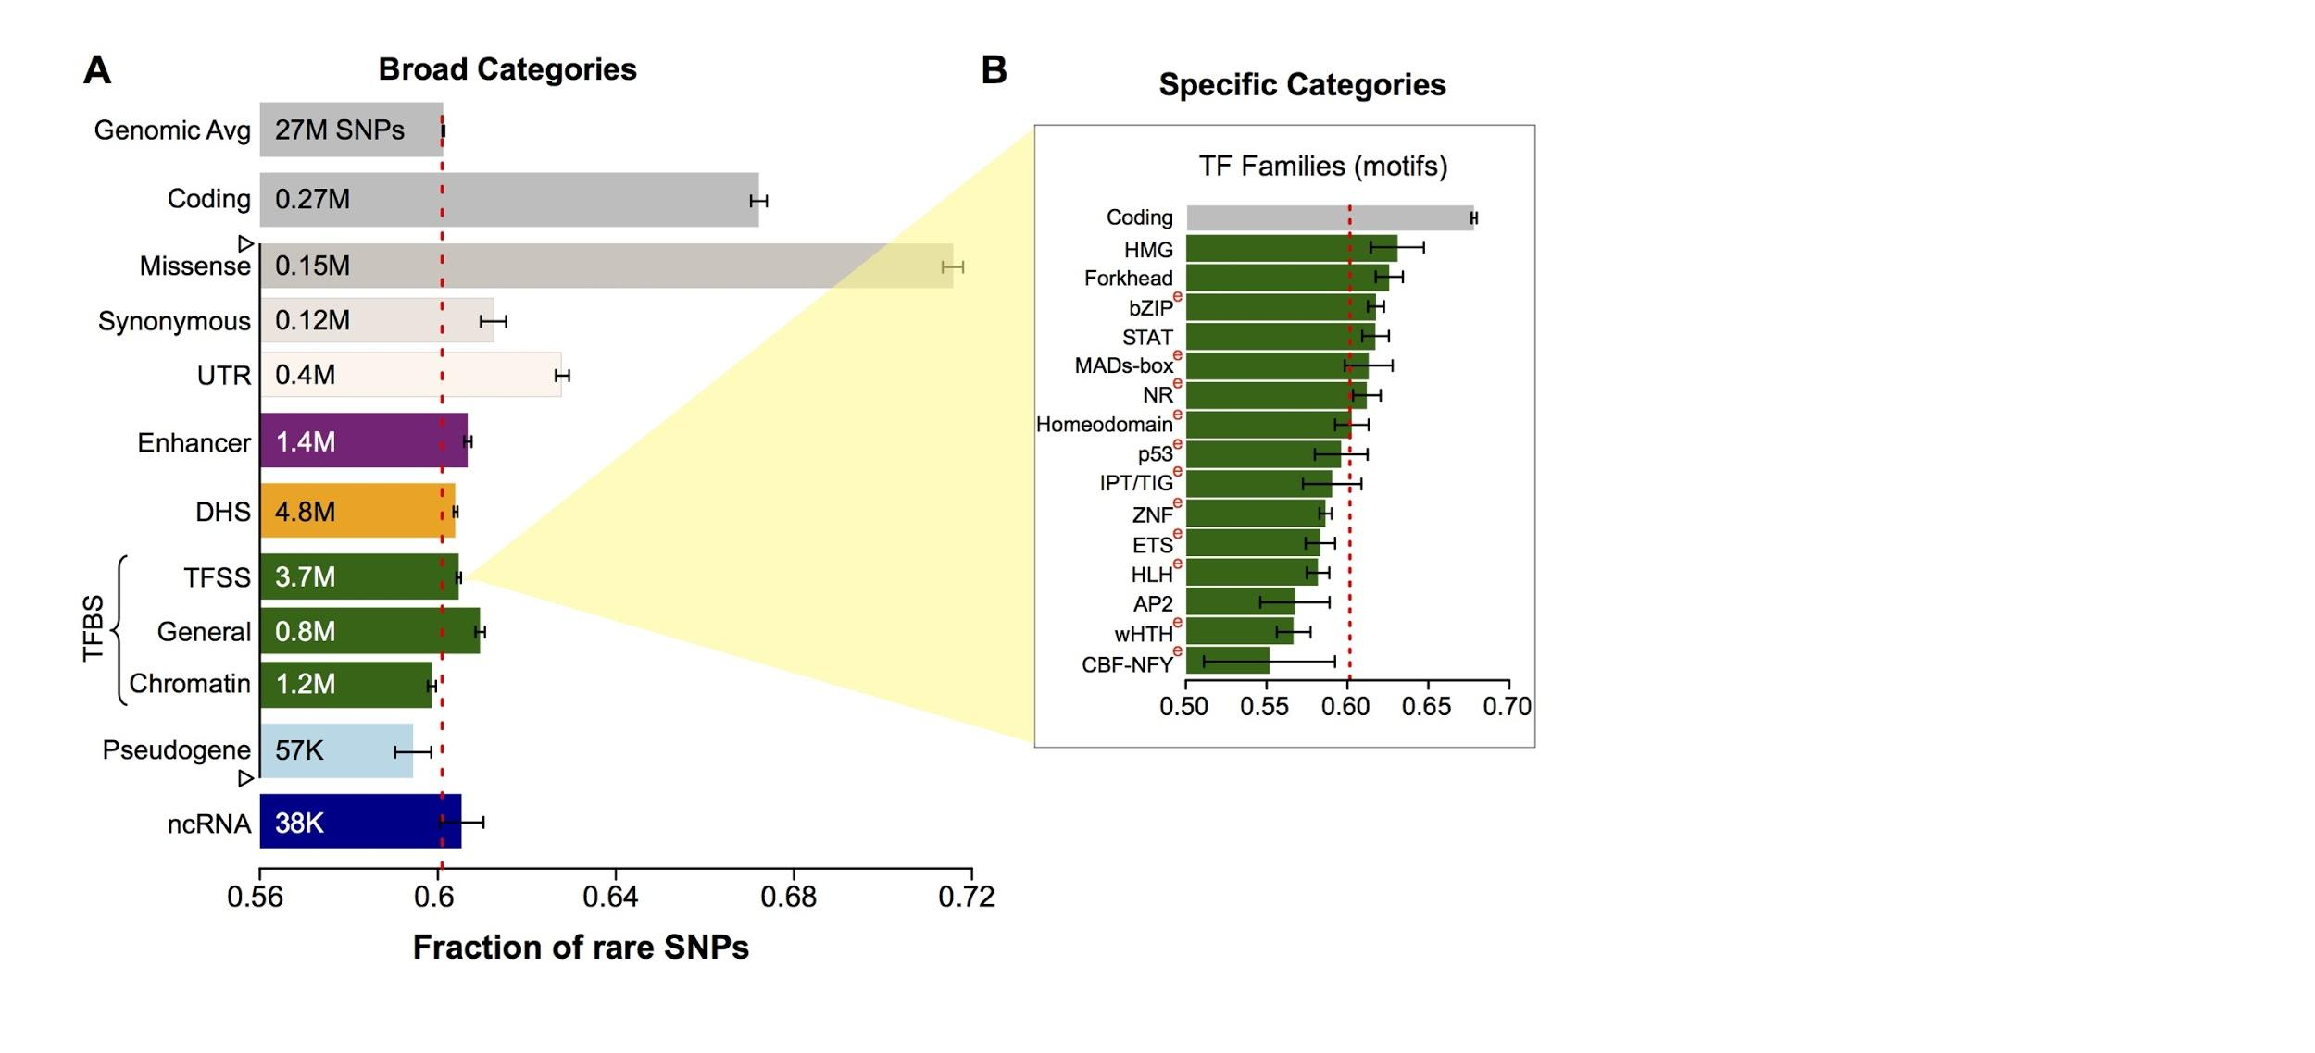
Differential selective constraints
among specific sub-categories
Sub-categorization possible because of better statistics from 1000G phase 1 v pilot
[Khurana et al., Science (‘13)]

Slide 30
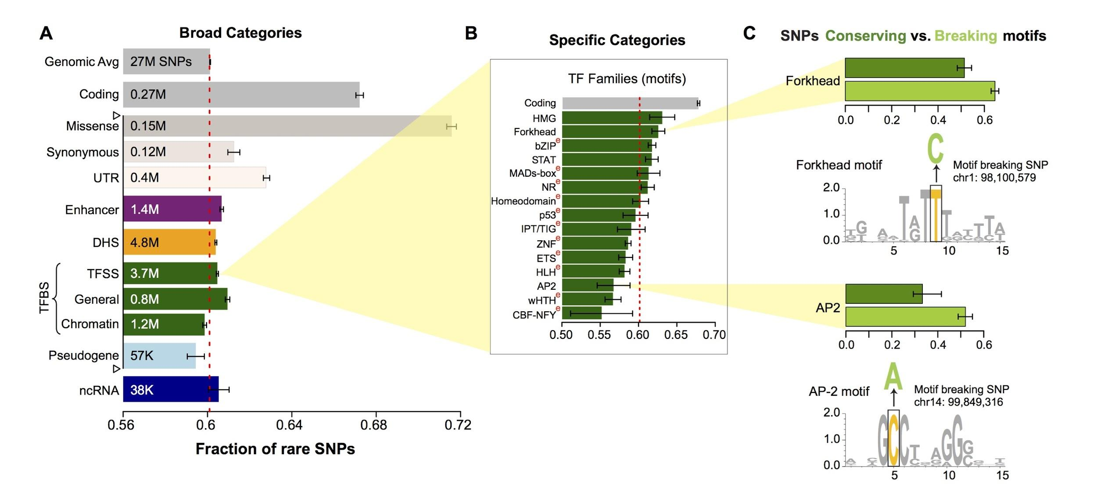
SNPs which break TF motifs are under stronger selection
[Khurana et al., Science (‘13)]

Slide 31
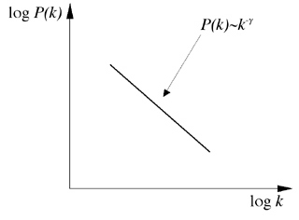
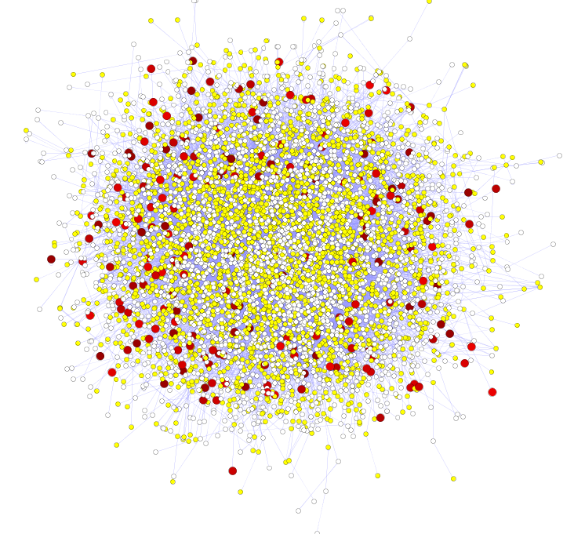
Hubs Under Constraint:
A Finding from the Network Biology Community
Power-law distribution
Hub
log(Frequency)
High likelihood of positive selection
Not under positive selection
Lower likelihood of positive selection
No data about positive selection
log(Degree)
[Nielsen et al. PLoS Biol. (2005), HPRD, Kim et al. PNAS (2007)]
More Connectivity, More Constraint: Genes & proteins that have a more central position in the network tend to evolve more slowly and are more likely to be essential.
This phenomenon is observed in
many organisms & different kinds of networks
  yeast PPI - Fraser et al ('02) Science,
  ('03) BMC Evo. Bio.
  Ecoli PPI - Butland et al ('04) Nature
  Worm/fly PPI - Hahn et al ('05) MBE
  miRNA net - Cheng et al ('09) BMC Genomics

Slide 32
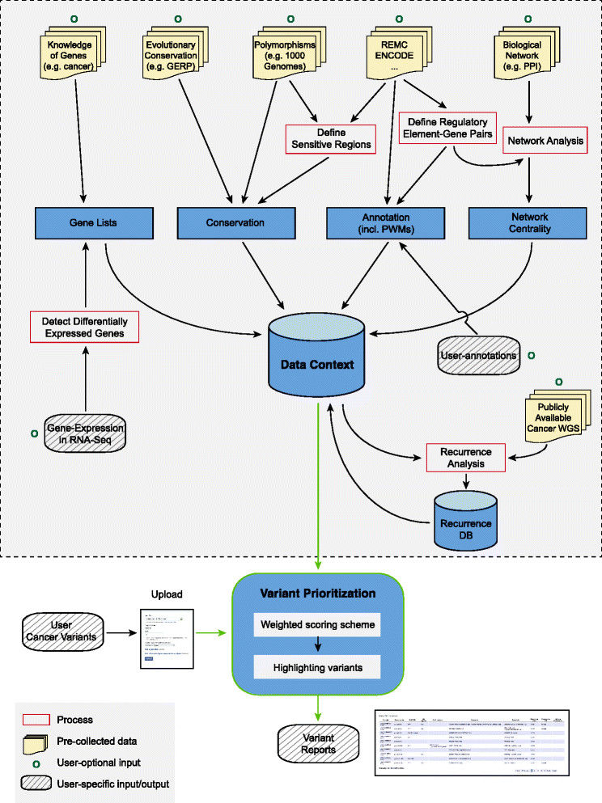
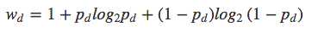
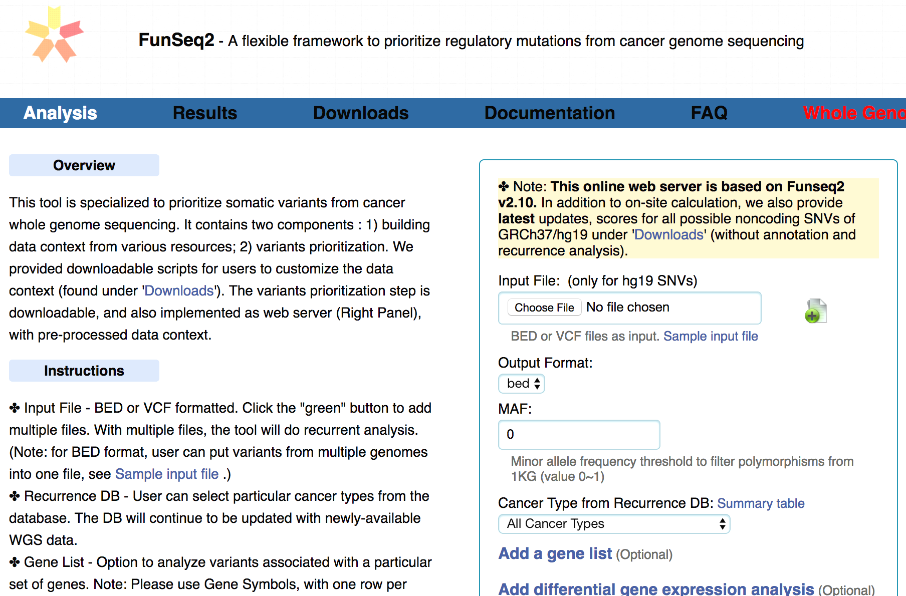
FunSeq.gersteinlab.org
HOT region
Sensitive region
Polymorphisms
Genome
Info. theory based method (ie annotation “surprisal”) for weighting consistently many genomic features
Practical web server
Submission of variants & pre-computed large data context from uniformly processing large-scale datasets
[Fu et al., GenomeBiology ('14)]

Slide 33
Thoughts on Genome Annotation, Prioritizing Variants &
Application of these concepts in a disease context
Background
  Types of variants: Germline, Somatic, &c
  Types of annotations: peaks, segmentations, model predictions
  Genomic covariates
Music
  Multi-scale peak calling
Matched Filter
  Integrating cross-assay signal-track patterns associated with enhancer
  Trained on high throughput STARR-seq experiments
  Validation in many different contexts
FunSeq
  Integrates evidence, with a “surprisal” based weighting scheme.
  Prioritizing variants within “sensitive sites” (human conserved)
RADAR
  Adapts FunSeq approach to RNA
  Prioritizes variants based on post-transcriptional regulome using ENCODE eCLIP
  Incorporates new features related to RNA sec. struc & tissue specific effects
uORFs
  Feature integration to find small subset of upstream mutations that potentially alter translation
LARVA & MOAT
  Uses parametric beta-binomial model, explicitly modeling covariates
  Non-parametric shuffles. Useful when explicit covariates not available.
PsychENCODE (Application)
    Population-level analysis of functional genomics data related to mental disease
    Single-cell deconvolution explaining across-population variation
    Large QTL resource (~2.5M eQTLs)
    Regulatory network construction using QTLs, Hi-C, & activity relationships. Used to link GWAS SNPs to genes.
    Embedding the reg. network in a deep-learning model (DSPN) to predict psychiatric disease phenotype from genotype and transcriptome data.

Slide 34
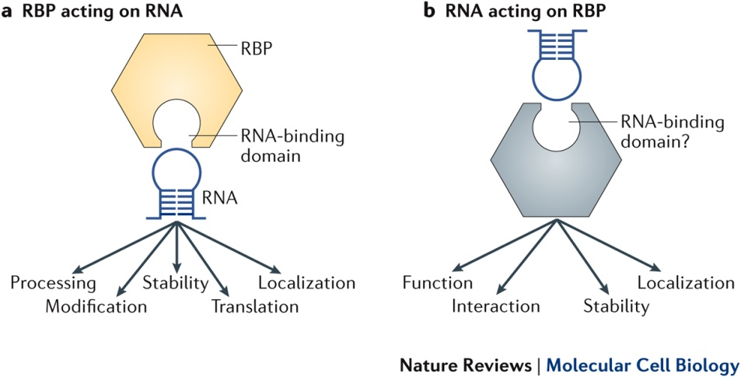
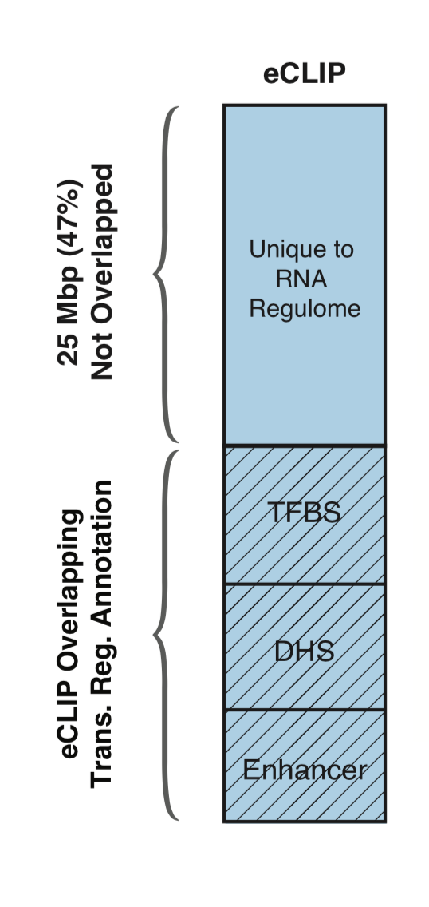
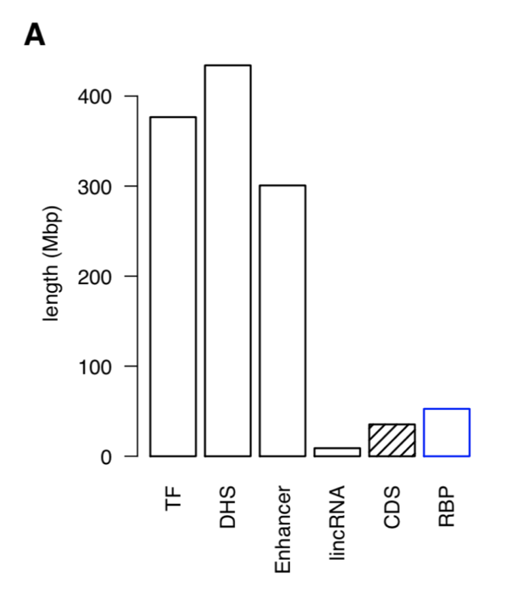
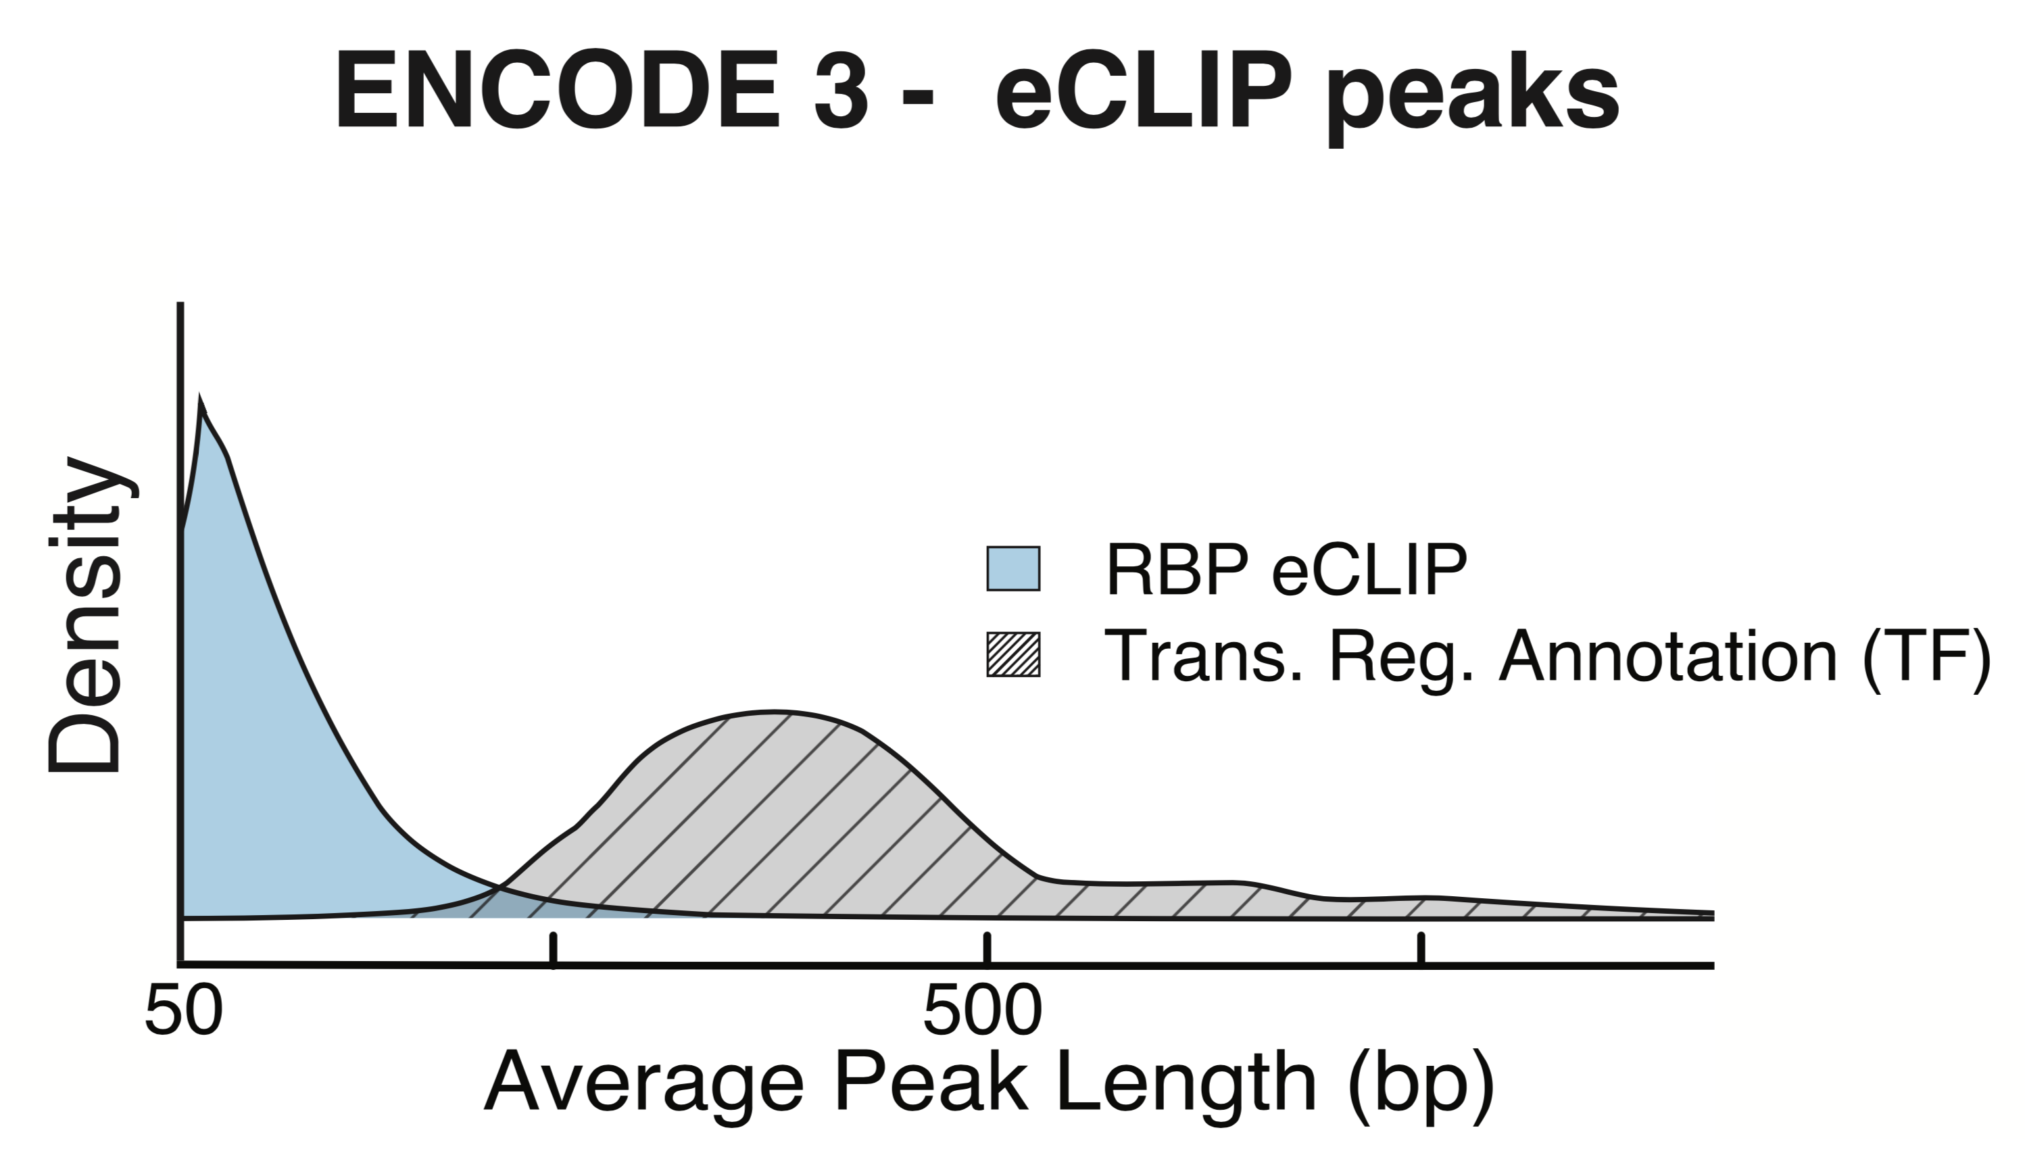
RNA Binding Proteins (RBPs)
Before ENCODE3: >150 expt.
in many different cell types
ENCODE3 did ~350 focused eCLIP expt. for >110 RBPs on HepG2 & K562
(Van Nostrand...Yeo. Nat. Meth. '16;
Van Nostrand...Graveley, Yeo
(submitted in relation to ENCODE3))
Nat Rev Mol Cell Biol. 2018 May;19(5):327-341. doi: 10.1038/nrm.2017.130. Epub 2018 Jan 17.
[Zhang*, Liu* et al., Genome Biology (in review ‘18)]

Slide 35
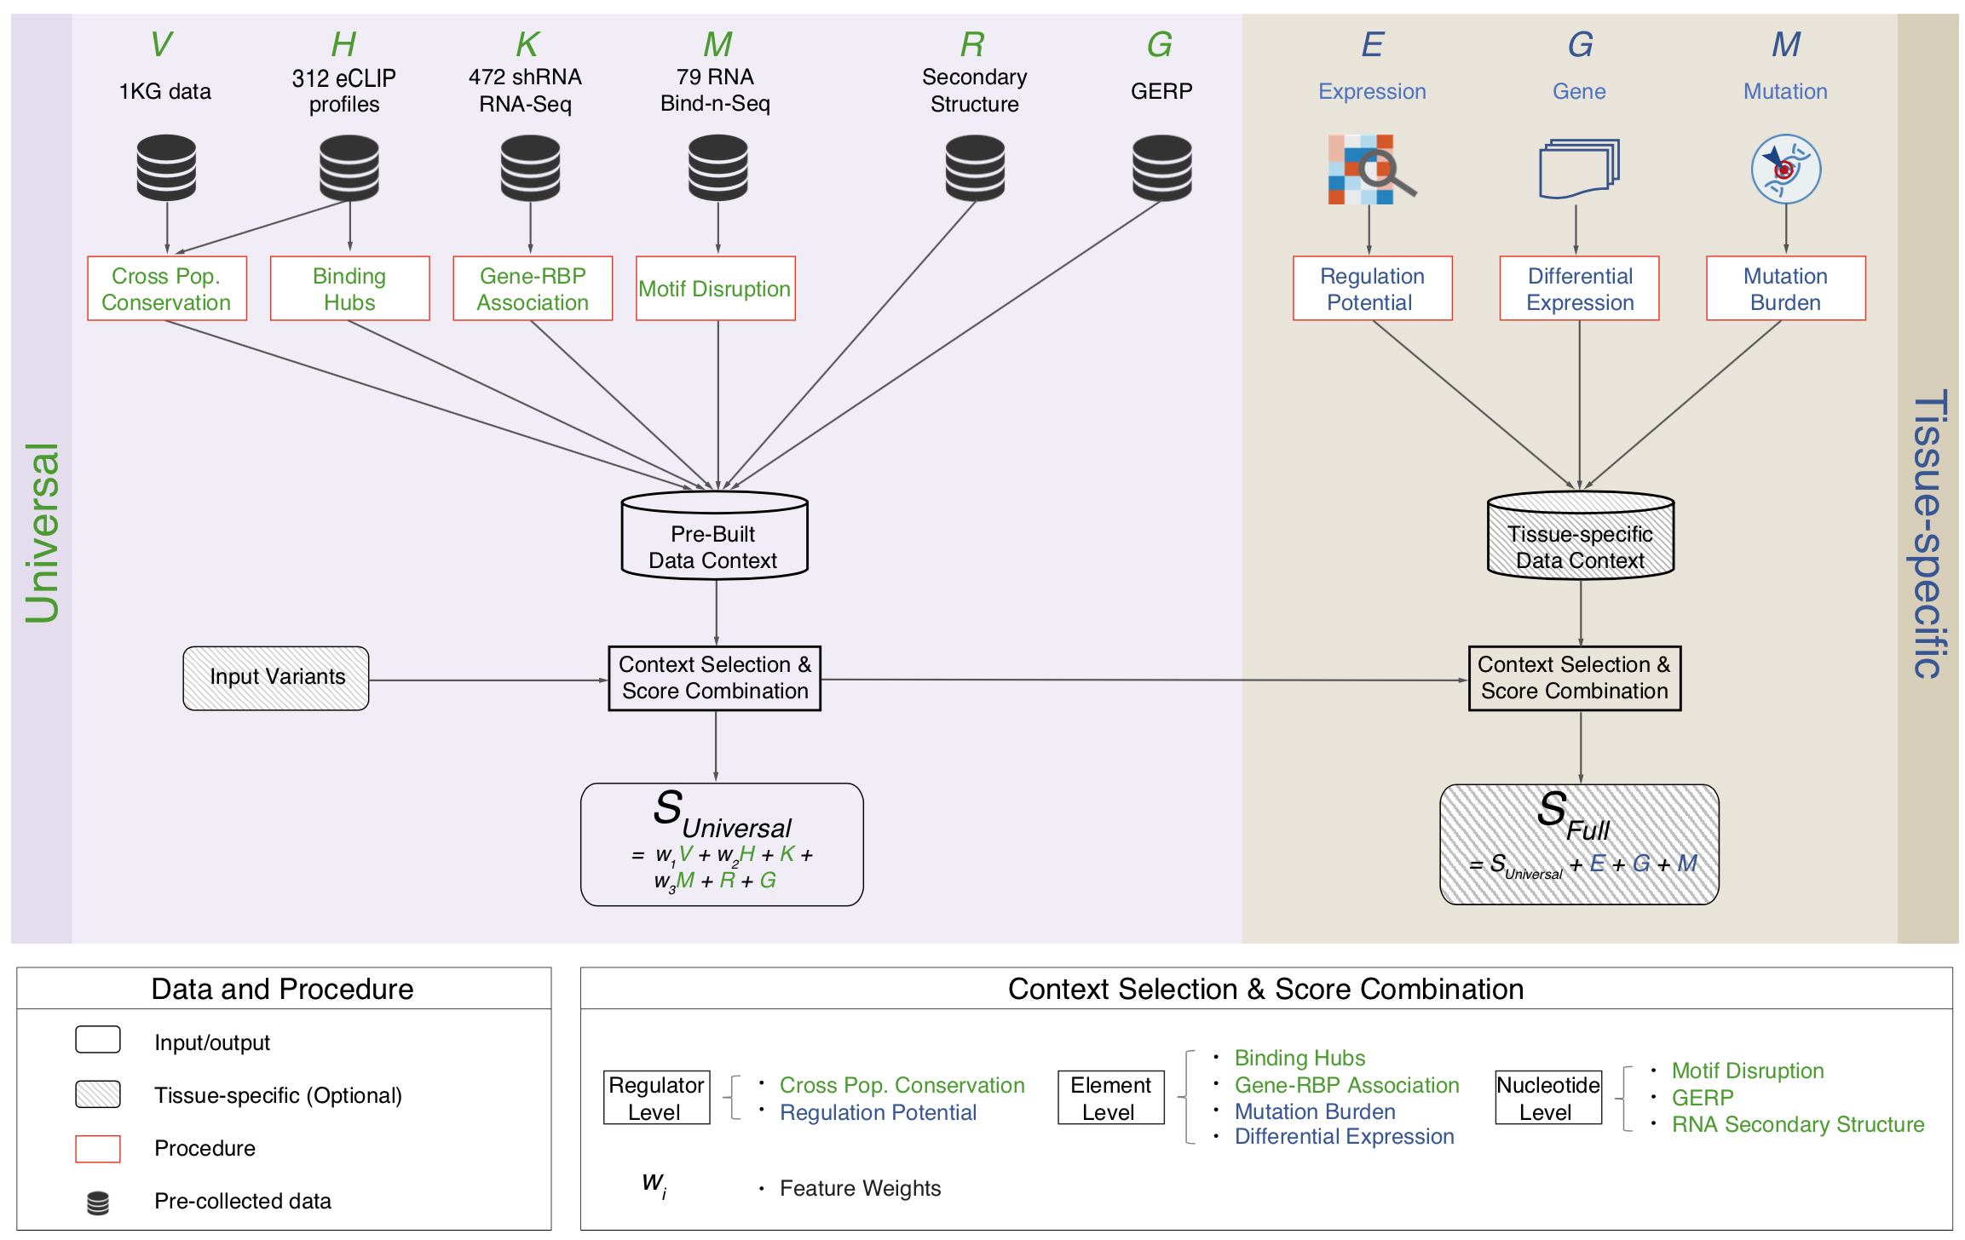
Schematic of RADAR Scoring
[Zhang*, Liu* et al., Genome Biology (in review ‘18)]

Slide 36
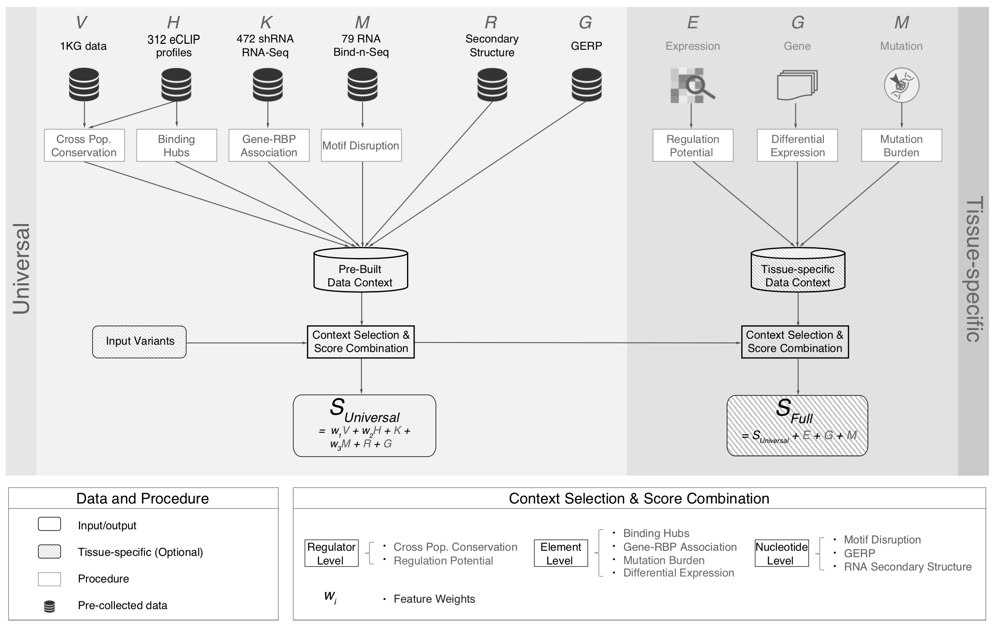
[Zhang*, Liu* et al., Genome Biology (in review ‘18)]

Slide 37
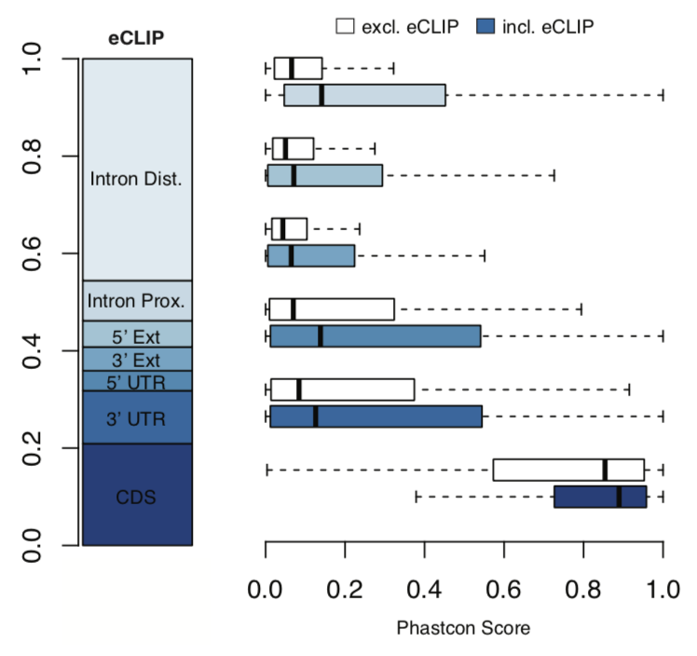
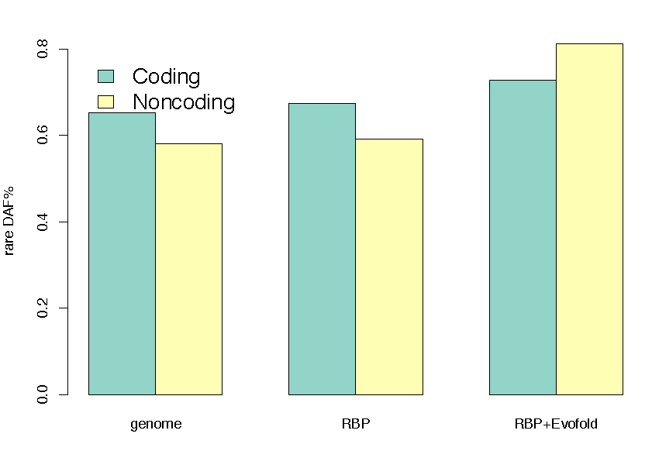
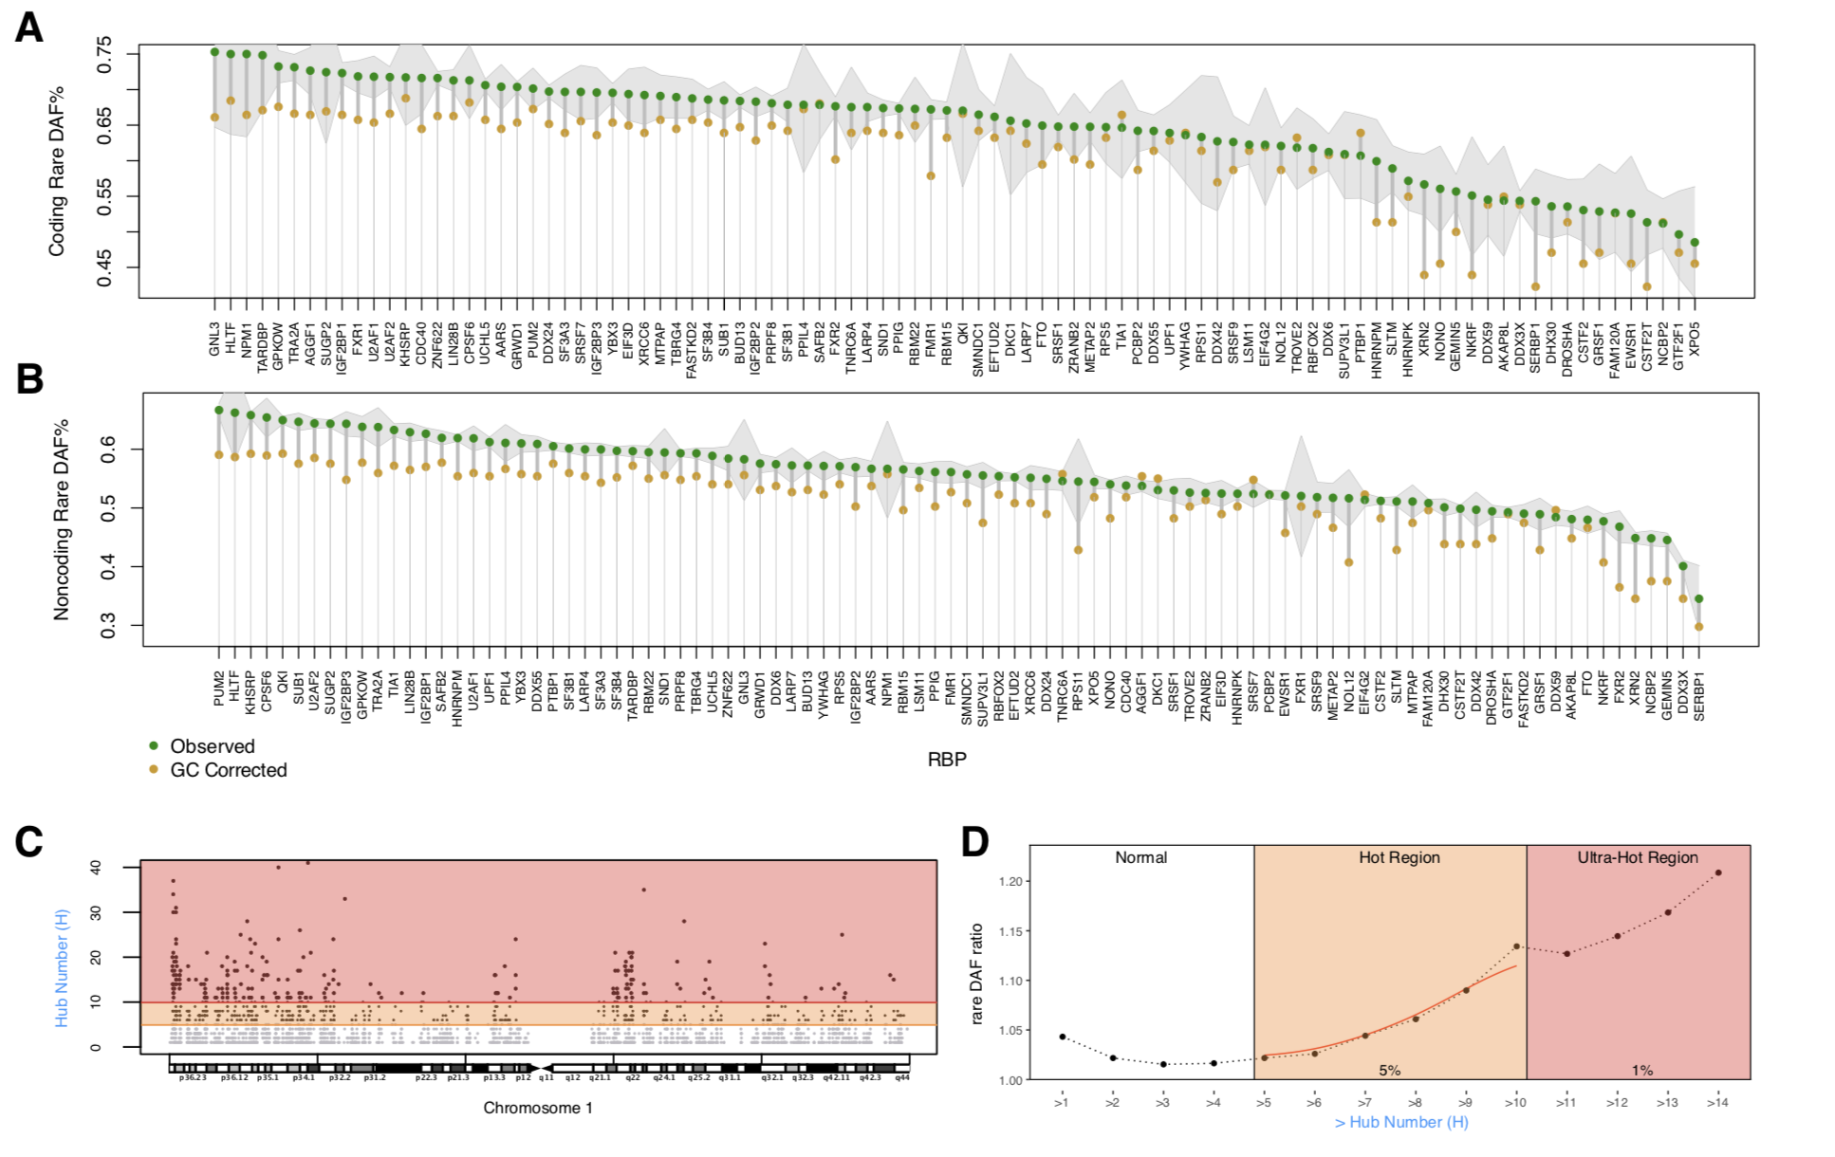
High Phastcon in RBP-overlapped annotations
RNA Structure Cons. from Evofold
Phastcon
Enriched rare DAF in eCLIP peaks
Rare DAF
[Zhang*, Liu* et al., Genome Biology (in review ‘18)]
RBP

Slide 38
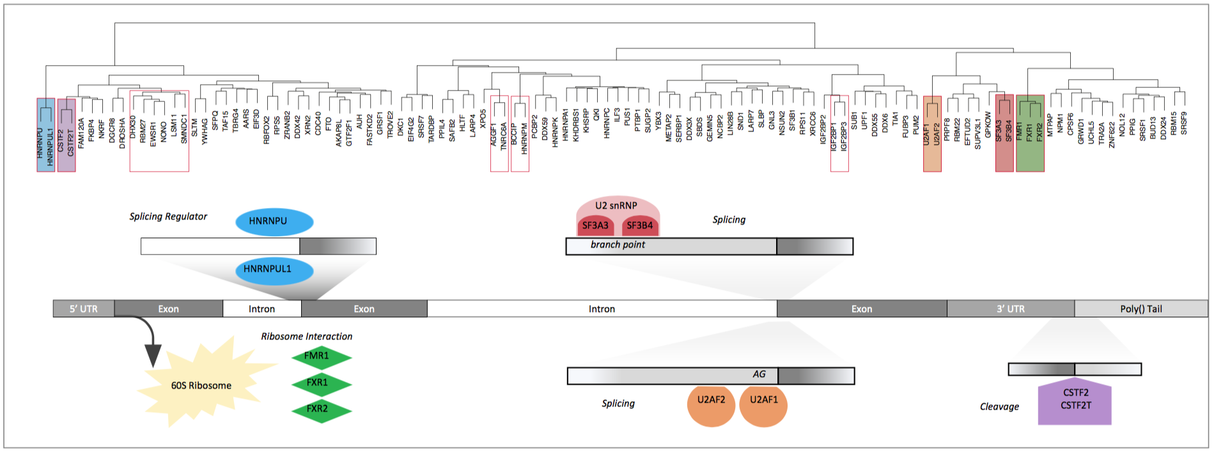
Co-binding of RBPs form biologically relevant complexes
Unique co-binding patterns of RBPs
Literature supported RBP complexes
RBP
RBP
Binding hubs are enriched for rare variants
Hub Number
(Hotness)
Rare DAF
[Zhang*, Liu* et al., Genome Biology (in review ‘18)]
Hub Number (Hotness)

Slide 39
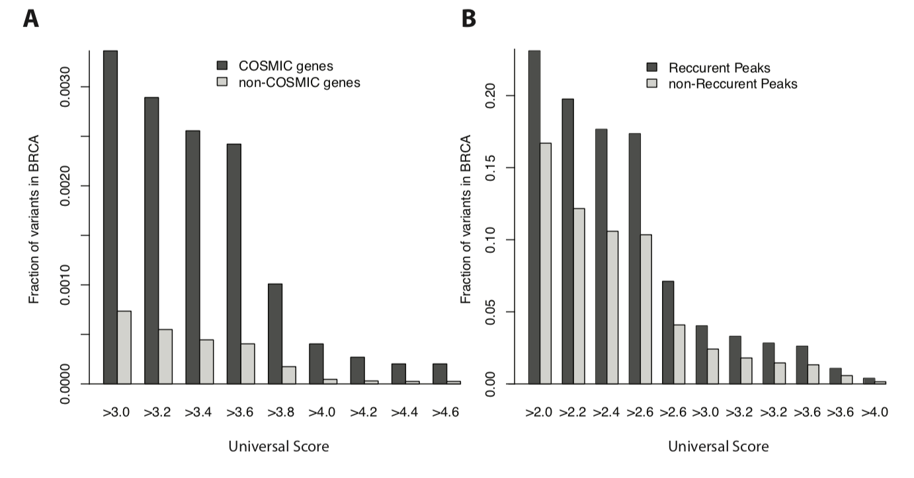
Validation for Somatic Variants:
RADAR Scores enriched in COSMIC genes & recurrently mutated regions
+ higher for tissue matched context

Slide 40
Thoughts on Genome Annotation, Prioritizing Variants &
Application of these concepts in a disease context
Background
  Types of variants: Germline, Somatic, &c
  Types of annotations: peaks, segmentations, model predictions
  Genomic covariates
Music
  Multi-scale peak calling
Matched Filter
  Integrating cross-assay signal-track patterns associated with enhancer
  Trained on high throughput STARR-seq experiments
  Validation in many different contexts
FunSeq
  Integrates evidence, with a “surprisal” based weighting scheme.
  Prioritizing variants within “sensitive sites” (human conserved)
RADAR
  Adapts FunSeq approach to RNA
  Prioritizes variants based on post-transcriptional regulome using ENCODE eCLIP
  Incorporates new features related to RNA sec. struc & tissue specific effects
uORFs
  Feature integration to find small subset of upstream mutations that potentially alter translation
LARVA & MOAT
  Uses parametric beta-binomial model, explicitly modeling covariates
  Non-parametric shuffles. Useful when explicit covariates not available.
PsychENCODE (Application)
    Population-level analysis of functional genomics data related to mental disease
    Single-cell deconvolution explaining across-population variation
    Large QTL resource (~2.5M eQTLs)
    Regulatory network construction using QTLs, Hi-C, & activity relationships. Used to link GWAS SNPs to genes.
    Embedding the reg. network in a deep-learning model (DSPN) to predict psychiatric disease phenotype from genotype and transcriptome data.

Slide 41
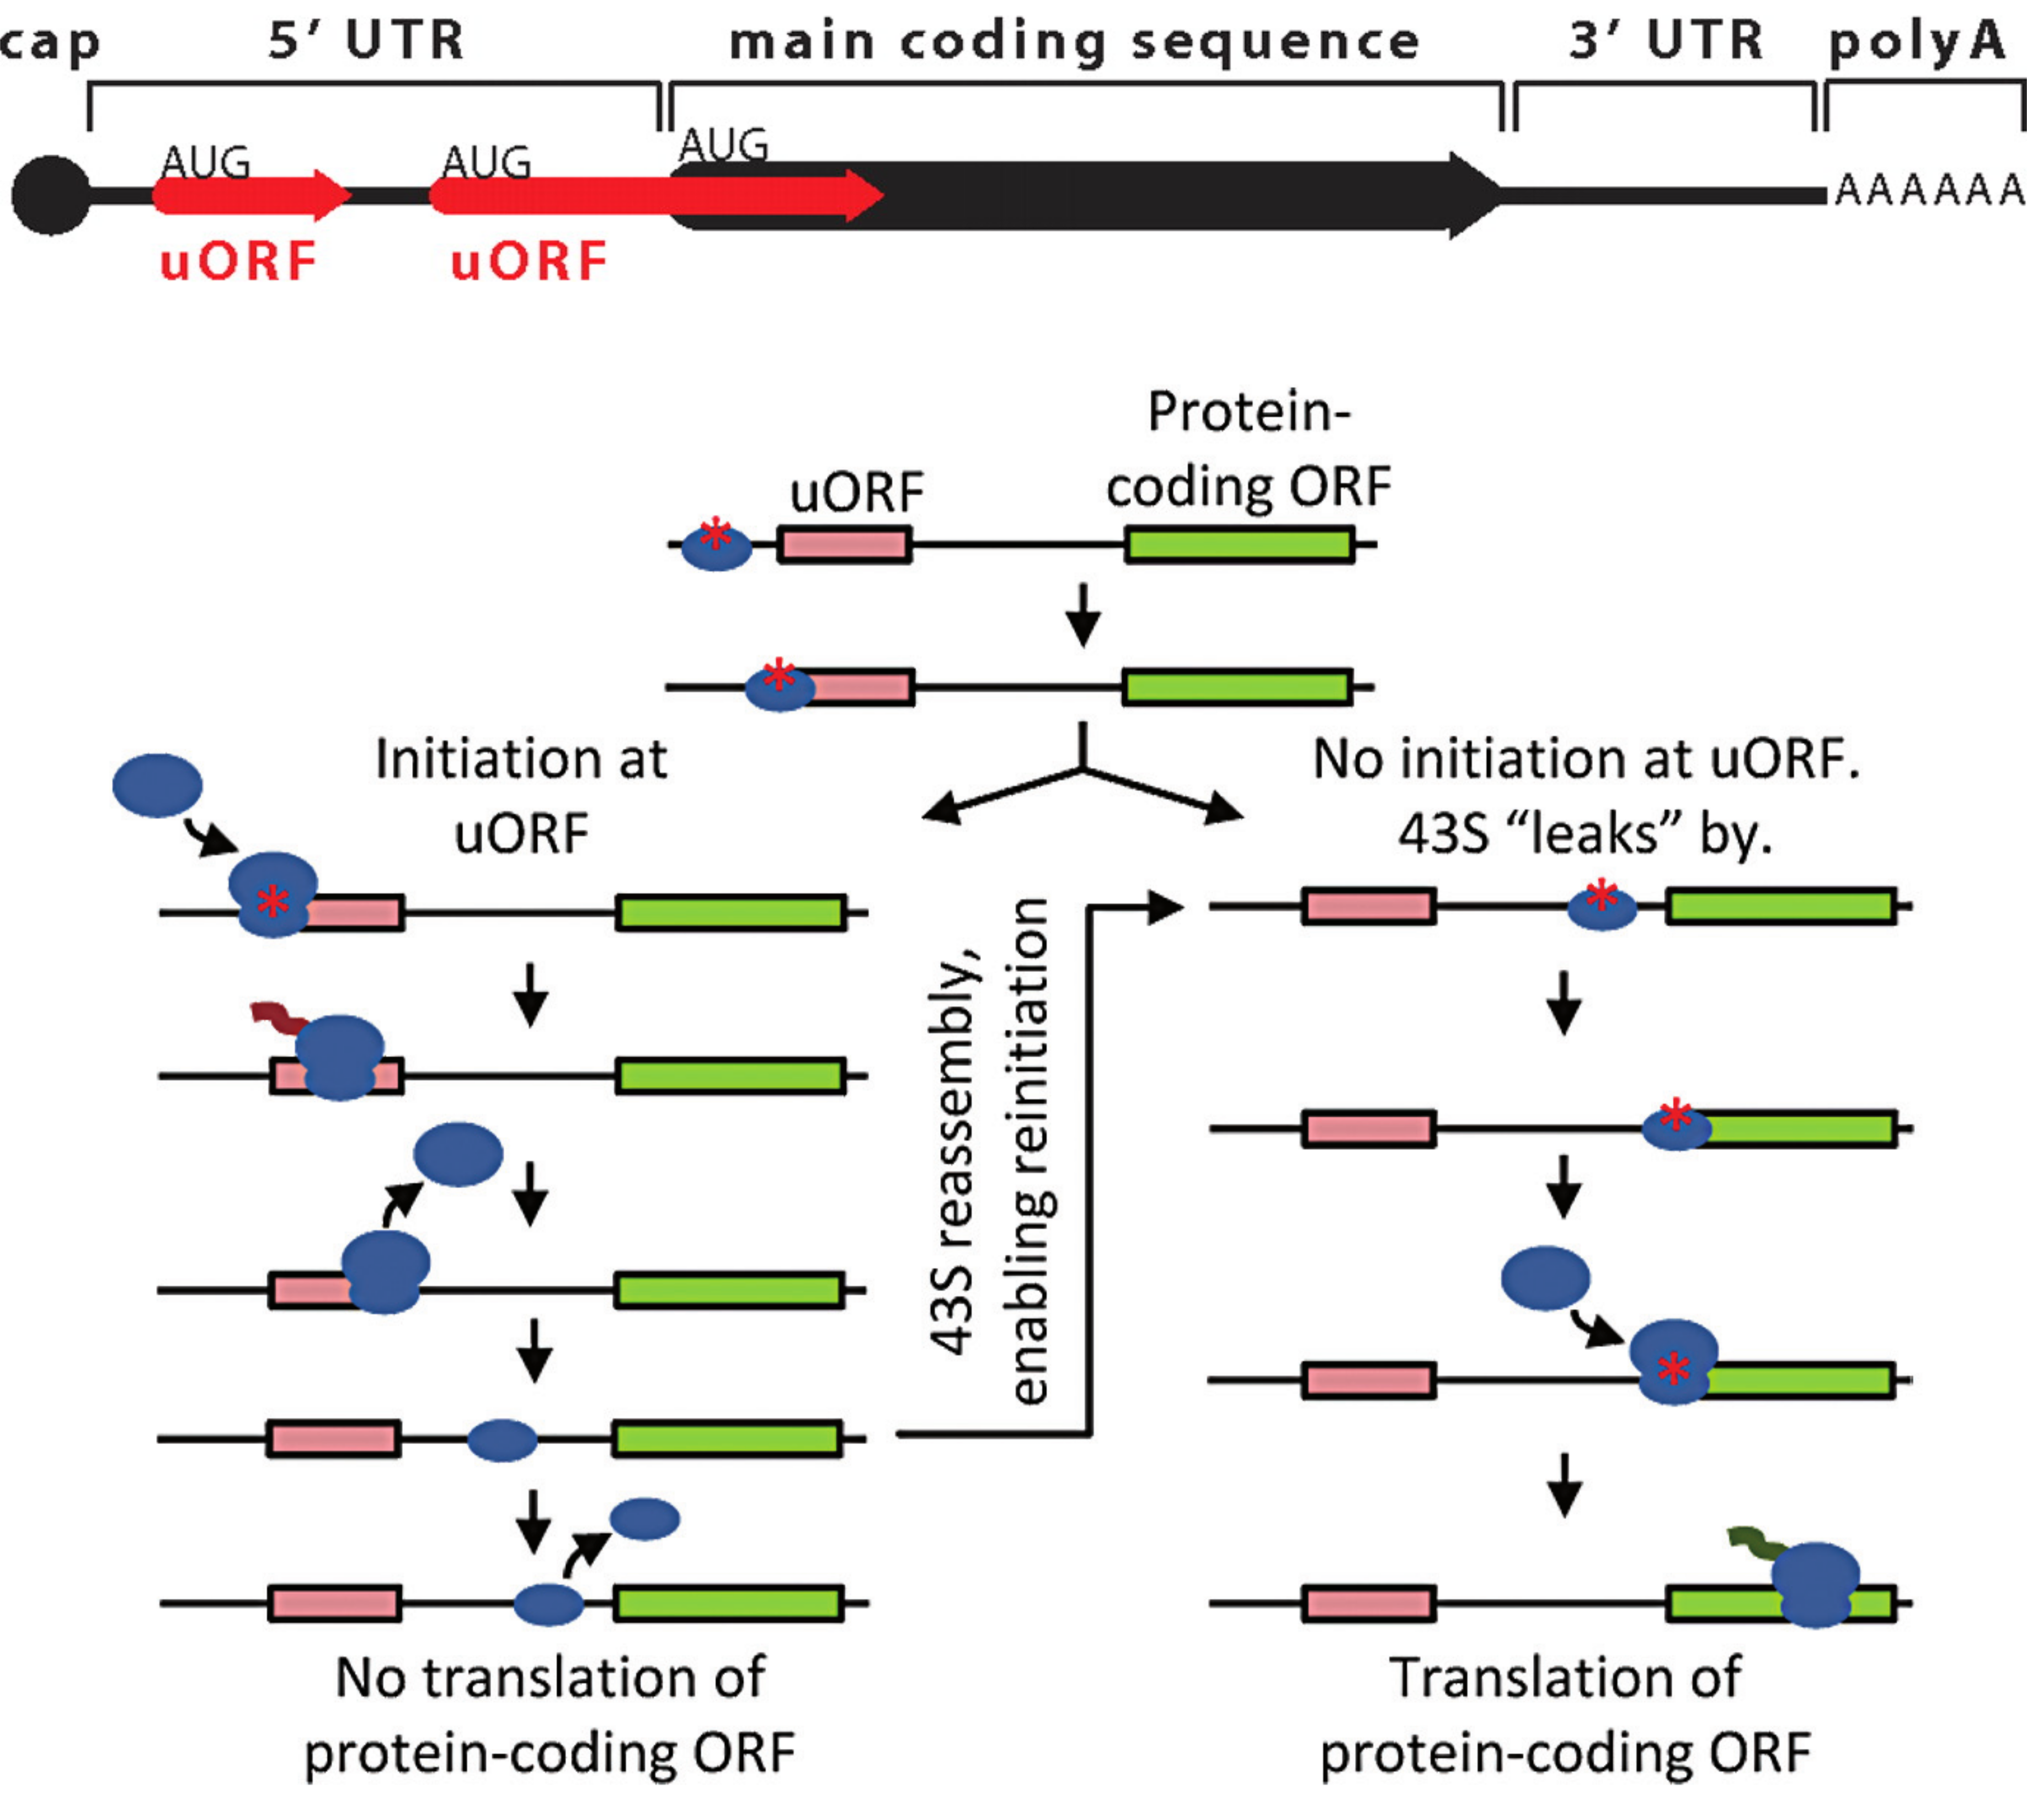
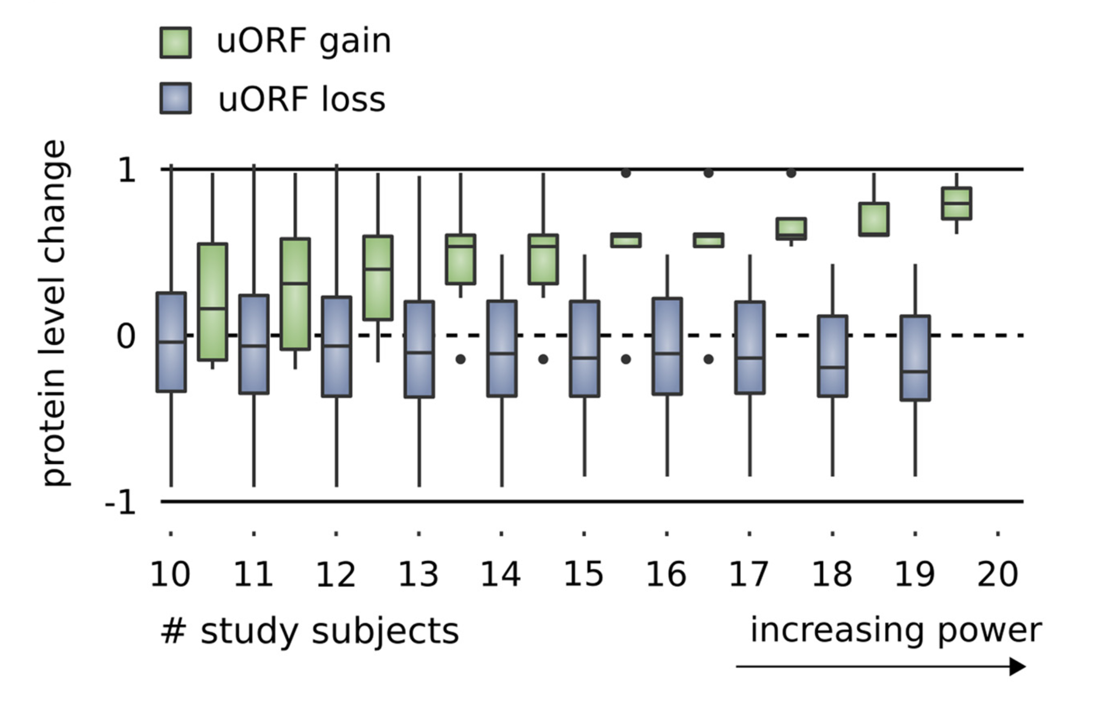
Upstream open reading frames (uORFs) regulate translation are affected by somatic mutation
uORFs regulate the translation of downstream coding regions.
This regulation may be altered by somatic mutation in cancer.
In Battle et al. 2014 data uORF gain & loss assoc. protein level change.
[Calvo et al., PNAS (‘09)]
[McGillivray et al., NAR (‘18)]
[Ferreira et al., Bioengineered (‘14)]

Slide 42
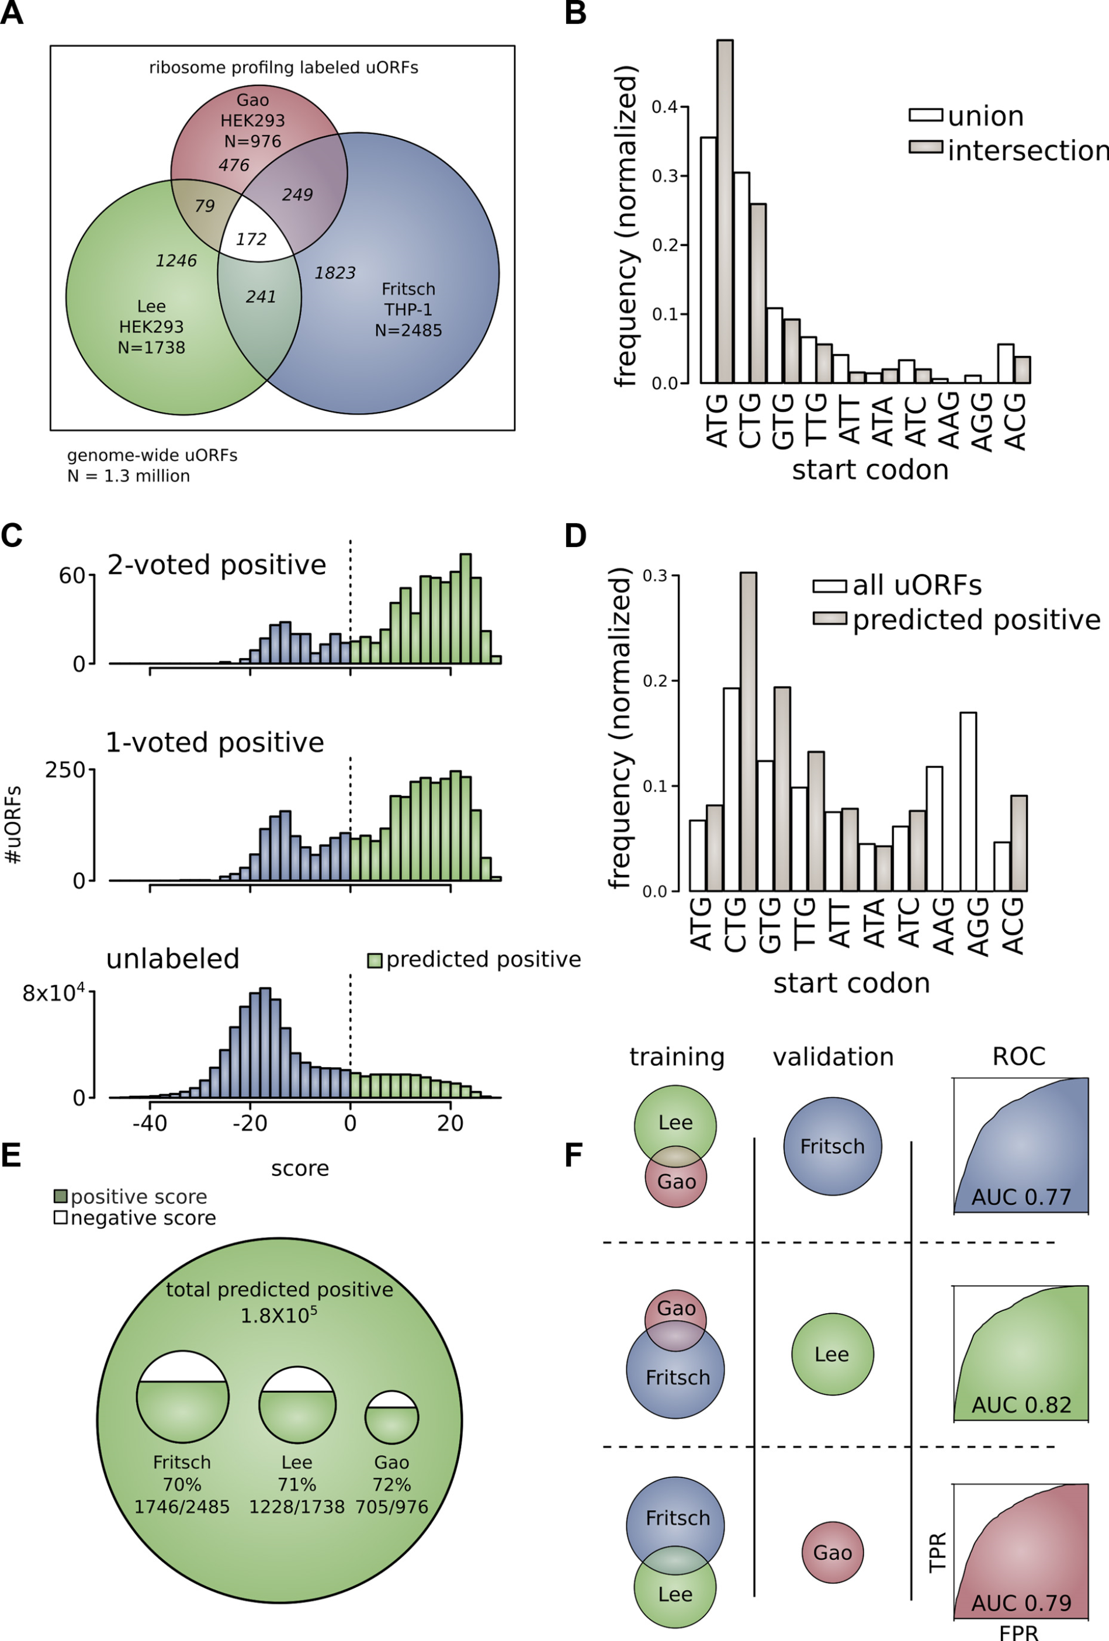
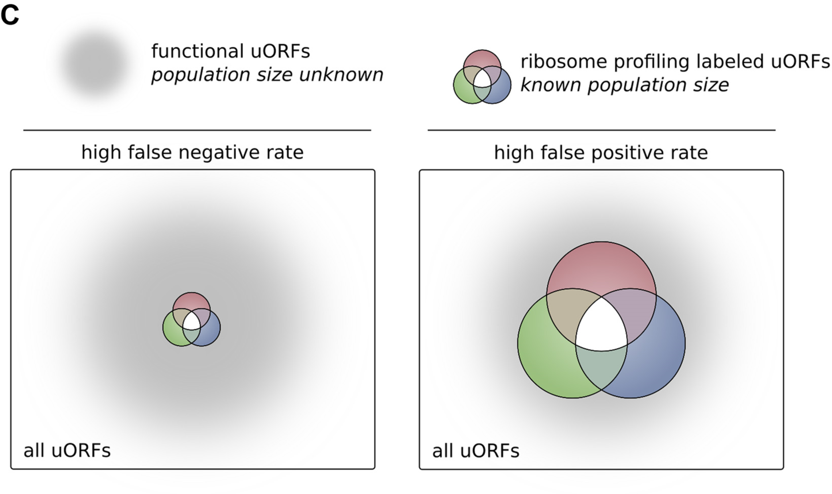
The population of functional uORFs may be significant
From a “Universe” of 1.3 M pot. uORFs
Ribosome profiling experiments have low overlap in identified uORFs.
This suggests high false-negative rate, and more functional uORFs than currently known.
[McGillivray et al., NAR (‘18)]

Slide 43
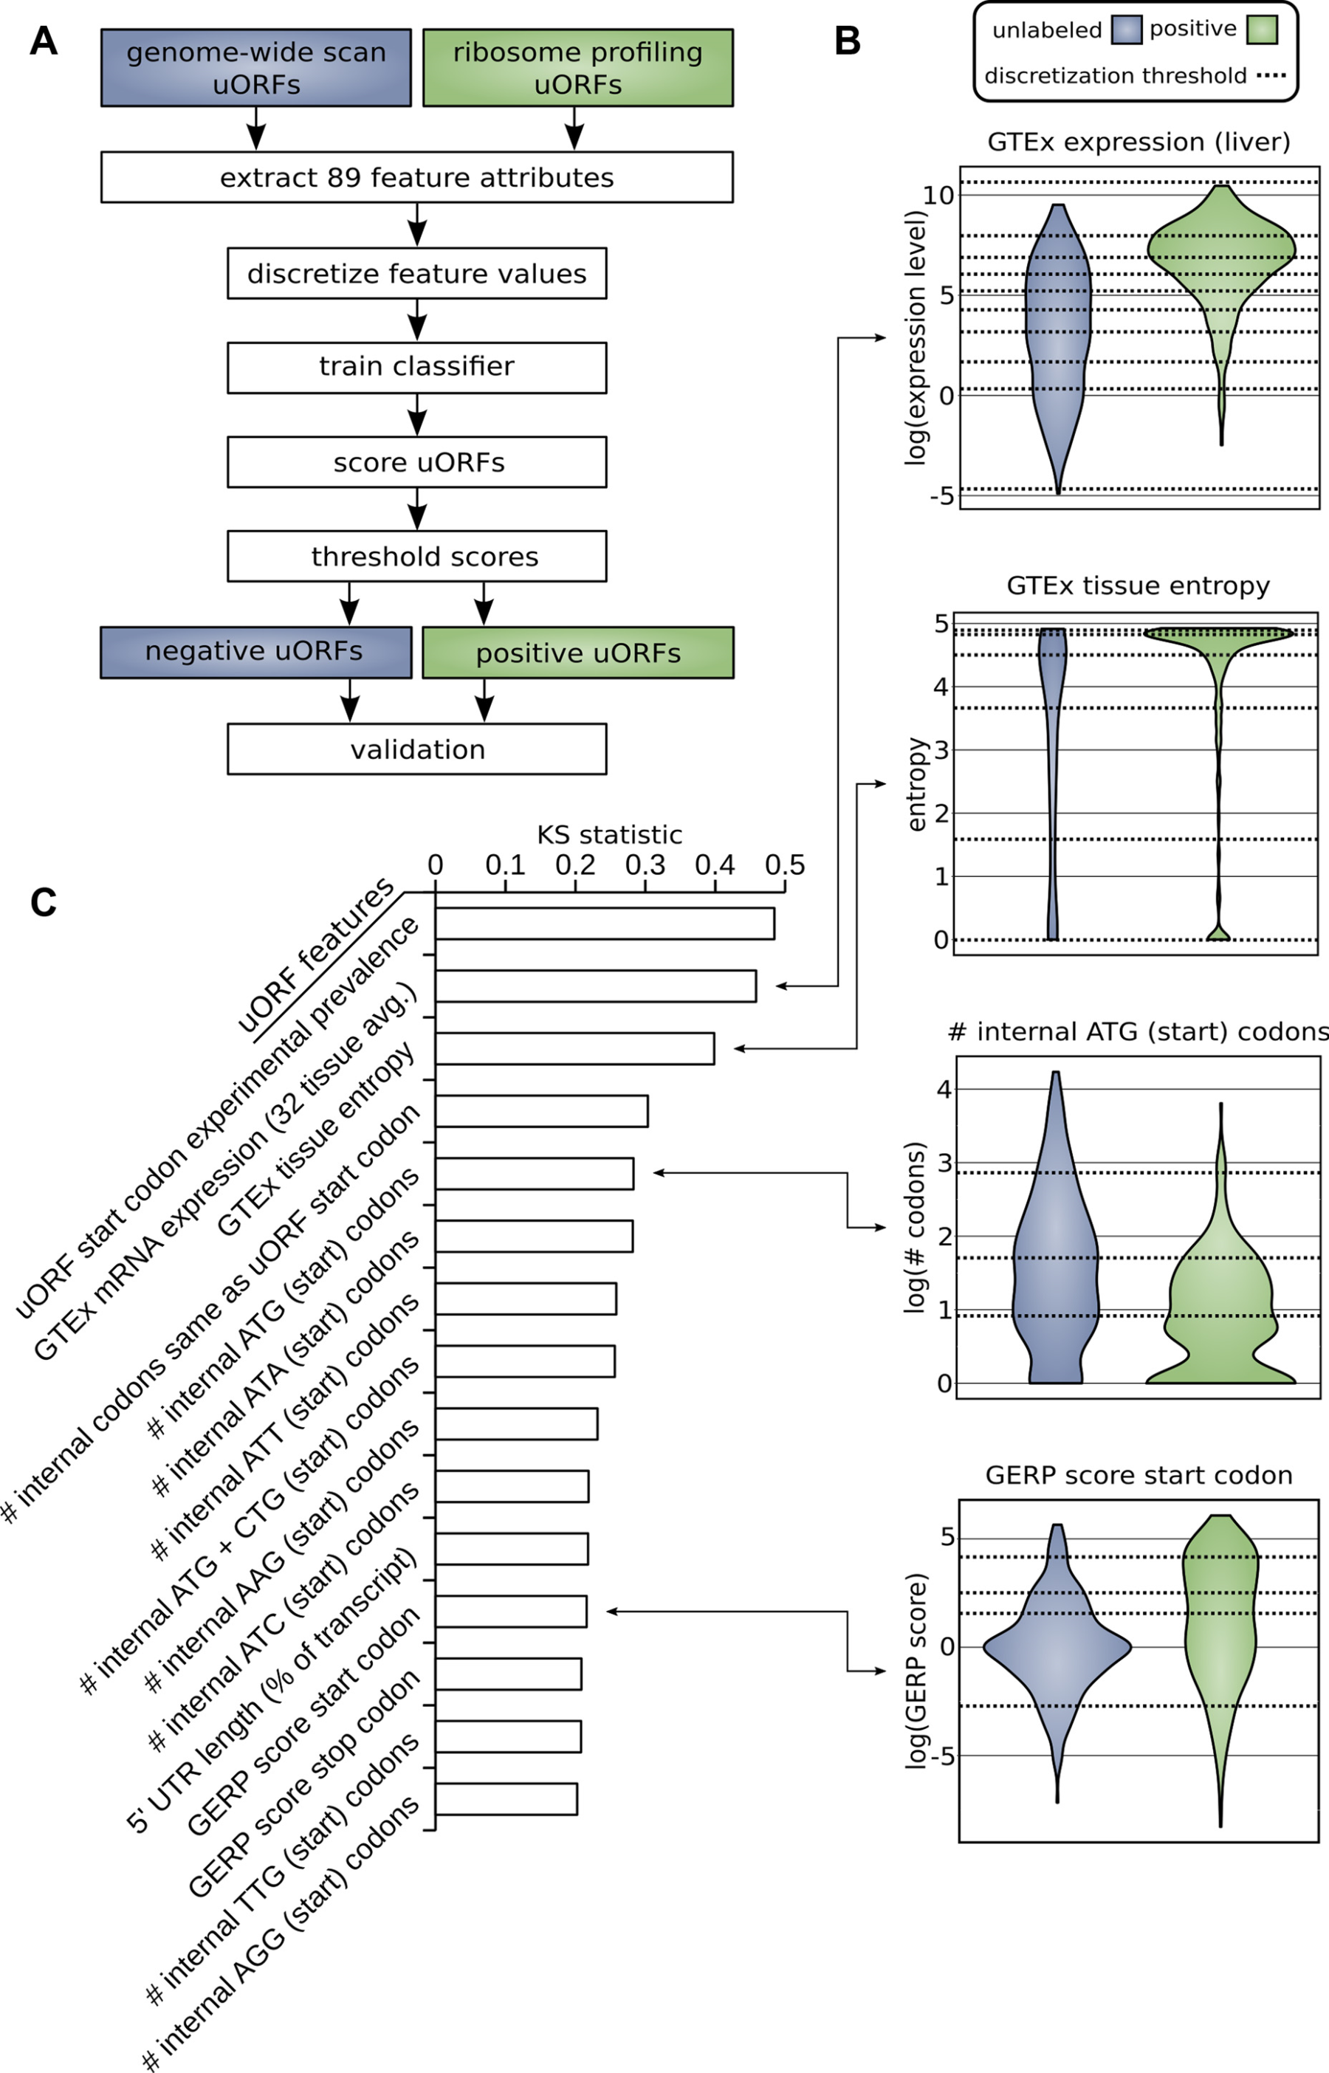
Prediction & validation of functional uORFs using 89 features
Expr.
Level
All near-cognate start codons predicted.
Cross-validation on independent ribosome profiling datasets and validation using in vivo protein levels and ribosome occupancy in humans (Battle et al. 2014).
Tissue
Dist.
Int.
ATG
Start
Conser-
vation
[McGillivray et al., NAR (‘18)]

Slide 44
A comprehensive catalog of functional uORFs
Universe of 1.3M uORFs scored via Simple Bayes algo.
180K: Large predicted positive set likely to affect translation
Calibration on gold standards, suggests getting ~70% of known
Predicted functional uORFs may be intersected with disease associated variants.
[McGillivray et al., NAR (‘18)]

Slide 45
Thoughts on Genome Annotation, Prioritizing Variants &
Application of these concepts in a disease context
Background
  Types of variants: Germline, Somatic, &c
  Types of annotations: peaks, segmentations, model predictions
  Genomic covariates
Music
  Multi-scale peak calling
Matched Filter
  Integrating cross-assay signal-track patterns associated with enhancer
  Trained on high throughput STARR-seq experiments
  Validation in many different contexts
FunSeq
  Integrates evidence, with a “surprisal” based weighting scheme.
  Prioritizing variants within “sensitive sites” (human conserved)
RADAR
  Adapts FunSeq approach to RNA
  Prioritizes variants based on post-transcriptional regulome using ENCODE eCLIP
  Incorporates new features related to RNA sec. struc & tissue specific effects
uORFs
  Feature integration to find small subset of upstream mutations that potentially alter translation
LARVA & MOAT
  Uses parametric beta-binomial model, explicitly modeling covariates
  Non-parametric shuffles. Useful when explicit covariates not available.
PsychENCODE (Application)
    Population-level analysis of functional genomics data related to mental disease
    Single-cell deconvolution explaining across-population variation
    Large QTL resource (~2.5M eQTLs)
    Regulatory network construction using QTLs, Hi-C, & activity relationships. Used to link GWAS SNPs to genes.
    Embedding the reg. network in a deep-learning model (DSPN) to predict psychiatric disease phenotype from genotype and transcriptome data.

Slide 46


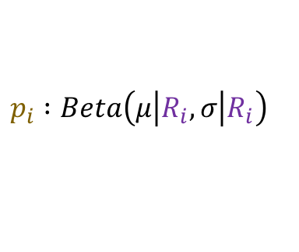
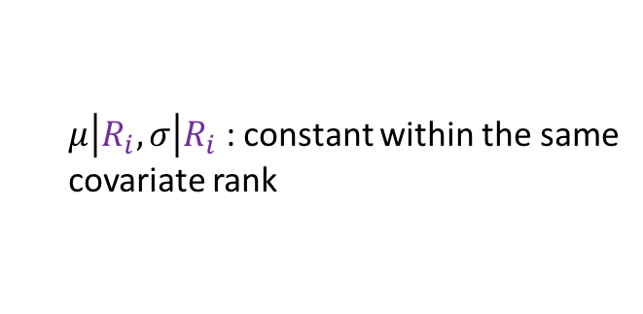

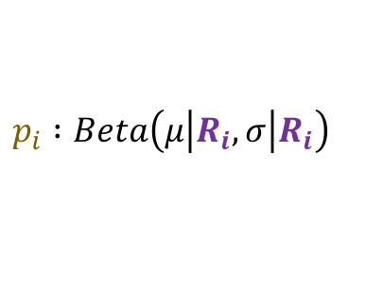

Cancer Somatic Mutation Modeling
PARAMETRIC MODELS
Suppose there are k genome elements. For element i, define:
  n_{i}: total number of nucleotides
  x_{i}: the number of mutations within the element
  p: the mutation rate
  R_{i}: the covariate rank of the element
Non-parametric model is useful when covariate data is missing for the studied annotations
  Also sidesteps issue of properly identifying and modeling every relevant covariate
  (possibly hundreds)
NON-PARAMETRIC MODELS
Model 1: Constant Background Mutation Rate (Model from Previous Work)
Assume constant background mutation rate in local regions.
Model 3a: Random Permutation of Input Annotations
Model 2a: Varying Mutation Rate
with Single Covariate Correction
Shuffle annotations within local region to assess background mutation rate.
Model 3b: Random Permutation of Input Variants
Shuffle variants within local region to assess background mutation rate.
Model 2b: Varying Mutation Rate
with Multiple Covariate Correction
[Lochovsky et al. Bioinformatics in press]
[Lochovsky et al. NAR (’15)]

Slide 47
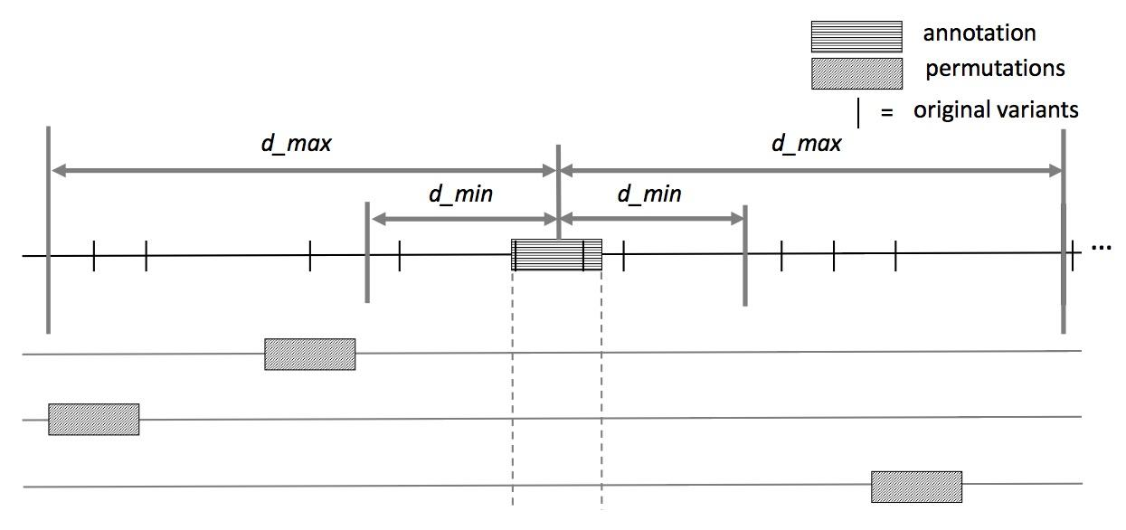
MOAT-a: Annotation-based permutation
[Lochovsky et al. Bioinformatics in press]
Notes:
Formally, this method incorporates the annotation length l, the number of random bins we’re going to place in the surrounding genome, n, and two parameters that determine the boundaries of the local genome in which we place random bins, d_min and d_max. d_max has to be small enough that the background mutation rate is roughly constant, while d_min exists to ensure that, if there’s some transitionary region between the mutation rate of a and the mutation rate of the surrounding genome, that the signal from a won’t bleed into our analysis of the local genome context.

Slide 48



MOAT-v: Variant-based Permutation
Can preserve tri-nt context in shuffle
[Lochovsky et al. Bioinformatics in press]
Notes:
The second version of MOAT operates on the idea of variant-based permutation. We place bins over the entire genome that each represent a local genome context, shuffle the variants in each bin, and track permuted variant counts for the annotation we’re studying.

Slide 49

MOAT-s: a variant on MOAT-v
A somatic variant simulator
  Given a set of input variants, shuffle to new locations, taking genome structure into account
[Lochovsky et al. Bioinformatics in press]

Slide 50

LARVA Model Comparison
Comparison of mutation count frequency implied by the binomial model (model 1) and the beta-binomial model (model 2) relative to the empirical distribution
The beta-binomial distribution is significantly better, especially for accurately modeling the over-dispersion of the empirical distribution
[Lochovsky et al. NAR (’15)]

Slide 51


Slide 52

MOAT: recapitulates LARVA with GPU-driven runtime scalability
Computational efficiency of MOAT’s NVIDIA™ CUDA™ version, with respect to the number of permutations, is dramatically enhanced compared to CPU version.
.
Number of permutations | Fold speedup of CUDA version
1k | 14x
10k | 100x
100k | 256x
.
.
MOAT’s high mutation burden elements recapitulate LARVA’s results & published noncoding cancer-associated elements.
[Lochovsky et al. Bioinformatics in press]

Slide 53
Thoughts on Genome Annotation, Prioritizing Variants &
Application of these concepts in a disease context
Background
  Types of variants: Germline, Somatic, &c
  Types of annotations: peaks, segmentations, model predictions
  Genomic covariates
Music
  Multi-scale peak calling
Matched Filter
  Integrating cross-assay signal-track patterns associated with enhancer
  Trained on high throughput STARR-seq experiments
  Validation in many different contexts
FunSeq
  Integrates evidence, with a “surprisal” based weighting scheme.
  Prioritizing variants within “sensitive sites” (human conserved)
RADAR
  Adapts FunSeq approach to RNA
  Prioritizes variants based on post-transcriptional regulome using ENCODE eCLIP
  Incorporates new features related to RNA sec. struc & tissue specific effects
uORFs
  Feature integration to find small subset of upstream mutations that potentially alter translation
LARVA & MOAT
  Uses parametric beta-binomial model, explicitly modeling covariates
  Non-parametric shuffles. Useful when explicit covariates not available.
PsychENCODE (Application)
    Population-level analysis of functional genomics data related to mental disease
    Single-cell deconvolution explaining across-population variation
    Large QTL resource (~2.5M eQTLs)
    Regulatory network construction using QTLs, Hi-C, & activity relationships. Used to link GWAS SNPs to genes.
    Embedding the reg. network in a deep-learning model (DSPN) to predict psychiatric disease phenotype from genotype and transcriptome data.

Slide 54



Multi-omics of PsychENCODE & other consortia to understand functional genomics in brain disorders
Brain transcriptome and epigenome
Single cell deconvolution
QTL
Regulatory network
Deep Neural Network for predicting disorders

Slide 55

Brain specific transcriptome and epigenome from comparative analysis
Transcriptome
Epigenome
(~79,000 brain enhancers)
Notes:
GTEX frontal cortex N=138

Slide 56
Single cell deconvolution
Step 1: unsupervised learning to see cell types
1866 individuals
25 top components
1866 individuals
Unsupervised
decomposition
(NMF)
Bulk
expression
(B)
NMF
comp
(V)
NMF comp fractions
(H)
All genes
25 top components
All genes (∼20K)
≈
×
Single cell signatures
~14,000 cells (Lake et al., Science, 2016&2018)
~400 cells (Darmanis et al., PNAS, 2015)
~18,000 cells (PsychENCODE, submitted)

Slide 57
24 selected cell types
(Neuronal, NonNeuronal, Developmental)
1866 individuals
1866 individuals
Bulk
expression
(B)
Deconvolution
24 selected cell types
All genes (∼20K)
≈
All genes
×
Single cell deconvolution
Step 2: supervised learning to estimate cell fractions
Cell fractions (W)
Single cell expression (C)
88%±4%
Individual and cross-population reconstruction accuracy via deconvolution

Slide 58

Larger Brain eQTL sets than previous studies
GWAS enrichment
2,542,908 eQTLs (FDR< 0.05)
Notes:
Brain eQTLs
32944(75%) eGenes
2,542,908 eQTLs (3% out of 66,441,766 total pairs)
1,341,182 unique cis-eSNP (~20%) (~238K independent SNPs after linkage-disequilibrium (LD) pruning)

Slide 59


multi-QTLs
eQTLs for mTOR mediated by cQTLs
eQTL
isoQTL
cQTL
fQTL
eQTLs and cQTLs significantly overlap
1391 SNPs (multi-QTLs) in at least three types among eQTLs, isoQTLs, cQTLs, fQTLs
Notes:
*top SNPs for each enhancer
To evaluate this precisely, we calculated π₁ statistics and found that the eQTL overlap with cQTLs was the most significant while that with fQTLs was lowest (0.89 vs 0.11). Moreover, eQTL-cQTL overlaps often suggested that the expression-modulating function of an eQTL derived from chromatin changes (e.g. for MTOR, Fig. 4F). Finally, 119 SNPs, which we dubbed multi-QTLs, functioned as QTLs in more than 3 different capacities (e.g. as eQTLs, cQTLs and isoQTLs).
https://www.nature.com/articles/nrn3068

Slide 60


Gene regulatory network inference
Imputed gene regulatory network linking TFs, enhancers and genes plus QTLs
e.g., subnetworks targeting single cell marker genes

Slide 61

Linking GWAS SNPs to new disease genes using gene regulatory network
142
321 high-confident SCZ genes
Activity
Notes:
* A. F. Pardinas et al., Common schizophrenia alleles are enriched in mutation-intolerant genes and in regions under strong background selection. Nat Genet 50, 381-389 (2018)
For example, we found a set of TFs having enriched binding sites (TFBSs) on the promoters of SCZ genes, revealing potential cis-regulatory mechanisms of TFs to SCZ gene expression (Fig. 6D). Also, we found additional TFs that have enriched binding sites on the enhancers that overlap with SCZ credible SNPs (Fig. 6D), suggesting potential distal regulatory mechanisms of SCZ credible SNPs via affecting TFBSs on enhancers. In particular, these TFs include REST, a transcriptional repressor for neuronal genes \cite{16150588}, and SOX7, a TF that promotes neuronal apoptosis \cite{25847511}.

Slide 62

Deep Structured Phenotype Network (DSPN)
Boltzmann machine
y: phenotypes
h: hidden units (e.g., circuits)
x: intermediate phenotypes (e.g., genes, enhancers)
z: genotypes (e.g., SNPs)
W: weights (e.g., regulatory network)
Gene regulatory network builds DSPN skeleton
Energy model:
$$p\left(x,y,h|z\right)∝\exp\left(−E\left(x,y, h|z\right)\right)$$
$$E\left(x,y, h|z\right)={−z}^{T}W_{1}x{−x}^{T}W_{2}x−x^{T}W_{3}h−h^{T}W_{4}h−h^{T}W_{5}y−Bias$$

Slide 63

DSPN improves brain disease prediction by adding deep layers
Method | LR-genotype | LR-transcriptome | cRBM | DSPN-imputation | DSPN-full
Schizophrenia | 54.6% | 63.0% | 70.0% | 59.0% | 73.6%
Bipolar Disorder | 56.7% | 63.3% | 71.1% | 67.2% | 76.7%
Autism Spectrum Disorder | 50.0% | 51.7% | 67.2% | 62.5% | 68.3%
X 6.0
Accuracy = chance to correctly predict disease/health

Slide 64
DSPN improves brain disease prediction by adding deep layers
Method | LR-genotype | LR-transcriptome | cRBM | DSPN-imputation | DSPN-full
Schizophrenia | 54.6% | 63.0% | 70.0% | 59.0% | 73.6%
Bipolar Disorder | 56.7% | 63.3% | 71.1% | 67.2% | 76.7%
Autism Spectrum Disorder | 50.0% | 51.7% | 67.2% | 62.5% | 68.3%
X 2.5
Accuracy = chance to correctly predict disease/health

Slide 65
DSPN improves brain disease prediction by adding deep layers
Method | LR-genotype | LR-transcriptome | cRBM | DSPN-imputation | DSPN-full
Schizophrenia | 54.6% | 63.0% | 70.0% | 59.0% | 73.6%
Bipolar Disorder | 56.7% | 63.3% | 71.1% | 67.2% | 76.7%
Autism Spectrum Disorder | 50.0% | 51.7% | 67.2% | 62.5% | 68.3%
X 3.1
Accuracy = chance to correctly predict disease/health

Slide 66


DSPN discovers molecular pathways from genotype to phenotype

Slide 67
Thoughts on Genome Annotation, Prioritizing Variants &
Application of these concepts in a disease context
Background
  Types of variants: Germline, Somatic, &c
  Types of annotations: peaks, segmentations, model predictions
  Genomic covariates
Music
  Multi-scale peak calling
Matched Filter
  Integrating cross-assay signal-track patterns associated with enhancer
  Trained on high throughput STARR-seq experiments
  Validation in many different contexts
FunSeq
  Integrates evidence, with a “surprisal” based weighting scheme.
  Prioritizing variants within “sensitive sites” (human conserved)
RADAR
  Adapts FunSeq approach to RNA
  Prioritizes variants based on post-transcriptional regulome using ENCODE eCLIP
  Incorporates new features related to RNA sec. struc & tissue specific effects
uORFs
  Feature integration to find small subset of upstream mutations that potentially alter translation
LARVA & MOAT
  Uses parametric beta-binomial model, explicitly modeling covariates
  Non-parametric shuffles. Useful when explicit covariates not available.
PsychENCODE (Application)
    Population-level analysis of functional genomics data related to mental disease
    Single-cell deconvolution explaining across-population variation
    Large QTL resource (~2.5M eQTLs)
    Regulatory network construction using QTLs, Hi-C, & activity relationships. Used to link GWAS SNPs to genes.
    Embedding the reg. network in a deep-learning model (DSPN) to predict psychiatric disease phenotype from genotype and transcriptome data.

Slide 68
Thoughts on Genome Annotation, Prioritizing Variants &
Application of these concepts in a disease context
Background
  Types of variants: Germline, Somatic, &c
  Types of annotations: peaks, segmentations, model predictions
  Genomic covariates
Music
  Multi-scale peak calling
Matched Filter
  Integrating cross-assay signal-track patterns associated with enhancer
  Trained on high throughput STARR-seq experiments
  Validation in many different contexts
FunSeq
  Integrates evidence, with a “surprisal” based weighting scheme.
  Prioritizing variants within “sensitive sites” (human conserved)
RADAR
  Adapts FunSeq approach to RNA
  Prioritizes variants based on post-transcriptional regulome using ENCODE eCLIP
  Incorporates new features related to RNA sec. struc & tissue specific effects
uORFs
  Feature integration to find small subset of upstream mutations that potentially alter translation
LARVA & MOAT
  Uses parametric beta-binomial model, explicitly modeling covariates
  Non-parametric shuffles. Useful when explicit covariates not available.
PsychENCODE (Application)
    Population-level analysis of functional genomics data related to mental disease
    Single-cell deconvolution explaining across-population variation
    Large QTL resource (~2.5M eQTLs)
    Regulatory network construction using QTLs, Hi-C, & activity relationships. Used to link GWAS SNPs to genes.
    Embedding the reg. network in a deep-learning model (DSPN) to predict psychiatric disease phenotype from genotype and transcriptome data.

Slide 69
PsychENCODE Acknowledgment
Daifeng Wang, Shuang Liu, Jonathan Warrell, Hyejung Won, Xu Shi, Fabio Navarro, Declan Clarke, Mengting Gu, Prashant Emani, Yucheng T. Yang, Min Xu, Michael Gandal, Shaoke Lou, Jing Zhang, Jonathan J. Park, Chengfei Yan, Suhn Kyong Rhie, Kasidet Manakongtreecheep, Holly Zhou, Aparna Nathan, Mette Peters, Eugenio Mattei, Dominic Fitzgerald, Tonya Brunetti, Jill Moore, Yan Jiang, Kiran Girdhar, Gabriel Hoffman, Selim Kalayci, Zeynep Hulya Gumus, Greg Crawford,
PsychENCODE Consortium,
Panos Roussos, Schahram Akbarian, Andrew E. Jaffe, Kevin White, Zhiping Weng, Nenad Sestan,
Daniel H. Geschwind, James A. Knowles
Dedicated to Pamela Sklar
Geetha Senthil
Lora Bingaman
David Panchision
Alexander Arguello
Thomas Lehner
The PsychENCODE Consortium: Allison E Ashley-Koch, Duke University; Gregory E Crawford, Duke University; Melanie E Garrett, Duke University; Lingyun Song, Duke University; Alexias Safi, Duke University; Graham D Johnson, Duke University; Gregory A Wray, Duke University; Timothy E Reddy, Duke University; Fernando S Goes, Johns Hopkins University; Peter Zandi, Johns Hopkins University; Julien Bryois, Karolinska Institutet; Andrew E Jaffe, Lieber Institute for Brain Development; Amanda J Price, Lieber Institute for Brain Development; Nikolay A Ivanov, Lieber Institute for Brain Development; Leonardo Collado-Torres, Lieber Institute for Brain Development; Thomas M Hyde, Lieber Institute for Brain Development; Emily E Burke, Lieber Institute for Brain Development; Joel E Kleiman, Lieber Institute for Brain Development; Ran Tao, Lieber Institute for Brain Development; Joo Heon Shin, Lieber Institute for Brain Development; Schahram Akbarian, Icahn School of Medicine at Mount Sinai; Kiran Girdhar, Icahn School of Medicine at Mount Sinai; Yan Jiang, Icahn School of Medicine at Mount Sinai; Marija Kundakovic, Icahn School of Medicine at Mount Sinai; Leanne Brown, Icahn School of Medicine at Mount Sinai; Bibi S Kassim, Icahn School of Medicine at Mount Sinai; Royce B Park, Icahn School of Medicine at Mount Sinai; Jennifer R Wiseman, Icahn School of Medicine at Mount Sinai; Elizabeth Zharovsky, Icahn School of Medicine at Mount Sinai; Rivka Jacobov, Icahn School of Medicine at Mount Sinai; Olivia Devillers, Icahn School of Medicine at Mount Sinai; Elie Flatow, Icahn School of Medicine at Mount Sinai; Gabriel E Hoffman, Icahn School of Medicine at Mount Sinai; Barbara K Lipska, Human Brain Collection Core, National Institutes of Health, Bethesda, MD; David A Lewis, University of Pittsburgh; Vahram Haroutunian, Icahn School of Medicine at Mount Sinai and James J Peters VA Medical Center; Chang-Gyu Hahn, University of Pennsylvania; Alexander W Charney, Mount Sinai; Stella Dracheva, Mount Sinai; Alexey Kozlenkov, Mount Sinai; Judson Belmont, Icahn School of Medicine at Mount Sinai; Diane DelValle, Icahn School of Medicine at Mount Sinai; Nancy Francoeur, Icahn School of Medicine at Mount Sinai; Evi Hadjimichael, Icahn School of Medicine at Mount Sinai; Dalila Pinto, Icahn School of Medicine at Mount Sinai; Harm van Bakel, Icahn School of Medicine at Mount Sinai; Panos Roussos, Mount Sinai; John F Fullard, Mount Sinai; Jaroslav Bendl, Mount Sinai; Mads E Hauberg, Mount Sinai; Lara M Mangravite, Sage Bionetworks; Mette A Peters, Sage Bionetworks; Yooree Chae, Sage Bionetworks; Junmin Peng, St. Jude Children's Hospital; Mingming Niu, St. Jude Children's Hospital; Xusheng Wang, St. Jude Children's Hospital; Maree J Webster, Stanley Medical Research Institute; Thomas G Beach, Banner Sun Health Research Institute; Chao Chen, Central South University; Yi Jiang, Central South University; Rujia Dai, Central South University; Annie W Shieh, SUNY Upstate Medical University; Chunyu Liu, SUNY Upstate Medical University; Kay S. Grennan, SUNY Upstate Medical University; Yan Xia, SUNY Upstate Medical University/Central South University; Ramu Vadukapuram, SUNY Upstate Medical University; Yongjun Wang, Central South University; Dominic Fitzgerald, The University of Chicago; Lijun Cheng, The University of Chicago; Miguel Brown, The University of Chicago; Mimi Brown, The University of Chicago; Tonya Brunetti, The University of Chicago; Thomas Goodman, The University of Chicago; Majd Alsayed, The University of Chicago; Michael J Gandal, University of California, Los Angeles; Daniel H Geschwind, University of California, Los Angeles; Hyejung Won, University of California, Los Angeles; Damon Polioudakis, University of California, Los Angeles; Brie Wamsley, University of California, Los Angeles; Jiani Yin, University of California, Los Angeles; Tarik Hadzic, University of California, Los Angeles; Luis De La Torre Ubieta, UCLA; Vivek Swarup, University of California, Los Angeles; Stephan J Sanders, University of California, San Francisco; Matthew W State, University of California, San Francisco; Donna M Werling, University of California, San Francisco; Joon-Yong An, University of California, San Francisco; Brooke Sheppard, University of California, San Francisco; A Jeremy Willsey, University of California, San Francisco; Kevin P White, The University of Chicago; Mohana Ray, The University of Chicago; Gina Giase, SUNY Upstate Medical University; Amira Kefi, University of Illinois at Chicago; Eugenio Mattei, University of Massachusetts Medical School; Michael Purcaro, University of Massachusetts Medical School; Zhiping Weng, University of Massachusetts Medical School; Jill Moore, University of Massachusetts Medical School; Henry Pratt, University of Massachusetts Medical School; Jack Huey, University of Massachusetts Medical School; Tyler Borrman, University of Massachusetts Medical School; Patrick F Sullivan, University of North Carolina - Chapel Hill; Paola Giusti-Rodriguez, University of North Carolina - Chapel Hill; Yunjung Kim, University of North Carolina - Chapel Hill; Patrick Sullivan, University of North Carolina - Chapel Hill; Jin Szatkiewicz, University of North Carolina - Chapel Hill; Suhn Kyong Rhie, University of Southern California; Christoper Armoskus, University of Southern California; Adrian Camarena, University of Southern California; Peggy J Farnham, University of Southern California; Valeria N Spitsyna, University of Southern California; Heather Witt, University of Southern California; Shannon Schreiner, University of Southern California; Oleg V Evgrafov, SUNY Downstate Medical Center; James A Knowles, SUNY Downstate Medical Center; Mark Gerstein, Yale University; Shuang Liu, Yale University; Daifeng Wang, Stony Brook University; Fabio C. P. Navarro, Yale University; Jonathan Warrell, Yale University; Declan Clarke, Yale University; Prashant S. Emani, Yale University; Mengting Gu, Yale University; Xu Shi, Yale University; Min Xu, Yale University; Yucheng T. Yang, Yale University; Robert R. Kitchen, Yale University; Gamze Gürsoy, Yale University; Jing Zhang, Yale University; Becky C Carlyle, Yale University; Angus C Nairn, Yale University; Mingfeng Li, Yale University; Sirisha Pochareddy, Yale University; Nenad Sestan, Yale University; Mario Skarica, Yale University; Zhen Li, Yale University; Andre M.M. Sousa, Yale University; Gabriel Santpere, Yale University; Jinmyung Choi, Yale University; Ying Zhu, Yale University; Tianliuyun Gao, Yale University; Daniel J Miller, Yale University; Adriana Cherskov, Yale University; Mo Yang, Yale University; Anahita Amiri, Yale University; Gianfilippo Coppola, Yale University; Jessica Mariani, Yale University; Soraya Scuderi, Yale University; Anna Szekely, Yale University; Flora M Vaccarino, Yale University; Feinan Wu, Yale University; Sherman Weissman, Yale University; Tanmoy Roychowdhury, Mayo Clinic Rochester; Alexej Abyzov, Mayo Clinic Rochester;.

Slide 70

MUSIC.gersteinlab.org
A Harmanci, J Rozowsky
github.com/gersteinlab/MatchedFilter
A Sethi, M Gu, E Gumusgoz, L Chan, KK Yan, J Rozowsky,
I Barozzi, V Afzal, J Akiyama, I Plajzer-Frick, C Yan, C Pickle,
M Kato, T Garvin, Q Pham, A Harrington, B Mannion, E Lee,
Y Fukuda-Yuzawa, A Visel, D E. Dickel, K Yip, R Sutton, LA Pennacchio
FunSeq.gersteinlab.org
Y Fu, E Khurana, Z Liu, S Lou, J Bedford, X Mu, K Yip
RADAR.gersteinlab.org
J Zhang, J Liu, D Lee, J-J Feng, L Lochovsky, S Lou, M Rutenberg-Schoenberg
github.gersteinlab.org/uORFs
P McGillivray, R Ault, M Pawashe, R Kitchen, S Balasubramanian
MOAT.gersteinlab.org
L Lochovsky, J Zhang
LARVA.gersteinlab.org
L Lochovsky, J Zhang, Y Fu, E Khurana
Acknowledgments! Also, Hiring: See Jobs.gersteinlab.org

Slide 71


Slide 72
Info about this talk
No Conflicts
Unless explicitly listed here. There are no conflicts of interest relevant to the material in this talk
General PERMISSIONS
This Presentation is copyright Mark Gerstein, Yale University, 2017.
Please read permissions statement at
sites.gersteinlab.org/Permissions
Basically, feel free to use slides & images in the talk with PROPER acknowledgement (via citation to relevant papers or website link). Paper references in the talk were mostly from Papers.GersteinLab.org.
PHOTOS & IMAGES
For thoughts on the source and permissions of many of the photos and clipped images in this presentation see streams.gerstein.info . In particular, many of the images have particular EXIF tags, such as kwpotppt , that can be easily queried from flickr, viz: flickr.com/photos/mbgmbg/tags/kwpotppt

