Slide 1


RADAR: Annotation & prioritization of variants in the post-transcriptional regulome for RBPs
Mark Gerstein
Yale
Slides freely downloadable from Lectures.GersteinLab.org & “tweetable” (via @MarkGerstein).
No Conflicts for this Talk. See last slide for more info.

Slide 2

Overall Problem:
Finding Key Variants in
Personal Genomes
CAN YOU FIND THE PANDA?
  Millions of variants in a personal genome
  Thousands, in a cancer genome
  Different contexts for prioritization
  In rare disease, only a few
  high-impact variants are associated with disease
  In cancer, a few positively selected drivers amongst many passengers
  In common disease, more variants associated & each has weaker effect,
  But one wants to find key ”functional” variant amongst many in LD
Notes:
2

Slide 3
Overall Problem:
Finding Key Variants in
Personal Genomes
CAN YOU FIND THE PANDA?
  Millions of variants in a personal genome
  Thousands, in a cancer genome
  Different contexts for prioritization
  In rare disease, only a few
  high-impact variants are associated with disease
  In cancer, a few positively selected drivers amongst many passengers
  In common disease, more variants associated & each has weaker effect,
  But one wants to find key ”functional” variant amongst many in LD
  Thus: Need to find & prioritize high impact variants.
  Particularly hard for non-coding regions.
Notes:
3

Slide 4
RADAR: Annotation & prioritization of variants in the post-transcriptional regulome for RBPs
Background on prioritizing non-coding variants:
FunSeq integrates evidence, with a “surprisal” based weighting scheme. Prioritizing variants within “sensitive sites” (human conserved)
RADAR
  Adapts FunSeq approach to RNA
  Prioritizes variants based on post-transcriptional regulome using ENCODE eCLIP
  Incorporates new features related to RNA sec. struc & tissue specific effects
Next step in prioritizing variants associated with RNA:
uORFs - Feature integration to find small subset of upstream mutations that potentially alter translation

Slide 5
RADAR: Annotation & prioritization of variants in the post-transcriptional regulome for RBPs
Background on prioritizing non-coding variants:
FunSeq integrates evidence, with a “surprisal” based weighting scheme. Prioritizing variants within “sensitive sites” (human conserved)
RADAR
  Adapts FunSeq approach to RNA
  Prioritizes variants based on post-transcriptional regulome using ENCODE eCLIP
  Incorporates new features related to RNA sec. struc & tissue specific effects
Next step in prioritizing variants associated with RNA:
uORFs - Feature integration to find small subset of upstream mutations that potentially alter translation

Slide 6
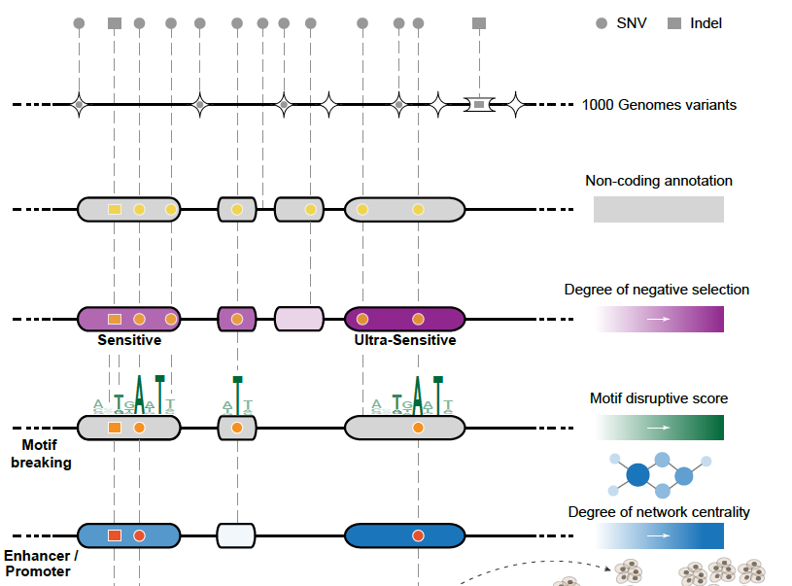
Funseq: a flexible framework to determine
functional impact & use this to prioritize variants
Annotation (tf binding sites open chromatin, ncRNAs) & Chromatin Dynamics
Conservation
(GERP, allele freq.)
Mutational impact (motif breaking, Lof)
Network (centrality position)
[Fu et al., GenomeBiology ('14), , Khurana et al., Science ('13)]

Slide 7
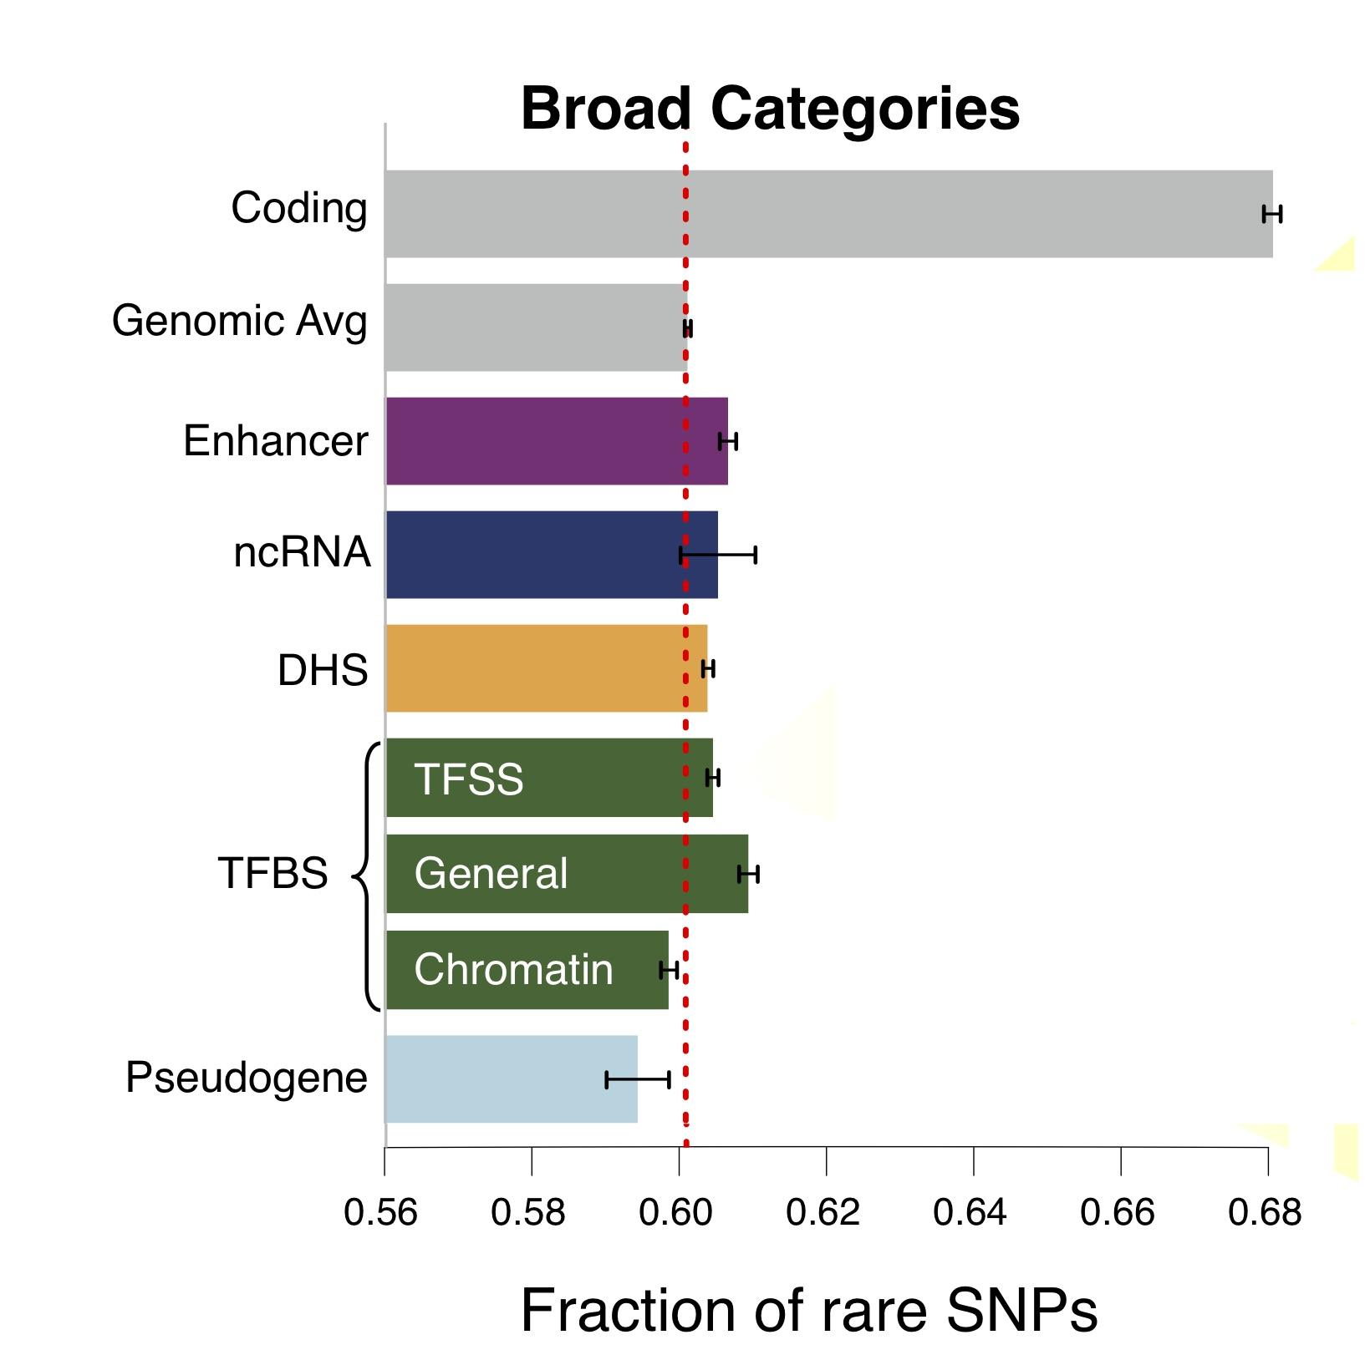
Finding "Conserved” Sites in the Human Population:
Negative selection in non-coding elements based on
Production ENCODE & 1000G Phase 1
Broad categories of regulatory regions under negative selection
Related to:
ENCODE, Nature, 2012
Ward & Kellis, Science, 2012
Mu et al, NAR, 2011
(Non-coding RNA)
(DNase I hypersensitive sites)
(TFSS: Sequence-specific TFs)
(Transcription factor binding sites)
Depletion of Common Variants
in the Human Population

Slide 8
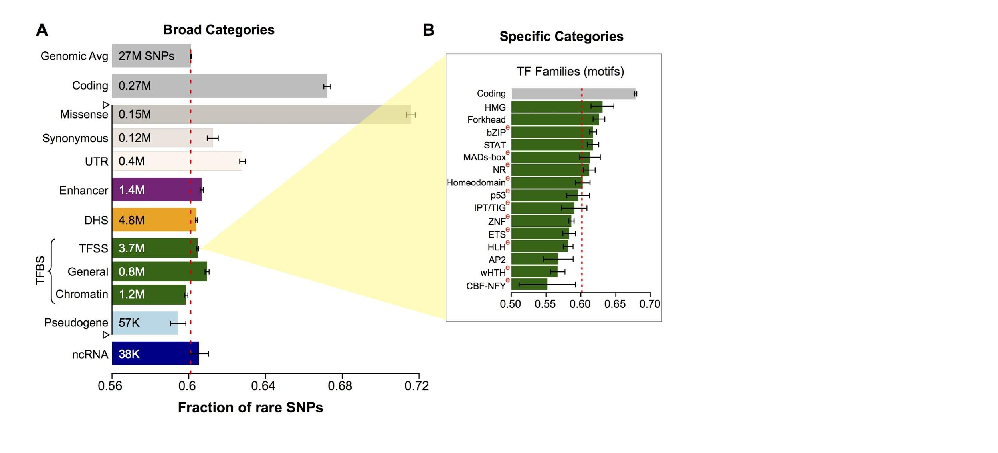
Differential selective constraints
among specific sub-categories
Sub-categorization possible because of better statistics from 1000G phase 1 v pilot
[Khurana et al., Science (‘13)]

Slide 9
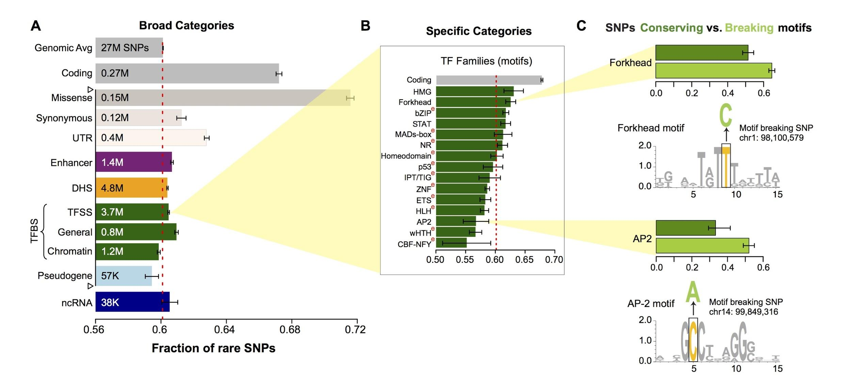
SNPs which break TF motifs are under stronger selection
[Khurana et al., Science (‘13)]

Slide 10
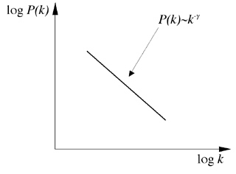
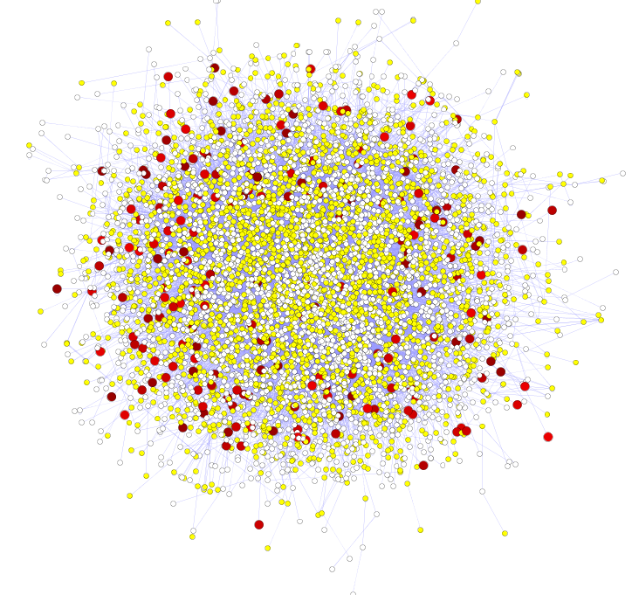
Hubs Under Constraint:
A Finding from the Network Biology Community
Power-law distribution
Hub
log(Frequency)
High likelihood of positive selection
Not under positive selection
Lower likelihood of positive selection
No data about positive selection
log(Degree)
[Nielsen et al. PLoS Biol. (2005), HPRD, Kim et al. PNAS (2007)]
More Connectivity, More Constraint: Genes & proteins that have a more central position in the network tend to evolve more slowly and are more likely to be essential.
This phenomenon is observed in
many organisms & different kinds of networks
  yeast PPI - Fraser et al ('02) Science,
  ('03) BMC Evo. Bio.
  Ecoli PPI - Butland et al ('04) Nature
  Worm/fly PPI - Hahn et al ('05) MBE
  miRNA net - Cheng et al ('09) BMC Genomics

Slide 11
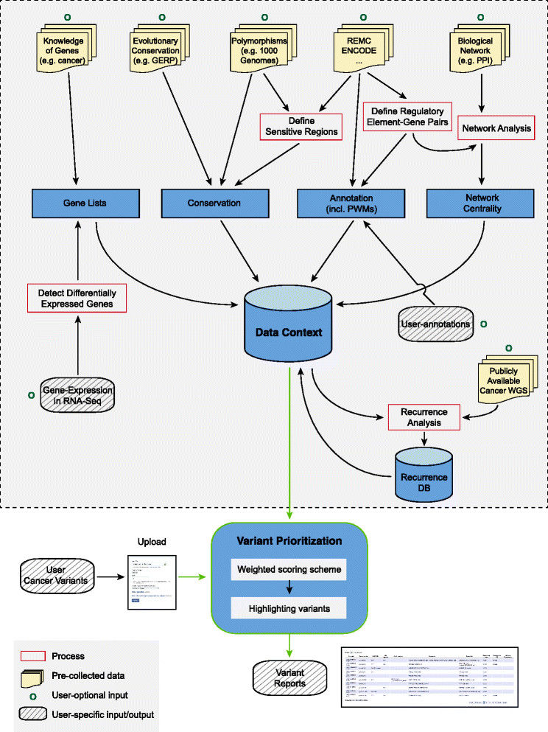
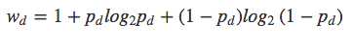
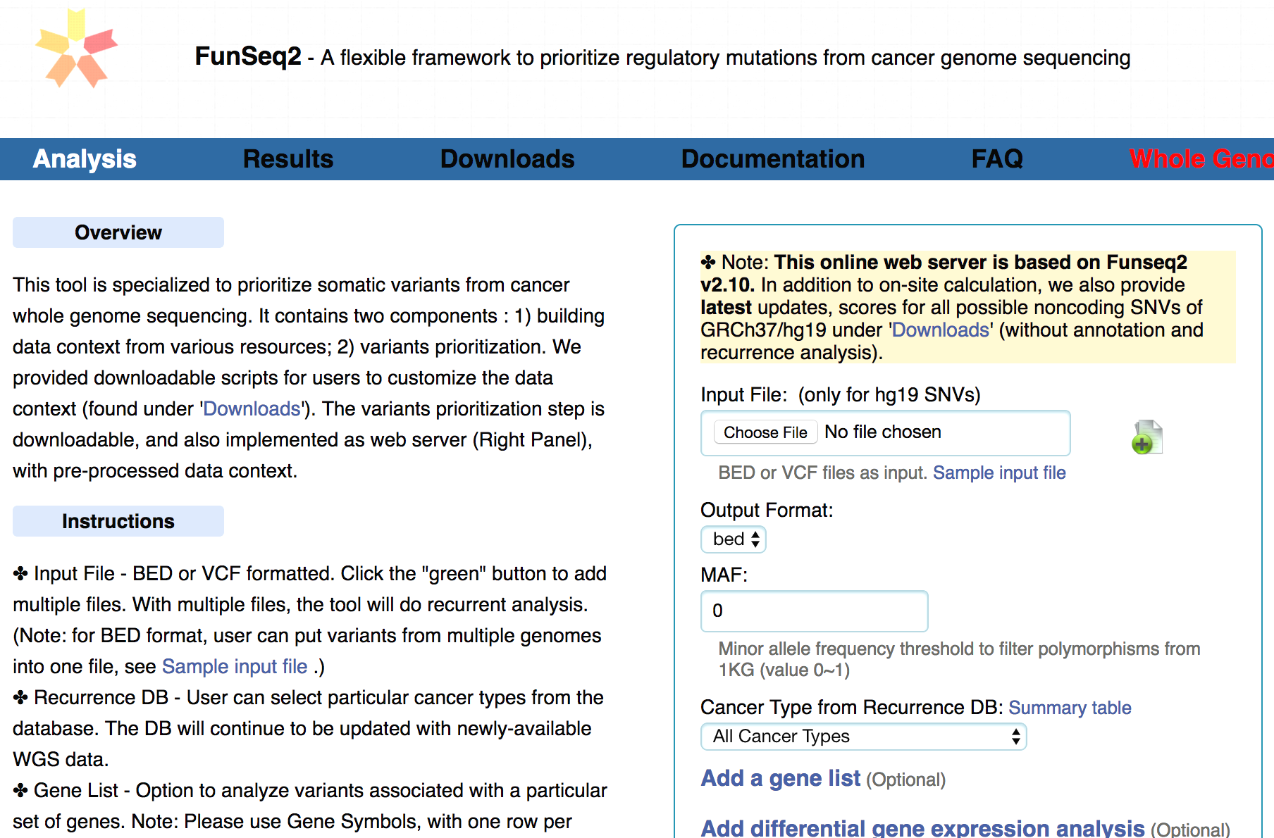
FunSeq.gersteinlab.org
HOT region
Sensitive region
Polymorphisms
Genome
Info. theory based method (ie annotation “surprisal”) for weighting consistently many genomic features
Practical web server
Submission of variants & pre-computed large data context from uniformly processing large-scale datasets
[Fu et al., GenomeBiology ('14)]

Slide 12
RADAR: Annotation & prioritization of variants in the post-transcriptional regulome for RBPs
Background on prioritizing non-coding variants:
FunSeq integrates evidence, with a “surprisal” based weighting scheme. Prioritizing variants within “sensitive sites” (human conserved)
RADAR
  Adapts FunSeq approach to RNA
  Prioritizes variants based on post-transcriptional regulome using ENCODE eCLIP
  Incorporates new features related to RNA sec. struc & tissue specific effects
Next step in prioritizing variants associated with RNA:
uORFs - Feature integration to find small subset of upstream mutations that potentially alter translation

Slide 13
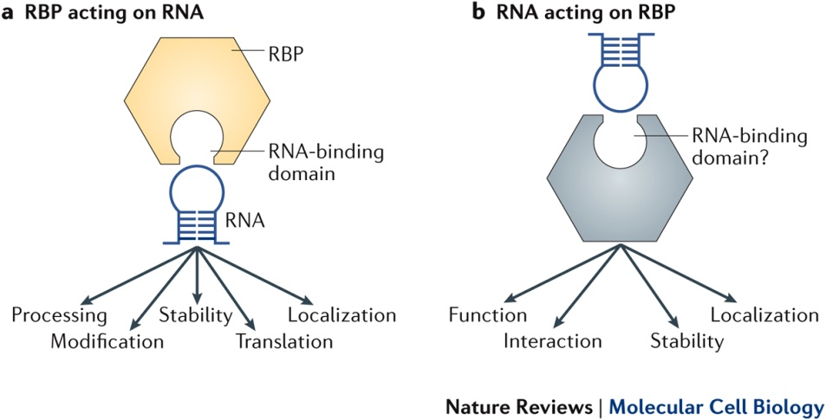
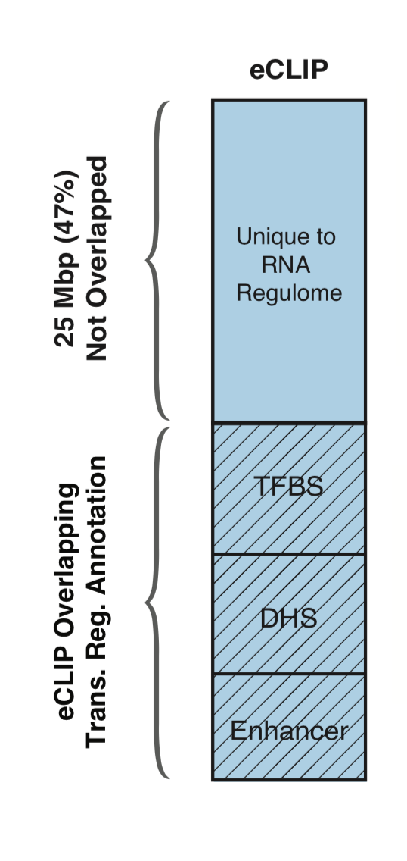
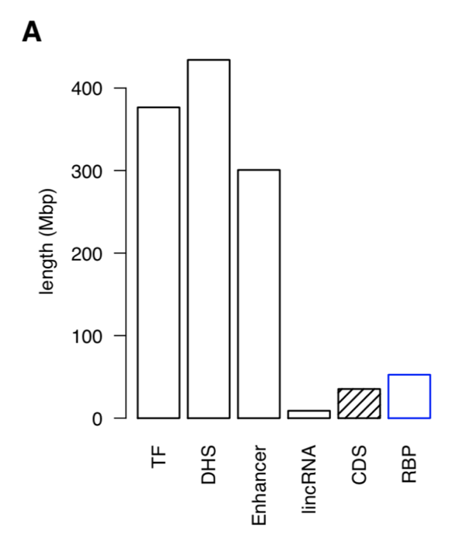
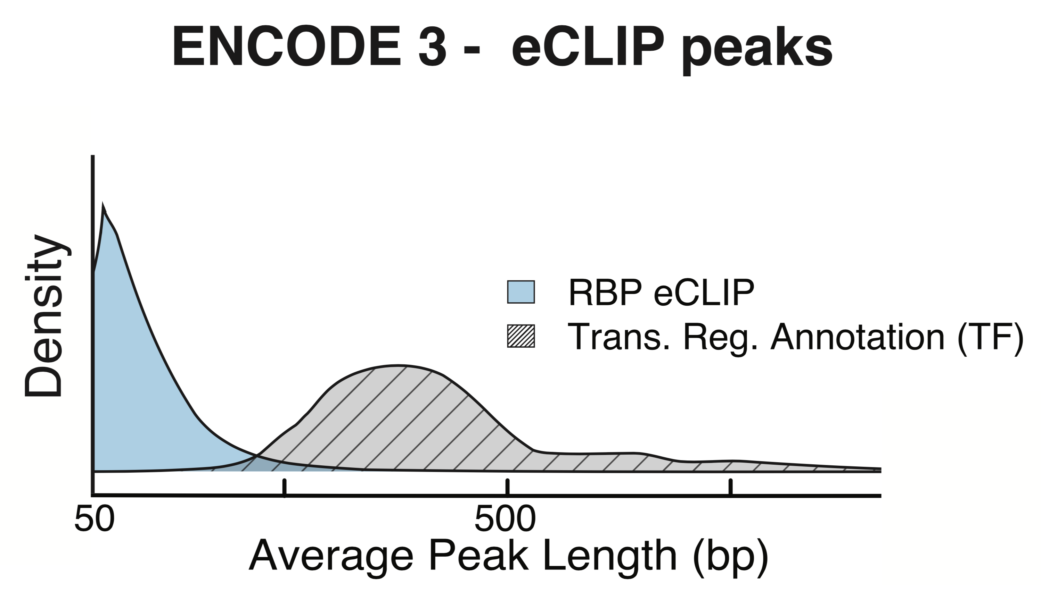
RNA Binding Proteins (RBPs)
Before ENCODE3: >150 expt.
in many different cell types
ENCODE3 did ~350 focused eCLIP expt. for >110 RBPs on HepG2 & K562
(Van Nostrand...Yeo. Nat. Meth. '16;
Van Nostrand...Graveley, Yeo
(submitted in relation to ENCODE3))
Nat Rev Mol Cell Biol. 2018 May;19(5):327-341. doi: 10.1038/nrm.2017.130. Epub 2018 Jan 17.
[Zhang*, Liu* et al., Genome Biology (in review ‘18)]

Slide 14
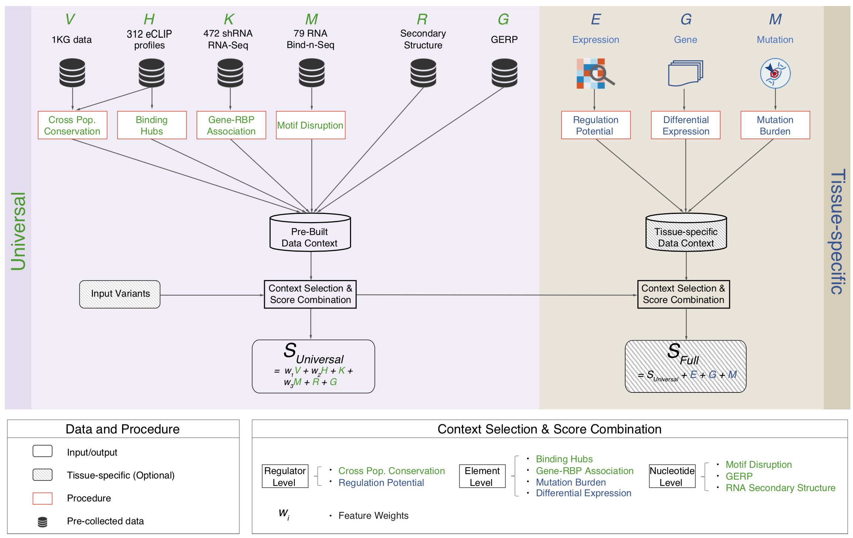
Schematic of RADAR Scoring
[Zhang*, Liu* et al., Genome Biology (in review ‘18)]

Slide 15
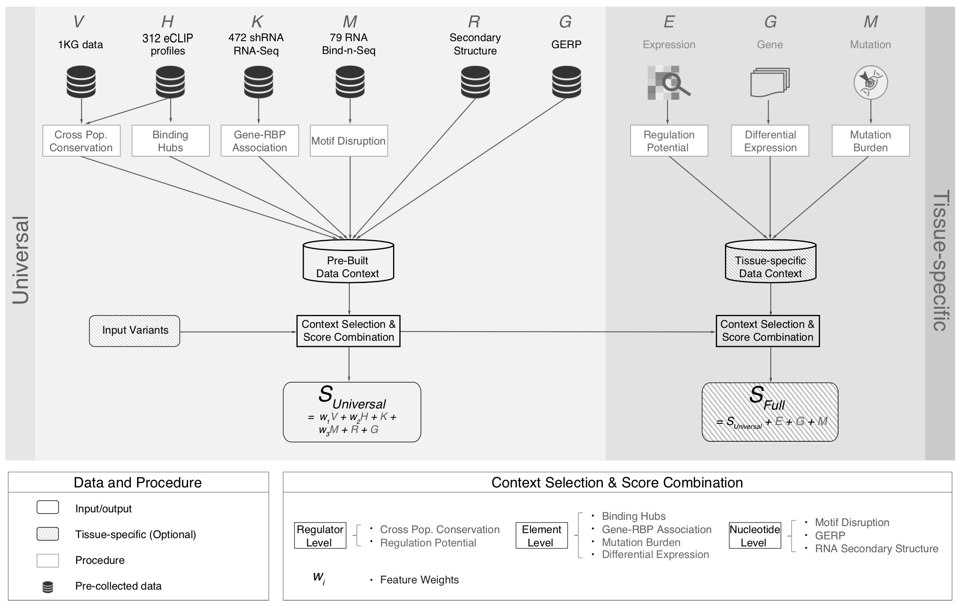
[Zhang*, Liu* et al., Genome Biology (in review ‘18)]

Slide 16
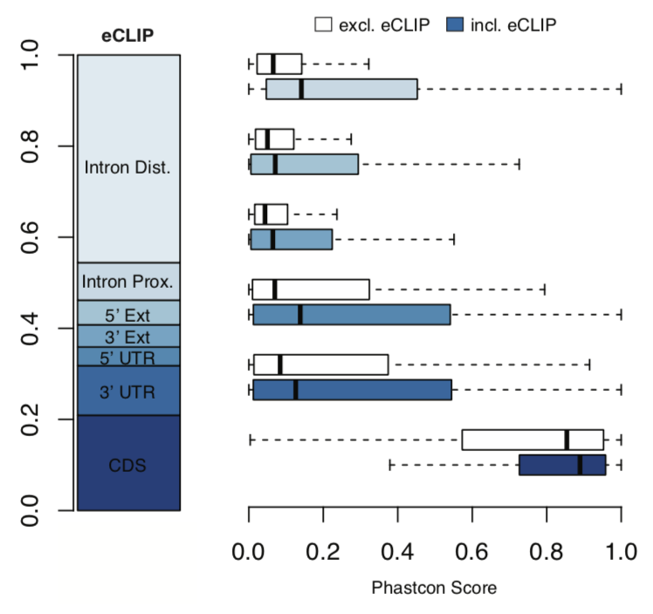
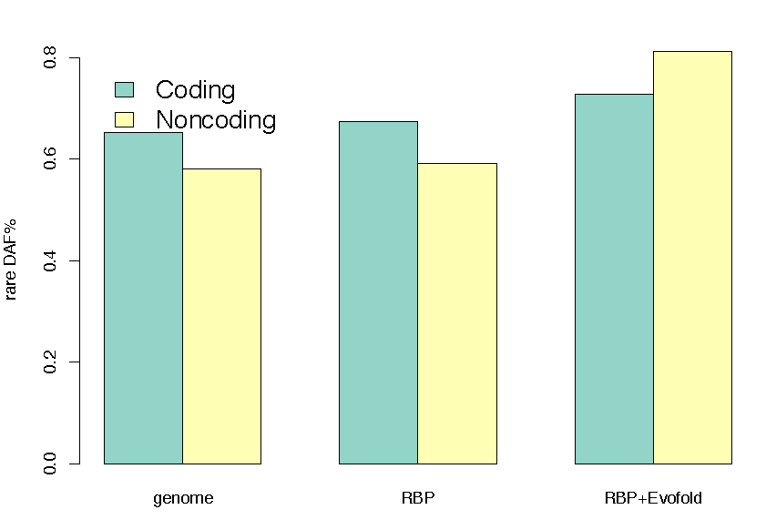
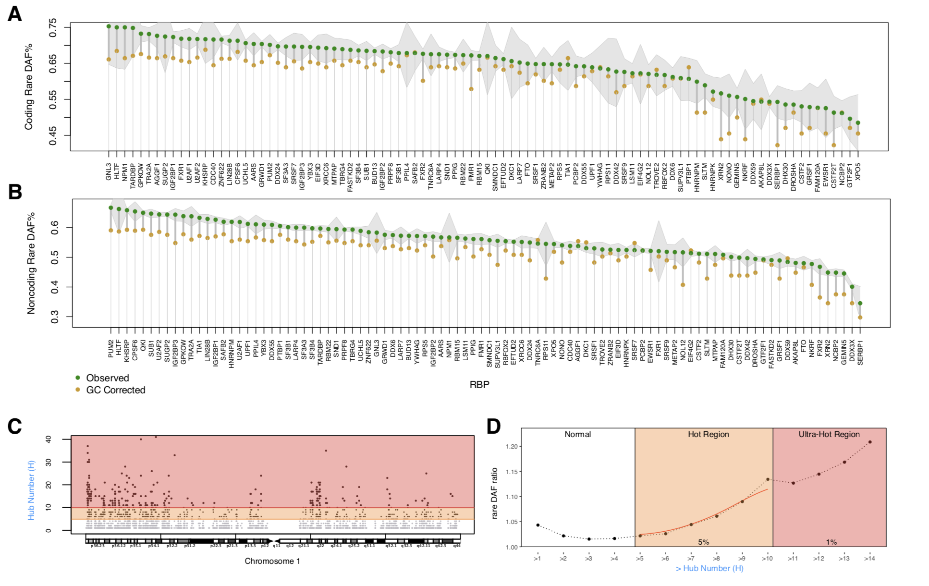
High Phastcon in RBP-overlapped annotations
RNA Structure Cons. from Evofold
Phastcon
Enriched rare DAF in eCLIP peaks
Rare DAF
[Zhang*, Liu* et al., Genome Biology (in review ‘18)]
RBP

Slide 17
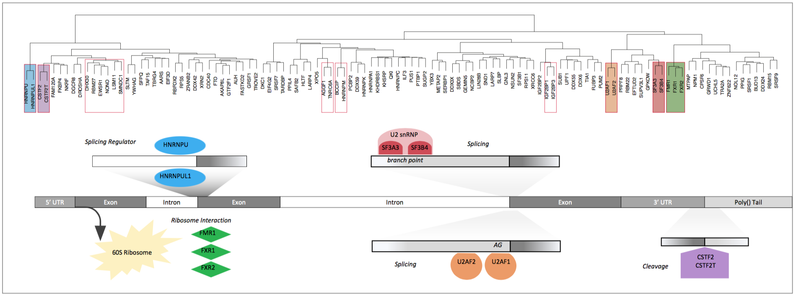
Co-binding of RBPs form biologically relevant complexes
Unique co-binding patterns of RBPs
Literature supported RBP complexes
RBP
RBP
Binding hubs are enriched for rare variants
Hub Number
(Hotness)
Rare DAF
[Zhang*, Liu* et al., Genome Biology (in review ‘18)]
Hub Number (Hotness)

Slide 18
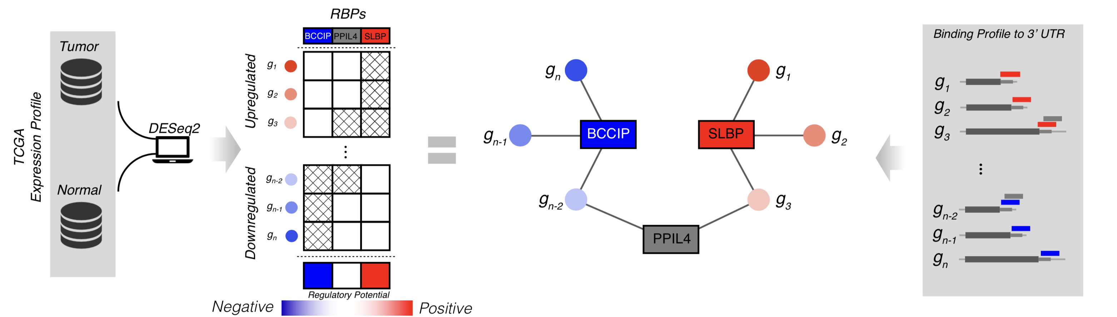
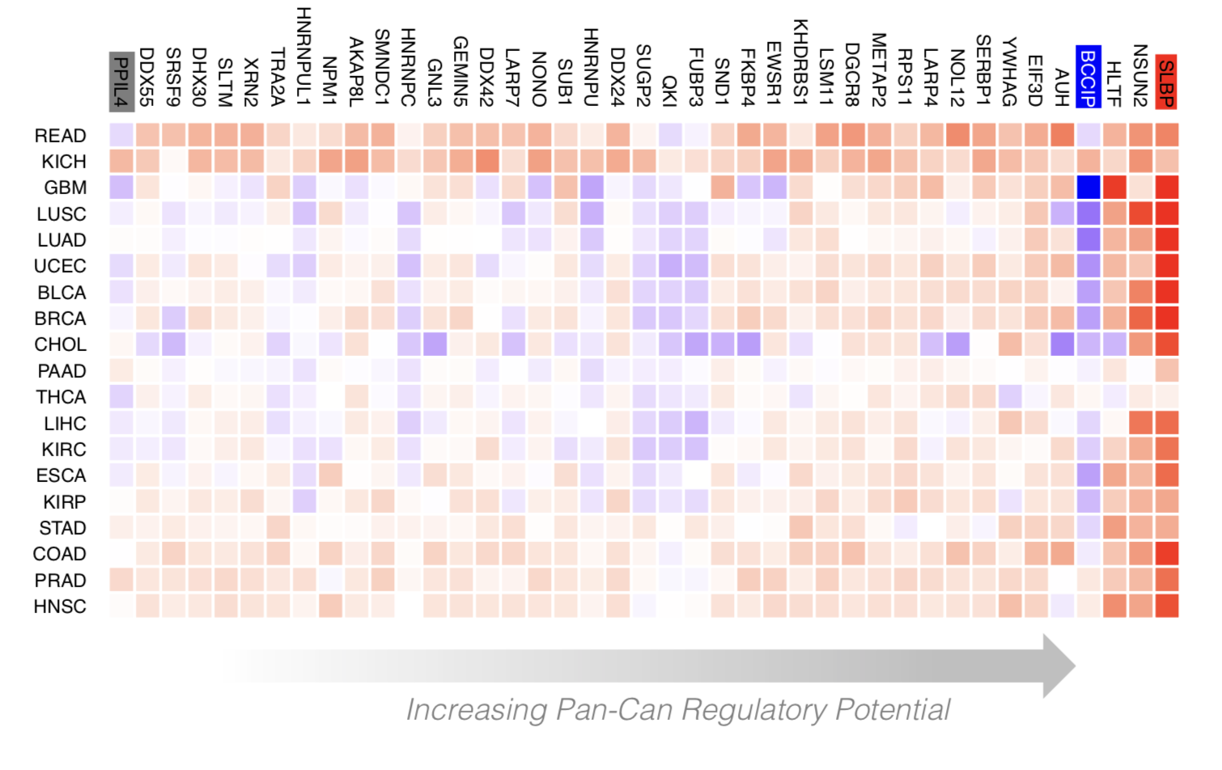
Regulatory Potential of RBPs derived from regression between gene network and expression levels
[Zhang*, Liu* et al., Genome Biology (in review ‘18)]

Slide 19
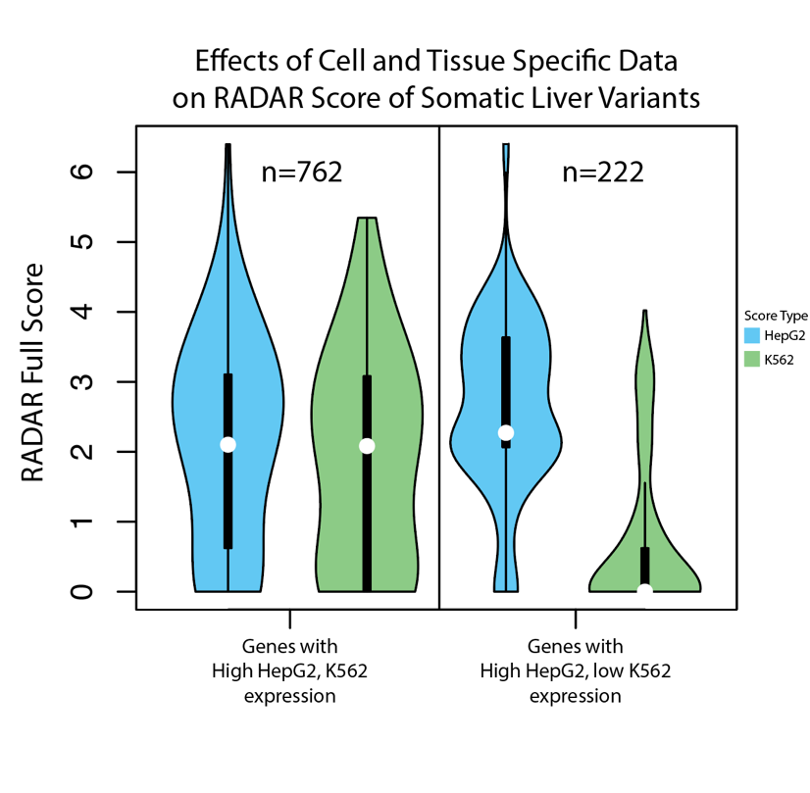
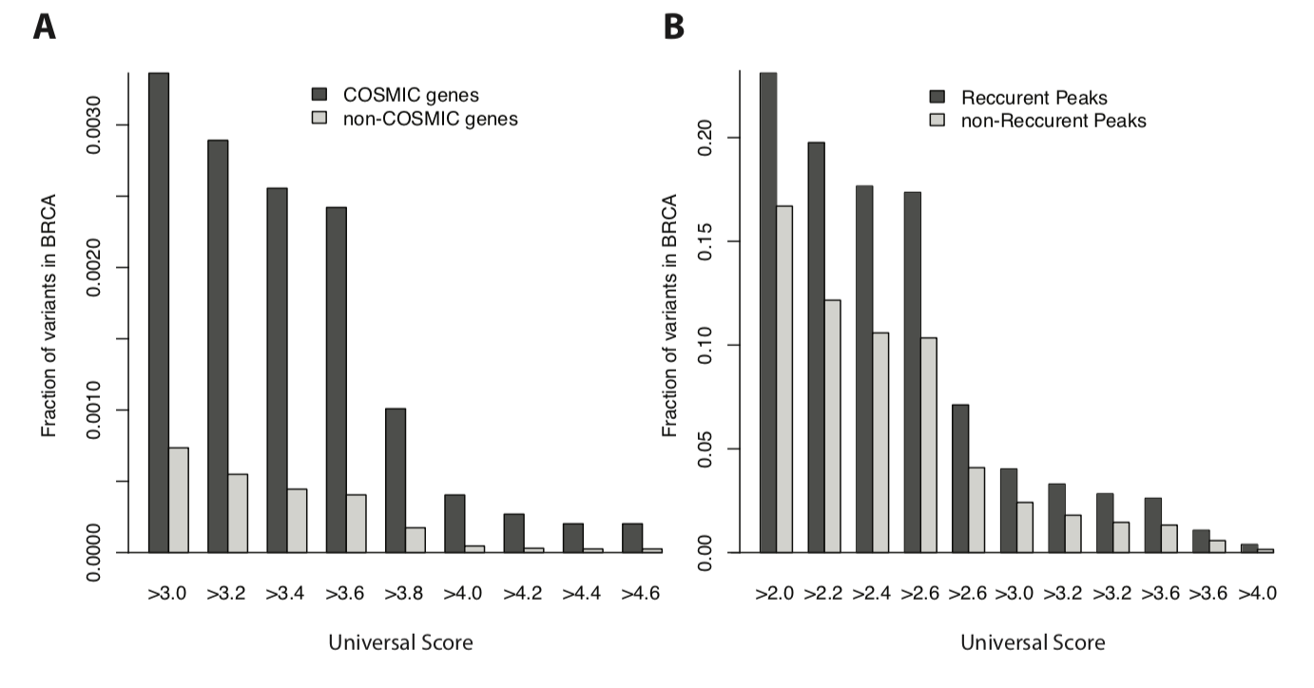
Validation for Somatic Variants:
RADAR Scores enriched in COSMIC genes & recurrently mutated regions
+ higher for tissue matched context

Slide 20
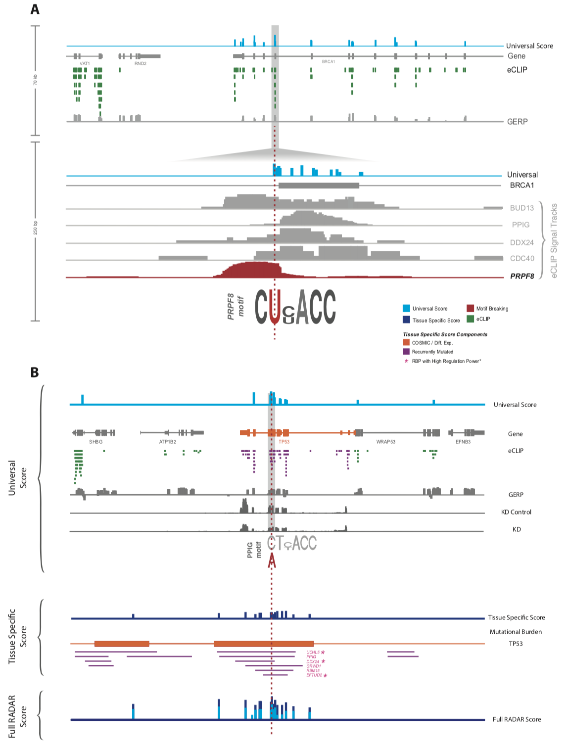
Visualization of RADAR Features and Scoring
Germline Variants are Score Using a Universal Scoring Scheme
Input Variants
eCLIP
GERP
Motif
…
[Zhang*, Liu* et al., Genome Biology (in review ‘18)]

Slide 21
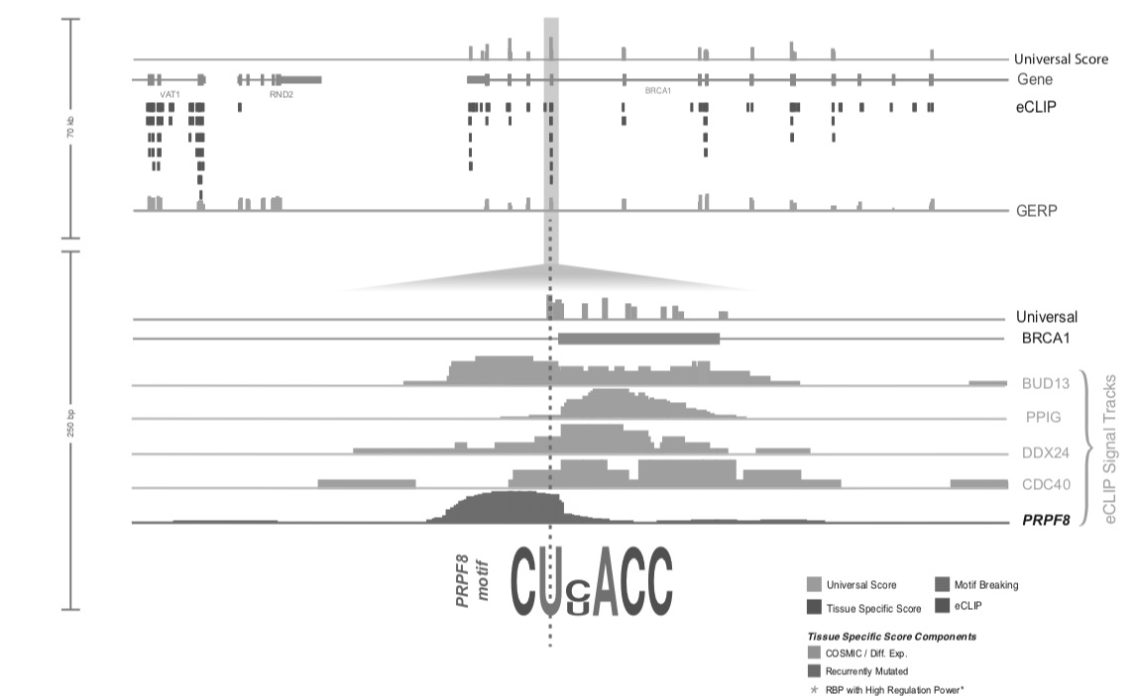
Visualization of RADAR Features and Scoring
Tissue Specific:
Variants
Expression
Regulatory Potential
Input Variants
eCLIP
GERP
Motif
…
Somatic Variant Scored with Universal + Tissue specific context score
[Zhang*, Liu* et al., Genome Biology (in review ‘18)]

Slide 22
RADAR: Annotation & prioritization of variants in the post-transcriptional regulome for RBPs
Background on prioritizing non-coding variants:
FunSeq integrates evidence, with a “surprisal” based weighting scheme. Prioritizing variants within “sensitive sites” (human conserved)
RADAR
  Adapts FunSeq approach to RNA
  Prioritizes variants based on post-transcriptional regulome using ENCODE eCLIP
  Incorporates new features related to RNA sec. struc & tissue specific effects
Next step in prioritizing variants associated with RNA:
uORFs - Feature integration to find small subset of upstream mutations that potentially alter translation

Slide 23
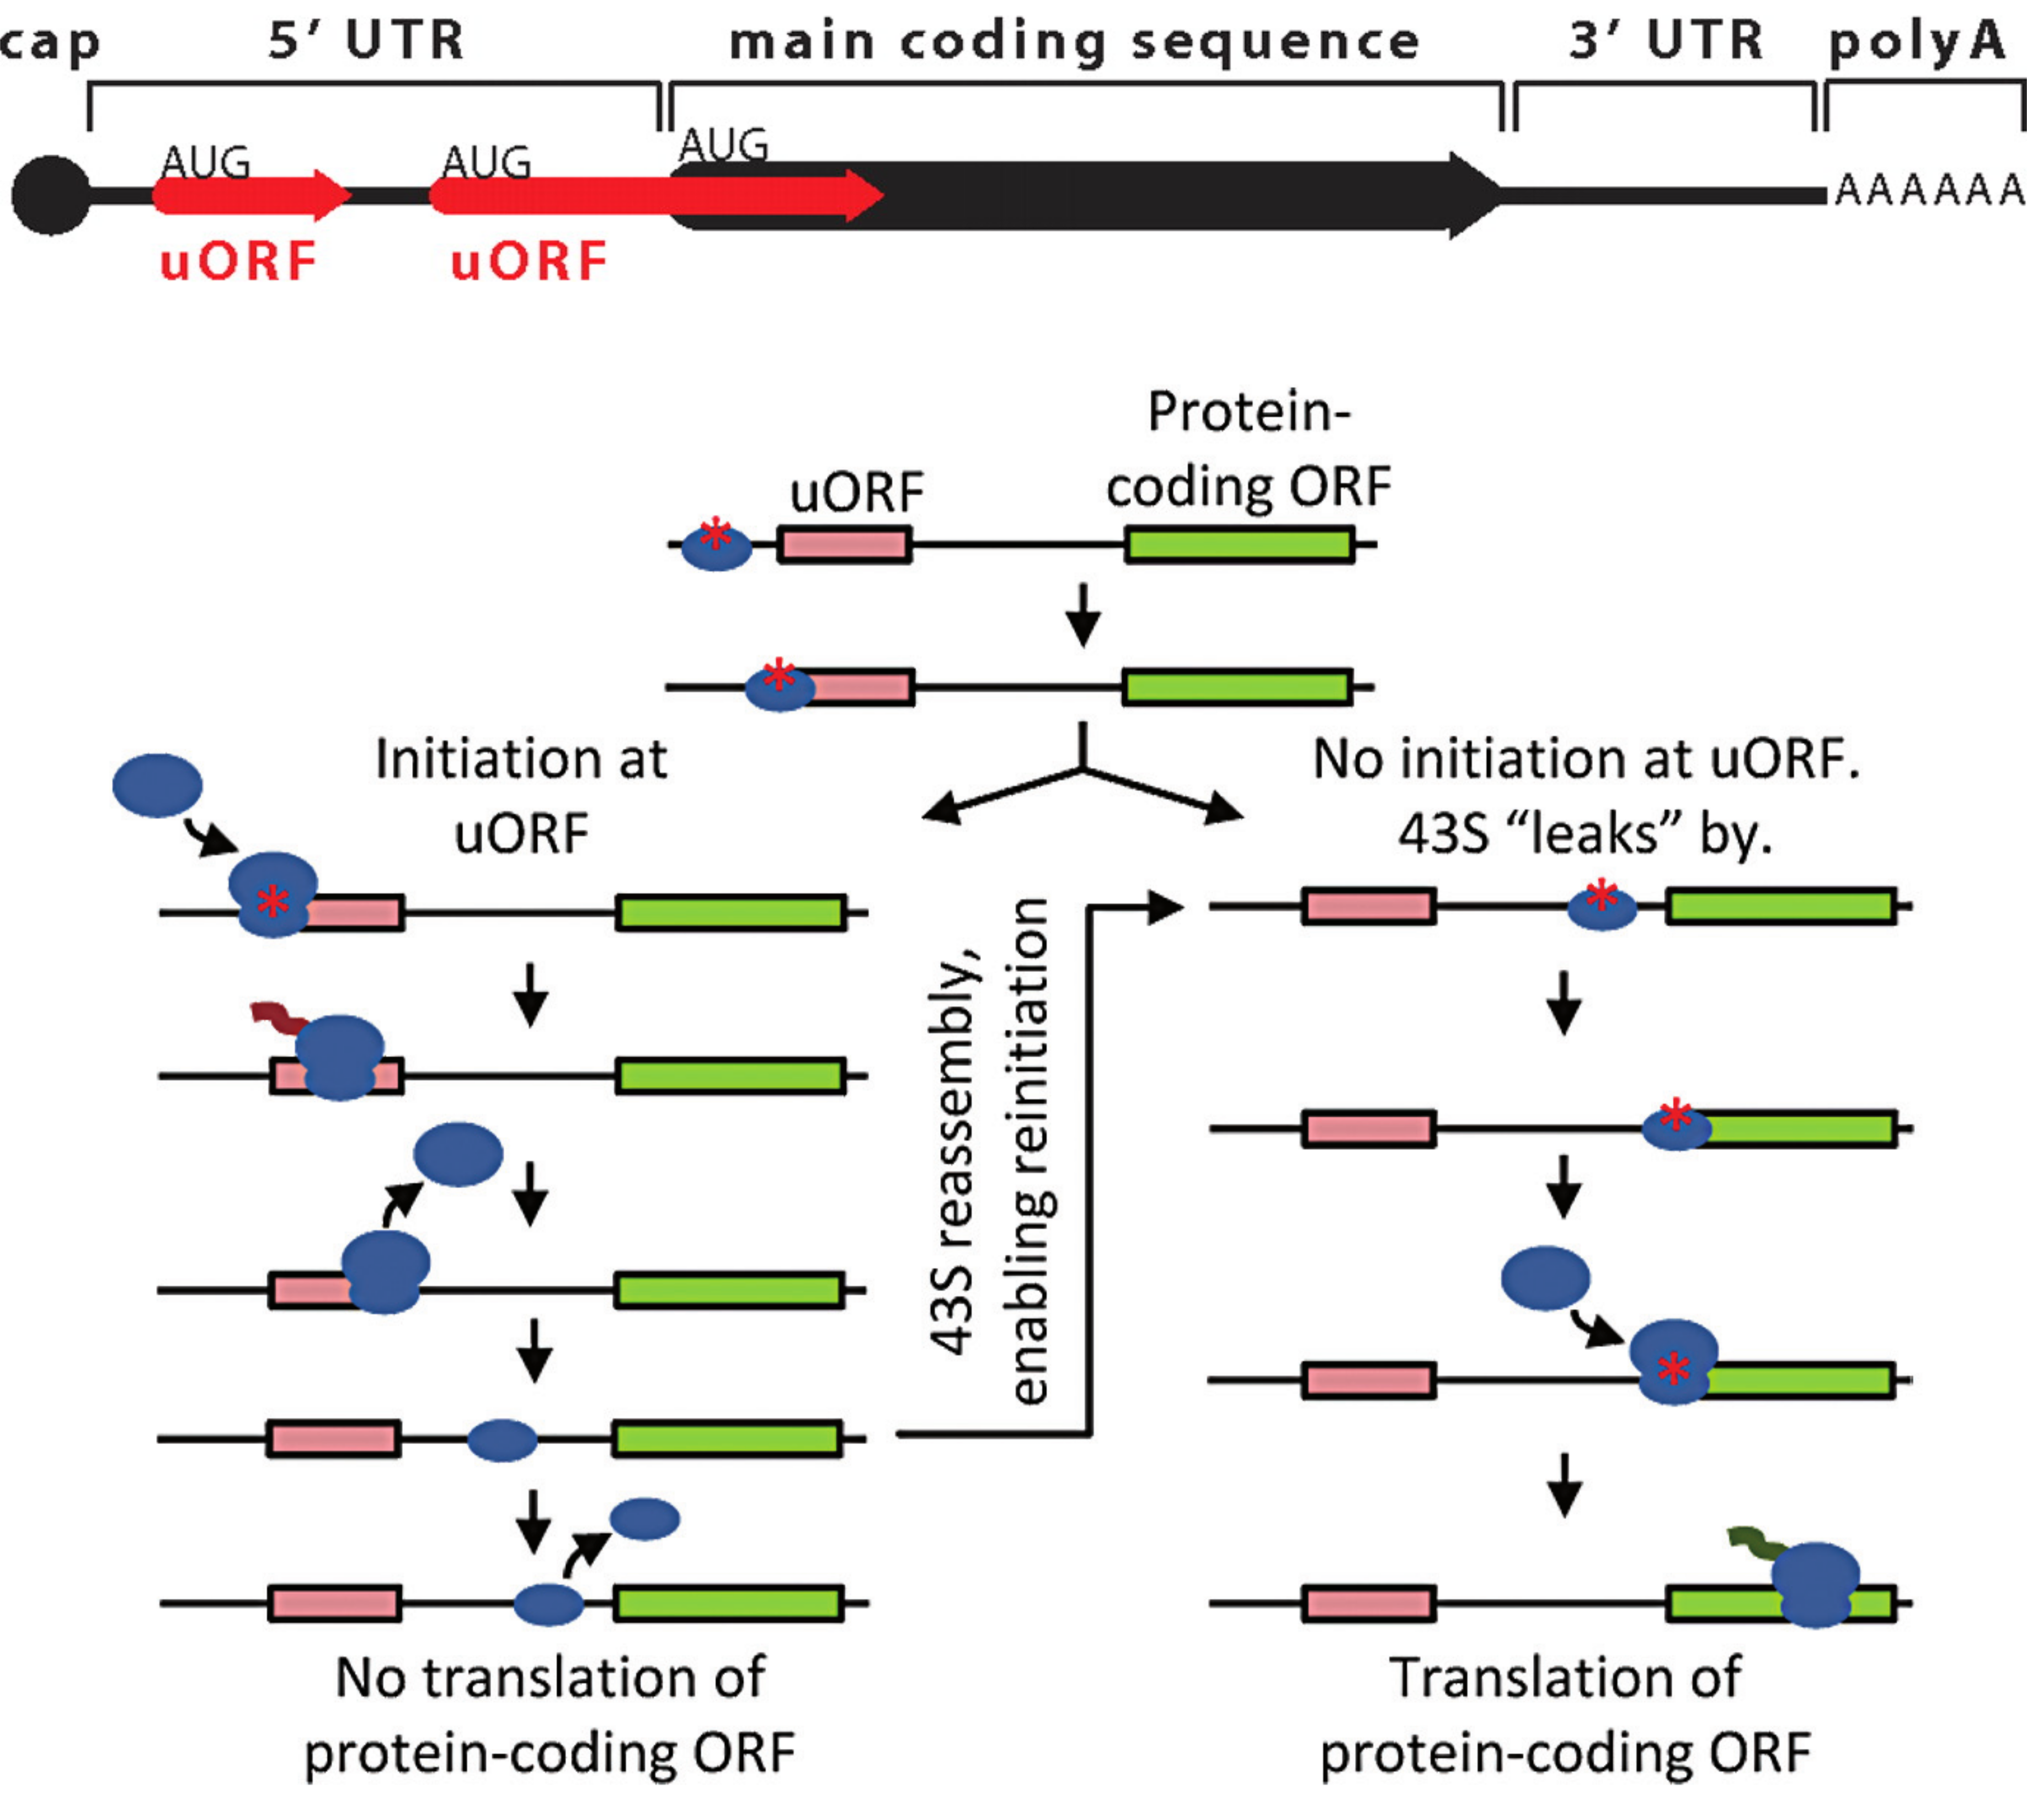
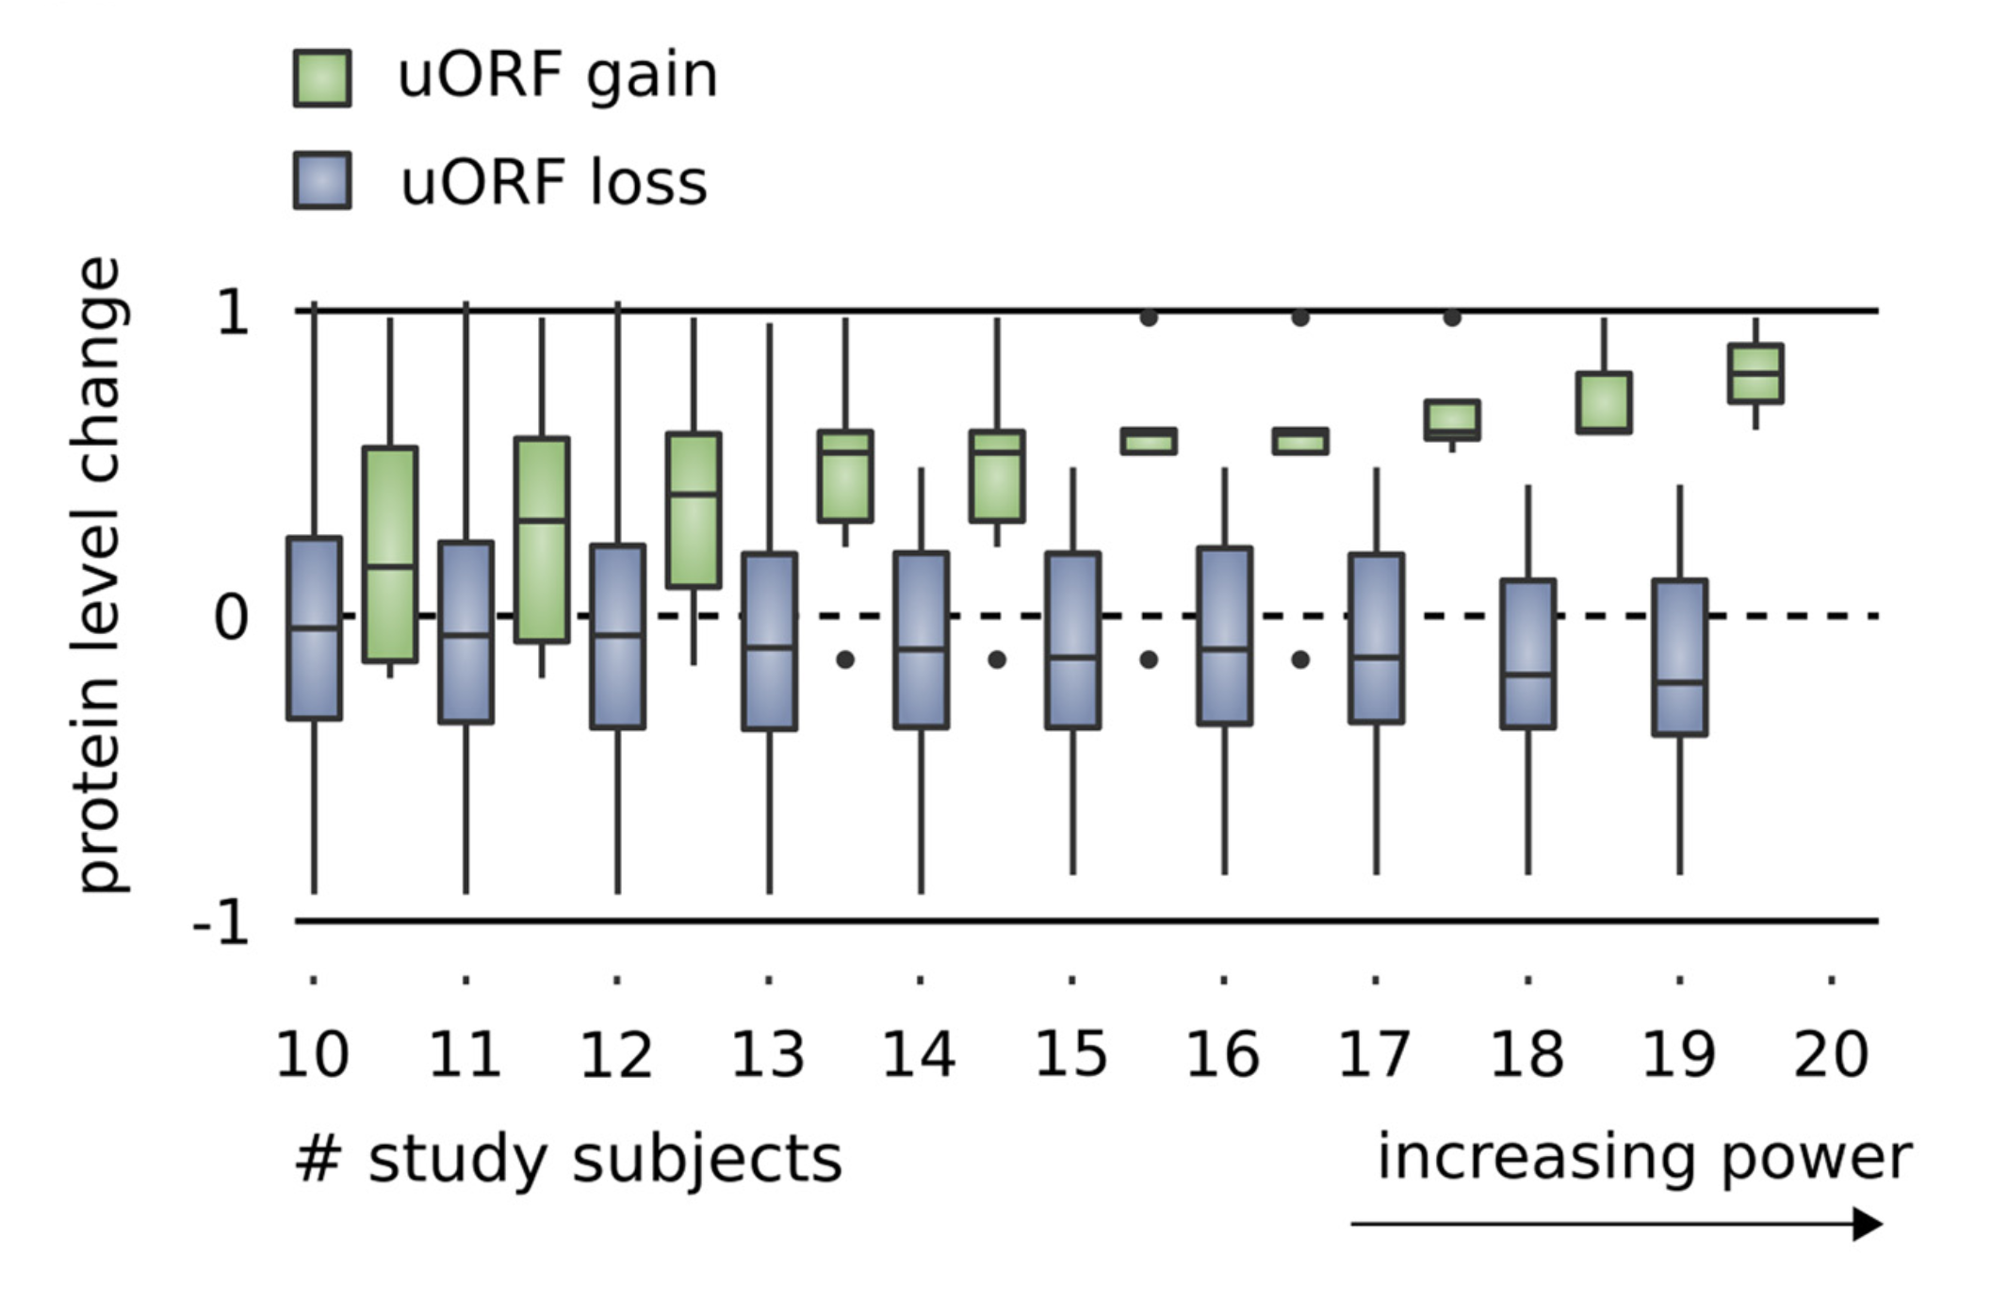
Upstream open reading frames (uORFs) regulate translation are affected by somatic mutation
uORFs regulate the translation of downstream coding regions.
This regulation may be altered by somatic mutation in cancer.
In Battle et al. 2014 data uORF gain & loss assoc. protein level change.
[Calvo et al., PNAS (‘09)]
[McGillivray et al., NAR (‘18)]
[Ferreira et al., Bioengineered (‘14)]

Slide 24
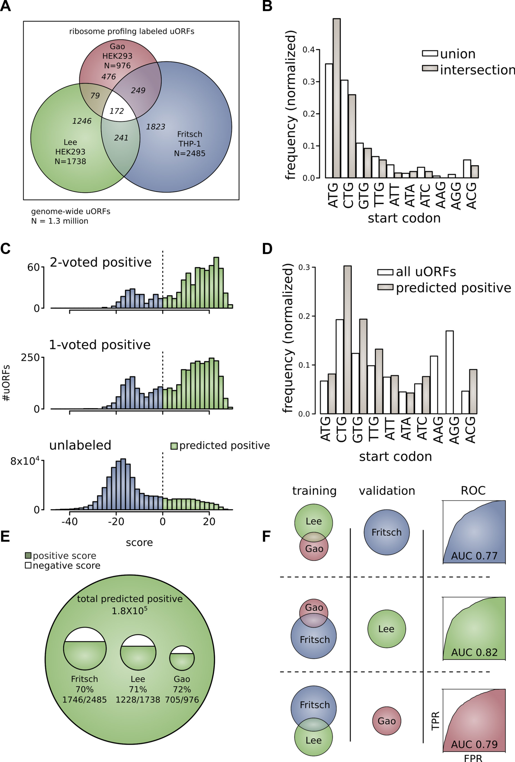
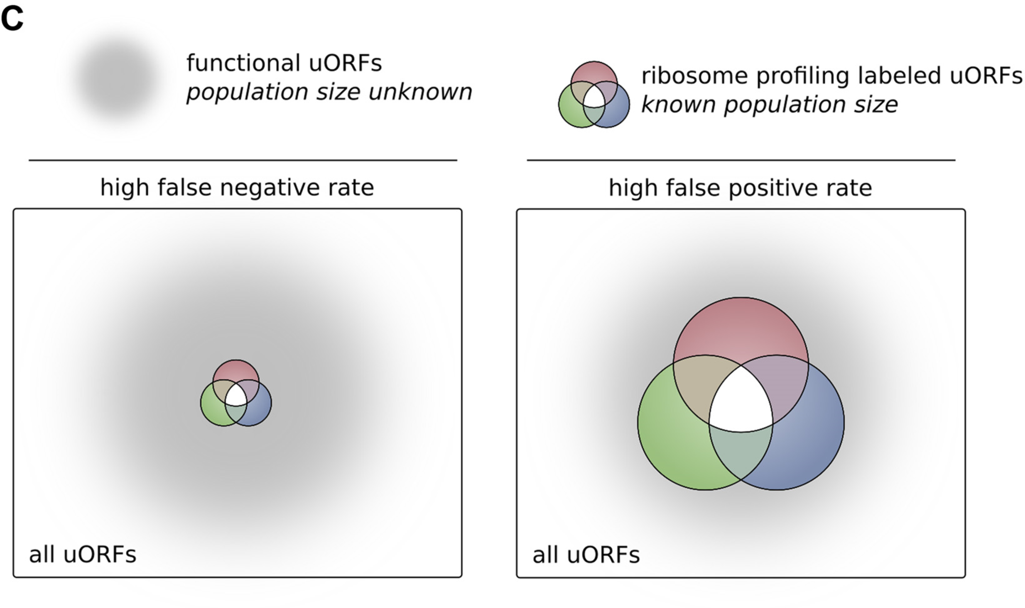
The population of functional uORFs may be significant
From a “Universe” of 1.3 M pot. uORFs
Ribosome profiling experiments have low overlap in identified uORFs.
This suggests high false-negative rate, and more functional uORFs than currently known.
[McGillivray et al., NAR (‘18)]

Slide 25
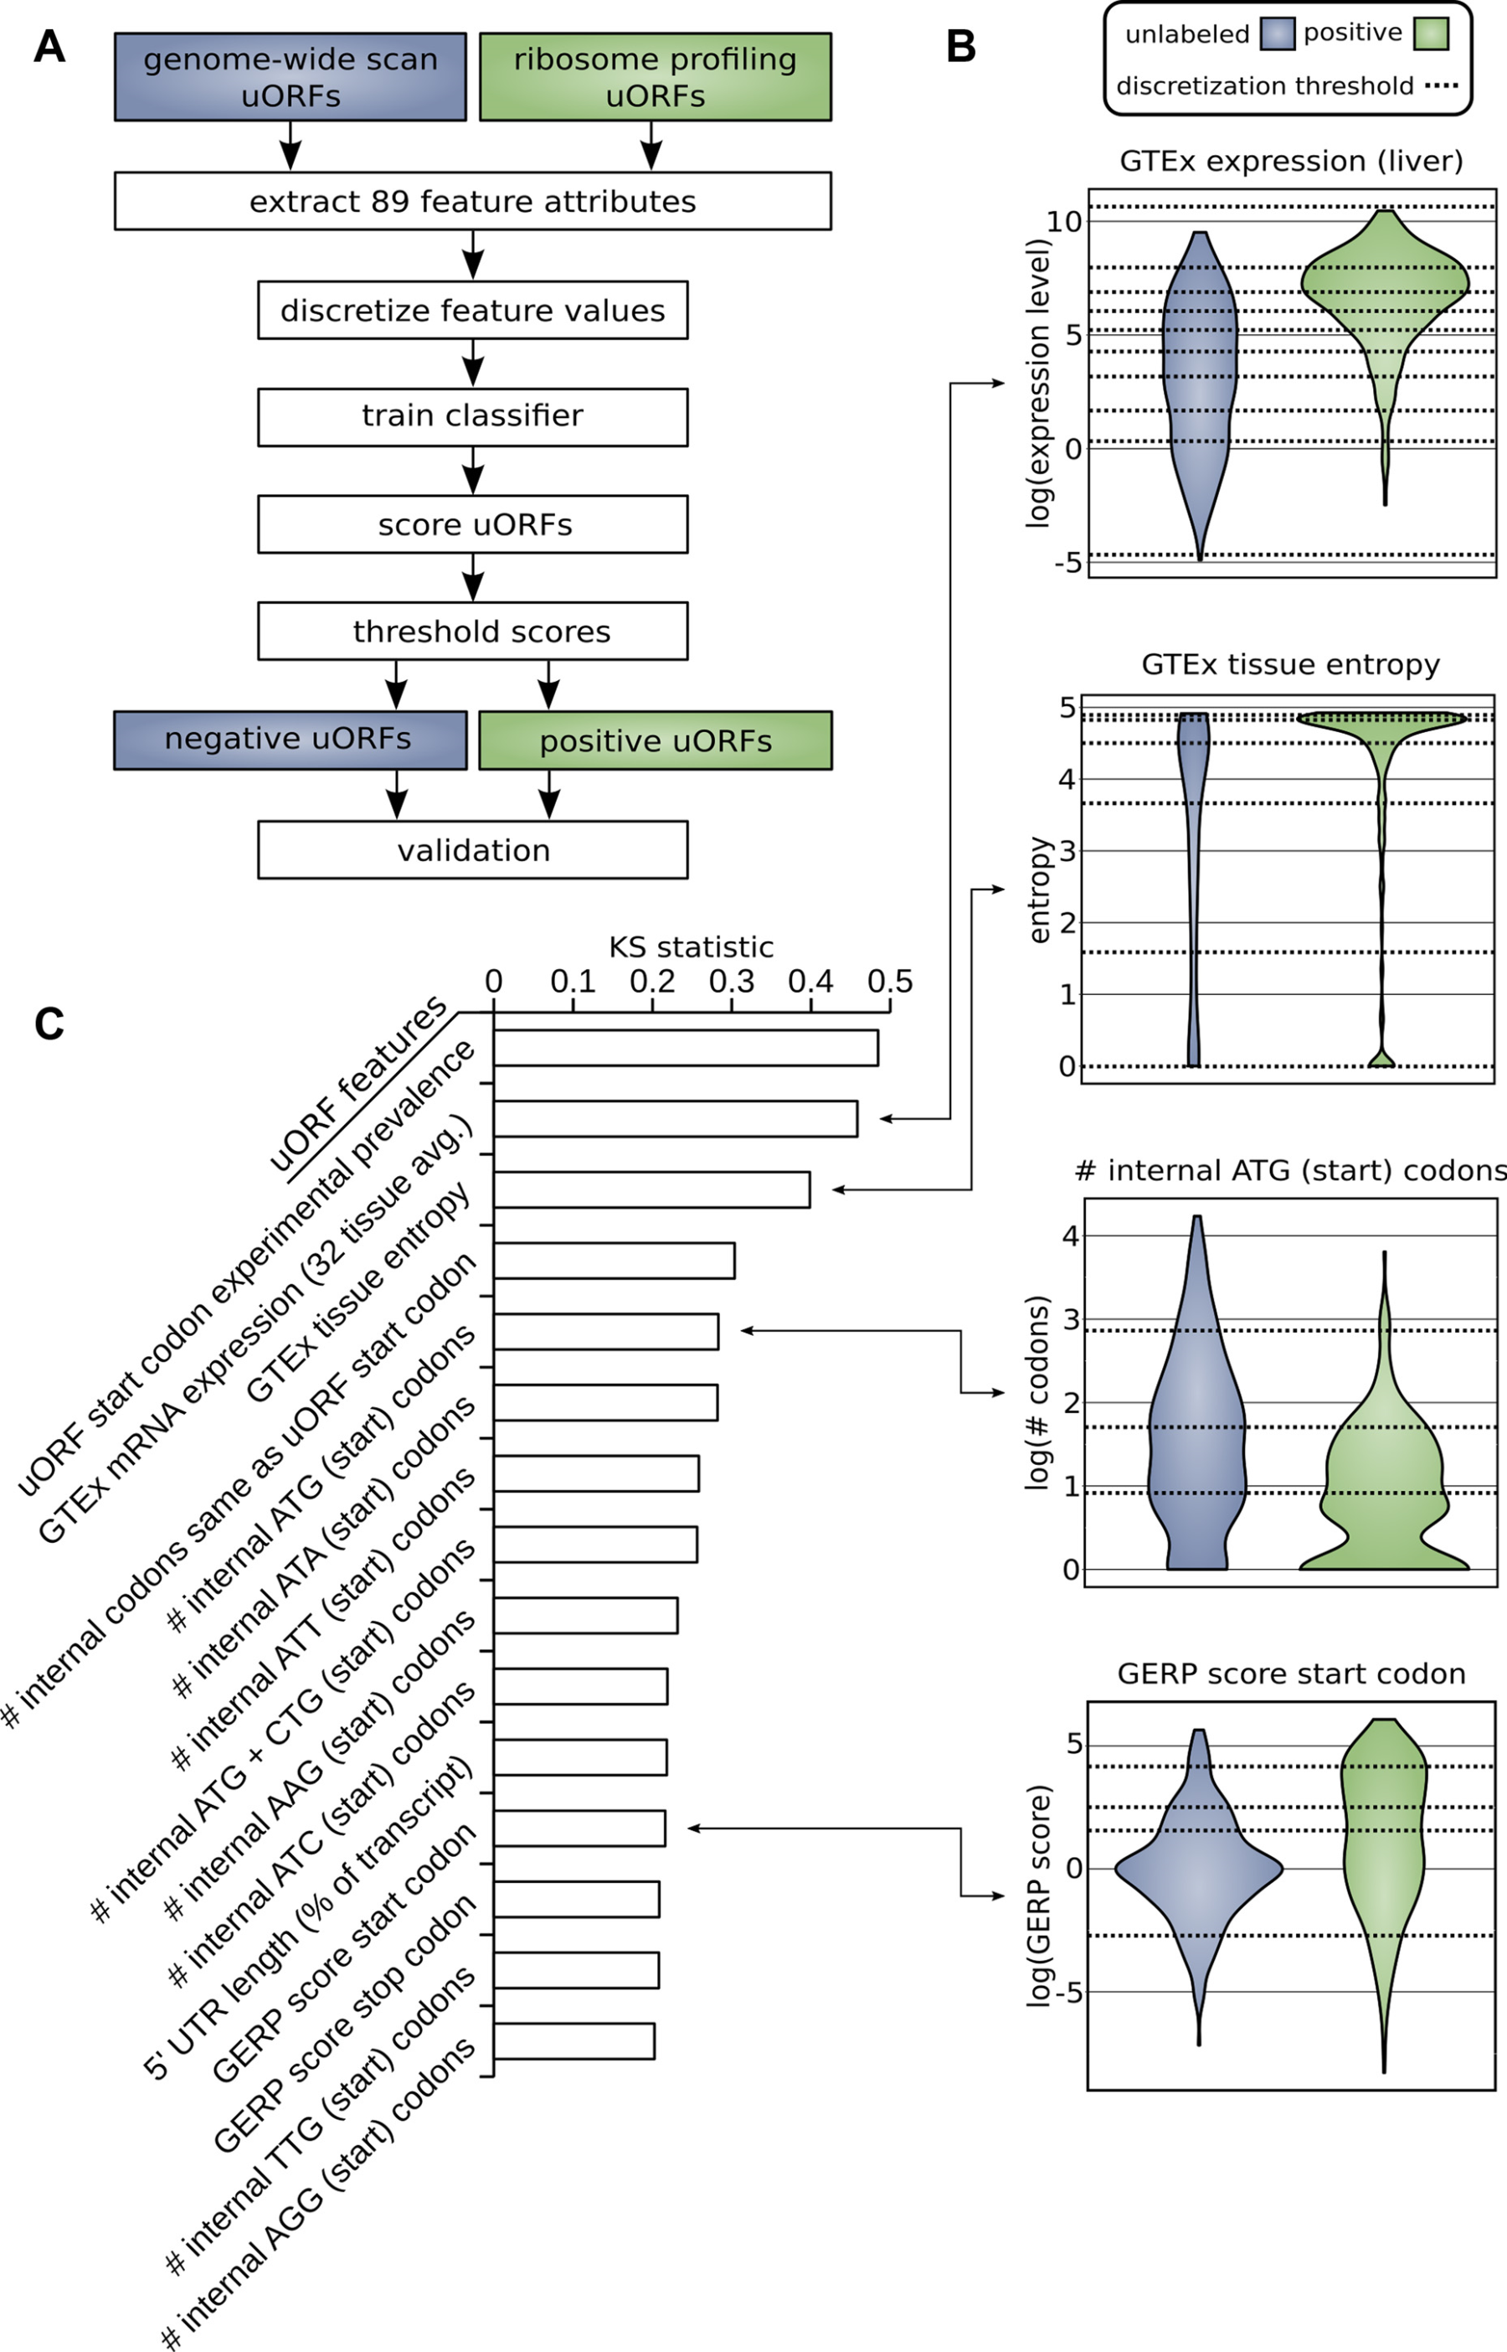
Prediction & validation of functional uORFs using 89 features
Expr.
Level
All near-cognate start codons predicted.
Cross-validation on independent ribosome profiling datasets and validation using in vivo protein levels and ribosome occupancy in humans (Battle et al. 2014).
Tissue
Dist.
Int.
ATG
Start
Cons-
ervation
[McGillivray et al., NAR (‘18)]

Slide 26
A comprehensive catalog of functional uORFs
Universe of 1.3M uORFs scored via Simple Bayes algo.
180K: Large predicted positive set likely to affect translation
Calibration on gold standards, suggests getting ~70% of known
Predicted functional uORFs may be intersected with disease associated variants.
[McGillivray et al., NAR (‘18)]

Slide 27
RADAR: Annotation & prioritization of variants in the post-transcriptional regulome for RBPs
Background on prioritizing non-coding variants:
FunSeq integrates evidence, with a “surprisal” based weighting scheme. Prioritizing variants within “sensitive sites” (human conserved)
RADAR
  Adapts FunSeq approach to RNA
  Prioritizes variants based on post-transcriptional regulome using ENCODE eCLIP
  Incorporates new features related to RNA sec. struc & tissue specific effects
Next step in prioritizing variants associated with RNA:
uORFs - Feature integration to find small subset of upstream mutations that potentially alter translation

Slide 28
RADAR: Annotation & prioritization of variants in the post-transcriptional regulome for RBPs
Background on prioritizing non-coding variants:
FunSeq integrates evidence, with a “surprisal” based weighting scheme. Prioritizing variants within “sensitive sites” (human conserved)
RADAR
  Adapts FunSeq approach to RNA
  Prioritizes variants based on post-transcriptional regulome using ENCODE eCLIP
  Incorporates new features related to RNA sec. struc & tissue specific effects
Next step in prioritizing variants associated with RNA:
uORFs - Feature integration to find small subset of upstream mutations that potentially alter translation

Slide 29
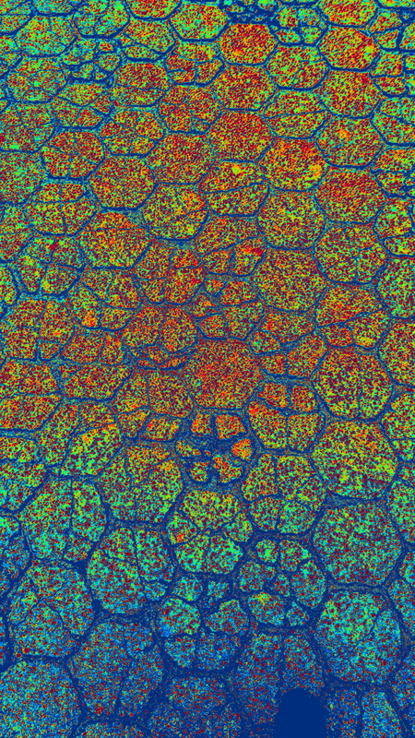
FunSeq.gersteinlab.org
Y Fu, E Khurana, Z Liu, S Lou,
J Bedford, X Mu, K Yip
RADAR.gersteinlab.org
J Zhang, J Liu, D Lee,
L Lochovsky, J-J Feng, S Lou,
M Rutenberg-Schoenberg
github.gersteinlab.org/uORFs
P McGillivray, R Ault,
M Pawashe, R Kitchen, S Balasubramanian
Acknowledgments! Also, Hiring: See Jobs.gersteinlab.org

Slide 30


Slide 31
Info about this talk
No Conflicts
Unless explicitly listed here. There are no conflicts of interest relevant to the material in this talk
General PERMISSIONS
This Presentation is copyright Mark Gerstein, Yale University, 2017.
Please read permissions statement at
sites.gersteinlab.org/Permissions
Basically, feel free to use slides & images in the talk with PROPER acknowledgement (via citation to relevant papers or website link). Paper references in the talk were mostly from Papers.GersteinLab.org.
PHOTOS & IMAGES
For thoughts on the source and permissions of many of the photos and clipped images in this presentation see streams.gerstein.info . In particular, many of the images have particular EXIF tags, such as kwpotppt , that can be easily queried from flickr, viz: flickr.com/photos/mbgmbg/tags/kwpotppt

