Slide 1

Transcriptome
Mining:
Tackling core issues related to gene regulation
& also analyzing the "data exhaust" associated with this activity
Mark Gerstein, Yale
Slides freely downloadable from Lectures.GersteinLab.org
& “tweetable” (via @markgerstein).
See last slide for more info.

Slide 2
Transcriptome = Gene Activity of All Genes in the Genome, usually quantified by RNA-seq
Genes (DNA)
Transcription
Regulation
RNA transcripts
Non-coding regulatory RNAs
Protein coding mRNA
Gene Expression measured by RNA-seq
Translation
Proteins
Expression of genes is quantified by transcription:
RNA-Seq measures mRNA transcript amounts
[ NATURE 459: 927; NAT. REV. GEN. 10: 57 ]

Slide 3

RNA-Seq Overview
ATACAAGCAAGTATAAGTTCGTATGCCGTCTT
GGAGGCTGGAGTTGGGGACGTATGCGGCATAG
TACCGATCGAGTCGACTGTAAACGTAGGCATA
ATTCTGACTGGTGTCATGCTGATGTACTTAAA
Fastq sequence files
~5-10 GB
Index-building + Alignment to reference genome
BAM files
~1-2-fold reduction
Successive steps of Data Reduction
Conversion to signal track by overlapping reads
BigWig files
~25-fold reduction
Mapping to genes
Gene/Transcript expression matrix
~20-fold reduction
Quantitative information from RNA-seq signal: average signals at exon level (RPKMs)
Reads => Signal
[NAT. REV. 10: 57; PLOS CB 4:e1000158; PNAS 4:107: 5254 ]

Slide 4

Activity Patterns
RNA Seq. gives rise to activity patterns of genes & regions in the genome

Slide 5
Some Core Science Qs Addressed by RNA-seq
Gene activity as a function of:
  Developmental stage: basic patterns of co-active genes across development
  Cell-type & Tissue: relationship to specialized functions
  Evolutionary relationships: behavior preserved across a wide range of organisms; patterns in model organisms in relation to those in humans
  Disease phenotypes: disruption of patterns in disease
Our overarching Qs:
Are there core, ancient patterns of gene expression?
Are they associated with development?
Are they disrupted by disease?

Slide 6
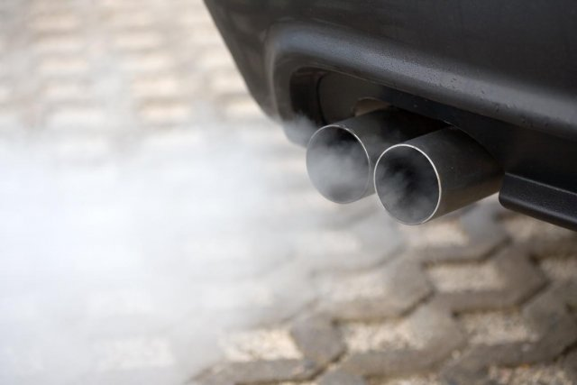
Studying large-scale transcriptome data also produces
Data Exhaust
Metadata
Core scientific purposes
Front End
Data collection and analysis
Back end
Data Exhaust
Data on Collaboration, publication and Infrastructure
Data Exhaust = Exploitable byproducts of big data collection and analysis
Creative use of Data is key to Data Science !
[PHOTO: RELAXNEWS; from http://www.lapresse.ca]

Slide 7
Transcriptome Mining: Tackling core issues related to gene regulation
& also analyzing the "data exhaust" associated with this activity
[Core-1] Expression Clustering,
Cross-species
  Comparative ENCODE – Lots of worm-fly-human matched data & developmental timecourses
  Optimization gives 16 conserved co-expression modules, 12 w/ hourglass
[Core-2] State Space Models
of Gene Expression
  Using dimensionality reduction to help determine internal & external drivers; Decoupling expression changes into those from conserved vs species-specific genes
  Conserved genes have similar canonical patterns (iPDPs) in contrast to species specific ones (Ex of ribosomal v signaling genes)
[Core-3] Logic Gates Modeling
  Preponderance of OR gates in cancer v. cell-cycle (esp. for MYC)
[Exhaust-1] Genomic Privacy
& RNA-seq
  The dilemma: The genome as fundamental, inherited info that’s very private v need for large-scale mining for med. research
  2-sided nature of RNA-seq presents a particularly tricky privacy issue
  Using file formats to remove obvious variants
  Quantifying & removing further variant info from expression levels + eQTLs using ICI & predictability
  Instantiating a practical linking attack using extreme expression levels
[Exhaust-2] Publication Patterns from data producing consortia
  Co-authorship network statistics relate to publication rollouts & show gradual adoption by a diverse community
  Key role of brokers in data dissemination

Slide 8
Transcriptome Mining: Tackling core issues related to gene regulation
& also analyzing the "data exhaust" associated with this activity
[Core-1] Expression Clustering,
Cross-species
  Comparative ENCODE – Lots of worm-fly-human matched data & developmental timecourses
  Optimization gives 16 conserved co-expression modules, 12 w/ hourglass
[Core-2] State Space Models
of Gene Expression
  Using dimensionality reduction to help determine internal & external drivers; Decoupling expression changes into those from conserved vs species-specific genes
  Conserved genes have similar canonical patterns (iPDPs) in contrast to species specific ones (Ex of ribosomal v signaling genes)
[Core-3] Logic Gates Modeling
  Preponderance of OR gates in cancer v. cell-cycle (esp. for MYC)
[Exhaust-1] Genomic Privacy
& RNA-seq
  The dilemma: The genome as fundamental, inherited info that’s very private v need for large-scale mining for med. research
  2-sided nature of RNA-seq presents a particularly tricky privacy issue
  Using file formats to remove obvious variants
  Quantifying & removing further variant info from expression levels + eQTLs using ICI & predictability
  Instantiating a practical linking attack using extreme expression levels
[Exhaust-2] Publication Patterns from data producing consortia
  Co-authorship network statistics relate to publication rollouts & show gradual adoption by a diverse community
  Key role of brokers in data dissemination

Slide 9
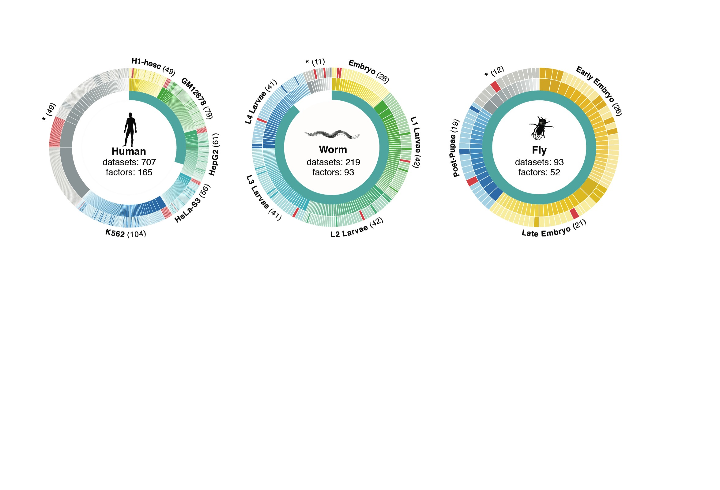
ENCODE Time-course gene expression data of worm & fly development + human conditions
[Nature 512:445 ('14); doi: 10.1038/nature13424]
Comparative ENCODE Functional Genomics Resource
(EncodeProject.org/comparative)
Broad sampling of conditions across transcriptomes for human, worm & fly
  embryo & ES cells
  developmental time course (worm-fly)
In total: ~3000 datasets
(~130B reads)
Organism | Major developmental stages
worm (C. elegans) | 33 stages: 0, 0.5, 1, …, 12 hours, L1, L2, L3, L4, …, Young Adults, Adults
fly (D. mel.) | 30 stages: 0, 2, 4, 6, 8,…, 20, 22 hours, L1-L4, Pupaes, Adults

Slide 10
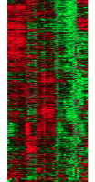
Expression clustering:
revisiting an ancient problem
Species A
Species B
Clustering
algorithm
Clustering
algorithm
co-expressed genes
responsible for the same
function in a species
Eisen MB et al. PNAS 1998
Langfelder P et al. BMC Bioinfo. 2008
Tamayo P et al. PNAS 1999
Kluger Y et al. Genome Res. 2003
two independent sets
of modules
Cross species
co-expression modules

Slide 11
Expression clustering:
revisiting an ancient problem
Species A
Orthologous pairs
between species
Species B
A novel unified framework to integrate co-expression data across species
OrthoClust
cross species modules
Yan et al. Genome Biol. 2014
Cross species
co-expression modules

Slide 12
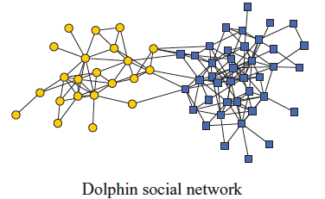
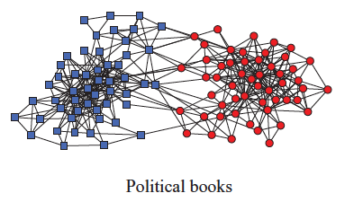
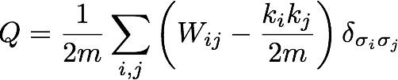
Network modularity
degree of node i
Newman Phy. Rev. E 2013
adjacency matrix
whether or not
i, j are in the
same module
number of edges
expected number of
edges between i and j

Slide 13

Network modularity
degree of node i
adjacency matrix
whether or not
i, j are in the
same module
number of edges
expected number of
edges between i and j

Slide 14

Network modularity
Optimization problem
for sim. annealing
degree of node i
adjacency matrix
whether or not
i, j are in the
same module
number of edges
expected number of
edges between i and j

Slide 15
A toy example [orthoclust]
[Yan et al. GenomeBiol 15:R100 ('14)]
2
Every node i is assigned with a label σ_{i} (labels of modules: 1,2,…q).
4
4
co-expressed
1
1
2
2
orthologs
Species A
3
3
Species B
reward an orthologous pair
with the same value
4
4
4
1
2
1
3
1
Q(for all σ_{i} in A) + Q(for all σ_{i} in B)
+
Favorableness = "Modularity" in species A + "Modularity" in species B + consistency betw. A & B

Slide 16
A toy example [orthoclust]
[Yan et al. GenomeBiol 15:R100 ('14)]
2
2
4
co-expressed
2
4
2
4
orthologs
Species A
2
4
Species B
4
1
4
1
4
4
1
1
species A specific
conserved modules
species B specific
Use Potts model (generalized Ising model) to simultaneously cluster co-expressed genes within an organism as well as orthologs shared between organisms. Here, the ground state configuration correspond to three modules: 1, 2, 4.

Slide 17
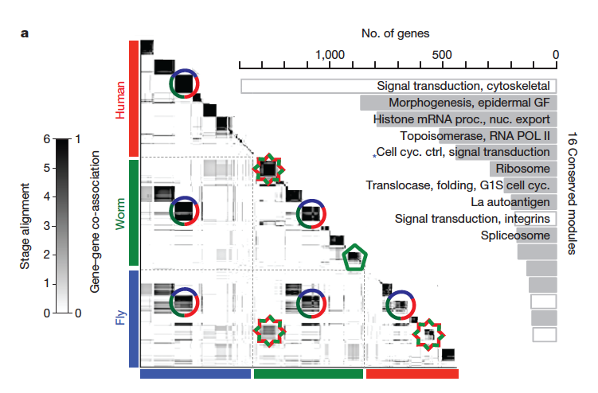
Application for more than 2 species
~55000 genes
[Nature 512:445 ('14); doi: 10.1038/nature13424]

Slide 18
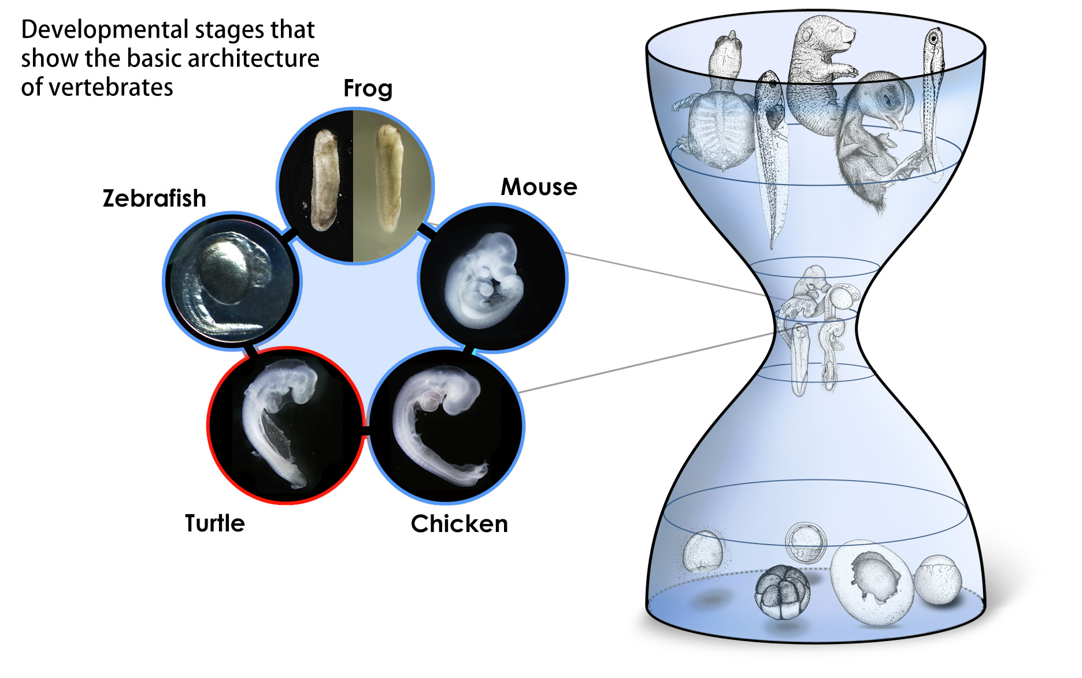
Conserved modules exhibit canonical hourglass behavior
Phylotypic stage
Illustrations courtesy Naoki Irie
Canonical Inter-organism Behavior
“Hourglass hypothesis”: all organisms go through a particular stage in embryonic development ("phylotypic" stage) where
inter-organism expression differences of orthologous genes are smallest.
12 out of our 16 modules have this behavior
[Nature 512:445 ('14); doi: 10.1038/nature13424]

Slide 19
Transcriptome Mining: Tackling core issues related to gene regulation
& also analyzing the "data exhaust" associated with this activity
[Core-1] Expression Clustering,
Cross-species
  Comparative ENCODE – Lots of worm-fly-human matched data & developmental timecourses
  Optimization gives 16 conserved co-expression modules, 12 w/ hourglass
[Core-2] State Space Models
of Gene Expression
  Using dimensionality reduction to help determine internal & external drivers; Decoupling expression changes into those from conserved vs species-specific genes
  Conserved genes have similar canonical patterns (iPDPs) in contrast to species specific ones (Ex of ribosomal v signaling genes)
[Core-3] Logic Gates Modeling
  Preponderance of OR gates in cancer v. cell-cycle (esp. for MYC)
[Exhaust-1] Genomic Privacy
& RNA-seq
  The dilemma: The genome as fundamental, inherited info that’s very private v need for large-scale mining for med. research
  2-sided nature of RNA-seq presents a particularly tricky privacy issue
  Using file formats to remove obvious variants
  Quantifying & removing further variant info from expression levels + eQTLs using ICI & predictability
  Instantiating a practical linking attack using extreme expression levels
[Exhaust-2] Publication Patterns from data producing consortia
  Co-authorship network statistics relate to publication rollouts & show gradual adoption by a diverse community
  Key role of brokers in data dissemination

Slide 20
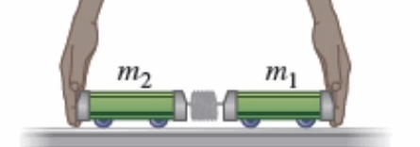
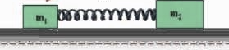
Is gene regulation among orthologs conserved?
To what degree can’t ortholog expression levels be predicted due to species-specific regulation?
Species A
Species B
orthologs
co-expressed
[Wang et al. PLOS CB, ‘16]
Regulation among orthologs (internal)
Regulation from species-specific factors (external)
Orthologous genes (orthologs)
Species-specific transcription factors
With External force
Purely Internal Dynamics
Notes:
connect loregic to here too! to see regulatory mechanisms similar too

Slide 21
State-space model for internal and external gene regulatory networks
State X_{t}: Gene expression vector of internal group at time t
A_{ij} captures temporal casual influence from Gene i to Gene j in internal group
B_{kl} captures temporal casual influence from external factor k to Gene l in internal group
Control U_{t}: Gene expression vector of external factors at time t
[Wang et al. PLOS CB, ‘16]

Slide 22
State-space model for internal
and external gene regulatory networks
Not enough data to estimate state space model for genes
(e.g., 25 time points per gene to estimate 4 million elements of A or B for 2000 genes)
Dimensionality reduction from genes to meta-genes (e.g., SVD)
Effective state space model for meta-genes
(e.g., 250 time points to estimate 50 matrix elements if 5 meta-genes)
[Wang et al. PLOS CB, ‘16]

Slide 23
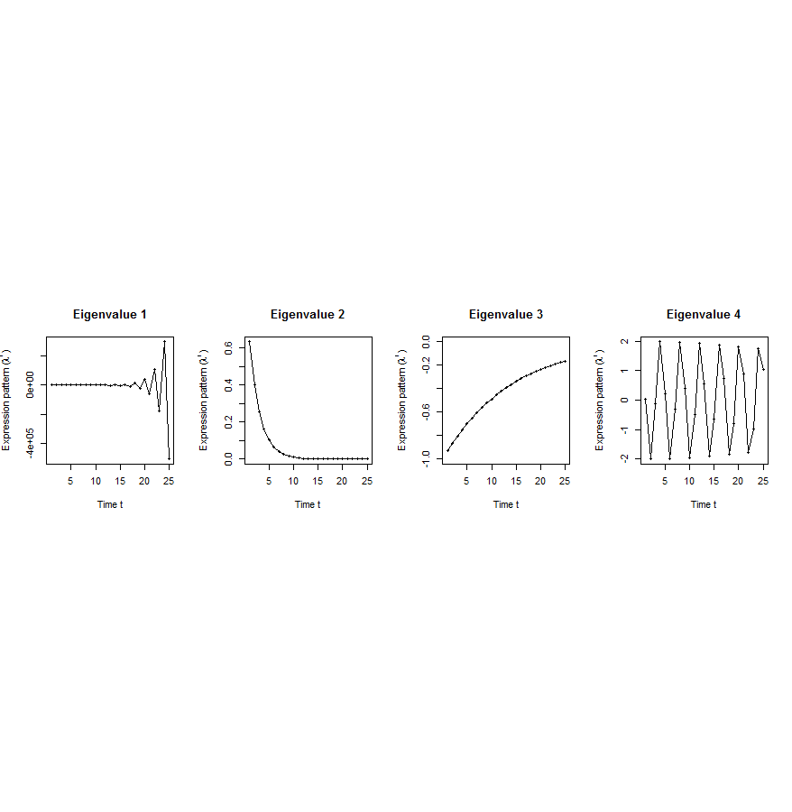
Canonical temporal expression trajectories from effective state space model
Is a std. 1st order homogeneous matrix difference equation. It can solved by diagonalizing A giving….
p^{th} internal principal dynamic pattern (iPDP): [λ_{p}¹, λ_{p}², …, λ_{p}^{T}],
where λ_{p} is p^{th} eigenvalue of Ã.
Canonical temporal expression trajectories
(e.g., degradation, growth, damped oscillation, etc.)
iPDP expression
time
[Wang et al. PLOS CB, ‘16]
Notes:
if we look at A tilde, it controls the dynamic trajectory of expression part internally driven by meta-genes of X. according to the analytic solution, the internally driven expression part Xtilde I can be linear combinations of A tilde’s eigenvalue’s exponentials across time, which are defined by us as internal principal dynamic pattern (iPDP). B tilde controls the dynamic trajectory of X’s metagene expression part externally driven by U. similarly, we can find external principal dynamic pattern (ePDP) based on B tilde’s eigenvalue exponentials across time. Actually, those patterns are canonical temporal expression trajectories, which are as simple as degradation, growth, damped oscillation temporal processes). In short, from metagene effective model, we are able to identify internal and external driven canonical temporal expression trajectories.

Slide 24
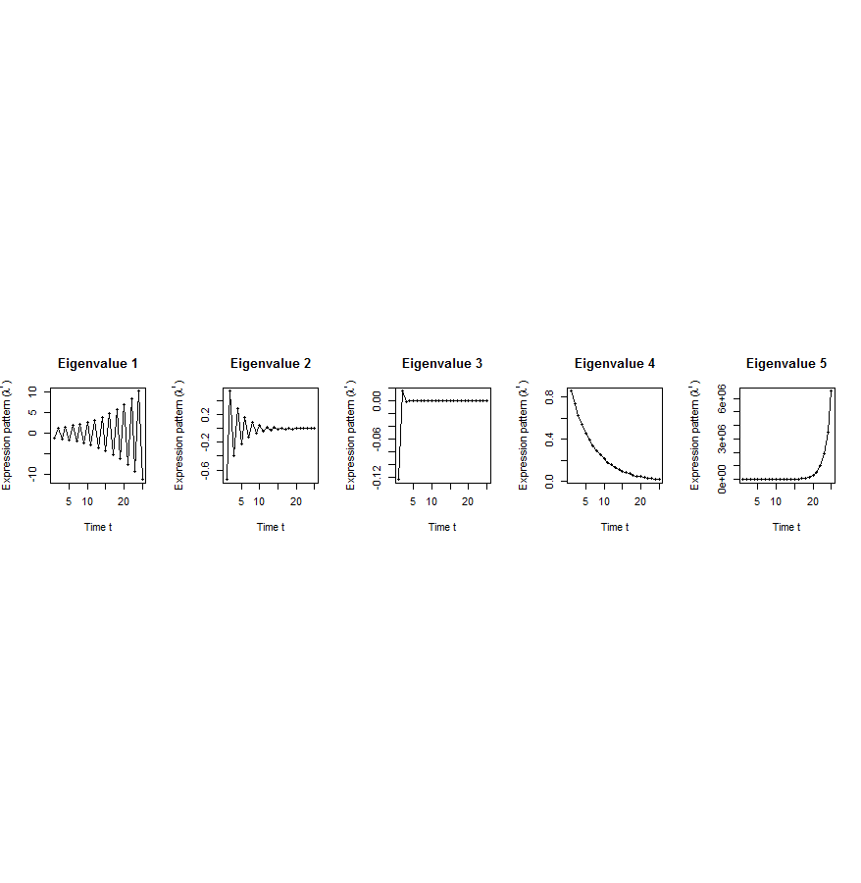
Flowchart
[Wang et al. PLOS CB, ‘16]
A. Gene state-space model
C. Meta-gene state-space model
B. Dimensionality Reduction
X_{t+1}=AX_{t}+BU_{t}
Genes of X
Meta-genes of X
time
E. Gene’s internal (INT) and external (EXT) driven expression dynamics composed of PDPs
time
D. Internal/External Principal Dynamic Patterns (PDPs)
x^{INT} = c₁ +c₂
+c₃ +c₄
[λ_{p}¹, λ_{p}², …, λ_{p}^{T}]
Genes of U
Meta-genes of U
time
time
x^{EXT} = d₁ +d₂
+d₃ +d₄
Internal regulation among internal genes/meta-genes by A/Ã
External regulation from external genes/meta-genes to internal genes/meta-genes in Group X by B/
Internal genes/meta-genes
External genes/meta-genes

Slide 25
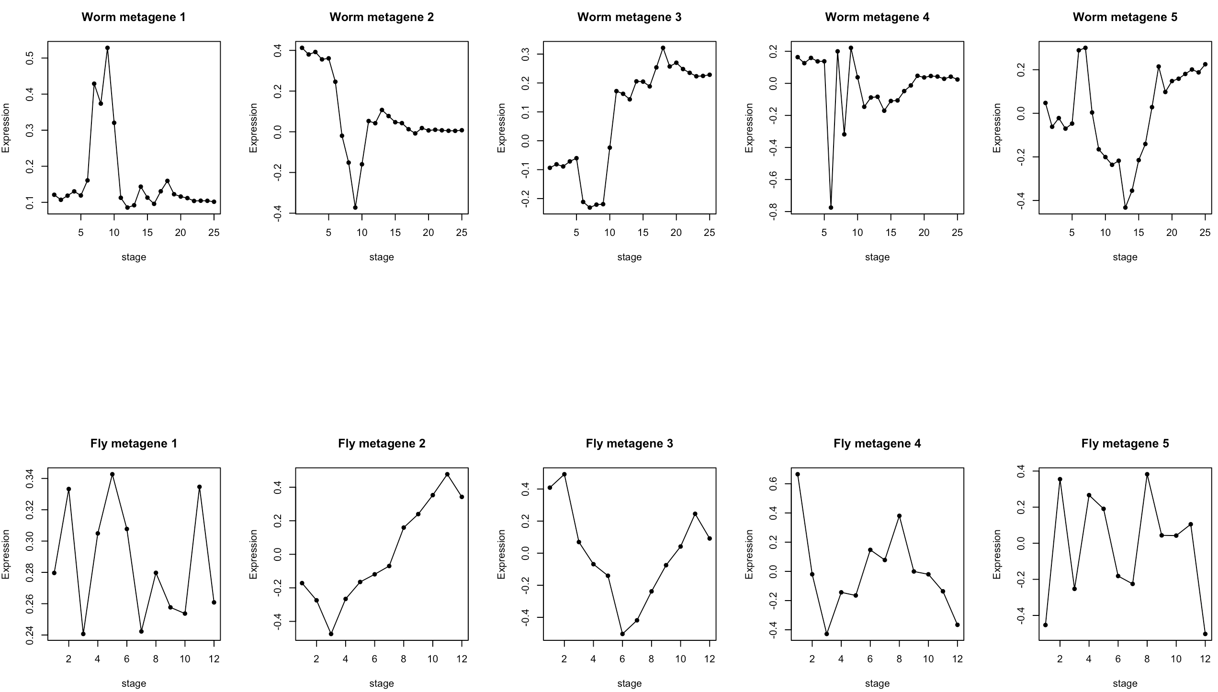
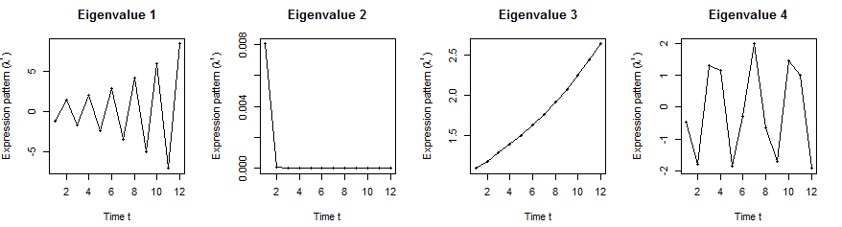
Orthologs have similar internal but different external dynamic patterns during embryonic development
Worm
ePDPs
iPDPs
Expression
Expession
Expression
Expression
Fly’s effective state space model
Meta-genes
[Wang et al. PLOS CB, ‘16]

Slide 26
Orthologs have correlated iPDP coefficients
1st iPDP
2nd iPDP
r=+0.33
r=+0.66
Coefficients of orthologs on fly
3rd iPDP
4th iPDP
r=+0.67
r=+0.73
Coefficients of orthologs on worm
[Wang et al. PLOS CB, ‘16]

Slide 27
Evolutionarily conserved & younger genes exhibit the opposite internal & external PDP coefficients
p<2.2e-16
p<2.6e-13
p<5.6e-11
p<8.3e-4
Worm
Fly
Ribosomal genes have significantly larger coefficients for the internal than external PDPs, but signaling genes exhibit the opposite trend
[Wang et al. PLOS CB, ‘16]

Slide 28
Human-specific TFs respond more strongly to hormonal stimulation during cell-cycle than conserved genes in breast cancer cell
Applied to Breast Cancer Cell Cycle
(2 periods) under hormonal stim.
  INT = conserved human genes
    ~1100 H-F-W orthologs
    follow normal cell cycle
  EXT = human spec TFs
    diff from above
    perhaps responding to stimulation
iPDPs
ePDPs

Slide 29
Transcriptome Mining: Tackling core issues related to gene regulation
& also analyzing the "data exhaust" associated with this activity
[Core-1] Expression Clustering,
Cross-species
  Comparative ENCODE – Lots of worm-fly-human matched data & developmental timecourses
  Optimization gives 16 conserved co-expression modules, 12 w/ hourglass
[Core-2] State Space Models
of Gene Expression
  Using dimensionality reduction to help determine internal & external drivers; Decoupling expression changes into those from conserved vs species-specific genes
  Conserved genes have similar canonical patterns (iPDPs) in contrast to species specific ones (Ex of ribosomal v signaling genes)
[Core-3] Logic Gates Modeling
  Preponderance of OR gates in cancer v. cell-cycle (esp. for MYC)
[Exhaust-1] Genomic Privacy
& RNA-seq
  The dilemma: The genome as fundamental, inherited info that’s very private v need for large-scale mining for med. research
  2-sided nature of RNA-seq presents a particularly tricky privacy issue
  Using file formats to remove obvious variants
  Quantifying & removing further variant info from expression levels + eQTLs using ICI & predictability
  Instantiating a practical linking attack using extreme expression levels
[Exhaust-2] Publication Patterns from data producing consortia
  Co-authorship network statistics relate to publication rollouts & show gradual adoption by a diverse community
  Key role of brokers in data dissemination

Slide 30
Modeling cooperativity between
TFs to target gene using logic gates
A regulatory triplet
2-input-1-output logic gate
10110101…
10110101…
RF1
RF1
?
T
00110101…
T
00110101…
10110101…
01110111…
RF2
RF2
0 – gene off
1 – gene on
after binarizing gene expression data*
Input type (RF1, RF2) | RF1 | 0 | 0 | 1 | 1
 | RF2 | 0 | 1 | 0 | 1
Output | T | X | X | X | X
Binarized expression
X can be 0 or 1, so there are 2⁴=16 possible output combinations, each of which corresponds to a unique 2-input-1-output logic gate
…
*BoolNet, R package
Notes:
let’s look at a particular triplet, TF1 and TF2 regulate Gene 1. At logical level, gene expression has two states, gene is on or off, i.e., 1 represents gene is expressed or 0 represents gene is not expressed. So, then we can look at the triplet as 2-input-1-output system. TF1 and TF2 are inputs, and Gene 1 are output, and then use a 2-input-1-output logic gate to model this triplet. As shown in a truth table, there are 4 different types of input of TF1 and TF2, 00, 01, 10, 11, and for each input type, there are 2 possible output types, 1 or 0. so in total, we have 2^4 = 16 possible logic gates that can be used to describe the triplet.

Slide 31
An example: selection of the best-matched logic gate
Laplace’s rule of succession
s=(# of selected output state for the input type + 1)
/(# of input type + 2)
Consistency score:
6/7*5/7*6/7*5/7=0.37
Wang, et al., PLoS Computational Biology, 2015
Notes:
*********************************************
This toy example demonstrates that how we choose the best matched logic gates. first, for each input type of TF1, TF2 like 01, green, we count numbers of 0 and 1 output from Gene 1 data. and select the most state as output of this input type. e.g., we have 4 zeros and 1 one, then 0 is considered as output of input type 01. we also calculate the output’s succession prob using laplace’s rule of succession derived from Bayes' theorem, like 5/7. after we go thru all four input types, we get a truth table. Here, it’s the table for the AND gate. Also, we define production of four output succession probs as consistency score to the matched logic gate. e.g. the consistency score is 0.37 for AND gate.

Slide 32
App. 1 – TF cooperativity in the cell cycle
Target gene | 2464
TF | 176
Triplet | 39,011
Time point | 59
AND-like gates
Wang, et al., PLoS Computational Biology, 2015
Notes:
First, we apply Loregic to characterize TF cooperativity during yeast cell cycle, and found AND gate matches the most triplets, which implies that yeast TFs need to cooperate during cell cycle. we were able to distinguish three categories for this triplet group: 1) “homogenous” gate-consistent triplets – matching the same logic gate across all targets (e.g., top table); 2) “inhomogeneous” gate-consistent triplets – matching different logic gates across all targets (e.g., middle table); and 3) non-gate-consistent triplets, i.e. triplets inconsistent with all logic gates across all targets (e.g., bottom table).

Slide 33


Acute Myeloid Leukemia (AML)
Target gene | 1824 | ENCODE Data (K562, ChIP-seq)
TF | 70
Regulatory triplet | 50,865 | TCGA Data (AML, level 3, RNA-seq) https://tcga-data.nci.nih.gov/tcga/tcgaDownload.jsp
Patient sample | 197
Wang, et al., PLoS Computational Biology, 2015
Notes:
Then, we apply Loregic to the human cancer data. e.g., we characterized the TF cooperativity in leukemia cancer using 70 TF chip-seq data in ENCODE and gene expression data across 200 patients in TCGA. it is interesting to find that OR gate matches the most triplets, which implies that TF may not cooperate with each other in human cancer.

Slide 34
App. 2 – TF cooperativity in AML
Regulatory triplet from ENCODE | 50,865
Patient sample for TCGA AML expression data | 197
OR-like gates
number of logic-gate consistent triplets
Wang, et al., PLoS Computational Biology, 2015
Notes:
Then, we apply Loregic to the human cancer data. e.g., we characterized the TF cooperativity in leukemia cancer using 70 TF chip-seq data in ENCODE and gene expression data across 200 patients in TCGA. it is interesting to find that OR gate matches the most triplets, which implies that TF may not cooperate with each other in human cancer.

Slide 35

Cancer-related TF, MYC, universally amplifies target expression
Restrict to RF1=MYC, giving 2,153 triplets
RF1
OR(RF1, RF2)
OR(RF1, NOT RF2)
number of logic-gate consistent triplets
High expression of MYC is sufficient for high target gene expression
Wang, et al., PLoS Computational Biology, 2015
Notes:
So, we then look at triplets with cancer-related TFs, e.g., MYC. biologists found that MYC universally amplifies target gene expressions in lymphocytes. we checked 2000 MYC associated triplets where MYC is 1st RF, and found the most MYC associated triplets are consistent with three logic gates, RF1, RF1+RF2 and RF1+~RF2 with significant enrichments. all three logic gates mean that high expression of MYC is sufficient for high target gene expression, which supports that MYC is a universal amplifier.
then use MYC to slince targe gene expresison in cancer

Slide 36
Transcriptome Mining: Tackling core issues related to gene regulation
& also analyzing the "data exhaust" associated with this activity
[Core-1] Expression Clustering,
Cross-species
  Comparative ENCODE – Lots of worm-fly-human matched data & developmental timecourses
  Optimization gives 16 conserved co-expression modules, 12 w/ hourglass
[Core-2] State Space Models
of Gene Expression
  Using dimensionality reduction to help determine internal & external drivers; Decoupling expression changes into those from conserved vs species-specific genes
  Conserved genes have similar canonical patterns (iPDPs) in contrast to species specific ones (Ex of ribosomal v signaling genes)
[Core-3] Logic Gates Modeling
  Preponderance of OR gates in cancer v. cell-cycle (esp. for MYC)
[Exhaust-1] Genomic Privacy
& RNA-seq
  The dilemma: The genome as fundamental, inherited info that’s very private v need for large-scale mining for med. research
  2-sided nature of RNA-seq presents a particularly tricky privacy issue
  Using file formats to remove obvious variants
  Quantifying & removing further variant info from expression levels + eQTLs using ICI & predictability
  Instantiating a practical linking attack using extreme expression levels
[Exhaust-2] Publication Patterns from data producing consortia
  Co-authorship network statistics relate to publication rollouts & show gradual adoption by a diverse community
  Key role of brokers in data dissemination

Slide 37

2-sided nature of functional genomics data: Analysis can be very General/Public or Individual/Private
General quantifications related to overall aspects
of a condition – ie gene activity as a function of:
  Developmental stage, Evolutionary relationships, Cell-type, Disease
Above are not tied to an individual’s genotype. However, data is derived from individuals & tagged with their genotypes
(Note, a few calculations aim to use explicitly genotype to derive general relations related to sequence variation & gene expression - eg allelic activity)

Slide 38












Genomics has similar "Big Data" Dilemma in the Rest of Society
Sharing & "peer-production" is central to success of many new ventures, with the same risks as in genomics
  EG web search: Large-scale mining essential
We confront privacy risks every day we access the internet
[Seringhaus & Gerstein ('09), Hart. Courant (Jun 5); Greenbaum & Gerstein ('11), NY Times (6 Oct)]

Slide 39

Tricky Privacy Considerations in Personal Genomics
Genetic Exceptionalism :
The Genome is very fundamental data, potentially very revealing about one’s identity & characteristics
Personal Genomic info. essentially meaningless currently but will it be in 20 yrs? 50 yrs?
  Genomic sequence very revealing about one’s children. Is true consent possible?
  Once put on the web it can’t be taken back
Culture Clash:
Genomics historically has been a proponent of “open data” but not clear personal genomics fits this.
  Clinical Medline has a very different culture.
Ethically challenged history of genetics
  Ownership of the data & what consent means (Hela)
    Could your genetic data give rise to a product line?
[D Greenbaum & M Gerstein (’08). Am J. Bioethics; D Greenbaum & M Gerstein, Hartford Courant, 10 Jul. '08 ; SF Chronicle, 2 Nov. '08;
Greenbaum et al. PLOS CB (‘11) ; Greenbaum & Gerstein ('13), The Scientist; Photo from NY Times]

Slide 40

The Other Side of the Coin:
Why we should share
Sharing helps speed research
  Large-scale mining of this information is important for medical research
  Privacy is cumbersome, particularly for big data
Sharing is important for reproducible research
Sharing is useful for education
  More fun to study a known person’s genome
    Eg Zimmer’s Game of Genomes in STAT
[Yale Law Roundtable (‘10). Comp. in Sci. & Eng. 12:8; D Greenbaum & M Gerstein (‘09). Am. J. Bioethics; D Greenbaum & M Gerstein (‘10). SF Chronicle, May 2, Page E-4;
Greenbaum et al. PLOS CB (‘11)]

Slide 41

The Dilemma
[Economist, 15 Aug ‘15]
The individual (harmed?) v the collective (benefits)
  But do sick patients care about their privacy?
How to balance risks v rewards - Quantification
  What is acceptable risk?
  Can we quantify leakage?
    Ex: photos of eye color
  Cost Benefit Analysis

Slide 42
Current Social & Technical Solutions
Closed Data Approach
  Consents
  “Protected” distribution via dbGAP
  Local computes on secure computer
Issues with Closed Data
  Non-uniformity of consents & paperwork
    Different international norms, leading to confusion
  Encryption & computer security creates burdensome requirements on data sharing & large scale analysis
  Many schemes get “hacked”
Open Data
  Genomic "test pilots” (ala PGP)?
    Sports stars & celebrities?
  Some public data & data donation is helpful but is this a realistic solution for an unbiased sample of ~1M
[Greenbuam et al ('04), Nat. Biotech; Greenbaum & Gerstein ('13), The Scientist]

Slide 43
Strawman Hybrid Social & Tech Proposed Solution?
Fundamentally, researchers have to keep genetic secrets.
  Need for an (international) legal framework
  Genetic Licensure & training for individuals
  (similar to medical license, drivers license)
Technology to make things easier
  Cloud computing & enclaves (eg solution of Genomics England)
Technological barriers shouldn't create a social incentive for “hacking”
Quantifying Leakage & allowing a small amounts of it
Careful separation & coupling of private & public data
  Lightweight, freely accessible secondary datasets coupled to underlying variants
  Selection of stub & "test pilot" datasets for benchmarking
  Develop programs on public stubs on your laptop, then move the program to the cloud for private production run
[D Greenbaum, M Gerstein (‘11). Am J Bioeth 11:39. Greenbaum & Gerstein, The Scientist ('13)]

Slide 44



Representative Functional Genomics, Genotype, eQTL Datasets
Genotypes are available from the 1000 Genomes Project
mRNA sequencing for 462 individuals from gEUVADIS and ENCODE
  Publicly available quantification for protein coding genes
Functional genomics data (ChIP-Seq, RNA-Seq, Hi-C) available from ENCODE
Approximately 3,000 cis-eQTL (FDR<0.05)

Slide 45
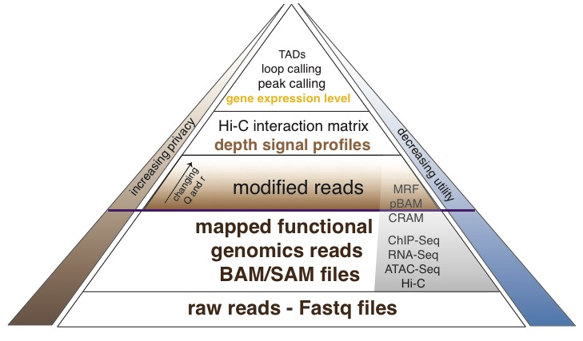
Functional genomics data comes with a great deal of sequencing
  NA12878 as case study - 1000 genomes variants are used as gold standard
We can quantify amount of leakage at every step of the data summarization process.
[Gursoy et al, Bioarvix]

Slide 46
How much information, for example, do RNA-Seq reads (or ChIP-Seq) reads contain? Does that information enough to identify individuals?
It might seem like we don’t infer much information from single ChIP-Seq and RNA-Seq experiments compared to WGS
  However putting 10 different ChIP-Seq experiments and RNA-Seq together with imputation provides a great deal of information about the individual
[Gursoy et al, Bioarvix]

Slide 47
Privacy-aware file formats that hide the variants but recover signal
Some lightweight format clearly separate public & private info., aiding exchange
Files become smaller
Distinction between formats to compute on and those to archive with – become sharper with big data
[Gursoy et al, Bioarvix]

Slide 48


eQTL Mapping Using RNA-Seq Data
eQTLs are genomic loci that contribute to variation in mRNA expression levels
eQTLs provide insights on transcription regulation, and the molecular basis of phenotypic outcomes
eQTL mapping can be done with RNA-Seq data
[Biometrics 68(1) 1–11]
Notes:
A diagram to illustrate the RNA‐seq count variation of one gene due to an cis‐eQTL. (a) RNA‐seq measurements of a hypothetic gene with two exons in three diploid individuals. The target SNP which we test for association has the genotype CT, CC, and TT for the three individuals. There is an SNP on the first exon, which has genotype AT, AT, and AA for the three individuals. ASE can be measured by those sequence reads that overlap with a heterozygous exonic SNP. Therefore we can measure ASE for individuals (i) and (ii). However, association testing by ASE is only possible if the target SNP is heterozygous, thus only individual (i) can be used to test for eQTL by ASE (b) ASE measurements for individual (i). (c) TReC measured for the three individuals across the two exons of this gene.
© IF THIS IMAGE HAS BEEN PROVIDED BY OR IS OWNED BY A THIRD PARTY, AS INDICATED IN THE CAPTION LINE, THEN FURTHER PERMISSION MAY BE NEEDED BEFORE ANY FURTHER USE. PLEASE CONTACT WILEY'S PERMISSIONS DEPARTMENT ON PERMISSIONS@WILEY.COM OR USE THE RIGHTSLINK SERVICE BY CLICKING ON THE 'REQUEST PERMISSION' LINK ACCOMPANYING THIS ARTICLE. WILEY OR AUTHOR OWNED IMAGES MAY BE USED FOR NON-COMMERCIAL PURPOSES, SUBJECT TO PROPER CITATION OF THE ARTICLE, AUTHOR, AND PUBLISHER.

Slide 49
Information Content and Predictability
Naive measure of information (no LD, distant correlations, pop. struc., &c)
Higher frequency: Lower ICI
Additive for multiple variants
Condition specific entropy
Higher cond. entropy: Lower predictability
Additive for multiple eQTLs
[Harmanci et al. Nat. Meth. 2016]

Slide 50
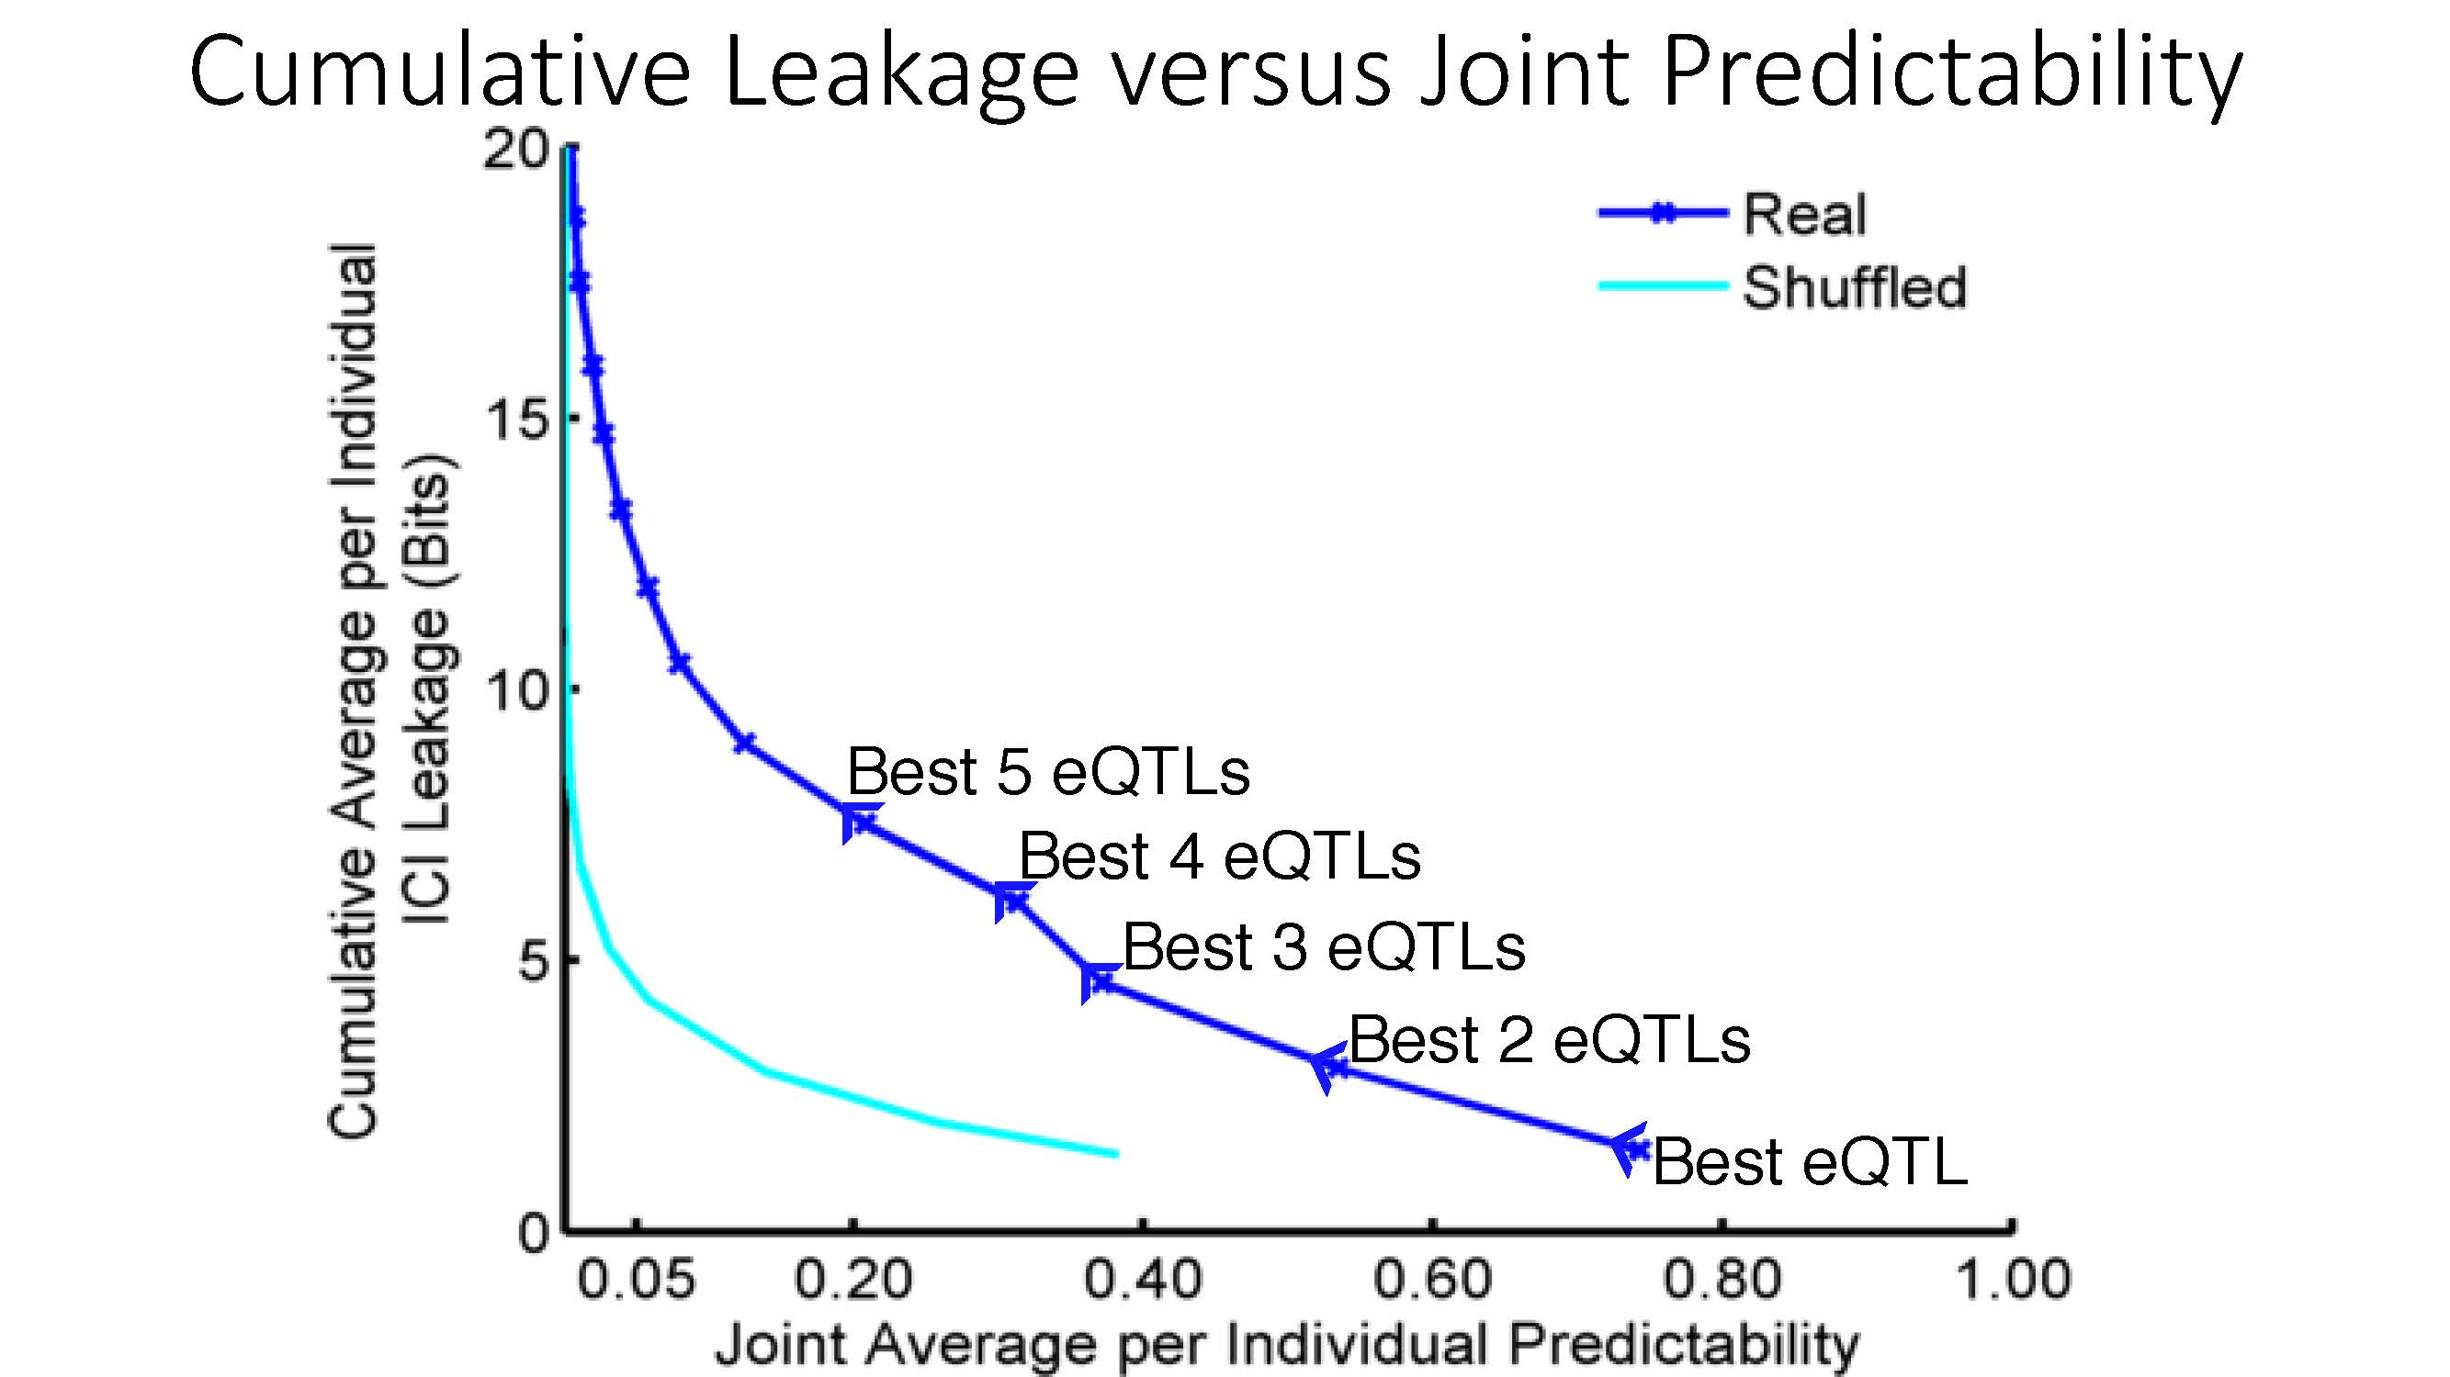

ICI Leakage versus Genotype Predictability
[Harmanciet al. Nat. Meth. (‘16]

Slide 51

Linking Attack Scenario
[Harmanciet al. Nat. Meth. (in revision)]

Slide 52


Linking Attacks: Case of Netflix Prize
Names available for many users!
User (ID) | Movie (ID) | Date of Grade | Grade [1,2,3,4,5]
NTFLX-0 | NTFLX-19 | 10/12/2008 | 1
NTFLX-1 | NTFLX-116 | 4/23/2009 | 3
NTFLX-2 | NTFLX-92 | 5/27/2010 | 2
NTFLX-1 | NTFLX-666 | 6/6/2016 | 5
… | … | … | …
… | … | … | …
User (ID) | Movie (ID) | Date of Grade | Grade [0-10]
IMDB-0 | IMDB-173 | 4/20/2009 | 5
IMDB-1 | IMDB-18 | 10/18/2008 | 0
IMDB-2 | IMDB-341 | 5/27/2010 | -
… | … | … | …
… | … | … | …
… | … | … | …
Many users are shared
The grades of same users are correlated
A user grades one movie around the same date in two databases
Anonymized Netflix Prize Training Dataset
made available to contestants
Notes:
This figure illustrates what these datasets look like. The movie titles can be matched directly. Date of ratings and rating values are expected to be similar to each other

Slide 53
Linking Attacks: Case of Netflix Prize
Names available for many users!
User (ID) | Movie (ID) | Date of Grade | Grade [1,2,3,4,5]
NTFLX-0 | NTFLX-19 | 10/12/2008 | 1
NTFLX-1 | NTFLX-116 | 4/23/2009 | 3
NTFLX-2 | NTFLX-92 | 5/27/2010 | 2
NTFLX-1 | NTFLX-666 | 6/6/2016 | 5
… | … | … | …
… | … | … | …
User (ID) | Movie (ID) | Date of Grade | Grade [0-10]
IMDB-0 | IMDB-173 | 4/20/2009 | 5
IMDB-1 | IMDB-18 | 10/18/2008 | 0
IMDB-2 | IMDB-341 | 5/27/2010 | -
… | … | … | …
… | … | … | …
… | … | … | …
Many users are shared
The grades of same users are correlated
A user grades one movie around the same date in two databases
IMDB users are public
NetFLIX and IMdB moves are public
Notes:
As you can see, Netflx-1 user can be matched to IMDB-0 user since the date of rating is very close and the ratings are very similar. The rating in imdb is from 0 to 10. So 5 is a similar score to 3 in Netflix rating system.

Slide 54
Linking Attacks: Case of Netflix Prize
Names available for many users!
User (ID) | Movie (ID) | Date of Grade | Grade [1,2,3,4,5]
NTFLX-0 | NTFLX-19 | 10/12/2008 | 1
NTFLX-1 | NTFLX-116 | 4/23/2009 | 3
NTFLX-2 | NTFLX-92 | 5/27/2010 | 2
NTFLX-1 | NTFLX-666 | 6/6/2016 | 5
… | … | … | …
… | … | … | …
User (ID) | Movie (ID) | Date of Grade | Grade [0-10]
IMDB-0 | IMDB-173 | 4/20/2009 | 5
IMDB-1 | IMDB-18 | 10/18/2008 | 0
IMDB-2 | IMDB-341 | 5/27/2010 | -
… | … | … | …
… | … | … | …
… | … | … | …
Many users are shared
The grades of same users are correlated
A user grades one movie around the same date in two databases
Notes:
The key idea is that in imdb, the names are available for many users. Also,
Secondly, although another movie in Netflix system is not rated by this user in imdb system, namely the netflx666, the adversary can see the rating of the individual for this movie.

Slide 55
Linking Attack Scenario
[Harmanciet al. Nat. Meth. (in revision)]

Slide 56
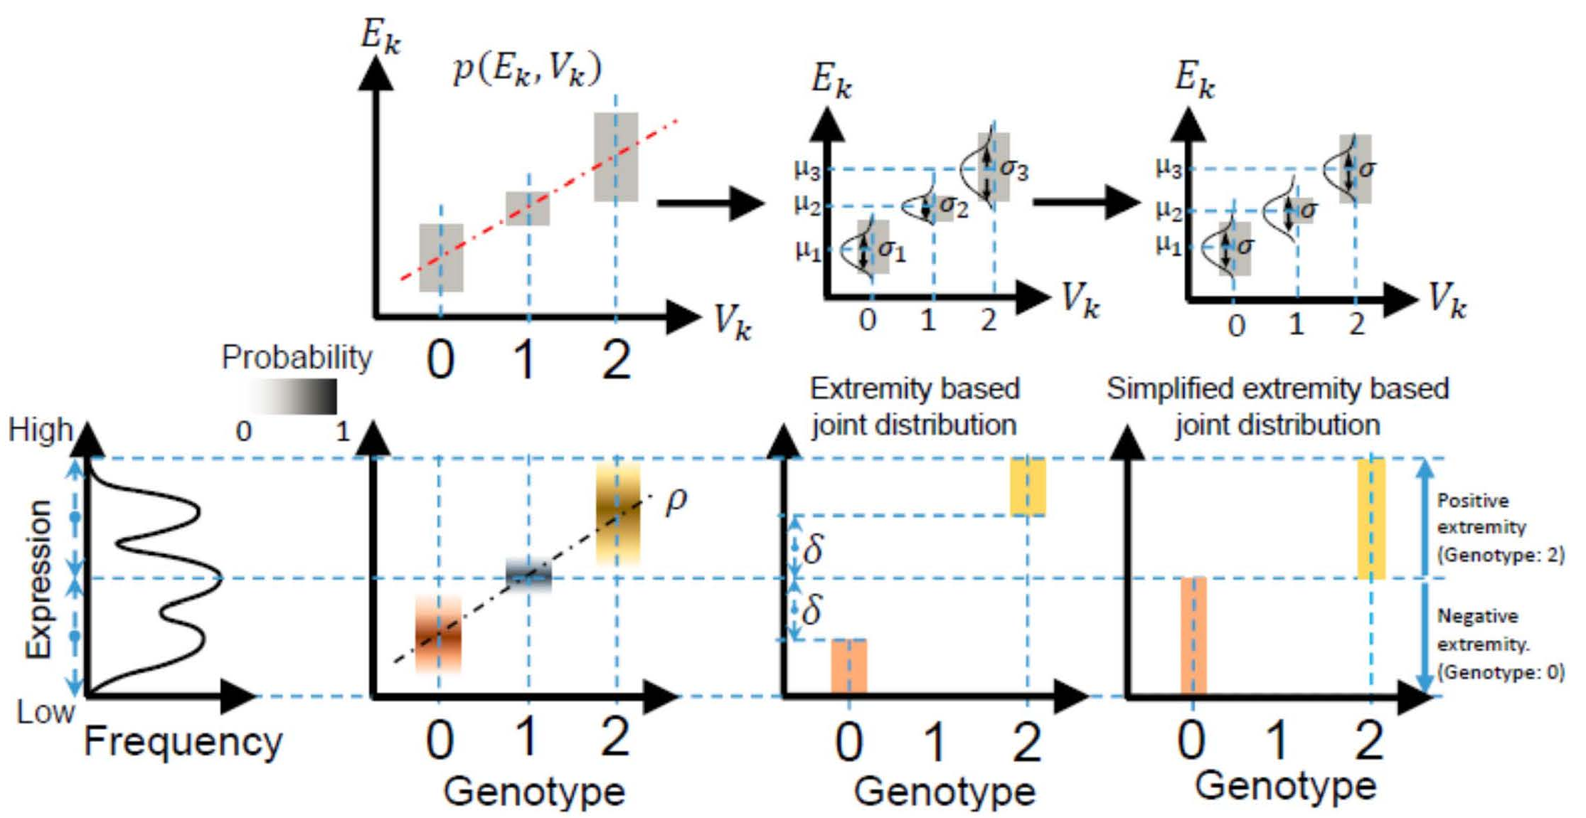
Levels of Expression-Genotype Model Simplifications for Genotype Prediction
[Harmanci et al. Nat. Meth. (16)]

Slide 57
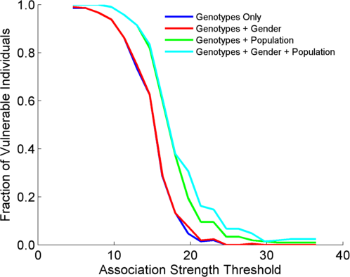
Success in Linking Attack with Extremity based Genotype Prediction
200 individuals eQTL Discovery
200 individuals in Linking Attack
High
Sensitivity
Low
Sensitivity
High Number
Of eQTLs
Low Number
Of eQTLs
[Harmanci et al. Nat. Meth. (16)]

Slide 58
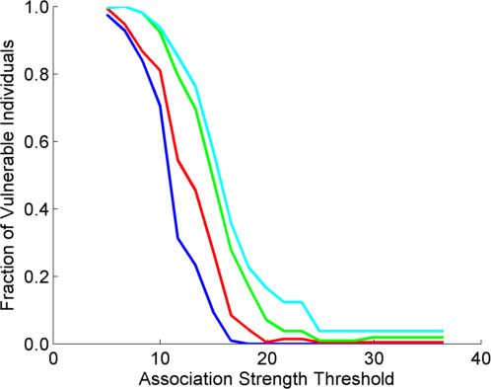
Success in Linking Attack with Extremity based Genotype Prediction
200 individuals eQTL Discovery
200 individuals in Linking Attack
200 individuals eQTL Discovery
100,200 individuals in Linking Attack
[Harmanci et al. Nat. Meth. (16)]

Slide 59
Transcriptome Mining: Tackling core issues related to gene regulation
& also analyzing the "data exhaust" associated with this activity
[Core-1] Expression Clustering,
Cross-species
  Comparative ENCODE – Lots of worm-fly-human matched data & developmental timecourses
  Optimization gives 16 conserved co-expression modules, 12 w/ hourglass
[Core-2] State Space Models
of Gene Expression
  Using dimensionality reduction to help determine internal & external drivers; Decoupling expression changes into those from conserved vs species-specific genes
  Conserved genes have similar canonical patterns (iPDPs) in contrast to species specific ones (Ex of ribosomal v signaling genes)
[Core-3] Logic Gates Modeling
  Preponderance of OR gates in cancer v. cell-cycle (esp. for MYC)
[Exhaust-1] Genomic Privacy
& RNA-seq
  The dilemma: The genome as fundamental, inherited info that’s very private v need for large-scale mining for med. research
  2-sided nature of RNA-seq presents a particularly tricky privacy issue
  Using file formats to remove obvious variants
  Quantifying & removing further variant info from expression levels + eQTLs using ICI & predictability
  Instantiating a practical linking attack using extreme expression levels
[Exhaust-2] Publication Patterns from data producing consortia
  Co-authorship network statistics relate to publication rollouts & show gradual adoption by a diverse community
  Key role of brokers in data dissemination

Slide 60

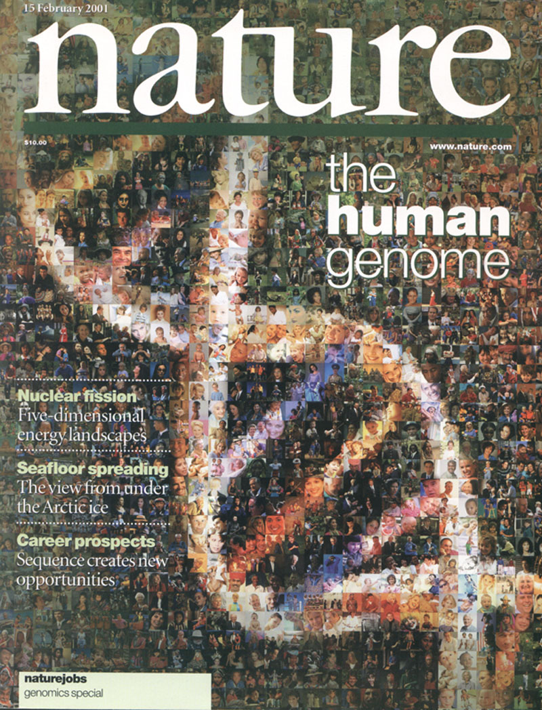

The Human
Genome Project
2000
2005
2010
2015
Worm
Genome

Slide 61
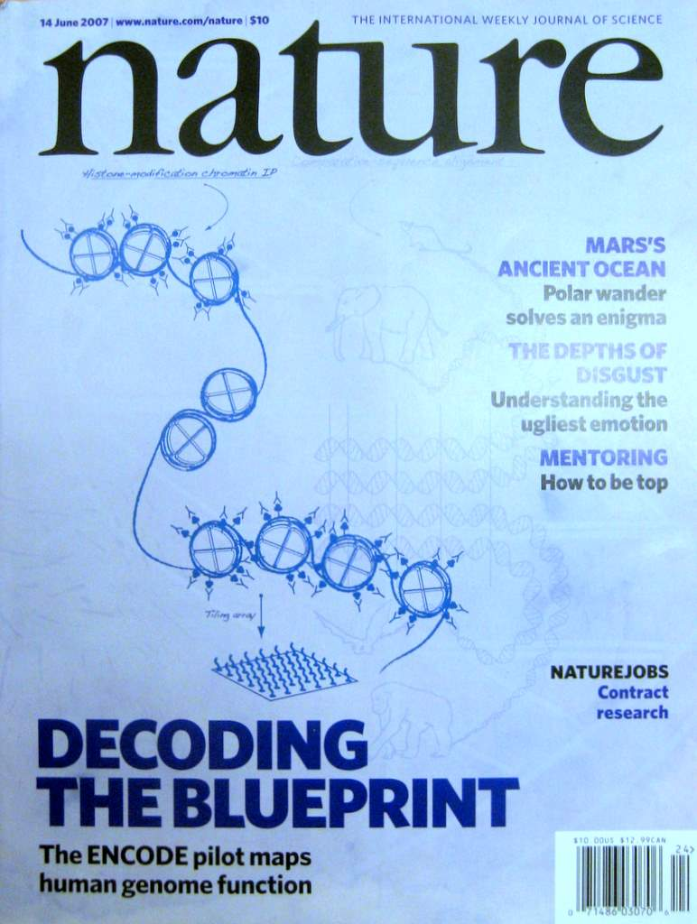


The Human
Genome Project
ENCODE
Pilot
ENCODE
Production
2000
2005
2010
Worm
Genome
modENCODE

Slide 62
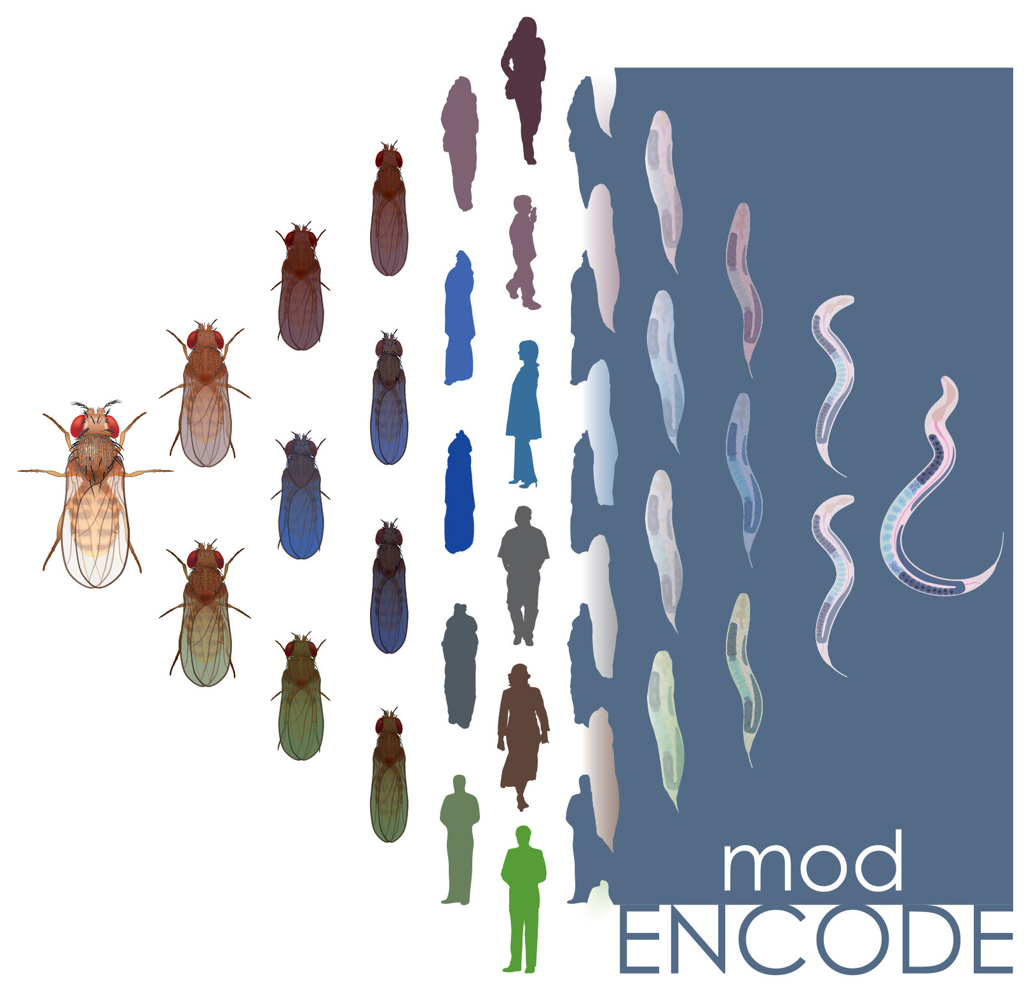

The Human
Genome Project
ENCODE
Pilot
ENCODE
Production
Comparative
ENCODE
2000
2005
2010
2015
Worm
Genome
modENCODE

Slide 63

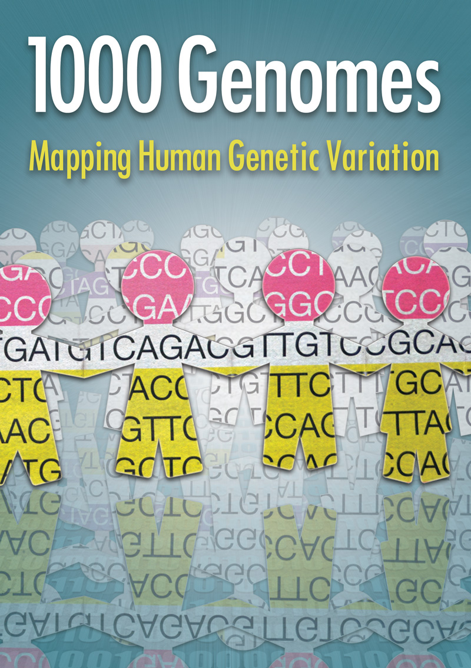
The Human
Genome Project
ENCODE
Pilot
ENCODE
Production
Comparative
ENCODE
2000
2005
2010
2015
Worm
Genome
modENCODE
1000 Genomes
Pilot
1000 Genomes
Production

Slide 64


The Human
Genome Project
ENCODE
Pilot
ENCODE
Production
Comparative
ENCODE
Epigenome
Roadmap
2000
2005
2010
2015
Worm
Genome
modENCODE
1000 Genomes
Pilot
1000 Genomes
Production
GTEx

Slide 65
With help of M Pazin at NHGRI, identified: 702 community papers that used ENCODE data but were not supported by ENCODE funding &
558 consortium papers supported by ENCODE funding
(https://www.encodeproject.org/search/?type=Publication for up-to-date query)
Then identified 1,786 ENCODE members & 8,263 non-members .
<= # Papers
# Authors Yr. (‘04 to ‘15)
[Wang et al., TIG (’16)]
Notes:
1 slides from dw encode authors

Slide 66
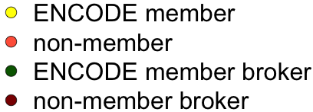
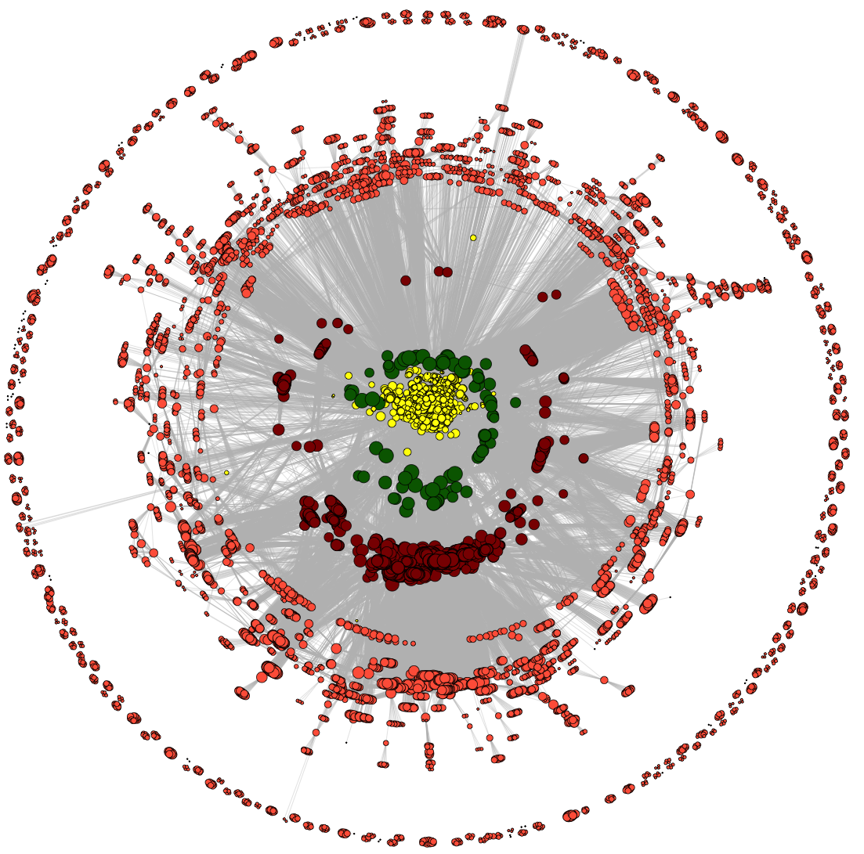
Co-authorship Network of ENCODE members
& Data Users
co-authorship
2014
[Wang et al., TIG (’16)]

Slide 67
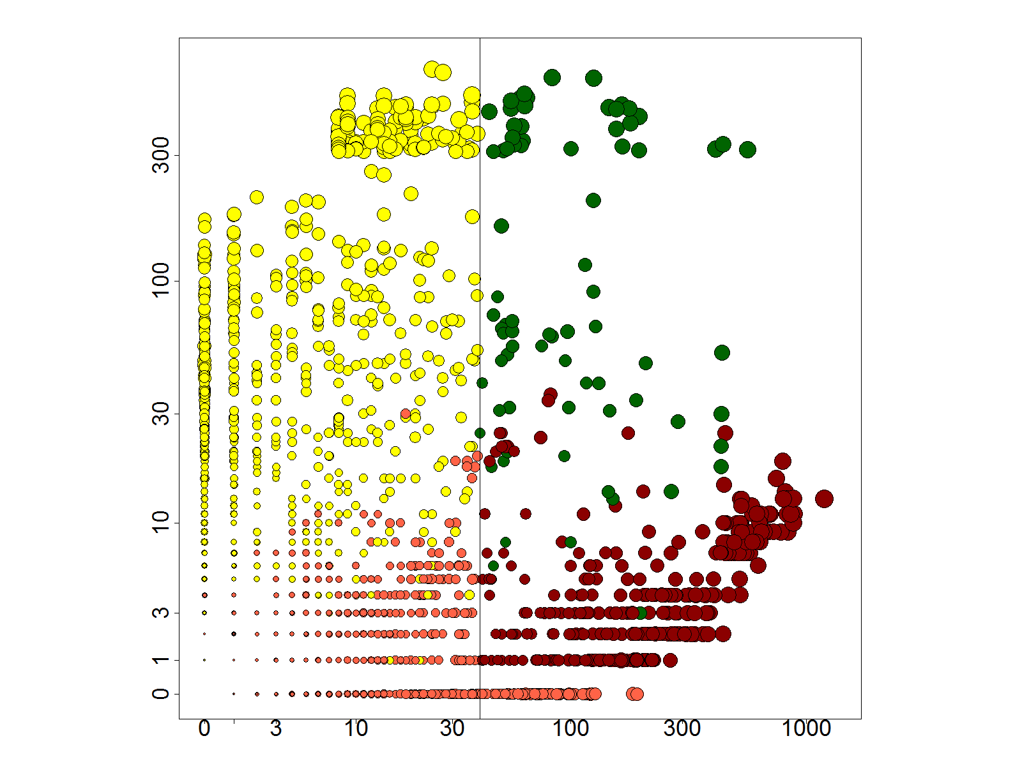
Co-authorship Network of ENCODE members
& Data Users
# neighbors: ENCODE ==>
co-authorship
# neighbors: non-ENCODE ==>
2014
[Wang et al., TIG (’16)]

Slide 68
Co-authorship Network of ENCODE members
& Data Users
co-authorship
2014
[Wang et al., TIG (’16)]

Slide 69
Dynamics of co-authorship network
2014
co-authorship
[Wang et al., TIG (’16)]

Slide 70
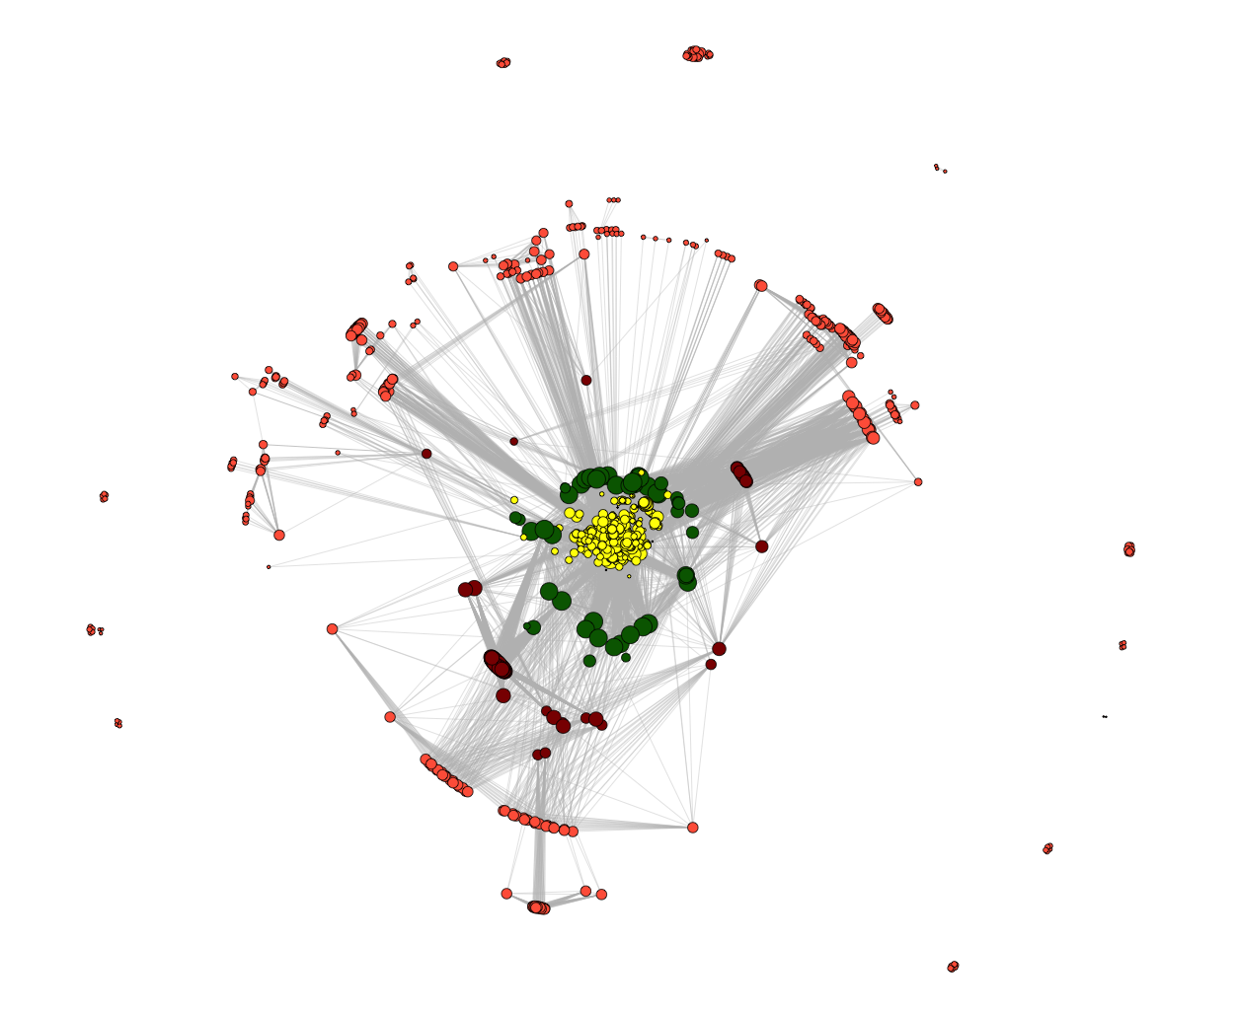
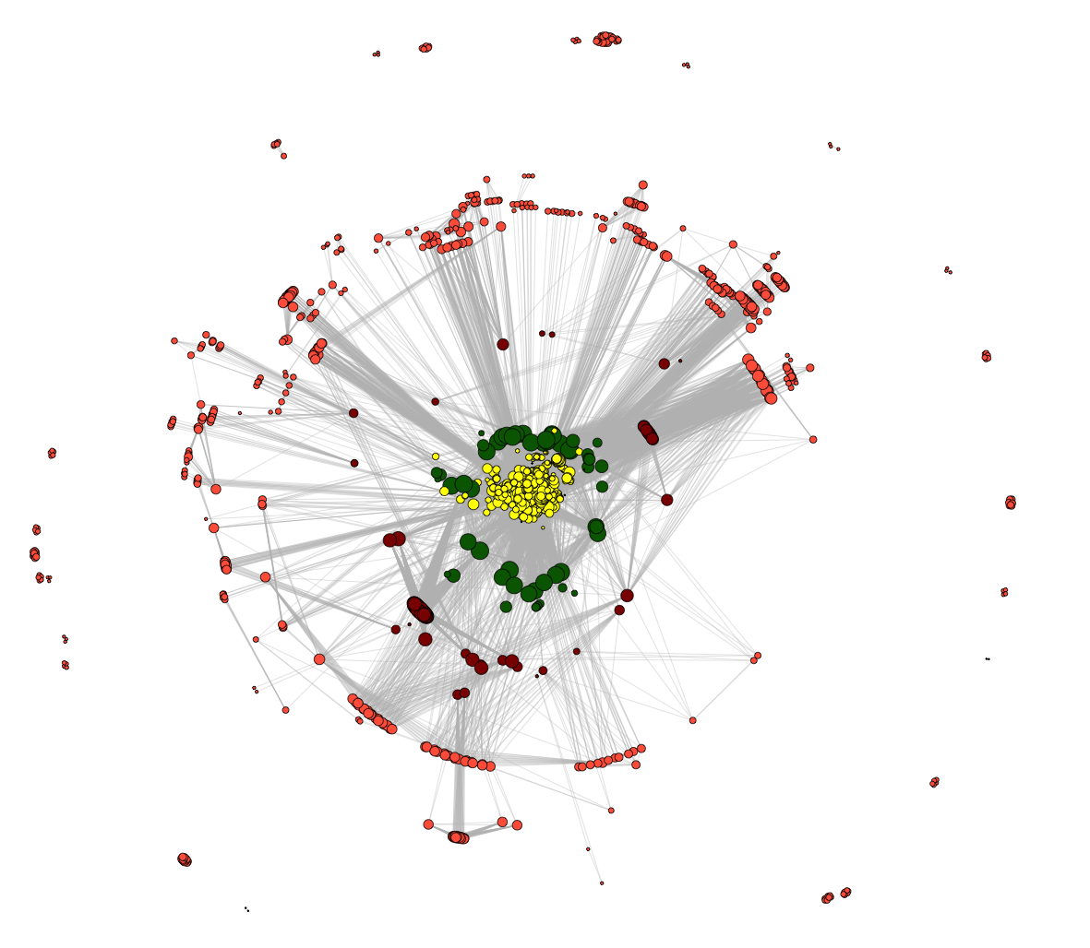
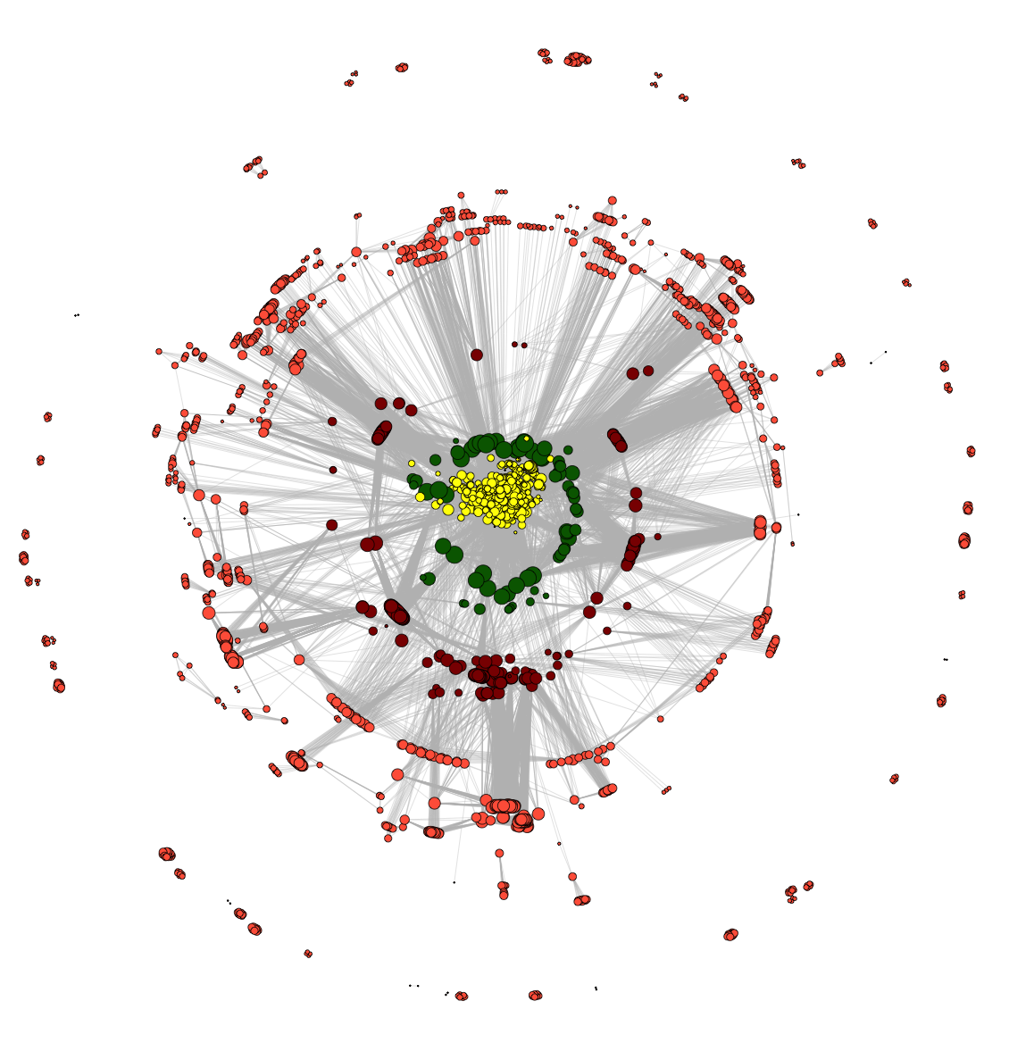
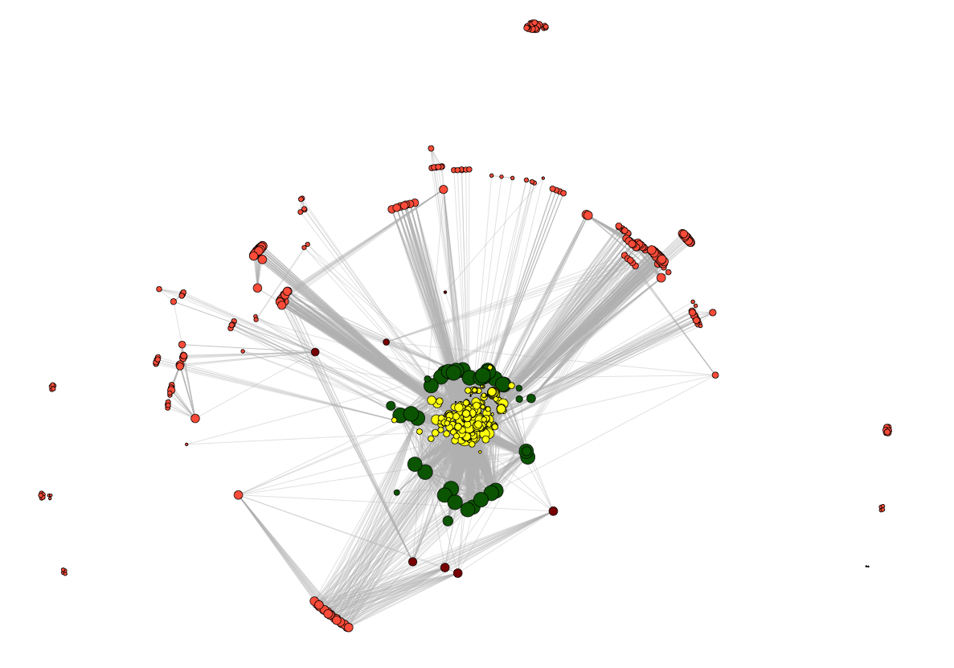
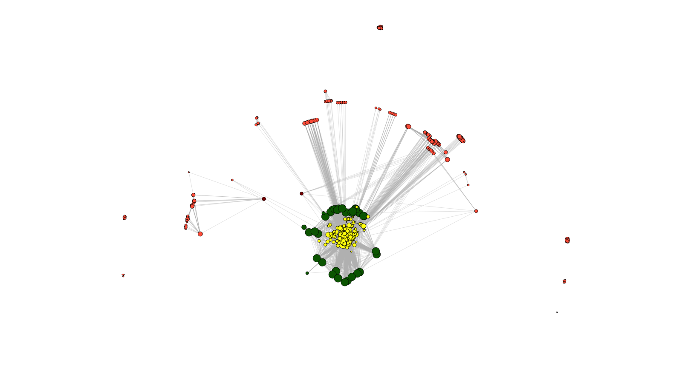
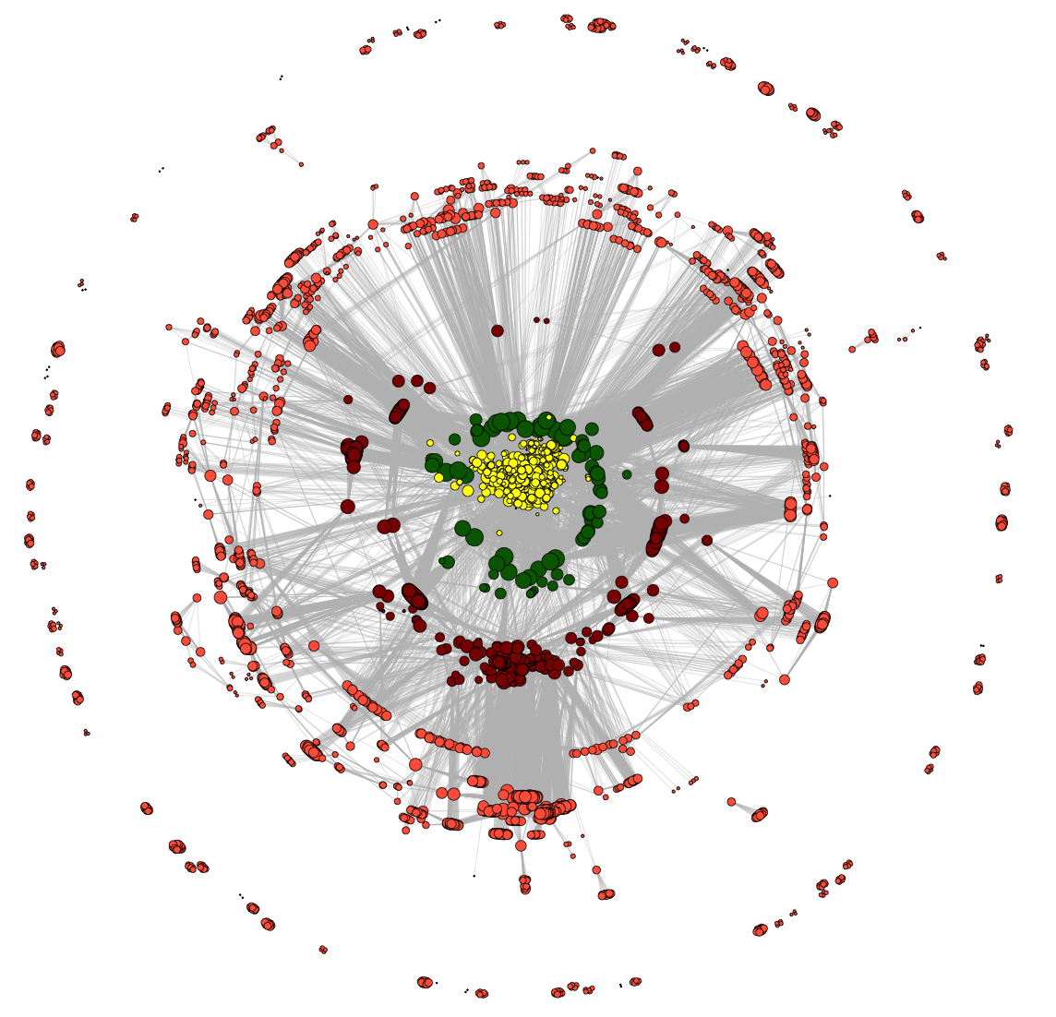
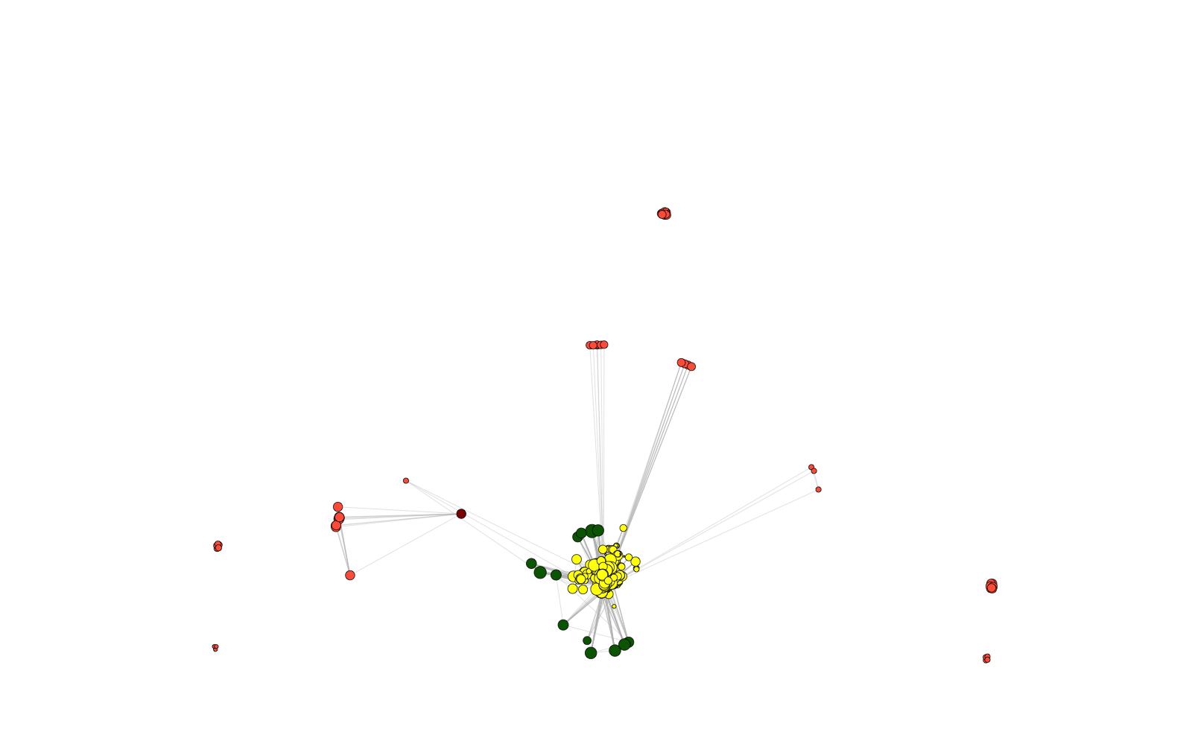
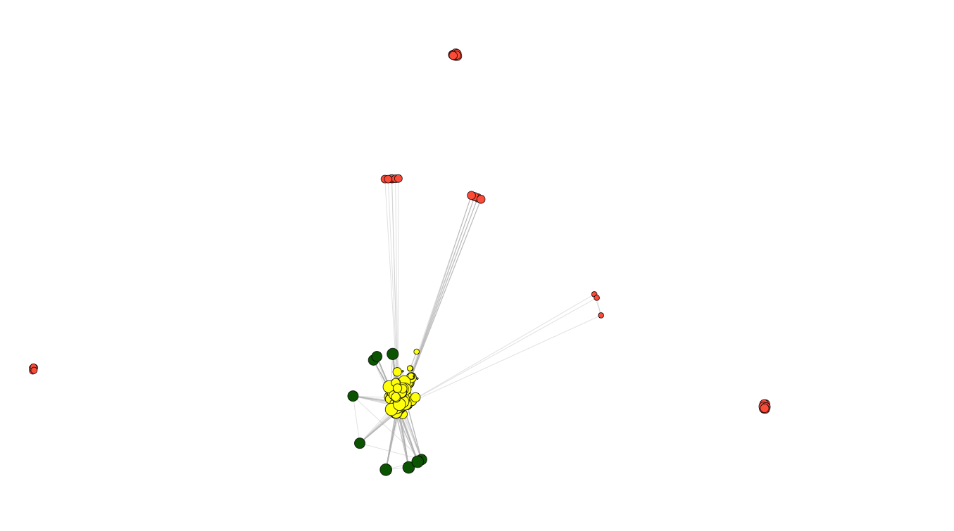
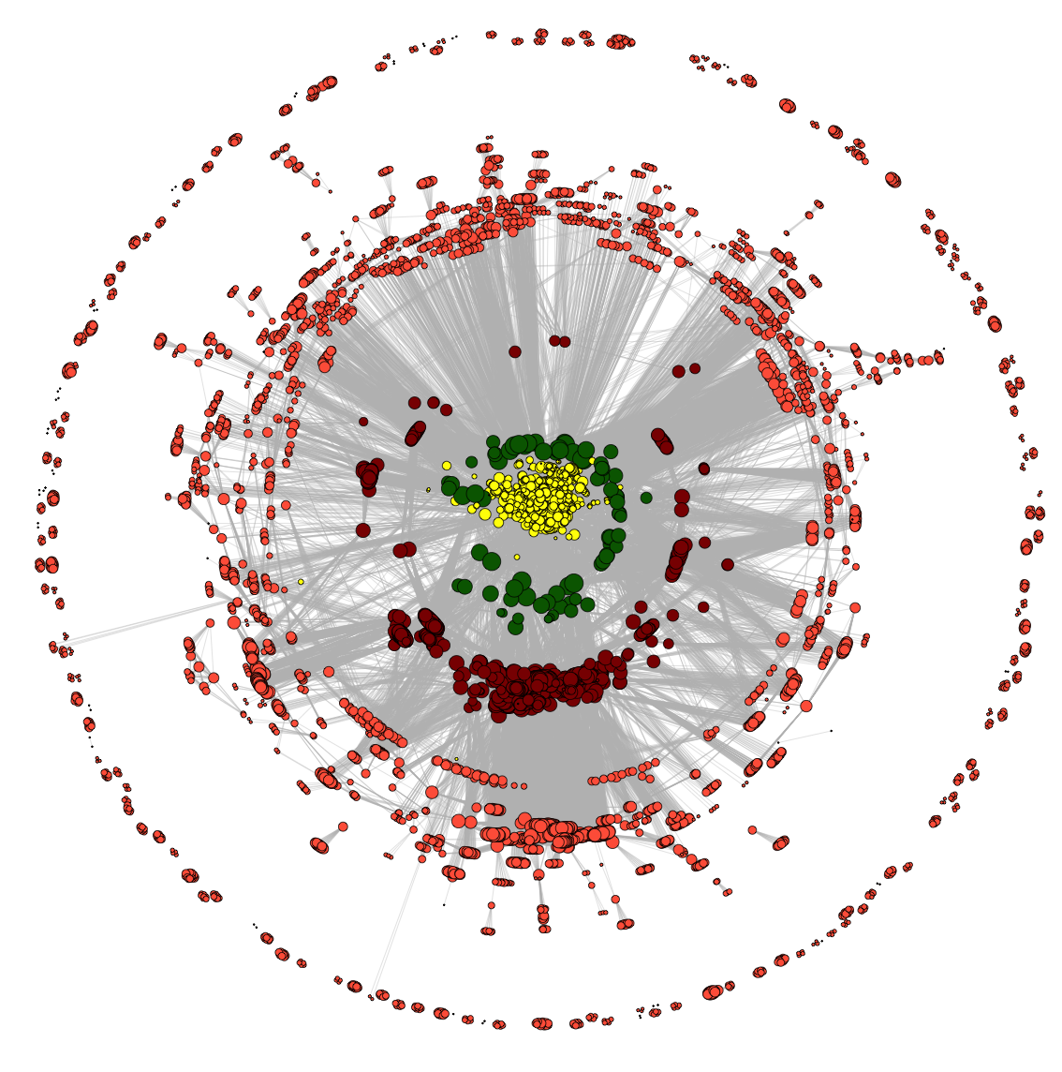
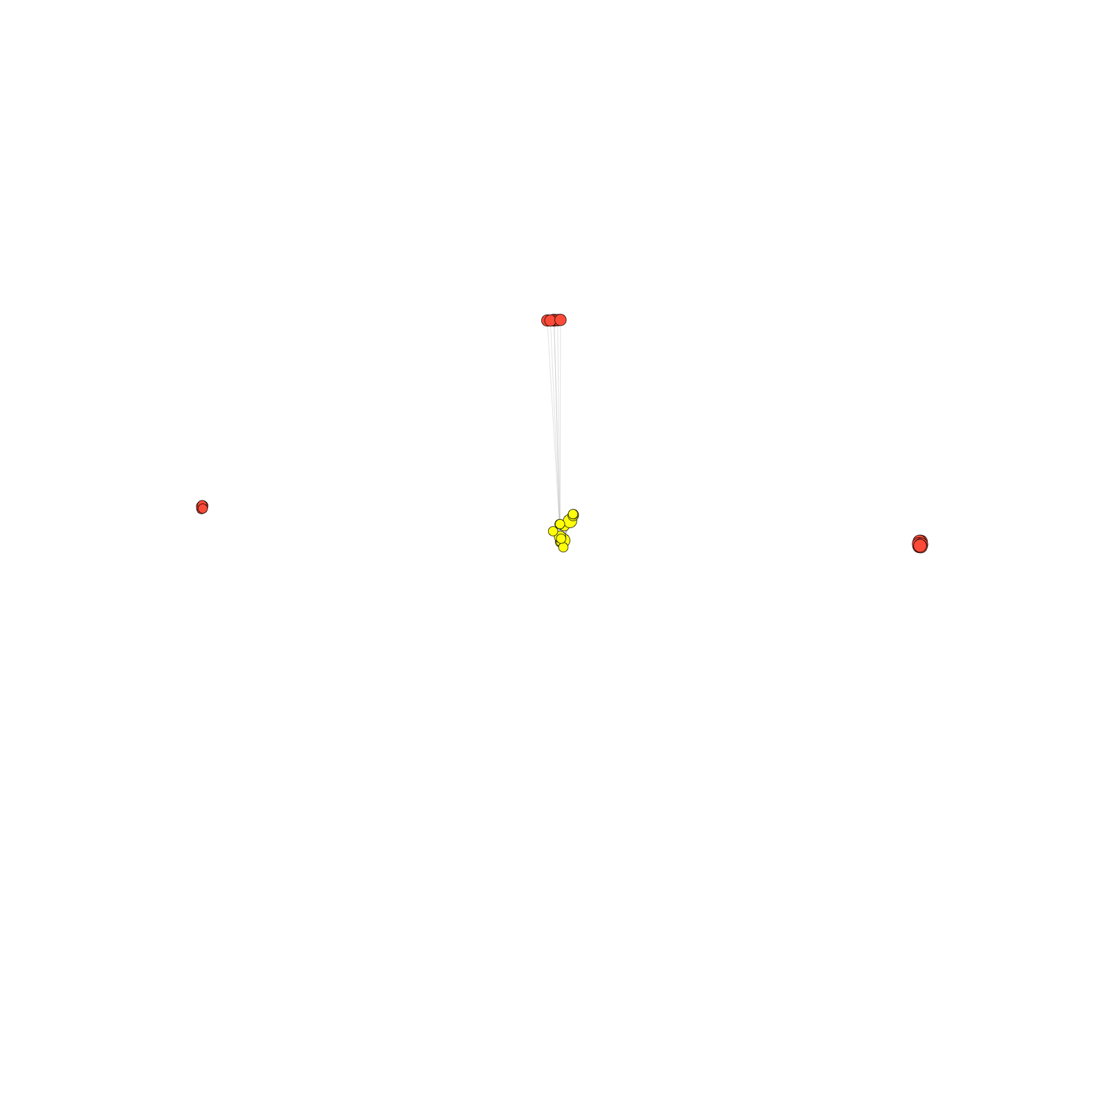
Dynamics of co-authorship network
2009
2010
2011
2008
2007
2012
2006
2005
2013
2004
2014
co-authorship
[Wang et al., TIG (’16)]

Slide 71
Dynamics of co-authorship network
2009
2010
2011
2008
2007
2012
“Modularity”
2006
2005
2013
2004
2014
co-authorship
[Wang et al., TIG (’16)]

Slide 72
Transcriptome Mining: Tackling core issues related to gene regulation
& also analyzing the "data exhaust" associated with this activity
[Core-1] Expression Clustering,
Cross-species
  Comparative ENCODE – Lots of worm-fly-human matched data & developmental timecourses
  Optimization gives 16 conserved co-expression modules, 12 w/ hourglass
[Core-2] State Space Models
of Gene Expression
  Using dimensionality reduction to help determine internal & external drivers; Decoupling expression changes into those from conserved vs species-specific genes
  Conserved genes have similar canonical patterns (iPDPs) in contrast to species specific ones (Ex of ribosomal v signaling genes)
[Core-3] Logic Gates Modeling
  Preponderance of OR gates in cancer v. cell-cycle (esp. for MYC)
[Exhaust-1] Genomic Privacy
& RNA-seq
  The dilemma: The genome as fundamental, inherited info that’s very private v need for large-scale mining for med. research
  2-sided nature of RNA-seq presents a particularly tricky privacy issue
  Using file formats to remove obvious variants
  Quantifying & removing further variant info from expression levels + eQTLs using ICI & predictability
  Instantiating a practical linking attack using extreme expression levels
[Exhaust-2] Publication Patterns from data producing consortia
  Co-authorship network statistics relate to publication rollouts & show gradual adoption by a diverse community
  Key role of brokers in data dissemination

Slide 73
Transcriptome Mining: Tackling core issues related to gene regulation
& also analyzing the "data exhaust" associated with this activity
[Core-1] Expression Clustering,
Cross-species
  Comparative ENCODE – Lots of worm-fly-human matched data & developmental timecourses
  Optimization gives 16 conserved co-expression modules, 12 w/ hourglass
[Core-2] State Space Models
of Gene Expression
  Using dimensionality reduction to help determine internal & external drivers; Decoupling expression changes into those from conserved vs species-specific genes
  Conserved genes have similar canonical patterns (iPDPs) in contrast to species specific ones (Ex of ribosomal v signaling genes)
[Core-3] Logic Gates Modeling
  Preponderance of OR gates in cancer v. cell-cycle (esp. for MYC)
[Exhaust-1] Genomic Privacy
& RNA-seq
  The dilemma: The genome as fundamental, inherited info that’s very private v need for large-scale mining for med. research
  2-sided nature of RNA-seq presents a particularly tricky privacy issue
  Using file formats to remove obvious variants
  Quantifying & removing further variant info from expression levels + eQTLs using ICI & predictability
  Instantiating a practical linking attack using extreme expression levels
[Exhaust-2] Publication Patterns from data producing consortia
  Co-authorship network statistics relate to publication rollouts & show gradual adoption by a diverse community
  Key role of brokers in data dissemination

Slide 74



Acknowledgements: ENCODE/modENCODE
Transcriptome Group
Joel Rozowsky, Koon-Kiu Yan, Daifeng Wang,
Chao Cheng, James B. Brown, Carrie A. Davis, LaDeana Hillier, Cristina Sisu, Jingyi Jessica Li, Baikang Pei, Arif O. Harmanci, Michael O. Duff, Sarah Djebali, Roger P. Alexander, Burak H. Alver, Raymond K. Auerbach, Kimberly Bell, Peter J. Bickel, Max E. Boeck, Nathan P. Boley, Benjamin W. Booth, Lucy Cherbas, Peter Cherbas, Chao Di, Alex Dobin, Jorg Drenkow, Brent Ewing, Gang Fang, Megan Fastuca, Elise A. Feingold, Adam Frankish, Guanjun Gao, Peter J. Good, Phil Green, Roderic Guigó, Ann Hammonds, Jen Harrow, Roger A. Hoskins, Cédric Howald, Long Hu, Haiyan Huang, Tim J. P. Hubbard, Chau Huynh, Sonali Jha, Dionna Kasper, Masaomi Kato, Thomas C. Kaufman, Rob Kitchen, Erik Ladewig, Julien Lagarde, Eric Lai, Jing Leng, Zhi Lu, Michael MacCoss, Gemma May, Rebecca McWhirter, Gennifer Merrihew, David M. Miller, Ali Mortazavi, Rabi Murad, Brian Oliver, Sara Olson, Peter Park, Michael J. Pazin, Norbert Perrimon, Dmitri Pervouchine, Valerie Reinke, Alexandre Reymond, Garrett Robinson, Anastasia Samsonova, Gary I. Saunders, Felix Schlesinger, Anurag Sethi, Frank J. Slack, William C. Spencer, Marcus H. Stoiber, Pnina Strasbourger, Andrea Tanzer, Owen A. Thompson, Kenneth H. Wan, Guilin Wang, Huaien Wang, Kathie L. Watkins, Jiayu Wen, Kejia Wen, Chenghai Xue, Li Yang, Kevin Yip, Chris Zaleski, Yan Zhang, Henry Zheng,
Steven E. Brenner, Brenton R. Graveley, Susan E. Celniker, Thomas R Gingeras, Robert Waterston
Hiring Postdocs. See gersteinlab.org/jobs !
EncodeProject.org/comparative/transcriptome

Slide 75

Acknowledgements
DREISS.gersteinlab.org
D Wang, F He, S Maslov
papers.gersteinlab.org/subject/privacy –
D Greenbaum
Loregic.gersteinlab.org
D Wang, KK Yan, C Sisu, C Cheng,
J Rozowsky, W Meyerson
PrivaSeq.gersteinlab.org
A Harmanci, G Gürsoy, F Navarro
github.com/gersteinlab/OrthoClust
K Yan, D Wang, J Rozowsky, H Zheng, C Cheng
Publication patterns [“encode authors”]
D Wang, KK Yan, J Rozowsky, E Pan
Hiring Postdocs. See JOBS.gersteinlab.org !

Slide 76

Extra

Slide 77
Info about content in this slide pack
General PERMISSIONS
  This Presentation is copyright Mark Gerstein,
  Yale University, 2017.
  Please read permissions statement at
  www.gersteinlab.org/misc/permissions.html .
  Feel free to use slides & images in the talk with PROPER acknowledgement
  (via citation to relevant papers or link to gersteinlab.org).
  Paper references in the talk were mostly from Papers.GersteinLab.org.
PHOTOS & IMAGES. For thoughts on the source and permissions of many of the photos and clipped images in this presentation see http://streams.gerstein.info .
  In particular, many of the images have particular EXIF tags, such as kwpotppt , that can be easily queried from flickr, viz: http://www.flickr.com/photos/mbgmbg/tags/kwpotppt

