Slide 1
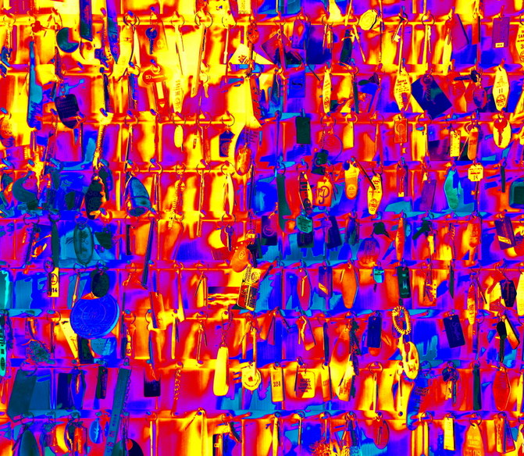
Prioritizing Variants in Personal Genomes: Using functional impact, with particular application to cancer
Mark Gerstein
Yale
Slides freely
downloadable from Lectures.GersteinLab.org
& “tweetable” (via @MarkGerstein).
No Conflicts for this Talk
See last slide for more info.

Slide 2
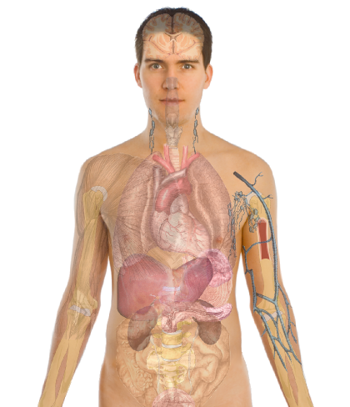
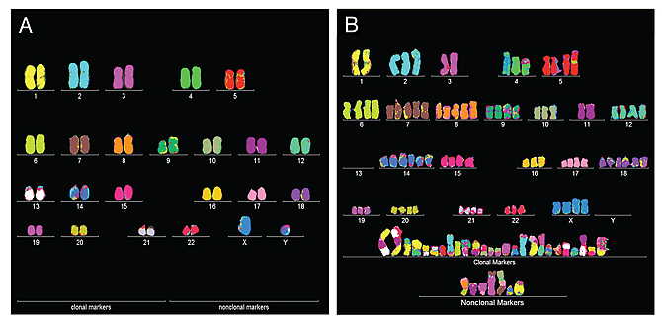
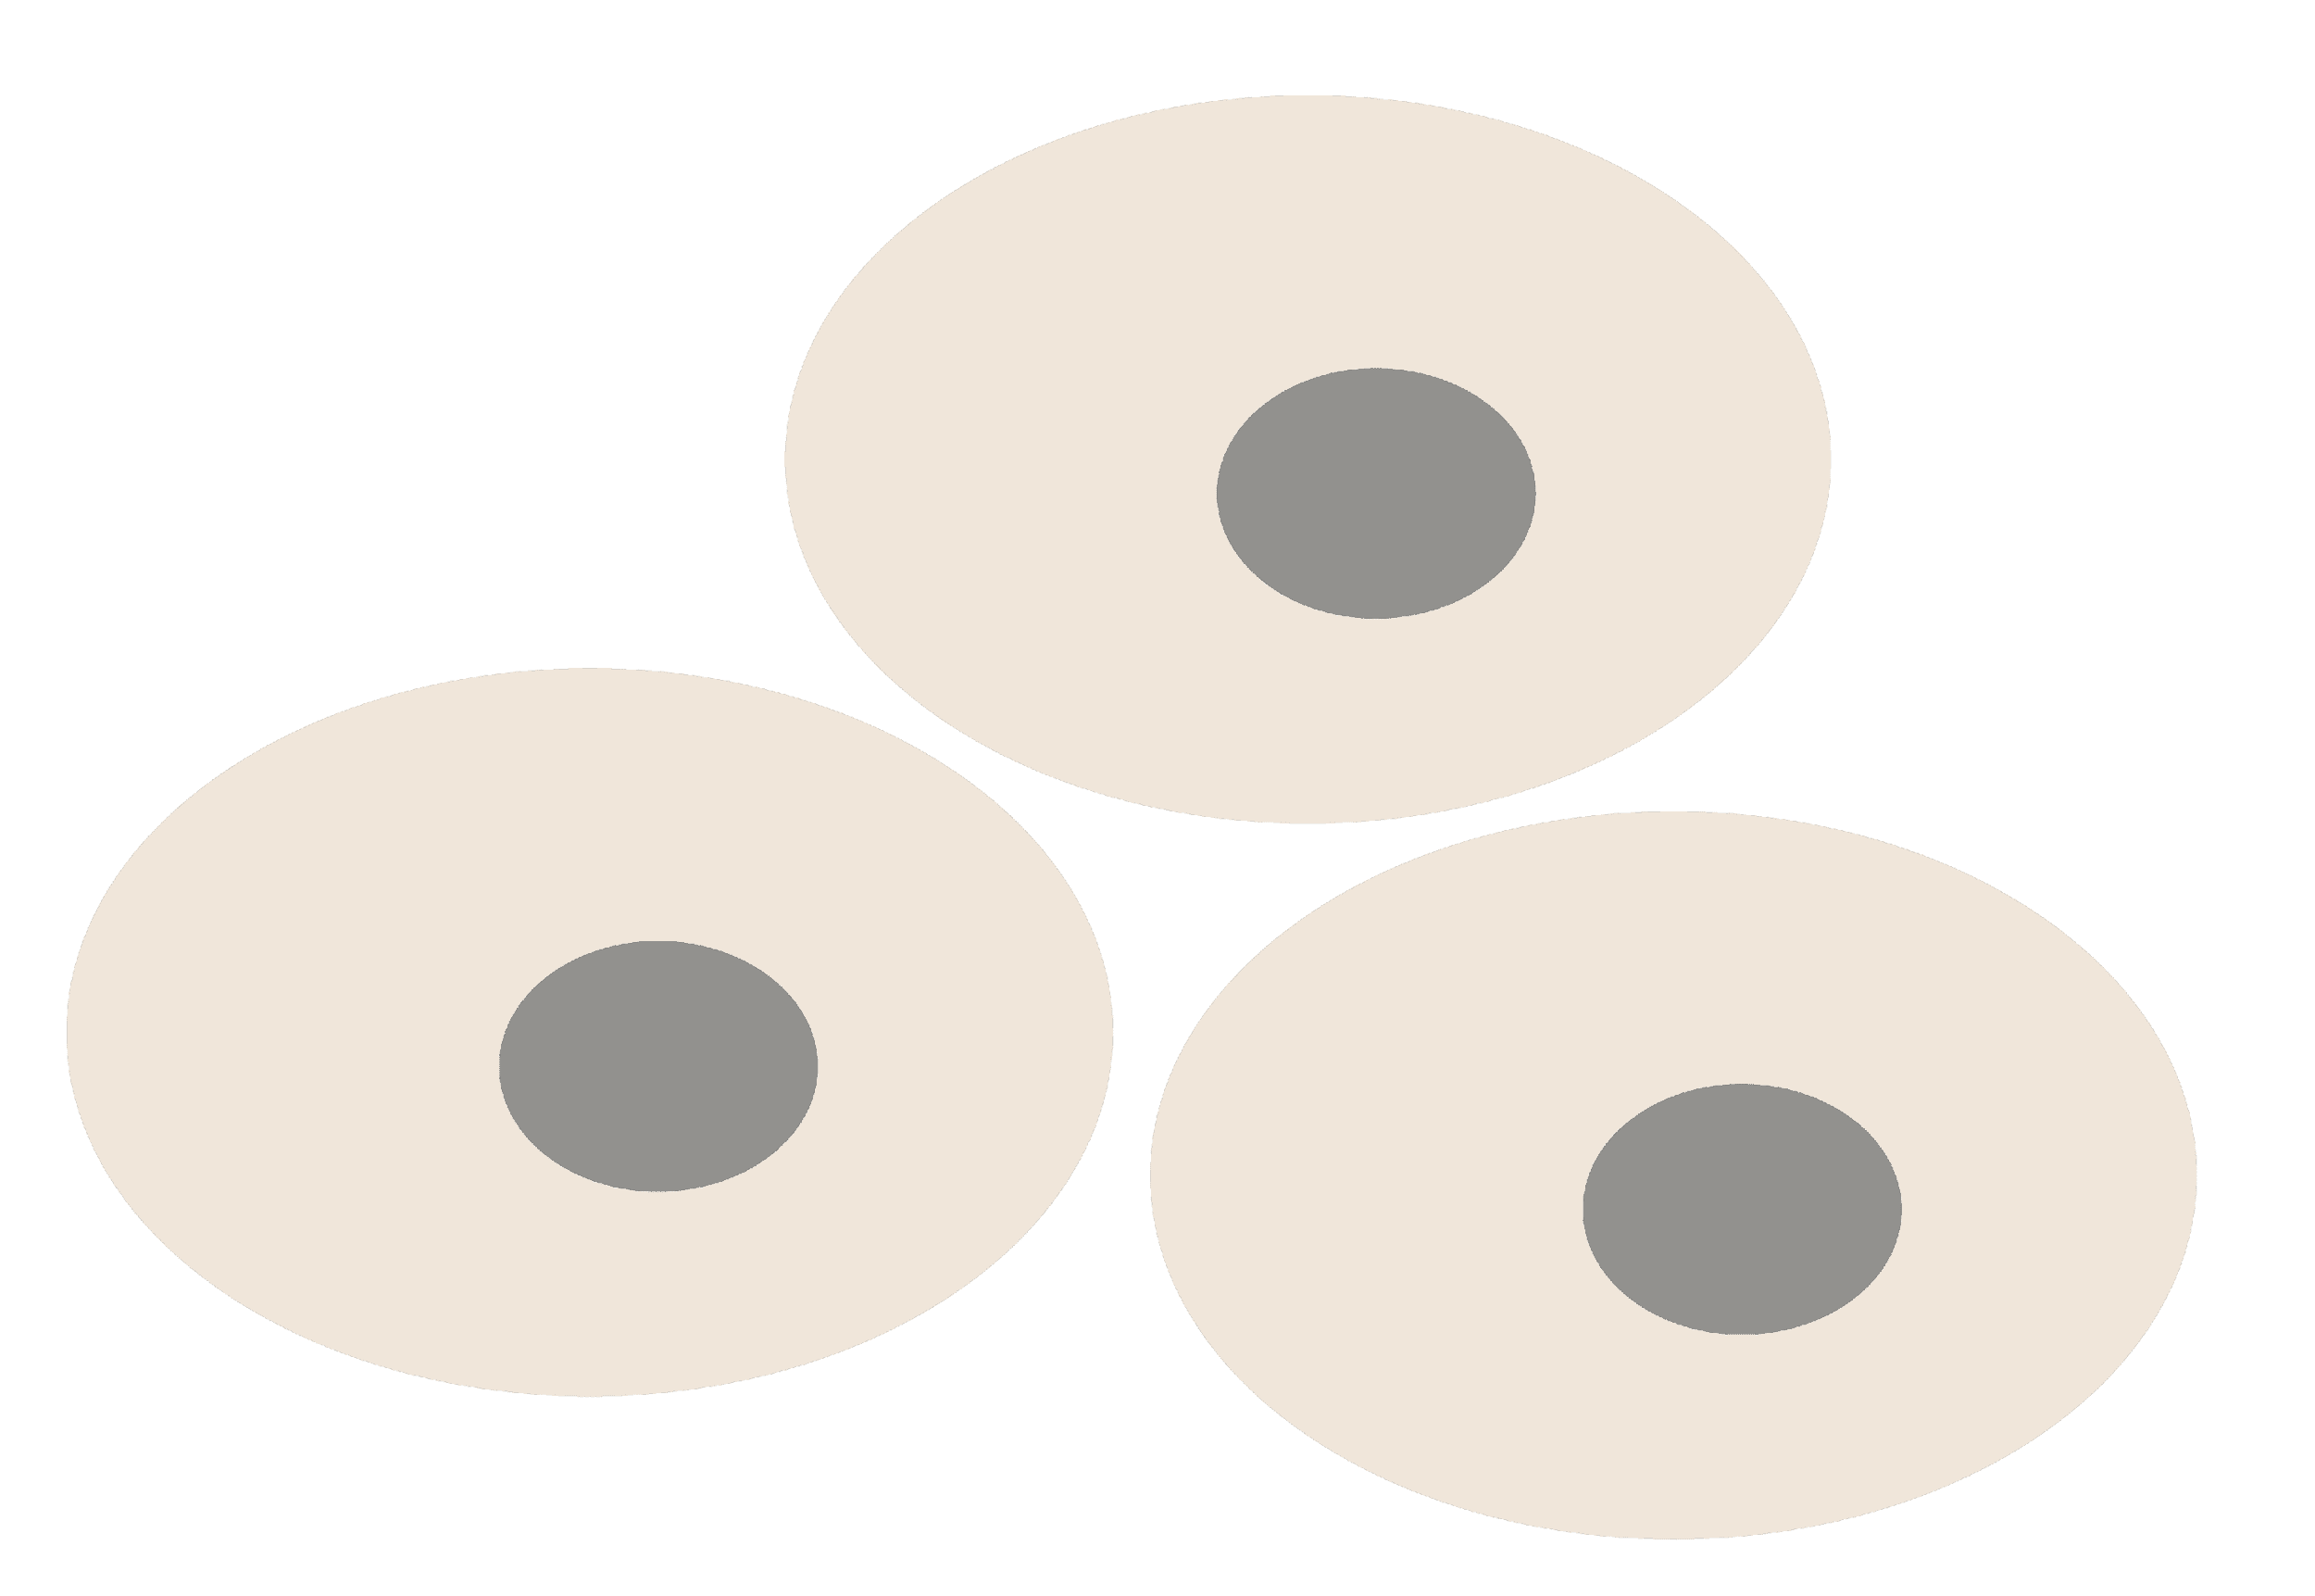
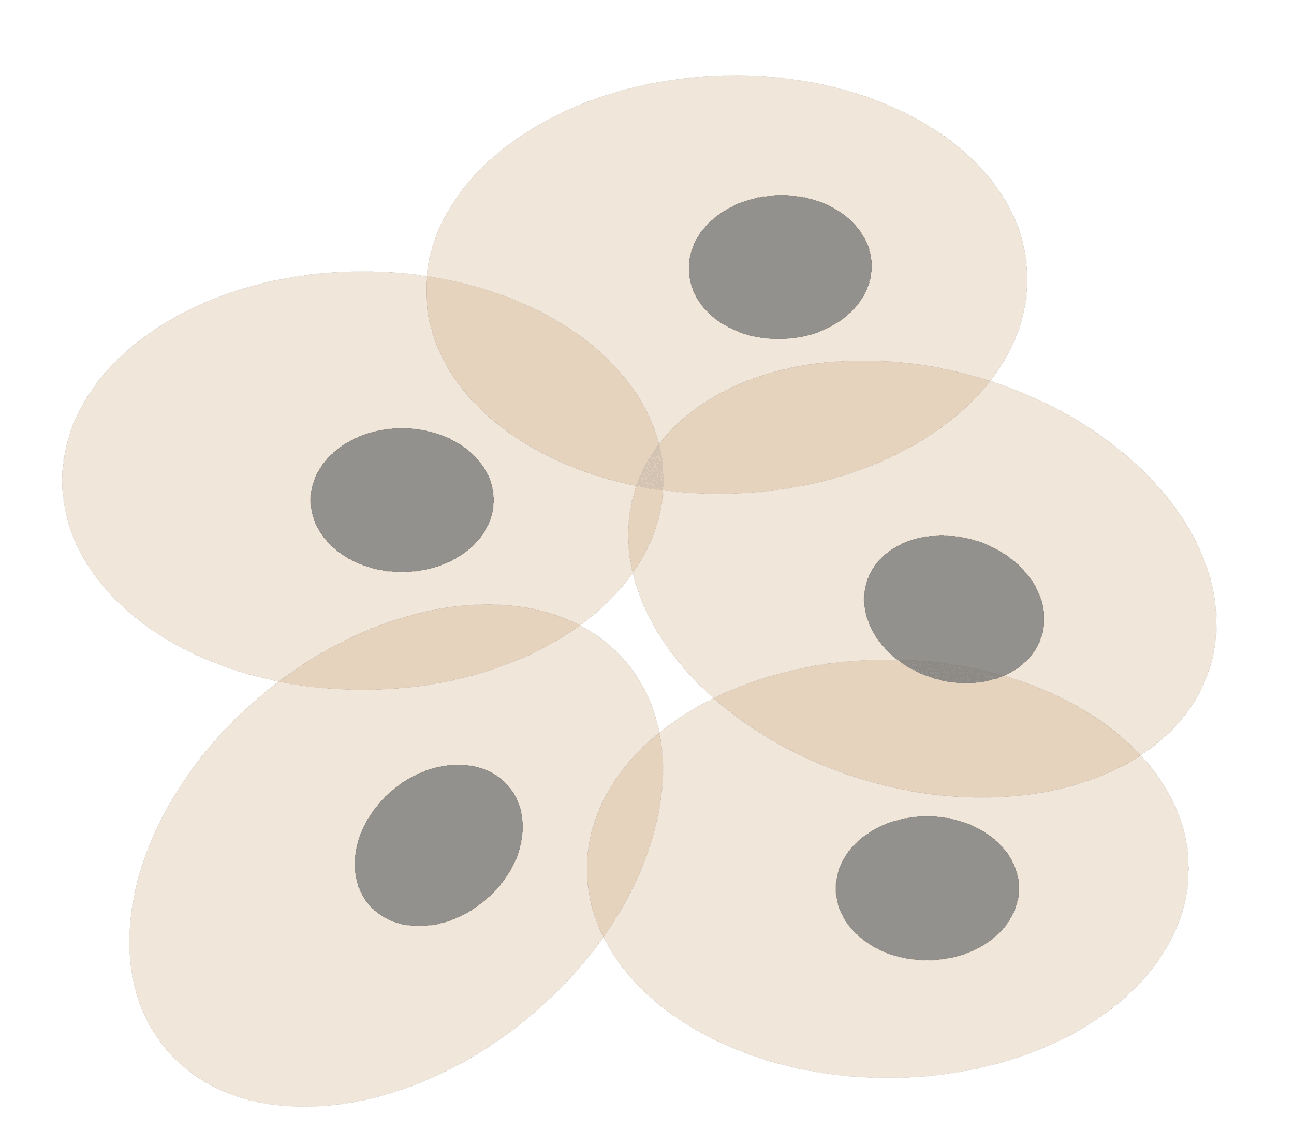
Personal Genomics
as a Gateway into Biology
Personal genomes will soon become a commonplace part of medical research & eventually treatment (esp. for cancer). They will provide a primary connection for biological science to the general public.
normal
tumor

Slide 3
Personal Genomics
as a Gateway into Biology
Personal genomes will soon become a commonplace part of medical research & eventually treatment (esp. for cancer). They will provide a primary connection for biological science to the general public.

Slide 4

Keys to genome interpretation
Relating individuals' variants to DBs
Scaling DBs to the population
Identifying key variants -
separating into rare, recurrent, common, &c

Slide 5
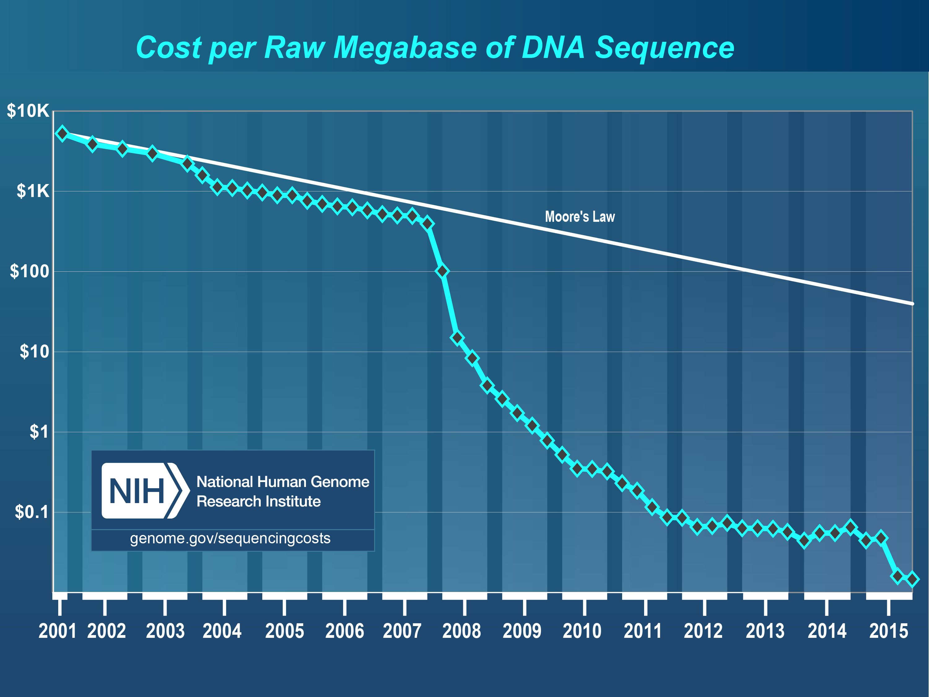
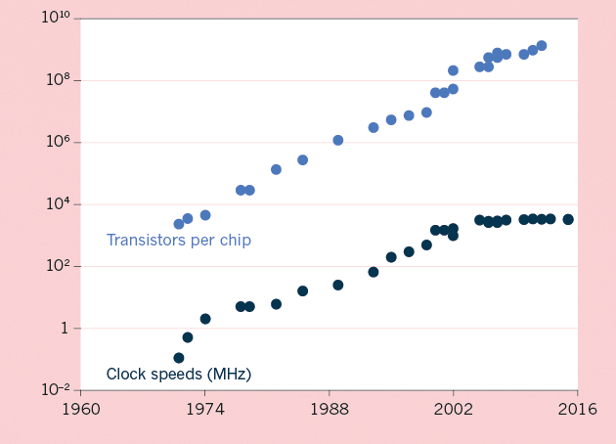
The Scaling of Genomic Data Science:
Powered by exponential increases in data & computing
(Moore’s Law)
[NHGRI website + Waldrop (‘15) Nature]

Slide 6
Exponential Scaling Changes Fields Using Genomic Data
[Muir et al. (‘15) GenomeBiol.]

Slide 7
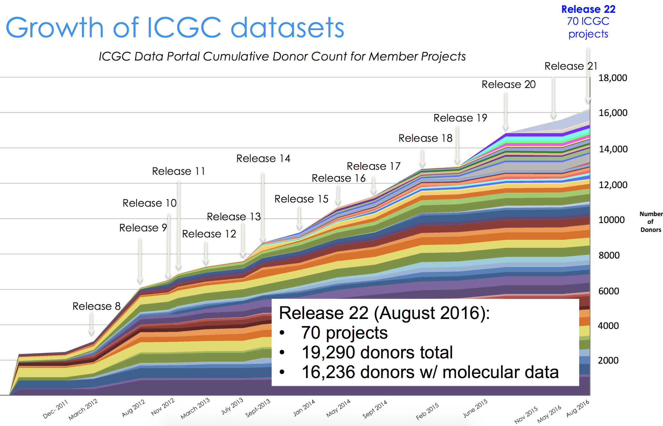
Growth of ICGC datasets
Hardeep Nahal , 12th Scientific
ICGC Workshop (Sept 2016)

Slide 8
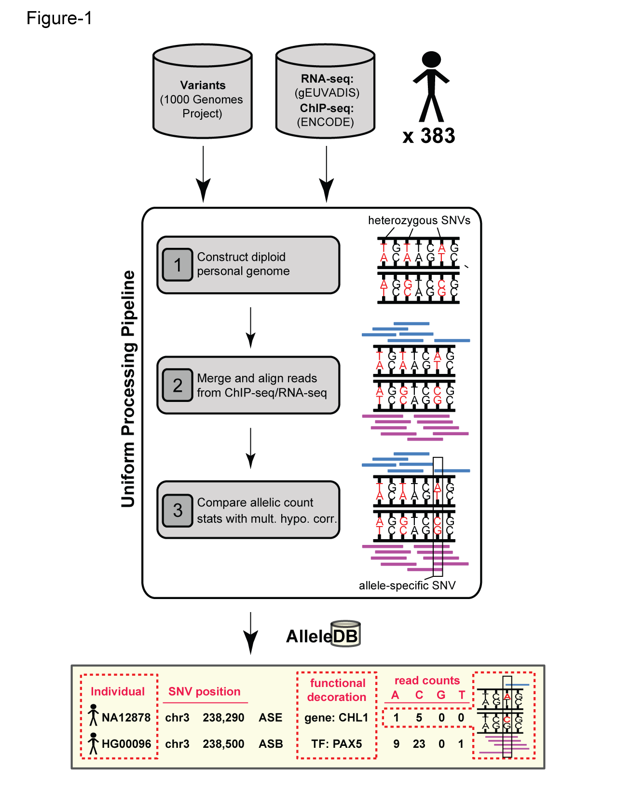


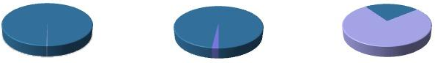
Human Genetic Variation
Population of
2,504 peoples
A Cancer Genome
A Typical Genome
Origin of Variants
Class of Variants
 | Coding | Non- coding
Germ- line | 22K | 4.1 – 5M
Somatic | ~50 | 5K
SNP | 3.5 – 4.3M
Indel | 550 – 625K
SV | 2.1 – 2.5K (20Mb)
Total | 4.1 – 5M
SNP | 84.7M
Indel | 3.6M
SV | 60K
Total | 88.3M
Prevalence of Variants
Common
Common
Passenger
Driver (~0.1%)
Rare* (1-4%)
Rare (~75%)
* Variants with allele frequency < 0.5% are considered as rare variants in 1000 genomes project.
The 1000 Genomes Project Consortium, Nature. 2015. 526:68-74
Khurana E. et al. Nat. Rev. Genet. 2016. 17:93-108

Slide 9

Finding Key Variants
Germline
CAN YOU FIND THE PANDA?
Common variants
  Can be most readily associated with phenotype (ie disease) via GWAS
  Usually their functional effect is weaker
  Many are non-coding
  Issue of LD in identifying the actual causal variant.
Rare variants
  Associations are usually underpowered due to low frequencies but often have larger functional impact
  Can be collapsed in the same element to gain statistical power (burden tests).
McCarthy, M. et al. Nat. Rev. Genet. 2008. 9, 356-369, Zuk, O. et al. PNSA. 2014. Vol. 11, no. 4, MacArthur DG et al. Nature 2014. 508:469-476

Slide 10
Finding Key Variants
Somatic
CAN YOU FIND THE PANDA?
Overall
  Often these can be thought of as very rare variants
Drivers
  Driver mutation is a mutation that directly or indirectly confers a selective growth advantage to the cell in which it occurs.
  A typical tumor contains 2-8 drivers; the remaining mutations are passengers.
Passengers
  Conceptually, a passenger mutation has no direct or indirect effect on the selective growth advantage of the cell in which it occurred.
Vogelstein B. Science 2013. 339(6127):1546-1558

Slide 11
Prioritizing Variants in Personal Genomes: Using functional impact, with particular application to cancer
Introduction
  An individual's disease variants as
  the public's gateway into genomics & biology
  The exponential scaling of data gen. & processing
  Big-data mining to prioritize key variants as drivers
  Functional impact #1: Coding
  Frustration as a localized metric of SNV impact. Differential profiles for oncogenes v. TSGs
Functional impact #2: Non-coding
  FunSeq integrates evidence,
  with a “surprisal” based weighting scheme. Prioritizing rare variants with “sensitive sites”
  (human conserved)
  RADAR: prioritize variants based on post-transcriptional regulome using ENCODE eCLIP
  uORFs: Feature integration to find small subset of upstream mutations that potentially alter translation
(Low-power) application to pRCC
  WGS finds additional facts on the canonical driver, MET. Other suggestive non-coding hotspots.
  Analysis of signatures & tumor evolution helps identify key mutations in different ways 15

Slide 12
Prioritizing Variants in Personal Genomes: Using functional impact, with particular application to cancer
Introduction
  An individual's disease variants as
  the public's gateway into genomics & biology
  The exponential scaling of data gen. & processing
  Big-data mining to prioritize key variants as drivers
  Functional impact #1: Coding
  Frustration as a localized metric of SNV impact. Differential profiles for oncogenes v. TSGs
Functional impact #2: Non-coding
  FunSeq integrates evidence,
  with a “surprisal” based weighting scheme. Prioritizing rare variants with “sensitive sites”
  (human conserved)
  RADAR: prioritize variants based on post-transcriptional regulome using ENCODE eCLIP
  uORFs: Feature integration to find small subset of upstream mutations that potentially alter translation
(Low-power) application to pRCC
  WGS finds additional facts on the canonical driver, MET. Other suggestive non-coding hotspots.
  Analysis of signatures & tumor evolution helps identify key mutations in different ways 15

Slide 13
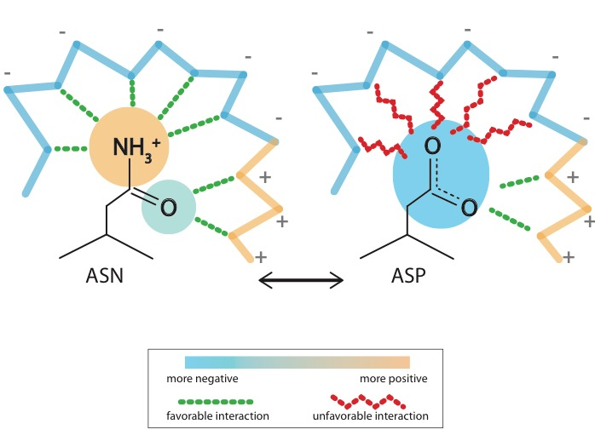
What is localized frustration?
[Ferreiro et al., PNAS (’07)]

Slide 14
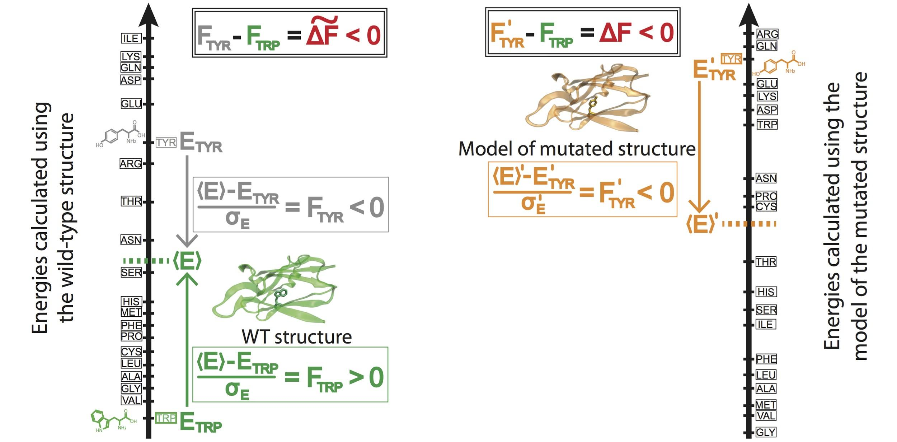
Workflow for evaluating localized frustration changes (∆F)
[Kumar et al. NAR (2016)]
Notes:
An example illustrating the case in which ∆F < 0. The ∆F associated with an SNV is negative if the SNV introduces a destabilizing effect. Shown here is the result of changing residue ID 31 in plastocyanin (pdb ID 3CVD) from the wild-type residue (Trp) to a mutated residue (Tyr). Left) The protein in its wild-type form (in green), in which the tryptophan residue at position 31 is substantially more energetically favorable relative to the mean energy ⟨E⟩ that would result from having any of the possible 20 amino acids at that position. This disparity is designated by (⟨E⟩ - E_{nat})/σ_{E} = F_{nat} > 0. Right) The entire protein structure is then modeled to generate the mutated structure after the SNV W31Y is introduced, thereby changing the relative energetic distributions for the different amino acids. The new mean and standard deviation associated with the energies of the modeled structure are designated by ⟨E⟩’ and σ_{E}’, respectively. In this case, the SNV that introduces 31Y results in an energy that is higher than the mean energy of all possible 20 amino acids at that position. This disparity is designated by (⟨E⟩’ - E_{mut})/σ_{E}’ = F_{mut} < 0. Taken together, the negative value associated with the disparity between the F_{mut} and F_{nat} values (F_{mut} - F_{nat} = ∆F < 0) indicates that the this SNV is locally unfavorable.

Slide 15
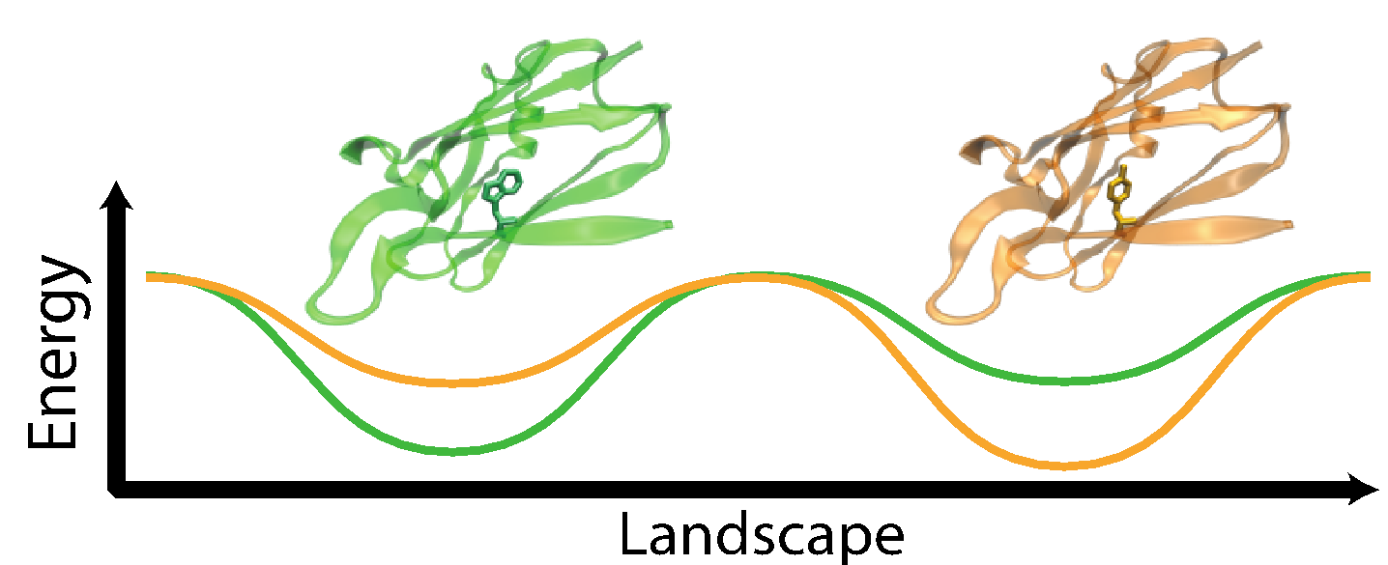
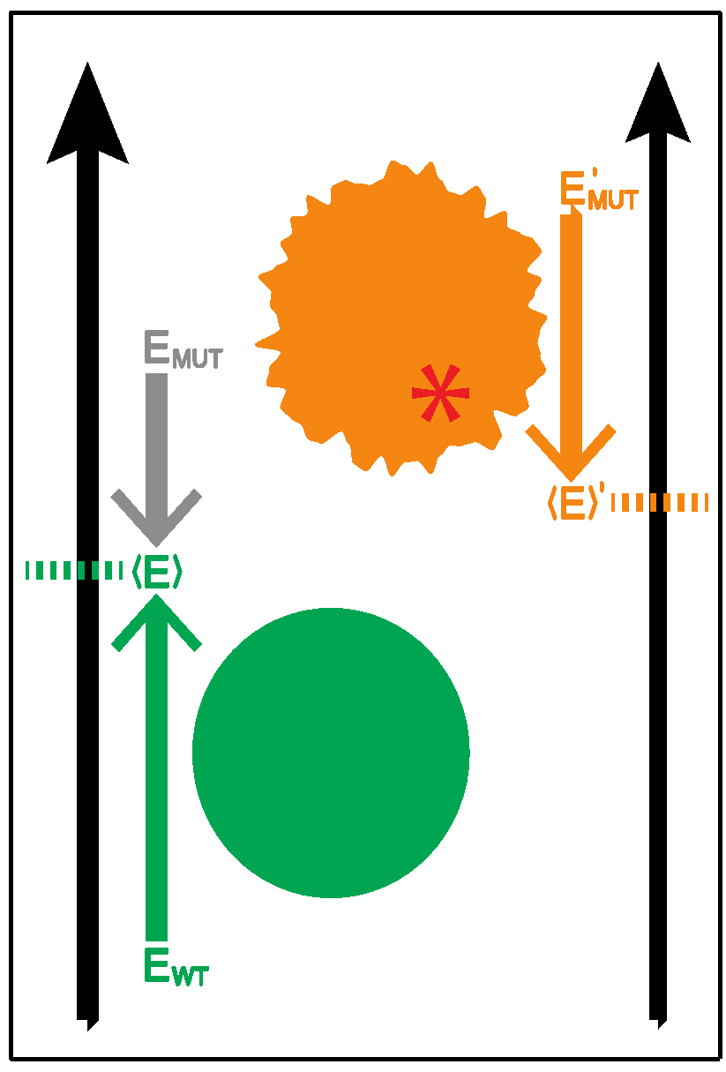
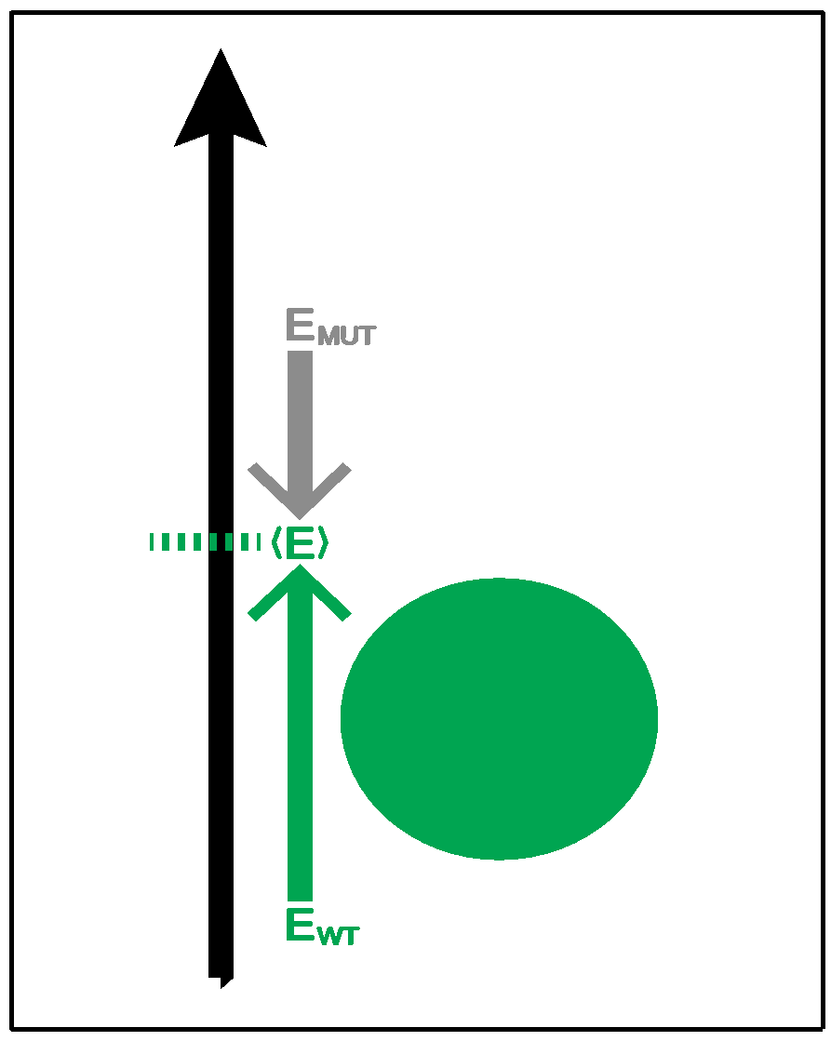
Complexity of the second order frustration calculation
MD-assisted free energy calculation (∆G)
Second order frustration calculation (∆F)
Time
First order frustration calculation (F)
Accuracy

Slide 16
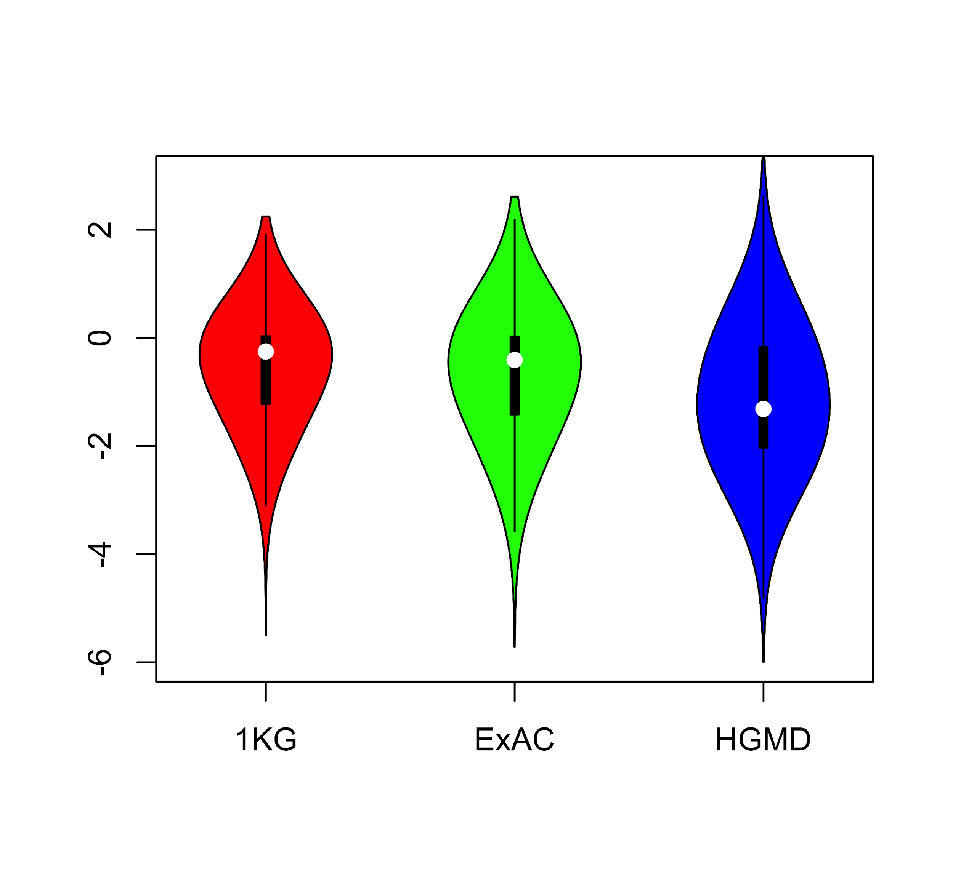
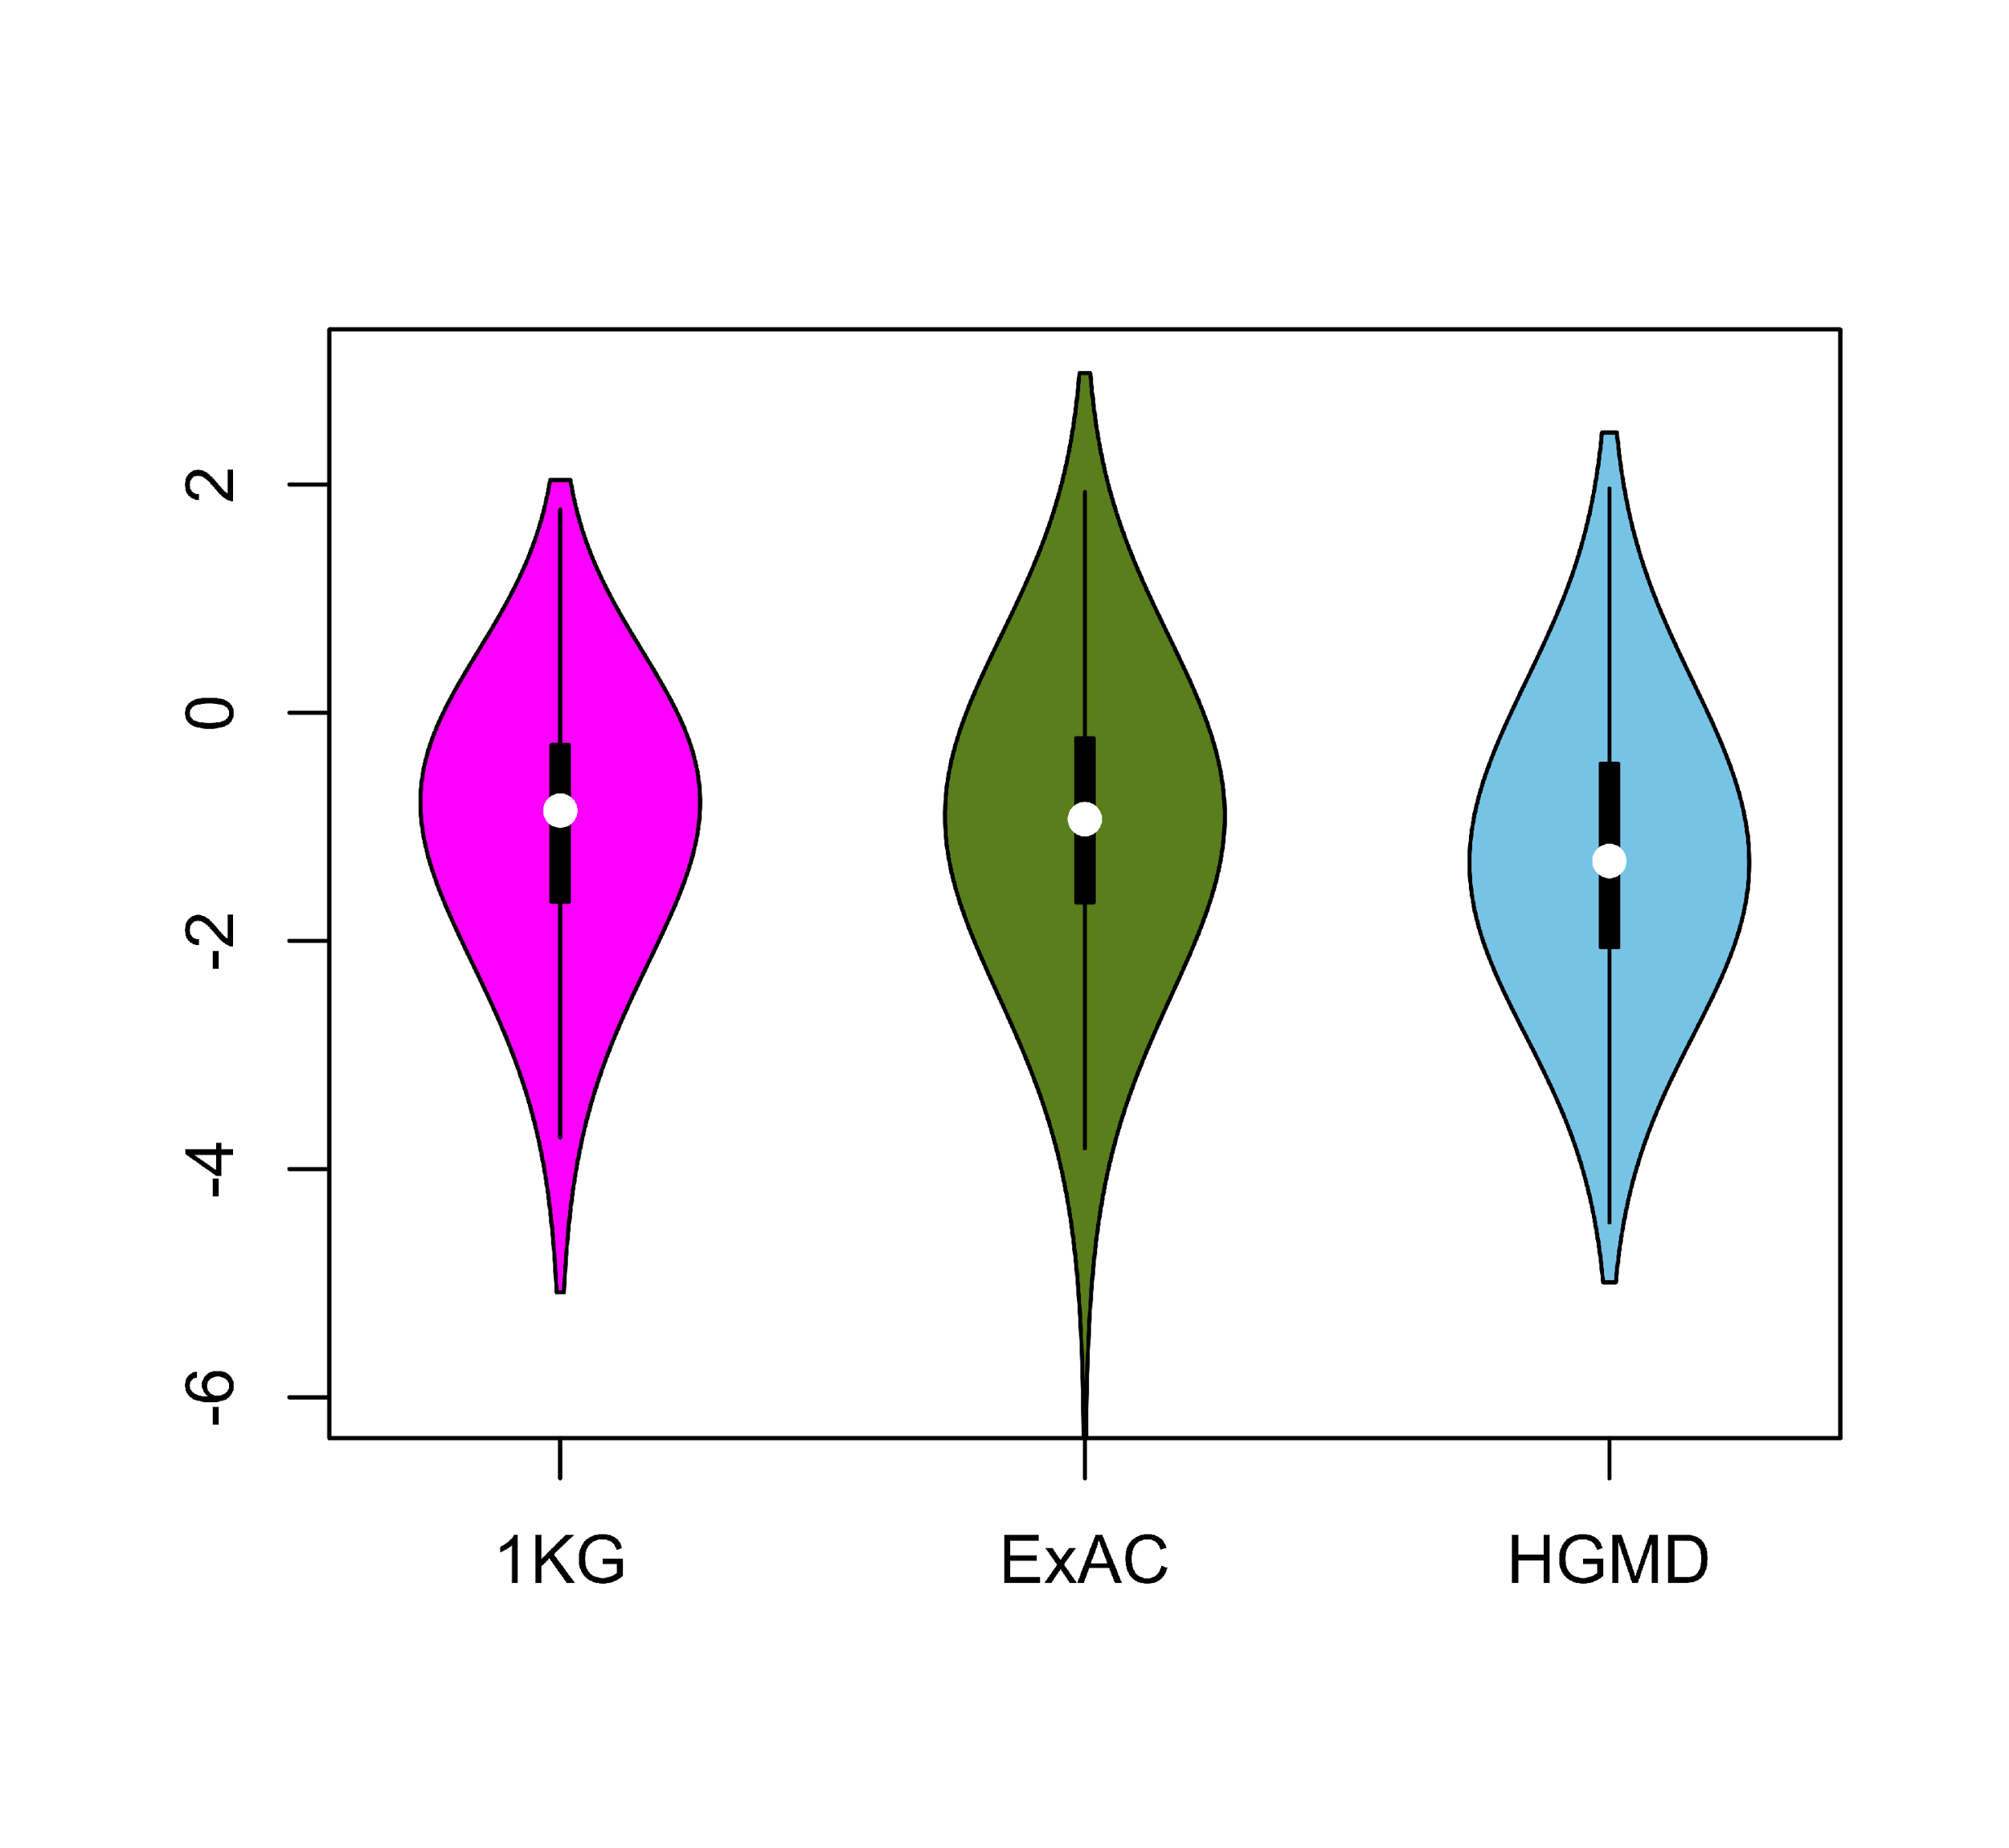
Comparing ∆F values across different SNV categories: disease v normal
Loss of frustration
Gain of frustration
Core residues
Surface residues
Normal mutations (1000G) tend to unfavorably frustrate (less frustrated) surface more than core,
but for disease mutations (HGMD)
no trend & greater changes
[Kumar et al, NAR (2016)]
Notes:
We observed that benign SNVs lead to greater disruptions within minimally frustrated surface residues compared to core residues in the native structure, and this trend is observed when using both ExAC and 1KG (Figure A & B). However, SNVs from HGMD that impact minimally frustrated core residues induce stronger perturbations than benign SNVs influencing minimally frustrated core residues (Figure C). This suggest that the mechanistic difference between benign and disease SNVs can be attributed to their impact on the local environment of core residues. Within the core, disease-associated SNVs result in more severe perturbations to local interactions relative to those introduced by benign SNVs. These local disruptions are propagated throughout the core and, in turn, drive the deleteriousness of various disease-associated SNVs.

Slide 17
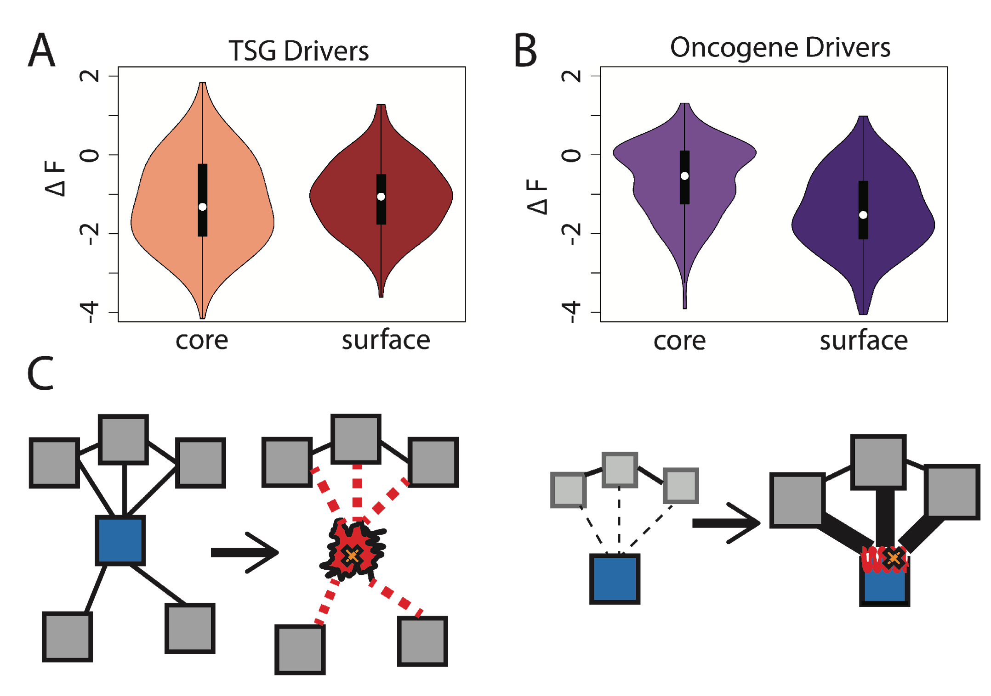
Comparison between ∆F distributions: TSGs v. oncogenes
[Kumar et al, NAR (2016)]
SNVs in TSGs change frustration more in core than the surface, whereas those associated with oncogenes manifest the opposite pattern. This is consistent with differences in LOF v GOF mechanisms.
Notes:
we observe that somatic SNVs associated with TSGs change the frustration more in core than the surface, whereas those associated with oncogenes manifest the opposite pattern. This is consistent with LOF and GOF mechanism proposed for TSG and oncogene driven cancer progression.

Slide 18
Prioritizing Variants in Personal Genomes: Using functional impact, with particular application to cancer
Introduction
  An individual's disease variants as
  the public's gateway into genomics & biology
  The exponential scaling of data gen. & processing
  Big-data mining to prioritize key variants as drivers
  Functional impact #1: Coding
  Frustration as a localized metric of SNV impact. Differential profiles for oncogenes v. TSGs
Functional impact #2: Non-coding
  FunSeq integrates evidence,
  with a “surprisal” based weighting scheme. Prioritizing rare variants with “sensitive sites”
  (human conserved)
  RADAR: prioritize variants based on post-transcriptional regulome using ENCODE eCLIP
  uORFs: Feature integration to find small subset of upstream mutations that potentially alter translation
(Low-power) application to pRCC
  WGS finds additional facts on the canonical driver, MET. Other suggestive non-coding hotspots.
  Analysis of signatures & tumor evolution helps identify key mutations in different ways 15

Slide 19
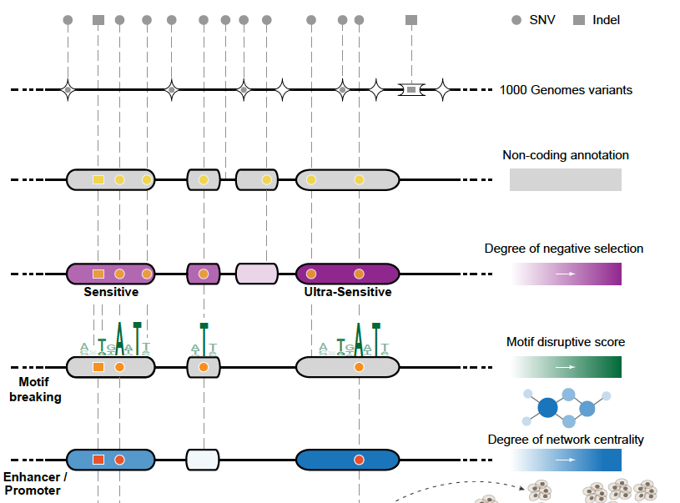
Funseq: a flexible framework to determine
functional impact & use this to prioritize variants
Annotation (tf binding sites open chromatin, ncRNAs) & Chromatin Dynamics
Conservation
(GERP, allele freq.)
Mutational impact (motif breaking, Lof)
Network (centrality position)
[Fu et al., GenomeBiology ('14), , Khurana et al., Science ('13)]

Slide 20
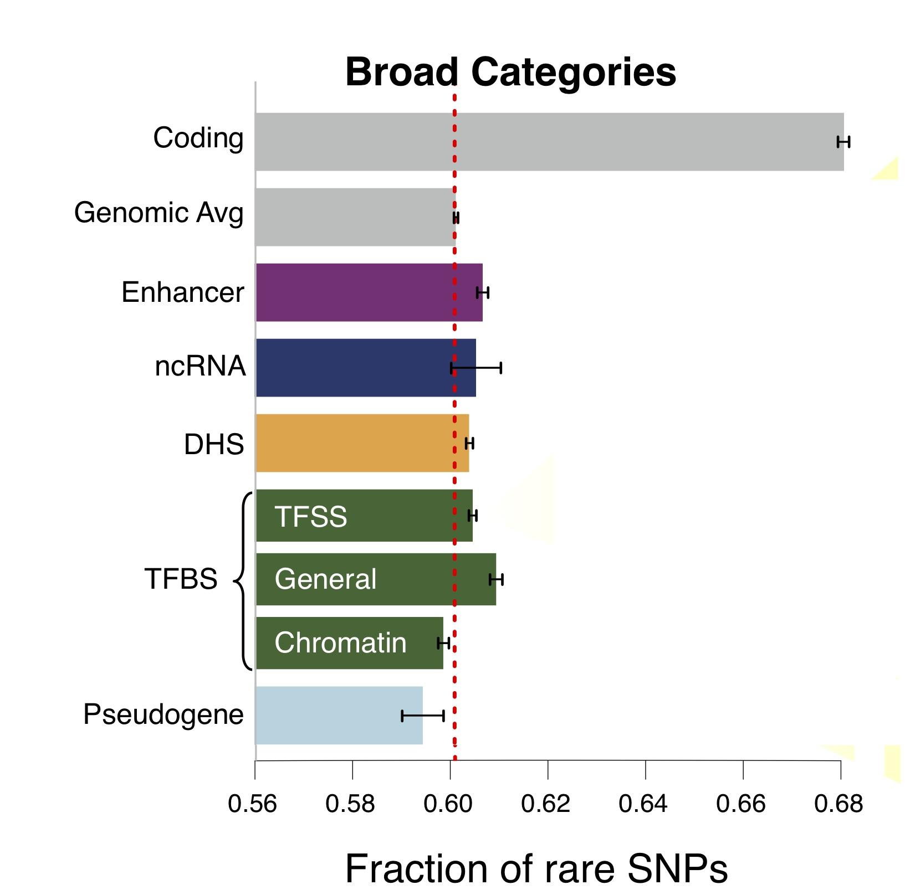
Finding "Conserved” Sites in the Human Population:
Negative selection in non-coding elements based on
Production ENCODE & 1000G Phase 1
Broad categories of regulatory regions under negative selection
Related to:
ENCODE, Nature, 2012
Ward & Kellis, Science, 2012
Mu et al, NAR, 2011
(Non-coding RNA)
(DNase I hypersensitive sites)
(TFSS: Sequence-specific TFs)
(Transcription factor binding sites)
Depletion of Common Variants
in the Human Population

Slide 21
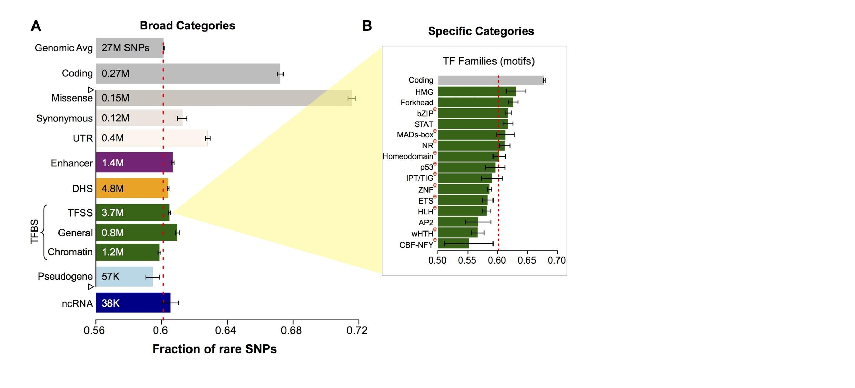
Differential selective constraints
among specific sub-categories
Sub-categorization possible because of better statistics from 1000G phase 1 v pilot
[Khurana et al., Science (‘13)]

Slide 22
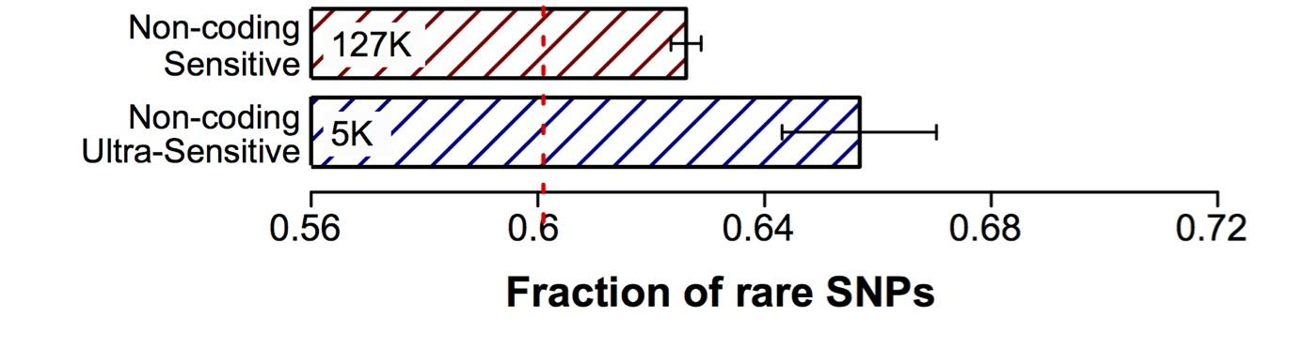
Defining Sensitive
non-coding Regions
~0.4% genomic coverage (~ top 25)
~0.02% genomic coverage (top 5)
Start 677 high-resolution non-coding categories; Rank & find those under strongest selection
Sub-categorization possible because of better statistics from 1000G phase 1 v pilot
[Khurana et al., Science (‘13)]

Slide 23
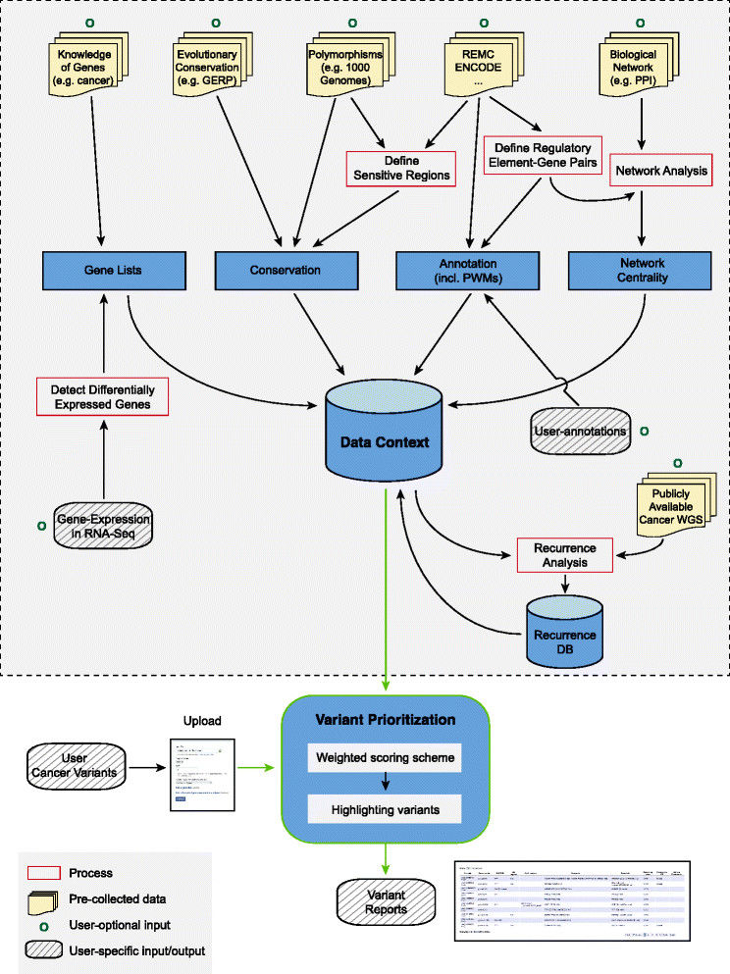
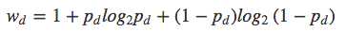
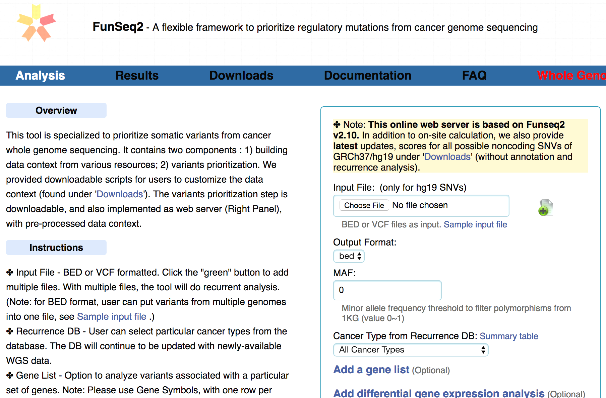
FunSeq.gersteinlab.org
HOT region
Sensitive region
Polymorphisms
Genome
Info. theory based method (ie annotation “surprisal”) for weighting consistently many genomic features
Practical web server
Submission of variants & pre-computed large data context from uniformly processing large-scale datasets
[Fu et al., GenomeBiology ('14)]

Slide 24
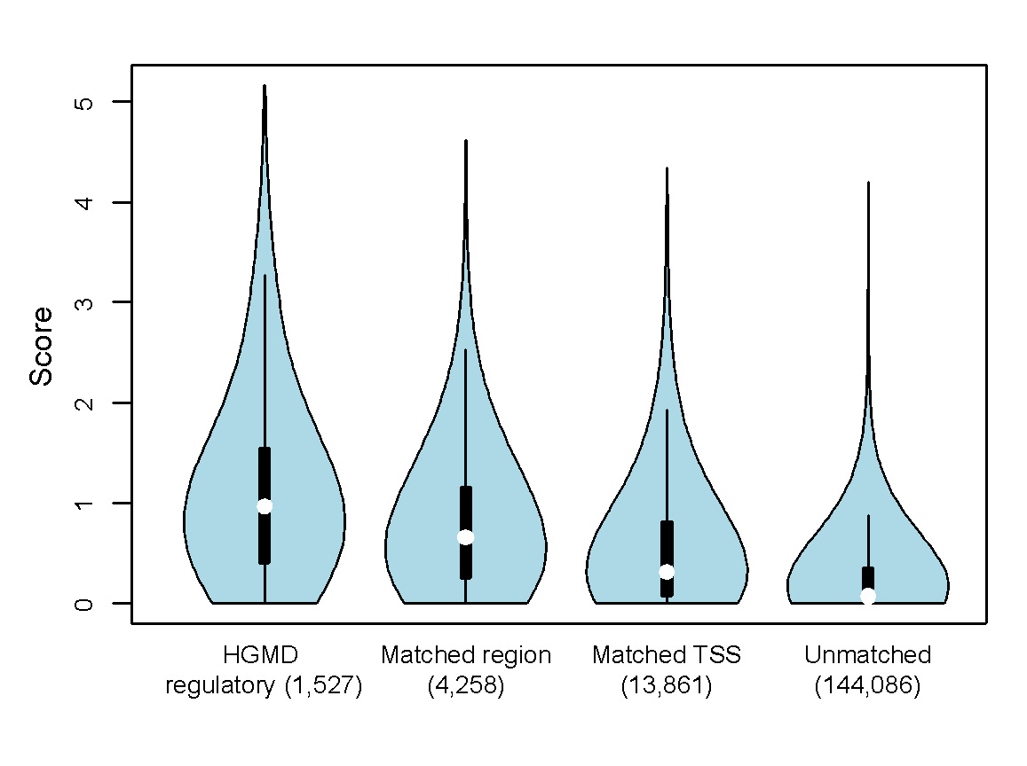
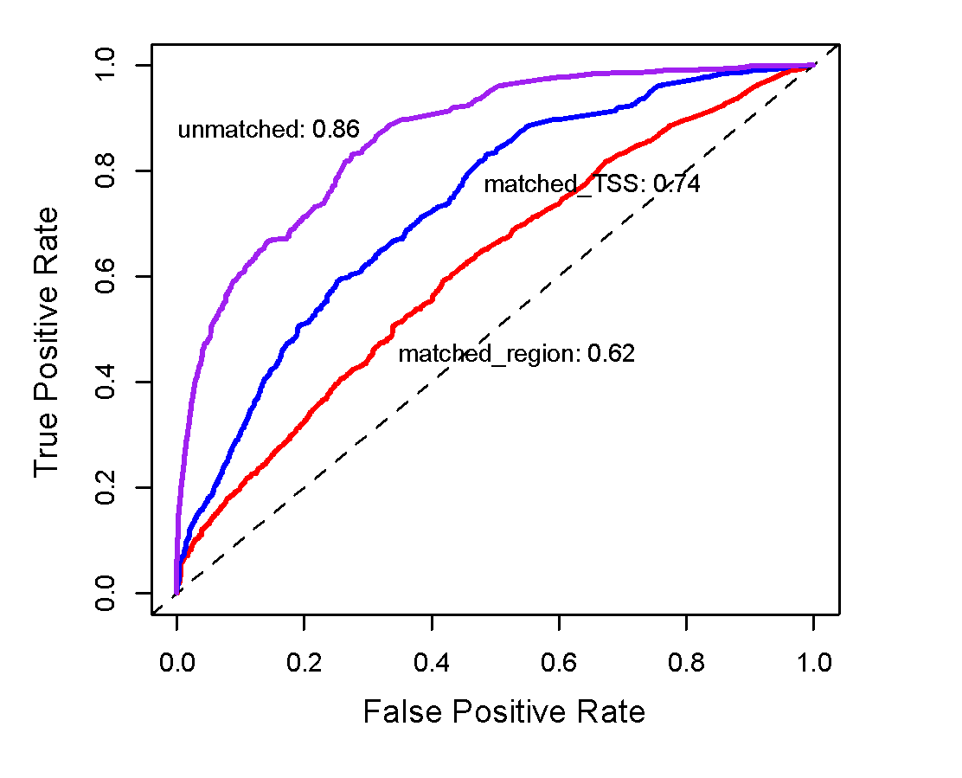
Germline pathogenic variants show higher core scores than controls
3 controls with natural polymorphisms (allele frequency >= 1% )
1. Matched region: 1kb around HGMD variants
2. Matched TSS: matched for distance to TSS
3. Unmatched: randomly selected
Ritchie et al., Nature Methods, 2014
[Fu et al., GenomeBiology ('14, in revision)]

Slide 25
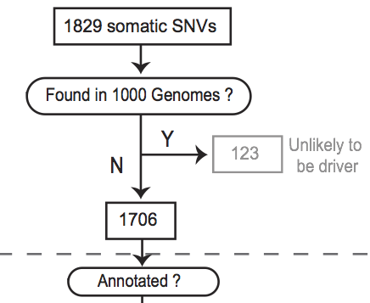
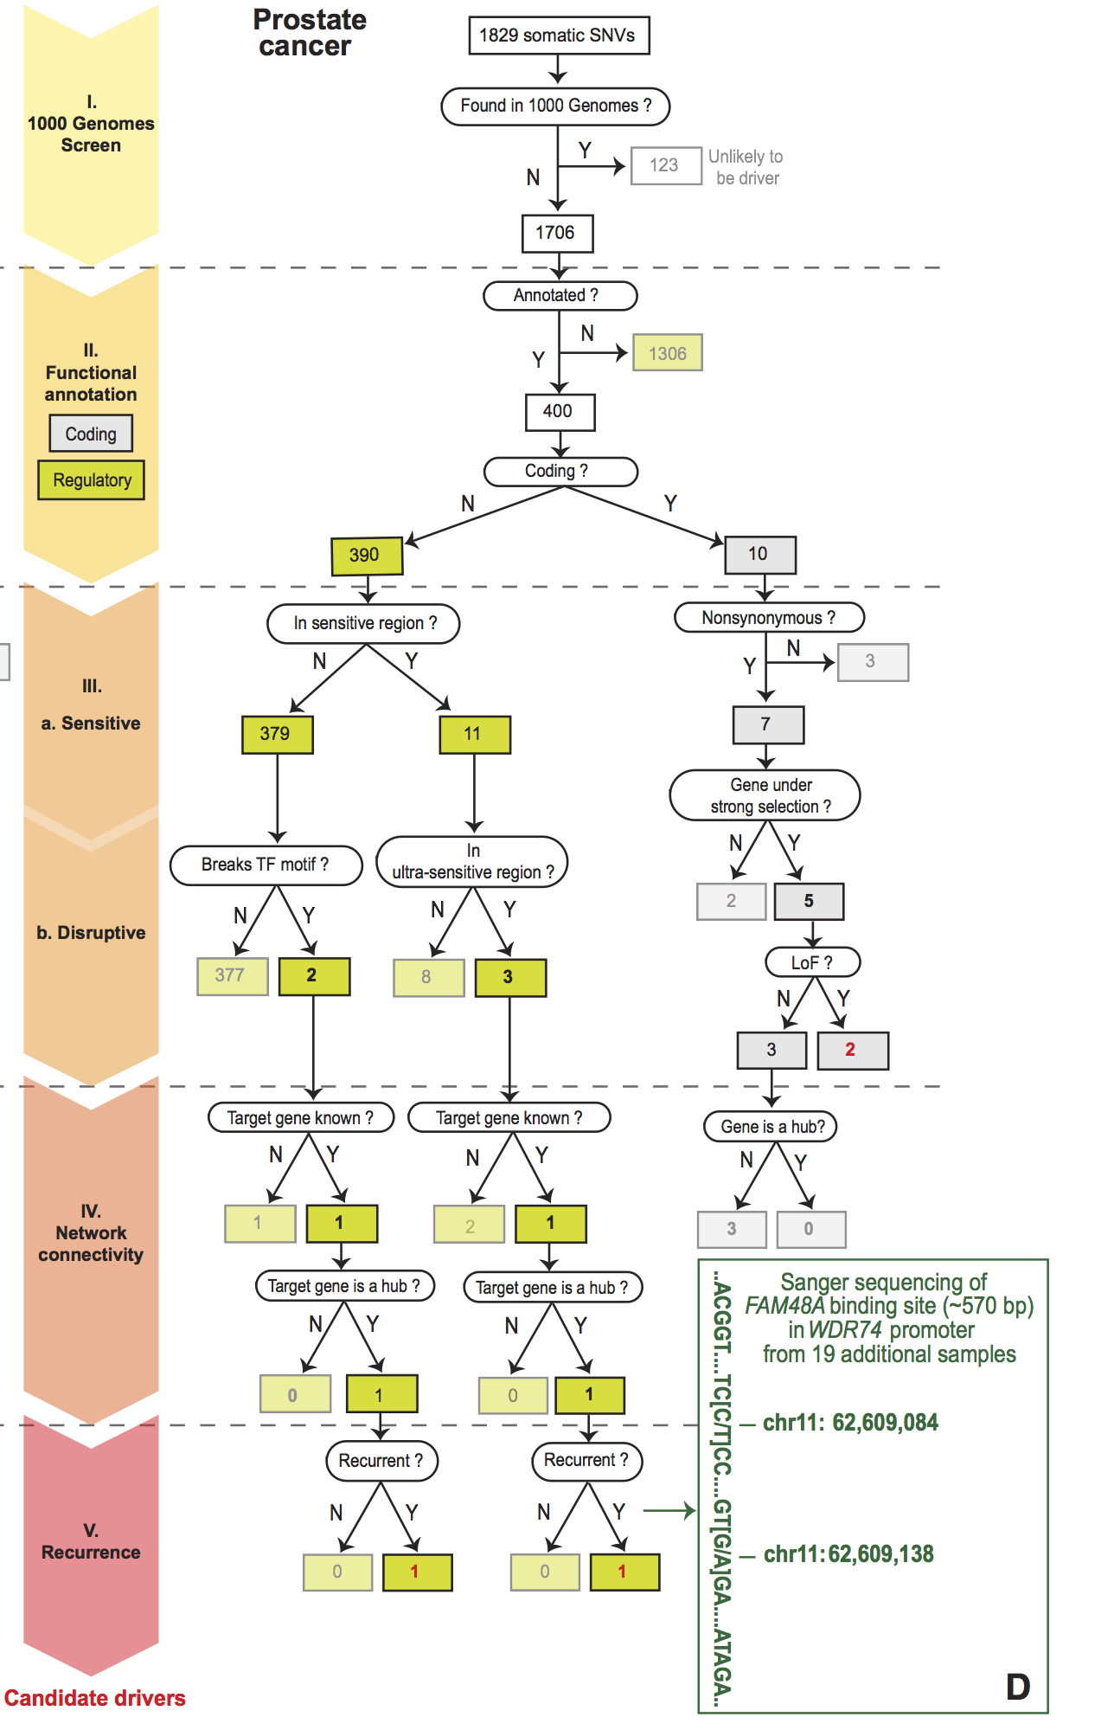
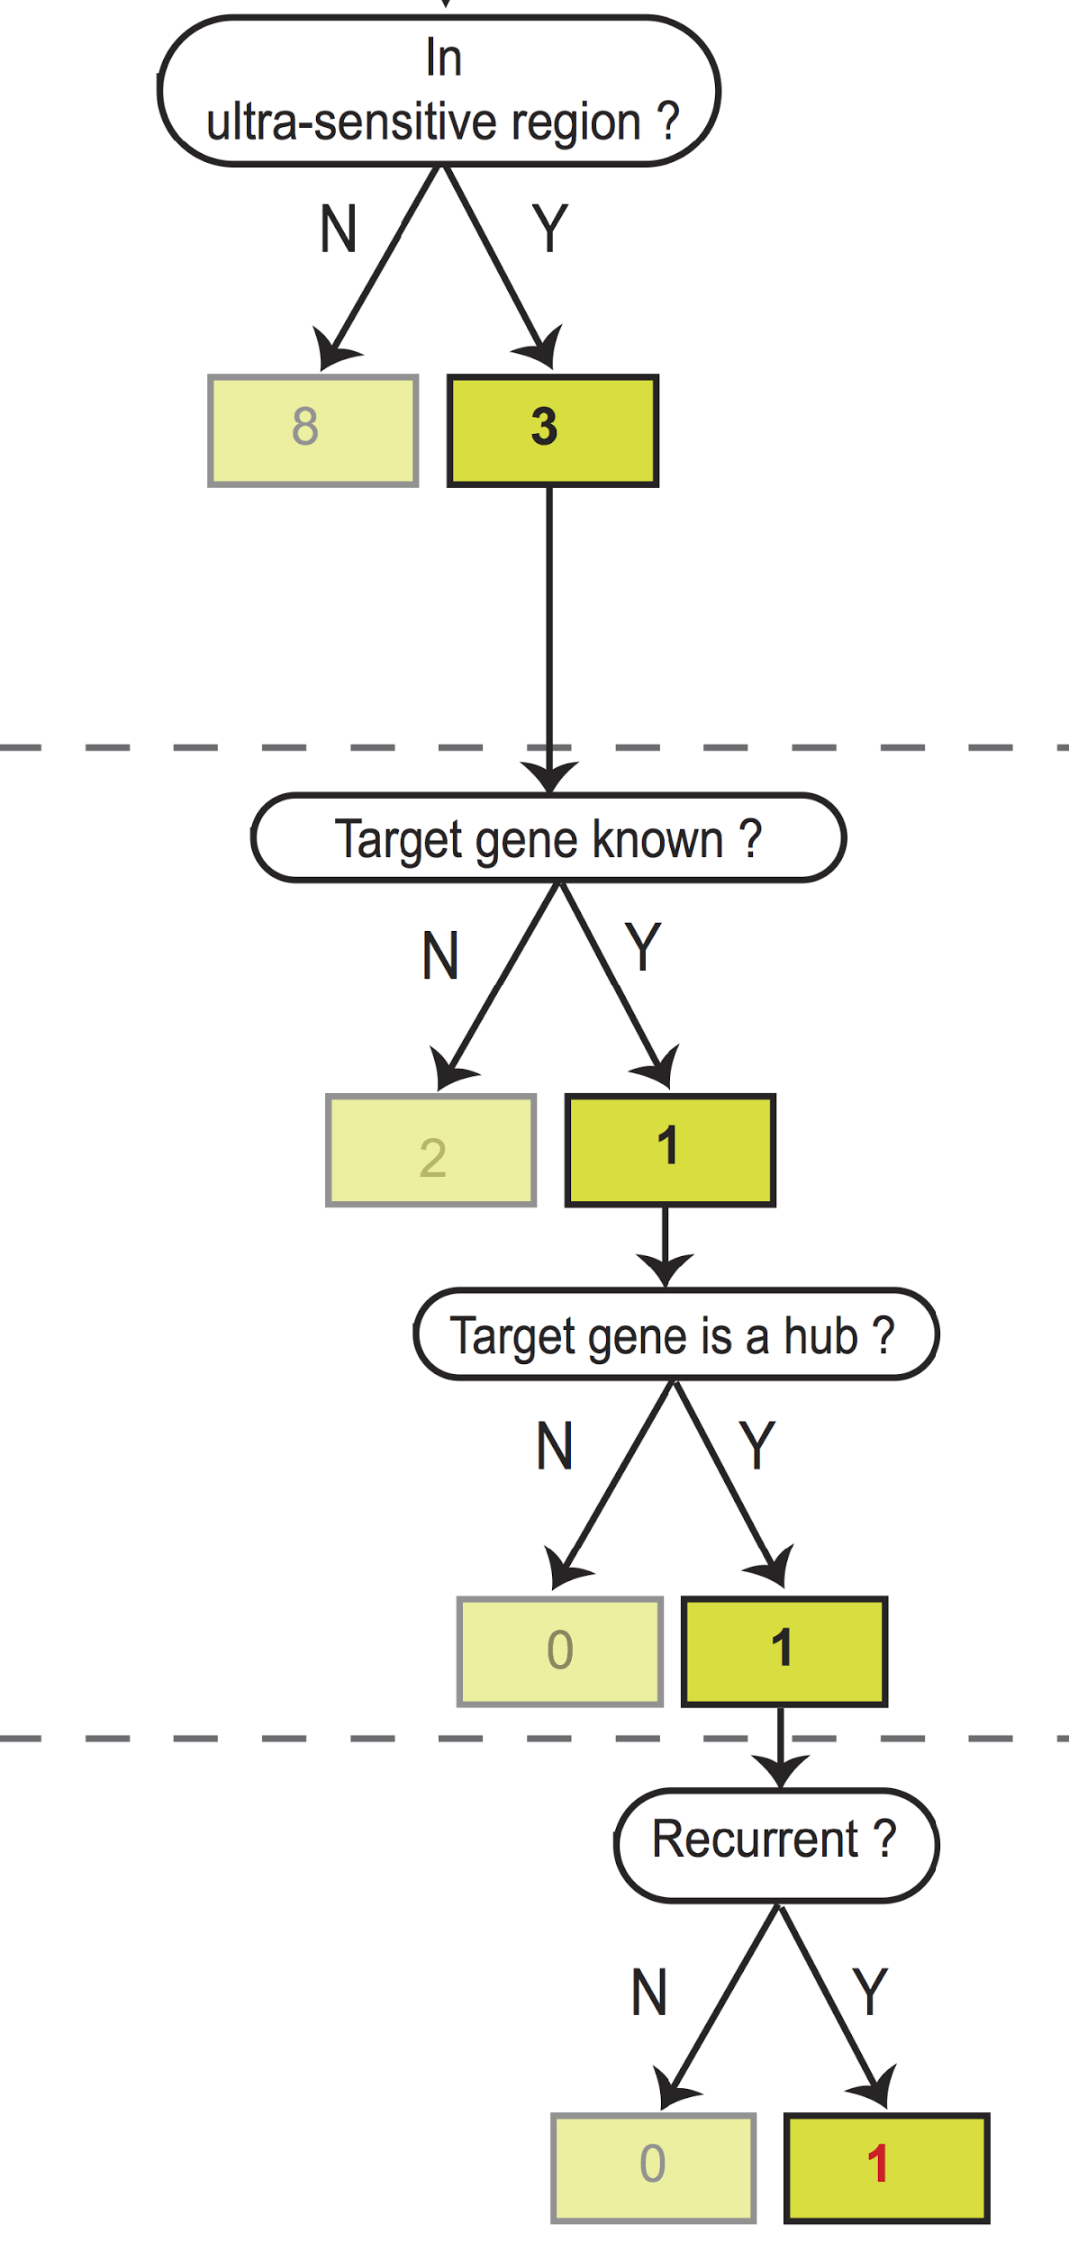
Flowchart for 1 Prostate Cancer
Genome (from Berger et al. '11)
[Khurana et al., Science (‘13)]

Slide 26
Prioritizing Variants in Personal Genomes: Using functional impact, with particular application to cancer
Introduction
  An individual's disease variants as
  the public's gateway into genomics & biology
  The exponential scaling of data gen. & processing
  Big-data mining to prioritize key variants as drivers
  Functional impact #1: Coding
  Frustration as a localized metric of SNV impact. Differential profiles for oncogenes v. TSGs
Functional impact #2: Non-coding
  FunSeq integrates evidence,
  with a “surprisal” based weighting scheme. Prioritizing rare variants with “sensitive sites”
  (human conserved)
  RADAR: prioritize variants based on post-transcriptional regulome using ENCODE eCLIP
  uORFs: Feature integration to find small subset of upstream mutations that potentially alter translation
(Low-power) application to pRCC
  WGS finds additional facts on the canonical driver, MET. Other suggestive non-coding hotspots.
  Analysis of signatures & tumor evolution helps identify key mutations in different ways 15

Slide 27
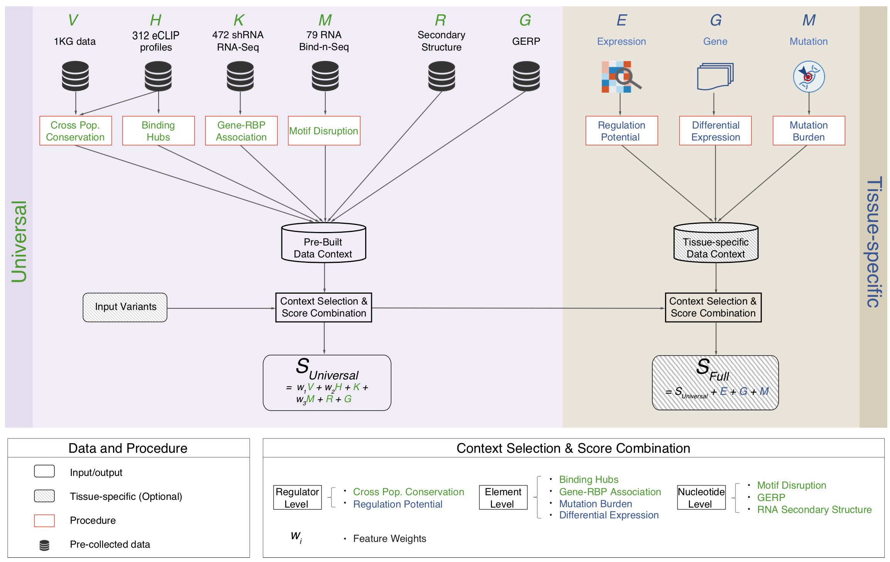
Schematic of RADAR Scoring
[Zhang*, Liu* et al., Genome Biology (in review ‘18)]

Slide 28
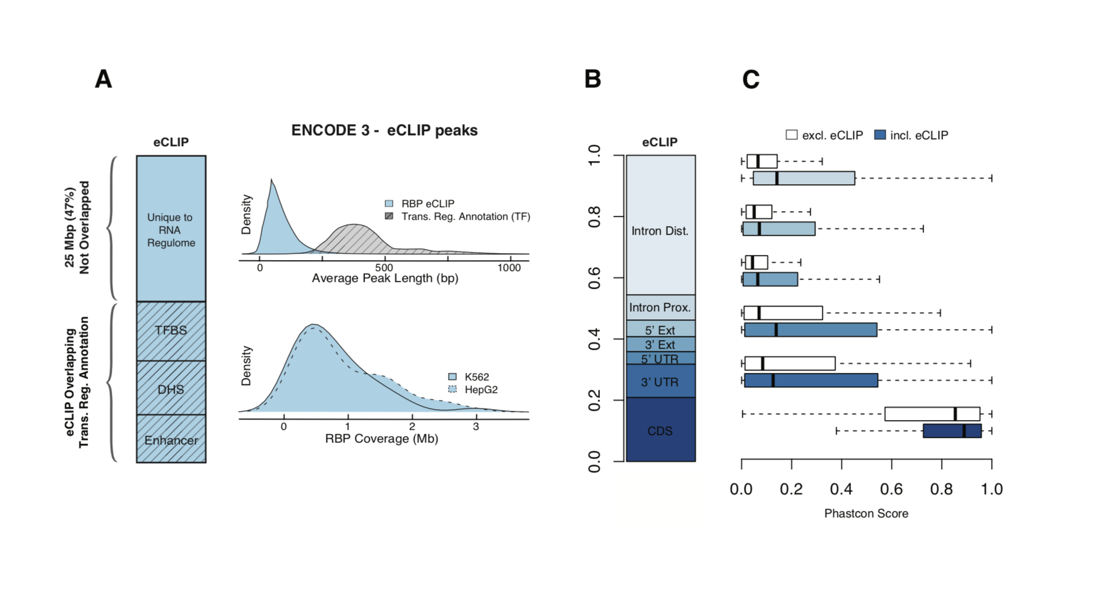
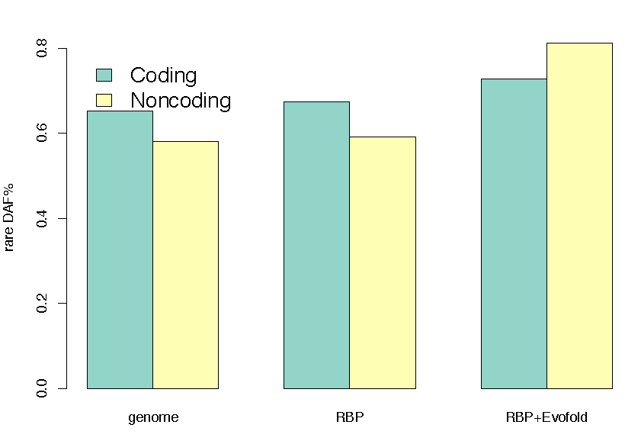
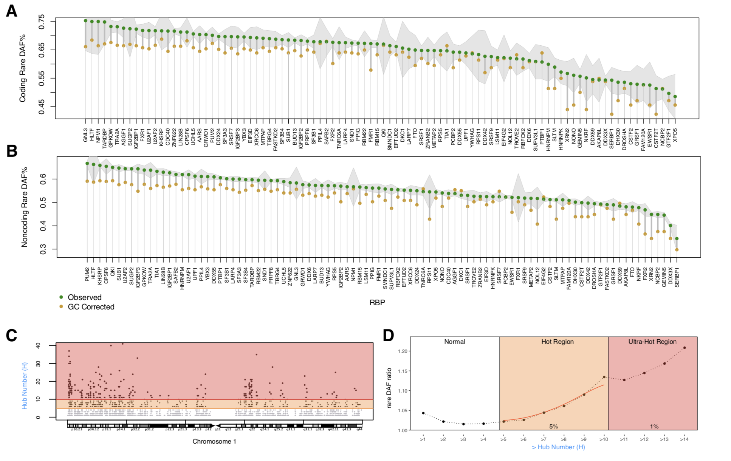
Summary of eCLIP and Phastcon
RNA Structure Cons. from Evofold
Enriched rare DAF in eCLIP peaks
[Zhang*, Liu* et al., Genome Biology (in review ‘18)]

Slide 29
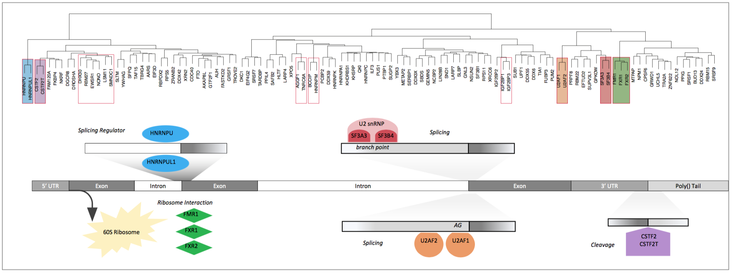
Co-binding of RBPs form biologically relevant complexes
Binding hubs are enriched for rare variants
[Zhang*, Liu* et al., Genome Biology (in review ‘18)]

Slide 30
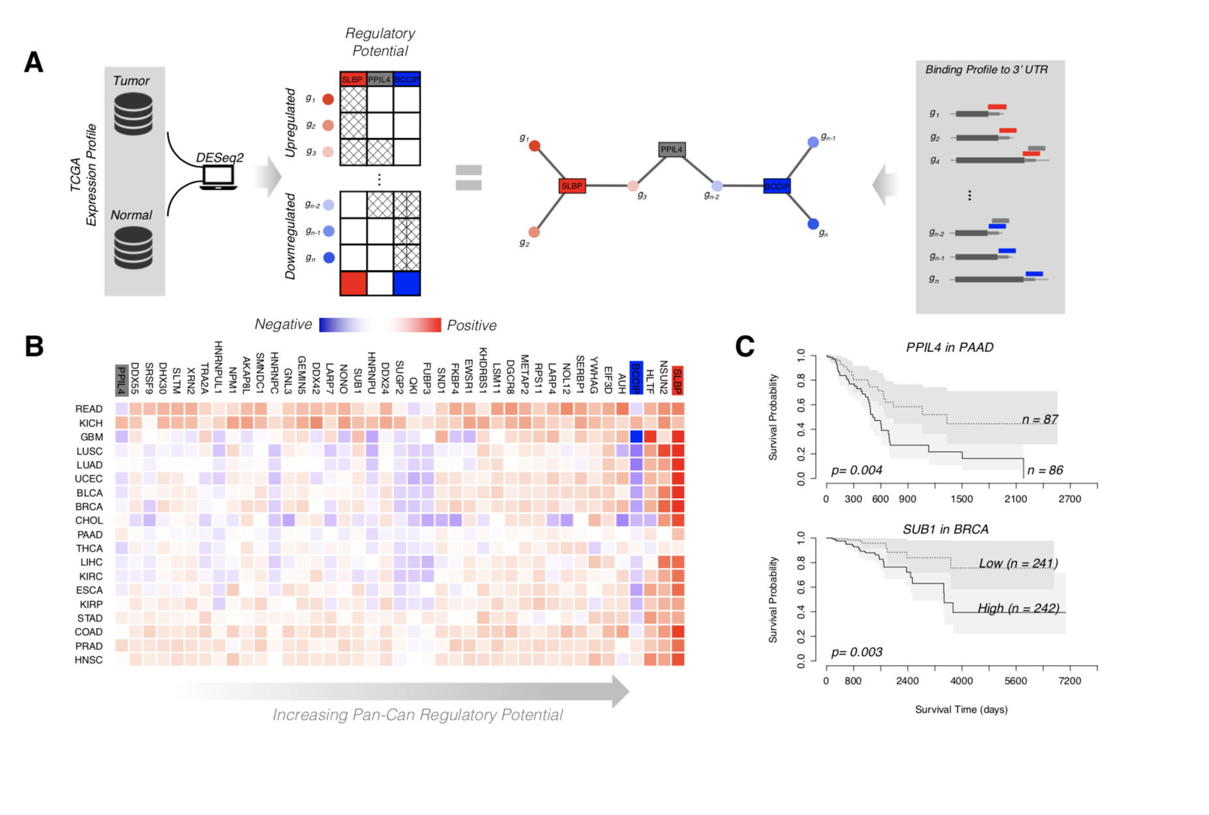
Regulatory Potential of RBPs derived from regression between gene network and expression levels
A
B
C
[Zhang*, Liu* et al., Genome Biology (in review ‘18)]

Slide 31
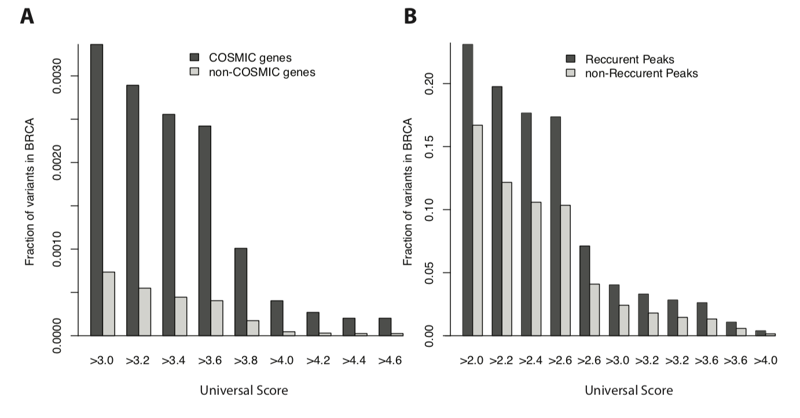
RADAR Scores enriched in COSMIC genes and recurrently mutated regions

Slide 32
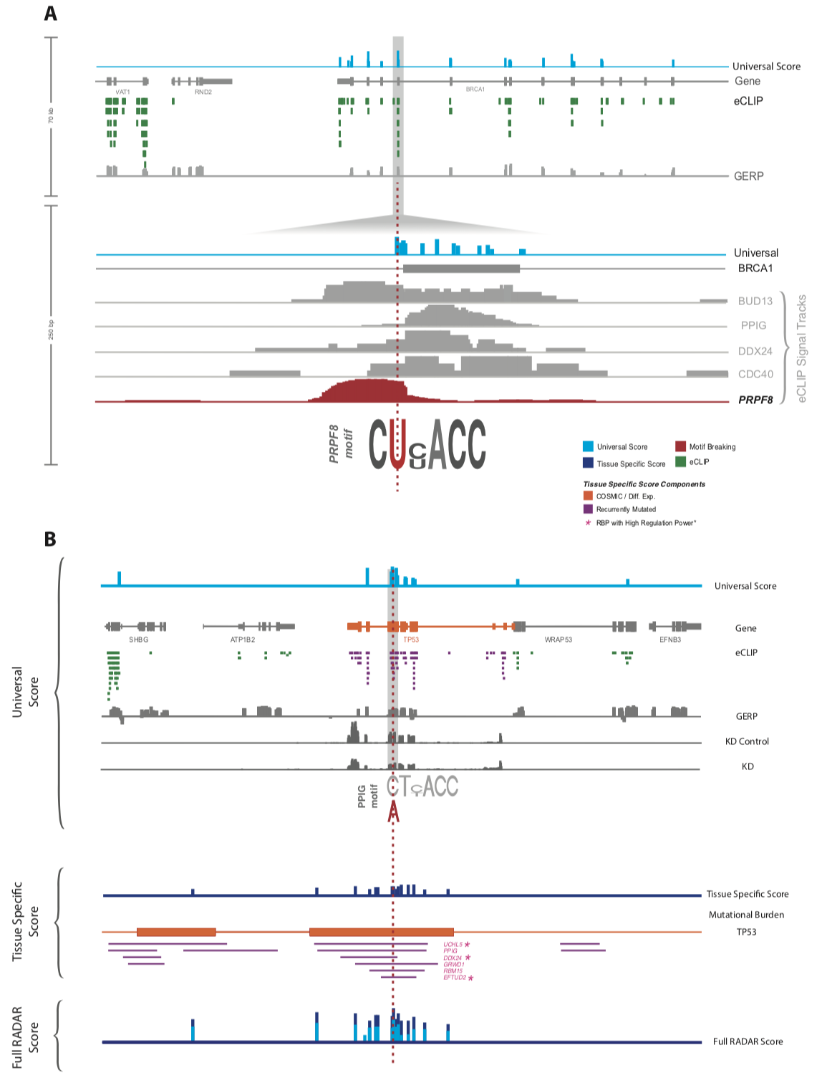
Visualization of RADAR Features and Scoring
[Zhang*, Liu* et al., Genome Biology (in review ‘18)]

Slide 33
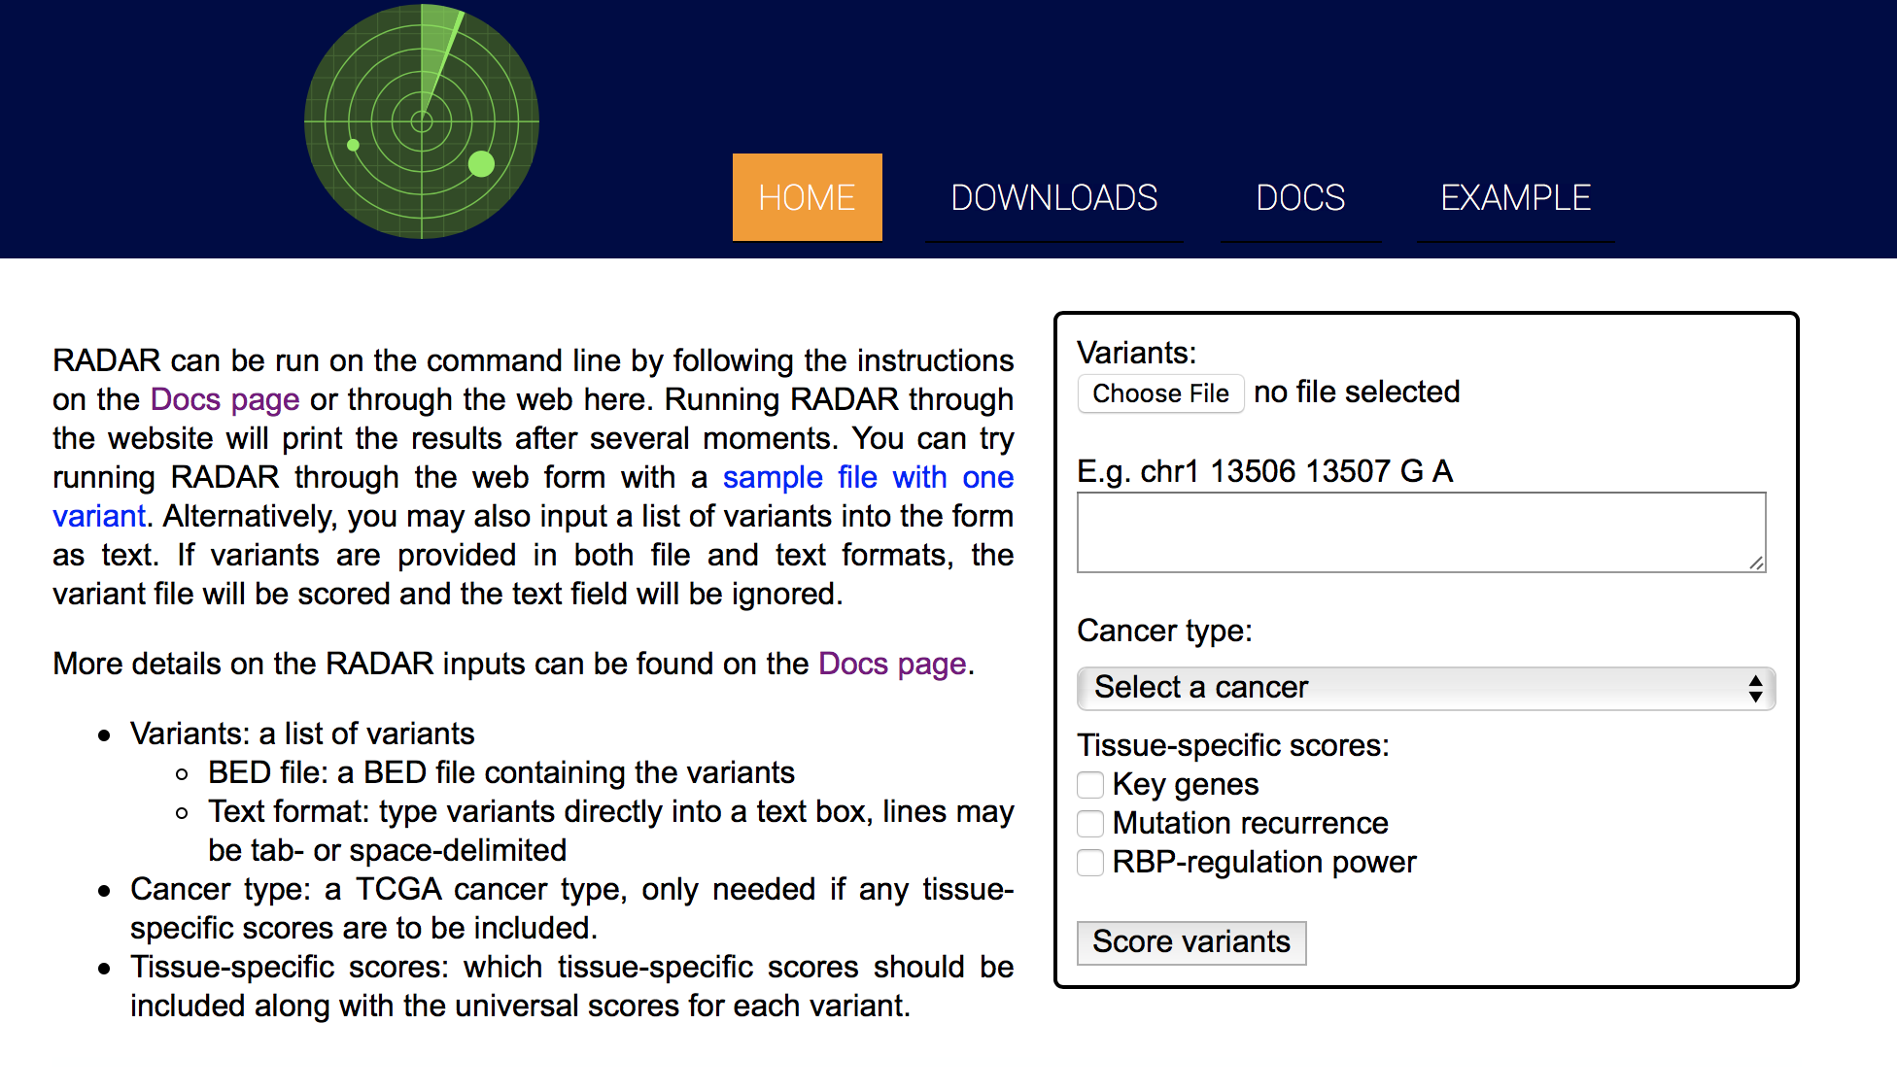

Slide 34
Prioritizing Variants in Personal Genomes: Using functional impact, with particular application to cancer
Introduction
  An individual's disease variants as
  the public's gateway into genomics & biology
  The exponential scaling of data gen. & processing
  Big-data mining to prioritize key variants as drivers
  Functional impact #1: Coding
  Frustration as a localized metric of SNV impact. Differential profiles for oncogenes v. TSGs
Functional impact #2: Non-coding
  FunSeq integrates evidence,
  with a “surprisal” based weighting scheme. Prioritizing rare variants with “sensitive sites”
  (human conserved)
  RADAR: prioritize variants based on post-transcriptional regulome using ENCODE eCLIP
  uORFs: Feature integration to find small subset of upstream mutations that potentially alter translation
(Low-power) application to pRCC
  WGS finds additional facts on the canonical driver, MET. Other suggestive non-coding hotspots.
  Analysis of signatures & tumor evolution helps identify key mutations in different ways 15

Slide 35
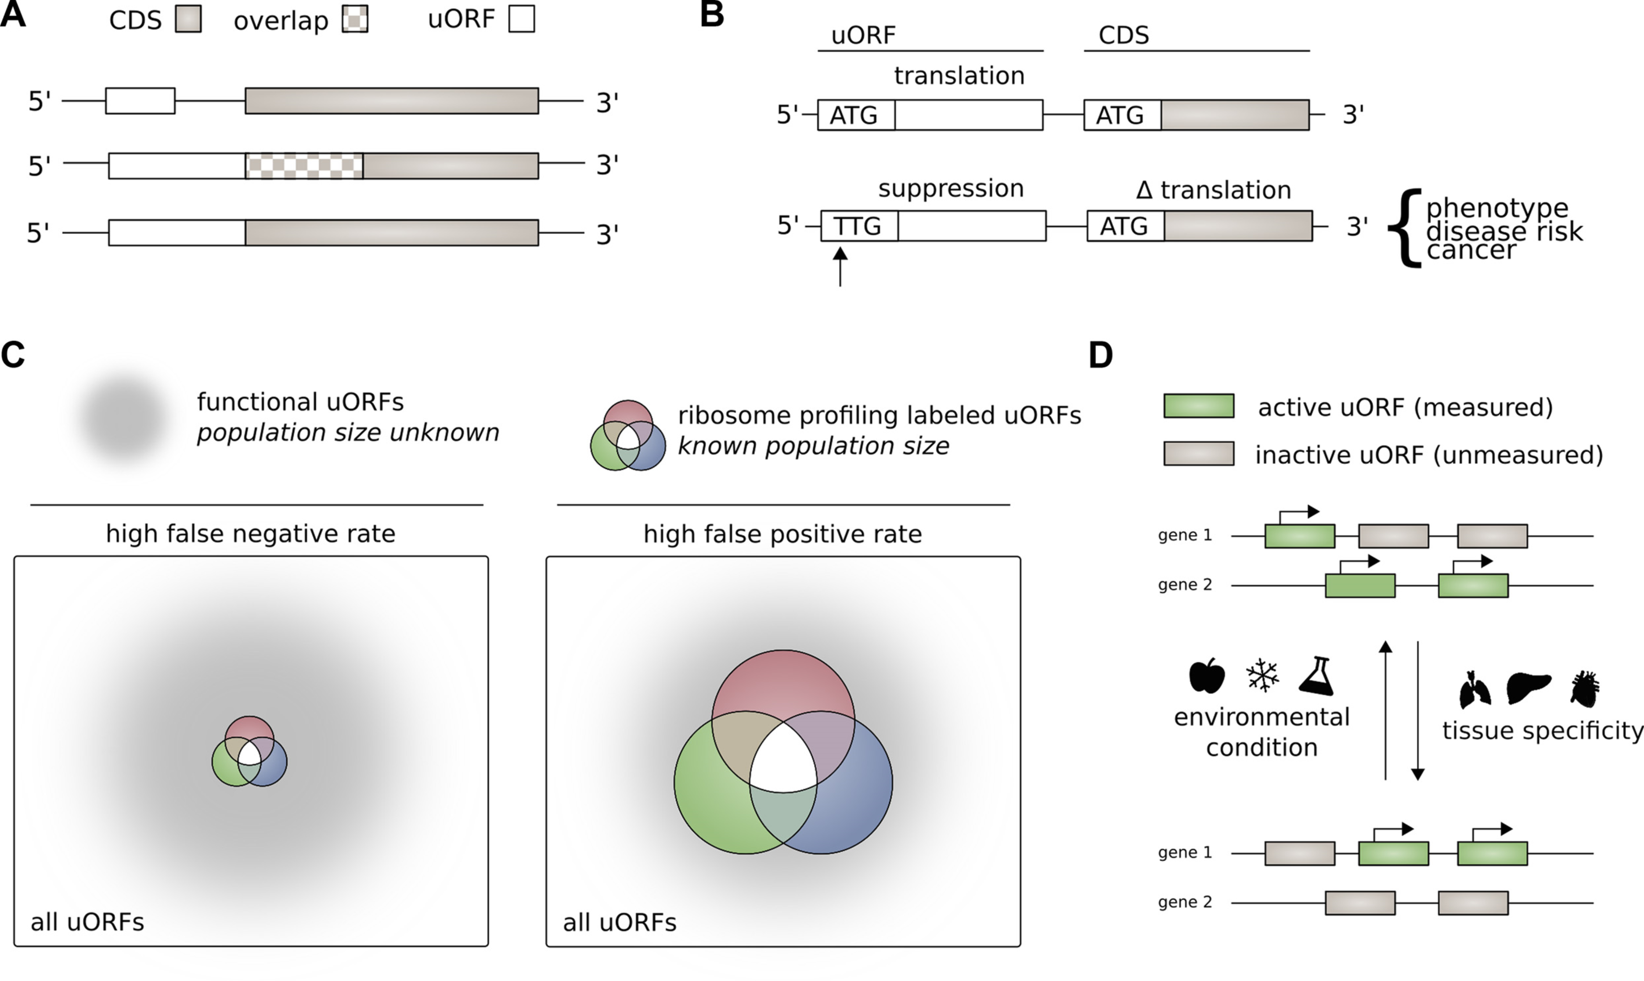
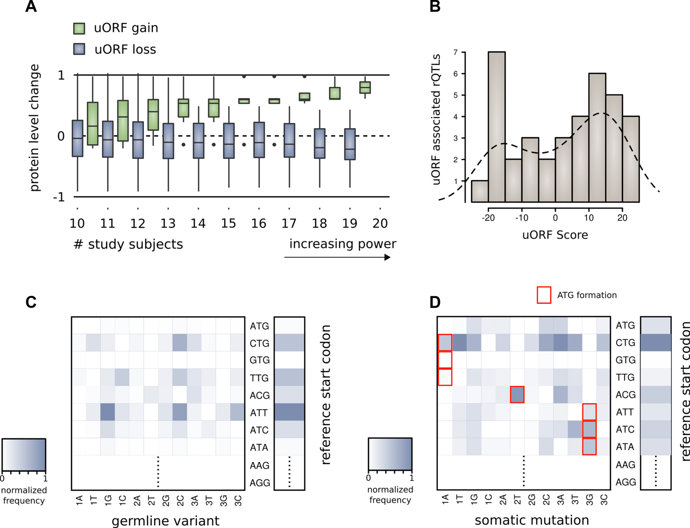
Upstream open reading frames (uORFs) regulate translation are affected by somatic mutation
uORFs regulate the translation of downstream coding regions.
This regulation may be altered by somatic mutation in cancer.
In Battle et al. 2014 data uORF gain & loss assoc. protein level change.
[McGillivray et al., NAR (‘18)]

Slide 36
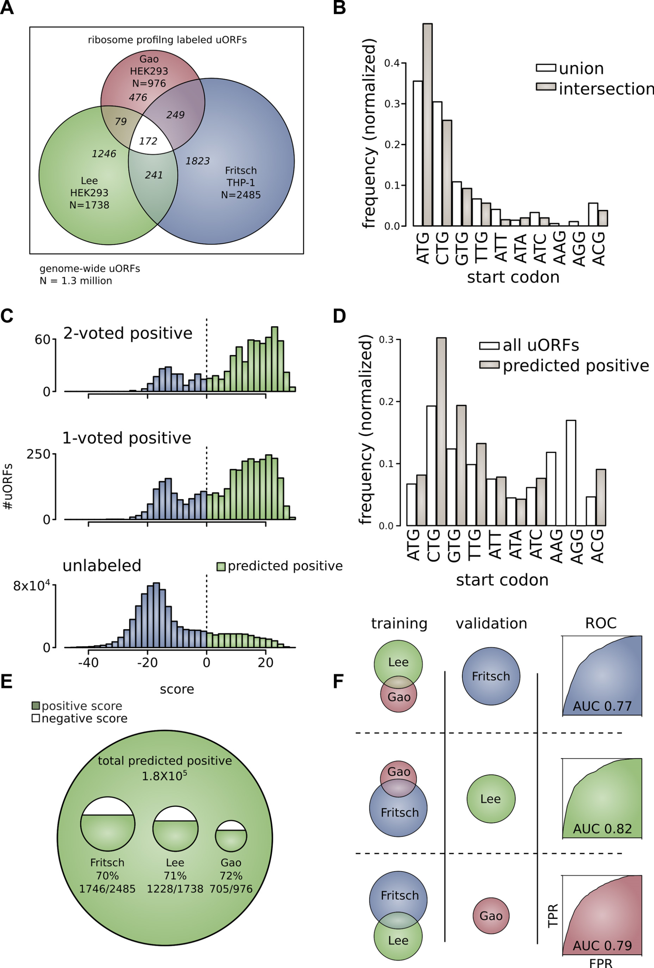
The population of functional uORFs may be significant
From a “Universe” of 1.3 M pot. uORFs
Ribosome profiling experiments have low overlap in identified uORFs.
This suggests high false-negative rate, and more functional uORFs than currently known.
[McGillivray et al., NAR (‘18)]

Slide 37
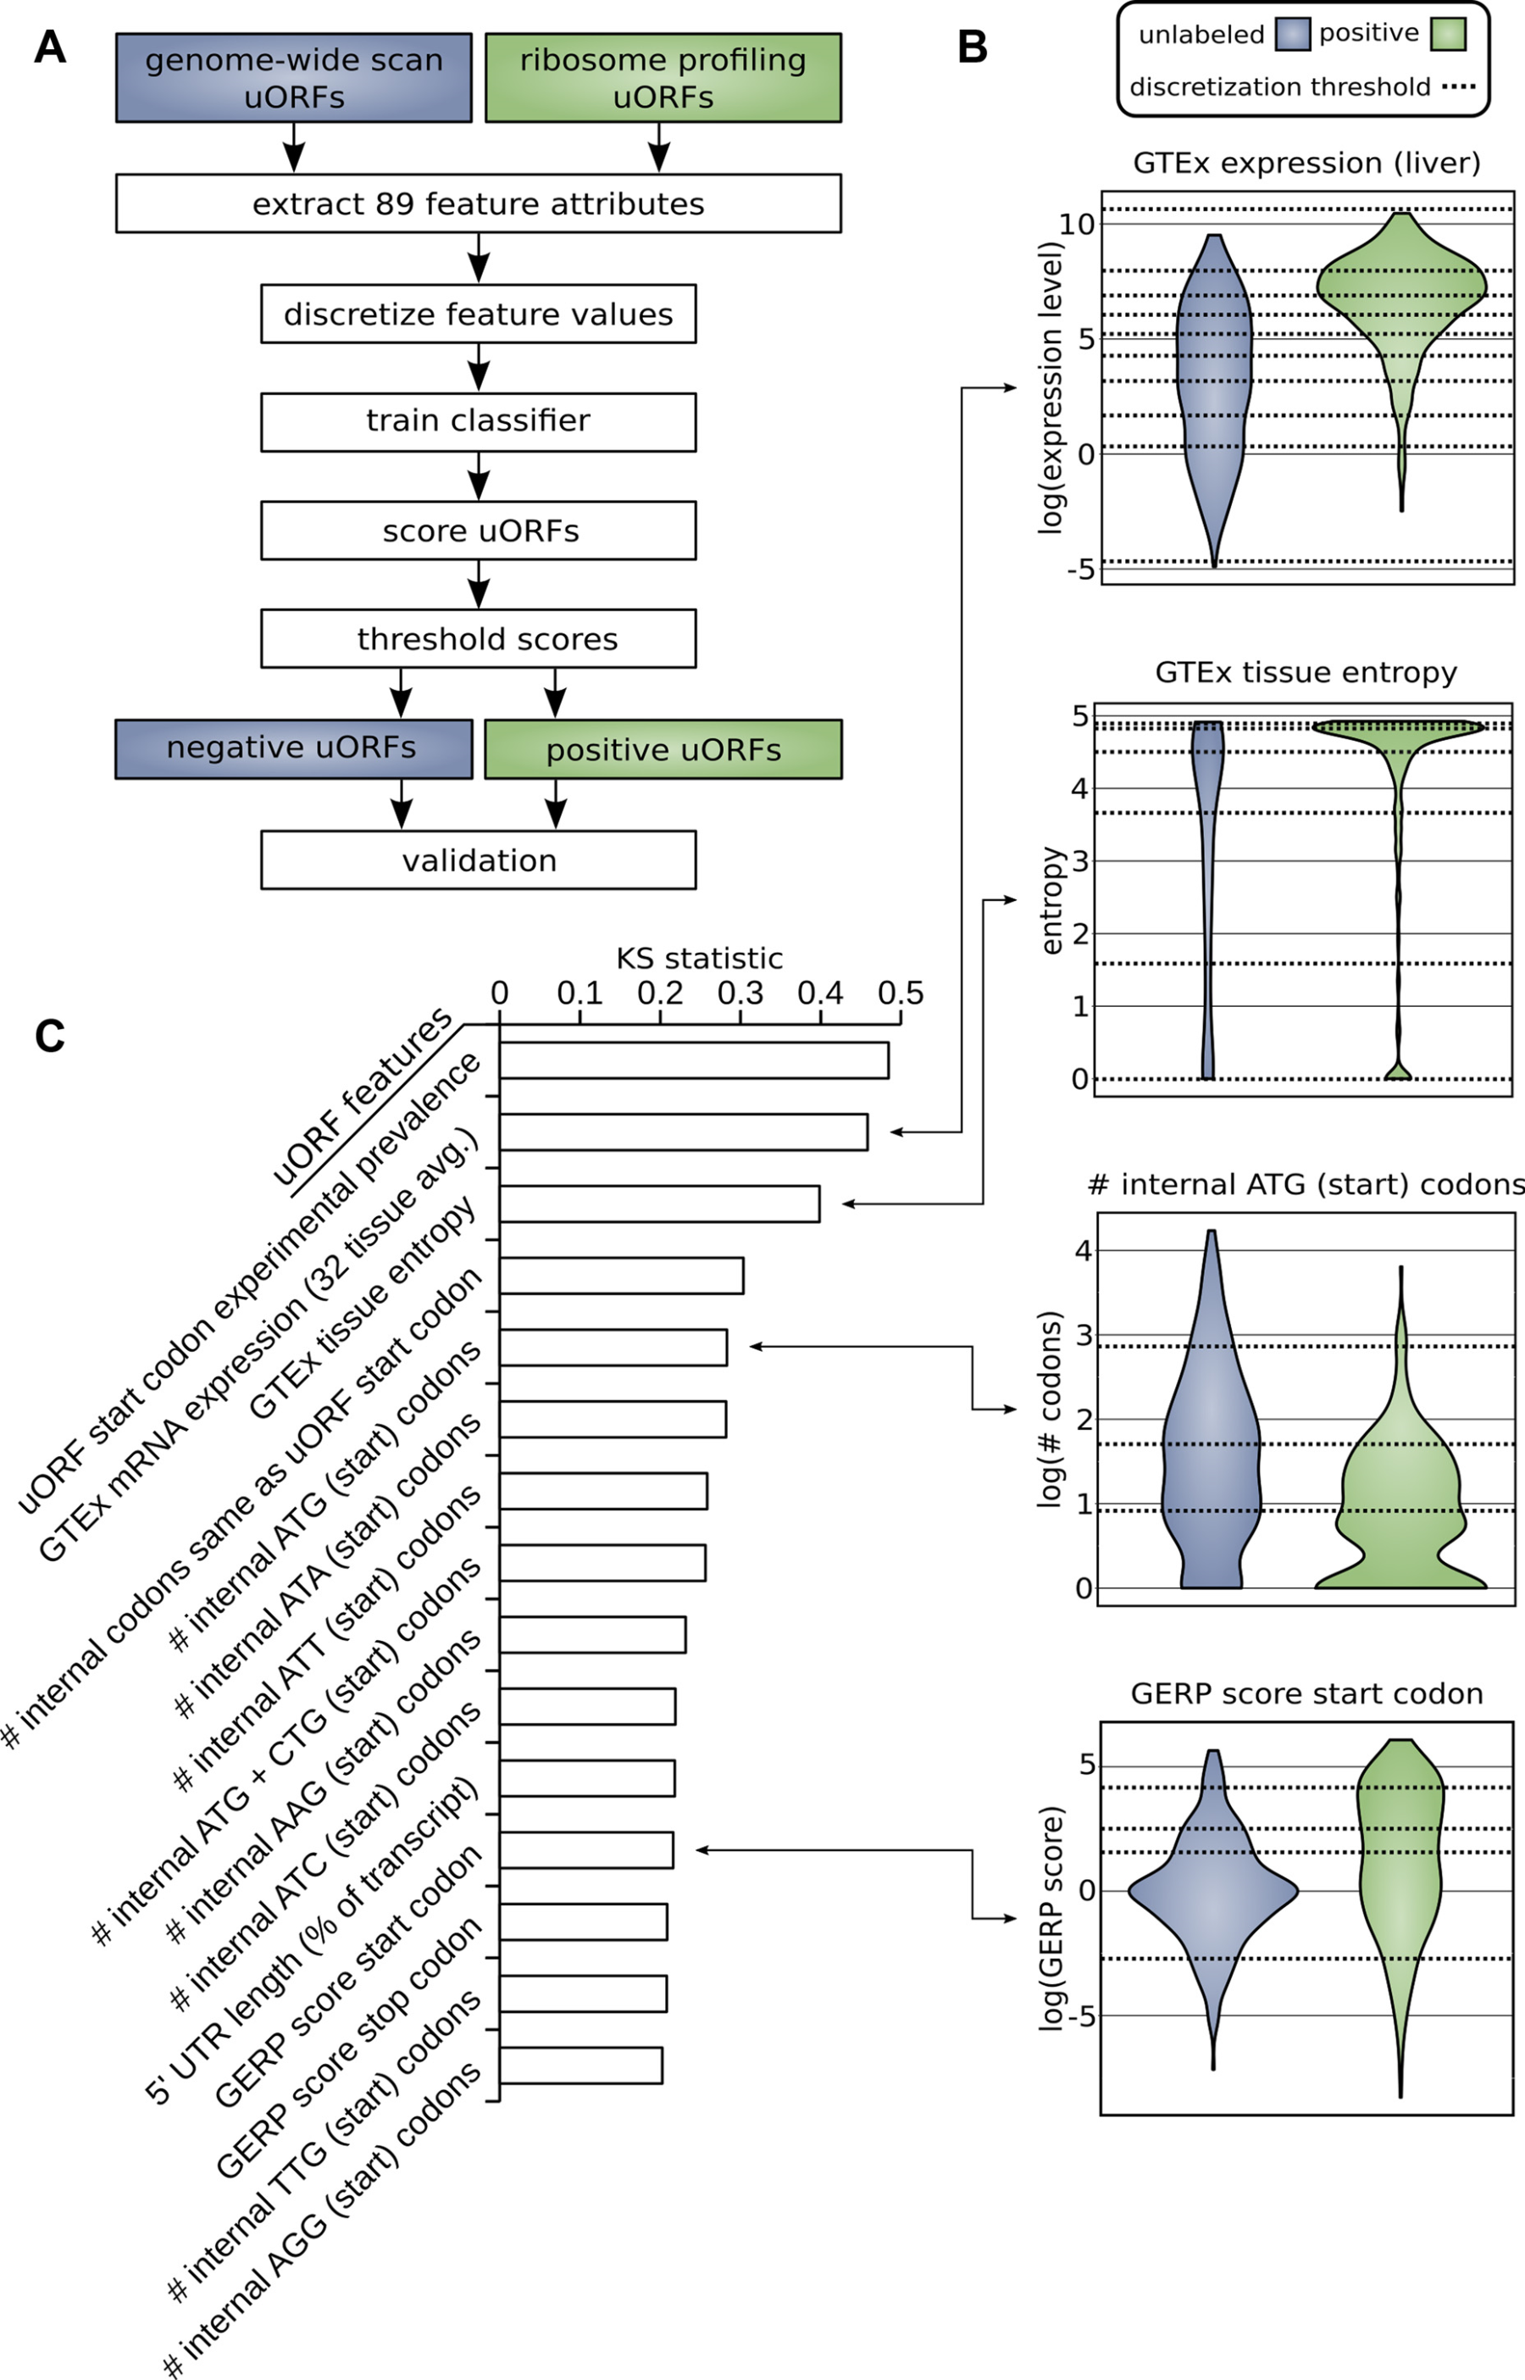
Prediction & validation of functional uORFs using 89 features
Expr.
Level
All near-cognate start codons predicted.
Cross-validation on independent ribosome profiling datasets and validation using in vivo protein levels and ribosome occupancy in humans (Battle et al. 2014).
Tissue
Dist.
Int.
ATG
Start
Cons-
ervation
[McGillivray et al., NAR (‘18)]

Slide 38
A comprehensive catalog of functional uORFs
Universe of 1.3M uORFs scored via Simple Bayes algo.
180K: Large predicted positive set likely to affect translation
Calibration on gold standards, suggests getting ~70% of known
Predicted functional uORFs may be intersected with disease associated variants.
[McGillivray et al., NAR (‘18)]

Slide 39
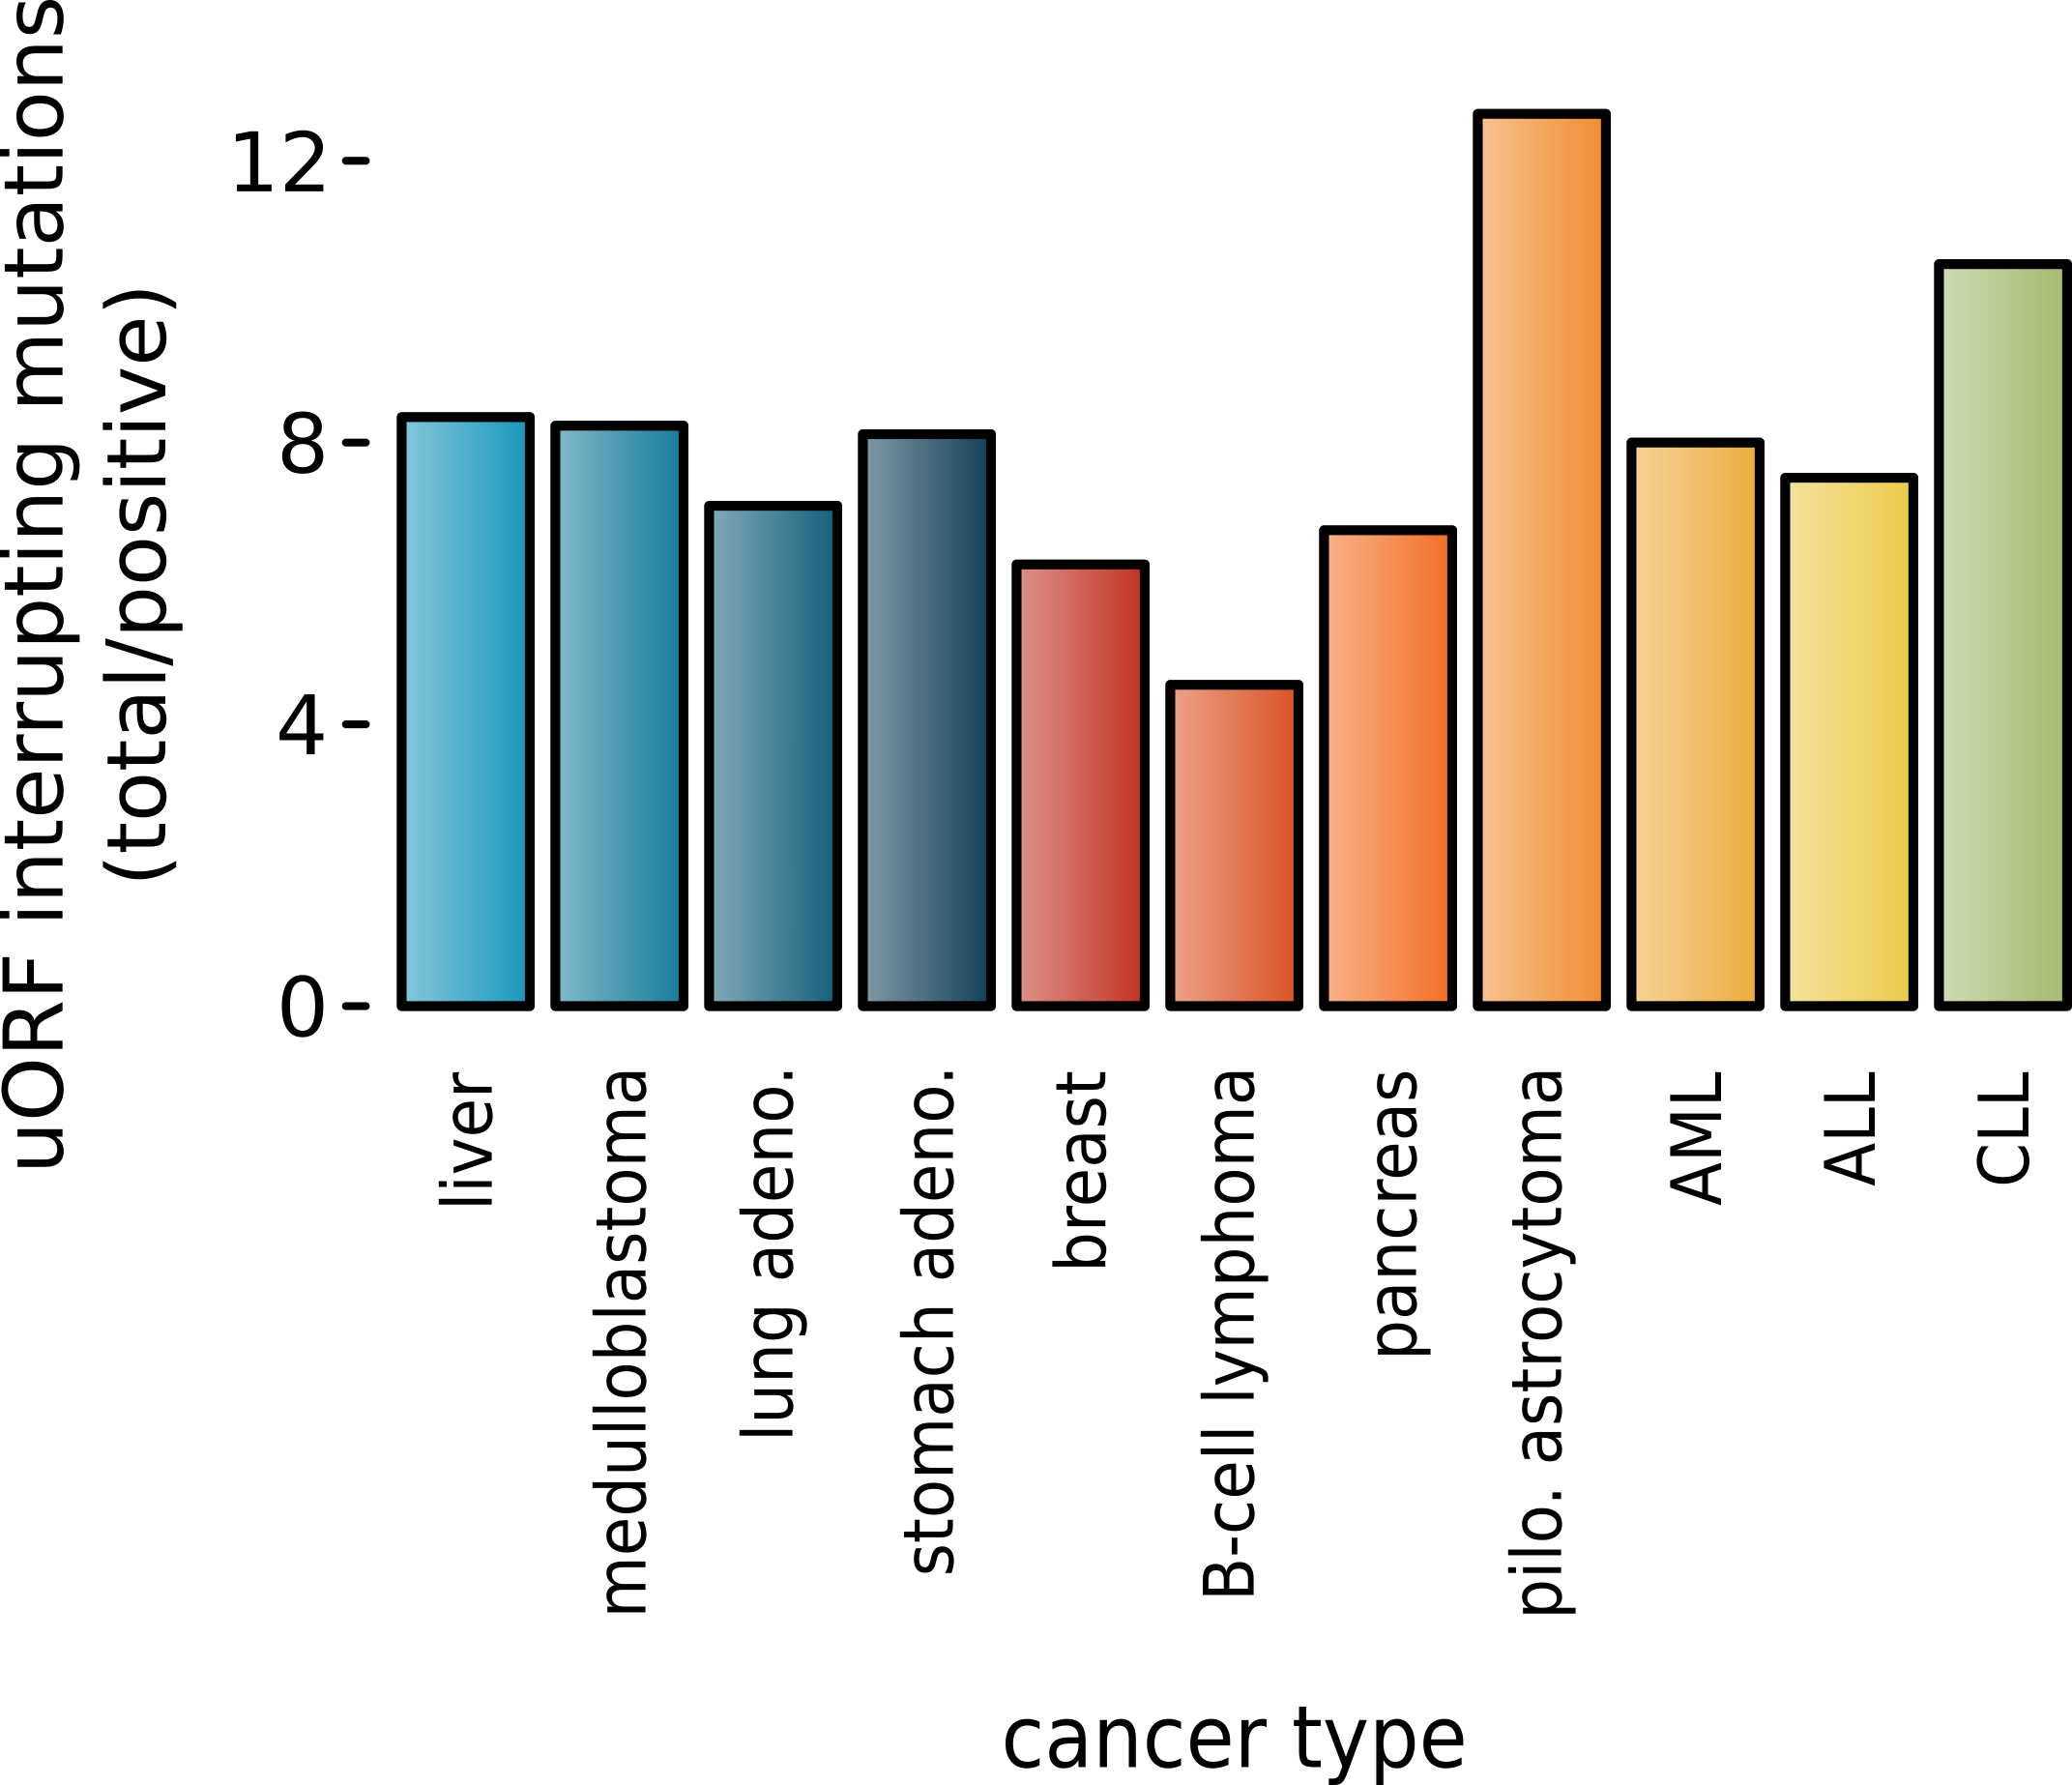
Somatic alteration of uORFs disproportionately affects certain cancers and molecular pathways
uORF gain and loss occurs in cancer (incl. in cancer associated genes, e.g., MYC, BCL2, etc.).
Alteration of translation may contribute to cancer.
These changes are concentrated in certain cancers and pathways.
Mutations leading to uORFs diff in somatic vs. germline.
[McGillivray et al., NAR (‘18)]

Slide 40
Prioritizing Variants in Personal Genomes: Using functional impact, with particular application to cancer
Introduction
  An individual's disease variants as
  the public's gateway into genomics & biology
  The exponential scaling of data gen. & processing
  Big-data mining to prioritize key variants as drivers
  Functional impact #1: Coding
  Frustration as a localized metric of SNV impact. Differential profiles for oncogenes v. TSGs
Functional impact #2: Non-coding
  FunSeq integrates evidence,
  with a “surprisal” based weighting scheme. Prioritizing rare variants with “sensitive sites”
  (human conserved)
  RADAR: prioritize variants based on post-transcriptional regulome using ENCODE eCLIP
  uORFs: Feature integration to find small subset of upstream mutations that potentially alter translation
(Low-power) application to pRCC
  WGS finds additional facts on the canonical driver, MET. Other suggestive non-coding hotspots.
  Analysis of signatures & tumor evolution helps identify key mutations in different ways 15

Slide 41
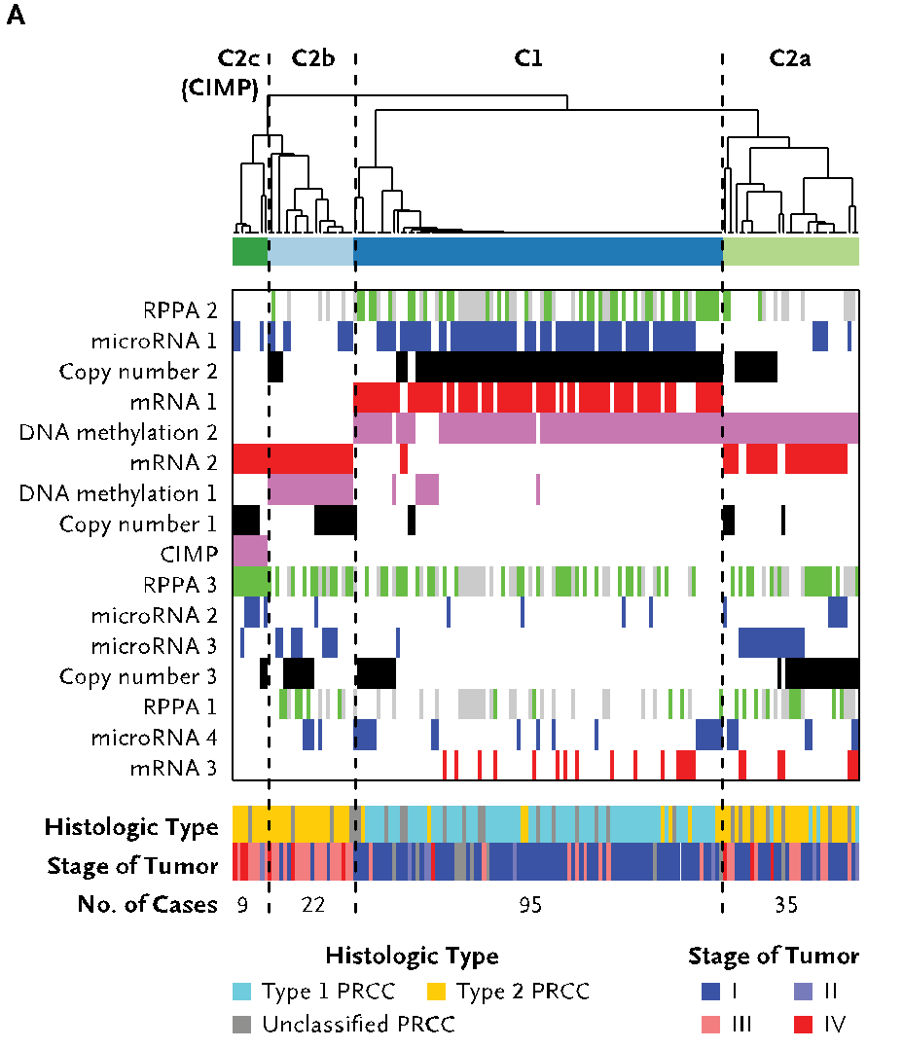
An (underpowered) case study: pRCC
Kidney cancer lifetime risk of 1.6% & the papillary type (pRCC) counts for ~10% of all cases
TCGA project sequenced 161 pRCC exomes & classified them into subtypes
  Yet, cannot pin down the cause for a significant portion of cases....
35 WGS of TN pairs,
perhaps useful? But not that definitive from a recurrence perspective
[Cancer Genome Atlas Research Network N Engl J Med. (‘16) ]

Slide 42
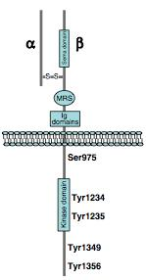
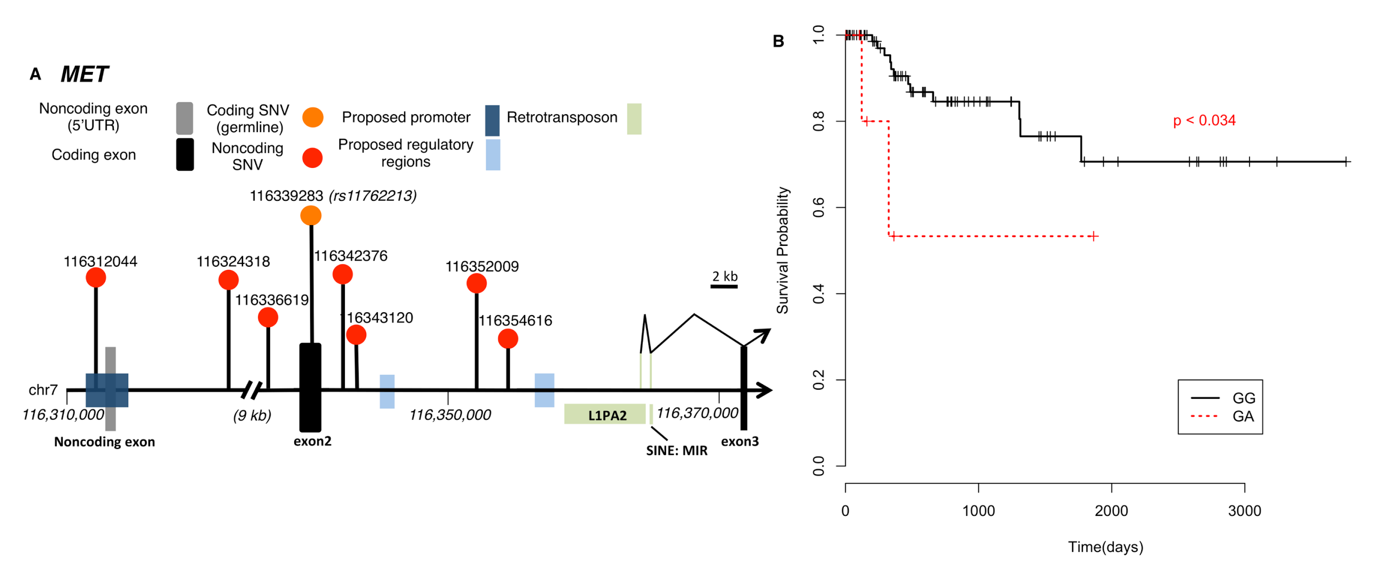
Tyr-kinase MET:
Known Facts & New Results
MET is long known pRCC driver
In MET, TCGA found somatic SNVs, dup-
lications & an alt. splicing event as drivers (43/161).
In addition, from 35 WGS we found
  A noncoding hotspot associated with MET
  Lack of SVs & breakpoints disrupting MET
  Germline SNP (rs11762213) predicts survival
  in type 2 patients
[A. Gentile, L. Trusolino and PM. Comoglio, Cancer and Metastasis Reviews (‘08); S. Li, B. Shuch and M. Gerstein PLOS Genetics (‘17)]

Slide 43
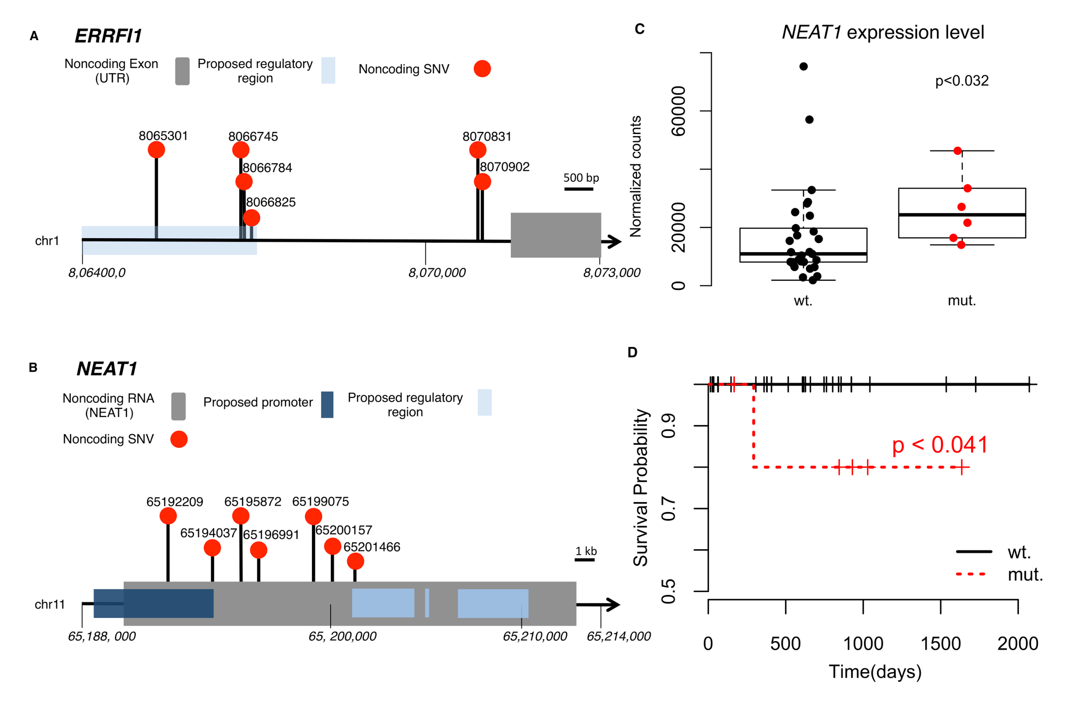
Beyond MET: 2 non-coding hotspots in NEAT & ERRFl1,
supported by expr. changes & survival analysis
[Li et al. PLOS Genetics (‘17)]

Slide 44
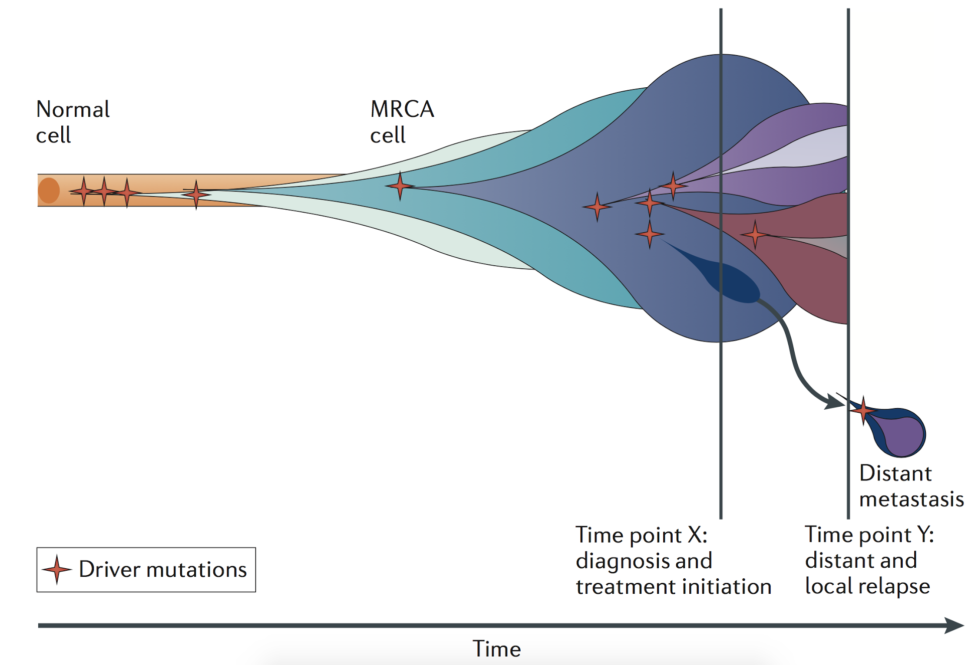
Tumor Evolution: Highlight the Ordering of Key Mutations
Yates et al, NRG (2012)

Slide 45
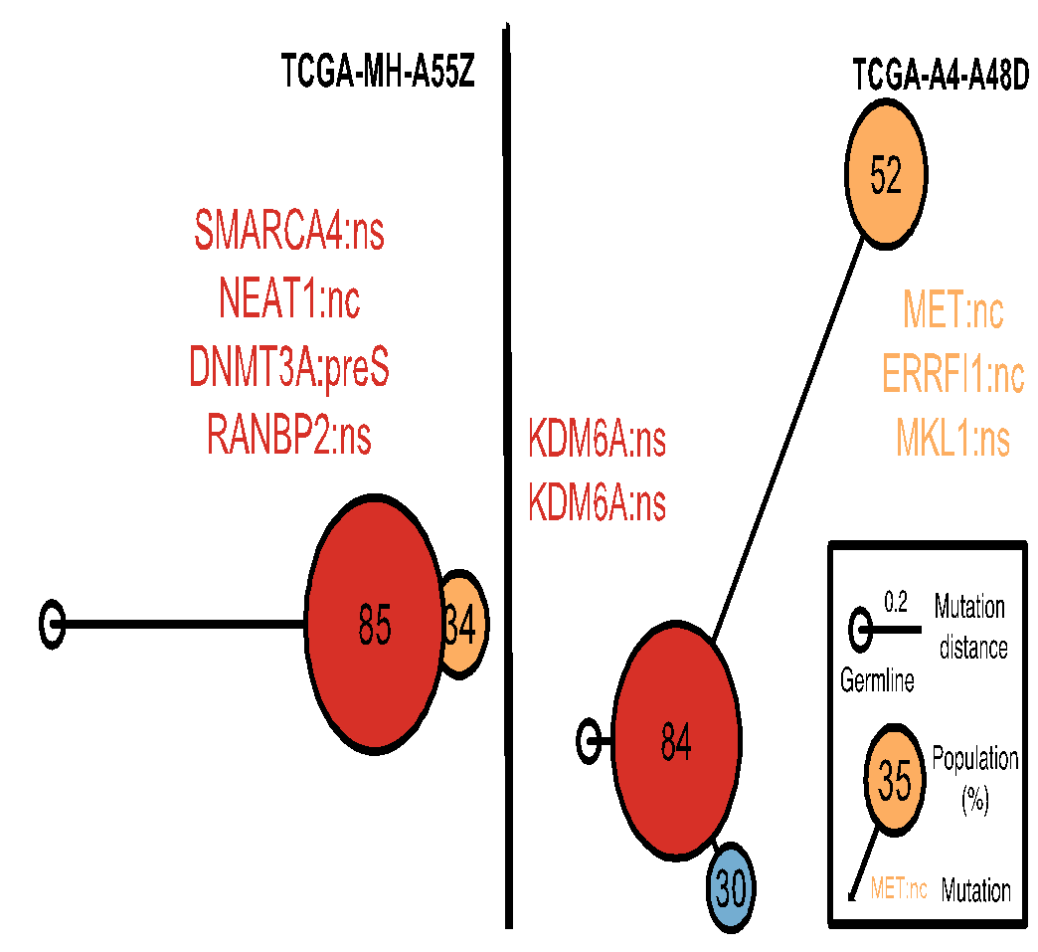


Construct evolutionary trees in pRCC
Infer mutation order and tree structure based on mutation abundance (PhyloWGS, Deshwar et al., 2015)
Some of the key mutations occur in all the clones while others are just in some parts of the tree
MET: noncoding
ERRFI1: noncoding
DNMT3A: premature stop
NEAT1: noncoding
SMARCA4: missense
KDM6A: missense
[S. Li, B. Shuch and M. Gerstein PLOS Genetics (‘17)]

Slide 46

Mutation
distance
Populations
(%)
0.5
Germline
[S. Li, B. Shuch and M. Gerstein PLOS Genetics (‘17)]

Slide 47
Mutation
distance
Populations
(%)
0.5
Germline
[S. Li, B. Shuch and M. Gerstein PLOS Genetics (‘17)]

Slide 48

Tree topology correlates with molecular subtypes
[Li et al., PLOS Genetics (‘17)]

Slide 49
Prioritizing Variants in Personal Genomes: Using functional impact, with particular application to cancer
Introduction
  An individual's disease variants as
  the public's gateway into genomics & biology
  The exponential scaling of data gen. & processing
  Big-data mining to prioritize key variants as drivers
  Functional impact #1: Coding
  Frustration as a localized metric of SNV impact. Differential profiles for oncogenes v. TSGs
Functional impact #2: Non-coding
  FunSeq integrates evidence,
  with a “surprisal” based weighting scheme. Prioritizing rare variants with “sensitive sites”
  (human conserved)
  RADAR: prioritize variants based on post-transcriptional regulome using ENCODE eCLIP
  uORFs: Feature integration to find small subset of upstream mutations that potentially alter translation
(Low-power) application to pRCC
  WGS finds additional facts on the canonical driver, MET. Other suggestive non-coding hotspots.
  Analysis of signatures & tumor evolution helps identify key mutations in different ways 15

Slide 50
Prioritizing Variants in Personal Genomes: Using functional impact, with particular application to cancer
Introduction
  An individual's disease variants as
  the public's gateway into genomics & biology
  The exponential scaling of data gen. & processing
  Big-data mining to prioritize key variants as drivers
  Functional impact #1: Coding
  Frustration as a localized metric of SNV impact. Differential profiles for oncogenes v. TSGs
Functional impact #2: Non-coding
  FunSeq integrates evidence,
  with a “surprisal” based weighting scheme. Prioritizing rare variants with “sensitive sites”
  (human conserved)
  RADAR: prioritize variants based on post-transcriptional regulome using ENCODE eCLIP
  uORFs: Feature integration to find small subset of upstream mutations that potentially alter translation
(Low-power) application to pRCC
  WGS finds additional facts on the canonical driver, MET. Other suggestive non-coding hotspots.
  Analysis of signatures & tumor evolution helps identify key mutations in different ways 15

Slide 51

github.com/gersteinlab/Frustration - S Kumar, D Clarke
pRCC - S Li, B Shuch
CostSeq2 - P Muir, S Li, S Lou, D Wang,
DJ Spakowicz, L Salichos, J Zhang,
GM Weinstock, F Isaacs, J Rozowsky
github.gersteinlab.org/uORFs
P McGillivray, R Ault,
M Pawashe, R Kitchen, S Balasubramanian
FunSeq.gersteinlab.org
Y Fu, E Khurana, Z Liu, S Lou, J Bedford, X Mu, K Yip
RADAR.gersteinlab.org
J Zhang, J Liu, D Lee, L Lochovsky, J-J Feng, S Lou,
M Rutenberg-Schoenberg
Acknowledgments! Also, Hiring: See Jobs.gersteinlab.org

Slide 52


Slide 53
Info about this talk
No Conflicts
Unless explicitly listed here. There are no conflicts of interest relevant to the material in this talk
General PERMISSIONS
This Presentation is copyright Mark Gerstein, Yale University, 2017.
Please read permissions statement at
sites.gersteinlab.org/Permissions
Basically, feel free to use slides & images in the talk with PROPER acknowledgement (via citation to relevant papers or website link). Paper references in the talk were mostly from Papers.GersteinLab.org.
PHOTOS & IMAGES
For thoughts on the source and permissions of many of the photos and clipped images in this presentation see streams.gerstein.info . In particular, many of the images have particular EXIF tags, such as kwpotppt , that can be easily queried from flickr, viz: flickr.com/photos/mbgmbg/tags/kwpotppt

