Slide 1
Databases in Biosciences
Kei Cheung, Ph.D.
Professor
Department of Emergency Medicine
Yale Center for Medical Informatics
CBB 752 (1/31/2018)

Slide 2
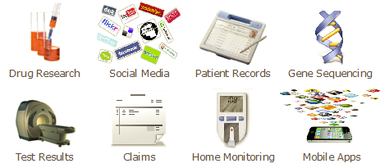
Healthcare and life sciences data sources
3Vs:
Volume – high-throughput technologies
Variety – diverse data types, different formats, structured vs. unstructured data
Velocity – data streaming

Slide 3
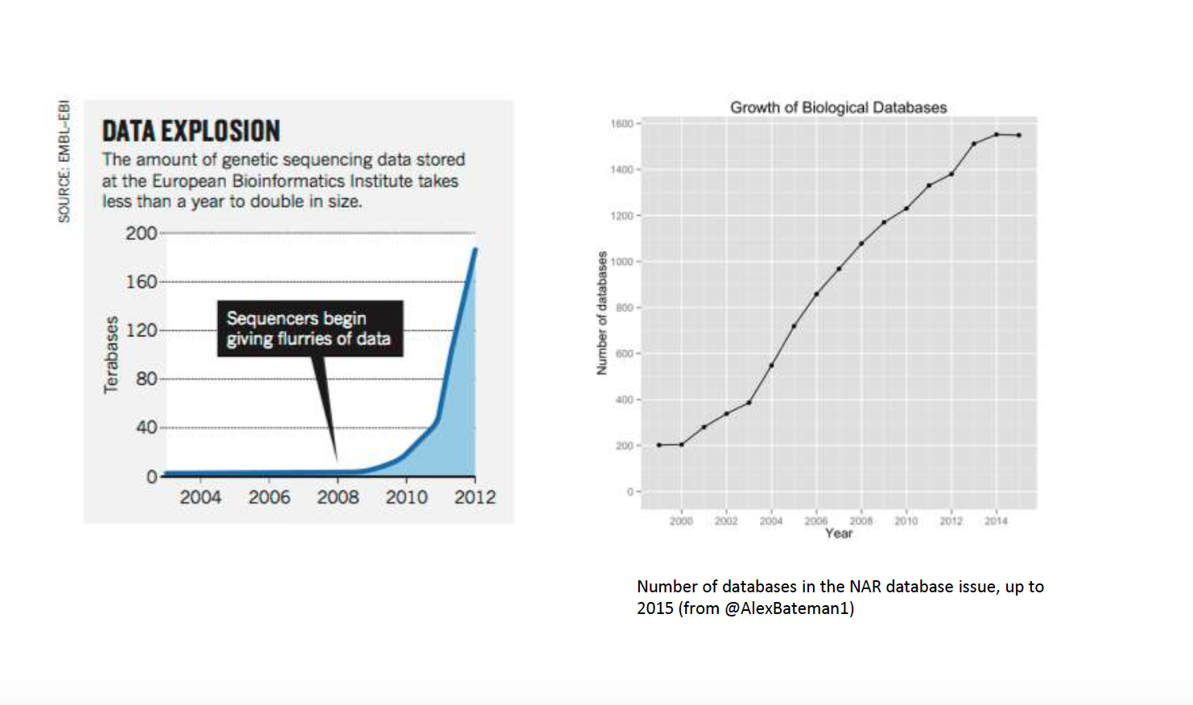
Growth of biological databases

Slide 4
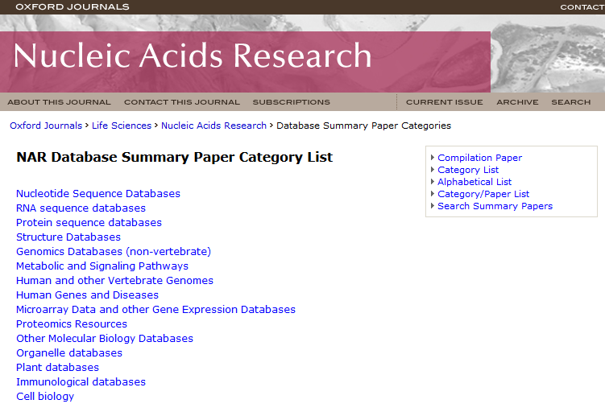
>1900 databases in 2017!

Slide 5
Database ecosystem
Data sources (structured and unstructured data)
Database
Database designer/developer
Data curator
API
Interactive queries
Data download
Data user

Slide 6
What is a database?
It’s not just a file
It’s not just an Excel spreadsheet
It’s an organized collection of related information that can easily be accessed, managed, and updated

Slide 7
Difference between Spreadsheet and Database
Spreadsheet | Database
Data analysis | Data management
Mathematical calculation | Structuring data and querying data to create subsets
Typically single user | Database management with multiple users
Formatting and chart display | Reports for data summarization
Limited in scale | Scalable
Worksheet size: | 1,048,576 rows by 16,384 columns
Column width: | 255 characters
Total no. of characters that a cell can have: | 32,767 characters

Slide 8
Some key database concepts
Data integrity is the assurance that data are correct and consistent (data correctly reflects the real world)
Data redundancy occurs if data are duplicated between files
Data dependency defines linkage between data files and their order of entry
Data security refers to data being protected so that only authorized personnel can access them
Data quality defines how well the data fits its intended uses in operations, decision making and planning

Slide 9
Relational database (SQL database)
The relational model was introduced by E.F. Codd in 1970, which is based on the mathematical set theory
A relational database management system (RDBMS) is a computer application (software) of the relational data model (e.g., MS SQLServer, MySQL, Oracle, …)
Relational databases have widely been used to manage data in different domains

Slide 10
Components of Relational Database
A table (relation) represents some class of objects (e.g., patients, doctors, drugs, hospitals)
Each table consists of columns (attributes) and rows (tuples).
Each column represents some attribute of the object represented by the table (e.g., patient id, patient name)
Each row corresponds to an instance of the object represented by the table (e.g., each row in the Patient table represents a patient who has a specific patient id and name.)

Slide 11
How to organize data into tables

Slide 12
Keys
Primary key: Every table should have a primary key comprising a single or multiple columns that contain unique values. A primary key is the unique identifier of a table row (e.g., “sample id” is the primary key for the Sample table)
Foreign key: it is a key taken from a different table. For example, in the Experiment table, the “sample id” is the foreign key to the Sample table.

Slide 13
Addition, Deletion and Modification Anomalies
Student ID | Name | Address | Subject
401 | Adam | Noida | Biology
402 | Alex | Panipat | Math
403 | Stuart | Jammu | Math
404 | Adam | Noida | Physics

Slide 14
Normalization
Normalization is a process in which we systematically organize columns and tables to eliminate anomalies due to data redundancy
It involves decomposing a (de-normalized) table into less redundant (smaller) tables without losing information
The objective is to isolate data so that additions, deletions, modifications of data can be made in just one table and then propagated to other tables using foreign keys.
Normalization is a trade-off between data redundancy and performance.
Normalizing a table reduces data redundancy but introduces the need for joins when all of the data is required for a report query.
Normal Form: A set of tables free from a certain set of addition, deletion and modification anomalies.

Slide 15
Different Normal Forms
First normal form (1NF)
Second normal form (2NF)
Third normal form (3NF)
Boyce-Codd normal form (BCNF)
Fourth normal form (4NF)
Fifth normal form (5NF)
Domain-Key normal form (DK/NF)
…

Slide 16
First Normal Form
Each column value must be a single value only.
All values for a given column must be of the same data type.
Each column name must be unique.
The order of columns is insignificant
The order of the rows is insignificant
No two rows in a table can be identical.

Slide 17
First Normal Form Example
Student | Age | Subject
Adam | 15 | Biology
Adam | 15 | Physics
Alex | 14 | Math
Stuart | 17 | Math

Slide 18
Second Normal Form
A table is in second normal form (2NF) if it is in 1NF and if all of its non-key columns are dependent on all of the key.
A table is in second normal form if it is free from partial-key dependencies
Tables that have a single column for a key are automatically in 2NF.
This is one reason why we often use artificial identifiers (non-composite keys) as keys.
To achieve second normal form, we may need to split a table into multiple tables and match rows between tables using primary and foreign keys

Slide 19
Second Normal Form Example
Student | Age
Adam | 15
Alex | 14
Stuart | 17
Student | Subject
Adam | Biology
Adam | Physics
Alex | Math
Stuart | Math
Subject
Biology
Physics
Math

Slide 20
Third Normal Form
Every non-primary key column must be dependent on primary key
There should not be the case that a non-primary key column is determined by another non-primary (transitive dependency)
Student (ID, Name, DOB, City, State, Zip)
A table is in 3NF if the following are true:
it is in 2NF
All transitive dependencies (Zip->City) are removed
Student (ID, Name, DOB, Zip)
Address (Zip, City, State)

Slide 21
Entity Relationship Diagram (ERD)

Slide 22
What is ERD
It is a data model associated with a diagrammatic method (P. Chen 1976) used to conduct/view data modeling
It describes the attributes of and the relationship between entities (data objects)
DBA uses ERD to perform data modeling and explain the diagram to stakeholders

Slide 23
Primary Components of ERD
Entity represents a collection of objects in the real world (e.g., person, place, event)
Attribute is a named property or characteristic of an entity
Relationship is an association between the instances of one or more entities

Slide 24
Relationship Cardinality
It expresses the minimum and maximum number of occurrences of one entity for a single occurrence of the other
One-to-One (1:1)
One-to-Many (1:N)
Many-to-Many (M:N)

Slide 25
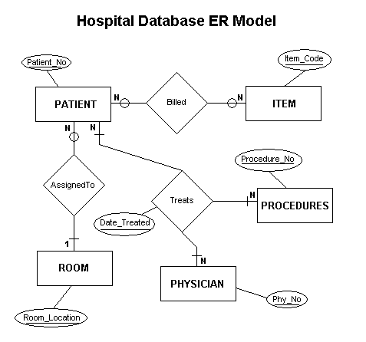
Example ERD (Hospital Database)

Slide 26
Vertabelo Demo

Slide 27
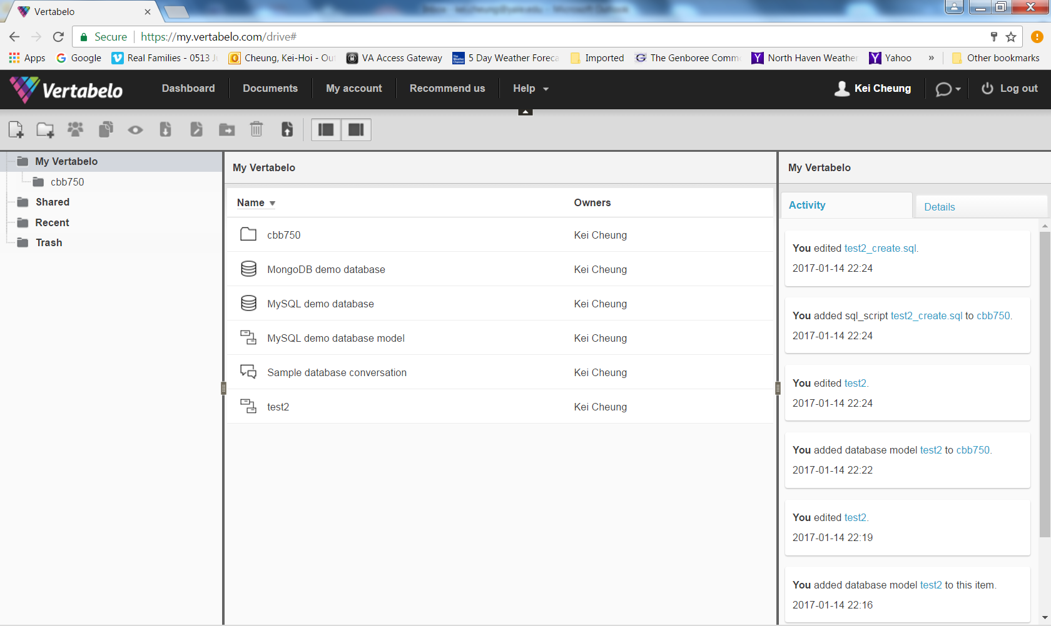

Slide 28
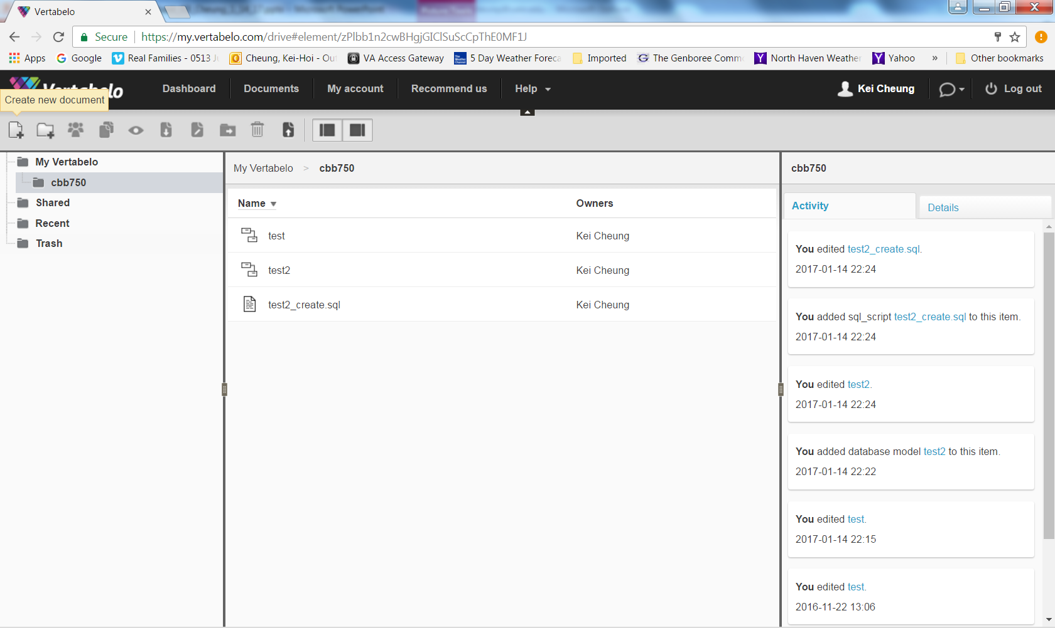
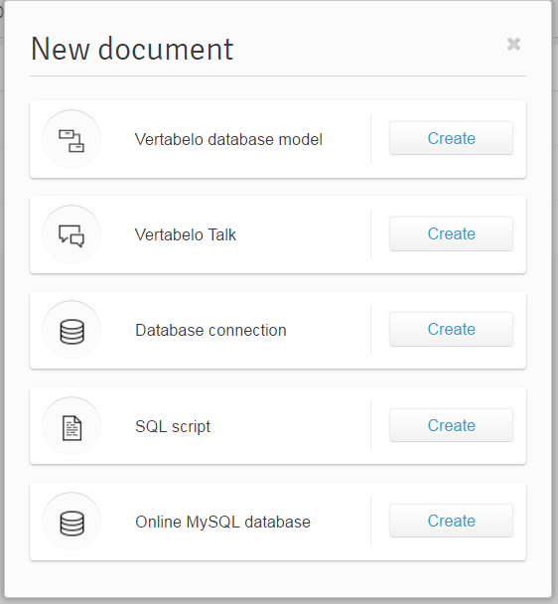

Slide 29
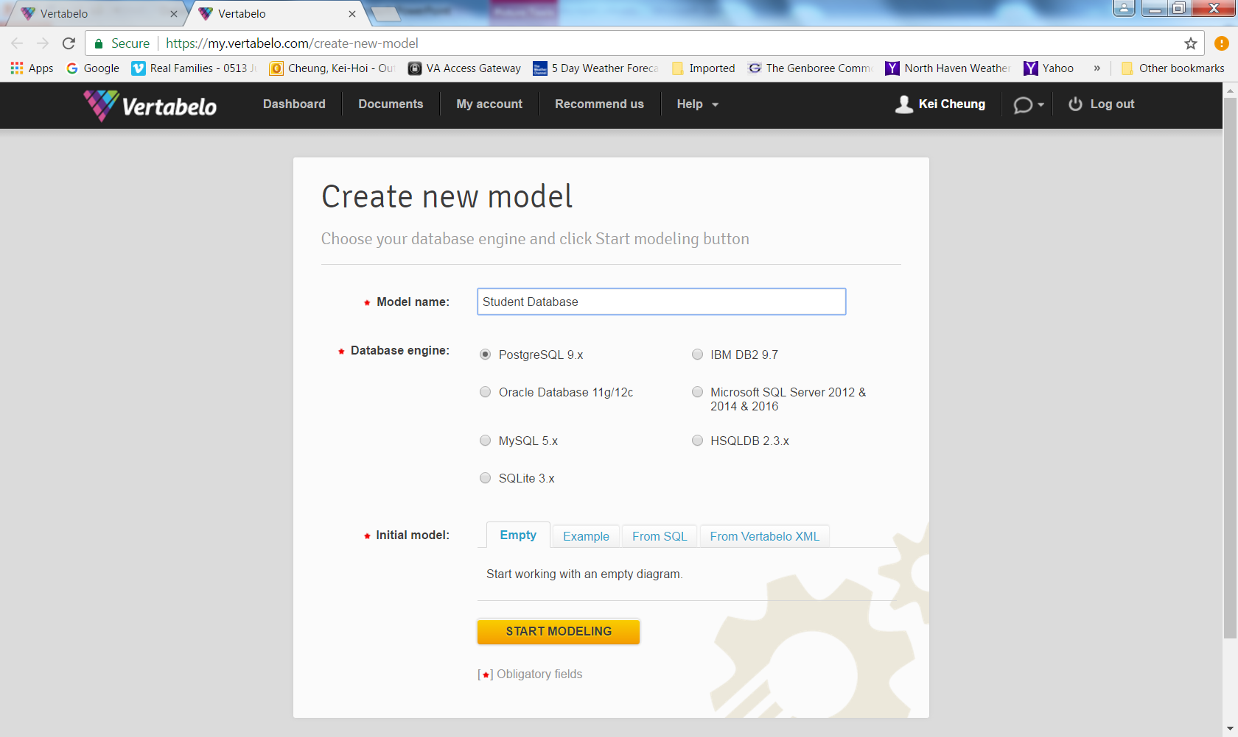

Slide 30
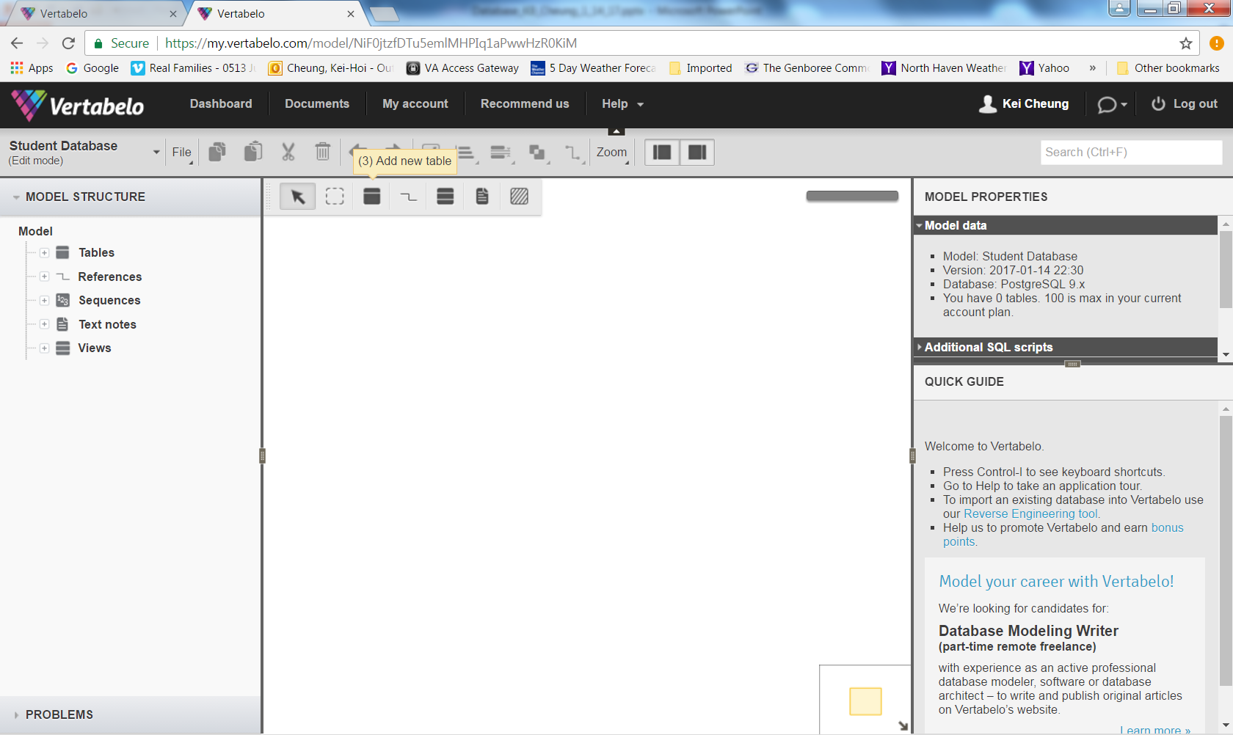

Slide 31
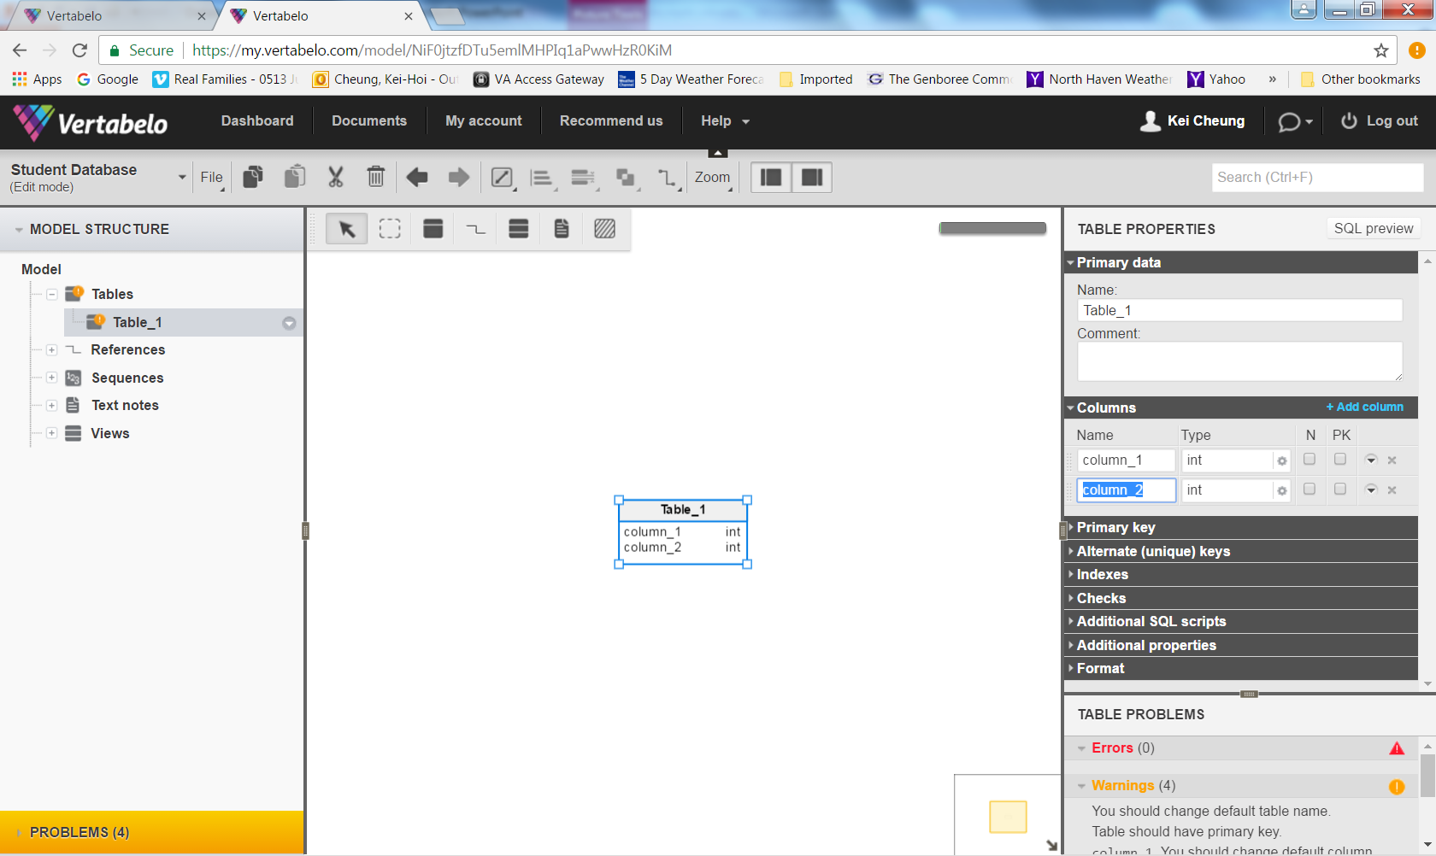

Slide 32
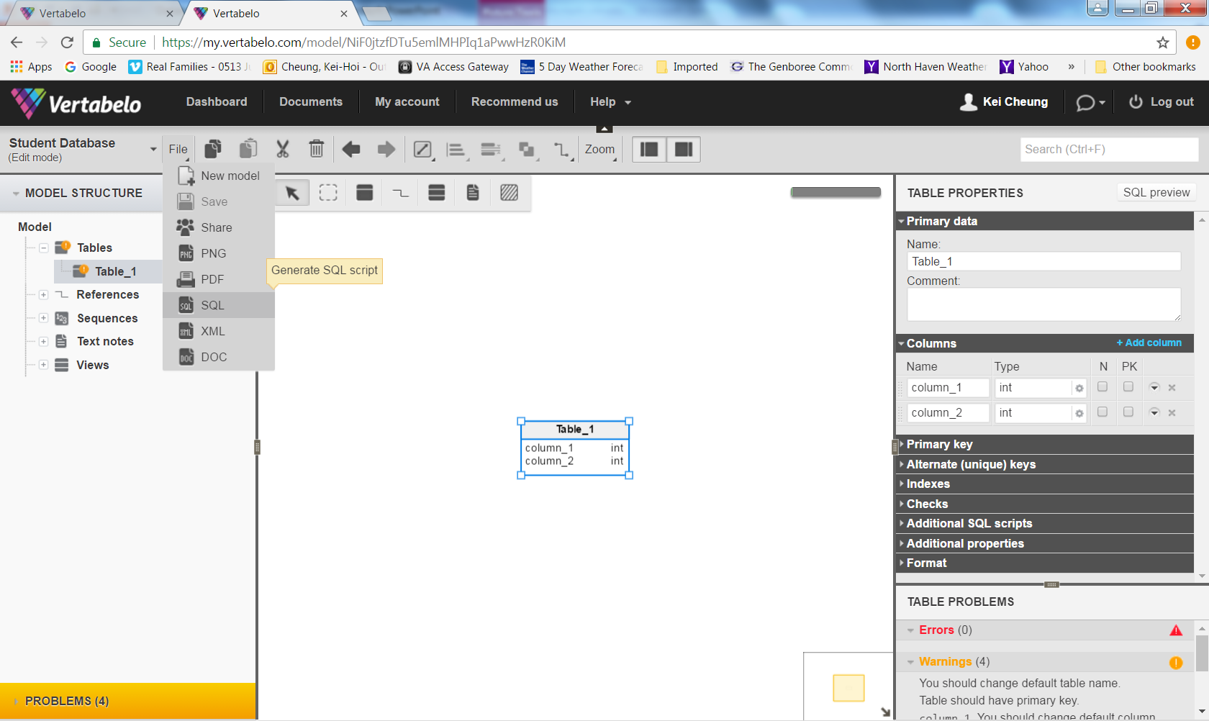

Slide 33
On-Line Transaction Processing (OLTP)

Slide 34
What is OLTP?
It is a class of information systems (e.g., databases) that facilitate and manage transaction-oriented applications, typically for data entry and retrieval transactions
A database that is based on a normalized relational model is considered an OLTP application. It supports the following transactions:
Insert new rows
Update existing rows
Delete rows
Select rows

Slide 35
Structured Query Language (SQL)
It is a standard programming language for creating (CREATE) relational databases and tables as well as retrieving (SELECT), adding (INSERT), deleting (DELETE) and updating (UPDATE) data in a relational database
It is compliant with ANSI and ISO standards

Slide 36
SQL Statement (CREATE DATABASE/TABLE)
CREATE DATABASE Patient_DB;
CREATE TABLE Patient_DB.Patient
(
ID int,
Name varchar (50),
Address varchar (250),
Age smallint
Sex varchar (2)
);

Slide 37
INSERT Statement
INSERT INTO Patient_DB.Patient
(ID, Name, Address, Age, Sex)
VALUES (1, ‘John Doe’, ‘XYZ’, 40, ‘M’)
…
ID | Name | Address | Age | Sex
1 | John Doe | XYZ | 40 | M
2 | Jane Smith | ABC | 34 | F
3 | Mary Queen | PQSRT | 46 | F
4 | Mike Lee | DWQER | 60 | M

Slide 38
UPDATE Statement
UPDATE Patient_DB.Patient
SET AGE=41
WHERE ID=1
ID | Name | Address | Age | Sex
1 | John Doe | XYZ | 41 | M
2 | Jane Smith | ABC | 34 | F
3 | Mary Queen | PQSRT | 46 | F
4 | Mike Lee | DWQER | 60 | M

Slide 39
DELETE Statement
DELETE Patient_DB.Patient
WHERE Name=‘Mike Lee’
ID | Name | Address | Age | Sex
1 | John Doe | XYZ | 41 | M
2 | Jane Smith | ABC | 34 | F
3 | Mary Queen | PQSRT | 46 | F

Slide 40
SELECT Statement
SELECT ID, Name, Age, Sex
FROM Patient_DB.Patient
WHERE Age>=40
ORDER BY Age
ID | Name | Address | Age | Sex
1 | John Doe | XYZ | 40 | M
2 | Jane Smith | ABC | 34 | F
3 | Mary Queen | PQSRT | 46 | F
4 | Mike Lee | DWQER | 60 | M

Slide 41
SELECT Statement (Aggregation)
SELECT Sex, avg(Age)
FROM Patient_DB.Patient
GROUP BY SEX
Results: M 50
F 40
ID | Name | Address | Age | Sex
1 | John Doe | XYZ | 40 | M
2 | Jane Smith | ABC | 34 | F
3 | Mary Queen | PQSRT | 46 | F
4 | Mike Lee | DWQER | 60 | M

Slide 42
SELECT Statement (JOIN)
SELECT A.*, B.Report_Text
FROM Patient_DB.Patient AS A
INNER JOIN Patient_DB.LabTest. AS B
ON A.ID = B.Patient_ID
ID | Name | Address | Age | Sex
1 | John Doe | XYZ | 40 | M
2 | Jane Smith | ABC | 34 | F
3 | Mary Queen | PQSRT | 46 | F
4 | Mike Lee | DWQER | 60 | M
Patient_ID | ID | Report_Text
1 | 1 | ……
1 | 2 | …….

Slide 43
Other Types of SQL Statements
TRUNCATE TABLE
DROP TABLE
CREATE VIEW
CREATE INDEX (boost query performace)
Full-Text index (e.g., part of MS SQLServer)

Slide 44
From OLTP to OLAP (On-Line Analytical Processing)

Slide 45
OLAP Overview
OLTP databases are tuned to small/medium size of data with relatively simple queries
Some applications use fewer but more time-consuming analytic queries
New architectures (data warehouses) have been developed to handle such analytic queries efficiently (De-normalization)

Slide 46
OLAP Example Queries
Amazon analyzes purchases by its customers to identify products of likely interest to customers
Analysts at Wal-Mart look for merchandise items with increasing sales in some region

Slide 47
Data Warehouse
The most common form of database integration
Copy source databases into a single database (data warehouse)
Update the data warehouse periodically (in batch mode)
Support analytic queries using a dimensional data model (vs. a normalized entity-relationship model)
Example: VA CDW

Slide 48
Star Schema
Dimension table
Dimension table
Fact table
Dimension table
Dimension table

Slide 49
Star Schema Example
Patients
Providers
ID
ID
Dimension Attributes
Dependent Attributes
Patient ID
Provider ID
Clinic ID
Procedure ID
Date
Comment
ID
ID
Clinics
Procedures

Slide 50
Example Queries
Compare numbers of patient visits across different clinics for a given year
Which are the top 10 most performed procedures among all clinics from 2010 to 2014

Slide 51
Beyond SQL
NoSQL (graph databases like NEO4J, document databases like MongoDB)
Semantic Web (standards for linked data and ontologies)

Slide 52
The End

Slide 53
Assignments
Install MySQL (http://dev.mysql.com/downloads/installer/)
Read the Jupyter paper
Bring your laptop on Thursday

