Slide 1


Genomic Privacy & the 2-sided Nature of RNA-seq:
Quantifying the Leakage of Individual Information
Mark Gerstein, Yale. Slides freely downloadable from Lectures.GersteinLab.org
& “tweetable” (via @markgerstein). See last slide for more info.

Slide 2

Activity Patterns
RNA Seq. gives rise to activity patterns of genes & regions in the genome

Slide 3

RNA-Seq Overview
ATACAAGCAAGTATAAGTTCGTATGCCGTCTT
GGAGGCTGGAGTTGGGGACGTATGCGGCATAG
TACCGATCGAGTCGACTGTAAACGTAGGCATA
ATTCTGACTGGTGTCATGCTGATGTACTTAAA
Fastq sequence files
~5-10 GB
Index-building + Alignment to reference genome
BAM files
~1-2-fold reduction
Successive steps of Data Reduction
Conversion to signal track by overlapping reads
BigWig files
~25-fold reduction
Mapping to genes
Gene/Transcript expression matrix
~20-fold reduction
Quantitative information from RNA-seq signal: average signals at exon level (RPKMs)
Reads => Signal
[NAT. REV. 10: 57; PLOS CB 4:e1000158; PNAS 4:107: 5254 ]

Slide 4

2-sided nature of functional genomics data: Analysis can be very General/Public or Individual/Private
General quantifications related to overall aspects
of a condition – ie gene activity as a function of:
  Developmental stage: basic patterns and clusters of co-active genes across an organisms development
  Evolutionary relationships: behavior preserved across a wide range of organisms
  Tissue- and cell-type
  Disease phenotypes: what genes go up in cancer?
Above are not tied to an individual’s genotype. However, data is derived from an individual & tagged with an individual’s genotype
Note, a few calculations aim to use explicitly genotype to derive general relations related to sequence variation & gene expression (eg allelic activity)

Slide 5
Importance of Leakage Quantification for Genomic Privacy
The overall dilemma of genomic privacy
  From sharing information, the individual is potentially harmed but society benefits in terms of medical research
  How to balance risks v rewards?
Need to quantify leakage
  Cost Benefit Analysis: how helpful is identifiable data in genomic research v. potential harm from a breach
  What is acceptable risk – ie what is acceptable data leakage?
Also, need careful separation & coupling of private & public data
  Lightweight, freely accessible secondary datasets coupled to underlying variants
  Selection of stub & "test pilot" datasets for benchmarking
  Develop programs on public stubs on your laptop, then move the program to the cloud for private production run
[D Greenbaum, M Gerstein (‘11). Am J Bioeth 11:39. Greenbaum & Gerstein, The Scientist ('13)]

Slide 6
Genomic Privacy & the 2-sided Nature of RNA-seq:
Quantifying the Leakage of Individual Information
Intro on RNA-seq & the General Dilemma of Genomic Privacy
  RNA-seq Presents a tricky privacy issue since much of the sequencing is for general, non-individual specific results yet it’s tagged with individual information
  The need to quantify leaks
Quantifying
RNA-seq Leakage
…from Reads
  Almost as much as WGS
  But can remove
  SNVs in reads w/ MRF
…from eQTLs
  Quantifying & removing variant info from expression levels +
  eQTLs using ICI & predictability
  Instantiating a practical linking attack
…from Indels/SVs
  Another source of leakage in RNA-seq data & how to use these for a related linking attack
NIH BD2K Program

Slide 7
Genomic Privacy & the 2-sided Nature of RNA-seq:
Quantifying the Leakage of Individual Information
Intro on RNA-seq & the General Dilemma of Genomic Privacy
  RNA-seq Presents a tricky privacy issue since much of the sequencing is for general, non-individual specific results yet it’s tagged with individual information
  The need to quantify leaks
Quantifying
RNA-seq Leakage
…from Reads
  Almost as much as WGS
  But can remove
  SNVs in reads w/ MRF
…from eQTLs
  Quantifying & removing variant info from expression levels +
  eQTLs using ICI & predictability
  Instantiating a practical linking attack
…from Indels/SVs
  Another source of leakage in RNA-seq data & how to use these for a related linking attack

Slide 8



Representative Expression,
Genotype, eQTL Datasets on Open Datasets
Publically available genotypes (not controlled access) are available from the 1000 Genomes Project
mRNA sequencing for 462 individuals from gEUVADIS and ENCODE
  Publicly available quantification for protein coding genes
Approximately 3,000 cis-eQTL (FDR<0.05)

Slide 9
Variants directly in the reads
Functional genomics data comes with a great deal of sequencing
  NA12878 as case study - 1000 genomes variants are used as gold standard
How much information, for example, do RNA-Seq reads (or ChIP-Seq) reads contain? Does that information enough to identify individuals?
Variants from RNA-Seq reads
It might seem like we don’t infer much information from single ChIP-Seq and RNA-Seq experiments compared to WGS
  However putting 10 different ChIP-Seq experiments and RNA-Seq together with imputation provides a great deal of information about the individual

Slide 10
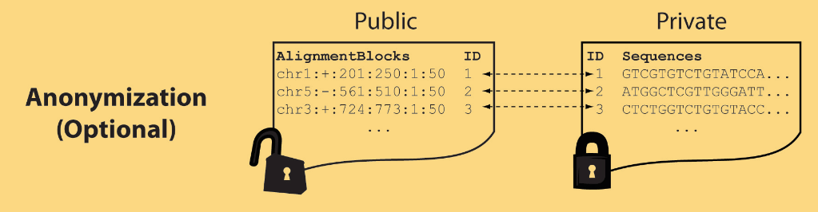
Light-weight formats to Hide Most of the Read Data (Signal Tracks)
Some lightweight format clearly separate public & private info., aiding exchange
Files become much smaller
Distinction between formats to compute on and those to archive with – become sharper with big data
Reads
(linked via ID,
10X larger than
mapping coord.)
Mapping coordinates without variants (MRF)
[Bioinformatics 27: 281]

Slide 11
Genomic Privacy & the 2-sided Nature of RNA-seq:
Quantifying the Leakage of Individual Information
Intro on RNA-seq & the General Dilemma of Genomic Privacy
  RNA-seq Presents a tricky privacy issue since much of the sequencing is for general, non-individual specific results yet it’s tagged with individual information
  The need to quantify leaks
Quantifying
RNA-seq Leakage
…from Reads
  Almost as much as WGS
  But can remove
  SNVs in reads w/ MRF
…from eQTLs
  Quantifying & removing variant info from expression levels +
  eQTLs using ICI & predictability
  Instantiating a practical linking attack
…from Indels/SVs
  Another source of leakage in RNA-seq data & how to use these for a related linking attack

Slide 12


eQTL Mapping Using RNA-Seq Data
eQTLs are genomic loci that contribute to variation in mRNA expression levels
eQTLs provide insights on transcription regulation, and the molecular basis of phenotypic outcomes
[Biometrics 68(1) 1–11]
Notes:
A diagram to illustrate the RNA‐seq count variation of one gene due to an cis‐eQTL. (a) RNA‐seq measurements of a hypothetic gene with two exons in three diploid individuals. The target SNP which we test for association has the genotype CT, CC, and TT for the three individuals. There is an SNP on the first exon, which has genotype AT, AT, and AA for the three individuals. ASE can be measured by those sequence reads that overlap with a heterozygous exonic SNP. Therefore we can measure ASE for individuals (i) and (ii). However, association testing by ASE is only possible if the target SNP is heterozygous, thus only individual (i) can be used to test for eQTL by ASE (b) ASE measurements for individual (i). (c) TReC measured for the three individuals across the two exons of this gene.
© IF THIS IMAGE HAS BEEN PROVIDED BY OR IS OWNED BY A THIRD PARTY, AS INDICATED IN THE CAPTION LINE, THEN FURTHER PERMISSION MAY BE NEEDED BEFORE ANY FURTHER USE. PLEASE CONTACT WILEY'S PERMISSIONS DEPARTMENT ON PERMISSIONS@WILEY.COM OR USE THE RIGHTSLINK SERVICE BY CLICKING ON THE 'REQUEST PERMISSION' LINK ACCOMPANYING THIS ARTICLE. WILEY OR AUTHOR OWNED IMAGES MAY BE USED FOR NON-COMMERCIAL PURPOSES, SUBJECT TO PROPER CITATION OF THE ARTICLE, AUTHOR, AND PUBLISHER.

Slide 13
Information Content and Predictability
Higher frequency: Lower ICI
Lower frequency: Higher ICI
Additive for multiple variants
Condition specific entropy
Higher cond. entropy: Lower predictability
Lower cond. entropy: Higher predictability
Additive for multiple eQTLs
[Harmanci et al. Nat. Meth. 2016]

Slide 14
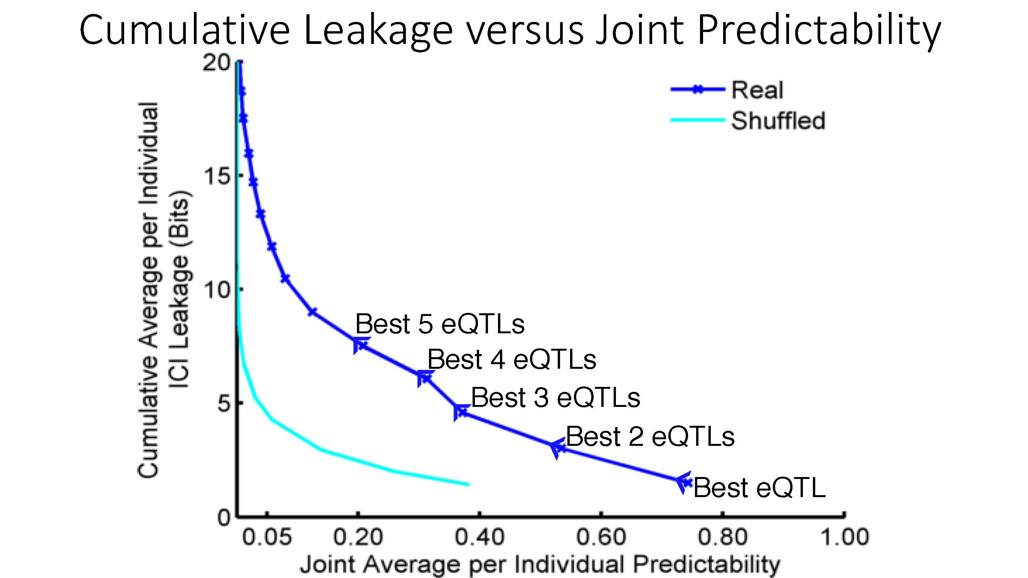

ICI Leakage versus Genotype Predictability
[Harmanciet al. Nat. Meth. (‘16]

Slide 15

Linking Attack Scenario
[Harmanciet al. Nat. Meth. (in revision)]

Slide 16
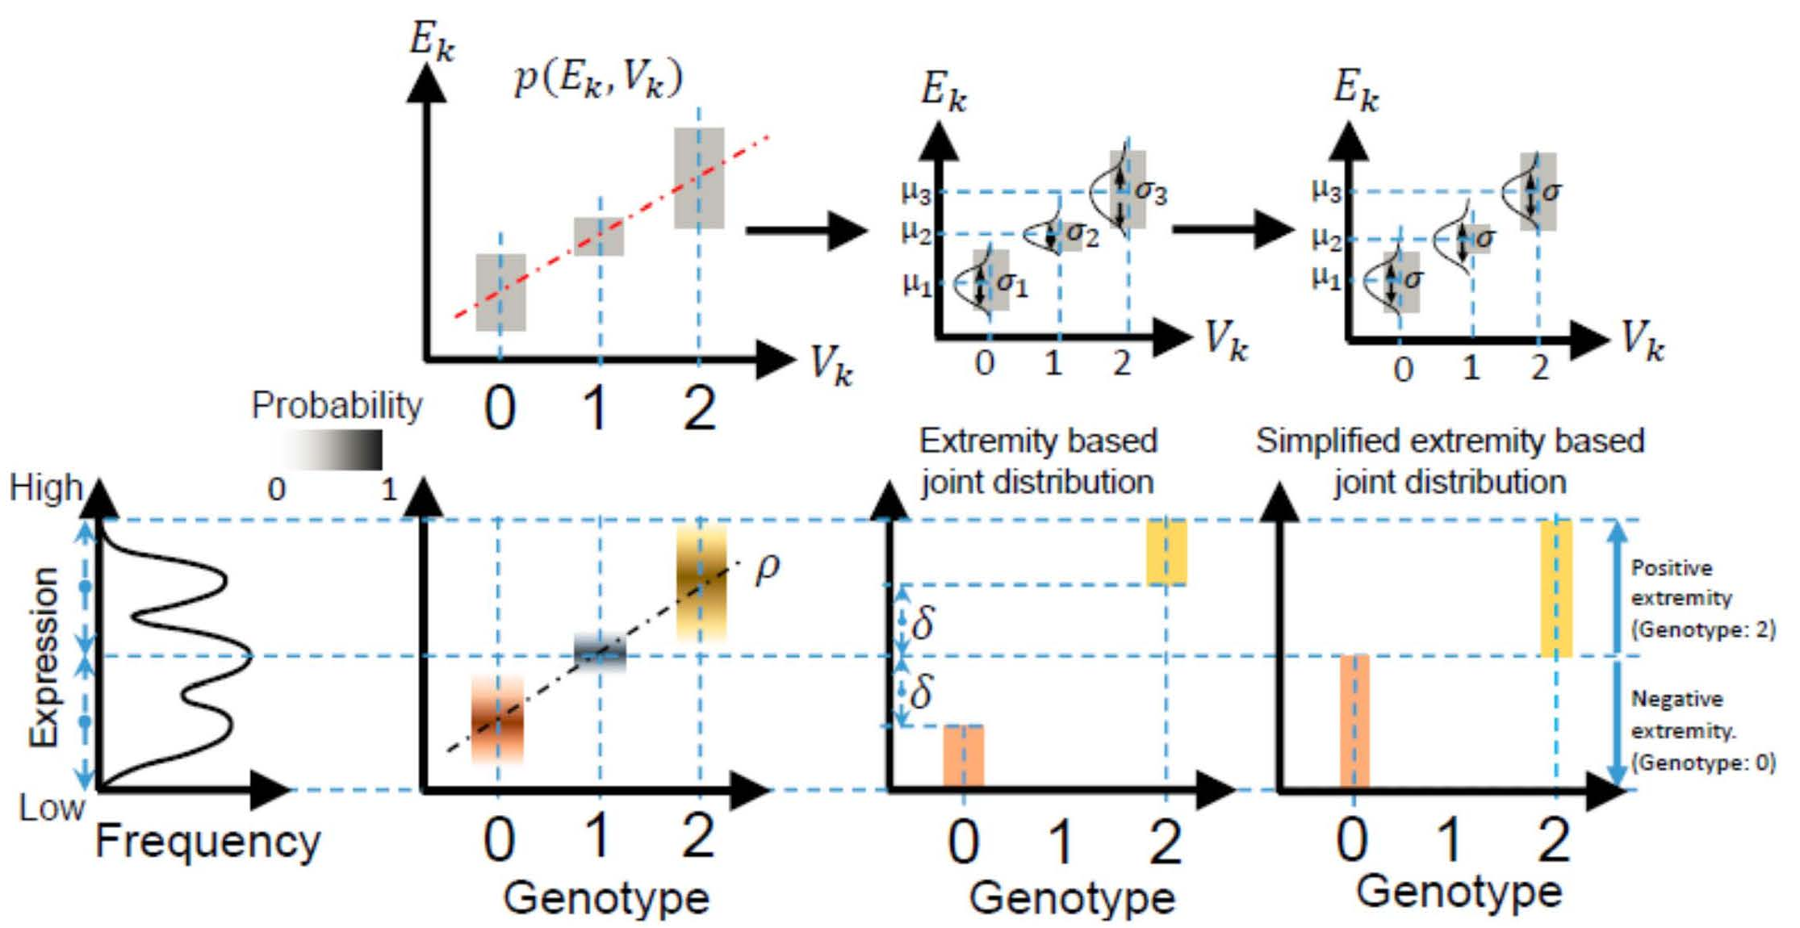
Levels of Expression-Genotype Model Simplifications for Genotype Prediction
[Harmanci et al. Nat. Meth. (16)]

Slide 17
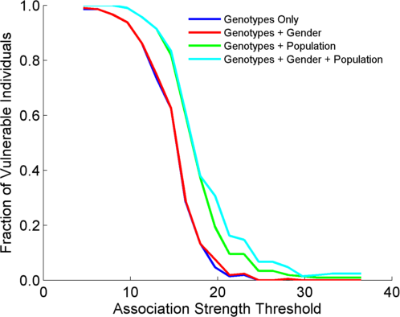
Success in Linking Attack with Extremity based Genotype Prediction
200 individuals eQTL Discovery
200 individuals in Linking Attack
High
Sensitivity
Low
Sensitivity
High Number
Of eQTLs
Low Number
Of eQTLs
[Harmanci et al. Nat. Meth. (16)]

Slide 18
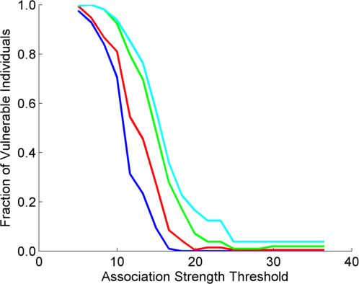
Success in Linking Attack with Extremity based Genotype Prediction
200 individuals eQTL Discovery
200 individuals in Linking Attack
200 individuals eQTL Discovery
100,200 individuals in Linking Attack
[Harmanci et al. Nat. Meth. (16)]

Slide 19
Genomic Privacy & the 2-sided Nature of RNA-seq:
Quantifying the Leakage of Individual Information
Intro on RNA-seq & the General Dilemma of Genomic Privacy
  RNA-seq Presents a tricky privacy issue since much of the sequencing is for general, non-individual specific results yet it’s tagged with individual information
  The need to quantify leaks
Quantifying
RNA-seq Leakage
…from Reads
  Almost as much as WGS
  But can remove
  SNVs in reads w/ MRF
…from eQTLs
  Quantifying & removing variant info from expression levels +
  eQTLs using ICI & predictability
  Instantiating a practical linking attack
…from Indels/SVs
  Another source of leakage in RNA-seq data & how to use these for a related linking attack

Slide 20
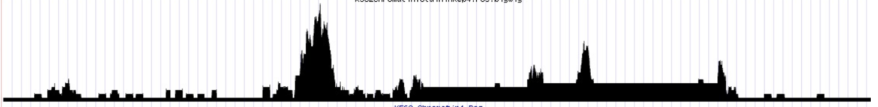

Slide 21
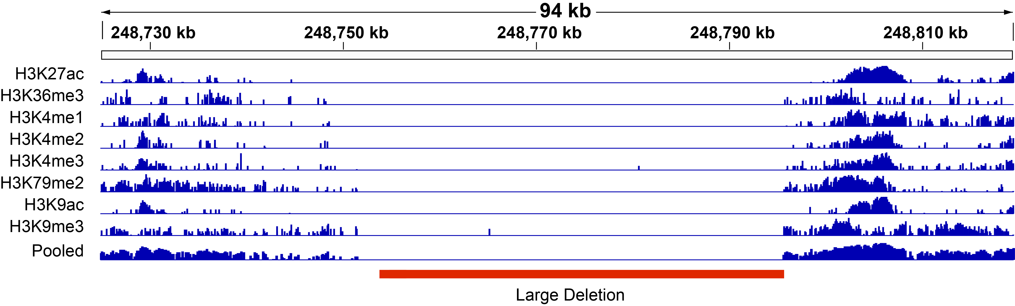

Slide 23
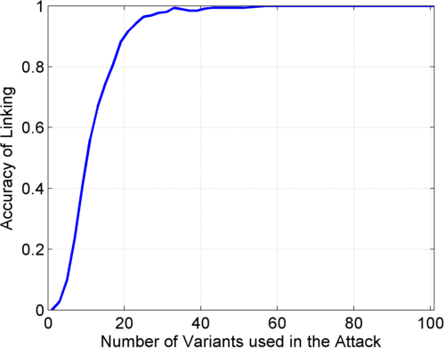
Notes:
GEUVADIS ICI-\Pi_GW estimates:

Slide 24
Genomic Privacy & the 2-sided Nature of RNA-seq:
Quantifying the Leakage of Individual Information
Intro on RNA-seq & the General Dilemma of Genomic Privacy
  RNA-seq Presents a tricky privacy issue since much of the sequencing is for general, non-individual specific results yet it’s tagged with individual information
  The need to quantify leaks
Quantifying
RNA-seq Leakage
…from Reads
  Almost as much as WGS
  But can remove
  SNVs in reads w/ MRF
…from eQTLs
  Quantifying & removing variant info from expression levels +
  eQTLs using ICI & predictability
  Instantiating a practical linking attack
…from Indels/SVs
  Another source of leakage in RNA-seq data & how to use these for a related linking attack

Slide 25
Genomic Privacy & the 2-sided Nature of RNA-seq:
Quantifying the Leakage of Individual Information
Intro on RNA-seq & the General Dilemma of Genomic Privacy
  RNA-seq Presents a tricky privacy issue since much of the sequencing is for general, non-individual specific results yet it’s tagged with individual information
  The need to quantify leaks
Quantifying
RNA-seq Leakage
…from Reads
  Almost as much as WGS
  But can remove
  SNVs in reads w/ MRF
…from eQTLs
  Quantifying & removing variant info from expression levels +
  eQTLs using ICI & predictability
  Instantiating a practical linking attack
…from Indels/SVs
  Another source of leakage in RNA-seq data & how to use these for a related linking attack
NIH BD2K Program

Slide 26
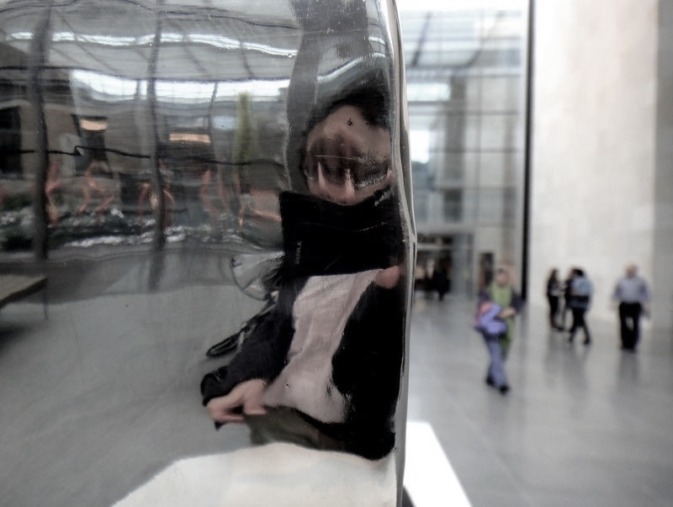

Acknowledgements
NIH BD2K
Program
PrivaSeq.gersteinlab.org –
A Harmanci, G Gürsoy,
F Navarro, S Wagner, X Kong
Hiring Postdocs. See JOBS.gersteinlab.org !

Slide 27

Extra

Slide 28
Info about content in this slide pack
General PERMISSIONS
  This Presentation is copyright Mark Gerstein,
  Yale University, 2017.
  Please read permissions statement at
  www.gersteinlab.org/misc/permissions.html .
  Feel free to use slides & images in the talk with PROPER acknowledgement
  (via citation to relevant papers or link to gersteinlab.org).
  Paper references in the talk were mostly from Papers.GersteinLab.org.
PHOTOS & IMAGES. For thoughts on the source and permissions of many of the photos and clipped images in this presentation see http://streams.gerstein.info .
  In particular, many of the images have particular EXIF tags, such as kwpotppt , that can be easily queried from flickr, viz: http://www.flickr.com/photos/mbgmbg/tags/kwpotppt

