Slide 1
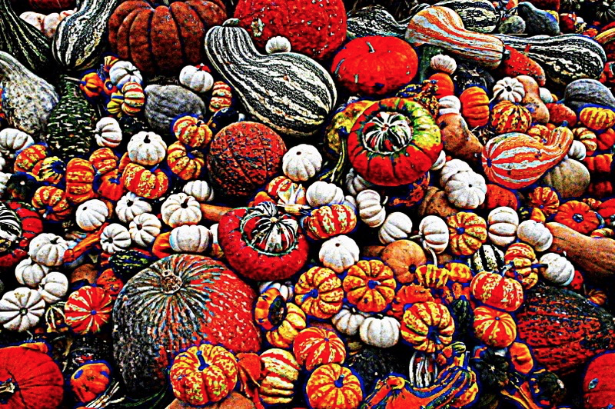
Prioritizing somatic variants: Approaches to identifying key variants through functional impact & recurrence
Mark Gerstein
Yale
Slides freely
downloadable from Lectures.GersteinLab.org
& “tweetable”
(via @markgerstein).
See last slide for more info.

Slide 2
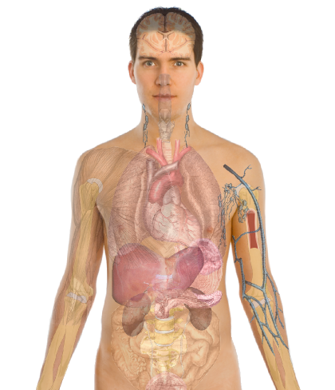
Personal Genomics as a Gateway into Biology
Personal genomes will soon become a commonplace part of medical research & eventually treatment (esp. for cancer). They will provide a primary connection for biological science to the general public.
normal
tumor

Slide 3
Personal Genomics as a Gateway into Biology
Personal genomes will soon become a commonplace part of medical research & eventually treatment (esp. for cancer). They will provide a primary connection for biological science to the general public.

Slide 5
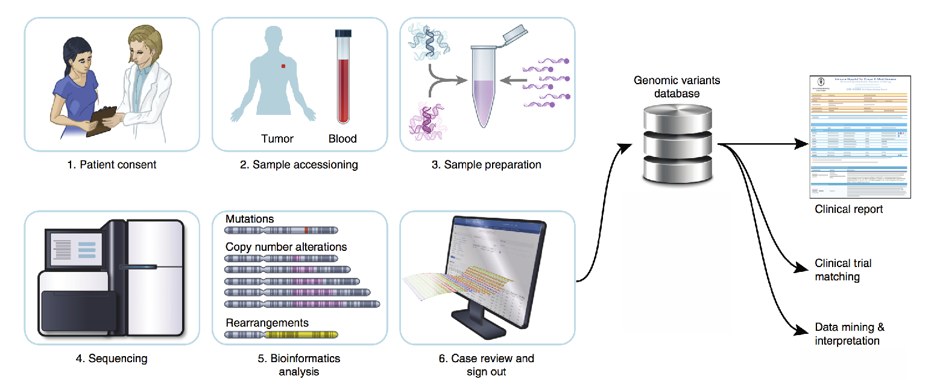
Key variants will increasingly play essential roles in precision medicine
Database of variants
1. General
diagnosis
2. Sample extraction
3. Sample preparation
Clinical report
Trial
matching
Refined
diagnosis
(ex: sub-
cancer type)
4. Sequencing
5. Analysis
6. Review
Modified from A. Zehir et al, Nat. Med (2017)

Slide 6
Growth of ICGC datasets
Hardeep Nahal , 12th Scientific
ICGC Workshop (Sept 2016)

Slide 7
Canonical model of drivers & passengers in cancer
Drivers
directly confer a selective growth advantage to the tumor cell.
A typical tumor contains 2-8 drivers.
identified through signals of positive selection.
Existing cohorts of ~100s give enough power to identify
Passengers
Conceptually, a passenger mutation has no direct or indirect effect on tumor progression.
There are 1000s of passengers in a typical cancer genome.
[Vogelstein Science 2013. 339:1546]

Slide 8
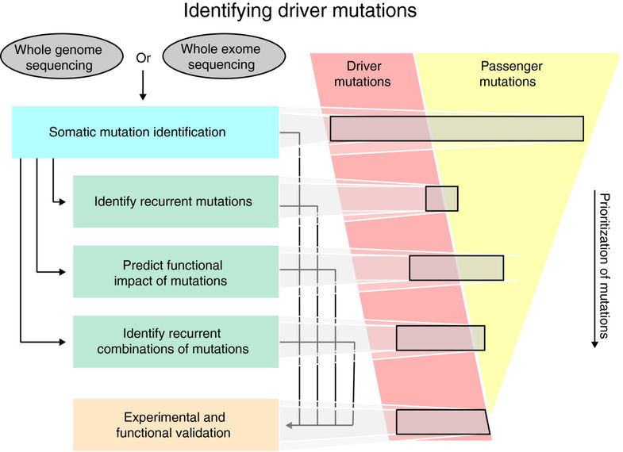
Identifying select driver variants from the large pool of candidate variants
Prioritizing key variants identifies drivers to better enable more precise diagnostics and targeted therapies
SNVs Amplifications Fusions
Number of patients in matched clinical trials identified on the basis of actionable variants in different genes
# patients in a targeted clinical trial
Top: Raphael, et al., Genome Med. (2014)
Bottom: Modified from Zehir et al, Nat. Med (2017)

Slide 9
Prioritizing somatic variants: Approaches to identifying key variants through functional impact & recurrence
Introduction
Large growth in cancer genome data
Mining the data to prioritize variants for key drivers
Functional impact #1: Coding
ALoFT: Annotation of Loss-of-Function Transcripts. LOF annotation as a complex problem.
Finding deleterious LoF SNVs
Frustration as a localized metric of SNV impact. Differential profiles for oncogenes vs. TSGs
Functional impact #2: Non-coding
FunSeq integrates evidence, with an entropy based weighting scheme
Recurrence #1: Statistics for driver identification
Background mutation rate significantly varies & is correlated with replication timing & TADs
Developed a variety of parametric & non-parametric methods taking this into account
LARVA uses parametric beta-binomial model, explicitly modeling covariates
MOAT does a variety of non-parm. shuffles (annotation, variants, &c). Useful when explicit covariates not available. Slower than but speeded up w/ GPUs
Recurrence #2: (Low-power) application to pRCC
WGS finds additional facts on the canonical driver, MET. Other suggestive non-coding hotspots.
Tumor evolution analysis of the timing of key mutations helps with classification

Slide 10
Prioritizing somatic variants: Approaches to identifying key variants through functional impact & recurrence
Introduction
Large growth in cancer genome data
Mining the data to prioritize variants for key drivers
Functional impact #1: Coding
ALoFT: Annotation of Loss-of-Function Transcripts. LOF annotation as a complex problem.
Finding deleterious LoF SNVs
Frustration as a localized metric of SNV impact. Differential profiles for oncogenes vs. TSGs
Functional impact #2: Non-coding
FunSeq integrates evidence, with an entropy based weighting scheme
Recurrence #1: Statistics for driver identification
Background mutation rate significantly varies & is correlated with replication timing & TADs
Developed a variety of parametric & non-parametric methods taking this into account
LARVA uses parametric beta-binomial model, explicitly modeling covariates
MOAT does a variety of non-parm. shuffles (annotation, variants, &c). Useful when explicit covariates not available. Slower than but speeded up w/ GPUs
Recurrence #2: (Low-power) application to pRCC
WGS finds additional facts on the canonical driver, MET. Other suggestive non-coding hotspots.
Tumor evolution analysis of the timing of key mutations helps with classification

Slide 11
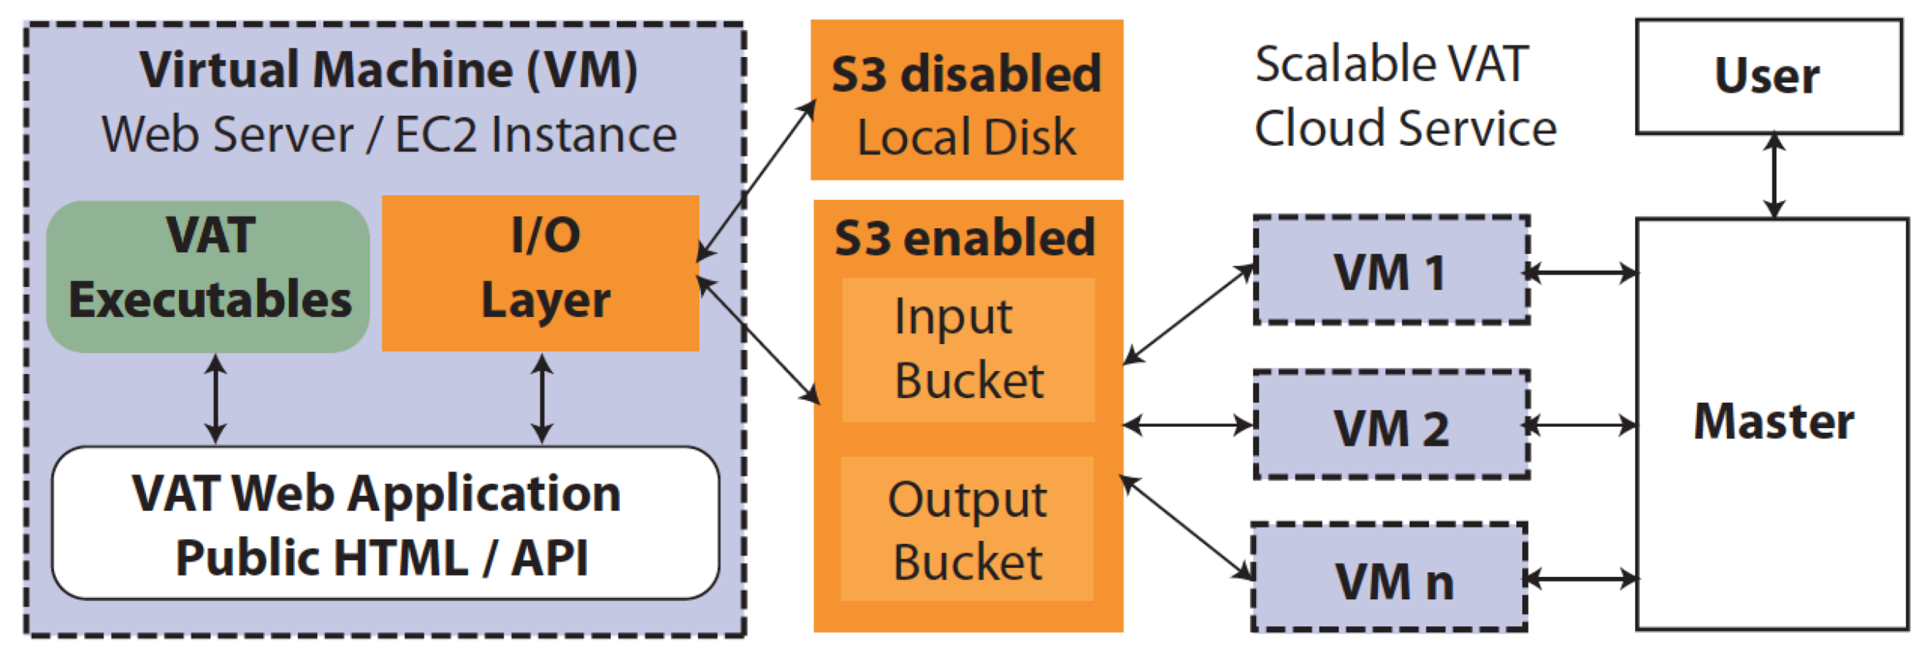
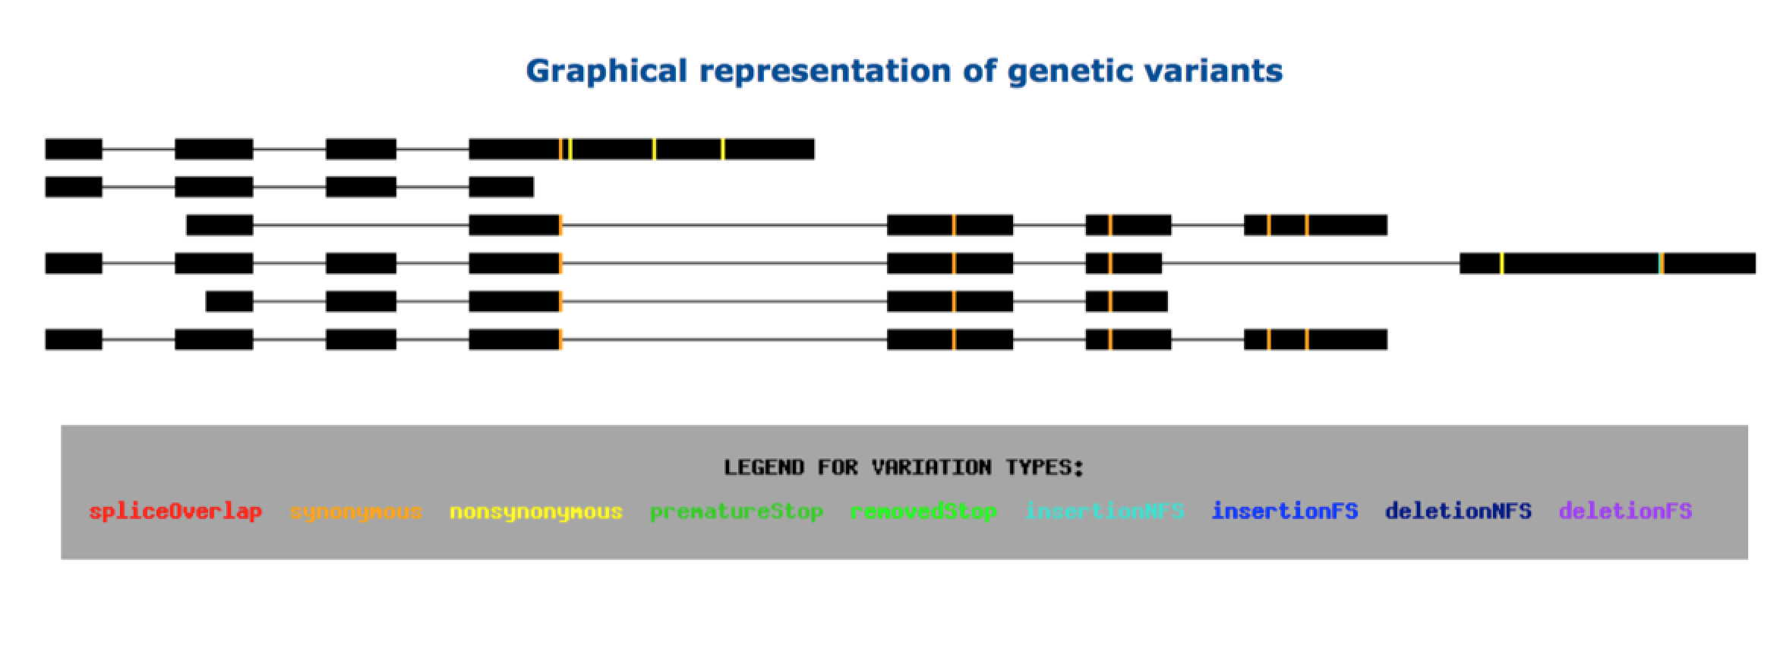
vat.gersteinlab.org
Variant Annotation Tool (VAT)
VCF Input
Output:
Annotated VCFs
Graphical representations of functional impact on transcripts
Access:
Webserver
AWS cloud instance
Source freely available
CLOUD APPLICATION
Habegger L.*, Balasubramanian S.*, et al. Bioinformatics, 2012
Notes:
11
Big data challenge, graphical interface is important

Slide 12
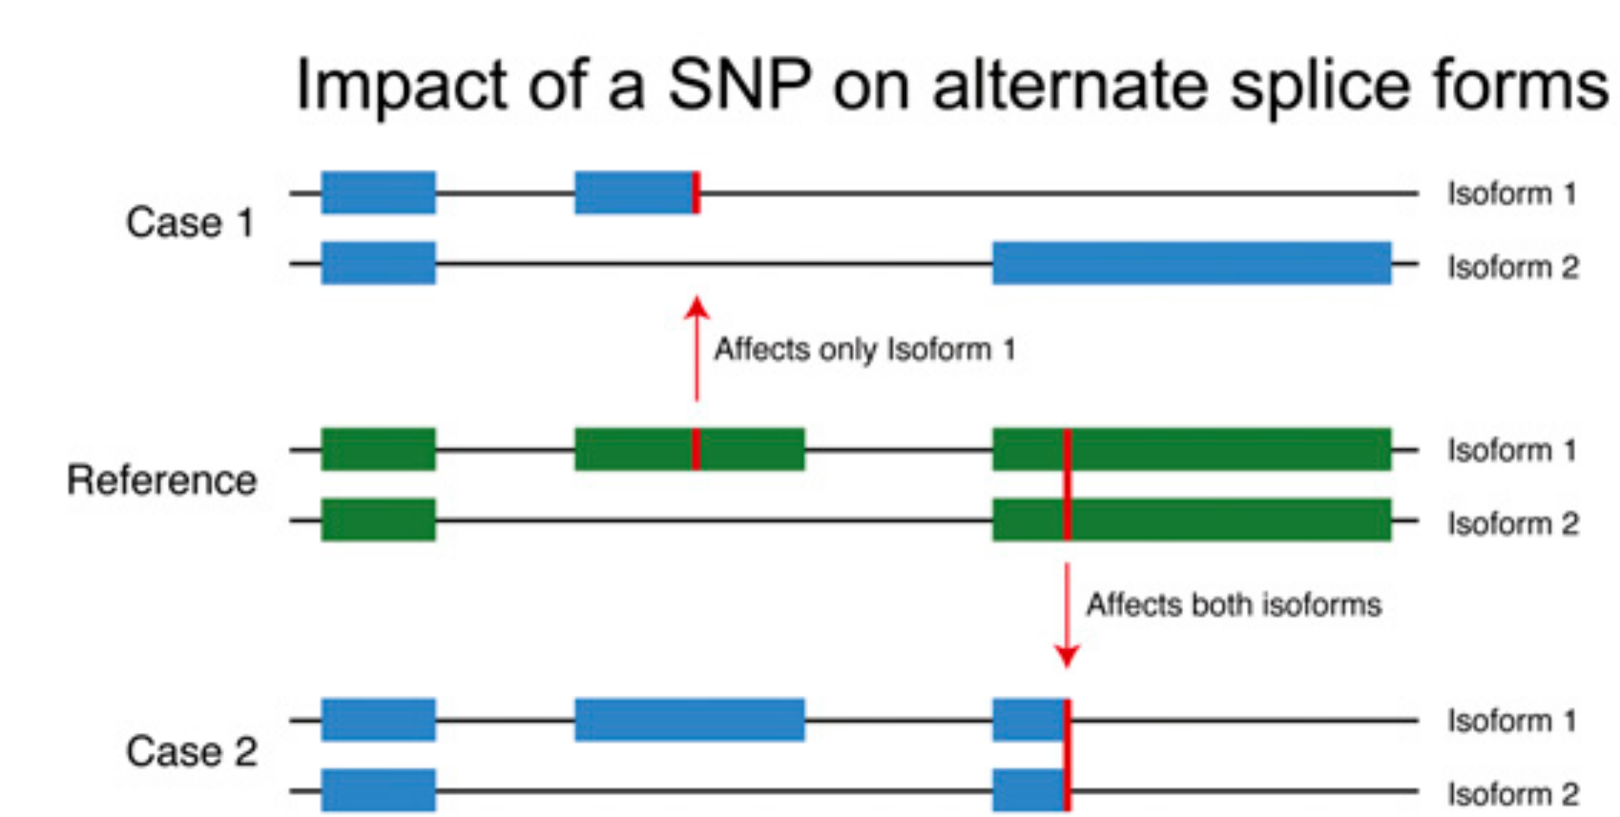
Complexities in LOF annotation
Transcript isoforms,
distance to stop,
functional domains,
protein folding,
etc.
Balasubramanian S. et al., Genes Dev., ’11
Balasubramanian S.*, Fu Y.* et al., NComms., ’17

Slide 13
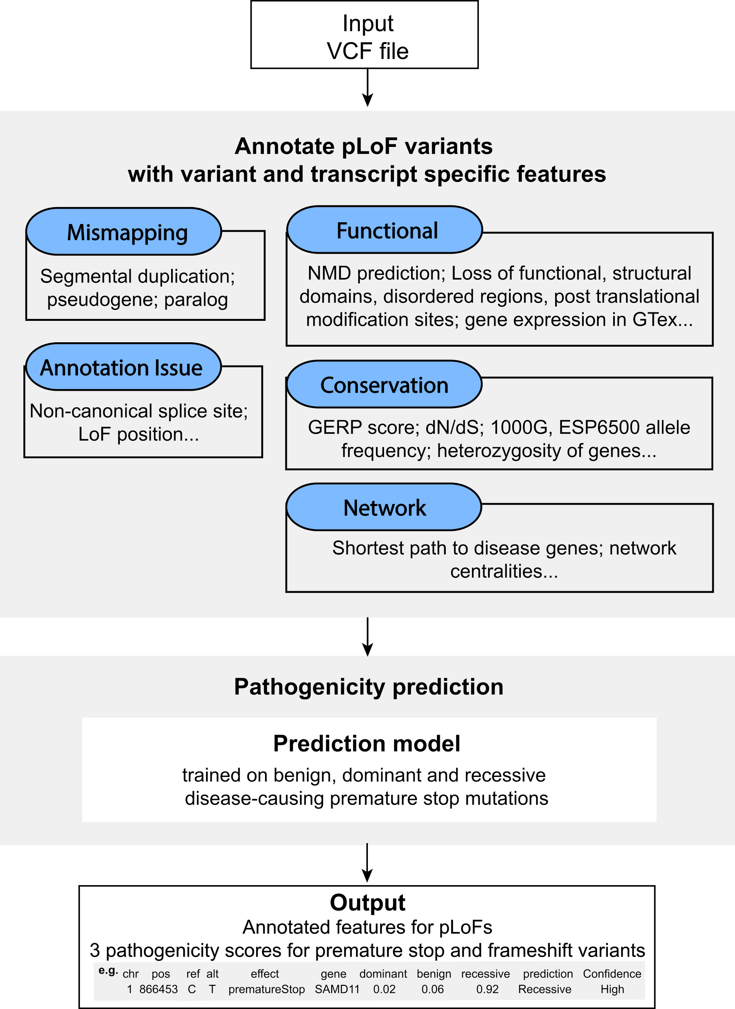
Annotation of Loss-of-Function Transcripts (ALoFT)
Runs on top of VAT
Output:
Impact score: benign or deleterious.
Confidence level.
Annotated VCF.
Access:
Software package: aloft.gersteinlab.org
GitHub: github.com/gersteinlab/aloft
Balasubramanian S.*, Fu Y.* et al., NComms., ’17

Slide 14
LoF distribution varies as expected by mutation set (from healthy people v from disease)
Balasubramanian S.*, Fu Y.* et al., NComms., ’17

Slide 15
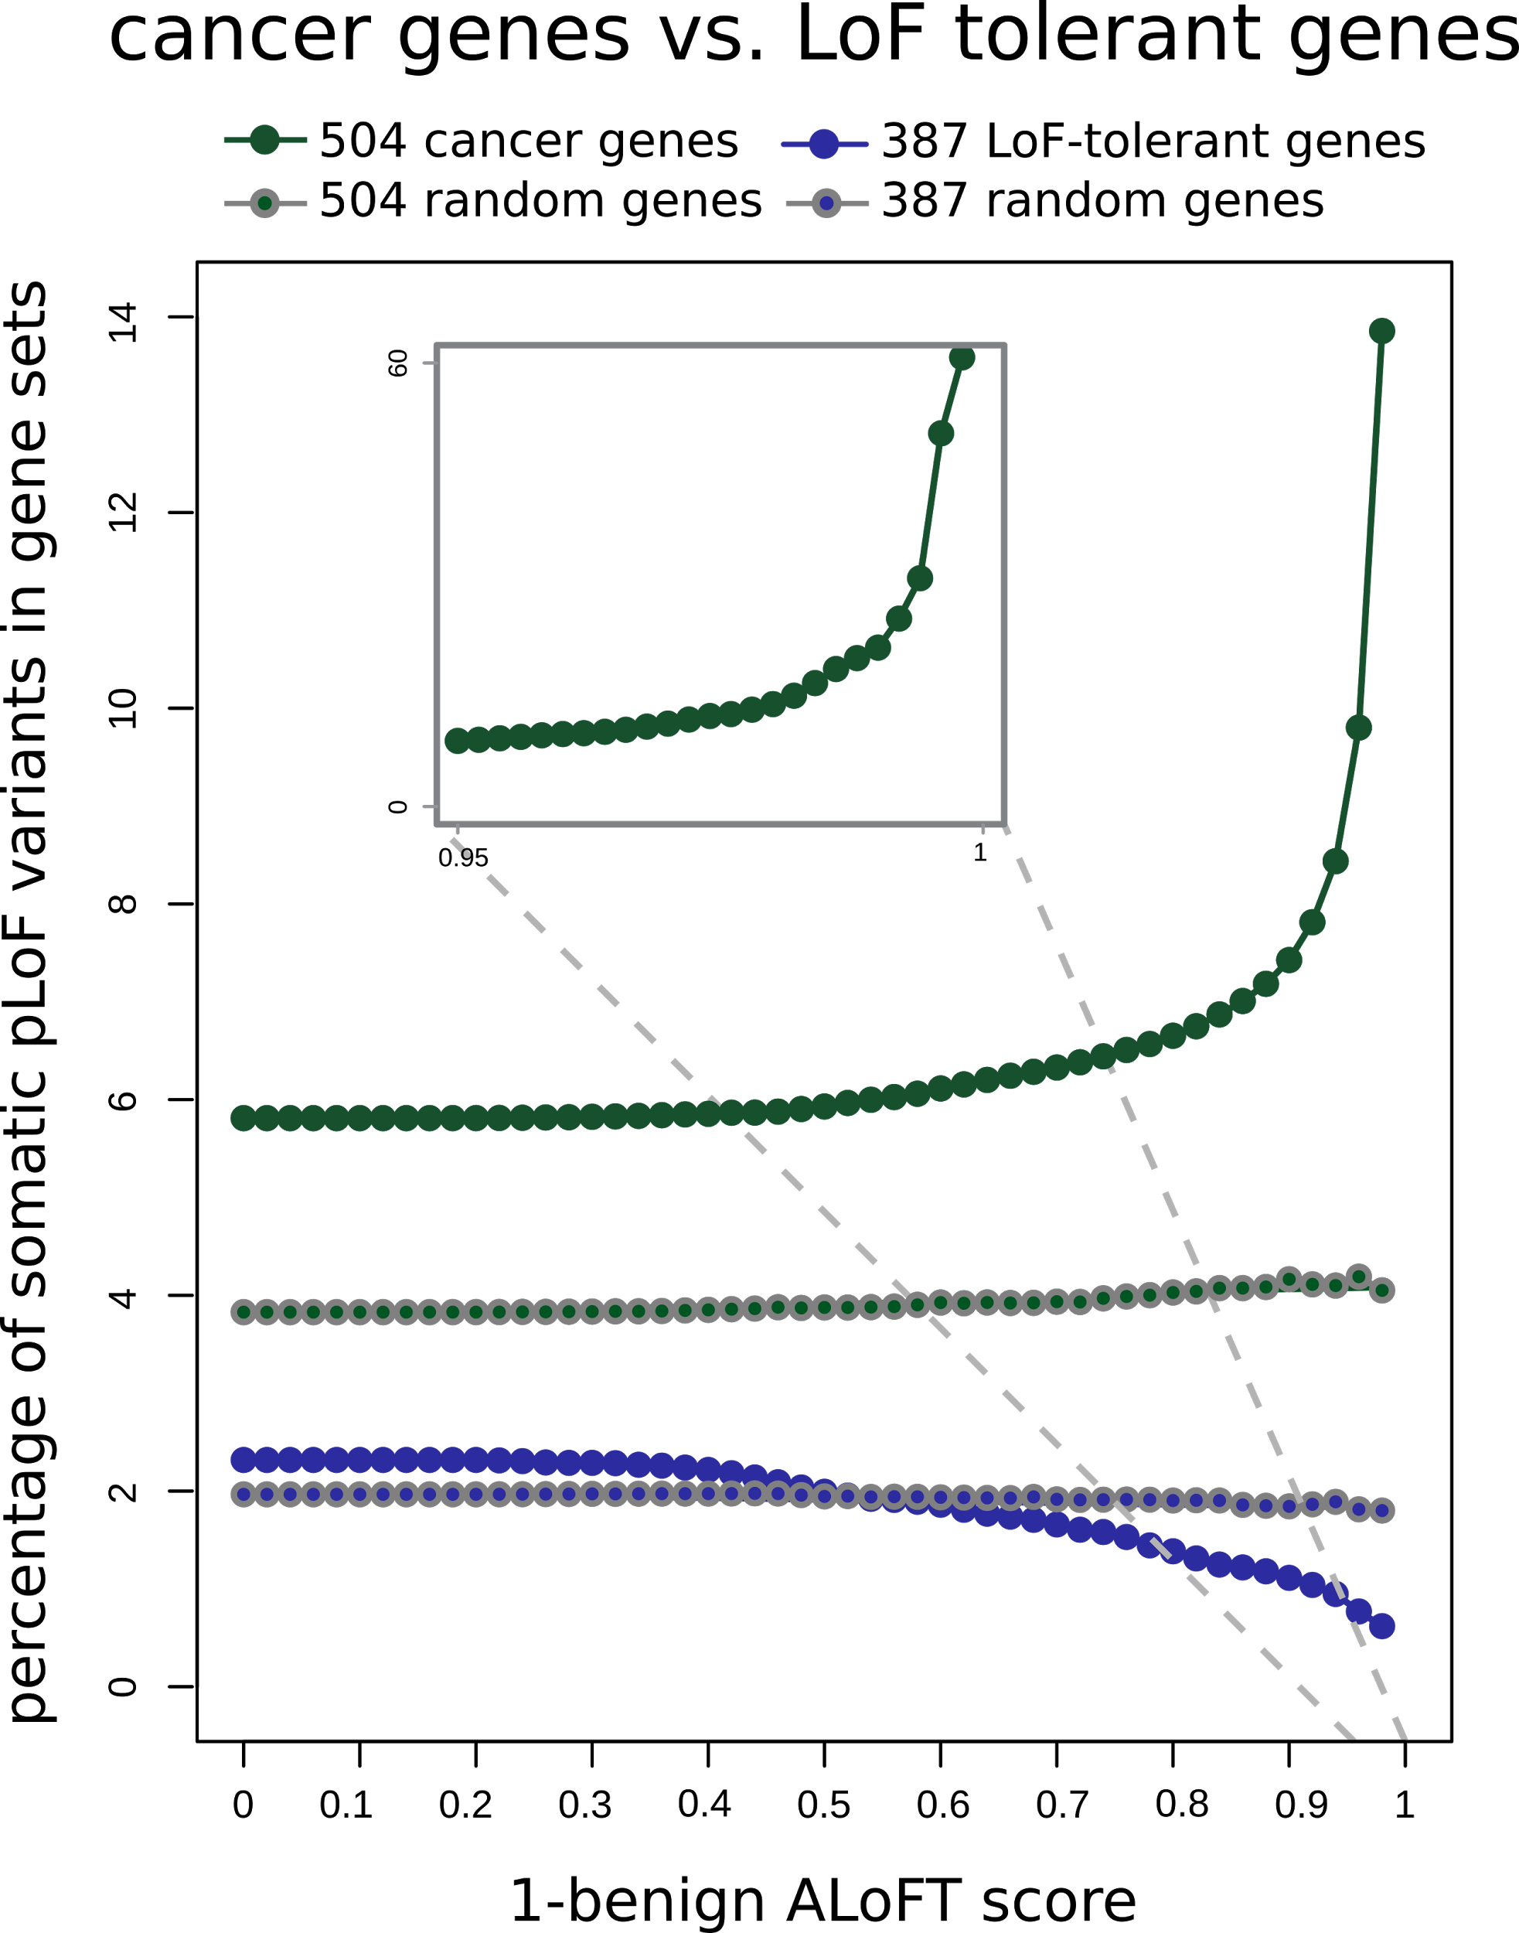
ALoFT identifies deleterious
somatic LoF variants
Cancer genes:
COSMIC consensus.
Enriched in deleterious LoFs.
LoF tolerant genes:
LoF in the 1KG cohort.
Depleted in deleterious LoFs.
Balasubramanian S.*, Fu Y.* et al., NComms., ’17

Slide 16
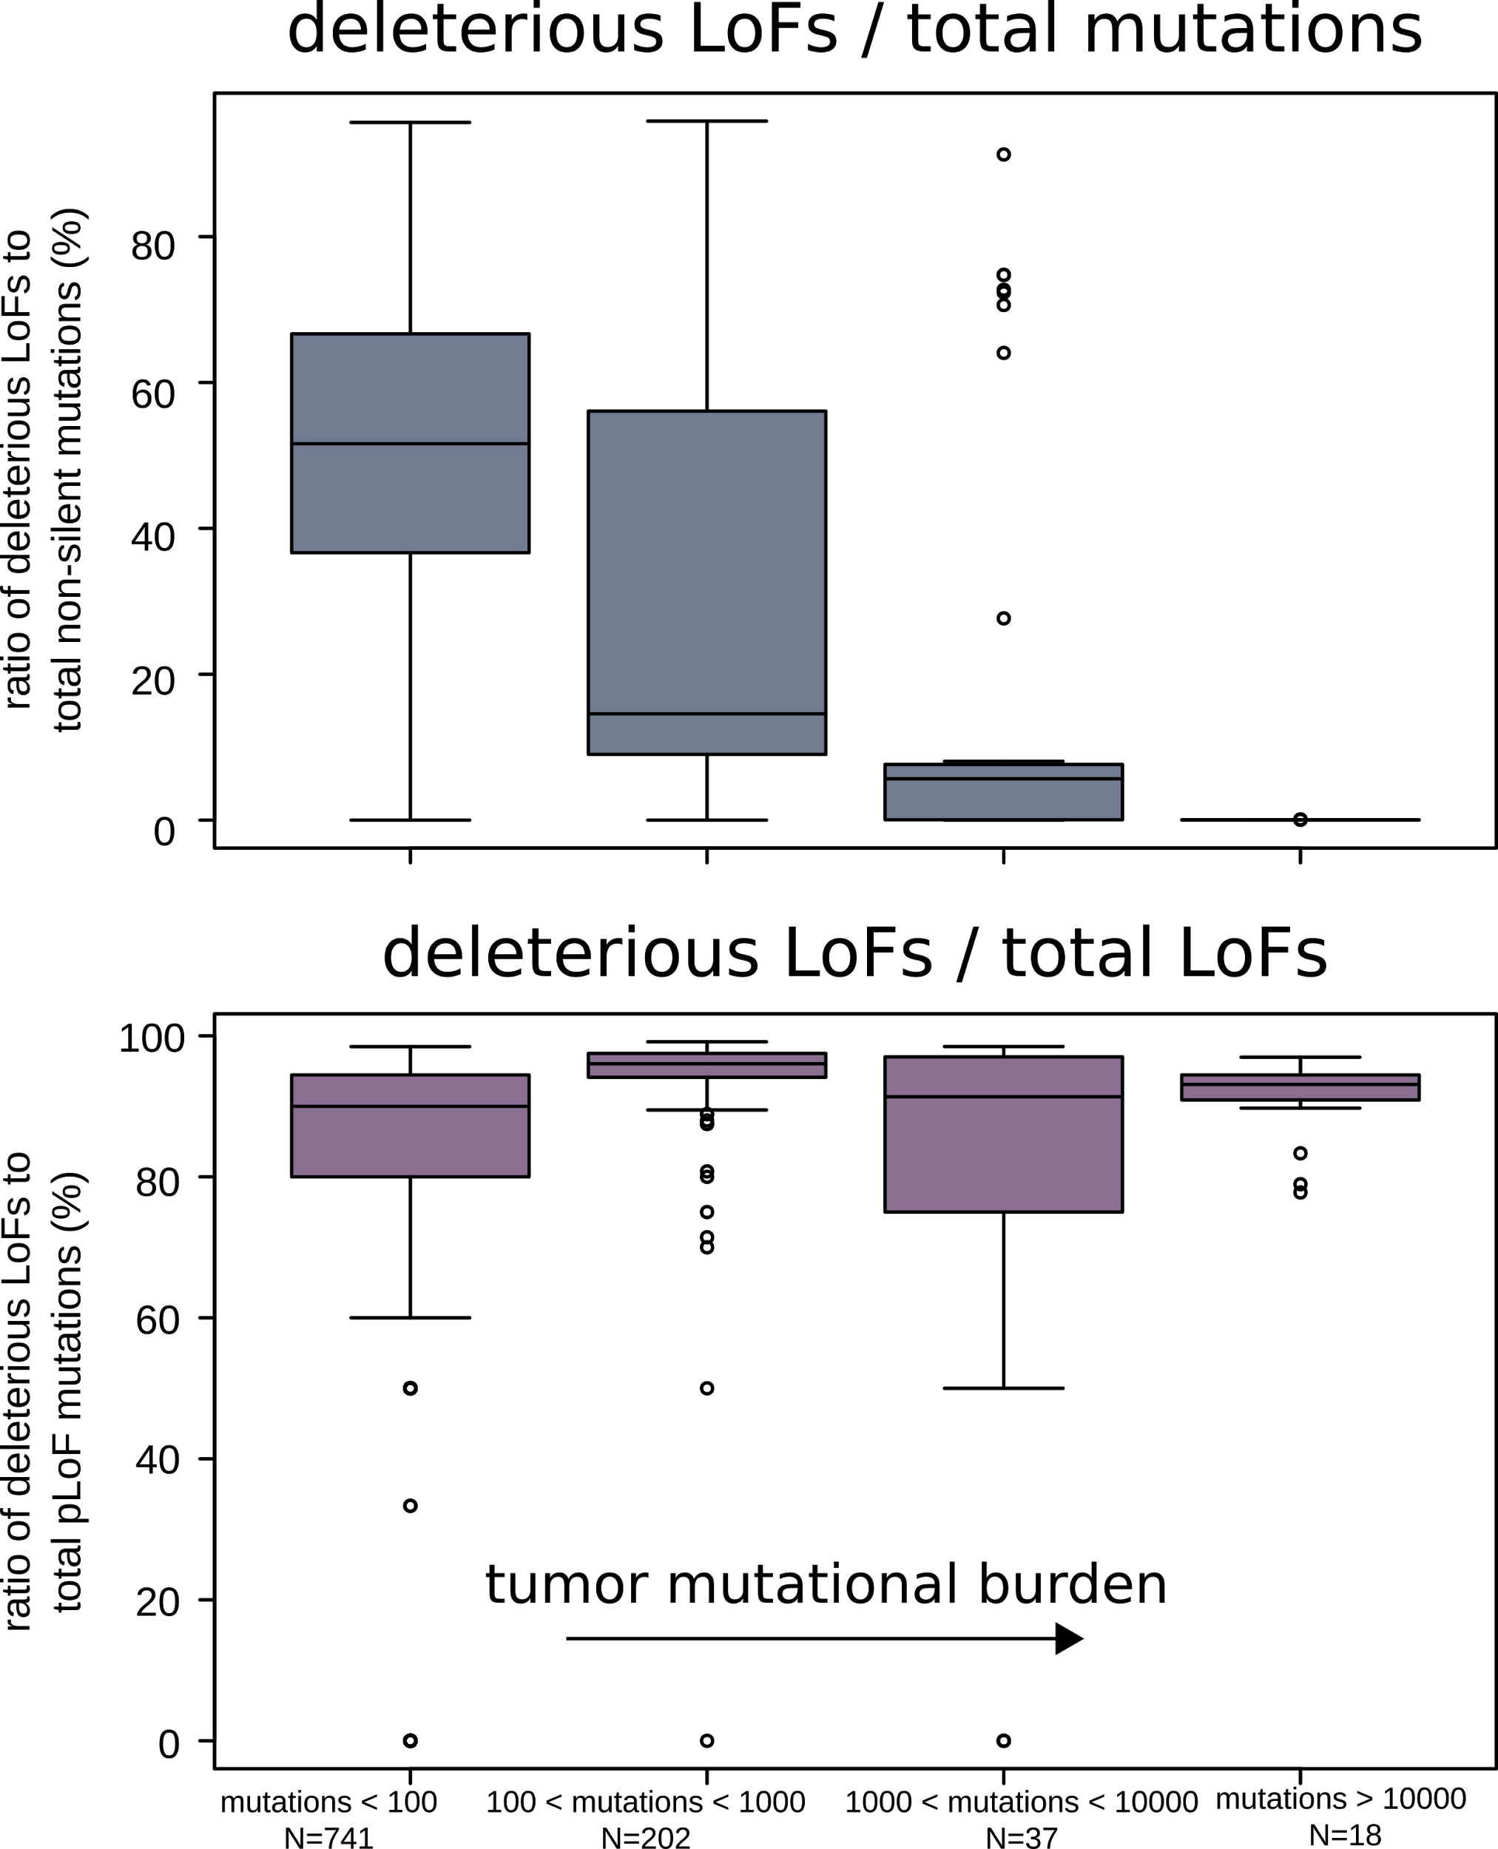
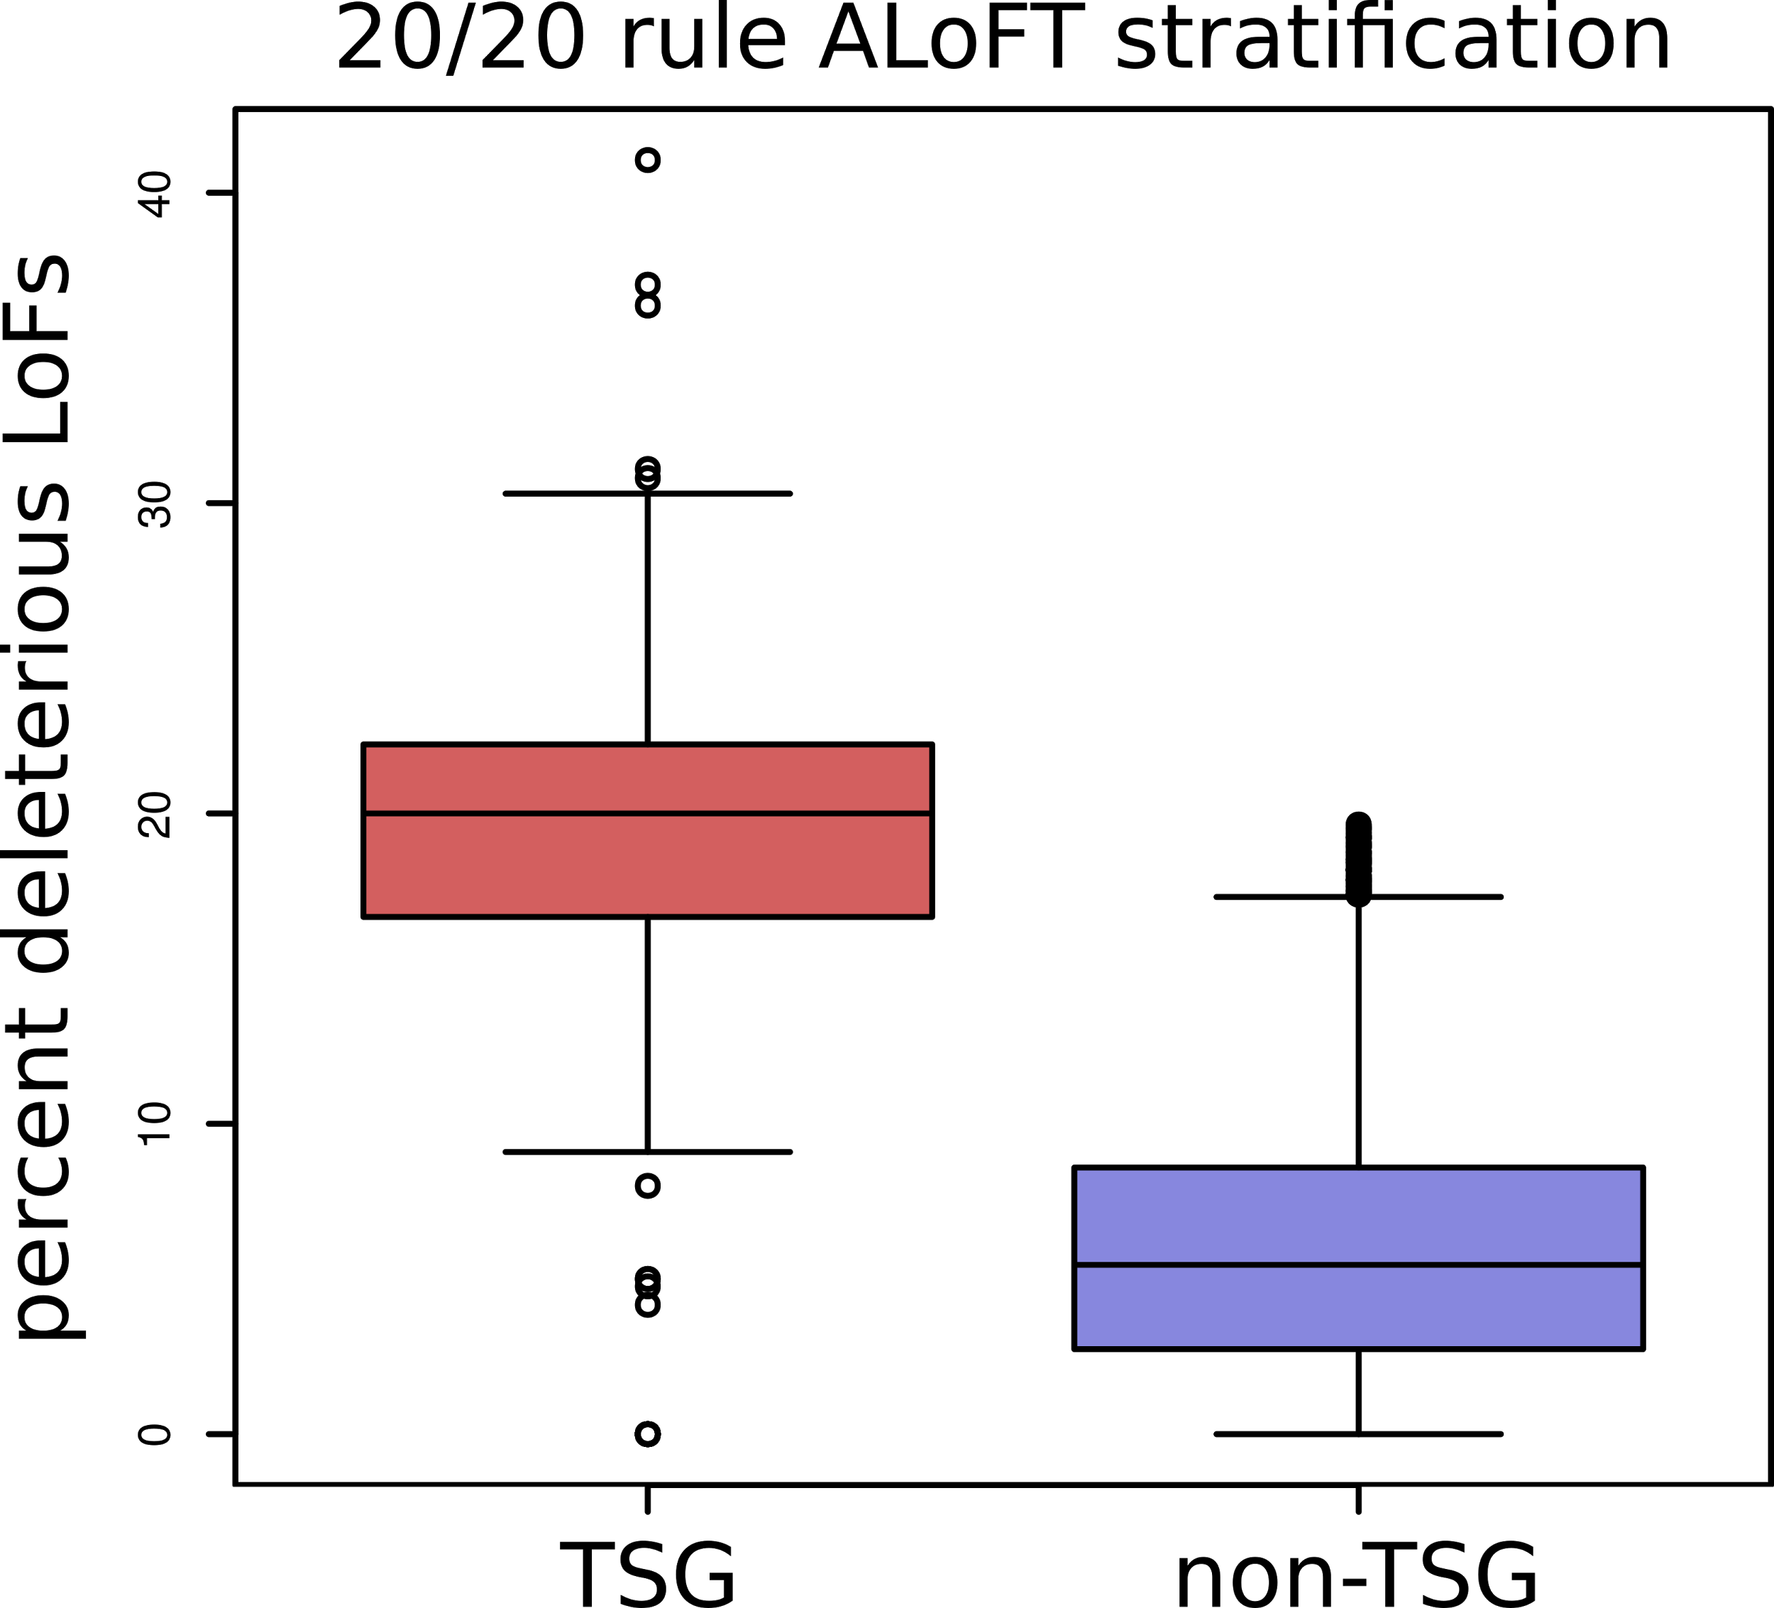
ALoFT refines cancer mutation characterization
Vogelstein et al. '13: if >20% of mutations in gene inactivating → tumor suppressor gene (TSG).
ALoFT further refines 20/20 rule predictions.
Balasubramanian S.*, Fu Y.* et al., NComms., ’17

Slide 17
Prioritizing somatic variants: Approaches to identifying key variants through functional impact & recurrence
Introduction
Large growth in cancer genome data
Mining the data to prioritize variants for key drivers
Functional impact #1: Coding
ALoFT: Annotation of Loss-of-Function Transcripts. LOF annotation as a complex problem.
Finding deleterious LoF SNVs
Frustration as a localized metric of SNV impact. Differential profiles for oncogenes vs. TSGs
Functional impact #2: Non-coding
FunSeq integrates evidence, with an entropy based weighting scheme
Recurrence #1: Statistics for driver identification
Background mutation rate significantly varies & is correlated with replication timing & TADs
Developed a variety of parametric & non-parametric methods taking this into account
LARVA uses parametric beta-binomial model, explicitly modeling covariates
MOAT does a variety of non-parm. shuffles (annotation, variants, &c). Useful when explicit covariates not available. Slower than but speeded up w/ GPUs
Recurrence #2: (Low-power) application to pRCC
WGS finds additional facts on the canonical driver, MET. Other suggestive non-coding hotspots.
Tumor evolution analysis of the timing of key mutations helps with classification

Slide 18
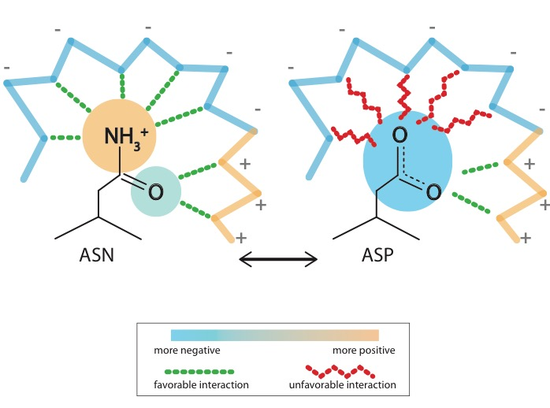
What is localized frustration?
[Ferreiro et al., PNAS (’07)]

Slide 19
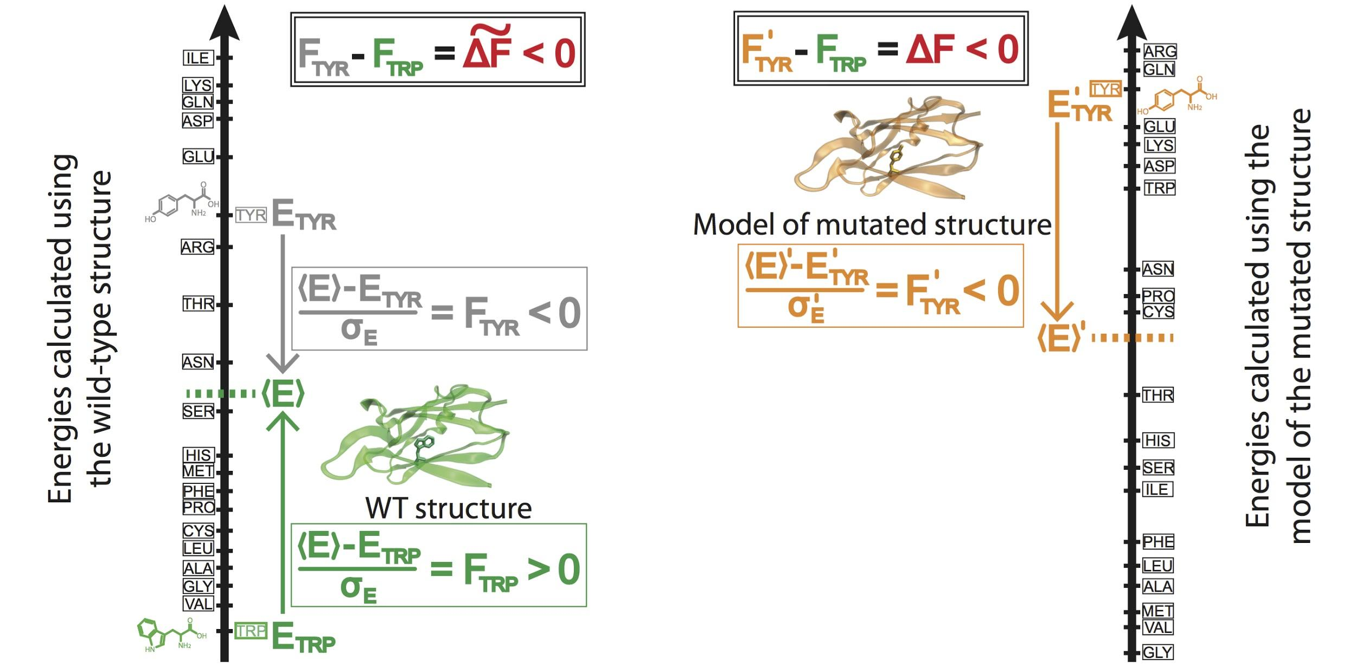
Workflow for evaluating localized frustration changes (∆F)
[Kumar et al. NAR (2016)]
Notes:
An example illustrating the case in which ∆F < 0. The ∆F associated with an SNV is negative if the SNV introduces a destabilizing effect. Shown here is the result of changing residue ID 31 in plastocyanin (pdb ID 3CVD) from the wild-type residue (Trp) to a mutated residue (Tyr). Left) The protein in its wild-type form (in green), in which the tryptophan residue at position 31 is substantially more energetically favorable relative to the mean energy ⟨E⟩ that would result from having any of the possible 20 amino acids at that position. This disparity is designated by (⟨E⟩ - E_{nat})/σ_{E} = F_{nat} > 0. Right) The entire protein structure is then modeled to generate the mutated structure after the SNV W31Y is introduced, thereby changing the relative energetic distributions for the different amino acids. The new mean and standard deviation associated with the energies of the modeled structure are designated by ⟨E⟩’ and σ_{E}’, respectively. In this case, the SNV that introduces 31Y results in an energy that is higher than the mean energy of all possible 20 amino acids at that position. This disparity is designated by (⟨E⟩’ - E_{mut})/σ_{E}’ = F_{mut} < 0. Taken together, the negative value associated with the disparity between the F_{mut} and F_{nat} values (F_{mut} - F_{nat} = ∆F < 0) indicates that the this SNV is locally unfavorable.

Slide 20
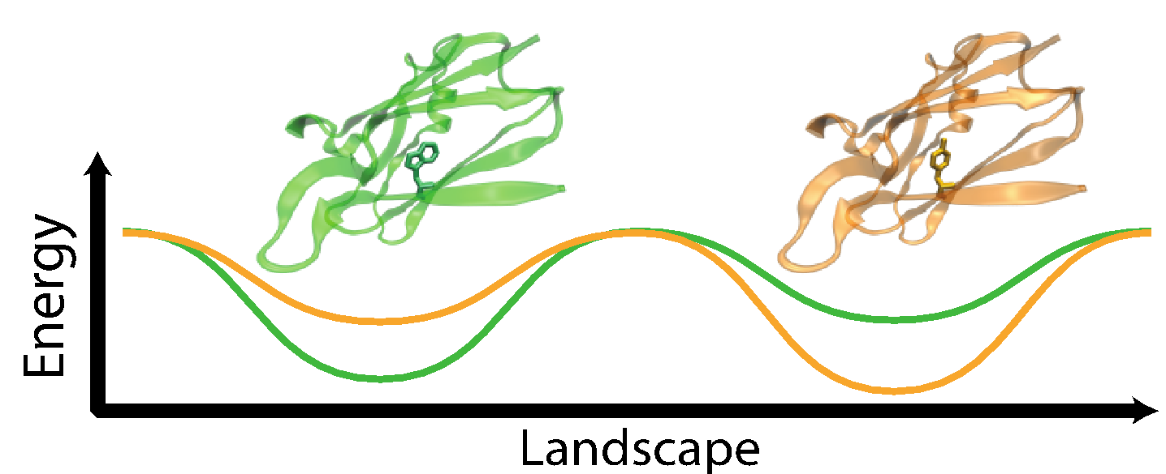
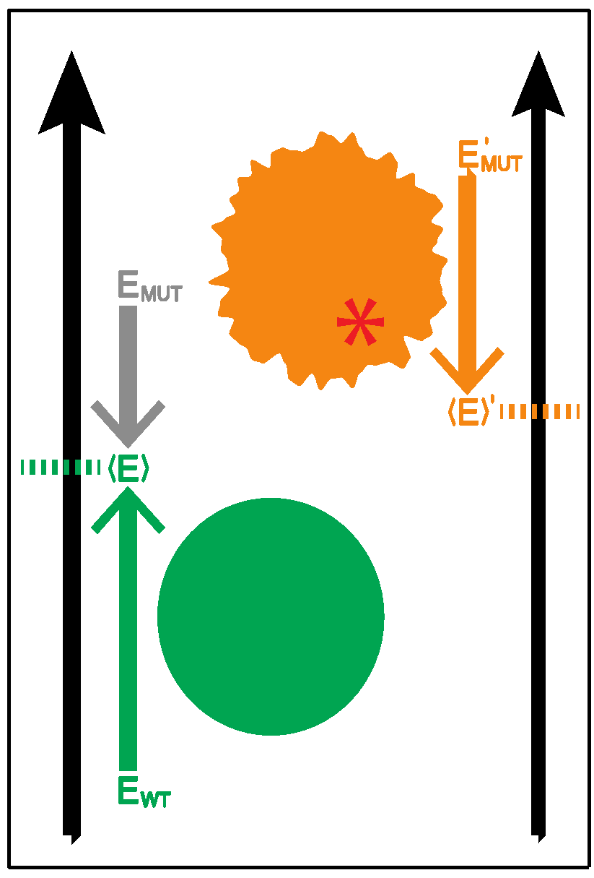
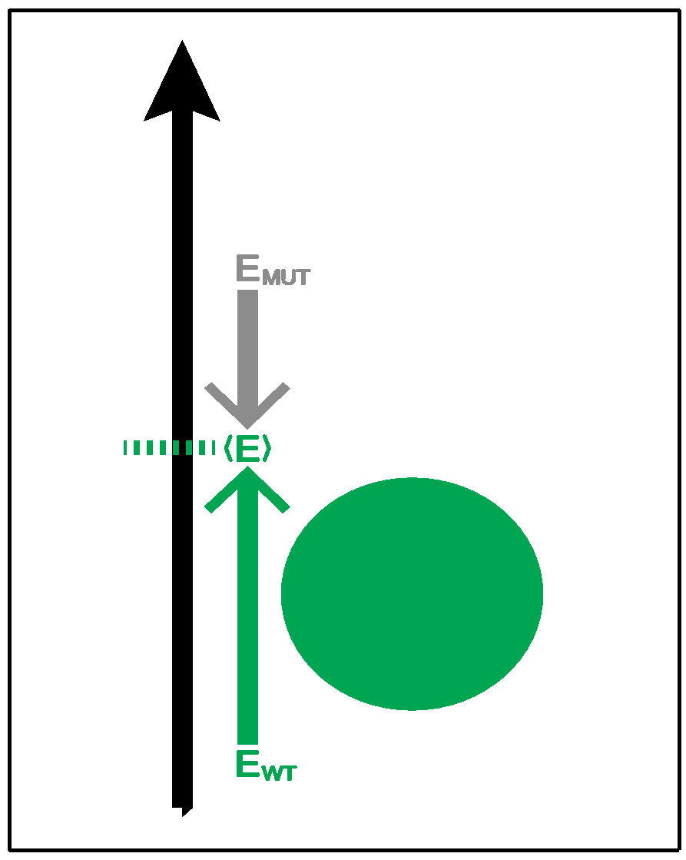
Complexity of the second order frustration calculation
MD-assisted free energy calculation (∆G)
Second order frustration calculation (∆F)
Time
First order frustration calculation (F)
Accuracy

Slide 21
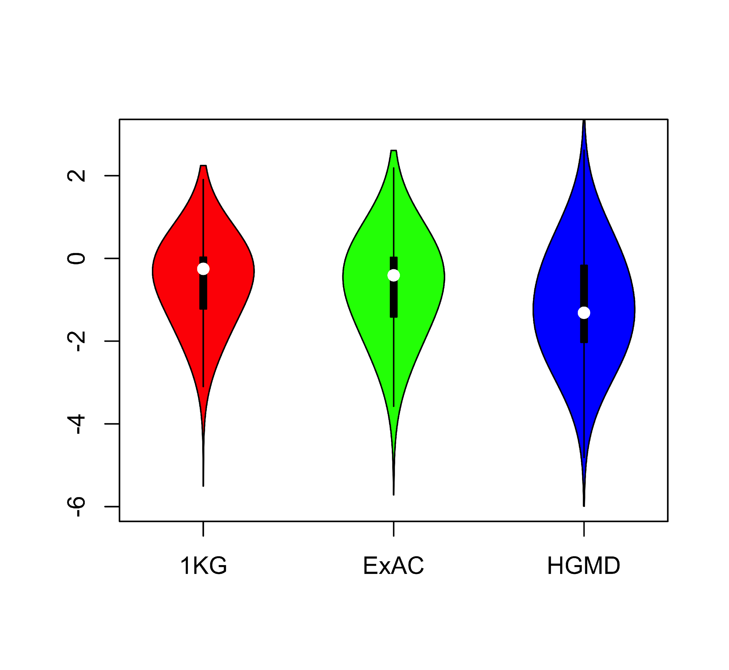
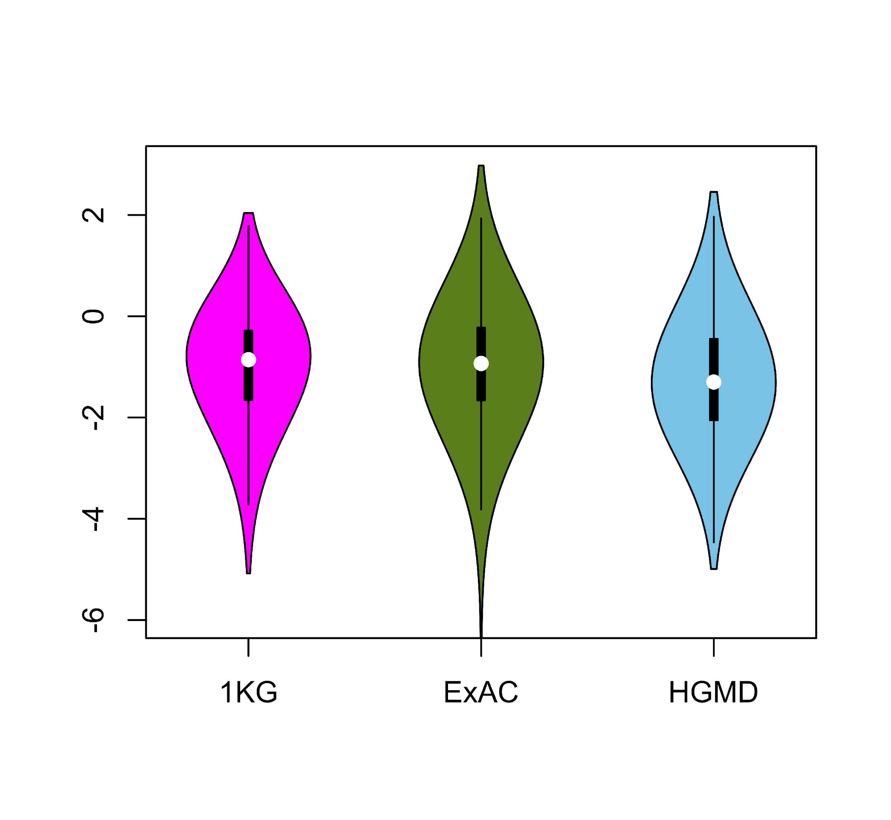
Comparing ∆F values across different SNV categories: disease v normal
Loss of frustration
Gain of frustration
Core residues
Surface residues
Normal mutations (1000G) tend to unfavorably frustrate (less frustrated) surface more than core, but for disease mutations (HGMD) no trend & greater changes
[Kumar et al, NAR (2016)]
Notes:
We observed that benign SNVs lead to greater disruptions within minimally frustrated surface residues compared to core residues in the native structure, and this trend is observed when using both ExAC and 1KG (Figure A & B). However, SNVs from HGMD that impact minimally frustrated core residues induce stronger perturbations than benign SNVs influencing minimally frustrated core residues (Figure C). This suggest that the mechanistic difference between benign and disease SNVs can be attributed to their impact on the local environment of core residues. Within the core, disease-associated SNVs result in more severe perturbations to local interactions relative to those introduced by benign SNVs. These local disruptions are propagated throughout the core and, in turn, drive the deleteriousness of various disease-associated SNVs.

Slide 22
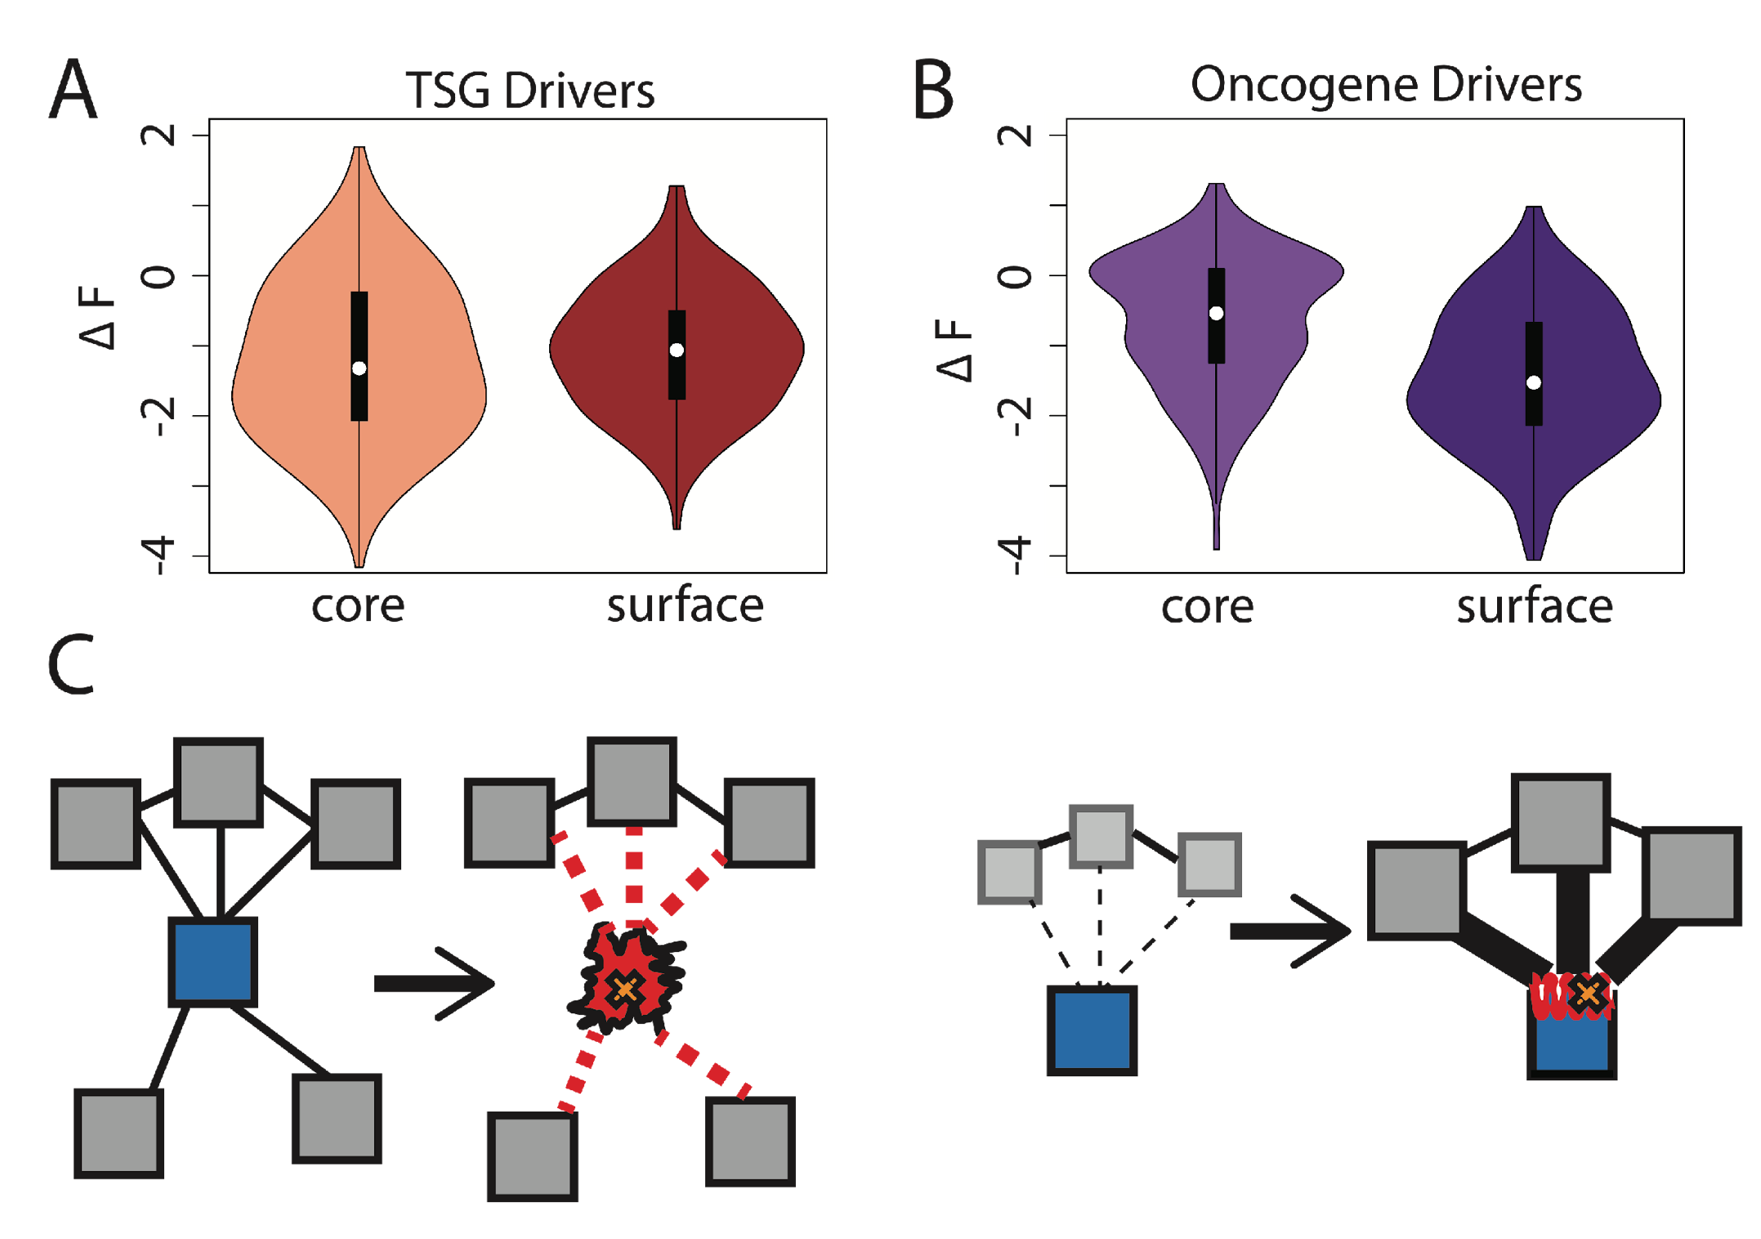
Comparison between ∆F distributions: TSGs v. oncogenes
[Kumar et al, NAR (2016)]
SNVs in TSGs change frustration more in core than the surface, whereas those associated with oncogenes manifest the opposite pattern. This is consistent with differences in LOF v GOF mechanisms.
Notes:
we observe that somatic SNVs associated with TSGs change the frustration more in core than the surface, whereas those associated with oncogenes manifest the opposite pattern. This is consistent with LOF and GOF mechanism proposed for TSG and oncogene driven cancer progression.

Slide 23
Prioritizing somatic variants: Approaches to identifying key variants through functional impact & recurrence
Introduction
Large growth in cancer genome data
Mining the data to prioritize variants for key drivers
Functional impact #1: Coding
ALoFT: Annotation of Loss-of-Function Transcripts. LOF annotation as a complex problem.
Finding deleterious LoF SNVs
Frustration as a localized metric of SNV impact. Differential profiles for oncogenes vs. TSGs
Functional impact #2: Non-coding
FunSeq integrates evidence, with an entropy based weighting scheme
Recurrence #1: Statistics for driver identification
Background mutation rate significantly varies & is correlated with replication timing & TADs
Developed a variety of parametric & non-parametric methods taking this into account
LARVA uses parametric beta-binomial model, explicitly modeling covariates
MOAT does a variety of non-parm. shuffles (annotation, variants, &c). Useful when explicit covariates not available. Slower than but speeded up w/ GPUs
Recurrence #2: (Low-power) application to pRCC
WGS finds additional facts on the canonical driver, MET. Other suggestive non-coding hotspots.
Tumor evolution analysis of the timing of key mutations helps with classification

Slide 24
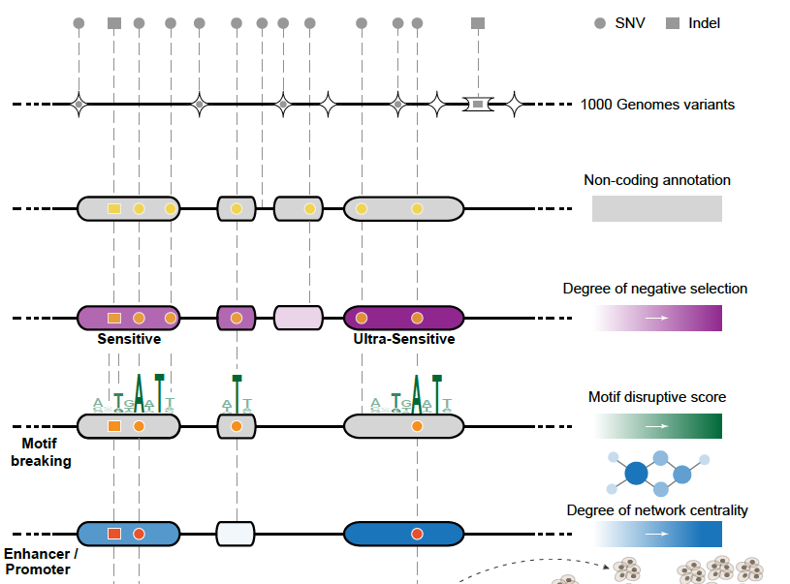
Funseq: a flexible framework to determine functional impact & use this to prioritize variants
Annotation (tf binding sites open chromatin, ncRNAs) & Chromatin Dynamics
Conservation (GERP, allele freq.)
Mutational impact (motif breaking, Lof)
Network (centrality position)
[Fu et al., GenomeBiology ('14), , Khurana et al., Science ('13)]

Slide 25
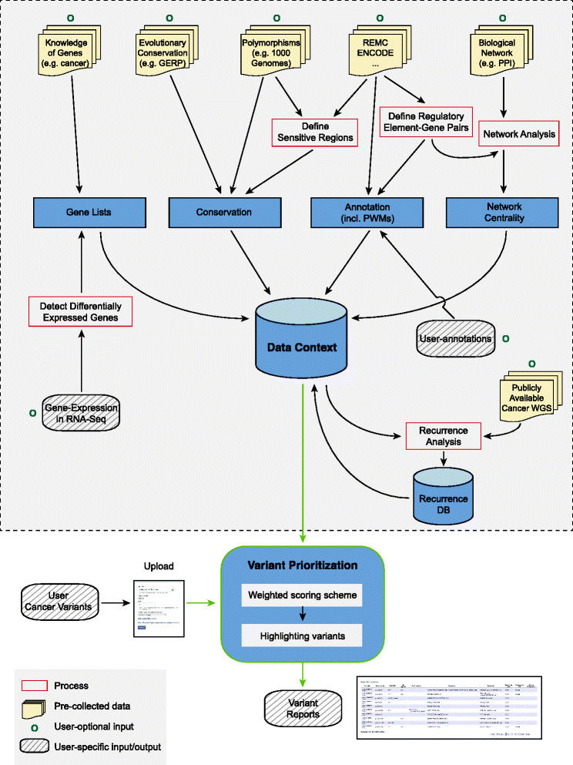
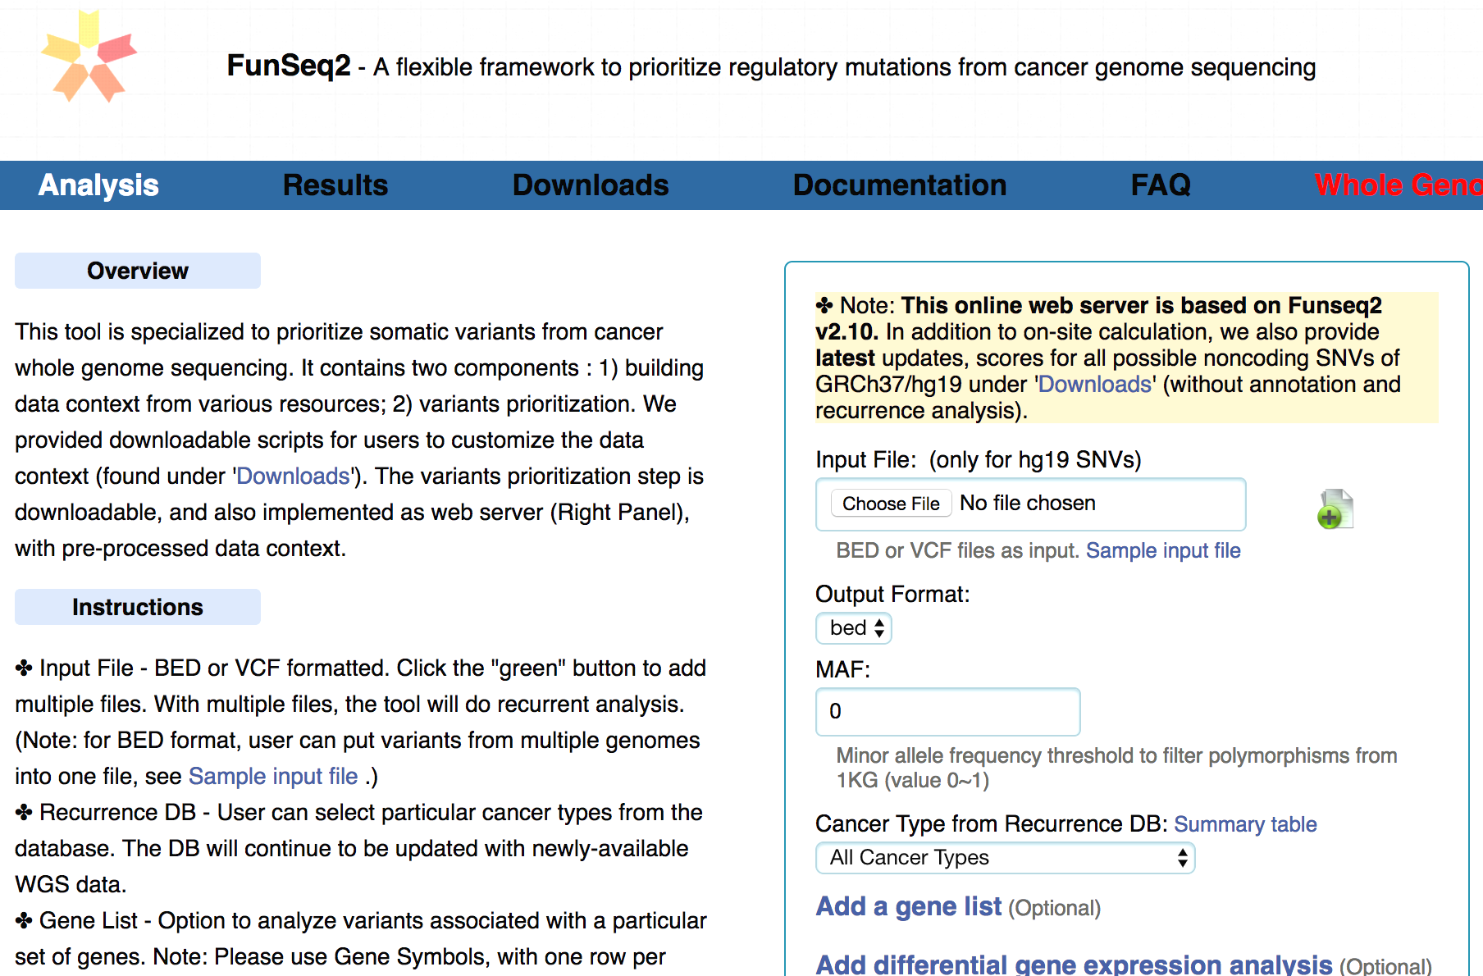
FunSeq.gersteinlab.org
HOT region
Sensitive region
Polymorphisms
Genome
Entropy based method for weighting consistently many genomic features
Practical web server
Submission of variants & pre-computed large data context from uniformly processing large-scale datasets
[Fu et al., GenomeBiology ('14)]

Slide 26
Prioritizing somatic variants: Approaches to identifying key variants through functional impact & recurrence
Introduction
Large growth in cancer genome data
Mining the data to prioritize variants for key drivers
Functional impact #1: Coding
ALoFT: Annotation of Loss-of-Function Transcripts. LOF annotation as a complex problem.
Finding deleterious LoF SNVs
Frustration as a localized metric of SNV impact. Differential profiles for oncogenes vs. TSGs
Functional impact #2: Non-coding
FunSeq integrates evidence, with an entropy based weighting scheme
Recurrence #1: Statistics for driver identification
Background mutation rate significantly varies & is correlated with replication timing & TADs
Developed a variety of parametric & non-parametric methods taking this into account
LARVA uses parametric beta-binomial model, explicitly modeling covariates
MOAT does a variety of non-parm. shuffles (annotation, variants, &c). Useful when explicit covariates not available. Slower than but speeded up w/ GPUs
Recurrence #2: (Low-power) application to pRCC
WGS finds additional facts on the canonical driver, MET. Other suggestive non-coding hotspots.
Tumor evolution analysis of the timing of key mutations helps with classification

Slide 27
Mutation recurrence
Cancer Type 1
Cancer Type 2
Cancer Type 3

Slide 28
Mutation recurrence
Cancer Type 1
Cancer Type 2
Cancer Type 3
Early replicated regions
Late replicated regions

Slide 29
Noncoding annotations
Cancer Type 1
Cancer Type 2
Cancer Type 3
Early replicated regions
Late replicated regions

Slide 30
Noncoding annotations
Cancer Type 1
Cancer Type 2
Cancer Type 3
Early replicated regions
Late replicated regions

Slide 31
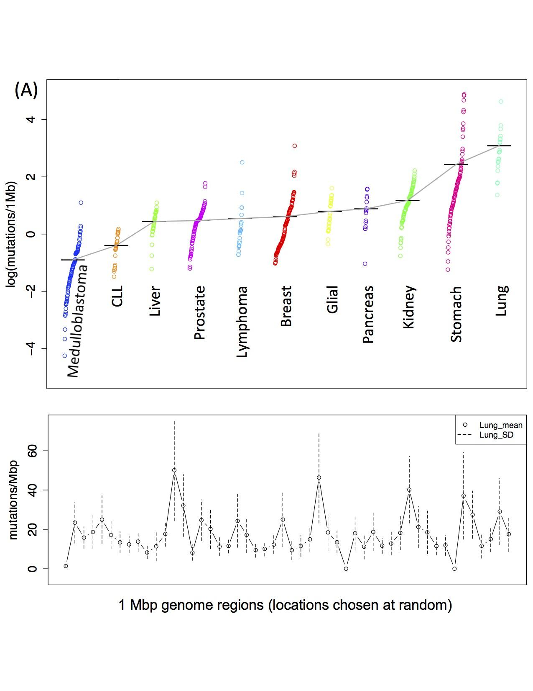
Cancer Somatic Mutational Heterogeneity, across cancer types, samples & regions
[Lochovsky et al. NAR (’15)]

Slide 32
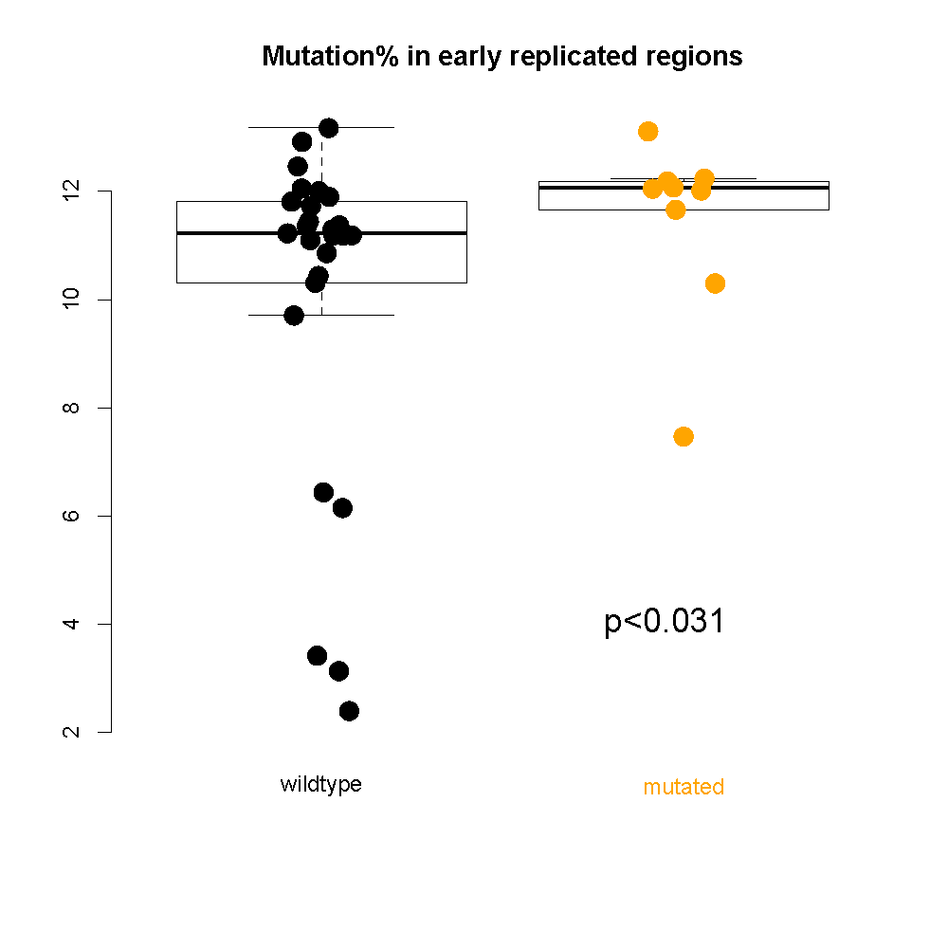
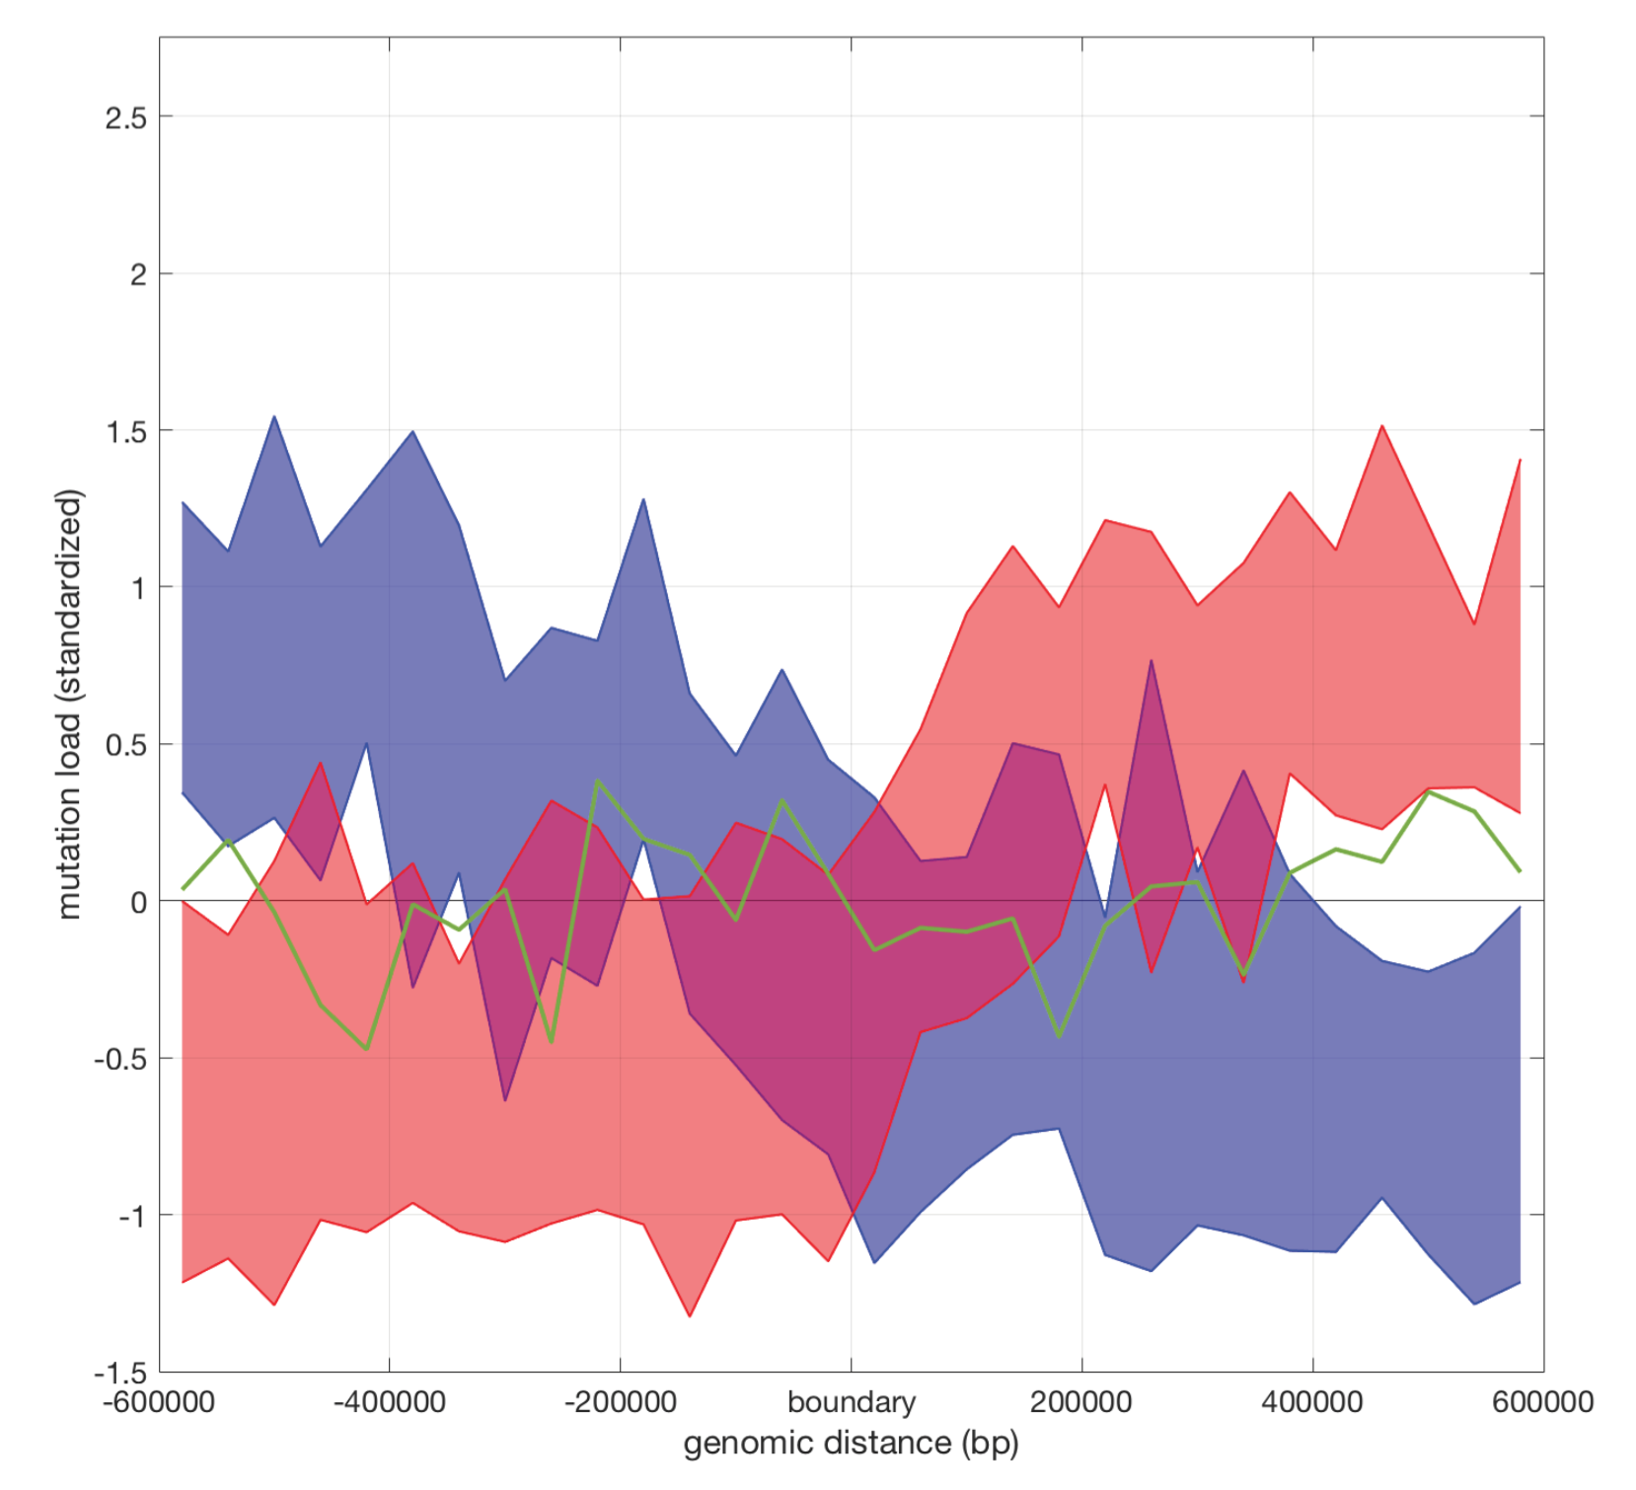
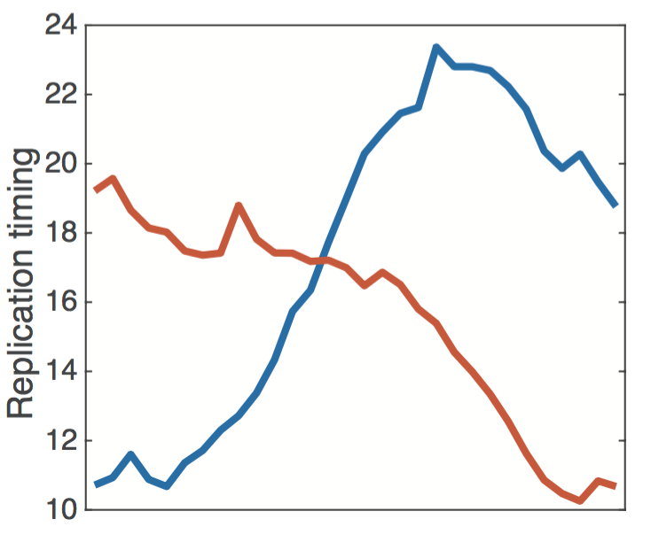
Chromatin remodeling failure leads to more mutations in early-replicating regions
Variation in somatic mutations is closely associated with chromatin structure (TADs) & replication timing
genomic distance from the TAD boundary
[Yan et al., PLOS Comp. Bio. (‘17); S. Li et al., PLOS Genetics (‘17)] ]

Slide 33
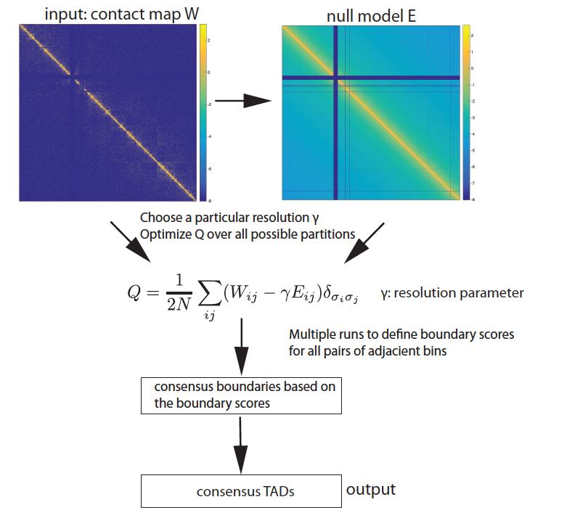
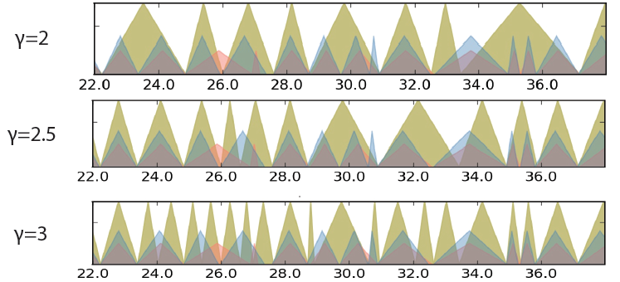
mrTADFinder: Identifying TADs at multiple resolutions by maximizing modularity vs appropriate null
[Yan et al., PLOS Comp. Bio. (‘17)]

Slide 34
Prioritizing somatic variants: Approaches to identifying key variants through functional impact & recurrence
Introduction
Large growth in cancer genome data
Mining the data to prioritize variants for key drivers
Functional impact #1: Coding
ALoFT: Annotation of Loss-of-Function Transcripts. LOF annotation as a complex problem.
Finding deleterious LoF SNVs
Frustration as a localized metric of SNV impact. Differential profiles for oncogenes vs. TSGs
Functional impact #2: Non-coding
FunSeq integrates evidence, with an entropy based weighting scheme
Recurrence #1: Statistics for driver identification
Background mutation rate significantly varies & is correlated with replication timing & TADs
Developed a variety of parametric & non-parametric methods taking this into account
LARVA uses parametric beta-binomial model, explicitly modeling covariates
MOAT does a variety of non-parm. shuffles (annotation, variants, &c). Useful when explicit covariates not available. Slower than but speeded up w/ GPUs
Recurrence #2: (Low-power) application to pRCC
WGS finds additional facts on the canonical driver, MET. Other suggestive non-coding hotspots.
Tumor evolution analysis of the timing of key mutations helps with classification

Slide 35
Cancer Somatic Mutation Modeling
PARAMETRIC MODELS
Suppose there are k genome elements. For element i, define:
n_{i}: total number of nucleotides
x_{i}: the number of mutations within the element
p: the mutation rate
R_{i}: the covariate rank of the element
Non-parametric model is useful when covariate data is missing for the studied annotations
Also sidesteps issue of properly identifying and modeling every relevant covariate (possibly hundreds)
NON-PARAMETRIC MODELS
Model 1: Constant Background Mutation Rate (Model from Previous Work)
Assume constant background mutation rate in local regions.
Model 3a: Random Permutation of Input Annotations
Model 2a: Varying Mutation Rate
with Single Covariate Correction
Shuffle annotations within local region to assess background mutation rate.
Model 3b: Random Permutation of Input Variants
Shuffle variants within local region to assess background mutation rate.
Model 2b: Varying Mutation Rate
with Multiple Covariate Correction
[Lochovsky et al. under review]
[Lochovsky et al. NAR (’15)]

Slide 36
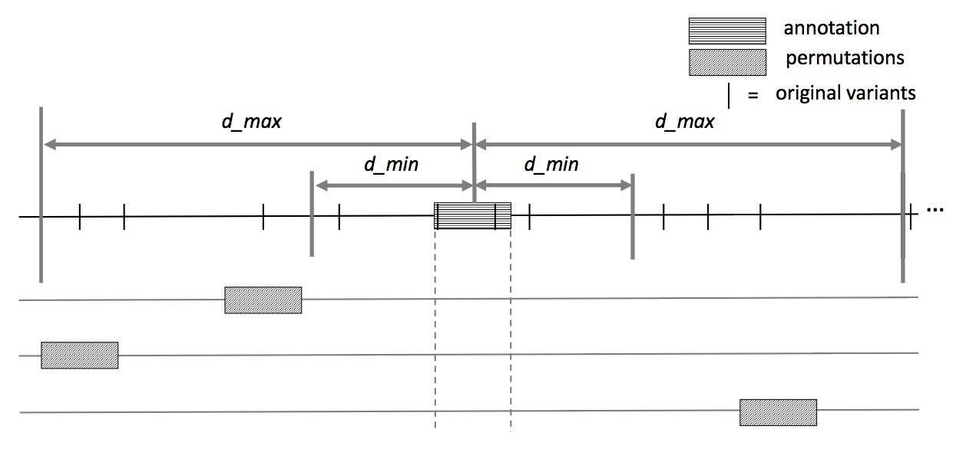
MOAT-a: Annotation-based permutation
[Lochovsky et al. under review]
Notes:
Formally, this method incorporates the annotation length l, the number of random bins we’re going to place in the surrounding genome, n, and two parameters that determine the boundaries of the local genome in which we place random bins, d_min and d_max. d_max has to be small enough that the background mutation rate is roughly constant, while d_min exists to ensure that, if there’s some transitionary region between the mutation rate of a and the mutation rate of the surrounding genome, that the signal from a won’t bleed into our analysis of the local genome context.

Slide 37
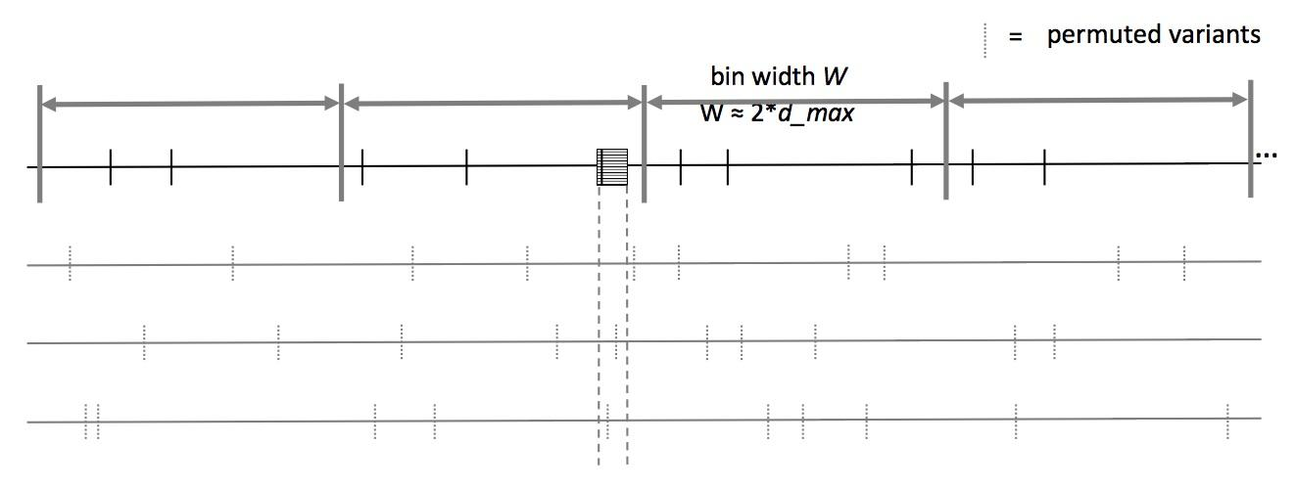
MOAT-v: Variant-based Permutation
Can preserve tri-nt context in shuffle
[Lochovsky et al. under review]
Notes:
The second version of MOAT operates on the idea of variant-based permutation. We place bins over the entire genome that each represent a local genome context, shuffle the variants in each bin, and track permuted variant counts for the annotation we’re studying.

Slide 38
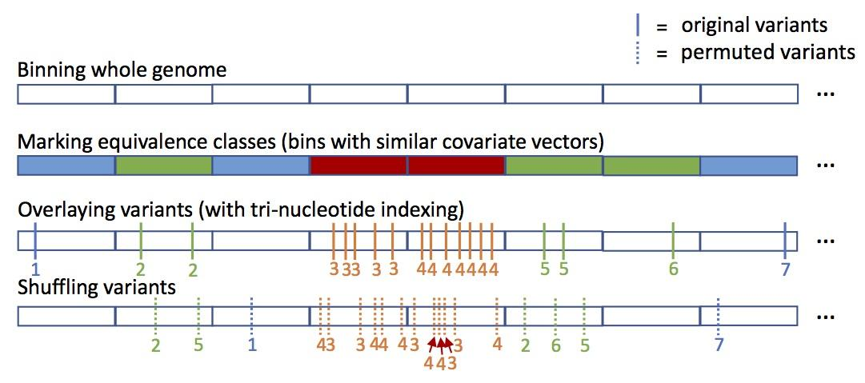
MOAT-s: a variant on MOAT-v
A somatic variant simulator
Given a set of input variants, shuffle to new locations, taking genome structure into account
[Lochovsky et al. under review]

Slide 39
Funseq Integration with MOAT
Run Funseq over the whole genome
Produce signal track that is the maximum score at each position
Calculate an annotation signal by summing the intersecting variants’ scores
Use the same procedure on permuted data
These are background scores to determine if the observed score is significantly elevated
80
80
50
20
20
50
+
30
20
= 50
0
40
[Lochovsky et al. under review]

Slide 40
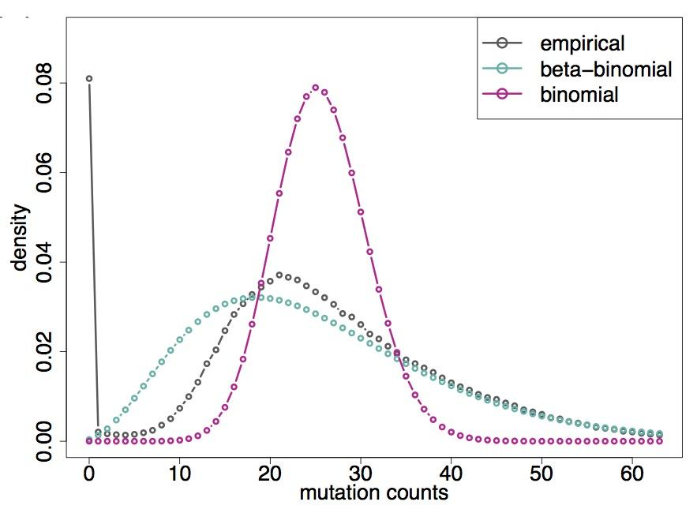
LARVA Model Comparison
Comparison of mutation count frequency implied by the binomial model (model 1) and the beta-binomial model (model 2) relative to the empirical distribution
The beta-binomial distribution is significantly better, especially for accurately modeling the over-dispersion of the empirical distribution
[Lochovsky et al. NAR (’15)]

Slide 43
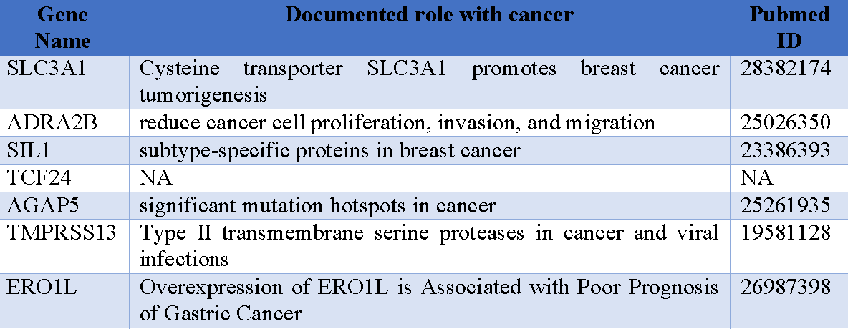
MOAT: recapitulates LARVA with GPU-driven runtime scalability
Computational efficiency of MOAT’s NVIDIA™ CUDA™ version, with respect to the number of permutations, is dramatically enhanced compared to CPU version.
.
Number of permutations | Fold speedup of CUDA version
1k | 14x
10k | 100x
100k | 256x
.
.
MOAT’s high mutation burden elements recapitulate LARVA’s results & published noncoding cancer-associated elements.
[Lochovsky et al. under review]

Slide 44
Prioritizing somatic variants: Approaches to identifying key variants through functional impact & recurrence
Introduction
Large growth in cancer genome data
Mining the data to prioritize variants for key drivers
Functional impact #1: Coding
ALoFT: Annotation of Loss-of-Function Transcripts. LOF annotation as a complex problem.
Finding deleterious LoF SNVs
Frustration as a localized metric of SNV impact. Differential profiles for oncogenes vs. TSGs
Functional impact #2: Non-coding
FunSeq integrates evidence, with an entropy based weighting scheme
Recurrence #1: Statistics for driver identification
Background mutation rate significantly varies & is correlated with replication timing & TADs
Developed a variety of parametric & non-parametric methods taking this into account
LARVA uses parametric beta-binomial model, explicitly modeling covariates
MOAT does a variety of non-parm. shuffles (annotation, variants, &c). Useful when explicit covariates not available. Slower than but speeded up w/ GPUs
Recurrence #2: (Low-power) application to pRCC
WGS finds additional facts on the canonical driver, MET. Other suggestive non-coding hotspots.
Tumor evolution analysis of the timing of key mutations helps with classification

Slide 45
Power, as an issue in driver discovery
[Kumar & Gerstein, Nature ('17)]
Better annotation or large number of samples could help.

Slide 46
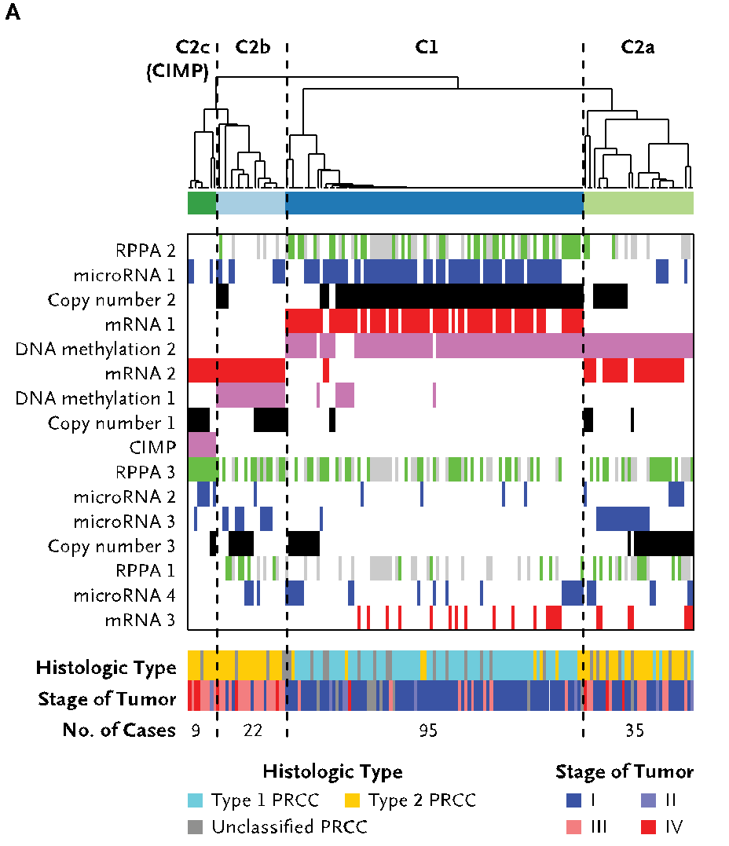
An (underpowered) case study: pRCC
Kidney cancer lifetime risk of 1.6% & the papillary type (pRCC) counts for ~10% of all cases
TCGA project sequenced 161 pRCC exomes & classified them into subtypes
Yet, cannot pin down the cause for a significant portion of cases....
35 WGS of TN pairs, perhaps useful?
[Cancer Genome Atlas Research Network N Engl J Med. (‘16) ]

Slide 47
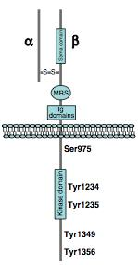
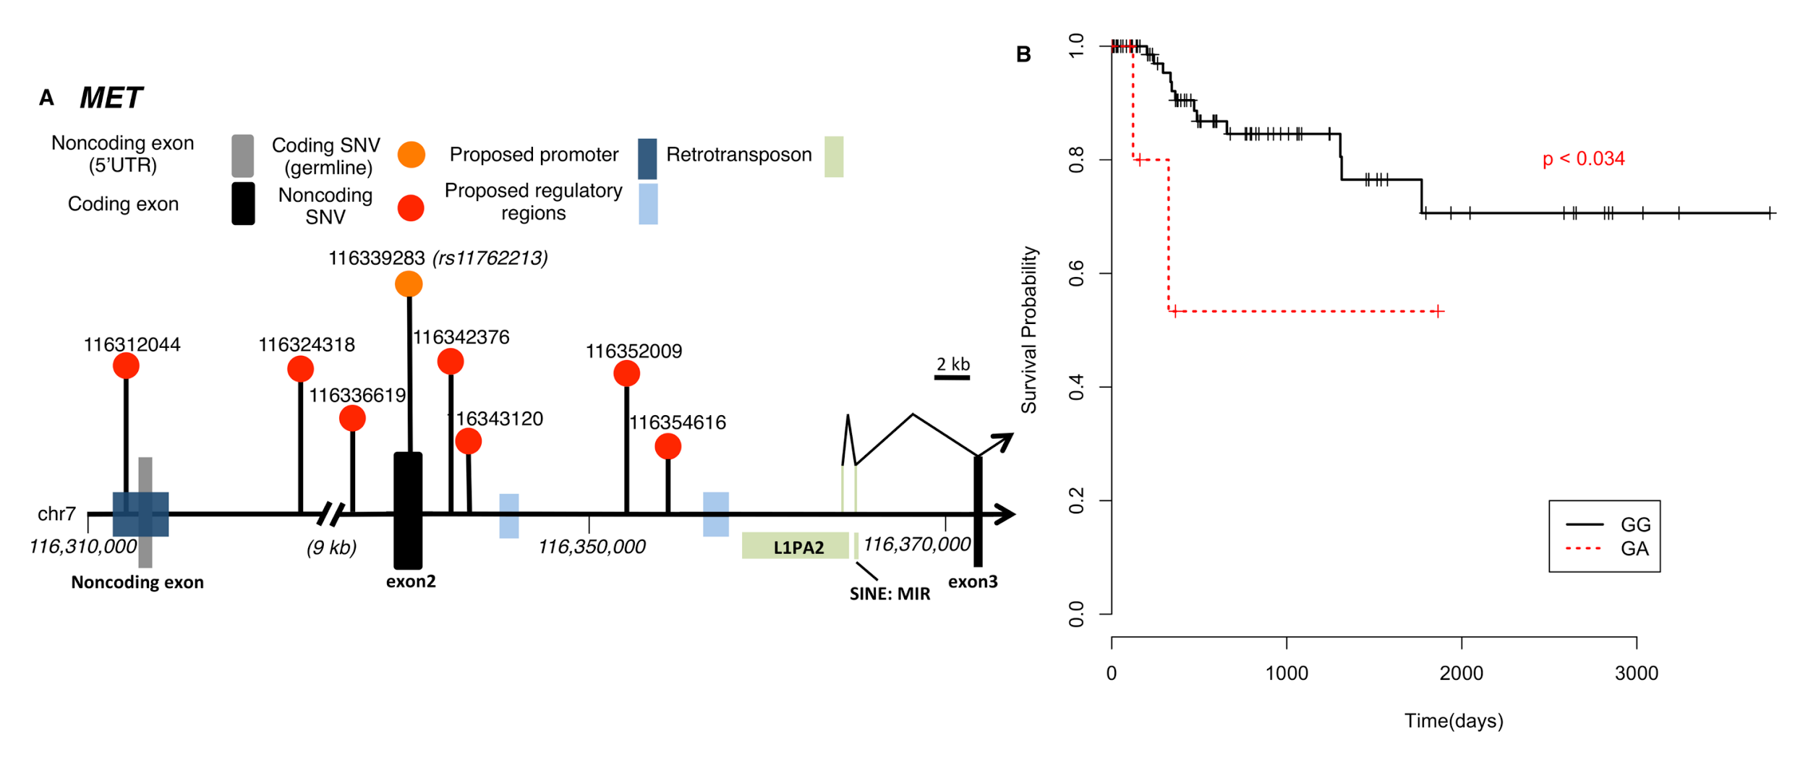
Tyr-kinase MET:
Known Facts & New Results
MET is long known pRCC driver
In MET, TCGA found somatic SNVs, dup- lications & an alt. splicing event as drivers (43/161).
In addition, from 35 WGS we found
A noncoding hotspot associated with MET
Lack of SV and breakpoint disrupting MET
Germline SNP (rs11762213) predicts survival in type 2 patients
[A. Gentile, L. Trusolino and PM. Comoglio, Cancer and Metastasis Reviews (‘08); S. Li, B. Shuch and M. Gerstein PLOS Genetics (‘17)]

Slide 48
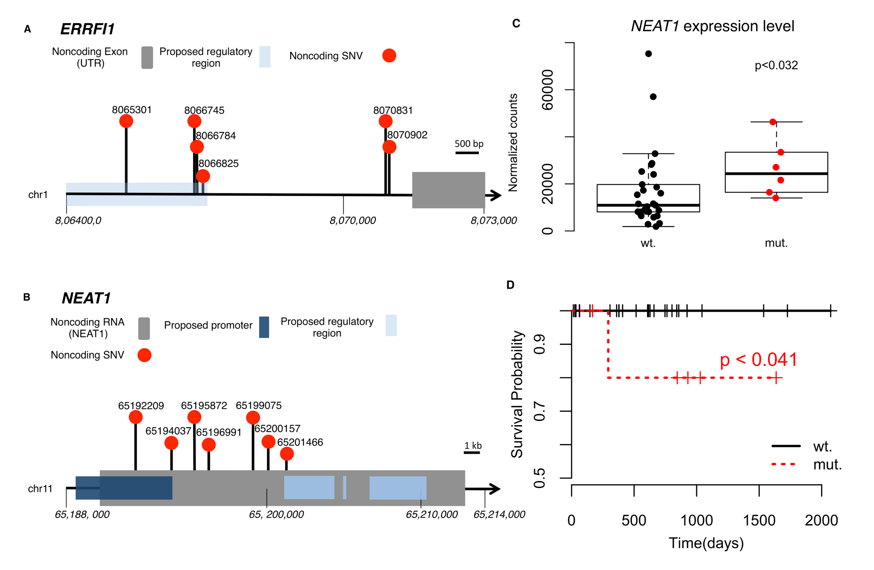
Beyond MET: 2 non-coding hotspots in NEAT & ERRFl1,
supported by expr. changes & survival analysis
[Li et al. PLOS Genetics (‘17)]

Slide 49
Tumor Evolution: Highlight the Ordering of Key Mutations
Yates et al, NRG (2012)

Slide 50
Construct evolutionary trees in pRCC
Infer mutation order and tree structure based on mutation abundance (PhyloWGS, Deshwar et al., 2015)
Some of the key mutations occur in all the clones while others are just in some parts of the tree
MET: noncoding
ERRFI1: noncoding
DNMT3A: premature stop
NEAT1: noncoding
SMARCA4: missense
KDM6A: missense
[S. Li, B. Shuch and M. Gerstein PLOS Genetics (‘17)]

Slide 51
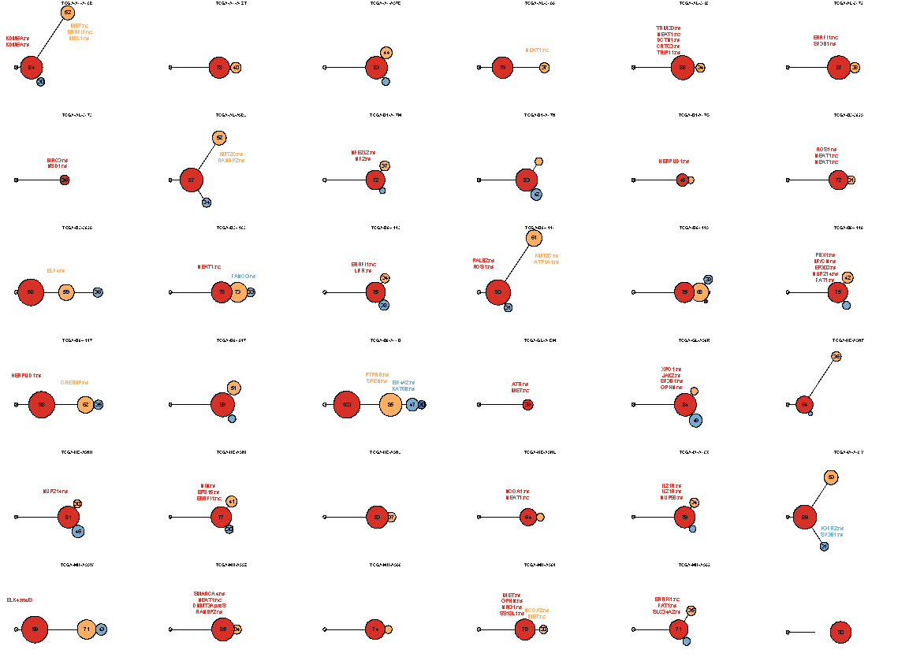
Mutation
distance
Populations
(%)
0.5
Germline
[S. Li, B. Shuch and M. Gerstein PLOS Genetics (‘17)]

Slide 52
Mutation
distance
Populations
(%)
0.5
Germline
[S. Li, B. Shuch and M. Gerstein PLOS Genetics (‘17)]

Slide 53
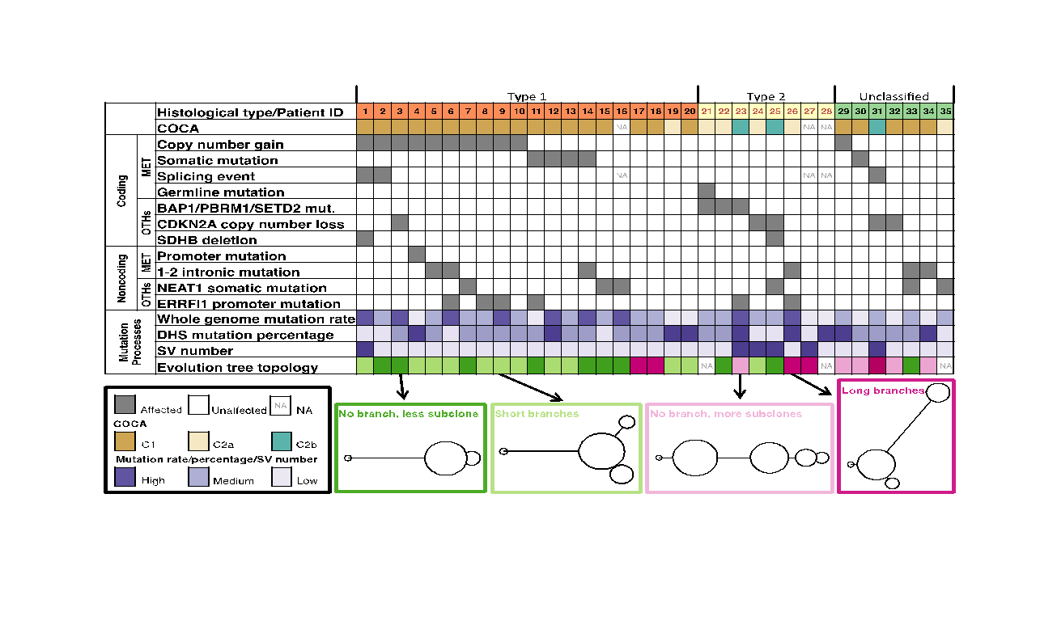
Tree topology correlates with molecular subtypes
[Li et al., PLOS Genetics (‘17)]

Slide 54
Prioritizing somatic variants: Approaches to identifying key variants through functional impact & recurrence
Introduction
Large growth in cancer genome data
Mining the data to prioritize variants for key drivers
Functional impact #1: Coding
ALoFT: Annotation of Loss-of-Function Transcripts. LOF annotation as a complex problem.
Finding deleterious LoF SNVs
Frustration as a localized metric of SNV impact. Differential profiles for oncogenes vs. TSGs
Functional impact #2: Non-coding
FunSeq integrates evidence, with an entropy based weighting scheme
Recurrence #1: Statistics for driver identification
Background mutation rate significantly varies & is correlated with replication timing & TADs
Developed a variety of parametric & non-parametric methods taking this into account
LARVA uses parametric beta-binomial model, explicitly modeling covariates
MOAT does a variety of non-parm. shuffles (annotation, variants, &c). Useful when explicit covariates not available. Slower than but speeded up w/ GPUs
Recurrence #2: (Low-power) application to pRCC
WGS finds additional facts on the canonical driver, MET. Other suggestive non-coding hotspots.
Tumor evolution analysis of the timing of key mutations helps with classification

Slide 55
Prioritizing somatic variants: Approaches to identifying key variants through functional impact & recurrence
Introduction
Large growth in cancer genome data
Mining the data to prioritize variants for key drivers
Functional impact #1: Coding
ALoFT: Annotation of Loss-of-Function Transcripts. LOF annotation as a complex problem.
Finding deleterious LoF SNVs
Frustration as a localized metric of SNV impact. Differential profiles for oncogenes vs. TSGs
Functional impact #2: Non-coding
FunSeq integrates evidence, with an entropy based weighting scheme
Recurrence #1: Statistics for driver identification
Background mutation rate significantly varies & is correlated with replication timing & TADs
Developed a variety of parametric & non-parametric methods taking this into account
LARVA uses parametric beta-binomial model, explicitly modeling covariates
MOAT does a variety of non-parm. shuffles (annotation, variants, &c). Useful when explicit covariates not available. Slower than but speeded up w/ GPUs
Recurrence #2: (Low-power) application to pRCC
WGS finds additional facts on the canonical driver, MET. Other suggestive non-coding hotspots.
Tumor evolution analysis of the timing of key mutations helps with classification

Slide 56
Acknowledgments
Hiring Postdocs.
See
Jobs.gersteinlab.org
github.com/gersteinlab/Frustration
S Kumar, D Clarke
github.com/gersteinlab/MrTADfinder
KK Yan, S Lou
VAT.gersteinlab.org
L Habegger, S Balasubramanian, DZ Chen, E Khurana, A Sboner, A Harmanci, J Rozowsky, D Clarke, M Snyder
ALoFT.gersteinlab.org
S Balasubramanian, Y Fu, M Pawashe, P McGillivray, M Jin, J Liu, KJ Karczewski, DG MacArthur
FunSeq.gersteinlab.org
Y Fu, E Khurana, Z Liu, S Lou, J Bedford, XJ Mu, KY Yip,
pRCC
S Li, B Shuch
LARVA.gersteinlab.org
L Lochovsky, J Zhang, Y Fu, E Khurana
MOAT.gersteinlab.org
L Lochovsky, J Zhang

Slide 57
Info about this talk
General PERMISSIONS
This Presentation is copyright Mark Gerstein, Yale University, 2016.
Please read permissions statement at gersteinlab.org/misc/permissions.html .
Feel free to use slides & images in the talk with PROPER acknowledgement (via citation to relevant papers or link to gersteinlab.org). Paper references in the talk were mostly from Papers.GersteinLab.org.
PHOTOS & IMAGES
For thoughts on the source and permissions of many of the photos and clipped images in this presentation see streams.gerstein.info . In particular, many of the images have particular EXIF tags, such as kwpotppt , that can be easily queried from flickr, viz: flickr.com/photos/mbgmbg/tags/kwpotppt

