Slide 1
Transcriptome Analysis: Tackling core issues related to gene regulation
& also mining the “data exhaust” produced by this activity
Mark Gerstein, Yale. Slides freely downloadable from Lectures.GersteinLab.org
& “tweetable” (via @markgerstein). See last slide for more info.

Slide 2
Expression of genes is quantified by transcription:
RNA-Seq measures mRNA transcript amounts
Genes (DNA)
Transcription
Regulation
RNA transcripts
Non-coding regulatory RNAs
Protein coding mRNA
Gene Expression measured by RNA-seq
Translation
Proteins
[ NATURE 459: 927; NAT. REV. GEN. 10: 57 ]

Slide 3

Activity Patterns
RNA Seq. gives rise to activity patterns of genes & regions in the genome

Slide 4
Some Core Science Qs Addressed by RNA-seq
Gene activity as a function of:
  Developmental stage: basic patterns and clusters of co-active genes across an organisms development
  Evolutionary relationships: behavior preserved across a wide range of organisms; patterns and clusters in model organisms in relation to those in humans
  Tissue- and cell-type: relationship of expression and specialized function
  Disease phenotypes: disruption of patterns in disease

Slide 5

RNA-Seq Overview
ATACAAGCAAGTATAAGTTCGTATGCCGTCTT
GGAGGCTGGAGTTGGGGACGTATGCGGCATAG
TACCGATCGAGTCGACTGTAAACGTAGGCATA
ATTCTGACTGGTGTCATGCTGATGTACTTAAA
Fastq sequence files
~5-10 GB
Index-building + Alignment to reference genome
BAM files
~1-2-fold reduction
Successive steps of Data Reduction
Conversion to signal track by overlapping reads
BigWig files
~25-fold reduction
Mapping to genes
Gene/Transcript expression matrix
~20-fold reduction
Quantitative information from RNA-seq signal: average signals at exon level (RPKMs)
Reads => Signal
[NAT. REV. 10: 57; PLOS CB 4:e1000158; PNAS 4:107: 5254 ]

Slide 6
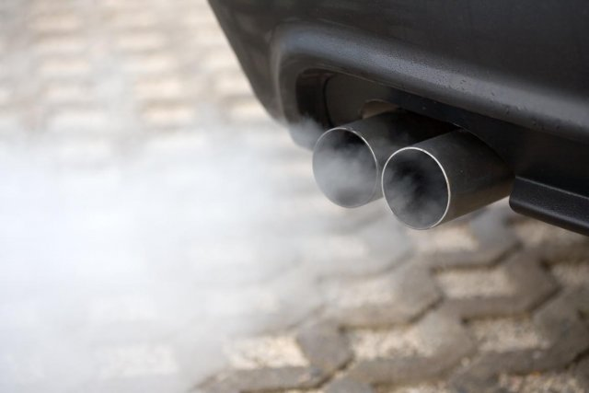
Studying large-scale functional genomics data also produces
Data Exhaust
Metadata
Core scientific purposes
Front End
Data collection and analysis
Back end
Data Exhaust
Data on Collaboration, publication and Infrastructure
Data Exhaust = Exploitable byproducts of big data collection and analysis
[PHOTO: RELAXNEWS; from http://www.lapresse.ca]

Slide 7
Transcriptome Analysis: Tackling core issues related to gene regulation
& also mining the “data exhaust” produced by this activity
[Core-1] Expression Clustering,
Cross-species
  Comparative ENCODE – Lots of worm-fly-human matched data & developmental timecourses
  Optimization gives 16 conserved co-expression modules
[Core-2] State Space Models
of Gene Expression
  Using dimensionality reduction to help determine internal & external drivers
  Decoupling expression changes into those from conserved vs species-specific genes
  Also, conserved genes have similar canonical patterns (iPDPs) in contrast to species specific ones (Ex of ribosomal v signaling genes)
[Exhaust-1] Genomic Privacy & RNA-seq
  The dilemma: The genome as fundamental, inherited info that’s very private v need for large-scale mining for med. research
  Issues w/ current social & tech approaches: inconsistencies & burdensome security
  RNA-seq presents a particularly tricky privacy issue
  Quantifying & removing variant info from expression levels + eQTLs using ICI & predictability
  Instantiating a practical linking attack using extreme expression levels
[Exhaust-2] Value of Publication Patterns generated by data producing consortia
  Co-authorship network statistics relate to publication rollouts & show gradual adoption by a diverse community
  Key role of brokers in data dissemination

Slide 8
Transcriptome Analysis: Tackling core issues related to gene regulation
& also mining the “data exhaust” produced by this activity
[Core-1] Expression Clustering,
Cross-species
  Comparative ENCODE – Lots of worm-fly-human matched data & developmental timecourses
  Optimization gives 16 conserved co-expression modules
[Core-2] State Space Models
of Gene Expression
  Using dimensionality reduction to help determine internal & external drivers
  Decoupling expression changes into those from conserved vs species-specific genes
  Also, conserved genes have similar canonical patterns (iPDPs) in contrast to species specific ones (Ex of ribosomal v signaling genes)
[Exhaust-1] Genomic Privacy & RNA-seq
  The dilemma: The genome as fundamental, inherited info that’s very private v need for large-scale mining for med. research
  Issues w/ current social & tech approaches: inconsistencies & burdensome security
  RNA-seq presents a particularly tricky privacy issue
  Quantifying & removing variant info from expression levels + eQTLs using ICI & predictability
  Instantiating a practical linking attack using extreme expression levels
[Exhaust-2] Value of Publication Patterns generated by data producing consortia
  Co-authorship network statistics relate to publication rollouts & show gradual adoption by a diverse community
  Key role of brokers in data dissemination

Slide 9
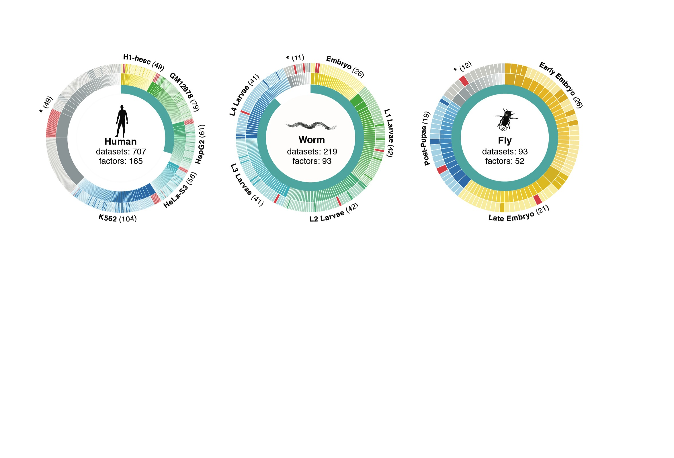
Time-course gene expression data of worm & fly development
[Nature 512:445 ('14); doi: 10.1038/nature13424]
Comparative ENCODE Functional Genomics Resource
(EncodeProject.org/comparative)
Broad sampling of conditions across transcriptomes & regulomes for human, worm & fly
  embryo & ES cells
  developmental time course (worm-fly)
In total: ~3000 datasets (~130B reads)
Organism | Major developmental stages
worm (C. elegans) | 33 stages: 0, 0.5, 1, …, 12 hours, L1, L2, L3, L4, …, Young Adults, Adults
fly (D. mel.) | 30 stages: 0, 2, 4, 6, 8,…, 20, 22 hours, L1-L4, Pupaes, Adults

Slide 10
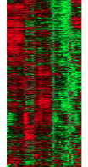
Expression clustering:
revisiting an ancient problem
Species A
Species B
Clustering
algorithm
Clustering
algorithm
co-expressed genes
responsible for the same
function in a species
Eisen MB et al. PNAS 1998
Langfelder P et al. BMC Bioinfo. 2008
Tamayo P et al. PNAS 1999
Kluger Y et al. Genome Res. 2003
two independent sets
of modules
Cross species
co-expression modules

Slide 11
Expression clustering:
revisiting an ancient problem
Species A
Orthologous pairs
between species
Species B
A novel unified framework to integrate co-expression data across species
OrthoClust
cross species modules
Yan et al. Genome Biol. 2014
Cross species
co-expression modules

Slide 12
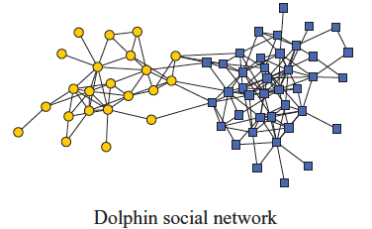
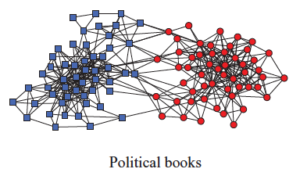
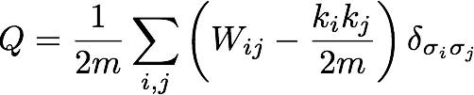
Network modularity
degree of node i
Newman Phy. Rev. E 2013
adjacency matrix
whether or not
i, j are in the
same module
number of edges
expected number of
edges between i and j

Slide 13

Network modularity
degree of node i
adjacency matrix
whether or not
i, j are in the
same module
number of edges
expected number of
edges between i and j

Slide 14

Network modularity
Optimization problem
for sim. annealing
degree of node i
adjacency matrix
whether or not
i, j are in the
same module
number of edges
expected number of
edges between i and j

Slide 15
A toy example [orthoclust]
[Yan et al. GenomeBiol 15:R100 ('14)]
2
Every node i is assigned with a label σ_{i} (labels of modules: 1,2,…q).
4
4
co-expressed
1
1
2
2
orthologs
Species A
3
3
Species B
reward an orthologous pair
with the same value
4
4
4
1
2
1
3
1
Q(for all σ_{i} in A) + Q(for all σ_{i} in B)
+
Favorableness = "Modularity" in species A + "Modularity" in species B + consistency betw. A & B

Slide 16
A toy example [orthoclust]
[Yan et al. GenomeBiol 15:R100 ('14)]
2
2
4
co-expressed
2
4
2
4
orthologs
Species A
2
4
Species B
4
1
4
1
4
4
1
1
species A specific
conserved modules
species B specific
Use Potts model (generalized Ising model) to simultaneously cluster co-expressed genes within an organism as well as orthologs shared between organisms. Here, the ground state configuration correspond to three modules: 1, 2, 4.

Slide 17
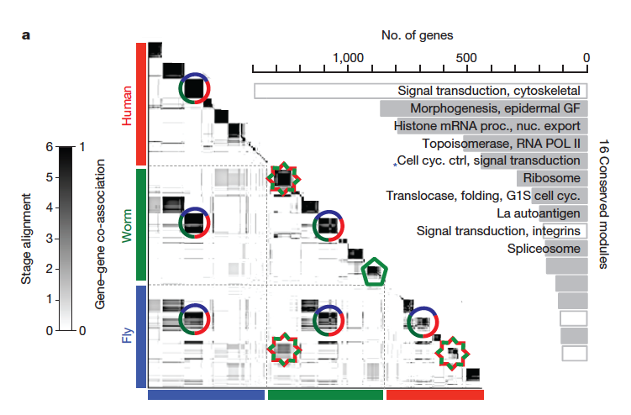
Application for more than 2 species
~55000 genes
[Nature 512:445 ('14); doi: 10.1038/nature13424]

Slide 18
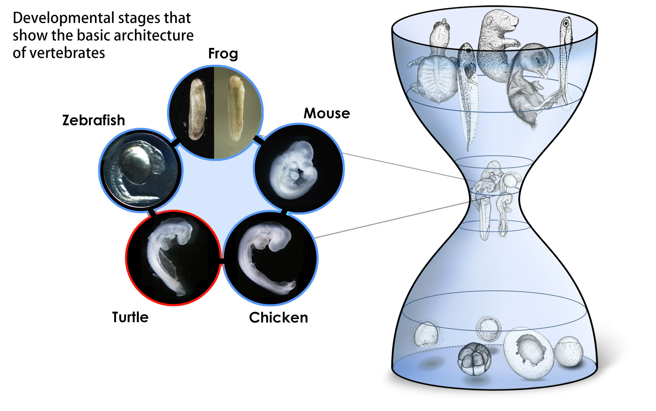
Conserved modules exhibit canonical hourglass behavior
Phylotypic stage
Illustrations courtesy Naoki Irie
Canonical Inter-organism Behavior
“Hourglass hypothesis”: all organisms go through a particular stage in embryonic development ("phylotypic" stage) where
inter-organism expression differences of orthologous genes are smallest.
We identify modules (12 out of 16) which have this behavior at the phylotypic stage.
[Nature 512:445 ('14); doi: 10.1038/nature13424]

Slide 19
Transcriptome Analysis: Tackling core issues related to gene regulation
& also mining the “data exhaust” produced by this activity
[Core-1] Expression Clustering,
Cross-species
  Comparative ENCODE – Lots of worm-fly-human matched data & developmental timecourses
  Optimization gives 16 conserved co-expression modules
[Core-2] State Space Models
of Gene Expression
  Using dimensionality reduction to help determine internal & external drivers
  Decoupling expression changes into those from conserved vs species-specific genes
  Also, conserved genes have similar canonical patterns (iPDPs) in contrast to species specific ones (Ex of ribosomal v signaling genes)
[Exhaust-1] Genomic Privacy & RNA-seq
  The dilemma: The genome as fundamental, inherited info that’s very private v need for large-scale mining for med. research
  Issues w/ current social & tech approaches: inconsistencies & burdensome security
  RNA-seq presents a particularly tricky privacy issue
  Quantifying & removing variant info from expression levels + eQTLs using ICI & predictability
  Instantiating a practical linking attack using extreme expression levels
[Exhaust-2] Value of Publication Patterns generated by data producing consortia
  Co-authorship network statistics relate to publication rollouts & show gradual adoption by a diverse community
  Key role of brokers in data dissemination

Slide 20
Are gene regulations among orthologs conserved across species?
Are gene regulatory networks among orthologs conserved across species?
Species A
Species B
orthologs
co-expressed
Regulation among orthologs (internal)
Regulation from species-specific factors (external)
Orthologous genes (orthologs)
Species-specific transcription factors
To what degree can’t ortholog expression levels be predicted due to species-specific regulation
[Wang et al. PLOS CB, ‘16]
Notes:
connect loregic to here too! to see regulatory mechanisms similar too

Slide 21
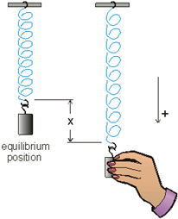
Internal & external gene regulatory networks
Internal Group
External Group
How to identify gene expression dynamics driven by internal/external regulation?
Internal regulation
External regulation
Interested system | Internal regulatory network | External regulatory network
Cross-species conserved genes | Conserved transcriptional factors (TFs) | Non-conserved TFs
Protein-coding genes | TFs | micro-RNAs
Individual’s protein coding genes | Wild-type TFs | Somatic mutated TFs
Protein-coding genes in brain | Commonly expressed TFs | Brain-specific expressed TFs
Protein-coding genes in development | House-keeping TFs | Developmental TFs
External force
[Wang et al. PLOS CB (in revision, ‘15)]
Notes:
connect loregic to here too! to see regulatory mechanisms similar too

Slide 22
State-space model for internal and external gene regulatory networks
State X_{t+1}: Gene expression vector of Group X at time t+1
A_{ij} captures temporal casual influence from Gene i to Gene j in internal group
State X_{t}: Gene expression vector of internal group at time t
B_{kl} captures temporal casual influence from external factor k to Gene l in internal group
Control U_{t}: Gene expression vector of external factors at time t
[Wang et al. PLOS CB, ‘16]

Slide 23
State-space model for internal
and external gene regulatory networks
Not enough data to estimate state space model for genes
(e.g., 25 time points per gene to estimate 4 million elements of A or B for 2000 genes)
Dimensionality reduction from genes to meta-genes (e.g., SVD)
Effective state space model for meta-genes
(e.g., 250 time points to estimate 50 matrix elements if 5 meta-genes)
[Wang et al. PLOS CB, ‘16]

Slide 24
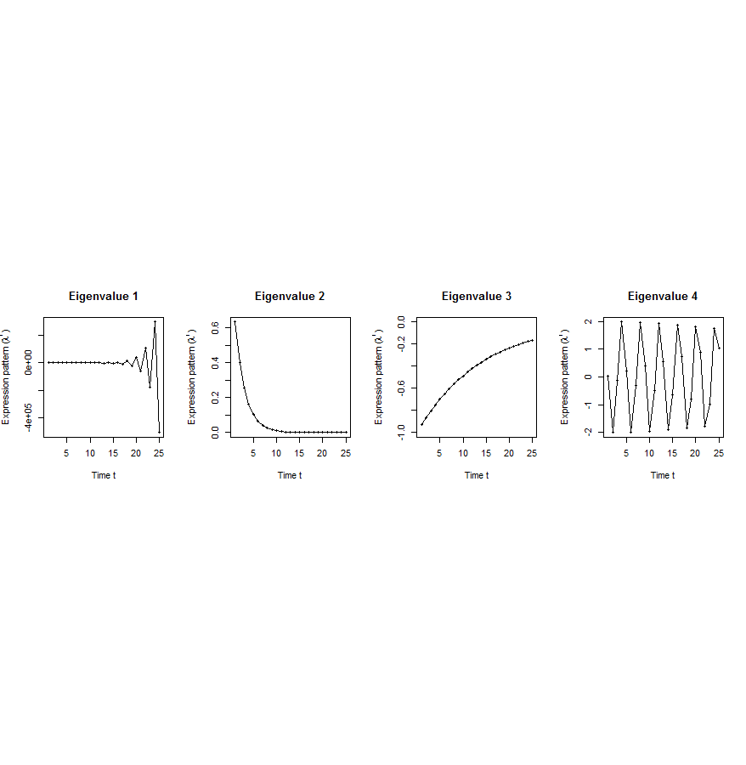
Canonical temporal expression trajectories from effective state space model
Is a std. 1st order homogeneous matrix difference equation. It can solved by diagonalizing A giving….
p^{th} internal principal dynamic pattern (iPDP): [λ_{p}¹, λ_{p}², …, λ_{p}^{T}],
where λ_{p} is p^{th} eigenvalue of Ã.
Canonical temporal expression trajectories
(e.g., degradation, growth, damped oscillation, etc.)
iPDP expression
time
[Wang et al. PLOS CB, ‘16]
Notes:
if we look at A tilde, it controls the dynamic trajectory of expression part internally driven by meta-genes of X. according to the analytic solution, the internally driven expression part Xtilde I can be linear combinations of A tilde’s eigenvalue’s exponentials across time, which are defined by us as internal principal dynamic pattern (iPDP). B tilde controls the dynamic trajectory of X’s metagene expression part externally driven by U. similarly, we can find external principal dynamic pattern (ePDP) based on B tilde’s eigenvalue exponentials across time. Actually, those patterns are canonical temporal expression trajectories, which are as simple as degradation, growth, damped oscillation temporal processes). In short, from metagene effective model, we are able to identify internal and external driven canonical temporal expression trajectories.

Slide 25
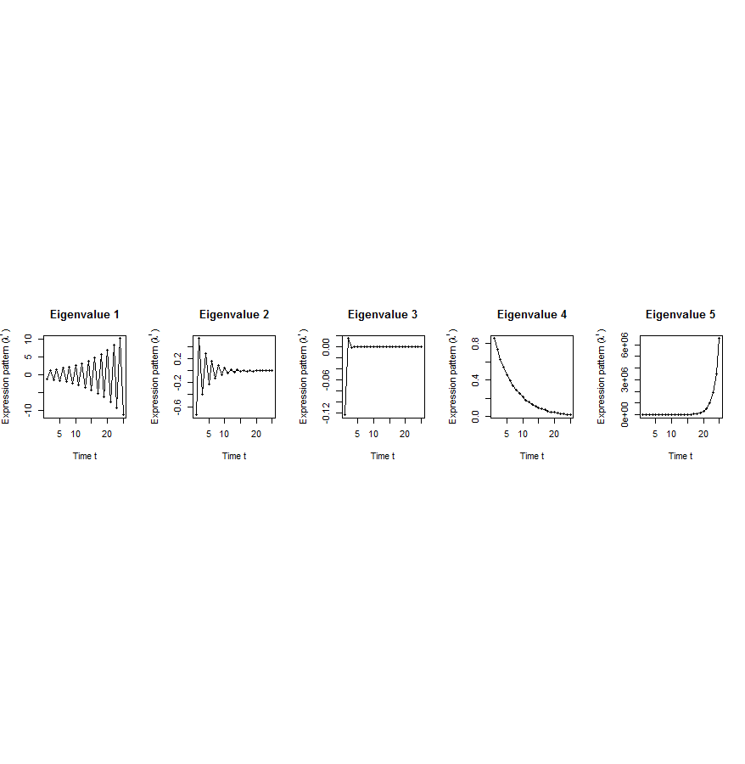
Flowchart
[Wang et al. PLOS CB, ‘16]
A. Gene state-space model
C. Meta-gene state-space model
B. Dimensionality Reduction
X_{t+1}=AX_{t}+BU_{t}
Genes of X
Meta-genes of X
time
E. Gene’s internal (INT) and external (EXT) driven expression dynamics composed of PDPs
time
D. Internal/External Principal Dynamic Patterns (PDPs)
x^{INT} = c₁ +c₂
+c₃ +c₄
[λ_{p}¹, λ_{p}², …, λ_{p}^{T}]
Genes of U
Meta-genes of U
time
time
x^{EXT} = d₁ +d₂
+d₃ +d₄
Internal regulation among internal genes/meta-genes by A/Ã
External regulation from external genes/meta-genes to internal genes/meta-genes in Group X by B/
Internal genes/meta-genes
External genes/meta-genes

Slide 26
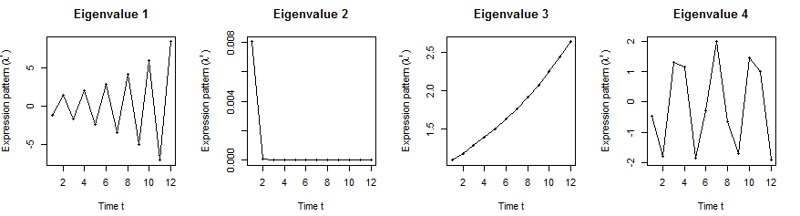
Orthologs have similar internal but different external dynamic patterns during embryonic development
Worm’s effective state space model
1st iPDP
2nd iPDP
3rd iPDP
4th iPDP
1st ePDP
2nd ePDP
3rd ePDP
4th ePDP
5th ePDP
Expression
Expression
Similar
Different
1st iPDP
2nd iPDP
3rd iPDP
4th iPDP
1st ePDP
2nd ePDP
3rd ePDP
4th ePDP
5th ePDP
Expression
Expression
Fly’s effective state space model
[Wang et al. PLOS CB, ‘16]

Slide 27
Orthologs have correlated iPDP coefficients
1st iPDP
2nd iPDP
r=+0.33
r=+0.66
Coefficients of orthologs on fly
3rd iPDP
4th iPDP
r=+0.67
r=+0.73
Coefficients of orthologs on worm
[Wang et al. PLOS CB, ‘16]

Slide 28
Evolutionarily conserved & younger genes exhibit the opposite internal & external PDP coefficients
p<2.2e-16
p<2.6e-13
p<5.6e-11
p<8.3e-4
Worm
Fly
Ribosomal genes have significantly larger coefficients for the internal than external PDPs, but signaling genes exhibit the opposite trend
[Wang et al. PLOS CB, ‘16]

Slide 29
Transcriptome Analysis: Tackling core issues related to gene regulation
& also mining the “data exhaust” produced by this activity
[Core-1] Expression Clustering,
Cross-species
  Comparative ENCODE – Lots of worm-fly-human matched data & developmental timecourses
  Optimization gives 16 conserved co-expression modules
[Core-2] State Space Models
of Gene Expression
  Using dimensionality reduction to help determine internal & external drivers
  Decoupling expression changes into those from conserved vs species-specific genes
  Also, conserved genes have similar canonical patterns (iPDPs) in contrast to species specific ones (Ex of ribosomal v signaling genes)
[Exhaust-1] Genomic Privacy & RNA-seq
  The dilemma: The genome as fundamental, inherited info that’s very private v need for large-scale mining for med. research
  Issues w/ current social & tech approaches: inconsistencies & burdensome security
  RNA-seq presents a particularly tricky privacy issue
  Quantifying & removing variant info from expression levels + eQTLs using ICI & predictability
  Instantiating a practical linking attack using extreme expression levels
[Exhaust-2] Value of Publication Patterns generated by data producing consortia
  Co-authorship network statistics relate to publication rollouts & show gradual adoption by a diverse community
  Key role of brokers in data dissemination

Slide 30

2-sided nature of functional genomics data: Analysis can be very General/Public or Individual/Private
General quantifications related to overall aspects of a condition & are not tied to an individual’s genotype - ie what genes go up in cancer
  However, data is derived from an individual & tagged with an individual’s genotype
Other calculations aim to use genotype & specific aspects of the quantification to derive general relations related to sequence variation & gene expression
Some calculations and data derive finding very specific to the variants in a particular individual

Slide 31

Tricky Privacy Considerations in Personal Genomics
Genetic Exceptionalism :
The Genome is very fundamental data, potentially very revealing about one’s identity & characteristics
Personal Genomic info. essentially meaningless currently but will it be in 20 yrs? 50 yrs?
  Genomic sequence very revealing about one’s children. Is true consent possible?
  Once put on the web it can’t be taken back
Culture Clash:
Genomics historically has been a proponent of “open data” but not clear personal genomics fits this.
  Clinical Medline has a very different culture.
Ethically challenged history of genetics
  Ownership of the data & what consent means (Hela)
    Could your genetic data give rise to a product line?
[D Greenbaum & M Gerstein (’08). Am J. Bioethics; D Greenbaum & M Gerstein, Hartford Courant, 10 Jul. '08 ; SF Chronicle, 2 Nov. '08;
Greenbaum et al. PLOS CB (‘11) ; Greenbaum & Gerstein ('13), The Scientist; Photo from NY Times]

Slide 32












Genomics has similar "Big Data" Dilemma in the Rest of Society
Sharing & "peer-production" is central to success of many new ventures, with the same risks as in genomics
  EG web search: Large-scale mining essential
We confront privacy risks every day we access the internet
(...or is the genome more exceptional & fundamental?)
[Seringhaus & Gerstein ('09), Hart. Courant (Jun 5); Greenbaum & Gerstein ('11), NY Times (6 Oct)]

Slide 33

The Other Side of the Coin:
Why we should share
Sharing helps speed research
  Large-scale mining of this information is important for medical research
  Privacy is cumbersome, particularly for big data
Sharing is important for reproducible research
Sharing is useful for education
  More fun to study a known person’s genome
    Eg Zimmer’s Game of Genomes in STAT
[Yale Law Roundtable (‘10). Comp. in Sci. & Eng. 12:8; D Greenbaum & M Gerstein (‘09). Am. J. Bioethics; D Greenbaum & M Gerstein (‘10). SF Chronicle, May 2, Page E-4;
Greenbaum et al. PLOS CB (‘11)]

Slide 34

The Dilemma
[Economist, 15 Aug ‘15]
The individual (harmed?) v the collective (benefits)
  But do sick patients care about their privacy?
How to balance risks v rewards - Quantification
  What is acceptable risk? What is acceptable data leakage? Can we quantify leakage?
    Ex: photos of eye color
  Cost Benefit Analysis: how helpful is identifiable data in genomic research v. potential harm from a breach?

Slide 35
Current Social & Technical Solutions
Closed Data Approach
  Consents
  “Protected” distribution via dbGAP
  Local computes on secure computer
Issues with Closed Data
  Non-uniformity of consents & paperwork
    Different international norms, leading to confusion
  Encryption & computer security creates burdensome requirements on data sharing & large scale analysis
  Many schemes get “hacked”
Open Data
  Genomic "test pilots” (ala PGP)?
    Sports stars & celebrities?
  Some public data & data donation is helpful but is this a realistic solution for an unbiased sample of ~1M
[Greenbuam et al ('04), Nat. Biotech; Greenbaum & Gerstein ('13), The Scientist]

Slide 36
Strawman Hybrid Social & Tech Proposed Solution?
Fundamentally, researchers have to keep genetic secrets.
  Need for an (international) legal framework
  Genetic Licensure & training for individuals
  (similar to medical license, drivers license)
Technology to make things easier
  Cloud computing & enclaves (eg solution of Genomics England)
Technological barriers shouldn't create a social incentive for “hacking”
Quantifying Leakage & allowing a small amounts of it
Careful separation & coupling of private & public data
  Lightweight, freely accessible secondary datasets coupled to underlying variants
  Selection of stub & "test pilot" datasets for benchmarking
  Develop programs on public stubs on your laptop, then move the program to the cloud for private production run
[D Greenbaum, M Gerstein (‘11). Am J Bioeth 11:39. Greenbaum & Gerstein, The Scientist ('13)]

Slide 37


Representative Expression, Genotype, eQTL Datasets
Genotypes are available from the 1000 Genomes Project
mRNA sequencing for 462 individuals from gEUVADIS and ENCODE
  Publicly available quantification for protein coding genes
Approximately 3,000 cis-eQTL (FDR<0.05)

Slide 38
Variants directly in the reads
Functional genomics data comes with a great deal of sequencing
  NA12878 as case study - 1000 genomes variants are used as gold standard
How much information, for example, do RNA-Seq reads (or ChIP-Seq) reads contain? Does that information enough to identify individuals?
Variants from RNA-Seq reads
It might seem like we don’t infer much information from single ChIP-Seq and RNA-Seq experiments compared to WGS
  However putting 10 different ChIP-Seq experiments and RNA-Seq together with imputation provides a great deal of information about the individual

Slide 39
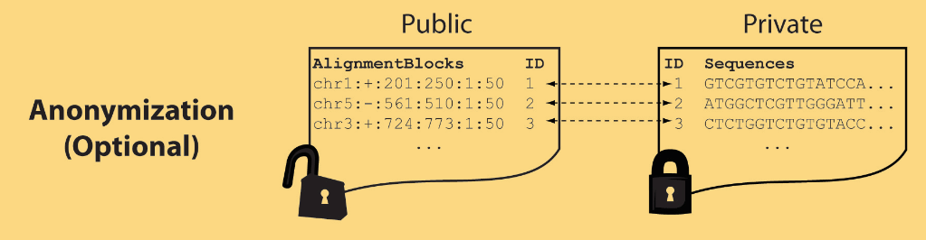
Light-weight formats to Hide Most of the Read Data (Signal Tracks)
Some lightweight format clearly separate public & private info., aiding exchange
Files become much smaller
Distinction between formats to compute on and those to archive with – become sharper with big data
Reads
(linked via ID,
10X larger than
mapping coord.)
Mapping coordinates without variants (MRF)
[Bioinformatics 27: 281]

Slide 40


eQTL Mapping Using RNA-Seq Data
eQTLs are genomic loci that contribute to variation in mRNA expression levels
eQTLs provide insights on transcription regulation, and the molecular basis of phenotypic outcomes
eQTL mapping can be done with RNA-Seq data
[Biometrics 68(1) 1–11]
Notes:
A diagram to illustrate the RNA‐seq count variation of one gene due to an cis‐eQTL. (a) RNA‐seq measurements of a hypothetic gene with two exons in three diploid individuals. The target SNP which we test for association has the genotype CT, CC, and TT for the three individuals. There is an SNP on the first exon, which has genotype AT, AT, and AA for the three individuals. ASE can be measured by those sequence reads that overlap with a heterozygous exonic SNP. Therefore we can measure ASE for individuals (i) and (ii). However, association testing by ASE is only possible if the target SNP is heterozygous, thus only individual (i) can be used to test for eQTL by ASE (b) ASE measurements for individual (i). (c) TReC measured for the three individuals across the two exons of this gene.
© IF THIS IMAGE HAS BEEN PROVIDED BY OR IS OWNED BY A THIRD PARTY, AS INDICATED IN THE CAPTION LINE, THEN FURTHER PERMISSION MAY BE NEEDED BEFORE ANY FURTHER USE. PLEASE CONTACT WILEY'S PERMISSIONS DEPARTMENT ON PERMISSIONS@WILEY.COM OR USE THE RIGHTSLINK SERVICE BY CLICKING ON THE 'REQUEST PERMISSION' LINK ACCOMPANYING THIS ARTICLE. WILEY OR AUTHOR OWNED IMAGES MAY BE USED FOR NON-COMMERCIAL PURPOSES, SUBJECT TO PROPER CITATION OF THE ARTICLE, AUTHOR, AND PUBLISHER.

Slide 41
Information Content and Predictability
Higher frequency: Lower ICI
Lower frequency: Higher ICI
Additive for multiple variants
Condition specific entropy
Higher cond. entropy: Lower predictability
Lower cond. entropy: Higher predictability
Additive for multiple eQTLs
[Harmanci et al. Nat. Meth. 2016]

Slide 42

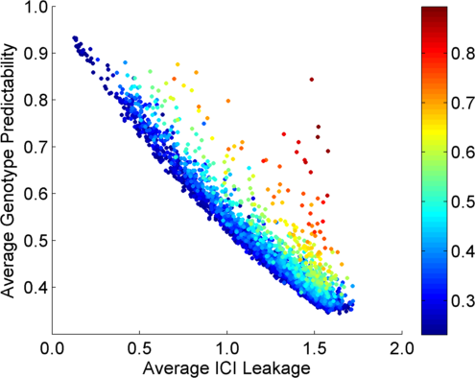
Per eQTL and ICI Cumulative Leakage versus Genotype Predictability
Colors by absolute correlation
Absolute Correlation
[Harmanciet al. Nat. Meth. (in revision)]

Slide 43
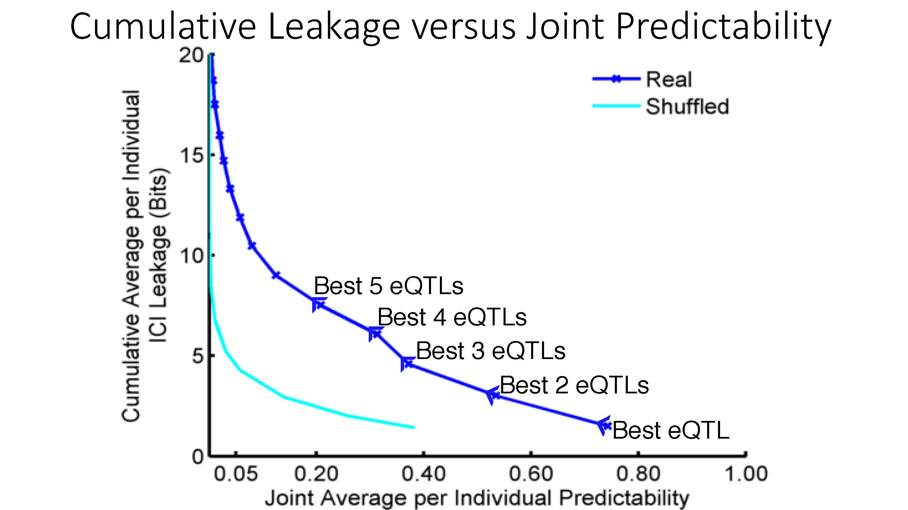
Cumulative Leakage versus Joint Predictability
More #
Vulnerable
Less #
Vulnerable
[Harmanciet al. Nat. Meth. (in revision)]

Slide 44

Linking Attack Scenario
[Harmanciet al. Nat. Meth. (in revision)]

Slide 45


Linking Attacks: Case of Netflix Prize
Names available for many users!
User (ID) | Movie (ID) | Date of Grade | Grade [1,2,3,4,5]
NTFLX-0 | NTFLX-19 | 10/12/2008 | 1
NTFLX-1 | NTFLX-116 | 4/23/2009 | 3
NTFLX-2 | NTFLX-92 | 5/27/2010 | 2
NTFLX-1 | NTFLX-666 | 6/6/2016 | 5
… | … | … | …
… | … | … | …
User (ID) | Movie (ID) | Date of Grade | Grade [0-10]
IMDB-0 | IMDB-173 | 4/20/2009 | 5
IMDB-1 | IMDB-18 | 10/18/2008 | 0
IMDB-2 | IMDB-341 | 5/27/2010 | -
… | … | … | …
… | … | … | …
… | … | … | …
Many users are shared
The grades of same users are correlated
A user grades one movie around the same date in two databases
Anonymized Netflix Prize Training Dataset
made available to contestants
Notes:
This figure illustrates what these datasets look like. The movie titles can be matched directly. Date of ratings and rating values are expected to be similar to each other

Slide 46
Linking Attacks: Case of Netflix Prize
Names available for many users!
User (ID) | Movie (ID) | Date of Grade | Grade [1,2,3,4,5]
NTFLX-0 | NTFLX-19 | 10/12/2008 | 1
NTFLX-1 | NTFLX-116 | 4/23/2009 | 3
NTFLX-2 | NTFLX-92 | 5/27/2010 | 2
NTFLX-1 | NTFLX-666 | 6/6/2016 | 5
… | … | … | …
… | … | … | …
User (ID) | Movie (ID) | Date of Grade | Grade [0-10]
IMDB-0 | IMDB-173 | 4/20/2009 | 5
IMDB-1 | IMDB-18 | 10/18/2008 | 0
IMDB-2 | IMDB-341 | 5/27/2010 | -
… | … | … | …
… | … | … | …
… | … | … | …
Many users are shared
The grades of same users are correlated
A user grades one movie around the same date in two databases
IMDB users are public
NetFLIX and IMdB moves are public
Notes:
As you can see, Netflx-1 user can be matched to IMDB-0 user since the date of rating is very close and the ratings are very similar. The rating in imdb is from 0 to 10. So 5 is a similar score to 3 in Netflix rating system.

Slide 47
Linking Attacks: Case of Netflix Prize
Names available for many users!
User (ID) | Movie (ID) | Date of Grade | Grade [1,2,3,4,5]
NTFLX-0 | NTFLX-19 | 10/12/2008 | 1
NTFLX-1 | NTFLX-116 | 4/23/2009 | 3
NTFLX-2 | NTFLX-92 | 5/27/2010 | 2
NTFLX-1 | NTFLX-666 | 6/6/2016 | 5
… | … | … | …
… | … | … | …
User (ID) | Movie (ID) | Date of Grade | Grade [0-10]
IMDB-0 | IMDB-173 | 4/20/2009 | 5
IMDB-1 | IMDB-18 | 10/18/2008 | 0
IMDB-2 | IMDB-341 | 5/27/2010 | -
… | … | … | …
… | … | … | …
… | … | … | …
Many users are shared
The grades of same users are correlated
A user grades one movie around the same date in two databases
Notes:
The key idea is that in imdb, the names are available for many users. Also,
Secondly, although another movie in Netflix system is not rated by this user in imdb system, namely the netflx666, the adversary can see the rating of the individual for this movie.

Slide 48
Linking Attack Scenario
[Harmanciet al. Nat. Meth. (in revision)]

Slide 49
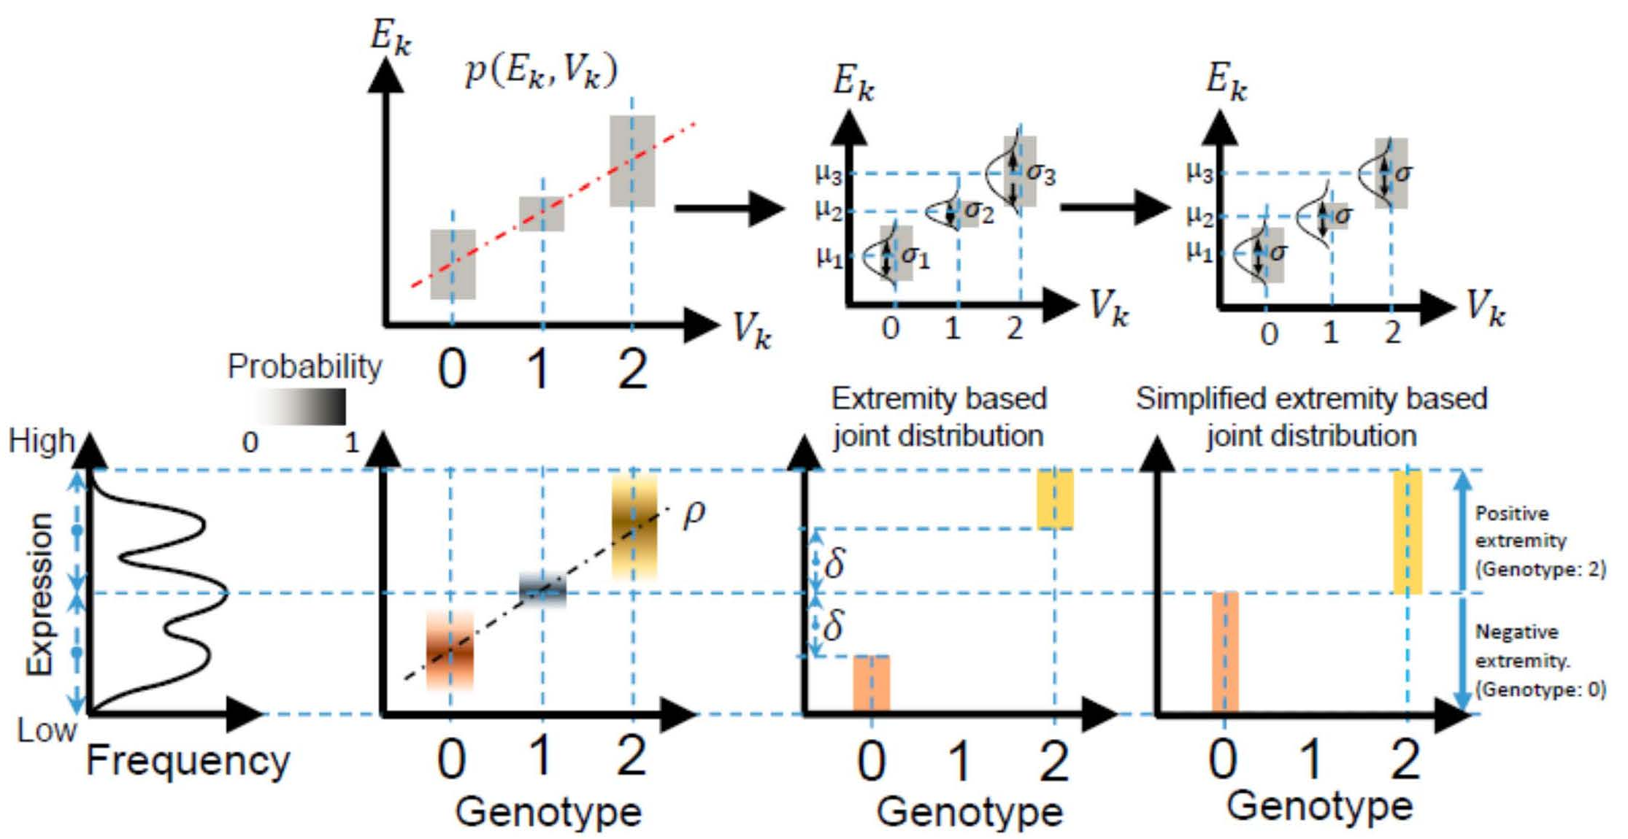
Levels of Expression-Genotype Model Simplifications for Genotype Prediction
[Harmanci et al. Nat. Meth. (16)]

Slide 50
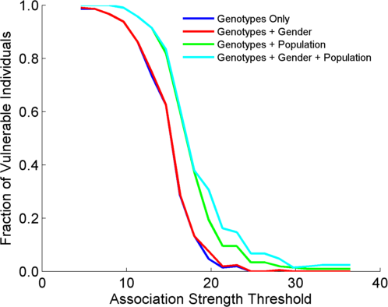
Success in Linking Attack with Extremity based Genotype Prediction
200 individuals eQTL Discovery
200 individuals in Linking Attack
High
Sensitivity
Low
Sensitivity
High Number
Of eQTLs
Low Number
Of eQTLs
[Harmanci et al. Nat. Meth. (16)]

Slide 51
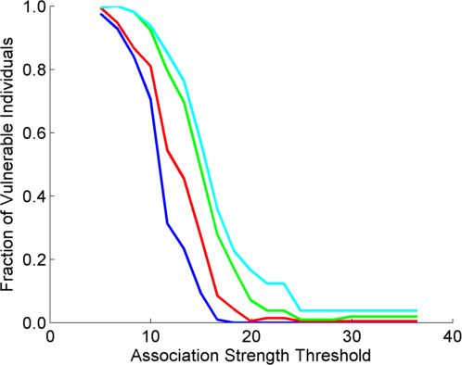
Success in Linking Attack with Extremity based Genotype Prediction
200 individuals eQTL Discovery
200 individuals in Linking Attack
200 individuals eQTL Discovery
100,200 individuals in Linking Attack
[Harmanci et al. Nat. Meth. (16)]

Slide 52
Transcriptome Analysis: Tackling core issues related to gene regulation
& also mining the “data exhaust” produced by this activity
[Core-1] Expression Clustering,
Cross-species
  Comparative ENCODE – Lots of worm-fly-human matched data & developmental timecourses
  Optimization gives 16 conserved co-expression modules
[Core-2] State Space Models
of Gene Expression
  Using dimensionality reduction to help determine internal & external drivers
  Decoupling expression changes into those from conserved vs species-specific genes
  Also, conserved genes have similar canonical patterns (iPDPs) in contrast to species specific ones (Ex of ribosomal v signaling genes)
[Exhaust-1] Genomic Privacy & RNA-seq
  The dilemma: The genome as fundamental, inherited info that’s very private v need for large-scale mining for med. research
  Issues w/ current social & tech approaches: inconsistencies & burdensome security
  RNA-seq presents a particularly tricky privacy issue
  Quantifying & removing variant info from expression levels + eQTLs using ICI & predictability
  Instantiating a practical linking attack using extreme expression levels
[Exhaust-2] Value of Publication Patterns generated by data producing consortia
  Co-authorship network statistics relate to publication rollouts & show gradual adoption by a diverse community
  Key role of brokers in data dissemination

Slide 53

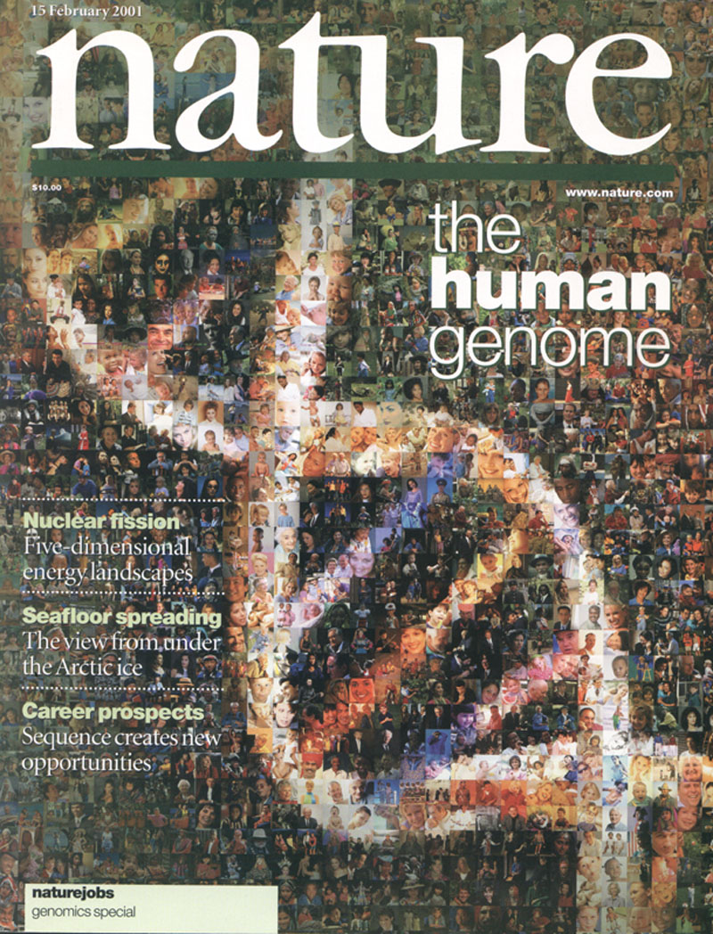

The Human
Genome Project
2000
2005
2010
2015
Worm
Genome

Slide 54
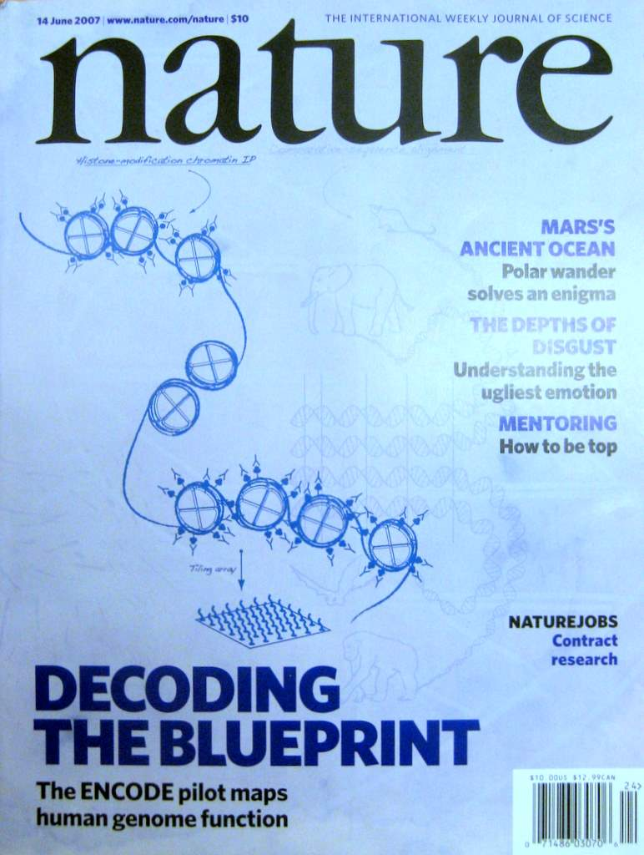

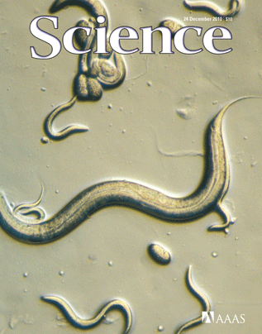
The Human
Genome Project
ENCODE
Pilot
ENCODE
Production
2000
2005
2010
Worm
Genome
modENCODE

Slide 55
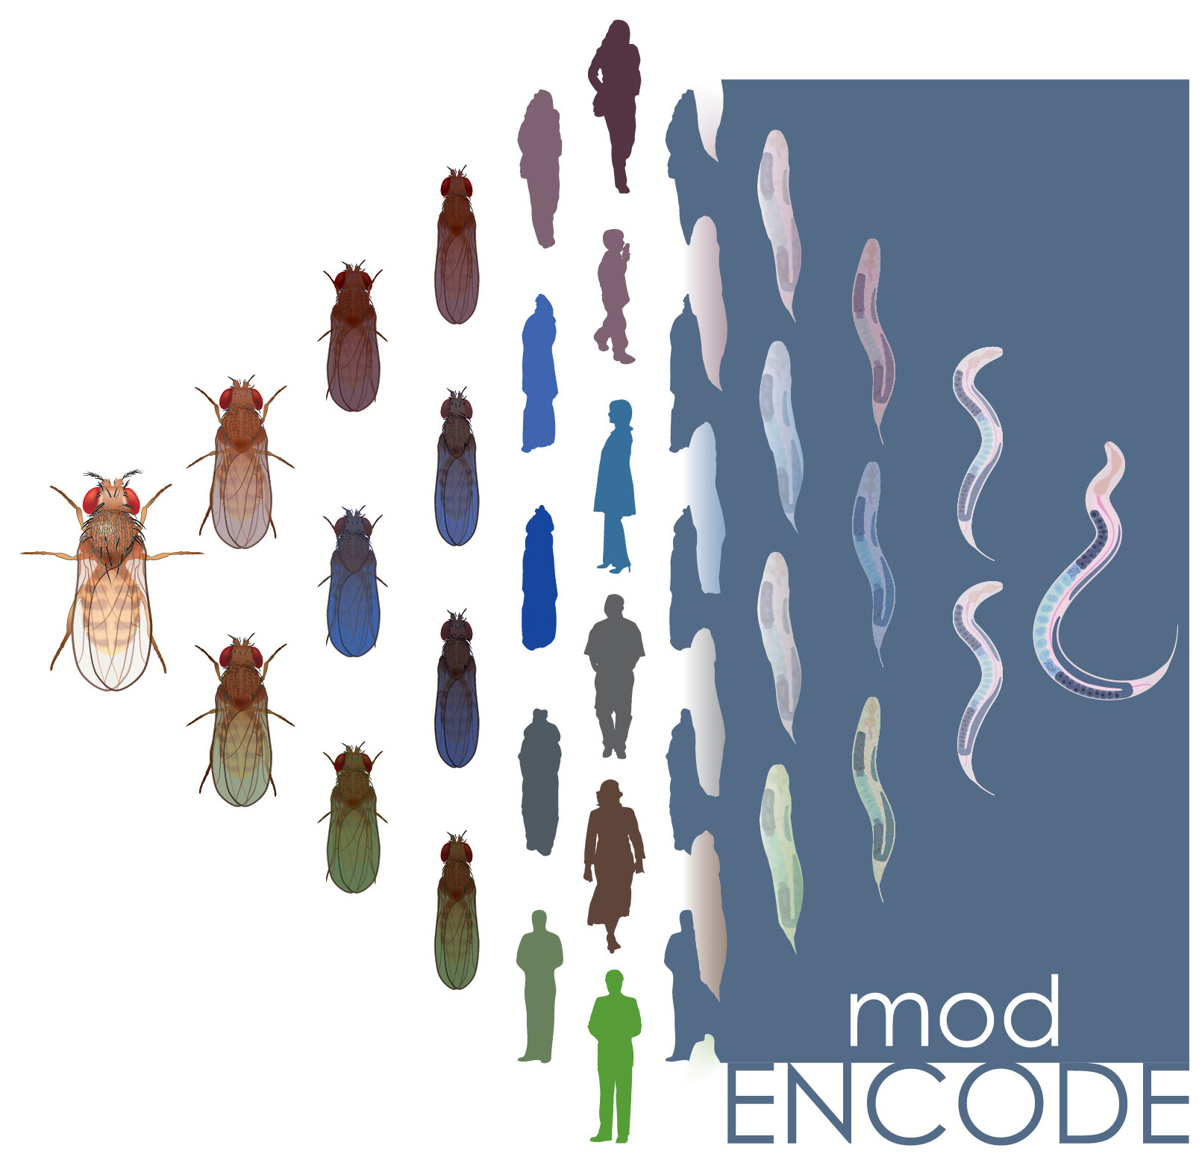

The Human
Genome Project
ENCODE
Pilot
ENCODE
Production
Comparative
ENCODE
2000
2005
2010
2015
Worm
Genome
modENCODE

Slide 56

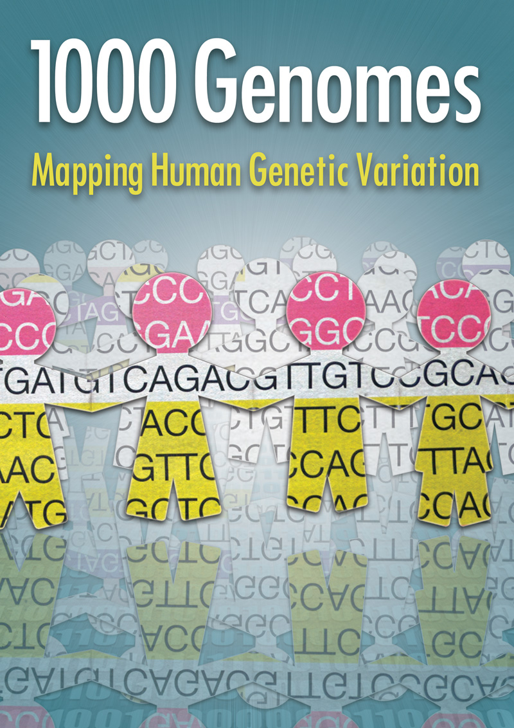
The Human
Genome Project
ENCODE
Pilot
ENCODE
Production
Comparative
ENCODE
2000
2005
2010
2015
Worm
Genome
modENCODE
1000 Genomes
Pilot
1000 Genomes
Production

Slide 57


The Human
Genome Project
ENCODE
Pilot
ENCODE
Production
Comparative
ENCODE
Epigenome
Roadmap
2000
2005
2010
2015
Worm
Genome
modENCODE
1000 Genomes
Pilot
1000 Genomes
Production
GTEx

Slide 58
With help of M Pazin at NHGRI, identified: 702 community papers that used ENCODE data but were not supported by ENCODE funding &
558 consortium papers supported by ENCODE funding
(https://www.encodeproject.org/search/?type=Publication for up-to-date query)
Then identified 1,786 ENCODE members & 8,263 non-members .
<= # Papers
# Authors Yr. (‘04 to ‘15)
[Wang et al., TIG (’16)]
Notes:
1 slides from dw encode authors

Slide 59
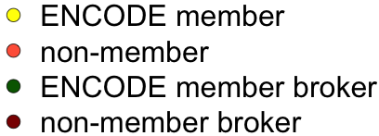
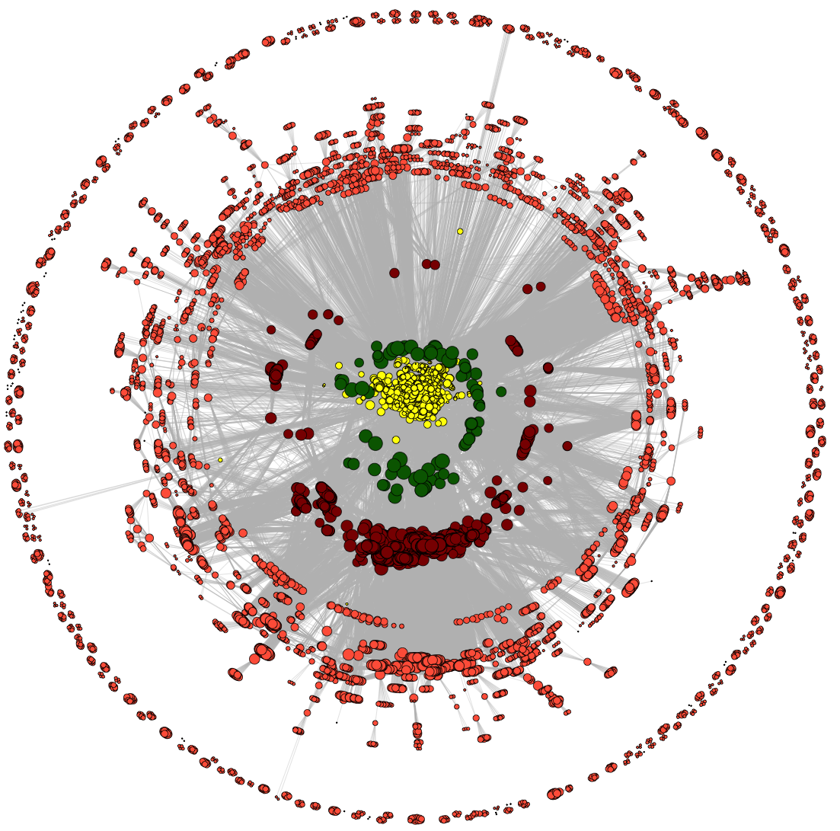
Co-authorship Network of ENCODE members
& Data Users
co-authorship
2014
[Wang et al., TIG (’16)]

Slide 60
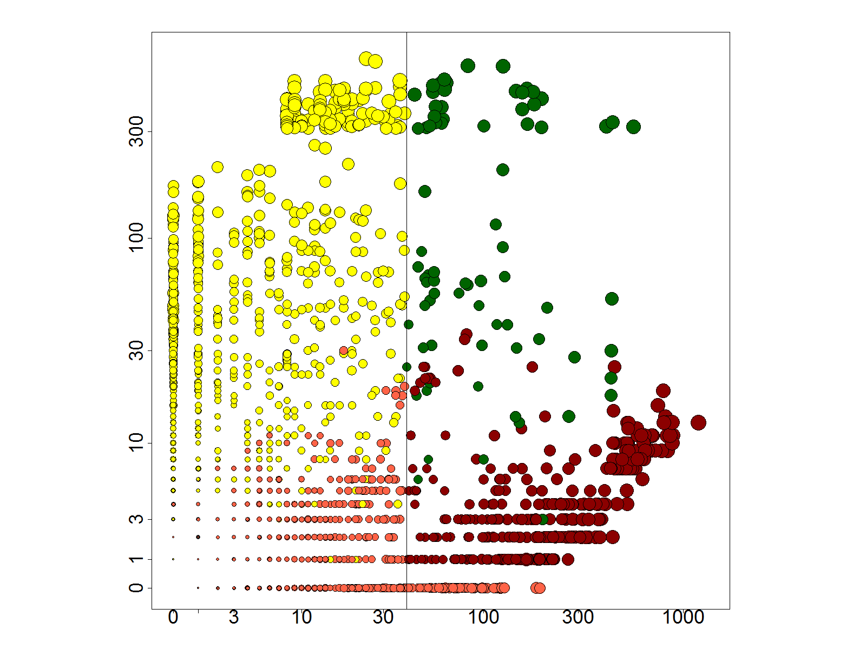
Co-authorship Network of ENCODE members
& Data Users
# neighbors: non-ENCODE ==>
co-authorship
# neighbors: ENCODE ==>
2014
[Wang et al., TIG (’16)]

Slide 61
Co-authorship Network of ENCODE members
& Data Users
co-authorship
2014
[Wang et al., TIG (’16)]

Slide 62
Dynamics of co-authorship network
2014
co-authorship
[Wang et al., TIG (’16)]

Slide 63
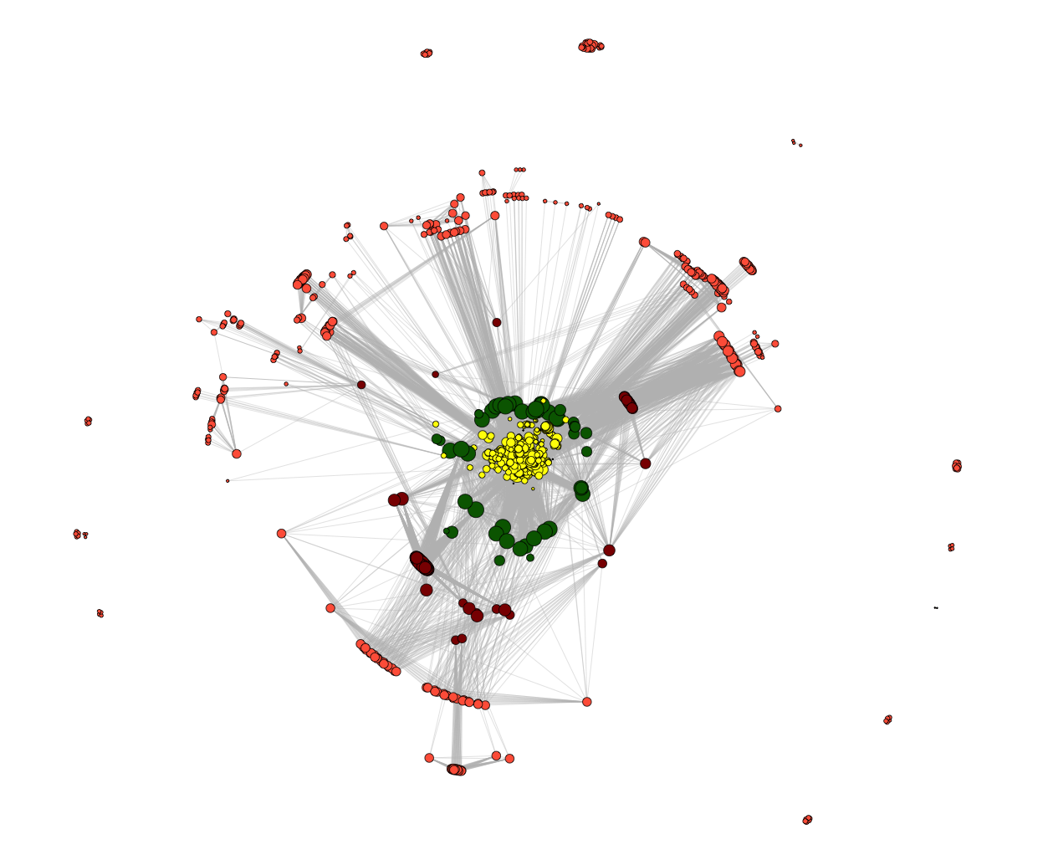
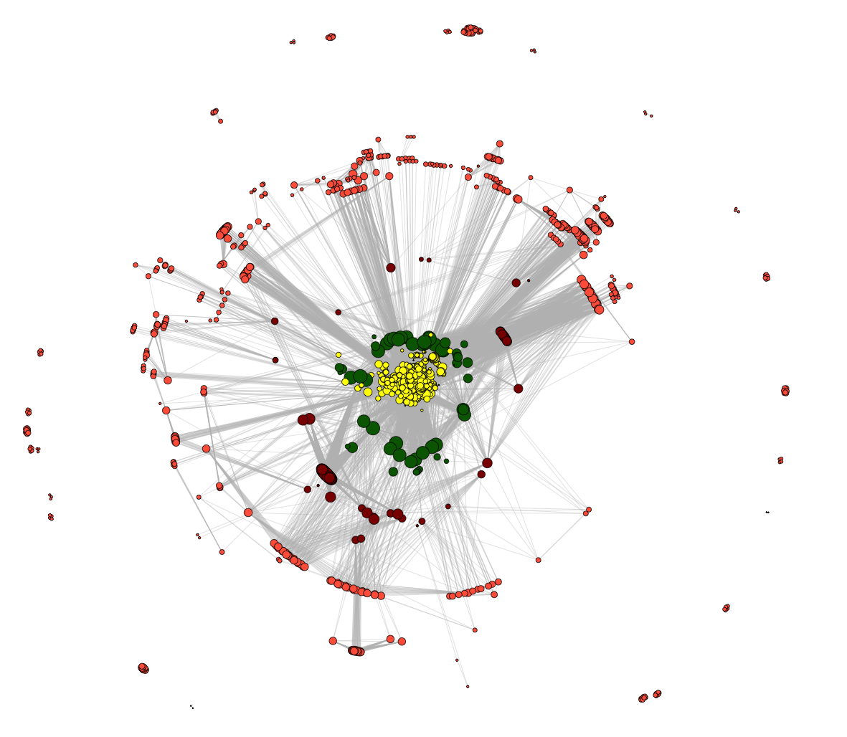
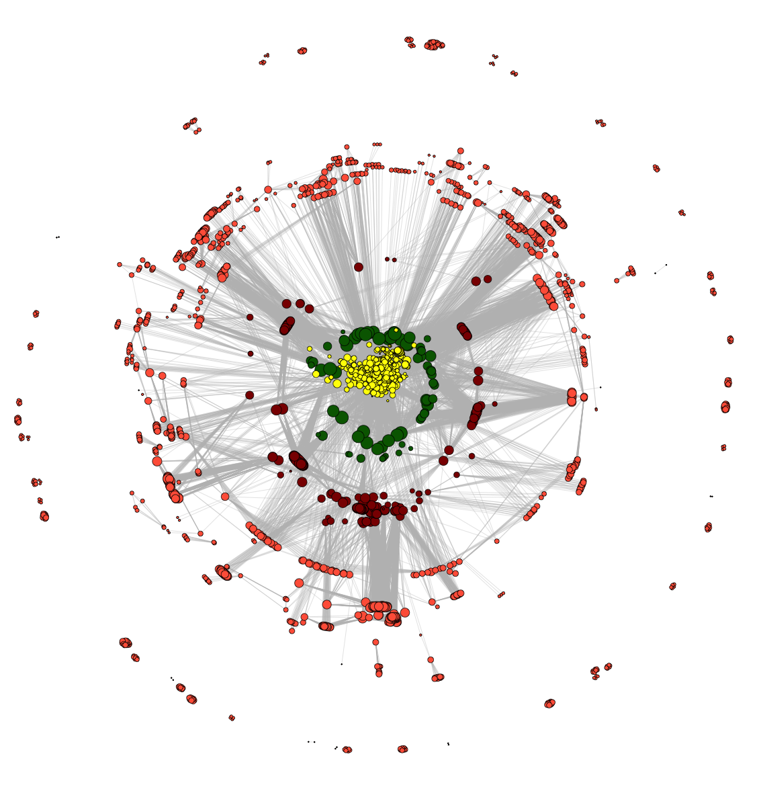
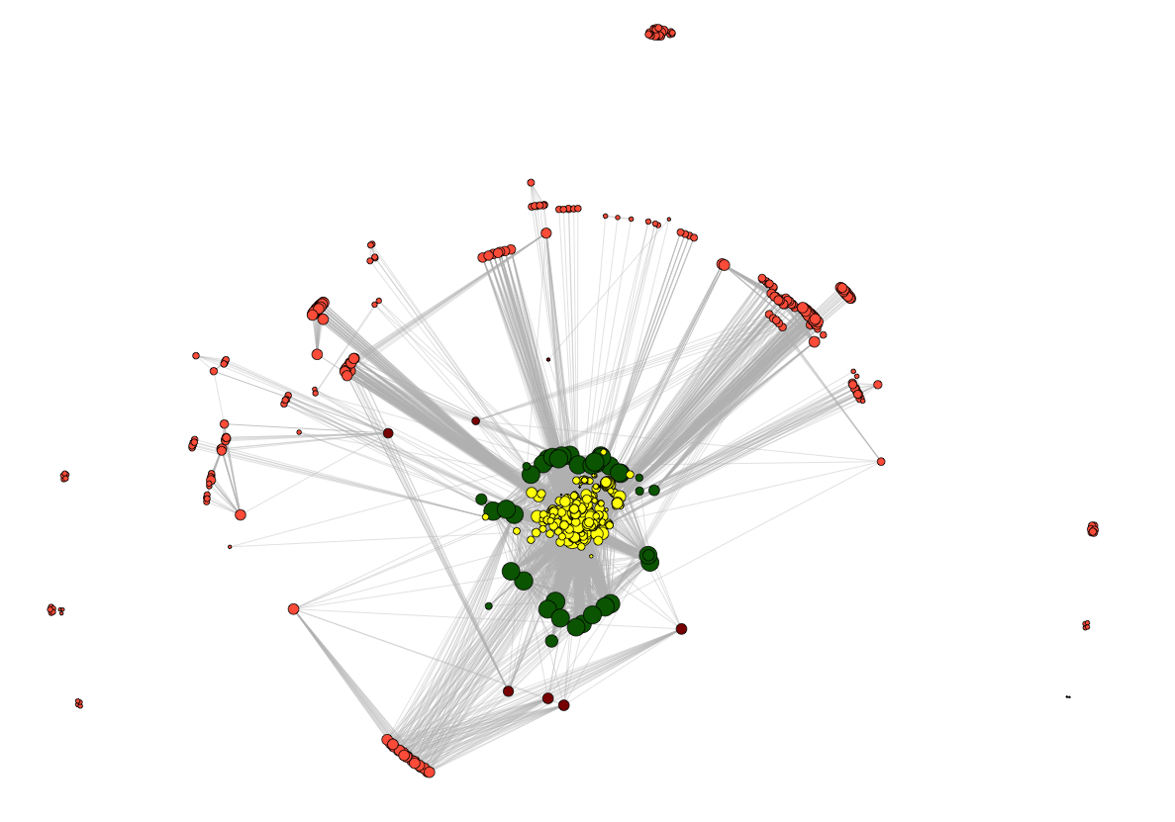
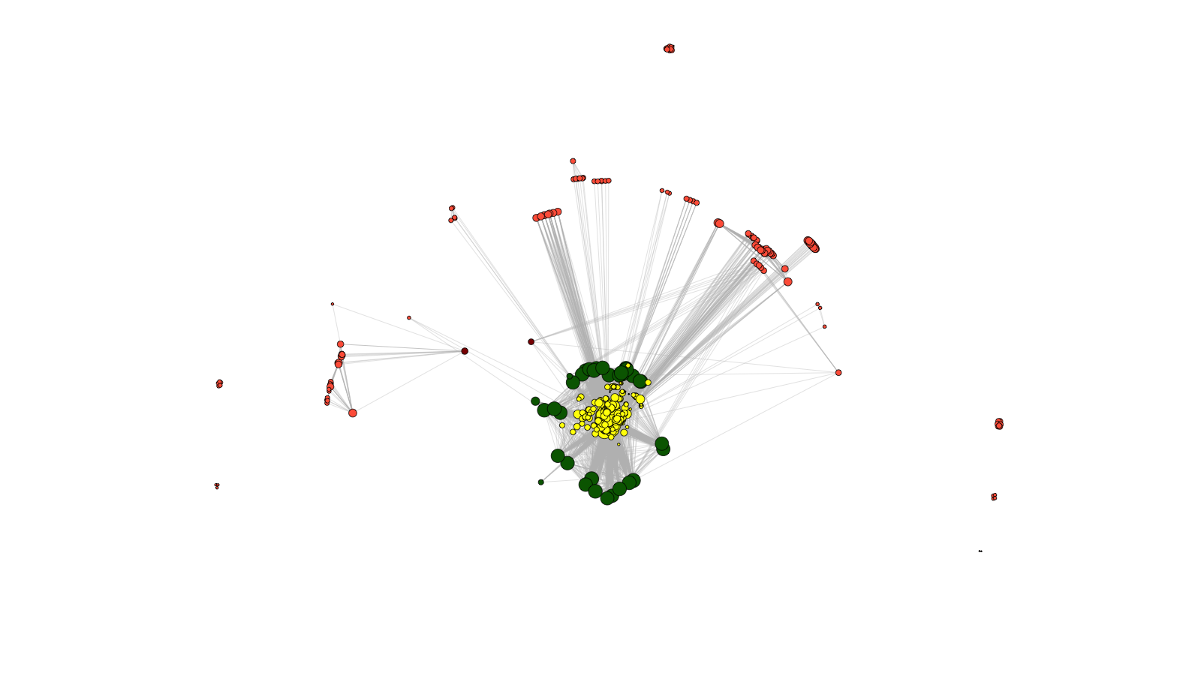
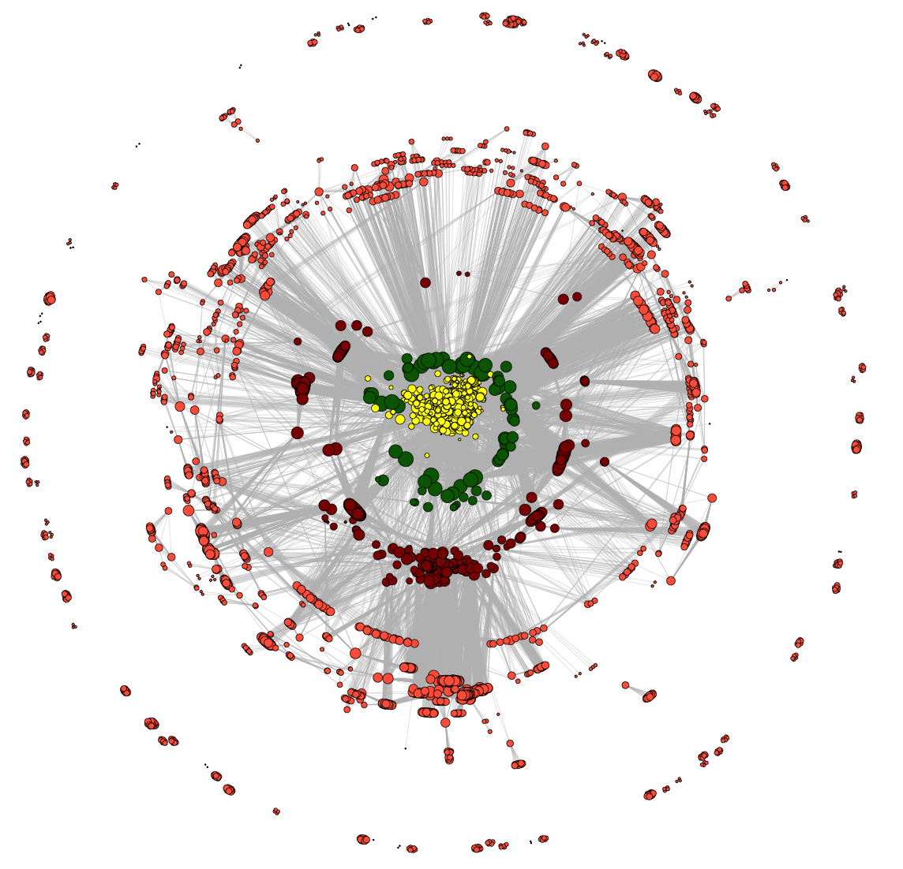
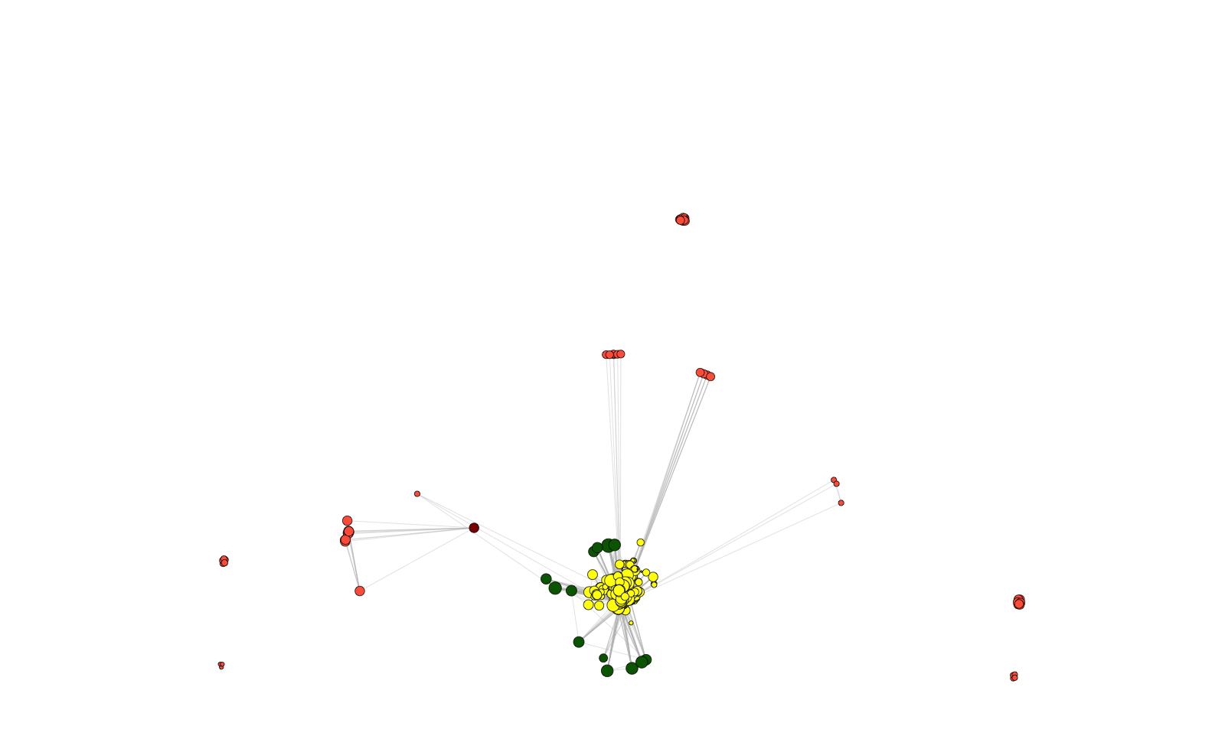
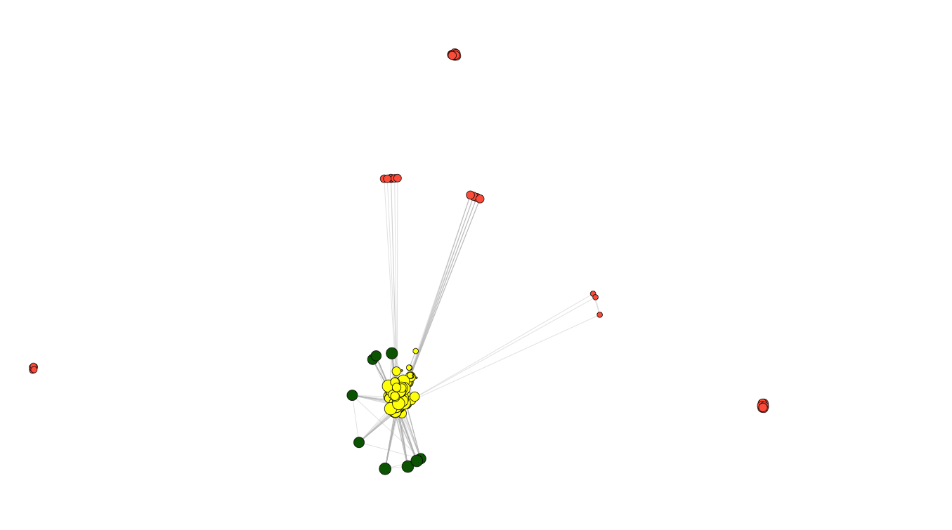
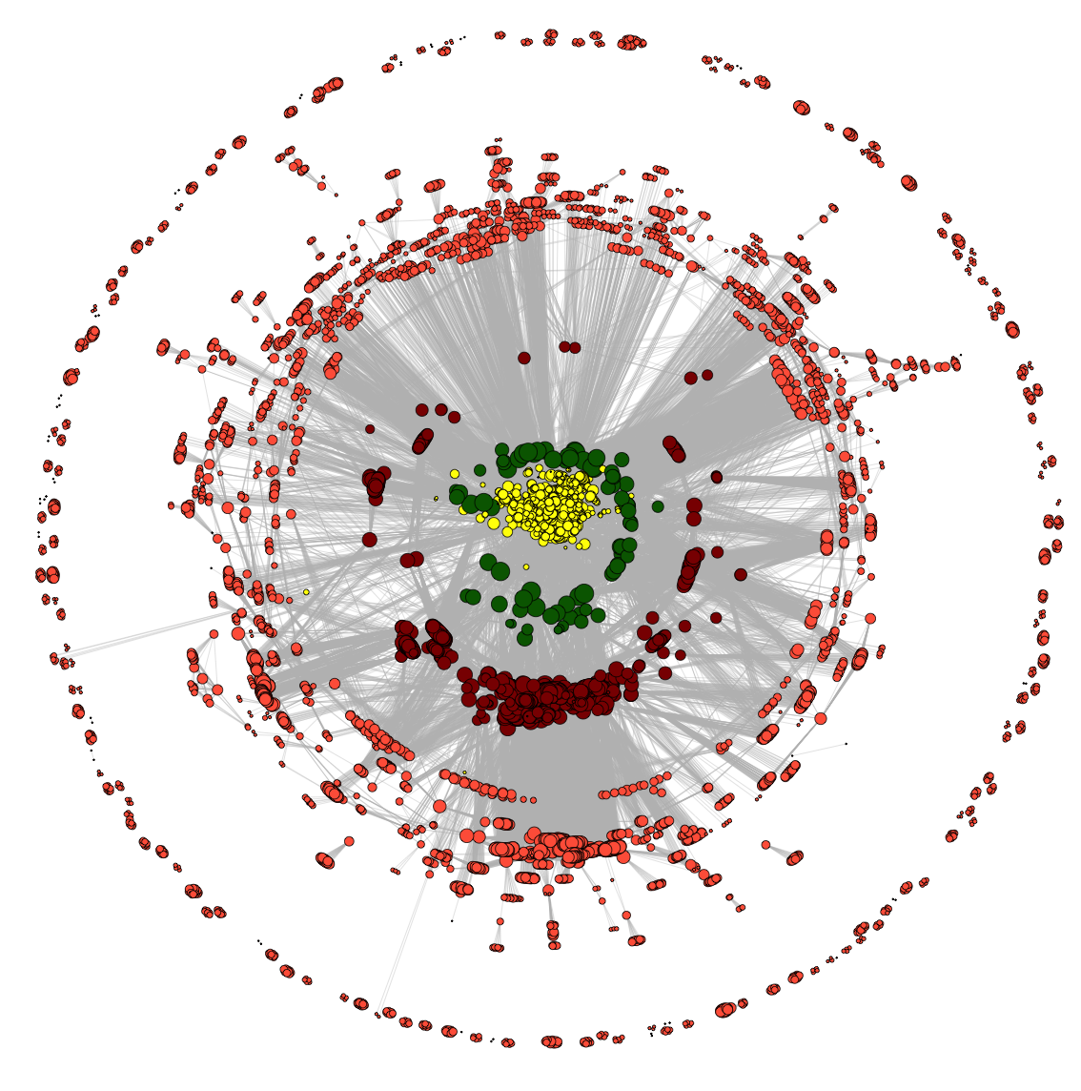
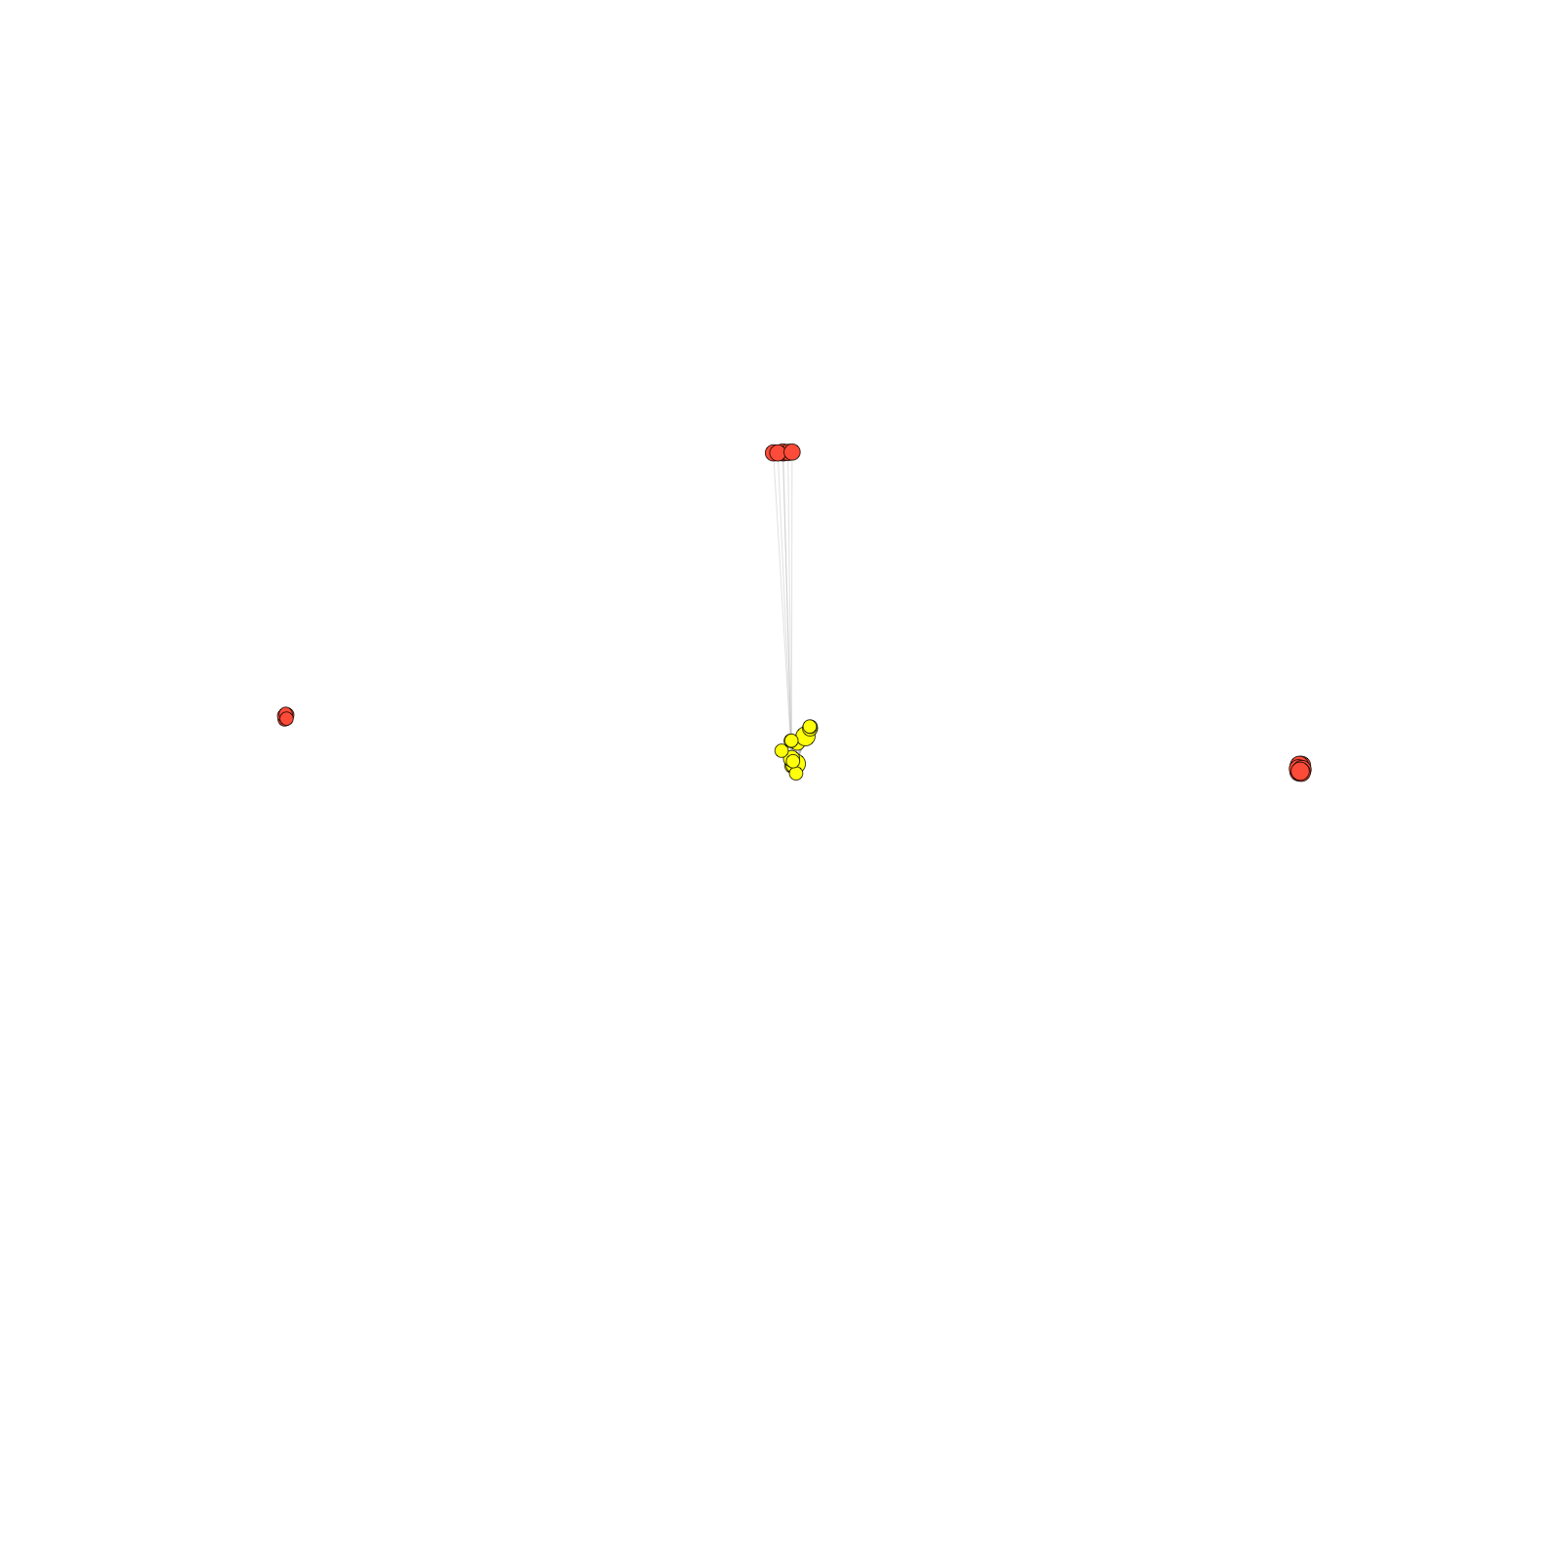
Dynamics of co-authorship network
2009
2010
2011
2008
2007
2012
2006
2005
2013
2004
2014
co-authorship
[Wang et al., TIG (’16)]

Slide 64
Dynamics of co-authorship network
2009
2010
2011
2008
2007
2012
“Modularity”
2006
2005
2013
2004
2014
co-authorship
[Wang et al., TIG (’16)]

Slide 65
Transcriptome Analysis: Tackling core issues related to gene regulation
& also mining the “data exhaust” produced by this activity
[Core-1] Expression Clustering,
Cross-species
  Comparative ENCODE – Lots of worm-fly-human matched data & developmental timecourses
  Optimization gives 16 conserved co-expression modules
[Core-2] State Space Models
of Gene Expression
  Using dimensionality reduction to help determine internal & external drivers
  Decoupling expression changes into those from conserved vs species-specific genes
  Also, conserved genes have similar canonical patterns (iPDPs) in contrast to species specific ones (Ex of ribosomal v signaling genes)
[Exhaust-1] Genomic Privacy & RNA-seq
  The dilemma: The genome as fundamental, inherited info that’s very private v need for large-scale mining for med. research
  Issues w/ current social & tech approaches: inconsistencies & burdensome security
  RNA-seq presents a particularly tricky privacy issue
  Quantifying & removing variant info from expression levels + eQTLs using ICI & predictability
  Instantiating a practical linking attack using extreme expression levels
[Exhaust-2] Value of Publication Patterns generated by data producing consortia
  Co-authorship network statistics relate to publication rollouts & show gradual adoption by a diverse community
  Key role of brokers in data dissemination

Slide 66
Transcriptome Analysis: Tackling core issues related to gene regulation
& also mining the “data exhaust” produced by this activity
[Core-1] Expression Clustering,
Cross-species
  Comparative ENCODE – Lots of worm-fly-human matched data & developmental timecourses
  Optimization gives 16 conserved co-expression modules
[Core-2] State Space Models
of Gene Expression
  Using dimensionality reduction to help determine internal & external drivers
  Decoupling expression changes into those from conserved vs species-specific genes
  Also, conserved genes have similar canonical patterns (iPDPs) in contrast to species specific ones (Ex of ribosomal v signaling genes)
[Exhaust-1] Genomic Privacy & RNA-seq
  The dilemma: The genome as fundamental, inherited info that’s very private v need for large-scale mining for med. research
  Issues w/ current social & tech approaches: inconsistencies & burdensome security
  RNA-seq presents a particularly tricky privacy issue
  Quantifying & removing variant info from expression levels + eQTLs using ICI & predictability
  Instantiating a practical linking attack using extreme expression levels
[Exhaust-2] Value of Publication Patterns generated by data producing consortia
  Co-authorship network statistics relate to publication rollouts & show gradual adoption by a diverse community
  Key role of brokers in data dissemination

Slide 67



Acknowledgements
Joel Rozowsky, Koon-Kiu Yan, Daifeng Wang,
Chao Cheng, James B. Brown, Carrie A. Davis, LaDeana Hillier, Cristina Sisu, Jingyi Jessica Li, Baikang Pei, Arif O. Harmanci, Michael O. Duff, Sarah Djebali, Roger P. Alexander, Burak H. Alver, Raymond K. Auerbach, Kimberly Bell, Peter J. Bickel, Max E. Boeck, Nathan P. Boley, Benjamin W. Booth, Lucy Cherbas, Peter Cherbas, Chao Di, Alex Dobin, Jorg Drenkow, Brent Ewing, Gang Fang, Megan Fastuca, Elise A. Feingold, Adam Frankish, Guanjun Gao, Peter J. Good, Phil Green, Roderic Guigó, Ann Hammonds, Jen Harrow, Roger A. Hoskins, Cédric Howald, Long Hu, Haiyan Huang, Tim J. P. Hubbard, Chau Huynh, Sonali Jha, Dionna Kasper, Masaomi Kato, Thomas C. Kaufman, Rob Kitchen, Erik Ladewig, Julien Lagarde, Eric Lai, Jing Leng, Zhi Lu, Michael MacCoss, Gemma May, Rebecca McWhirter, Gennifer Merrihew, David M. Miller, Ali Mortazavi, Rabi Murad, Brian Oliver, Sara Olson, Peter Park, Michael J. Pazin, Norbert Perrimon, Dmitri Pervouchine, Valerie Reinke, Alexandre Reymond, Garrett Robinson, Anastasia Samsonova, Gary I. Saunders, Felix Schlesinger, Anurag Sethi, Frank J. Slack, William C. Spencer, Marcus H. Stoiber, Pnina Strasbourger, Andrea Tanzer, Owen A. Thompson, Kenneth H. Wan, Guilin Wang, Huaien Wang, Kathie L. Watkins, Jiayu Wen, Kejia Wen, Chenghai Xue, Li Yang, Kevin Yip, Chris Zaleski, Yan Zhang, Henry Zheng, Steven E. Brenner, Brenton R. Graveley, Susan E. Celniker, Thomas R Gingeras, Robert Waterston
Hiring Postdocs. See gersteinlab.org/jobs !
EncodeProject.org/comparative/transcriptome

Slide 68
Acknowledgements
DREISS.gersteinlab.org - D Wang, F He, S Maslov
papers.gersteinlab.org/subject/privacy - D Greenbaum
PrivaSeq.gersteinlab.org - A Harmanci, G Gürsoy, F Navarro, S Wagner
github.com/gersteinlab/OrthoClust - K Yan, D Wang, J Rozowsky, H Zheng, C Cheng
Publication patterns [“encode authors”] - D Wang, KK Yan, J Rozowsky, E Pan
Hiring Postdocs. See JOBS.gersteinlab.org !

Slide 69

Extra

Slide 70
Info about content in this slide pack
General PERMISSIONS
  This Presentation is copyright Mark Gerstein,
  Yale University, 2017.
  Please read permissions statement at
  www.gersteinlab.org/misc/permissions.html .
  Feel free to use slides & images in the talk with PROPER acknowledgement
  (via citation to relevant papers or link to gersteinlab.org).
  Paper references in the talk were mostly from Papers.GersteinLab.org.
PHOTOS & IMAGES. For thoughts on the source and permissions of many of the photos and clipped images in this presentation see http://streams.gerstein.info .
  In particular, many of the images have particular EXIF tags, such as kwpotppt , that can be easily queried from flickr, viz: http://www.flickr.com/photos/mbgmbg/tags/kwpotppt

