Slide 1

Large-scale Transcriptome Mining:
Clustering,
Dynamic Modelling & Logic-gate Analysis while Protecting Individual Privacy
Mark Gerstein, Yale
Slides freely downloadable from Lectures.GersteinLab.org
& “tweetable” (via @markgerstein)
See last slide for more info.

Slide 2

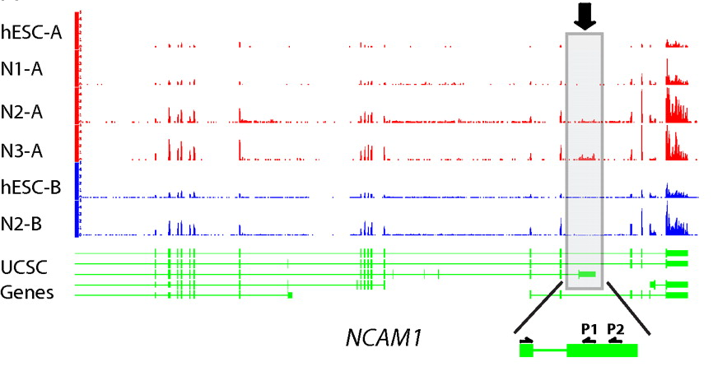
RNA-seq
RNA-seq uses next-generation sequencing technologies to reveal RNA presence and quantity within a biological sample.
ATACAAGCAAGTATAAGTTCGTATGCCGTCTT
GGAGGCTGGAGTTGGGGACGTATGCGGCATAG
TACCGATCGAGTCGACTGTAAACGTAGGCATA
ATTCTGACTGGTGTCATGCTGATGTACTTAAA
Reads (fasta)
－ Quality scores (fastq)
－ Mapping (BAM)
－ Contain variant information in transcribed regions
Quantitative information from RNA-seq signal: average signals at exon level (RPKMs)
Reads => Signal
[PLOS CB 4:e1000158; PNAS 4:107: 5254 ; IJC 123:569 ]

Slide 3
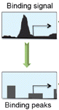
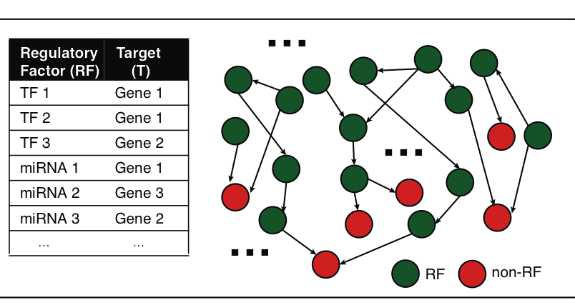
ChIP-seq:
Creating an Explicit Regulatory Network
Next generation sequencing techniques (e.g., ChIP-seq, CLIP-seq) predict gene regulatory factors (RFs) and their target genes
transcription factors (TFs)
micro-RNAs
Less data than RNA-seq but provides explicit notion of regulation
…
Gene regulatory network
Peak calling
Notes:
besides gene expression data, next generation sequencing technologies such as ChIP-seq and CLIP-seq can identify the target genes of gene regulatory factors. the regulatory factors include TF, mirnas and so on like TF1 and TF2 regulate Gene 1. Then, we can create a gene regulatory network. it is very likely that a target gene can be regulated by two or more RFs. e.g., we can get a lot of regulatory triplets where RF1 and RF2 regulate a common target gene T. Then, we would ask how two RFs coordinate to regulate T? are they really cooperative, or competitive, or independent? Is there a way to describe their cooperativity?

Slide 4










Activity Patterns
RNA Seq. gives rise to activity patterns
of genes & regions in the genome
Across
  time (development & disease),
  different tissues &
  individuals in a population

Slide 5
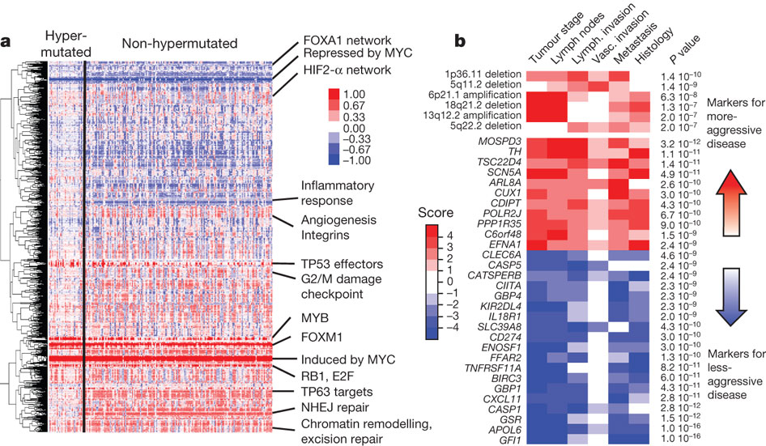
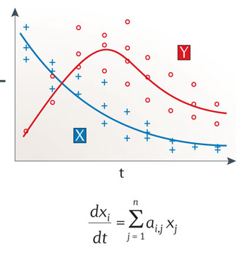
Modeling for RNA-seq & Chip-seq data across many samples & individuals…
Clusters
Logical model
Continuous model
Probabilistic model
Population
Gene
Over expressed
Under expressed
Gene Regulatory Mechanisms
The Cancer Genome Atlas Network Nature 487, 330-337 (2012) doi:10.1038/nature11252
Istrail & Davidson, PNAS, ‘04
Nicolas Le Novère, Nature Reviews Genetics, ‘15

Slide 6

2-sided nature of functional genomics data: Analysis can be very General/Public or Individual/Private
General quantifications related to overall aspects of a condition & are not tied to an individual’s genotype - ie what genes go up in cancer
  However, data is derived from an individual & tagged with an individual’s genotype
Other calculations aim to use genotype & specific aspects of the quantification to derive general relations related to sequence variation & gene expression
Some calculations and data derive finding very specific to the variants in a particular individual

Slide 7
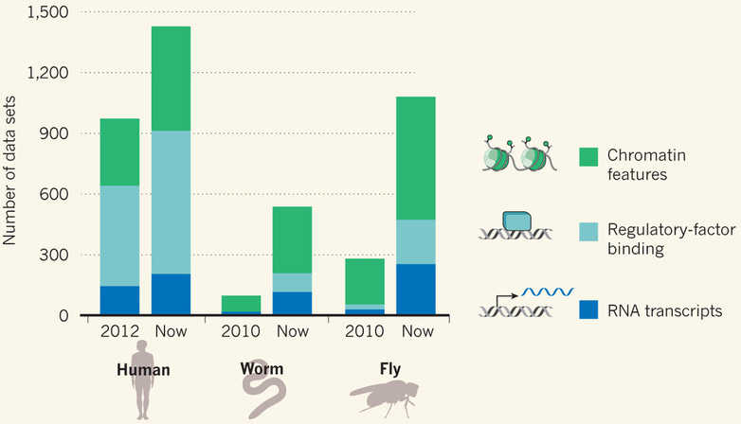
Comparative ENCODE Functional Genomics Resource
(EncodeProject.org/comparative)
Broad sampling of conditions across transcriptomes & regulomes for human, worm & fly
  embryo & ES cells
  developmental time course (worm-fly)
In total: ~3000 datasets (~130B reads)

Slide 8
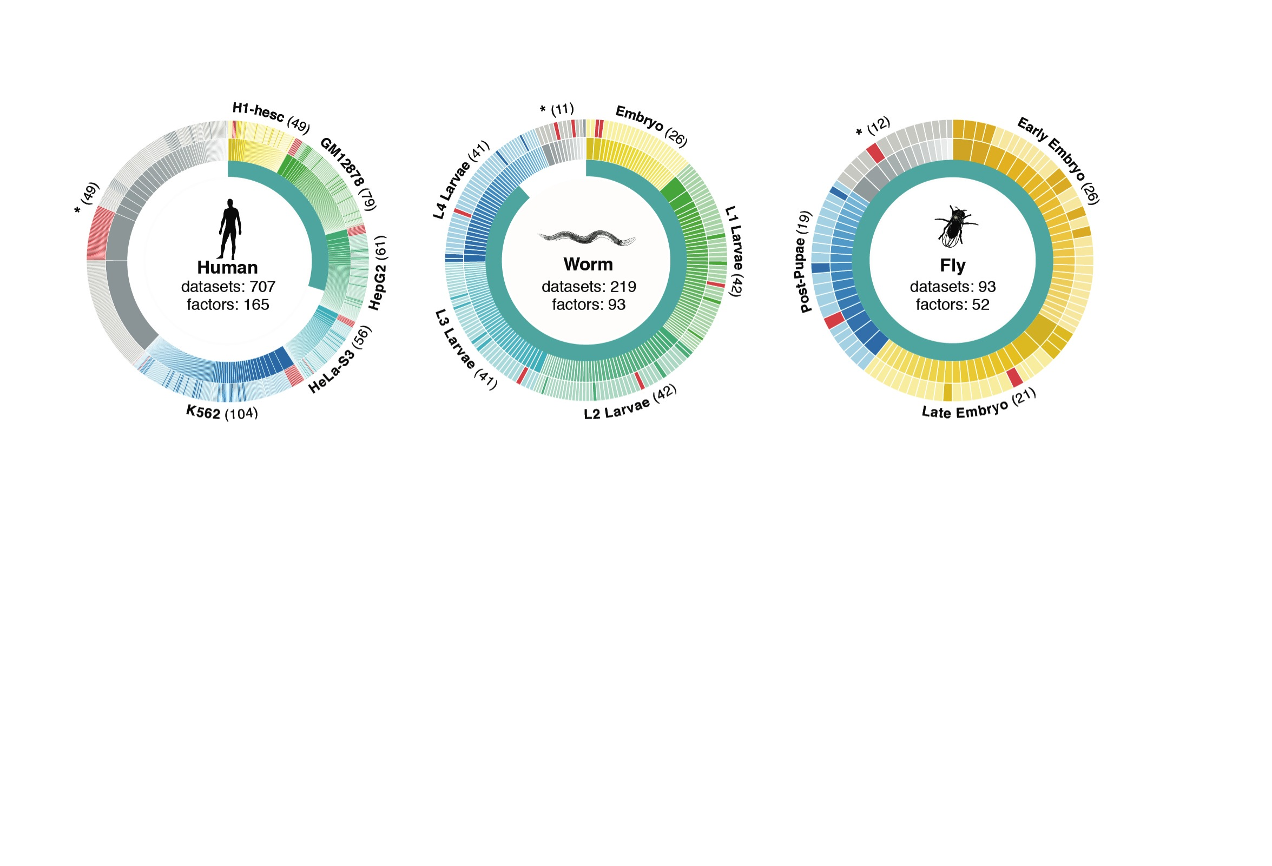
Time-course gene expression data of worm & fly development
[Nature 512:445 ('14); doi: 10.1038/nature13424]
Organism | Major developmental stages
worm (C. elegans) | 33 stages: 0, 0.5, 1, …, 12 hours, L1, L2, L3, L4, …, Young Adults, Adults
fly (D. mel.) | 30 stages: 0, 2, 4, 6, 8,…, 20, 22 hours, L1-L4, Pupaes, Adults

Slide 9


Acute Myeloid Leukemia (AML)
Target gene | 1824 | ENCODE Data (K562, ChIP-seq)
TF | 70
Regulatory triplet | 50,865 | TCGA Data (AML, level 3, RNA-seq) https://tcga-data.nci.nih.gov/tcga/tcgaDownload.jsp
Patient sample | 197
Wang, et al., PLoS Computational Biology, 2015
Notes:
Then, we apply Loregic to the human cancer data. e.g., we characterized the TF cooperativity in leukemia cancer using 70 TF chip-seq data in ENCODE and gene expression data across 200 patients in TCGA. it is interesting to find that OR gate matches the most triplets, which implies that TF may not cooperate with each other in human cancer.

Slide 10


Representative Expression, Genotype, eQTL Datasets
Genotypes are available from the 1000 Genomes Project
mRNA sequencing for 462 individuals
  Publicly available quantification for protein coding genes
Approximately 3,000 cis-eQTL (FDR<0.05)

Slide 11
Large-scale Transcriptome Mining:
Clustering, Dynamic Modelling & Logic-gate Analysis while Protecting Individual Privacy
Much RNA-seq (+TF ChIP) Data
  Comparative ENCODE – Lots of Matched Data
  TCGA
  Geuvadis w/ 1000G genotypes
Expression Clustering, Cross-species
  Optimization gives 16 conserved co-expression modules
State Space Models
of Gene Expression
  Using dimensionality reduction to help determine internal & external drivers
  Decoupling expression changes into those from conserved vs species-specific genes
  Also, conserved genes have similar canonical patterns (iPDPs) in contrast to species specific ones (Ex of ribosomal v signaling genes)
Using Logic Gates to Model of Transcriptome Activity
  Preponderance of OR gates in cancer v. cell-cycle (esp. for MYC)
The General
Dilemma of Genomic Privacy
  Fundamental, inherited info that’s very private v need for large-scale mining for med. research
  Issues w/ current social & tech approaches: inconsistencies & burdensome security
RNA-seq: How to Publicly Share it
  Presents a tricky privacy issue since much of the sequencing is for general, non-individual specific results yet it’s tagged with individual information
  Removing SNVs in reads w/ MRF
  Quantifying & removing variant info from expression levels + eQTLs using ICI & predictability
  Instantiating a practical linking attack using extreme expression levels
  Quantifying accuracy of prediction, via gap between best & 2nd best match
Value of publication patterns generated by the data producing consortia
  Co-authorship network statistics relate to publication rollouts & show gradual adoption by a diverse community
  Key role of brokers in data dissemination

Slide 12
Large-scale Transcriptome Mining:
Clustering, Dynamic Modelling & Logic-gate Analysis while Protecting Individual Privacy
Much RNA-seq (+TF ChIP) Data
  Comparative ENCODE – Lots of Matched Data
  TCGA
  Geuvadis w/ 1000G genotypes
Expression Clustering, Cross-species
  Optimization gives 16 conserved co-expression modules
State Space Models
of Gene Expression
  Using dimensionality reduction to help determine internal & external drivers
  Decoupling expression changes into those from conserved vs species-specific genes
  Also, conserved genes have similar canonical patterns (iPDPs) in contrast to species specific ones (Ex of ribosomal v signaling genes)
Using Logic Gates to Model of Transcriptome Activity
  Preponderance of OR gates in cancer v. cell-cycle (esp. for MYC)
The General
Dilemma of Genomic Privacy
  Fundamental, inherited info that’s very private v need for large-scale mining for med. research
  Issues w/ current social & tech approaches: inconsistencies & burdensome security
RNA-seq: How to Publicly Share it
  Presents a tricky privacy issue since much of the sequencing is for general, non-individual specific results yet it’s tagged with individual information
  Removing SNVs in reads w/ MRF
  Quantifying & removing variant info from expression levels + eQTLs using ICI & predictability
  Instantiating a practical linking attack using extreme expression levels
  Quantifying accuracy of prediction, via gap between best & 2nd best match
Value of publication patterns generated by the data producing consortia
  Co-authorship network statistics relate to publication rollouts & show gradual adoption by a diverse community
  Key role of brokers in data dissemination

Slide 13
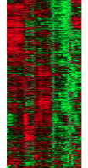
Expression clustering:
revisiting an ancient problem
Species A
Species B
Clustering
algorithm
Clustering
algorithm
co-expressed genes
responsible for the same
function in a species
Eisen MB et al. PNAS 1998
Langfelder P et al. BMC Bioinfo. 2008
Tamayo P et al. PNAS 1999
Kluger Y et al. Genome Res. 2003
two independent sets
of modules
Cross species
co-expression modules

Slide 14
Expression clustering:
revisiting an ancient problem
Species A
Orthologous pairs
between species
Species B
A novel unified framework to integrate co-expression data across species
OrthoClust
cross species modules
Yan et al. Genome Biol. 2014
Cross species
co-expression modules

Slide 15
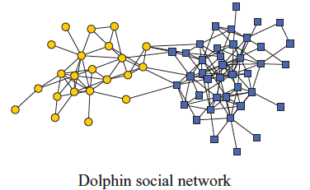
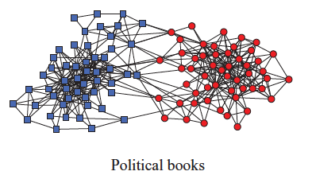
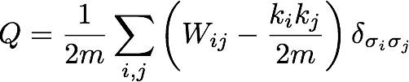
Network modularity
degree of node i
Newman Phy. Rev. E 2013
adjacency matrix
whether or not
i, j are in the
same module
number of edges
expected number of
edges between i and j

Slide 16

Network modularity
degree of node i
adjacency matrix
whether or not
i, j are in the
same module
number of edges
expected number of
edges between i and j

Slide 17

Network modularity
Optimization problem
for sim. annealing
degree of node i
adjacency matrix
whether or not
i, j are in the
same module
number of edges
expected number of
edges between i and j

Slide 18
A toy example [orthoclust]
[Yan et al. GenomeBiol 15:R100 ('14)]
2
Every node i is assigned with a label σ_{i} (labels of modules: 1,2,…q).
4
4
co-expressed
1
1
2
2
orthologs
Species A
3
3
Species B
reward an orthologous pair
with the same value
4
4
4
1
2
1
3
1
Q(for all σ_{i} in A) + Q(for all σ_{i} in B)
+
Favorableness = "Modularity" in species A + "Modularity" in species B + consistency betw. A & B

Slide 19
A toy example [orthoclust]
[Yan et al. GenomeBiol 15:R100 ('14)]
2
2
4
co-expressed
2
4
2
4
orthologs
Species A
2
4
Species B
4
1
4
1
4
4
1
1
species A specific
conserved modules
species B specific
Use Potts model (generalized Ising model) to simultaneously cluster co-expressed genes within an organism as well as orthologs shared between organisms. Here, the ground state configuration correspond to three modules: 1, 2, 4.

Slide 20
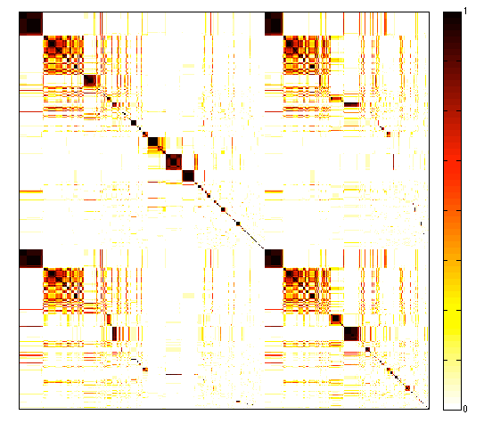
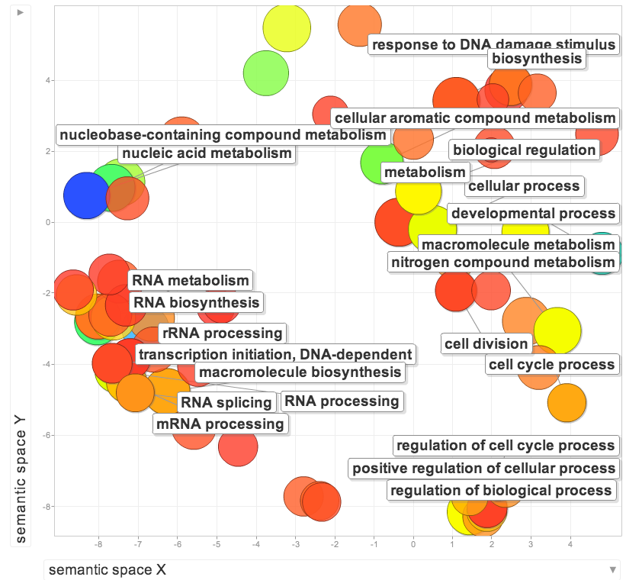
Cross-species clusters for worm and fly
GO terms of conserved modules
Worm genes (20377)
Fly genes (13623)
GO terms of specific modules
worm specific | dauer entry
fly specific | chitin activities
co-association
frequency
Yan KK et al. Genome Biology. 2014

Slide 21
Large-scale Transcriptome Mining:
Clustering, Dynamic Modelling & Logic-gate Analysis while Protecting Individual Privacy
Much RNA-seq (+TF ChIP) Data
  Comparative ENCODE – Lots of Matched Data
  TCGA
  Geuvadis w/ 1000G genotypes
Expression Clustering, Cross-species
  Optimization gives 16 conserved co-expression modules
State Space Models
of Gene Expression
  Using dimensionality reduction to help determine internal & external drivers
  Decoupling expression changes into those from conserved vs species-specific genes
  Also, conserved genes have similar canonical patterns (iPDPs) in contrast to species specific ones (Ex of ribosomal v signaling genes)
Using Logic Gates to Model of Transcriptome Activity
  Preponderance of OR gates in cancer v. cell-cycle (esp. for MYC)
The General
Dilemma of Genomic Privacy
  Fundamental, inherited info that’s very private v need for large-scale mining for med. research
  Issues w/ current social & tech approaches: inconsistencies & burdensome security
RNA-seq: How to Publicly Share it
  Presents a tricky privacy issue since much of the sequencing is for general, non-individual specific results yet it’s tagged with individual information
  Removing SNVs in reads w/ MRF
  Quantifying & removing variant info from expression levels + eQTLs using ICI & predictability
  Instantiating a practical linking attack using extreme expression levels
  Quantifying accuracy of prediction, via gap between best & 2nd best match
Value of publication patterns generated by the data producing consortia
  Co-authorship network statistics relate to publication rollouts & show gradual adoption by a diverse community
  Key role of brokers in data dissemination

Slide 22
Are gene regulations among orthologs conserved across species?
Are gene regulatory networks among orthologs conserved across species?
Species A
Species B
orthologs
co-expressed
Regulation among orthologs (internal)
Regulation from species-specific factors (external)
Orthologous genes (orthologs)
Species-specific transcription factors
To what degree can’t ortholog expression levels be predicted due to species-specific regulation
[Wang et al. PLOS CB, ‘16]
Notes:
connect loregic to here too! to see regulatory mechanisms similar too

Slide 23
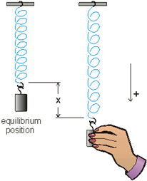
Internal & external gene regulatory networks
Internal Group
External Group
How to identify gene expression dynamics driven by internal/external regulation?
Internal regulation
External regulation
Interested system | Internal regulatory network | External regulatory network
Cross-species conserved genes | Conserved transcriptional factors (TFs) | Non-conserved TFs
Protein-coding genes | TFs | micro-RNAs
Individual’s protein coding genes | Wild-type TFs | Somatic mutated TFs
Protein-coding genes in brain | Commonly expressed TFs | Brain-specific expressed TFs
Protein-coding genes in development | House-keeping TFs | Developmental TFs
External force
[Wang et al. PLOS CB (in revision, ‘15)]
Notes:
connect loregic to here too! to see regulatory mechanisms similar too

Slide 24
State-space model for internal and external gene regulatory networks
Internal Group
External Group
How to identify gene expression dynamics driven by internal/external regulation?
Internal regulation
External regulation
Control: Gene expression vector of external factors at time t
State space model
X_{t+1}
A
X_{t}
B
U_{t}
B_{kl} captures temporal casual influence from external factor k to Gene l in internal group
State: Gene expression vector of Group X at time t+1
A_{ij} captures temporal casual influence from Gene i to Gene j in internal group
State: Gene expression vector of internal group at time t
[Wang et al. PLOS CB, ‘16]
Notes:
connect loregic to here too! to see regulatory mechanisms similar too

Slide 25
Effective state space model for meta-genes
Not enough data to estimate state space model for genes
(e.g., 25 time points per gene to estimate 4 million elements of A or B for 2000 genes)
Dimensionality reduction from genes to meta-genes (e.g., SVD)
Effective state space model for meta-genes
(e.g., 250 time points to estimate 50 matrix elements if 5 meta-genes)
[Wang et al. PLOS CB, ‘16]

Slide 26
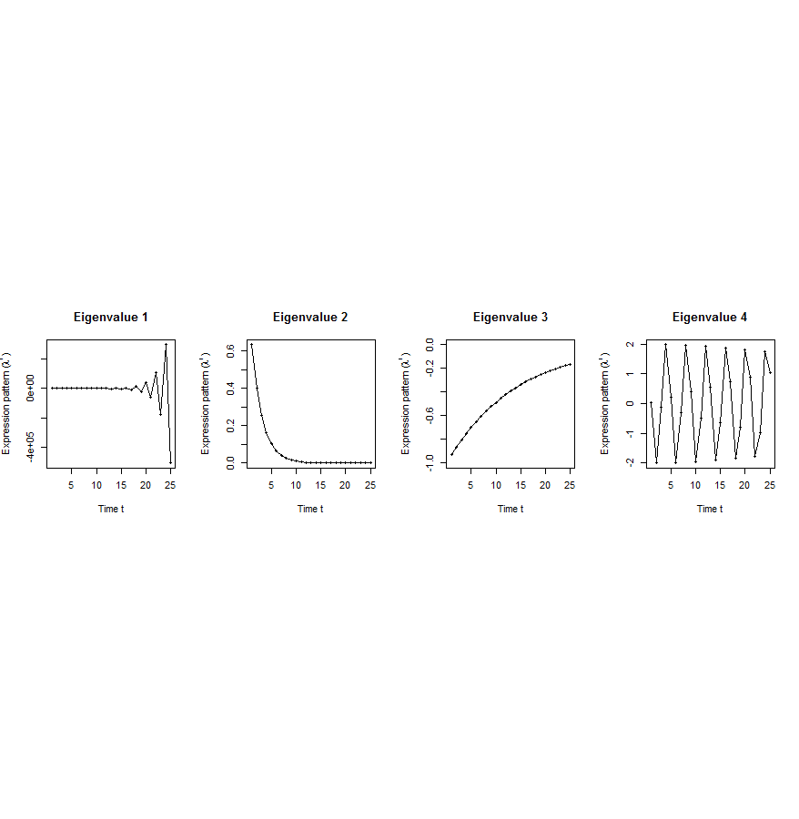
Canonical temporal expression trajectories from effective state space model
Internal driven dynamics
p^{th} internal principal dynamic pattern (iPDP): [λ_{p}¹, λ_{p}², …, λ_{p}^{T}],
where λ_{p} is p^{th} eigenvalue of Ã.
Canonical temporal expression trajectories
(e.g., degradation, growth, damped oscillation, etc.)
iPDP expression
time
[Wang et al. PLOS CB, ‘16]
Notes:
if we look at A tilde, it controls the dynamic trajectory of expression part internally driven by meta-genes of X. according to the analytic solution, the internally driven expression part Xtilde I can be linear combinations of A tilde’s eigenvalue’s exponentials across time, which are defined by us as internal principal dynamic pattern (iPDP). B tilde controls the dynamic trajectory of X’s metagene expression part externally driven by U. similarly, we can find external principal dynamic pattern (ePDP) based on B tilde’s eigenvalue exponentials across time. Actually, those patterns are canonical temporal expression trajectories, which are as simple as degradation, growth, damped oscillation temporal processes). In short, from metagene effective model, we are able to identify internal and external driven canonical temporal expression trajectories.

Slide 27
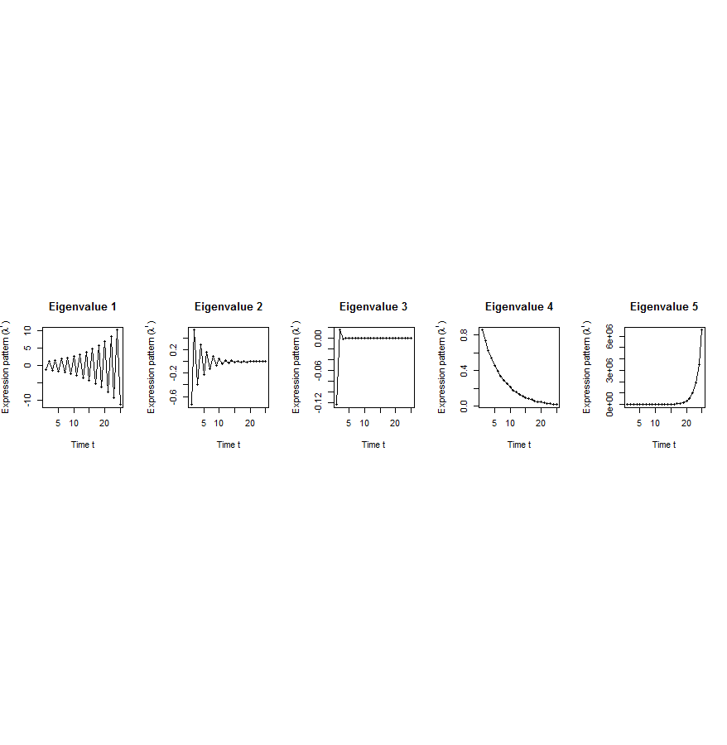
Flowchart
[Wang et al. PLOS CB, ‘16]
A. Gene state-space model
C. Meta-gene state-space model
B. Dimensionality Reduction
X_{t+1}=AX_{t}+BU_{t}
Genes of X
Meta-genes of X
time
E. Gene’s internal (INT) and external (EXT) driven expression dynamics composed of PDPs
time
D. Internal/External Principal Dynamic Patterns (PDPs)
x^{INT} = c₁ +c₂
+c₃ +c₄
[λ_{p}¹, λ_{p}², …, λ_{p}^{T}]
Genes of U
Meta-genes of U
time
time
x^{EXT} = d₁ +d₂
+d₃ +d₄
Internal regulation among internal genes/meta-genes by A/Ã
External regulation from external genes/meta-genes to internal genes/meta-genes in Group X by B/
Internal genes/meta-genes
External genes/meta-genes

Slide 28
Specific Scale of the Data Used
Not enough time samples!
Dataset | Internal Group | External Group | Developmental stages | # of unknown parameters in A and B | # of available time samples
worm (C. elegans) | N₁=3147 worm-fly orthologs (incl. ortholog TFs) | N₂=509 worm-specific transcription factors | T=25 time points: 0, 0.5, 1, …, 12 hours | 3147*3147+3147*509=11.5M | 3147*25+509*25=91400
fly (D. mel.) |  | N₂=442 fly-specific transcription factors | T=12 time points: 0, 2, 4, 6, 8,…, 20, 22 hours | 3147*3147+3147*442=11.3M | 3147*25+442*25=89725
Notes:
we apply this method to time-series gene expression data in embryonic development of worm and fly in modENCODE, and identified internal principal dynamic patterns of ortholog gene expressions driven by orthologous TFs, and external patterns driven by species-specific TFs.

Slide 29
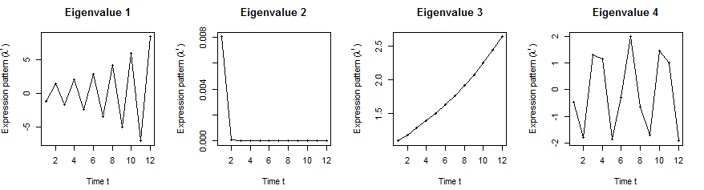
Orthologs have similar internal but different external dynamic patterns during embryonic development
Worm’s effective state space model
1st iPDP
2nd iPDP
3rd iPDP
4th iPDP
1st ePDP
2nd ePDP
3rd ePDP
4th ePDP
5th ePDP
Expression
Expression
Similar
Different
1st iPDP
2nd iPDP
3rd iPDP
4th iPDP
1st ePDP
2nd ePDP
3rd ePDP
4th ePDP
5th ePDP
Expression
Expression
Fly’s effective state space model
[Wang et al. PLOS CB, ‘16]

Slide 30
Orthologs have correlated iPDP coefficients
1st iPDP
2nd iPDP
r=+0.33
r=+0.66
Coefficients of orthologs on fly
3rd iPDP
4th iPDP
r=+0.67
r=+0.73
Coefficients of orthologs on worm
[Wang et al. PLOS CB, ‘16]

Slide 31
Evolutionarily conserved & younger genes exhibit the opposite internal & external PDP coefficients
p<2.2e-16
p<2.6e-13
p<5.6e-11
p<8.3e-4
Worm
Fly
Ribosomal genes have significantly larger coefficients for the internal than external PDPs, but signaling genes exhibit the opposite trend
[Wang et al. PLOS CB, ‘16]

Slide 32
Large-scale Transcriptome Mining:
Clustering, Dynamic Modelling & Logic-gate Analysis while Protecting Individual Privacy
Much RNA-seq (+TF ChIP) Data
  Comparative ENCODE – Lots of Matched Data
  TCGA
  Geuvadis w/ 1000G genotypes
Expression Clustering, Cross-species
  Optimization gives 16 conserved co-expression modules
State Space Models
of Gene Expression
  Using dimensionality reduction to help determine internal & external drivers
  Decoupling expression changes into those from conserved vs species-specific genes
  Also, conserved genes have similar canonical patterns (iPDPs) in contrast to species specific ones (Ex of ribosomal v signaling genes)
Using Logic Gates to Model of Transcriptome Activity
  Preponderance of OR gates in cancer v. cell-cycle (esp. for MYC)
The General
Dilemma of Genomic Privacy
  Fundamental, inherited info that’s very private v need for large-scale mining for med. research
  Issues w/ current social & tech approaches: inconsistencies & burdensome security
RNA-seq: How to Publicly Share it
  Presents a tricky privacy issue since much of the sequencing is for general, non-individual specific results yet it’s tagged with individual information
  Removing SNVs in reads w/ MRF
  Quantifying & removing variant info from expression levels + eQTLs using ICI & predictability
  Instantiating a practical linking attack using extreme expression levels
  Quantifying accuracy of prediction, via gap between best & 2nd best match
Value of publication patterns generated by the data producing consortia
  Co-authorship network statistics relate to publication rollouts & show gradual adoption by a diverse community
  Key role of brokers in data dissemination

Slide 33
Modeling cooperativity between
TFs to target gene using logic gates
A regulatory triplet
2-input-1-output logic gate
10110101…
10110101…
RF1
RF1
?
T
00110101…
T
00110101…
10110101…
01110111…
RF2
RF2
0 – gene off
1 – gene on
after binarizing gene expression data*
Input type (RF1, RF2) | RF1 | 0 | 0 | 1 | 1
 | RF2 | 0 | 1 | 0 | 1
Output | T | X | X | X | X
Binarized expression
X can be 0 or 1, so there are 2⁴=16 possible output combinations, each of which corresponds to a unique 2-input-1-output logic gate
…
*BoolNet, R package
Notes:
let’s look at a particular triplet, TF1 and TF2 regulate Gene 1. At logical level, gene expression has two states, gene is on or off, i.e., 1 represents gene is expressed or 0 represents gene is not expressed. So, then we can look at the triplet as 2-input-1-output system. TF1 and TF2 are inputs, and Gene 1 are output, and then use a 2-input-1-output logic gate to model this triplet. As shown in a truth table, there are 4 different types of input of TF1 and TF2, 00, 01, 10, 11, and for each input type, there are 2 possible output types, 1 or 0. so in total, we have 2^4 = 16 possible logic gates that can be used to describe the triplet.

Slide 34
An example: selection of the best-matched logic gate
Laplace’s rule of succession
s=(# of selected output state for the input type + 1)
/(# of input type + 2)
Consistency score:
6/7*5/7*6/7*5/7=0.37
Wang, et al., PLoS Computational Biology, 2015
Notes:
*********************************************
This toy example demonstrates that how we choose the best matched logic gates. first, for each input type of TF1, TF2 like 01, green, we count numbers of 0 and 1 output from Gene 1 data. and select the most state as output of this input type. e.g., we have 4 zeros and 1 one, then 0 is considered as output of input type 01. we also calculate the output’s succession prob using laplace’s rule of succession derived from Bayes' theorem, like 5/7. after we go thru all four input types, we get a truth table. Here, it’s the table for the AND gate. Also, we define production of four output succession probs as consistency score to the matched logic gate. e.g. the consistency score is 0.37 for AND gate.

Slide 35
App. 1 – TF cooperativity in the cell cycle
Target gene | 2464
TF | 176
Triplet | 39,011
Time point | 59
AND-like gates
Wang, et al., PLoS Computational Biology, 2015
Notes:
First, we apply Loregic to characterize TF cooperativity during yeast cell cycle, and found AND gate matches the most triplets, which implies that yeast TFs need to cooperate during cell cycle. we were able to distinguish three categories for this triplet group: 1) “homogenous” gate-consistent triplets – matching the same logic gate across all targets (e.g., top table); 2) “inhomogeneous” gate-consistent triplets – matching different logic gates across all targets (e.g., middle table); and 3) non-gate-consistent triplets, i.e. triplets inconsistent with all logic gates across all targets (e.g., bottom table).

Slide 36
App. 2 – TF cooperativity in AML
Regulatory triplet from ENCODE | 50,865
Patient sample for TCGA AML expression data | 197
OR-like gates
number of logic-gate consistent triplets
Wang, et al., PLoS Computational Biology, 2015
Notes:
Then, we apply Loregic to the human cancer data. e.g., we characterized the TF cooperativity in leukemia cancer using 70 TF chip-seq data in ENCODE and gene expression data across 200 patients in TCGA. it is interesting to find that OR gate matches the most triplets, which implies that TF may not cooperate with each other in human cancer.

Slide 37

Cancer-related TF, MYC, universally amplifies target expression
Restrict to RF1=MYC, giving 2,153 triplets
RF1
OR(RF1, RF2)
OR(RF1, NOT RF2)
number of logic-gate consistent triplets
High expression of MYC is sufficient for high target gene expression
Wang, et al., PLoS Computational Biology, 2015
Notes:
So, we then look at triplets with cancer-related TFs, e.g., MYC. biologists found that MYC universally amplifies target gene expressions in lymphocytes. we checked 2000 MYC associated triplets where MYC is 1st RF, and found the most MYC associated triplets are consistent with three logic gates, RF1, RF1+RF2 and RF1+~RF2 with significant enrichments. all three logic gates mean that high expression of MYC is sufficient for high target gene expression, which supports that MYC is a universal amplifier.
then use MYC to slince targe gene expresison in cancer

Slide 38
Large-scale Transcriptome Mining:
Clustering, Dynamic Modelling & Logic-gate Analysis while Protecting Individual Privacy
Much RNA-seq (+TF ChIP) Data
  Comparative ENCODE – Lots of Matched Data
  TCGA
  Geuvadis w/ 1000G genotypes
Expression Clustering, Cross-species
  Optimization gives 16 conserved co-expression modules
State Space Models
of Gene Expression
  Using dimensionality reduction to help determine internal & external drivers
  Decoupling expression changes into those from conserved vs species-specific genes
  Also, conserved genes have similar canonical patterns (iPDPs) in contrast to species specific ones (Ex of ribosomal v signaling genes)
Using Logic Gates to Model of Transcriptome Activity
  Preponderance of OR gates in cancer v. cell-cycle (esp. for MYC)
The General
Dilemma of Genomic Privacy
  Fundamental, inherited info that’s very private v need for large-scale mining for med. research
  Issues w/ current social & tech approaches: inconsistencies & burdensome security
RNA-seq: How to Publicly Share it
  Presents a tricky privacy issue since much of the sequencing is for general, non-individual specific results yet it’s tagged with individual information
  Removing SNVs in reads w/ MRF
  Quantifying & removing variant info from expression levels + eQTLs using ICI & predictability
  Instantiating a practical linking attack using extreme expression levels
  Quantifying accuracy of prediction, via gap between best & 2nd best match
Value of publication patterns generated by the data producing consortia
  Co-authorship network statistics relate to publication rollouts & show gradual adoption by a diverse community
  Key role of brokers in data dissemination

Slide 39


The Conundrum of Genomic Privacy: Is it a Problem?
Yes
Genetic Exceptionalism :
The Genome is very fundamental data, potentially very revealing about one’s identity & characteristics
Identification Risk: Find that someone participated in a study [eg Craig, Erlich]
Characterization Risk: Finding that you have a particular trait from studying your identified genome [eg Watson ApoE status]
No
Shifting societal foci
No one really cares
about your genes
You might not care
[Klitzman & Sweeney ('11), J Genet Couns 20:98l; Greenbaum & Gerstein ('09), New Sci. (Sep 23) ]

Slide 40












Genomics has similar "Big Data" Dilemma in the Rest of Society
Sharing & "peer-production" is central to success of many new ventures, with the same risks as in genomics
  EG web search: Large-scale mining essential
We confront privacy risks every day we access the internet
(...or is the genome more exceptional & fundamental?)
[Seringhaus & Gerstein ('09), Hart. Courant (Jun 5); Greenbaum & Gerstein ('11), NY Times (6 Oct)]

Slide 41

Tricky Privacy Considerations in Personal Genomics
Personal Genomic info. essentially meaningless currently but will it be in 20 yrs? 50 yrs?
  Genomic sequence very revealing about one’s children. Is true consent possible?
  Once put on the web it can’t be taken back
Culture Clash:
Genomics historically has been a proponent of “open data” but not clear personal genomics fits this.
  Clinical Medline has a very different culture.
Ethically challenged history of genetics
  Ownership of the data & what consent means (Hela)
    Could your genetic data give rise to a product line?
[D Greenbaum & M Gerstein (’08). Am J. Bioethics; D Greenbaum & M Gerstein, Hartford Courant, 10 Jul. '08 ; SF Chronicle, 2 Nov. '08;
Greenbaum et al. PLOS CB (‘11) ; Greenbaum & Gerstein ('13), The Scientist; Photo from NY Times]

Slide 42

The Other Side of the Coin:
Why we should share
Sharing helps speed research
  Large-scale mining of this information is important for medical research
  Privacy is cumbersome, particularly for big data
Sharing is important for reproducible research
Sharing is useful for education
  More fun to study a known person’s genome
    Eg Zimmer’s Game of Genomes in STAT
[Yale Law Roundtable (‘10). Comp. in Sci. & Eng. 12:8; D Greenbaum & M Gerstein (‘09). Am. J. Bioethics; D Greenbaum & M Gerstein (‘10). SF Chronicle, May 2, Page E-4;
Greenbaum et al. PLOS CB (‘11)]

Slide 43

The Dilemma
[Economist, 15 Aug ‘15]
The individual (harmed?) v the collective (benefits)
  But do sick patients care about their privacy?
How to balance risks v rewards - Quantification
  What is acceptable risk? What is acceptable data leakage? Can we quantify leakage?
    Ex: photos of eye color
  Cost Benefit Analysis: how helpful is identifiable data in genomic research v. potential harm from a breach?

Slide 44
Current Social & Technical Solutions
Closed Data Approach
  Consents
  “Protected” distribution via dbGAP
  Local computes on secure computer
Issues with Closed Data
  Non-uniformity of consents & paperwork
    Different international norms, leading to confusion
  Encryption & computer security creates burdensome requirements on data sharing & large scale analysis
  Many schemes get “hacked”
Open Data
  Genomic "test pilots” (ala PGP)?
    Sports stars & celebrities?
  Some public data & data donation is helpful but is this a realistic solution for an unbiased sample of ~1M
[Greenbuam et al ('04), Nat. Biotech; Greenbaum & Gerstein ('13), The Scientist]

Slide 45
Strawman Hybrid Social & Tech Proposed Solution?
Fundamentally, researchers have to keep genetic secrets.
  Need for an (international) legal framework
  Genetic Licensure & training for individuals
  (similar to medical license, drivers license)
Technology to make things easier
  Cloud computing & enclaves (eg solution of Genomics England)
Technological barriers shouldn't create a social incentive for “hacking”
Quantifying Leakage & allowing a small amounts of it
Careful separation & coupling of private & public data
  Lightweight, freely accessible secondary datasets coupled to underlying variants
  Selection of stub & "test pilot" datasets for benchmarking
  Develop programs on public stubs on your laptop, then move the program to the cloud for private production run
[D Greenbaum, M Gerstein (‘11). Am J Bioeth 11:39. Greenbaum & Gerstein, The Scientist ('13)]

Slide 46



What is a linking attack? Case of Netflix Prize
Anonymized Netflix Prize Training Dataset
made available to contestants
Movie ratings database
User (ID) | Movie (ID) | Date of Rating | Rating [1,2,3,4,5]
NTFLX-0 | NTFLX-19 | 10/12/2008 | 1
NTFLX-1 | NTFLX-116 | 4/23/2009 | 3
NTFLX-2 | NTFLX-92 | 5/27/2010 | 2
NTFLX-1 | NTFLX-666 | 6/6/2016 | 5
… | … | … | …
… | … | … | …
100 million ratings
500,000 users
200 movie ratings/user
5,000 users/movie rating
Notes:
Before presenting our work in detail, I would like to motivate the our study with an example.
Netflix, the movie rental company, had organized these contests to improve their movie recommendation system.
The setup was like this: Netflix released this huge data matrix with user ids, movie titles, date of movie rating and the actual rating. There were 100 million entries for 500k users. On average each user rated 200 movies and each movie has been rated, on average by 5000 users.
This data matrix was used to train recommendation algorithms, which were then tested on other datasets.
This dataset was anonymized by removing names of users but Netflix also added noise and removed some other entries in the matrix to make it more secure.

Slide 47


Linking Attacks: Case of Netflix Prize
Names available for many users!
User (ID) | Movie (ID) | Date of Grade | Grade [1,2,3,4,5]
NTFLX-0 | NTFLX-19 | 10/12/2008 | 1
NTFLX-1 | NTFLX-116 | 4/23/2009 | 3
NTFLX-2 | NTFLX-92 | 5/27/2010 | 2
NTFLX-1 | NTFLX-666 | 6/6/2016 | 5
… | … | … | …
… | … | … | …
User (ID) | Movie (ID) | Date of Grade | Grade [0-10]
IMDB-0 | IMDB-173 | 4/20/2009 | 5
IMDB-1 | IMDB-18 | 10/18/2008 | 0
IMDB-2 | IMDB-341 | 5/27/2010 | -
… | … | … | …
… | … | … | …
… | … | … | …
Many users are shared
The grades of same users are correlated
A user grades one movie around the same date in two databases
Notes:
This figure illustrates what these datasets look like. The movie titles can be matched directly. Date of ratings and rating values are expected to be similar to each other

Slide 48
Linking Attacks: Case of Netflix Prize
Names available for many users!
User (ID) | Movie (ID) | Date of Grade | Grade [1,2,3,4,5]
NTFLX-0 | NTFLX-19 | 10/12/2008 | 1
NTFLX-1 | NTFLX-116 | 4/23/2009 | 3
NTFLX-2 | NTFLX-92 | 5/27/2010 | 2
NTFLX-1 | NTFLX-666 | 6/6/2016 | 5
… | … | … | …
… | … | … | …
User (ID) | Movie (ID) | Date of Grade | Grade [0-10]
IMDB-0 | IMDB-173 | 4/20/2009 | 5
IMDB-1 | IMDB-18 | 10/18/2008 | 0
IMDB-2 | IMDB-341 | 5/27/2010 | -
… | … | … | …
… | … | … | …
… | … | … | …
Many users are shared
The grades of same users are correlated
A user grades one movie around the same date in two databases
IMDB users are public
NetFLIX and IMdB moves are public
Notes:
As you can see, Netflx-1 user can be matched to IMDB-0 user since the date of rating is very close and the ratings are very similar. The rating in imdb is from 0 to 10. So 5 is a similar score to 3 in Netflix rating system.

Slide 49
Linking Attacks: Case of Netflix Prize
Names available for many users!
User (ID) | Movie (ID) | Date of Grade | Grade [1,2,3,4,5]
NTFLX-0 | NTFLX-19 | 10/12/2008 | 1
NTFLX-1 | NTFLX-116 | 4/23/2009 | 3
NTFLX-2 | NTFLX-92 | 5/27/2010 | 2
NTFLX-1 | NTFLX-666 | 6/6/2016 | 5
… | … | … | …
… | … | … | …
User (ID) | Movie (ID) | Date of Grade | Grade [0-10]
IMDB-0 | IMDB-173 | 4/20/2009 | 5
IMDB-1 | IMDB-18 | 10/18/2008 | 0
IMDB-2 | IMDB-341 | 5/27/2010 | -
… | … | … | …
… | … | … | …
… | … | … | …
Many users are shared
The grades of same users are correlated
A user grades one movie around the same date in two databases
Notes:
The key idea is that in imdb, the names are available for many users. Also,
Secondly, although another movie in Netflix system is not rated by this user in imdb system, namely the netflx666, the adversary can see the rating of the individual for this movie.

Slide 50
Large-scale Transcriptome Mining:
Clustering, Dynamic Modelling & Logic-gate Analysis while Protecting Individual Privacy
Much RNA-seq (+TF ChIP) Data
  Comparative ENCODE – Lots of Matched Data
  TCGA
  Geuvadis w/ 1000G genotypes
Expression Clustering, Cross-species
  Optimization gives 16 conserved co-expression modules
State Space Models
of Gene Expression
  Using dimensionality reduction to help determine internal & external drivers
  Decoupling expression changes into those from conserved vs species-specific genes
  Also, conserved genes have similar canonical patterns (iPDPs) in contrast to species specific ones (Ex of ribosomal v signaling genes)
Using Logic Gates to Model of Transcriptome Activity
  Preponderance of OR gates in cancer v. cell-cycle (esp. for MYC)
The General
Dilemma of Genomic Privacy
  Fundamental, inherited info that’s very private v need for large-scale mining for med. research
  Issues w/ current social & tech approaches: inconsistencies & burdensome security
RNA-seq: How to Publicly Share it
  Presents a tricky privacy issue since much of the sequencing is for general, non-individual specific results yet it’s tagged with individual information
  Removing SNVs in reads w/ MRF
  Quantifying & removing variant info from expression levels + eQTLs using ICI & predictability
  Instantiating a practical linking attack using extreme expression levels
  Quantifying accuracy of prediction, via gap between best & 2nd best match
Value of publication patterns generated by the data producing consortia
  Co-authorship network statistics relate to publication rollouts & show gradual adoption by a diverse community
  Key role of brokers in data dissemination

Slide 51
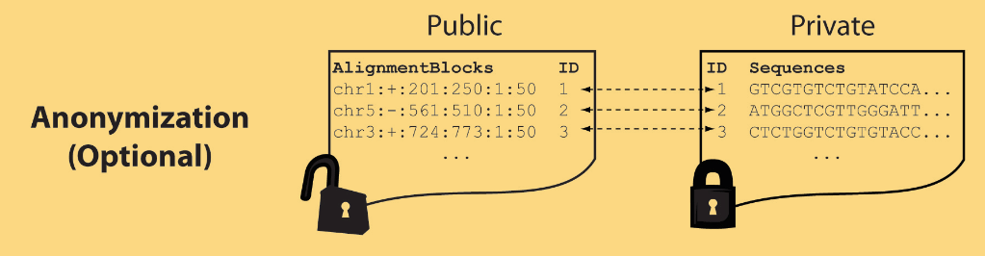
Light-weight formats
Some lightweight format clearly separate public & private info., aiding exchange
Files become much smaller
Distinction between formats to compute on and those to archive with – become sharper with big data
Reads
(linked via ID,
10X larger than
mapping coord.)
Mapping coordinates without variants (MRF)
[Bioinformatics 27: 281]

Slide 52


eQTL Mapping Using RNA-Seq Data
eQTLs are genomic loci that contribute to variation in mRNA expression levels
eQTLs provide insights on transcription regulation, and the molecular basis of phenotypic outcomes
eQTL mapping can be done with RNA-Seq data
[Biometrics 68(1) 1–11]
Notes:
A diagram to illustrate the RNA‐seq count variation of one gene due to an cis‐eQTL. (a) RNA‐seq measurements of a hypothetic gene with two exons in three diploid individuals. The target SNP which we test for association has the genotype CT, CC, and TT for the three individuals. There is an SNP on the first exon, which has genotype AT, AT, and AA for the three individuals. ASE can be measured by those sequence reads that overlap with a heterozygous exonic SNP. Therefore we can measure ASE for individuals (i) and (ii). However, association testing by ASE is only possible if the target SNP is heterozygous, thus only individual (i) can be used to test for eQTL by ASE (b) ASE measurements for individual (i). (c) TReC measured for the three individuals across the two exons of this gene.
© IF THIS IMAGE HAS BEEN PROVIDED BY OR IS OWNED BY A THIRD PARTY, AS INDICATED IN THE CAPTION LINE, THEN FURTHER PERMISSION MAY BE NEEDED BEFORE ANY FURTHER USE. PLEASE CONTACT WILEY'S PERMISSIONS DEPARTMENT ON PERMISSIONS@WILEY.COM OR USE THE RIGHTSLINK SERVICE BY CLICKING ON THE 'REQUEST PERMISSION' LINK ACCOMPANYING THIS ARTICLE. WILEY OR AUTHOR OWNED IMAGES MAY BE USED FOR NON-COMMERCIAL PURPOSES, SUBJECT TO PROPER CITATION OF THE ARTICLE, AUTHOR, AND PUBLISHER.

Slide 53
Information Content and Predictability
Higher frequency: Lower ICI
Lower frequency: Higher ICI
Additive for multiple variants
Higher cond. entropy: Lower predictability
Lower cond. entropy: Higher predictability
Additive for multiple eQTLs
[Harmanci et al. Nat. Meth. 2016]

Slide 54

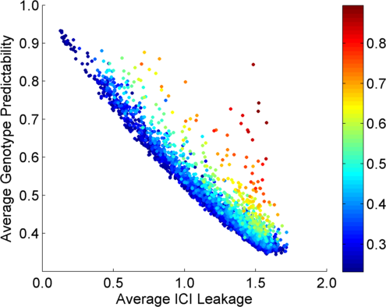
Per eQTL and ICI Cumulative Leakage versus Genotype Predictability
Colors by absolute correlation
Absolute Correlation
[Harmanciet al. Nat. Meth. (in revision)]

Slide 55
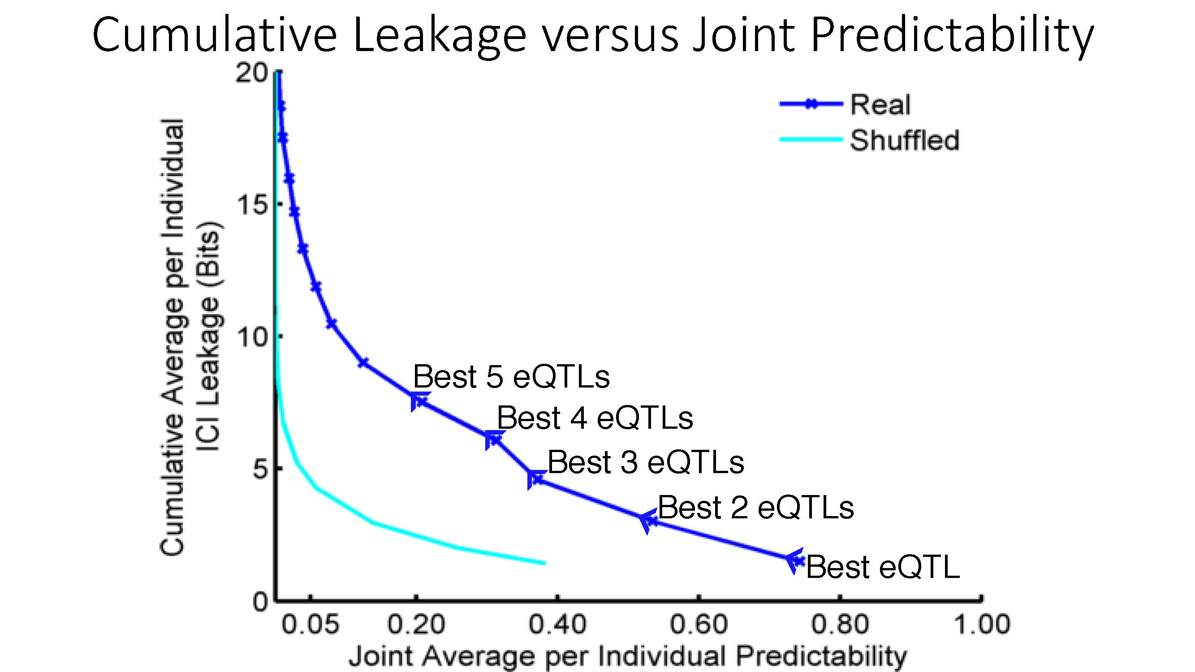
Cumulative Leakage versus Joint Predictability
More #
Vulnerable
Less #
Vulnerable
[Harmanciet al. Nat. Meth. (in revision)]

Slide 56

Linking Attack Scenario
[Harmanciet al. Nat. Meth. (in revision)]

Slide 57
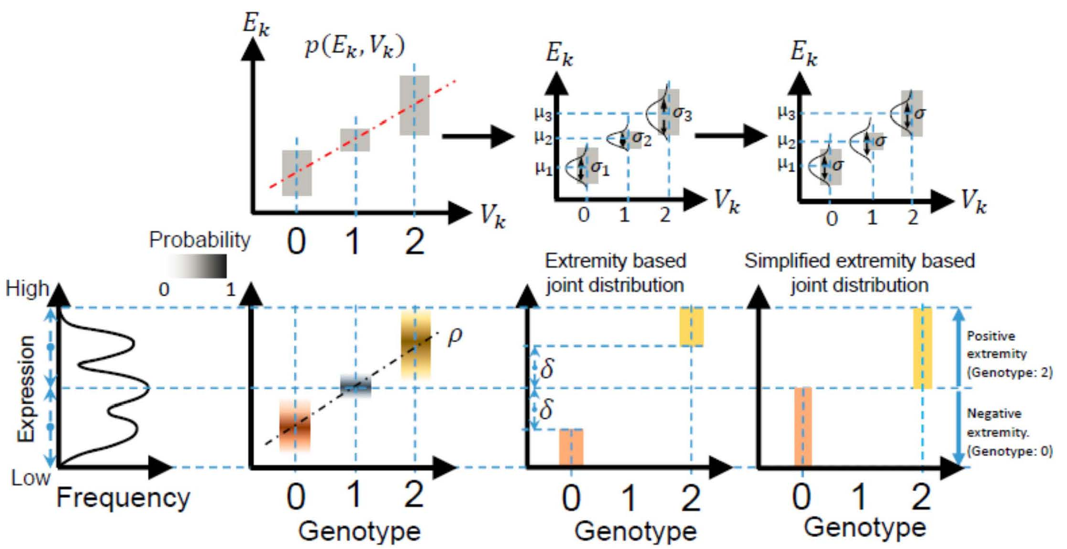
Levels of Expression-Genotype Model Simplifications for Genotype Prediction
[Harmanci et al. Nat. Meth. (16)]

Slide 58
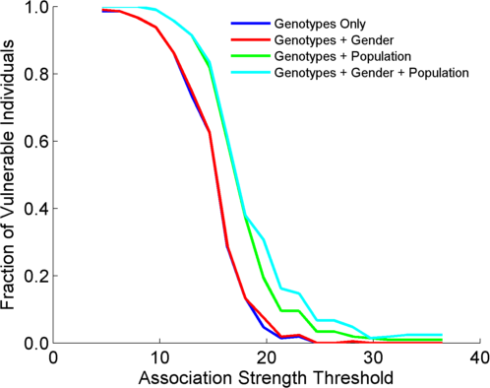
Success in Linking Attack with Extremity based Genotype Prediction
200 individuals eQTL Discovery
200 individuals in Linking Attack
High
Sensitivity
Low
Sensitivity
High Number
Of eQTLs
Low Number
Of eQTLs
[Harmanci et al. Nat. Meth. (16)]

Slide 59
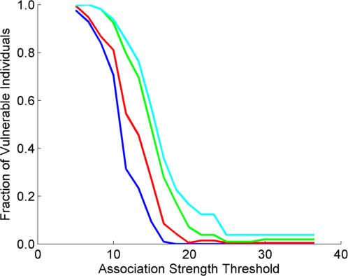
Success in Linking Attack with Extremity based Genotype Prediction
200 individuals eQTL Discovery
200 individuals in Linking Attack
200 individuals eQTL Discovery
100,200 individuals in Linking Attack
[Harmanci et al. Nat. Meth. (16)]

Slide 60
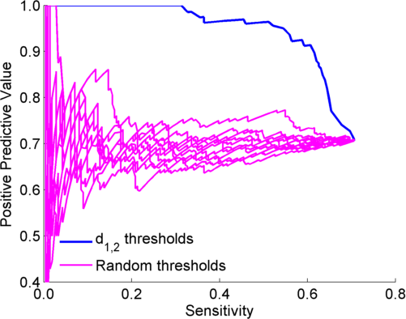

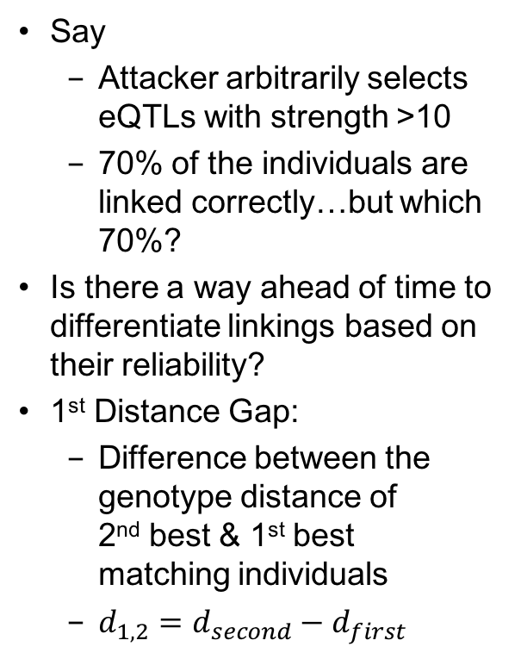
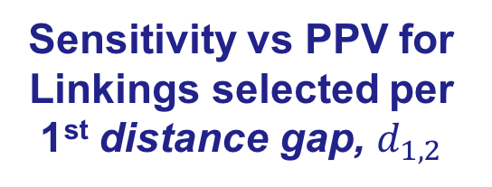
Sensitivity vs PPV for Linkings selected per 1st distance gap, $d_{1,2}$
Say
  Attacker arbitrarily selects eQTLs with strength >10
  70% of the individuals are linked correctly…but which 70%?
Is there a way ahead of time to differentiate linkings based on their reliability?
1st Distance Gap:
  Difference between the genotype distance of
  2nd best & 1st best matching individuals
  $d_{1,2}=d_{second}−d_{first}$
Decreasing $d_{1,2}$
52%
[Harmanci et al. Nat. Meth. (16)]

Slide 61
Large-scale Transcriptome Mining:
Clustering, Dynamic Modelling & Logic-gate Analysis while Protecting Individual Privacy
Much RNA-seq (+TF ChIP) Data
  Comparative ENCODE – Lots of Matched Data
  TCGA
  Geuvadis w/ 1000G genotypes
Expression Clustering, Cross-species
  Optimization gives 16 conserved co-expression modules
State Space Models
of Gene Expression
  Using dimensionality reduction to help determine internal & external drivers
  Decoupling expression changes into those from conserved vs species-specific genes
  Also, conserved genes have similar canonical patterns (iPDPs) in contrast to species specific ones (Ex of ribosomal v signaling genes)
Using Logic Gates to Model of Transcriptome Activity
  Preponderance of OR gates in cancer v. cell-cycle (esp. for MYC)
The General
Dilemma of Genomic Privacy
  Fundamental, inherited info that’s very private v need for large-scale mining for med. research
  Issues w/ current social & tech approaches: inconsistencies & burdensome security
RNA-seq: How to Publicly Share it
  Presents a tricky privacy issue since much of the sequencing is for general, non-individual specific results yet it’s tagged with individual information
  Removing SNVs in reads w/ MRF
  Quantifying & removing variant info from expression levels + eQTLs using ICI & predictability
  Instantiating a practical linking attack using extreme expression levels
  Quantifying accuracy of prediction, via gap between best & 2nd best match
Value of publication patterns generated by the data producing consortia
  Co-authorship network statistics relate to publication rollouts & show gradual adoption by a diverse community
  Key role of brokers in data dissemination

Slide 62

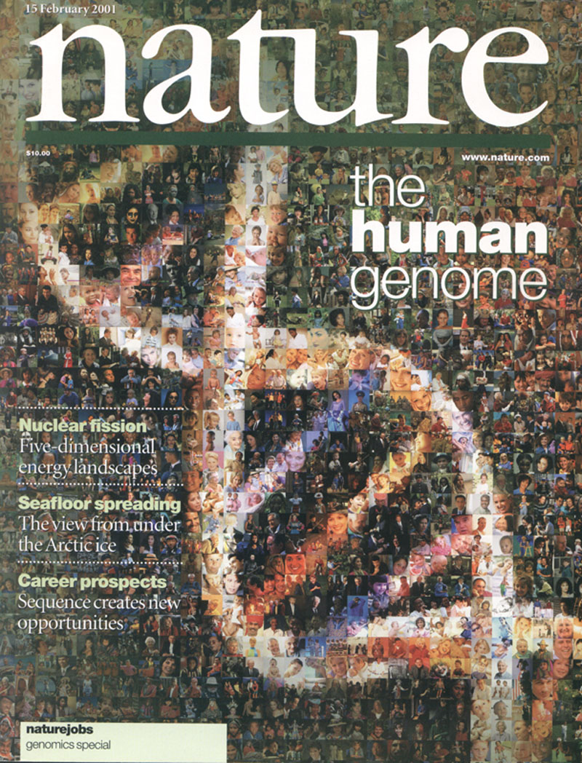

The Human
Genome Project
2000
2005
2010
2015
Worm
Genome

Slide 63
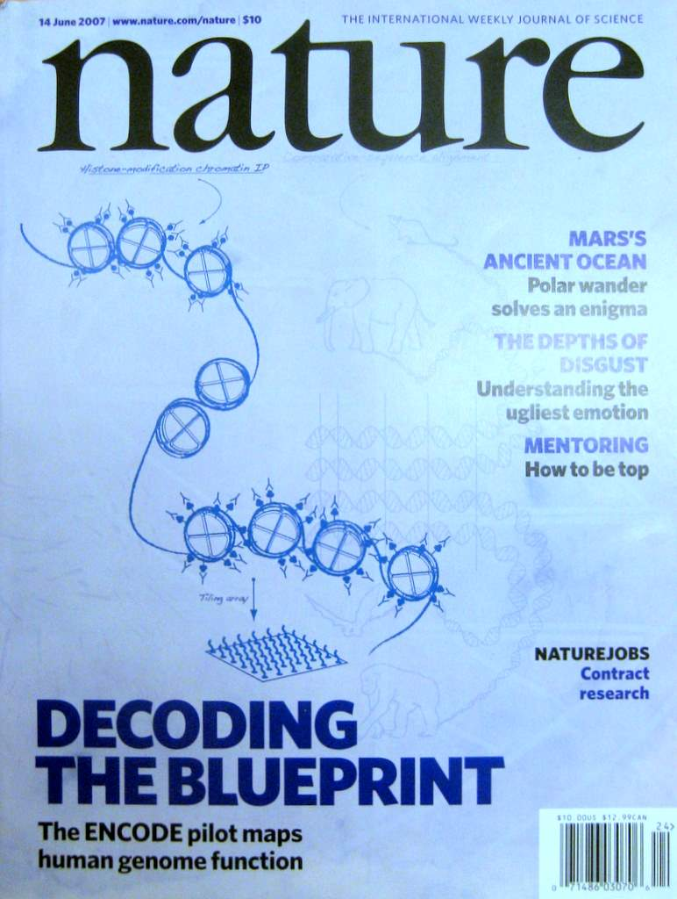


The Human
Genome Project
ENCODE
Pilot
ENCODE
Production
2000
2005
2010
Worm
Genome
modENCODE

Slide 64
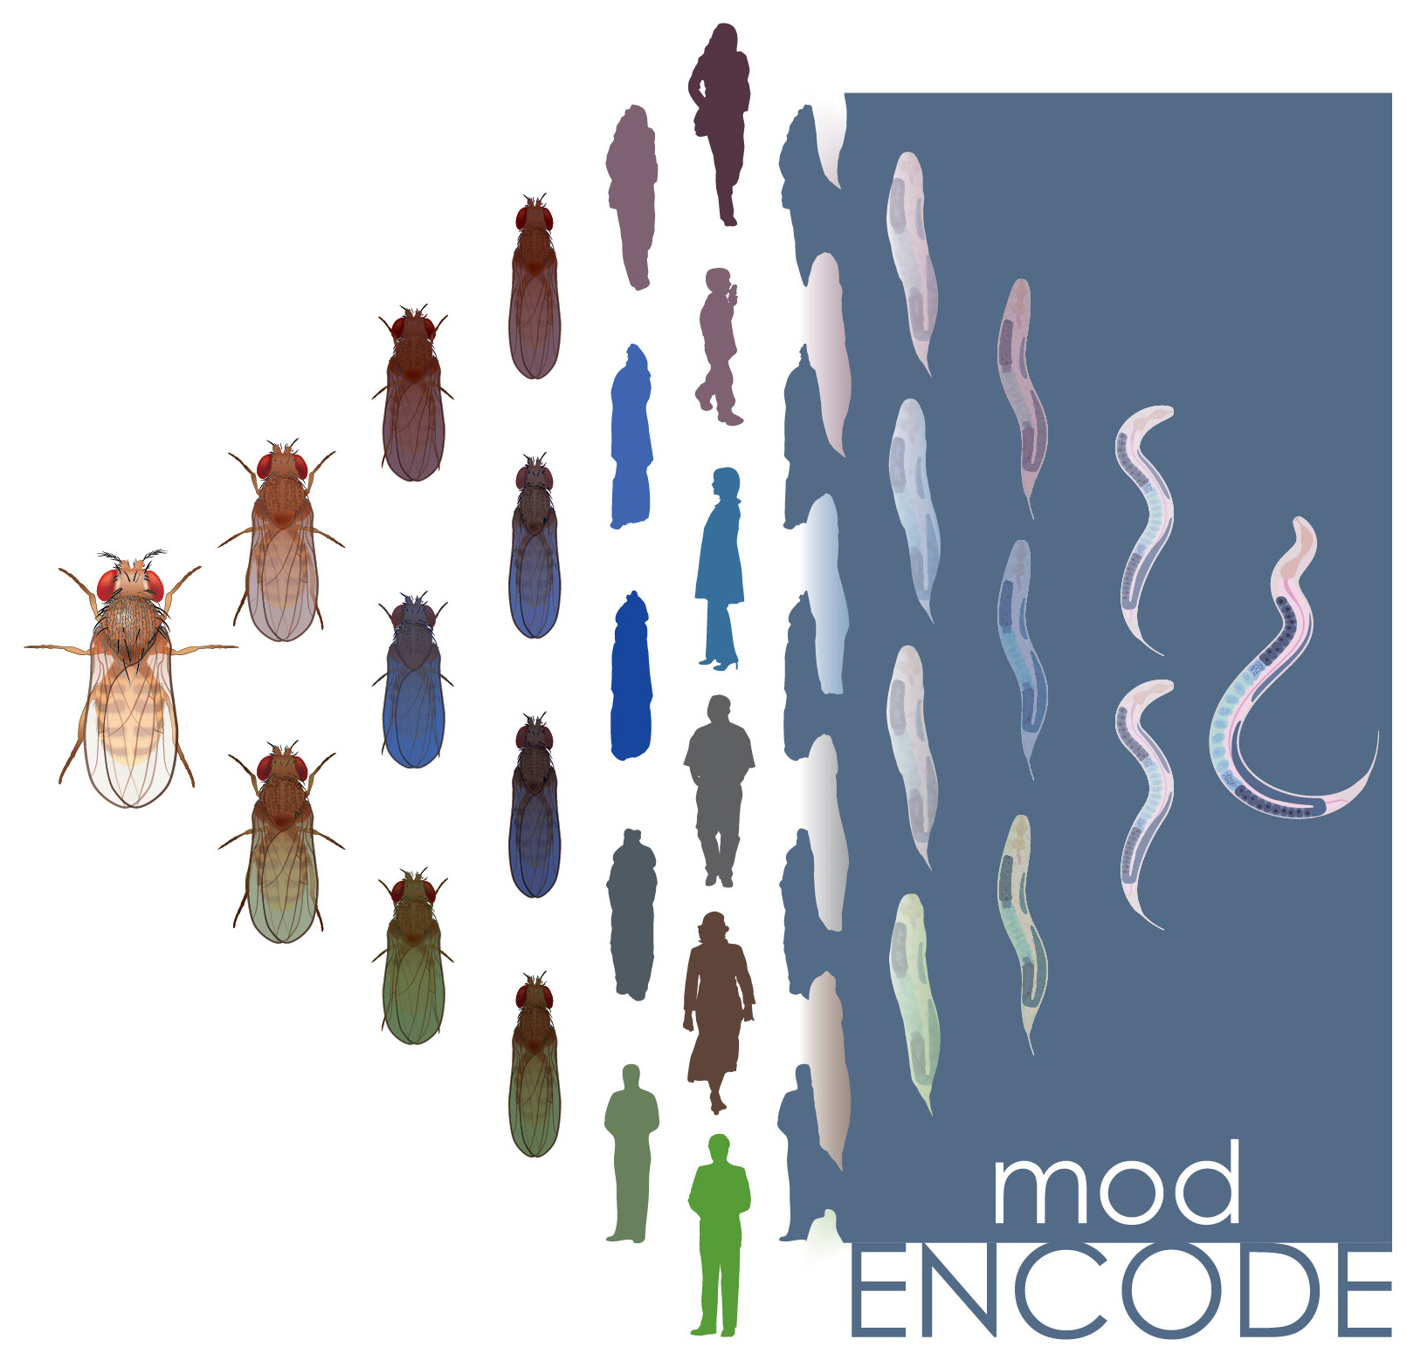

The Human
Genome Project
ENCODE
Pilot
ENCODE
Production
Comparative
ENCODE
2000
2005
2010
2015
Worm
Genome
modENCODE

Slide 65

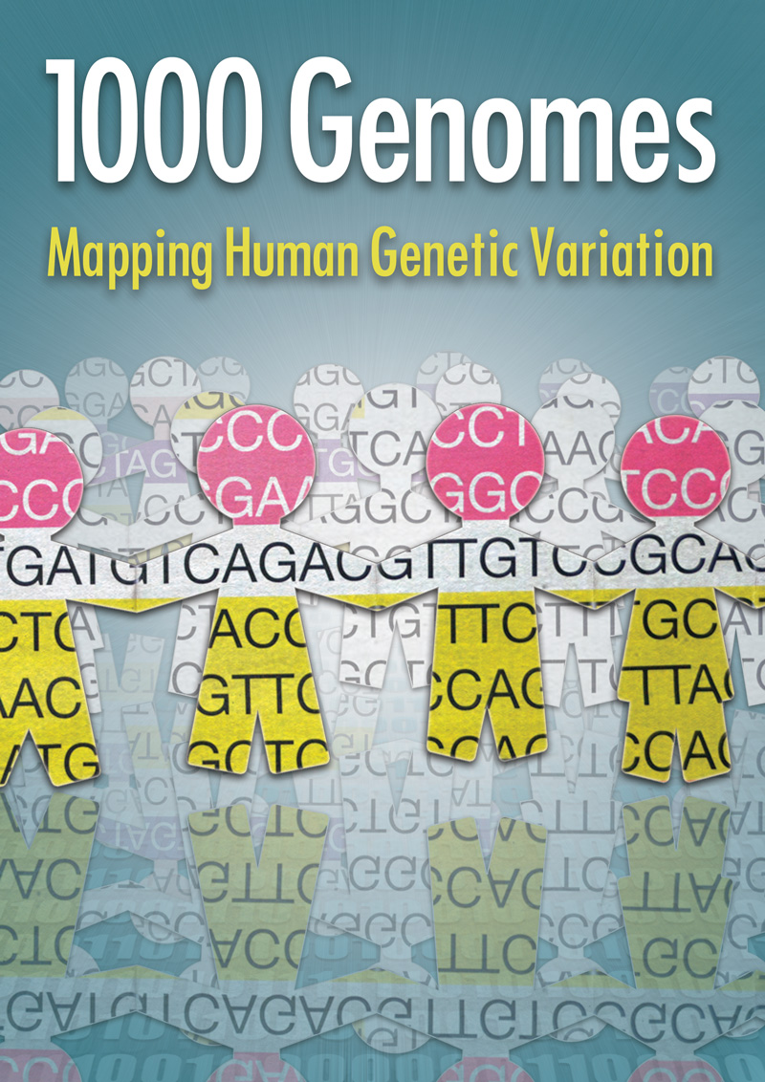
The Human
Genome Project
ENCODE
Pilot
ENCODE
Production
Comparative
ENCODE
2000
2005
2010
2015
Worm
Genome
modENCODE
1000 Genomes
Pilot
1000 Genomes
Production

Slide 66


The Human
Genome Project
ENCODE
Pilot
ENCODE
Production
Comparative
ENCODE
Epigenome
Roadmap
2000
2005
2010
2015
Worm
Genome
modENCODE
1000 Genomes
Pilot
1000 Genomes
Production
GTEx

Slide 67
With help of M Pazin at NHGRI, identified: 702 community papers that used ENCODE data but were not supported by ENCODE funding &
558 consortium papers supported by ENCODE funding
(https://www.encodeproject.org/search/?type=Publication for up-to-date query)
Then identified 1,786 ENCODE members & 8,263 non-members .
<= # Papers
# Authors Yr. (‘04 to ‘15)
[Wang et al., TIG (’16)]
Notes:
1 slides from dw encode authors

Slide 68
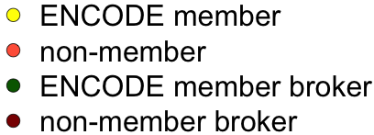
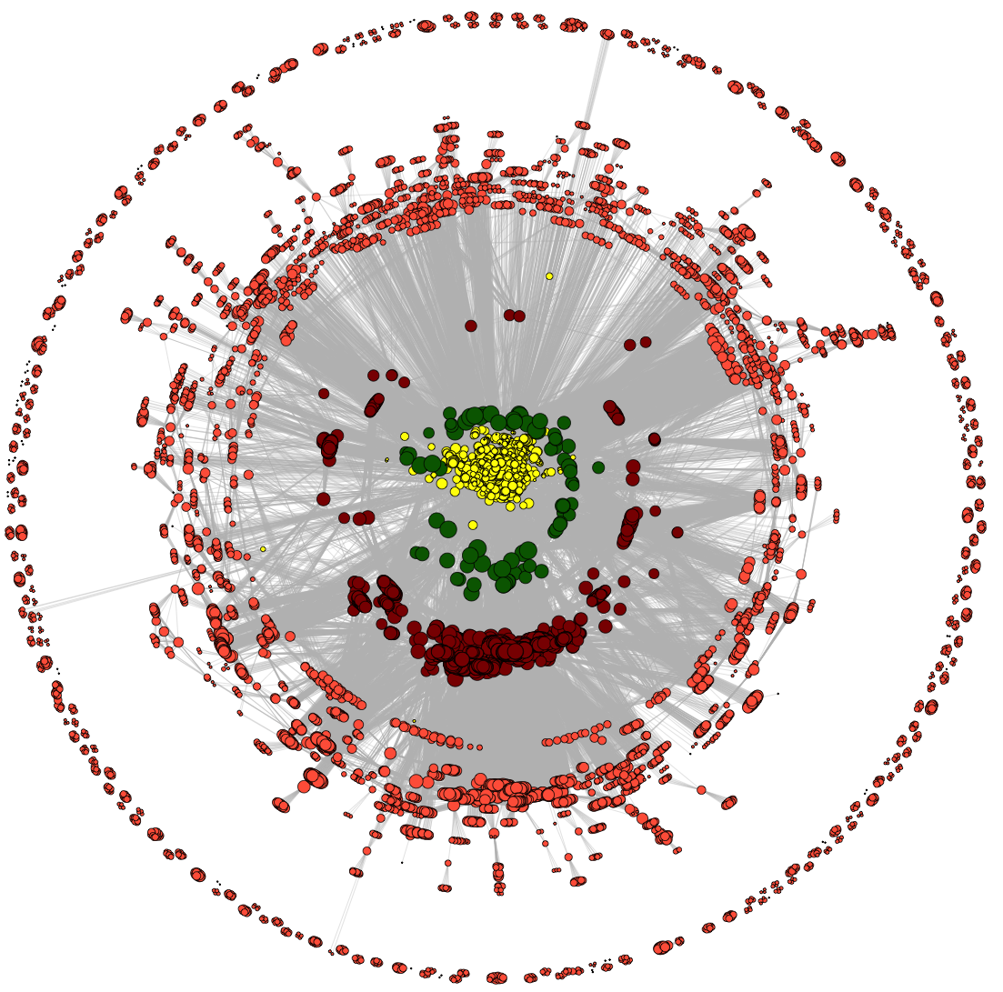
Co-authorship Network of ENCODE members
& Data Users
co-authorship
2014
[Wang et al., TIG (’16)]

Slide 69
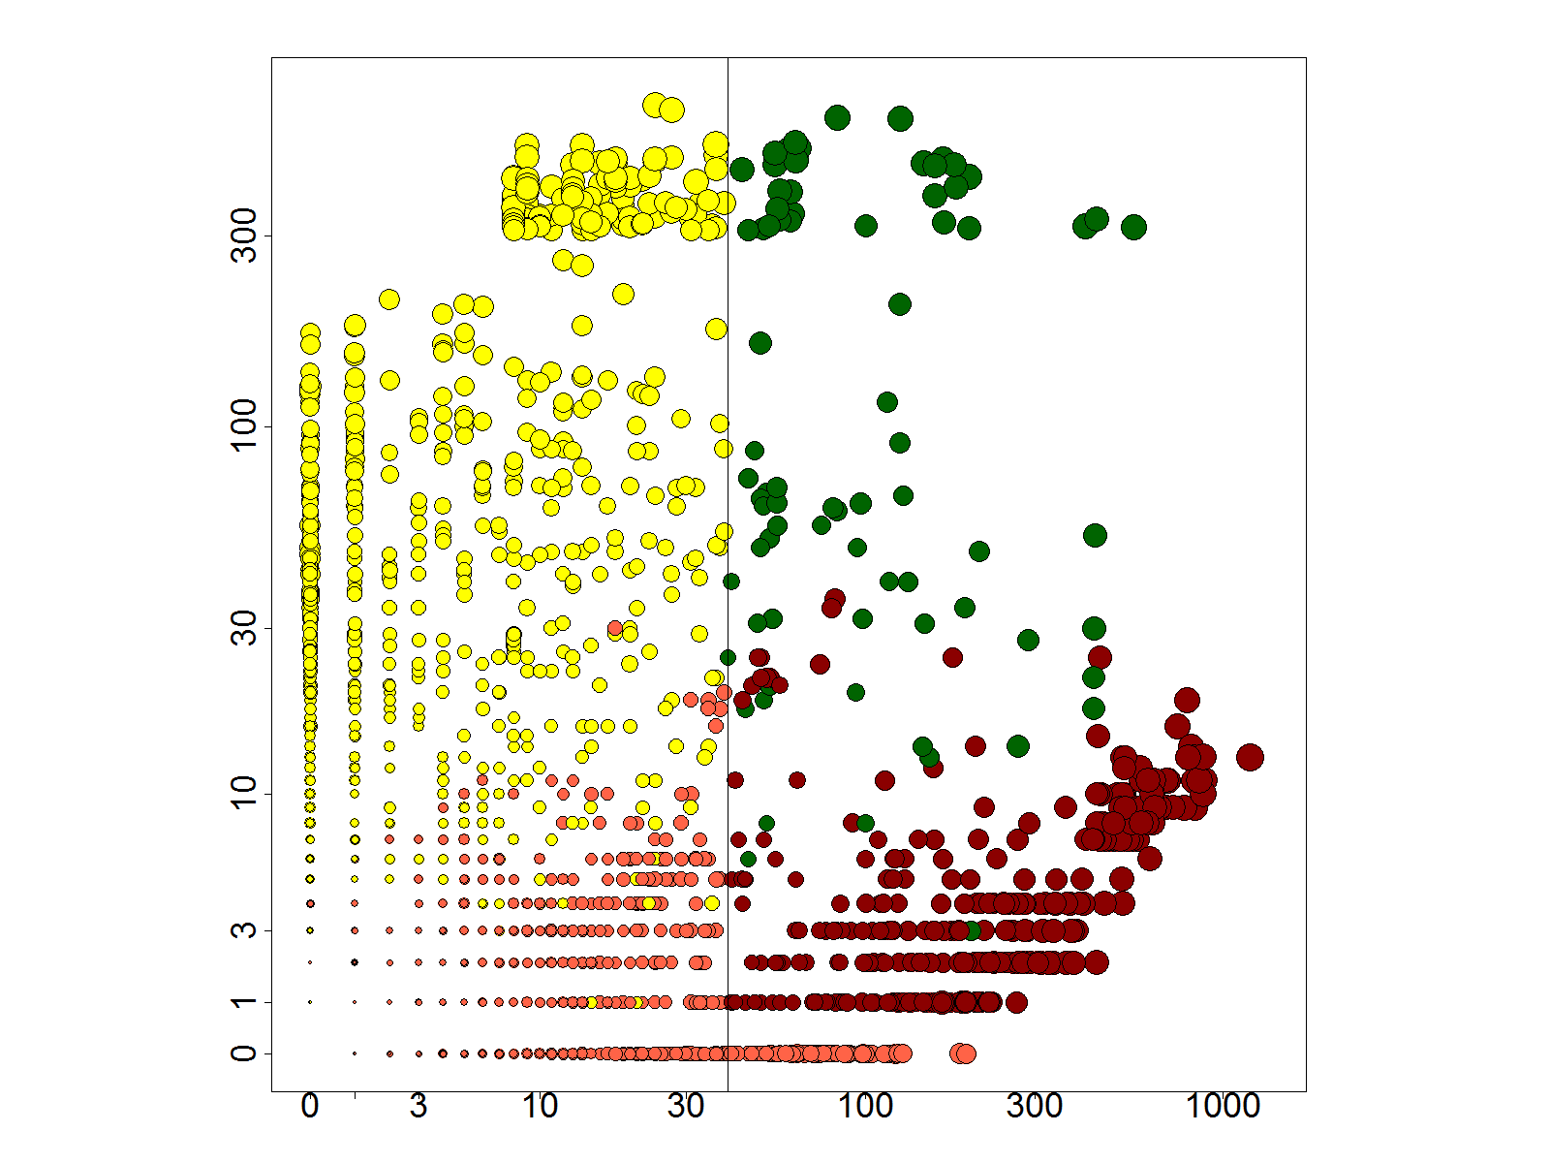
Co-authorship Network of ENCODE members
& Data Users
# neighbors: non-ENCODE ==>
co-authorship
# neighbors: ENCODE ==>
2014
[Wang et al., TIG (’16)]

Slide 70
Co-authorship Network of ENCODE members
& Data Users
co-authorship
2014
[Wang et al., TIG (’16)]

Slide 71
Dynamics of co-authorship network
2014
co-authorship
[Wang et al., TIG (’16)]

Slide 72
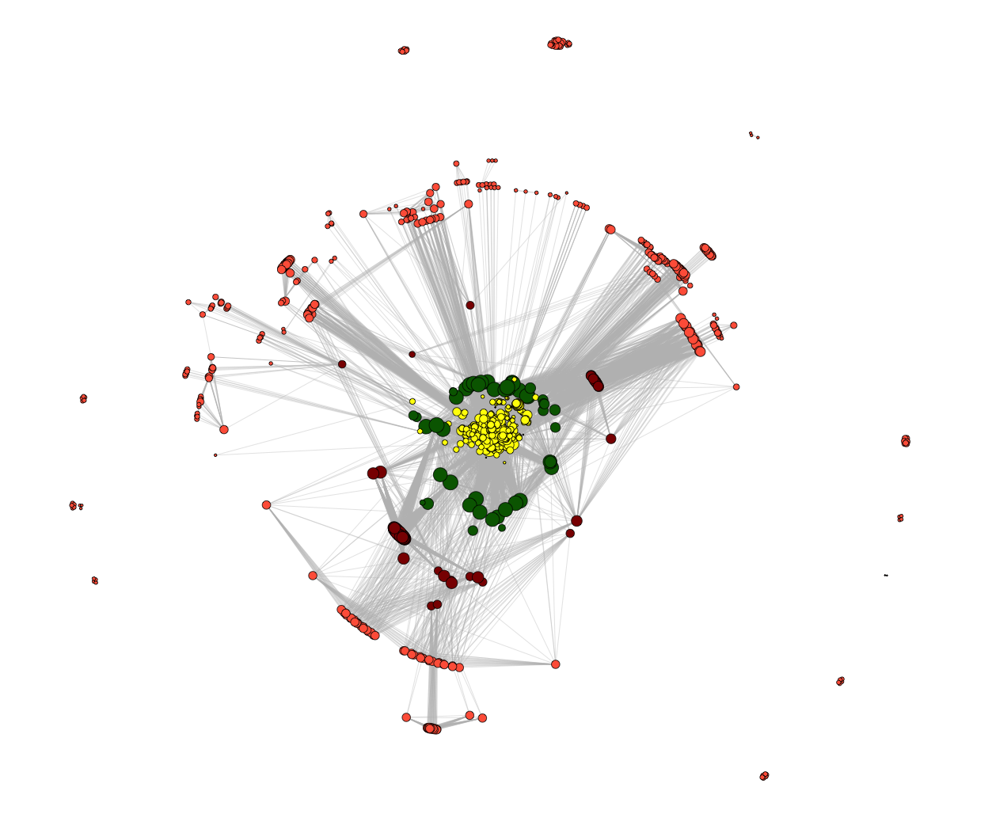
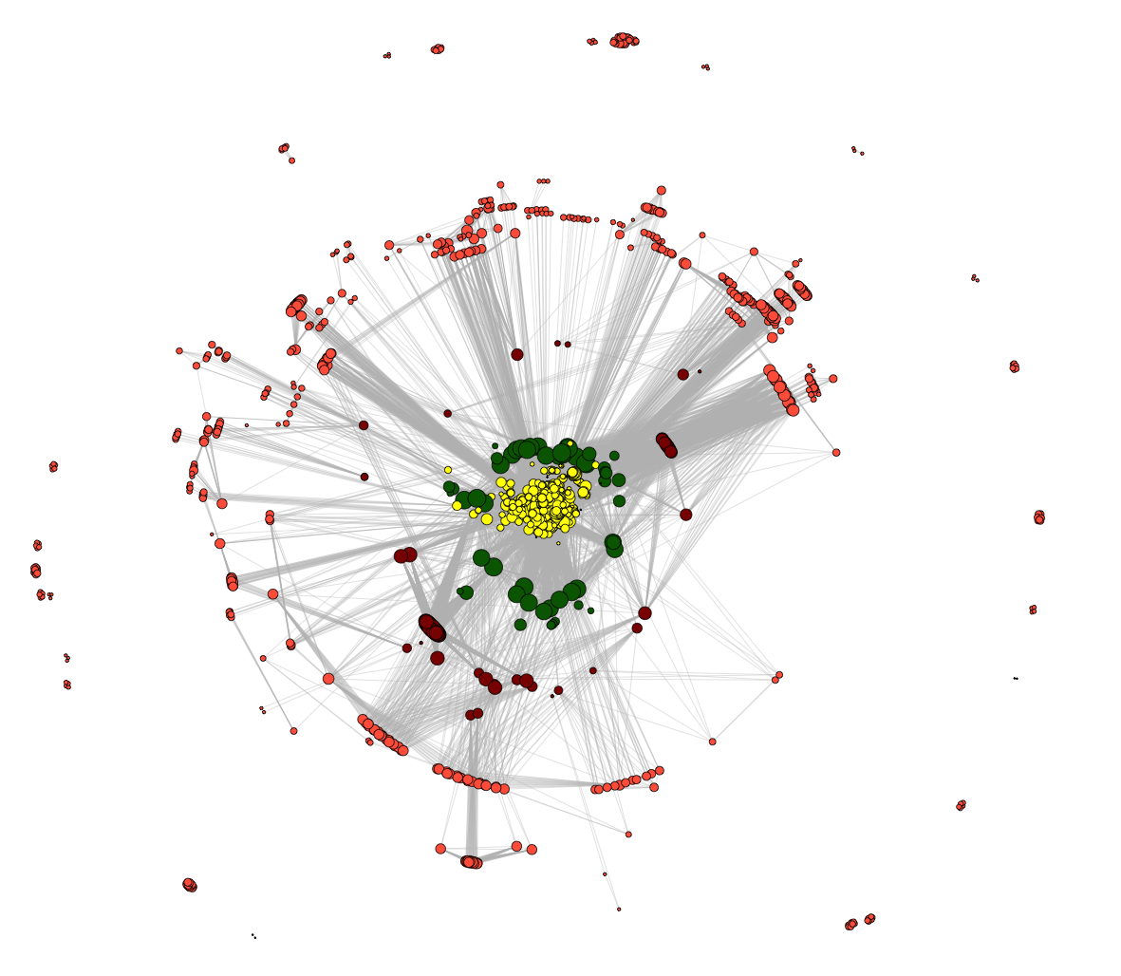
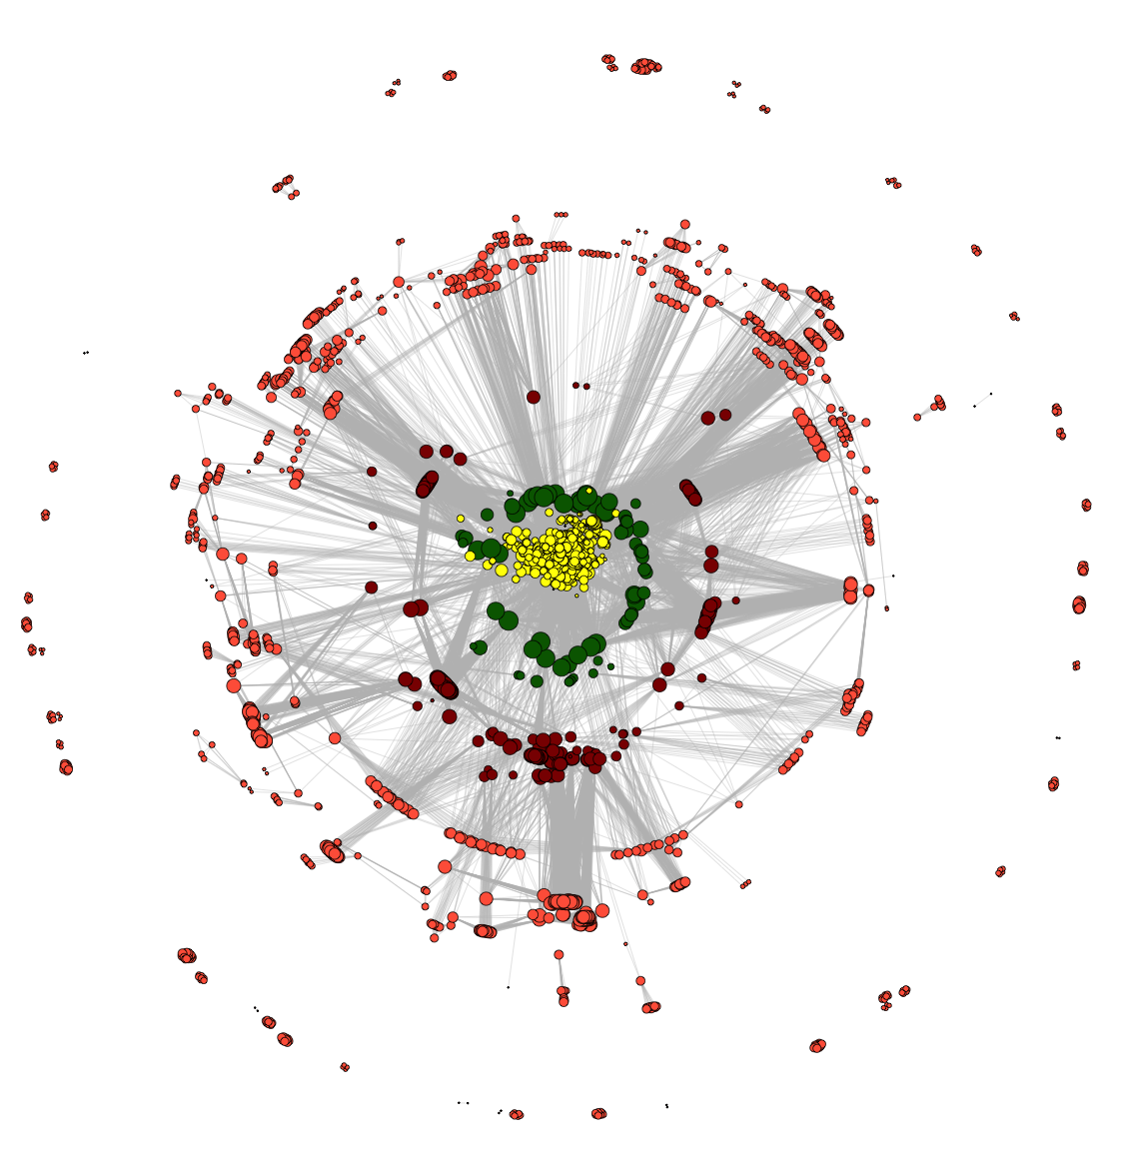
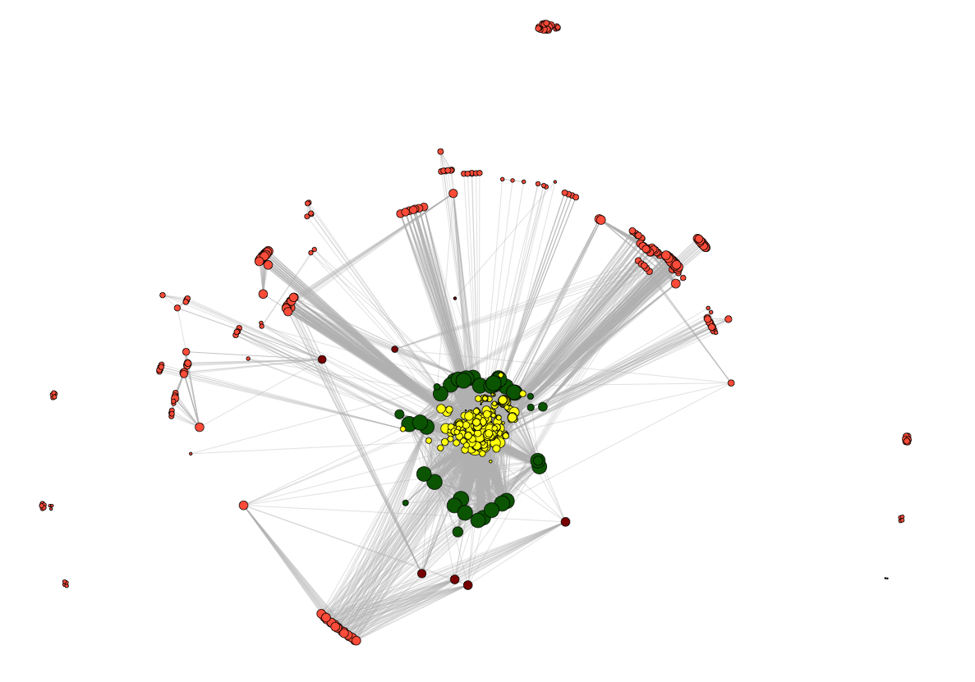
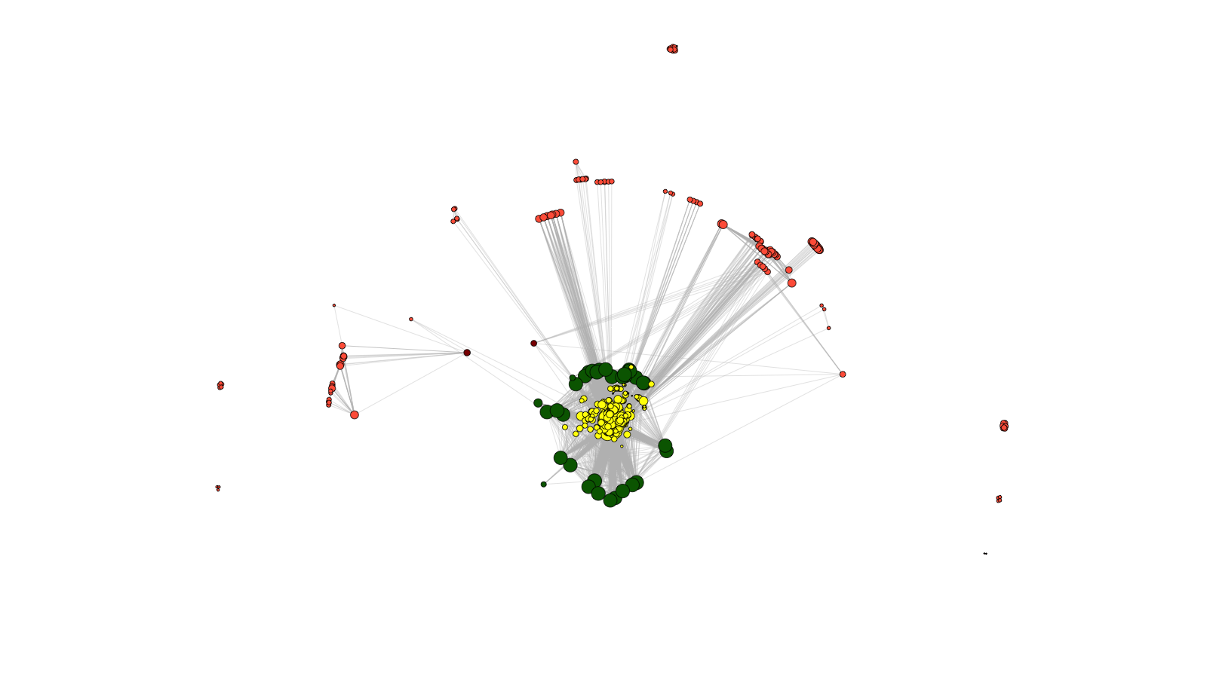
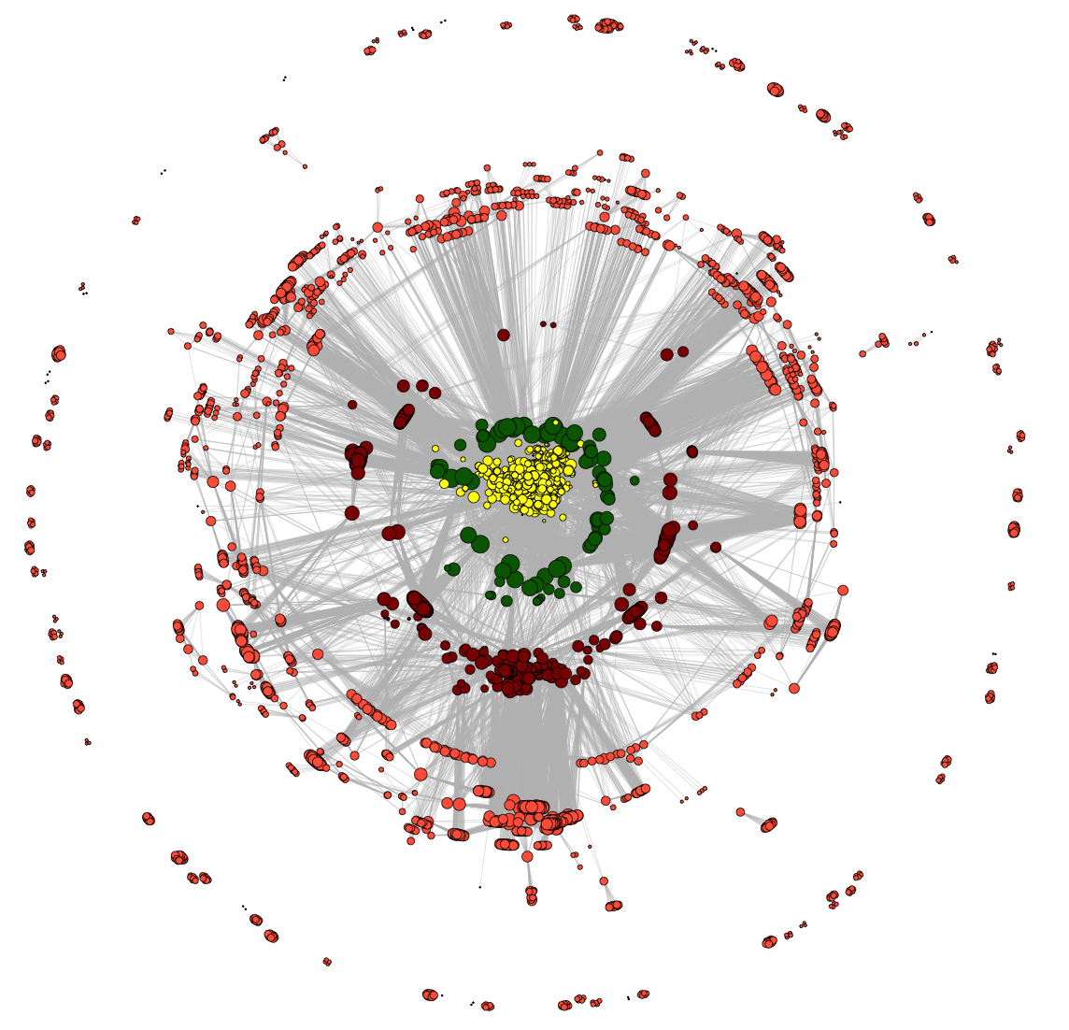
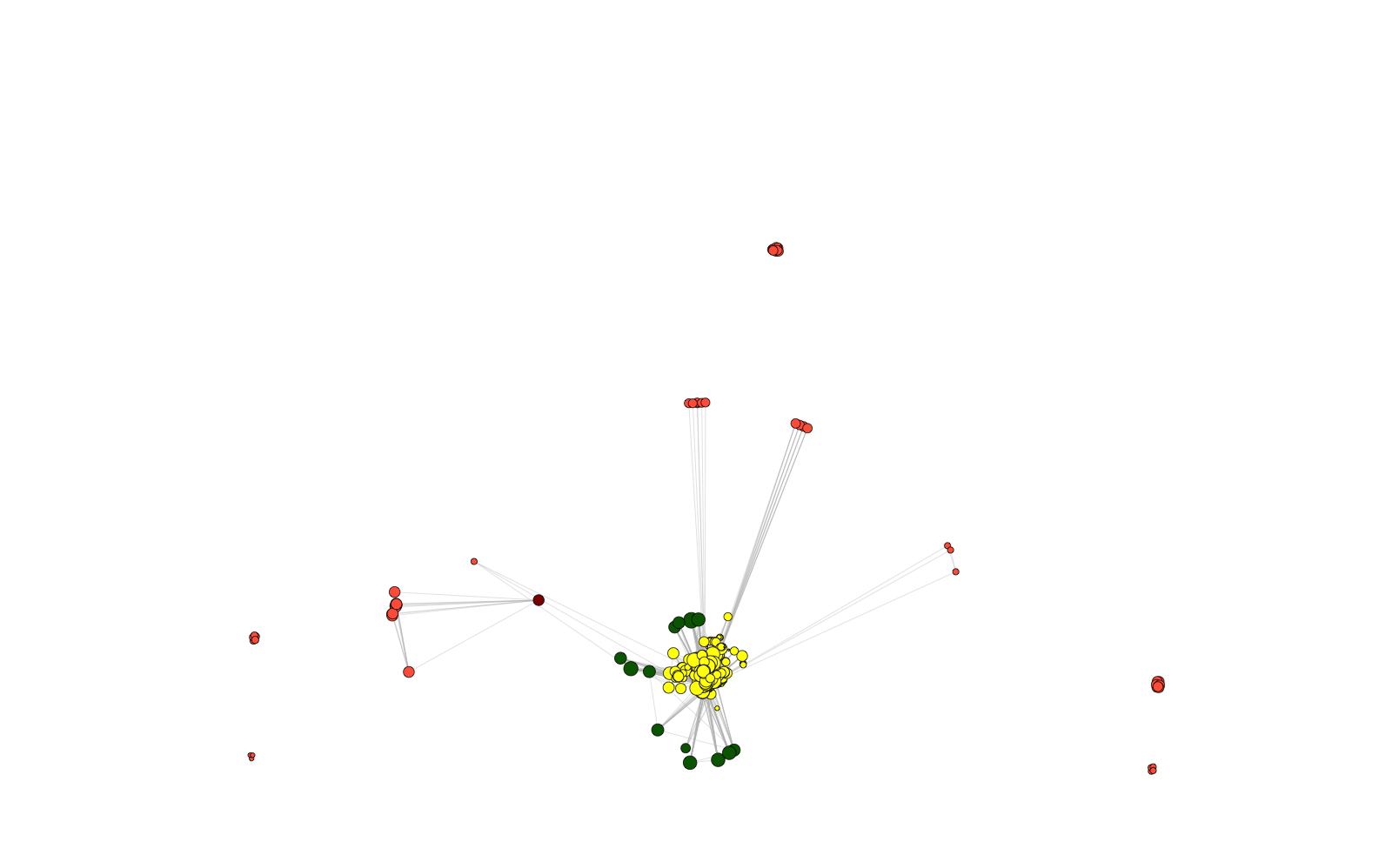
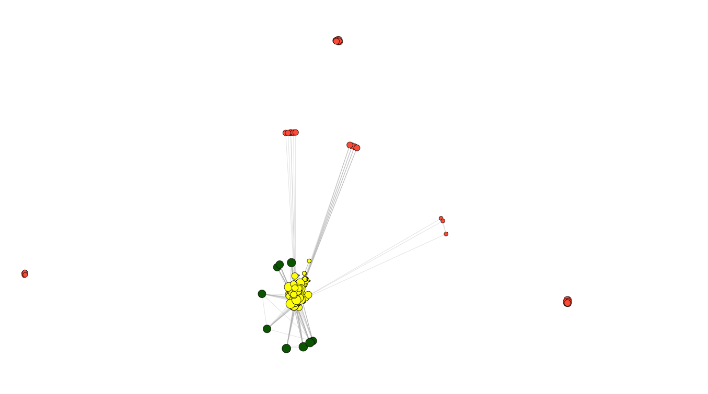
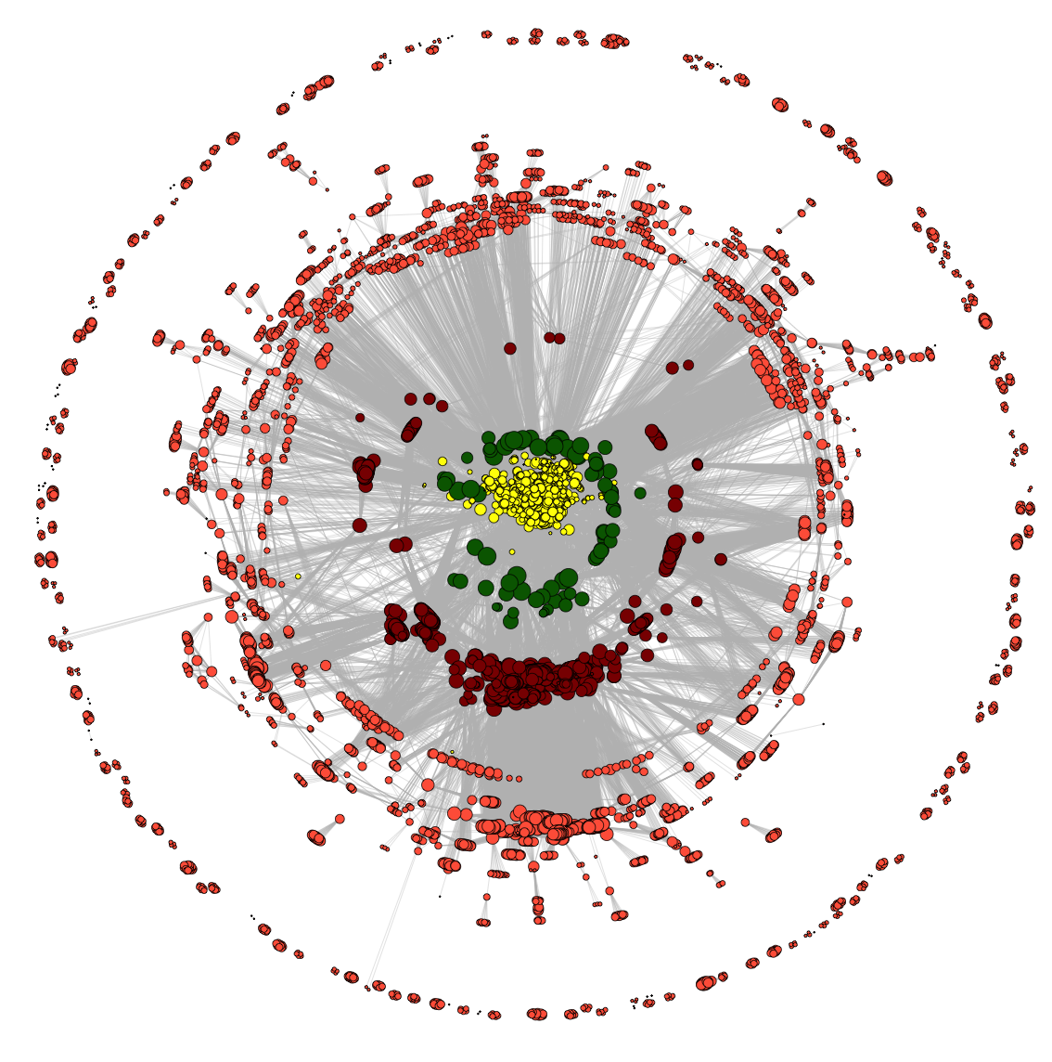
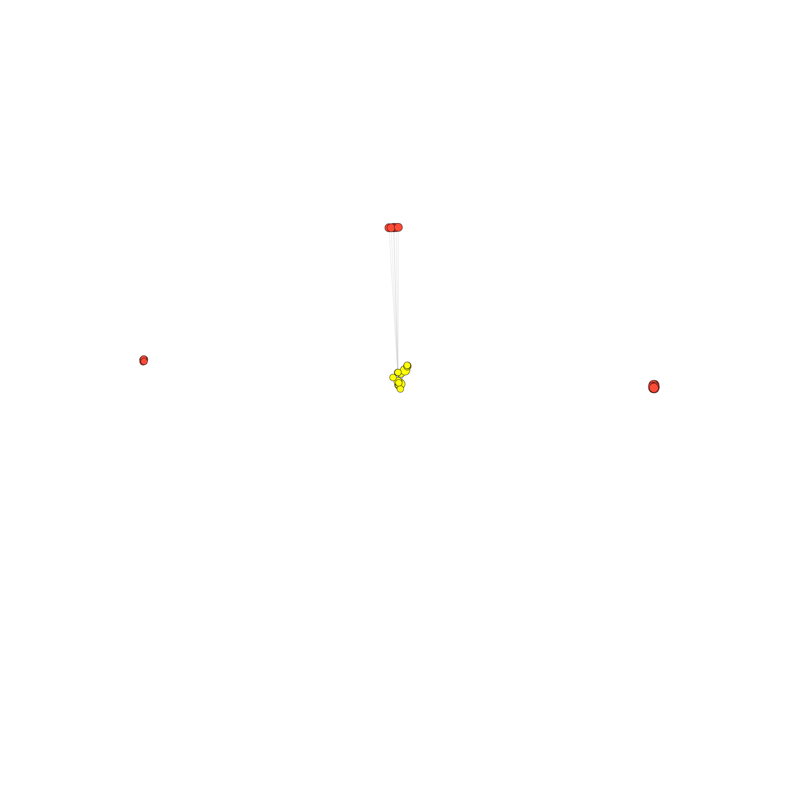
Dynamics of co-authorship network
2009
2010
2011
2008
2007
2012
2006
2005
2013
2004
2014
co-authorship
[Wang et al., TIG (’16)]

Slide 73
Dynamics of co-authorship network
2009
2010
2011
2008
2007
2012
“Modularity”
2006
2005
2013
2004
2014
co-authorship
[Wang et al., TIG (’16)]

Slide 74
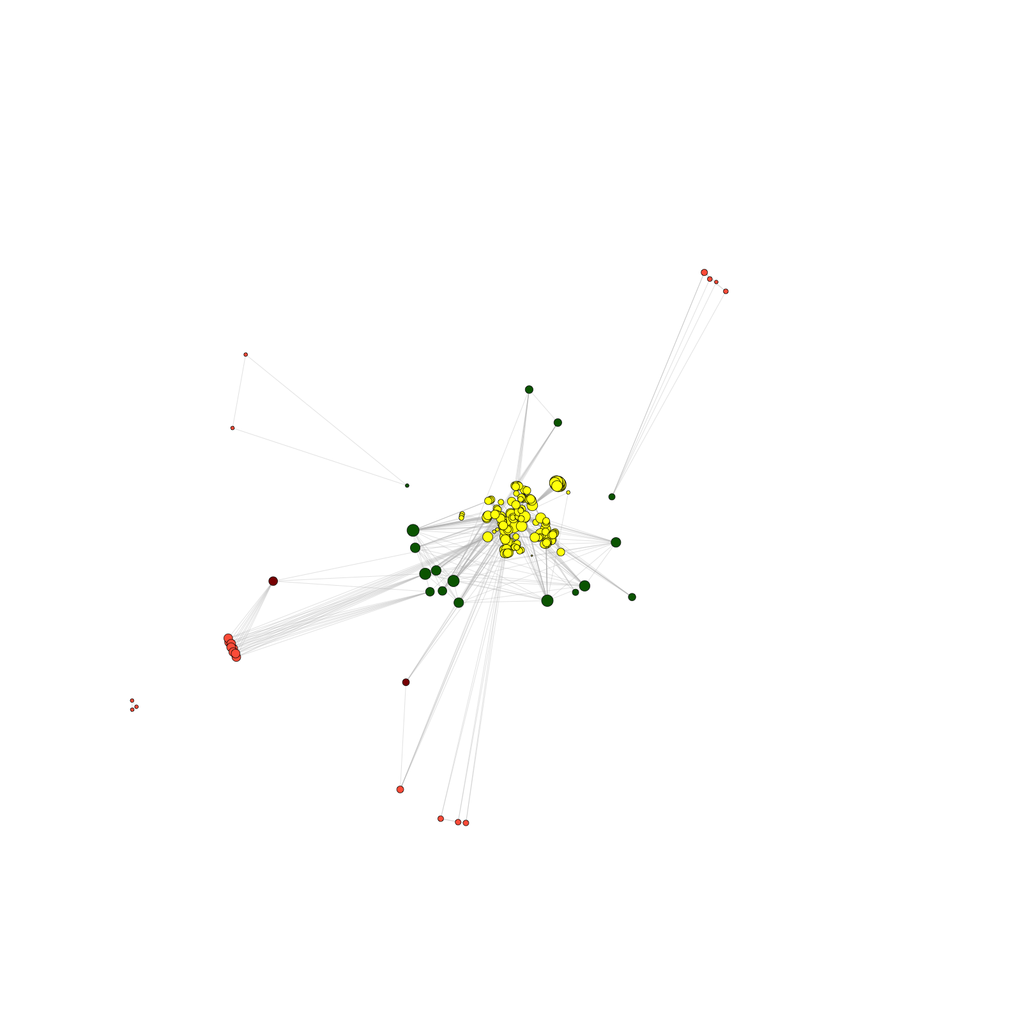
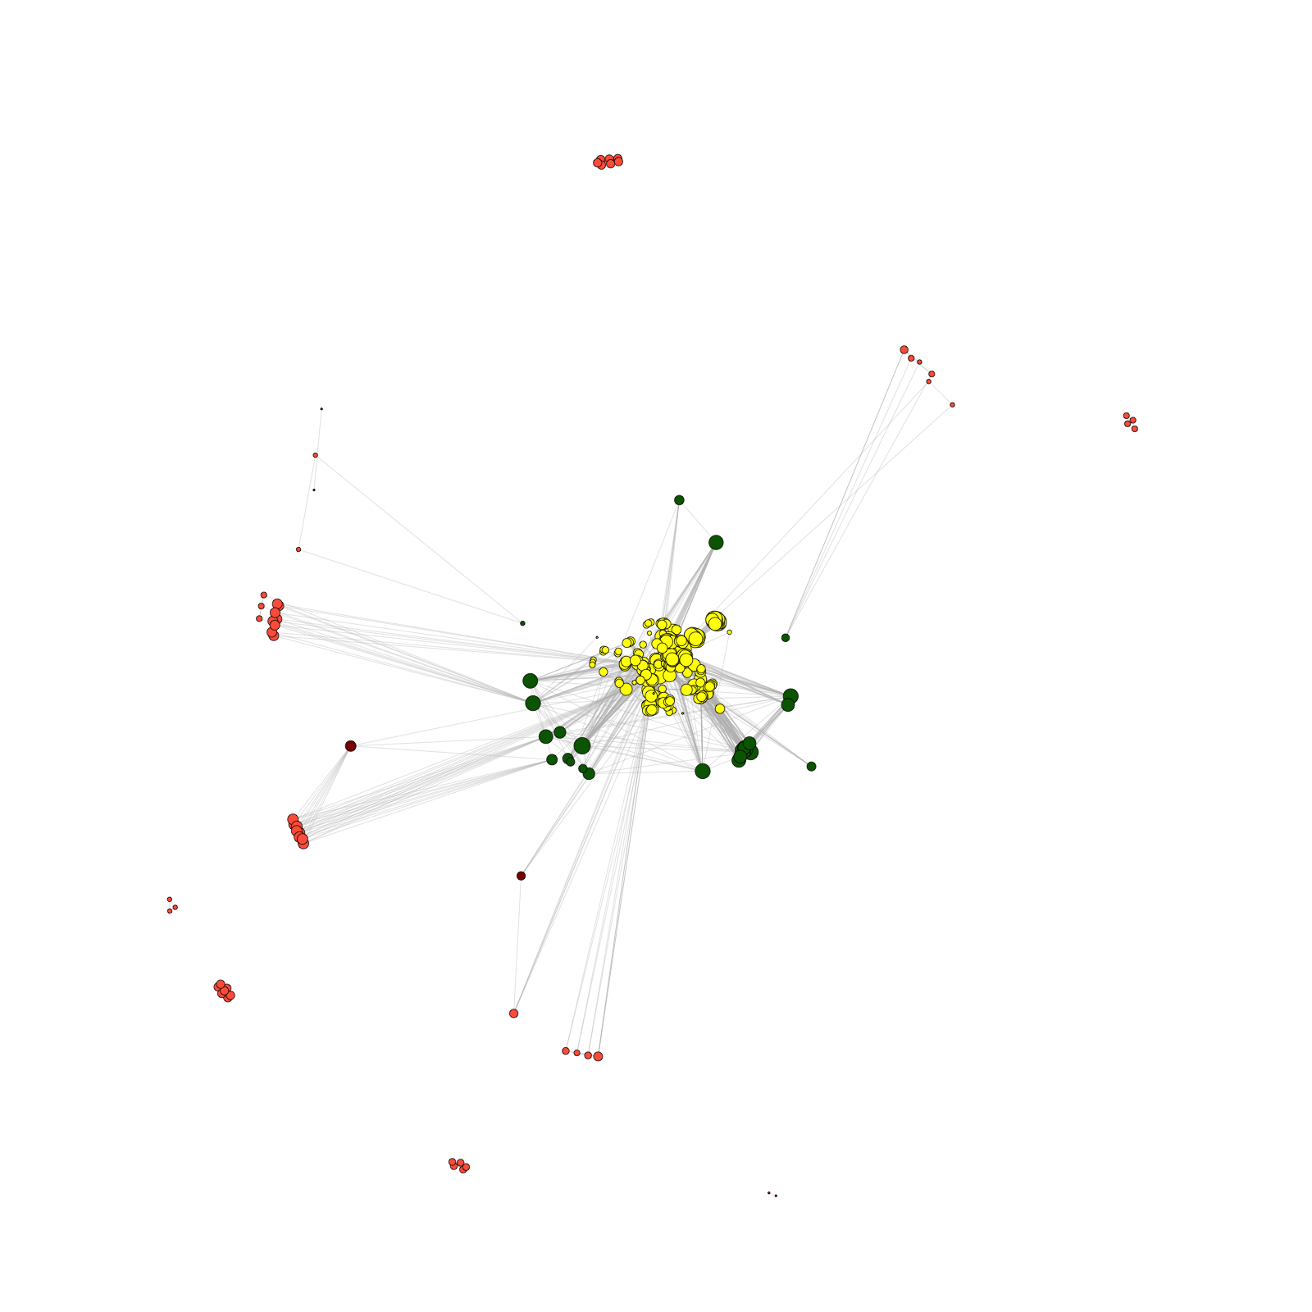
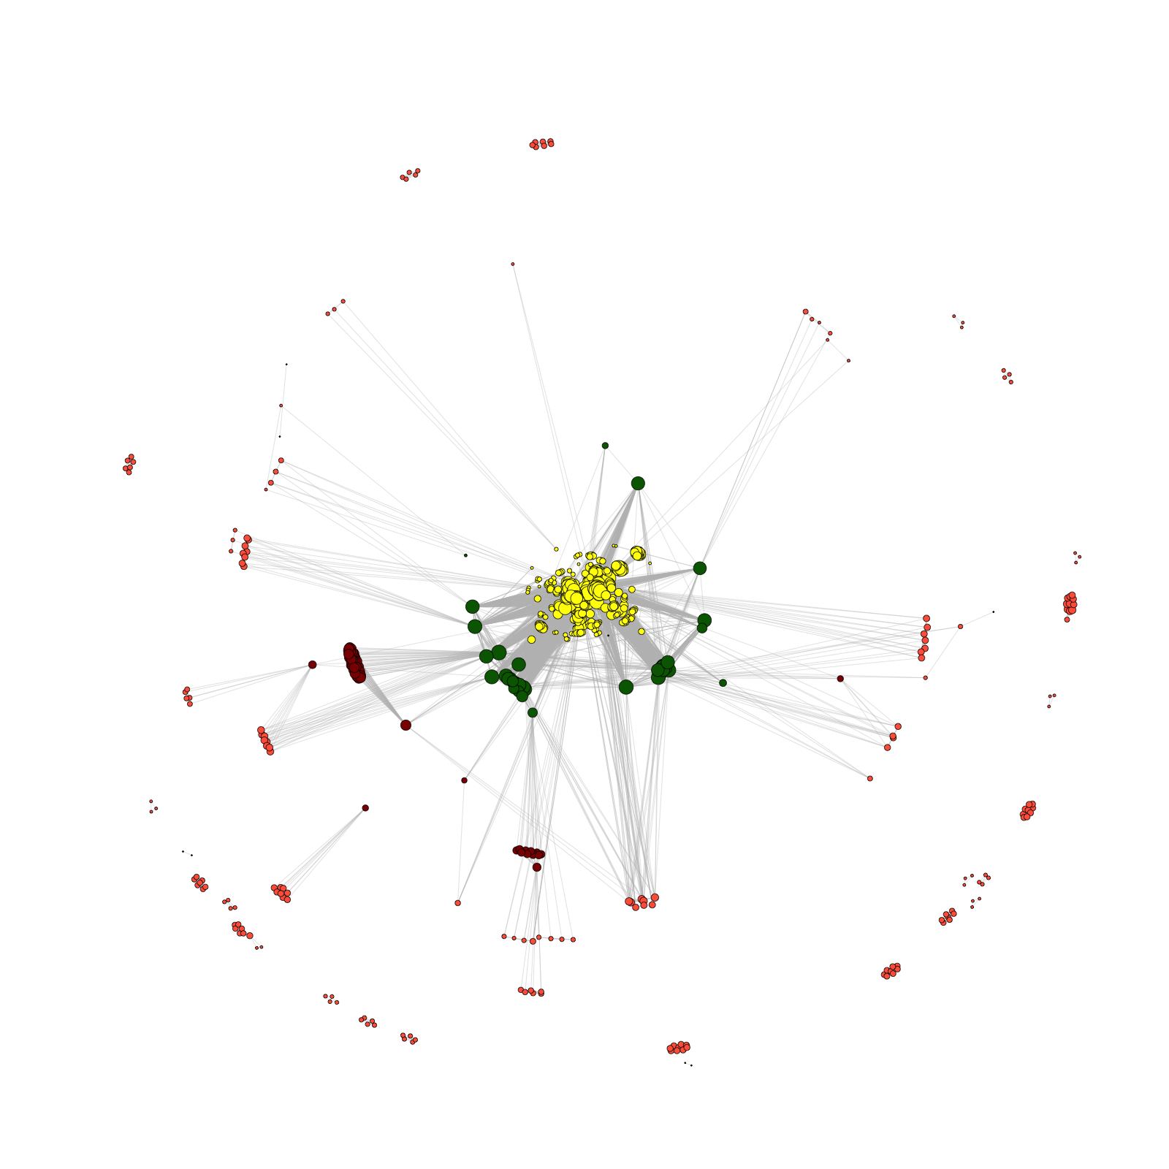
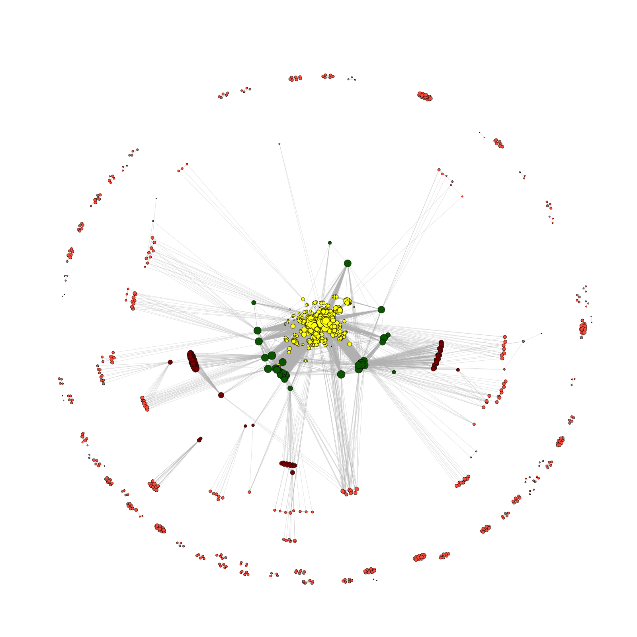
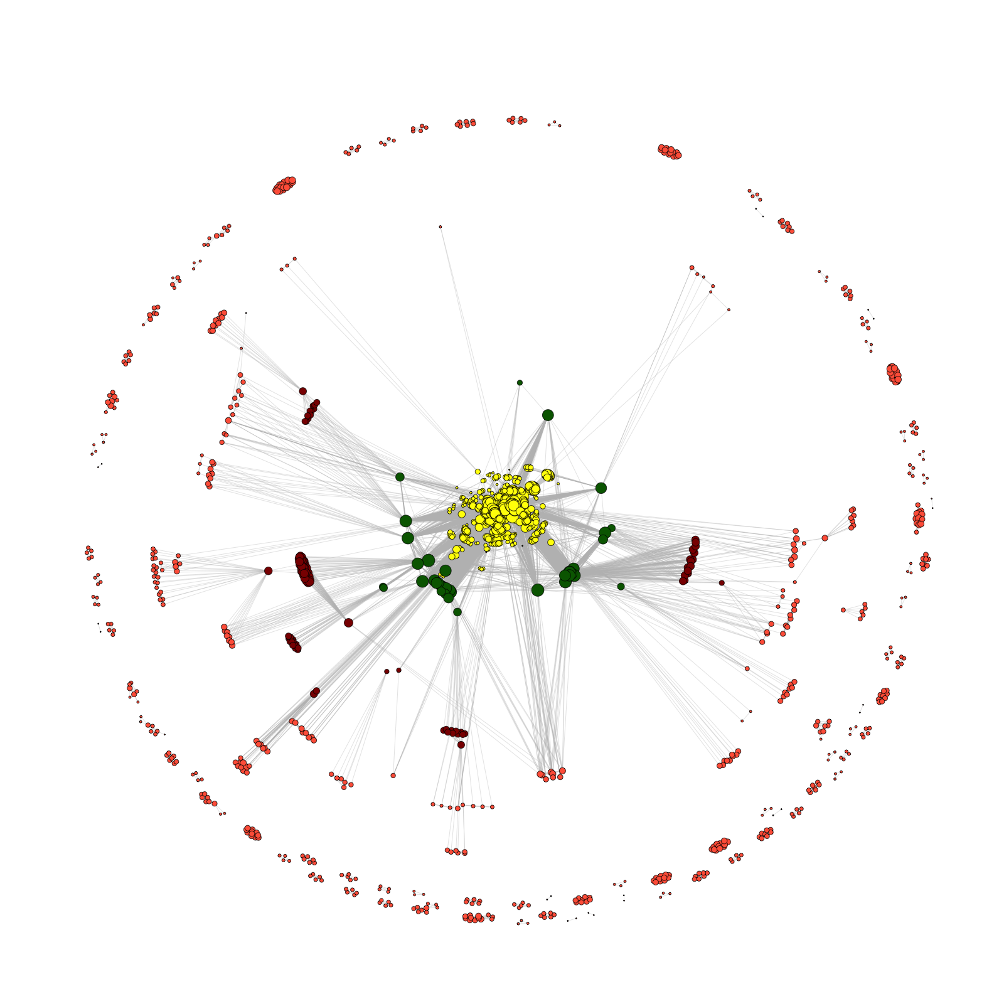
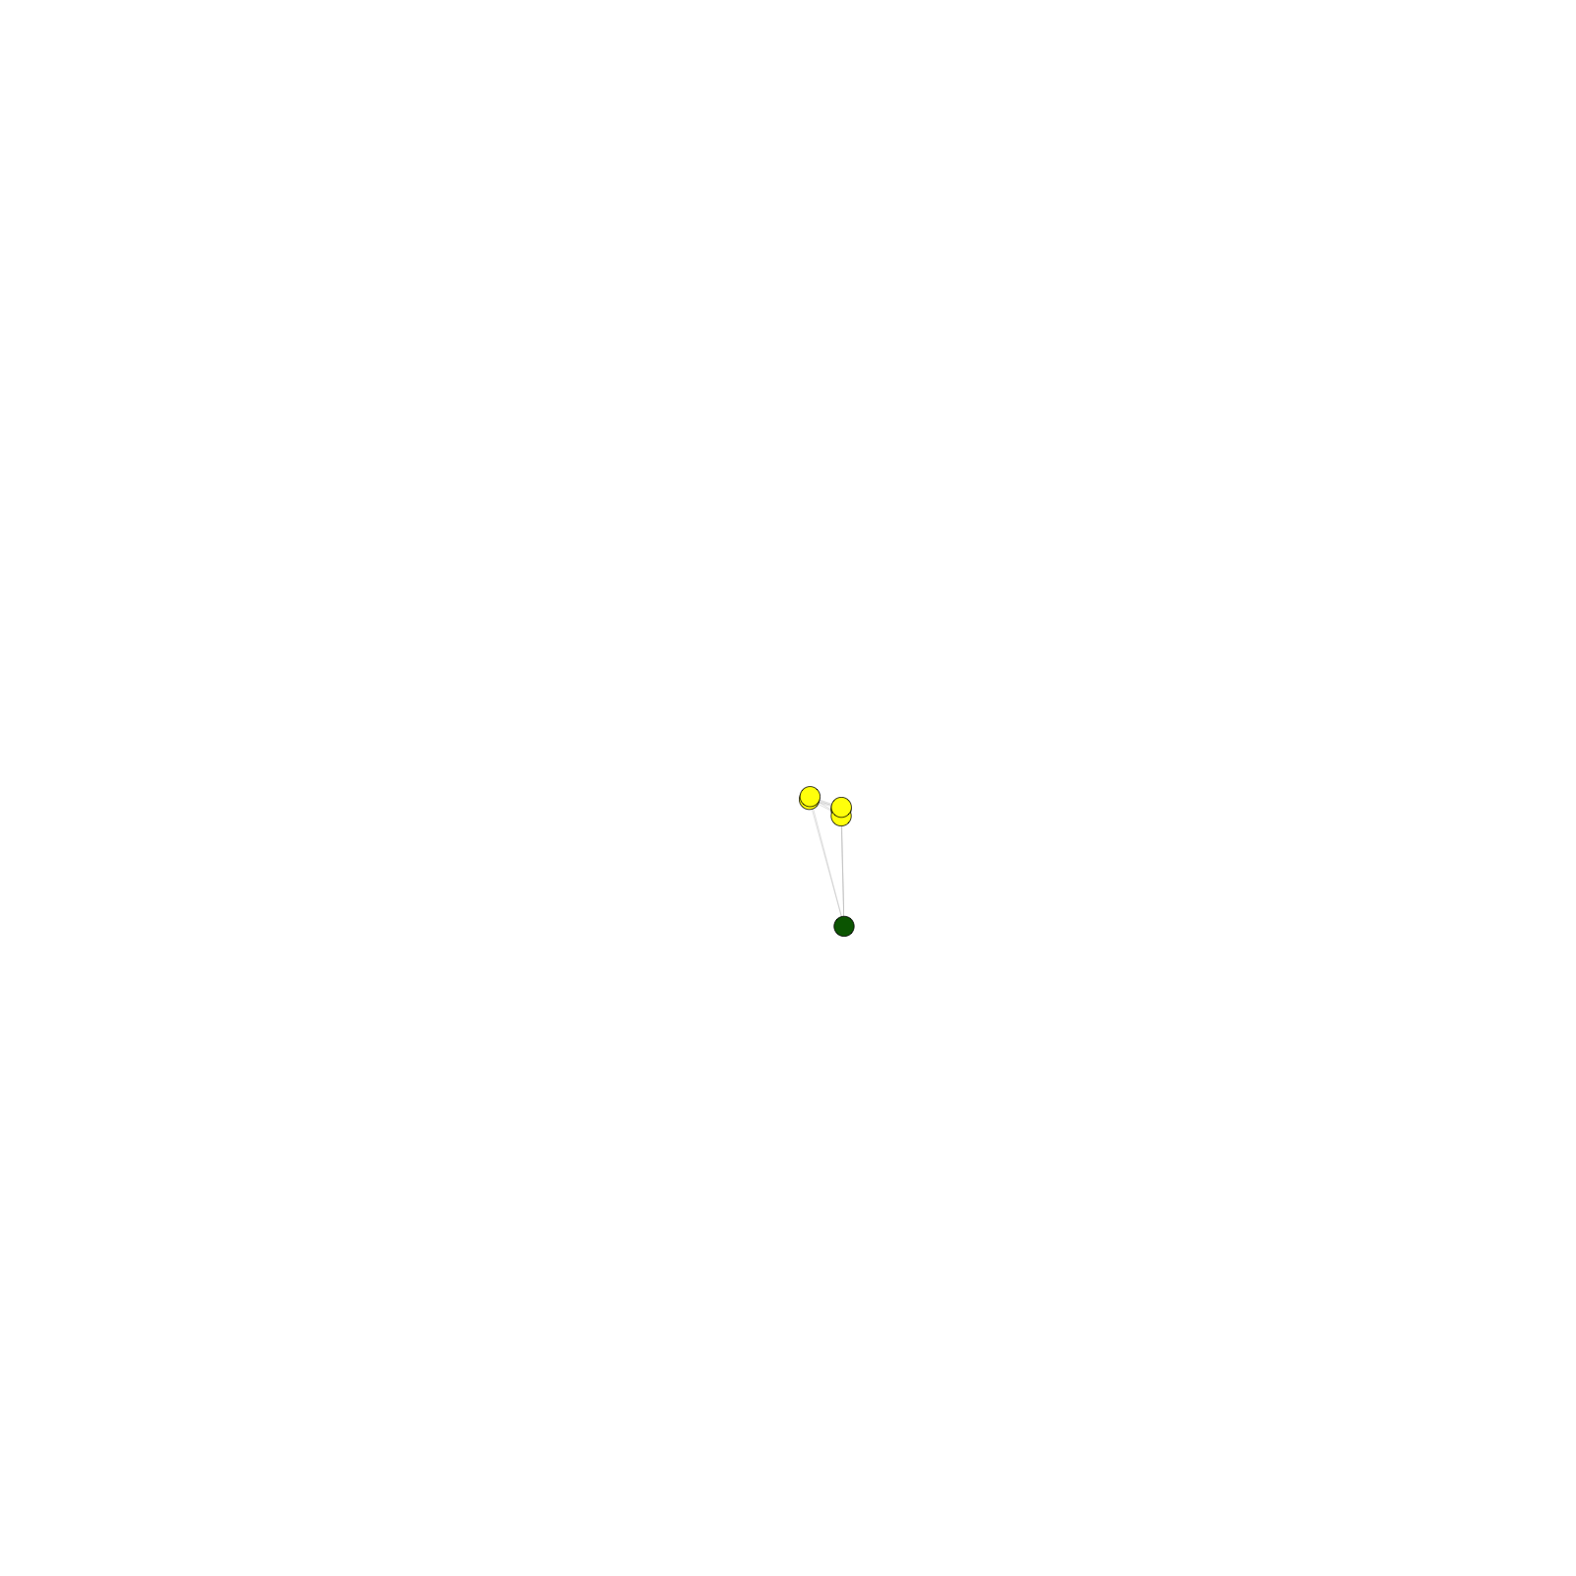
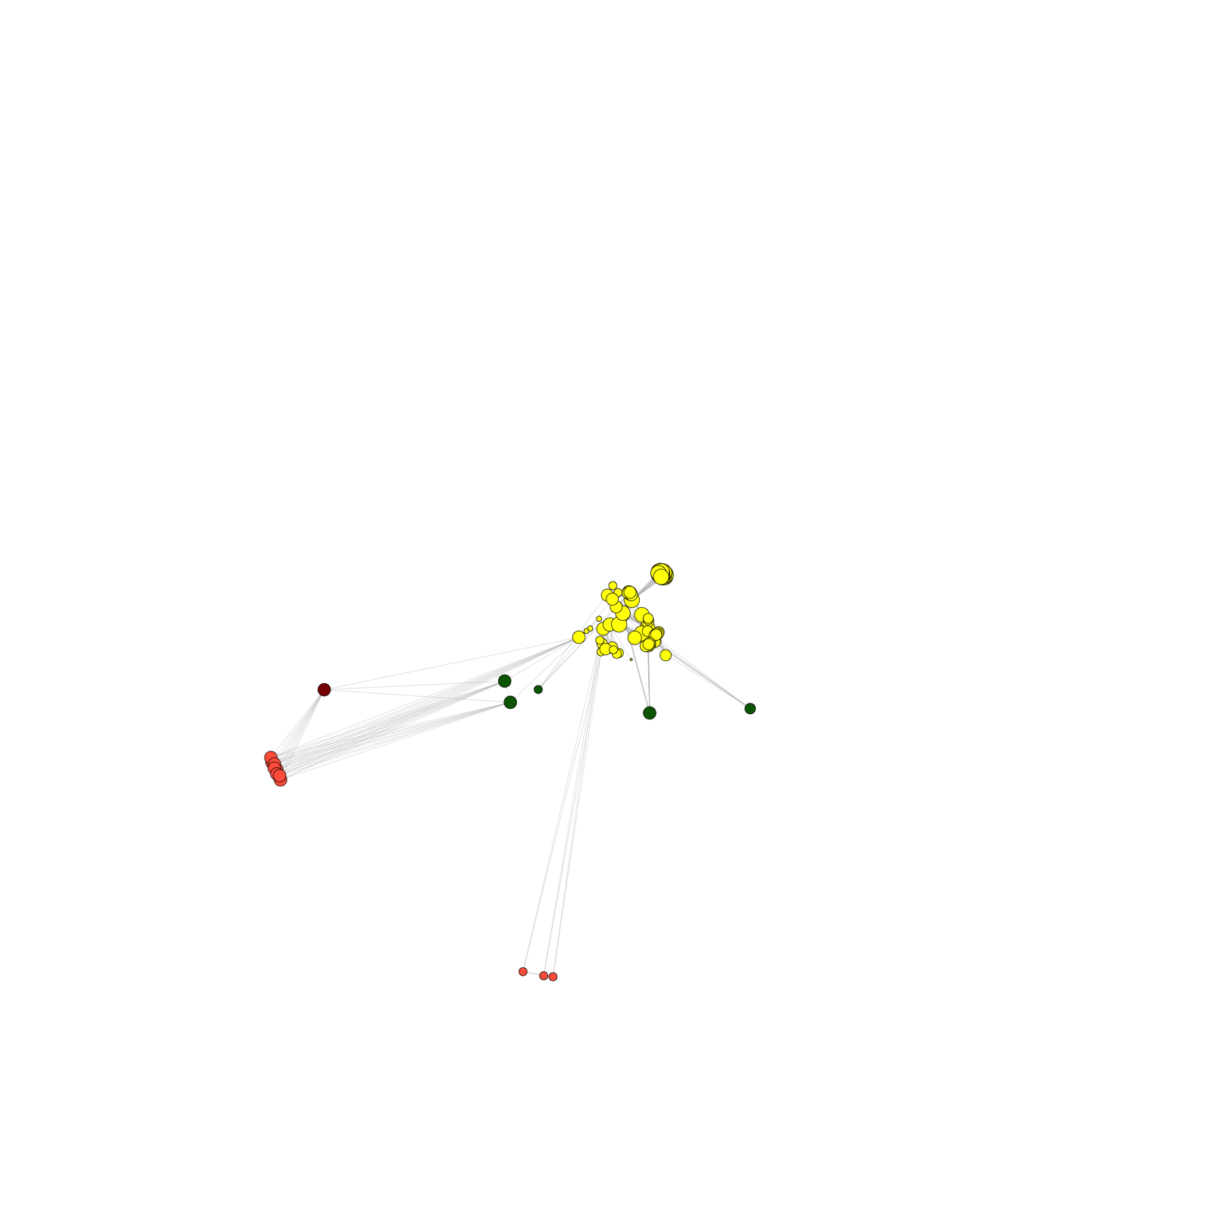


Similar findings in terms of slow growth trends & broker scientists in the modENCODE consortium as for ENCODE
2014
2013
2012
2011
2010
2009
2008
2007
Number of member neighbors
modENCODE
Number of non-member neighbors
[Wang et al., TIG (‘16)]

Slide 75
Large-scale Transcriptome Mining:
Clustering, Dynamic Modelling & Logic-gate Analysis while Protecting Individual Privacy
Much RNA-seq (+TF ChIP) Data
  Comparative ENCODE – Lots of Matched Data
  TCGA
  Geuvadis w/ 1000G genotypes
Expression Clustering, Cross-species
  Optimization gives 16 conserved co-expression modules
State Space Models
of Gene Expression
  Using dimensionality reduction to help determine internal & external drivers
  Decoupling expression changes into those from conserved vs species-specific genes
  Also, conserved genes have similar canonical patterns (iPDPs) in contrast to species specific ones (Ex of ribosomal v signaling genes)
Using Logic Gates to Model of Transcriptome Activity
  Preponderance of OR gates in cancer v. cell-cycle (esp. for MYC)
The General
Dilemma of Genomic Privacy
  Fundamental, inherited info that’s very private v need for large-scale mining for med. research
  Issues w/ current social & tech approaches: inconsistencies & burdensome security
RNA-seq: How to Publicly Share it
  Presents a tricky privacy issue since much of the sequencing is for general, non-individual specific results yet it’s tagged with individual information
  Removing SNVs in reads w/ MRF
  Quantifying & removing variant info from expression levels + eQTLs using ICI & predictability
  Instantiating a practical linking attack using extreme expression levels
  Quantifying accuracy of prediction, via gap between best & 2nd best match
Value of publication patterns generated by the data producing consortia
  Co-authorship network statistics relate to publication rollouts & show gradual adoption by a diverse community
  Key role of brokers in data dissemination

Slide 76
Large-scale Transcriptome Mining:
Clustering, Dynamic Modelling & Logic-gate Analysis while Protecting Individual Privacy
Much RNA-seq (+TF ChIP) Data
  Comparative ENCODE – Lots of Matched Data
  TCGA
  Geuvadis w/ 1000G genotypes
Expression Clustering, Cross-species
  Optimization gives 16 conserved co-expression modules
State Space Models
of Gene Expression
  Using dimensionality reduction to help determine internal & external drivers
  Decoupling expression changes into those from conserved vs species-specific genes
  Also, conserved genes have similar canonical patterns (iPDPs) in contrast to species specific ones (Ex of ribosomal v signaling genes)
Using Logic Gates to Model of Transcriptome Activity
  Preponderance of OR gates in cancer v. cell-cycle (esp. for MYC)
The General
Dilemma of Genomic Privacy
  Fundamental, inherited info that’s very private v need for large-scale mining for med. research
  Issues w/ current social & tech approaches: inconsistencies & burdensome security
RNA-seq: How to Publicly Share it
  Presents a tricky privacy issue since much of the sequencing is for general, non-individual specific results yet it’s tagged with individual information
  Removing SNVs in reads w/ MRF
  Quantifying & removing variant info from expression levels + eQTLs using ICI & predictability
  Instantiating a practical linking attack using extreme expression levels
  Quantifying accuracy of prediction, via gap between best & 2nd best match
Value of publication patterns generated by the data producing consortia
  Co-authorship network statistics relate to publication rollouts & show gradual adoption by a diverse community
  Key role of brokers in data dissemination

Slide 77


DREISS.gersteinlab.org - D Wang, F He, S Maslov
papers.gersteinlab.org/subject/privacy - D Greenbaum
PrivaSeq.gersteinlab.org - A Harmanci
Loregic.gersteinlab.org - D Wang, KK Yan, C Sisu, C Cheng, J Rozowsky, W Meyerson
github.com/gersteinlab/OrthoClust - K Yan, D Wang, J Rozowsky, H Zheng, C Cheng
Publication patterns [“encode authors”] - D Wang, KK Yan, J Rozowsky, E Pan
Acknowledgements
Hiring Postdocs.
See gersteinlab.org/jobs !

Slide 78

Extra

Slide 79
Info about content in this slide pack
General PERMISSIONS
  This Presentation is copyright Mark Gerstein,
  Yale University, 2016.
  Please read permissions statement at
  www.gersteinlab.org/misc/permissions.html .
  Feel free to use slides & images in the talk with PROPER acknowledgement
  (via citation to relevant papers or link to gersteinlab.org).
  Paper references in the talk were mostly from Papers.GersteinLab.org.
PHOTOS & IMAGES. For thoughts on the source and permissions of many of the photos and clipped images in this presentation see http://streams.gerstein.info .
  In particular, many of the images have particular EXIF tags, such as kwpotppt , that can be easily queried from flickr, viz: http://www.flickr.com/photos/mbgmbg/tags/kwpotppt

