Slide 1
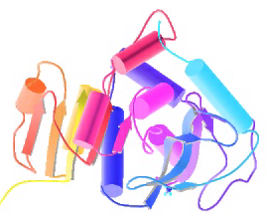
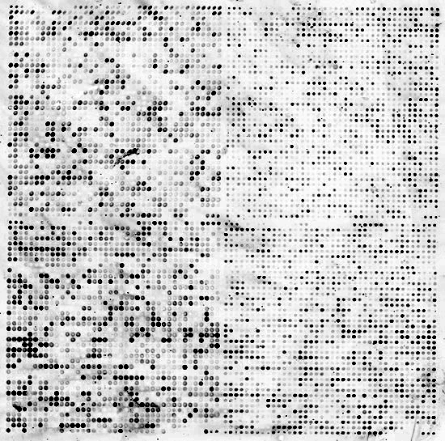


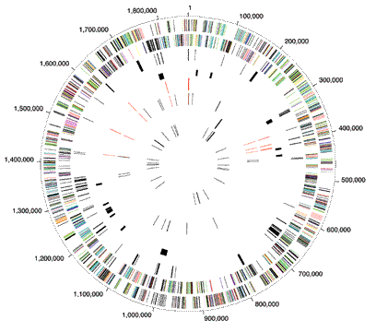
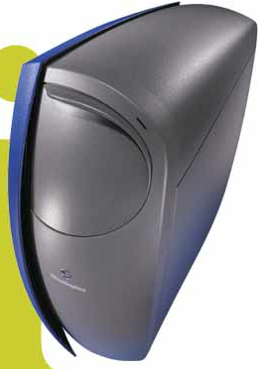

Bioinformatics:
Predicting Networks
Mark Gerstein, Yale University
gersteinlab.org/courses/452
(last edit in Spring '17)

Slide 2
Origin of Biological Networks

Slide 3
Origin of Networks
Protein-protein interactions
  Phosphorylation networks
Metabolic Networks
Regulatory networks
  from Chip-Seq (see next slide)
“Squared” scale
  6K genes in yeast but ~18M potential interactions
  (6000 chose 2 pairs of interactions)

Slide 4
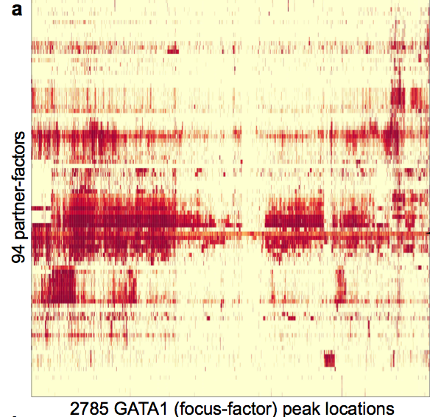
Data Flow: Chip-seq expts. to co-associating peaks
119 TFs from 458 ChIP-Seq experiments (2 Tb tot.)
Signal Tracks
7M Peaks from Uniform Peak Calling
TF1
TF2
TF119
[ Gerstein et al. Nature (in press, '12) ]

Slide 5
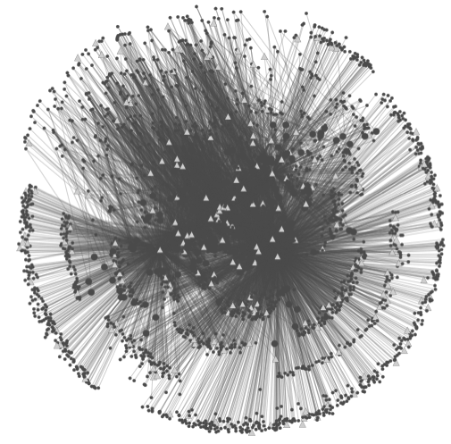
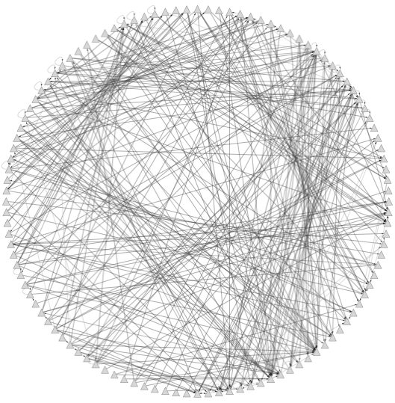
Data Flow: peaks to proximal & distal networks
Peak Calling
Assigning TF binding sites to targets
Filtering high confidence edges & distal regulation
[ Cheng et al., Bioinfo. ('11);
Gerstein et al. Nature (in press, '12) ;
Yip et al., GenomeBiology (in press, '12)]
~500K Edges
Based on stat. model combining
signal strength & location relative to typical binding
~26K Edges
TF
TF
Potential
Distal
Edge
Strong
Proximal
Edge

Slide 6
Predicting Networks via Bayesian Integration: Problem Motivation

Slide 7
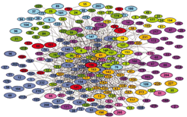
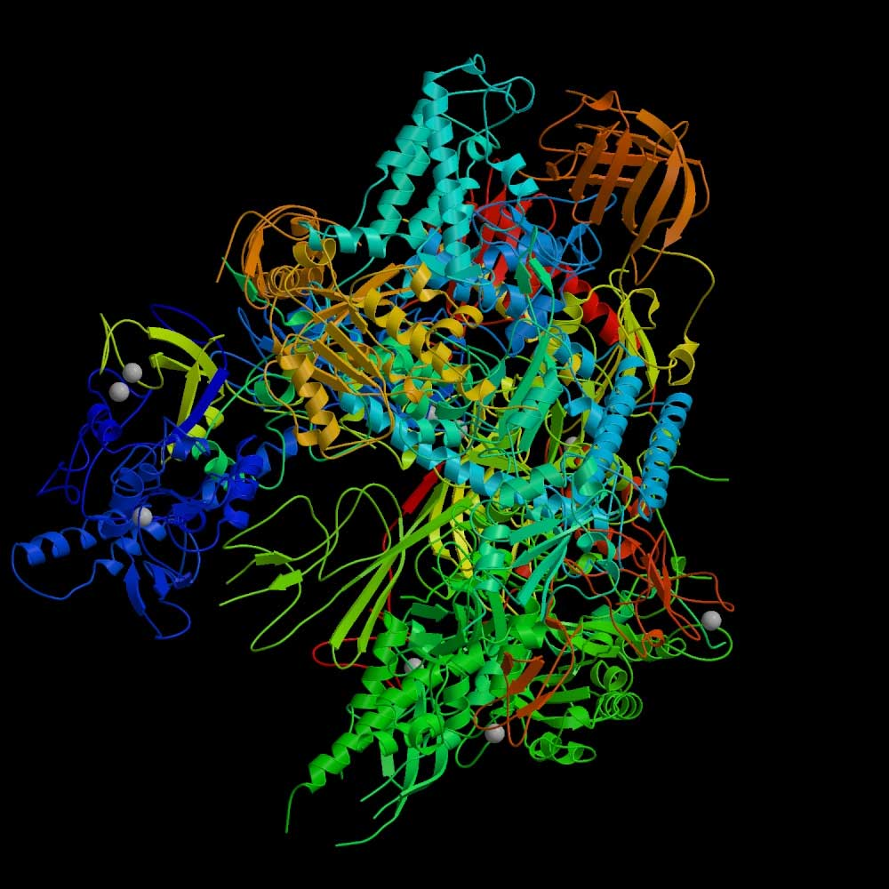
RNA polymerase II: Structure
Which subunits interact?
Based on Binding
experiments
Compare with Gold Std. Structure
5
3
6
2
8
1
9
12
10
11
Source: Cramer et al., 2000, Science, 288:632-633
Source: Edwards et al., 2002, Trends in Genetics

Slide 8
Binding Experiments on Subunit Pairs
Subunits
1
1
1
1
1
1
1
1
1
2
2
2
2
2
2
2
2
3
3
3
3
3
3
3
5
5
5
5
5
5
6
6
6
6
6
8
8
8
8
9
9
9
10
10
12
Subunits
2
3
5
6
8
9
10
11
12
3
5
6
8
9
10
11
12
5
6
8
9
10
11
12
6
8
9
10
11
12
8
9
10
11
12
9
10
11
12
10
11
12
11
11
12
Pull-down 1
1
1
0
1
0
1
0
1
1
0
1
0
1
0
1
1
1
0
1
1
1
1
0
1
0
0
0
0
0
0
1
0
0
0
0
Pull-down 2
1
1
1
1
0
1
0
1
1
0
1
0
1
0
1
1
1
0
1
1
0
1
0
1
0
0
0
0
0
0
0
0
0
0
0
Pull-down 3
1
1
1
0
1
0
0
1
0
Cross-linking
1
1
1
1
1
0
1
1
1
1
1
0
1
1
1
1
1
1
0
1
Far Western 1
1
1
1
1
1
0
0
0
0
0
0
1
0
0
0
Far Western 2
1
1
1
1
1
1
1
1
1
1
0
0
0
1
0
0
0
0
0
0
0
0
0
0
0
0
0
0
0
0
Far Western 3
1
0
0
0
1
0
Interaction experiments
before structure was known

Slide 9
Gold-Standard Positives
Subunits
1
1
1
1
1
1
1
1
1
2
2
2
2
2
2
2
2
3
3
3
3
3
3
3
5
5
5
5
5
5
6
6
6
6
6
8
8
8
8
9
9
9
10
10
12
Subunits
2
3
5
6
8
9
10
11
12
3
5
6
8
9
10
11
12
5
6
8
9
10
11
12
6
8
9
10
11
12
8
9
10
11
12
9
10
11
12
10
11
12
11
11
12
Gold-Standard Positive (GSTD+): 13
5
3
6
2
8
1
9
12
10
11

Slide 10
Gold-Standard Negatives
Subunits
1
1
1
1
1
1
1
1
1
2
2
2
2
2
2
2
2
3
3
3
3
3
3
3
5
5
5
5
5
5
6
6
6
6
6
8
8
8
8
9
9
9
10
10
12
Subunits
2
3
5
6
8
9
10
11
12
3
5
6
8
9
10
11
12
5
6
8
9
10
11
12
6
8
9
10
11
12
8
9
10
11
12
9
10
11
12
10
11
12
11
11
12
Gold-Standard Negative (GSTD-): 32
5
3
6
2
8
1
9
12
10
11

Slide 11
RNA Polymerase II: Gold-Standards
Subunits
1
1
1
1
1
1
1
1
1
2
2
2
2
2
2
2
2
3
3
3
3
3
3
3
5
5
5
5
5
5
6
6
6
6
6
8
8
8
8
9
9
9
10
10
12
Subunits
2
3
5
6
8
9
10
11
12
3
5
6
8
9
10
11
12
5
6
8
9
10
11
12
6
8
9
10
11
12
8
9
10
11
12
9
10
11
12
10
11
12
11
11
12
Gold-Standard Positive (GSTD+): 13
Gold-Standard Negative (GSTD-): 32
5
3
6
2
8
1
9
12
10
11

Slide 12
Assess Quality and Coverage of PPints
Subunits
1
1
1
1
1
1
1
1
1
2
2
2
2
2
2
2
2
3
3
3
3
3
3
3
5
5
5
5
5
5
6
6
6
6
6
8
8
8
8
9
9
9
10
10
12
Subunits
2
3
5
6
8
9
10
11
12
3
5
6
8
9
10
11
12
5
6
8
9
10
11
12
6
8
9
10
11
12
8
9
10
11
12
9
10
11
12
10
11
12
11
11
12
Pull-down 1
1
1
0
1
0
1
0
1
1
0
1
0
1
0
1
1
1
0
1
1
1
1
0
1
0
0
0
0
0
0
1
0
0
0
0
Pull-down 2
1
1
1
1
0
1
0
1
1
0
1
0
1
0
1
1
1
0
1
1
0
1
0
1
0
0
0
0
0
0
0
0
0
0
0
Pull-down 3
1
1
1
0
1
0
0
1
0
Cross-linking
1
1
1
1
1
0
1
1
1
1
1
0
1
1
1
1
1
1
0
1
Far Western 1
1
1
1
1
1
0
0
0
0
0
0
1
0
0
0
Far Western 2
1
1
1
1
1
1
1
1
1
1
0
0
0
1
0
0
0
0
0
0
0
0
0
0
0
0
0
0
0
0
Far Western 3
1
0
0
0
1
0
GSTD+
GSTD-
True
False

Slide 13
Data integration: RNA polymerase II

Slide 14
Data integration: RNA polymerase II
Integrate using naive Bayes classifier

Slide 15
Data integration: RNA polymerase II
Integrate using naive Bayes classifier

Slide 16
Data integration: RNA polymerase II
Integrate using naive Bayes classifier
(Cross validate)

Slide 17
Weighted Voting: the Likelihood Ratio
Maj. Vote: 0 = round(avg( 0 + 0 + 0 + 1 + 1 + 0 + 0 )
With weights: likelihood ratio L = L₁ + L₂ + L₃ …

Slide 18
Predicting Networks via Bayesian Integration: Intuition & Formalism

Slide 19
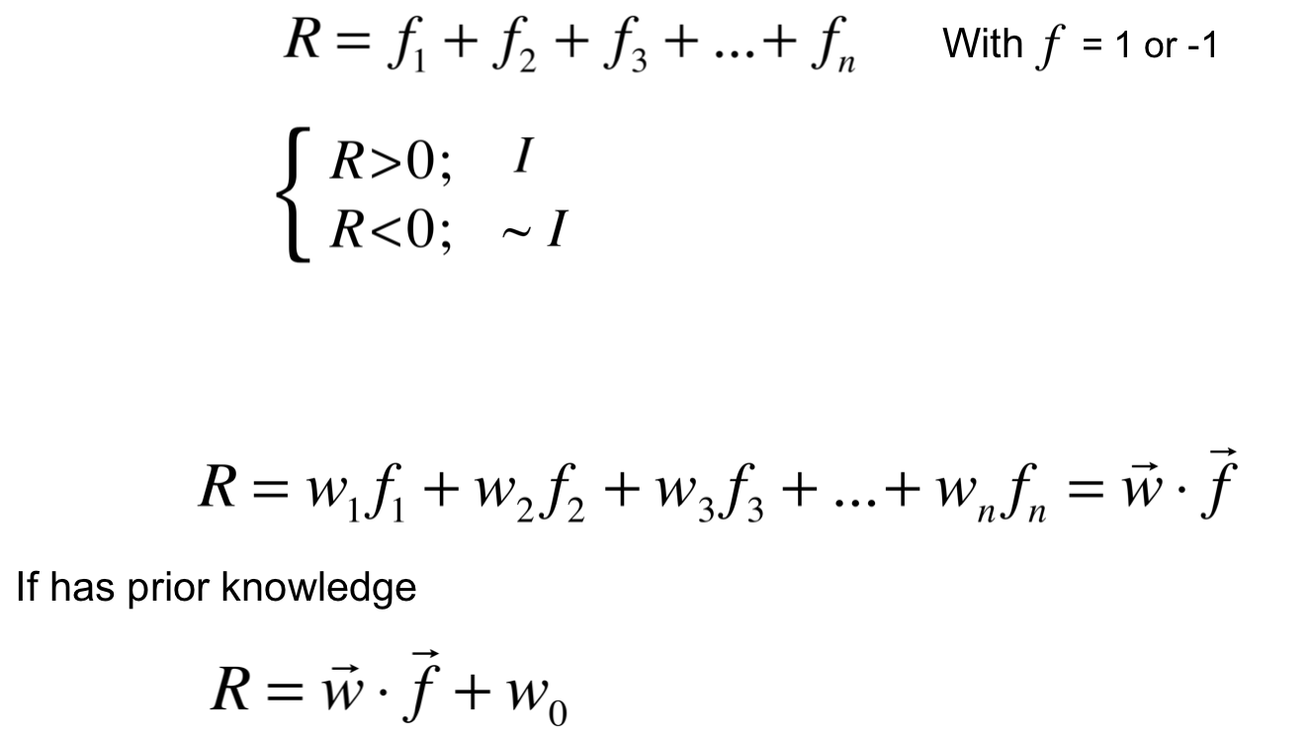
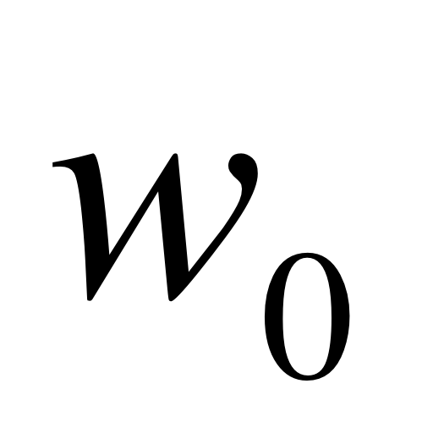
Supervised
Classification by Weighted Voting
Derived from
"perceptron model”
R = <w,f> + b
Simple Vote:
Interact
If
No interaction
Modify with feature weight:

Slide 20
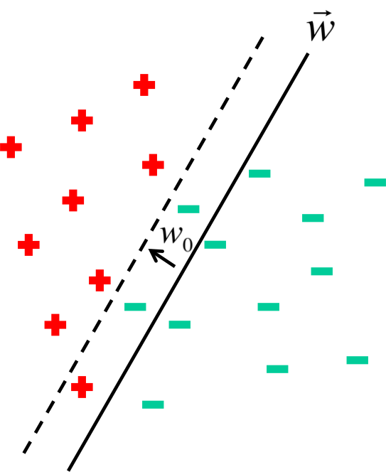
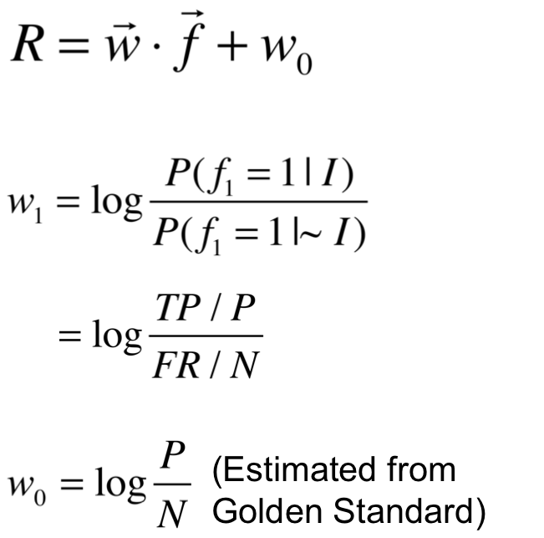
Classification by Voting
On Training Set

Slide 21
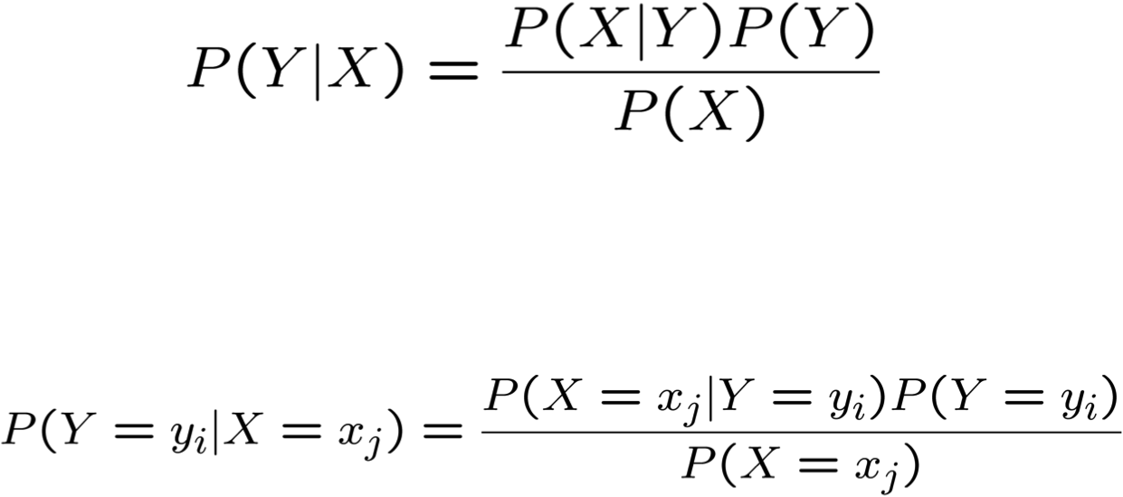
Bayes Rule
Which is shorthand for:
[From Mitchell, Machine Learning]

Slide 22
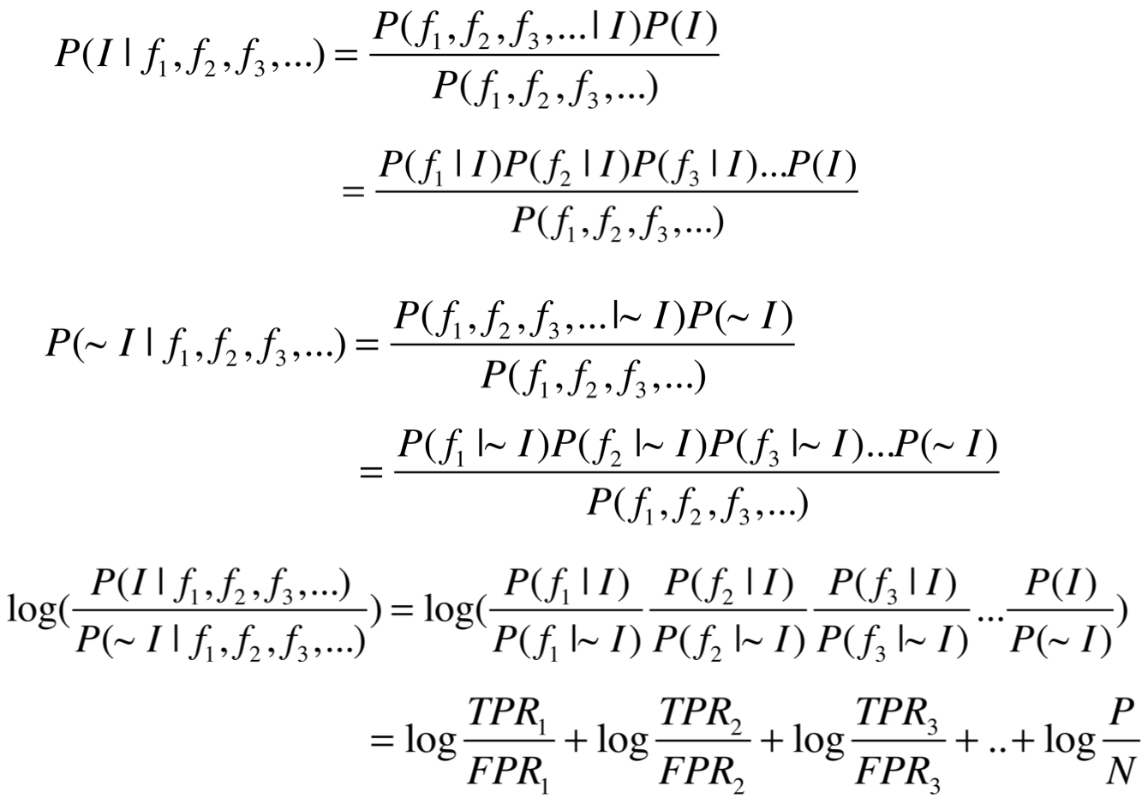
More Bayes Rule
Thus
Assume Naïve Bayes (independent)

Slide 23
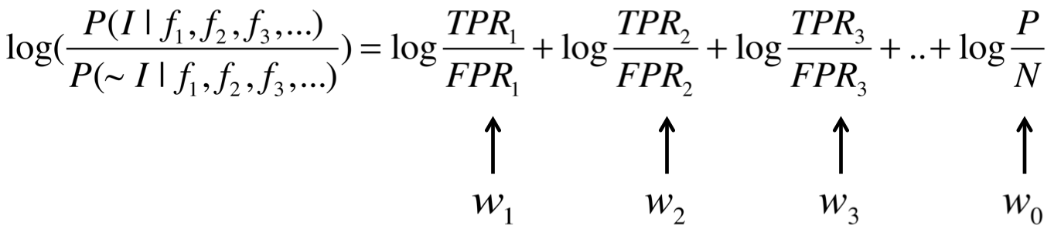
More Bayes Rule

Slide 24
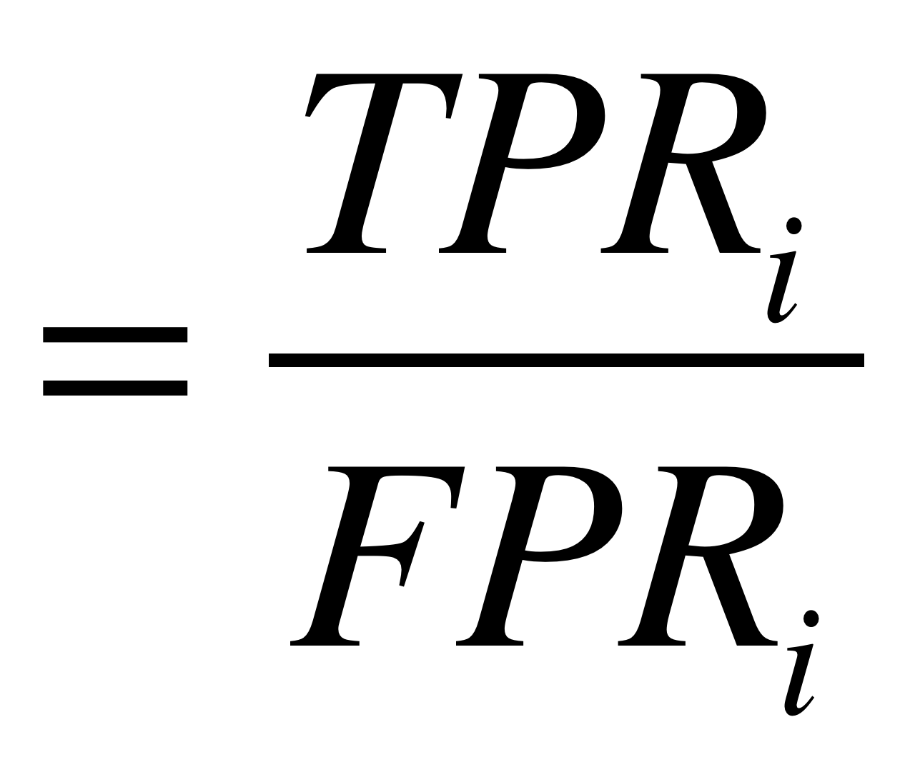
Estimating Probabilities
We have so far estimated P(X=x | Y=y) by the fraction n_{x|y}/n_{y}, where n_{y} is the number of instances for which Y=y and n_{x|y} is the number of these for which X=x
This is a problem when n_{x} is small
  E.g., assume P(X=x | Y=y)=0.05 and the training set is s.t. that n_{y}=5. Then it is highly probable that n_{x|y}=0
  The fraction is thus an underestimate of the actual probability
  It will dominate the Bayes classifier for all new queries with X=x
# count with feature i in GS+
# count with feature i in GS-

Slide 25
m-estimate
Replace n_{x|y}/n_{y} by:
Dummy Counts
Where p is our prior estimate of the probability we wish to determine and m is a constant
  Typically, p = 1/k (where k is the number of possible values of X)
  m acts as a weight (similar to adding m virtual instances distributed according to p)

Slide 26
Predicting Networks:
Assessment via Cross-Validation

Slide 27
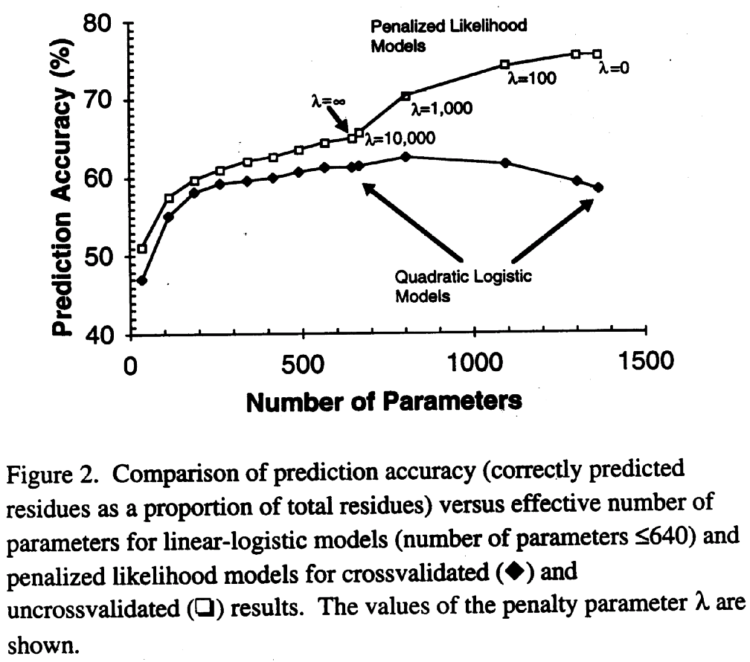
Training and Testing Set
Cross Validation
Test
Cross Validation: Leave one out, seven-fold
Training
4-fold
Credits: Munson, 1995;
Garnier et al., 1996

Slide 28
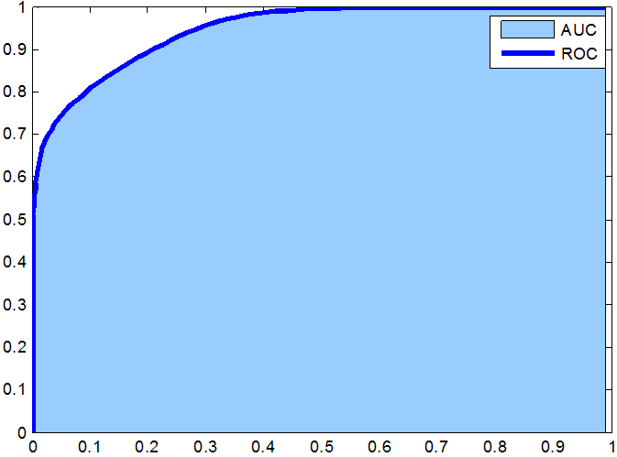
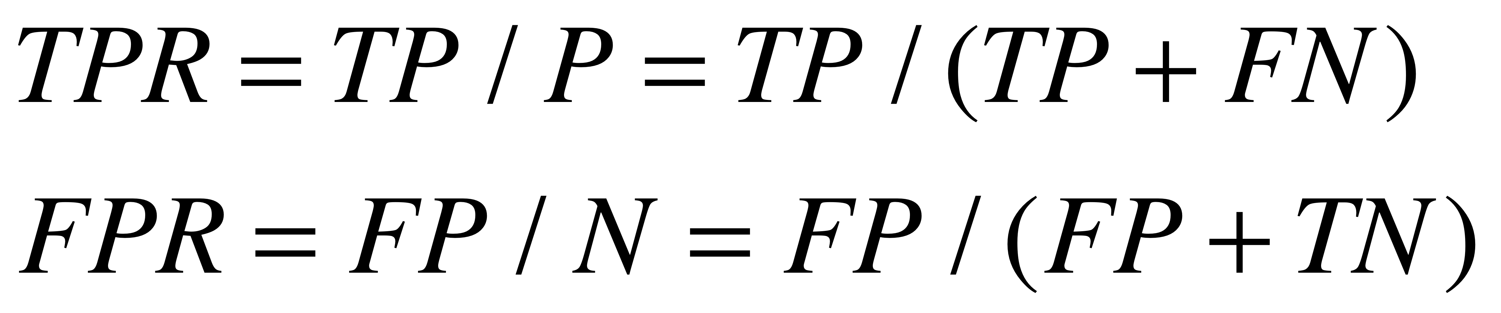
Intuition :
ROC Curve & the prior
True Positive Rate (TPR)
Random
False Positive Rate (FPR)
[From Biometrical Fusion - input statistical distribution ]

Slide 29
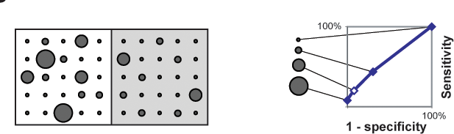
Comparison of Predictions against a Positive and Negative Gold Standard
"Coverage"
Threshold "predictions" at different levels and compare to + and - gold standards
"Error Rate"
ROC plot
(cross validated)

Slide 30
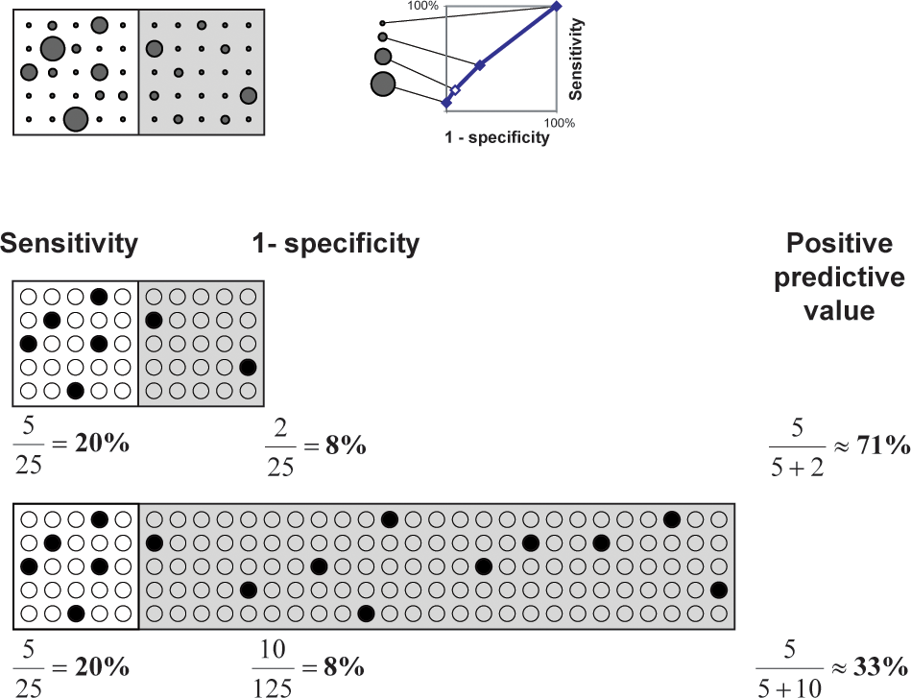
Effect on Predictions of Large Number of Negatives

Slide 31
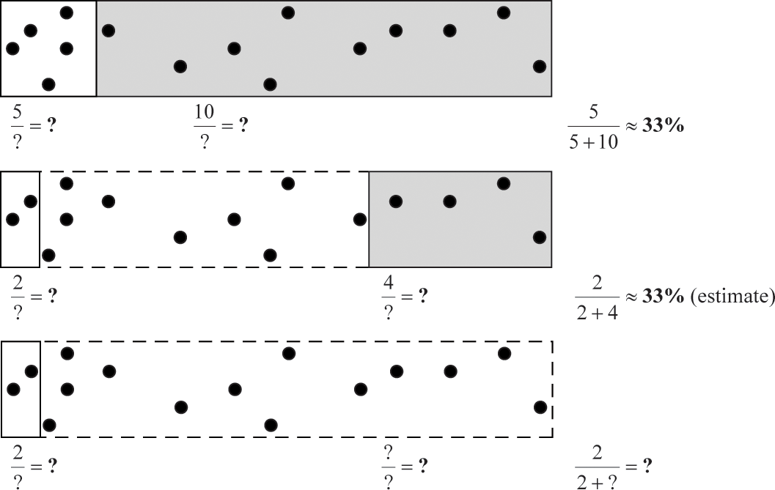
Importance of Balanced
Positive and Negative Examples

Slide 32
Predicting Networks via Bayesian Integration: Worked Examples

Slide 33
Likelihood Ratios
Subunits
1
1
1
1
1
1
1
1
1
2
2
2
2
2
2
2
2
3
3
3
3
3
3
3
5
5
5
5
5
5
6
6
6
6
6
8
8
8
8
9
9
9
10
10
12
Subunits
2
3
5
6
8
9
10
11
12
3
5
6
8
9
10
11
12
5
6
8
9
10
11
12
6
8
9
10
11
12
8
9
10
11
12
9
10
11
12
10
11
12
11
11
12
Pull-down 1
1
1
0
1
0
1
0
1
1
0
1
0
1
0
1
1
1
0
1
1
1
1
0
1
0
0
0
0
0
0
1
0
0
0
0
Likelihood Ratio
for Feature f:
GSTD+
GSTD-
True
False

Slide 34
Calculating Likelihood Ratios
Subunits
1
1
1
1
1
1
1
1
1
2
2
2
2
2
2
2
2
3
3
3
3
3
3
3
5
5
5
5
5
5
6
6
6
6
6
8
8
8
8
9
9
9
10
10
12
Subunits
2
3
5
6
8
9
10
11
12
3
5
6
8
9
10
11
12
5
6
8
9
10
11
12
6
8
9
10
11
12
8
9
10
11
12
9
10
11
12
10
11
12
11
11
12
Pull-down 1
1
0
1
0
0
1
0
1
1
1
GSTD+
GSTD-
True
False

Slide 35
Calculating Likelihood Ratios
Subunits
1
1
1
1
1
1
1
1
1
2
2
2
2
2
2
2
2
3
3
3
3
3
3
3
5
5
5
5
5
5
6
6
6
6
6
8
8
8
8
9
9
9
10
10
12
Subunits
2
3
5
6
8
9
10
11
12
3
5
6
8
9
10
11
12
5
6
8
9
10
11
12
6
8
9
10
11
12
8
9
10
11
12
9
10
11
12
10
11
12
11
11
12
Pull-down 1
Pull-down 1
1
1
1
0
1
0
1
1
0
1
1
1
0
0
1
1
0
1
0
0
1
1
1
1
1
1
0
0
1
1
1
1
1
1
0
0
1
1
0
0
0
0
0
0
0
0
0
0
0
0
1
1
0
0
0
0
0
0
0
0
=1.34
=0.70
GSTD+
GSTD-
True
False

Slide 36
Calculating Likelihood Ratios
Subunits
1
1
1
1
1
1
1
1
1
2
2
2
2
2
2
2
2
3
3
3
3
3
3
3
5
5
5
5
5
5
6
6
6
6
6
8
8
8
8
9
9
9
10
10
12
Subunits
2
3
5
6
8
9
10
11
12
3
5
6
8
9
10
11
12
5
6
8
9
10
11
12
6
8
9
10
11
12
8
9
10
11
12
9
10
11
12
10
11
12
11
11
12
Pull-down 1
1
1
0
1
0
1
0
1
1
0
1
0
1
0
1
1
1
0
1
1
1
1
0
1
0
0
0
0
0
0
1
0
0
0
0
Pull-down 2
1
1
1
1
0
1
0
1
1
0
1
0
1
0
1
1
1
0
1
1
0
1
0
1
0
0
0
0
0
0
0
0
0
0
0
Pull-down 3
1
1
1
0
1
0
0
1
0
Cross-linking
1
1
1
1
1
0
1
1
1
1
1
0
1
1
1
1
1
1
0
1
Far Western 1
1
1
1
1
1
0
0
0
0
0
0
1
0
0
0
Far Western 2
1
1
1
1
1
1
1
1
1
1
0
0
0
1
0
0
0
0
0
0
0
0
0
0
0
0
0
0
0
0
Far Western 3
1
0
0
0
1
0
Pull-down 1
L1 = (6/13) / (11/32) = 1.34
L0 = (4/13) / (14/32) = 0.70
Pull-down 2
L1 = (7/13) / (9/32) = 1.91
L0 = (2/13) / (16/32) = 0.31
Pull-down 3
L1 = (2/13) / (3/32) = 1.64
L0 = (2/13) / (2/32) = 2.46
Cross-linking
L1 = (10/13) / (7/32) = 3.52
L0 = (0/13) / (3/32) = 0
Far Western 1
L1 = (2/13) / (4/32) = 1.23
L0 = (3/13) / (6/32) = 1.23
Far Western 2
L1 = (6/13) / (5/32) = 2.95
L0 = (2/13) / (17/32) = 0.29
Far Western 3
L1 = (1/13) / (1/32) = 2.46
L0 = (2/13) / (2/32) = 2.46
GSTD+
GSTD-
True
False

Slide 37
Data Integration: ROC-Curve
Subunits
1
1
1
1
1
1
1
1
1
2
2
2
2
2
2
2
2
3
3
3
3
3
3
3
5
5
5
5
5
5
6
6
6
6
6
8
8
8
8
9
9
9
10
10
12
Subunits
2
3
5
6
8
9
10
11
12
3
5
6
8
9
10
11
12
5
6
8
9
10
11
12
6
8
9
10
11
12
8
9
10
11
12
9
10
11
12
10
11
12
11
11
12
Pull-down 1
1
1
0
1
0
1
0
1
1
0
1
0
1
0
1
1
1
0
1
1
1
1
0
1
0
0
0
0
0
0
1
0
0
0
0
Pull-down 2
1
1
1
1
0
1
0
1
1
0
1
0
1
0
1
1
1
0
1
1
0
1
0
1
0
0
0
0
0
0
0
0
0
0
0
Pull-down 3
1
1
1
0
1
0
0
1
0
Cross-linking
1
1
1
1
1
0
1
1
1
1
1
0
1
1
1
1
1
1
0
1
Far Western 1
1
1
1
1
1
0
0
0
0
0
0
1
0
0
0
Far Western 2
1
1
1
1
1
1
1
1
1
1
0
0
0
1
0
0
0
0
0
0
0
0
0
0
0
0
0
0
0
0
Far Western 3
1
0
0
0
1
0
3.52
18.2
11.1
13.9
26.6
0.22
0
2.25
10.4
18.2
11.1
2.25
0
0.22
26.6
2.25
10.4
12.7
5.52
3.68
0.53
19.5
132
2.16
0.52
0
0.22
0.91
0.08
0.36
0.22
0.22
0.06
0.06
0.29
0.22
0.12
0.06
0.29
0.22
0.22
0
0.06
0.29
0.29
Combined (Bayes)
1
1
1
1
1
0
0
0
1
1
1
0
0
0
1
0
1
1
0
0
0
1
1
0
0
0
0
0
0
0
0
0
0
0
0
0
0
0
0
0
0
0
0
0
0
GSTD+
“Weighted Voting”
GSTD-
True
False

Slide 38
Data Integration: ROC Curve
Subunits
1
1
1
1
1
1
1
1
1
2
2
2
2
2
2
2
2
3
3
3
3
3
3
3
5
5
5
5
5
5
6
6
6
6
6
8
8
8
8
9
9
9
10
10
12
Subunits
2
3
5
6
8
9
10
11
12
3
5
6
8
9
10
11
12
5
6
8
9
10
11
12
6
8
9
10
11
12
8
9
10
11
12
9
10
11
12
10
11
12
11
11
12
3.52
18.2
11.1
13.9
26.6
0.22
0
2.25
10.4
18.2
11.1
2.25
0
0.22
26.6
2.25
10.4
12.7
5.52
3.68
0.53
19.5
132
2.16
0.52
0
0.22
0.91
0.08
0.36
0.22
0.22
0.06
0.06
0.29
0.22
0.12
0.06
0.29
0.22
0.22
0
0.06
0.29
0.29
Combined (Bayes)
1
1
1
1
1
0
0
0
1
1
1
0
0
0
1
0
1
1
0
0
0
1
1
0
0
0
0
0
0
0
0
0
0
0
0
0
0
0
0
0
0
0
0
0
0
Majority
1
1
1
1
1
0
1
0
1
1
1
0
1
0
1
0
1
1
0
0
0
0
1
0
0
1
0
0
0
0
0
0
0
0
0
0
0
0
0
0
0
0
0
0
0
Intersection
1
1
1
0
1
0
0
0
1
1
1
0
0
0
1
0
1
1
0
0
0
0
0
0
0
0
0
0
0
0
0
0
0
0
0
0
0
0
0
0
0
0
0
0
0
Union
1
1
1
1
1
0
1
1
1
1
1
1
1
0
1
1
1
1
1
1
0
1
1
0
1
1
0
1
0
0
1
0
0
0
0
0
1
0
0
0
0
0
0
0
0
1.0
0.8
0.6
Bayesian Integration
Majority
Intersection
Union
TPR=TP/P=Sensitivity
0.4
GSTD+
GSTD-
0.2
True
ROC Curves of RNA Polymerase II
False
0.2
0.4
0.6
0.8
1.0
FPR=FP/N=1-Specificity

Slide 39
Predicting Networks via Bayesian Integration: Features Correlation

Slide 40
Correlations between similar features

Slide 41
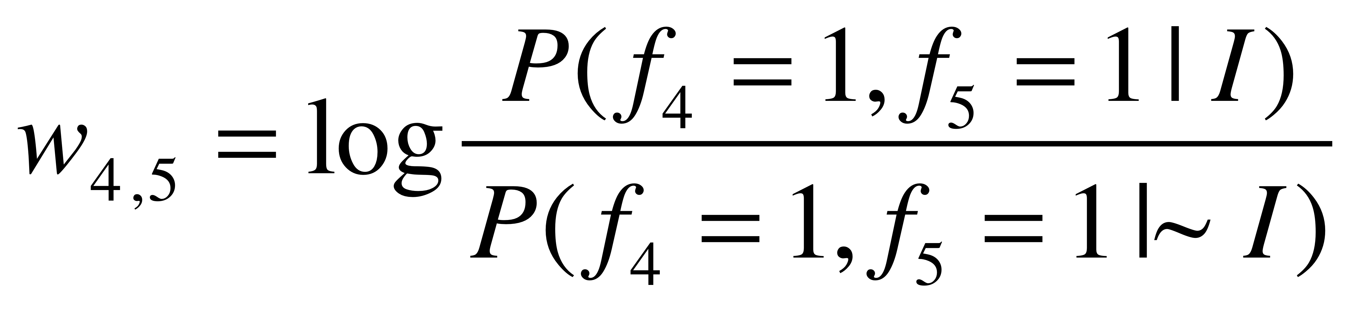
Feature Correlation and Fully Connected Bayes
GS | 1 | 0 | 0 | 1 | 1 | 1 | …
F1 | 1 | 0 | 0 | 1 | 0 | 0 | ...
F2 | 1 | 0 | 0 | 1 | 0 | 0 | …
F3 | 0 | 0 | 1 | 0 | 1 | 0 | …
F4 | 0 | 1 | 0 | 0 | 1 | 0 | …
F5 | 0 | 1 | 0 | 0 | 1 | 0 | …
F6 | 1 | 0 | 1 | 1 | 0 | 0 | …

Slide 42
Naive Bayes

Slide 43
A ‘correct’ factorisation

Slide 44
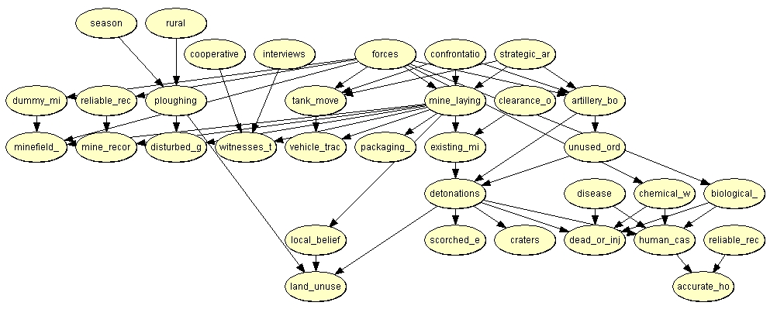
A Typical BBN

Slide 45
Predicting Networks via Bayesian Integration: Real Thing but with a few features

Slide 46
Papers on Predicting Protein Interactions
  A Enright et al. (1999) "Protein interaction maps for complete genomes based on gene fusion events." Nature. 402(6757):86-90.
  E Marcotte et al. (1999) "A Combined Algorithm for Genome-Wide Prediction of Protein Function." Nature 402, 83-86 (1999).
  E Marcotte et al. (1999) "Detecting Protein Function & Protein-Protein Interactions from Genome Sequences." Science 285, 751-753
  M Pellegrini et al. (1999) "Assigning protein functions by comparative genome analysis: protein phylogenetic profiles." Proc.Natl. Acad. Sci. 96, 4285-4288.
  R Jansen et al. (2003). "A Bayesian networks approach for predicting protein-protein interactions from genomic data." Science 302: 449-53.
  I Lee et al. (2004) "A Probabilistic Functional Network of Yeast Genes". Science 206: 1555-1558
  H Yu et al. (2004) "Annotation transfer between genomes: protein-protein interologs and protein-DNA regulogs." Genome Res 14: 1107-18.
  L Lu et al. (2005) "Assessing the limits of genomic data integration for predicting protein networks." Genome Res 15: 945-53.
  A Ramani et al. (2005) "Consolidating the set of known human protein-protein interactions in preparation for large-scale mapping of the human interactome." Genome Biology 6:r40.
  Xia et al. (2006) "Integrated prediction of the helical membrane protein interactome in yeast." J Mol Biol. 357:339-49

