Slide 1
Education forum
#biodata16

Slide 2
Johns Hopkins Biological Data Sciences
Biostatistics (Med Campus)
Computer Science (Undergrad Campus)
Biology (Undergrad Campus)
Biomedical Engineering (Both)
Human Genetics (Med Campus)
Genomic Data Science (the internet)
https://ccb.jhu.edu/

Slide 4
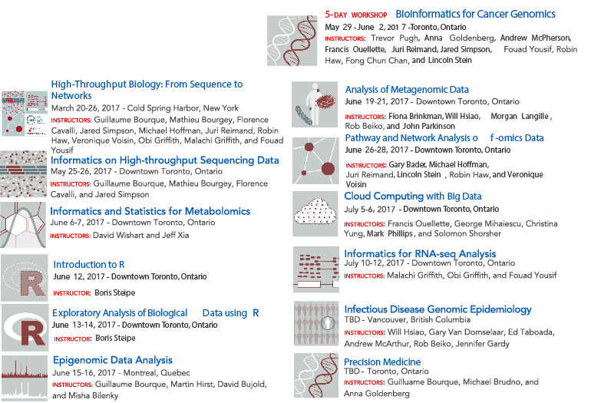
Canadian Bioinformatics Workshop
Draft schedule
2017
Subject to change
bioinformatics.ca
@bioinfodotca
Ann Meyer
@meyer_ann

Slide 6
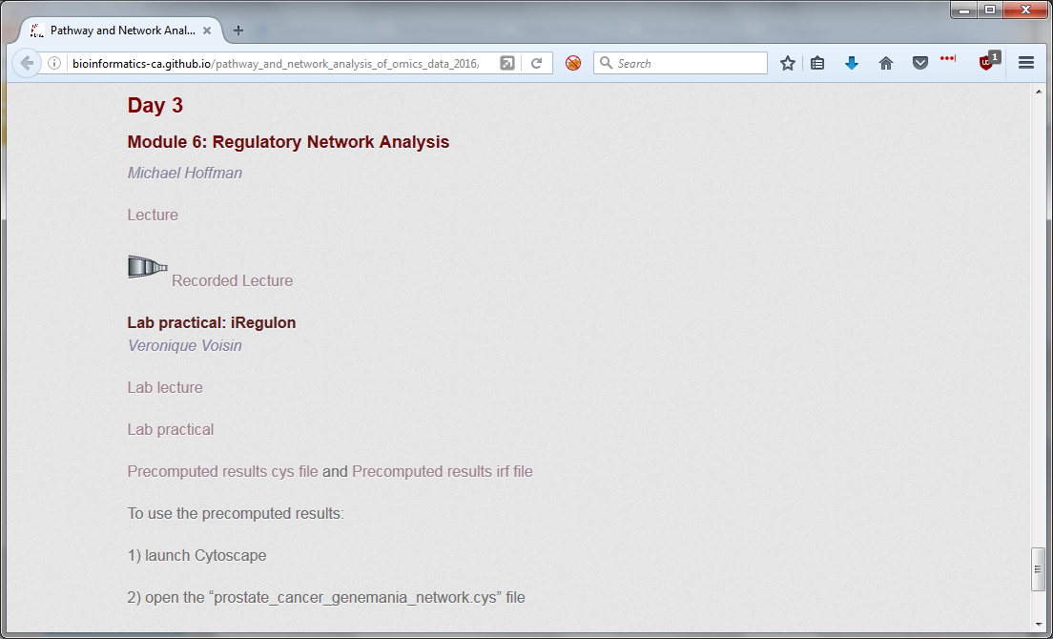
PDF of slide deck
YouTube video
Step-by-step instructions
Precomputed results

Slide 7
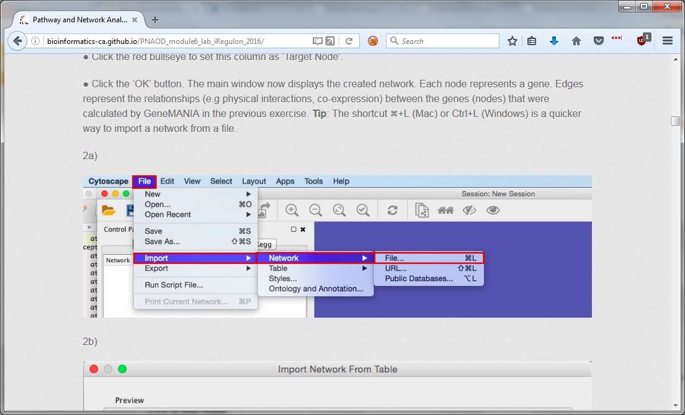
Veronique Voisin

Slide 8
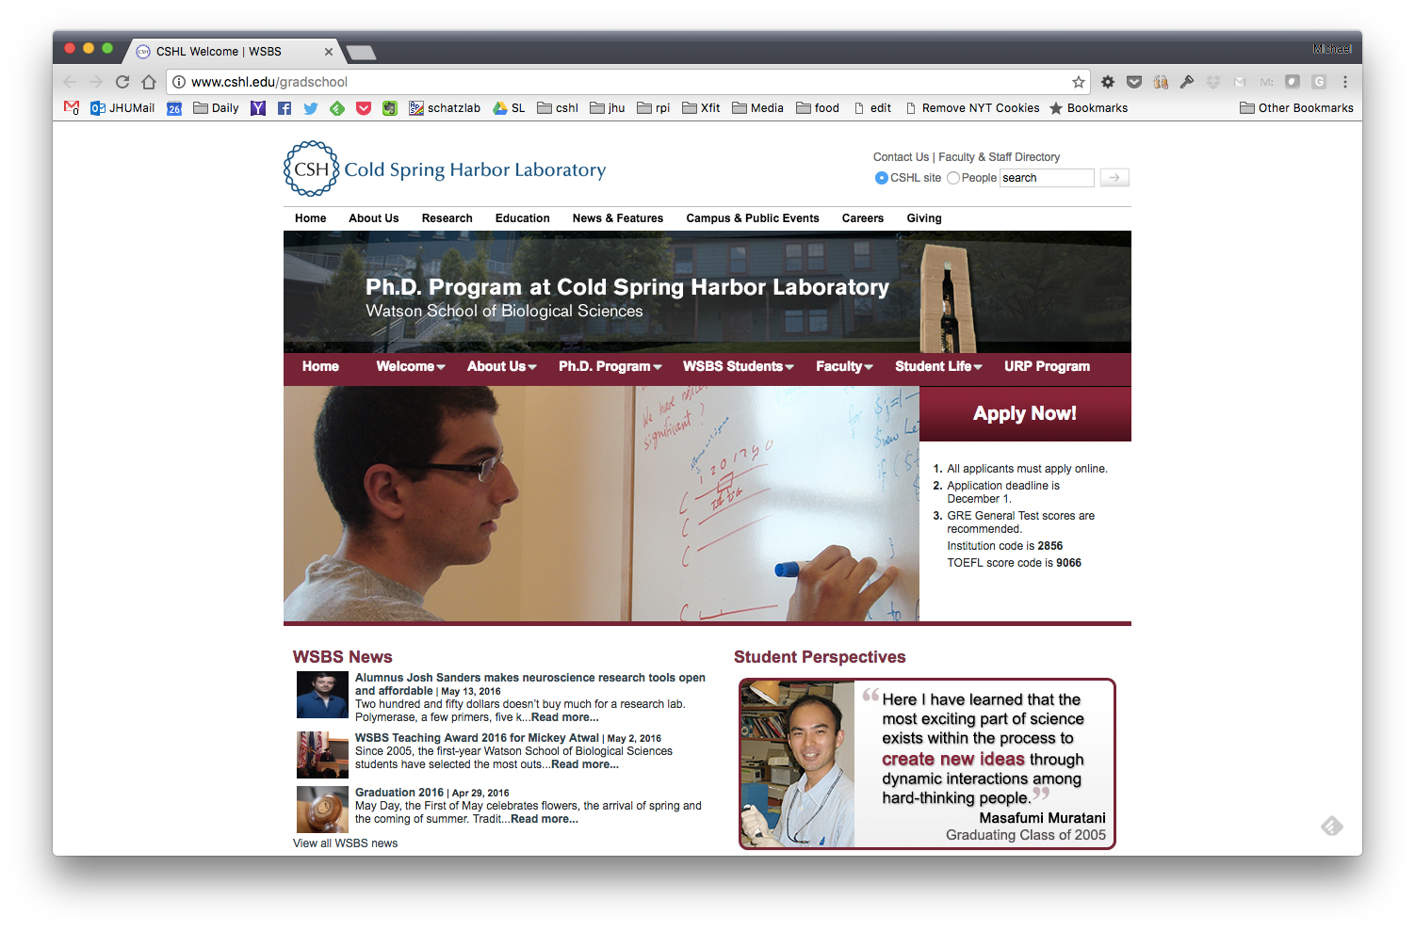

Slide 9
Watson School History
Founded in 1999; First graduates in 2004
Currently 8 to 10 students a year; 60 Ph.D. degrees awarded to date
Everyone is extremely bright and motivated; diverse backgrounds
About 25% currently hold tenure track faculty positions
Very focused and intense

Slide 10
CSHL Watson School Highlights
Our innovative doctoral program includes the following key features:
A broad representation of the biological sciences
Approximately four to five years from matriculation to Ph.D.
Emphasis on the principles of scientific reasoning and logic as well as the importance of ethics and effective communication
Extensive mentoring and support in large part through our "two-tier" mentoring program
A first year with course work and laboratory rotations in separate phases
Continued advanced course instruction throughout the graduate curriculum
http://www.cshl.edu/gradschool/message-from-dean-alexander-gann.html

Slide 11
CSHL Watson School Highlights
Our innovative doctoral program includes the following key features:
A broad representation of the biological sciences
Approximately four to five years from matriculation to Ph.D.
Emphasis on the principles of scientific reasoning and logic as well as the importance of ethics and effective communication
Extensive mentoring and support in large part through our "two-tier" mentoring program
A first year with course work and laboratory rotations in separate phases
Continued advanced course instruction throughout the graduate curriculum
http://www.cshl.edu/gradschool/message-from-dean-alexander-gann.html

Slide 12
CSHL Watson School Curriculum
Core Courses
Scientific Reason and Logic
Scientific Exposition and Ethics
Topics in Biology: Evolution, Physical Biology of the Cell, Immunology…
Specialized Courses: Systems Neuroscience, Genetics & Genomics, Cell Structure & Function, and Quantitative Biology,
QB: Introductory Computer Science, Introductory Statistics & Machine Learning, Introductory Statistical Physics, Bioinformatics and Population Genetics
Bootcamps (including Quantitative Biology)
Advanced Courses
Attend at Columbia, Statistics Summer School, Coursera
http://www.cshl.edu/gradschool/the-first-year.html

Slide 13
http://masterdatascience.science.ubc.ca/ç
Joint venture between the Departments of Statistics & Computer Science at the University of British Columbia (Vancouver, Canada)
First cohort started Sept. 2016
Teaching Data science with modern practices & methods:

Slide 14
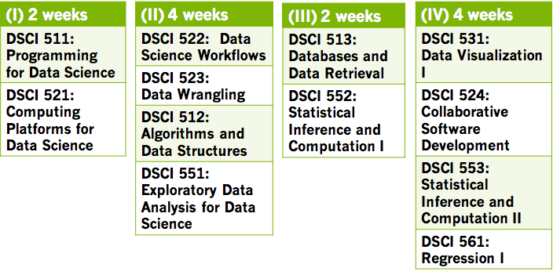
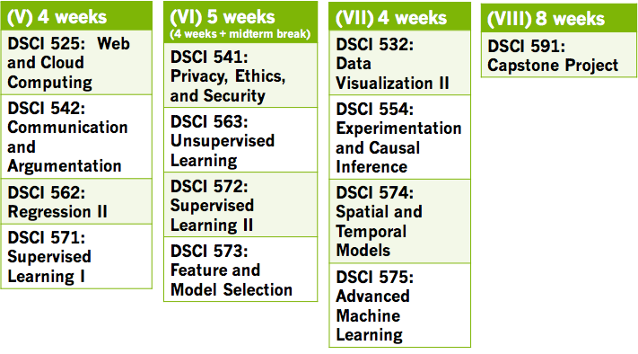
Each course:
8 lectures
4 hands-on labs
assessed via 2 quizzes & 4 assignments
Student support per course:
Instructor
Teaching Fellow
Teaching Assistant
Learning Management Systems:
Github enterprise
Slack
10 month MDS Program
Capstone project:
2 months long
groups of ~4 students
opportunities to work with partners in academia, not-for-profit & industry
https://ubc-mds.github.io/about/ç

Slide 15
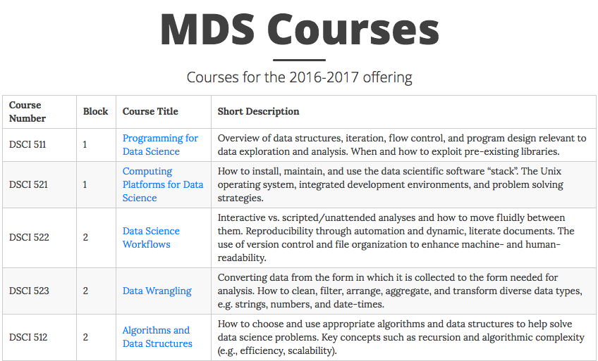
Public course descriptions and learning objectives:
https://ubc-mds.github.io/descriptions/

Slide 16
List of curricular topics in bioinformatics & Qs
https://goo.gl/5CO3QN
Field Definers
Q: What is driving the development of biological data science as a field?
Q: How is biological data science related to other sub-disciplines of data science ?
The Students
Q: What backgrounds do students of this discipline have?
Q: What careers are we preparing for?
Curriculum
Q: Should we have standard curriculum ? What would we put into in?
Q: Does data science include physical modelling?
Q: What are good metaphors for the subject?

