Slide 1

Genomic Privacy & Individualized RNA-seq: Incompatible or Feasible?
Mark Gerstein, Yale
Slides freely
downloadable from Lectures.GersteinLab.org
& “tweetable” (via @markgerstein).
See last slide for more info.
Notes:
1

Slide 2
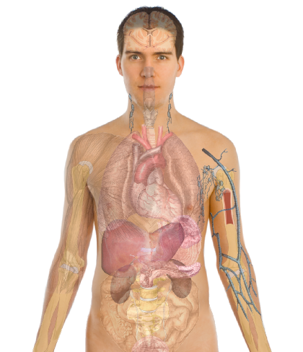
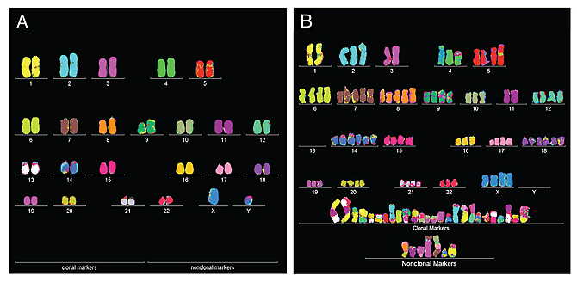
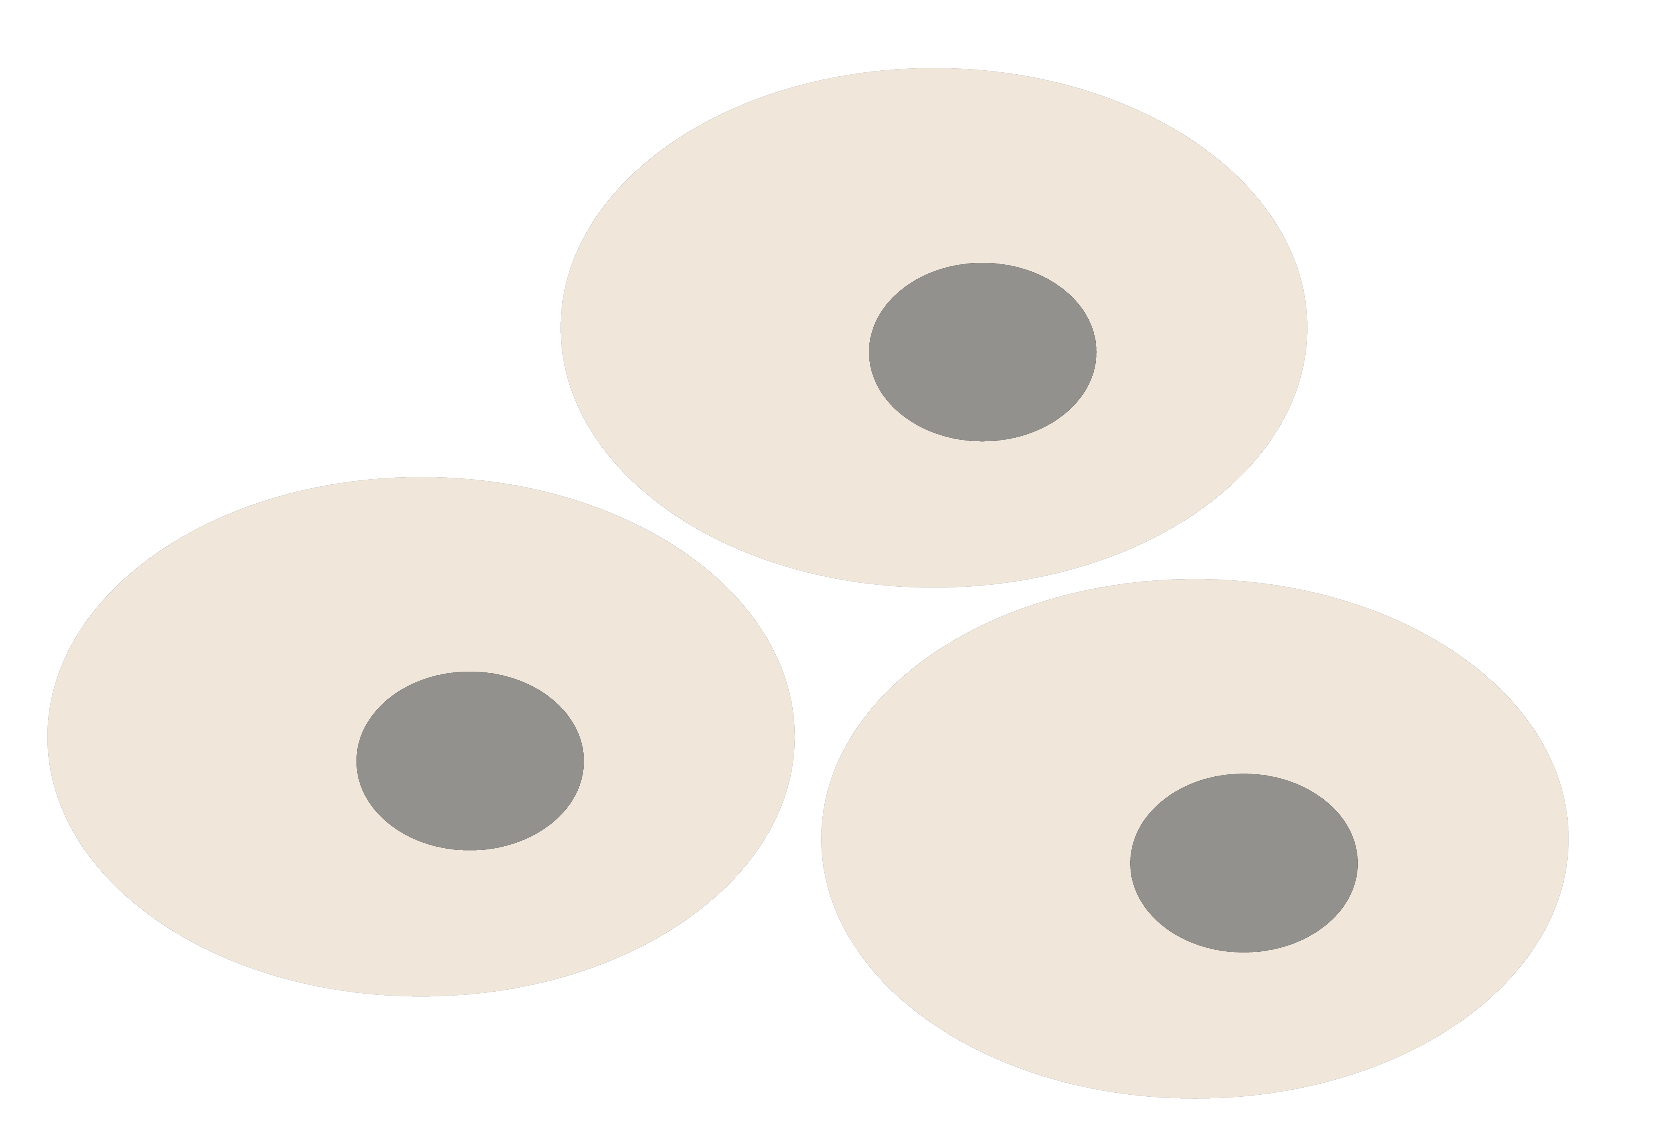
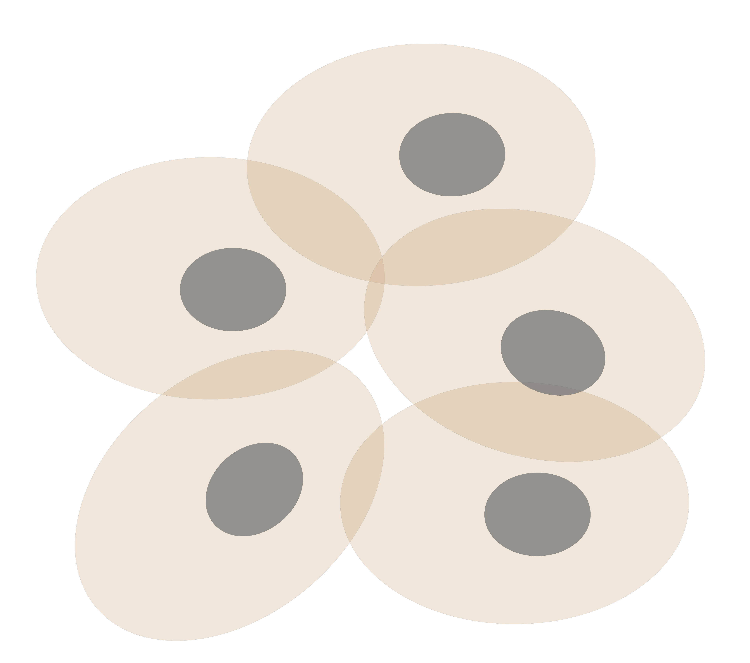
Personal Genomics & Transcriptomics
as a Gateway into Biology
Personal genomes (& Transcriptomes) soon will become a commonplace part of medical research & eventually treatment (esp. for cancer).
They will provide a primary connection for biological science to the general public.
normal
tumor

Slide 3

Placing the individual into the context of the population
&
using the population to build a interpretative model

Slide 4
Genomic Privacy & Individualized RNA-seq: Incompatible or Feasible?
RNA-seq: How to Publicly Share Some of it
  Presents a tricky privacy issue since much of the sequencing is for general, non-individual specific results yet it’s tagged with individual information
  Removing SNVs in reads w/ MRF
  Quantifying & removing variant info from expression levels + eQTLs using ICI & predictability
  Instantiating a practical linking attack using extreme expression levels
Allelic Expression & Binding Activity
  Difference in molecular activity between specific alleles
  RNA-seq calculations that fundamentally involve individual variants
  Aggregating results with AlleleDB to define allelic elements & subnetworks
  Allelic elements tend to be under weaker selection
The General Dilemma of Genomic Privacy
  Fundamental, inherited info that’s very private v need for large-scale mining for med. research
  Issues w/ current social & tech approaches: inconsistencies, burdensome security, various "hacks”
  Strawman Hybrid Soc-Tech Proposal (Cloud Enclaves. Quantifying Leaks & Closely Coupled priv.-public datasets)

Slide 5
Genomic Privacy & Individualized RNA-seq: Incompatible or Feasible?
RNA-seq: How to Publicly Share Some of it
  Presents a tricky privacy issue since much of the sequencing is for general, non-individual specific results yet it’s tagged with individual information
  Removing SNVs in reads w/ MRF
  Quantifying & removing variant info from expression levels + eQTLs using ICI & predictability
  Instantiating a practical linking attack using extreme expression levels
Allelic Expression & Binding Activity
  Difference in molecular activity between specific alleles
  RNA-seq calculations that fundamentally involve individual variants
  Aggregating results with AlleleDB to define allelic elements & subnetworks
  Allelic elements tend to be under weaker selection
The General Dilemma of Genomic Privacy
  Fundamental, inherited info that’s very private v need for large-scale mining for med. research
  Issues w/ current social & tech approaches: inconsistencies, burdensome security, various "hacks”
  Strawman Hybrid Soc-Tech Proposal (Cloud Enclaves. Quantifying Leaks & Closely Coupled priv.-public datasets)

Slide 6


The Conundrum of Genomic Privacy: Is it a Problem?
Yes
Genetic Exceptionalism :
genome is potentially very revealing about one’s identity & characteristics
Most discussion of Identification Risk but what about Characterization Risk?
  Finding you were in study X vs identifying that you have trait Y from studying your identified genome
No
Shifting societal foci
No one really cares
about your genes
You might not care
[Klitzman & Sweeney ('11), J Genet Couns 20:98l; Greenbaum & Gerstein ('09), New Sci. (Sep 23) ]

Slide 7


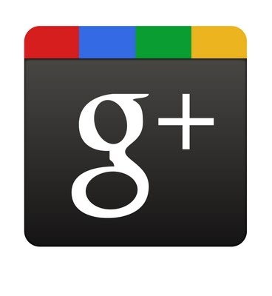









Genomics has similar "Big Data" Dilemma in the Rest of Society
Sharing & "peer-production" is central to success of many new ventures, with the same risks as in genomics
We confront privacy risks every day we access the internet
(...or is the genome more exceptional & fundamental?)
[Seringhaus & Gerstein ('09), Hart. Courant (Jun 5); Greenbaum & Gerstein ('11), NY Times (6 Oct)]

Slide 8

Tricky Privacy Considerations in Personal Genomics
Personal Genomic info. essentially meaningless currently but will it be in 20 yrs? 50 yrs?
  Genomic sequence very revealing about one’s children. Is true consent possible?
  Once put on the web it can’t be taken back
Culture Clash: Genomics historically has been a proponent of “open data” but not clear personal genomics fits this
Ethically challenged history of genetics
Ownership of the data & what consent means (Hela)
  Could your genetic data give rise to a product line?
[D Greenbaum & M Gerstein (’08). Am J. Bioethics; D Greenbaum & M Gerstein, Hartford Courant, 10 Jul. '08 ; SF Chronicle, 2 Nov. '08;
Greenbaum et al. PLOS CB (‘11) ; Greenbaum & Gerstein ('13), The Scientist; Photo from NY Times]

Slide 9

The Other Side of the Coin:
Why we should share
Sharing helps speed research
  Large-scale mining of this information is important for medical research
  Privacy is cumbersome, particularly for big data
Sharing is important for reproducible research
Sharing is useful for education
[Yale Law Roundtable (‘10). Comp. in Sci. & Eng. 12:8; D Greenbaum & M Gerstein (‘09). Am. J. Bioethics; D Greenbaum & M Gerstein (‘10). SF Chronicle, May 2, Page E-4;
Greenbaum et al. PLOS CB (‘11)]

Slide 10

The Dilemma
[Economist, 15 Aug ‘15]
The individual (harmed?) v the collective (benefits)
  But do sick patients care about their privacy?
Quantification
  What is acceptable risk? What is acceptable data leakage? Can we quantify leakage?
    Ex: photos of eye color
  Cost Benefit Analysis: how helpful is identifiable data in genomic research v. potential harm from a breach?
Maybe a we need a few "test pilots” (ala PGP)?
  Sports stars & celebrities?

Slide 11
Current Social & Technical Solutions
Consents
“Protected” distribution of data (dbGAP)
Local computes on secure computer
Issues
  Non-uniformity of consents & paperwork
    Different international norms, leading to confusion
  Encryption & computer security creates burdensome requirements on data sharing & large scale analysis
  Many schemes get “hacked”
[Greenbuam et al ('04), Nat. Biotech; Greenbaum & Gerstein ('13), The Scientist]

Slide 12
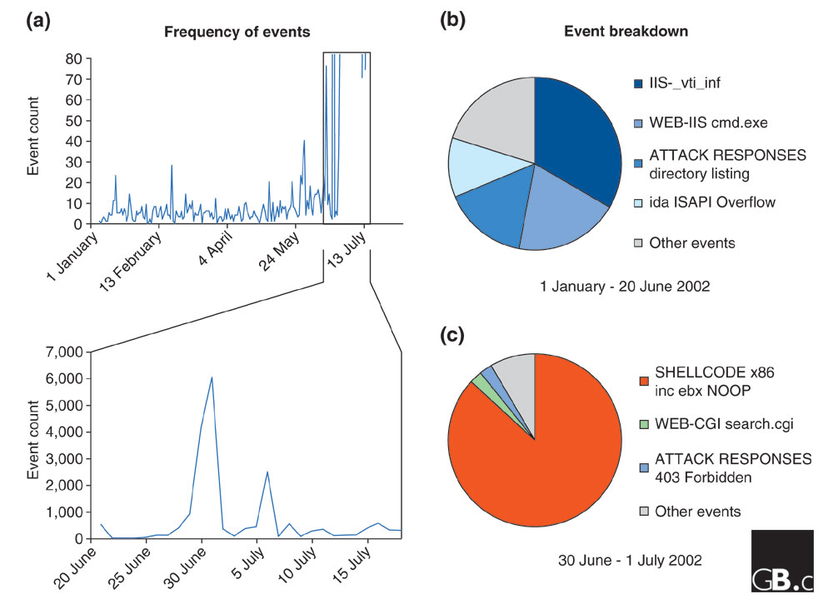
Difficulty in Securing Computers & Data
[Smith et al ('05), Genome Bio]

Slide 13
Genomic Privacy Hacks,
Mostly Focusing on Identification
Early genomic studies were based on small cohorts
  Individuals give consent to participate but request anonymity
    HAPMAP, PGP, 1000 Genomes…
  Focus on hiding the participation of individuals
  Attacks aimed at detecting whether an individual with known genotypes participated a study
    “Detection of genomes in a mixture” (Homer et al 2008, Im et al 2012)
As more people are genotyped, more individuals are in large private genomic databases
  Detection of an individual is irrelevant, as their participation is already known
    Current EX: “An individual’s genomic/phenotypic data is most certainly stored in their hospital”
    Future: >1M people’s health information is part of a NIH/PMI or NHS databases
Identification attacks now focus on pinpointing individuals by cross-referencing large seemingly independent datasets
  Illustrates that a leaked/hacker/stolen dataset, even when anonymized, can leak information
  Sweeney et al 2013, Gymrek et al 2013
Gymrek et al, “Identifying Personal Genomes by Surname Inference” (2013)
Homer et al, “Resolving individuals contributing trace amounts of DNA to highly complex mixtures using high-density SNP genotyping microarrays.” (2008)
Im et al, “On Sharing Quantitative Trait GWAS Results in an Era of Multiple-omics Data and the Limits of Genomic Privacy” (2012)
Sweeney et al, “Identifying Participants in the Personal Genome Project by Name” (2013)

Slide 14

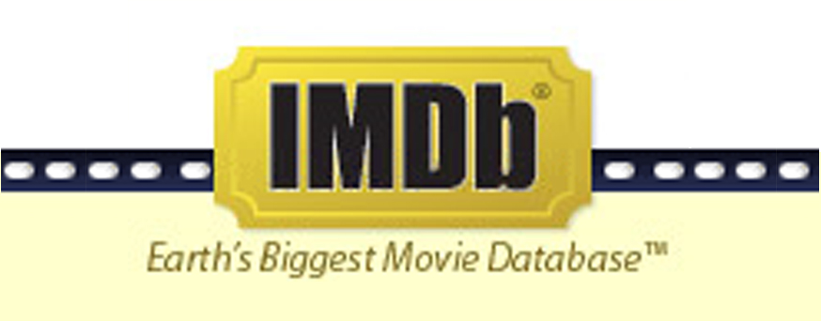
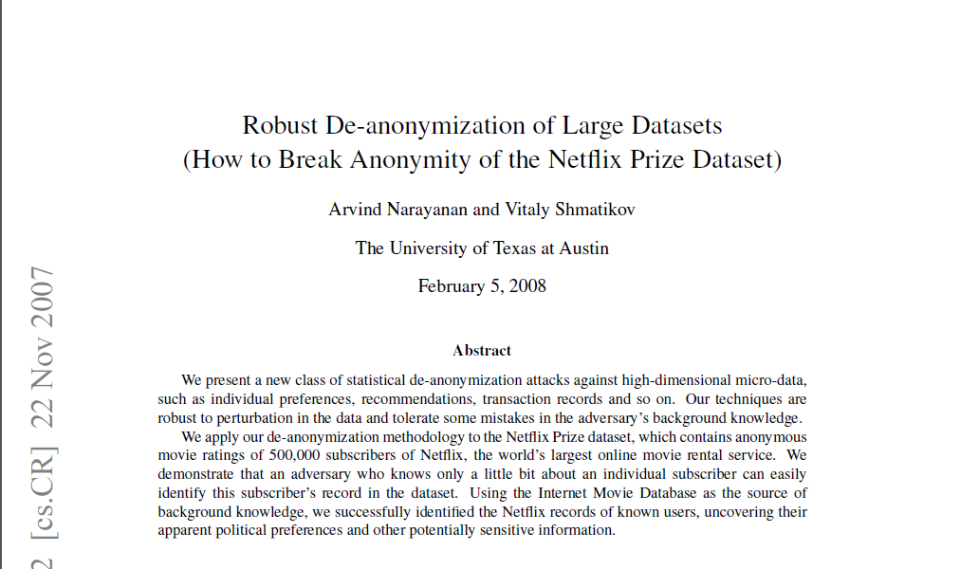
NetFlix challenge as an example of a “Linking Attack”,
characterizing already identified individuals in IMDB,
with their (previously hidden) movie viewing habits
Cross correlated small set of identifiable IMDB rating records with large set of “anonymized” Netflix customer ratings, which were being used for a Machine Learning competition

Slide 15
Strawman Hybrid Social & Tech Proposed Solution?
Fundamentally, researchers have to keep genetic secrets
  Genetic Licensure & training for individuals
  (similar to medical license, drivers license)
Technology to make things easier
  Cloud computing & enclaves (eg solution of Genomics England)
Technological barriers shouldn't create a social incentive for “hacking”
Quantifying Leakage & allowing a small amounts of it
Careful separation & coupling of private & public data
  Lightweight, freely accessible secondary datasets coupled to underlying variants
  Selection of stub & "test pilot" datasets for benchmarking
  Develop programs on public stubs on your laptop, then move the program to the cloud for private production run
[D Greenbaum, M Gerstein (‘11). Am J Bioeth 11:39. Greenbaum & Gerstein, The Scientist ('13)]

Slide 16
Genomic Privacy & Individualized RNA-seq: Incompatible or Feasible?
RNA-seq: How to Publicly Share Some of it
  Presents a tricky privacy issue since much of the sequencing is for general non-individual specific results yet it’s tagged with individual information
  Removing SNVs in reads w/ MRF
  Quantifying & removing variant info from expression levels + eQTLs using ICI & predictability
  Instantiating a practical linking attack using extreme expression levels
Allelic Expression & Binding Activity
  Difference in molecular activity between specific alleles
  RNA-seq calculations that fundamentally involve individual variants
  Aggregating results with AlleleDB to define allelic elements & subnetworks
  Allelic elements tend to be under weaker selection
The General Dilemma of Genomic Privacy
  Fundamental, inherited info that’s very private v need for large-scale mining for med. research
  Issues w/ current social & tech approaches: inconsistencies, burdensome security, various "hacks”
  Strawman Hybrid Soc-Tech Proposal (Cloud Enclaves. Quantifying Leaks & Closely Coupled priv.-public datasets)

Slide 17
Large-scale RNA
Recent advent of much large scale RNA-seq (& other functional genomics data) following on DNA sequencing
Often this is of human subjects & produced by large consortia (eg TCGA, PCAWG, GTEx) and needs to be protected
Useful to build tools & approaches that interact with these data

Slide 18

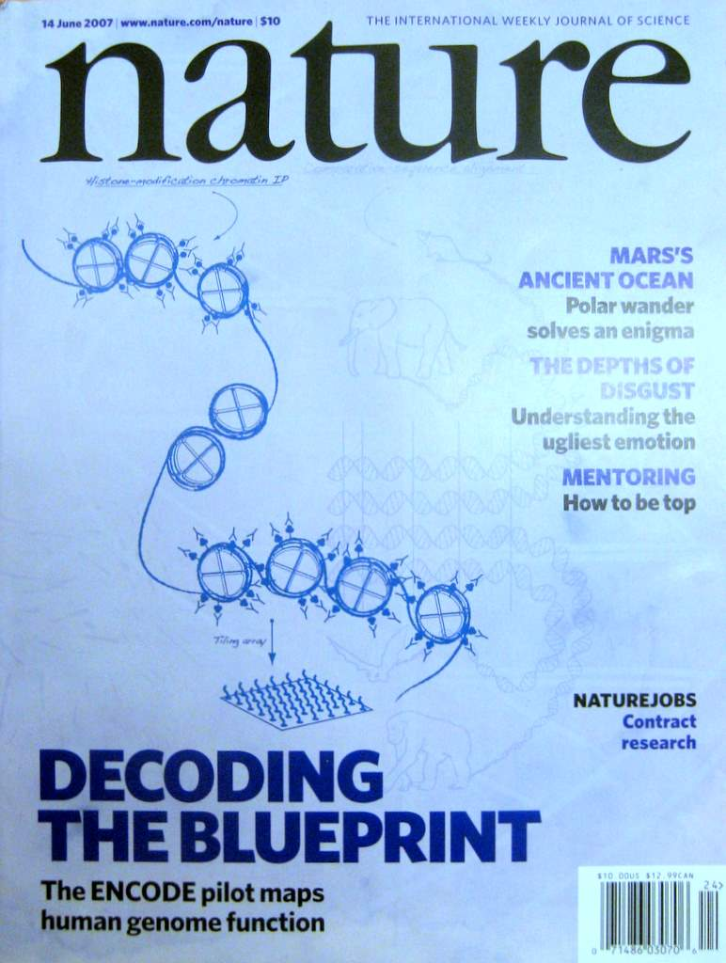
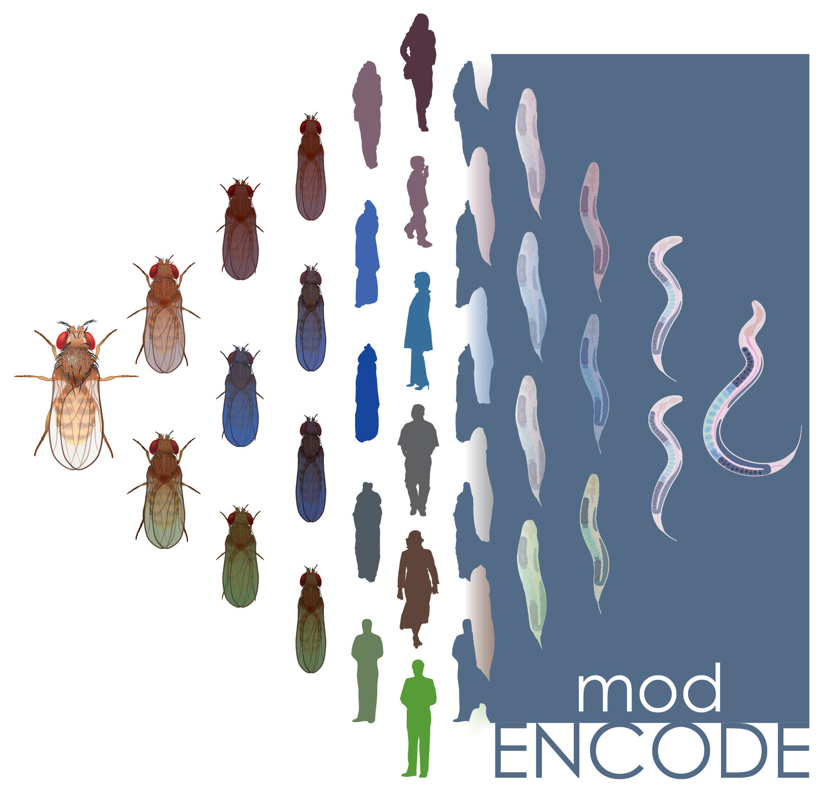

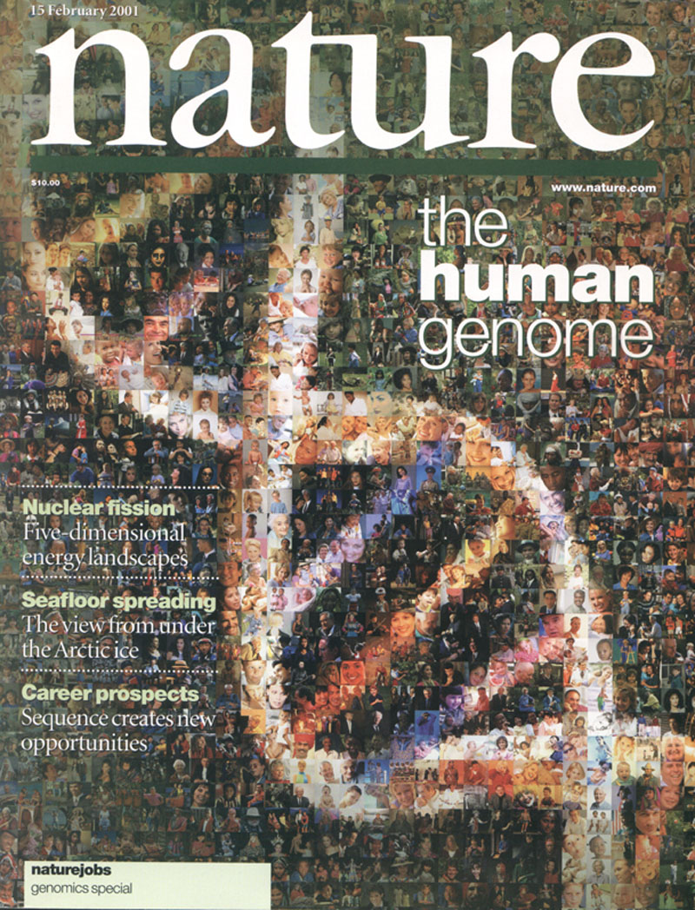



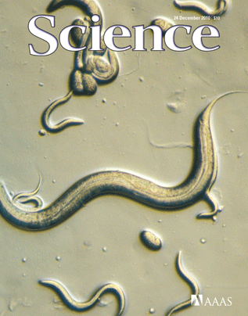

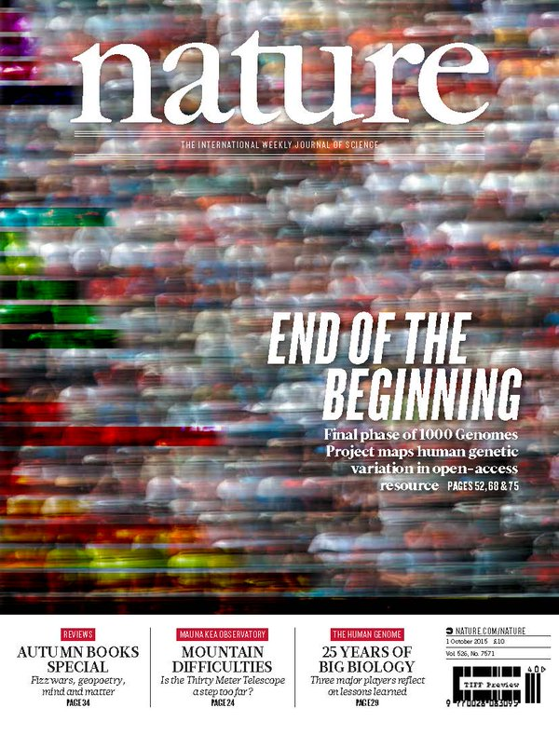

The Human
Genome Project
ENCODE
Pilot
ENCODE
Production
Comparative
ENCODE
Epigenome
Roadmap
2000
2005
2010
2015
Worm
Genome
modENCODE
1000 Genomes
Pilot
1000 Genomes
Phase 3
GTEx

Slide 19

2-side nature of functional genomics data: Analysis can be very General/Public or Individual/Private
General quantifications related to overall aspects of a condition & are not tied to an individual’s genotype - ie what genes go up in cancer
  However, data is derived from an individual & tagged with an individual’s genotype
Other calculations aim to use genotype & specific aspects of the quantification to derive general relations related to sequence variation & gene expression
Some calculations and data derive finding very specific to the variants in a particular individual

Slide 20

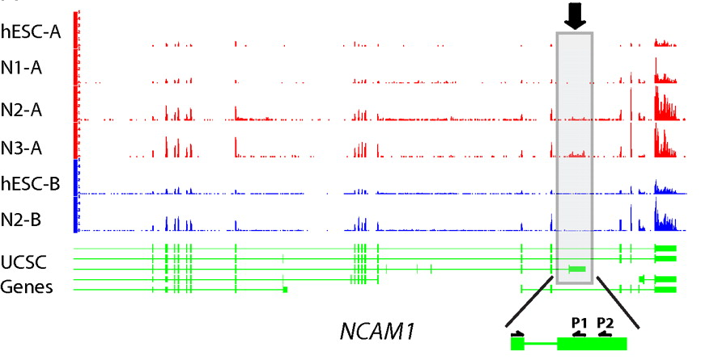
RNA-seq
RNA-seq uses next-generation sequencing technologies to reveal RNA presence and quantity within a biological sample.
ATACAAGCAAGTATAAGTTCGTATGCCGTCTT
GGAGGCTGGAGTTGGGGACGTATGCGGCATAG
TACCGATCGAGTCGACTGTAAACGTAGGCATA
ATTCTGACTGGTGTCATGCTGATGTACTTAAA
Reads (fasta)
－ Quality scores (fastq)
－ Mapping (BAM)
－ Contain variant information in transcribed regions
Quantitative information from RNA-seq signal: average signals at exon level (RPKMs)
Reads => Signal
[PLOS CB 4:e1000158; PNAS 4:107: 5254 ; IJC 123:569 ]

Slide 21
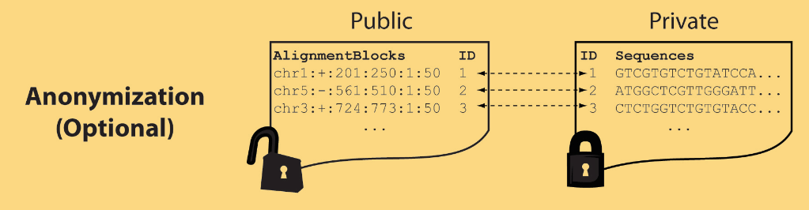
Light-weight formats
Some lightweight format clearly separate public & private info., aiding exchange
Files become much smaller
Distinction between formats to compute on and those to archive with – become sharper with big data
Reads
(linked via ID,
10X larger than
mapping coord.)
Mapping coordinates without variants (MRF)
[Bioinformatics 27: 281]

Slide 22
MRF Examples
chr2:+:601:630:1:30,chr2:+:921:940:31:50
TS
TE
TS
TE
Reference
AlignmentBlock 1
AlignmentBlock 2
Reference based compression
(ie CRAM)
is similar but it stores actual variant beyond just position of alignment block
Splice junction Read
QS
QE/QS
QE
Legend: TS = TargetStart, TE = TargetEnd, QS = QueryStart, QE = QueryEnd
chr9:+:431:480:1:50|chr9:+:945:994:1:50
TS
TE
TS
TE
Reference
AlignmentBlock 1
AlignmentBlock 2
Paired-end Read
QS
QE
QS
QE
Legend: TS = TargetStart, TE = TargetEnd, QS = QueryStart, QE = QueryEnd
[Habegger et al., Bioinformatics (‘11)]

Slide 23


eQTL Mapping Using RNA-Seq Data
eQTLs are genomic loci that contribute to variation in mRNA expression levels
eQTLs provide insights on transcription regulation, and the molecular basis of phenotypic outcomes
eQTL mapping can be done with RNA-Seq data
[Biometrics 68(1) 1–11]
Notes:
A diagram to illustrate the RNA‐seq count variation of one gene due to an cis‐eQTL. (a) RNA‐seq measurements of a hypothetic gene with two exons in three diploid individuals. The target SNP which we test for association has the genotype CT, CC, and TT for the three individuals. There is an SNP on the first exon, which has genotype AT, AT, and AA for the three individuals. ASE can be measured by those sequence reads that overlap with a heterozygous exonic SNP. Therefore we can measure ASE for individuals (i) and (ii). However, association testing by ASE is only possible if the target SNP is heterozygous, thus only individual (i) can be used to test for eQTL by ASE (b) ASE measurements for individual (i). (c) TReC measured for the three individuals across the two exons of this gene.
© IF THIS IMAGE HAS BEEN PROVIDED BY OR IS OWNED BY A THIRD PARTY, AS INDICATED IN THE CAPTION LINE, THEN FURTHER PERMISSION MAY BE NEEDED BEFORE ANY FURTHER USE. PLEASE CONTACT WILEY'S PERMISSIONS DEPARTMENT ON PERMISSIONS@WILEY.COM OR USE THE RIGHTSLINK SERVICE BY CLICKING ON THE 'REQUEST PERMISSION' LINK ACCOMPANYING THIS ARTICLE. WILEY OR AUTHOR OWNED IMAGES MAY BE USED FOR NON-COMMERCIAL PURPOSES, SUBJECT TO PROPER CITATION OF THE ARTICLE, AUTHOR, AND PUBLISHER.

Slide 24
Information Content and Predictability
[Harmanciet al. Nat. Meth. (in revision)]

Slide 25


Representative Expression, Genotype, eQTL Datasets
Genotypes are available from the 1000 Genomes Project
mRNA sequencing for 462 individuals
  Publicly available quantification for protein coding genes
Approximately 3,000 cis-eQTL (FDR<0.05)

Slide 26

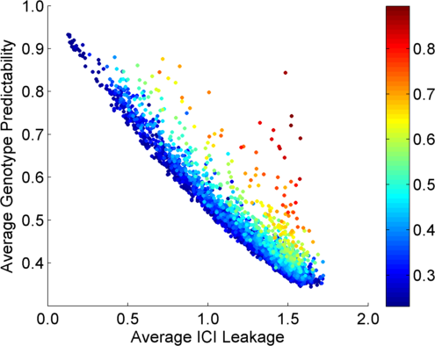
Per eQTL and ICI Cumulative Leakage versus Genotype Predictability
Colors by absolute correlation
Absolute Correlation
[Harmanciet al. Nat. Meth. (in revision)]

Slide 27
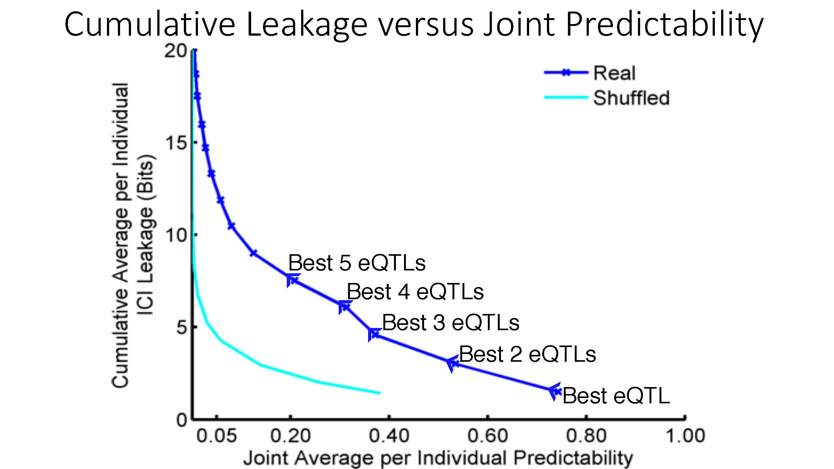
Cumulative Leakage versus Joint Predictability
[Harmanciet al. Nat. Meth. (in revision)]

Slide 28

Linking Attack Scenario
[Harmanciet al. Nat. Meth. (in revision)]

Slide 29
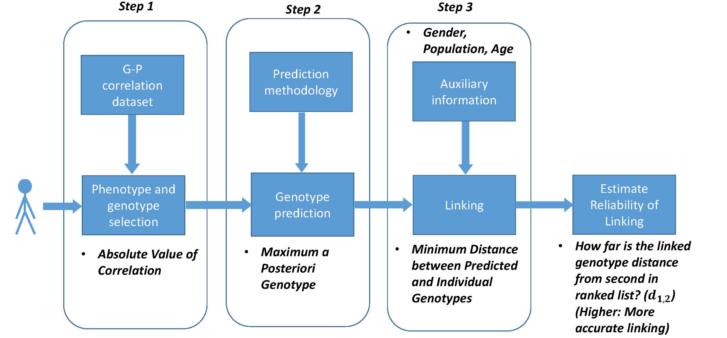
Steps in Instantiation of a (Mock) Linking Attack
[Harmanciet al. Nat. Meth. (in revision)]

Slide 30
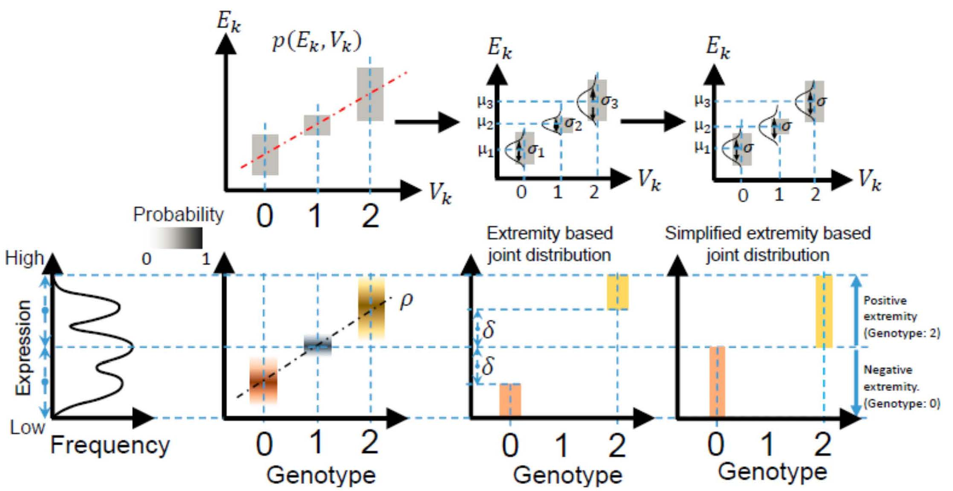
Levels of Expression-Genotype Model Simplifications
[Harmanciet al. Nat. Meth. (in revision)]

Slide 31
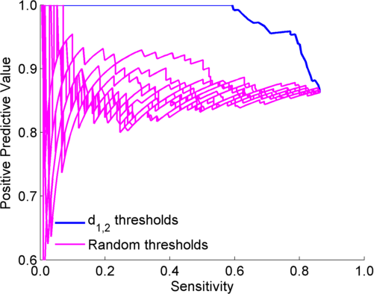
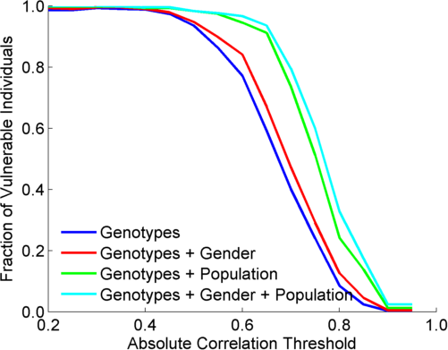
Extremity based linking with
homozygous genotypes
Attacker can estimate the
reliability of linkings
Sensitivity: Fraction of correctly linked
Individuals among all individuals
PPV: Fraction of correctly linked individuals
among selected individuals
[Harmanciet al. Nat. Meth. (in revision)]

Slide 32
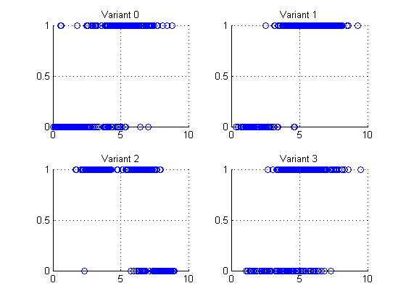
Small Data Leakage from just Gene Expression Data:
4 eQTL-SNP genotypes
Expression levels are outliers and are predictive of the genotype!
Example: Vulnerable sample variants, expressions
Variant 0 (1, 6)
Variant 1 (0, 2)
Variant 2 (1, 3)
Variant 3 (0, 2)
Genotype (0,1)
Log RPKM of overlapping gene

Slide 33
Genomic Privacy & Individualized RNA-seq: Incompatible or Feasible?
RNA-seq: How to Publicly Share Some of it
  Presents a tricky privacy issue since much of the sequencing is for general non-individual specific results yet it’s tagged with individual information
  Removing SNVs in reads w/ MRF
  Quantifying & removing variant info from expression levels + eQTLs using ICI & predictability
  Instantiating a practical linking attack using extreme expression levels
Allelic Expression & Binding Activity
  Difference in molecular activity between specific alleles
  RNA-seq calculations that fundamentally involve individual variants
  Aggregating results with AlleleDB to define allelic elements & subnetworks
  Allelic elements tend to be under weaker selection
The General Dilemma of Genomic Privacy
  Fundamental, inherited info that’s very private v need for large-scale mining for med. research
  Issues w/ current social & tech approaches: inconsistencies, burdensome security, various "hacks”
  Strawman Hybrid Soc-Tech Proposal (Cloud Enclaves. Quantifying Leaks & Closely Coupled priv.-public datasets)

Slide 34
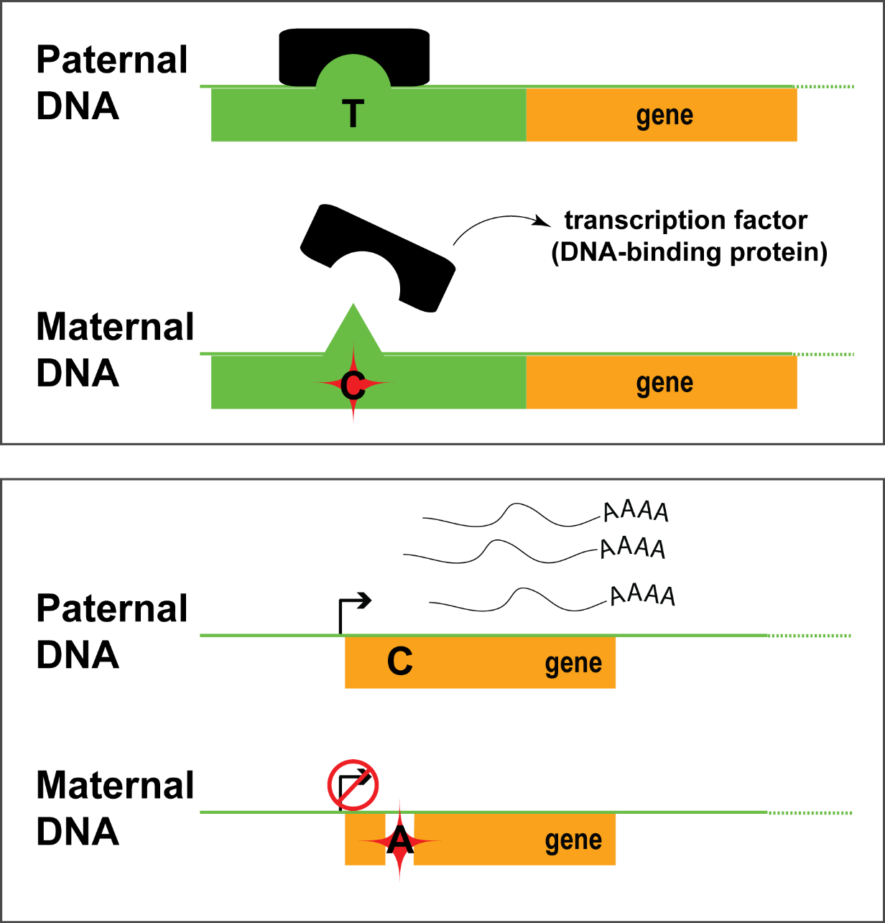
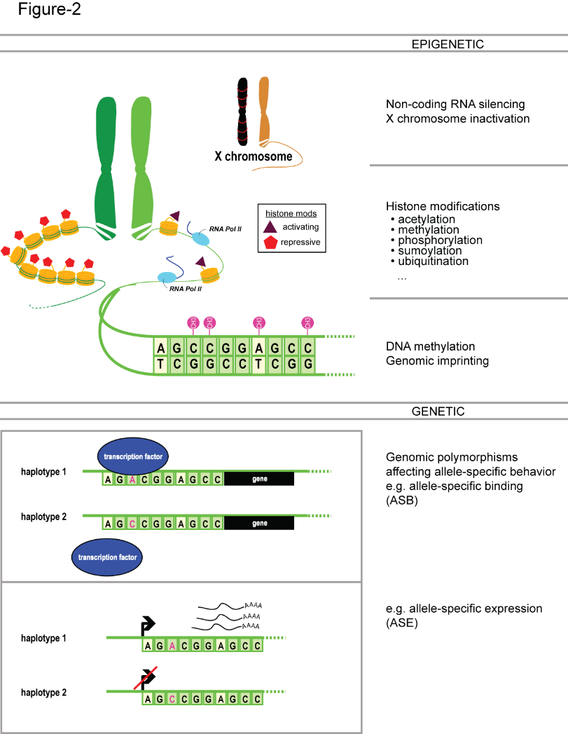
Allele-specific binding and expression
variants

Slide 35



Inferring Allele Specific Binding/Expression using Sequence Reads
RNA/ChIP-Seq Reads
ACTTTGATAGCGTCAATG
CTTTGATAGCGTCAATGC
CTTTGATAGCGTCAACGC
TTGACAGCGTCAATGCAC
TGATAGCGTCAATGCACG
ATAGCGTCAATGCACGTC
TAGCGTCAATGCACGTCG
CGTCAACGCACGTCGGGA
GTCAATGCACGTCGAGAG
CAATGCACGTCGGGAGTT
AATGCACGTCGGGAGTTG
TGCACGTTGGGAGTTGGC
10 x T
2 x C
…AACGC…
TF
…AATGC…
Haplotypes with a
Heterozygous Polymorphism
Interplay of the annotation and individual sequence variants
Does not format to std. theme

Slide 36
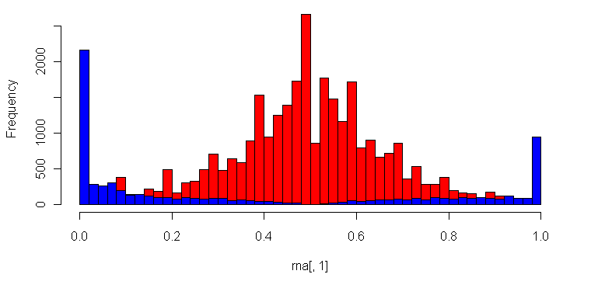
Many Technical Issues in Determining ASE/ASB:
Reference Bias
(naïve alignment against reference)
ASE/ASB Example:
…GTCAATGCAC
…GTCAATGCACG
…GTCAATGCACGTC
…GTCAATGCACGTCG
…GTCAACGCACGTCGGGA
GTCAATGCACGTCGAGAG
CAATGCACGTCGGGAGTT
AATGCACGTCGGGAGTTG
Null Example:
ACTTTGATAGCGTCAATG
CTTTGATAGCGTCAACGC
TTGACAGCGTCAATGCAC
ATAGCGTCAATGCACGT…
TAGCGTCAACGCACGT…
CGTCAACGCACGT…
CAATGCACGT…
AATGCACGT…
Allele-Specific SNPs
Binomial Null Distribution
(no allele-specific behavior)
Reference Allele
Alternate Allele
Fraction of Reads Mapping to Alternative Allele
[Rozowsky et al., MSB (‘11)]
Notes:
Alternative allele/Reference allele

Slide 37
Figure 1a
Construction of a Personal Diploid Genome & Transcriptome
[alleleseq.gersteinlab.org]
[Rozowsky et al., MSB ('11)]
Notes:
Construction of personal genome by vcf2diplod tool is made by incorporating personal variants into the reference genome. Personal variants may require addition pre-processing, i.e., filtering, genotyping, and/or phasing. The output is the two (paternal and maternal) haplotypes of personal genome. During the construction step the reference genome is represented as an array of nucleotides with each cell representing a single base. Iteratively the nucleotides in the array are being modified to reflect personal variations. Once all variation have been applied a personal haplotype is constructed by reading though the array. Simultaneously, equivalence map (MAP-file) between personal haplotypes and reference genome is being constructed.

Slide 38
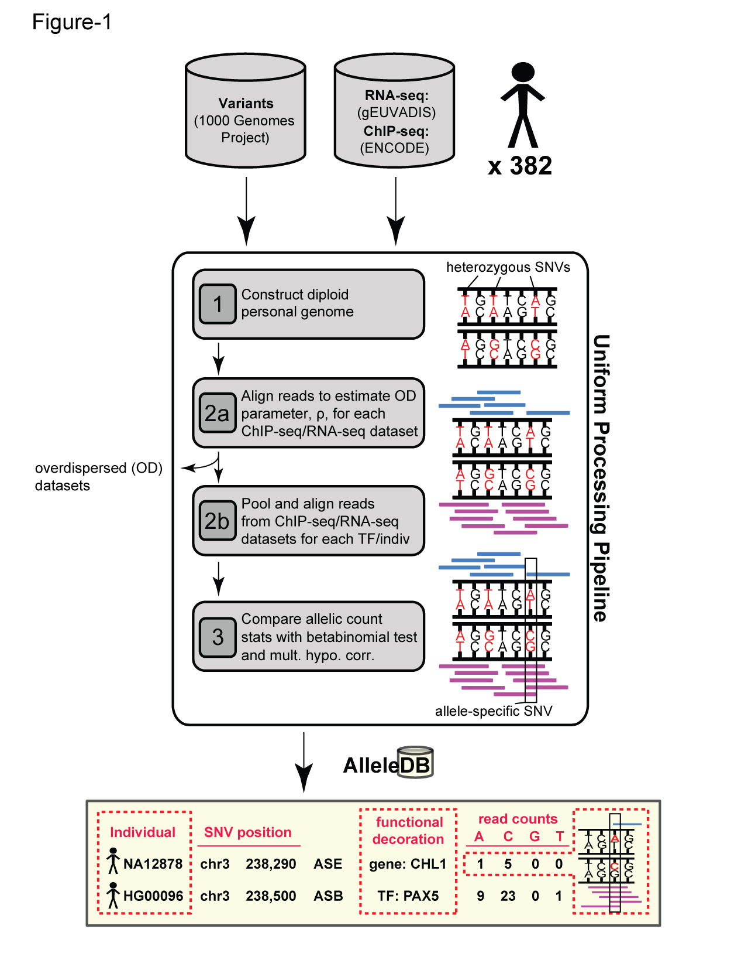
AlleleDB: Building 382 personal genomes to detect allele-specific variants on a large-scale
Build personal genomes
Align ChIP-seq & RNA-seq reads
Detect allele-specific variants
via a series of filters and tests
Many Technical Issues: Reference bias, Ambiguous mapping bias, Over-dispersed (non binomial null)
alleledb.gersteinlab.org
Chen J. et al. (Nature Commun, ‘16)

Slide 39
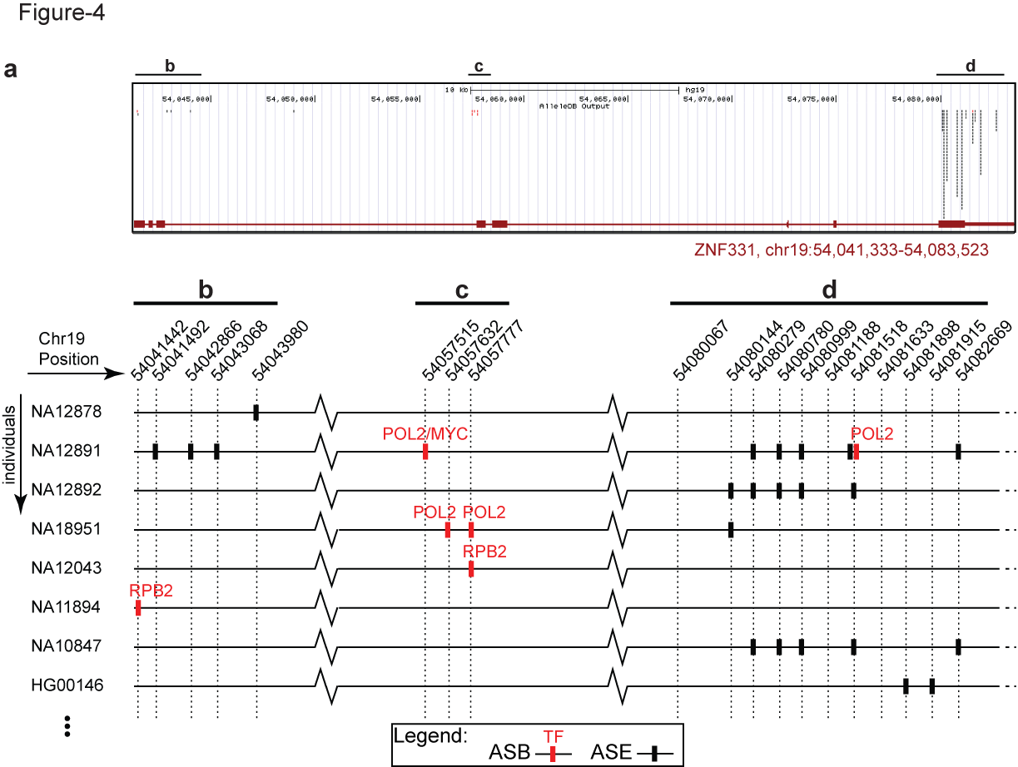
AlleleDB: Annotating rare & common allele-specific variants over a population
Interfaces with UCSC genome browser
Showing ZNF331 gene structure
AlleleDB output
UCSC track
alleledb.gersteinlab.org
Chen J. et al. (Nature Commun, in press)

Slide 40
AlleleDB: Annotating rare & common allele-specific variants over a population
Interfaces with UCSC genome browser
Showing ZNF331 gene structure
AlleleDB output
UCSC track
Allele-specific binding variants
Allele-specific expression variants
Chen J. et al. (Nature Commun, ‘16)

Slide 41



Collecting ASE/ASB variants into allele-specific genomic regions
Does a particular genomic element have a higher tendency to be allele-specific? Fisher’s exact test, for the enrichment of allele-specific variants in the element (with respect to non-allele-specific variants that could potentially be called as allelic)
allele-specific
non-allele-specific
Human reference
genome
alleledb.gersteinlab.org
Chen J. et al. (Nature Commun,’16)
Does not format to std. theme

Slide 42
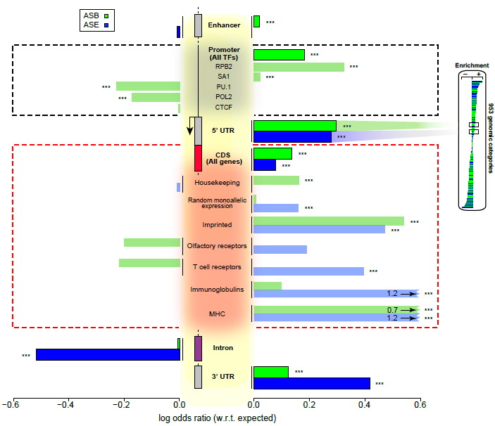
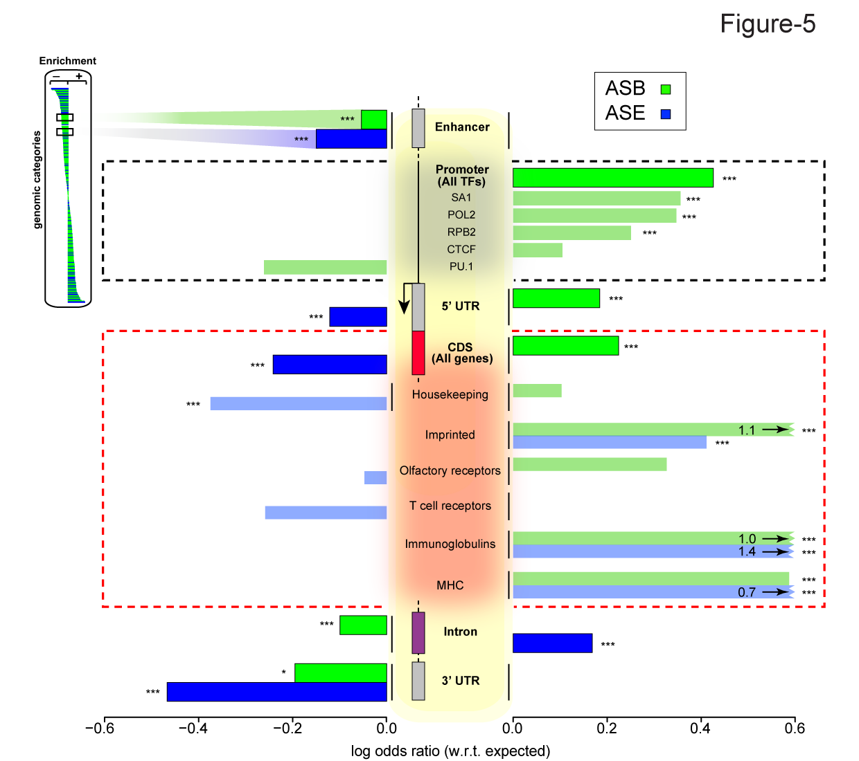
Groups of elements that are enriched or depleted in allelic activity
Chen J. et al. (Nature Commun, ’16)

Slide 43
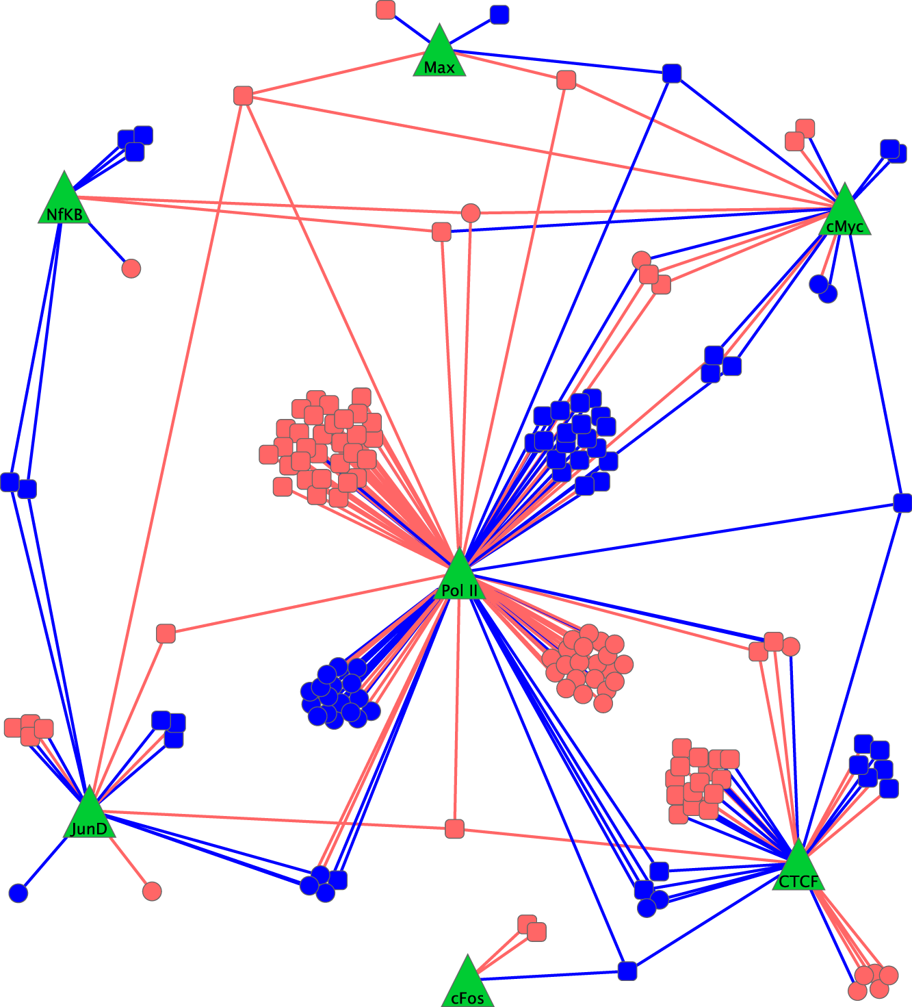
Allele-Specific Behavior in the Regulatory Network
In GM12878, determine ASB for ~50 TFs & ASE using RNA-Seq
  ~20% of expressed genes show ASE
  ~10% of binding sites show ASB
GM12878 Allele-Specific "Difference" Network
  Just proximal edges with ASB
  Just target nodes with ASE
[ Rozowsky et al. MSB ('11) ]

Slide 44
Maternal & Paternal Personal Regulatory Networks: combinatorial coordination of ASE & ASB
[ Rozowsky et al. MSB ('11) ]

Slide 45
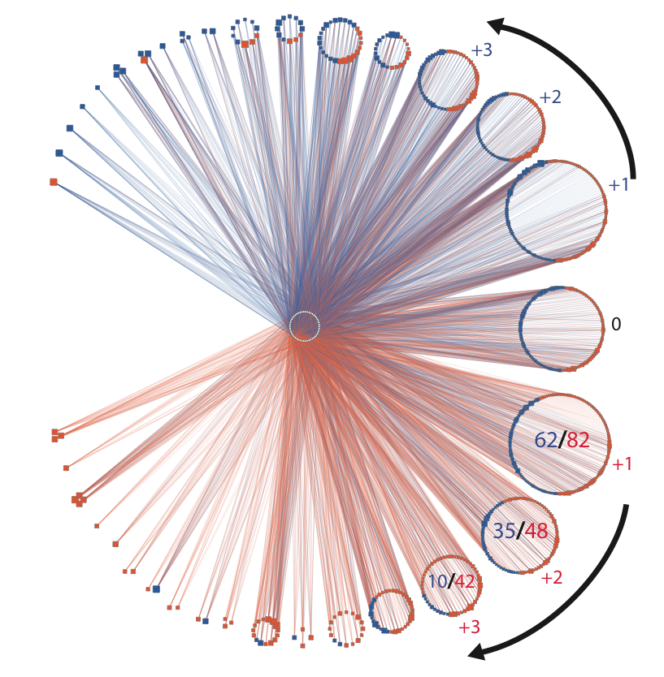
Maternal & Paternal Personal Regulatory Networks: combinatorial coordination of ASE & ASB
[ Rozowsky et al. MSB ('11) ]

Slide 46
(from 1000G pilot & phase I)
More "allelic" components under weaker selection
[ Gerstein et al. Nature ('12) ]

Slide 47
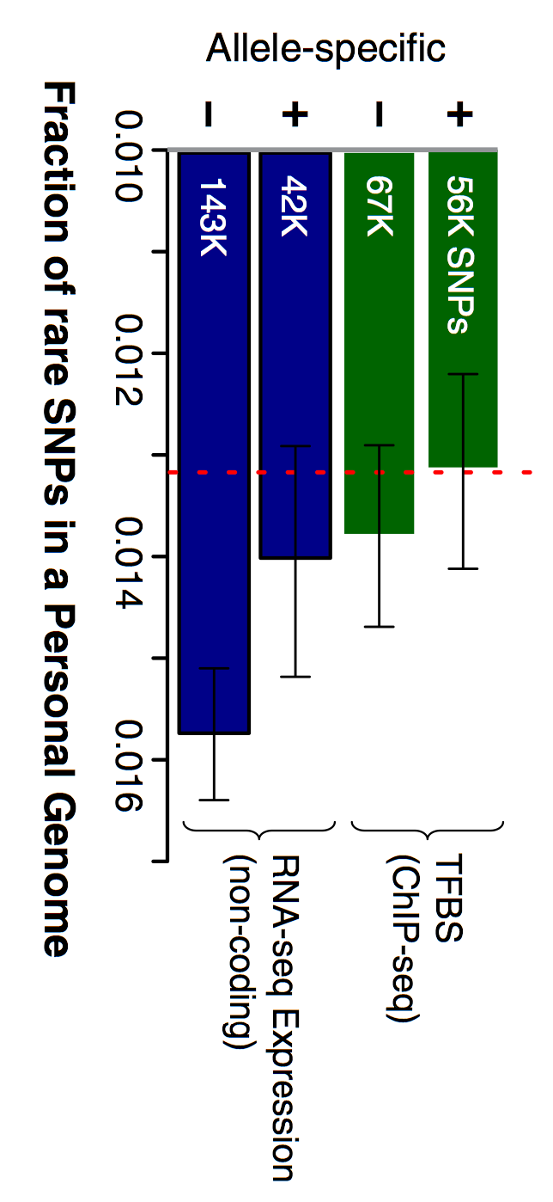
(from 1000G pilot & phase I)
More "allelic" components under weaker selection
[ Khurana et al. Science ('13) ]
[ Gerstein et al. Nature ('12) ]

Slide 48
Genomic Privacy & Individualized RNA-seq: Incompatible or Feasible?
RNA-seq: How to Publicly Share Some of it
  Presents a tricky privacy issue since much of the sequencing is for general, non-individual specific results yet it’s tagged with individual information
  Removing SNVs in reads w/ MRF
  Quantifying & removing variant info from expression levels + eQTLs using ICI & predictability
  Instantiating a practical linking attack using extreme expression levels
Allelic Expression & Binding Activity
  Difference in molecular activity between specific alleles
  RNA-seq calculations that fundamentally involve individual variants
  Aggregating results with AlleleDB to define allelic elements & subnetworks
  Allelic elements tend to be under weaker selection
The General Dilemma of Genomic Privacy
  Fundamental, inherited info that’s very private v need for large-scale mining for med. research
  Issues w/ current social & tech approaches: inconsistencies, burdensome security, various "hacks”
  Strawman Hybrid Soc-Tech Proposal (Cloud Enclaves. Quantifying Leaks & Closely Coupled priv.-public datasets)

Slide 49
Genomic Privacy & Individualized RNA-seq: Incompatible or Feasible?
RNA-seq: How to Publicly Share Some of it
  Presents a tricky privacy issue since much of the sequencing is for general, non-individual specific results yet it’s tagged with individual information
  Removing SNVs in reads w/ MRF
  Quantifying & removing variant info from expression levels + eQTLs using ICI & predictability
  Instantiating a practical linking attack using extreme expression levels
Allelic Expression & Binding Activity
  Difference in molecular activity between specific alleles
  RNA-seq calculations that fundamentally involve individual variants
  Aggregating results with AlleleDB to define allelic elements & subnetworks
  Allelic elements tend to be under weaker selection
The General Dilemma of Genomic Privacy
  Fundamental, inherited info that’s very private v need for large-scale mining for med. research
  Issues w/ current social & tech approaches: inconsistencies, burdensome security, various "hacks”
  Strawman Hybrid Soc-Tech Proposal (Cloud Enclaves. Quantifying Leaks & Closely Coupled priv.-public datasets)

Slide 50

papers.gersteinlab.org/subject/privacy - D Greenbaum
PrivaSeq.gersteinlab.org - A Harmanci
RSEQtools.gersteinlab.org [MRF]
L Habegger, A Sboner,
TA Gianoulis, J Rozowsky, A Agarwal, M Snyder
AlleleDB.gersteinlab.org
J Chen, J Rozowsky,
T Galeev, A Harmanci,
R Kitchen, J Bedford,
A Abyzov, Y Kong, L Regan
AlleleSeq.gersteinlab.org
J Rozowsky,
A Abyzov,
J Wang, P Alves, D Raha,
A Harmanci, J Leng,
R Bjornson,
Y Kong,
N Kitabayashi,
N Bhardwaj,
M Rubin,
M Snyder
Acknowledgements
Hiring Postdocs. See gersteinlab.org/jobs !

Slide 51
Default Theme
Default Outline Level 1
  Level 2

Slide 52
More Information on this Talk
SUBJECT: Networks
DESCRIPTION:
NOTES:
This PPT should work on mac & PC. Paper references in the talk were mostly from Papers.GersteinLab.org.
PERMISSIONS: This Presentation is copyright Mark Gerstein, Yale University, 2010. Please read permissions statement at http://www.gersteinlab.org/misc/permissions.html . Feel free to use images in the talk with PROPER acknowledgement (via citation to relevant papers or link to gersteinlab.org).
PHOTOS & IMAGES. For thoughts on the source and permissions of many of the photos and clipped images in this presentation see http://streams.gerstein.info . In particular, many of the images have particular EXIF tags, such as kwpotppt , that can be easily queried from flickr, viz: http://www.flickr.com/photos/mbgmbg/tags/kwpotppt .
Notes:
52

