Slide 1
Thoughts on
PsychENCODE joint data analysis
Mark Gerstein

Slide 2
Broad Aims of PsychENCODE data analysis
(based on the gdoc)
Establish uniform data processing pipelines
Characterize Functional Genomics Data from Normal Brains
  Comparison with non-brain specific resources (GTEx, ENCODE, Roadmap)
    Discover brain specific spliced transcripts and enhancers
  Enlarged group of eQTLs
  Characterization of Brain Development
Conduct integrative analysis to discover functional genomic elements and genotypes associated with psychiatric disease

Slide 3
Building up to Broad Analyses
Uniform collection & processing of data
Developing analyses specific to particular individuals
(ie postdocs and students) & sub-projects
Joining these together into larger themes

Slide 4
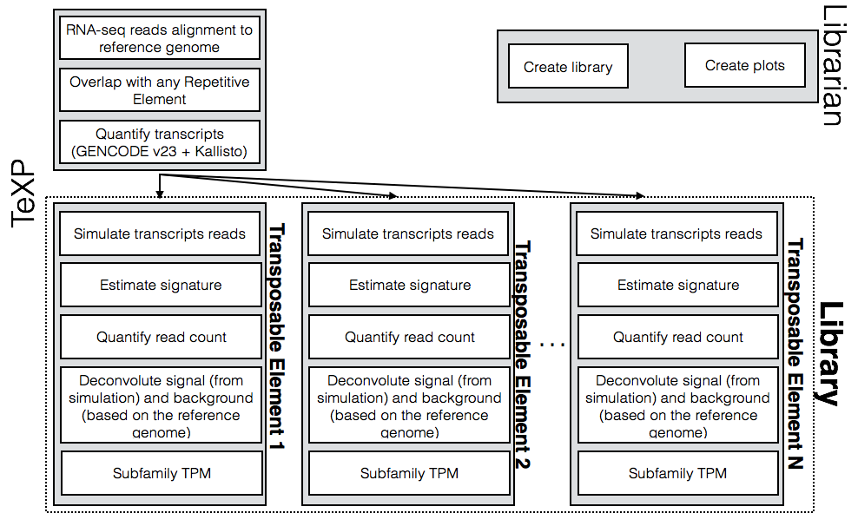
Example Focused Project #1:
Analysis of Repetitive Element transcription in brain
Use RNA-seq samples from different developmental stages and conditions
Estimate transcription signatures of L1Hs, ALUY, HERVK functional transcripts
Remove the effect of background transcription

Slide 5
Ex of Focused Project #2: Allelic analysis in brain
Notes:
research focus

