Slide 1

LARVA: An integrative framework for Large-scale Analysis
of Recurrent Variants in noncoding Annotations
M Gerstein, Yale
Slides freely downloadable from Lectures.GersteinLab.org
& “tweetable” (via @markgerstein). See last slide for references & more info.

Slide 2

Finding Key Variants in Cancer Genomes: the Needle in the Haystack
[Image credit: www.yourgrantauthority.com ‘15]
Increasing number of whole genome sequenced for tumor/normal pairs
  Eg >2500 for PCAWG
Lots of somatic mutations in an average tumor (~5K/sample), particularly in non-coding regions
A focus is distinguishing drivers & passengers
  Canonical Drivers are mutations driving cancer progression
    Thought to be under positive selection
    Recur in the same position, gene or functional element across tumors in different individuals
  Passengers are thought not be significant to driving cancer progression
    Collateral damage
    Could result from impaired DNA repair processes
Most driver work has focused on genes
  eg Youn & Simon (‘11). Bioinformatics; Lawrence et al. (‘13). Nature

Slide 3
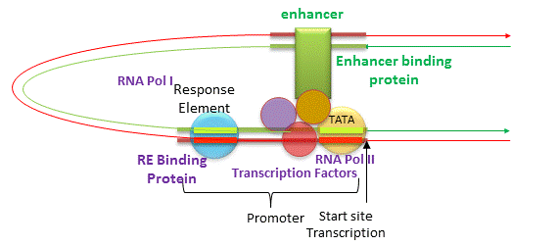
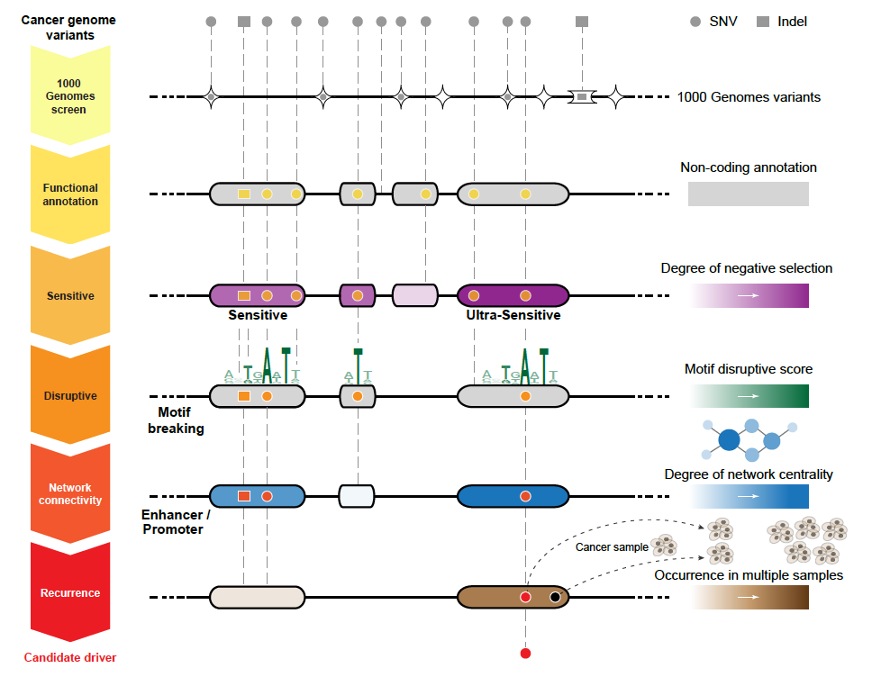
Noncoding Annotations
Promoters
TF binding sites
Transcription start sites
DHS sites
Enhancers
[Jakubowski, csbsju.edu ‘14]
Ultra-sensitive & Ultra-conserved elements Non-coding regions more conserved than expectation across the human population & between species [Bejerano et al. (‘04). Science; Khurana et al., Science (‘13)]

Slide 4
Identification of non-coding candidate drivers amongst somatic variants: FunSeq
[Khurana et al., Science (‘13)]

Slide 5
Identification of non-coding candidate drivers amongst somatic variants: FunSeq
Funseq 1.0
Function
Prioritization
Funseq 2.0
Better
Functional
Annotation
LARVA
[Khurana et al., Science (‘13)]

Slide 6
From Funseq 1.0 to Funseq 2.0
Elaborated features
  Motif disruption score: changes in PWMs
  Network centrality analysis: PPI, regulatory, and phosphorylation networks
New scoring system
  Entropy based scoring system
HOT region
Sensitive region
Polymorphisms
Genome
Feature weight:
p = probability of the feature overlapping natural polymorphisms
For a variant:
6
[Fu et al., GenomeBiology ('14)]
Notes:
Better schematic ….

Slide 7


Mutation recurrence
Cancer Type 1
Cancer Type 2
Cancer Type 3

Slide 8
Mutation recurrence
Cancer Type 1
Cancer Type 2
Cancer Type 3
Early replicated regions
Late replicated regions

Slide 9
Noncoding annotations
Cancer Type 1
Cancer Type 2
Cancer Type 3
Early replicated regions
Late replicated regions

Slide 10
Noncoding annotations
Cancer Type 1
Cancer Type 2
Cancer Type 3
Early replicated regions
Late replicated regions

Slide 11
Cancer Somatic Mutational Heterogeneity, across cancer types, samples & regions
[Lochovsky et al. NAR (’15)]

Slide 12




Cancer Somatic Mutation Modeling
3 models to evaluate the significance of mutation burden
Suppose there are k genome elements. For element i, define:
  n_{i}: total number of nucleotides
  x_{i}: the number of mutations within the element
  p: the mutation rate
  R: the replication timing bin of the element
Model 1: Constant Background Mutation Rate (Model from Previous Work)
Model 2: Varying Mutation Rate
Model 3: Varying Mutation Rate with Replication Timing Correction
[Lochovsky et al. NAR (’15)]

Slide 13
LARVA Model Comparison
Comparison of mutation count frequency implied by the binomial model (model 1) and the beta-binomial model (model 2) relative to the empirical distribution
The beta-binomial distribution is significantly better, especially for accurately modeling the over-dispersion of the empirical distribution
[Lochovsky et al. NAR (’15)]

Slide 14
Adding DNA replication timing correction further improves the beta-binomial model
Bottom 10% of rep. timing bins requires large correction
Top 10% of rep. timing bins
requires little correction
[Lochovsky et al. NAR (’15)]

Slide 15
LARVA Results
TSS LARVA results
These have
literature-verified
cancer associations
β-binomial
noncoding annotation
p-values in sorted order
binomial
[Lochovsky et al. NAR (’15)]

Slide 16
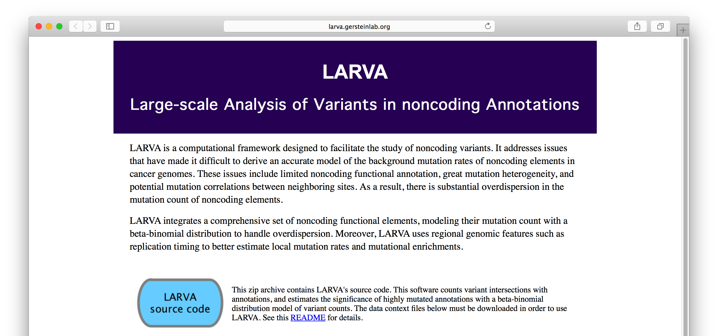
LARVA Implementation
http://larva.gersteinlab.org/
Freely downloadable C++ program
  Verified compilation and correct execution on Linux
A Docker image is also available to download
  Runs on any operating system supported by Docker
Running time on transcription factor binding sites (a worst case input size) is ~80 min
  Running time scales linearly with the number of annotations in the input

Slide 17
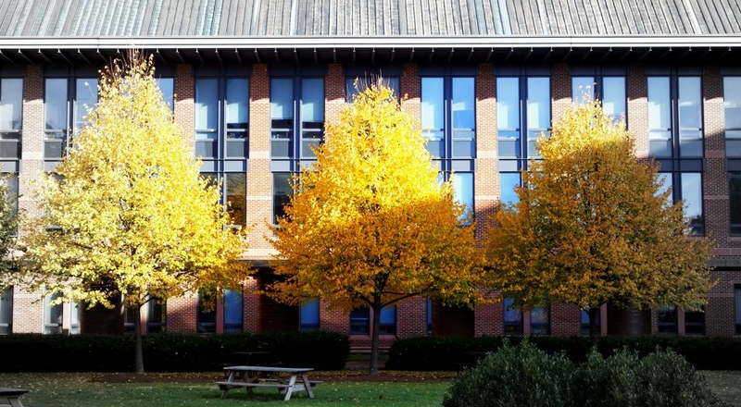
Acknowledgements
LARVA.gersteinlab.org
  L Lochovsky*, J Zhang*, Y Fu, E Khurana
FunSeq2.gersteinlab.org
  Y Fu, Z Liu, S Lou, J Bedford, X Mu, K Yip, E Khurana

Slide 18
Info about content in this slide pack
General PERMISSIONS
  This Presentation is copyright Mark Gerstein,
  Yale University, 2015.
  Please read permissions statement at
  www.gersteinlab.org/misc/permissions.html .
  Feel free to use slides & images in the talk with PROPER acknowledgement
  (via citation to relevant papers or link to gersteinlab.org).
  Paper references in the talk were mostly from Papers.GersteinLab.org.
PHOTOS & IMAGES. For thoughts on the source and permissions of many of the photos and clipped images in this presentation see http://streams.gerstein.info .
  In particular, many of the images have particular EXIF tags, such as kwpotppt , that can be easily queried from flickr, viz: http://www.flickr.com/photos/mbgmbg/tags/kwpotppt

