Slide 1
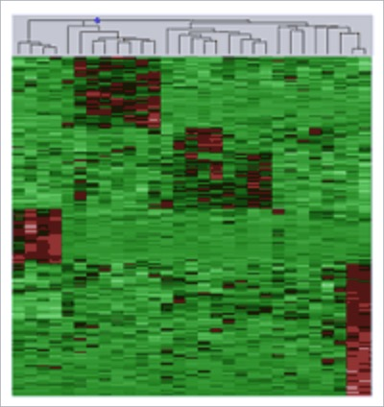
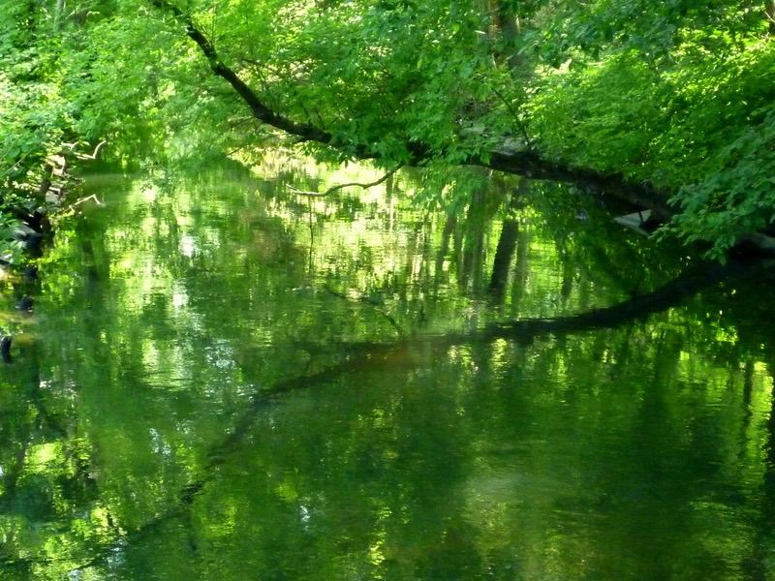
Transcriptome Analysis:
Expression Clustering across Distant Organisms
M Gerstein, Yale
See last slide for references & more info. (Background image from http://www.genomenewsnetwork.org/articles/04_02/leukemia.shtml)
Slides freely downloadable from Lectures.GersteinLab.org & “tweetable” (via @markgerstein)

Slide 2
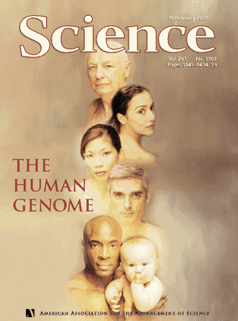
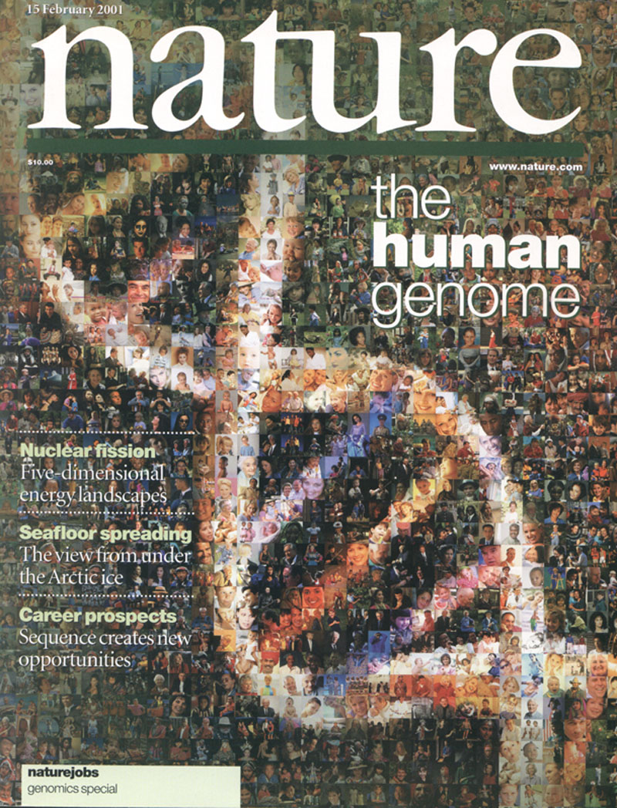

The Human
Genome Project
2000
2005
2010
2015
Worm
Genome

Slide 3
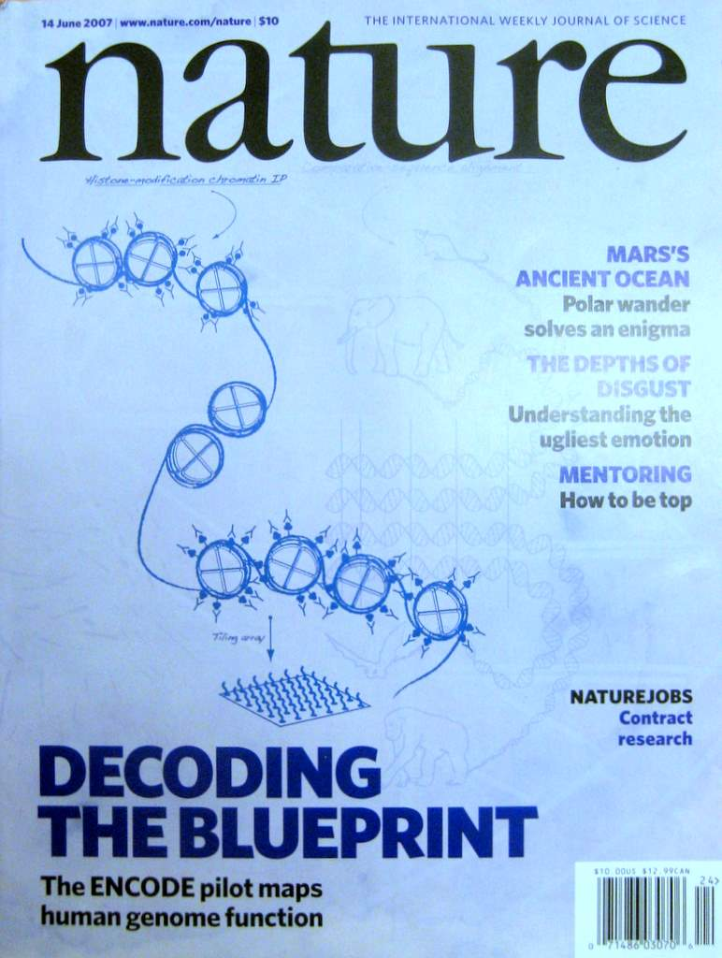

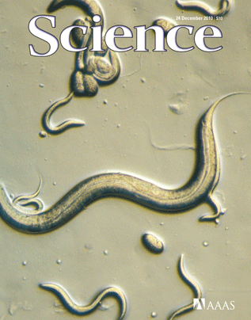
The Human
Genome Project
ENCODE
Pilot
ENCODE
Production
2000
2005
2010
Worm
Genome
modENCODE

Slide 4
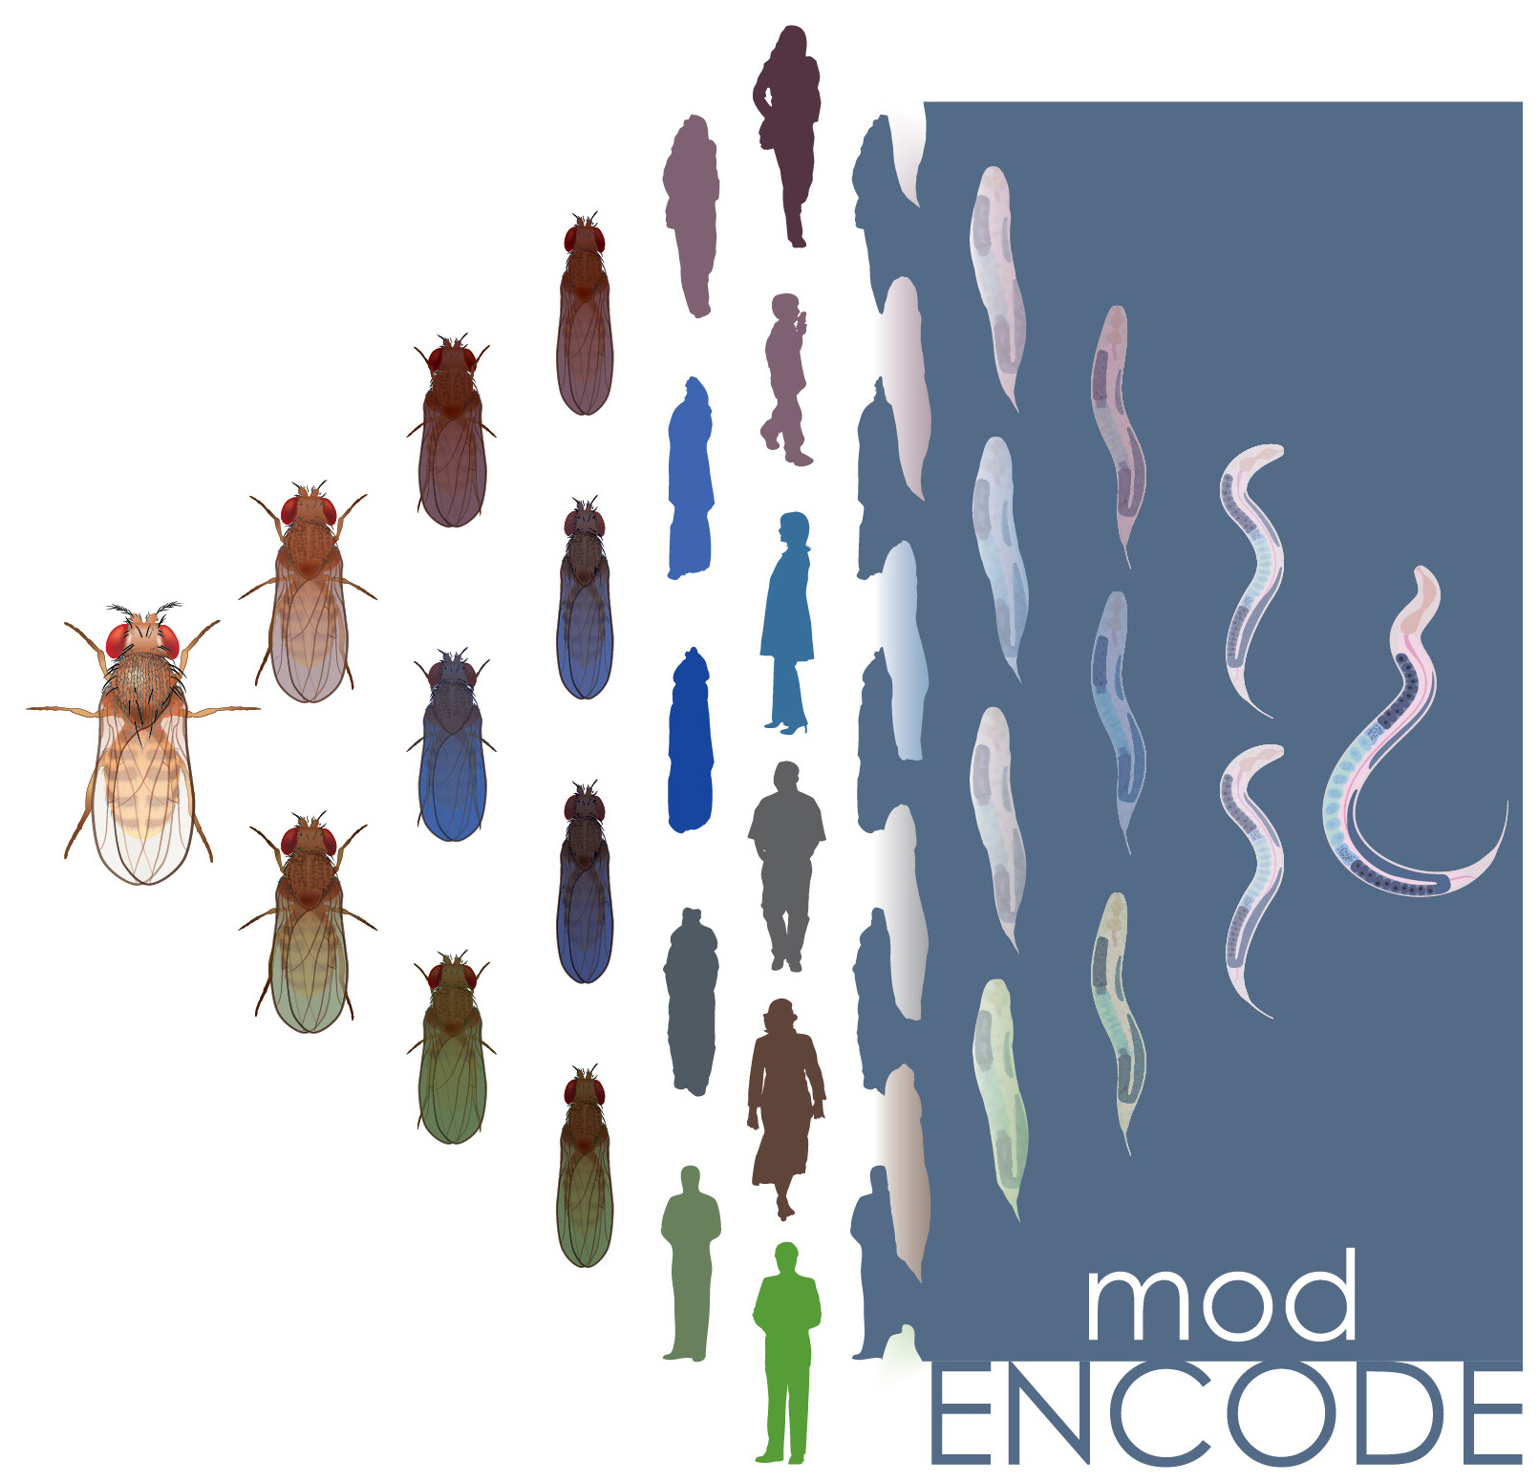

The Human
Genome Project
ENCODE
Pilot
ENCODE
Production
Comparative
ENCODE
2000
2005
2010
2015
Worm
Genome
modENCODE

Slide 5

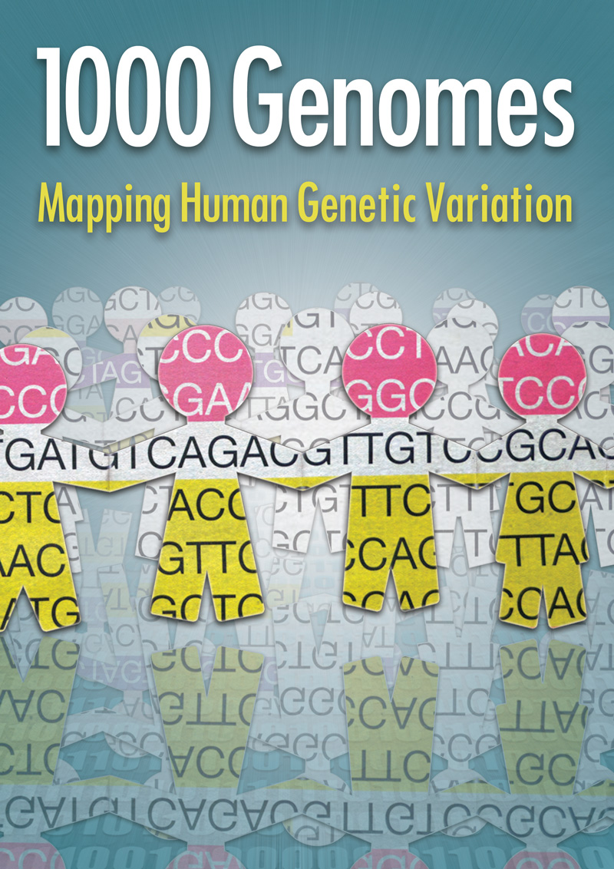
The Human
Genome Project
ENCODE
Pilot
ENCODE
Production
Comparative
ENCODE
2000
2005
2010
2015
Worm
Genome
modENCODE
1000 Genomes
Pilot
1000 Genomes
Production

Slide 6


The Human
Genome Project
ENCODE
Pilot
ENCODE
Production
Comparative
ENCODE
Epigenome
Roadmap
2000
2005
2010
2015
Worm
Genome
modENCODE
1000 Genomes
Pilot
1000 Genomes
Production
GTEx

Slide 7
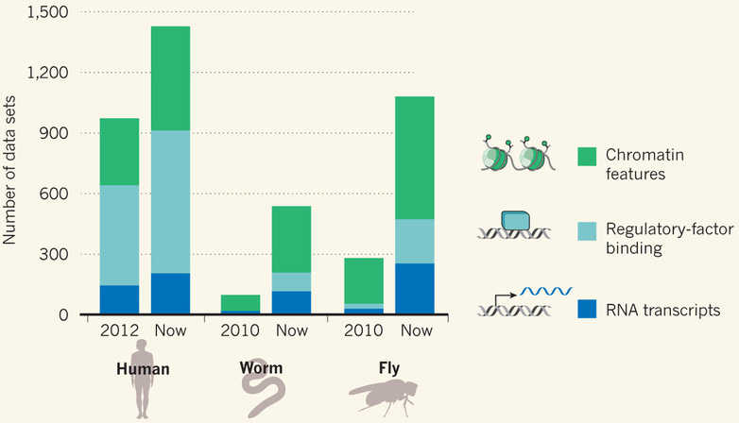
Comparative ENCODE Functional Genomics Resource
(EncodeProject.org/comparative)
Broad sampling of conditions across transcriptomes & regulomes for human, worm & fly
  embryo & ES cells
  developmental time course (worm-fly)
In total: ~3000 datasets (~130B reads)

Slide 8
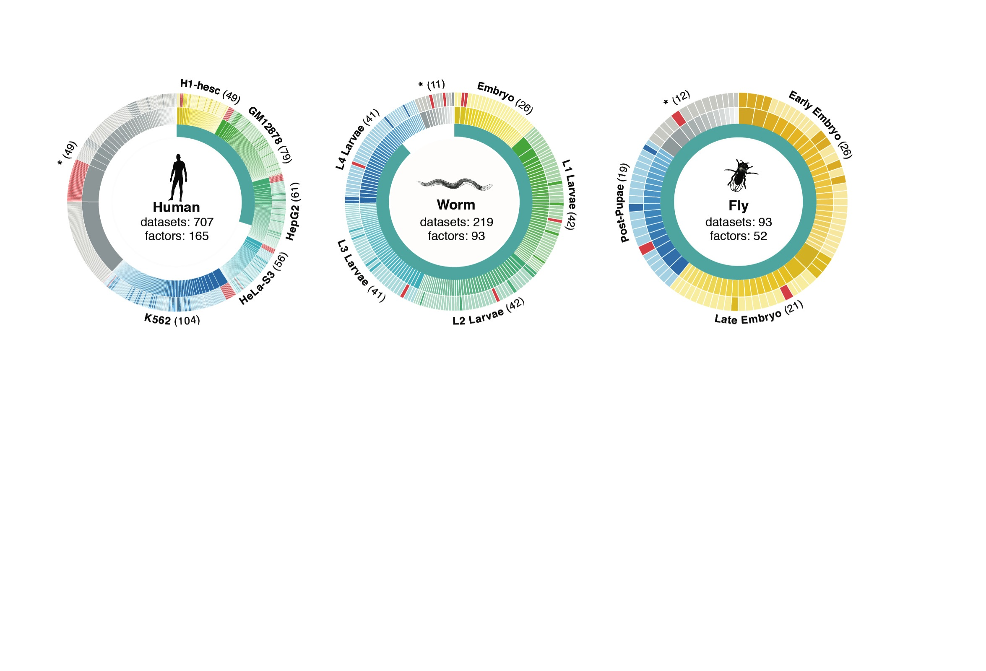
Time-course gene expression data of worm & fly development
[Nature 512:445 ('14); doi: 10.1038/nature13424]
Organism | Major developmental stages
worm (C. elegans) | 33 stages: 0, 0.5, 1, …, 12 hours, L1, L2, L3, L4, …, Young Adults, Adults
fly (D. mel.) | 30 stages: 0, 2, 4, 6, 8,…, 20, 22 hours, L1-L4, Pupaes, Adults

Slide 9
Transcriptome Analysis:
Expression Clustering across Distant Organisms
Intro to Comparative ENCODE
  Lots of Matched Data for Comparative Analysis
Expression Clustering, Cross-species
  Potts-model optimization gives 16 conserved co-expression modules (which can potentially annotate ncRNAs/TARs)
Relating Clusters to Hourglass Genes
  Developmental 'hourglass' genes in 12 of the clusters. They also exhibit intra-organism hourglass behavior.
  Stage alignment of worm & fly development, strongest with hourglass genes
Decoupling expression changes into those driven by worm-fly conserved genes vs species-specific ones
  Using dimensionality reduction to help determine internal & external drivers
  Conserved genes have similar canonical patterns (iPDPs) in contrast to species specific ones (Ex of ribosomal v signaling genes)

Slide 10
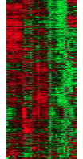
Expression clustering:
revisiting an ancient problem
Species A
Species B
Clustering
algorithm
Clustering
algorithm
co-expressed genes
responsible for the same
function in a species
co-expressed genes
responsible for the same
function in a species
Eisen MB et al. PNAS 1998
Langfelder P et al. BMC Bioinfo. 2008
Tamayo P et al. PNAS 1999
Kluger Y et al. Genome Res. 2003
two independent sets
of modules
Cross species
co-expression modules

Slide 11
Expression clustering:
revisiting an ancient problem
Species A
Orthologous pairs
between species
Species B
A novel unified framework to integrate co-expression data across species
OrthoClust
cross species modules
Yan et al. Genome Biol. 2014
Cross species
co-expression modules

Slide 12

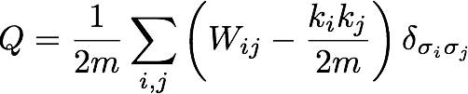
Network modularity
degree of node i
adjacency matrix
whether or not
i, j are in the
same module
number of edges
expected number of
edges between i and j

Slide 13

Network modularity
Optimization problem
degree of node i
adjacency matrix
whether or not
i, j are in the
same module
number of edges
expected number of
edges between i and j

Slide 14
OrthoClust: toy example
Every node i is assigned with a label σ_{i} (labels of modules: 1,2,…q).
2
4
3
co-expressed
1
1
2
2
orthologs
Species A
3
3
Species B
4
4
4
1
2
1
3
2
￼
Yan KK et al. Genome Biology. 2014

Slide 15
OrthoClust: toy example
Every node i is assigned with a label σ_{i} (labels of modules: 1,2,…q).
2
4
3
co-expressed
1
1
2
2
orthologs
Species A
3
3
Species B
4
4
4
1
2
1
3
2
￼
Yan KK et al. Genome Biology. 2014

Slide 16
OrthoClust: toy example
Use Potts model (generalized Ising model) to simultaneously cluster co-expressed genes within an organism as well as orthologs shared between organisms. Here, the ground state configuration correspond to three modules: 1, 2, 4.
species A specific
conserved modules
species B specific
2
2
4
co-expressed
2
4
2
4
orthologs
Species A
2
4
Species B
4
1
4
1
4
4
1
1
￼

Slide 17
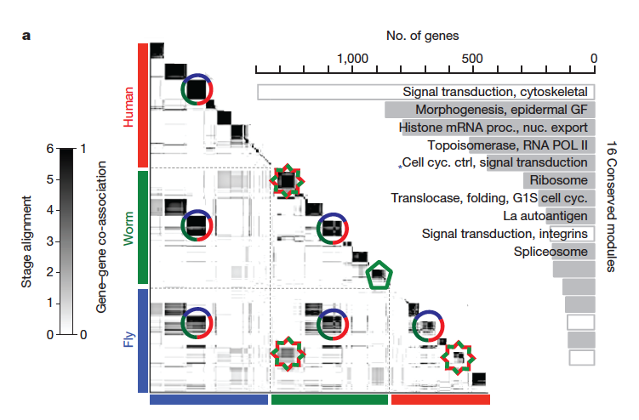
Application for 3 species
~55000 genes
[Nature 512:445 ('14); doi: 10.1038/nature13424]

Slide 18
ncRNAs associated with modules
Identify ncRNAs & TARs that are significantly correlated and anti-correlated with genes in the 16 modules.
Human, Worm & Fly
[Nature 512:445 ('14); doi: 10.1038/nature13424]

Slide 19
Transcriptome Analysis:
Expression Clustering across Distant Organisms
Intro to Comparative ENCODE
  Lots of Matched Data for Comparative Analysis
Expression Clustering, Cross-species
  Potts-model optimization gives 16 conserved co-expression modules (which can potentially annotate ncRNAs/TARs)
Relating Clusters to Hourglass Genes
  Developmental 'hourglass' genes in 12 of the clusters. They also exhibit intra-organism hourglass behavior.
  Stage alignment of worm & fly development, strongest with hourglass genes
Decoupling expression changes into those driven by worm-fly conserved genes vs species-specific ones
  Using dimensionality reduction to help determine internal & external drivers
  Conserved genes have similar canonical patterns (iPDPs) in contrast to species specific ones (Ex of ribosomal v signaling genes)

Slide 20
Transcriptome Analysis:
Expression Clustering across Distant Organisms
Intro to Comparative ENCODE
  Lots of Matched Data for Comparative Analysis
Expression Clustering, Cross-species
  Potts-model optimization gives 16 conserved co-expression modules (which can potentially annotate ncRNAs/TARs)
Relating Clusters to Hourglass Genes
  Developmental 'hourglass' genes in 12 of the clusters. They also exhibit intra-organism hourglass behavior.
  Stage alignment of worm & fly development, strongest with hourglass genes
Decoupling expression changes into those driven by worm-fly conserved genes vs species-specific ones
  Using dimensionality reduction to help determine internal & external drivers
  Conserved genes have similar canonical patterns (iPDPs) in contrast to species specific ones (Ex of ribosomal v signaling genes)

Slide 21
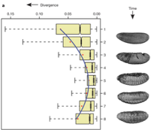
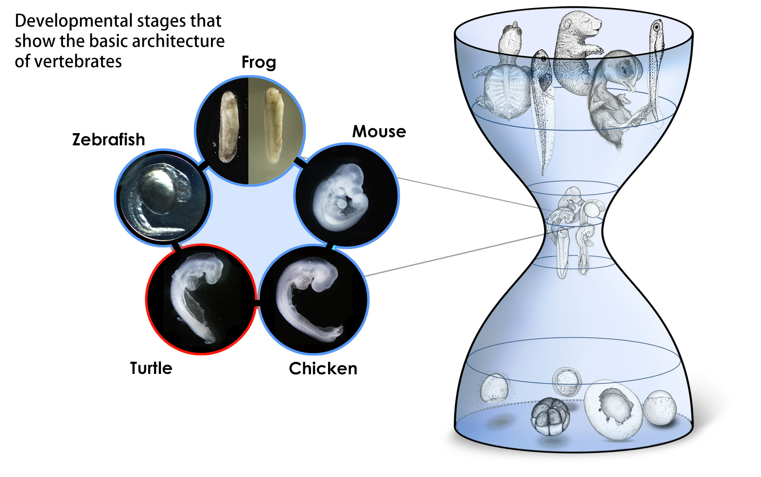
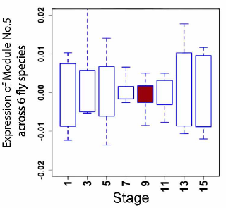
Conserved modules exhibit canonical hourglass behavior
Phylotypic stage
Expression divergence across species is minimized during phylotypic stage (Kalinka et al. Nature 2010)
Illustrations courtesy Naoki Irie
Canonical Inter-organism Behavior
“Hourglass hypothesis”: all organisms go through a particular stage in embryonic development ("phylotypic" stage) where
inter-organism expression differences of orthologous genes are smallest.
We identify modules (12 out of 16) which have this behavior at the phylotypic stage.
phylotypic stage
[Nature 512:445 ('14); doi: 10.1038/nature13424]

Slide 22
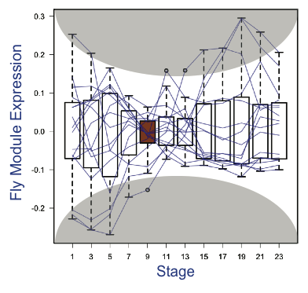
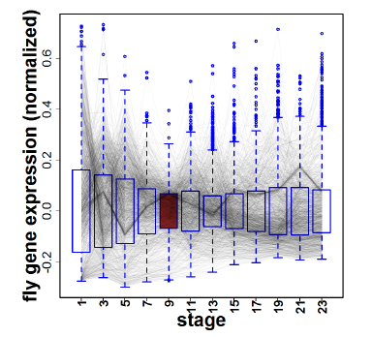
Hourglass Behavior
phylotypic stage
Intra-organism Behavior also Present
We observe that the expression of genes across 12 modules are the most tightly coordinated at the phylotypic stage (fly).
[Nature 512:445 ('14); doi: 10.1038/nature13424]

Slide 23
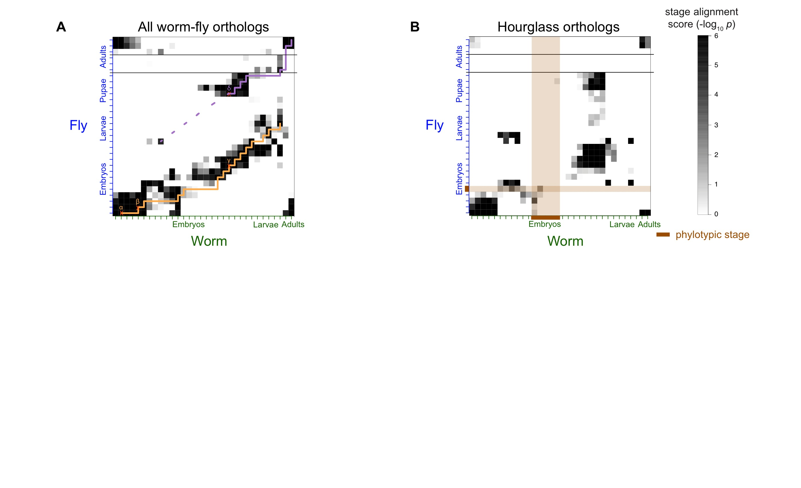
Alignment of Developmental Time-Course
For worm & fly find stage-specific genes
We can align developmental stages using fraction of shared orthologs between worm and fly amongst these
Reuse of genes from LE in worm in fly pupa
Fly
Align developmental stages using shared orthologs between worm and fly
  Reuse of genes from LE in worm in fly pupa
Using only orthologs in hourglass modules we find similar behavior except for absence of genes at the phylotypic stage
primary alignment
secondary alignment
Worm
[Nature 512:445 ('14); doi: 10.1038/nature13424]

Slide 24
Alignment of Developmental Time-Course
Using only orthologs in 12 "hourglass" modules show stronger alignment except for absence of genes at the phylotypic stage
  By definition genes in hourglass modules are not phylotypic stage specific, hence the gap
[Nature 512:445 ('14); doi: 10.1038/nature13424]

Slide 25
Transcriptome Analysis:
Expression Clustering across Distant Organisms
Intro to Comparative ENCODE
  Lots of Matched Data for Comparative Analysis
Expression Clustering, Cross-species
  Potts-model optimization gives 16 conserved co-expression modules (which can potentially annotate ncRNAs/TARs)
Relating Clusters to Hourglass Genes
  Developmental 'hourglass' genes in 12 of the clusters. They also exhibit intra-organism hourglass behavior.
  Stage alignment of worm & fly development, strongest with hourglass genes
Decoupling expression changes into those driven by worm-fly conserved genes vs species-specific ones
  Using dimensionality reduction to help determine internal & external drivers
  Conserved genes have similar canonical patterns (iPDPs) in contrast to species specific ones (Ex of ribosomal v signaling genes)

Slide 26
Are gene regulations among orthologs conserved across species?
Are gene regulatory networks among orthologs conserved across species?
Species A
Species B
orthologs
co-expressed
Regulation among orthologs (internal)
Regulation from species-specific factors (external)
Orthologous genes (orthologs)
Species-specific transcription factors
To what degree can’t ortholog expression levels be predicted due to species-specific regulation
[Wang et al. PLOS CB (in revision, ‘15)]
Notes:
connect loregic to here too! to see regulatory mechanisms similar too

Slide 27
State-space model for internal and external gene regulatory networks
Internal Group
External Group
Internal regulation
How to identify gene expression dynamics driven by internal/external regulation?
External regulation
Control: Gene expression vector of external factors at time t
State space model
X_{t+1}
A
X_{t}
B
U_{t}
B_{kl} captures temporal casual influence from external factor k to Gene l in internal group
State: Gene expression vector of Group X at time t+1
A_{ij} captures temporal casual influence from Gene i to Gene j in internal group
State: Gene expression vector of internal group at time t
[Wang et al. PLOS CB (in revision, ‘15)]
Notes:
connect loregic to here too! to see regulatory mechanisms similar too

Slide 28
Effective state space model for meta-genes
Not enough data to estimate state space model for genes (e.g., 91K time points to estimate 11.5M elements of A & B in worm)
Dimensionality reduction from genes to meta-genes (e.g., SVD)
Effective state space model for meta-genes (e.g., 250 time points to estimate 50 matrix elements if 5 worm meta-genes)
[Wang et al. PLOS CB (in revision, ‘15)]

Slide 29
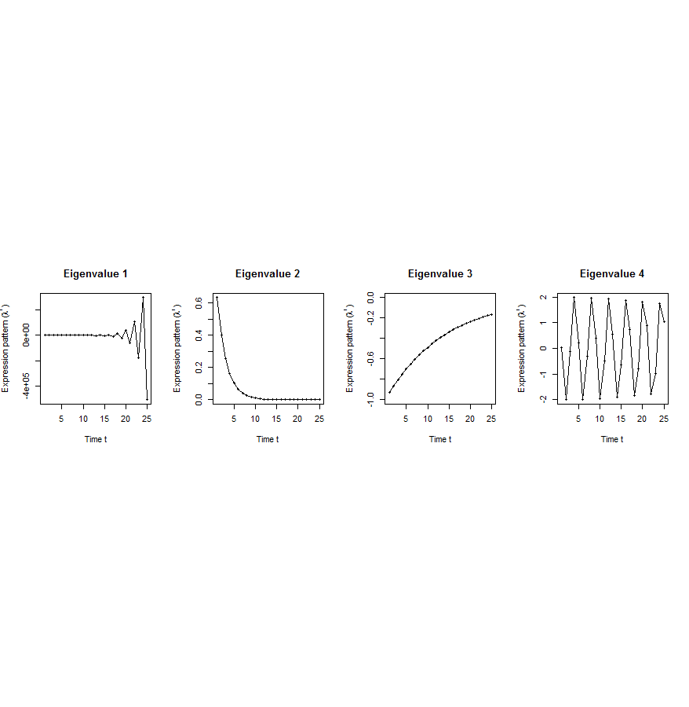
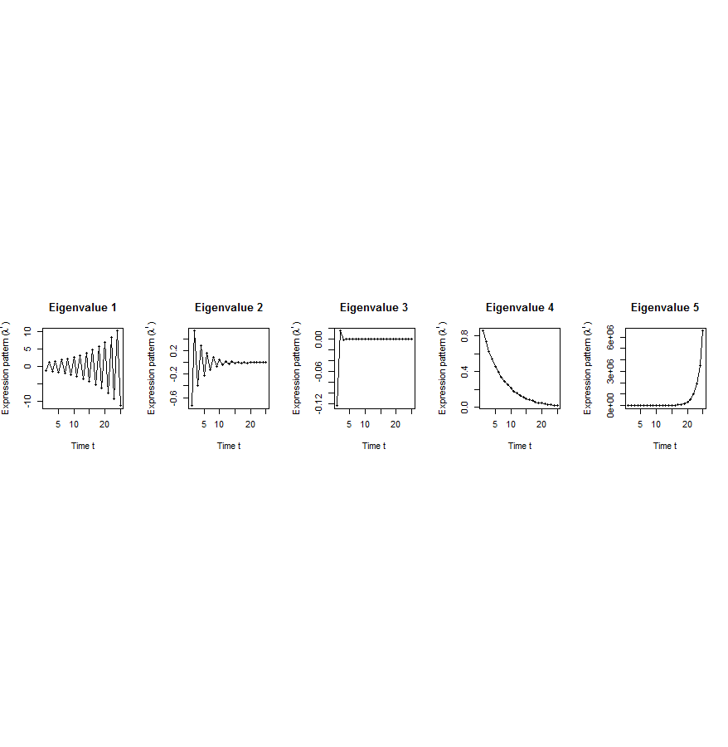
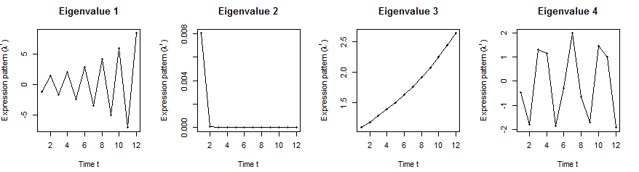
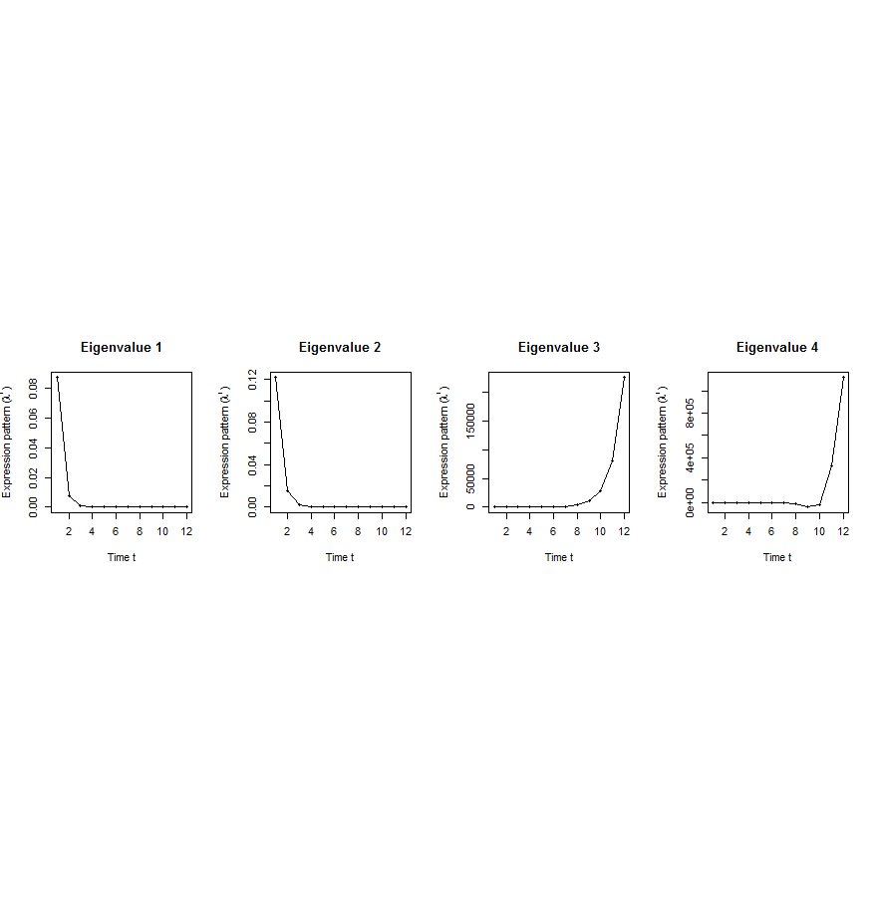
Orthologs have similar internal but different external dynamic patterns during embryonic development
Worm’s effective state space model
iPDPs: time exponentials of Ã eigenvalues in worm
ePDPs: time exponentials of eigenvalues in worm
1st iPDP
2nd iPDP
3rd iPDP
4th iPDP
1st ePDP
2nd ePDP
3rd ePDP
4th ePDP
Expression
Expression
Similar iPDP canonical trajectories
Different ePDP canonical trajectories
1st iPDP
2nd iPDP
3rd iPDP
4th iPDP
1st ePDP
2nd ePDP
3rd ePDP
4th ePDP
Expression
Expression
iPDPs: time exponentials of Ã eigenvalues in fly
ePDPs: time exponentials of eigenvalues in fly
Fly’s effective state space model
[Wang et al. PLOS CB (in revision, ‘15)]

Slide 30
[Wang et al. PLOS CB (in revision, ‘15)]
A. Gene state-space model
C. Meta-gene state-space model
B. Dimensionality Reduction
X_{t+1}=AX_{t}+BU_{t}
Genes of X
Meta-genes of X
time
E. Gene’s internal (INT) and external (EXT) driven expression dynamics composed of PDPs
D. Internal/External Principal Dynamic Patterns (PDPs)
time
[λ_{p}¹, λ_{p}², …, λ_{p}^{T}] [σ_{q}¹, σ_{q}², …, σ_{q}^{T}]
x^{INT}=c₁ +c₂
+c₃ +c₄
Genes of U
Meta-genes of U
time
time
We can also get gene coefficients over PDPs
…
x^{EXT}=d₁ +d₂
+d₃ +d₄
/
Internal regulation among genes/meta-genes Group X by A/Ã
/
External regulation from genes/meta-genes in Group U
to genes/meta-genes in Group X by B/
/
Genes/Meta-genes in Group X
/
Genes/Meta-genes in Group U

Slide 31
Orthologs have correlated iPDP coefficients
1st iPDP
2nd iPDP
r=+0.33
r=+0.66
Coefficients of orthologs on fly iPDPs
3rd iPDP
4th iPDP
r=+0.67
r=+0.73
Coefficients of orthologs on worm iPDPs
[Wang et al. PLOS CB (in revision, ‘15)]

Slide 32
Evolutionarily conserved and younger genes exhibit the opposite internal and external PDP coefficients
iPDP coeffs > ePDP coeffs | Worm | Fly
Ribosomal genes | p<0.001 | p<2.2e-16
Ribosomal genes have significantly larger coefficients for the internal than external PDPs, but signaling genes exhibit the opposite trend
Coefficients of ribosomal related genes (absolute)
iPDPs ePDPs
iPDP coeffs < ePDP coeffs | Worm | Fly
Signaling genes | p<7e-4 | p<6e-4
* p-values from KS-test
[Wang et al. PLOS CB (in revision, ‘15)]
Notes:
Ribosomal related genes: coefficients over conserved (iPDP) and specific (ePDP) meta-patterns

Slide 33
Transcriptome Analysis:
Expression Clustering across Distant Organisms
Intro to Comparative ENCODE
  Lots of Matched Data for Comparative Analysis
Expression Clustering, Cross-species
  Potts-model optimization gives 16 conserved co-expression modules (which can potentially annotate ncRNAs/TARs)
Relating Clusters to Hourglass Genes
  Developmental 'hourglass' genes in 12 of the clusters. They also exhibit intra-organism hourglass behavior.
  Stage alignment of worm & fly development, strongest with hourglass genes
Decoupling expression changes into those driven by worm-fly conserved genes vs species-specific ones
  Using dimensionality reduction to help determine internal & external drivers
  Conserved genes have similar canonical patterns (iPDPs) in contrast to species specific ones (Ex of ribosomal v signaling genes)

Slide 34
Transcriptome Analysis:
Expression Clustering across Distant Organisms
Intro to Comparative ENCODE
  Lots of Matched Data for Comparative Analysis
Expression Clustering, Cross-species
  Potts-model optimization gives 16 conserved co-expression modules (which can potentially annotate ncRNAs/TARs)
Relating Clusters to Hourglass Genes
  Developmental 'hourglass' genes in 12 of the clusters. They also exhibit intra-organism hourglass behavior.
  Stage alignment of worm & fly development, strongest with hourglass genes
Decoupling expression changes into those driven by worm-fly conserved genes vs species-specific ones
  Using dimensionality reduction to help determine internal & external drivers
  Conserved genes have similar canonical patterns (iPDPs) in contrast to species specific ones (Ex of ribosomal v signaling genes)

Slide 35



Acknowledgements
modENCODE/ENCODE Transcriptome group [EncodeProject.org/comparative]
Joel Rozowsky, Koon-Kiu Yan, Daifeng Wang,
Chao Cheng, James B. Brown, Carrie A. Davis, LaDeana Hillier, Cristina Sisu, Jingyi Jessica Li, Baikang Pei, Arif O. Harmanci, Michael O. Duff, Sarah Djebali, Roger P. Alexander, Burak H. Alver, Raymond K. Auerbach, Kimberly Bell, Peter J. Bickel, Max E. Boeck, Nathan P. Boley, Benjamin W. Booth, Lucy Cherbas, Peter Cherbas, Chao Di, Alex Dobin, Jorg Drenkow, Brent Ewing, Gang Fang, Megan Fastuca, Elise A. Feingold, Adam Frankish, Guanjun Gao, Peter J. Good, Phil Green, Roderic Guigó, Ann Hammonds, Jen Harrow, Roger A. Hoskins, Cédric Howald, Long Hu, Haiyan Huang, Tim J. P. Hubbard, Chau Huynh, Sonali Jha, Dionna Kasper, Masaomi Kato, Thomas C. Kaufman, Rob Kitchen, Erik Ladewig, Julien Lagarde, Eric Lai, Jing Leng, Zhi Lu, Michael MacCoss, Gemma May, Rebecca McWhirter, Gennifer Merrihew, David M. Miller, Ali Mortazavi, Rabi Murad, Brian Oliver, Sara Olson, Peter Park, Michael J. Pazin, Norbert Perrimon, Dmitri Pervouchine, Valerie Reinke, Alexandre Reymond, Garrett Robinson, Anastasia Samsonova, Gary I. Saunders, Felix Schlesinger, Anurag Sethi, Frank J. Slack, William C. Spencer, Marcus H. Stoiber, Pnina Strasbourger, Andrea Tanzer, Owen A. Thompson, Kenneth H. Wan, Guilin Wang, Huaien Wang, Kathie L. Watkins, Jiayu Wen, Kejia Wen, Chenghai Xue, Li Yang, Kevin Yip, Chris Zaleski, Yan Zhang, Henry Zheng, Steven E. Brenner, Brenton R. Graveley, Susan E. Celniker,
Thomas R Gingeras, Robert Waterston
Hiring Postdocs. See gersteinlab.org/jobs !

Slide 36

Models
Acknowledgements
ORTHOCLUST.gersteinlab.org :
KK Yan, D Wang,
J Rozowsky, H Zheng, C Cheng
DREISS.gersteinlab.org
D Wang, F He, S Maslov
Hiring Postdocs. See gersteinlab.org/jobs !

Slide 37
Default Theme
Default Outline Level 1
  Level 2

Slide 38
Info about content in this slide pack
PERMISSIONS: This Presentation is copyright Mark Gerstein, Yale University, 2012 (and beyond). Please read statement at
http://www.gersteinlab.org/misc/permissions.html . Feel free to use images in the talk with PROPER acknowledgement (via citation to relevant papers or link to appropriate place on gersteinlab.org).
Paper references in the talk were mostly from Papers.GersteinLab.org.
PHOTOS & IMAGES. For thoughts on the source and permissions of many of the photos and clipped images in this presentation see http://streams.gerstein.info . In particular, many of the images have particular EXIF tags, such as kwpotppt , that can be easily queried from flickr, viz: http://www.flickr.com/photos/mbgmbg/tags/kwpotppt

Slide 39
Are there any conserved regulatory networks between worm and fly during embryonic development?
Dataset | Internal Group | External Group | Developmental stages | # of unknown parameters in A and B | # of available time samples
worm (C. elegans) | N₁=3147 worm-fly orthologs (incl. ortholog TFs) | N₂=509 worm-specific transcription factors | T=25 time points: 0, 0.5, 1, …, 12 hours | 3147*3147+3147*509=11.5M | 3147*25+509*25=91400
fly (D. mel.) |  | N₂=442 fly-specific transcription factors | T=12 time points: 0, 2, 4, 6, 8,…, 20, 22 hours | 3147*3147+3147*442=11.3M | 3147*25+442*25=89725
No enough time samples!
A_{w}
B_{w}
A_{f}
B_{f}
worm
fly
If A_{w} and A_{f} have similarities, cross-species conserved regulatory networks in embryonic development
Embryonic stem cells (ESCs)
Notes:
we apply this method to time-series gene expression data in embryonic development of worm and fly in modENCODE, and identified internal principal dynamic patterns of ortholog gene expressions driven by orthologous TFs, and external patterns driven by species-specific TFs.

