Slide 1


ENCODE:
“Evolution” of Approaches to Annotate the Human Genome & Interpret its Variants
Mark Gerstein, Yale
Slides freely downloadable from
Lectures.GersteinLab.org
& “tweetable” (via @markgerstein). See last slide for more info.
Notes:
1

Slide 2

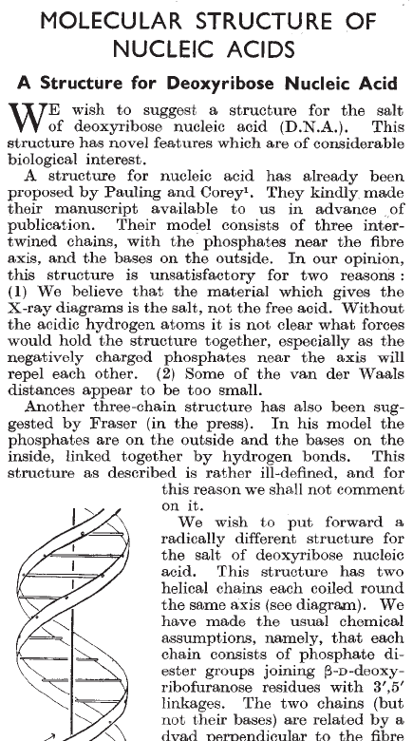
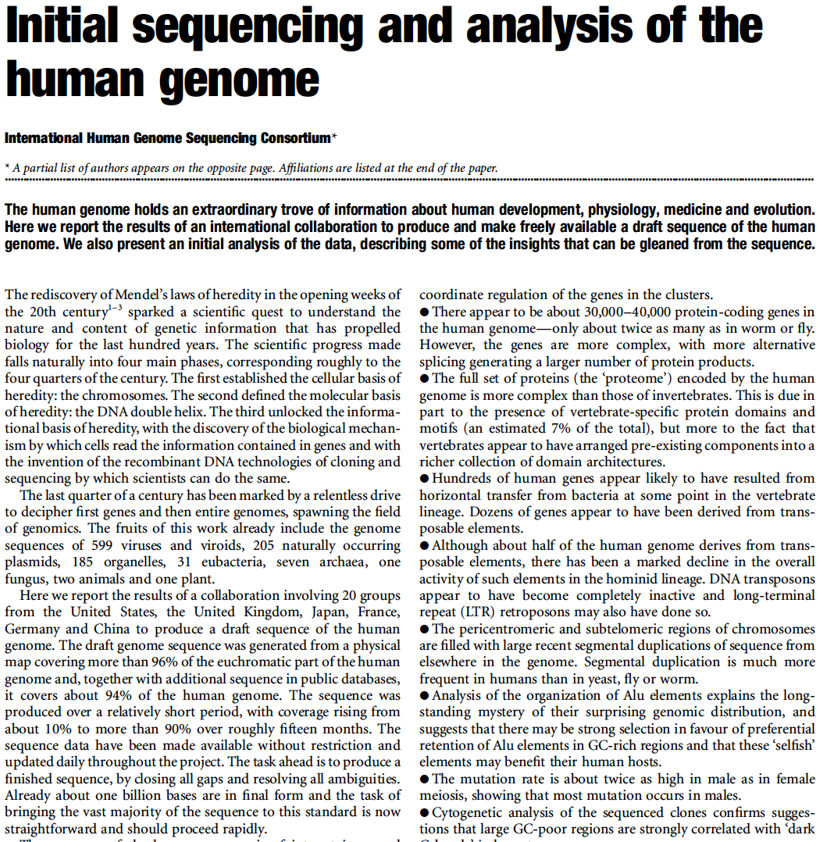
What is Annotation? (For Written Texts?)

Slide 3
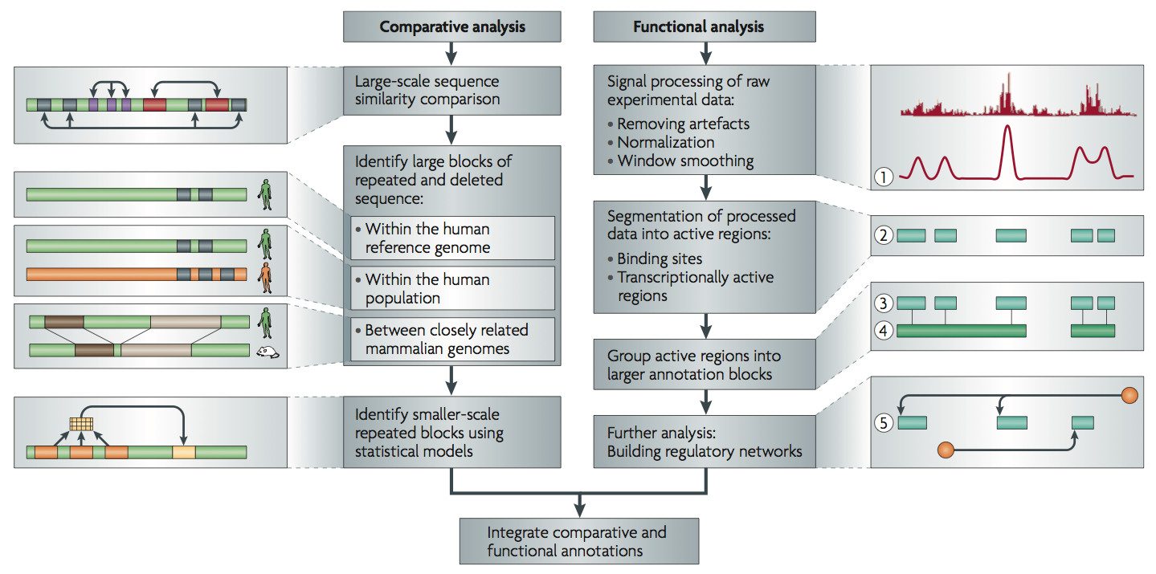
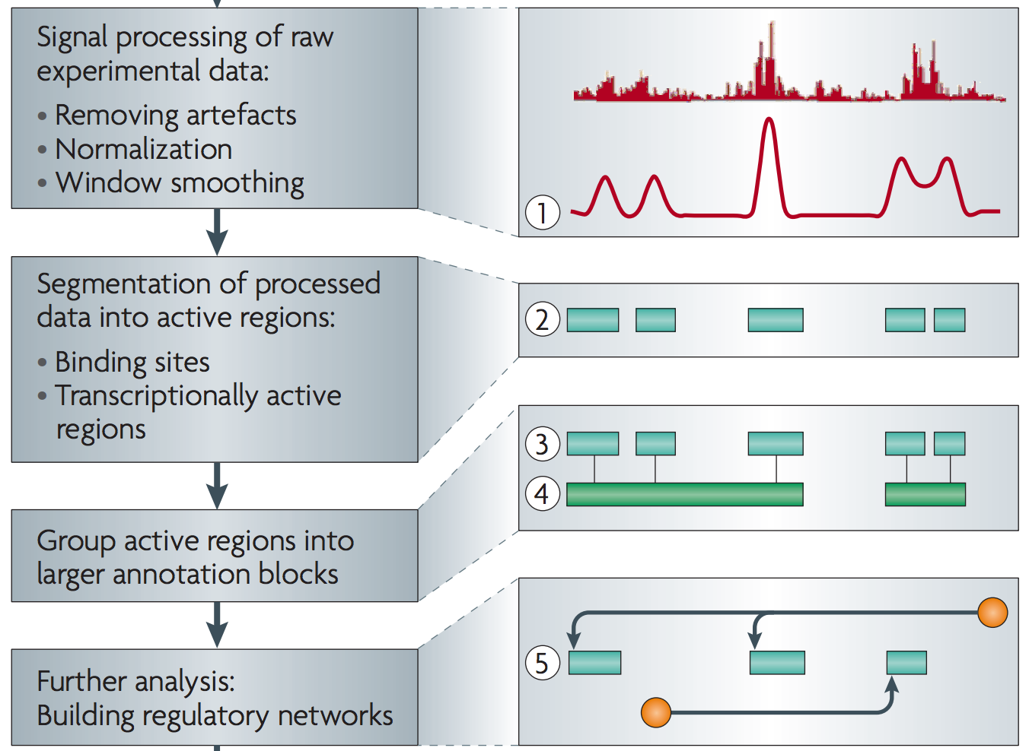
Non-coding Annotations: Overview
[Nat. Rev. Genet. (2010) 11: 559]
Sequence features, incl. Conservation
Functional Genomics
ChIP-seq (Epigenome & seq. specific TF) and ncRNA & un-annotated transcription

Slide 4

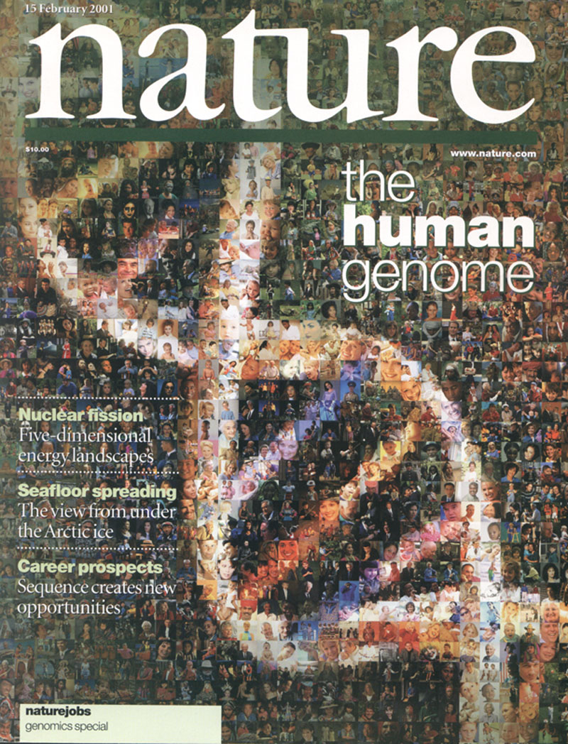

The Human
Genome Project
2000
2005
2010
2015
Worm
Genome

Slide 5
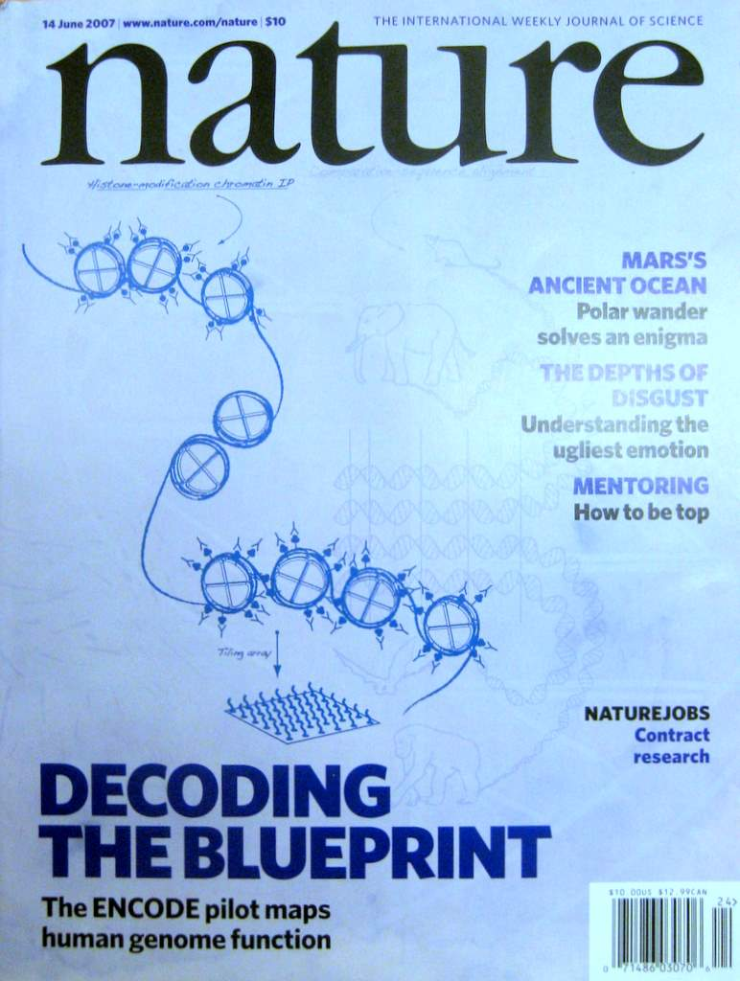
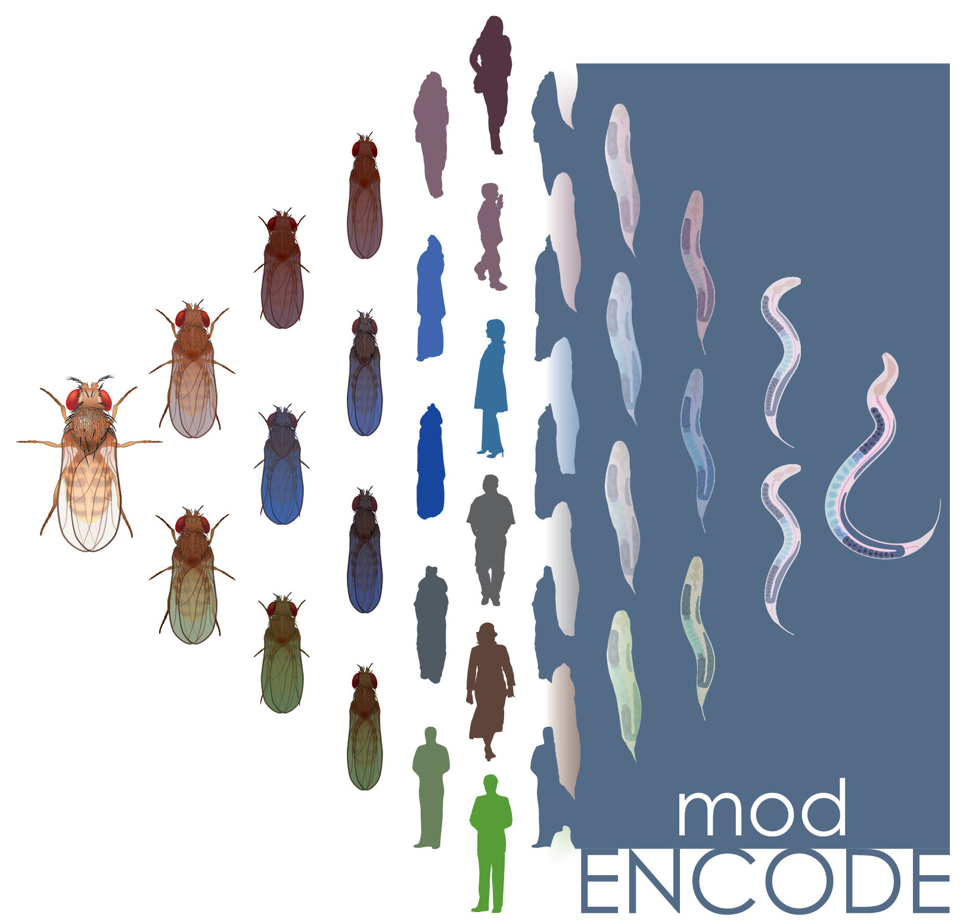


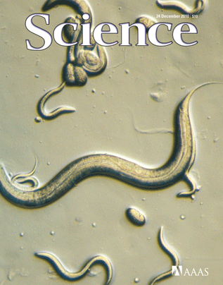
The Human
Genome Project
ENCODE
Pilot
ENCODE
Production
Comparative
ENCODE
2000
2005
2010
2015
Worm
Genome
modENCODE

Slide 6

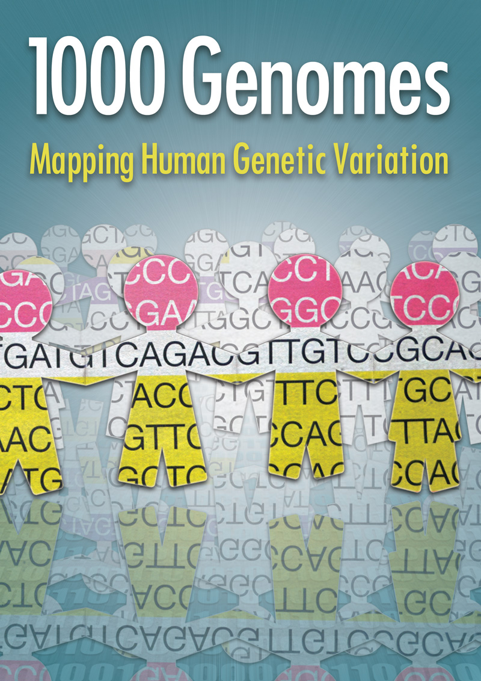
The Human
Genome Project
ENCODE
Pilot
ENCODE
Production
Comparative
ENCODE
2000
2005
2010
2015
Worm
Genome
modENCODE
1000 Genomes
Pilot
1000 Genomes
Production

Slide 7
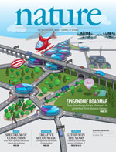

The Human
Genome Project
ENCODE
Pilot
ENCODE
Production
Comparative
ENCODE
Epigenome
Roadmap
2000
2005
2010
2015
Worm
Genome
modENCODE
1000 Genomes
Pilot
1000 Genomes
Production
GTEx

Slide 8

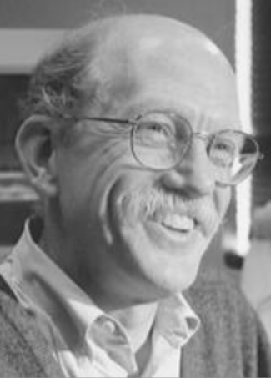
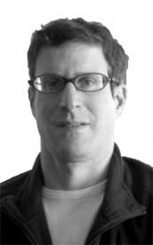
MBG: ‘03-’15: (happy little)
COG in a Big-science
Machine
Mark, Redo the PCA -Again!

Slide 9
Encode Production People
Dunham I, Kundaje A, Aldred SF, Collins PJ, Davis CA, Doyle F, Epstein CB, Frietze S, Harrow J, Kaul R, Khatun J, Lajoie BR, Landt SG, Lee BK, Pauli F, Rosenbloom KR, Sabo P, Safi A, Sanyal A, Shoresh N, Simon JM, Song L, Trinklein ND, Altshuler RC, Birney E, Brown JB, Cheng C, Djebali S, Dong X, Dunham I, Ernst J, Furey TS, Gerstein M, Giardine B, Greven M, Hardison RC, Harris RS, Herrero J, Hoffman MM, Iyer S, Kellis M, Khatun J, Kheradpour P, Kundaje A, Lassmann T, Li Q, Lin X, Marinov GK, Merkel A, Mortazavi A, Parker SC, Reddy TE, Rozowsky J, Schlesinger F, Thurman RE, Wang J, Ward LD, Whitfield TW, Wilder SP, Wu W, Xi HS, Yip KY, Zhuang J, Pazin MJ, Lowdon RF, Dillon LA, Adams LB, Kelly CJ, Zhang J, Wexler JR, Green ED, Good PJ, Feingold EA, Bernstein BE, Birney E, Crawford GE, Dekker J, Elnitski L, Farnham PJ, Gerstein M, Giddings MC, Gingeras TR, Green ED, Guigó R, Hardison RC, Hubbard TJ, Kellis M, Kent W, Lieb JD, Margulies EH, Myers RM, Snyder M, Stamatoyannopoulos JA, Tenenbaum SA, Weng Z, White KP, Wold B, Khatun J, Yu Y, Wrobel J, Risk BA, Gunawardena HP, Kuiper HC, Maier CW, Xie L, Chen X, Giddings MC, Bernstein BE, Epstein CB, Shoresh N, Ernst J, Kheradpour P, Mikkelsen TS, Gillespie S, Goren A, Ram O, Zhang X, Wang L, Issner R, Coyne MJ, Durham T, Ku M, Truong T, Ward LD, Altshuler RC, Eaton ML, Kellis M, Djebali S, Davis CA, Merkel A, Dobin A, Lassmann T, Mortazavi A, Tanzer A, Lagarde J, Lin W, Schlesinger F, Xue C, Marinov GK, Khatun J, Williams BA, Zaleski C, Rozowsky J, Röder M, Kokocinski F, Abdelhamid RF, Alioto T, Antoshechkin I, Baer MT, Batut P, Bell I, Bell K, Chakrabortty S, Chen X, Chrast J, Curado J, Derrien T, Drenkow J, Dumais E, Dumais J, Duttagupta R, Fastuca M, Fejes-Toth K, Ferreira P, Foissac S, Fullwood MJ, Gao H, Gonzalez D, Gordon A, Gunawardena HP, Howald C, Jha S, Johnson R, Kapranov P, King B, Kingswood C, Li G, Luo OJ, Park E, Preall JB, Presaud K, Ribeca P, Risk BA, Robyr D, Ruan X, Sammeth M, Sandhu KS, Schaeffer L, See LH, Shahab A, Skancke J, Suzuki AM, Takahashi H, Tilgner H, Trout D, Walters N, Wang H, Wrobel J, Yu Y, Hayashizaki Y, Harrow J, Gerstein M, Hubbard TJ, Reymond A, Antonarakis SE, Hannon GJ, Giddings MC, Ruan Y, Wold B, Carninci P, Guigó R, Gingeras TR, Rosenbloom KR, Sloan CA, Learned K, Malladi VS, Wong MC, Barber GP, Cline MS, Dreszer TR, Heitner SG, Karolchik D, Kent W, Kirkup VM, Meyer LR, Long JC, Maddren M, Raney BJ, Furey TS, Song L, Grasfeder LL, Giresi PG, Lee BK, Battenhouse A, Sheffield NC, Simon JM, Showers KA, Safi A, London D, Bhinge AA, Shestak C, Schaner MR, Kim SK, Zhang ZZ, Mieczkowski PA, Mieczkowska JO, Liu Z, McDaniell RM, Ni Y, Rashid NU, Kim MJ, Adar S, Zhang Z, Wang T, Winter D, Keefe D, Birney E, Iyer VR, Lieb JD, Crawford GE, Li G, Sandhu KS, Zheng M, Wang P, Luo OJ, Shahab A, Fullwood MJ, Ruan X, Ruan Y, Myers RM, Pauli F, Williams BA, Gertz J, Marinov GK, Reddy TE, Vielmetter J, Partridge E, Trout D, Varley KE, Gasper C, Bansal A, Pepke S, Jain P, Amrhein H, Bowling KM, Anaya M, Cross MK, King B, Muratet MA, Antoshechkin I, Newberry KM, McCue K, Nesmith AS, Fisher-Aylor KI, Pusey B, DeSalvo G, Parker SL, Balasubramanian S, Davis NS, Meadows SK, Eggleston T, Gunter C, Newberry J, Levy SE, Absher DM, Mortazavi A, Wong WH, Wold B, Blow MJ, Visel A, Pennachio LA, Elnitski L, Margulies EH, Parker SC, Petrykowska HM, Abyzov A, Aken B, Barrell D, Barson G, Berry A, Bignell A, Boychenko V, Bussotti G, Chrast J, Davidson C, Derrien T, Despacio-Reyes G, Diekhans M, Ezkurdia I, Frankish A, Gilbert J, Gonzalez JM, Griffiths E, Harte R, Hendrix DA, Howald C, Hunt T, Jungreis I, Kay M, Khurana E, Kokocinski F, Leng J, Lin MF, Loveland J, Lu Z, Manthravadi D, Mariotti M, Mudge J, Mukherjee G, Notredame C, Pei B, Rodriguez JM, Saunders G, Sboner A, Searle S, Sisu C, Snow C, Steward C, Tanzer A, Tapanari E, Tress ML, van Baren MJ, Walters N, Washietl S, Wilming L, Zadissa A, Zhang Z, Brent M, Haussler D, Kellis M, Valencia A, Gerstein M, Reymond A, Guigó R, Harrow J, Hubbard TJ, Landt SG, Frietze S, Abyzov A, Addleman N, Alexander RP, Auerbach RK, Balasubramanian S, Bettinger K, Bhardwaj N, Boyle AP, Cao AR, Cayting P, Charos A, Cheng Y, Cheng C, Eastman C, Euskirchen G, Fleming JD, Grubert F, Habegger L, Hariharan M, Harmanci A, Iyengar S, Jin VX, Karczewski KJ, Kasowski M, Lacroute P, Lam H, Lamarre-Vincent N, Leng J, Lian J, Lindahl-Allen M, Min R, Miotto B, Monahan H, Moqtaderi Z, Mu XJ, O'Geen H, Ouyang Z, Patacsil D, Pei B, Raha D, Ramirez L, Reed B, Rozowsky J, Sboner A, Shi M, Sisu C, Slifer T, Witt H, Wu L, Xu X, Yan KK, Yang X, Yip KY, Zhang Z, Struhl K, Weissman SM, Gerstein M, Farnham PJ, Snyder M, Tenenbaum SA, Penalva LO, Doyle F, Karmakar S, Landt SG, Bhanvadia RR, Choudhury A, Domanus M, Ma L, Moran J, Patacsil D, Slifer T, Victorsen A, Yang X, Snyder M, Auer T, Centanin L, Eichenlaub M, Gruhl F, Heermann S, Hoeckendorf B, Inoue D, Kellner T, Kirchmaier S, Mueller C, Reinhardt R, Schertel L, Schneider S, Sinn R, Wittbrodt B, Wittbrodt J, Weng Z, Whitfield TW, Wang J, Collins PJ, Aldred SF, Trinklein ND, Partridge EC, Myers RM, Dekker J, Jain G, Lajoie BR, Sanyal A, Balasundaram G, Bates DL, Byron R, Canfield TK, Diegel MJ, Dunn D, Ebersol AK, Frum T, Garg K, Gist E, Hansen R, Boatman L, Haugen E, Humbert R, Jain G, Johnson AK, Johnson EM, Kutyavin TV, Lajoie BR, Lee K, Lotakis D, Maurano MT, Neph SJ, Neri FV, Nguyen ED, Qu H, Reynolds AP, Roach V, Rynes E, Sabo P, Sanchez ME, Sandstrom RS, Sanyal A, Shafer AO, Stergachis AB, Thomas S, Thurman RE, Vernot B, Vierstra J, Vong S, Wang H, Weaver MA, Yan Y, Zhang M, Akey JM, Bender M, Dorschner MO, Groudine M, MacCoss MJ, Navas P, Stamatoyannopoulos G, Kaul R, Dekker J, Stamatoyannopoulos JA, Dunham I, Beal K, Brazma A, Flicek P, Herrero J, Johnson N, Keefe D, Lukk M, Luscombe NM, Sobral D, Vaquerizas JM, Wilder SP, Batzoglou S, Sidow A, Hussami N, Kyriazopoulou-Panagiotopoulou S, Libbrecht MW, Schaub MA, Kundaje A, Hardison RC, Miller W, Giardine B, Harris RS, Wu W, Bickel PJ, Banfai B, Boley NP, Brown JB, Huang H, Li Q, Li JJ, Noble WS, Bilmes JA, Buske OJ, Hoffman MM, Sahu AD, Kharchenko PV, Park PJ, Baker D, Taylor J, Weng Z, Iyer S, Dong X, Greven M, Lin X, Wang J, Xi HS, Zhuang J, Gerstein M, Alexander RP, Balasubramanian S, Cheng C, Harmanci A, Lochovsky L, Min R, Mu XJ, Rozowsky J, Yan KK, Yip KY, Birney E.
Pubmed record

Slide 10
Worm modENCODE
Mark Gerstein, Zhi John Lu^{1,2,*}, Eric L. Van Nostrand^{4,*}, Chao Cheng^{1,2,*}, Bradley I. Arshinoff^{5,6,*}, Tao Liu^{7,8,*}, Kevin Y. Yip^{1,2,*}, Rebecca Robilotto^{1,*}, Andreas Rechtsteiner^{9,*}, Kohta Ikegami^{10,*}, Pedro Alves^{1,*}, Aurelien Chateigner^{11,*}, Marc Perry^{5,*}, Mitzi Morris^{12,*}, Raymond K. Auerbach^{1,*}, Xin Feng^{5,22,*}, Jing Leng^{1,*}, Anne Vielle^{13,*}, Wei Niu^{14,15,*}, Kahn Rhrissorrakrai^{12,*}, Ashish Agarwal^{2,3}, Roger P. Alexander^{1,2}, Galt Barber¹⁶, Cathleen M. Brdlik⁴, Jennifer Brennan¹⁰, Jeremy Jean Brouillet⁴, Adrian Carr¹¹, Ming-Sin Cheung¹³, Hiram Clawson¹⁶, Sergio Contrino¹¹, Luke O. Dannenberg¹⁷, Abby F. Dernburg¹⁸, Arshad Desai¹⁹, Lindsay Dick¹⁰, Andréa C. Dosé¹⁸, Jiang Du³, Thea Egelhofer⁹, Sevinc Ercan¹⁰, Ghia Euskirchen¹⁴, Brent Ewing²⁰, Elise A. Feingold²¹, Reto Gassman¹⁹, Peter J. Good²¹, Phil Green²⁰, Francois Gullier¹¹, Michelle Gutwein¹², Mark S. Guyer²¹, Lukas Habegger¹, Ting Han²³, Jorja G. Henikoff²⁴, Stefan R. Henz²⁹, Angie Hinrichs¹⁶, Heather Holster¹⁷, Tony Hyman²⁶, A. Leo Iniguez¹⁷, Judith Janette¹⁵, Morten Jensen¹⁰, Masaomi Kato²⁸, W. James Kent¹⁶, Ellen Kephart⁵, Vishal Khivansara²³, Ekta Khurana^{1,2}, John K. Kim²³, Paulina Kolasinska-Zwierz¹³, Eric C. Lai³⁰, Isabel Latorre¹³, Amber Leahey²⁰, Suzanna Lewis³¹, Paul Lloyd⁵, Lucas Lochovsky¹, Rebecca F. Lowdon²¹, Yaniv Lubling³², Rachel Lyne¹¹, Michael MacCoss²⁰, Sebastian D. Mackowiak³³, Marco Mangone¹², Sheldon McKay³⁴, Desirea Mecenas¹², Gennifer Merrihew²⁰, David M. Miller III²⁷, Andrew Muroyama¹⁹, John I. Murray²⁰, Siew-Loon Ooi²⁴, Hoang Pham¹⁸, Taryn Phippen⁹, Elicia A. Preston²⁰, Nikolaus Rajewsky³³, Gunnar Rätsch²⁵, Heidi Rosenbaum¹⁷, Joel Rozowsky^{1,2}, Kim Rutherford¹¹, Peter Ruzanov⁵, Mihail Sarov²⁶, Rajkumar Sasidharan², Andrea Sboner^{1,2}, Paul Scheid¹², Eran Segal³², Hyunjin Shin^{7,8}, Chong Shou¹, Frank J. Slack²⁸, Cindie Slightam³⁵, Richard Smith¹¹, William C. Spencer²⁷, E.O. Stinson³¹, Scott Taing⁷, Teruaki Takasaki⁹, Dionne Vafeados²⁰, Ksenia Voronina¹⁹, Guilin Wang¹⁵, Nicole L. Washington³¹, Christina Whittle¹⁰, Beijing Wu³⁵, Koon-Kiu Yan^{1,2}, Georg Zeller^{25,36}, Zheng Zha⁵, Mei Zhong¹⁴, Xingliang Zhou¹⁰, modENCODE Consortium, Julie Ahringer^{13,#}, Susan Strome^{9,#}, Kristin C. Gunsalus^{12,37,#}, Gos Micklem^{11,#}, X. Shirley Liu^{7,8,#}, Valerie Reinke^{15,#}, Stuart K. Kim^{35,4,#}, LaDeana W. Hillier^{20,#}, Steven Henikoff^{24,#}, Fabio Piano^{12,37,#},
Michael Snyder^{4,14,#}, Lincoln Stein^{34,5,6,#}, Jason D. Lieb^{10,#}, Robert H. Waterston^{20,#}

Slide 11
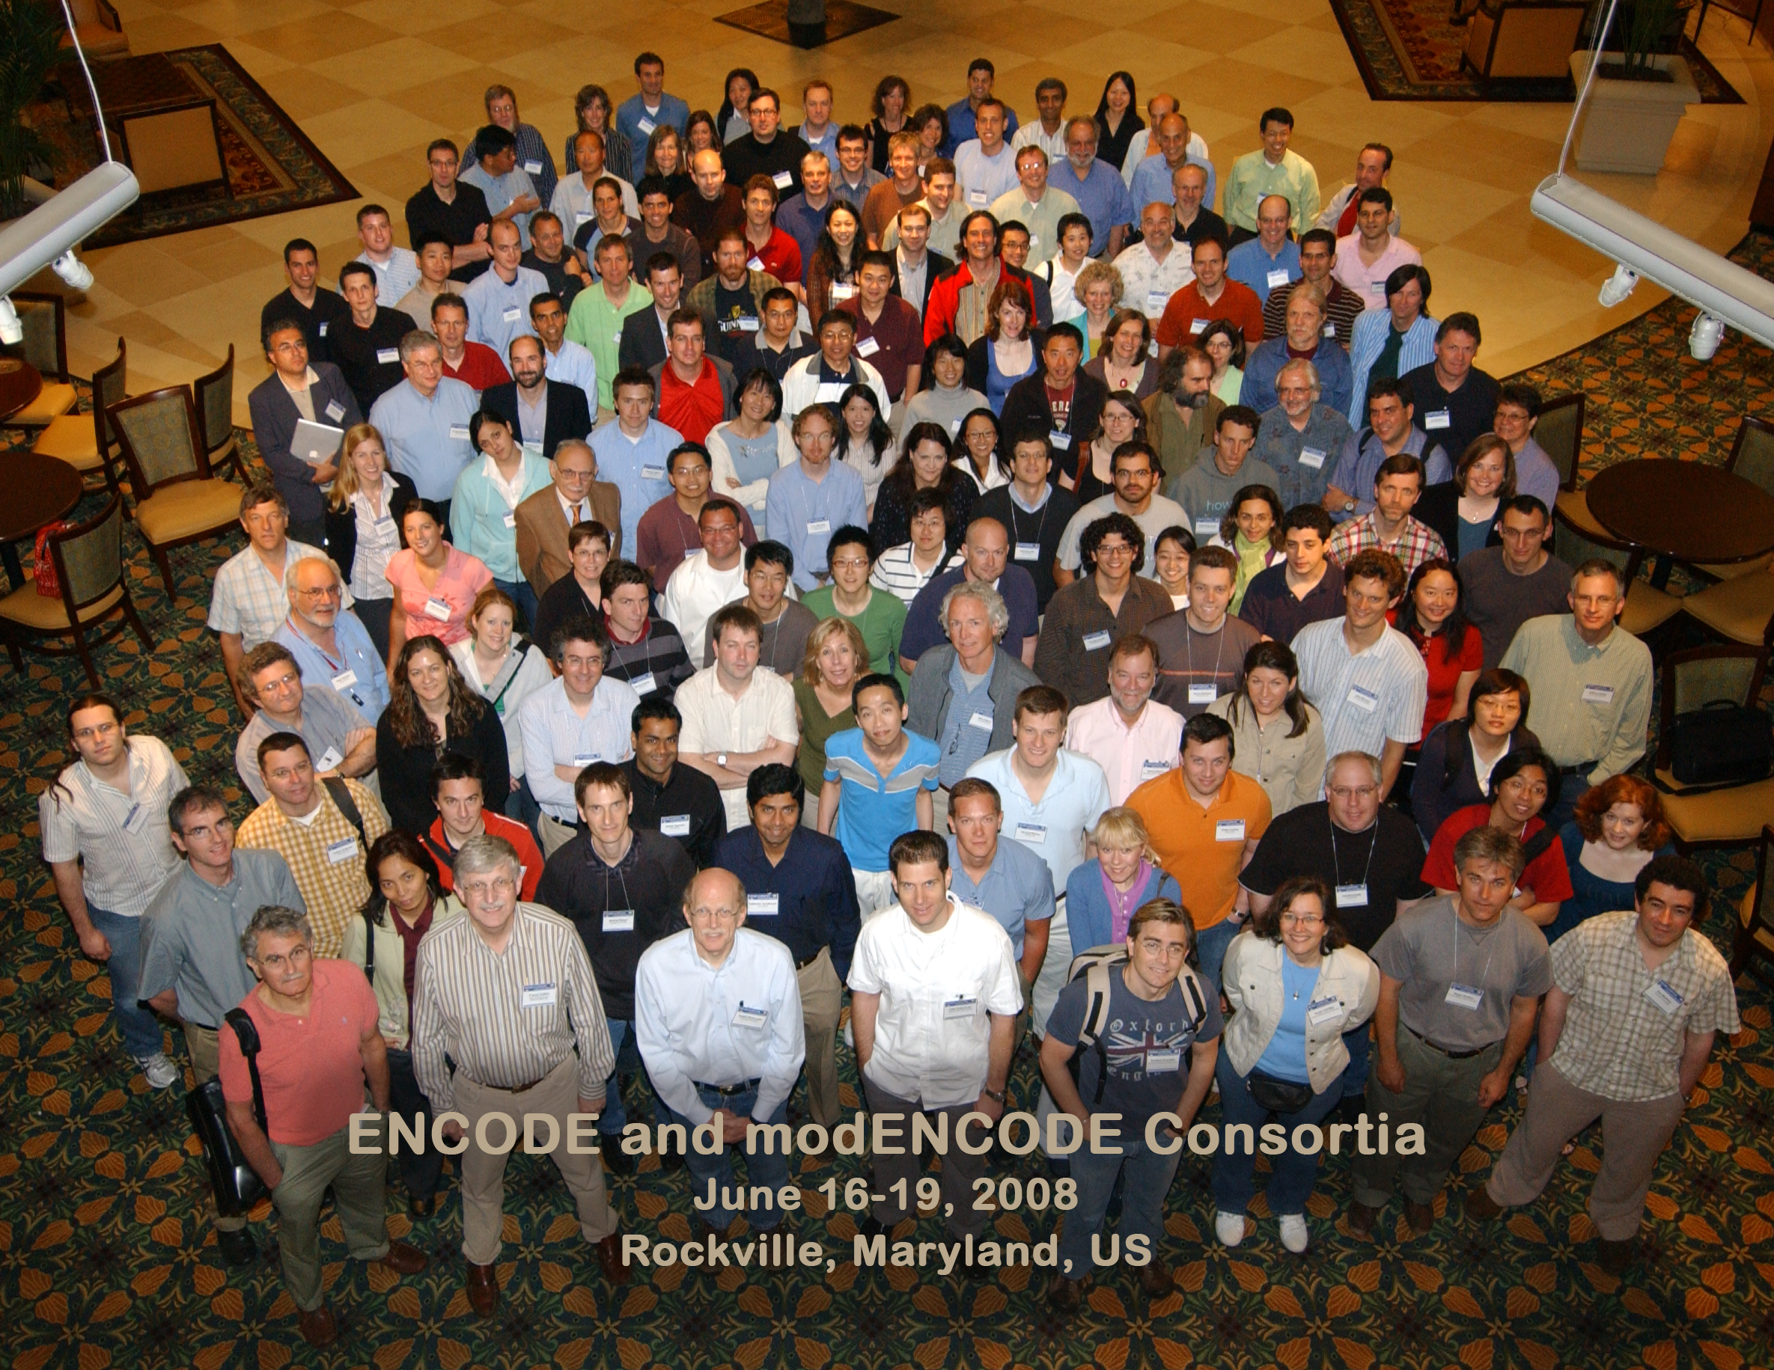

Slide 12

Network
Acknowledgements
A Kundaje, M Hariharan,
S Landt, K Yan, C Cheng,
X Mu, E Khurana,
J Rozowsky,
R Alexander, R Min, P Alves,
A Abyzov, N Addleman, N Bhardwaj,
A Boyle, P Cayting, A Charos, D Chen,
Y Cheng, D Clarke, C Eastman,
G Euskirchen, S Frietze, Y Fu, J Gertz,
F Grubert, A Harmanci, P Jain,
M Kasowski, P Lacroute, J Leng, J Lian,
H Monahan, H O'Geen, Z Ouyang,
E Partridge, D Patacsil, F Pauli, D Raha,
L Ramirez, T Reddy, B Reed, M Shi, T Slifer, J Wang, L Wu, X Yang, K Yip,
G Zilberman-Schapira, S Batzoglou,
A Sidow, P Farnham, R Myers,
S Weissman, M Snyder
(11 Main Projects, ~50 labs, >700 substantial contributors + NHGRI)
Networks/Elements
(~60 participants):
Also:
E Birney, B Wold, J Stam,
T Gingeras, B Bernstein,
R Hardison, Z Weng,
P Bickel, B Noble, M Kellis,
R Guigo, T Hubbard,
J Harrow, E Feingold,
B Graveley, M Pazin, J Kent, M Cherry

Slide 13
ENCODE:
“Evolution” of Approaches to Annotate the Human Genome & Interpret its Variants
Introduction
  Being a happy cog in a 500+ person Big-science project
Evolution of Linear Annotation based on
Functional Genomics
  Chip-Chip, Chip-Seq, Thresholding v Control,
  Segmentation, Multi-scale site calling
Its Relation to Conservation:
An Enduring Puzzle from Pilot to Production
  Many unconstrained regulatory sites
  But finding small number of sites particularly sensitive to mutations
Development of a 2nd Level Network Annotation
  Creating it from the linear annotation &
  connecting it to network science & hubs
  More connectivity, more constraint
New Direction: Applying the Annotation to Prioritize Mutations
  Tools (eg FunSeq) for systematically weighting non-coding features
Postscript
  Culture Clash: Open Data in Genomics v Patient Privacy
  Genomics Legacy: the discipline as a exemplar for Data Science

Slide 14
ENCODE:
“Evolution” of Approaches to Annotate the Human Genome & Interpret its Variants
Introduction
  Being a happy cog in a 500+ person Big-science project
Evolution of Linear Annotation based on
Functional Genomics
  Chip-Chip, Chip-Seq, Thresholding v Control,
  Segmentation, Multi-scale site calling
Its Relation to Conservation:
An Enduring Puzzle from Pilot to Production
  Many unconstrained regulatory sites
  But finding small number of sites particularly sensitive to mutations
Development of a 2nd Level Network Annotation
  Creating it from the linear annotation &
  connecting it to network science & hubs
  More connectivity, more constraint
New Direction: Applying the Annotation to Prioritize Mutations
  Tools (eg FunSeq) for systematically weighting non-coding features
Postscript
  Culture Clash: Open Data in Genomics v Patient Privacy
  Genomics Legacy: the discipline as a exemplar for Data Science

Slide 15
ChIP-seq vs ChIP-chip: Much cleaner signal from sequencing than arrays
[Rozowsky et al. Nat. Biotech ('09)]

Slide 16
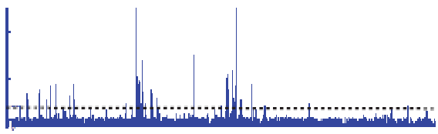

Summarizing the Signal:
"Traditional" ChipSeq Peak Calling
Generate & threshold the signal profile to identify candidate target regions
  Simulation (PeakSeq)
  Local window based Poisson (MACS)
  Fold change statistics (SPP)
ChIP
Threshold
Potential Targets
Normalized Control
Score against the control
Significantly Enriched targets
[Rozowsky et al. ('09) Nat Biotech]

Slide 17
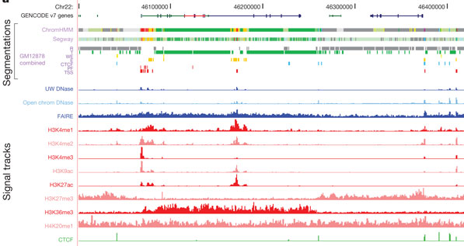
Multi-track analysis: Segmentation
[Encode Consortium (’12), Nature; Ernst & Kellis, Hoffman & Noble]

Slide 18
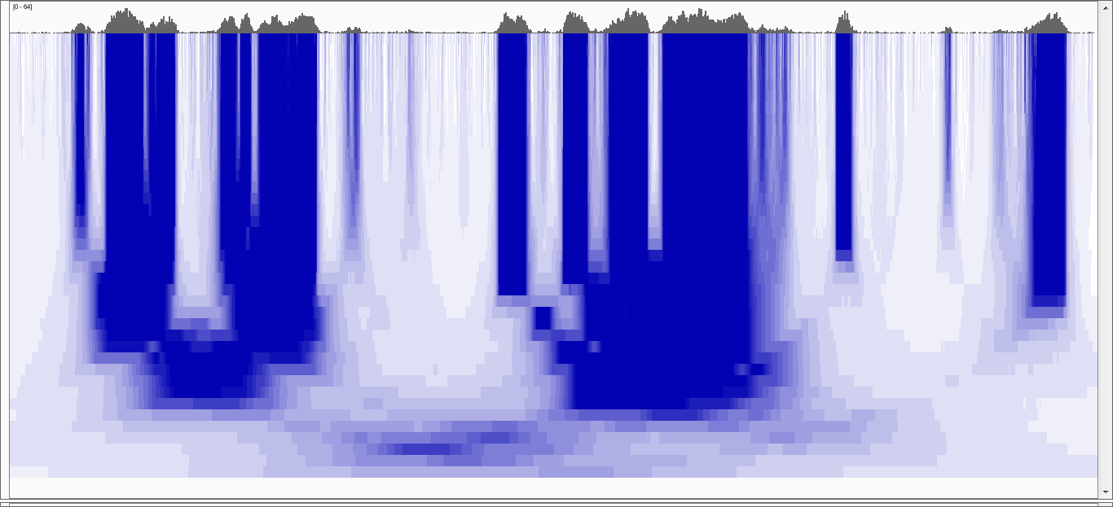
Multiscale Decomposition
Very
Punctate
ER
20kb
Broader
ER
Punctate
ER
Broad
ER
100 b
Increasing Scale
Very Broad
ER
100 kb
[Harmanci et al, Genome Biol. ('14)]
Notes:
In comparison with Gaussian decomp, median based decomp conserves the enriched regions upto a certain scale then removes them completely. Unlike
Gaussian, where all the signal features are transferred till the highest scale in the decomposition. This property makes median filtering a better candidate
For analysing the which scales levels are enriched in the signal

Slide 19
ENCODE:
“Evolution” of Approaches to Annotate the Human Genome & Interpret its Variants
Introduction
  Being a happy cog in a 500+ person Big-science project
Evolution of Linear Annotation based on
Functional Genomics
  Chip-Chip, Chip-Seq, Thresholding v Control,
  Segmentation, Multi-scale site calling
Its Relation to Conservation:
An Enduring Puzzle from Pilot to Production
  Many unconstrained regulatory sites
  But finding small number of sites particularly sensitive to mutations
Development of a 2nd Level Network Annotation
  Creating it from the linear annotation &
  connecting it to network science & hubs
  More connectivity, more constraint
New Direction: Applying the Annotation to Prioritize Mutations
  Tools (eg FunSeq) for systematically weighting non-coding features
Postscript
  Culture Clash: Open Data in Genomics v Patient Privacy
  Genomics Legacy: the discipline as a exemplar for Data Science

Slide 20
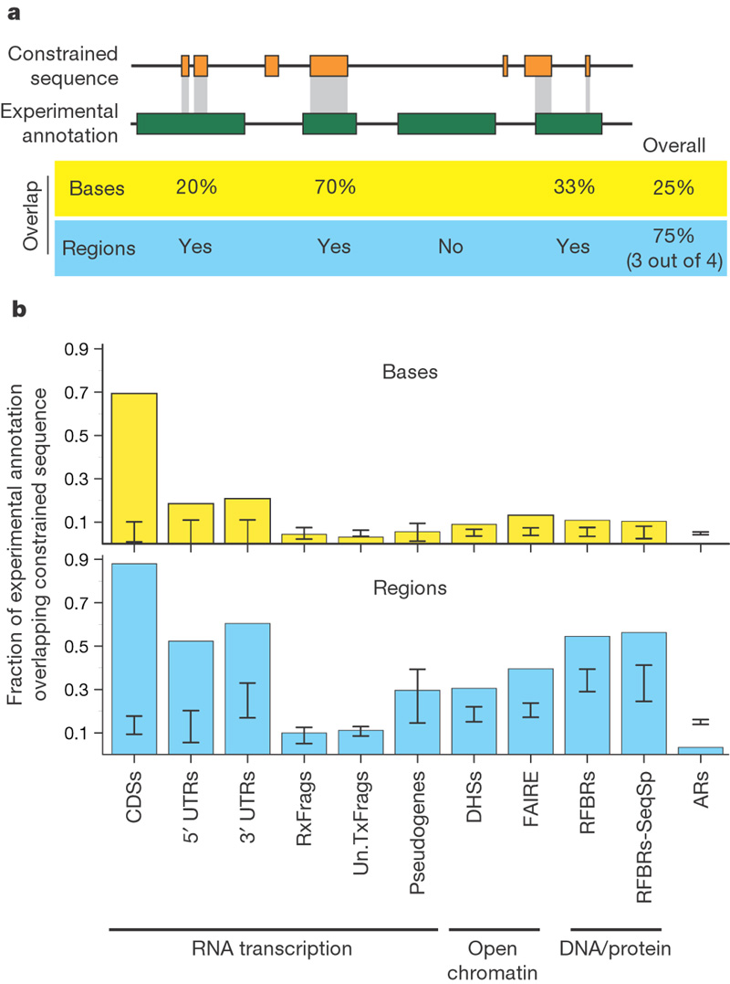
A Puzzle from the Pilot: Why so much biochemical activity w/o Sequence Constraints
"At the outset of the ENCODE Project, many believed that the broad collection of experimental data would nicely dovetail with the detailed evolutionary information derived from comparing multiple mammalian sequences to provide a neat ‘dictionary’ of conserved genomic elements, each with a growing annotation about their biochemical function(s). In one sense, this was achieved; the majority of constrained bases in the ENCODE regions are now associated with at least some experimentally-derived information about function. However, we have also encountered a remarkable excess of unconstrained experimentally-identified functional elements, and these cannot be dismissed for technical reasons. This is perhaps the biggest surprise of the pilot phase of the ENCODE Project, and suggests that we take a more ‘neutral’ view of many of the functions conferred by the genome. "
TFBS
CDS
[ENCODE Consortium, Nature 447, 2007]

Slide 21
Many Regulatory Sites still unconstrained in Model Organism Analysis (Worm)
[Science 330:6012]

Slide 22
Finding "Conserved” Sites in the Human Population:
Negative selection in non-coding elements based on
Production ENCODE & 1000G Phase 1
Broad categories of regulatory regions under negative selection
Related to:
ENCODE, Nature, 2012
Ward & Kellis, Science, 2012
Mu et al, NAR, 2011
(Non-coding RNA)
(DNase I hypersensitive sites)
(TFSS: Sequence-specific TFs)
(Transcription factor binding sites)
Depletion of Common Variants
in the Human Population
[Khurana et al., Science (‘13)]

Slide 23
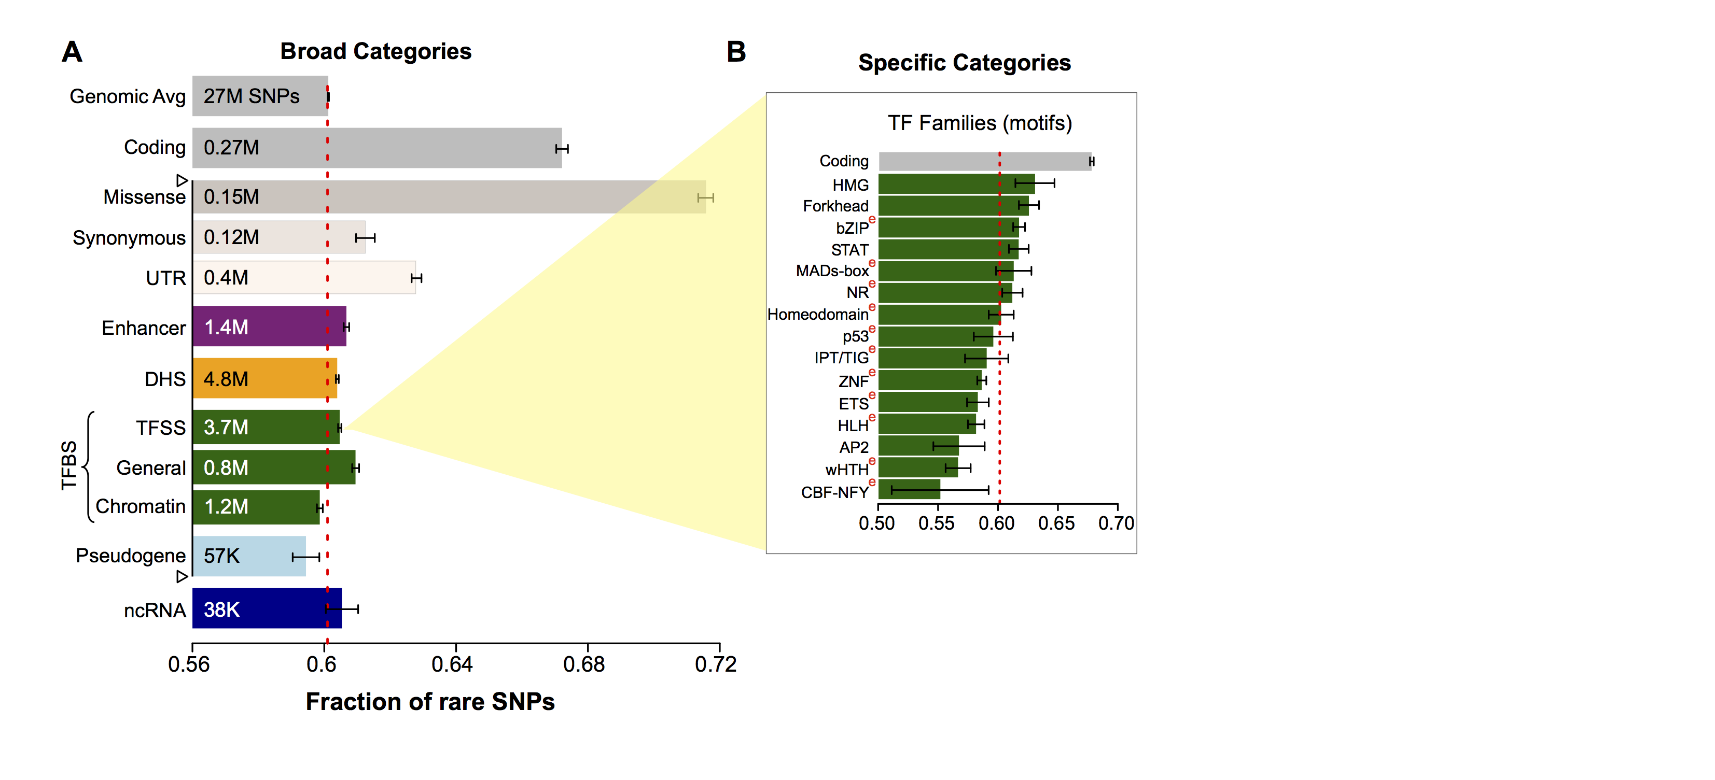
Differential selective constraints among specific sub-categories
Sub-categorization possible because of better statistics from 1000G phase 1 v pilot
[Khurana et al., Science (‘13)]

Slide 24
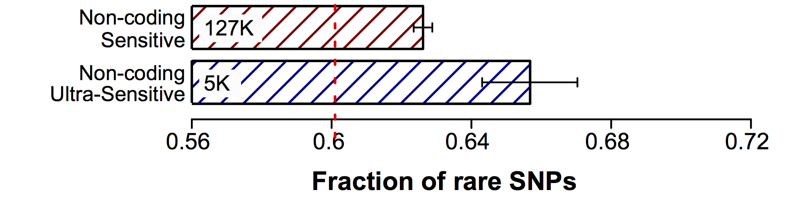
Defining Sensitive non-coding Regions
~0.4% genomic coverage (~ top 25)
~0.02% genomic coverage (top 5)
Start 677 high-resolution non-coding categories; Rank & find those under strongest selection
Sub-categorization possible because of better statistics from 1000G phase 1 v pilot
[Khurana et al., Science (‘13)]

Slide 25
ENCODE:
“Evolution” of Approaches to Annotate the Human Genome & Interpret its Variants
Introduction
  Being a happy cog in a 500+ person Big-science project
Evolution of Linear Annotation based on
Functional Genomics
  Chip-Chip, Chip-Seq, Thresholding v Control,
  Segmentation, Multi-scale site calling
Its Relation to Conservation:
An Enduring Puzzle from Pilot to Production
  Many unconstrained regulatory sites
  But finding small number of sites particularly sensitive to mutations
Development of a 2nd Level Network Annotation
  Creating it from the linear annotation &
  connecting it to network science & hubs
  More connectivity, more constraint
New Direction: Applying the Annotation to Prioritize Mutations
  Tools (eg FunSeq) for systematically weighting non-coding features
Postscript
  Culture Clash: Open Data in Genomics v Patient Privacy
  Genomics Legacy: the discipline as a exemplar for Data Science

Slide 26
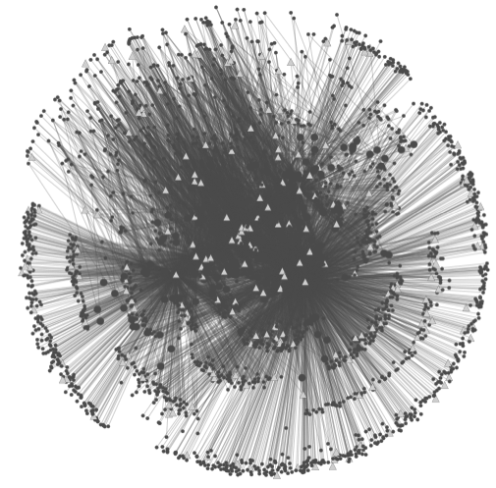
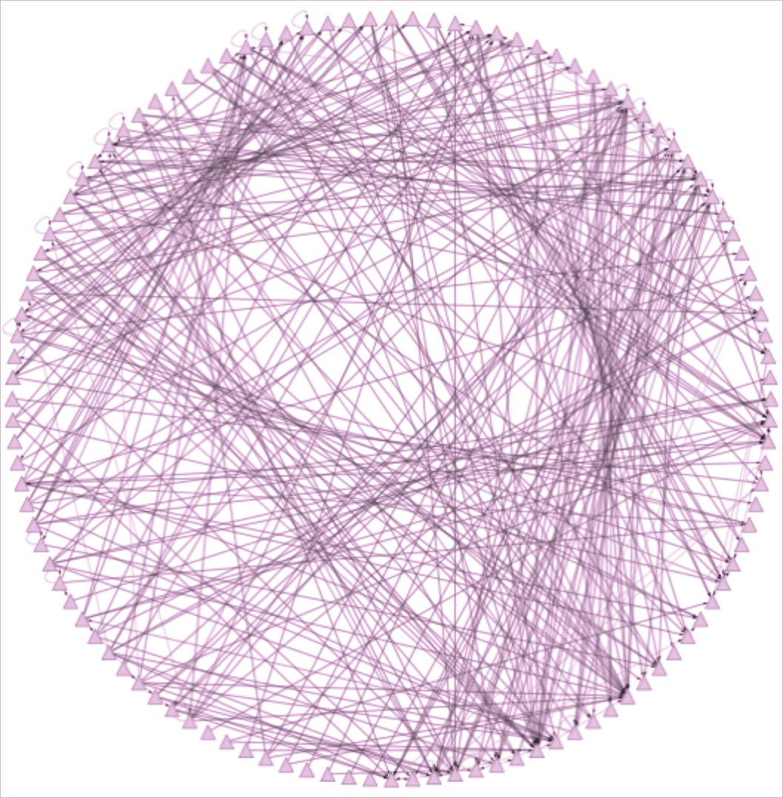
Relating Non-coding Annotation to Protein-coding Genes via Networks
[ Cheng et al., Bioinfo. ('11),
Gerstein et al., Nature ('12) ,
Yip et al., GenomeBiology ('12),
Fu et al., GenomeBiology('14) ]
Regulatory elements
TF
Assigning proximal sites (< 1Kb) to target genes
Proximal
Edge
~500K Prox. Edges
Filtering
~26K
Assigning distal sites (10Kb-1Mb) to targets
TF
Distal
Edge
~700K Edges
Distal signals
Expression levels
Methylation
H3K27ac
...
Gene 1
Gene 2
Gene 3
...
Scale
GM12878
Strong
Cell lines
H1-hESC
HeLa-S3
Connecting Distal Elements
via Activity Correlations.
Other strategies to create linkage incl. eQTL and Hi-C. Much in recent Epigenomics Roadmap.
Hep-G2
K562
...
Weak

Slide 27
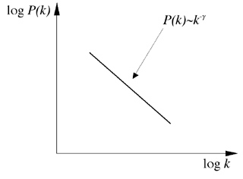
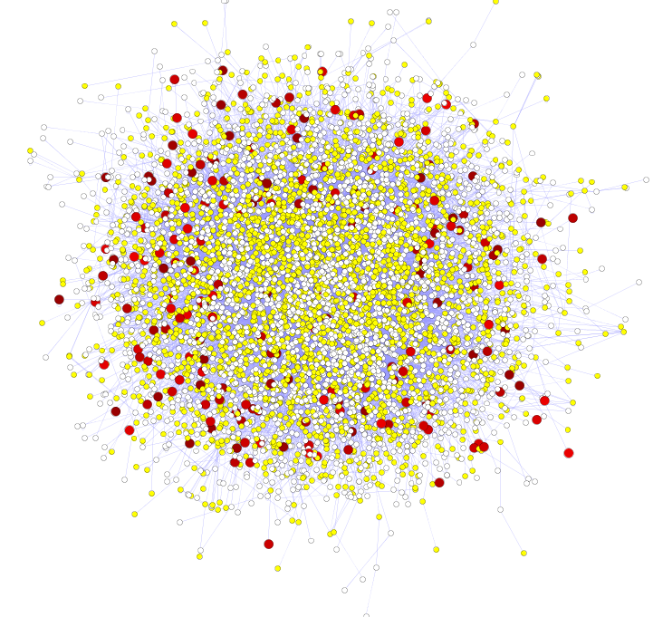
Hubs Under Constraint:
A Finding from the Network Biology Community
Power-law distribution
Hub
log(Frequency)
High likelihood of positive selection
Not under positive selection
Lower likelihood of positive selection
No data about positive selection
log(Degree)
[Nielsen et al. PLoS Biol. (2005), HPRD, Kim et al. PNAS (2007)]
More Connectivity, More Constraint: Genes & proteins that have a more central position in the network tend to evolve more slowly and are more likely to be essential.
This phenomenon is observed in
many organisms & different kinds of networks
  yeast PPI - Fraser et al ('02) Science,
  ('03) BMC Evo. Bio.
  Ecoli PPI - Butland et al ('04) Nature
  Worm/fly PPI - Hahn et al ('05) MBE
  miRNA net - Cheng et al ('09) BMC Genomics

Slide 28
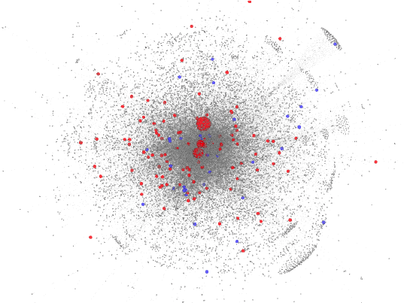
Regulatory Hubs are more Essential
Unified network
degree (log scale)
LoF-tolerant
Essential
Proximal Regulatory Network
Total degree (IN + OUT)
(log scale)
LoF-tolerant genes
Essential genes
Size of nodes scaled by total degree
LoF-tolerant
Essential
[Khurana et al., PLOS Comp. Bio. ’13]

Slide 29
ENCODE:
“Evolution” of Approaches to Annotate the Human Genome & Interpret its Variants
Introduction
  Being a happy cog in a 500+ person Big-science project
Evolution of Linear Annotation based on
Functional Genomics
  Chip-Chip, Chip-Seq, Thresholding v Control,
  Segmentation, Multi-scale site calling
Its Relation to Conservation:
An Enduring Puzzle from Pilot to Production
  Many unconstrained regulatory sites
  But finding small number of sites particularly sensitive to mutations
Development of a 2nd Level Network Annotation
  Creating it from the linear annotation &
  connecting it to network science & hubs
  More connectivity, more constraint
New Direction: Applying the Annotation to Prioritize Mutations
  Tools (eg FunSeq) for systematically weighting non-coding features
Postscript
  Culture Clash: Open Data in Genomics v Patient Privacy
  Genomics Legacy: the discipline as a exemplar for Data Science

Slide 30
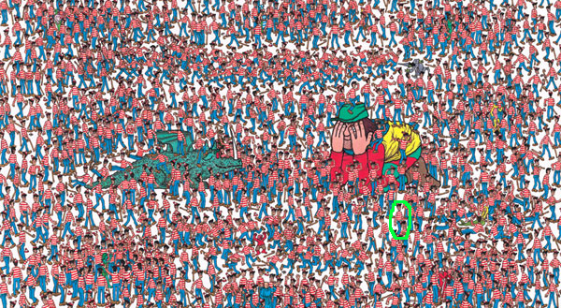
Where is Waldo?
(Finding the key mutations in ~4M Germline variants &
~5K Somatic Variants in a Tumor Sample)

Slide 31
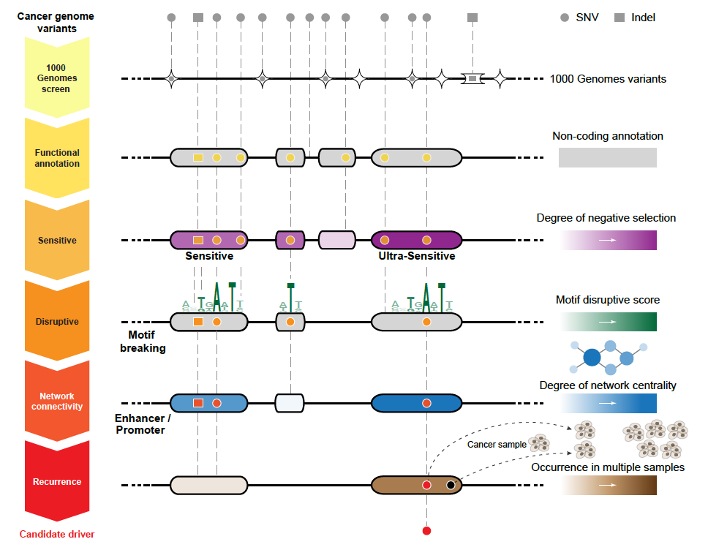
Applying Linear & Network Annotation to Prioritize Somatic Mutations as Possible Drivers
FunSeq
Other Tools
for
non-coding
prioritization:
HaploReg,
VEP,
CADD….
[Khurana et al., Science (‘13)]

Slide 32
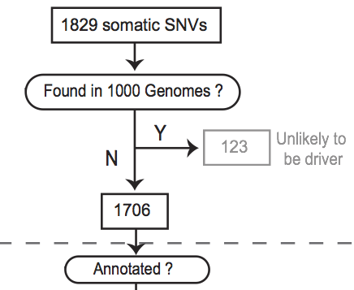
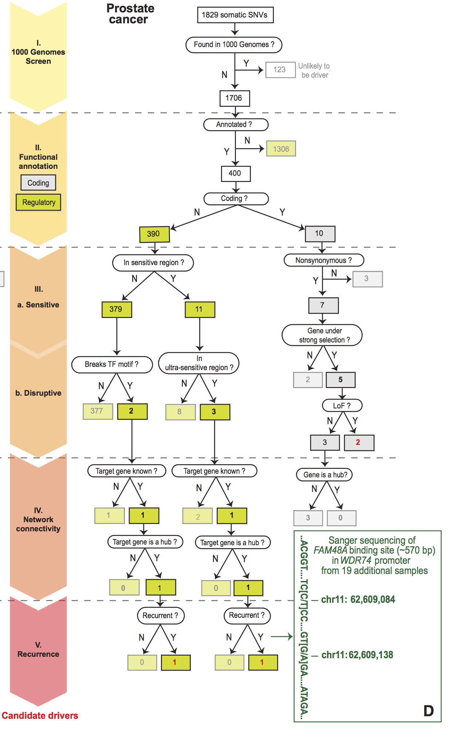
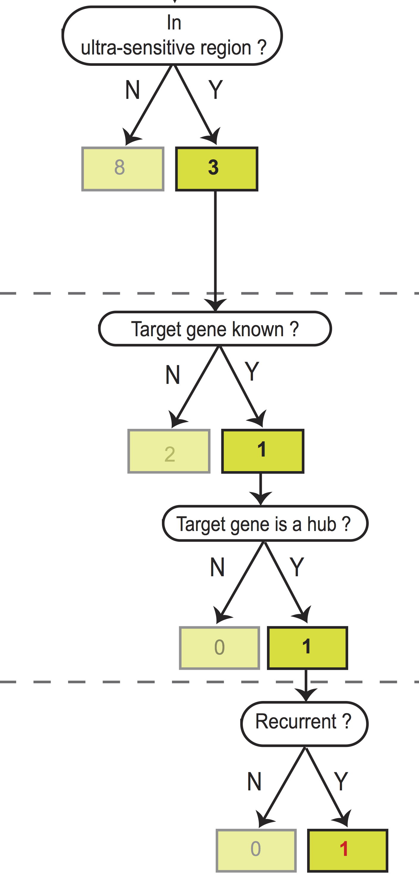
Start: 1829
Somatic SNVs
Flowchart for 1 Prostate Cancer Genome (from Berger et al. '11)
[Khurana et al., Science (‘13)]
End: 1 Somatic SNV in ultra-sensitive region & hub. Potential non-coding Driver
Notes:
Just have one path

Slide 33
ENCODE:
“Evolution” of Approaches to Annotate the Human Genome & Interpret its Variants
Introduction
  Being a happy cog in a 500+ person Big-science project
Evolution of Linear Annotation based on
Functional Genomics
  Chip-Chip, Chip-Seq, Thresholding v Control,
  Segmentation, Multi-scale site calling
Its Relation to Conservation:
An Enduring Puzzle from Pilot to Production
  Many unconstrained regulatory sites
  But finding small number of sites particularly sensitive to mutations
Development of a 2nd Level Network Annotation
  Creating it from the linear annotation &
  connecting it to network science & hubs
  More connectivity, more constraint
New Direction: Applying the Annotation to Prioritize Mutations
  Tools (eg FunSeq) for systematically weighting non-coding features
Postscript
  Culture Clash: Open Data in Genomics v Patient Privacy
  Genomics Legacy: the discipline as a exemplar for Data Science

Slide 34
ENCODE:
“Evolution” of Approaches to Annotate the Human Genome & Interpret its Variants
Introduction
  Being a happy cog in a 500+ person Big-science project
Evolution of Linear Annotation based on
Functional Genomics
  Chip-Chip, Chip-Seq, Thresholding v Control,
  Segmentation, Multi-scale site calling
Its Relation to Conservation:
An Enduring Puzzle from Pilot to Production
  Many unconstrained regulatory sites
  But finding small number of sites particularly sensitive to mutations
Development of a 2nd Level Network Annotation
  Creating it from the linear annotation &
  connecting it to network science & hubs
  More connectivity, more constraint
New Direction: Applying the Annotation to Prioritize Mutations
  Tools (eg FunSeq) for systematically weighting non-coding features
Postscript
  Culture Clash: Open Data in Genomics v Patient Privacy
  Genomics Legacy: the discipline as a exemplar for Data Science

Slide 35

Culture Clash: Open Data in Genomics v Patient Privacy
Open Data, Open Source, &c is the culture of Genomics (“its meta-DNA”)
  Origins in worm project
Strong Reasons for Genomic Privacy in the Future
  Personal Genomic info. essentially meaningless currently but will it be in 20 yrs? 50 yrs?
  Genomic sequence very revealing about one’s children
  Once put on the web it can’t be taken back
[D Greenbaum & M Gerstein (’08). Am J. Bioethics; D Greenbaum & M Gerstein, Hartford Courant, 10 Jul. '08 ; SF Chronicle, 2 Nov. '08;
Greenbaum et al. PLOS CB (‘11) ; Greenbaum & Gerstein ('13), The Scientist; Photo from NY Times]

Slide 36
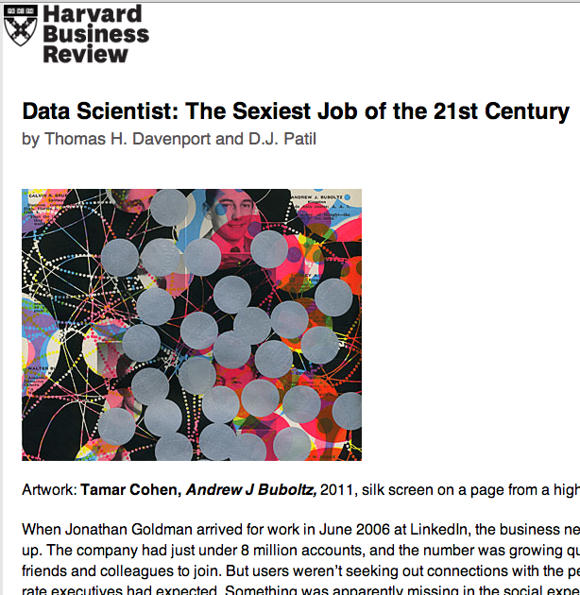
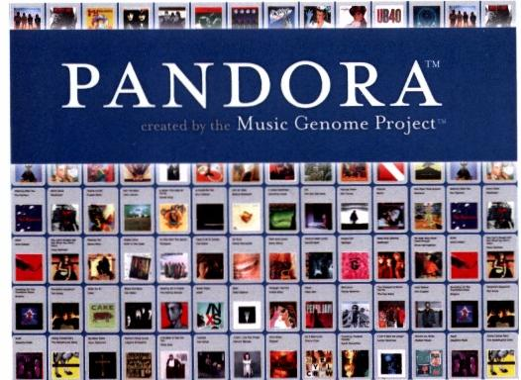
Legacy of Human Genome Annotation?
Is it an early exemplar for Data Science
[Oct. ‘12 issue]

Slide 37
Info about content in this slide pack
General PERMISSIONS
  This Presentation is copyright Mark Gerstein,
  Yale University, 2015.
  Please read permissions statement at
  http://www.gersteinlab.org/misc/permissions.html .
  Feel free to use slides & images in the talk with PROPER acknowledgement
  (via citation to relevant papers or link to gersteinlab.org).
  Paper references in the talk were mostly from Papers.GersteinLab.org.
For SeqUniverse slide, please contact Heidi Sofia, NHGRI
PHOTOS & IMAGES. For thoughts on the source and permissions of many of the photos and clipped images in this presentation see http://streams.gerstein.info .
  In particular, many of the images have particular EXIF tags, such as kwpotppt , that can be easily queried from flickr, viz: http://www.flickr.com/photos/mbgmbg/tags/kwpotppt

Slide 38
MUSIC makes music
-get_multiscale_music: Generates a .wav file using the aggregate multiscale decomposition
Listen to K562 H3K36me3 chromosome 1: http://archive.gersteinlab.org/proj/MUSIC/music/H3K36me3.mp3
  Telomeres are vocal, centromeres (46:00-53:00) are silent
Listen K562 H3K4me3 chromosome 1: http://archive.gersteinlab.org/proj/MUSIC/music/H3K4me3.mp3
  More “clicky” than H3K36me3 with more punctate enriched regions

Slide 39
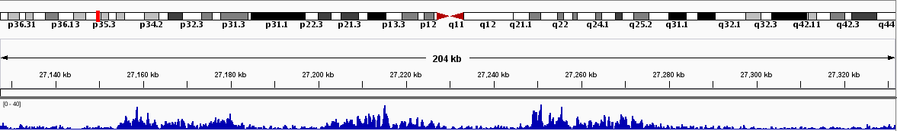
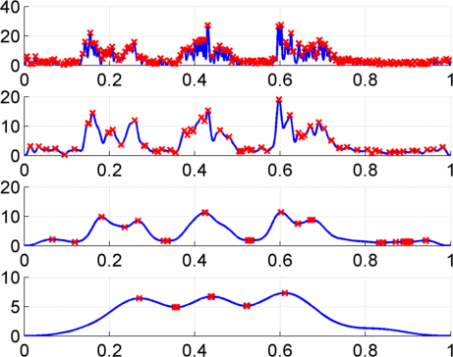
Multiscale Analysis, Minima/Maxima based Coarse Segmentation
Multiscale analysis is a natural way to analyze the ChIP-Seq data
Window Length
1kb
4kb
Harmanci et al, Genome Biology 2014, MUSIC.gersteinlab.org
16kb
Maxima
64kb
Minima
Notes:
Shown is the H3K36me3 track over 200kb regions with 3 active genes, indicated by green lines. The signal increases on the 3 genes. Our problem is to identify 3 enriched regions corresponding to these 3 genes. Thresholding usually overfragments these regions. To get around this issue, we apply a a multiscale filtering that smooths the signal with a sliding window using different window lengths, or scale lengths. At the top scale one can see that 3 peaks are identified.

Slide 40
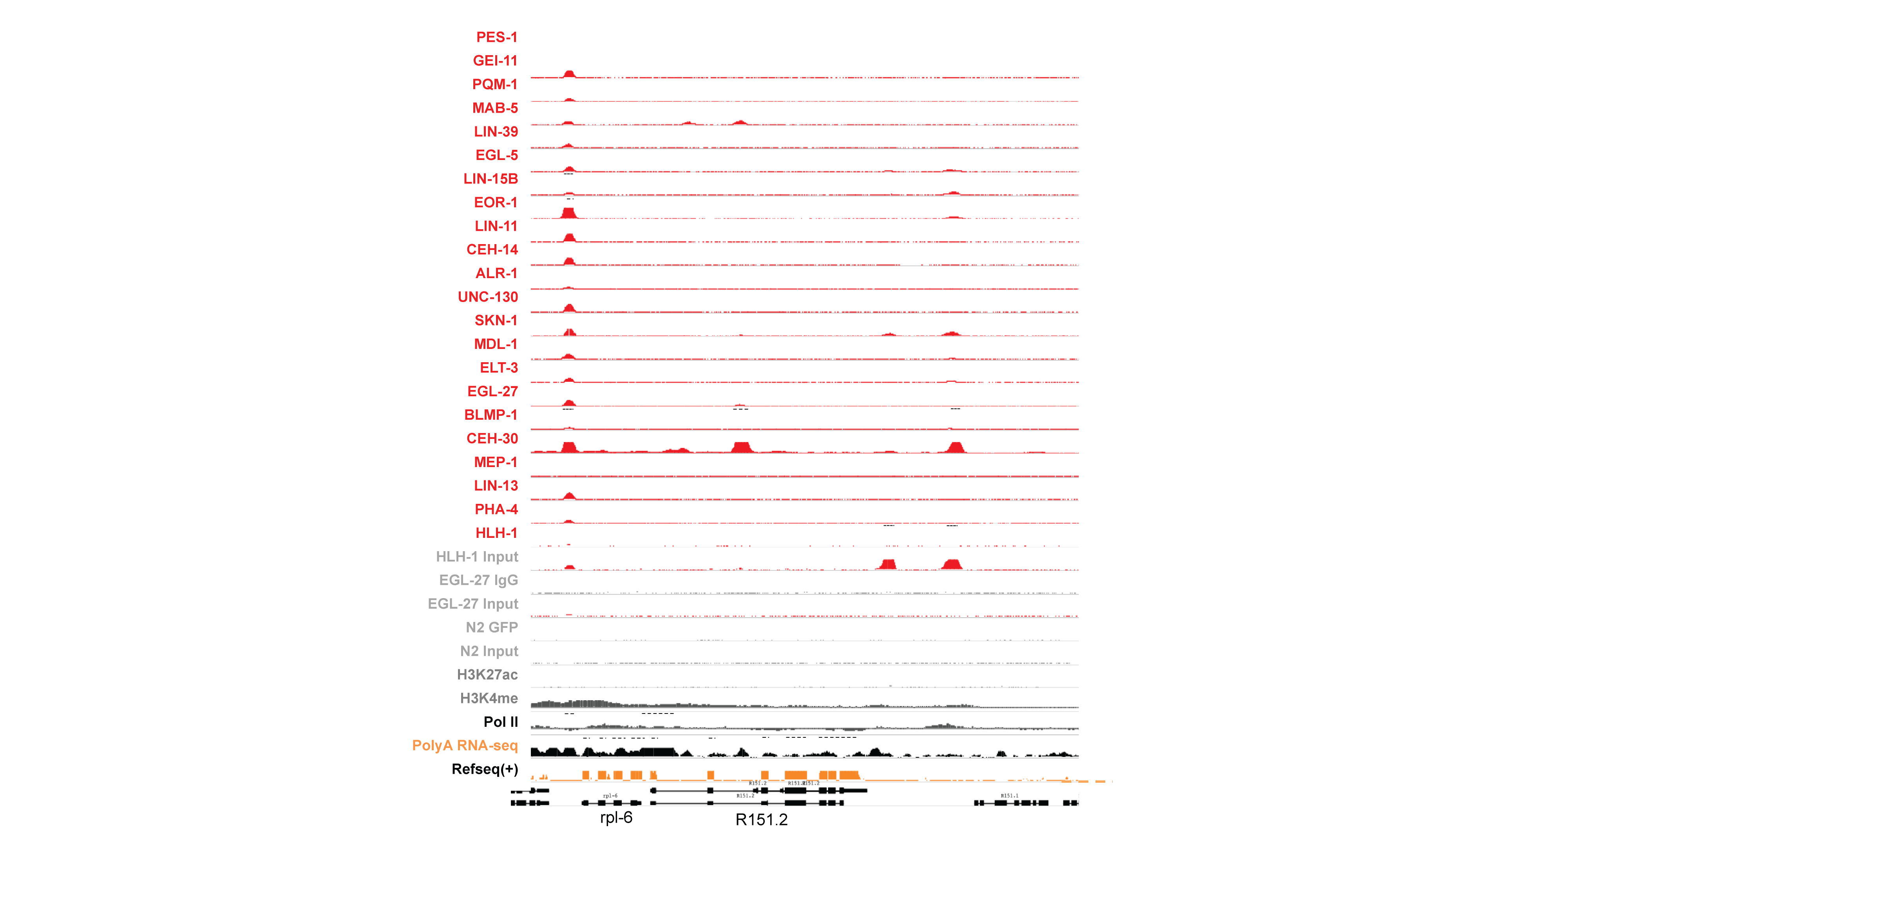
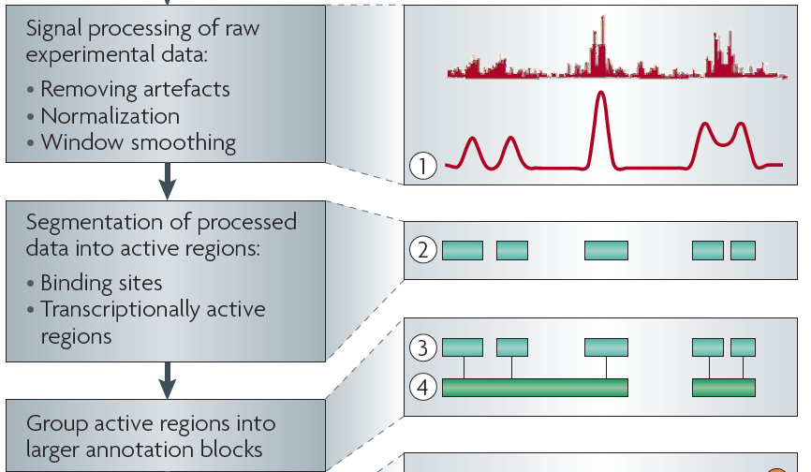
Sources of Annotation:
Comparative
&
Functional
[Nat. Rev. Genet. (2010) 11: 559]
[Science 330:6012]

Slide 41
Multinet – the ultimate hairball!
Genes participate in many networks and no single network captures the global picture of gene interactions
Combine regulatory interactions with other networks : physical protein-protein, signaling, metabolic, phosphorylation and genetic to create a unified network (Multinet)
Nodes: ~15,000 genes
Edges: ~110,000 interactions
Edges shown in gray
[Khurana et al., PLOS Comp. Bio. ’13]

Slide 42
Centrality in Gene Networks Weakly Associated with Essentiality
Proximal Regulatory Network
PPI degree (log scale)
Higher
Centrality
In PPI
Total degree (IN + OUT)
(log scale)
Num of interfaces
More interaction interfaces
LoF-tolerant
Essential
LoF-tolerant
Essential
Khurana et al., PLoS Comp. Bio., 2013
[Nielsen et al. PLoS Biol. (2005), HPRD, Kim et al. PNAS (2007)]

Slide 43
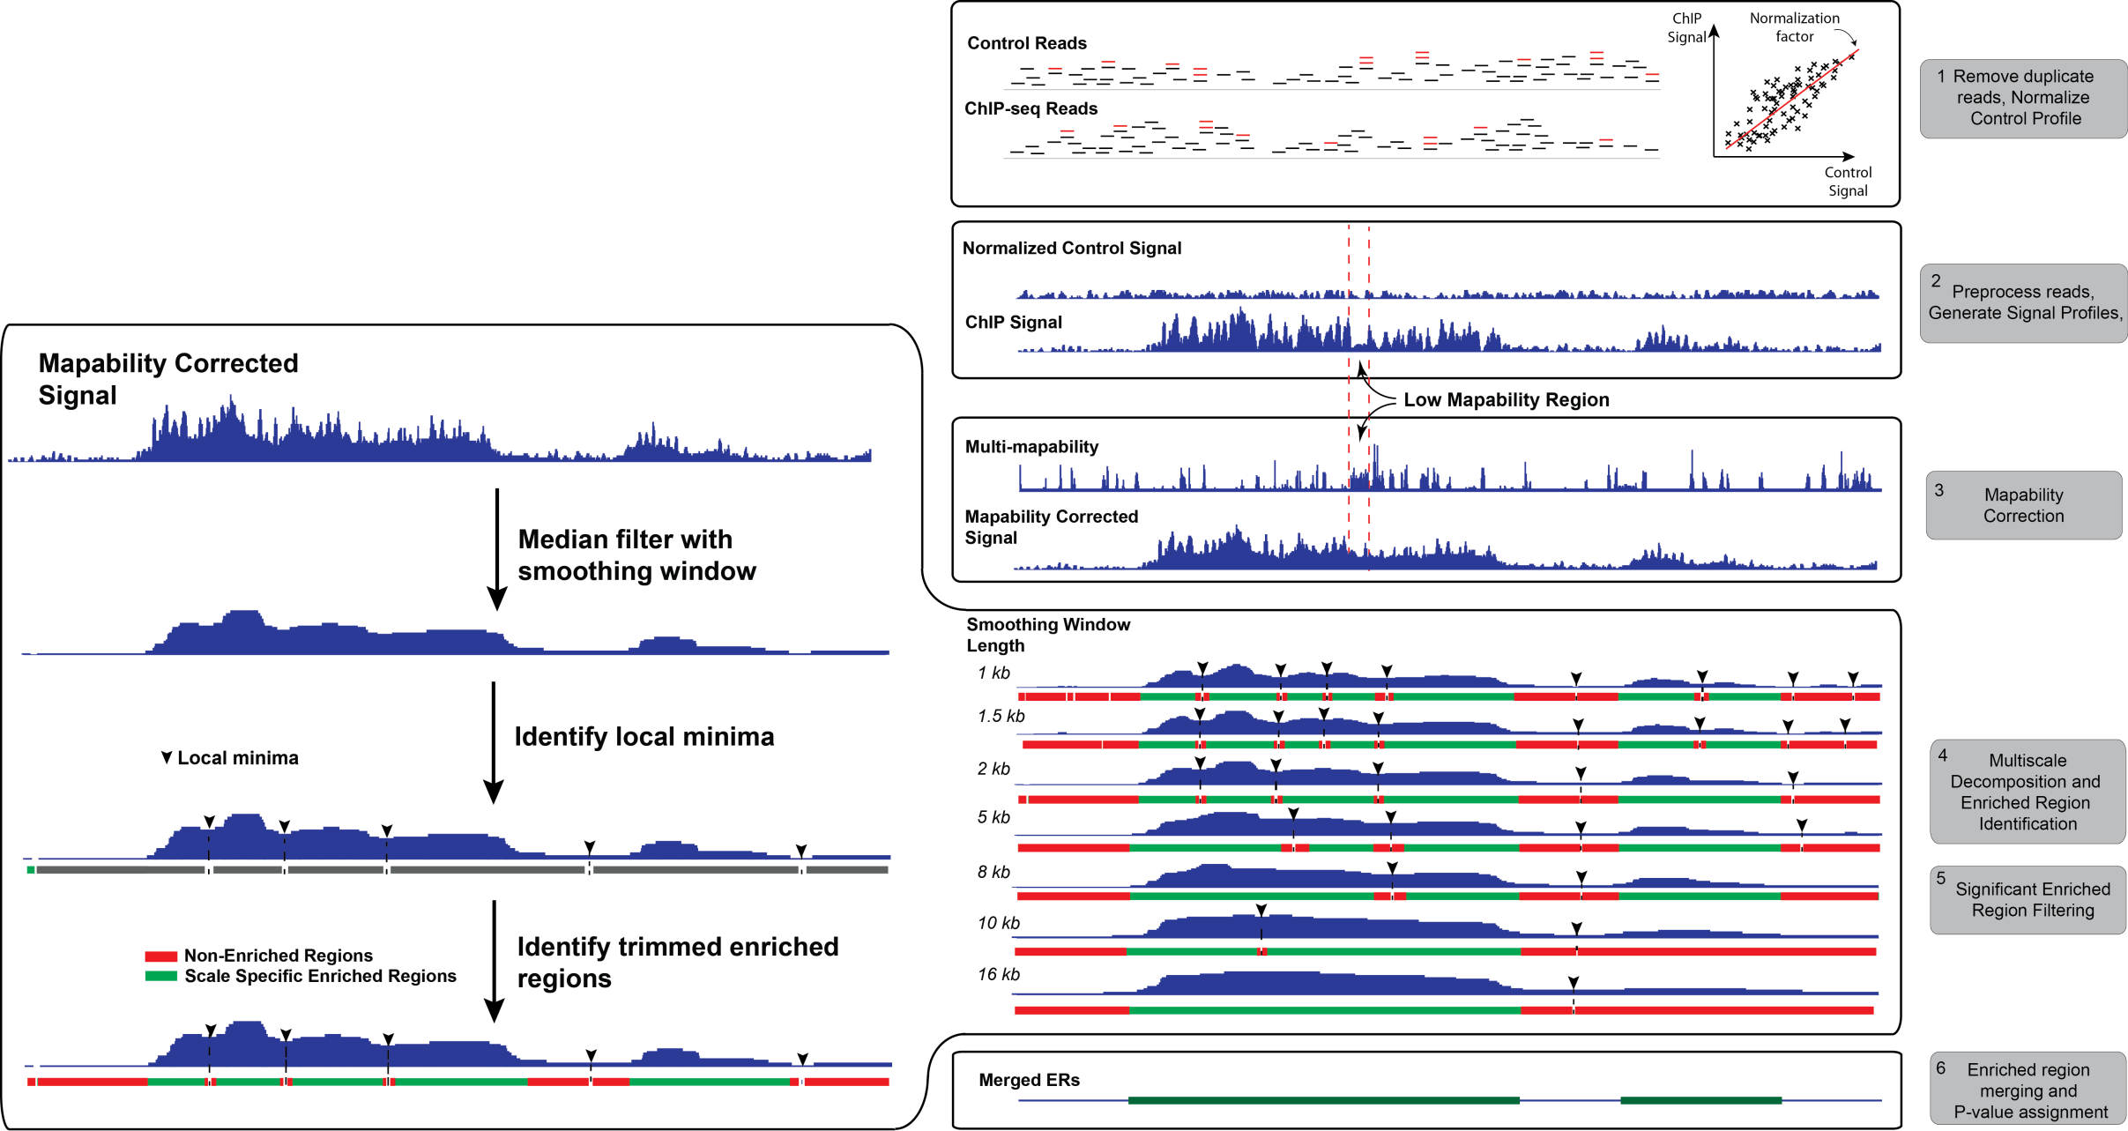
MUSIC.gersteinlab.org
Algorithm
Mapability Correction
Multi-scale Peak Calling
[Harmanci et al, Genome Biol. ('14)]
Notes:
Put all these together

Slide 44
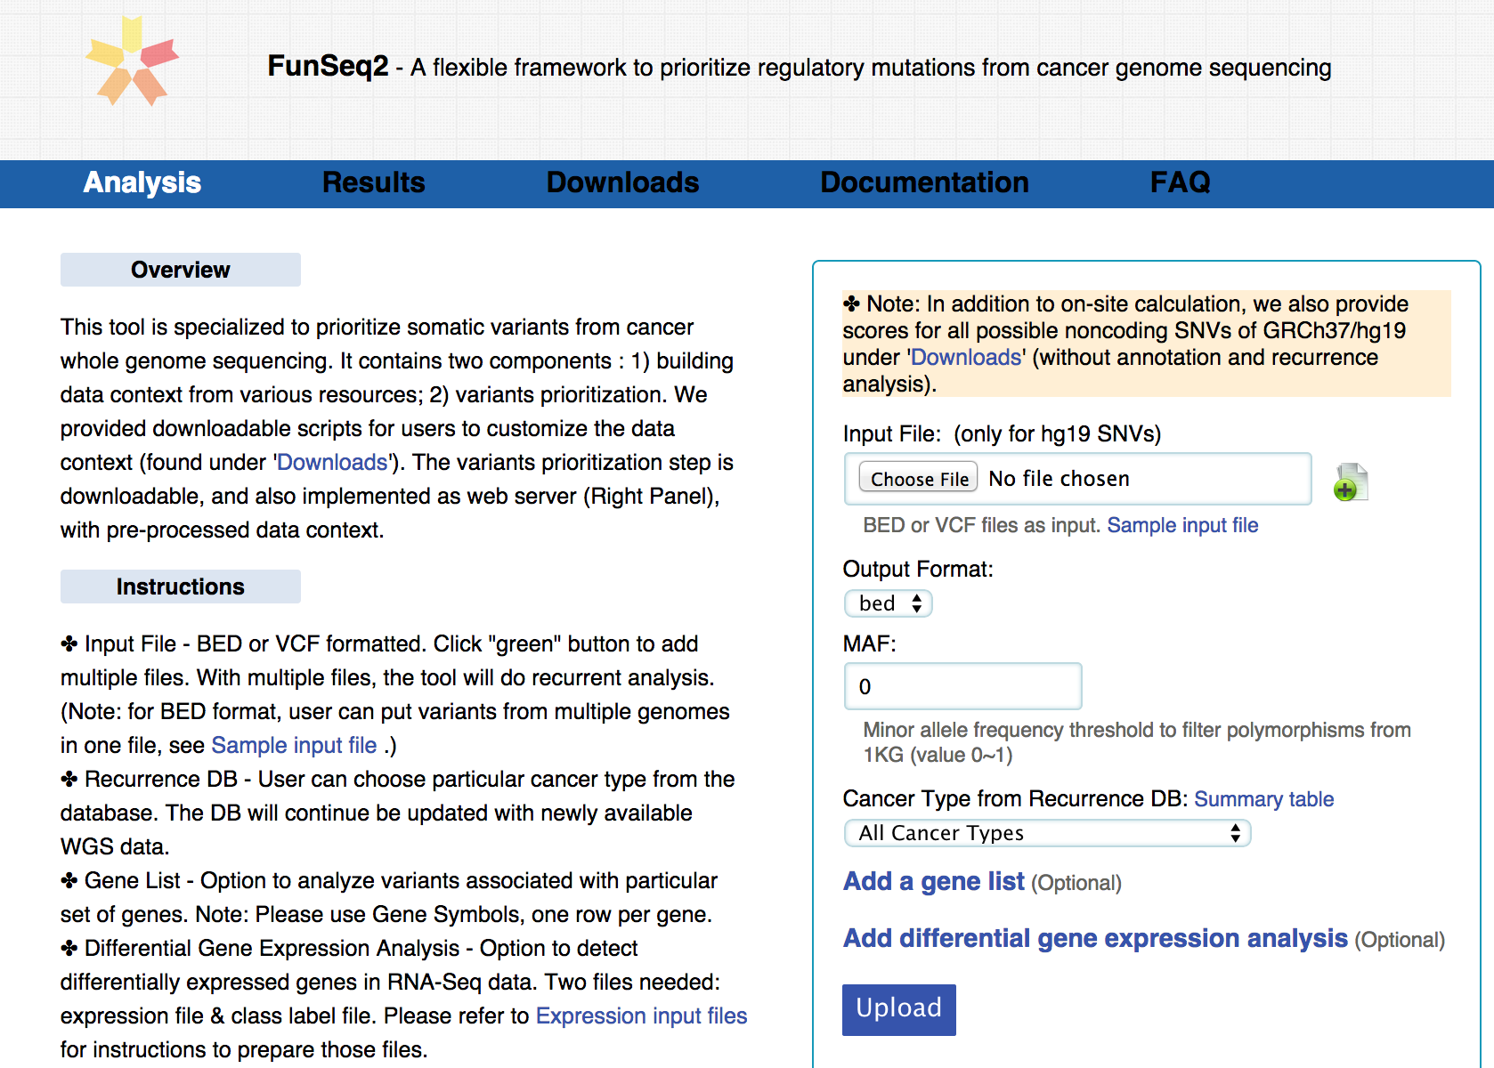
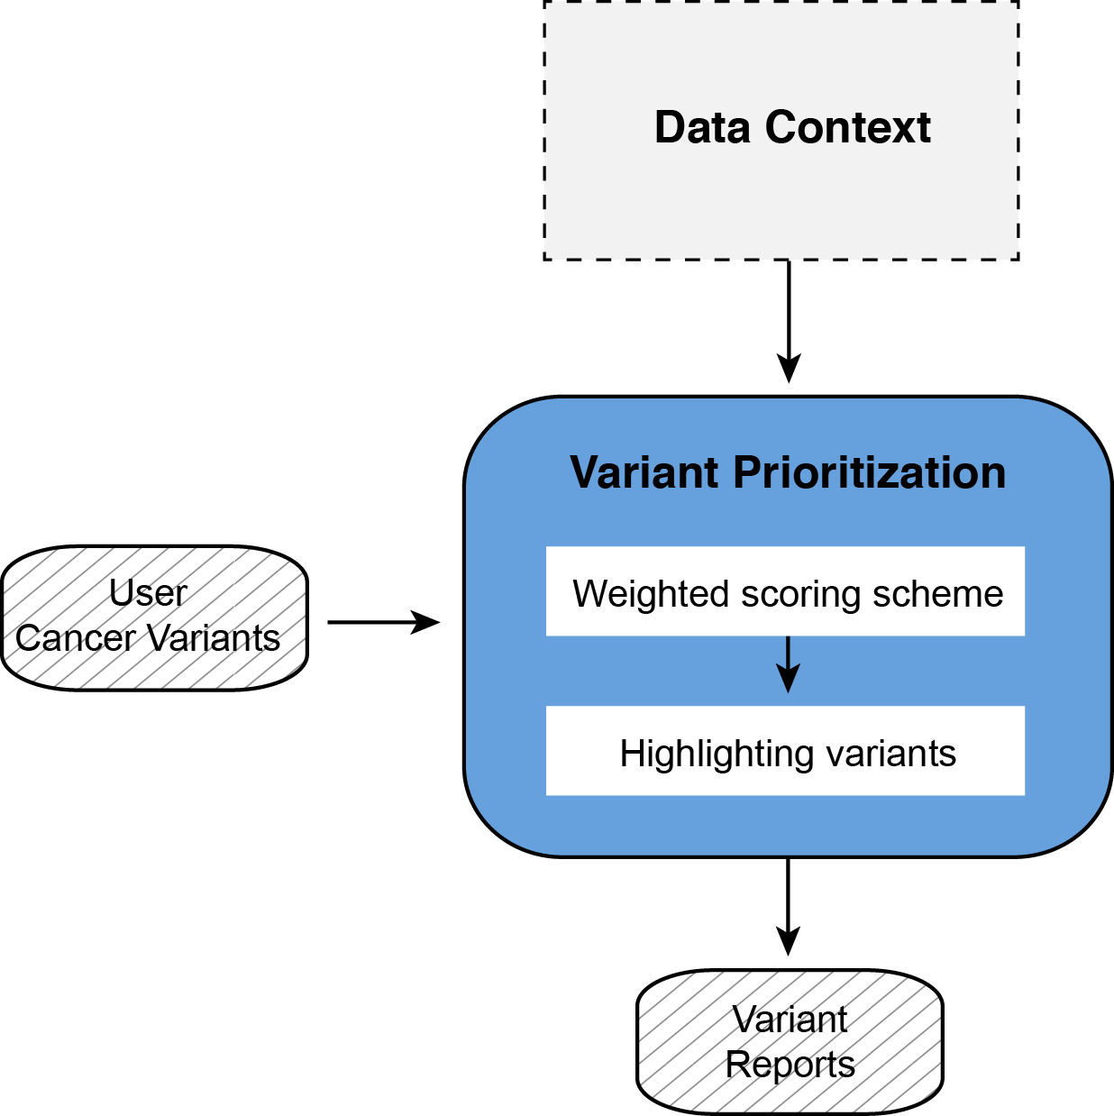
Site integrates user variants with large-scale context
~5 Tb (rebuilt slowly)
FunSeq.gersteinlab.org
~5K
[Fu et al., GenomeBiology ('14)]

Slide 45
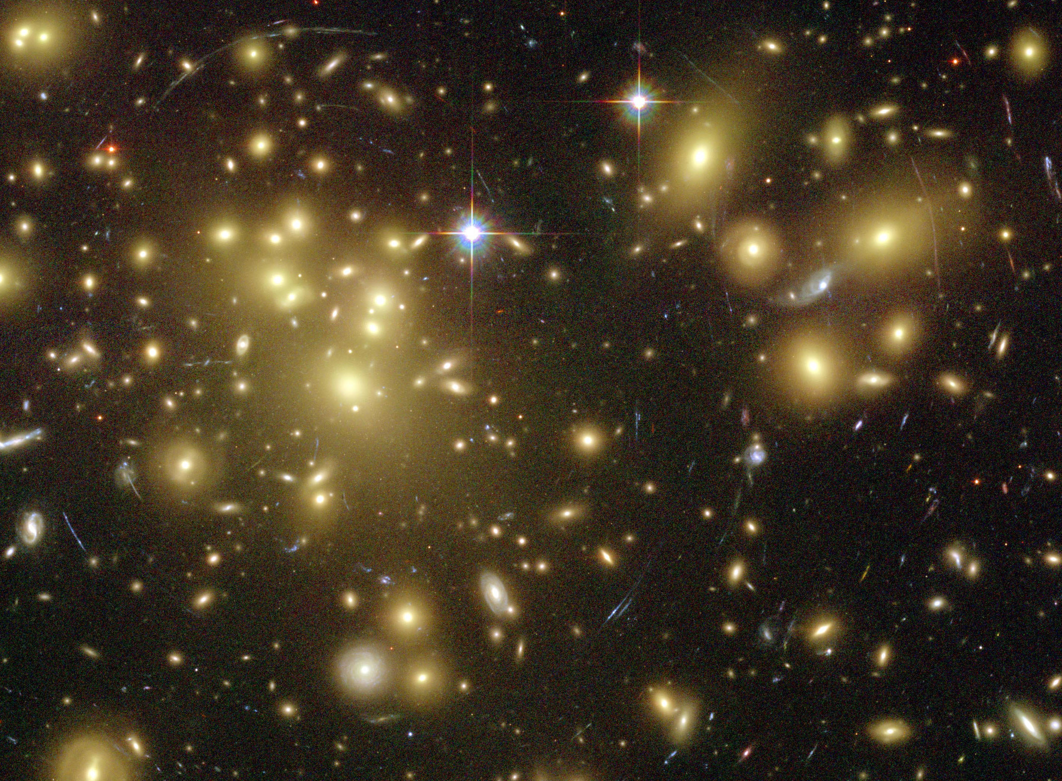
Only ~1% of the Human Genome is Genes. Importance of Non-coding “Dark Matter” of the Genome
  Non-coding regions contain the control elements
  for coding regions.
  Some non-coding regions are functional
  & are pervasively transcribed.
  “Molecular Fossils” in the non-coding genome
  represent a historical record of the genome
  Most disease-associated mutations (e.g. GWAS hits)
  are in non-coding regions.
[Gravitational lensing by dark matter in Abell 1689 – HST (NASA, ESA)]

Slide 46
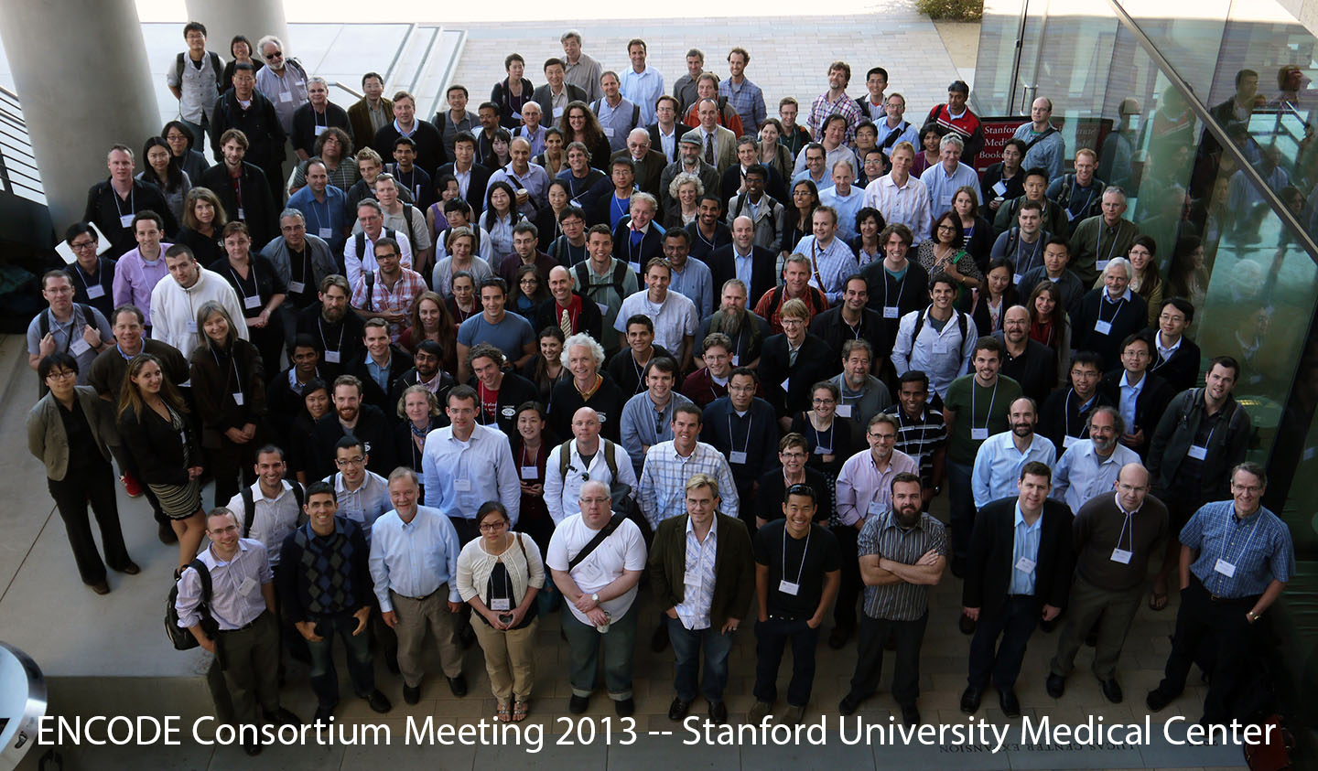

Slide 47
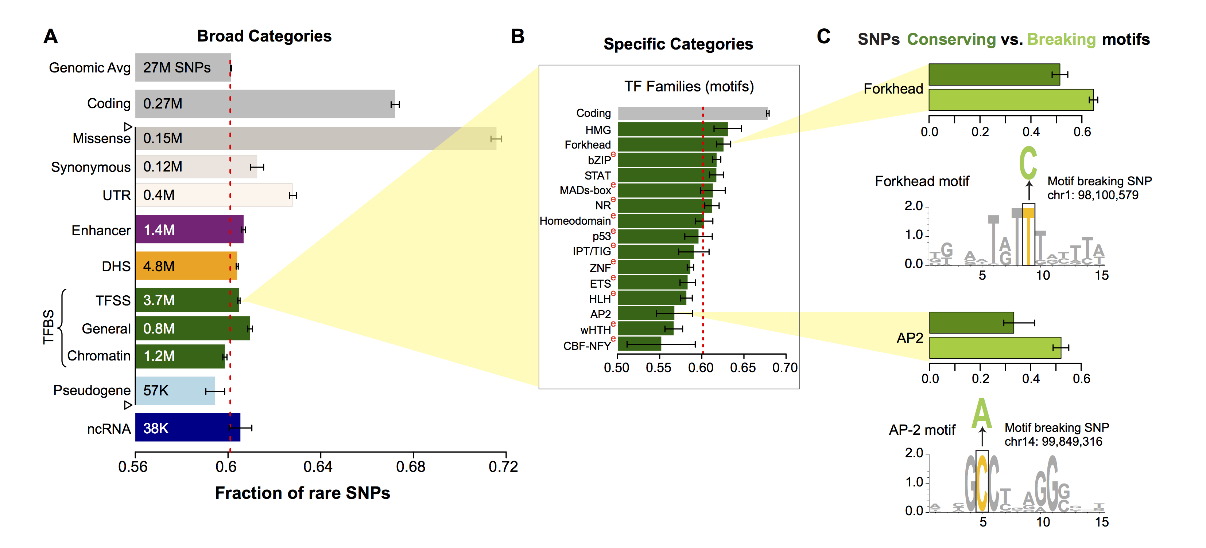
SNPs which break TF motifs are under particularly strong selection
[Khurana et al., Science (‘13)]

Slide 48

Acknowledgements
Hiring postdocs, see
GersteinLab.org/jobs
MUSIC.gersteinlab.org
  A Harmanci, J Rozowsky
FunSeq2.gersteinlab.org
  Y Fu, Z Liu, S Lou, J Bedford, X Mu, K Yip, E Khurana

Slide 49
Biochemically Active Regions Don't all Appear to be Under Constraint
Integrating & averaging results over larger and larger sets
Comparison of integrated quantities
[ENCODE Consortium, Nature 447, 2007]
Notes:
a, A schematic depiction shows the different tests used for assessing overlap between experimental annotations and constrained sequences, both for individual bases and for entire regions. b, Observed fraction of overlap, depicted separately for bases and regions. The results are shown for selected experimental annotations. The internal bars indicate 95% confidence intervals of randomized placement of experimental elements using the GSC methodology to account for heterogeneity in the data sets. When the bar overlaps the observed value one cannot reject the hypothesis that these overlaps are consistent with random placements.
==
Identification and analysis of functional elements in 1% of the human genome by the ENCODE pilot project
The ENCODE Project Consortium
Nature 447, 799-816(14 June 2007)
doi:10.1038/nature05874

Slide 50
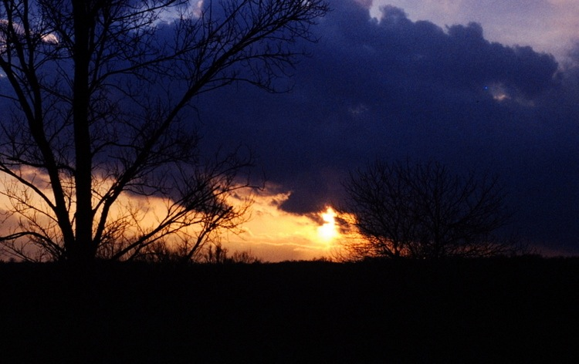
Fusion Group
1000G FIG-Cancer
Acknowledgements
~50 people
~1000 “authors”
Functional Interpretation Subgroup
Yale
Ekta Khurana, Yao Fu, Jieming Chen,
Xinmeng Mu, Lucas Lochovsky,
Arif Harmanci, Alexej Abyzov, Suganthi Balasubramanian, Cristina Sisu,
Declan Clarke, Mike Wilson
Sanger
Vincenza Colonna, Yali Xue,
Chris Tyler-Smith
Cornell
Steven Lipkin, Jishnu Das, Robert Fragoza, Xiaomu Wei, Haiyuan Yu
Andrea Sboner, Dimple Chakravarty, Naoki Kitabayashi, Vaja Liluashvili,
Zeynep H. Gümüş,
Mark A. Rubin
US, UK, Switzerland….
Hyun Min Kang, Tuuli Lappalainen, Kathryn Beal, Daniel Challis, Yuan Chen, Laura Clarke, Fiona Cunningham, Emmanouil T. Dermitzakis, Uday Evani, Paul Flicek, Erik Garrison, Javier Herrero, Yong Kong, Kasper Lage, Daniel G. MacArthur, Gabor Marth, Donna Muzny, Tune H. Pers, Graham R. S. Ritchie, Jeffrey A. Rosenfeld, Fuli Yu, Richard Gibbs

