Slide 1
Thoughts on ENCODE Annotations
Mark Gerstein

Slide 2
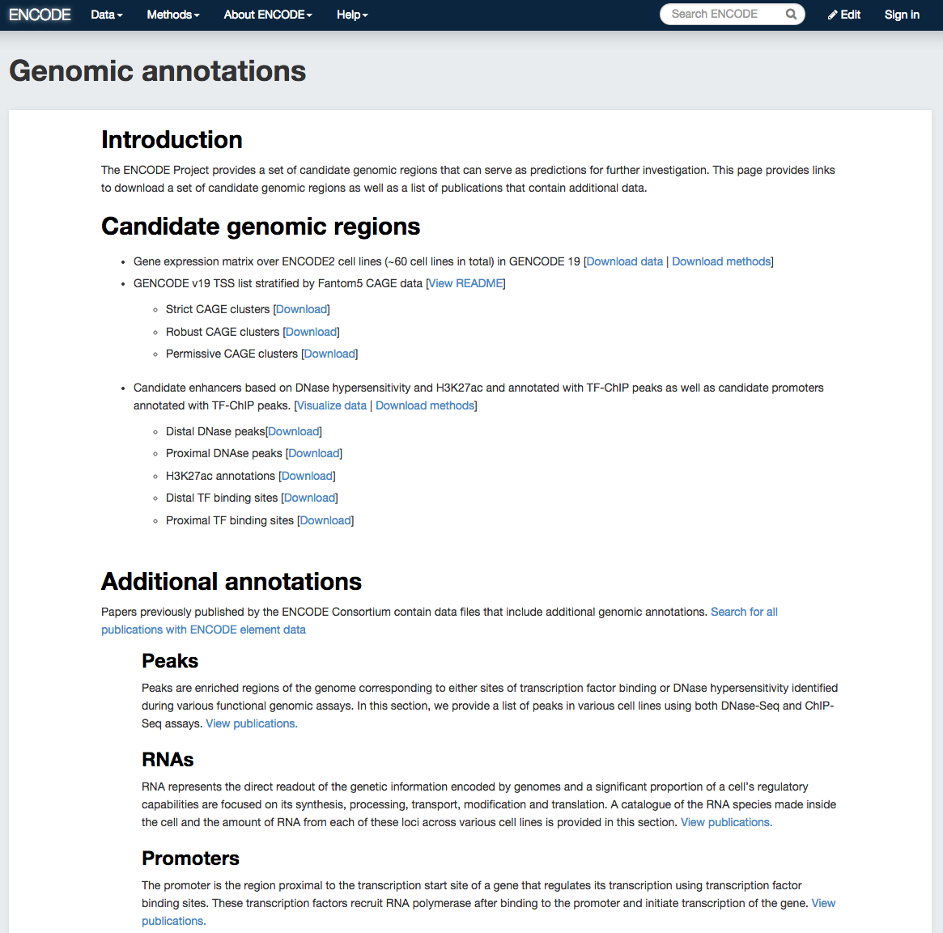
Simplified
Comprehensive
(published annotation, mostly in '12 & '14 rollouts)

Slide 3
“Comprehensive”
Functional Genomics Annotations
A) PEAKS
1. DNase peaks at the UCSC genome browser {on many cell lines}
2. The regulation track at the UCSC genome browser, with compilation of TF ChIP-seq peaks from uniform processing (individual peaks are annotated with TF and cell line)
3. Blacklist Regions
B) PROMOTERS
Annotated GENCODE TSSes (also, TSSes with FANTOM CAGE support)
C) ENHANCERS (Supervised)
D) UNSUPERVISED SEGMENTATIONS,
INCLUDING ENHANCERS
ChromHMM, SegWay, HiHMM....
E) HOT/LOT REGIONS
F) CONNECTIVITY
1. Enhancer-target gene connection
2. TF-target network connectivity
3. TADs: Topologically Associated Domain
G) MOTIFS
for TF binding
H) RNA
1. A matrix of expression data of known genes (or exons) for protein-coding genes & known ncRNAs {on many cell lines}
2. Novel RNA contigs track, i.e., possible novel transcripts (ie Transcriptionally Active Regions or TARs)
3. Novel junctions
I) OTHER
1. List of Allelic SNPs & Regions
2. Models

Slide 4
“App Store” for Annotation v Defaults: Encourage innovation & remain organized
Simplified, "monolithic" annotation deliberately does not include everything
Want to encourage innovation by many both inside & outside consortium -- yet still have organization. Want to feature not squelch work of others.
Metaphor:
App Store v Default Apps v everything on web
Need to develop a process for getting into the ENCODE "app store" – eg specs, being published, give a presentation on the AWG, &c
How does ENCODE interact w/ individuals creating annotation from ENCODE data, other annotation resources (eg ENSEMBL), other consortia developing annotation (eg GTEx)
All Annotation
on the Web
Comprehensive
Annotation
Simplified
Annotation

Slide 5
Additional Issues to Consider Beyond What’s in Simplified Annotations
How to represent uncertainty in the boundaries
  Overlapping & conditional annotations (e.g. this UTR goes with this promotor & enhancer)
How to represent connectivity & large-scale structures ?
How to represent on personal genomes (including cancer genomes)
  Personal annotation on NA12878
  Mapping to the personal genome
Relationship to eQTLs & allelic SNPs

Slide 6
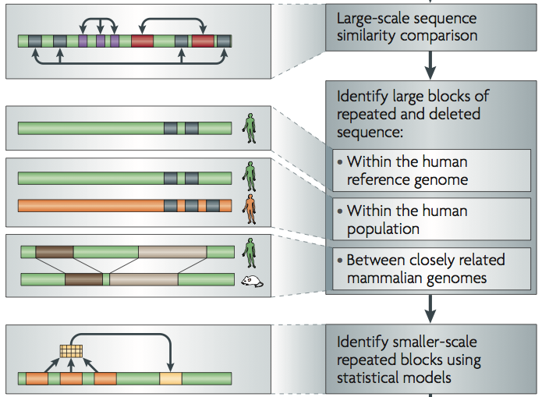
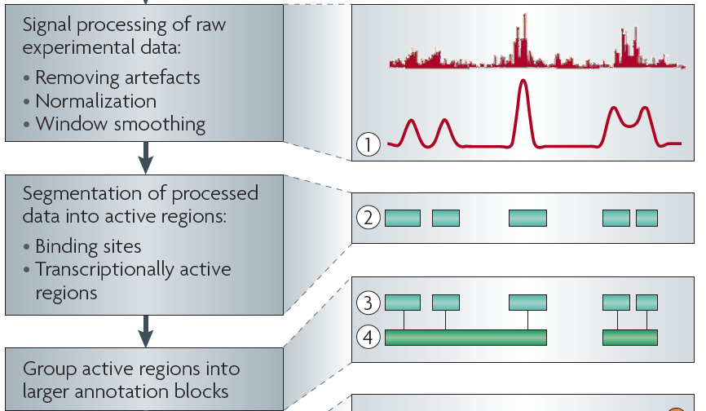
Sources of Annotation:
Comparative
&
Functional
[Nat. Rev. Genet. (2010) 11: 559]
Integrating Conservation
Across organisms &
just in humans
Not trivial to represent (ie related to short size of elements)
Many representations: Motifs, conserved “peaks”, CpGs
What "critics" often bring up

Slide 7

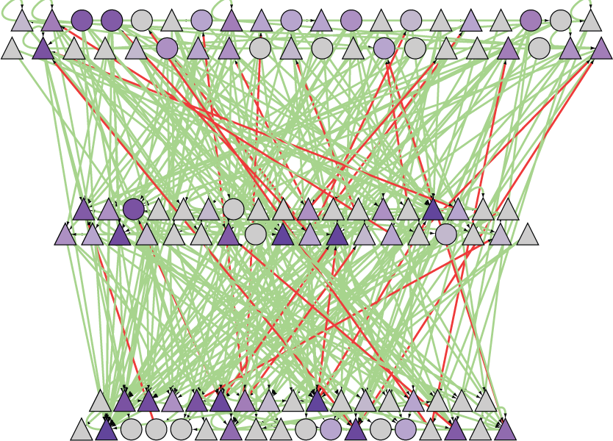
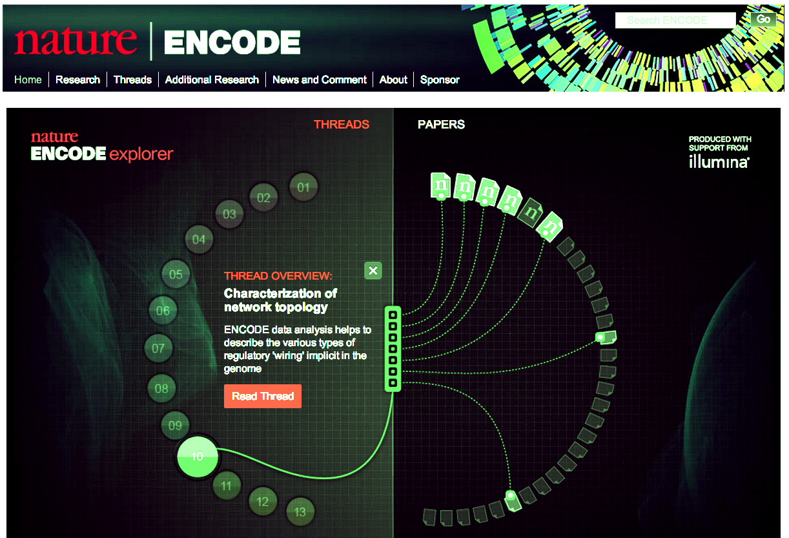
Overall ENCODE presentation as a structured hierarchy
Raw data (reads)
at the bottom
Progressive Processed Summaries
  Signals
  (e.g. representing the degree to which DNA is bound by TFs)
  (Simplified Annotation?)
  Site locations
  Reg. networks, chromatin states & stat. models
Code & VMs
At top are linked publications documenting everything, forming metadata
  Preferable to separate online docs.
[PLOS CB 4:e1000158;
Nature.com/encode + Nature 489: 208]

