Slide 1
Recommendations related to genome function from NHGRI’s Planning Workshop on the Future Opportunities for Genome Sequencing & Beyond
Mark Gerstein & Rick Myers

Slide 2
Recommendations related to genome function
Part 1: Workshop summary (Mark)
Part 2: Our Additional Suggestions (Rick)
Overall Key Message of both Parts
Functional annotation is critical for NHGRI's mission
Biotechnological & computational tools need to be developed for this
Need a systematic catalog of non-coding elements & their interactions

Slide 3
Recommendations related to genome function
Part 1: Workshop summary (Mark)
Part 2: Our Additional Suggestions (Rick)
Overall Key Message of both Parts
Functional annotation is critical for NHGRI's mission
Biotechnological & computational tools need to be developed for this
Need a systematic catalog of non-coding elements & their interactions

Slide 4
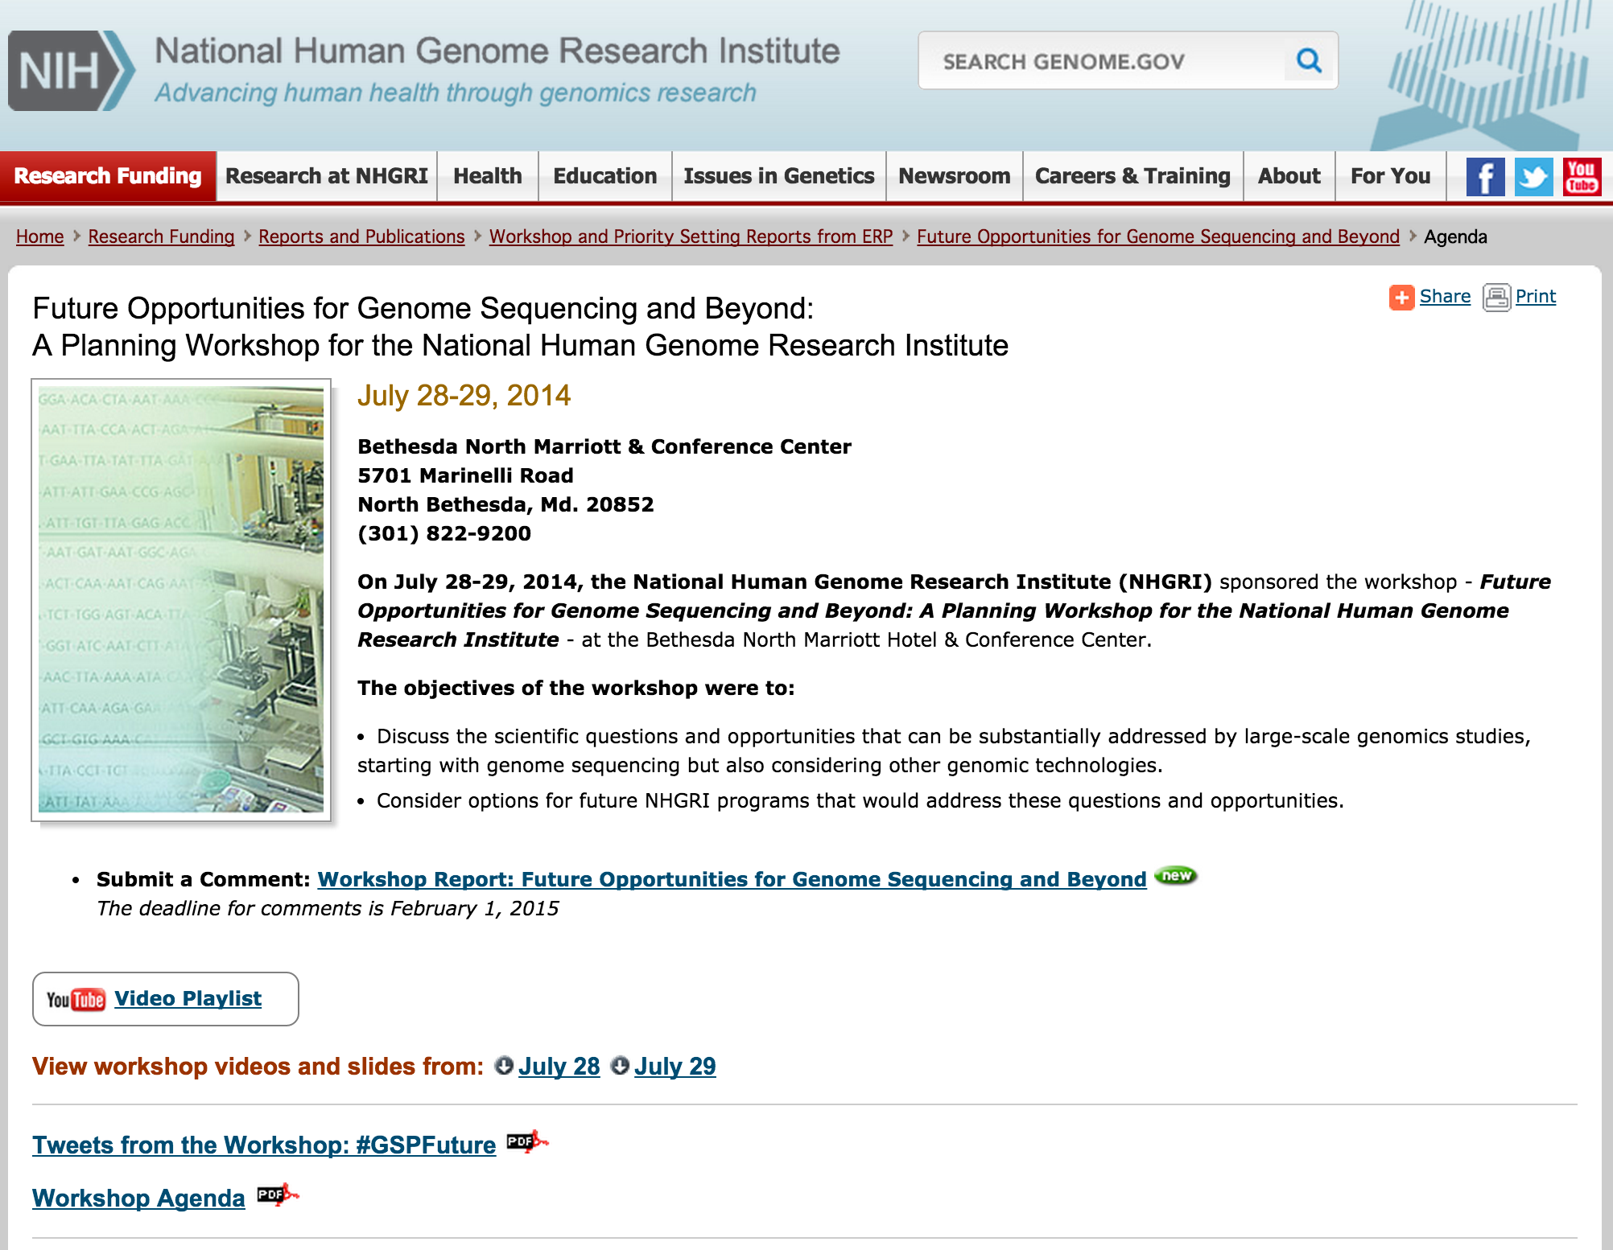
Workshop last summer: Future Opportunities for Genome Sequencing & Beyond
Goals:
“Discuss Qs & opportunities addressed using genomics studies, starting with genomic sequencing but also using other technologies”
“Consider future NHGRI programs addressing” these
Slides and videos available at
Genome.gov/27558042

Slide 5
Backdrop: A Future where NHGRI is only involved in minority of HG sequencing
Human Genome Sequencing is a success story… but what to do now?
Most genome sequencing will be done outside of NHGRI
“NHGRI needs to position itself to positively influence the large amount of sequencing that will occur.”
Involving itself in partnerships
Creating exportable technology, platforms & standards for interpreting the genome
Focusing on things that scale

Slide 6
Sections within Workshop
Genomic Architecture of Disease at Scale
Exec Summary : “Using genomic sequencing to determine variants underlying human disease & healthy traits, including both Mendelian & complex diseases, continues to be an important activity & will need to be addressed at scale.”
Integrating Genomic Variant Discovery with Function
“Improving our understanding of the impact of variants through functional genomics studies is critical to inform gene-disease relationships.”
Clinical Genomic Sequencing at Scale
“Translating genomics to medical practice will require a critical evaluation of the utility of sequencing & approaches to clinical implementation.”
Comparative & Evolutionary Genomics
“This is still needed to inform the prioritization and interpretation of genetic variants.”
[Text adapted from workshop report genome.gov/27559219]

Slide 7
Sections within Workshop
Genomic Architecture of Disease at Scale
Exec Summary : “Using genomic sequencing to determine variants underlying human disease & healthy traits, including both Mendelian & complex diseases, continues to be an important activity & will need to be addressed at scale.”
Integrating Genomic Variant Discovery with Function
“Improving our understanding of the impact of variants through functional genomics studies is critical to inform gene-disease relationships.”
Clinical Genomic Sequencing at Scale
“Translating genomics to medical practice will require a critical evaluation of the utility of sequencing & approaches to clinical implementation.”
Comparative & Evolutionary Genomics
“This is still needed to inform the prioritization and interpretation of genetic variants.”
[Text adapted from workshop report genome.gov/27559219]

Slide 8
Integrating Genomic Variant Discovery with Function
1 Overview talk by J Ecker
Discussion Group (~25): Mark Adams, Toby Bloom, Jim Broach, Carol Bult, Carlos Bustamante, Deborah Colantuoni, Joe Ecker, Elise Feingold, Kelly Frazer, Ross Hardison, Chanita Hughes-Halbert, Stephen Kingsmore, Jim Lupski, Gabor Marth, Debbie Nickerson, Mike Pazin, Len Pennacchio, Ulrike Peters, Aviv Regev, Jay Shendure, Mike Snyder, Simona Volpi, Peter Good
Discussion summary by 2 (R Myers & M Gerstein)

Slide 9
Opportune time to study “function” on a large scale
Huge number of variants available from many studies from NHGRI & beyond
Functional characterization = connection between genomes & biology
Recent development of new technologies
CRISPR, large-scale epigenomics, single cell, etc.
We need a foundational resource to integrate functional information on many discovered variants

Slide 10
What should the resource be?
Different types of function
At molecular/biochemical and cellular levels
can be studied at scale & systematized
Also, is closer to the variants
At organismal level
Not as easy to scale or to systematize
NHGRI should find the “sweet spot”
Problems that capitalize on the new technologies
Lots of readout with modest investment
Best models – cells? mouse? model diseases?

Slide 11
Dichotomy of Directions
Top-down: Develop catalogs of elements &/or all possible variants & then intersect them with variants found in disease studies
ex: Shendure challenge talk
Bottom-up: Start from a list of disease variants & characterize them functionally
Both have merits

Slide 12
Multiple Approaches
Approaches that look at large numbers of genes, variants, cell types, etc. in a standardized, high-throughput way
In contrast: Deep disease/gene-specific studies
Require domain experts & detailed assays, many of which cannot be scaled
Not the province of NHGRI -- at least not on their own
Important to have both & integrate them
Build special informatics infrastructure to tie them together

Slide 13
Other considerations
Scaling from the genome-scale assays to population-scale
Success of eQTL & related projects
Personal functional genomics, value in longitudinal studies
Functional genomics is valuable beyond just variant characterization
Use high-throughput sequencing to characterize cell types
e.g., to develop cellular biomarkers
ex: Regev challenge talk (Single-cell transcriptomics & Human Cell Atlas Project)

Slide 14
NHGRI synthesis of broader discussion (involving >100 people) of goals, opportunities & recommendations from the meeting

Slide 15
Rec #1: Defining the function of coding & noncoding sequences is foundational for genomics
Develop & deploy assays reporting disease-relevant functions at the variant, gene & pathway levels
[Text adapted from workshop report genome.gov/27559219]

Slide 16
Rec #1: Defining the function of coding & noncoding sequences is foundational for genomics
Develop & deploy assays reporting disease-relevant functions at the variant, gene & pathway levels
Functions should be considered at different scales (e.g. molecular v. cellular)
NHGRI should consider both function-first approaches and variant-first approaches.
Computational methods need to be developed to predict the effect of coding and non-coding variants
[Text adapted from workshop report genome.gov/27559219]

Slide 17
Rec #2: Develop tools to manipulate genomic sequences at scale & experimentally characterize their impact
Need develop new ways to measure function & determine causality of stat. significant variants
NHGRI should raise the technical challenge on how to scale up (to whole genome or whole population) the most important functional assays, while maintaining assay validity.
Large scale assays need to be scaled from molecular to organ, organism, and clinical levels.
Need to improve understanding on how proteins interact with the genome.
NHGRI could help foster assays and models that allow us to test how drugs and other environmental agents interact with the genome.
Personal genomics can be expanded to include personal functional genomics.
[Text adapted from workshop report genome.gov/27559219]

Slide 18
Rec #2: Develop tools to manipulate genomic sequences at scale & experimentally characterize their impact
Need develop new ways to measure function & determine causality of stat. significant variants
NHGRI should raise the technical challenge on how to scale up (to whole genome or whole population) the most important functional assays, while maintaining assay validity.
Large scale assays need to be scaled from molecular to organ, organism, and clinical levels.
Need to improve understanding on how proteins interact with the genome.
NHGRI could help foster assays and models that allow us to test how drugs & other environmental agents interact with the genome.
Personal genomics can be expanded to include personal functional genomics.
[Text adapted from workshop report genome.gov/27559219]

Slide 19
Rec #3: Need to systematically catalog molecular components & their interactions
Function should also be considered at the systems biology level
The catalog of regulatory elements is not complete. Additional profiling of regulatory data needs to be done in key tissues and cell types.
Functional genomics is valuable beyond characterization of variants. Sequencing can be used to characterize cell types.
NHGRI should probably limit consideration to genetic effects, and should not further consider environmental…or microbiome effects
[Text adapted from workshop report genome.gov/27559219]

Slide 20
Rec #3: Need to systematically catalog molecular components & their interactions
Function should also be considered at the systems biology level
The catalog of regulatory elements is not complete. Additional profiling of regulatory data needs to be done in key tissues and cell types.
Functional genomics is valuable beyond characterization of variants. Sequencing can be used to characterize cell types.
NHGRI should probably limit consideration to genetic effects, and should not further consider environmental…or microbiome effects
[Text adapted from workshop report genome.gov/27559219]

Slide 21
Recommendations related to genome function
Part 1: Workshop summary (Mark)
Part 2: Our Additional Suggestions (Rick)
Overall Key Message of both Parts
Functional annotation is critical for NHGRI's mission
Biotechnological & computational tools need to be developed for this
Need a systematic catalog of non-coding elements & their interactions

Slide 22
Some important, crosscutting themes
Large-scale genomics projects have helped to establish:
Standardized experimental and analytical approaches
Quality control metrics, resource development, economies of scale, and data sharing
Generation of multiple data types and large studies that lead to meta-analysis and integration
Small- and medium-scale genomics projects have advantages:
More detailed knowledge and interest in specific biological problems
Often geared towards determining mechanism, testing specific hypotheses
Support wide range of researchers

Slide 23
Some important, crosscutting themes
Large-scale genomics projects have helped to establish:
Standardized experimental and analytical approaches
Quality control metrics, resource development, economies of scale, and data sharing
Generation of multiple data types and large studies that lead to meta-analysis and integration
Small- and medium-scale genomics projects have advantages:
More detailed knowledge and interest in specific biological problems
Often geared towards determining mechanism, testing specific hypotheses
Support wide range of researchers

Slide 24
Some important, crosscutting themes
Knowledge of genome function is essential to understand human biology and genomic basis of disease

Slide 25
Some important, crosscutting themes
Knowledge of genome function is essential to understand human biology and genomic basis of disease
Evolutionary genomics is important
Sequencing and alignment of primate and vertebrate genomes has helped identify >3 million conserved elements

Slide 26
Some important, crosscutting themes
Knowledge of genome function is essential to understand human biology and genomic basis of disease
Evolutionary genomics is important
Sequencing and alignment of primate and vertebrate genomes has helped identify >3 million conserved elements
We have learned an incredible amount by identifying human knock-outs (i.e. Mendelian diseases) and, to a smaller extent, dominant mutations

Slide 27
1: Additional suggestions for NHGRI
Don’t try to do everything in genomics: Partner with other NIH institutes

Slide 28
1: Additional suggestions for NHGRI
Don’t try to do everything in genomics: Partner with other NIH institutes
Many very large-scale whole genome sequencing and functional genomics DNA projects are already being done -- and will continue to be done -- by other institutes
Disease/organ-specific genomics

Slide 29
1: Additional suggestions for NHGRI
Don’t try to do everything in genomics: Partner with other NIH institutes
Many very large-scale whole genome sequencing and functional genomics DNA projects are already being done -- and will continue to be done -- by other institutes
Disease/organ-specific genomics
But NHGRI can and should still play a major role in these studies (as follows)

Slide 30
2: Additional suggestions for NHGRI
Continue to support development of new DNA sequencing technologies (and other high-throughput genomics/genetics approaches)

Slide 31
2: Additional suggestions for NHGRI
Continue to support development of new DNA sequencing technologies (and other high-throughput genomics/genetics approaches)
Support work that allows us to analyze every single base pair accurately, regardless of length or context of sequence variants
e.g., missing sequence data may miss undiagnosed diseases

Slide 32
2: Additional suggestions for NHGRI
Continue to support development of new DNA sequencing technologies (and other high-throughput genomics/genetics approaches)
Support work that allows us to analyze every single base pair accurately, regardless of length or context of sequence variants
e.g., missing sequence data may miss undiagnosed diseases
Emphasize phenotypes

Slide 33
2: Additional suggestions for NHGRI
Continue to support development of new DNA sequencing technologies (and other high-throughput genomics/genetics approaches)
Support work that allows us to analyze every single base pair accurately, regardless of length or context of sequence variants
e.g., missing sequence data may miss undiagnosed diseases
Emphasize phenotypes
Give much more support for advances in bioinformatics, computing and data analysis

Slide 34
2: Additional suggestions for NHGRI
Continue to support development of new DNA sequencing technologies (and other high-throughput genomics/genetics approaches)
Support work that allows us to analyze every single base pair accurately, regardless of length or context of sequence variants
e.g., missing sequence data may miss undiagnosed diseases
Emphasize phenotypes
Give much more support for advances in bioinformatics, computing and data analysis
Take a more systems biology approach
Consider the effects of genetic variants in the larger context of the cell, the individual and the environment
Perturbation approaches

Slide 35
3: Additional suggestions for NHGRI
Put a much heavier emphasis on integration functional studies with evolutionary information
This is not just measurement of conservation. Must integrate phylogeny, sequence similarity, human population genetics
Continue to improve predictions of deleterious mutations (e.g., CADD, tolerance scores, FunSeq, etc.)

Slide 36
4: Additional suggestions for NHGRI
Foster new and emerging methods for assessing function of base pairs in the genome
Some production-type grants (but not too large)
R01s to support creative technology development (perhaps partner with NIGMS)
Very high-throughput genome editing
Ultra-high throughput functional assays

Slide 37
5: Additional suggestions for NHGRI
Be the lead in cataloguing different sequencing efforts

Slide 38
5: Additional suggestions for NHGRI
Be the lead in cataloguing different sequencing efforts
Create data sharing standards for more interoperability and collaboration

Slide 39
5: Additional suggestions for NHGRI
Be the lead in cataloguing different sequencing efforts
Create data sharing standards for more interoperability and collaboration
Continue to expand beyond whole genome sequencing (e.g., very broad and deep functional genomics studies)

Slide 40
5: Additional suggestions for NHGRI
Be the lead in cataloguing different sequencing efforts
Create data sharing standards for more interoperability and collaboration
Continue to expand beyond whole genome sequencing (e.g., very broad and deep functional genomics studies)
Include large-scale efforts in epigenomics and metabolomics

Slide 41
5: Additional suggestions for NHGRI
Be the lead in cataloguing different sequencing efforts
Create data sharing standards for more interoperability and collaboration
Continue to expand beyond whole genome sequencing (e.g., very broad and deep functional genomics studies)
Include large-scale efforts in epigenomics and metabolomics
Continue to lead in training genome scientists, clinical researchers, and support diversity

Slide 42
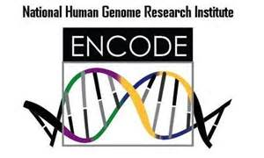
Why coordination would be good: #s of RNA-seq datasets from different consortia
ENCODE: 588
REMC: 166
GTEx: 837
TCGA: 24,662
ICGC: 1,486
And many other functional genomic datasets are available from different consortia

Slide 43
For example:
Establish a coordinated data integration and analysis hub

Slide 44
For example:
Establish a coordinated data integration and analysis hub
Integrate NHGRI-funded standardized data with large amount of other functional genomics data produced worldwide

Slide 45
For example:
Establish a coordinated data integration and analysis hub
Integrate NHGRI-funded standardized data with large amount of other functional genomics data produced worldwide
Make functional genomics data into digestible annotation that can be interrelated with a variety of variants (common, rare, SVs, disease, etc.)

Slide 46
For example:
Establish a coordinated data integration and analysis hub
Integrate NHGRI-funded standardized data with large amount of other functional genomics data produced worldwide
Make functional genomics data into digestible annotation that can be interrelated with a variety of variants (common, rare, SVs, disease, etc.)
Develop standardized and exportable pipelines, QC metrics, and analysis approaches

Slide 47
For example:
Establish a coordinated data integration and analysis hub
Integrate NHGRI-funded standardized data with large amount of other functional genomics data produced worldwide
Make functional genomics data into digestible annotation that can be interrelated with a variety of variants (common, rare, SVs, disease, etc.)
Develop standardized and exportable pipelines, QC metrics, and analysis approaches
Amazon model: build a shopping platform on a core (i.e., books) and then expand it outwards to everything

Slide 48
Recommendations related to genome function
Part 1: Workshop summary (Mark)
Part 2: Our Additional Suggestions (Rick)
Overall Key Message of both Parts
Functional annotation is critical for NHGRI's mission
Biotechnological & computational tools need to be developed for this
Need a systematic catalog of non-coding elements & their interactions

Slide 49
Recommendations related to genome function
Part 1: Workshop summary (Mark)
Part 2: Our Additional Suggestions (Rick)
Overall Key Message of both Parts
Functional annotation is critical for NHGRI's mission
Biotechnological & computational tools need to be developed for this
Need a systematic catalog of non-coding elements & their interactions

