Slide 1
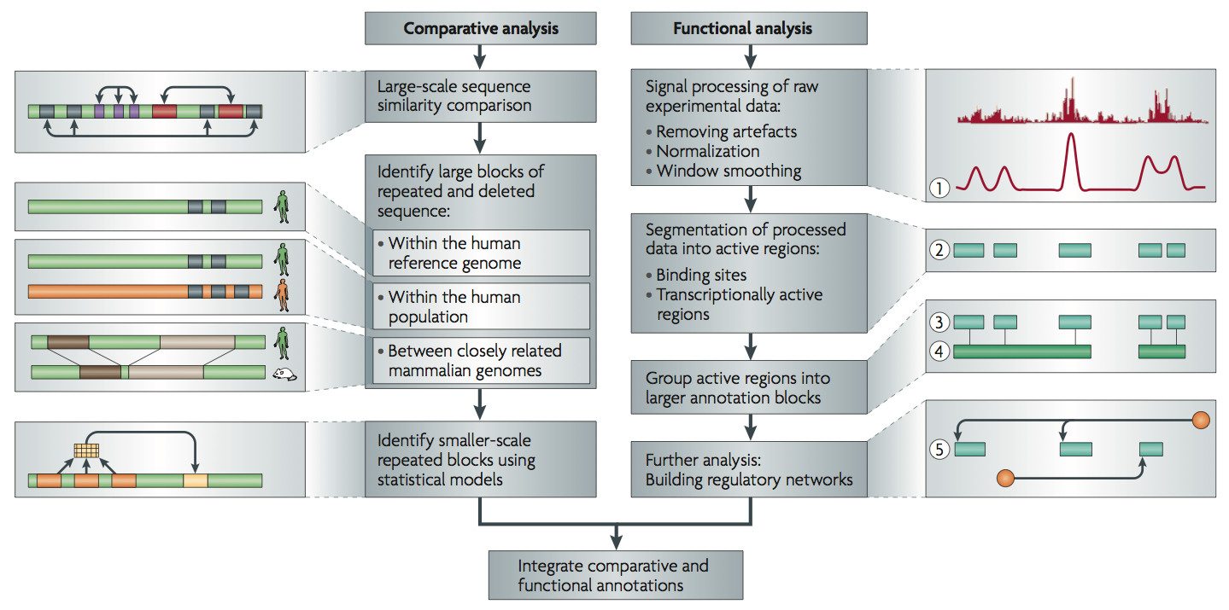
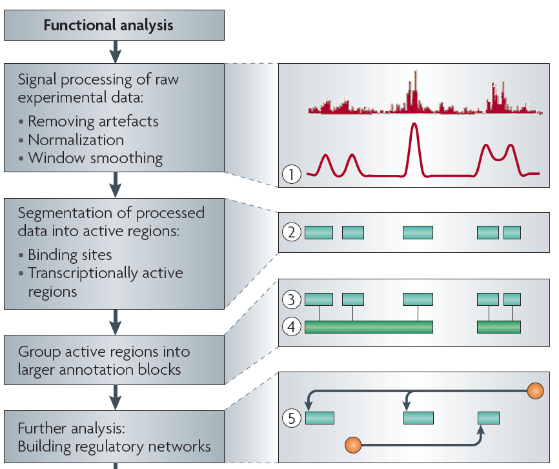
Non-coding Annotations: Overview
There are several collections of information "tracks" related to non-coding features
Sequence features, incl. Conservation
Functional Genomics
ChIP-seq (Epigenome & seq. specific TF) and ncRNA & un-annotated transcription
[Nat. Rev. Genet. (2010) 11: 559]

Slide 2
Functional Genomics Annotations
A) PEAKS
1. DNase peaks at the UCSC genome browser {on many cell lines}
2. The regulation track at the UCSC genome browser, with compilation of TF ChIP-seq peaks from uniform processing (individual peaks are annotated with TF and cell line)
3. Blacklist Regions
B) PROMOTERS
Annotated GENCODE TSSes (also, TSSes with FANTOM CAGE support)
C) ENHANCERS (Supervised)
D) UNSUPERVISED SEGMENTATIONS,
INCLUDING ENHANCERS
ChromHMM, SegWay, HiHMM....
E) HOT/LOT REGIONS
F) CONNECTIVITY
1. Enhancer-target gene connection
2. TF-target network connectivity
3. TADs: Topologically Associated Domain
G) MOTIFS
for TF binding
H) RNA
1. A matrix of expression data of known genes (or exons) for protein-coding genes & known ncRNAs {on many cell lines}
2. Novel RNA contigs track, i.e., possible novel transcripts (ie Transcriptionally Active Regions or TARs)
3. Novel junctions
I) OTHER
1. List of Allelic SNPs & Regions
2. Models

Slide 3
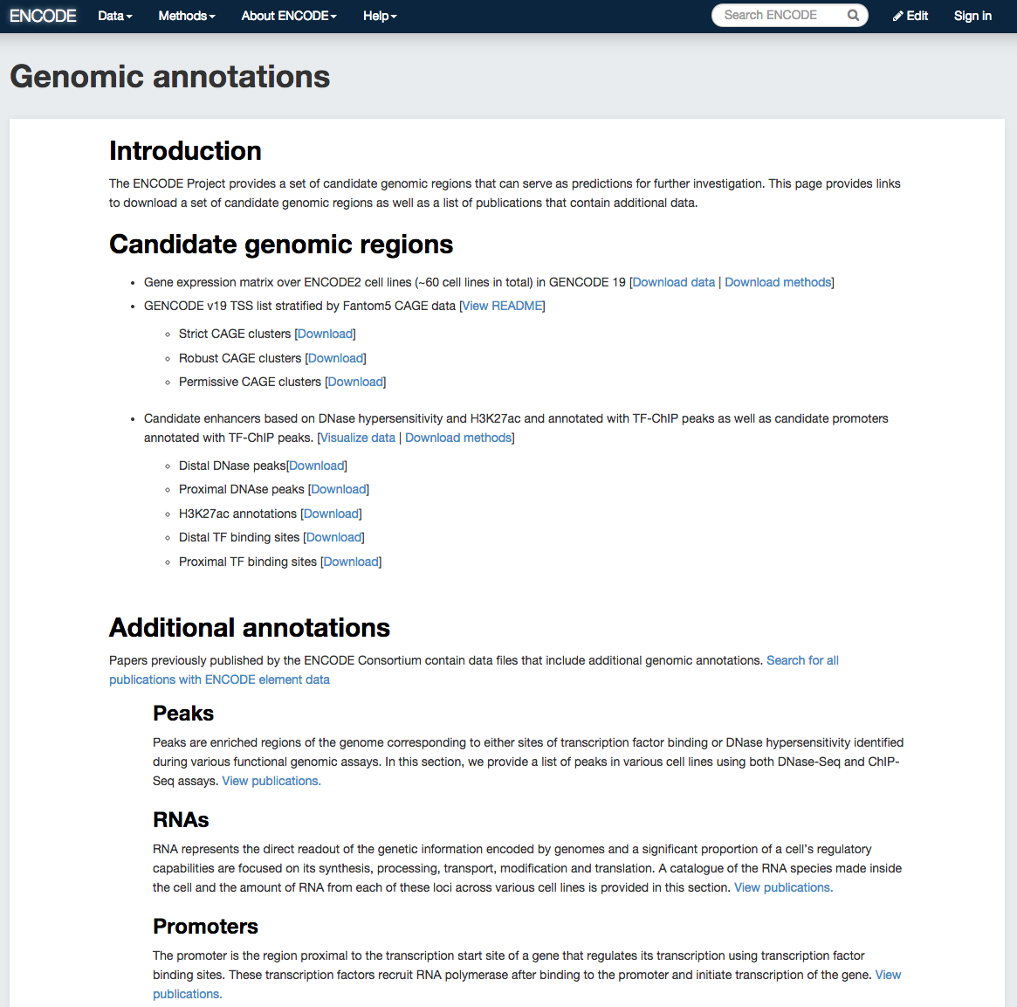
Simplified
Comprehensive
(published annotation, mostly in '12 & '14 rollouts)

Slide 4
"Simplified" Annotation
"Slice" through the ENCODE, providing close-to-data subset of the annotations
Gene expression matrix
  over ENCODE2 cell lines (~60 cell lines in total) in GENCODE 19
TSS list
  GENCODE v19
“Tissue type” facet for the cell lines (DCC)

Slide 5
Simplified regulatory sites
Candidate enhancers: The master list of TSS-distal DHS peaks annotated with
    H3K27ac enrichment (percentile over background) in a cell-type-specific manner.
    TF ChIP-seq peaks across cell-types
Candidate promoters: The master list of TSS-proximal DHS peaks annotated with TF ChIP-seq peaks across cell types.

Slide 7
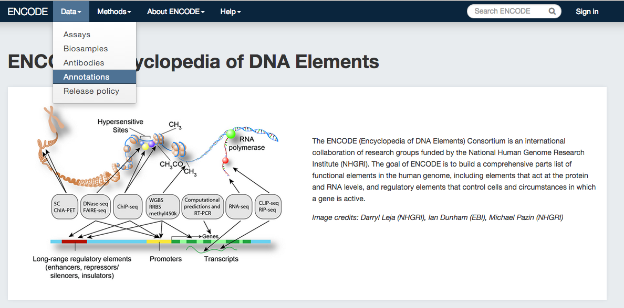
Access candidate genomic annotations via encodeproject.org on the "Data" menu bar
encodeproject.org/data/annotations

