Slide 1
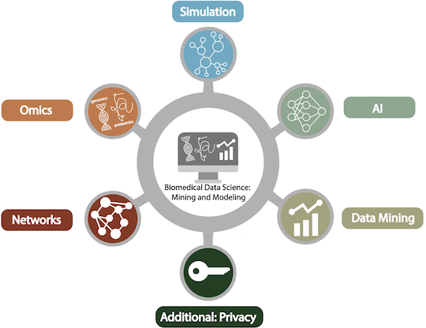
Biomedical Data Science:
Data Privacy
Eric Ni
CBB752b23

Slide 2
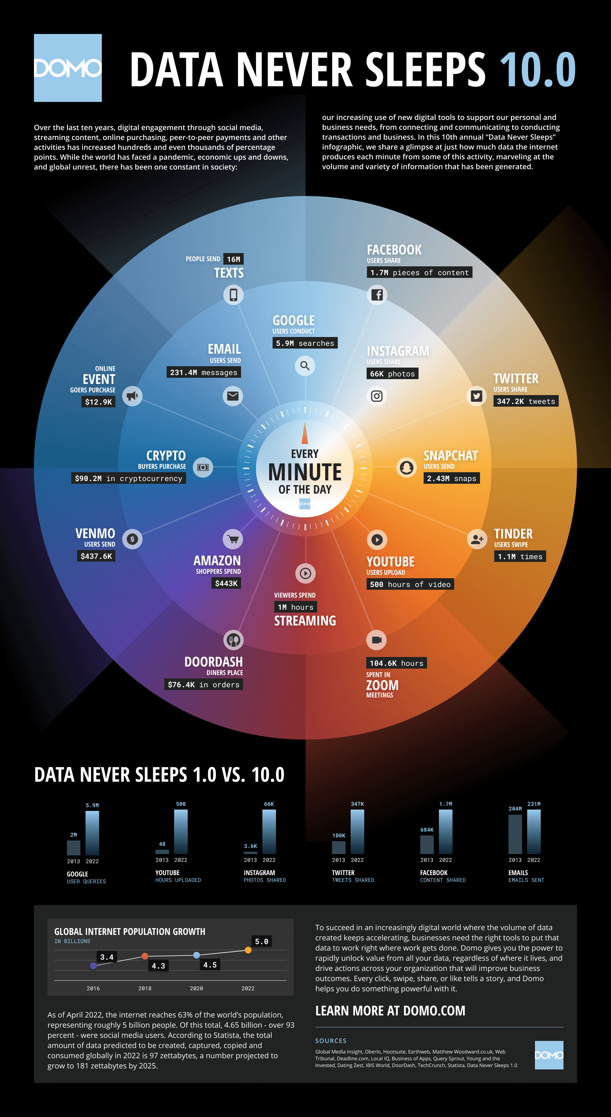


Slide 3
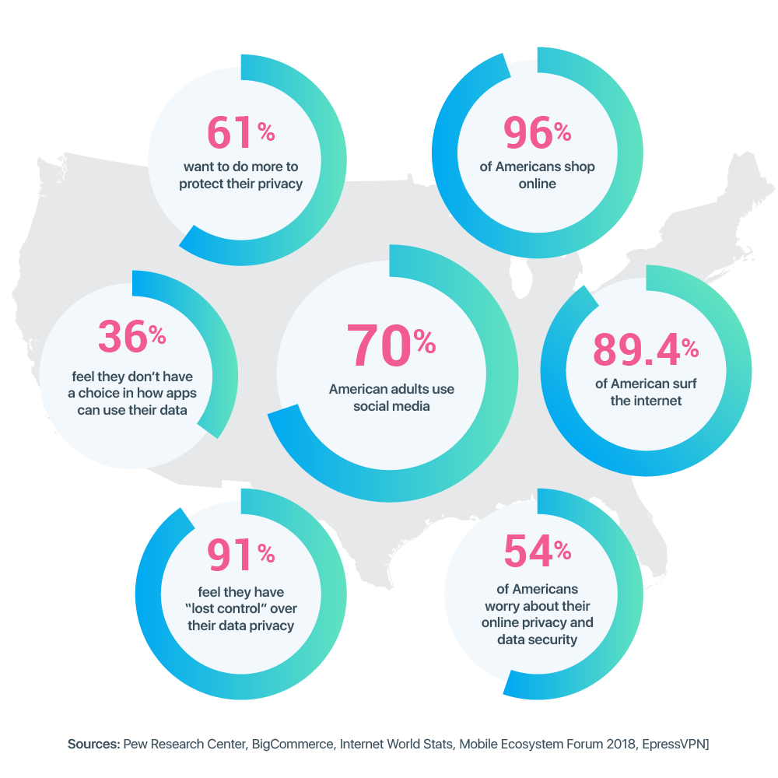

Slide 4
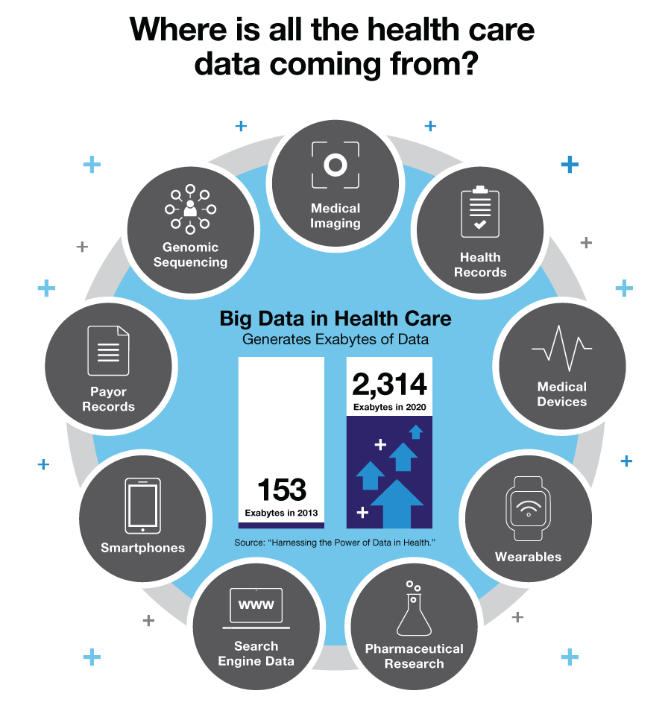

Slide 5
What is privacy anyway?
“the claim of individuals, groups, or institutions to determine for themselves when, how, and to what extent information about them is communicated to others” – Alan Westin (1967)
Ownership: “‘personal data’ means any information relating to an identified or identifiable natural person (‘data subject’)” – GDPR (2018)
  consent, the rights to be informed, of controlling/restricting access, of rectification, and erasure

Slide 6
Who owns your health data?
Legally, varies by state, but usually, not the patients
  In most states, legal ownership still resides in your healthcare provider
HIPAA establishes standards for protecting “individually identifiable health information”, and patients can “inspect, review and receive a copy of his or her own medical records and billing records”

Slide 7
HIPAA PHI for de-identification
1. Names;
2. All geographical subdivisions smaller than a State, including street address, city, county, precinct, zip code, and their equivalent geocodes
3. All elements of dates (except year) for dates directly related to an individual, including birth date, admission date, discharge date, date of death;
4. Phone numbers;
5. Fax numbers;
6. Electronic mail addresses;
7. Social Security numbers;
8. Medical record numbers;
9. Health plan beneficiary numbers;
10. Account numbers;
11. Certificate/license numbers;
12. Vehicle identifiers and serial numbers, including license plate numbers;
13. Device identifiers and serial numbers;
14. Web Universal Resource Locators (URLs);
15. Internet Protocol (IP) address numbers;
16. Biometric identifiers, including finger and voice prints;
17. Full face photographic images and any comparable images; and
18. Any other unique identifying number, characteristic, or code
https://cphs.berkeley.edu/hipaa/hipaa18.html

Slide 8

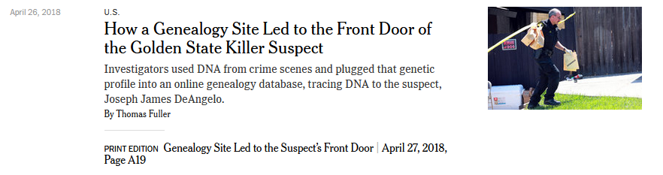
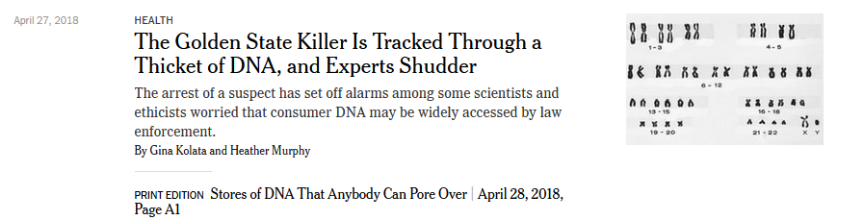
Re-identification using genetic data

Slide 9
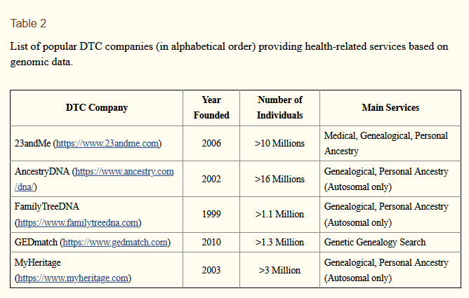
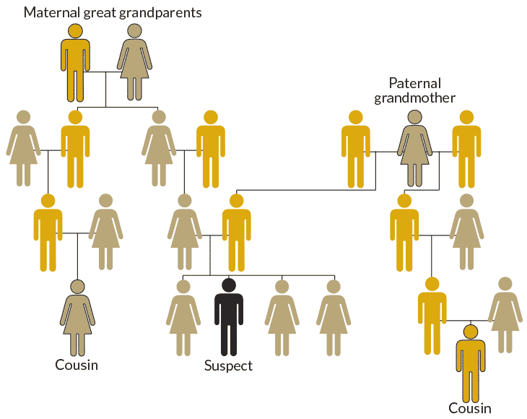
Bonomi et al. Nature Genetics (2020)
https://www.sciencenews.org/article/genetic-genealogy-forensics-top-science-stories-2018-yir

Slide 10
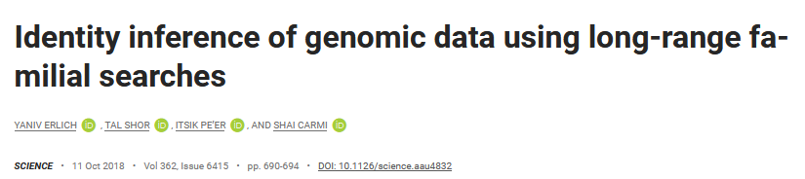
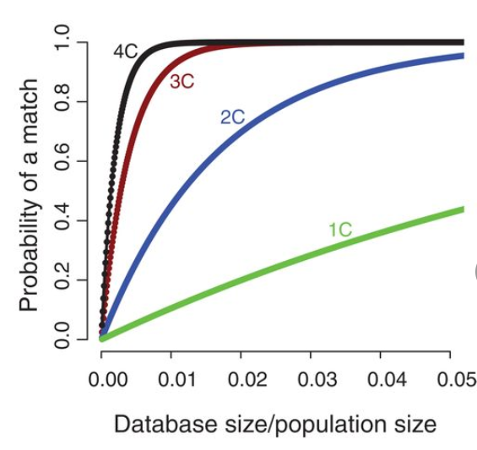

Slide 11
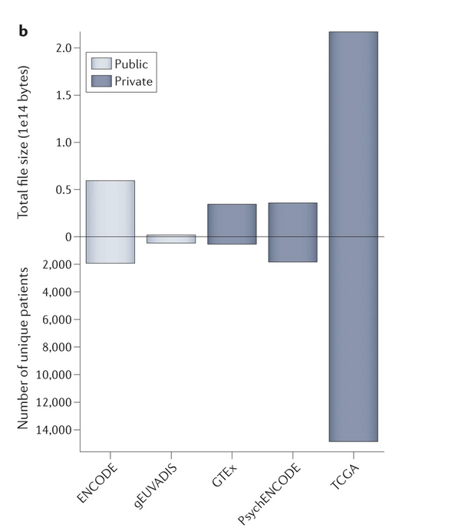


Biomedical data: To share … or not?

Slide 12
Privacy vs Utility

Slide 13
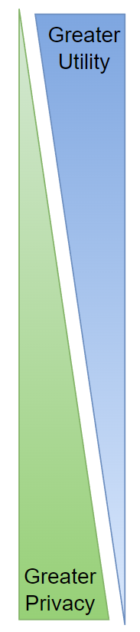
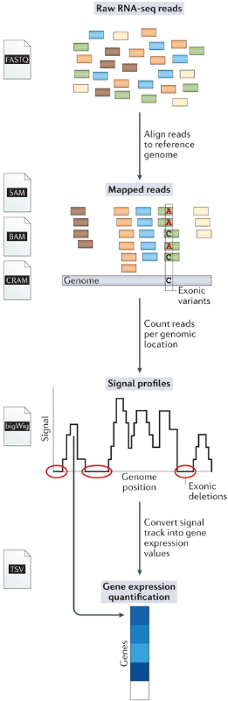
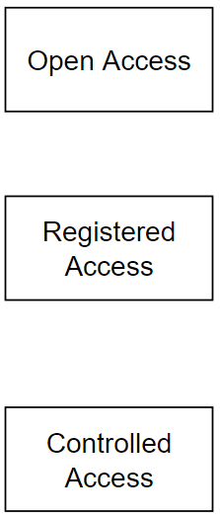


Slide 14
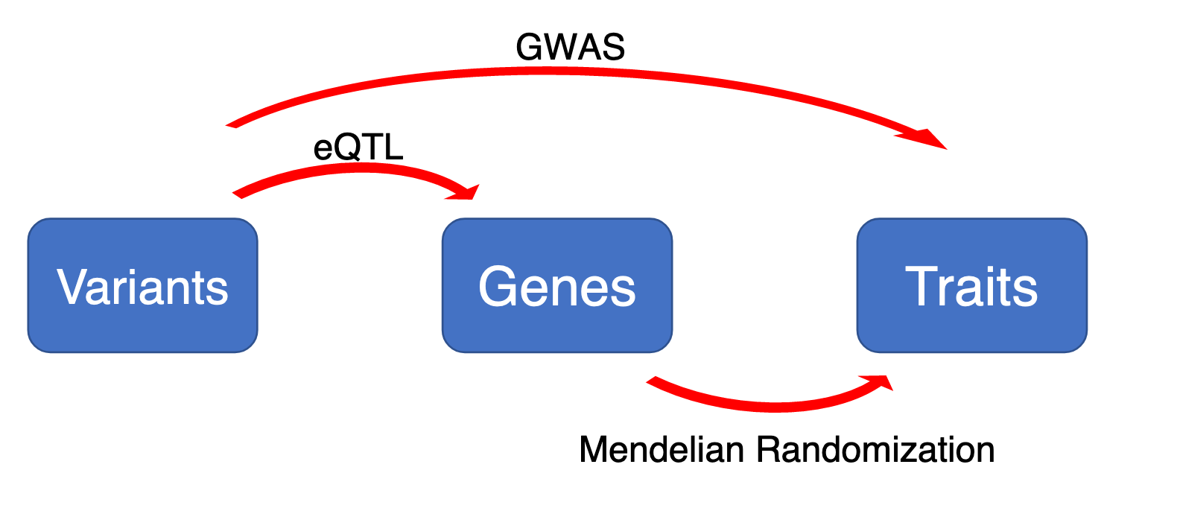
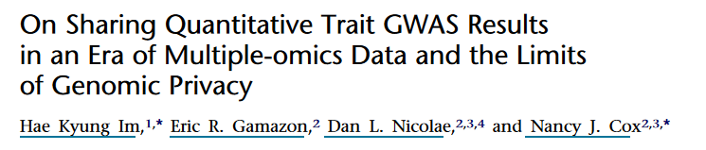
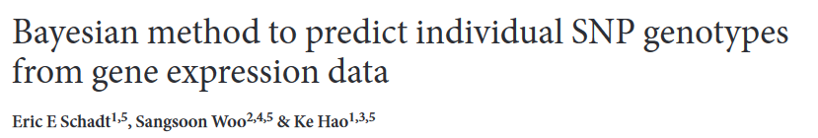
Privacy leakage in functional genomics

Slide 15


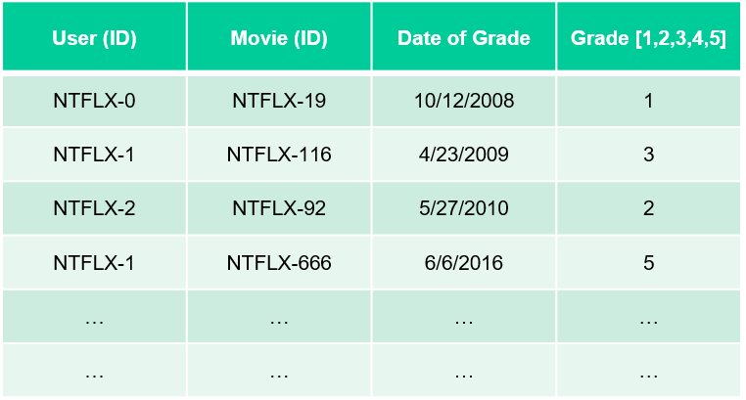
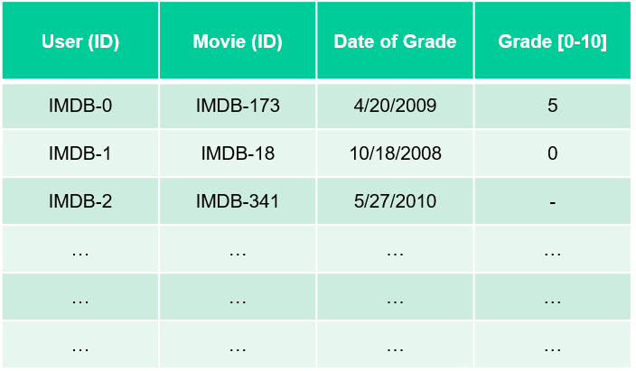
Linking Attacks: Case of Netflix Prize
Names available for many users!
Many users are shared
The grades of same users are correlated
A user grades one movie around the same date in two databases
Anonymized Netflix Prize Training Dataset
made available to contestants

Slide 16
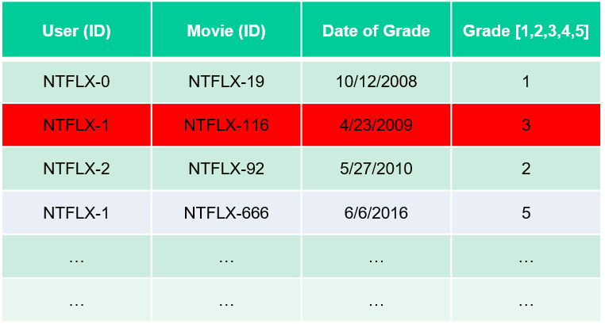
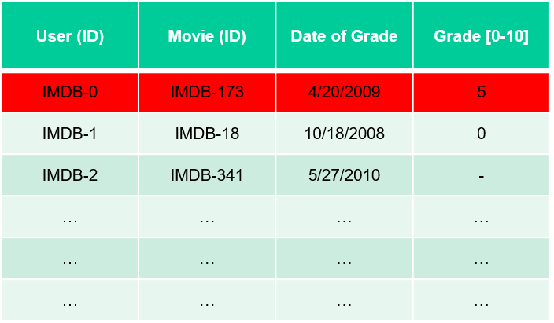
Linking Attacks: Case of Netflix Prize
Names available for many users!
Many users are shared
The grades of same users are correlated
A user grades one movie around the same date in two databases
IMDB users are public
NetFLIX and IMdB moves are public

Slide 17
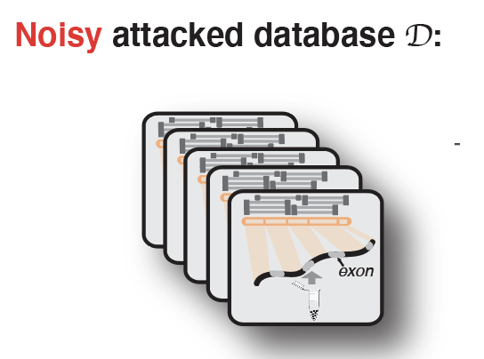
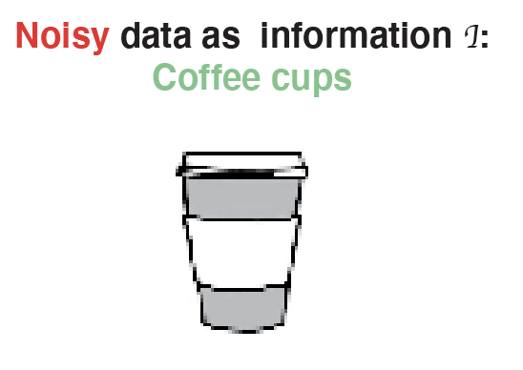

Linking attack: genotype can be linked to reveal phenotypes
Gursoy et al., Cell, 2020

Slide 18
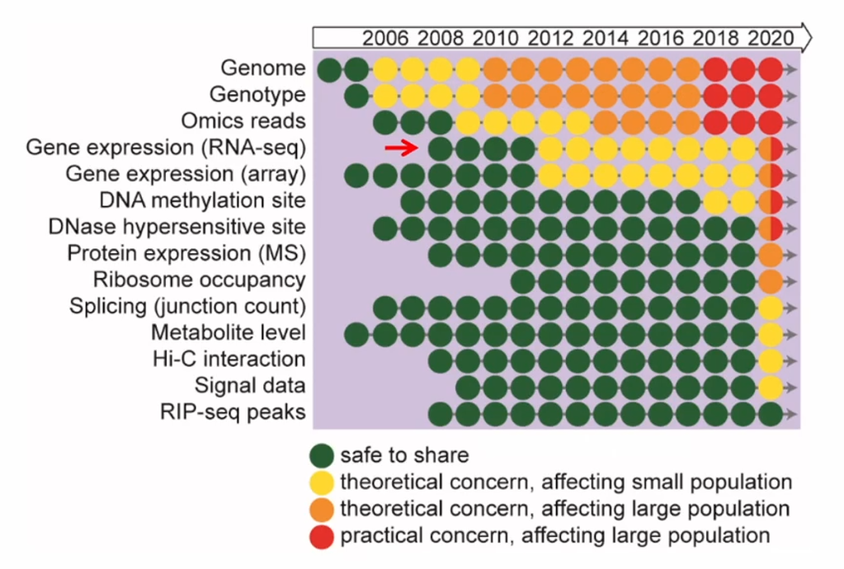
Latent functional risk in genomics data manifests over time
Slide from Zhiqiang Hu, GenoPri’21

Slide 19
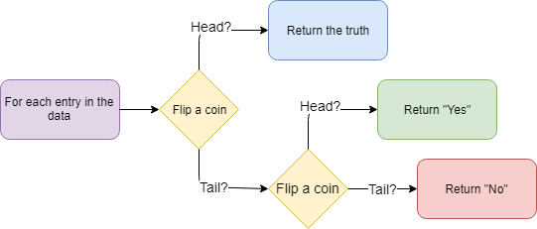
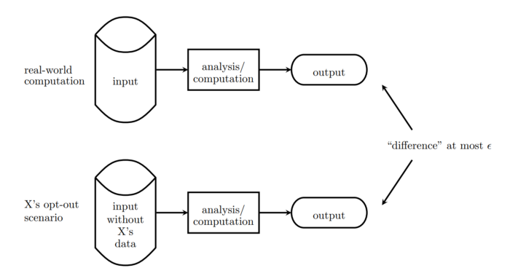
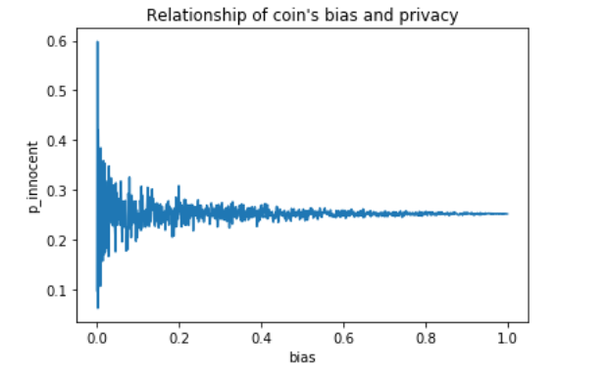
Differential privacy
A mathematical definition for privacy that provides a provable guarantee for the degree of privacy protection
https://towardsdatascience.com/understanding-differential-privacy-85ce191e198a

Slide 20
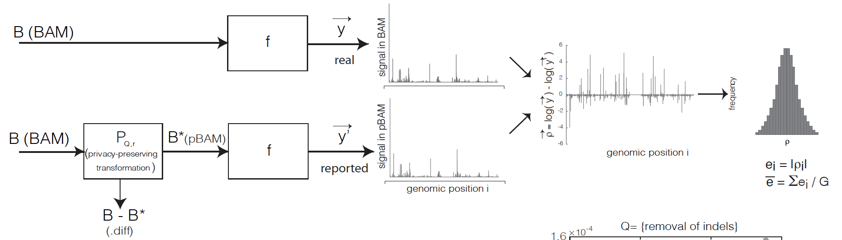
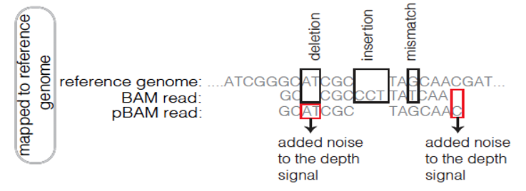
Privacy-preserving Binary Alignment Mapping (pBAM)
  No need to know the sequence of mapped reads to aggregate them
  A manipulation on Binary Alignment Files (BAM)
    Find leaky fields/tags
    Generalization
  Goal:
    Accurate gene/transcript expression quantification
    Works with the pipelines / SAMtools
[Gursoy et al., Cell, 2020]

Slide 21
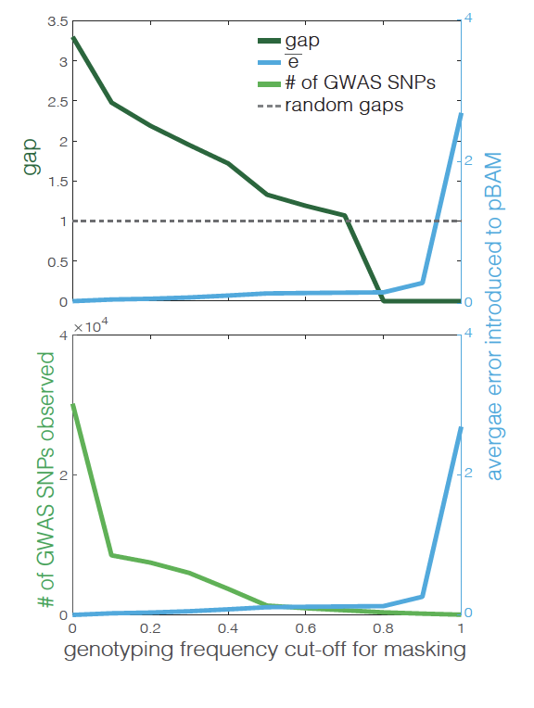
Privacy-preserving Binary Alignment Mapping (pBAM)
(grounded in privacy and utility)
x10⁻⁶
Unit = nucleotide (signal track)
NA12878 RNA-Seq data
Test the privacy for each level of masking
Measure the error introduced
𝜀 decreases as we introduce more error
x10⁻⁶
𝛿 increases as we mask more and more common variants
[Gursoy et al., Cell, 2020]

Slide 22
Privacy & Security

Slide 23
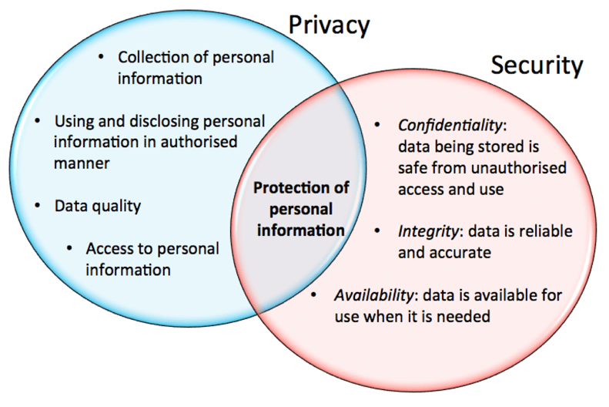
Privacy is different than Security
Figure: https://www.davidfroud.com/information-security-vs-privacy-are-the-lines-blurring/

Slide 24
Biomedical data storage needs
Data integrity: ensuring accuracy and reliability for data during its entire life cycle
Access control: appropriate access to those who need it, and not to those who don’t
Ownership rights: ability to access, create, modify, package, derive benefit from, sell, or remove the data, and also the right to assign these access privileges to others

Slide 25

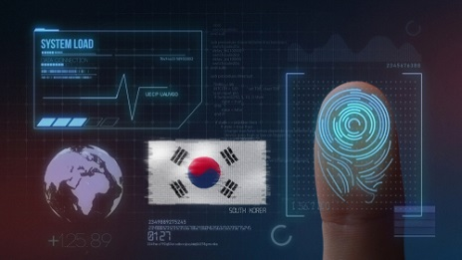
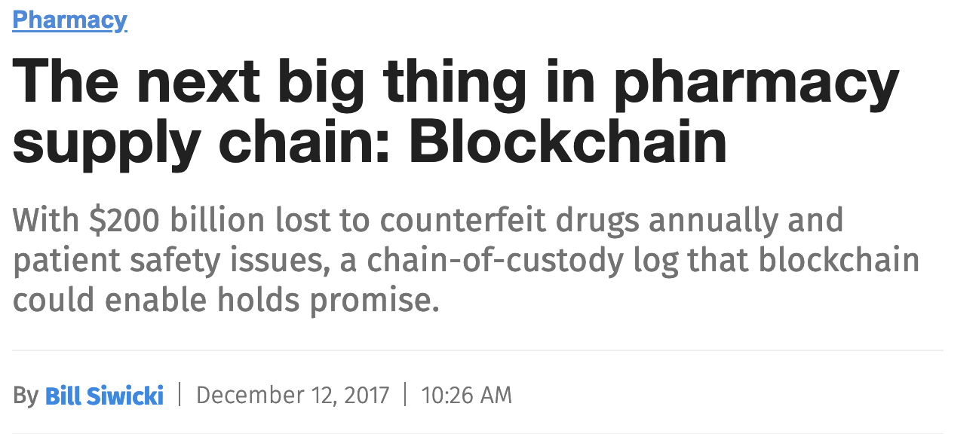
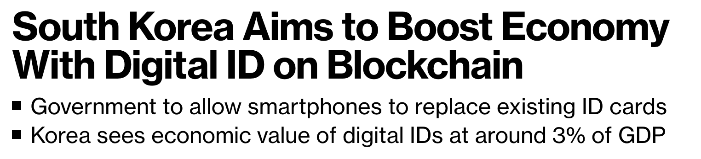
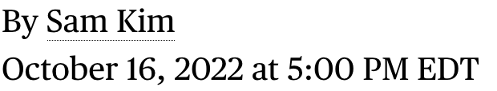
Blockchain can be useful for data storage/sharing
Why?
  Decentralization - information on a blockchain is distributed across a network of computers, prevents a single point of failure
  Immutability - once data is added to the blockchain, it cannot be altered or removed.
  Auditability - the ability to easily track and verify the history of the blockchain
Blockchain has many potential non-financial applications

Slide 26
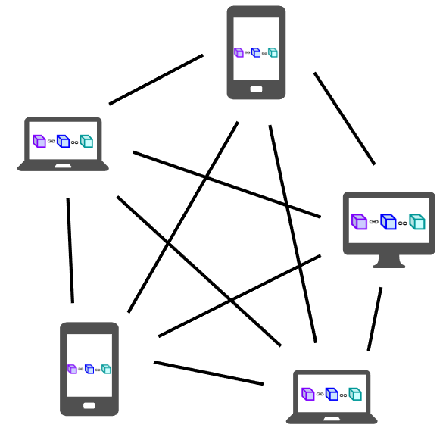
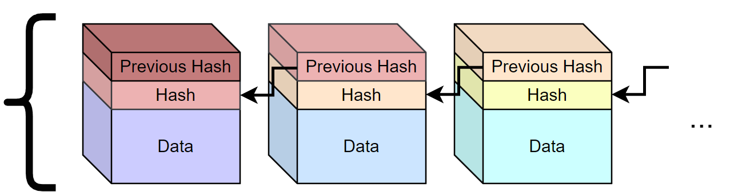
Blockchain:
Distributed ledgers of information
Synchronized across all participants
Cryptographic links for data immutability
What is blockchain?

Slide 27
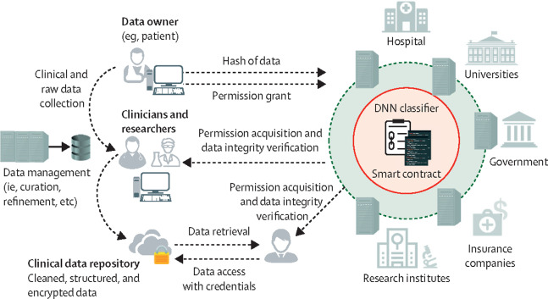
Blockchain: a solution for EHR sharing
Ng et al. Lancet Digital Health (2021)

Slide 28
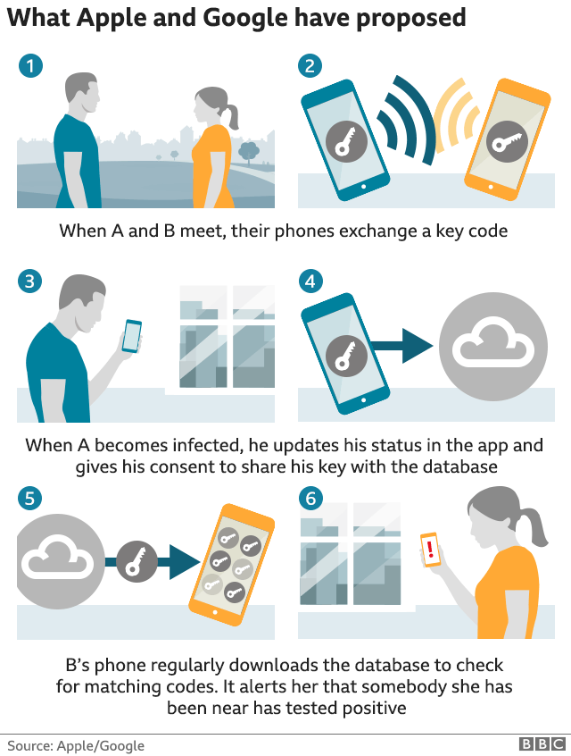
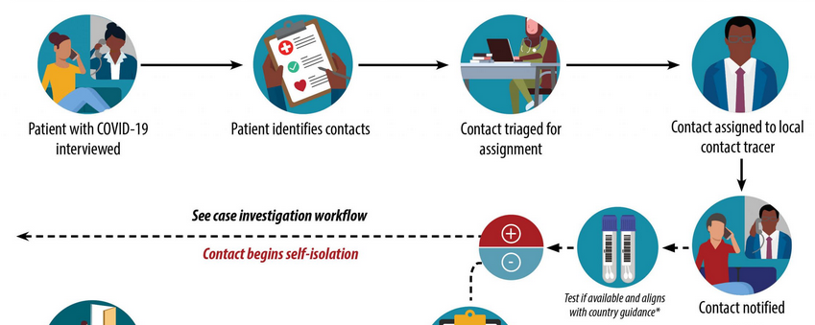
Contact tracing
App-based
Interview-based
https://www.cdc.gov/coronavirus/2019-ncov/global-covid-19/contact-tracing-workflow.html

Slide 29
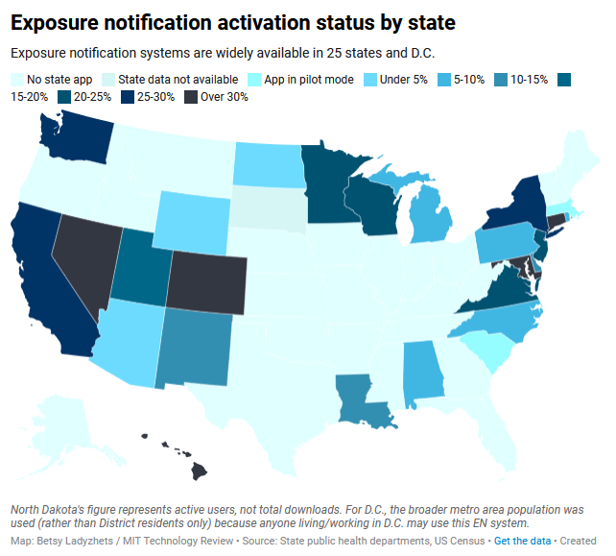
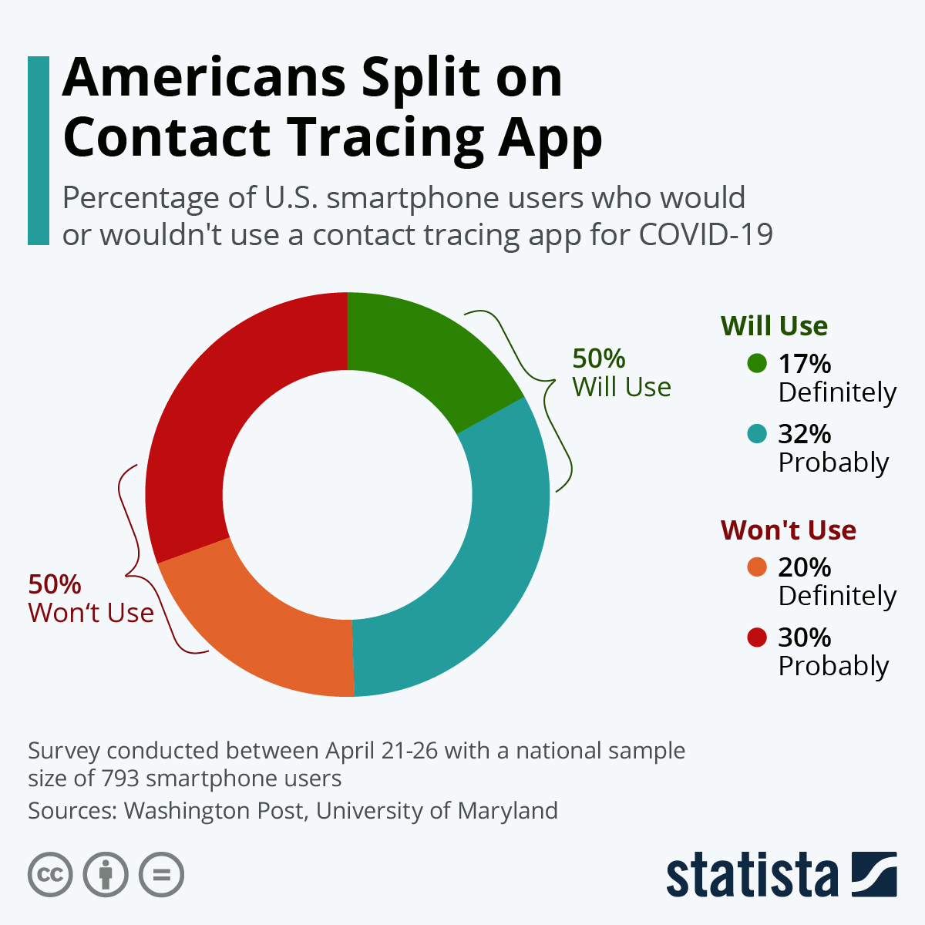
Utility practically

