Slide 1
Biomedical Data Science (GersteinLab.org/courses/452)
Unsupervised Datamining – General Clustering (23m9a)
Last edit in spring ’23. Similar to
2022’s 22m9a &
2021’s M9a [which has a video].
Mark Gerstein
Yale U.

Slide 2
Unsupervised Mining
Columns & Rows
of the Data Matrix

Slide 3
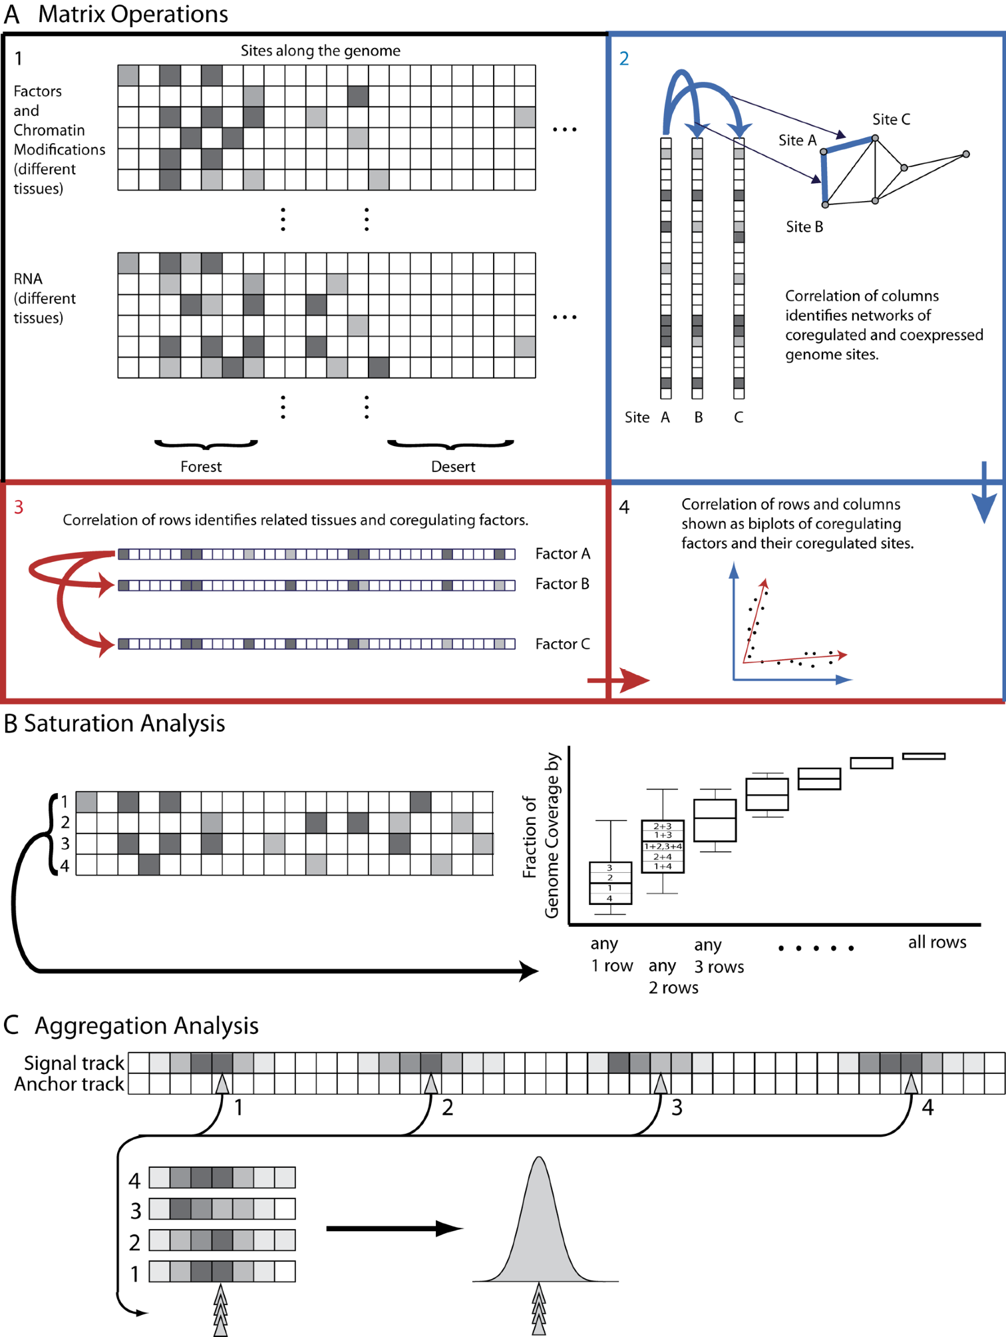
Structure of Genomic Features Matrix

Slide 4
Unsupervised Mining
  Simple overlaps & enriched regions
  Clustering rows & columns (networks)
  PCA/SVD (theory + appl.)
  Biplot
  RCA
  CCA
  tSNE
  LDA
  (Variational Autoencoders)

Slide 5
Genomic Features Matrix: Deserts & Forests

Slide 6
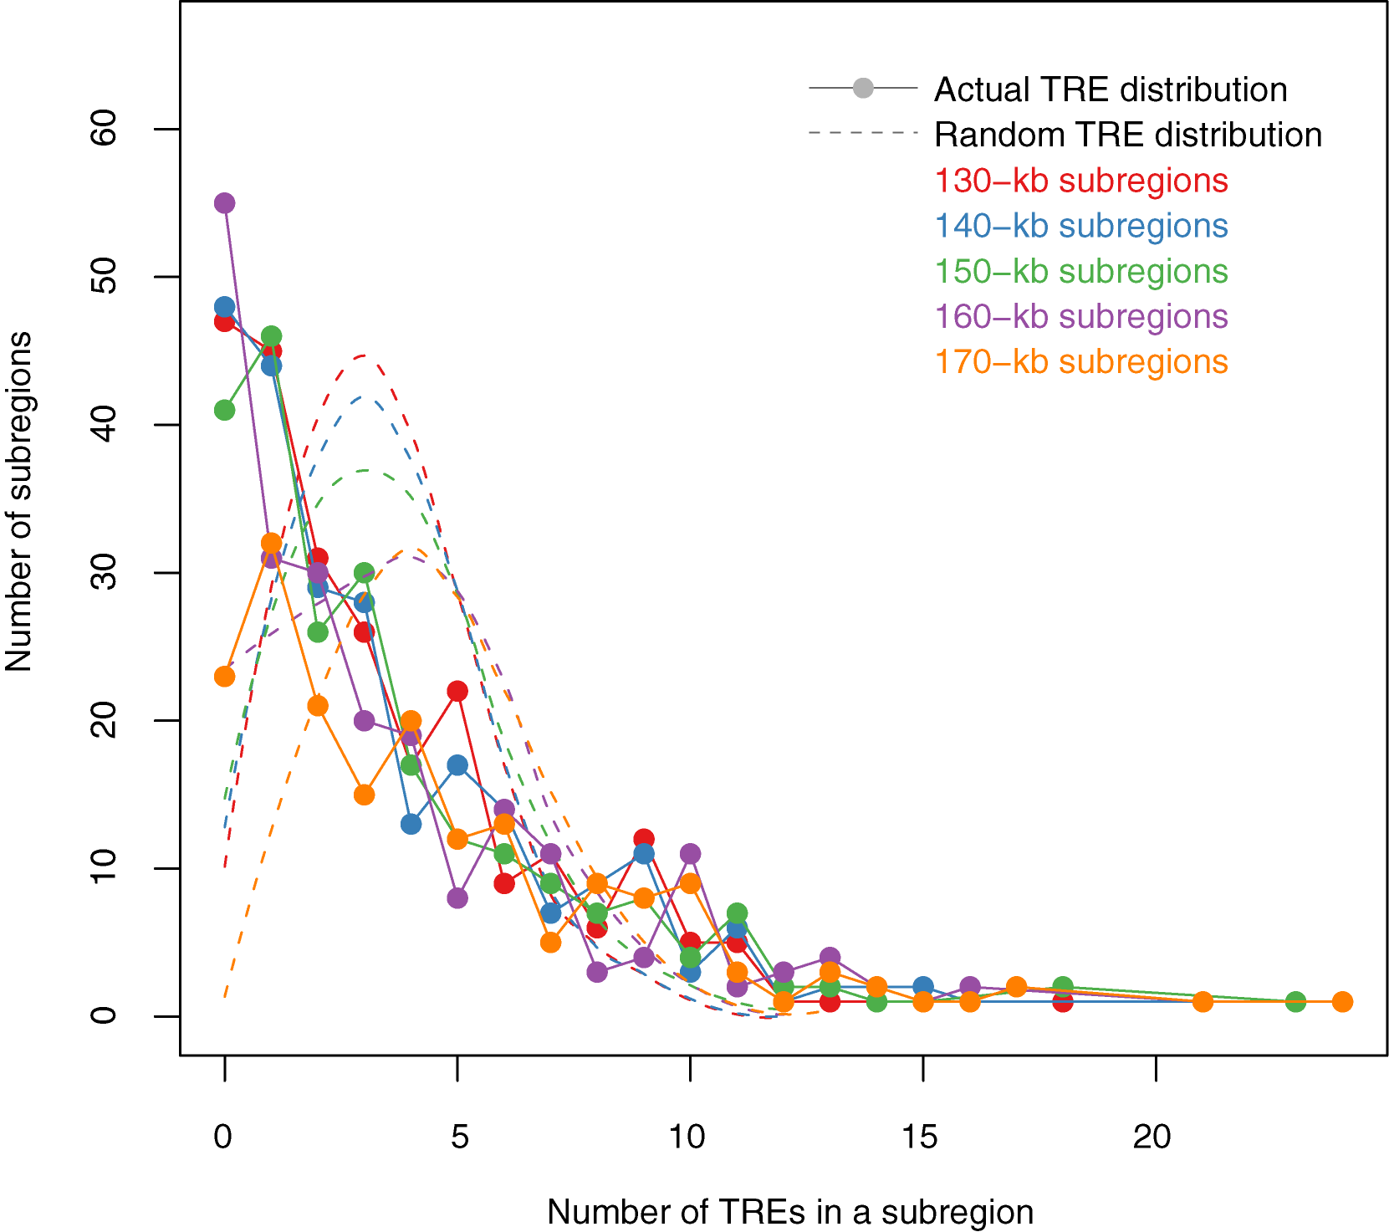
Modelling Distribution of Genomic Elements & Looking for Outliers
TREs (Genomic Elements) are not evenly distributed throughout the genome
The actual TRE distribution is power-law.
The null distribution is ‘Poissonesque.’
Many genomic subregions with extreme numbers of TREs.
Zhang et al. (2007) Gen. Res.

Slide 7
Aggregation & Saturation
[Nat. Rev. Genet. (2010) 11: 559]

Slide 8
Expression Clustering

Slide 9
Correlating Rows & Columns
[Nat. Rev. Genet. (2010) 11: 559]

Slide 10
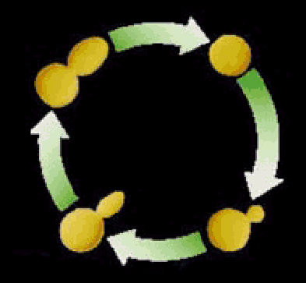

Clustering the yeast cell cycle to uncover interacting proteins
[Brown, Davis]
mRNA expression level (ratio)
Time->
Microarray timecourse of
1 ribosomal protein
Notes:
REM: Picking interesting relationships between genes pairs from ~18M possibilities

Slide 11
Clustering the yeast cell cycle to uncover interacting proteins
mRNA expression level (ratio)
Time->
Random relationship from ~18M
Notes:
REM: Picking interesting relationships between genes pairs from ~18M possibilities

Slide 12
Clustering the yeast cell cycle to uncover interacting proteins
[Botstein; Church, Vidal]
mRNA expression level (ratio)
Time->
Close relationship from 18M
(2 Interacting Ribosomal Proteins)
Notes:
REM: Picking interesting relationships between genes pairs from ~18M possibilities

Slide 13
Clustering the yeast cell cycle to uncover interacting proteins
mRNA expression level (ratio)
Time->
Predict Functional Interaction of
Unknown Member of Cluster
Notes:
REM: Picking interesting relationships between genes pairs from ~18M possibilities

Slide 14
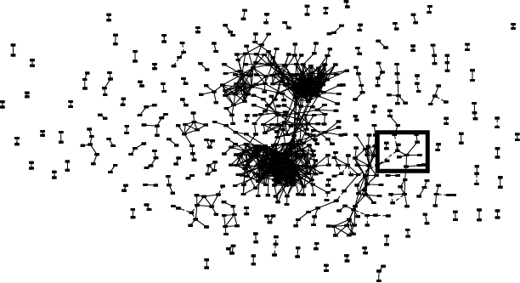
Global Network of Relationships
~470K significant
relationships
from ~18M possible

Slide 15
Unsupervised Mining
General Thoughts on Clustering

Slide 16
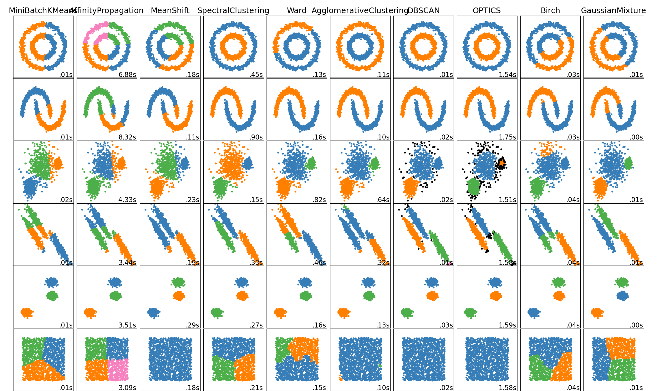
Overview of Clustering Methods
(Very High Level)
Connectivity-based
Centroid-based
Distribution-based
Density-based
Community Detection
Image reference: https://scikit-learn.org/stable/modules/clustering.html

Slide 17
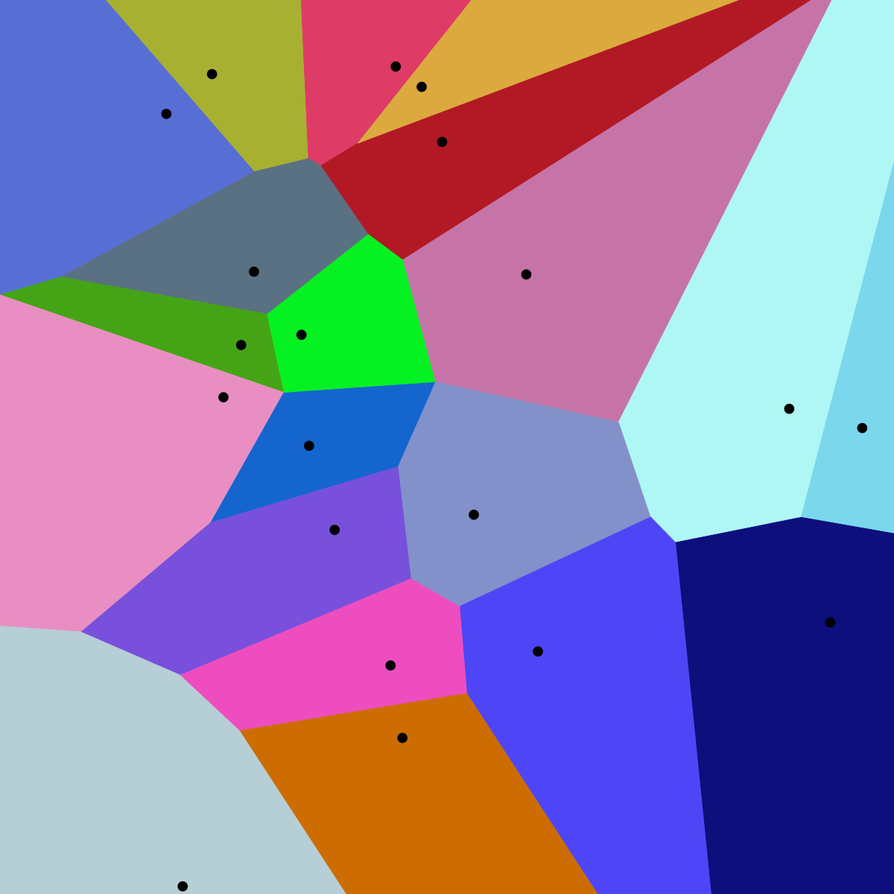
Centroid-based Methods
Optimizes a center vector to find data clusters
Clusters data into a Voronoi diagram, which is interpretable
Assumes a spherical shape for the clusters centered around the center vector
E.g. K-means clustering
  Heavily parameterized by K
  Optimized by Lloyd’s algorithm
Image reference:
https://upload.wikimedia.org/wikipedia/commons/thumb/5/54/Euclidean_Voronoi_diagram.svg/1200px-Euclidean_Voronoi_diagram.svg.png

Slide 18
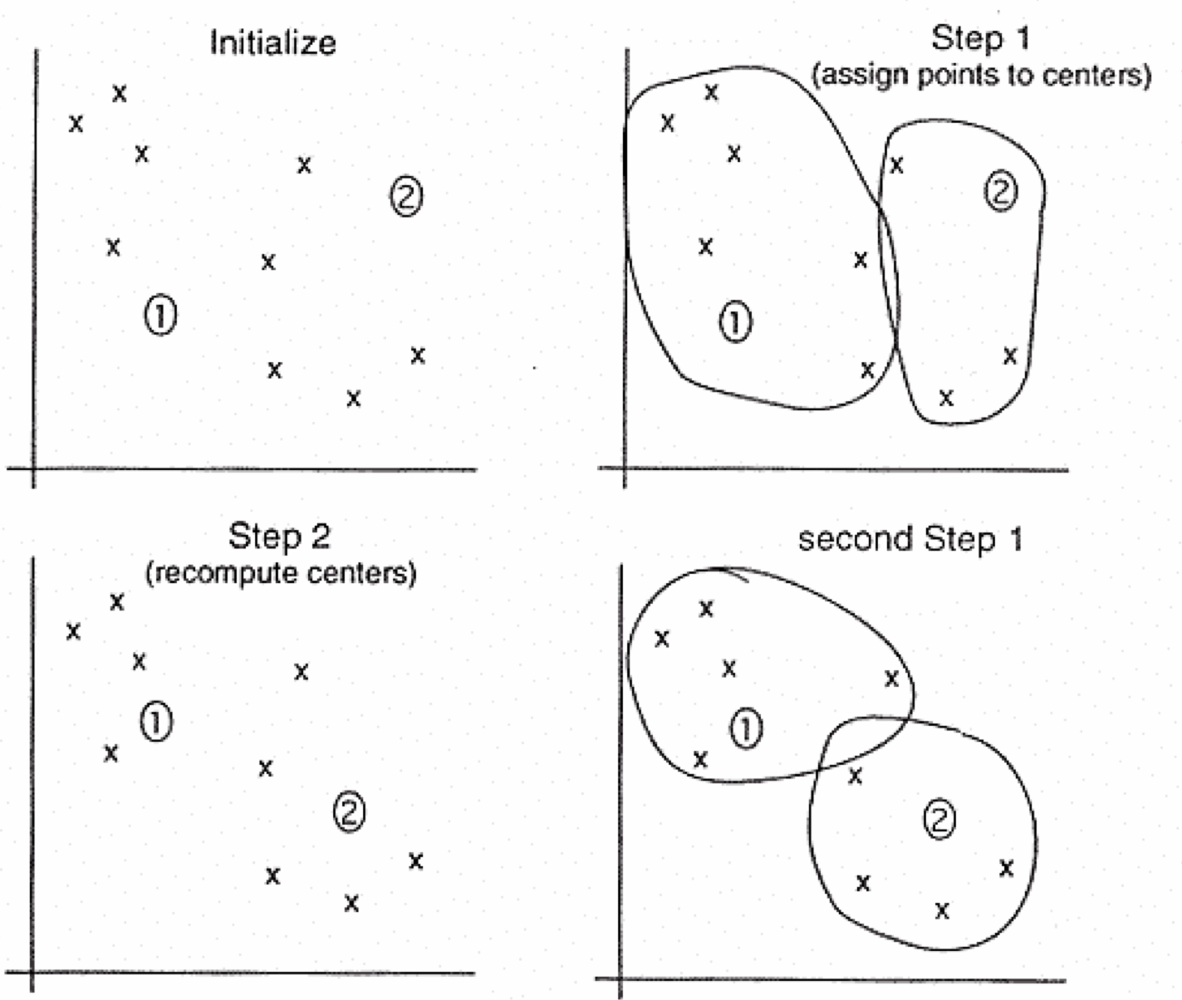
K-means
1) Pick ten (i.e. k?) random points as putative cluster centers.
2) Group the points to be clustered by the center to which they are
closest.
3) Then take the mean of each group and repeat, with the means now at
the cluster center.
4) Stop when the centers stop moving.

Slide 19
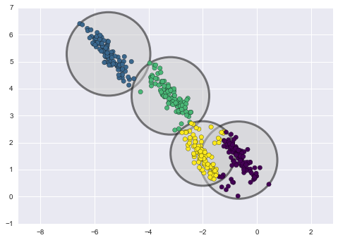
Distribution-based Methods
Clusters are defined as samples from certain distributions
Assumes the shape and number of distributions
E.g. Gaussian Mixture Model Clustering
  Can easily overfit by increasing the number of distributions
LDA & tSNE (coming later)
Image reference: https://towardsdatascience.com/gaussian-mixture-models-d13a5e915c8e

Slide 20
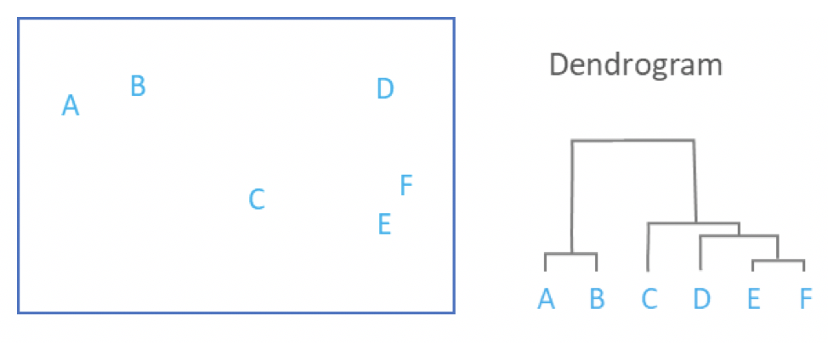
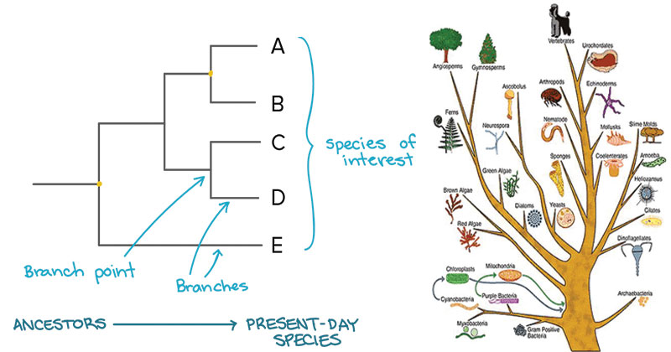
Connectivity-based Methods
Each data point start in their own cluster
Iteratively merge clusters together based on some evaluation of distance to form a hierarchical structure
Can be represented by a dendrogram (data point on one axis while tracking merge history on another axis)
No definitive cut off, but can be used to trace developmental pseudo-time
E.g. Hierarchical clustering & sequence trees (such as those for multiple alignment [mentioned earlier])
Image references:
https://46gyn61z4i0t1u1pnq2bbk2e-wpengine.netdna-ssl.com/wp-content/uploads/2018/03/Screen-Shot-2018-03-28-at-11.48.48-am.png
https://microbenotes.com/how-to-construct-a-phylogenetic-tree/

Slide 21
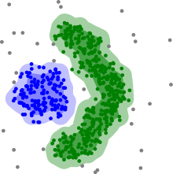
Density-based Methods
Utilize sparse regions and reachability to define clusters
Assumes some range parameter
E.g. DBSCAN
Pro: Fast - O(nlogn) runtime
Con: Some data points will not be assigned a cluster (undefined) because they are unreachable
Edge detection
MSB (mentioned earlier)
Image reference: https://upload.wikimedia.org/wikipedia/commons/thumb/0/05/DBSCAN-density-data.svg/440px-DBSCAN-density-data.svg.png

