Slide 1
Biomedical Data Science (GersteinLab.org/courses/452)
Supervised Datamining – SVMs (23m8c)
Last edit in spring ’23. Condensed (with ~1 slide deletion), which is similar to
2021’s M8c [which has a video].
Mark Gerstein
Yale U.

Slide 2
Supervised Mining:
SVMs

Slide 3
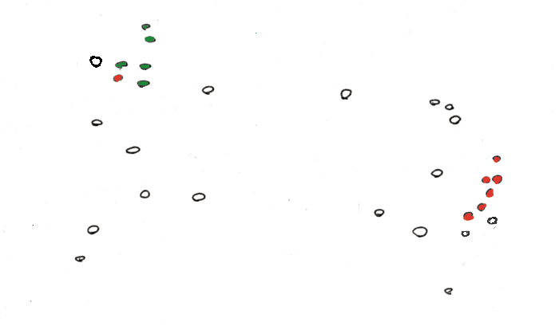
Find a Division to Separate Tagged Points

Slide 4
Discriminant to Position Plane

Slide 5
Fisher discriminant analysis
Use the training set to reveal the structure of class distribution by seeking a linear combination
y = w₁x₁ + w₂x₂ + ... + w_{n}x_{n} which maximizes the ratio of the separation of the class means to the sum of each class variance (within class variance). This linear combination is called the first linear discriminant or first canonical variate. Classification of a future case is then determined by choosing the nearest class in the space of the first linear discriminant and significant subsequent discriminants, which maximally separate the class means and are constrained to be uncorrelated with previous ones.
Solution of 1st variate

Slide 6
Support Vector Machines
A very powerful tool for classifications
Example Applications:
  Text categorization
  Image classification
  Spam email recognition, etc
It has also been successfully applied in many biological problems:
  Disease diagnosis
  Automatic genome functional annotation
  Prediction of protein-protein interactions
  and more…

Slide 7
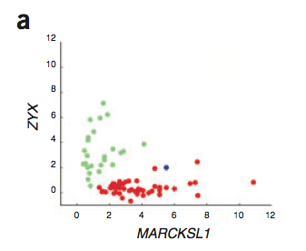
Example: Leukemia patient classification
ALL: acute lymphoblastic leukemia
AML: acute myeloid leukemia
William S Nobel. What is a support vector machine? Nature Biotechnology. 2006

Slide 8
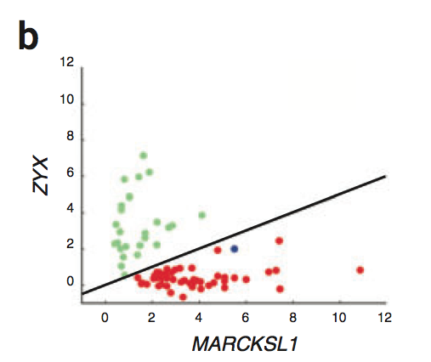
A simple line suffices to separate the expression profiles of ALL and AML
William S Nobel. What is a support vector machine? Nature Biotechnology. 2006

Slide 9
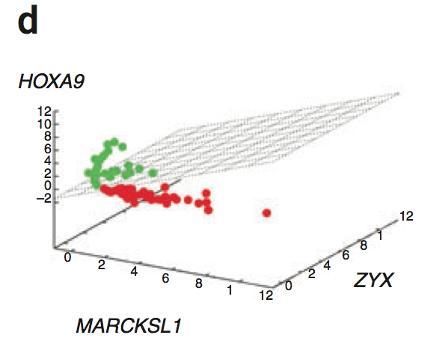
In the case of more than two genes, a line generalizes to a plane or “hyperplane”.
For generality, we refer to them all as “hyperplane”
William S Nobel. What is a support vector machine? Nature Biotechnology. 2006

Slide 10
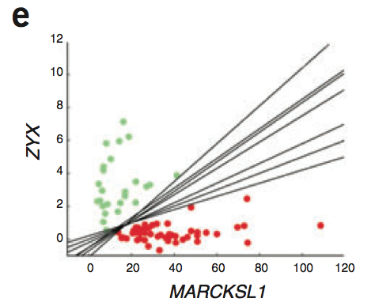
Is there a “best” line?
William S Nobel. What is a support vector machine? Nature Biotechnology. 2006

Slide 11
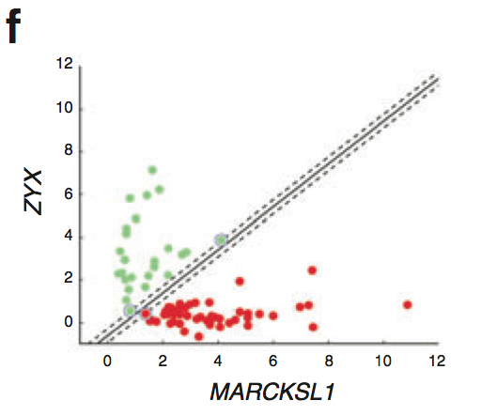
The maximum margin hyperplane
William S Nobel. What is a support vector machine? Nature Biotechnology. 2006

Slide 12
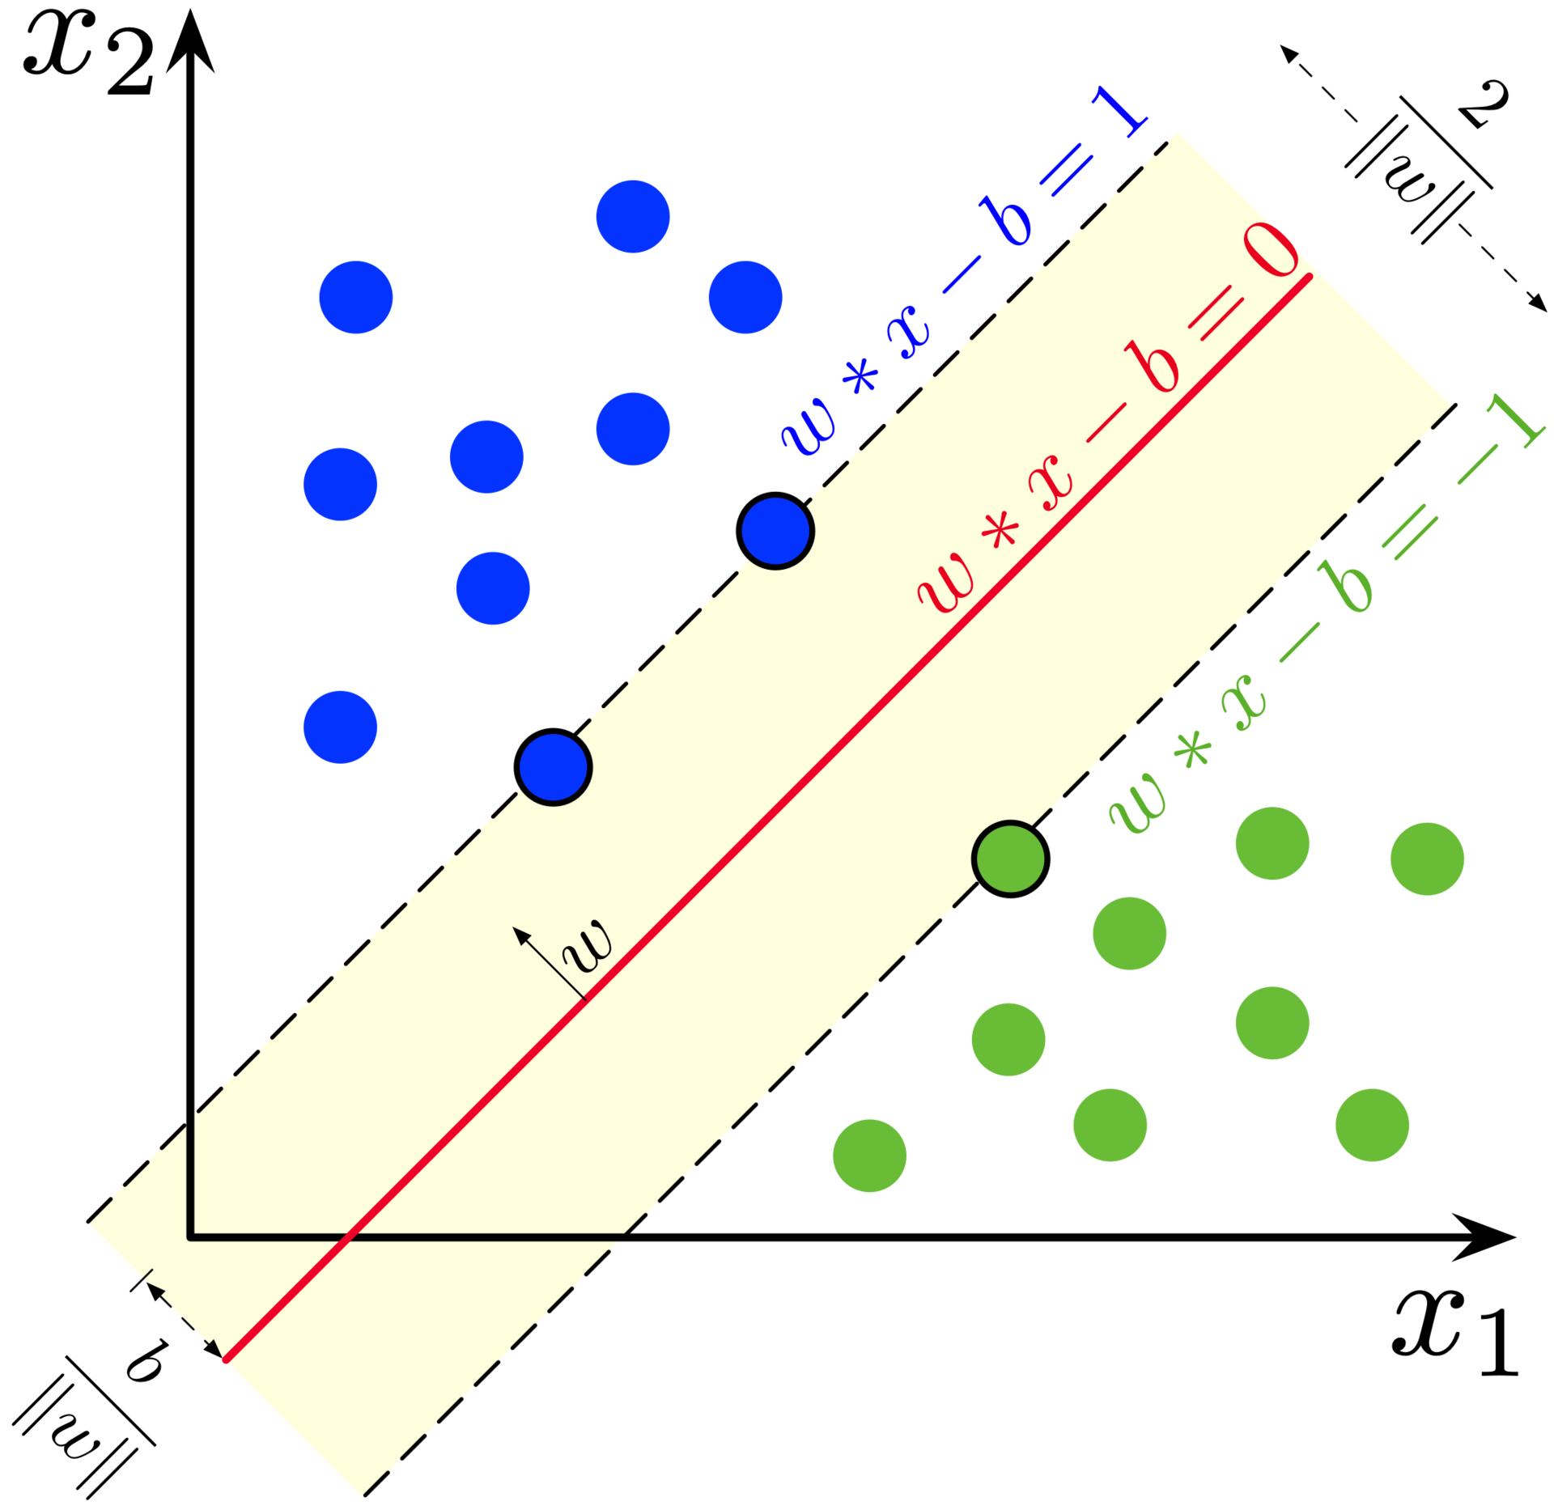
Denote each data point as (x_{i}, y_{i})
x_{i} is a vector of the expression profiles
y_{i} = -1 or 1, which labels the class
A hyperplane can be represented as: w*x + b = 0
The margin-width equals to:
http://en.wikipedia.org/wiki/Support_vector_machine

Slide 13
Find a hyperplane such that:
  No data points fall between the lines and
  The margin 2/||w|| is maximized
Mathematically,
  Minimize_{w,b} 1/2 ||w||², subject to:
  for y_{i} = 1,
  for y_{i} = -1,
  Combining them, for any i,
The solution expresses w as a linear combination of the x_{i}
So far, we have been assuming that the data points from two classes are always easily linearly separable. But that’s not always the case. (Also, could allow a “soft margin” via slack parameters – something we are not covering.)
http://en.wikipedia.org/wiki/Support_vector_machine

Slide 14
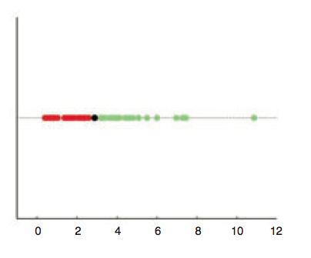
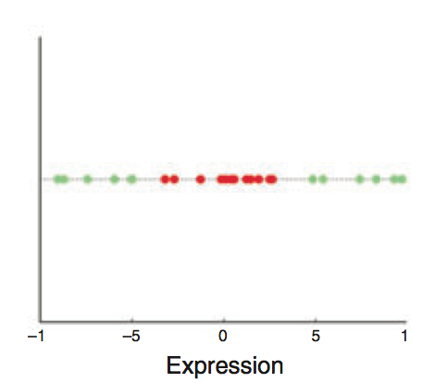
Are linear separating hyperplanes enough?
Yes
(by a 1D-hyperplane
= dot)
NO
William S Nobel. What is a support vector machine? Nature Biotechnology. 2006

Slide 15
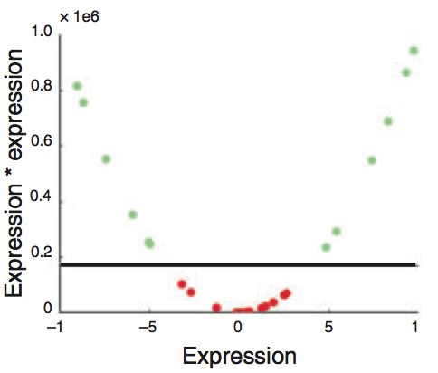
Transform (x_{i}) into (x_{i}, x_{i}²)
William S Nobel. What is a support vector machine? Nature Biotechnology. 2006

Slide 16
Non-linear SVM
  In some cases (e.g. the above example), even soft-margin cannot solve the non-separable problem
  Generally speaking, we can apply some function to the original data points so that different classes become linearly separable (maybe with the help of soft-margin)
  In the above example, the function is f(x) = (x, x²)
  The most import trick in SVM: to allow for the transformation, we only need to define the “kernel function”,
  The above example essentially uses a polynomial kernel

Slide 17
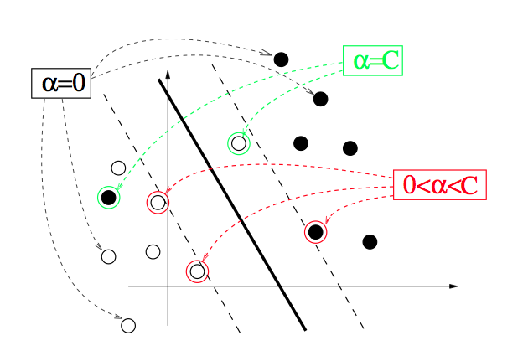
“Support vector machine”, where does the name come from?
  The x_{i} for which α_{i} > 0 are called support vectors
  They fall between or right on the separating margins
from http://cbio.ensmp.fr/~jvert/talks/110401mines/mines.pdf

Slide 18
Key idea in the Kernel Trick
Original SVM optimization for refining the hyperplane parameters w & b in terms of a linear combination of x_{i} can be replaced by a different optimization problem using "Lagrange multipliers" α_{i}
  One only optimizes using the product of x_{i}*x_{j}, now expressing the solution in terms of α_{i} which are non-zero for x_{i} that function as support vectors
In a non-linear SVM x_{i}*x_{j} is replaced by f(x_{i})*f(x_{j}), so you don't need to know f(x_{i}) itself only the product
  This is further formalized in the kernel trick where f(x_{i})*f(x_{j}) is just replaced by k(x_{i}, x_{j}). That is, one only has to know the “distance” between x_{i} & x_{j} in the high-dimensional space -- not their actual representation

Slide 19
Two commonly used kernels
(and there are more)
Polynomial kernel:
  a = 1 (inhomogeneous) or 0 (homogenous)
  d controls the degree of polynomial and henceforth the flexibility of the classifier
  degenerates to linear kernel when a = 0 and d = 1
Gaussian kernel:
  σ controls the width of the Gaussian and plays a similar role as d in the polynomial kernels

Slide 20
More about kernels
  With kernels, non-vector data can be easily handled – we only need to define the kernel function between two objects
  Examples of non-vector biological data include DNA and protein sequences (“string kernels”), nodes in metabolic or protein-protein interaction networks, microscopy images, etc.
  Allows for combining different types of data naturally – define kernels on different data types and combine them with simple algebra
Questions for practitioners: Which kernel to use? How to choose parameters?
  Trial and error
  Cross-validation
High-degree kernels always fit the training data well, but at increased risks of over-fitting, i.e., the classifier will not generalize to new data points
  One needs to find a balance between classification accuracy on the training data and regularity of the kernel (not allowing the kernel to be too flexible)
Notes:
references

Slide 21
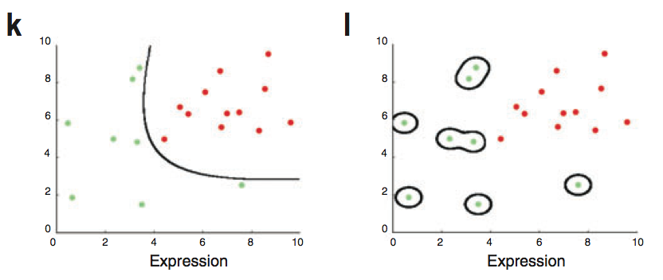
A low-degree kernel (left) and an over-fitting high-degree kernel (right)
William S Nobel. What is a support vector machine? Nature Biotechnology. 2006

Slide 22
Supervised Mining:
Decision Boundary & Semi-supervised Approaches

Slide 23
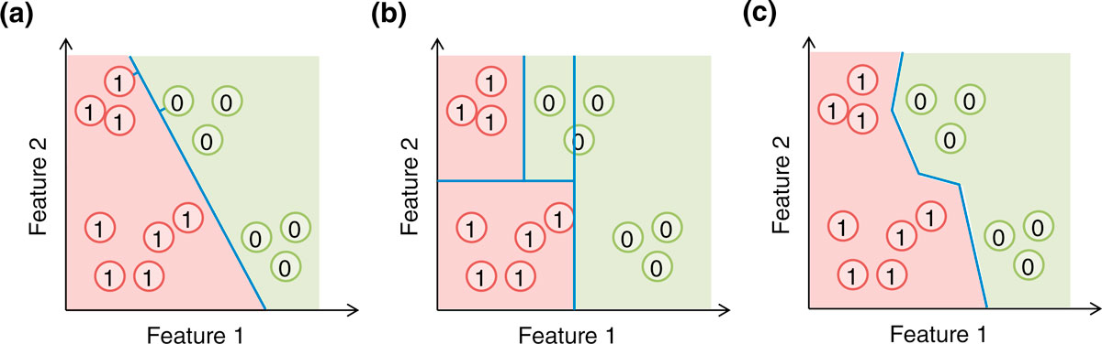
Decision boundaries:
SVM v Tree v Nearest NBR
(a) A support vector machine (SVM) forms an affine decision surface (a straight line in the case of two dimensions) in the original feature space or a vector space defined by the similarity matrix (the kernel), to separate the positive and negative examples and maximize the distance of it from the closest training examples (the support vectors, those with a perpendicular line from the decision surface drawn). It predicts the label of a genomic region based on its direction from the decision surface. In the case a kernel is used, the decision surface in the original feature space could be highly non-linear. (b) A basic decision tree uses feature-parallel decision surfaces to repeatedly partition the feature space, and predicts the label of a genomic region based on the partition it falls within. (c) The one-nearest neighbor (1-NN) method predicts the label of a genomic region based on the label of its closest labeled example. In all three cases, the areas predicted to be positive and negative are indicated by the red and green background colors, respectively.
[Yip et al. Genome Biology 2013 14:205 doi:10.1186/gb-2013-14-5-205]

Slide 24
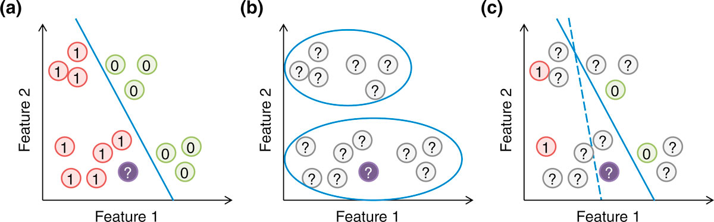
Semi-supervised Methods
Supervised & Unsupervised:
Can you combine them? YES
  RHS (c) shows modifying the optimum decision boundary in (a) by "clustering" of unlabeled points
[Yip et al. Genome Biol. ('13)]
Supervised, unsupervised and semi-supervised learning. (a) In supervised learning, the model (blue line) is learned based on the positive and negative training examples, and the genomic region without a known class label (purple circle) is classified as positive according to the model. (b) In unsupervised learning, all examples are unlabeled, and they are grouped according to the data distribution. (c) In semi-supervised learning, information of both labeled and unlabeled examples is used to learn the parameters of the model. In this illustration, a purely supervised model (dashed blue line) classifies the purple object as negative, while a semi-supervised model that avoids cutting at regions with a high density of genomic regions (solid blue line) classifies it as positive.

