Slide 1
Biomedical Data Science (GersteinLab.org/courses/452)
Supervised Datamining – Decision Trees (23m8a)
Last edit in spring ’23. Condensed (with ~2 slide deletions) from 22m8a, which is similar to
2021’s M8a [which has a video].
Mark Gerstein
Yale U.

Slide 2
Supervised Mining:
Overview

Slide 3
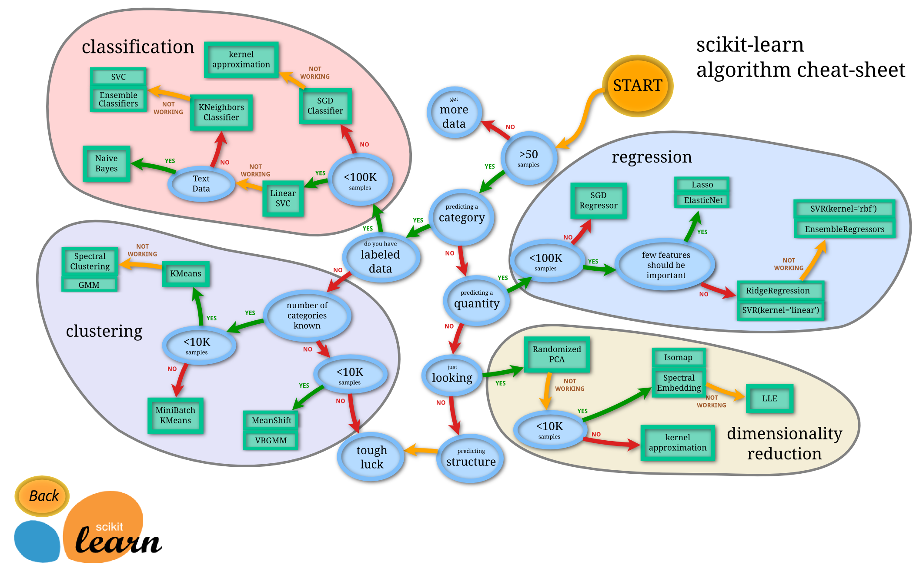
The World of Machine Learning
SciKit learn: http://scikit-learn.org/stable/tutorial/machine_learning_map/

Slide 4
Distinctions in
Supervised Learning
Regression vs Classification
  Regression: labels are quantitative
  Classification: labels are categorical
Regularized vs Un-regularized
  Regularized: penalize model complexity to avoid over-fitting
  Un-regularized: no penalty on model complexity
Parametric vs Non-parametric
  Parametric: an explicit parametric model is assumed
  Non-parametric: otherwise
Ensemble vs Non-ensemble
  Ensemble: combines multiple models
  Non-ensemble: a single model

Slide 5
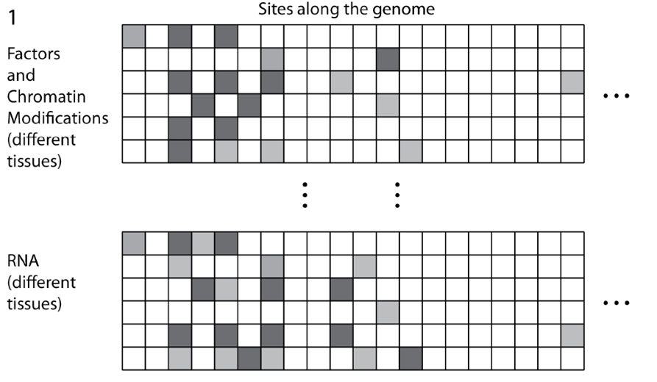
Structure of Genomic Features Matrix

Slide 6
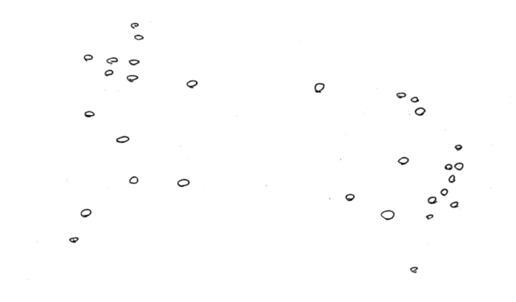
Represent predictors in abstract high dimensional space

Slide 7
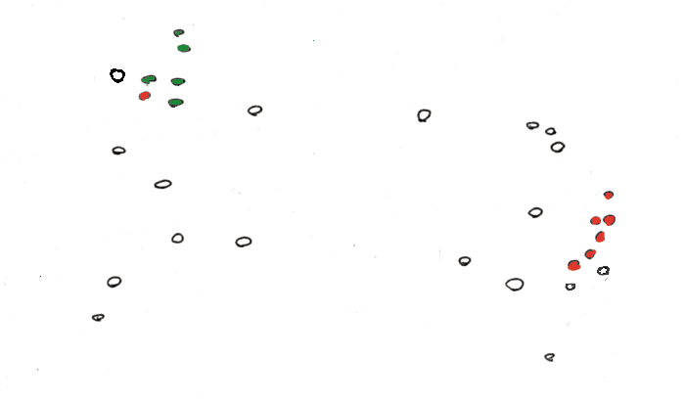
“Label” Certain Points

Slide 8
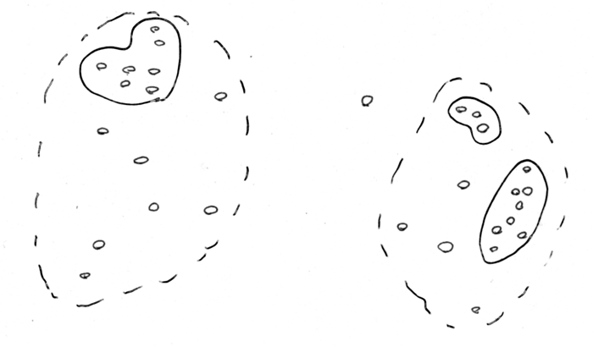
“Cluster” predictors (Unsupervised)

Slide 9
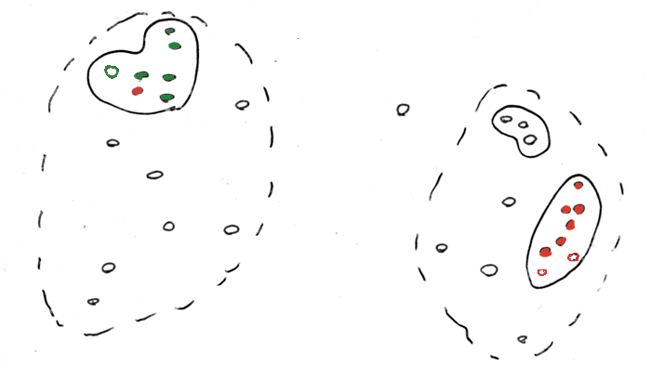
Use Clusters to predict Response (Unsupervised, guilt-by-association)

Slide 10
Find a Division to Separate Tagged Points

Slide 11
Extrapolate to Untagged Points

Slide 12
Probabilistic Predictions of Class

Slide 13
Find a Division to Separate Tagged Points

Slide 14
Supervised Mining:
Decision Trees

Slide 15
Decision Trees
Classify data by asking questions that divide data in subgroups
Keep asking questions until subgroups become homogenous
Use tree of questions to make predictions
Example: Is a picture taken inside or outside?
Criminisi, Shotton, and Konukoglu Microsoft Technical Report 2011

Slide 16
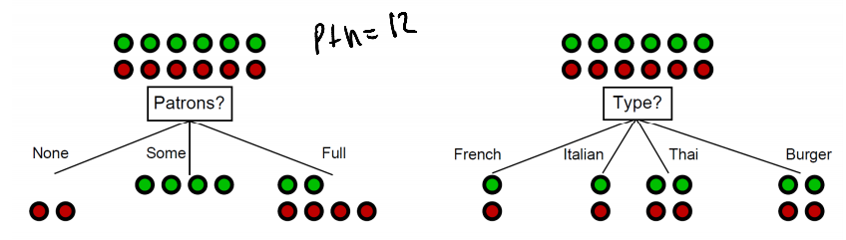
What makes a good rule?
Want resulting groups to be as homogenous as possible
Rule 1
Rule 2
All groups still 50/50
→ Unhelpful rule
2/3 Groups homogenous
→Good rule
Nando de Freitas 2012 University of British Columbia CPSC 340
Notes:
Emphasize that classification is based on underlying characteristics

Slide 17
Quantifying the value of rules
Decrease in inhomogeneity
  Most popular metric: Information theoretic entropy
  Use frequency of classifier characteristic within group as probability
  Minimize entropy to achieve homogenous group
S =

Slide 18
Algorithm
For each characteristic:
  Split into subgroups based on each possible value of characteristic
Choose rule from characteristic that maximizes decrease in inhomogeneity
For each subgroup:
  if (inhomogeneity < threshold):
    Stop
  else:
    Restart rule search (recursion)

Slide 19
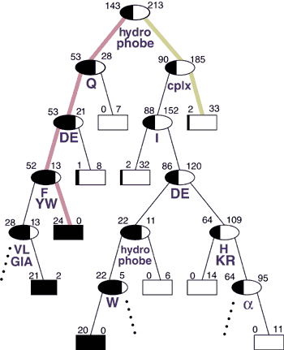
Retrospective Decision Trees
356 total
Not Expressible
Express-ible
Analysis of the Suitability of 500 M. thermo. proteins
to find optimal sequences purification
Has a hydrophobic stretch? (Y/N)
[Bertone et al. NAR (‘01)]

Slide 20
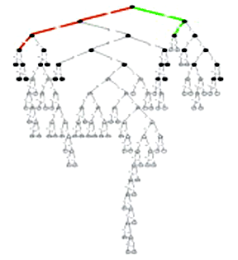
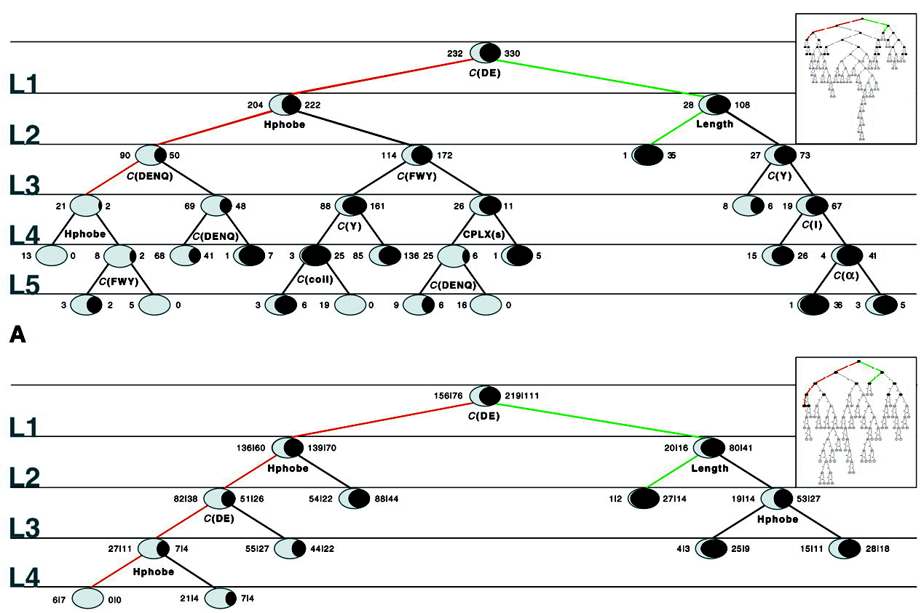
Overfitting, Cross Validation, and Pruning

Slide 21
Extensions of Decision Trees
Decision Trees method is very sensitive to noise in data
Random forests is an ensemble of decision trees and is much more effective.

