Slide 1
Biomedical Data Science (GersteinLab.org/courses/452)
1000 Genomes & PCAWG Summary (23m6b)
Last edit in spring ’23. Unchanged (but with slight edits) from 22m6b & 2021’s M6b [which has a video].
Mark Gerstein
Yale U.

Slide 2
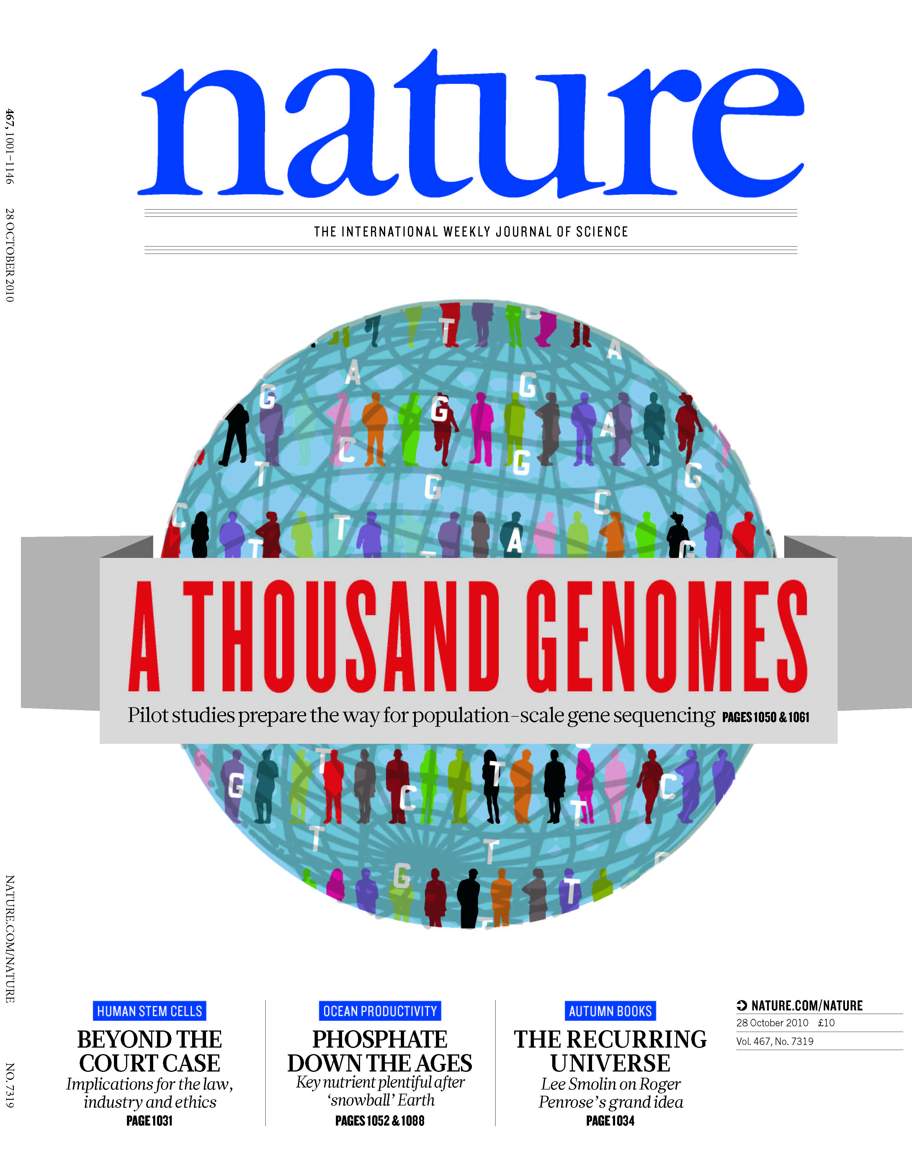
1000G SV
(Pilot, Phase I & III)
[1000 Genomes Consortium, Nature (2010, 2012); Mills et al., Nature (2011)]

Slide 3
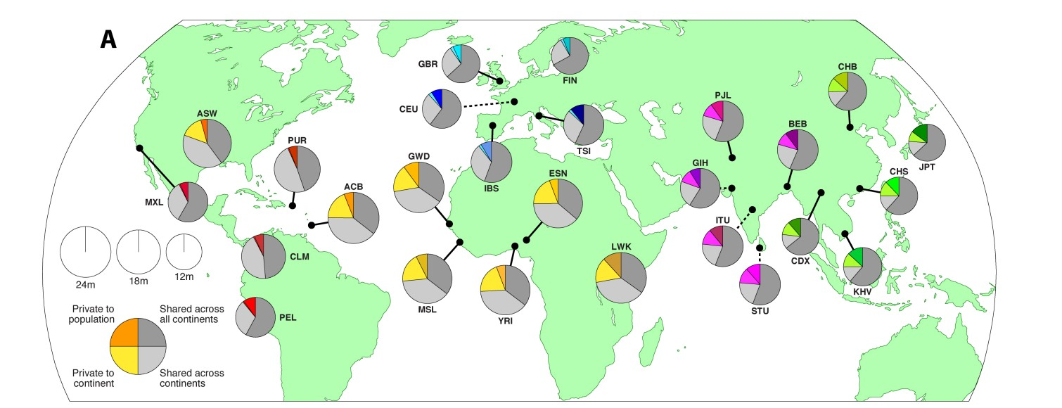
Summary Stats of 1000GP SV Phase3
• 68,818 SVs
• 2,504 unrelated individuals
• 26 populations
• 37,250 SVs with resolved breakpoints
[2] 1000GP Phase3 SV paper. Submided to Nature, 2015. [3] 1000GP ConsorSum. Submided to Nature, 2015.
8

Slide 4
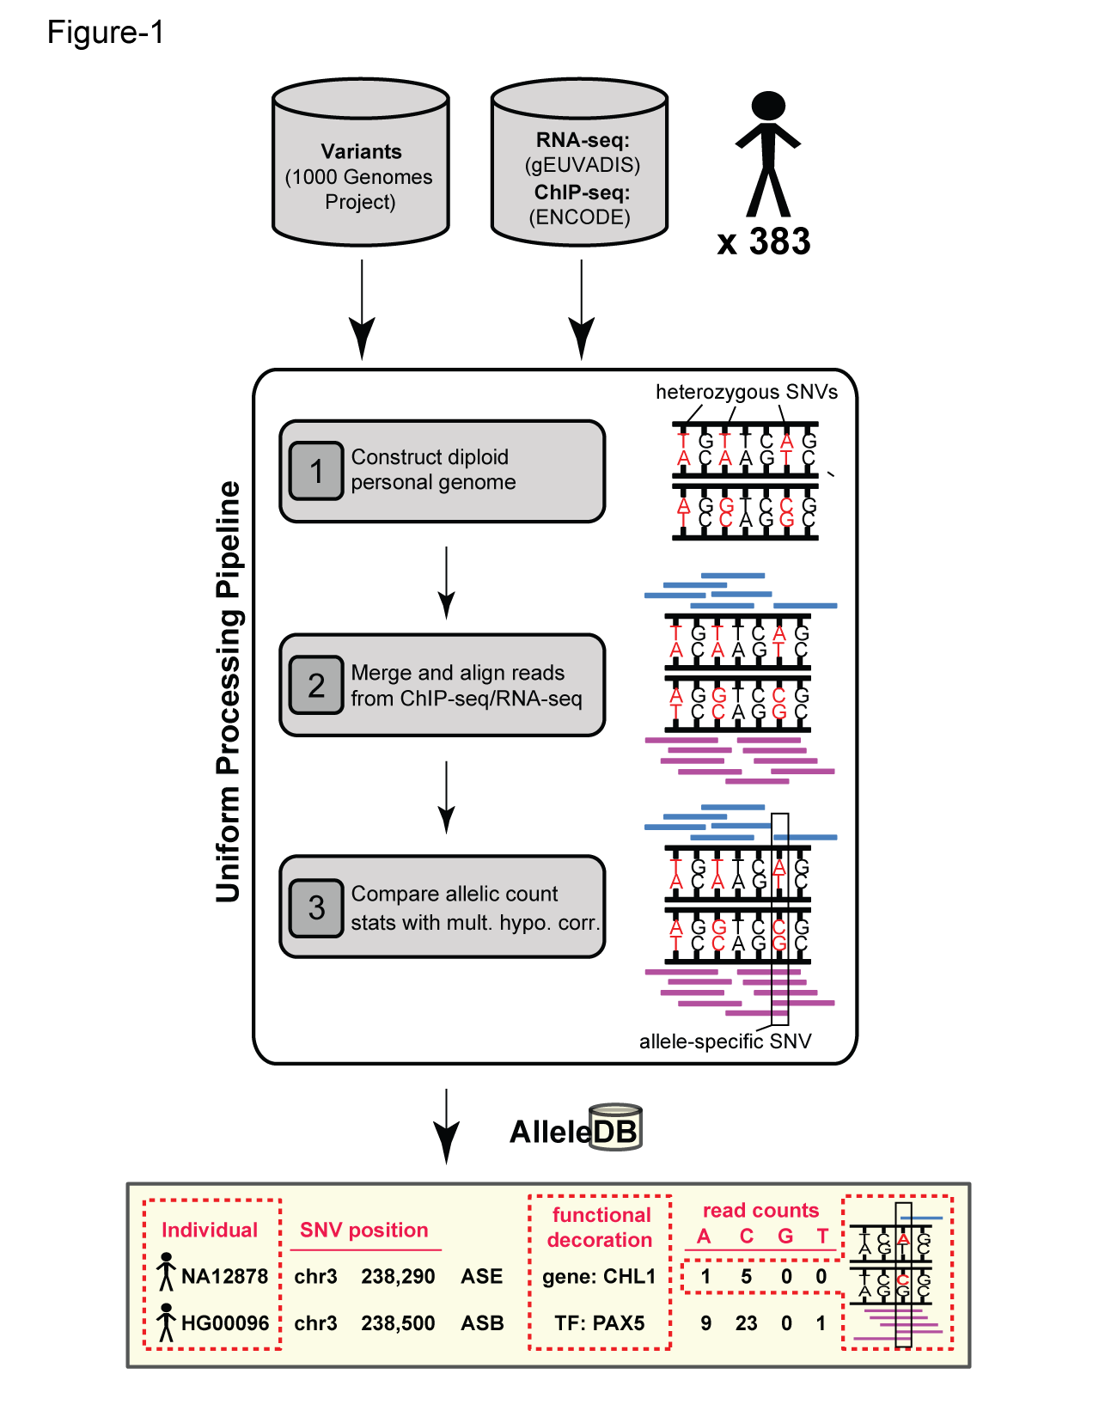
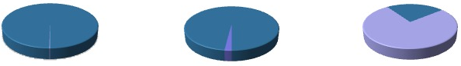
Human Genetic Variation
Population of
2,504 peoples
A Cancer Genome
A Typical Genome
Origin of Variants
Class of Variants
 | Coding | Non-coding
Germ-line | 22K | 4.1 – 5M
Somatic | ~50 | 5K
SNP | 3.5 – 4.3M
Indel | 550 – 625K
SV | 2.1 – 2.5K (20Mb)
Total | 4.1 – 5M
SNP | 84.7M
Indel | 3.6M
SV | 60K
Total | 88.3M
Prevalence of Variants
Common
Common
Passenger
Driver (~0.1%)
Rare* (1-4%)
Rare (~75%)
* Variants with allele frequency < 0.5% are considered as rare variants in 1000 genomes project.
The 1000 Genomes Project Consortium, Nature. 2015. 526:68-74
Khurana E. et al. Nat. Rev. Genet. 2016. 17:93-108

Slide 5
Association of Variants with Diseases
Common
Variants
Healthy
Rare or
Somatic
Variants
Pooled
Variants
High
Function
Impact
Diseased
Burden Test
GWAS Positive

Slide 6
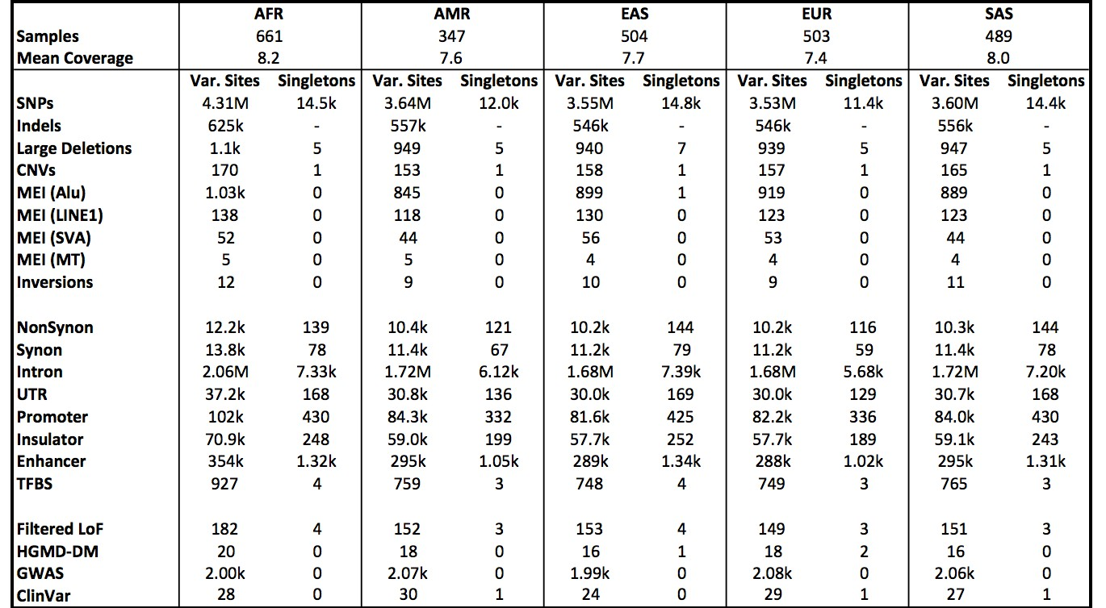
Phase 3: Median Autosomal Variant Sites Per Genome
[3] 1000GP Consortium. Submitted to Nature, 2015.
33

Slide 7
Different Approaches Work Differently on Different Events
[Zhang et al. ('11) BMC Genomics]

Slide 8
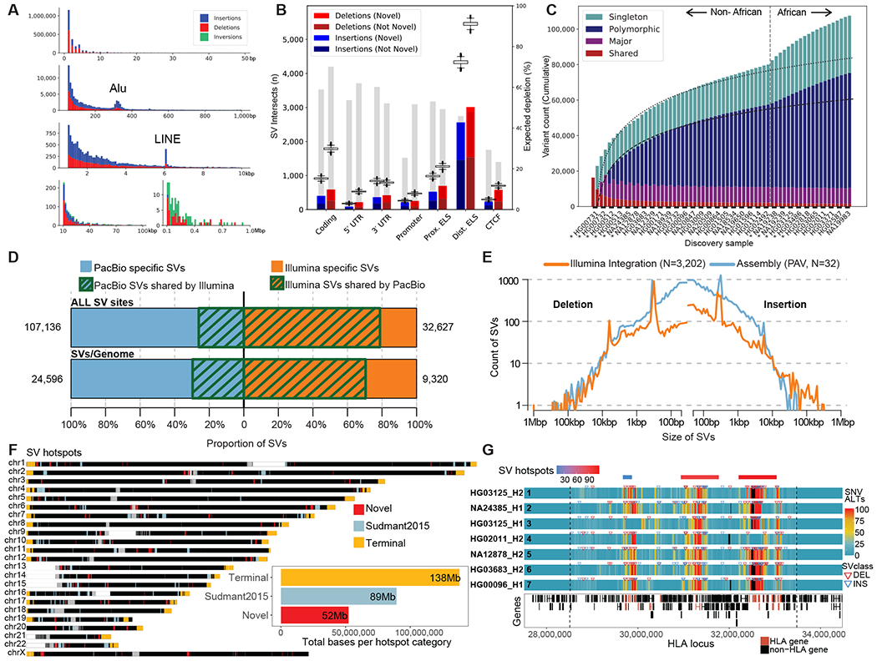
Updating the SV Numbers with Most Current Technology (PacBio HiFi)
On average, detected:
24,653 SVs,
794,406 indels, and 3,895,274 SNVs
per diploid human genome
[Ebert et al. Science (‘21)]

Slide 9
PCAWG summary

Slide 10
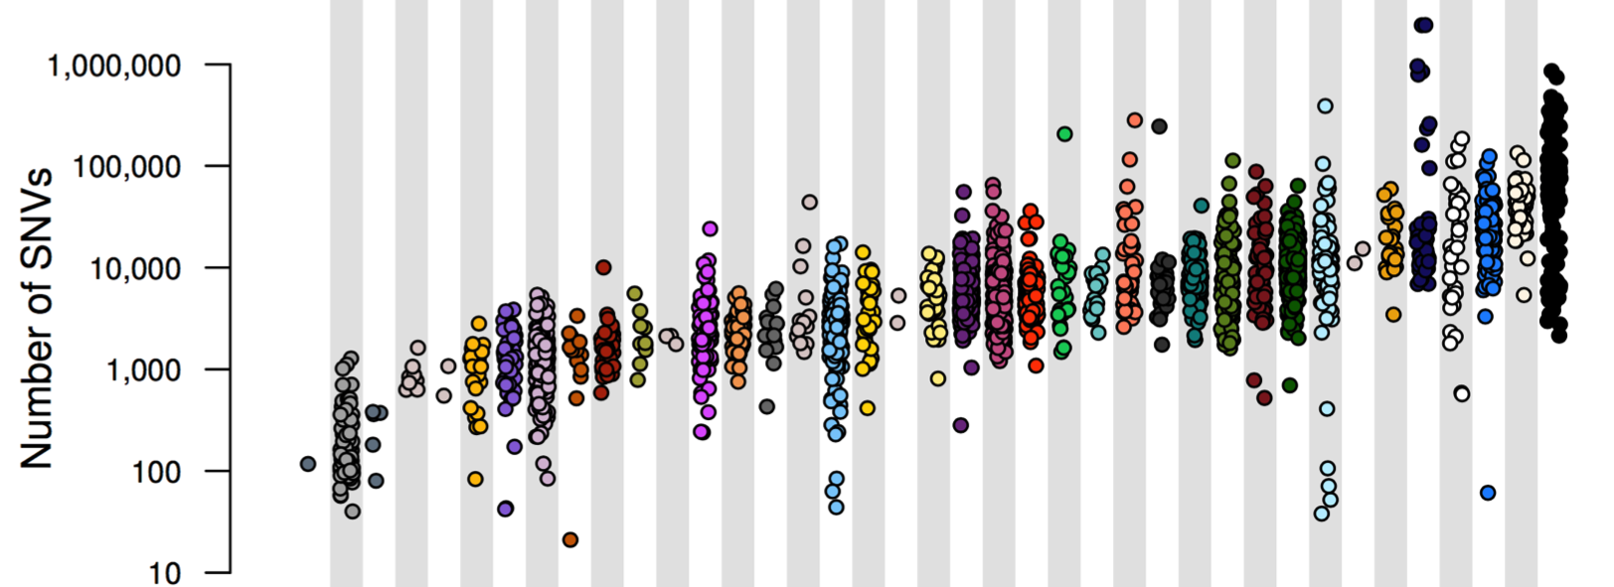
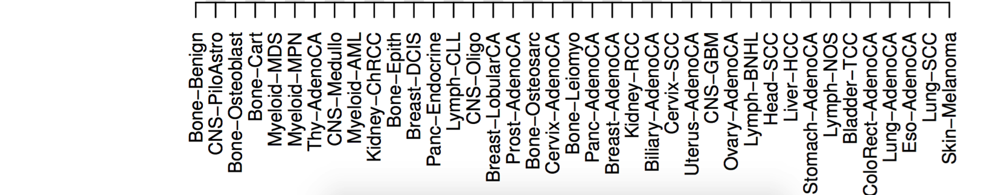
PCAWG : most comprehensive resource for
cancer whole genome analysis
Project Goals:
To understand role of non-coding regions of cancer genomes in disease progression.
Union of TCGA-ICGC efforts
Jointly analyzing ~2800 whole genome tumor/normal pairs
  > 580 researchers
  16 thematic working groups
  ~30M total somatic SNVs
Adapted from Campbell et. al., bioRxiv (’17).
Now published as Nature 578: 82–93 (2020)

Slide 11
PCAWG Summary
Variant Totals
by Cancer
Nature 578: 82–93 (2020)

