Slide 1
Biomedical Data Science (GersteinLab.org/courses/452)
Introduction (23i1)
Last edit in spring ’23. Similar to 22i1 & 2021’s I1 [which has a video]. Has additions beginning at slides 29 & 33, describing course topics, format & goals. Usually takes ~45’ with rest of class going over syllabus
Mark Gerstein
Yale U.

Slide 2
Overview: what is
Biomed. Data science?
(Placing it into the context of Data Science, in general)

Slide 3
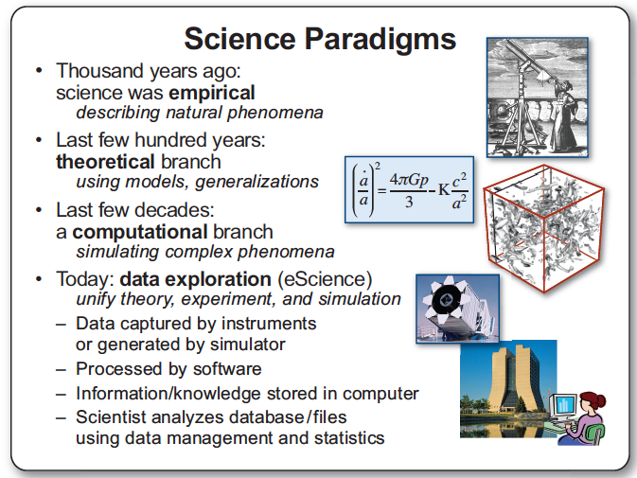
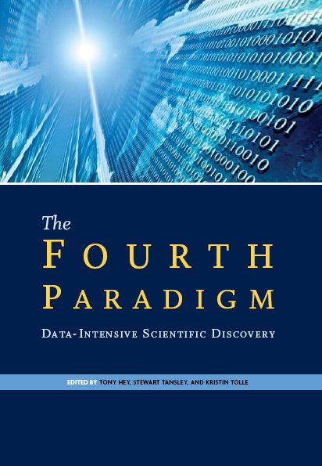
Jim Gray’s 4th Paradigm

Slide 4
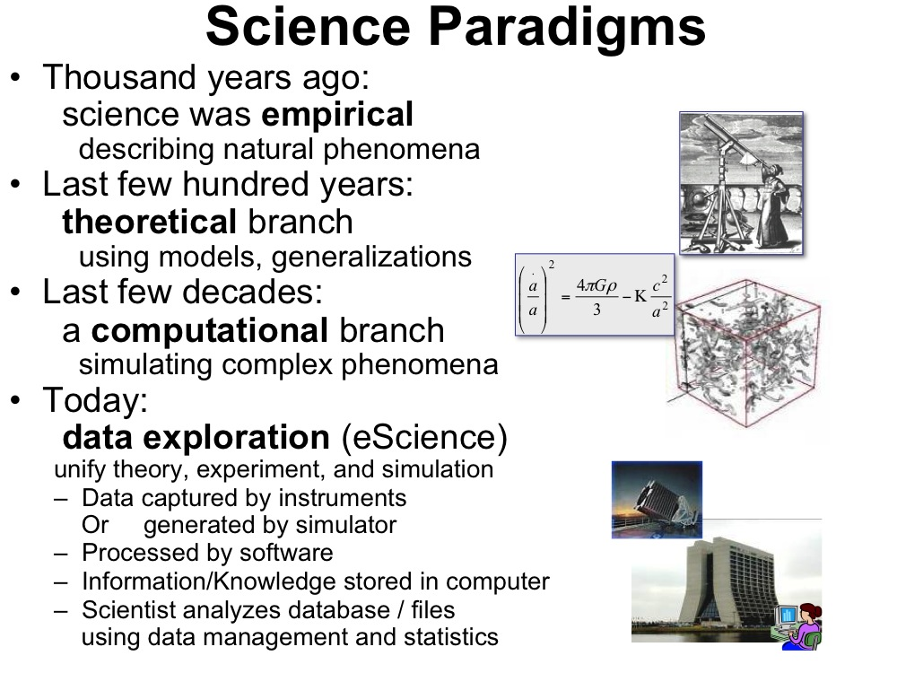
Jim Gray’s 4th Paradigm
#3 - Simulation
  Prediction based on physical principles (eg Exact Determination of Rocket Trajectory)
  Emphasis on: Supercomputers
#4 - Data Mining
  Classifying information & discovering unexpected relationships
  Emphasis: networks, “federated” DBs
Gray died in ’07.
Book about his ideas came out in ‘09…..
[Slide from : http://research.microsoft.com/en-us/um/people/gray/talks/stanford%2520symbolic%2520systems%2520seminar.ppt]

Slide 5
What is Data Science? An overall, bland definition…
Data Science encompasses the study of the entire lifecycle of data
  Understanding of how data are gathered &
  the issues that arise in its collection
  Knowledge of what data sources are available
  & how they may be synthesized to solve problems
  The storage, access, annotation, management, &
  transformation of data
Data Science encompasses many aspects of data analysis
  Statistical inference, machine learning, & the design of algorithms and computing systems that enable data mining
  Connecting this mining where possible with physical modeling
  The presentation and visualization of data analysis
  The use of data analysis to make practical decisions & policy
Secondary aspects of data, not its intended use – eg the data exhaust
  The appropriate protection of privacy
  Creative secondary uses of data – eg for Science of science
  The elimination of inappropriate bias in the entire process

Slide 6
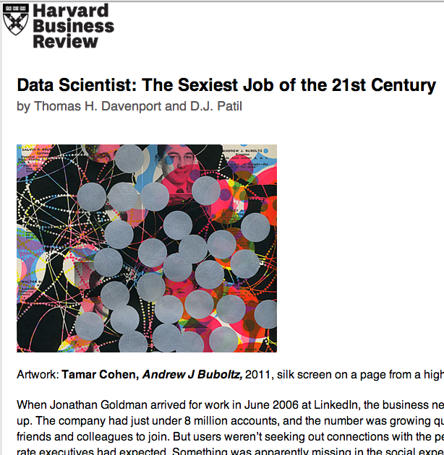
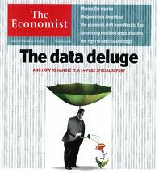
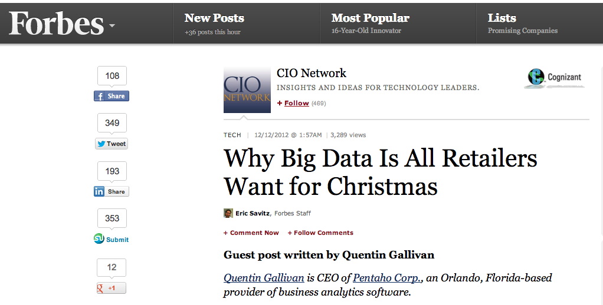
Data Science in the wider world: a buzz-word for successful Ads
Ads, media, product placement,
supply optimization,
Integral to success of GOOG, FB, AMZN, WMT…
[Oct. ‘12 issue]

Slide 7
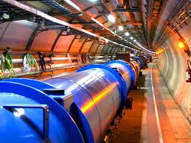
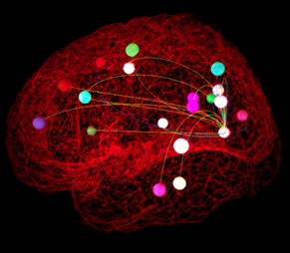
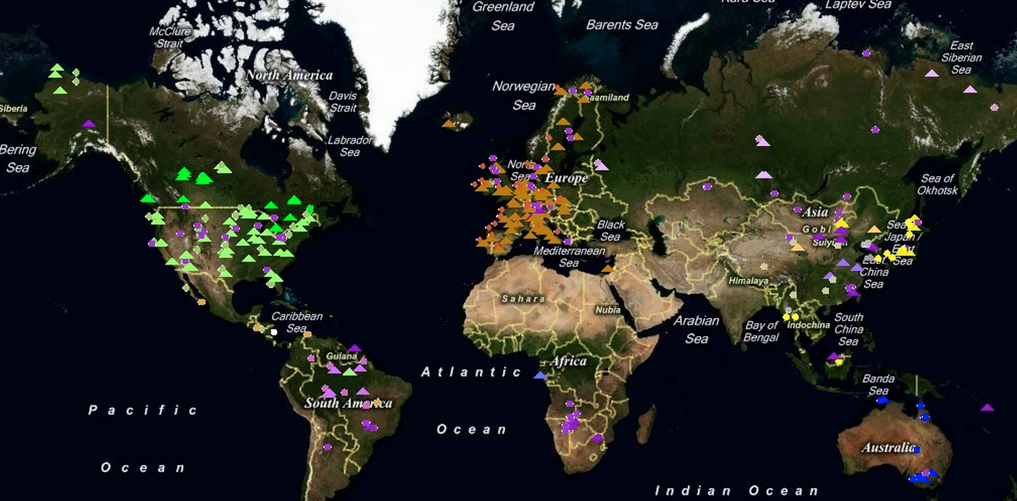
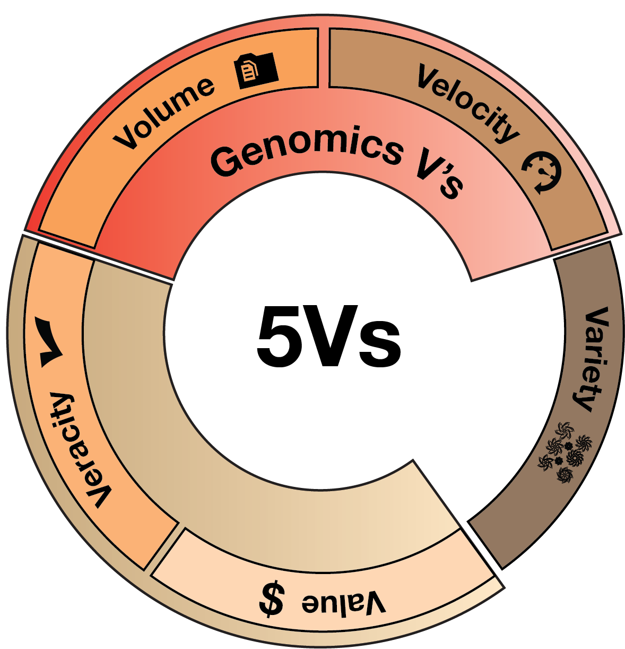
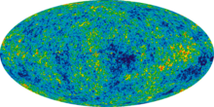
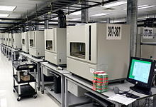
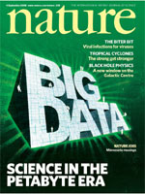

Data Science in Traditional Science
Pre-dated commercial mining
Instrument generated
Large data sets often created by large teams not to answer one Q but to be mined broadly
Often coupled to a physical/biological model
Interplay w/ experiments
[Navarro et al. GenomeBiol. (’19, in press)]
Ecology
& Earth Sci.
- Fluxnet
High energy physics -
Large Hadron Collider
Neuroscience -
The Human Connectome Project
Astronomy -
Sloan Digital Sky survey
Genomics
DNA sequencer

Slide 8
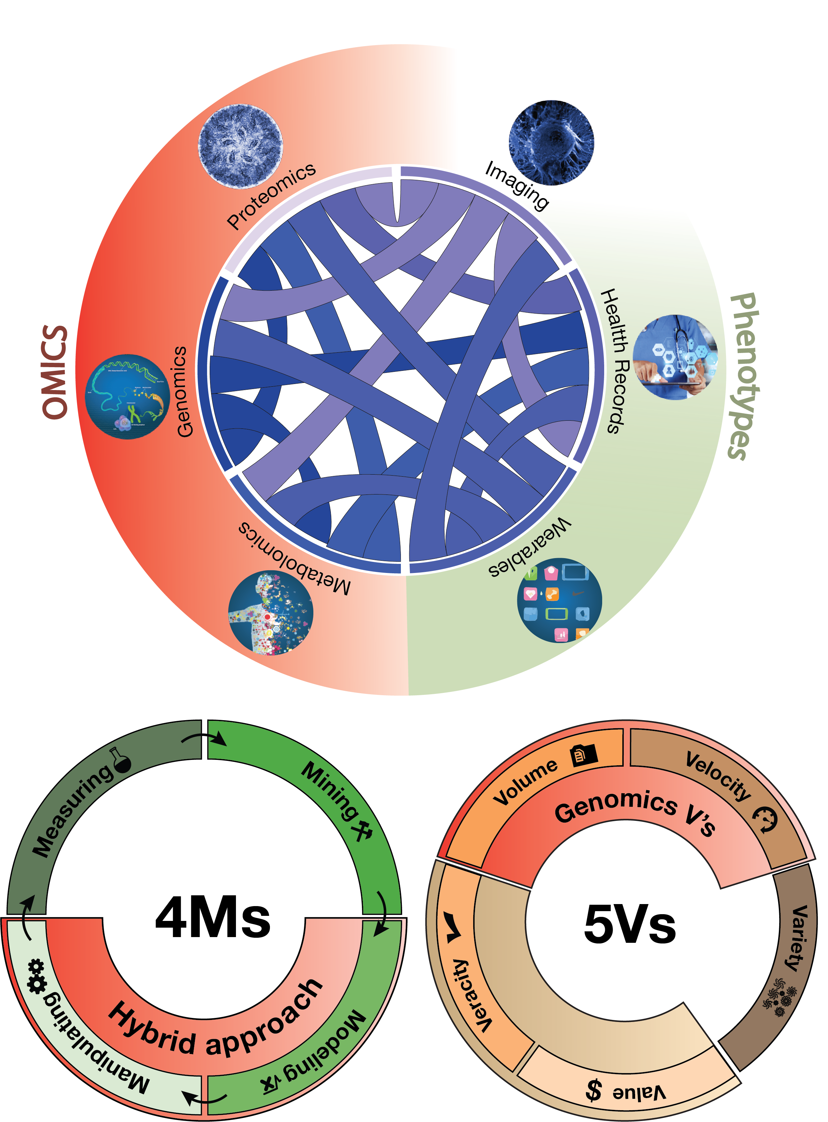
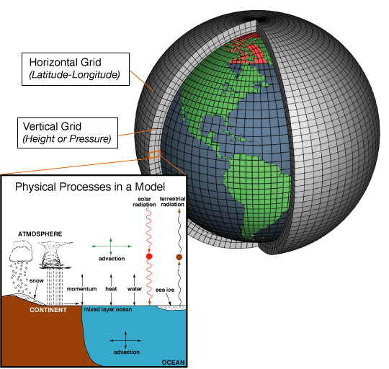
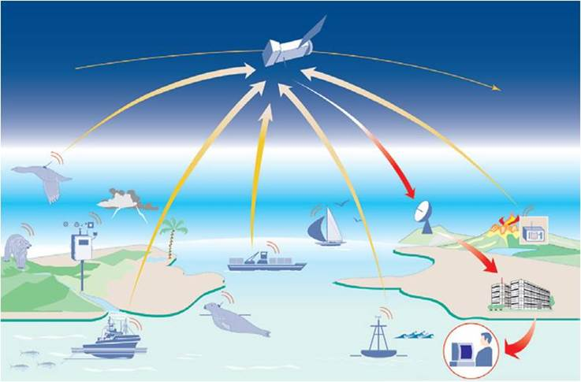
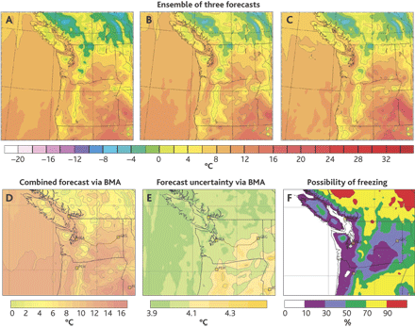
Coupling of Scientific Data to Models & Experiments
  Scientific data often coupled to a physical/biological model
Lauffenburger’s Sys. Biol. 4Ms:
Measurement, Mining, Modeling & Manipulation
(Ideker et al.’06. Annals of Biomed. Eng.)
Weather forecasting as an exemplar
  Physical models & simulation useful but not sufficient (“butterfly” effect)
  Success via coupling to large-scale sensor data collection
Models + Data Mining
Forecasts
[Navarro et al. GenomeBiol. (’19,
in press)]
Image from http://web.aibn.uq.edu.au/cssb/ResearchProjects.htm
NOAA

Slide 9
Biomed. Data science:
Scaling & Integration

Slide 10
Drivers of Biomedical Data Science
Integration across data types
Scaling
of individual data types
[Navarro et al. GenomeBiol. (’19, in press)]

Slide 11


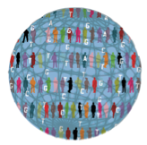

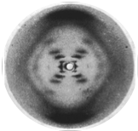
Case Study: Amazing Progress in Scaling & Integration with Genotype-Phenotype Relationships
2015
2008
Integrated health data
1995
1000
Genomes
UKBB study with over 500K participants, genotypes to phenotypic details & clinical information
1953
Sequenced Genome
Catalogue
of human variation
Double Helix
H.
influenzae
Watson
& Crick

Slide 12
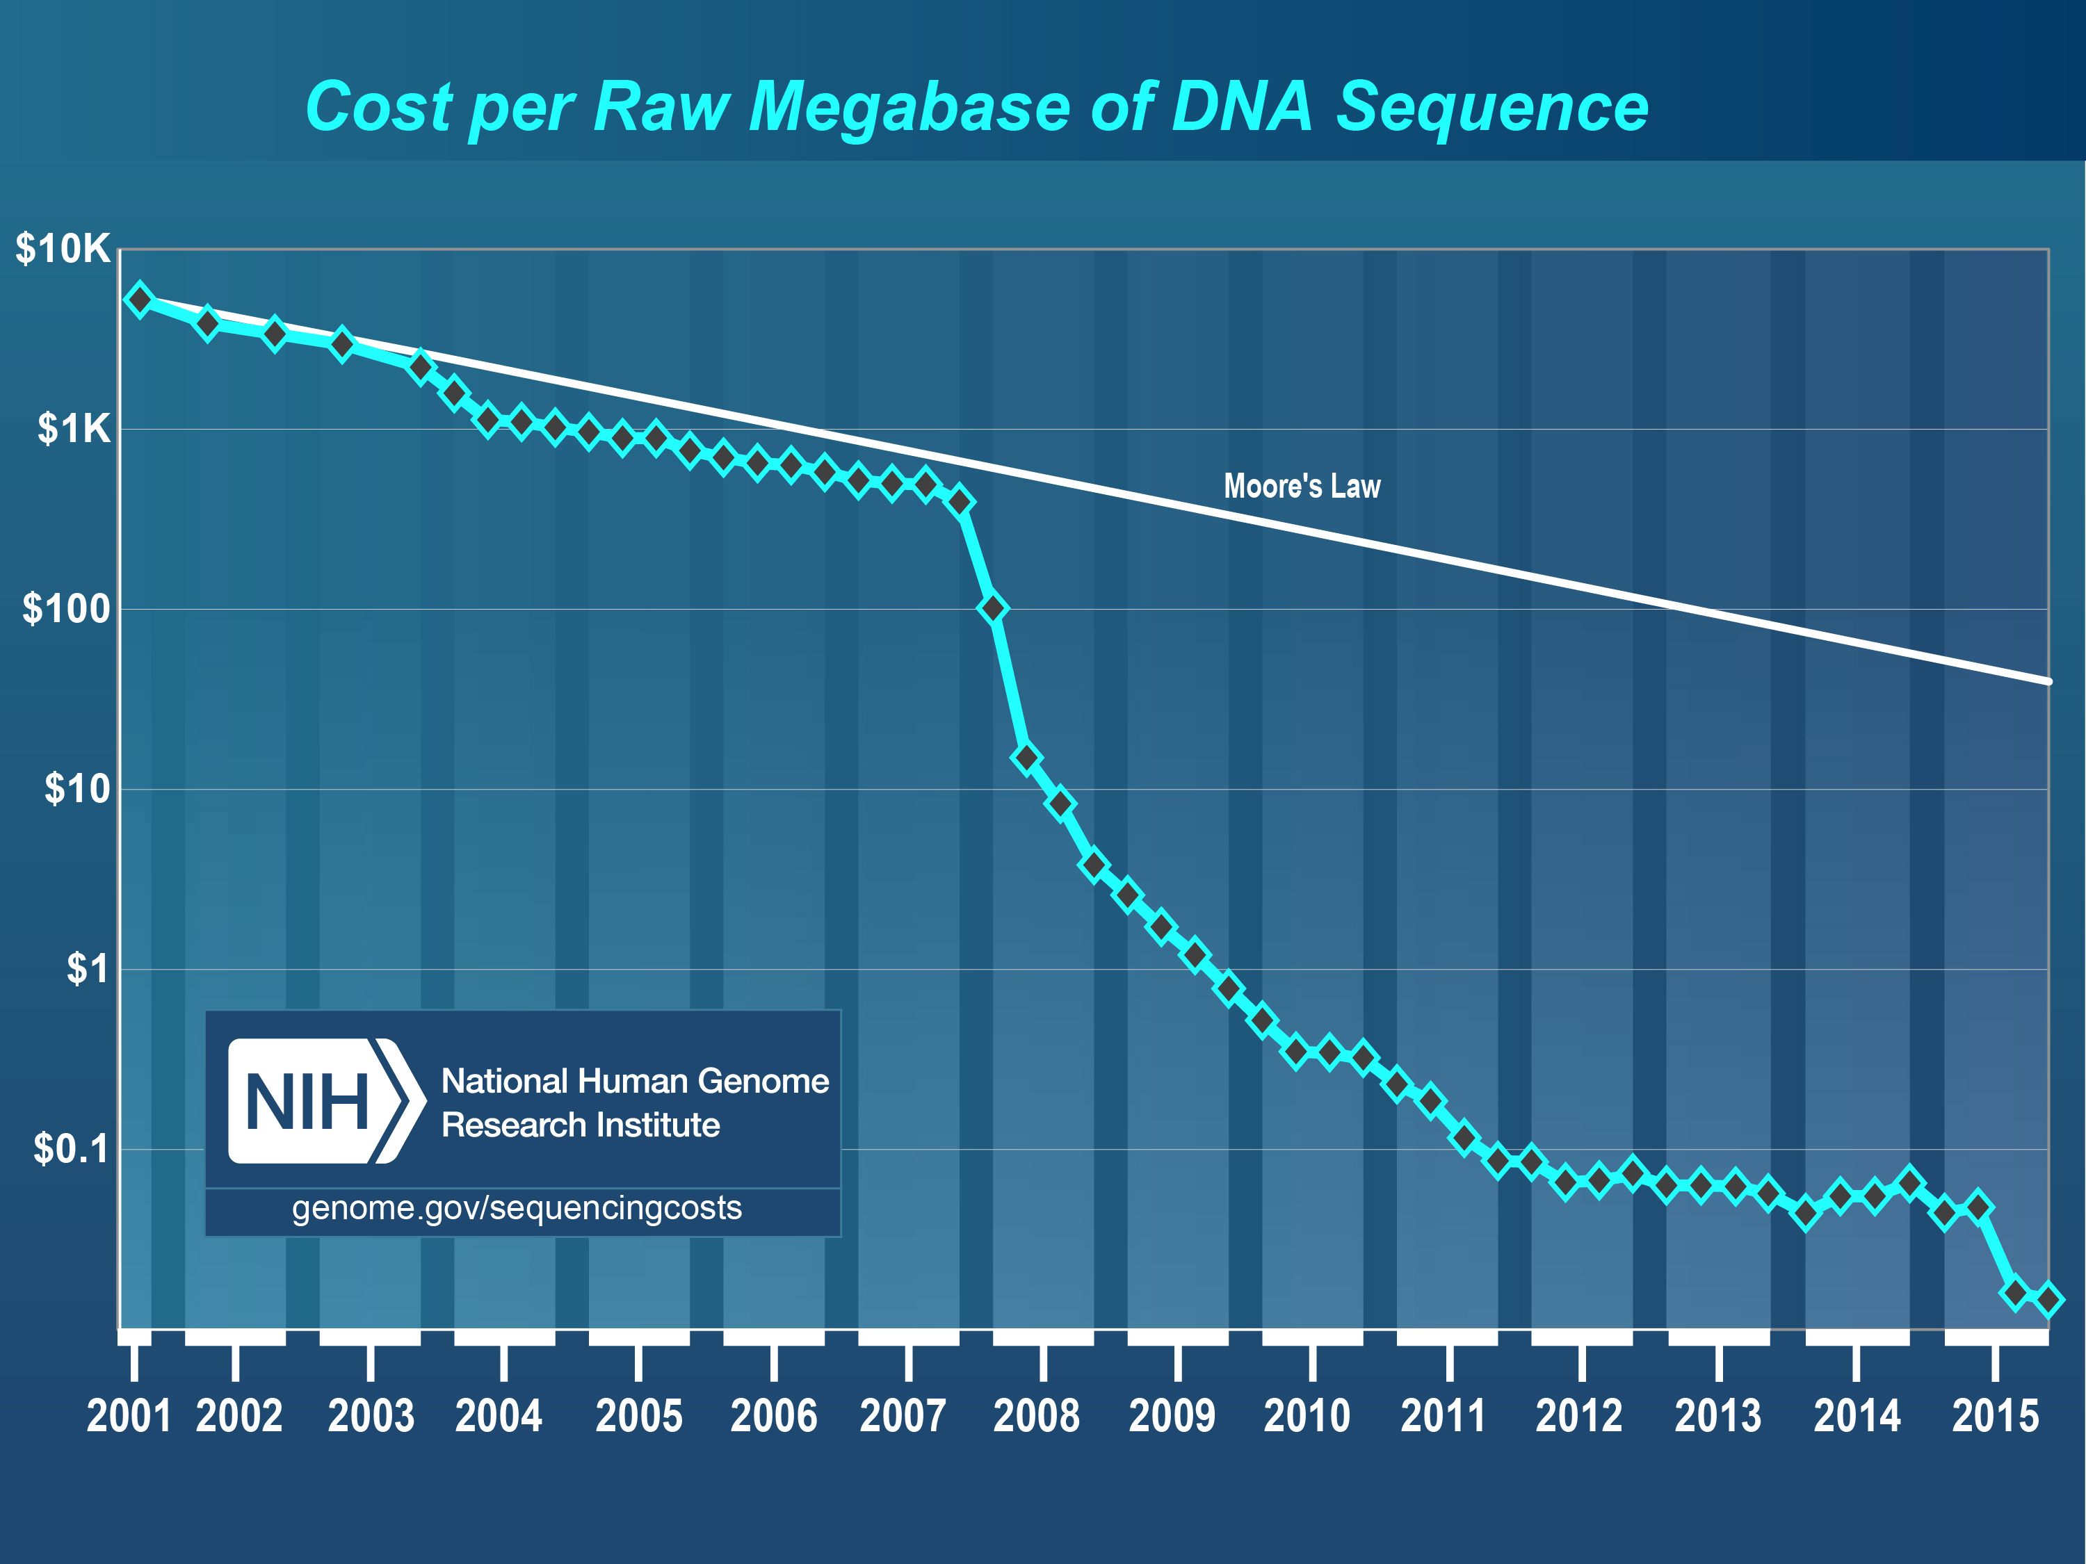
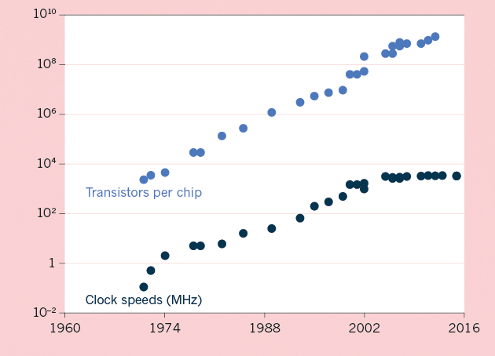
The Scaling of Genomic Data Science:
Powered by exponential increases in data & computing
(Moore’s Law)
[NHGRI website + Waldrop (‘15) Nature]

Slide 13
Kryder’s Law and S-curves underlying exponential growth
Moore’s & Kryder’s Laws
  As important as the increase in computer speed has been, the ability to store large amounts of information on computers is even more crucial
Exponential increase seen in Kryder’s law is a superposition of
S-curves for different technologies
[Muir et al. (‘15) GenomeBiol.]

Slide 14
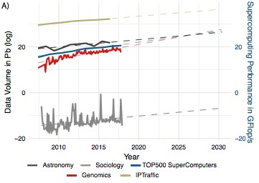
Sequencing cost reductions have resulted in an explosion of data
The type of sequence data deposited has changed as well.
[Muir et al. (‘15) GenomeBiol.]

Slide 15
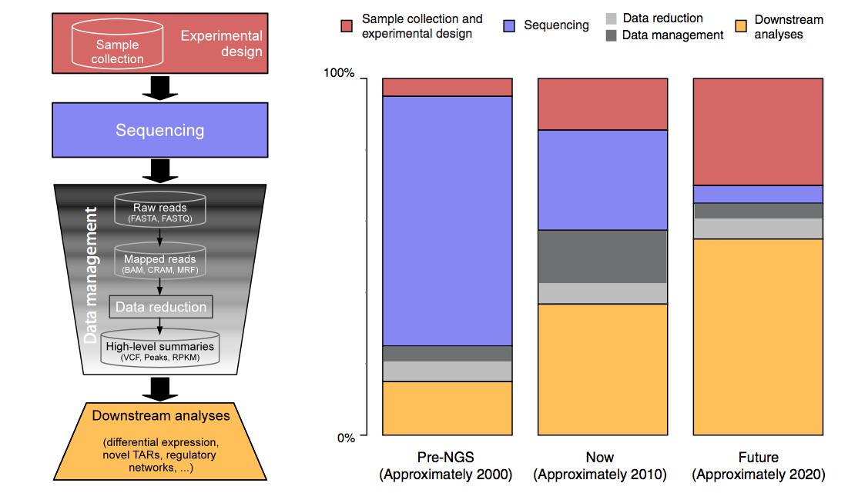
The changing costs of a sequencing pipeline
From ‘00 to ~’20,
cost of DNA sequencing expt. shifts from the actual seq. to sample
collection & analysis
[Sboner et al. (‘11), Muir et al. (‘15) Genome Biology]

Slide 16
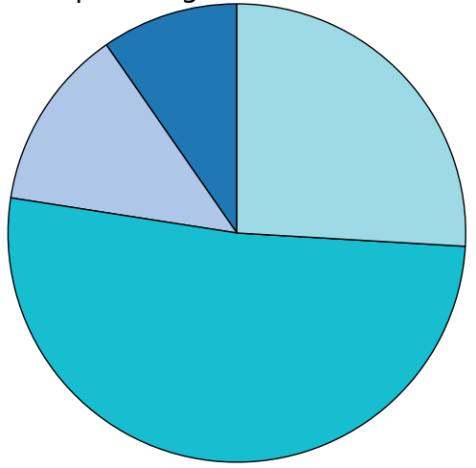
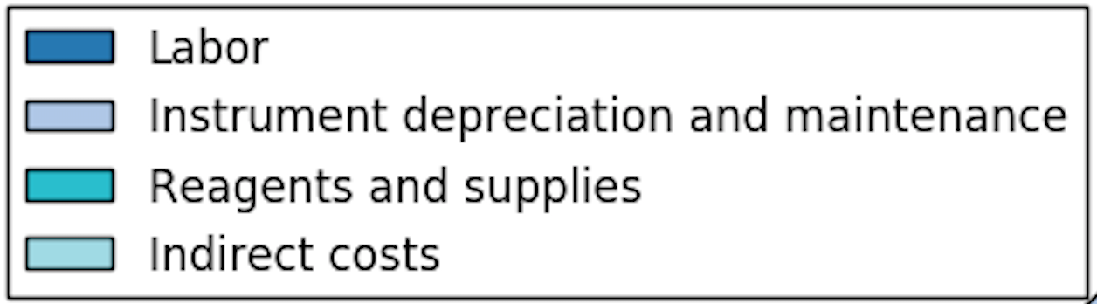
The changing costs of a sequencing pipeline
From ‘00 to ~’20,
cost of DNA sequencing expt. shifts from the actual seq. to sample
collection & analysis
[Sboner et al. (‘11), Muir et al. (‘15) Genome Biology]

Slide 17
The changing costs of a sequencing pipeline
From ‘00 to ~’20,
cost of DNA sequencing expt. shifts from the actual seq. to sample
collection & analysis
Alignment algorithms scaling to keep pace with data generation
[Sboner et al. (‘11), Muir et al. (‘15) Genome Biology]

Slide 18
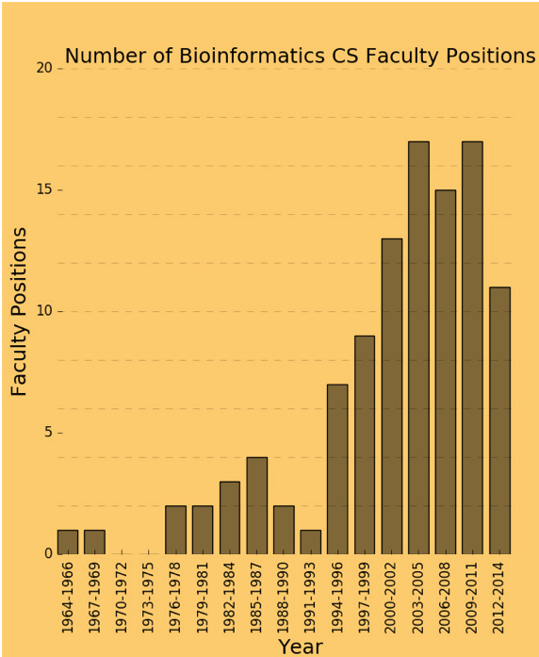
The changing costs of a sequencing pipeline
From ‘00 to ~’20,
cost of DNA sequencing expt. shifts from the actual seq. to sample
collection & analysis
[Sboner et al. (‘11), Muir et al. (‘15) Genome Biology]

Slide 19
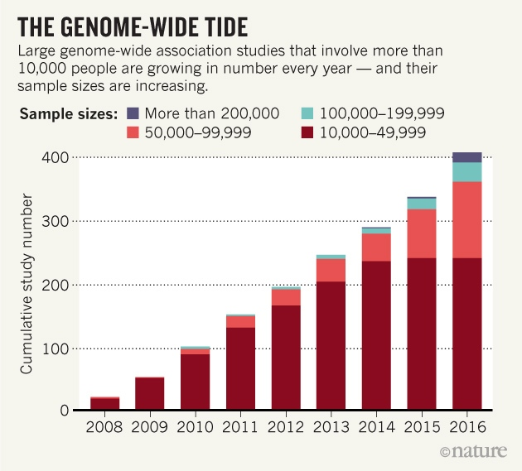
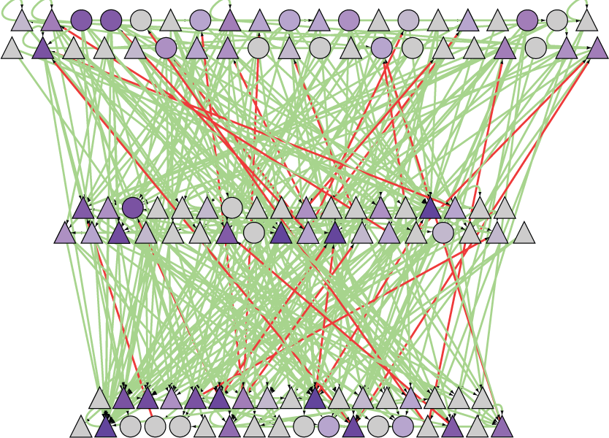
A Success of
Scale & Integration:
Many GWAS variants found, most not in genes, but affecting regulatory network
A 1st GWAS done at Yale, for AMD:
(Klein et al. 05, Science)
Many since then
Most SNVs fall into non-coding regulatory regions
(major contributions by Yale groups to this ENCODE annotation effort)
[Nature 489: 91]

Slide 20
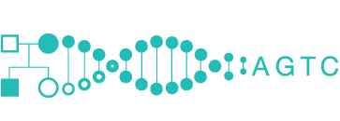
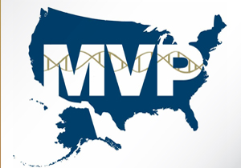




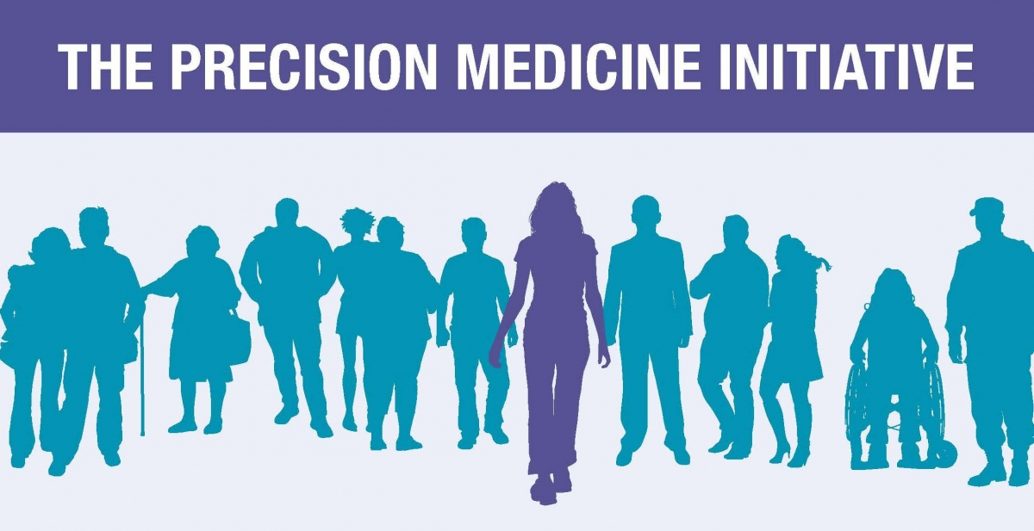
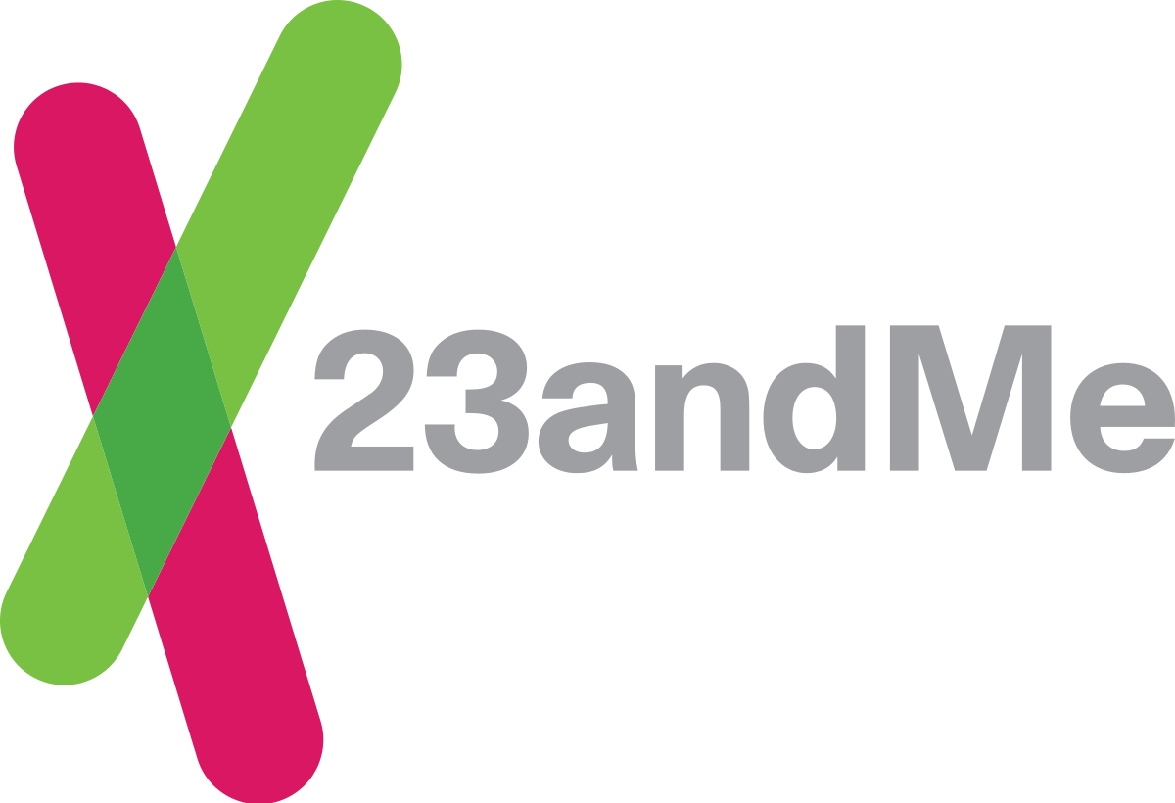



Basic Science to Medicine
INITIATIVES
Large-scale ‘omics data as an anchor to organize phenotypic data – EMRs, wearables…
1st [‘05-]: Exomes & chips of disease-focused cohorts – init. GWAS, TCGA, PGC
2nd [‘15-]: Integration of full WGS with rich & diverse phenotypes - UKBiobank, TopMed, Genomics England, PCAWG, All of Us
STARTUPS
Medical Big Data: Promise and Challenges (Lee and Yoon , Kidney Res. Clin. Pract., 2017)

Slide 21
Biomed. Data science:
The Future

Slide 22
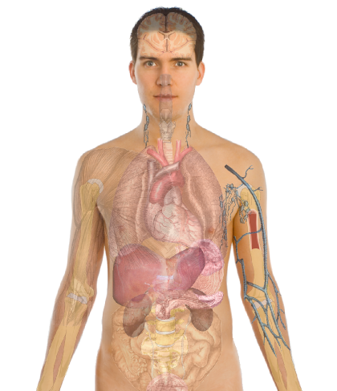
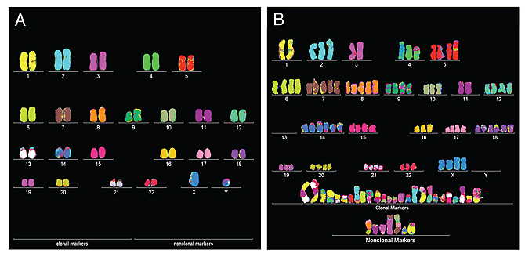
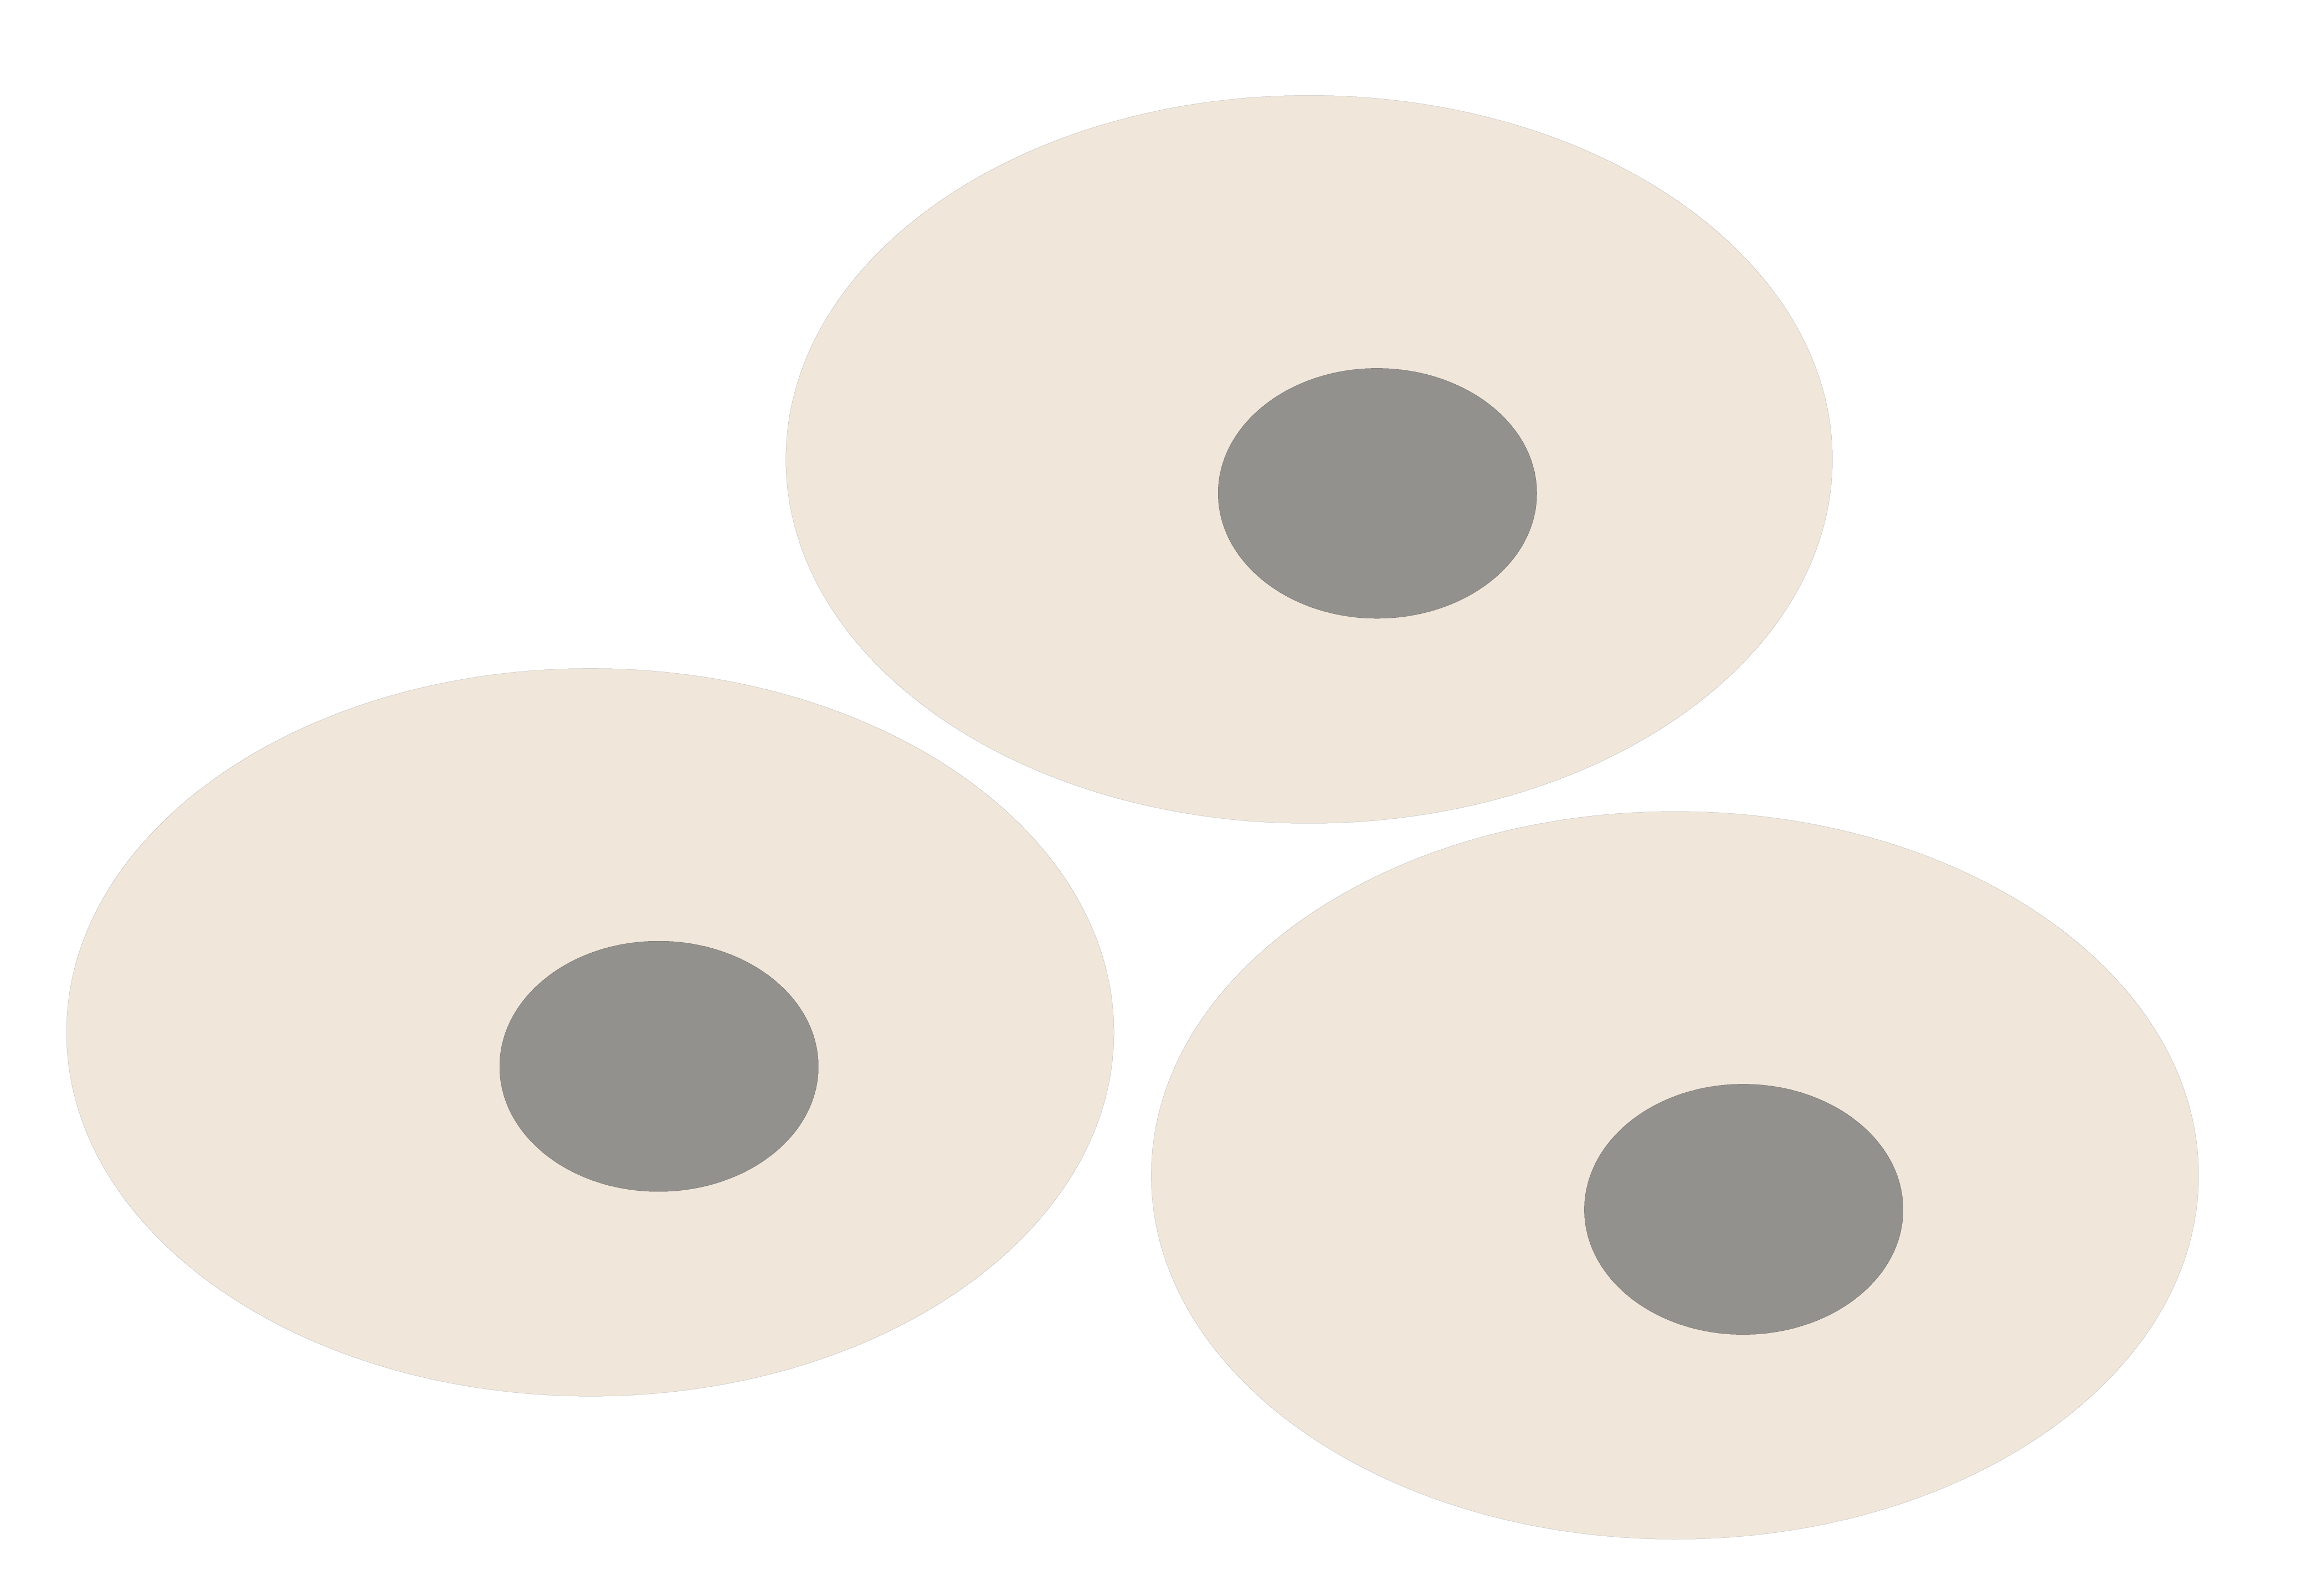
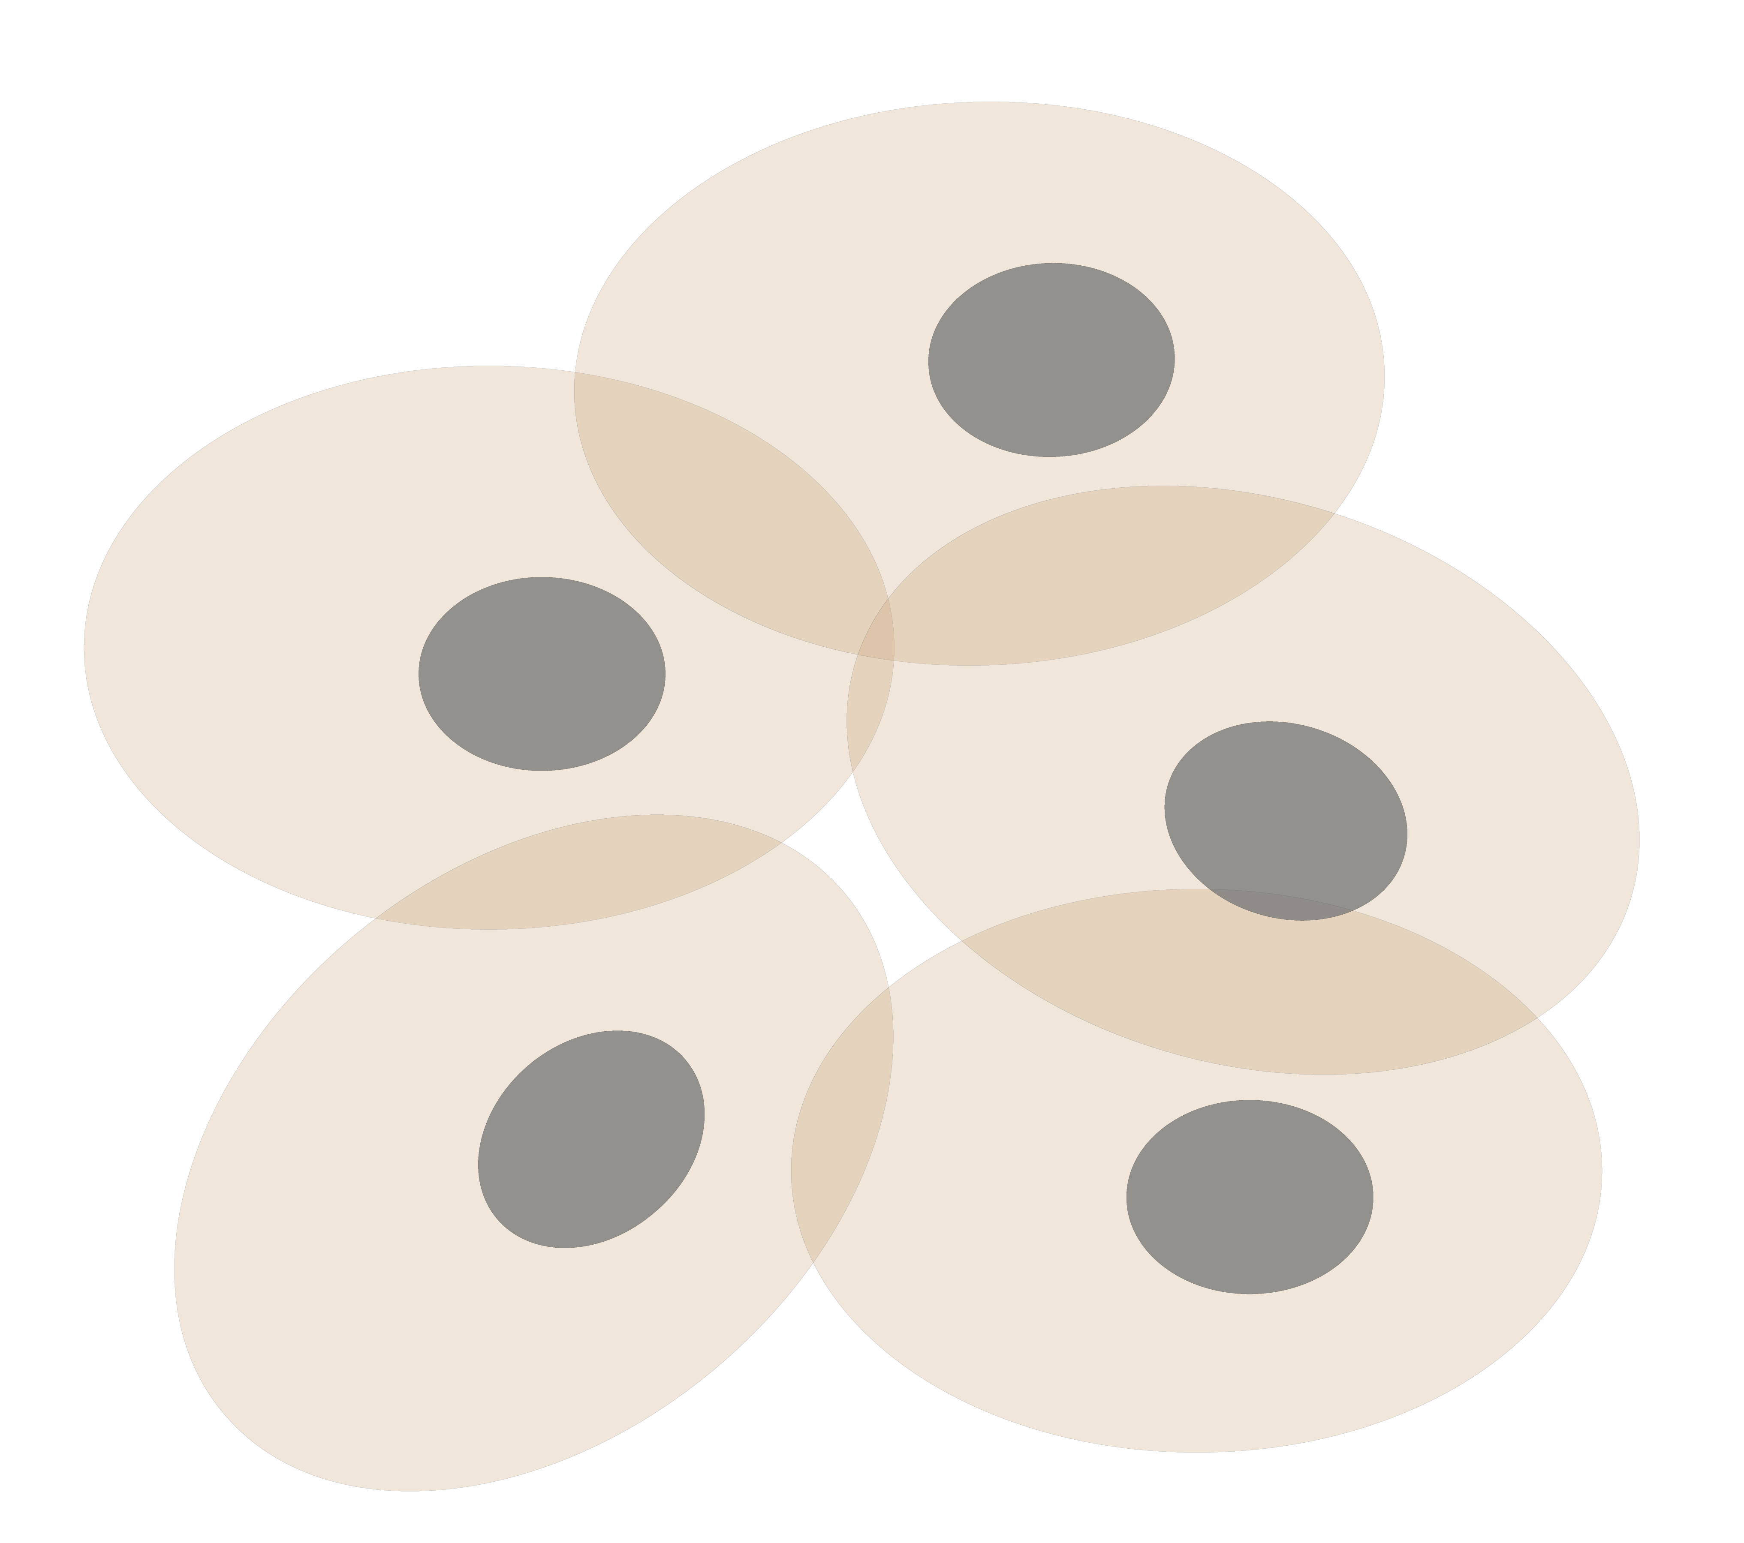
Our field as future Gateway –
Personal Genomics
as a Gateway into Biology
Personal genomes soon will become a commonplace part of medical research & eventually treatment (esp. for cancer). They will provide a primary connection for biological science to the general public.
normal
tumor

Slide 23
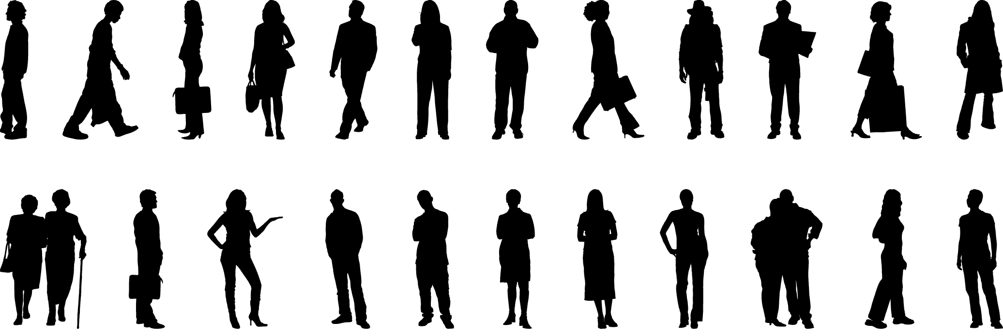
Placing the individual into the context of the population
&
using the population to build a interpretative model

Slide 24
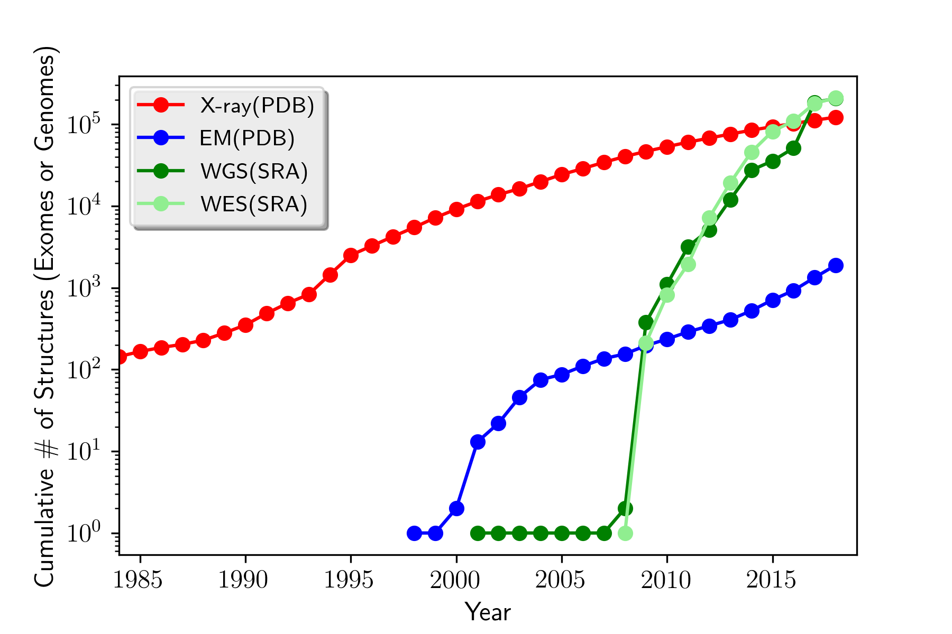
How will the Data Scaling Continue?
The Past, Present & Future Ecosystem of Large-scale Biomolecular Data
Molecular Structures
Seqences (Human WGS & WES)
Images (Cryo-EM)

Slide 25
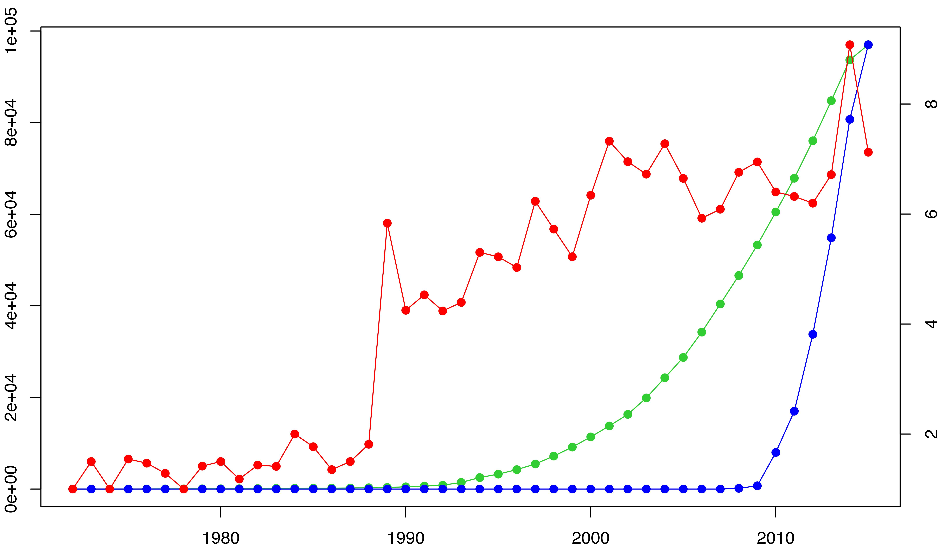
Trends in data generation point to growing opportunities for leveraging sequence variants to study structure (and vice versa)
The volume of sequenced exomes is outpacing that of structures, while solved structures have become more complex in nature.
Avg # chains per PDB (top 10% for each year)
Year
Exome data hosted on NCBI Sequence Read Archive (SRA)
[Sethi et al. COSB (’15)]

Slide 26
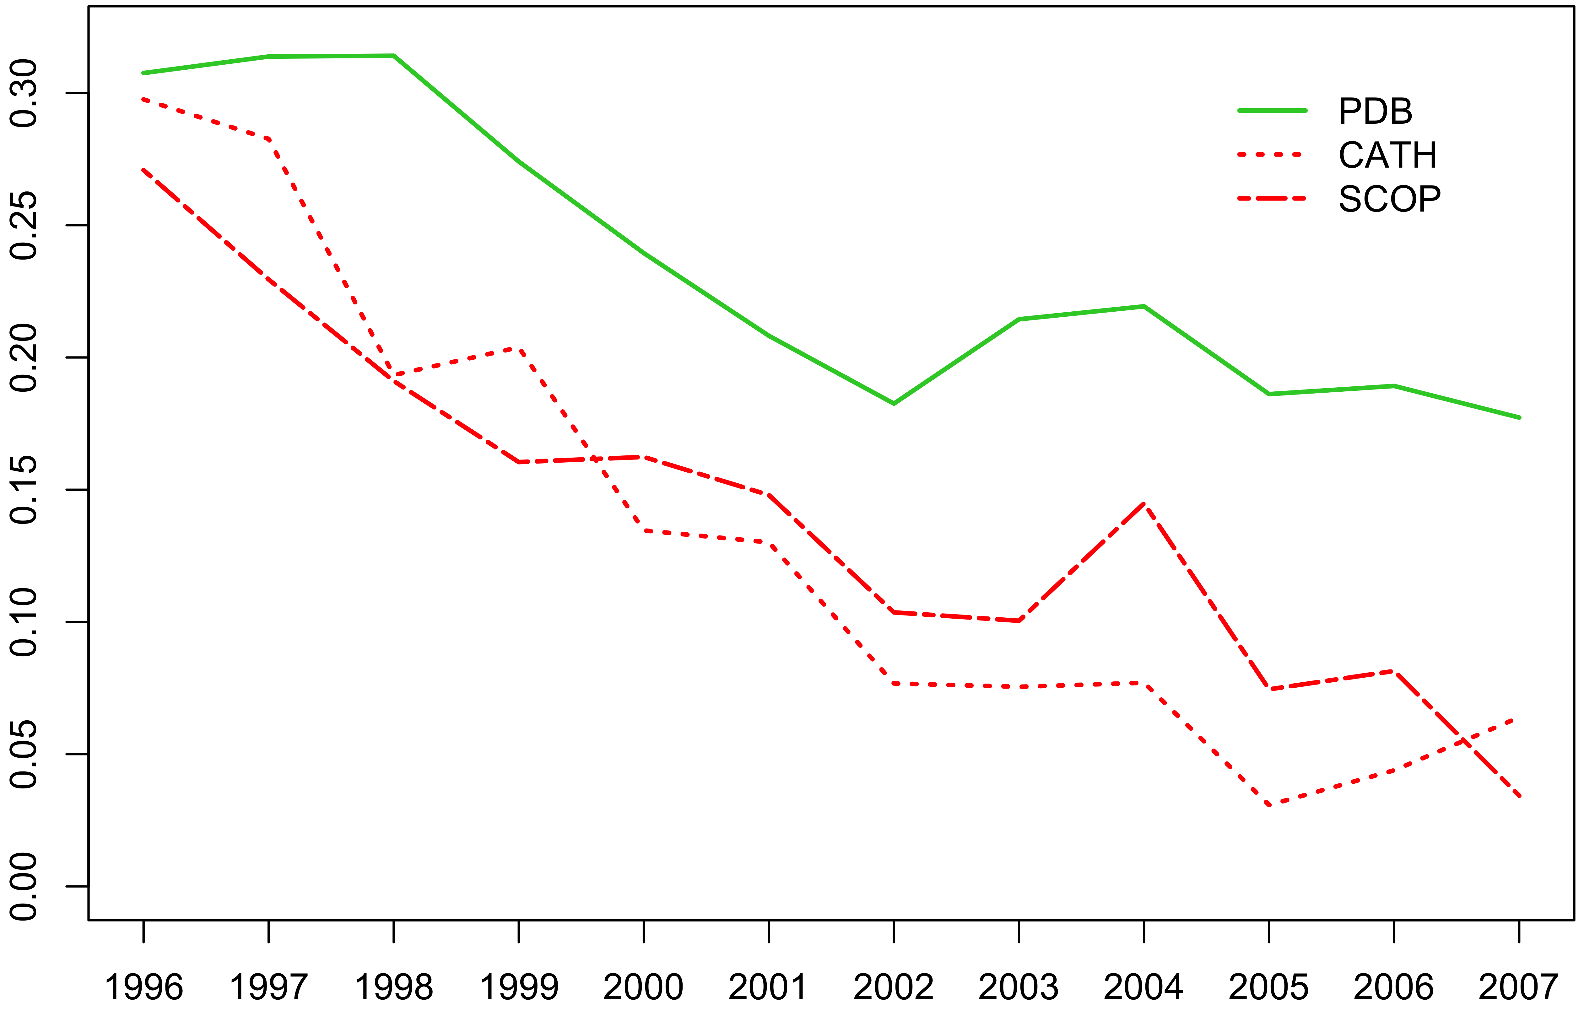
Growing sequence redundancy in the PDB (as evidenced by a reduced pace of novel fold discovery) offers a more comprehensive view of how such sequences occupy conformational landscapes – Gene & Struc. Families as main organizing principle
% Increase
Year
PDB: Berman HM, et al. NAR. (2000)
CATH: Sillitoe I, et al. NAR. (2015)
SCOP: Fox NK et al. NAR. (2014)
[Sethi et al. COSB (’15)]

Slide 27
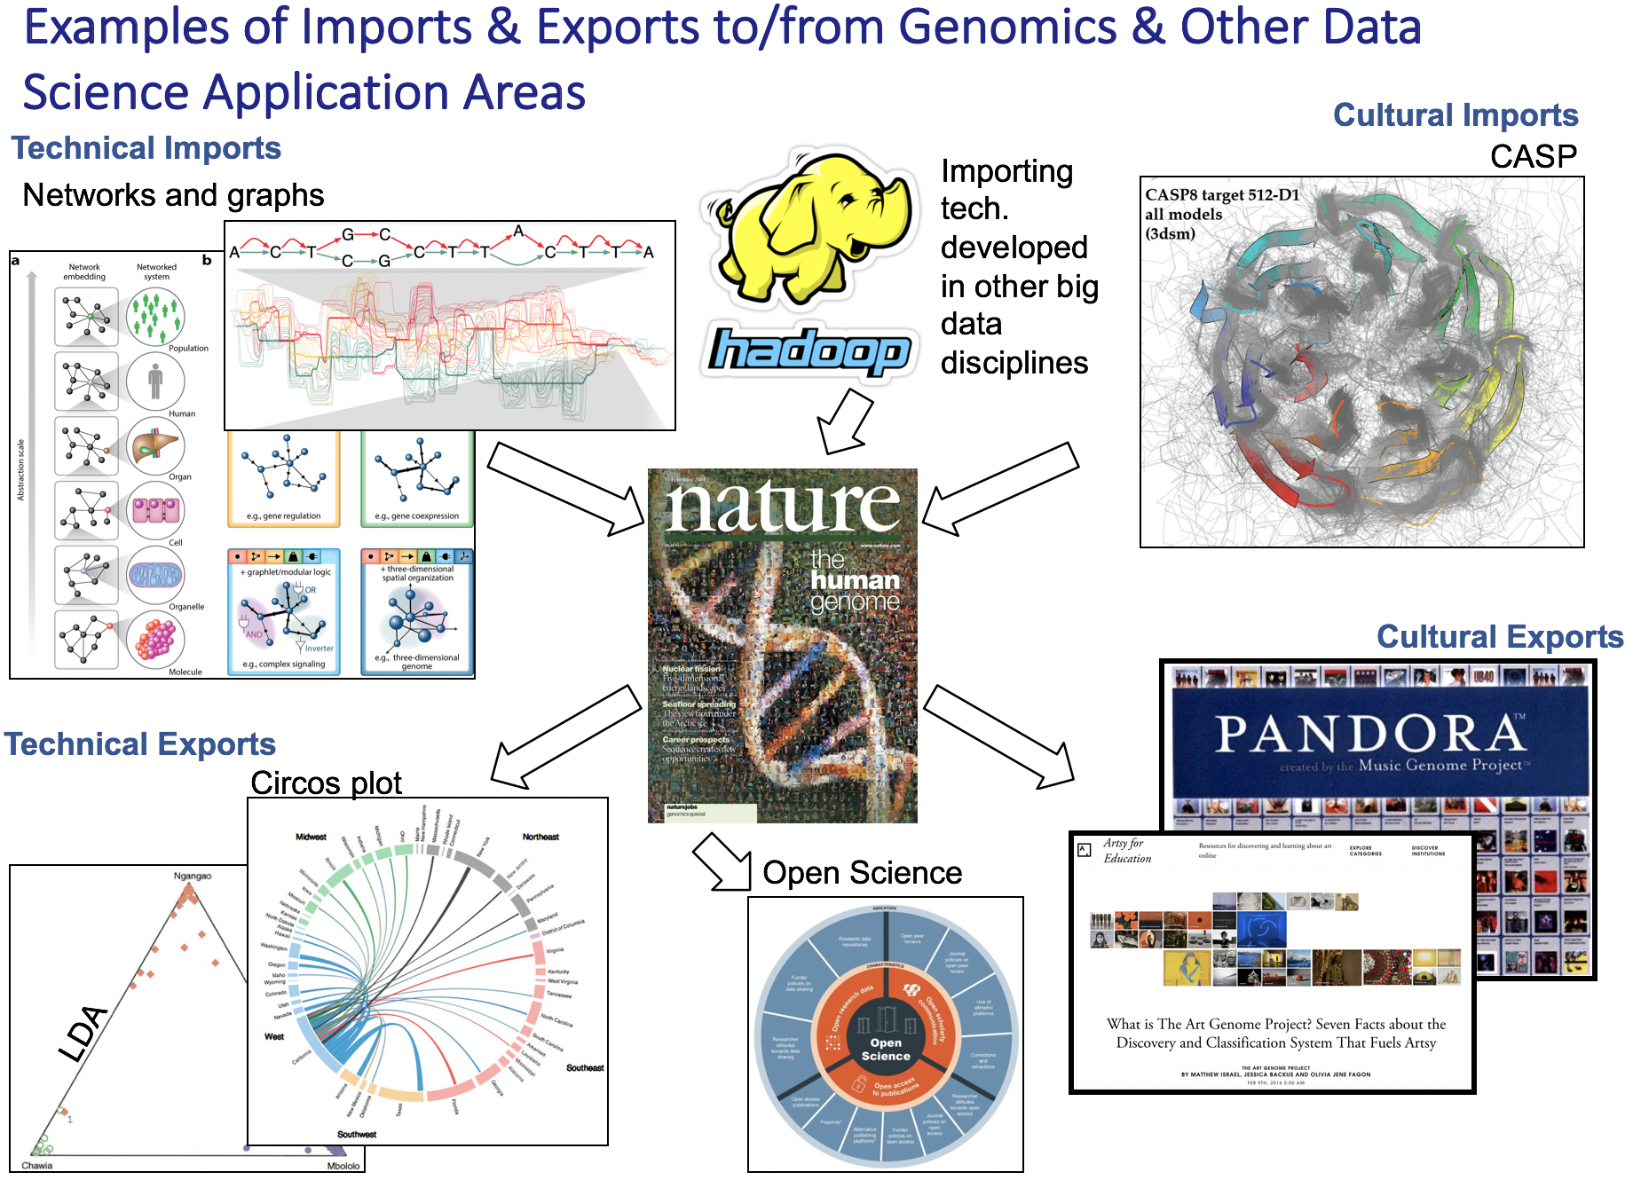
[Navarro et al. GenomeBiol. (’19, in press)]

Slide 28
Biomed. Data science:
The Course

Slide 29
Thoughts on the Class
GersteinLab.org/courses/452
(Class Web Page)
Broad overview with a few deep dives
  Fundamentally interdisciplinary field
  Here, focusing on molecular bioinformatics
  Some deep dives into sequence comparison, Bayesian approaches, low-dimensional representations
  Steering away from material in related Yale classes
Goal is good intuition on approaches & the application area
  Apply to related problems
Lectures provide structure of knowledge to be assimilated
  Varied backgrounds
  Variety of learning approaches
  Note references on
  & for the slides
Sections for interaction & more hands-on treatment
Quizzes & homework for individual command of basic knowledge
Final Project for teamwork

Slide 30
Biomedical Data Science
(Molecular) BIOINFORMATICS
BIOMEDICNE
Data Mining
INFORMATICS
Sequence &
Genome Analysis
Other 'omic
& Network Analyses
Medical & Translational
Informatics
3D Structure Analysis
Systems Analysis
Modeling &
Simulation
[Luscombe et al. ('01). Methods Inf Med 40: 346 ]

Slide 31
What is Bioinformatics?
(Molecular) Bio - informatics
One idea for a definition?
Bioinformatics is conceptualizing biology in terms of molecules (in the sense of physical-chemistry) and then applying “informatics” techniques (derived from disciplines such as applied math, CS, and statistics) to organize, mine, model & understand the information associated with these molecules, on a large-scale.
Bioinformatics is a practical discipline with many applications.
[Luscombe et al. ('01). Methods Inf Med 40: 346 ]

Slide 32
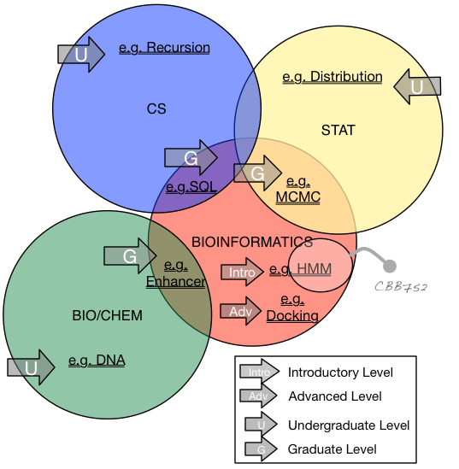
Defining the field – by crowd-sourced judgement
Bioinformatics
  Related terms
    Biological Data Science
    Bioinformatics & / or / vs Computational Biology
    Bio-computing
    Systems Biology
    “Qbio”
What are its boundaries
  Determining the "Support Vectors”

Slide 33
Overview of Topics Surveyed
Introduction
& Overview of the Data
Genomics & Sequencing
Proteomics & Structure
Databases as Tables
Data Mining & Machine Learning
Supervised & Unsupervised Approaches
  Decision Tree
  Clustering & SVD
Application to ’Omics Data
  Calculating with sequences
  Single cell data & epigenomics
Network Analysis
Principles of Topology & Connectivity
Gene Networks
Deep Learning
Basic Theory & Applications
Physical Modeling
Macromolecular Simulation
Markov Models
Molecular Packing
Additional Topics
Privacy
Sensor Technologies
Personal Genome Analysis
(Image Analysis)

Slide 34
Topics Covered in Other Related Courses
CBB 740: Intro to Health Informatics
Survey Course
Clinical Outcomes and Decision Support
EHRs
CBB 750: Core Topics in Biomedical Informatics
Application of Machine Learning on Clinical Data
MIMIC and other EHR Datasets
Text mining (i.e., word2vec) for EHR
CBB 562: Modeling Biological Systems II
Modeling Biological Networks
Differential Equations
Biochemical Signaling Pathways
S&DS 665: Intermediate Machine Learning
Theory of Machine Learning Methods
Developments in Deep Learning Models
Wider Range of Data Modalities and Contexts

Slide 35
Lectures conventions
Convention for numbering lectures:
YYMN = (Y)ear, (M)odule, (N)umber
e.g. 23m3, 22m3, (21) M3
We will mostly follow the flow in 2021 and 2022 and note the differences (See the notations at the top of each slide pack.)
Mostly 2021 has well-produced videos, with a few from following years
This year will have current, lecture-hall recorded videos put up quickly on canvas

Slide 36
Short Office Hours
Today right after class.
After that email me!
(in Bass 432,
contact.gerstein.info)

