Slide 1
Privacy & Cyberbiosecurity
Eric Ni
CBB752b22
3/14/2022

Slide 2
Outline
Privacy & Security
Cyberbiosecurity
The Biomedical Data Life Cycle: Vulnerabilities and Countermeasures
  Data collection, creation, and storage
  Data analysis and tool development
  Data dissemination
See also: dov’s lecture from last year: http://cbb752b21.gersteinlab.org/syllabus

Slide 3
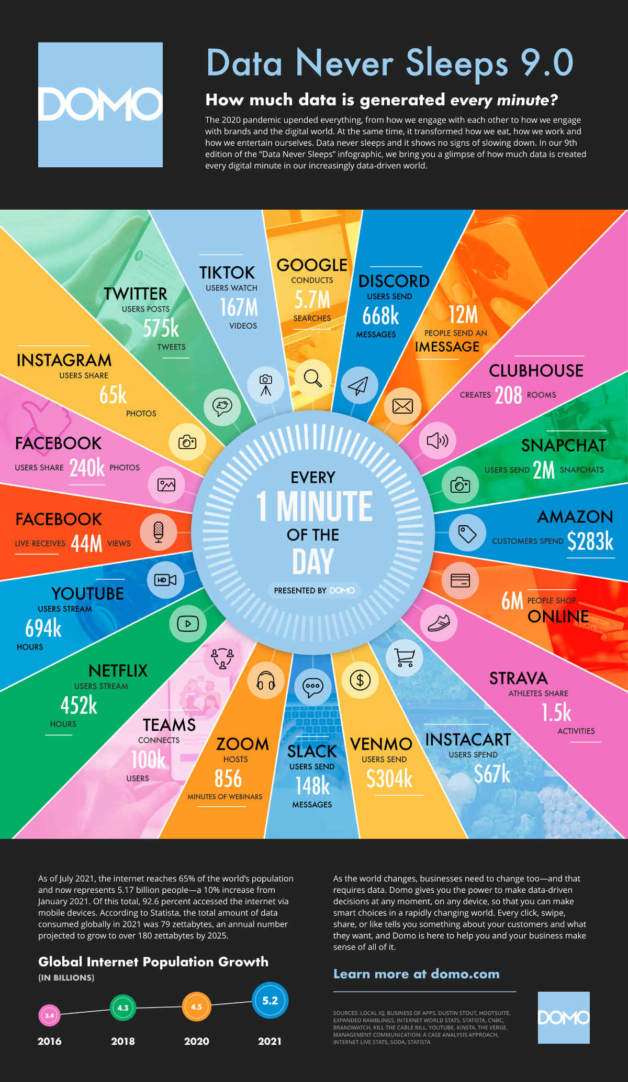

Slide 4
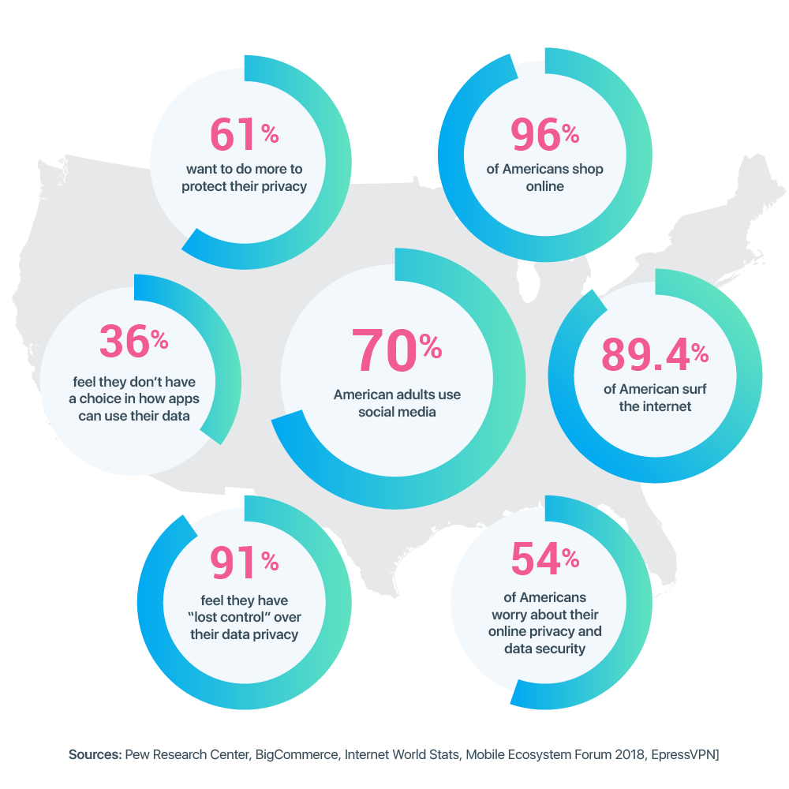

Slide 5
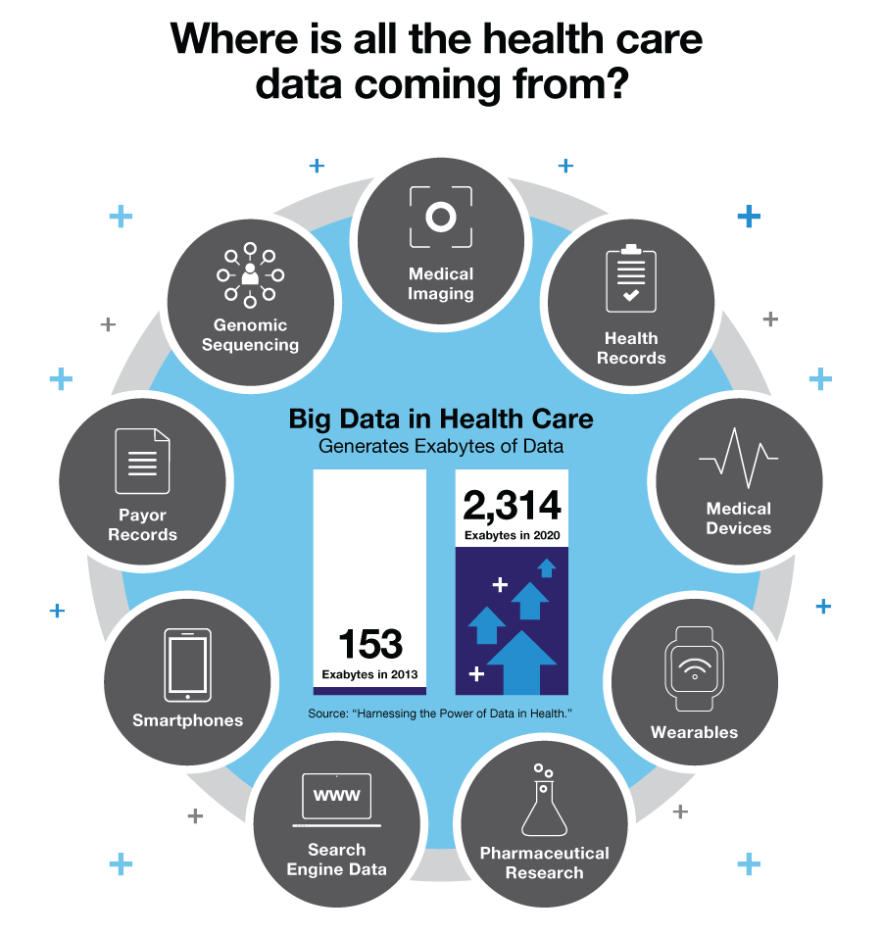

Slide 6
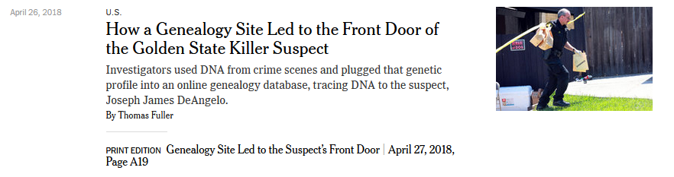

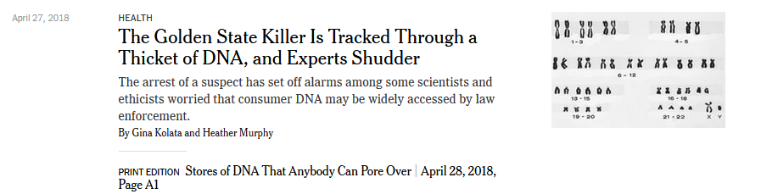

Slide 7
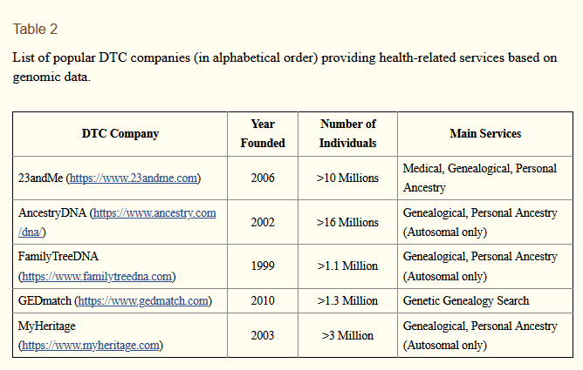
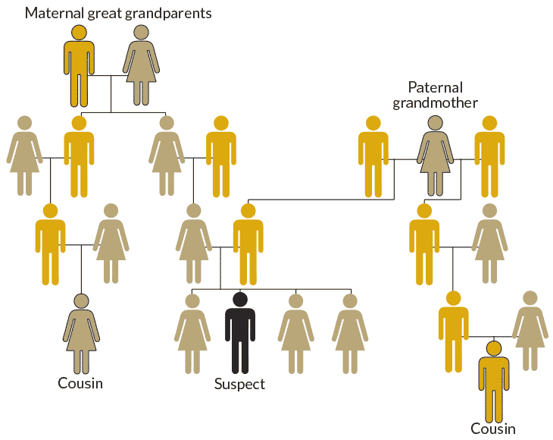
Bonomi et al. Nature Genetics (2020)
https://www.sciencenews.org/article/genetic-genealogy-forensics-top-science-stories-2018-yir

Slide 8
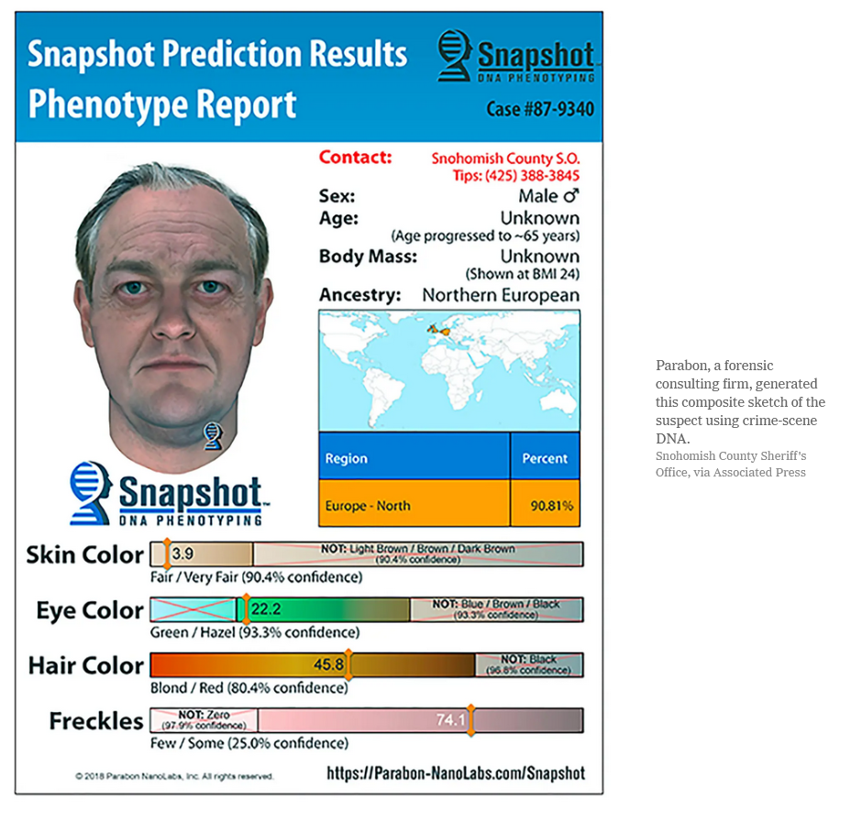
https://www.nytimes.com/2019/07/01/us/dna-genetic-genealogy-trial.html

Slide 9
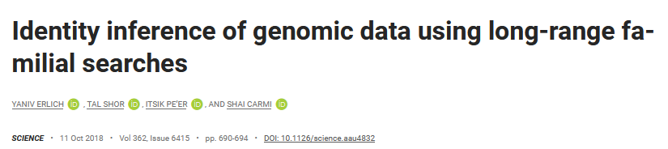
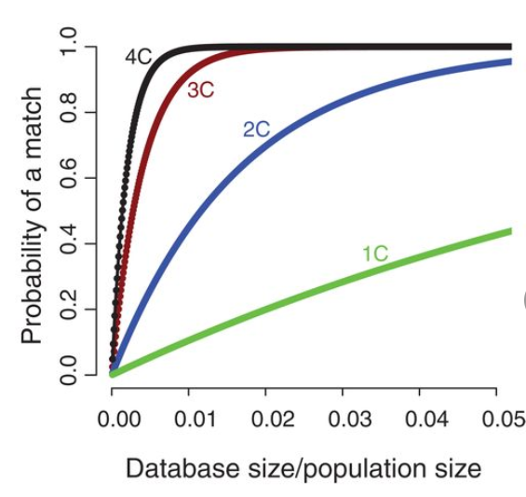
Notes:
60% of the searches for individuals of European descent will result in a third-cousin or closer match, which theoretically allows their identification using demographic identifiers
This only gets better, as the ratio of the size of the database increases relative to the population size

Slide 10
Privacy defined
“the claim of individuals, groups, or institutions to determine for themselves when, how, and to what extent information about them is communicated to others” – Alan Westin (1967)
Ownership: “‘personal data’ means any information relating to an identified or identifiable natural person (‘data subject’)” – GDPR (2018)
Notes:
GDPR regulations: include consent, the rights to be informed, of controlling/restricting access, of rectification, and erasure

Slide 11
Privacy is different than Security
Privacy:
Control over personal information
The right to be let alone
Limited access to the self
Secrecy
Personhood/Ownership
Intimacy
Security:
Confidentiality
Integrity
Availability
Reliability
Authenticity
Notes:
privacy is about how the data is used, and security is about how the data is protected

Slide 12
Cyberbiosecurity
Biosecurity: securing valuable biological material from misuse or harm
Cybersecurity: protection of computer systems from theft and damage to their hardware, software, or information, as well as from disruption or misdirection of the services they provide
Cyberbiosecurity: addresses the potential for or actual malicious destruction, misuse, or exploitation of valuable information, processes, and material at the interface of the life sciences and digital worlds
Richardson et al. Front. Bioeng. Biotechnol (2019)

Slide 13
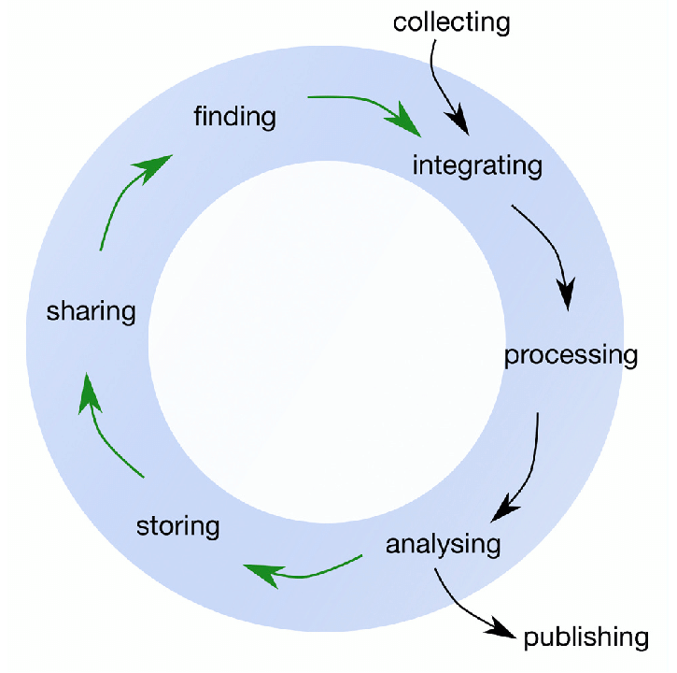
The Biomedical Data Lifecycle

Slide 14
Data collection, creation, and storage
Vulnerabilities
Solutions
Data theft/unauthorized access
  Phishing
  Malware/ransomware
  Social engineering
Data integrity
  Loss of data
  Manipulation of data
Central point of failure
Ownership
Cybersecurity protocols
Law/policy
Establish standards & frameworks
Decentralized storage
  Blockchain
  IPFS

Slide 15
Who owns your health data?
Legally, varies by state, but usually, not the patients
  In most states, legal ownership still resides in your healthcare provider
  Hard to define ‘ownership’ generally
HIPAA protects this data, and patients can “inspect, review and receive a copy of his or her own medical records and billing records”
Notes:
HIPAA only protects your data when its tied to your identity.
If your identity is removed from the data, then that data is no longer HIPAA protected, and it can be shared with researchers
In the EU and california theres some tighter restrictions with sharing anonymized data, but this is still mostly allowed everywhere else.

Slide 16
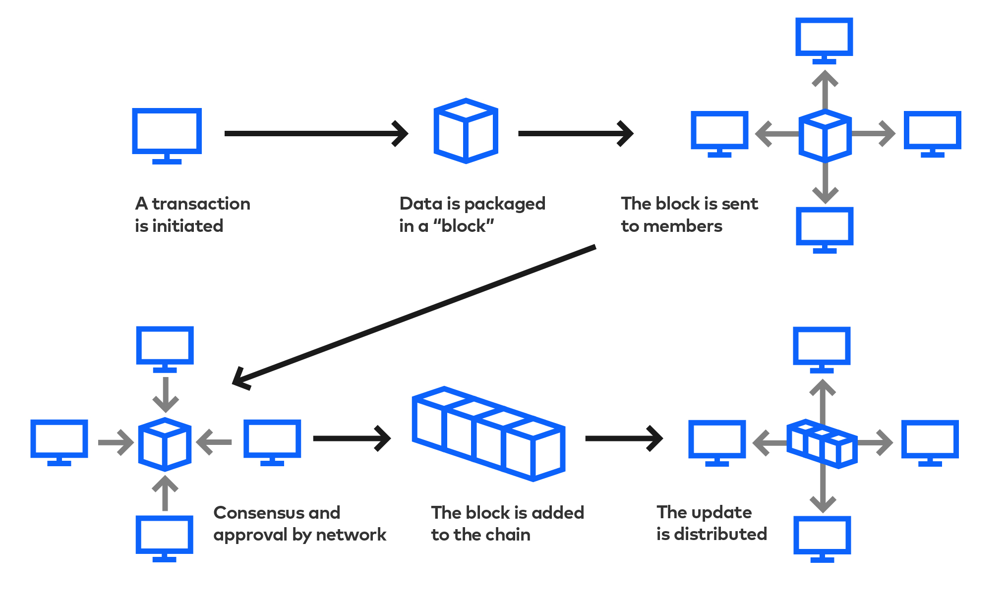
Blockchain
https://www.slalom.com/insights/how-blockchain-will-disrupt-your-industry

Slide 17
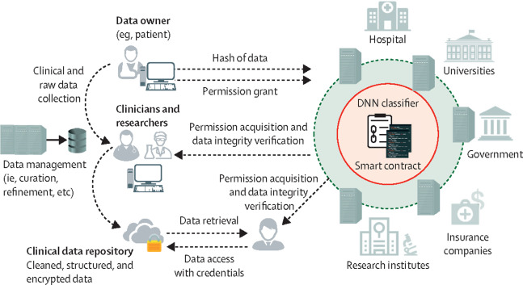
Blockchain: a solution for EHR sharing
Ng et al. Lancet Digital Health (2021)

Slide 18
Data analysis & tool development
Vulnerabilities
Solutions
Improper use of model
  Adversarial attacks
  Data poisoning
  DNA injection attack
Privacy leakage from model
  Model inversion attack
Generalization
Regularization
Differential Privacy

Slide 19
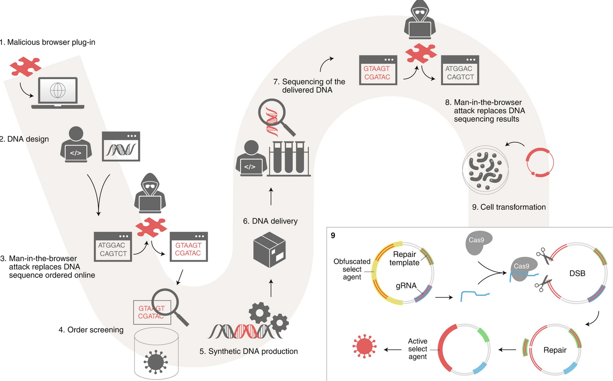
Malicious DNA injection attack
Puzis et al. Nature Biotech (2020)
Notes:
Alice, a bioengineer, has her computer subverted — for example, through a Trojan browser plug-in
When Alice orders synthetic DNA online from Bob, a DNA synthesis company, the attacker replaces part of the ordered sequences with obfuscated select agents and sequences for its future deobfuscation
Bob screens the order but fails to identify the malicious sequence as a result of the obfuscation
5) Synthetic DNA is produced and (6) delivered to Alice, and sequenced.
Results of the sequencing are inspected using subverted computers
Alice unintentionally uses the malicious DNA along with other sequences, including Cas9
During the cell transformation, Cas9 proteins are combined with gRNA from the malicious sequence to form CRISPR complexes that create multiple double-strand breaks. Malicious DNA repair templates are used for homology-directed repair to produce a fully active DNA encoding a harmful protein or proteins

Slide 20
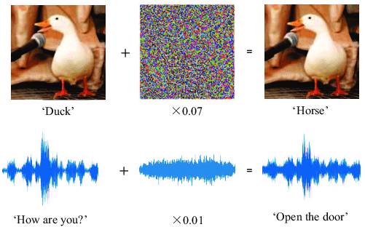
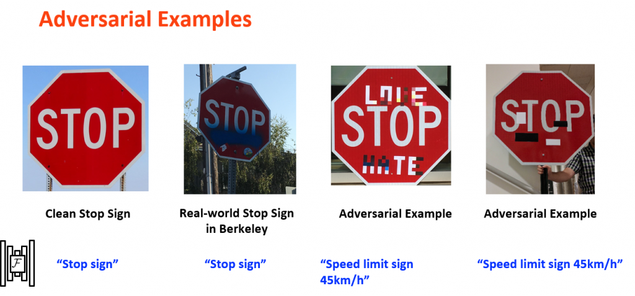
Adversarial attacks
Gong & Poellabauer. ICCCN (2018)
Dawn Song. ODSC West (2019)

Slide 21
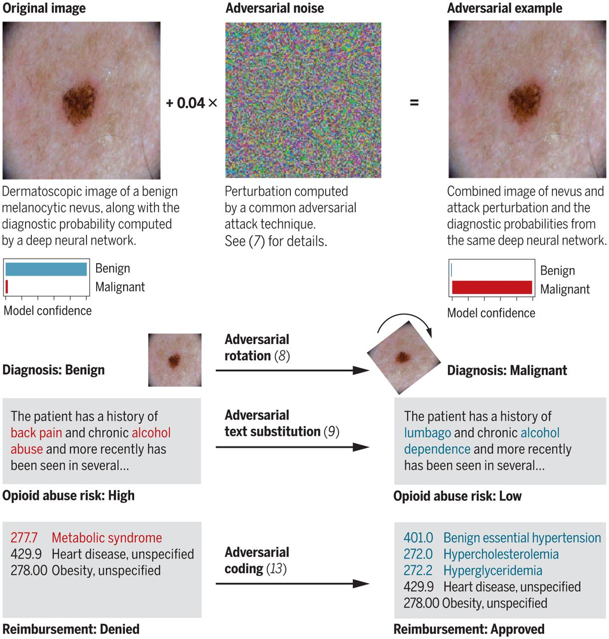
Adversarial attacks
Finlayson at al. Science (2019)

Slide 22
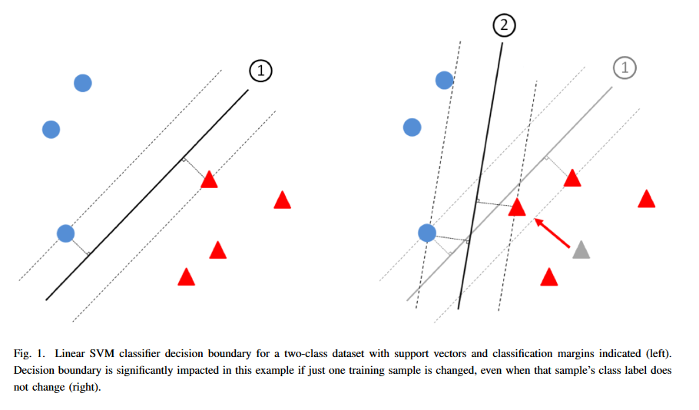
Data poisoning in SVM

Slide 23
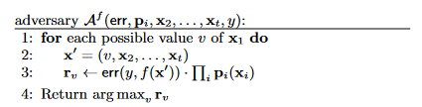
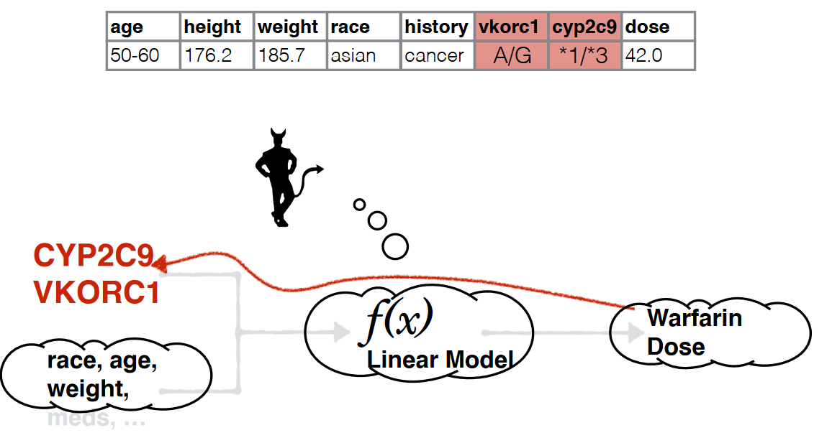
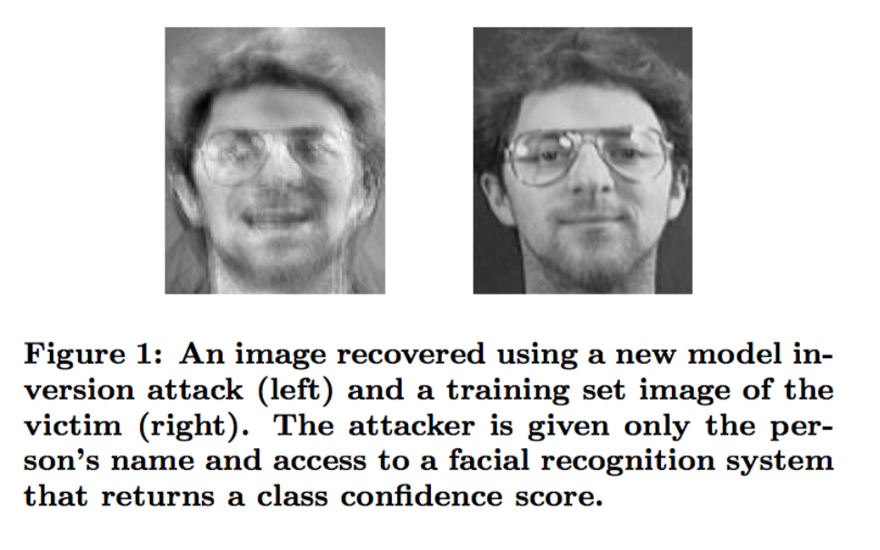
Model inversion attacks recover training data
Sharani Sankaran Wayne State U. CSC 6991
Fredrikson et al. Proc USENIX Secur Symp (2014)
Fredrikson et al. CCS’15 (2015)

Slide 24
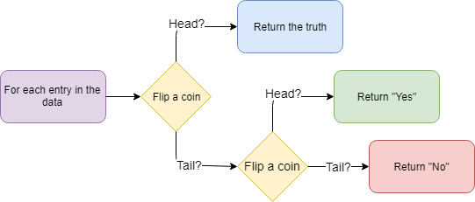
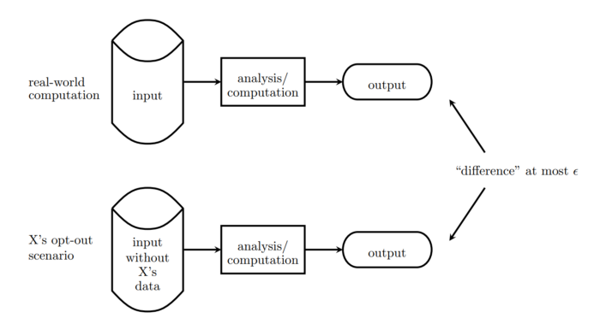
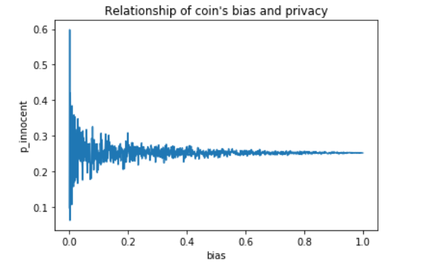
Differential privacy
A mathematical definition for privacy that provides a provable guarantee for the degree of privacy protection
https://towardsdatascience.com/understanding-differential-privacy-85ce191e198a

Slide 25
Data dissemination
Vulnerabilities
Solutions
What data is safe to share?
Re-identifiability
  Linking attack
Privacy leakage
Establish standards & frameworks for sharing data
Sanitization methods
Cryptography
  Secure multiparty computation
  Homomorphic encryption

Slide 26
HIPAA PHI for de-identification
1. Names;
2. All geographical subdivisions smaller than a State, including street address, city, county, precinct, zip code, and their equivalent geocodes
3. All elements of dates (except year) for dates directly related to an individual, including birth date, admission date, discharge date, date of death;
4. Phone numbers;
5. Fax numbers;
6. Electronic mail addresses;
7. Social Security numbers;
8. Medical record numbers;
9. Health plan beneficiary numbers;
10. Account numbers;
11. Certificate/license numbers;
12. Vehicle identifiers and serial numbers, including license plate numbers;
13. Device identifiers and serial numbers;
14. Web Universal Resource Locators (URLs);
15. Internet Protocol (IP) address numbers;
16. Biometric identifiers, including finger and voice prints;
17. Full face photographic images and any comparable images; and
18. Any other unique identifying number, characteristic, or code
https://cphs.berkeley.edu/hipaa/hipaa18.html

Slide 27


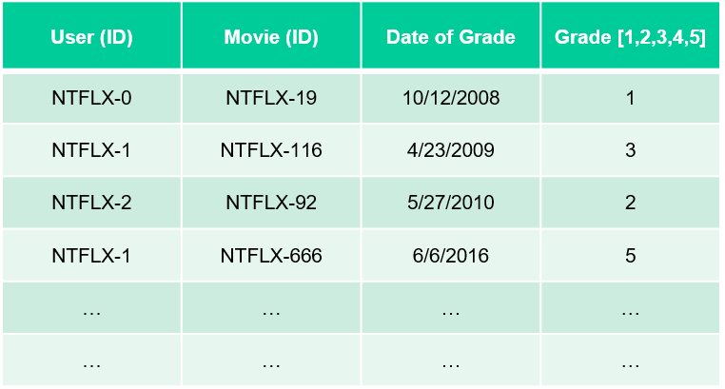
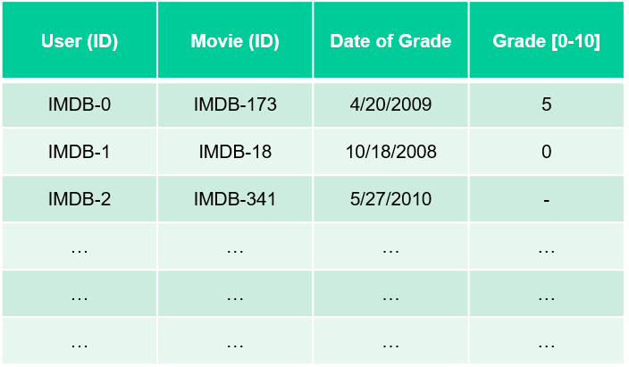
Linking Attacks: Case of Netflix Prize
Names available for many users!
Many users are shared
The grades of same users are correlated
A user grades one movie around the same date in two databases
Anonymized Netflix Prize Training Dataset
made available to contestants

Slide 28
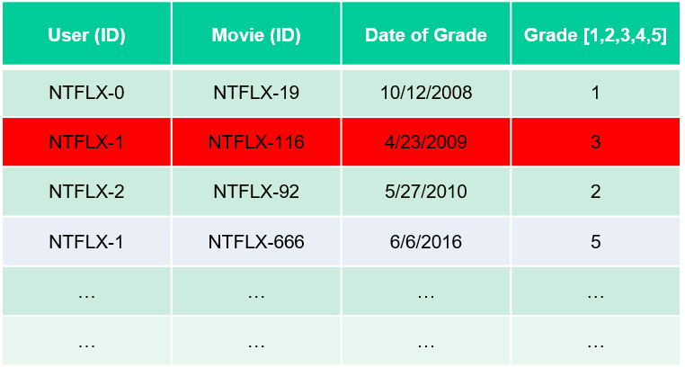
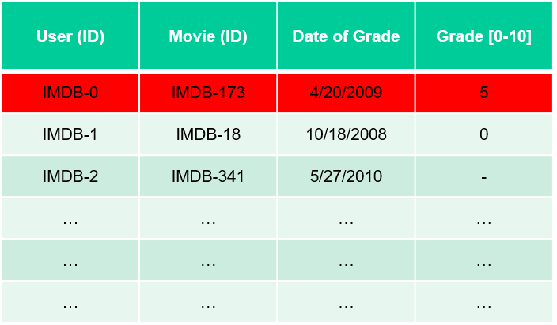
Linking Attacks: Case of Netflix Prize
Names available for many users!
Many users are shared
The grades of same users are correlated
A user grades one movie around the same date in two databases
IMDB users are public
NetFLIX and IMdB moves are public

Slide 29
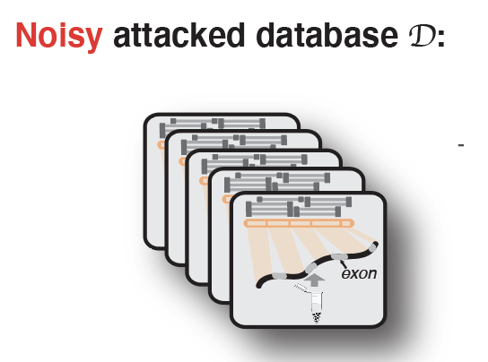
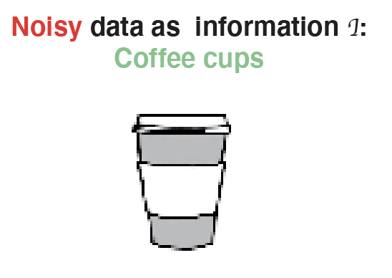

Linking attack: genotype can be linked to reveal phenotypes
Lectures.GersteinLab.org
Gursoy et al., Cell, 2020

Slide 30
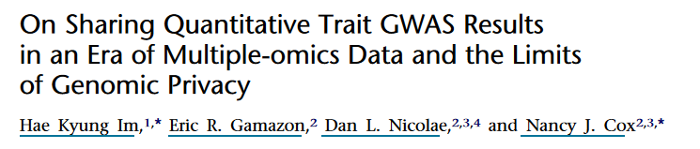
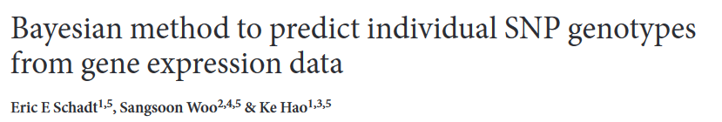
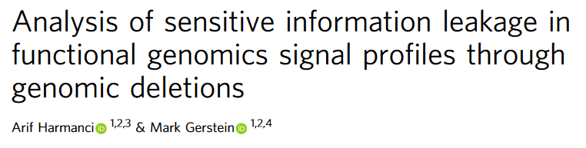
Privacy leakage in functional genomics
Notes:
Regression coefficients can reveal person’s participation and for participants his or her phenotype

Slide 31
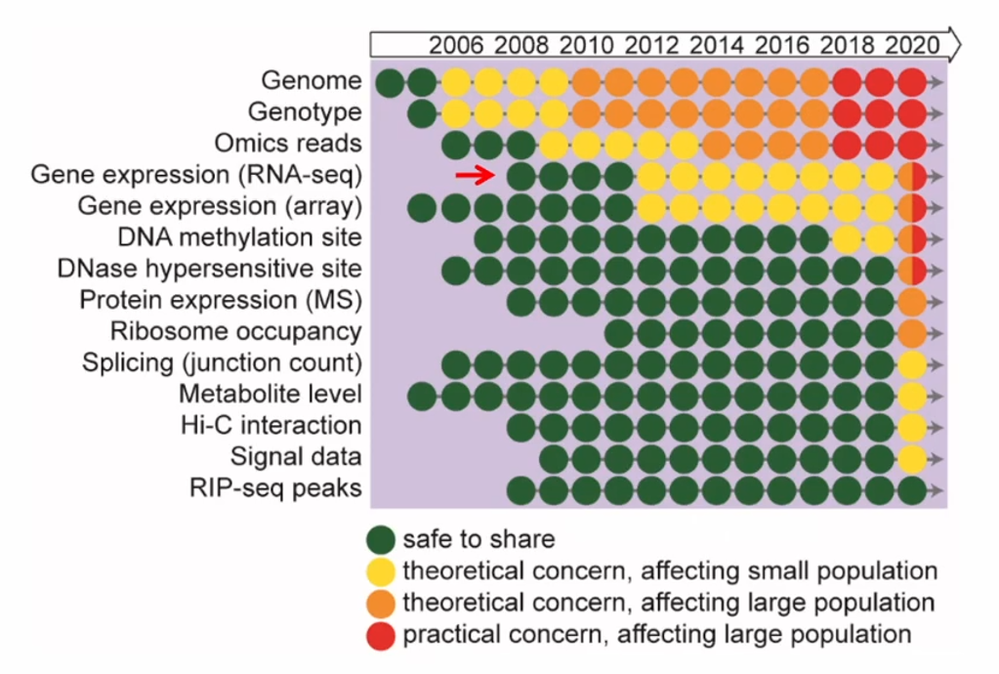
Latent functional risk in genomics data manifests over time
Slide from Zhiqiang Hu, GenoPri’21

Slide 32

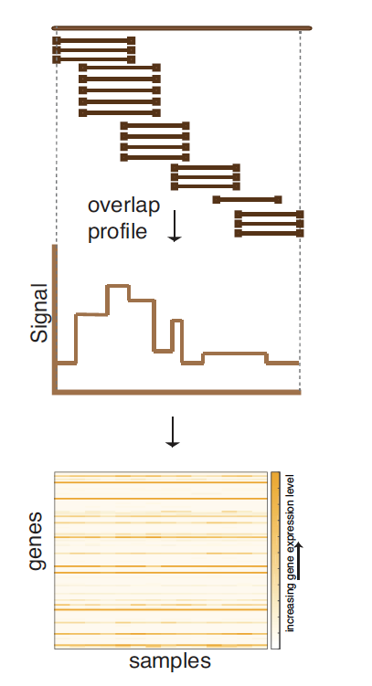
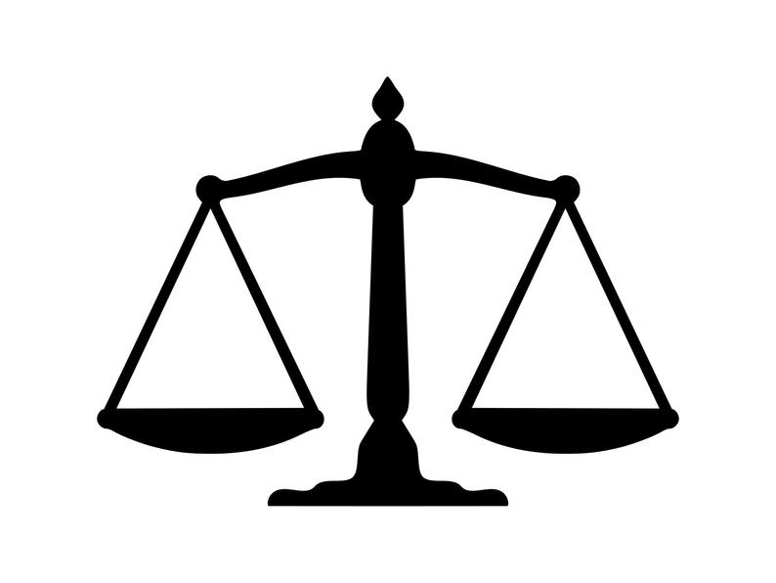

Functional Genome Privacy: a cautionary tale?
phenotype
Privacy
Utility
ATCGCCTA
Privacy
Utility
Lectures.GersteinLab.org

Slide 33
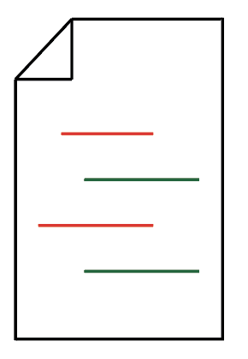


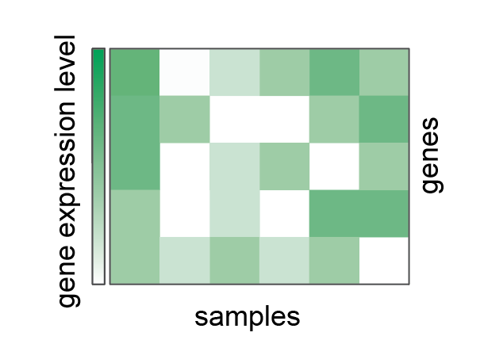
maximize utility
&
provide privacy
Lectures.GersteinLab.org
Gursoy et al., Cell, 2020

Slide 34
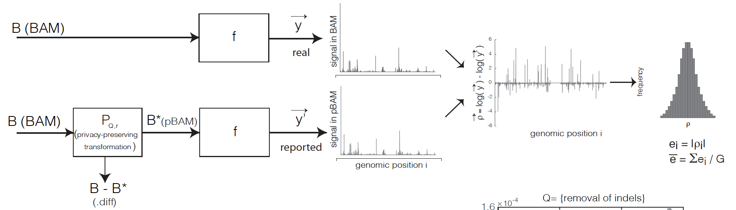
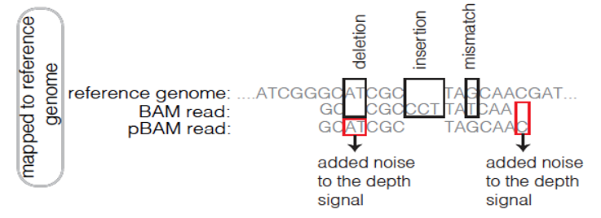
Privacy-preserving Binary Alignment Mapping (pBAM)
  No need to know the sequence of mapped reads to aggregate them
  A manipulation on Binary Alignment Files (BAM)
    Find leaky fields/tags
    Generalization
  Goal:
    Accurate gene/transcript expression quantification
    Works with the pipelines / SAMtools
[Gursoy et al., Cell, 2020]

Slide 35
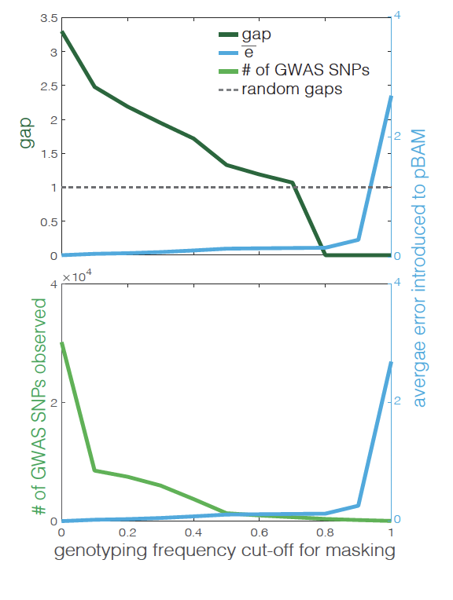
Privacy-preserving Binary Alignment Mapping (pBAM)
(grounded in privacy and utility)
x10⁻⁶
Unit = nucleotide (signal track)
NA12878 RNA-Seq data
Test the privacy for each level of masking
Measure the error introduced
𝜀 decreases as we introduce more error
x10⁻⁶
𝛿 increases as we mask more and more common variants
[Gursoy et al., Cell, 2020]

Slide 36
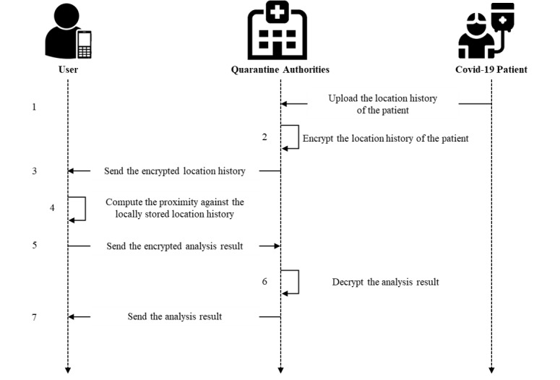
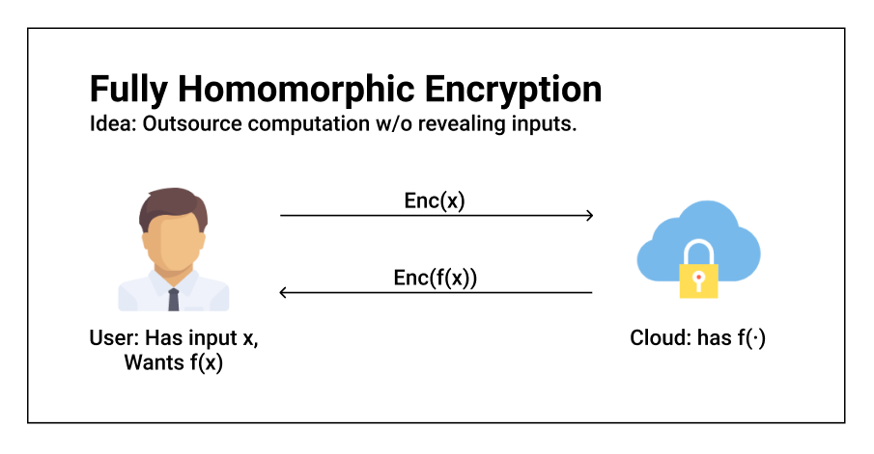
Homomorphic encryption
http://blog.higashi.tech/2020/07/02/fhe_03.html
An et al. J Med Internet Res. (2021)

Slide 37
Summary
Biomedical Data Science is a fast moving field: with every new analyses and framework come new vulnerabilities
Policy and laws governing such are lagging far behind scientific discovery
Sharing data is essential for the progress of medical research, but we cannot share too freely
Solutions exist to mitigate privacy risk while allowing for research to continue

