Slide 1
Biomedical Data Science: Biosensor Analysis
Mark Gerstein, Yale University gersteinlab.org/courses/452
(Last edit in spring ’22. Pack 22m11, which has no counterpart in ‘21.)

Slide 2
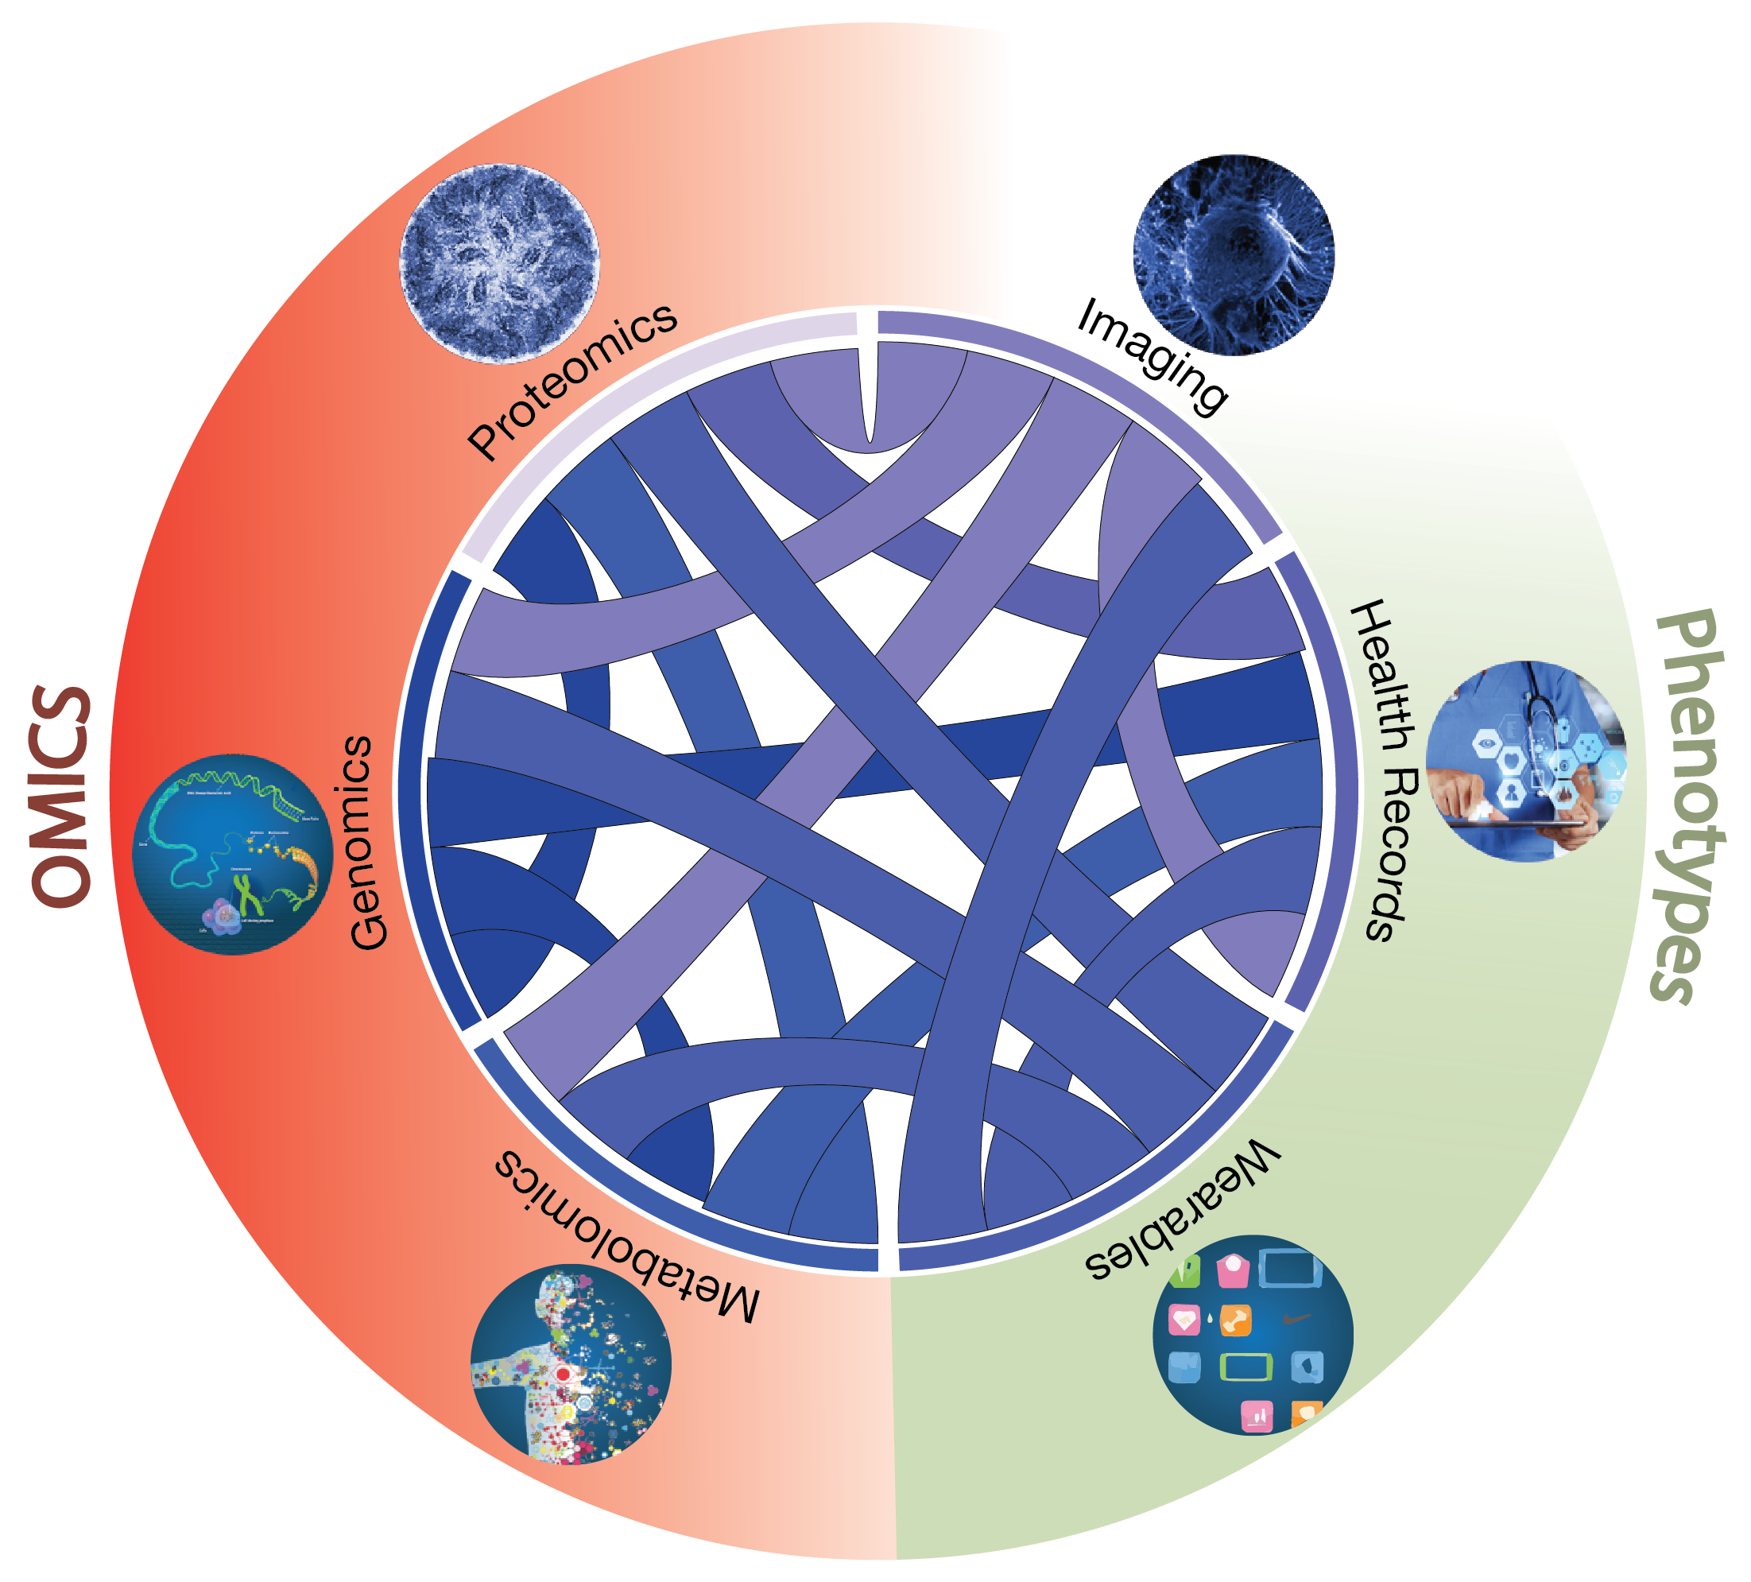
Data Drivers for Biomedical Data Science
[Navarro et al. GenomeBiol. (’19)]

Slide 3
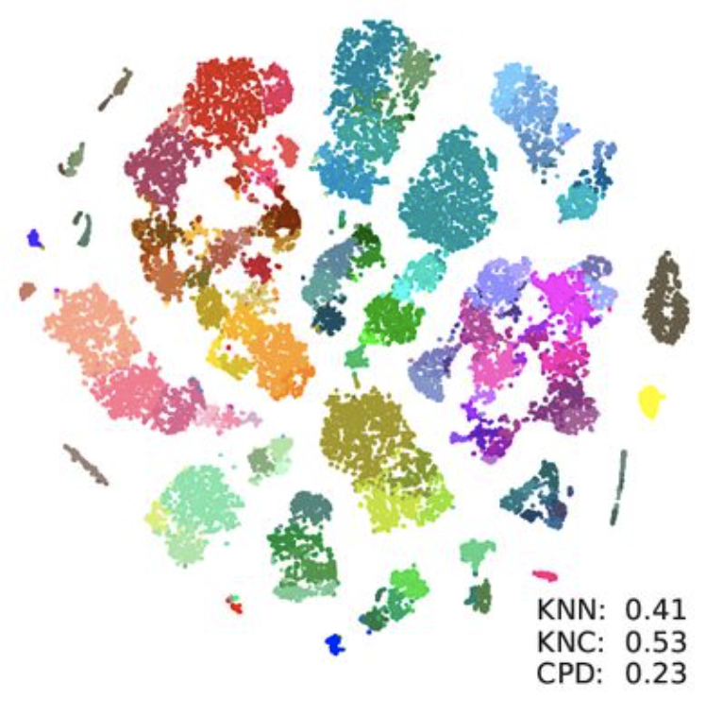
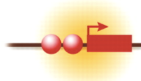
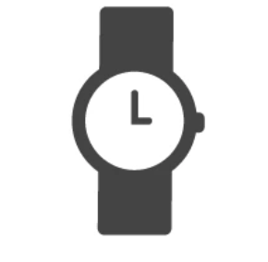
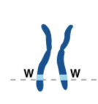
Genotype-Phenotype Correlations
Single Cell Sequencing
Epigenetics
Digital Health
Genomics
Phenotype
Biosensors
Genotyping
Wearables
EHRs
Population
Variation
Functional
Annotations
Disease/Disorder
Privacy

Slide 4
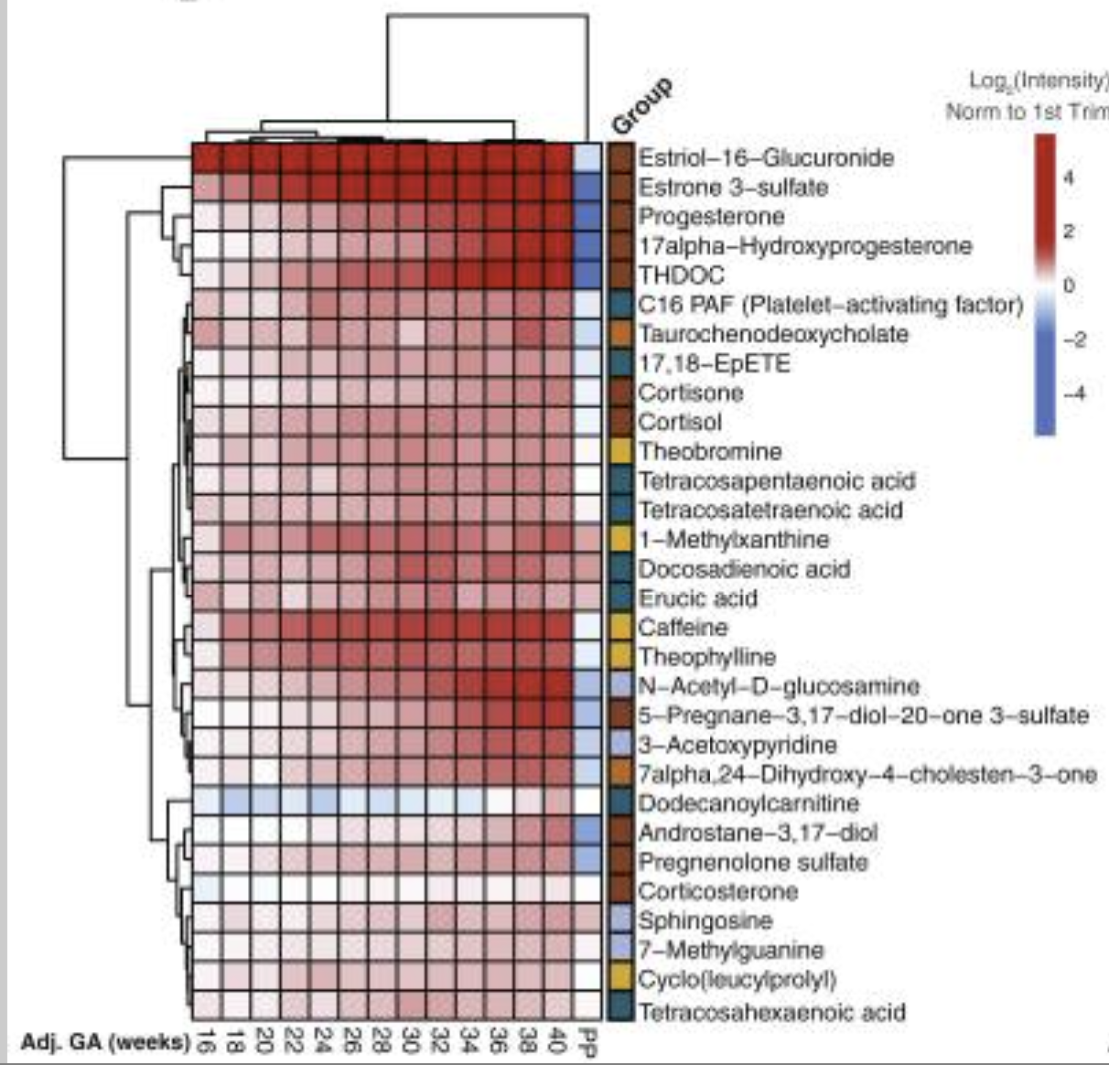
Deep Phenotyping through Digital Health
Scale
Digital Health
Liu*, Spakowicz* et al, PLOS Comp Bio 2021
Macro Level
Genomics
Phenotype
Mishra et al, Nature 2020
…
Organ
Digital Health
…
Biosensors
Wearables
EHRs
Chemical/Metabolome
Liang et al, Cell 2020
Liu*, Spakowicz* et al, PLOS Comp Bio 2021
Time
As mobile technology advances rapidly, the global mobile healthcare market is projected to be over 90 billion USD in 2022 (Lee SM, Lee D. Healthcare wearable devices: An analysis of key factors for continuous use intention. Service Business 2020; 12/01;14(4):503–531)

Slide 5
Biosensors
Direct Models of Sensor data

Slide 6
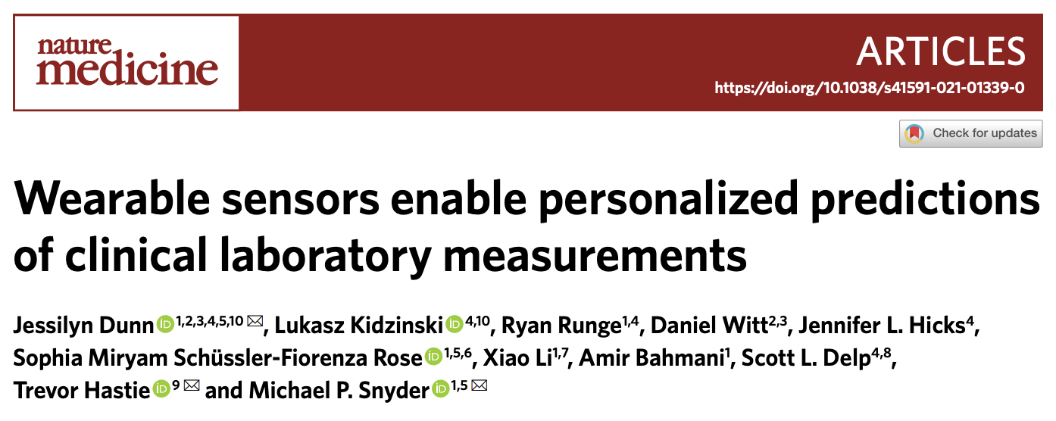
Wearable Sensors in Biomedical and Clinical Research

Slide 7
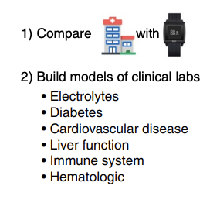
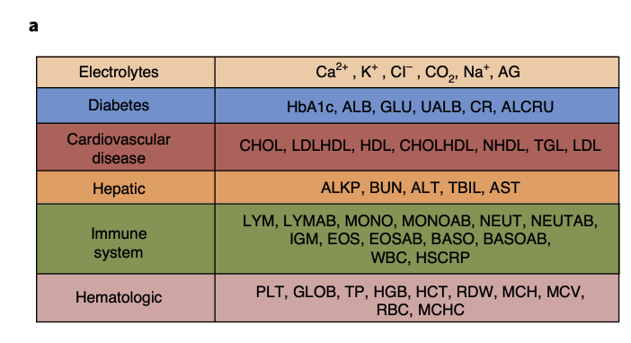
Predicting Clinical Lab Values from Vitals taken from the Hospital vs Wearables
Lab Values to Predict

Slide 8
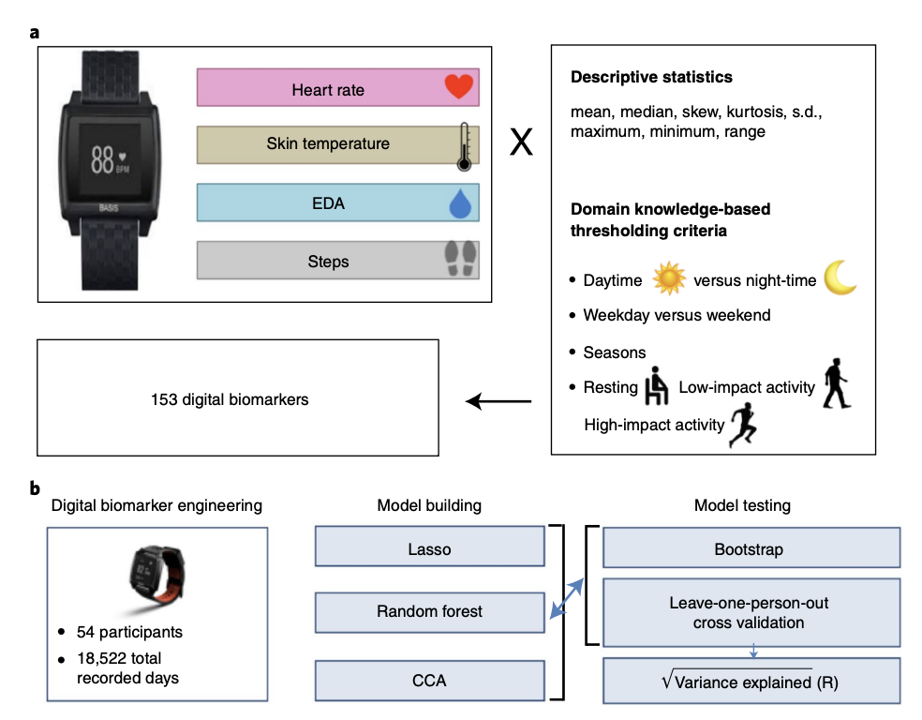
Engineering Wearable Features Used to Predict Clinical Lab Values
Wearable Features
Lab Values to Predict
Prediction using Random Forest
And Linear model (Lasso)

Slide 9
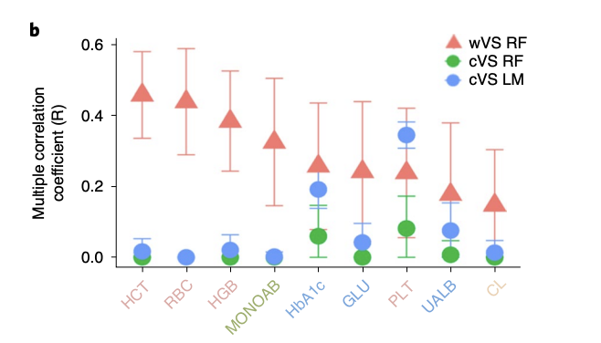
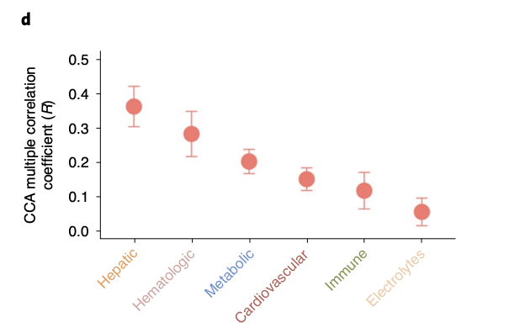
Correlation of Predicted and Observed Lab Values using Wearable vs Clinical Vital Signs
Overall CCA between predicted (wearable) and observed variables within each clinical category
Comparing predictions between wearables and clinical vital signs

Slide 10
Biosensors
Analysis of the Impact of an Intervention

Slide 11
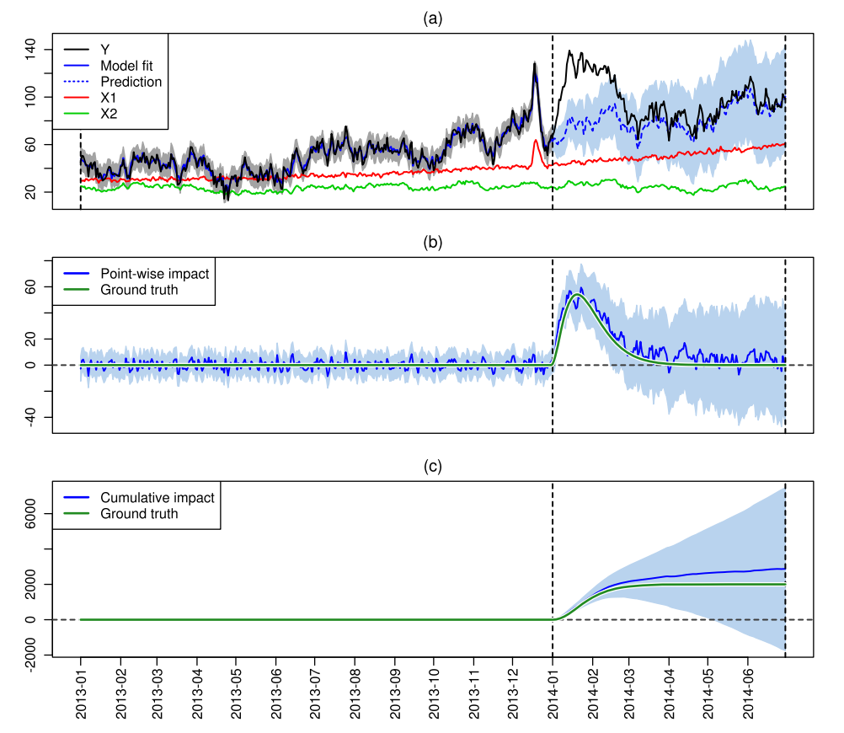
Bayesian Structural Time Series and Causal Impact
Brodersen et al

Slide 12
Bayesian Structural Time Series and Causal Impact
Understanding the causal effect of an intervention as measured by biosensors
As an example:
$y_{t} :$ weight (observed)
${y′}_{t} :$ weight (predicted)
$S_{t} :$ latent state variable
$X_{t} :$ Covariates (calories, weather, etc.)
$$y_{t}=S_{t}+X_{t}β$$
$$y_{t}$$
Impact
$${y′}_{t}$$
$$X_{t}$$
Liu*, Spakowicz* et al, PLOS Comp Bio 2021
Intervention
Brodersen et al, The Annals of App. Stat. 2015

Slide 13
Using a Bayesian Structural Time Series Framework for Modeling Biosensor Data to Evaluate Interventions
$${y′}_{t}=μ_{t}+X_{t}β+e_{t},e_{t} \sim N(0, σ_{e}^{2})$$
$$μ_{t+1}=μ_{t}+ δ_{t},δ_{t} \sim N(0, σ_{δ}^{2})$$
$y_{t} :$ weight
$X_{t} :$ Covariates (calories, weather, etc.)
${ e}_{t} :$ error term
$μ_{t} :$ local level (unobserved trend)
$δ_{t} :$slope
$$P\left({y^{′}}_{n+1:N}\right|y_{1:n})$$
$$y_{t}$$
Impact
$${y′}_{t}$$
$$X_{t}$$
Liu*, Spakowicz* et al, PLOS Comp Bio 2021
Brodersen et al, The Annals of App. Stat. 2015

Slide 14
Simple Ex of Performance on Biosensor Data
Acceleration
(m/s²)
Time
Intervention
Acceleration
(m/s²)
Cumulative
Impact
Intervention with Noise
and Paired Covariate
Time
Liu*, Spakowicz* et al, PLOS Comp Bio 2021

Slide 15
Analyzing Behavioral Sensor Data using Paired and Spatial Covariates
Behavior
(Crime)
Cumulative
Impact
Behavior
(Crime)
Intervention
Cumulative
Impact
No intervention (paired covariate)
Liu*, Spakowicz* et al, PLOS Comp Bio 2021

Slide 16
Collecting Biosensor and Wearable Data from Diabetes Patients

Slide 17
Evaluating The Efficacy of Exercise Regimens in Diabetes Patients

