Slide 1
Biomedical Text Mining
Tianxiao Li
cbb752

Slide 2
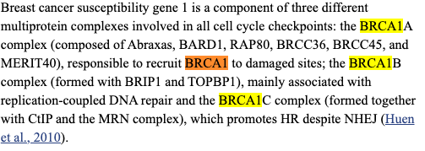
Structured vs unstructured data (free text)
https://string-db.org/
Torgovnick, Alessandro, and Björn Schumacher. "DNA repair mechanisms in cancer development and therapy." Frontiers in genetics 6 (2015): 157.

Slide 3
PART I: Supervised Mining

Slide 4
Mining of Biomedical Literature

Slide 5
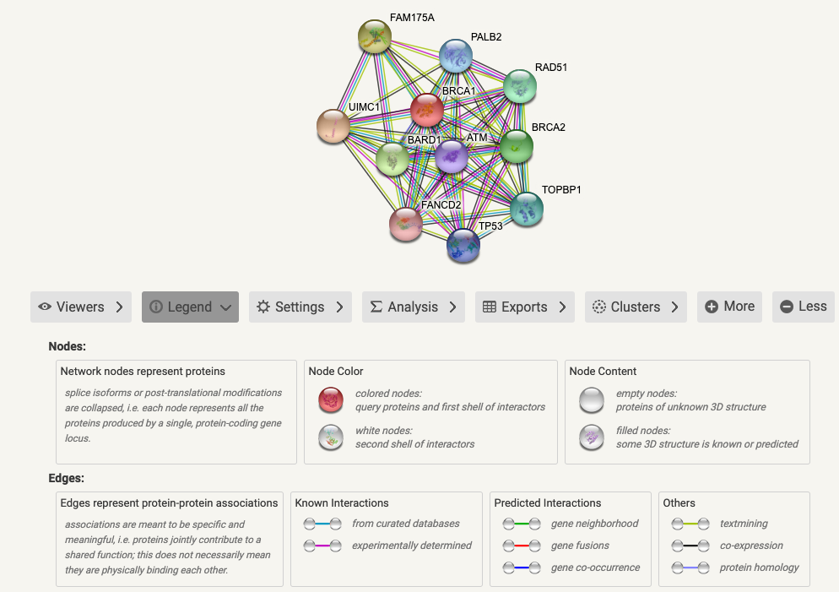
https://string-db.org/

Slide 6
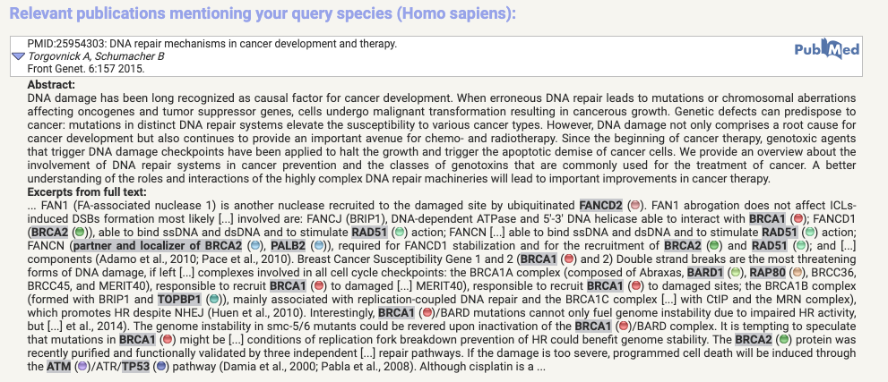

Slide 8
http://pages.cs.wisc.edu/~bsettles/abner/

Slide 9
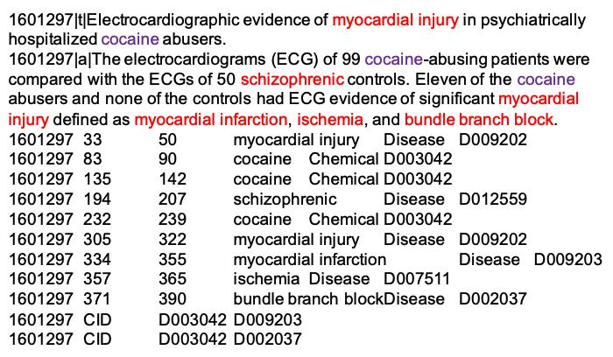
Named Entity Recognition
Is it (part of) a named entity?
Boundary?
Class?
Nguyen, Dat Quoc, and Karin Verspoor. "Convolutional neural networks for chemical-disease relation extraction are improved with character-based word embeddings." arXiv preprint arXiv:1805.10586 (2018).
Wei, Chih-Hsuan, et al. "Assessing the state of the art in biomedical relation extraction: overview of the BioCreative V chemical-disease relation (CDR) task." Database 2016 (2016).

Slide 10
Named Entity Recognition
Challenges in biomedical texts
Large, and increasing, numbers of new technical terms
Names are long (“12-o-tetradecanoylphorbol 13-acetate”)
Abbreviations (“TCF: “T cell factor” or “Tissue Culture Fluid”)
Combinations
Lee, Jinhyuk, et al. "BioBERT: a pre-trained biomedical language representation model for biomedical text mining." Bioinformatics 36.4 (2020): 1234-1240.
Song, Hye-Jeong, et al. "Comparison of named entity recognition methodologies in biomedical documents." Biomedical engineering online 17.2 (2018): 1-14.

Slide 11
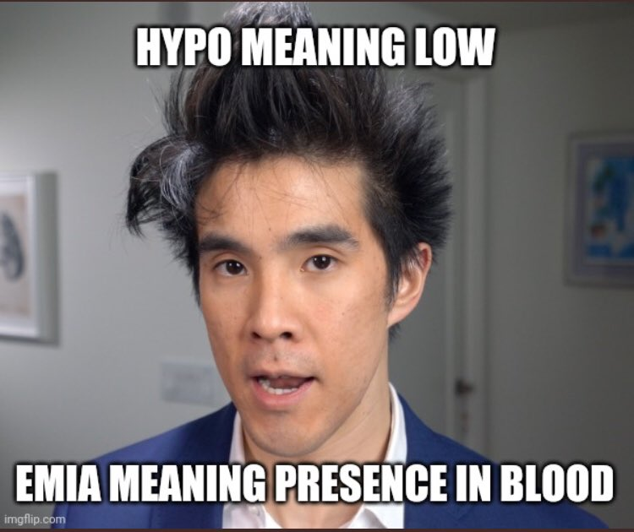
Named Entity Recognition
Dictionary-based
Rule-based
“Mr. [X]” -> X is a named entity (a person’s name)
Upper cases, hyphens and numbers, etc.
“Methylphenidate” -> likely a chemical
“Hypoxemia” -> likely a disease

Slide 12
Named Entity Recognition
Supervised learning
Need hand-curated training data
Features
The word itself
Capitalized?
Contains non-alphabetic characters?
…
Parse features
Part-of-speech tag?
Part of a lexical/grammatical rule?
Which part?
…
Contextual features
…
Model
Label
Beginning/End/Inside/Outside of a [CLASS] named entity?
Finkel, Jenny Rose, Trond Grenager, and Christopher D. Manning. "Incorporating non-local information into information extraction systems by gibbs sampling." Proceedings of the 43rd annual meeting of the association for computational linguistics (ACL’05). 2005.
Finkel, Jenny Rose, Alex Kleeman, and Christopher D. Manning. "Efficient, feature-based, conditional random field parsing." Proceedings of ACL-08: HLT. 2008.
Lee, Jinhyuk, et al. "BioBERT: a pre-trained biomedical language representation model for biomedical text mining." Bioinformatics 36.4 (2020): 1234-1240.

Slide 14
Relation Extraction
Co-occurrence
“[A] interacts with [B]” 🟢
“[A] does not interact with [B]” ❌
Rule-based
“[A] [relational verb phrase] [B]”
“[A] does not [relational verb phrase] [B]”

Slide 15
Relation Extraction
Supervised learning
Eleven of the cocaine abusers and none of the controls had ECG evidence of significant myocardial injury defined as …
Eleven of the [CHEMICAL] abusers and none of the controls had ECG evidence of significant [DISEASE] defined as …
Features
Model
Label
Are [CHEMICAL] and [DISEASE] related?
Type of relation?

Slide 16
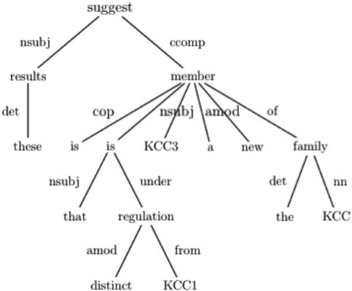
Relation Extraction
These results suggest KCC3 is a new member of the KCC family that is under distinct regulation from KCC1
Dependency parse tree
Features
Distance to root
Path between the terms
…
SVM
Özgür, Arzucan, et al. "Identifying gene-disease associations using centrality on a literature mined gene-interaction network." Bioinformatics 24.13 (2008): i277-i285.

Slide 17
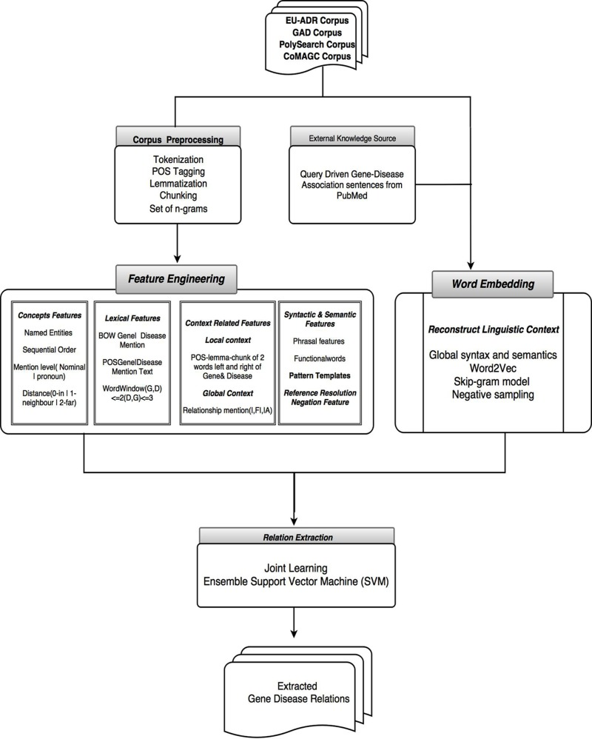
Relation Extraction
SVM
Bhasuran, Balu, and Jeyakumar Natarajan. "Automatic extraction of gene-disease associations from literature using joint ensemble learning." PloS one 13.7 (2018): e0200699.

Slide 18
Mining of Clinical Records

Slide 19
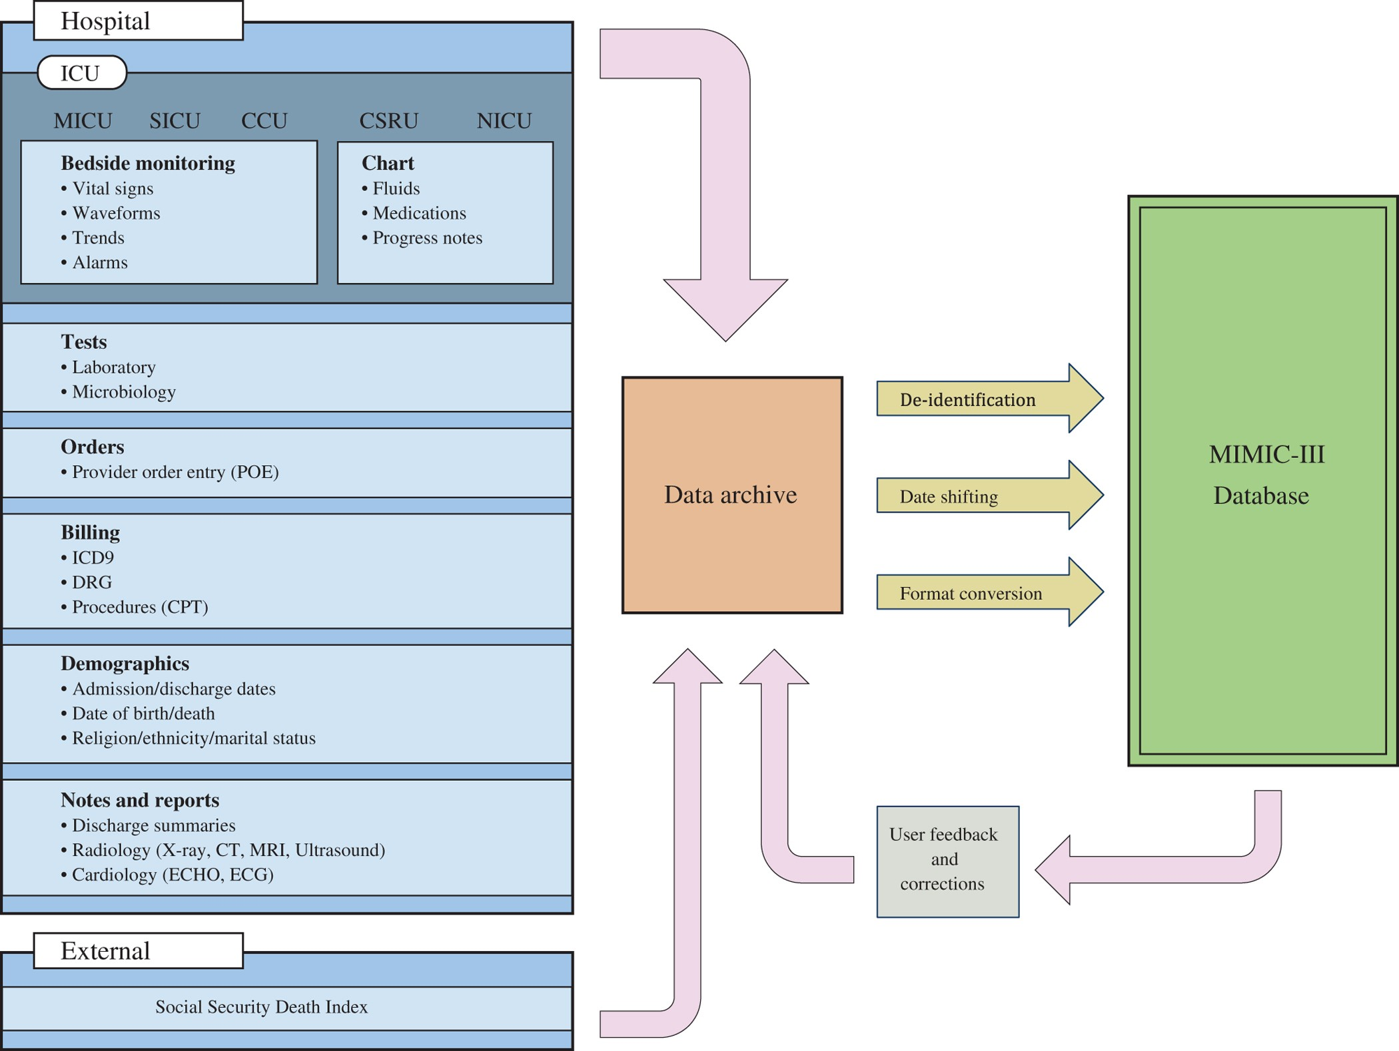
MIMIC-III

Slide 20
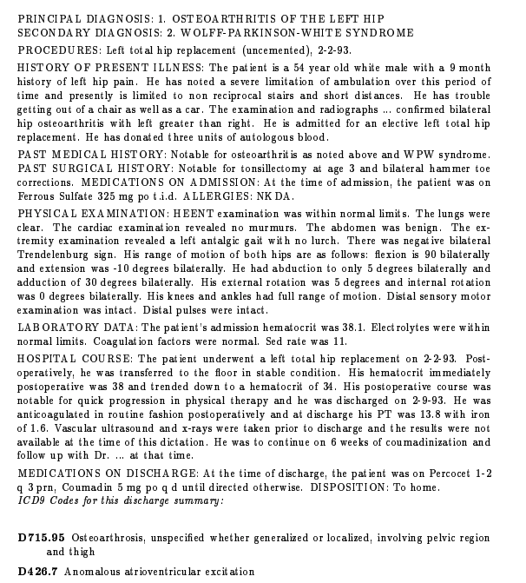
Principle diagnosis code (ICD9)
Free text (discharge summary)
Larkey, Leah S., and W. Bruce Croft. Automatic assignment of icd9 codes to discharge summaries. Technical report, University of Massachusetts at Amherst, Amherst, MA, 1995.

Slide 21
PART II: Unsupervised Mining

Slide 22
Word Embedding

Slide 23
Representation of Words
Hand-curated features
One-hot encoding
Denaxas, Spiros, et al. "Application of Clinical Concept Embeddings for Risk Prediction in EHR data."

Slide 24
Word Embedding
Reduce dimensionality
Information-rich
Unsupervised
Denaxas, Spiros, et al. "Application of Clinical Concept Embeddings for Risk Prediction in EHR data."

Slide 25
Word Embedding
A straightforward idea: can we learn an embedding vector for each word from which we can…
Retrieve their similarities/co-occurrences/dependencies, etc.?
Infer their relations? (e.g., king -> queen, man -> woman)
Pre-training
Training data are typically small
But many rules, dependencies, etc. in the language are universal
First learn the word embeddings from a large corpus of text, then apply them to the specific supervised task

Slide 26
GloVe
http://building-babylon.net/2015/07/29/glove-global-vectors-for-word-representations/

Slide 27
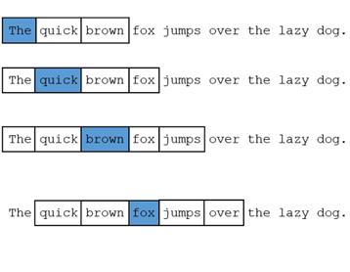
word2vec
https://medium.com/@zafaralibagh6/a-simple-word2vec-tutorial-61e64e38a6a1
Mikolov, Tomas, et al. "Efficient estimation of word representations in vector space." arXiv preprint arXiv:1301.3781 (2013).
Bai, Tian, et al. "EHR phenotyping via jointly embedding medical concepts and words into a unified vector space." BMC medical informatics and decision making 18.4 (2018): 15-25.

Slide 28
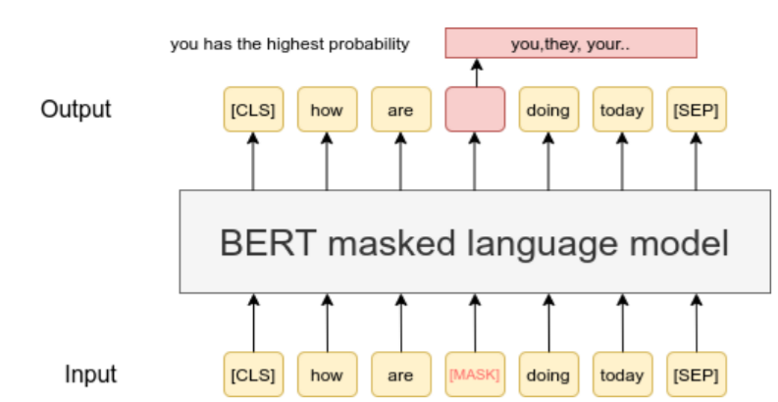
BERT
https://www.sbert.net/examples/unsupervised_learning/MLM/README.html
Devlin, Jacob, et al. "Bert: Pre-training of deep bidirectional transformers for language understanding." arXiv preprint arXiv:1810.04805 (2018).

Slide 29
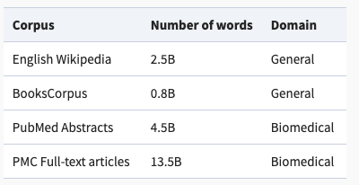
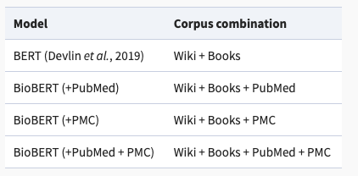
BioBERT
Lee, Jinhyuk, et al. "BioBERT: a pre-trained biomedical language representation model for biomedical text mining." Bioinformatics 36.4 (2020): 1234-1240.

Slide 30
Topic Modelling

Slide 31
Topic Modelling
Blei, David M. "Probabilistic topic models." Communications of the ACM 55.4 (2012): 77-84.

Slide 32
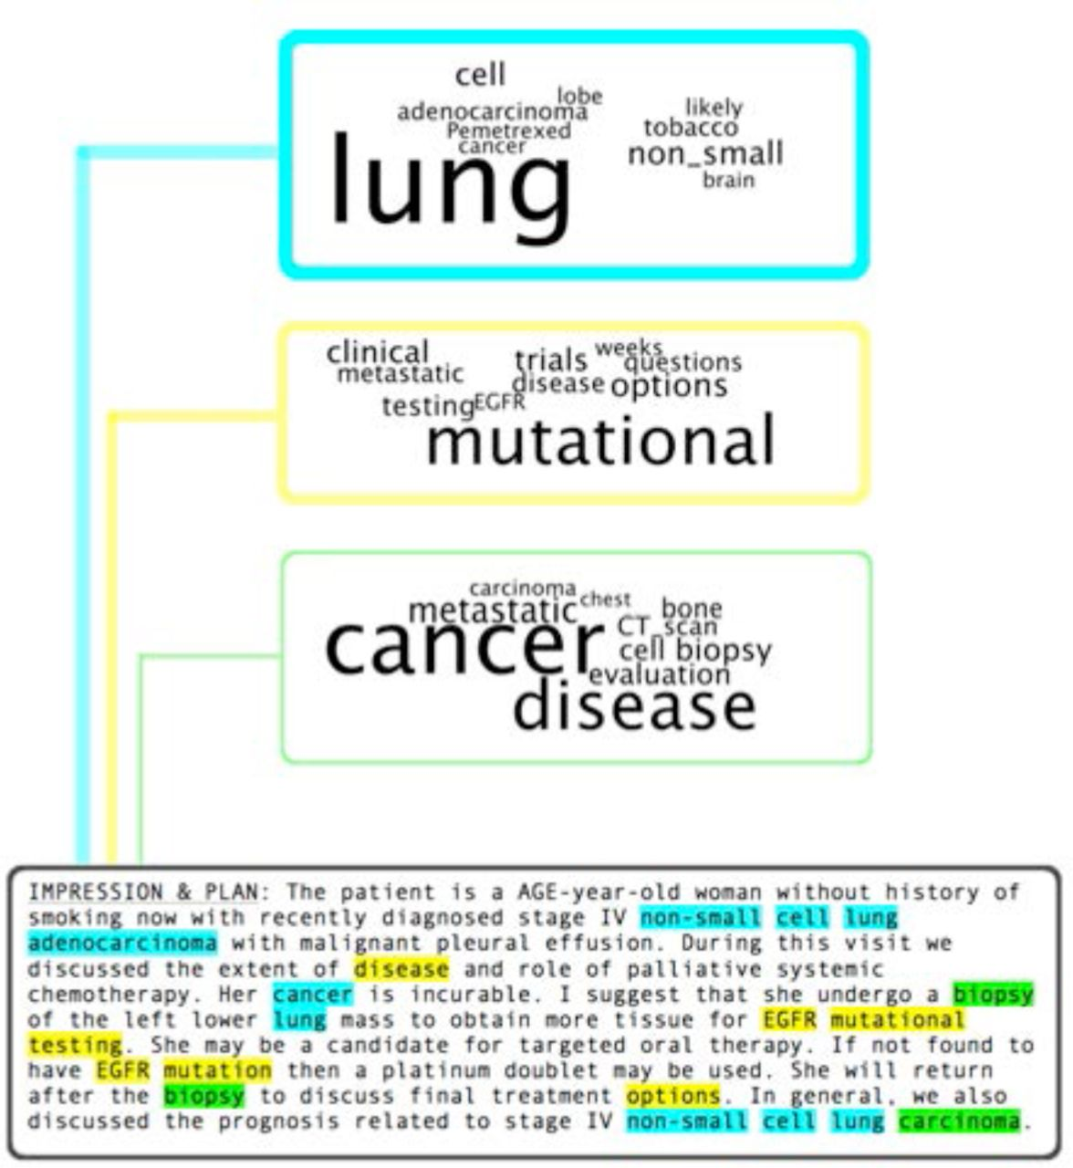
Topic Modelling
Some basic assumptions:
Each document contains certain latent topics
Each topic generates certain words (with a certain probability)~component
In other words:
If a document has high proportion of a certain topic, it should also contain many words related to that topic.
Chang, Katherine Redfield, et al. "An Empirical Analysis of Topic Modeling for Mining Cancer Clinical Notes." bioRxiv (2016): 062307.

Slide 33
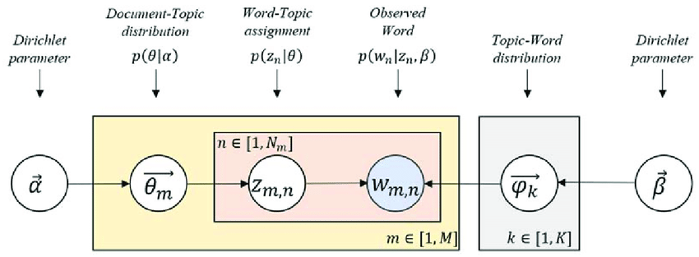
Topic Modelling
Latent Dirichlet Allocation
“Topic proportion”
Your observation
“Topic component”
https://www.analyticsvidhya.com/blog/2021/06/part-2-topic-modeling-and-latent-dirichlet-allocation-lda-using-gensim-and-sklearn/

Slide 34
Topic Modelling
Latent Dirichlet Allocation
Gibbs sampling:
Assign words to topics based on topic proportion & topic component
Update topic proportion & topic component based on topic assignments
Topic proportion ~ # of words are assigned to the topic (for each doc)
Topic component ~ # of times a certain word is assigned to the topic

Slide 35
Thank you!

