Slide 1
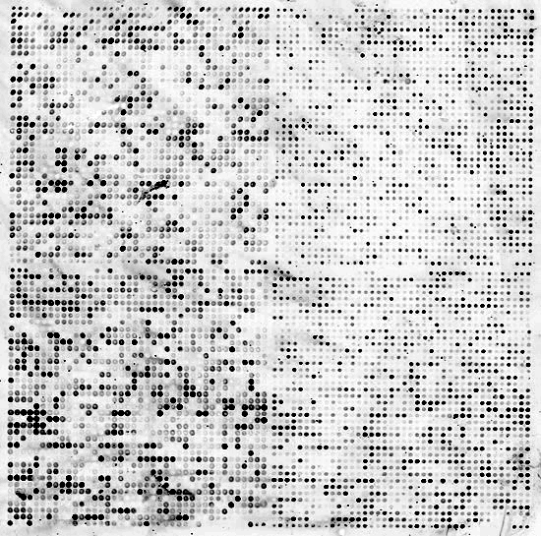
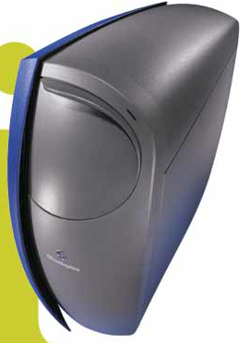

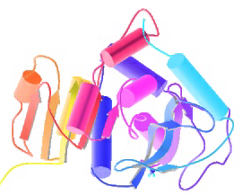
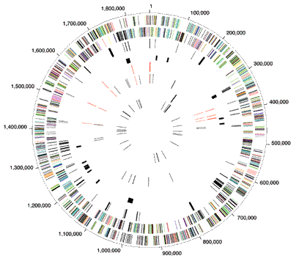


Biomed. Data Science:
Unsupervised Datamining D:
SVD Extensions
Mark Gerstein, Yale University
gersteinlab.org/courses/452
(last edit in spring ’21, pack #9d, final)

Slide 2
Unsupervised Mining
Biplot

Slide 3
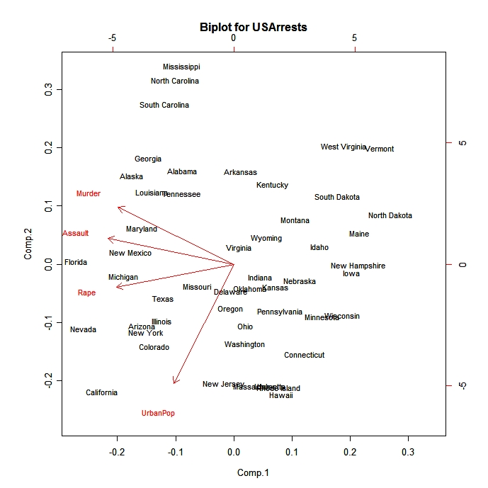
Introduction
A biplot is a low-dimensional (usually 2D) representation of a data matrix A.
  A point for each of the m observation vectors (rows of A)
  A line (or arrow) for each of the n variables (columns of A)
Notes:
A biplot can be obtained through either PCA or SVD.
A biplot is a direct visual representation of three types of relationships.
Observation to observation (point to point): are two observations like each other?
Variable to variable (line to line): are two variables correlated?
Observation to variable (point to line): How significant is a variable to an observation?

Slide 4
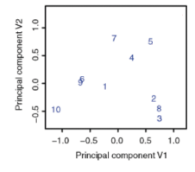
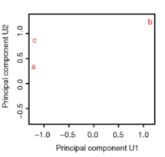
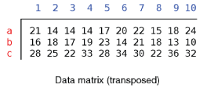
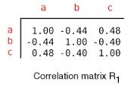
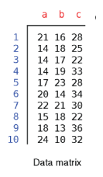
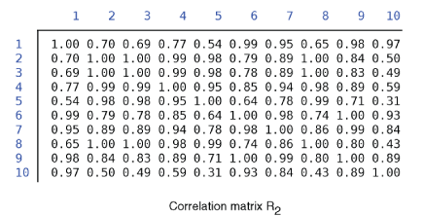
PCA
TFs: a, b, c...
Genomic
Sites: 1,2,3...
A
A^{T}A (TF-TF corr.)
A^{T}
AA^{T} (site-site correlation)
Notes:
4

Slide 5
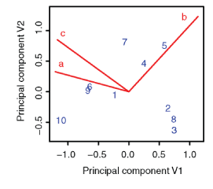
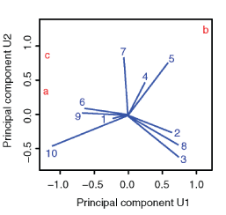
Biplot to Show Overall Relationship of TFs & Sites
TFs: a, b, c...
Genomic
Sites: 1,2,3...
A=USV^{T}
A^{T}A (TF-TF corr.)
A^{T}
AA^{T} (site-site correlation)
Notes:
5

Slide 6
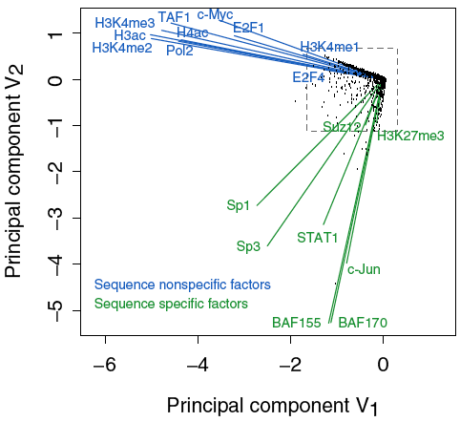
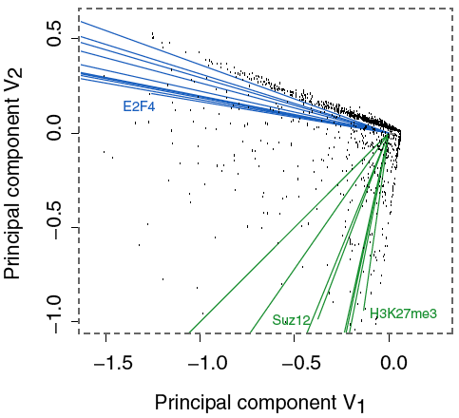
Results of Biplot
Pilot ENCODE (1% genome): 5996 10 kb genomic bins (adding all hits) + 105 TF experiments → biplot
Angle between TF vectors shows relation b/w factors
Closeness of points gives clustering of "sites"
Projection of site onto vector gives degree to which site is assoc. with a particular factor
Zhang et al. (2007) Gen. Res.
Notes:
6

Slide 7
Results of Biplot
Biplot groups TFs into sequence-specific and sequence-nonspecific clusters.
  c-Myc may behave more like a sequence-nonspecific TF.
  H3K27me3 functions in a transcriptional regulatory process in a rather sequence-specific manner.
Genomic Bins are associated with different TFs and in this fashion each bin is "annotated" by closest TF cluster
Zhang et al. (2007) Gen. Res.
Notes:
7

Slide 8
Unsupervised Mining
RCA

Slide 9
What is RCA?
RCA stands for Reference Component Analysis
RCA is an algorithm that expands the standard PCA to address noisy data:
  Batch effect
  Low signal to noise datasets
It is still an unsupervised clustering method but, RCA adds external information to address noisy data:
  Instead of projecting the original data into new axis
  It first correlates the original data to a reference panel
  And then, performs PCA on the correlations
In single-cell or bulk RNA-seq

Slide 10
Projection to external dataset
CORRELATION MATRIX
Reference
Dataset
Reference
Dataset
R1 R2 R3 … Rm
Samples
S1 S2 S3 … Sn
R1 R2 R3 … Rm
S1 S2 S3 … Sn
X
Samples
G1 G2 G3 … Gm
G1 G2 G3 … Gm
=
CORR
Genes
Genes

Slide 11
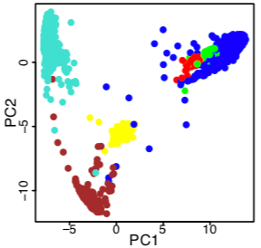
PCA on correlation matrix
PCA
Reference Dataset
V^{T}
^{(Loadings)}
K
components
R1 R2 R3 … Rm
U
^{(scores)}
C
^{Correlation}
^{Matrix}
PCA
S1 S2 S3 … Sn
Samples
C = U * V^{T}

Slide 12
Placing
Brain expression data in context of all other Body Tissues
(expression from GTEx)
[Wang et al. (‘18) Science]

Slide 13
Unsupervised Mining
CCA

Slide 14

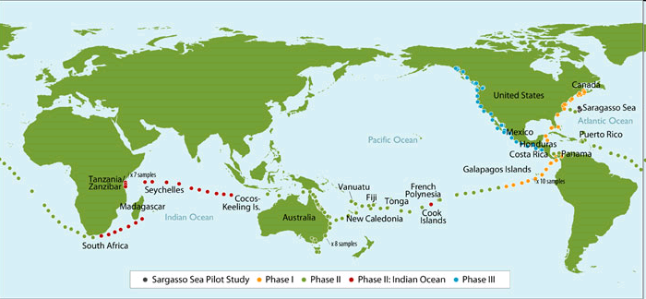
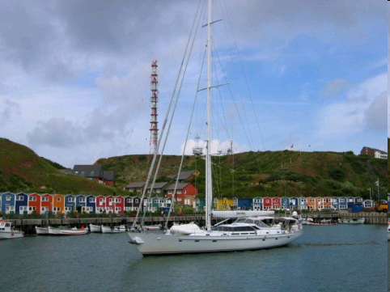
Sorcerer II Global Ocean Survey
Sorcerer II journey August 2003- January 2006
Sample approximately every 200 miles
Rusch, et al., PLOS Biology 2007
Notes:
Add viral dataaverage trimmed sequence read length 822 bp (1-2 genes)

Slide 15
Sorcerer II Global Ocean Survey
Additional Metadata via GPS coordinates
Metadata
GPS coordinates, Sample Depth, Water Depth, Salinity, Temperature, Chlorophyll Content
Metagenomic Sequence: 6.25 GB of data
0.1–0.8 μm size fraction (bacteria)
6.3 billion base pairs (7.7 million reads)
Reads were assembled and genes annotated
1 million CPU hours to process
Metabolic Pathways
Membrane Protein Families
Rusch, et al., PLOS Biology 2007
Notes:
trimmed sequence read length 822 bp (1-2 genes)
Rusch et. al., (2007) PLOS Biology
starting in Halifax, Canada and samples were collected at sites along the U.S. east coast, Gulf of Mexico, Galapagos Islands, central and south Pacific Oceans, Australia, Indian Ocean, South Africa, across the Atlantic back to the U.S.,

Slide 16
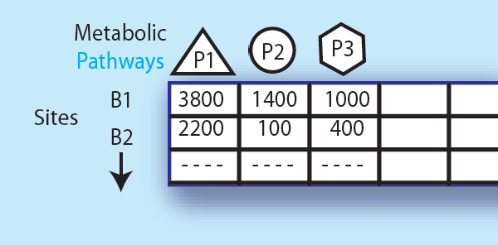
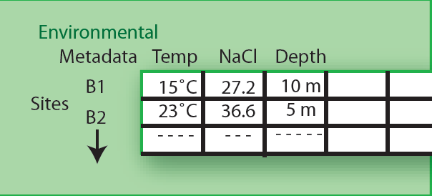
Expressing data as matrices indexed by site, env. var., and pathway usage
Pathway Sequences
(Community Function)
Environmental
Features
[Rusch et. al., (2007) PLOS Biology;
Gianoulis et al., PNAS (in press, 2009]
Notes:
16
What is GOS
In this study, water was filtered and sequenced. In addition, environmental features such as temperature, salinity, etc were also collected
WE USED THIS DATASET to investigate our initial hypothesis that
QUANTITATIVE DESCRIPTION OF how our environments are changing
There would be co-variation between particular pathways and environmental features
To do this, we first needed to map sequences to pathways
Further, we wanted to use the measurements from the environment explicitly and in the remainder of this section of the talk
I will discuss the development of these methodologies and provide a few examples

Slide 17
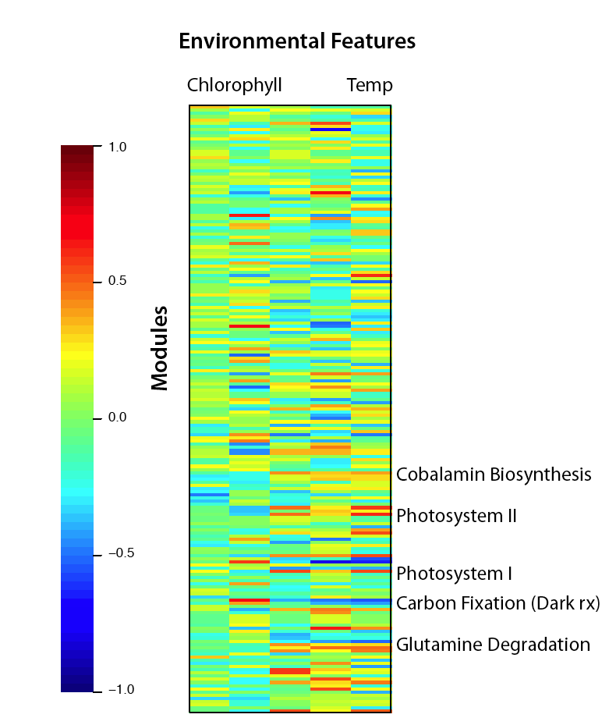
Simple Relationships: Pairwise Correlations
Pathways
[ Gianoulis et al., PNAS (in press, 2009) ]
Notes:
17
Step-wise (backwards elimination) linear regression to select features
Metabolic repertoire of microbial community modulated by a number of different environmental features
This treats each feature in isolation
We want a way to look at the environment as a whole

Slide 18






Canonical Correlation Analysis:
Simultaneous weighting
# km run/week
Weight
Lifestyle Index
Fit Index
Lifestyle Index = a +b + c
Fit Index = a + b +c
Notes:
18
Blood pressure, cholesterol levels, body weight

Slide 19
Canonical Correlation Analysis:
Simultaneous weighting
# km run/week
Weight
Lifestyle Index
Fit Index
Environmental
Features
Metabolic Pathways/
Protein Families
Lifestyle Index = a +b + c
etc
Photosynthesis
etc
Temp
Fit Index = a + b +c
Chlorophyll
Lipid Metabolism
Notes:
19
Blood pressure, cholesterol levels, body weight

Slide 20
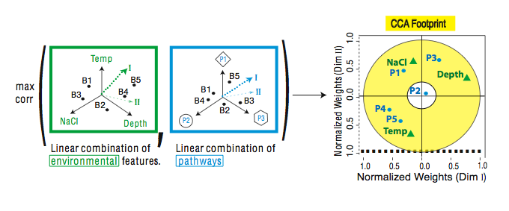
CCA: Finding Variables with Large Projections in "Correlation Circle"
The goal of this technique is to interpret cross-variance matrices
We do this by defining a change of basis.
Gianoulis et al., PNAS 2009
Notes:
20
I am first going to give a high-level overview of how we can use this technique to investigate the co-variation between the environment and metabolic pathways
Next, since George mentioned a few statisticians will be in the audience, I want to briefly provide a little bit of the technical details to give some intiution (you can ignore this).
Maximize the objective function, can be formulated as an eigen problem
Plotting degrees in the same coordinate system with carbohydrate metabolism or methionine biosynthesis would not make any sense.
First dimension then we take the orthogonal direction
The goal of this technique is to interpret cross-variance matrices.
More formally, we are defining a change of basis.
We compute the covariance
The units are completely different!!
However, the power of CCA is that defines a new coordinate system as shown by the heavy dotted line and thin dashed line in the plot
The normalized weights essentially give pathways and environment the same units
The circle around 0.3 represents the accepted cut-off for features that do “fit the model” or are co-varying and those that don’t
In the next few slides, I will show these results plotted in a couple of different ways to provide some intuition on what they mean
Further, I will use “footprints” derived from all three levels of the analysis: linear models, DPM, and CCA to illustrate more general trends in linking environment and metabolism

Slide 21
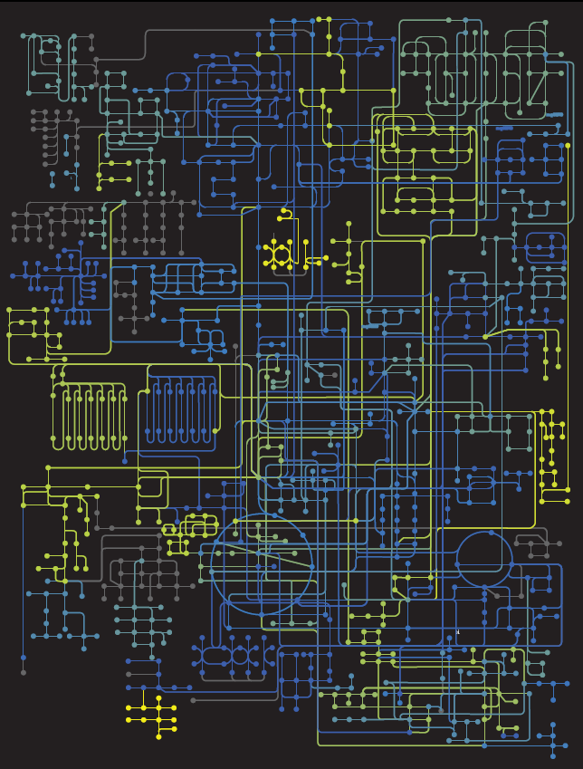

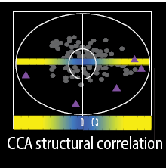
Circuit Map
Strength of Pathway co-variation with environment
Environmentally
invariant
Environmentally
variant
Gianoulis et al., PNAS 2009
Notes:
21
Because if we showed this bullseye it would just be a cloud dense mess of points; I am going to display the results in a slightly different way
Here I am showing a representation of the metabolic map
The strength of the pathways’ environmental co-variation is color-coded (yellow strongest to blue weakest) as measured by the absolute value of their structural correlations (normalized weights) derived from CCA.
Nodes (balls) symbolize compound, whereas connecting lines are enzymes.
Balls and lines are color-coded according to their KEGG-level co-variation score, which is calculated as an aggregate over all enzymes (lines) in a given map; all enzymes (lines) corresponding to a single KEGG map will have the same color.

Slide 22
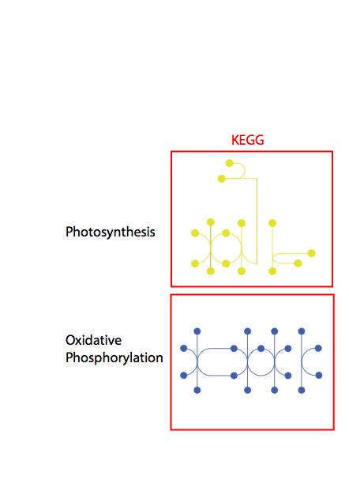
Conclusion #1: energy conversion strategy, temp and depth
Gianoulis et al., PNAS 2009
Notes:
22

