Slide 1
Introduction to eQTL
Jiahao Gao
2021/03/29

Slide 2
Variants
Genes
Traits

Slide 3
GWAS
eQTL
Variants
Genes
Traits
Mendelian Randomization

Slide 4
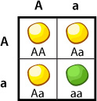
Mendelian traits
Quantitative traits
16
28
40
52
64
76
88
Height

Slide 5
Quantitative trait locus (QTL)
A quantitative trait locus (QTL) is a locus (section of DNA) that correlates with variation of a quantitative trait in the phenotype of a population of organisms (Wikipedia)
16
28
40
52
64
76
88
Height

Slide 6
16
28
40
52
64
76
88
0.5
1.0
1.5
2.0
2.5
3.0
3.5
Height
Gene expression

Slide 7
eQTL
Expression quantitative trait loci (eQTLs) are genomic loci that explain variation in expression levels of mRNAs (Wikipedia)
cis-eQTLs: eQTLs located near the gene of origin
trans-eQTLs: eQTLs located distant from their gene of origin, often on different chromosomes

Slide 8
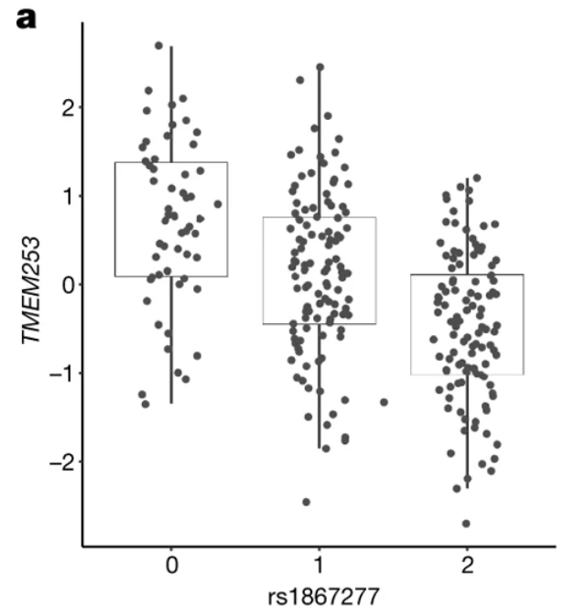
GG
GA
AA
X: Number of alternative (alt) allele
Y: Expression level of the gene
$$Y=β∗X+ε$$
T-test for null hypothesis $β=0$
GTEx Consortium, 2017, Nature

Slide 9
“The Genotype-Tissue Expression (GTEx) project is an ongoing effort to build a comprehensive public resource to study tissue-specific gene expression and regulation. Samples were collected from 54 non-diseased tissue sites across nearly 1000 individuals, primarily for molecular assays including WGS, WES, and RNA-Seq. The GTEx Portal provides open access to data including gene expression, QTLs, and histology images.”
https://www.gtexportal.org/home/

Slide 10
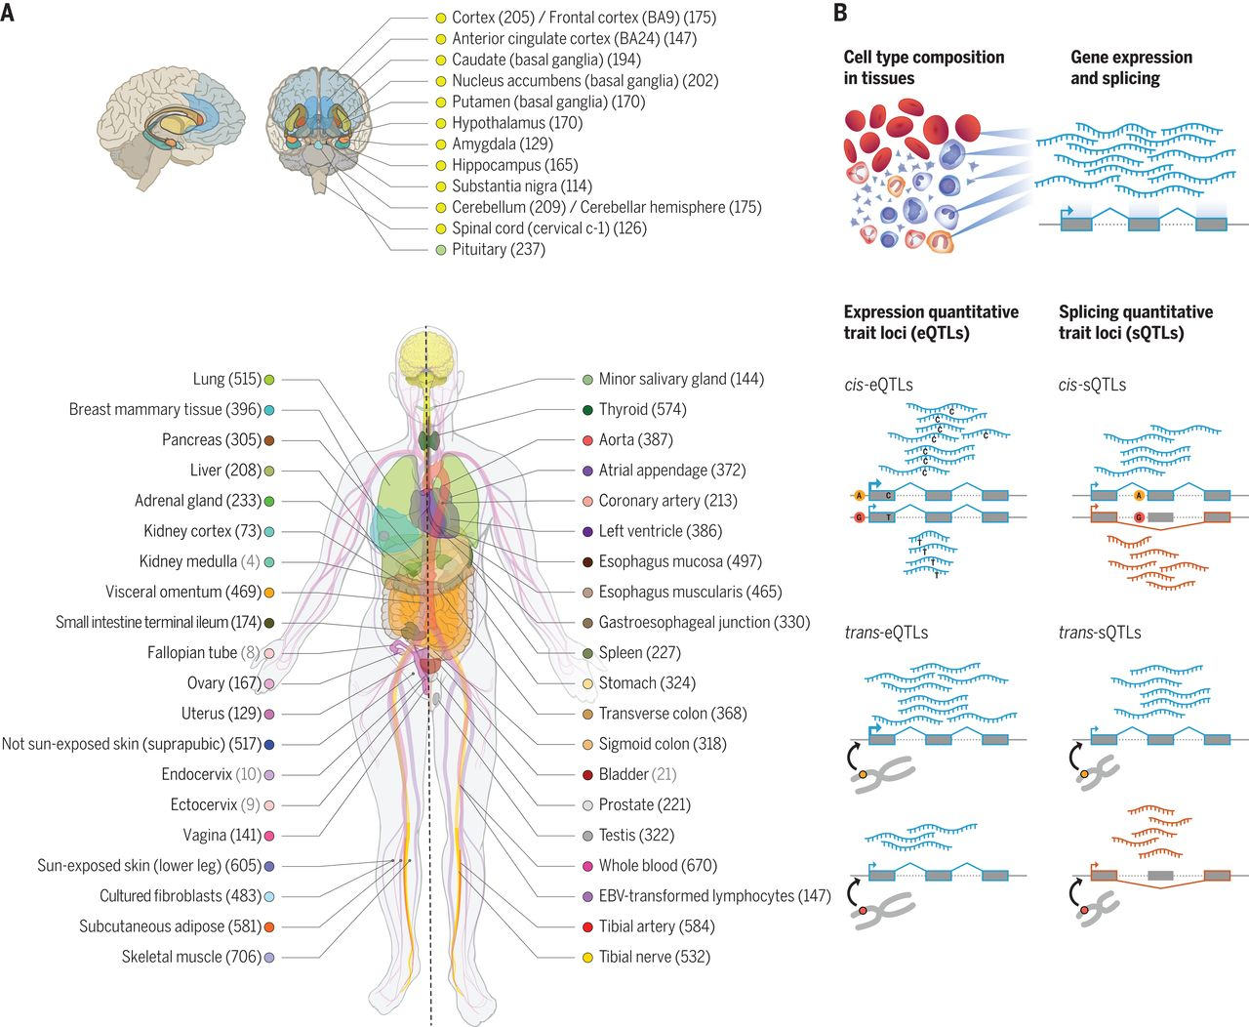
GTEx Consortium, 2020, Science

Slide 11
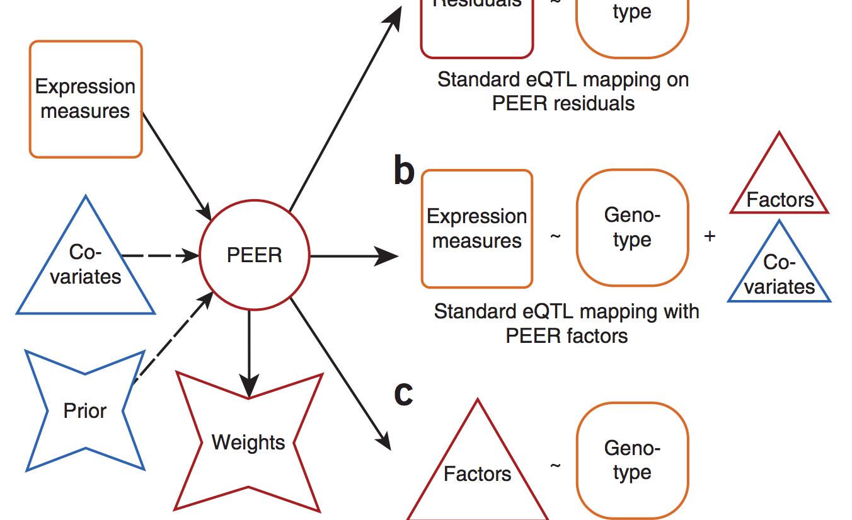
GTEx dataset:
Phenotypes: N samples × M genes
Genotypes: N samples × L loci
Covariates: N samples × C covariates (PEER factors)

Slide 12
Calling cis-eQTLs with FastQTL (now TensorQTL)
github.com/francois-a/fastqtl
github.com/broadinstitute/tensorqtl

Slide 13
1. Nominal run - finding a candidate QTL per gene
$N$ samples
$P = \left(P1, P2, … PN\right)$ is a single molecular phenotype (one gene)
$G$ (N×L) is the set of genotype dosages of $L$ variants located within a cis-window of 1Mb of the genomic location of $P$
(Nica and Dermitzakis, 2013, Philos Trans R Soc Lond B Biol Sci.)
Calculate Pearson product-moment correlation coefficients between $P$ and all $L$ variants in $G$
Standard significance tests for Pearson correlation (t test) -> Nominal P-value $p_{norminal}$
Equivalent to testing for $β≠0$ in a linear model $P=βG+ε$ using least squares fitting
The most strongly correlated variant $q∈G$ is used as the candidate QTL

Slide 14
2. Permutation scheme – correction for multiple testing in one phenotype
For each genes, we test multiple variants that are correlated because of LD and have a wide allele frequency spectrum. All this properties vary from one phenotype to another
Permutate $P$, leaving the genotype data $G$ unchanged to preserve the correlation between variants, and store the strongest correlation
$$P_{ }= \left(P1, P2, … PN\right)$$
$$P_{permute}= \left(P32, P15, … PN\right)$$
$$P_{ }=βG+ε$$
$$P_{permute}=βG+ε$$
Variant $q$ has the
smallest p-value ${P_{norminal}^{q}}_{ }$
Variant $q2$ has the
smallest p-value ${P_{permute}^{q2}}_{ }$

Slide 15
Permutation with beta distribution approximation
Order statistics of independent uniformly distributed random variables are beta-distributed
$k$^{th} smallest value obtained when independently drawing n times from the uniform is distributed as
P-values obtained through permutations are also beta-distributed
Variant $q2$ (1 SNP from total L SNPs) has the smallest p-value ${P_{permute}^{q2}}_{ }$
For strongest (1st) p-value from L variants tests: k=1, n=L

Slide 16
Retrieve null distribution:
Beta-adjusted p-value:
Notes:
The underlying idea of this approach is to characterize the extreme tail of the null distribution without directly sampling from it

Slide 17
3. False discovery rate – correction for testing multiple genes
For each gene, we have one eQTL candidate $q$ with adjust p-value $P_{b}$.
We need to test ~20k genes in the whole genome
Benjamini–Hochberg (BH) procedure
Storey and Tibshirani (ST) procedure (Storey and Tibshirani, 2003 PNAS)
For each gene, we now have one eQTL candidate $q$ with adjust p-value $P_{b}$ and Q-value.
Apply filter q < 0.05. This gives you the final significant eQTL associations (genes - SNPs)
Notes:
The ST procedure assumes that the set of association tests originates from a mixture of both the null and the alternative hypothesis and estimates π0, defined as the proportion of hypotheses for which the null is true
BH procedure assumes π0 is 1, whereas the ST procedure learns it from the data

Slide 18
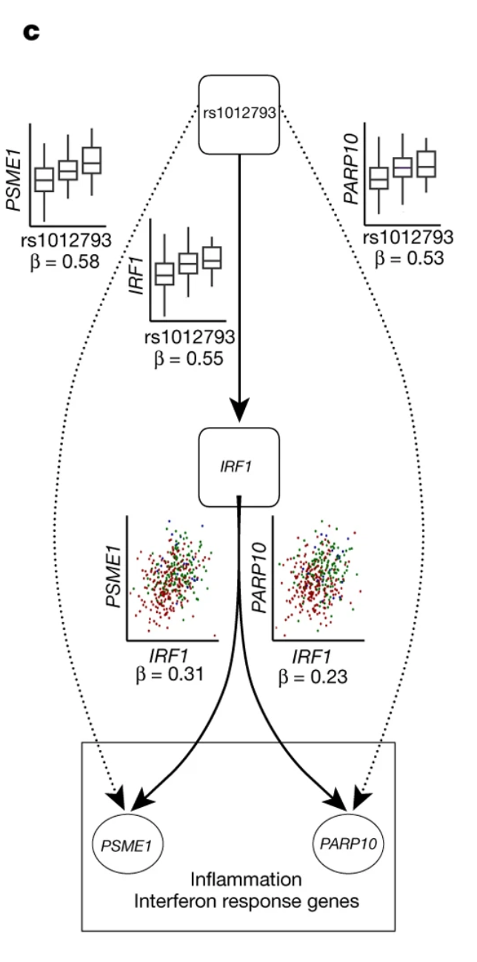

Slide 19
GWAS

Slide 20
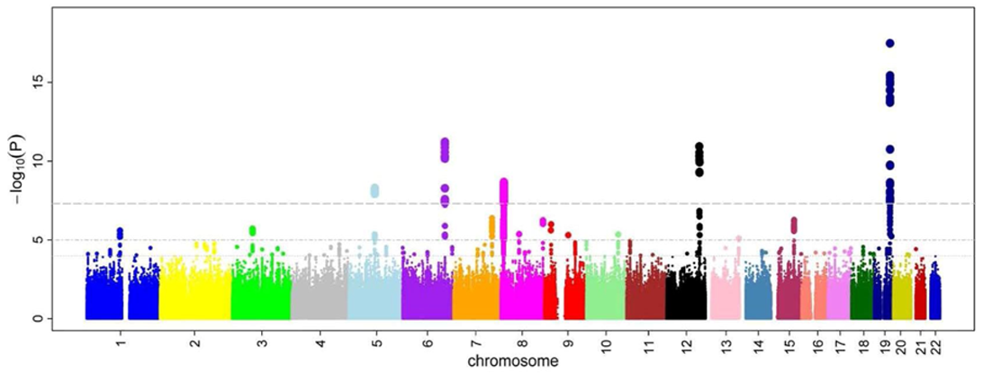
Manhattan plot
(Ikram et al, 2010 PLoS Genet.)

Slide 21
Thanks

Slide 22
Independent cis-eQTL mapping
Only lead variants have been considered as eQTLs
Multiple independent signals for a given expression phenotype were identified by forward stepwise regression followed by a backwards selection step

Slide 23
Set gene-level significance threshold to the maximum beta-adjusted P-value over all eGenes.
Forward step:
For each eGene:
Add the most significant variant to list
Add variants in the list to covariates, then do cis-QTL mapping as previously described.
If lead variant pass gene-level significance threshold: add this lead variant to list, go to step 1
Else: end forward step for this gene.
Backward step:
For each eVariant:
Add all other eVariants to covariates, then do cis-QTL mapping as previously described.
If no variant from this scan is significant at the gene-level threshold: drop the eVariant
Else: add the lead variant to final result

Slide 24
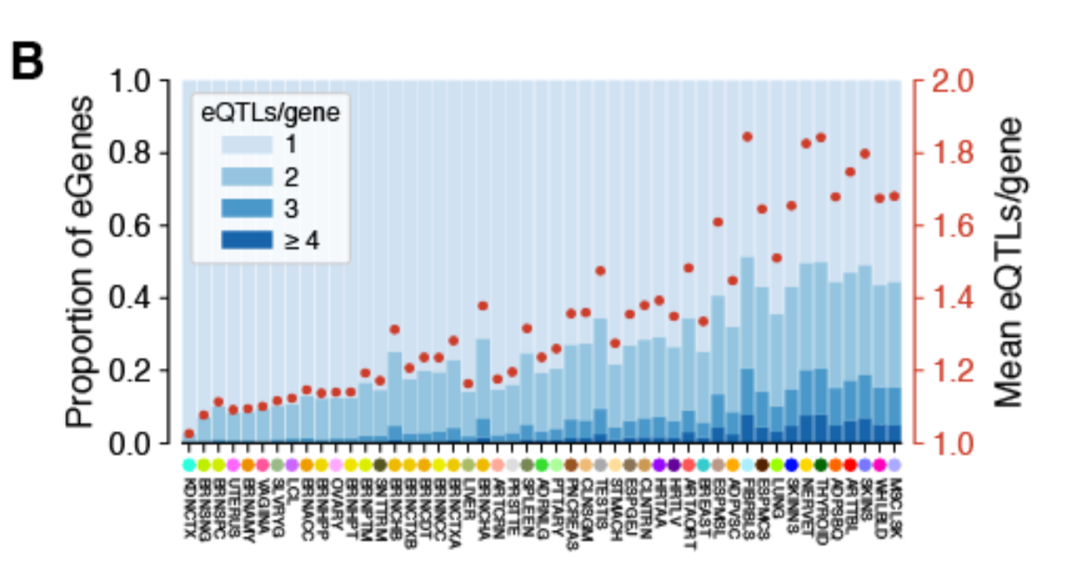
GTEx Consortium, 2019, bioRxiv

