Slide 1
Biomed. Data Sci: Variant Identification, Focusing on SVs
Mark Gerstein, Yale University gersteinlab.org/courses/452
(last edit in spring ’20, pack #6)

Slide 2
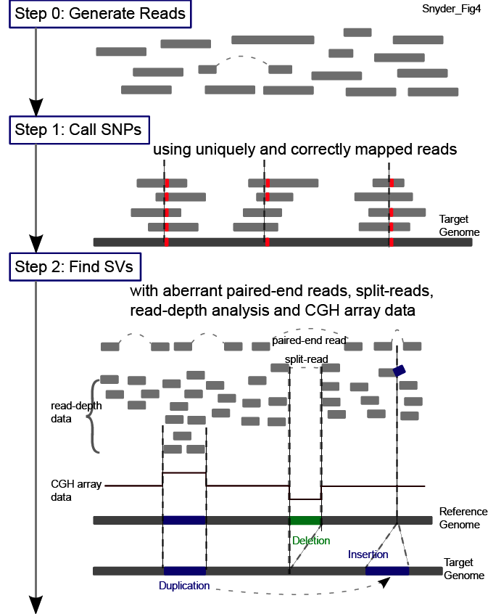
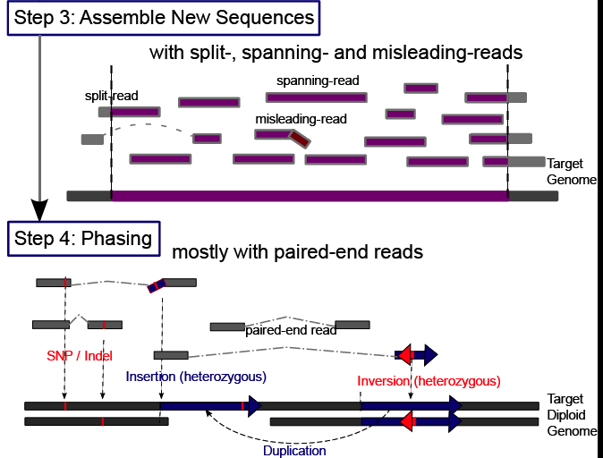
Main Steps in Genome Resequencing
[Snyder et al. Genes & Dev. ('10)]

Slide 3
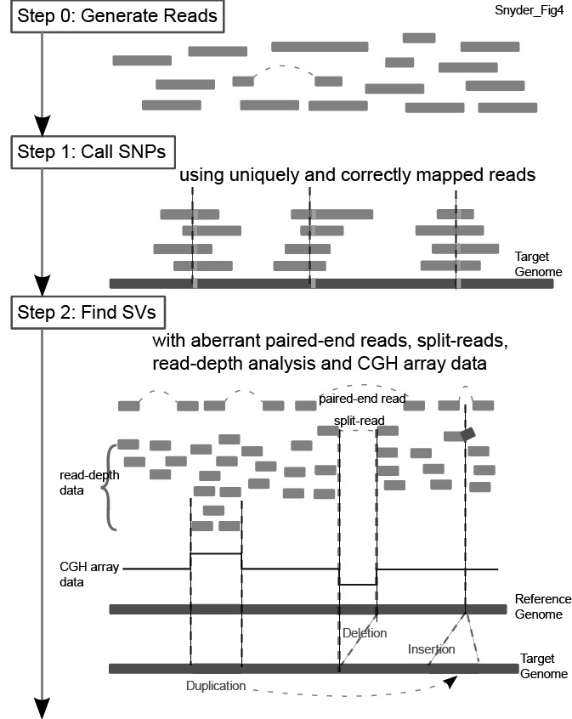
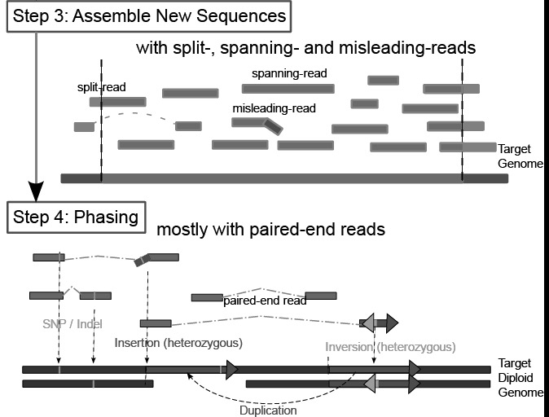
Main Steps in Genome Resequencing
[Snyder et al. Genes & Dev. ('10)]

Slide 4
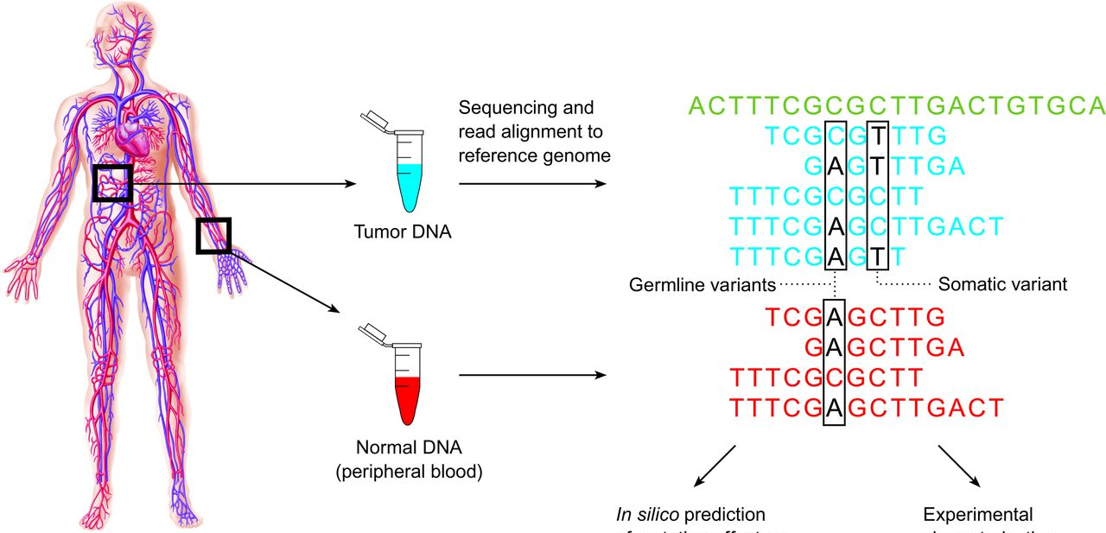
Characterization of genomic variations: somatic vs germline
Sequencing tumor and normal samples from cancer patients provide insight into somatic and germline variation profile.
Samuel et al, Clinical chemistry, 2013

Slide 5
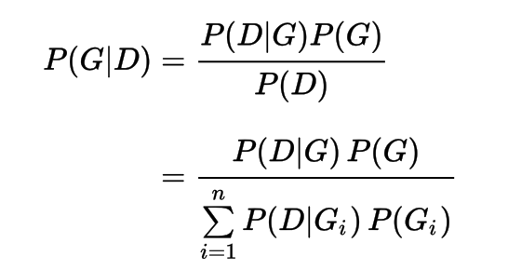
Bayes’ Theorem to detect genomic variant
In the above equation:
$D$ refers to the observed data
$G$ is the genotype whose probability is being calculated
$G_{i}$refers to the $i$th possible genotype, out of n possibilities
[You et al. (‘12) Bioinformatics 28: 643 doi: 10.1093/bioinformatics/bts001]

Slide 6
Calculating the conditional distribution $P\left(D | G\right):$
Assuming an error free model, for each heterozygous SNP site of the diploid genome, covered by K reads, the number of reads $i$ representing one of the two alleles follows binomial distribution.
$$P_{err_free}\left(D | G\right)=f\left(i | k,0.5\right)=\left({k \atop i}\right){0.5}^{k}$$
With errors, the calculation is more complicated.
In general:
$$P\left(D | G\right)=P_{err_free}\left(D | G\right)+P_{err}(D|G)$$
[You et al. (‘12) Bioinformatics 28: 643 doi: 10.1093/bioinformatics/bts001]
Notes:
Change to explain the error / error free

Slide 7
Main Steps in Genome Resequencing
[Snyder et al. Genes & Dev. ('10)]

Slide 8
Methods to Find SVs
1. Paired ends
Deletion
Reference
Mapping
Genome
Sequenced paired-ends
Reference
2. Split read
3. Read depth (or aCGH)
Deletion
Deletion
Reference
Reference
Genome
Genome
Read
Reads
Mapping
Mapping
Read count
Reference
Zero level
4. Local Reassembly
[Snyder et al. Genes & Dev. ('10)]

Slide 9
Read Depth

Slide 10
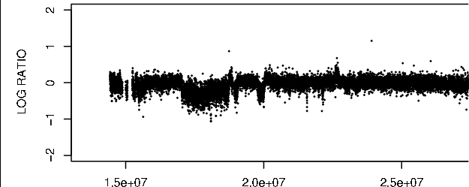
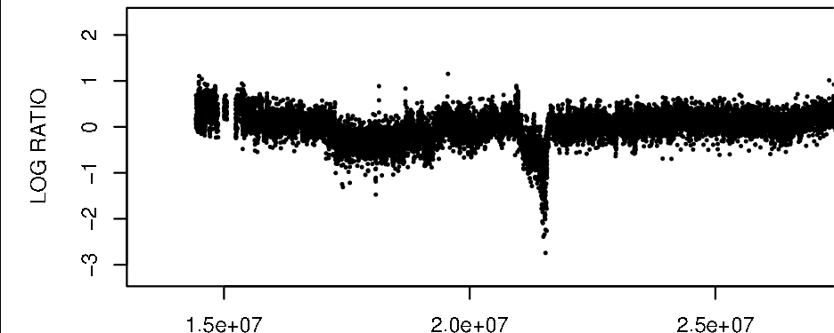
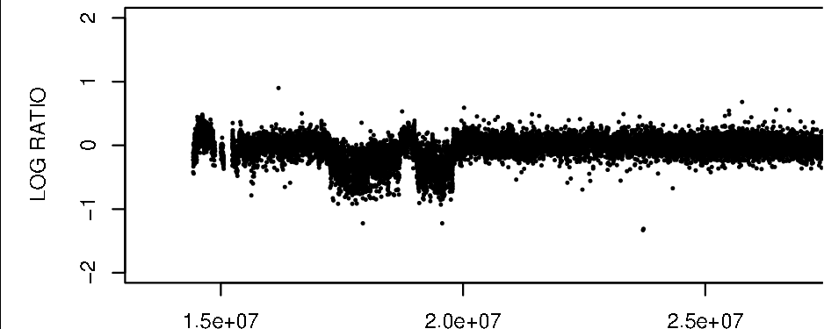
Array Signal Read depth
Patient 98-135
Individual genome
Patient 99-199
Reads
Mapping
Patient 97-237
Reference genome
[Urban et al. ('06) PNAS; Wang et al. Gen. Res. ('09); Abyzov et al. Gen. Res. (’11)]
Counting mapped reads
Read depth signal
LCR A B C D
Zero level

Slide 11
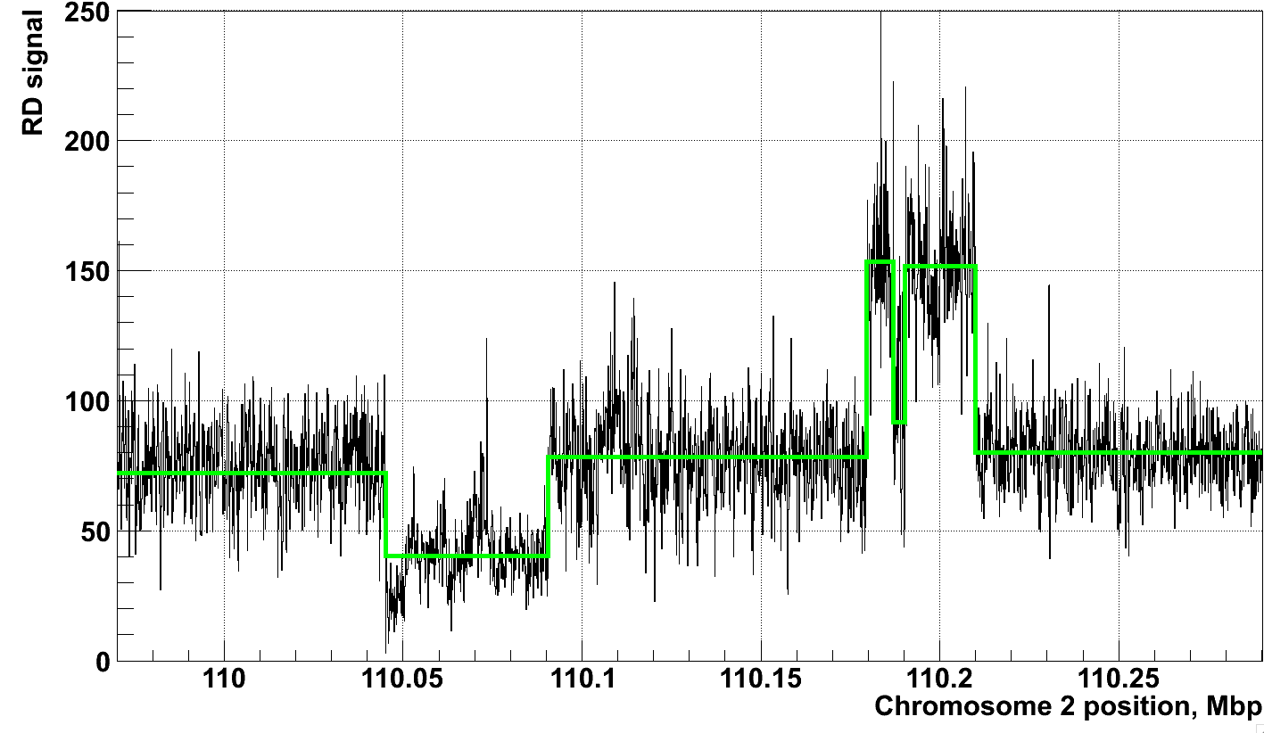
Example of Application to RD data
[Abyzov et al. Gen. Res. (’11)]
NA12878, Solexa 36 bp paired reads, ~30x coverage

Slide 12
0.5
Fluorescence
0
log2 ratio
-0.5
Korbel*, Urban* et al., PNAS (2007)
Notes:
Need illustrator + do edits

Slide 13
Statistically integrates array signal and DNA sequence signatures (using a discrete-valued bivariate HMM)
alues
v
y
a
r
r
A
alues
S
equen
c
e
v
y
Transition
A
Transition
B
a
r
r
A
S
equen
c
e
Duplication
Normal
Deletion
Transition
A’
Transition
B’
Korbel*, Urban* et al., PNAS (2007)
Notes:
- The y-axis captures the distribution of fluorescent intensity log2-ratios
- While the x-axis captures DNA sequence characteristics!

Slide 14
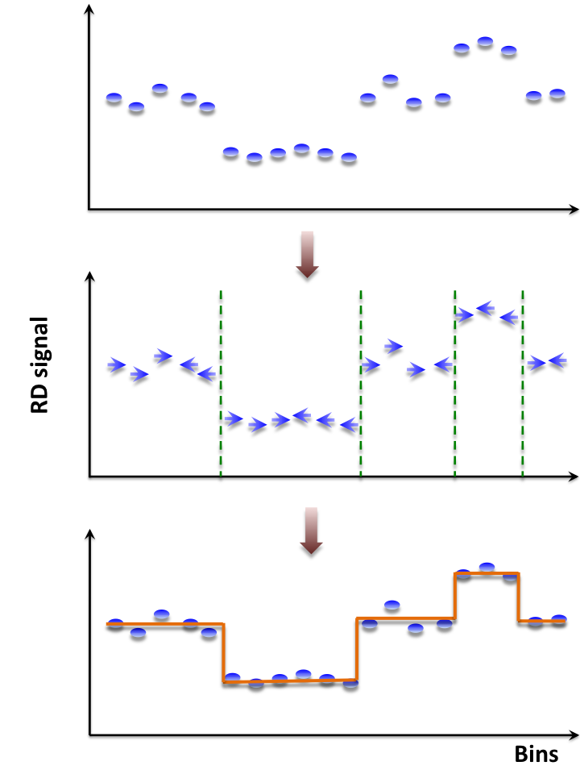
Mean-shift-based (MSB) segmentation: no explicit model
CNVnator
For each bin attraction (mean-shift) vector points in the direction of bins with most similar RD signal
No prior assumptions about number, sizes, haplotype, frequency and density of CNV regions
Not Model-based (e.g. like HMM) with global optimization, distr. assumption & parms. (e.g. num. of segments).
Achieves discontinuity-preserving smoothing
Derived from image-processing applications
[Abyzov et al. Gen. Res. (’11)]

Slide 15
Intuitive Description of MSB
Observed depth of coverage counts as samples from PDF
Kernel-based approach to estimate local gradient of PDF
Iteratively follow grad to determine local modes
Region of
interest
Center of
mass
[ Adapted from S Ullman et al. "Advanced Topics in Computer Vision," www.wisdom.weizmann.ac.il/~vision/courses/2004_2 ]
Mean Shift
vector
Objective : Find the densest region
Distribution of identical billiard balls

Slide 16
Paired-End

Slide 17
Paired-End Mapping
Breakpoint
Breakpoint
Breakpoint
Breakpoint
Breakpoint
Reference
Deletion
Inversion
Target
Insertion
Inversion
Paired-End Sequencing and Mapping
Reference
Span << expected
Span >> expected
Altered end orientation
Both paired-ends map within repeats.
Limited the distance between pairs; therefore, neither large nor very small rearrangements can be detected

Slide 18
Split Read

Slide 19
Split-read Analysis
Breakpoint
Breakpoint
Reference
Deletion
Read
Target Genome
Breakpoint
Reference
Read
Target Genome
Insertion
Notes:
This schematic shows you the idea of a split-read analysis. Its simple but powerful enough to identify nucleotide-resolution SVs. Before we talk about how it works, we should know that by convention, when say it’s a deletion, it’s a deletion relative to the reference genome. In other words, the affected sequence actually exists in the reference genome, but is deleted in the query genome. Similar idea for insertion. So a split-read analysis is straight-forward.

Slide 20
Deletions are the Easiest to Identify
[Zhang et al. ('11) BMC Genomics]

Slide 21
RDV & Mobile Elements

Slide 22
Retroduplication variation (RDV)
Retroduplications
(pot. retro-pseudogenes or retro-genes)
mRNA
Gene
Reference
…
Person 1
…
Person 2
…
Known retroduplication
Person 3
…
. . .
Reference
…
Person 1
…
Person 2
…
Novel retroduplication
Person 3
…
. . .
mRNA
[Abyzov et al. Gen. Res. ('13) ]

Slide 23
Gene
Novel retroduplication
Read pairs
1 2 3 4
…
…
Reference
Alignment to
the reference
…
3
1
Evidence
from alignment
Unaligned reads
Aligned
reads
Splice-junction library
…
2
4
Evidence
from cluster
1
[Abyzov et al. Gen. Res. ('13) ]
…
3
2 3 4
Evidence from
read depth
1
Pipeline to identify novel retro-dups. from 3 evidence sources
Zero level
Notes:
Split-read and paired-end approaches

