Slide 1
Biomed. Data Sci. Personal Genomes Intro.
Mark Gerstein, Yale University
GersteinLab.org/courses/452
(last edit in spring‘21)

Slide 2
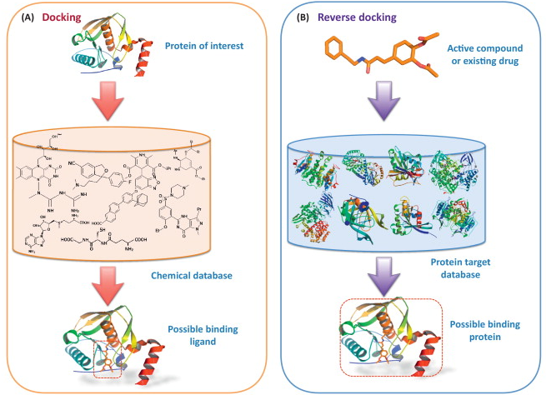
Major Application I: Designing Drugs from Structural Targets
Understanding how structures bind other molecules
Designing inhibitors using docking, structure modeling
In silico screens of chemical and protein databases
(From left to right, figures adapted from Olsen Group Docking Page at Scripps, Zheng et al. Trends in Pharmacological Sciences 2013)

Slide 3
Major Application II: Finding Homologs, to Find Experimentally Tractable Gene Targets
[Adapted from Sci. Am.]

Slide 4
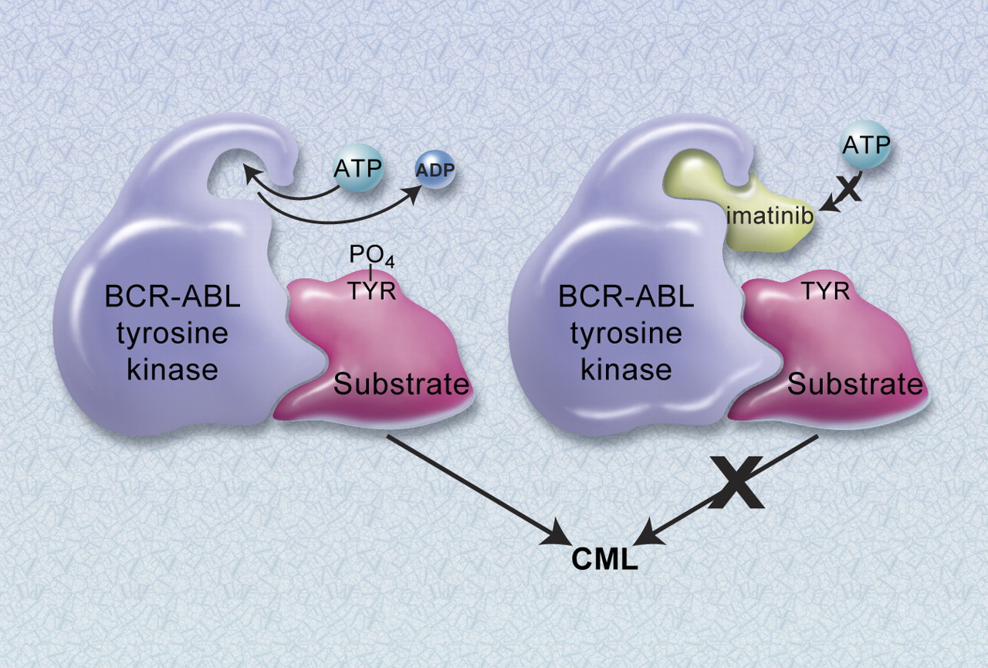
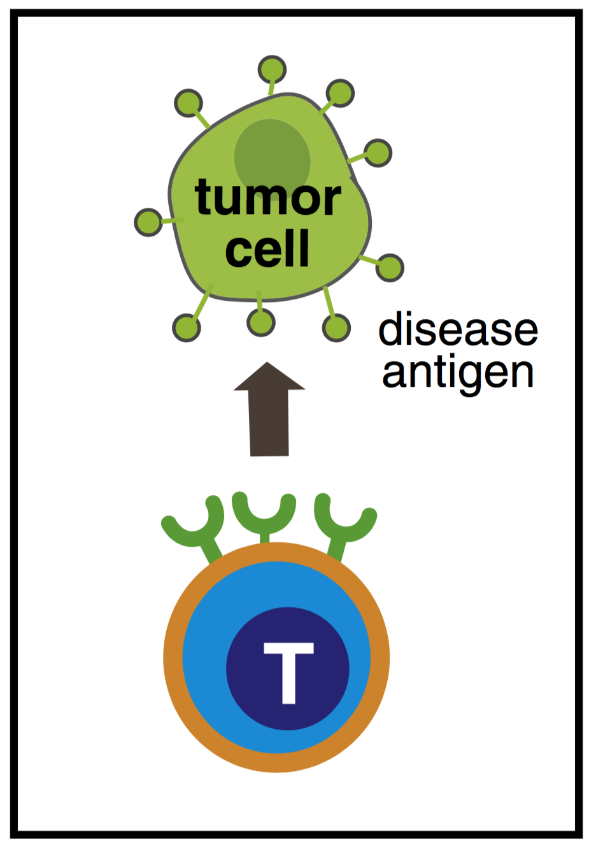
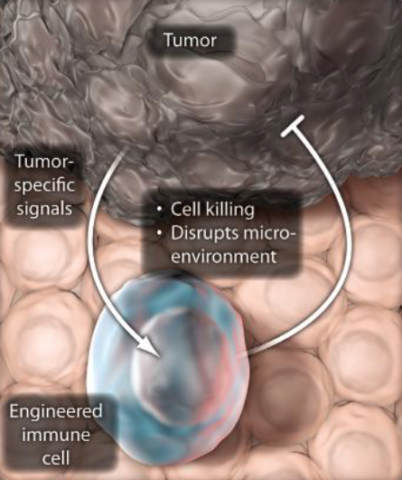
Major Application III: Customizing treatment in oncology
Identifying disease causing mutations in individual patients
Designing targeted therapeutics
e.g. BCR-abl and Gleevec
Cancer immunotherapies targeting neoantigens
(From left to right, figures adapted from Druker BJ. Blood 2008 and the Lim Lab at UCSF)

Slide 5
Major Application IV: Finding molecular mechanisms & drug targets for diseases we know little about (Neuro-psychiatic Diseases)
Disease | Heritability* | Molecular Mechanisms
Schizophrenia | 81% | -
Bipolar disorder | 70% | -
Alzheimer's disease | 58 - 79% | Apolipoprotein E (APOE), Tau
Hypertension | 30% | Renin–angiotensin–aldosterone
Heart disease | 34-53% | Atherosclerosis, VCAM-1
Stroke | 32% | Reactive oxygen species (ROS), Ischemia
Type-2 diabetes | 26% | Insulin resistance
Breast Cancer | 25-56% | BRCA, PTEN
Phenotype
SCZ
BPD
AGE
…
*https://www.snpedia.com/index.php/Heritability
pathways, circuits
Cell types
Modules
Regulatory elements
Genes
Genotype
Many psychiatric conditions are highly heritable
Schizophrenia: up to 80%
But we don’t understand basic molecular mechanisms underpinning this association (in contrast to many other diseases such as cancer & heart disease)
Moreover, current models substantially underestimate heritability using genetic data
Schizophrenia : ~25%
Thus, interested in developing predictive models of psychiatric traits which:
Use observations at intermediate (molecular levels) levels to inform latent structure. Use the predictive features of these “molecular endo phenotypes” to begin to suggest actors involved in mechanism

Slide 6
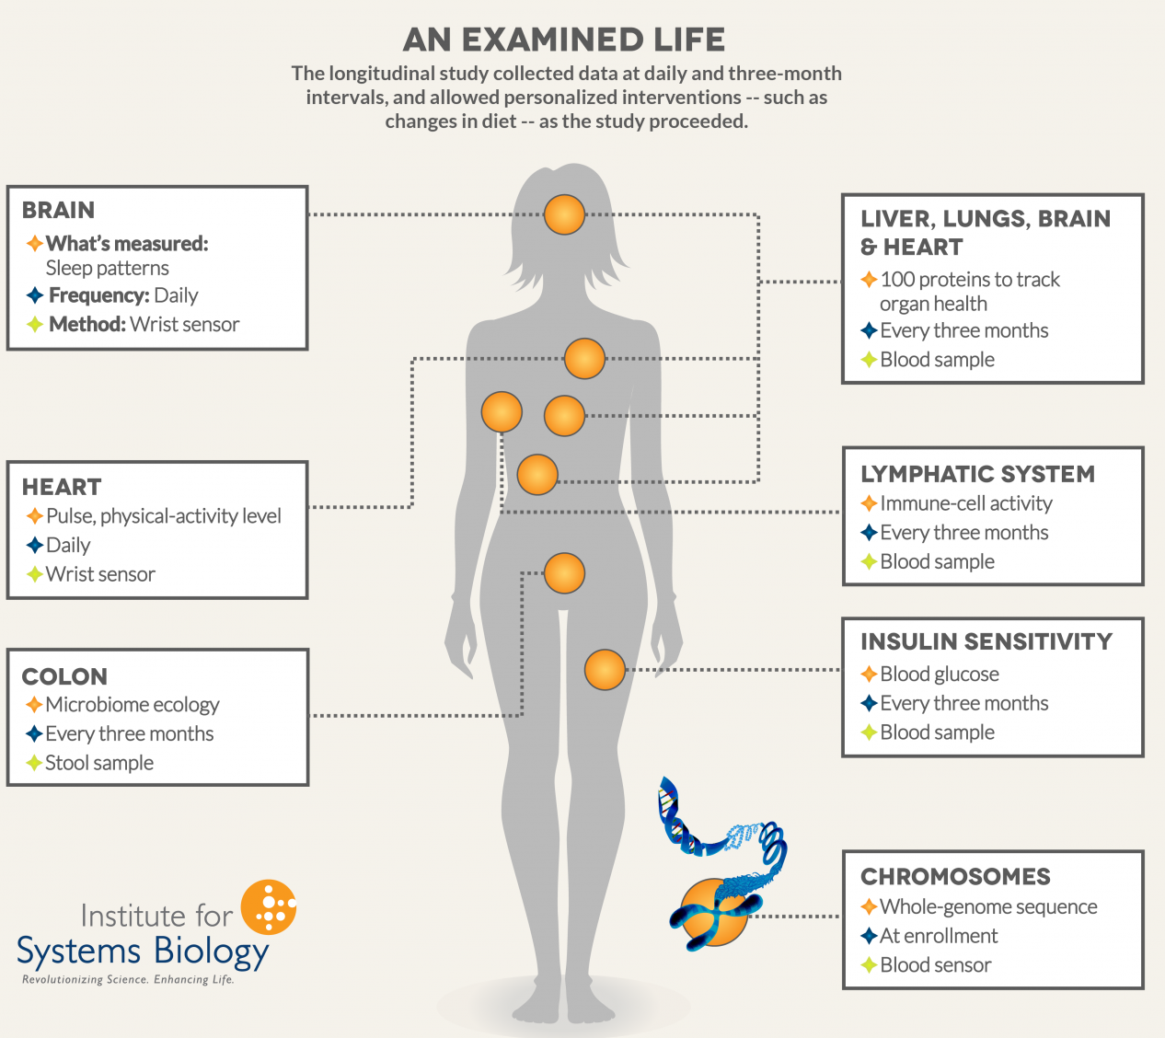
Major Application V: Holistic Personal Genome Characterization, in Normal Individuals
Mental disease & cancer are two extremes with respect to genomics (CEN, 92: 26)
Many other conditions in between, often involving interaction with the environment
Pers. Genome Characterization
Identify mutations in personal genomes (SNPs, SVs, &c)
Estimate phenotypic (deleterious or protective) impact of variants.
Compare one person to wider population.
Track changes over time & consider interaction w/ environment
Transcriptome studies
Longitudinal health studies (e.g. 100K wellness project, Framingham Heart Study)
(Figure from Institute for Systems Biology)

Slide 7
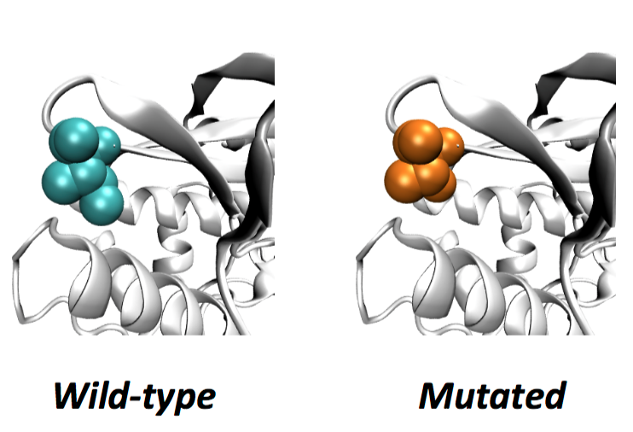
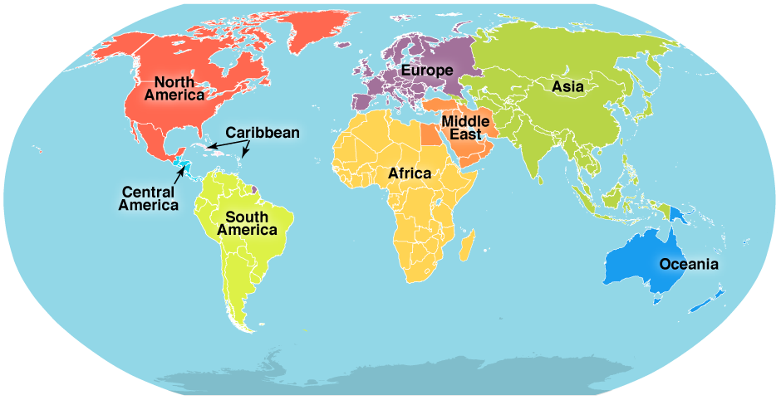
Analyzing Carl Zimmer’s genome
SNV
AAGCT
ACGCT
Protein Structure
Ancestry

Slide 8
Expanding personalized medicine beyond the genome.
An integrated personal omics profile (iPOP) is an example of a more comprehensive version of personalized medicine.
Michael Snyder had his genome sequenced and collected many other large scale datasets over an extended period of time.
https://med.stanford.edu/news/all-news/2017/01/wearable-sensors-can-tell-when-you-are-getting-sick.html

Slide 9
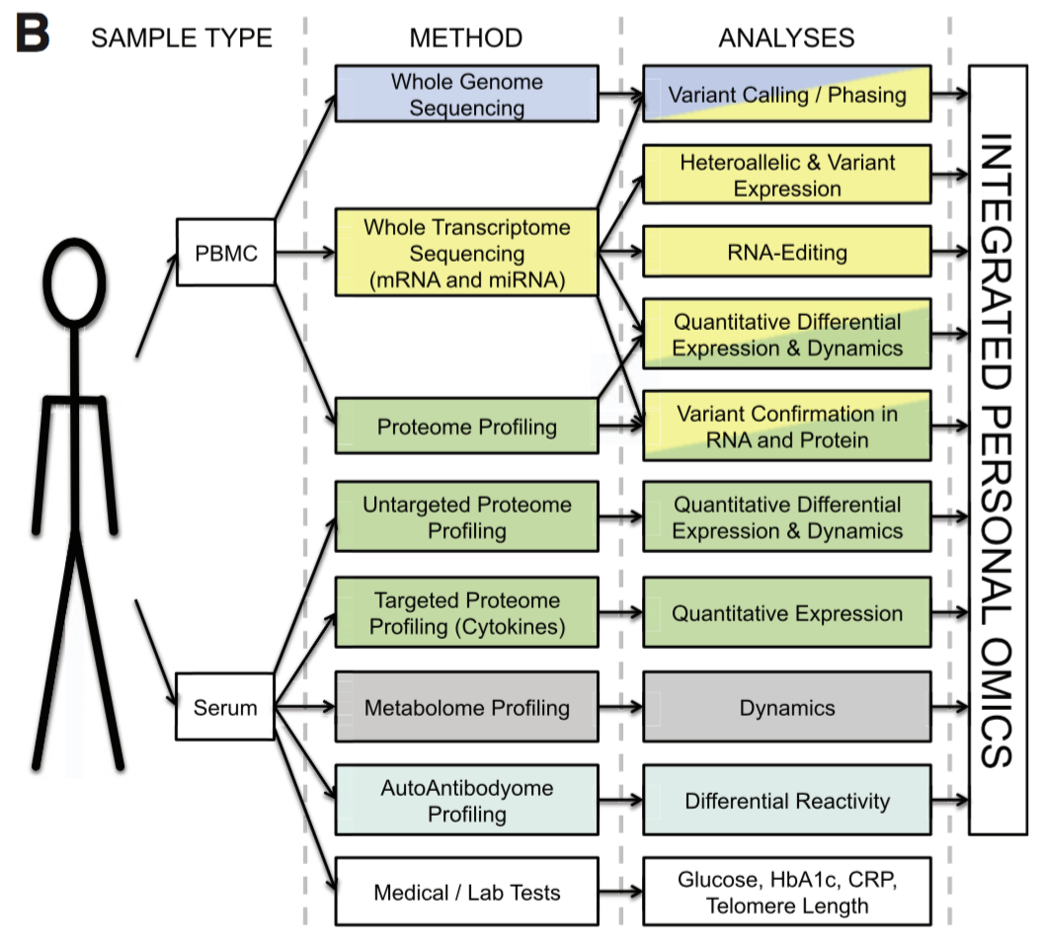
Integrated personal omics profile (iPOP)
Numerous types of data were collected, primarily from blood samples. The datasets include:
Transcriptomic
Proteomic
Metabolomic
Cytokine profiling
Autoantibody profiling
Medical exams
Chen et al. Cell 2012

