Slide 1
Topics in Precision Oncology: Addressing the role of the non-coding genome in cancer
Mark Gerstein
Yale
Slides freely downloadable from Lectures.GersteinLab.org & “tweetable” (via @MarkGerstein). No Conflicts for this Talk. See last slide for more info.

Slide 2
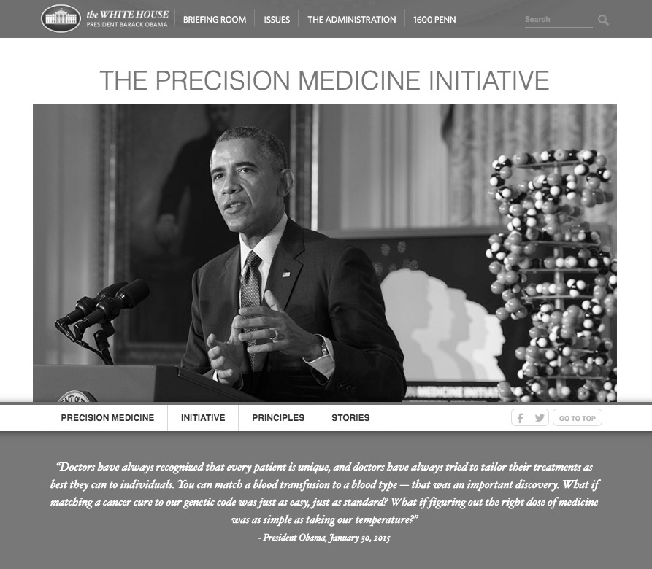
Precision Oncology
Sub-topic of precision medicine
Analysis of the exact somatic mutations in a individual, suggesting individualized treatment
What if matching a cancer cure to our genetic code was just as easy
https://obamawhitehouse.archives.gov/blog/2016/02/25/precision-medicine-health-care-tailored-you

Slide 3
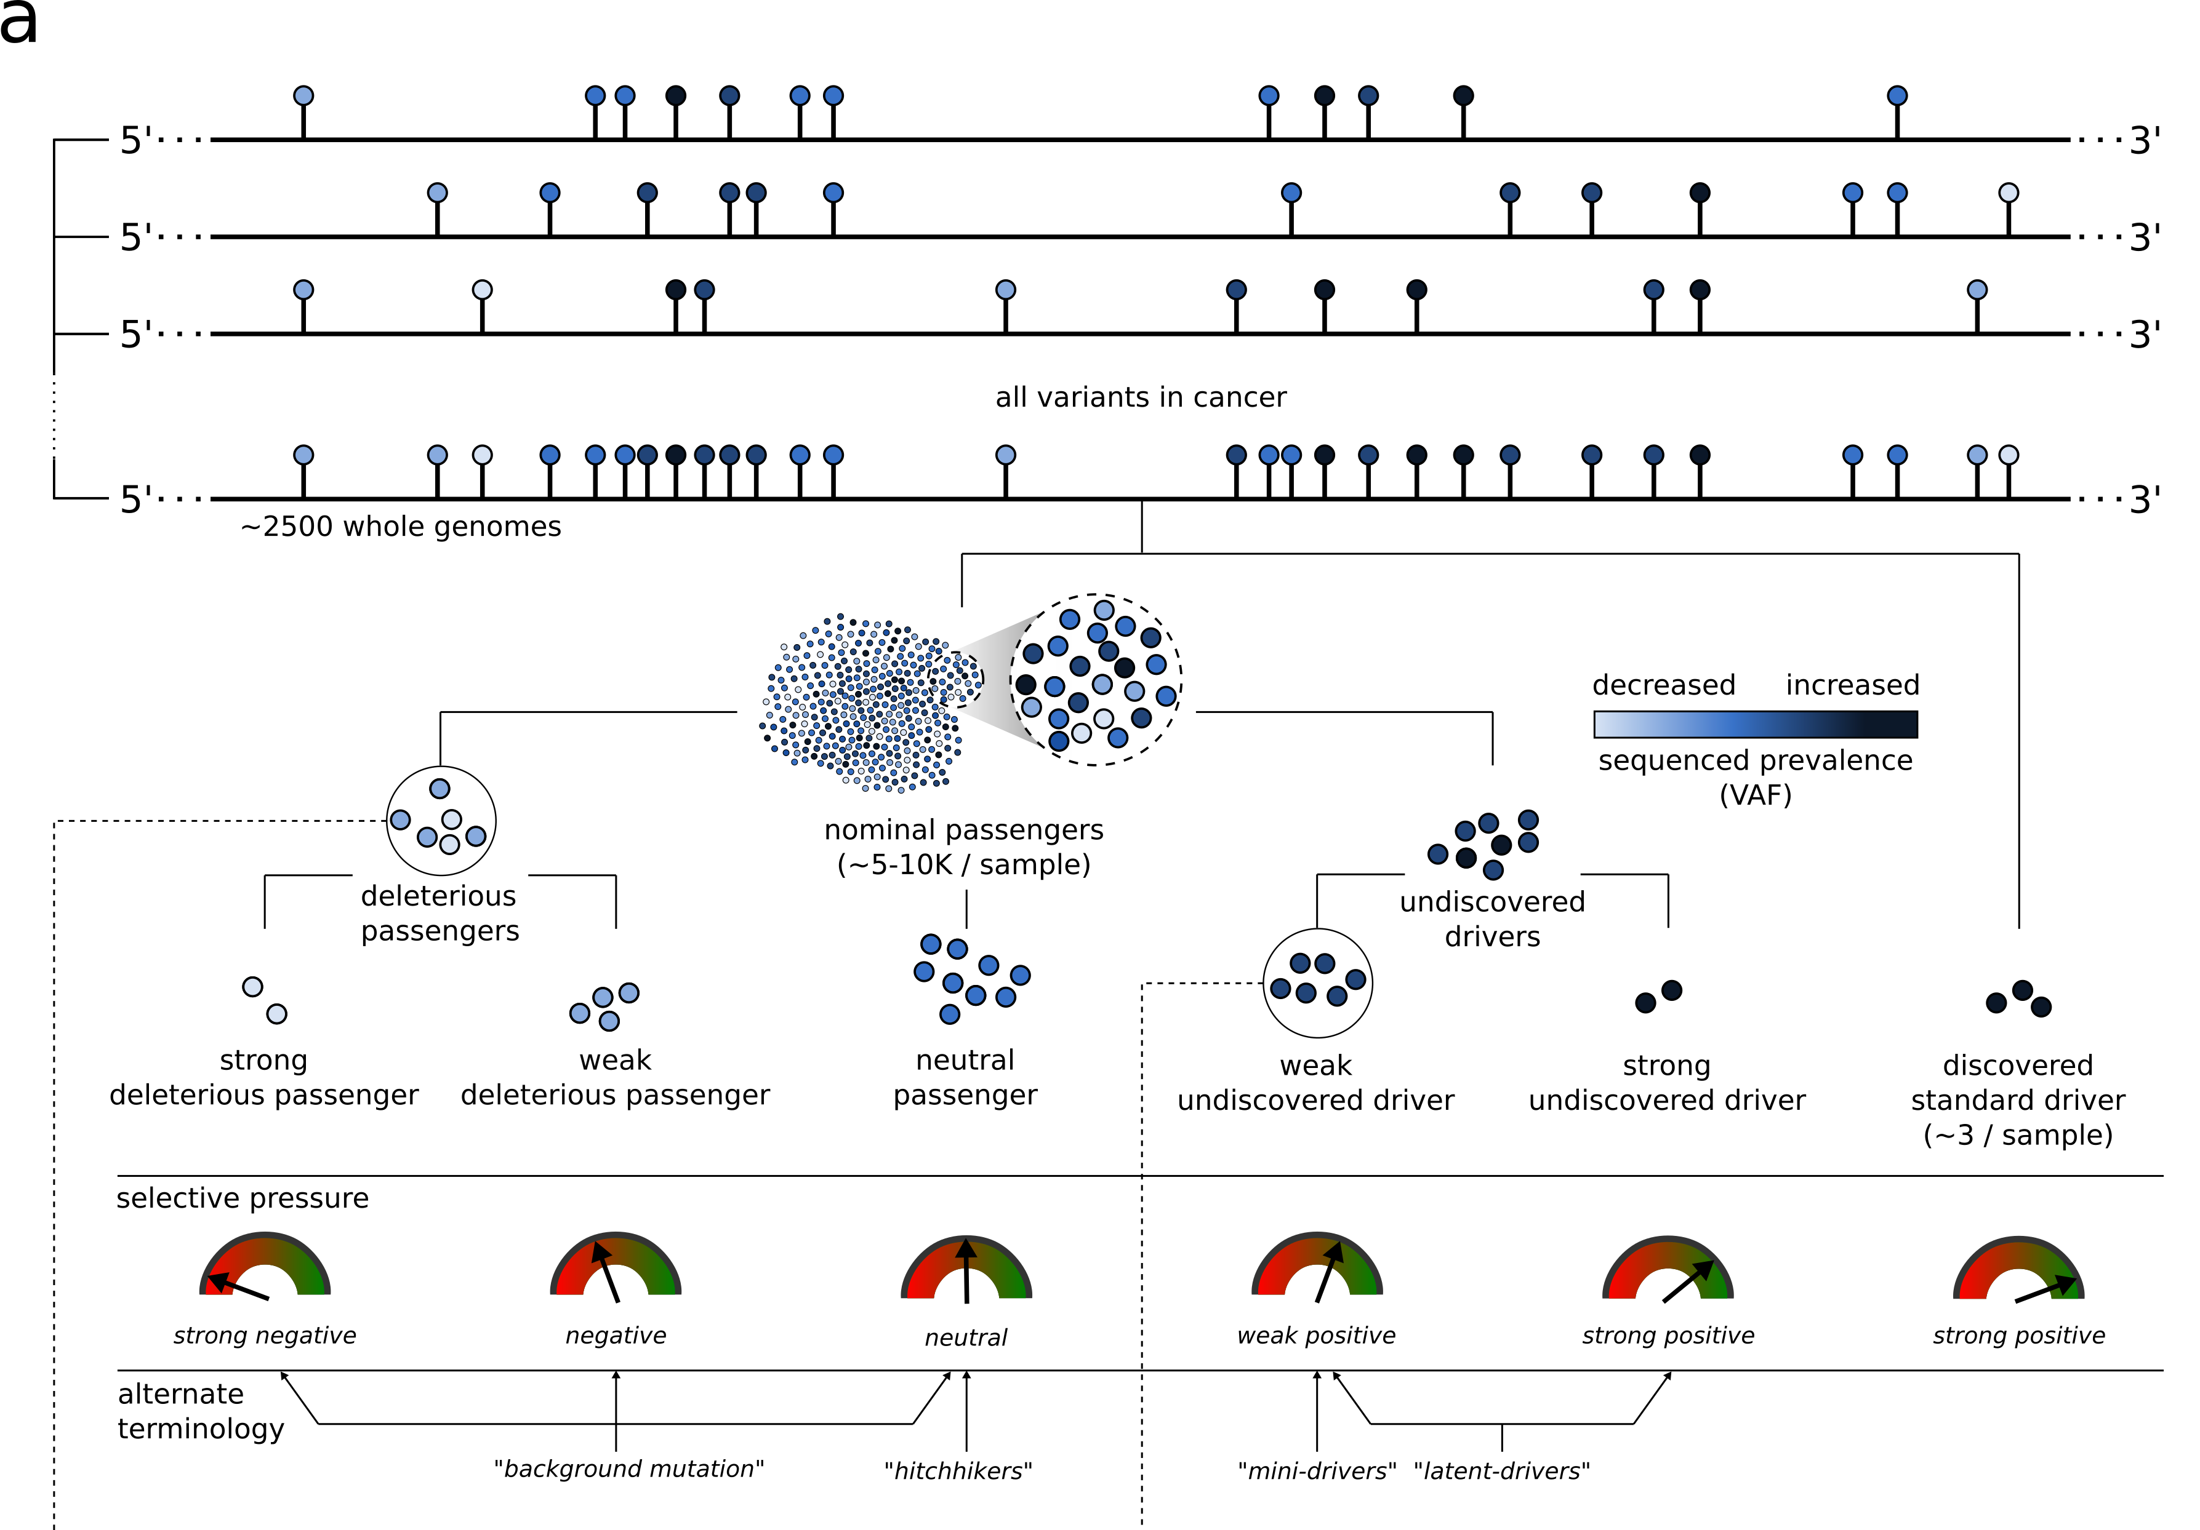
Extension of the canonical model of drivers and passengers
Coding regions are only ~1-2% of the genome yet contain almost all the drivers.
Open Q: what is the role of the non-coding genome in cancer?
[Kumar, Warrell et al. (’20, in press) Cell + biorxiv]

Slide 4
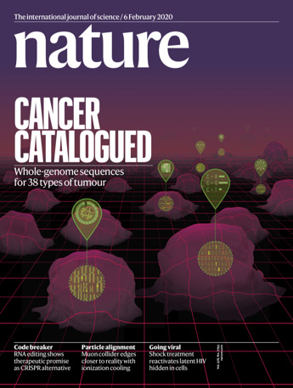
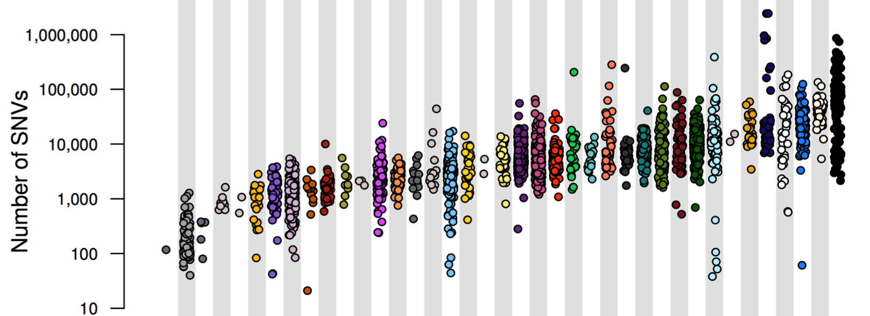
PCAWG : most comprehensive resource for cancer whole genome analysis
Union of TCGA-ICGC efforts
Jointly analyzing ~2800 whole genome tumor/normal pairs
> 580 researchers
~30M total somatic SNVs
Adapted from Campbell et. al., bioRxiv (’17). Now published as Nature 578: 82–93 (2020)

Slide 5
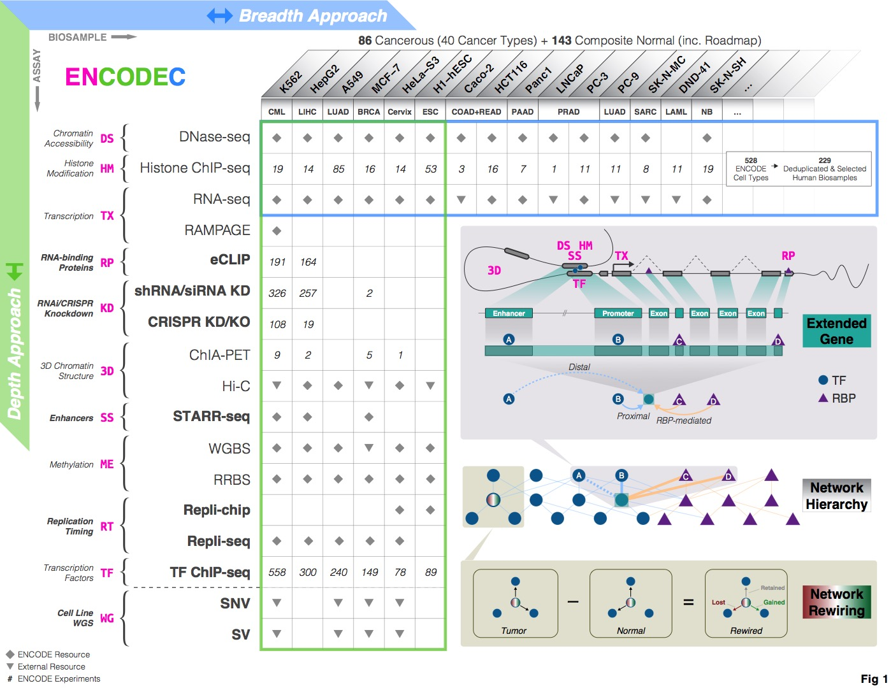
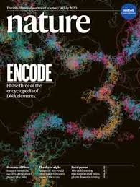
http://encodec.encodeproject.org/
Comprehensive non-coding Annotation
Applicable to cancer genomics
[Zhang et al. (‘20), biorxiv + Nat. Comm. (in press)]

Slide 6
Topics in Precision Oncology: Addressing the role of the non-coding genome in cancer
Background
Drivers v passenger
Coding v noncoding
Pcawg & encode 3
Additive-Effects model to measure the Impact of non-coding v coding mutations
Repurposing a formalism from germline genetics for missing heritability to cancer
Using it to assess the overall Impact of passengers v drivers, non-coding vs coding, distal vs proximal non-coding
Notable effect, particularly for non-coding passengers, in addition to known coding drivers.
Recasting as a predictive model to est. number of weak drivers
Network Rewiring in Cancer
Large-scale ENCODE chip-seq data highlights TFs changing targets greatly in oncogenesis. (Focus on CML)
TopicNet LDA approach (from text-mining) finds regulators that greatly change their gene communities

Slide 7
Topics in Precision Oncology: Addressing the role of the non-coding genome in cancer
Background
Drivers v passenger
Coding v noncoding
Pcawg & encode 3
Additive-Effects model to measure the Impact of non-coding v coding mutations
Repurposing a formalism from germline genetics for missing heritability to cancer
Using it to assess the overall Impact of passengers v drivers, non-coding vs coding, distal vs proximal non-coding
Notable effect, particularly for non-coding passengers, in addition to known coding drivers.
Recasting as a predictive model to est. number of weak drivers
Network Rewiring in Cancer
Large-scale ENCODE chip-seq data highlights TFs changing targets greatly in oncogenesis. (Focus on CML)
TopicNet LDA approach (from text-mining) finds regulators that greatly change their gene communities

Slide 8
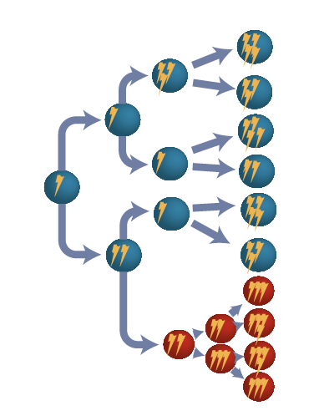
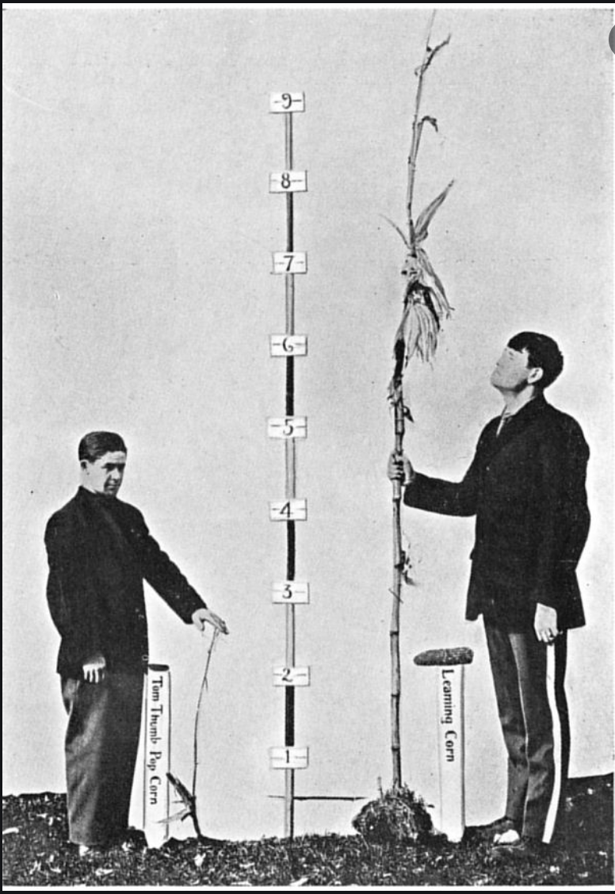
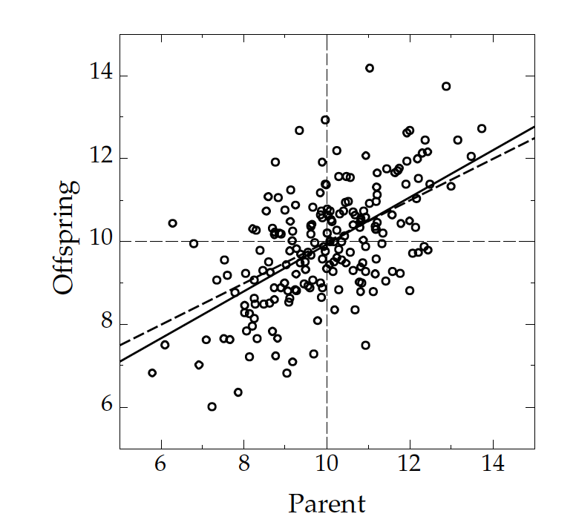
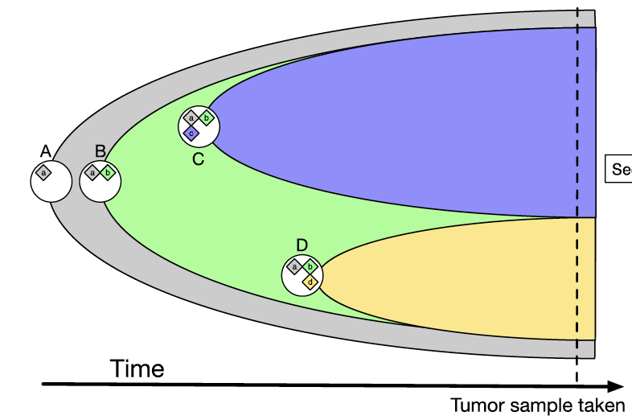
Relating Germline Missing Heritability to Cancer Studies
Population level definitions:
Parent-offspring heritability;
Twin-based heritability …
Subclonal trait in cancer: Growth rate
Organismal trait: Height
$$h^{2}$$
SNP-based polygenic & additive model:
$$Z$$
$$h^{2}=σ_{u}$$
Trait
Covariates & fixed effects
Genetic predictors & random effects
Environmental noise

Slide 9
Missing heritability for height & other traits
Height is a highly polygenic trait:
Many other traits have substantial missing GWAS-based heritability⁵:
SNP category | # SNPs | Heritability estimate (h²) | Year
GWAS SNPs¹ | 50 | ~0.05 | 2008
Common SNPs² | ~295K | 0.54 (SE 0.1) | 2010
Common+rare SNPs³ | 47.1M | 0.79 (SE 0.09) | 2019
Population estimate (twins)⁴ | - | 0.8 | (2012)
SE = standard error
[1] Weedon, M.N., Lango, H., Lindgren, C.M., Wallace, C., Evans, D.M., Mangino, M., Freathy, R.M., Perry, J.R., Stevens, S., Hall, A.S. and Samani, N.J., 2008. Genome-wide association analysis identifies 20 loci that influence adult height. Nature genetics, 40(5), p.575.
[2] Yang, J., Benyamin, B., McEvoy, B.P., Gordon, S., Henders, A.K., Nyholt, D.R., Madden, P.A., Heath, A.C., Martin, N.G., Montgomery, G.W., Goddard, M.E.,…, Visscher, P., 2010. Common SNPs explain a large proportion of the heritability for human height. Nature genetics, 42(7), p.565.
[3] Wainschtein, P., Jain, D.P., Yengo, L., Zheng, Z., Cupples, L.A., Shadyab, A.H., McKnight, B., Shoemaker, B.M., Mitchell, B.D., Psaty, B.M., Kooperberg, C., …, Visscher, P., 2019. Recovery of trait heritability from whole genome sequence data. bioRxiv, p.588020.
[4] Visscher, P.M., Brown, M.A., McCarthy, M.I. and Yang, J., 2012. Five years of GWAS discovery. The American Journal of Human Genetics, 90(1), pp.7-24.
[5] Manolio, T.A., Collins, F.S., Cox, N.J., Goldstein, D.B., Hindorff, L.A., Hunter, D.J., McCarthy, M.I., Ramos, E.M., Cardon, L.R., Chakravarti, A., Cho, J.H., and Visscher, P., 2009. Finding the missing heritability of complex diseases. Nature, 461(7265), p.747.

Slide 10
Additive effects model to quantify cumulative effect of nominal passengers in PCAWG
Model for the effect of an individual SNP on a phenotype
Extension to model the combined effects of multiple SNPs
[Kumar, Warrell et al. (’20, in press) Cell + biorxiv]
$$y_{j}=μ+z_{ij}u_{i}+e_{j}$$
$$u∼N(0,σ_{u}^{2}I)$$

Slide 11
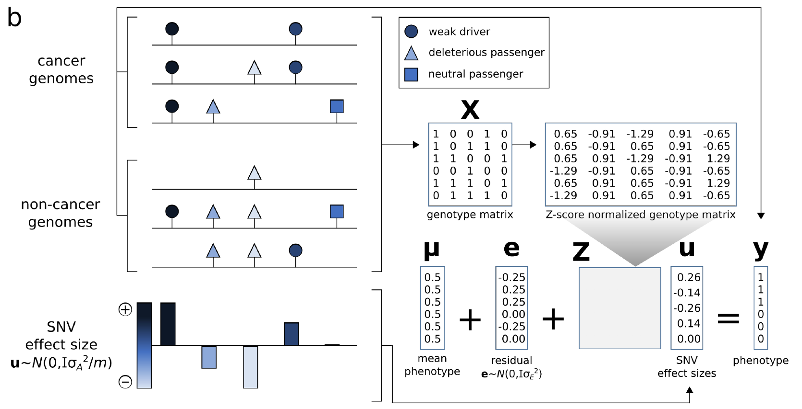
Using additive effects to compare different categories of variants
[Kumar, Warrell et al. (’20, in press) Cell + biorxiv]
$$u∼N(0,σ_{u}^{2}I)$$
Variant categories:
$k=1$: coding drivers
$k=2$: coding other
$k=3$: promoters
$k=4$: other non-coding
Model:
Parameters:

Slide 12
Overall additive variance increase for multiple cancer cohorts in PCAWG with the inclusion of passengers
Increase in the variance from ~50% using drivers alone to ~59% with putative passengers included, averaged across all cohorts.
[Kumar, Warrell et al. (’20, in press) Cell + biorxiv]

Slide 13
Element level additive variance for multiple cancer cohorts in PCAWG, comparing coding & non-coding
In addition to coding mutations, promoter & other non-coding mutations contributed significant amounts of extra variance (~2% & 7%) .
[Kumar, Warrell et al. (’20, in press) Cell + biorxiv]

Slide 14
Recasting the additive effects model in a predictive context: Best Linear Unbiased Predictor (BLUP) analysis
All SNPs
[Kumar, Warrell et al. (’20, in press) Cell + biorxiv]
95% CI
Additive variance
Cummulative
SNVs added
SNVs, ordered by descending BLUP ($\hat{u}$):
BLUP predictor:
$$\hat{u}=argmax_{u}\left(P\left(u | y,σ_{u}^{2}\right)\right)$$
…
$$=argmax_{u}\left(P\left(y | u\right)P(u|σ_{u}^{2})\right)$$
Lower bound on # weak drivers (8.4 pan-cancer average; enriched for PCAWG genes w/ FDR<0.25)

Slide 15
Topics in Precision Oncology: Addressing the role of the non-coding genome in cancer
Background
Drivers v passenger
Coding v noncoding
Pcawg & encode 3
Additive-Effects model to measure the Impact of non-coding v coding mutations
Repurposing a formalism from germline genetics for missing heritability to cancer
Using it to assess the overall Impact of passengers v drivers, non-coding vs coding, distal vs proximal non-coding
Notable effect, particularly for non-coding passengers, in addition to known coding drivers.
Recasting as a predictive model to est. number of weak drivers
Network Rewiring in Cancer
Large-scale ENCODE chip-seq data highlights TFs changing targets greatly in oncogenesis. (Focus on CML)
TopicNet LDA approach (from text-mining) finds regulators that greatly change their gene communities

Slide 16
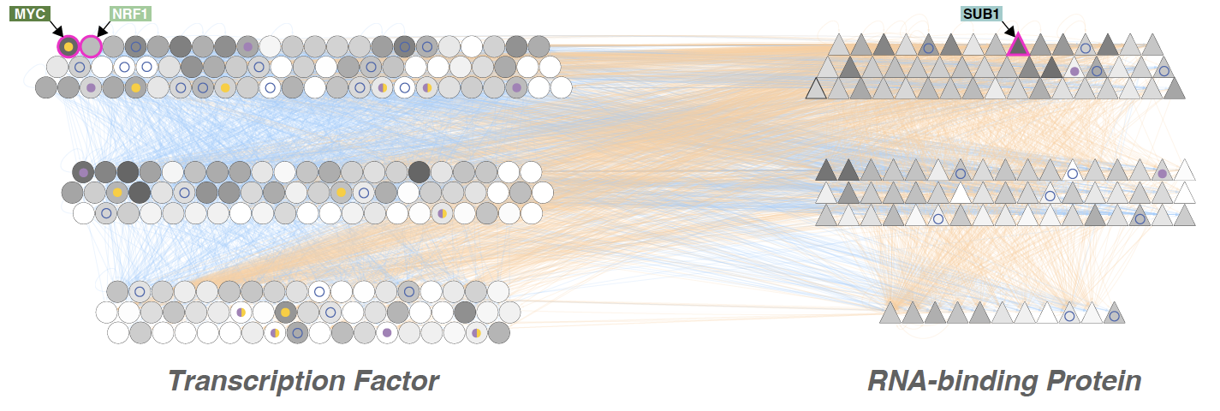
Regulatory Network Construction
[Zhang et al. ('20), Nat. Comm. + biorxiv]

Slide 17
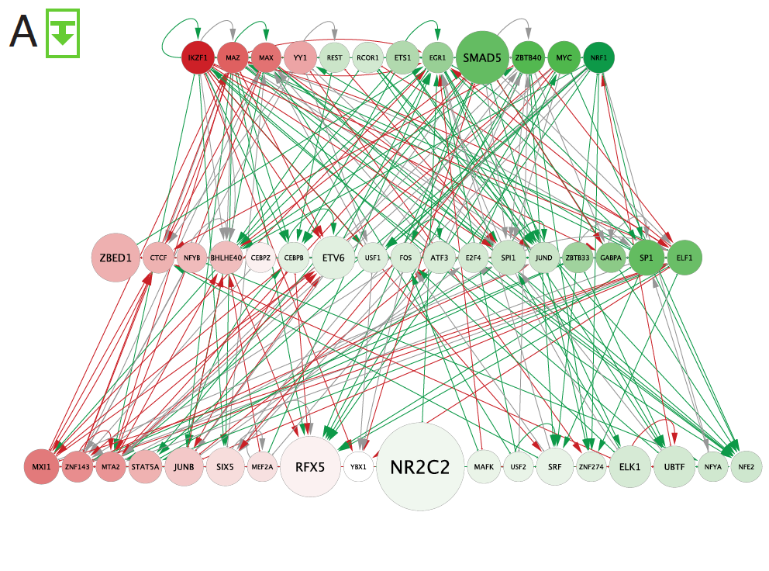
Rewired edges in
comparison of GM12878 to K562 109 node TF-TF network
(approx. CML)
[Zhang et al. (‘20), biorxiv + Nat. Comm. (in press)]

Slide 18
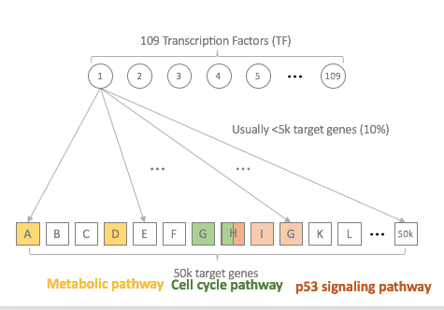
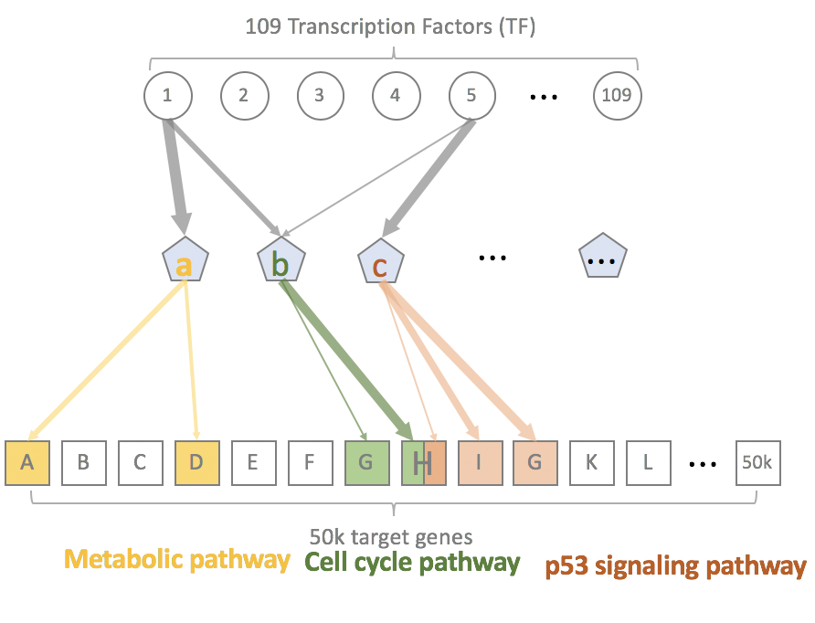
Simplifying Network Rewiring
From $TF→gene (109×50,000)$
to $TF→pathway (109×50)$
[Zhang et al. (‘20), biorxiv + Nat. Comm. (in press)]

Slide 19
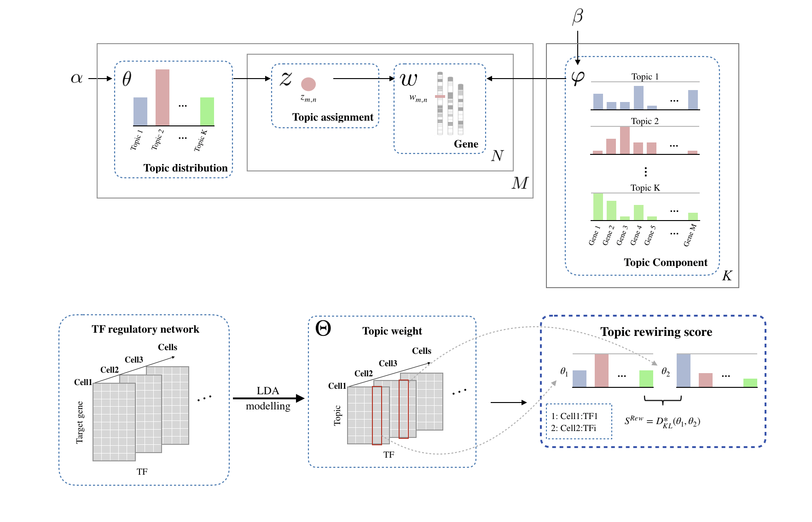
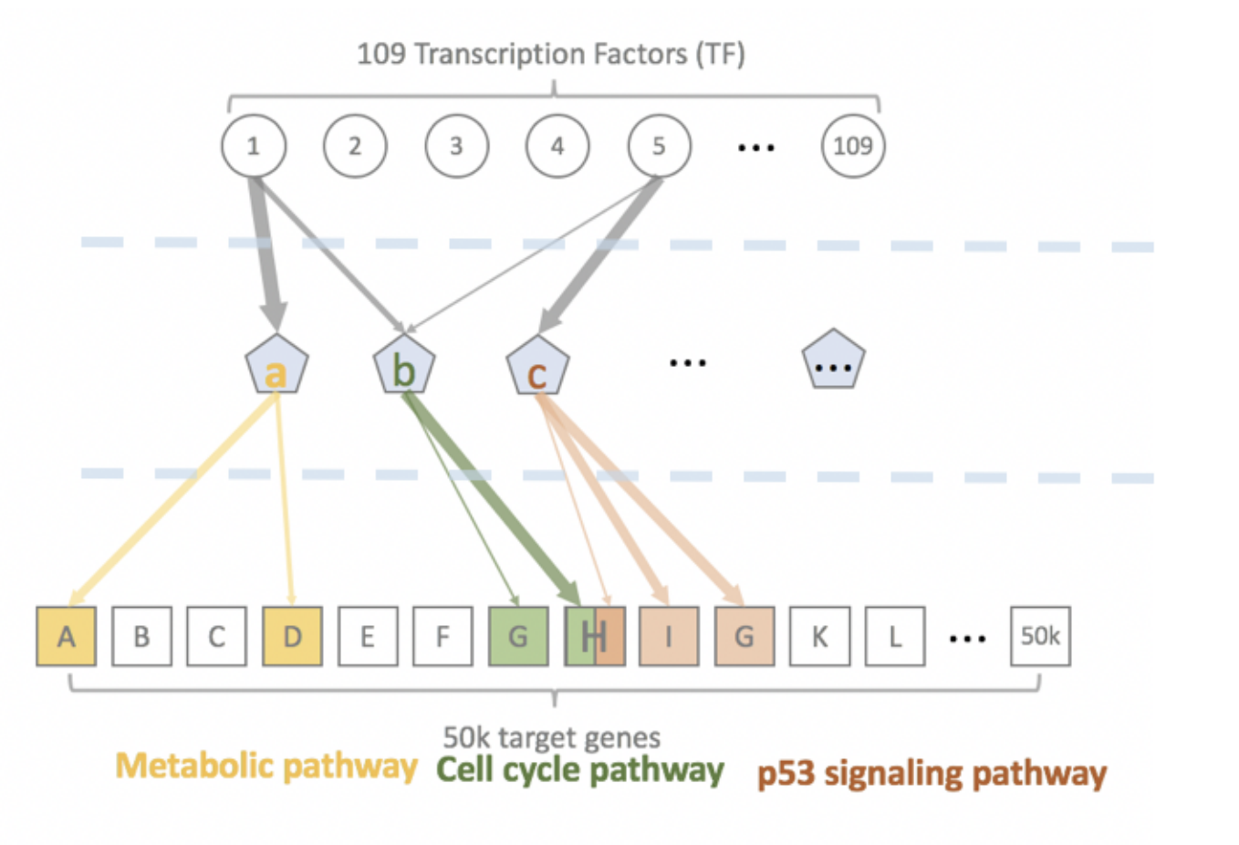
TopicNet: Measuring transcriptional regulatory network change using LDA
Documents
Topics
Words
[Lou et al. bioxriv + Bioinformatics (’20)]

Slide 20
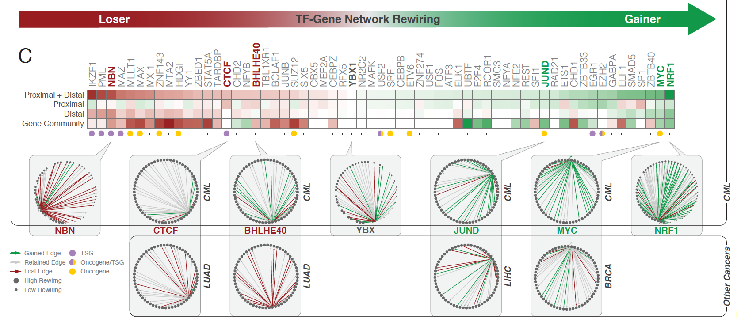
[Zhang et al. (‘20), biorxiv + Nat. Comm. (in press)]
[Zhang et al. ('19), biorxiv.org] Lectures.gersteinlab.org

Slide 21
Topics in Precision Oncology: Addressing the role of the non-coding genome in cancer
Background
Drivers v passenger
Coding v noncoding
Pcawg & encode 3
Additive-Effects model to measure the Impact of non-coding v coding mutations
Repurposing a formalism from germline genetics for missing heritability to cancer
Using it to assess the overall Impact of passengers v drivers, non-coding vs coding, distal vs proximal non-coding
Notable effect, particularly for non-coding passengers, in addition to known coding drivers.
Recasting as a predictive model to est. number of weak drivers
Network Rewiring in Cancer
Large-scale ENCODE chip-seq data highlights TFs changing targets greatly in oncogenesis. (Focus on CML)
TopicNet LDA approach (from text-mining) finds regulators that greatly change their gene communities

Slide 22
Topics in Precision Oncology: Addressing the role of the non-coding genome in cancer
Background
Drivers v passenger
Coding v noncoding
Pcawg & encode 3
Additive-Effects model to measure the Impact of non-coding v coding mutations
Repurposing a formalism from germline genetics for missing heritability to cancer
Using it to assess the overall Impact of passengers v drivers, non-coding vs coding, distal vs proximal non-coding
Notable effect, particularly for non-coding passengers, in addition to known coding drivers.
Recasting as a predictive model to est. number of weak drivers
Network Rewiring in Cancer
Large-scale ENCODE chip-seq data highlights TFs changing targets greatly in oncogenesis. (Focus on CML)
TopicNet LDA approach (from text-mining) finds regulators that greatly change their gene communities

Slide 23
PCAWG.gersteinlab.org S Kumar, J Warrell, S Li, P McGillivray, W Meyerson, L Salichos, A Harmanci, A Martinez-Fundichely, C Chan, M Nielsen, L Lochovsky, Y Zhang, X Li, S Lou, J Skou Pedersen, C H, G Getz, E Khurana
ENCODEC.gersteinlab.org
J Zhang, D Lee, V Dhiman, P Jiang, J Xu, P McGillivray…. S Liu, K White
github.com/gersteinlab/TopicNet
S Lou, T Li, X Kong, J Zhang, J Liu, D Li
Acknowledgments! Also, Hiring: See Jobs.gersteinlab.org

Slide 25
Info about this talk
No Conflicts
Unless explicitly listed here. There are no conflicts of interest relevant to the material in this talk
General PERMISSIONS
This Presentation is copyright Mark Gerstein, Yale University, 2019.
Please read permissions statement at sites.gersteinlab.org/Permissions
Basically, feel free to use slides & images in the talk with PROPER acknowledgement (via citation to relevant papers or website link). Paper references in the talk were mostly from Papers.GersteinLab.org.
PHOTOS & IMAGES
For thoughts on the source and permissions of many of the photos and clipped images in this presentation see streams.gerstein.info . In particular, many of the images have particular EXIF tags, such as kwpotppt , that can be easily queried from flickr, viz: flickr.com/photos/mbgmbg/tags/kwpotppt

