Slide 1
Evaluation of
“near-coding” elements: uORFs & RBP sites
M Gerstein
(Gencode call)

Slide 2
Coding v Non-coding
Coding
  Easily interpretable, particularly related to structure
  Available in large quantities
  Exomes have the current potential for great scale (Scale of EXAC, >60K exomes [Lek et al. ‘16])
Non-coding
  Not as interpretable & hard to connect to genes
“Near coding”
  Bits of non-coding, close to genes & readily linked to them
  EX: Splice sites, promotors, uORF

Slide 3
Evaluation of “near-coding” elements
  uORFs:
  Feature integration to find small subset of upstream mutations that potentially alter translation
  RADAR:
  prioritize variants based on post-transcriptional regulome using ENCODE eCLIP

Slide 4
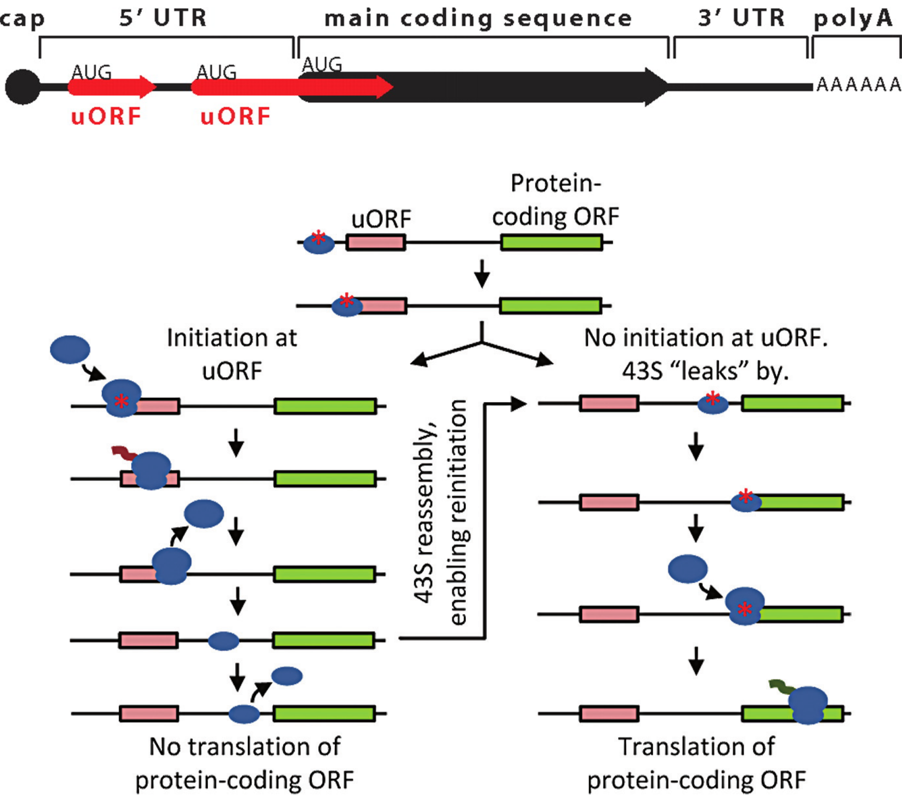
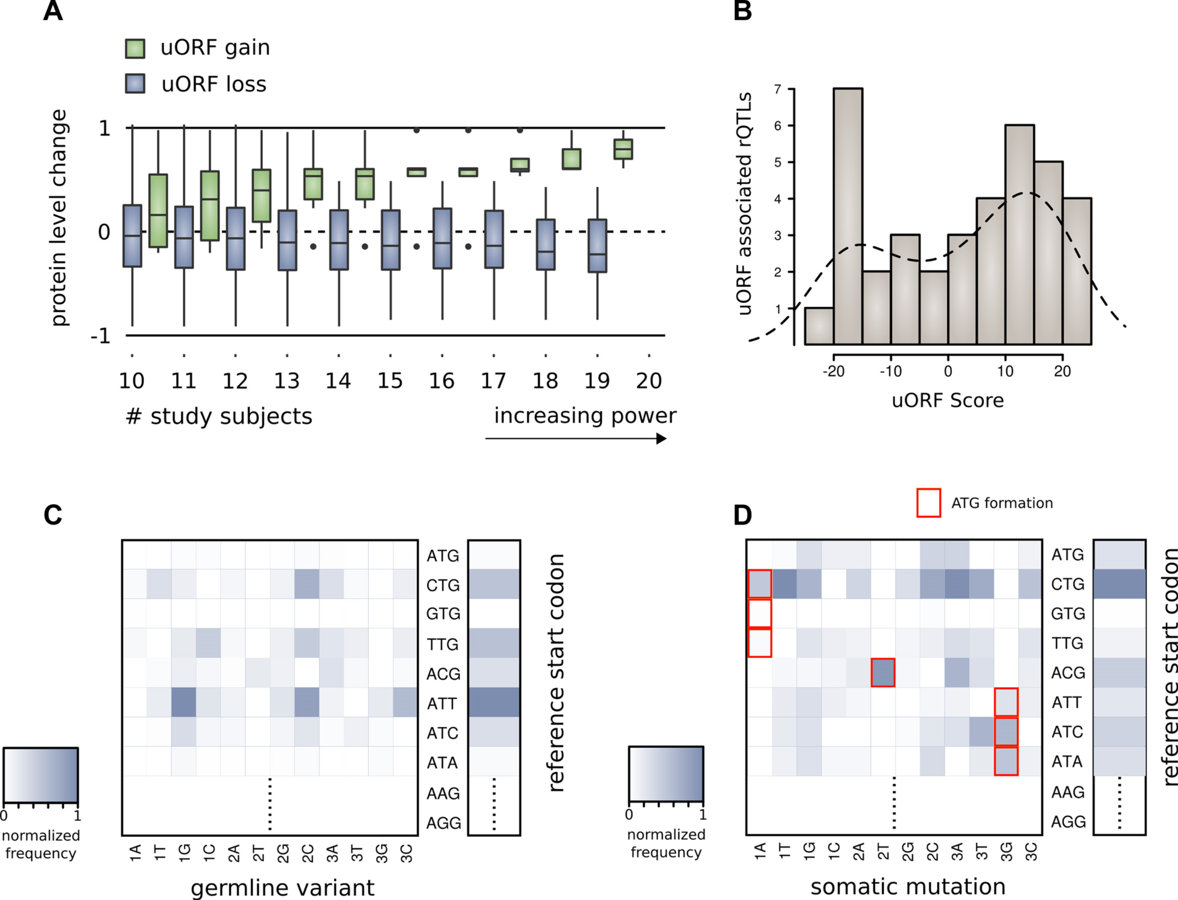
Upstream open reading frames (uORFs) regulate translation are affected by mutation
uORFs regulate the translation of downstream coding regions.
This regulation may be altered by somatic mutation in cancer.
In Battle et al. 2014 data uORF gain & loss assoc. protein level change.
[Calvo et al., PNAS (‘09)]
[Ferreira et al., Bioengineered (‘14)]

Slide 5
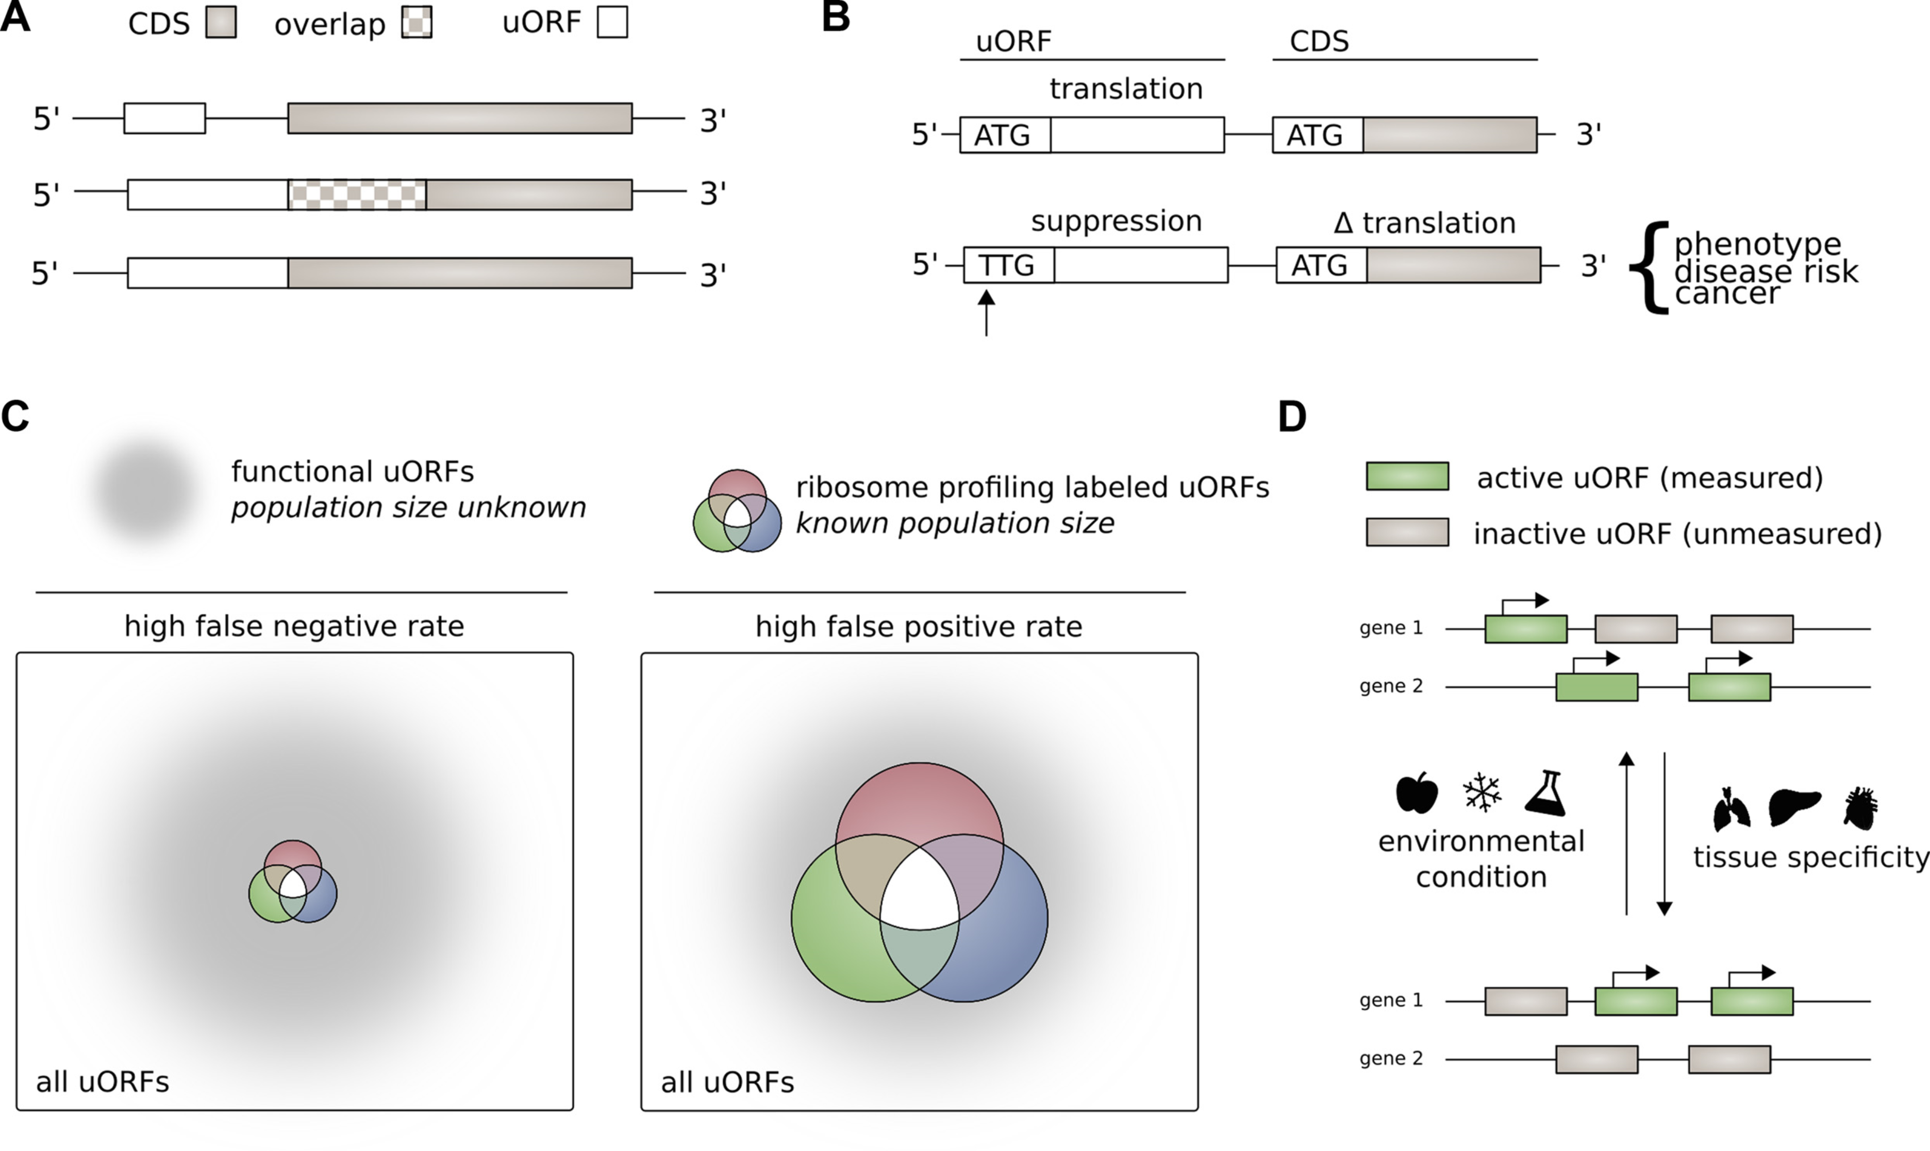
Upstream open reading frames (uORFs) regulate translation are affected by mutation
uORFs regulate the translation of downstream coding regions.
This regulation may be altered by somatic mutation in cancer.
In Battle et al. 2014 data uORF gain & loss assoc. protein level change.
[McGillivray et al., NAR (‘18)]

Slide 6
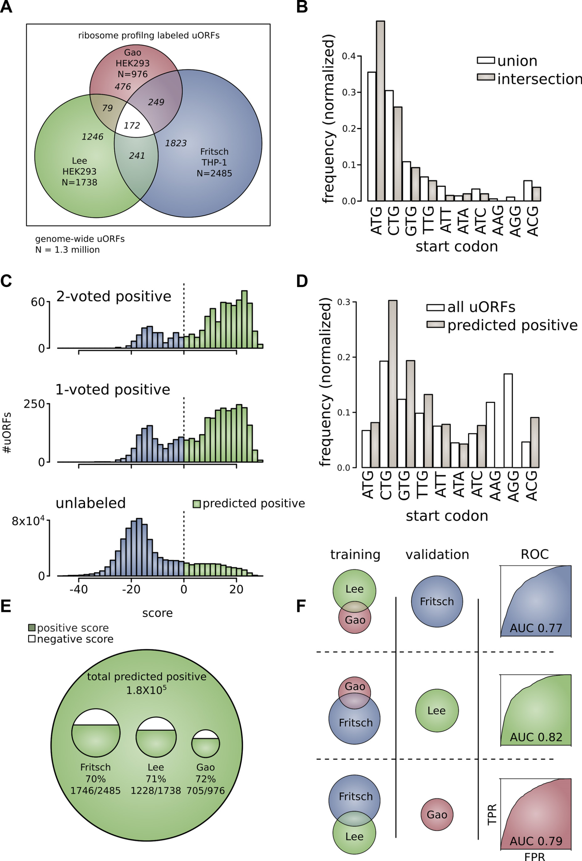
The population of functional uORFs may be significant
From a “Universe” of 1.3 M pot. uORFs
Ribosome profiling experiments have low overlap in identified uORFs.
This suggests high false-negative rate, and more functional uORFs than currently known.
[McGillivray et al., NAR (‘18)]

Slide 7
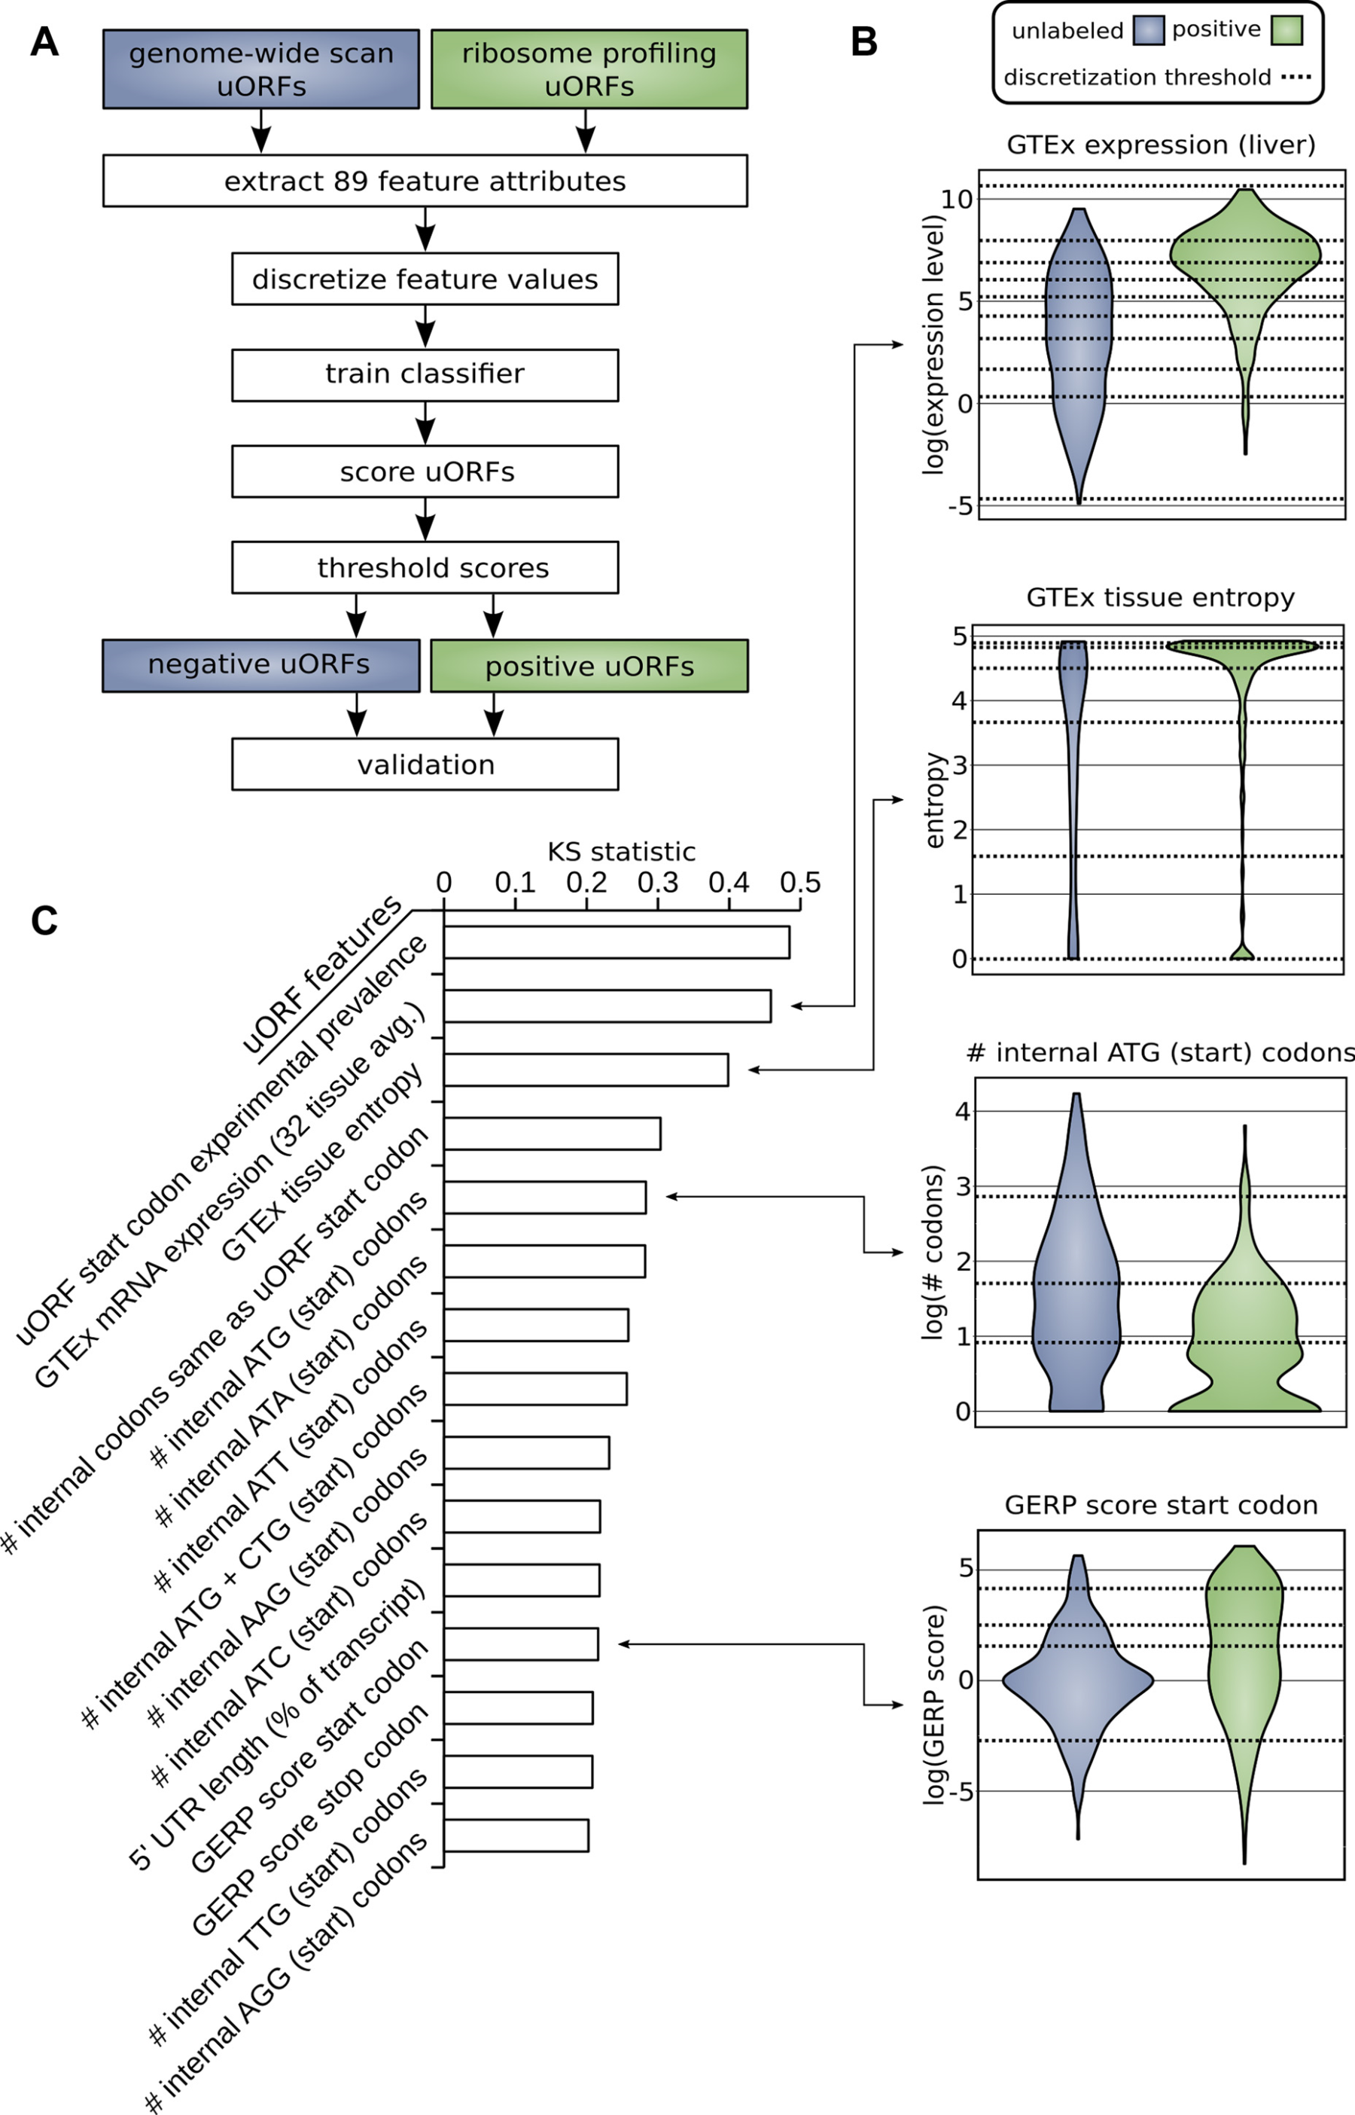
Prediction & validation of functional uORFs using 89 features
Expr.
Level
All near-cognate start codons predicted.
Cross-validation on independent ribosome profiling datasets and validation using in vivo protein levels and ribosome occupancy in humans (Battle et al. 2014).
Tissue
Dist.
Int.
ATG
Start
Cons-
ervation
[McGillivray et al., NAR (‘18)]

Slide 8
A comprehensive catalog of functional uORFs
Universe of 1.3M uORFs scored via Simple Bayes algo.
180K: Large predicted positive set likely to affect translation
Calibration on gold standards, suggests getting ~70% of known
Predicted functional uORFs may be intersected with disease associated variants.
[McGillivray et al., NAR (‘18)]

Slide 9
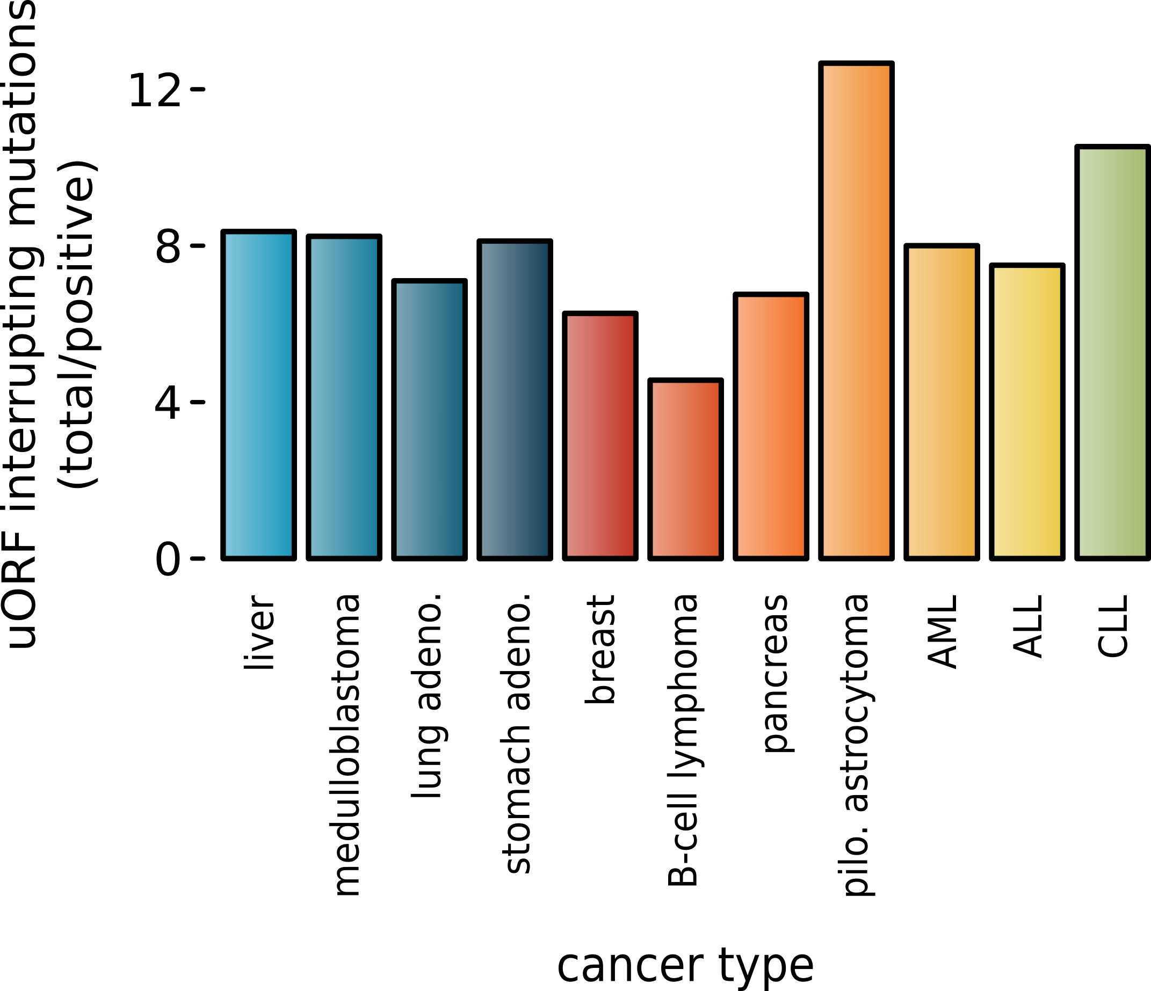
Somatic alteration of uORFs disproportionately affects certain cancers and molecular pathways
uORF gain and loss occurs in cancer (incl. in cancer associated genes, e.g., MYC, BCL2, etc.).
Alteration of translation may contribute to cancer.
These changes are concentrated in certain cancers and pathways.
Mutations leading to uORFs diff in somatic vs. germline.
[McGillivray et al., NAR (‘18)]

Slide 10
Evaluation of “near-coding” elements
  uORFs:
  Feature integration to find small subset of upstream mutations that potentially alter translation
  RADAR:
  prioritize variants based on post-transcriptional regulome using ENCODE eCLIP

Slide 11
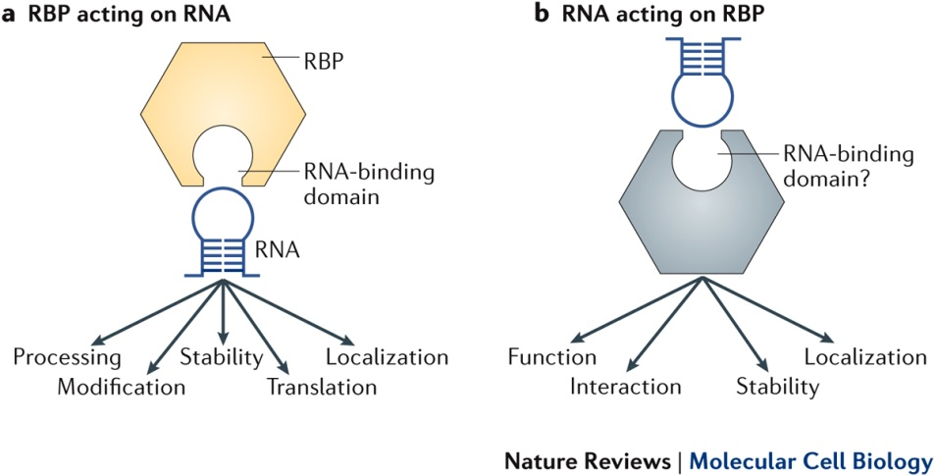
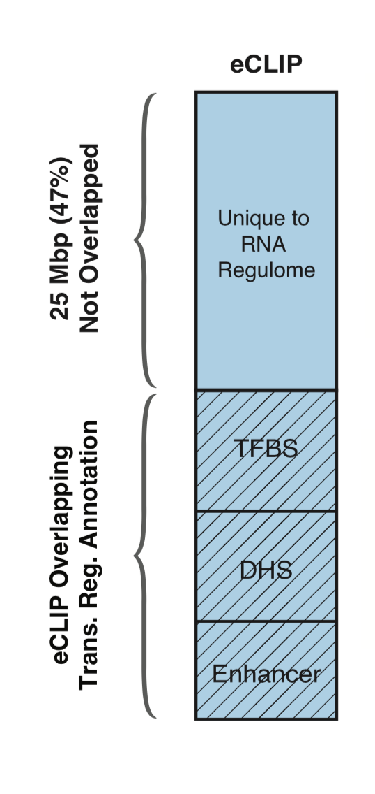
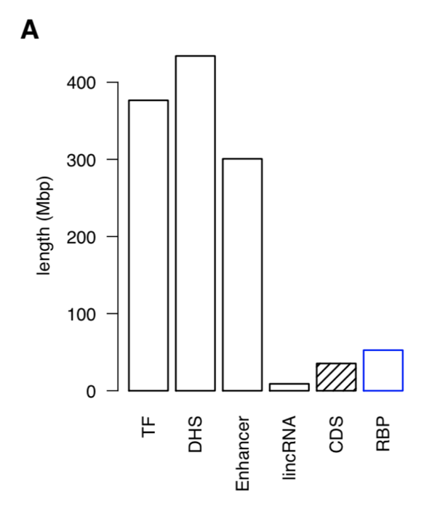
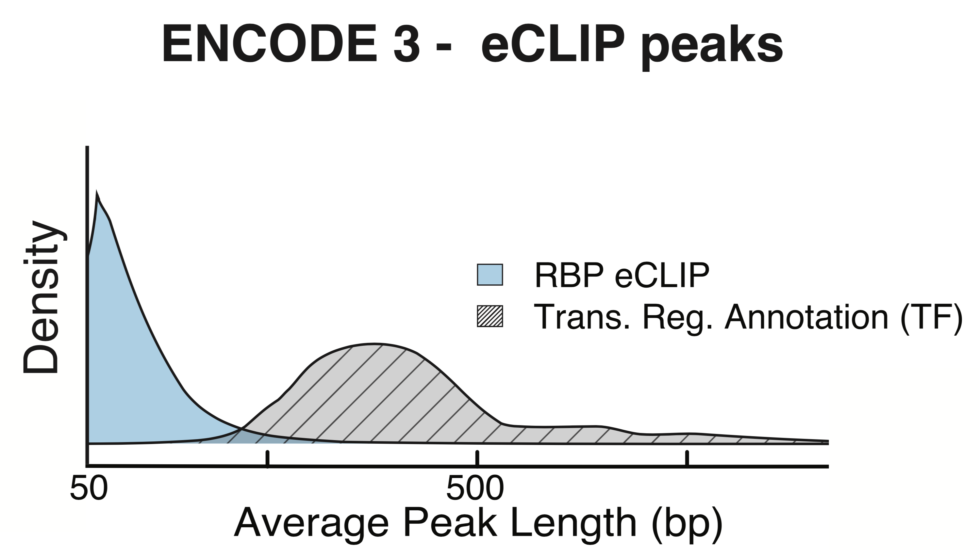
RNA Binding Proteins (RBPs)
Before ENCODE3: >150 expt.
in many different cell types
ENCODE3 did ~350 focused eCLIP expt. for >110 RBPs on HepG2 & K562
(Van Nostrand...Yeo. Nat. Meth. '16;
Van Nostrand...Graveley, Yeo
(submitted in relation to ENCODE3))
Nat Rev Mol Cell Biol. 2018 May;19(5):327-341. doi: 10.1038/nrm.2017.130. Epub 2018 Jan 17.
[Zhang*, Liu* et al., Genome Biology (in review ‘18)]

Slide 12
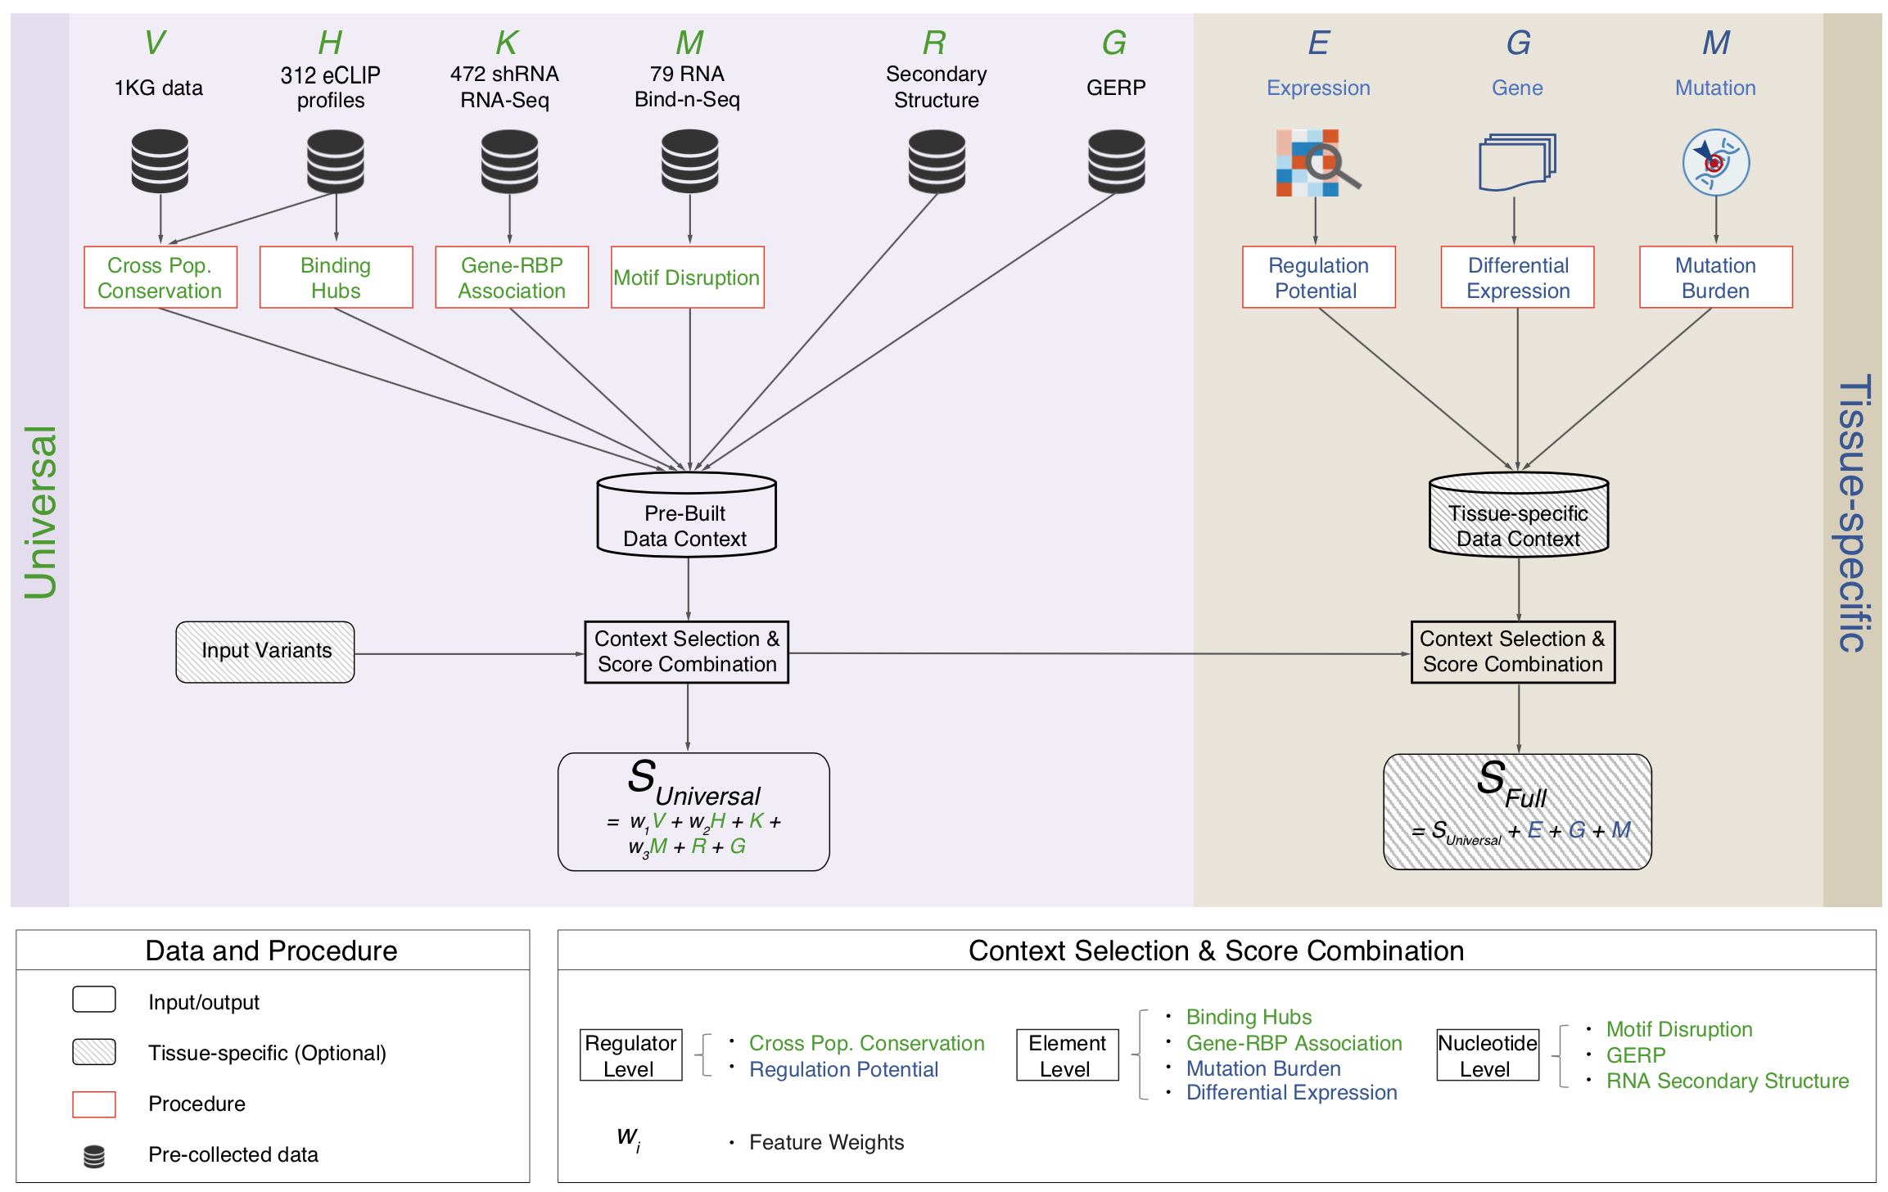
Schematic of RADAR Scoring
[Zhang*, Liu* et al., Genome Biology (in review ‘18)]

Slide 13
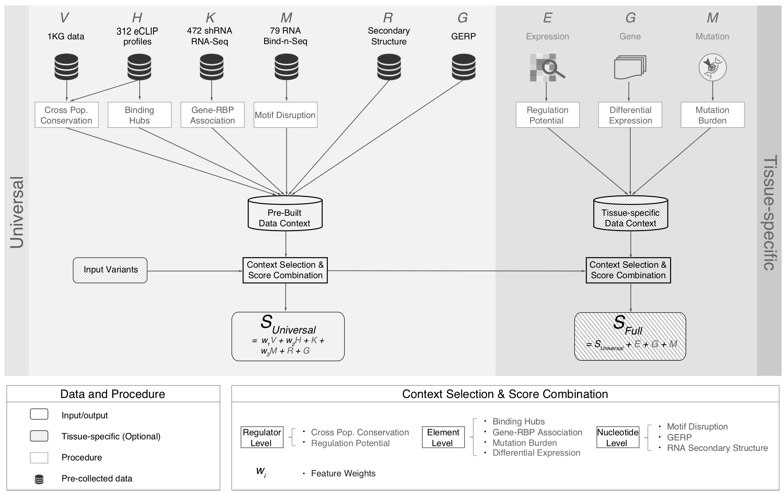
[Zhang*, Liu* et al., Genome Biology (in review ‘18)]

Slide 14
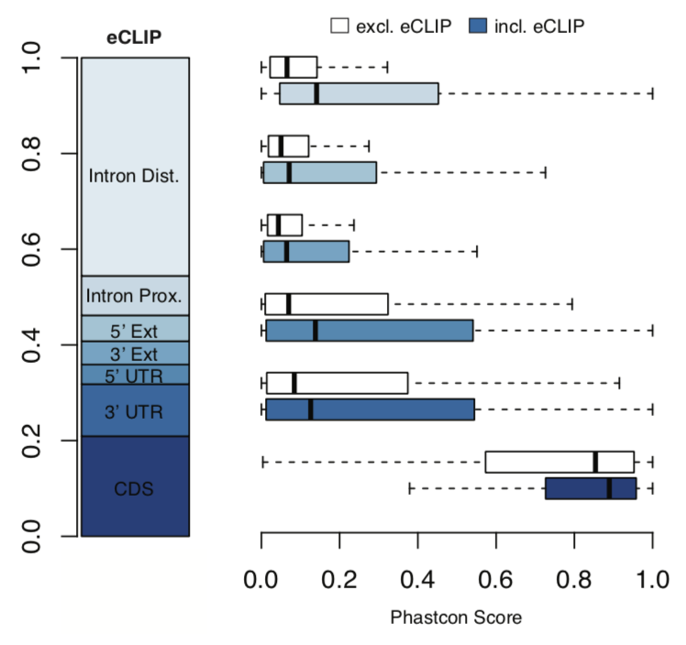
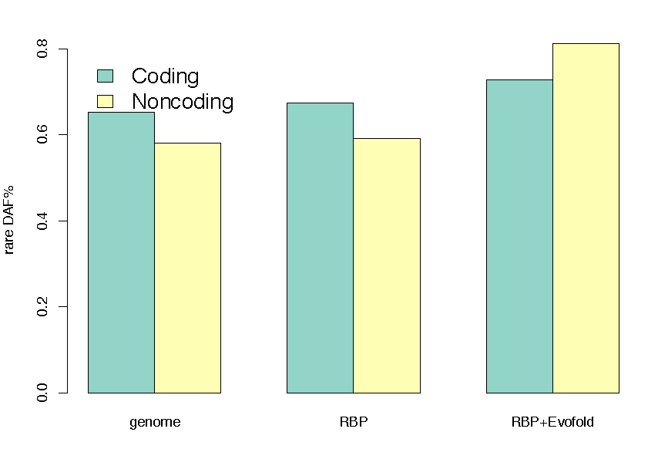
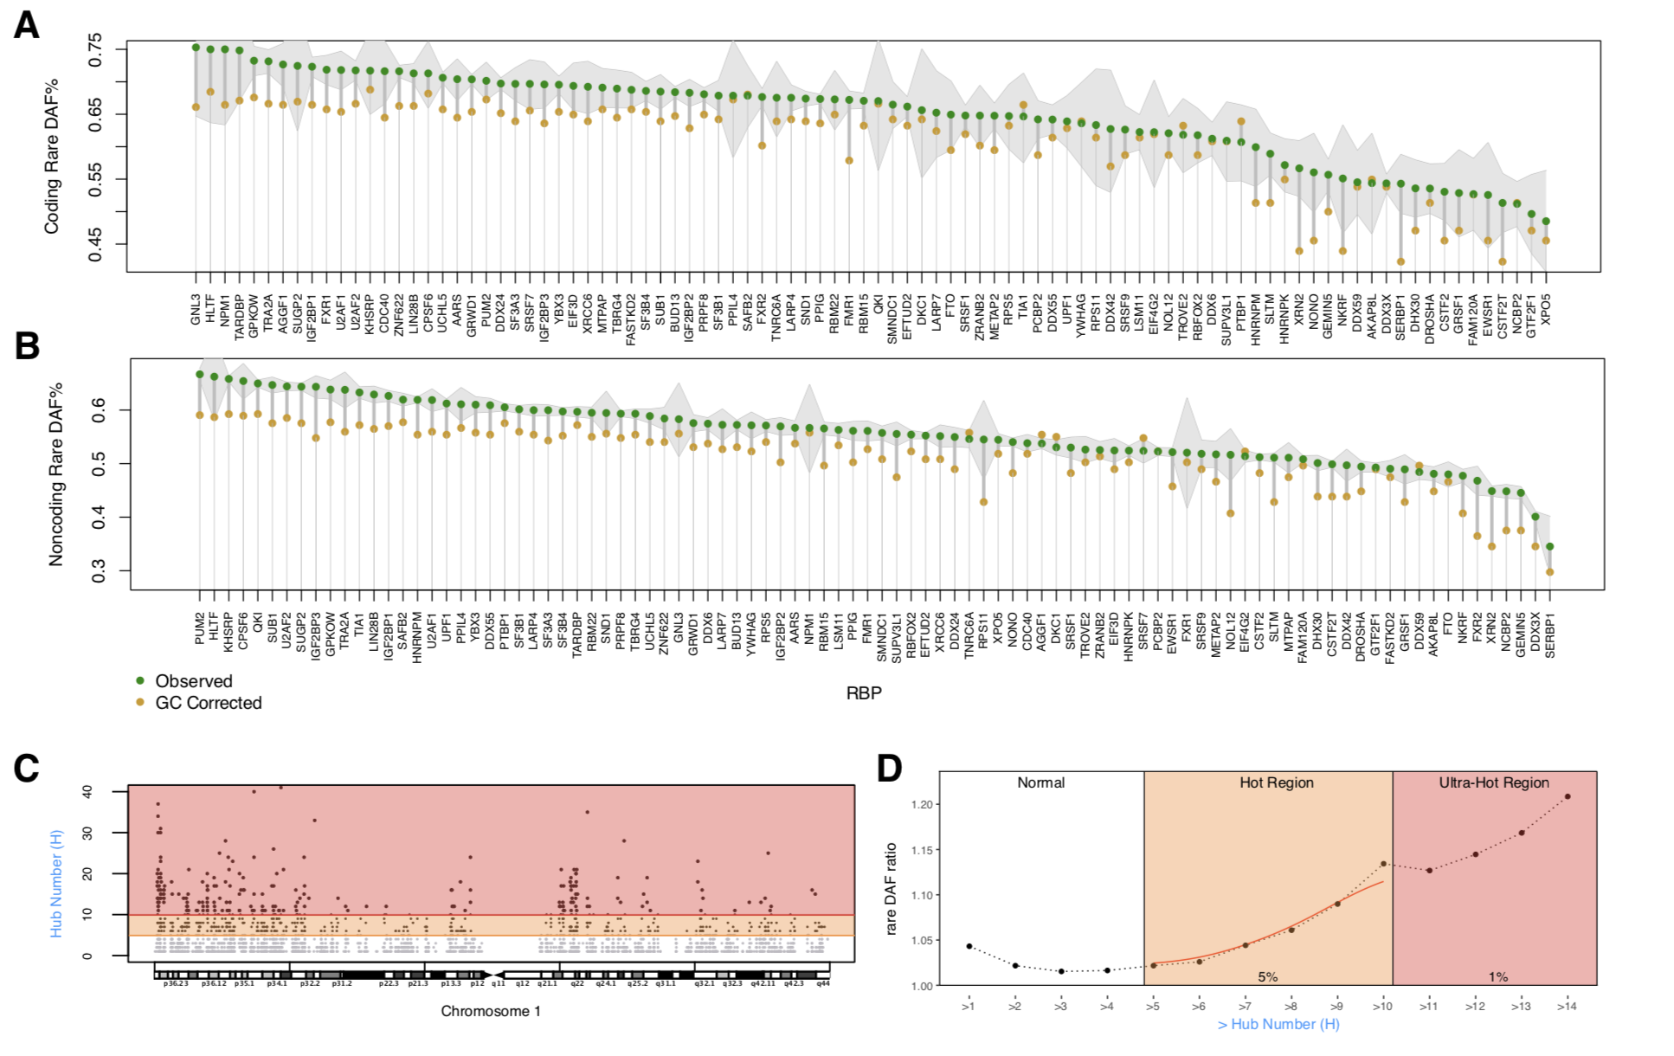
High Phastcon in RBP-overlapped annotations
RNA Structure Cons. from Evofold
Phastcon
Enriched rare DAF in eCLIP peaks
Rare DAF
[Zhang*, Liu* et al., Genome Biology (in review ‘18)]
RBP

Slide 15
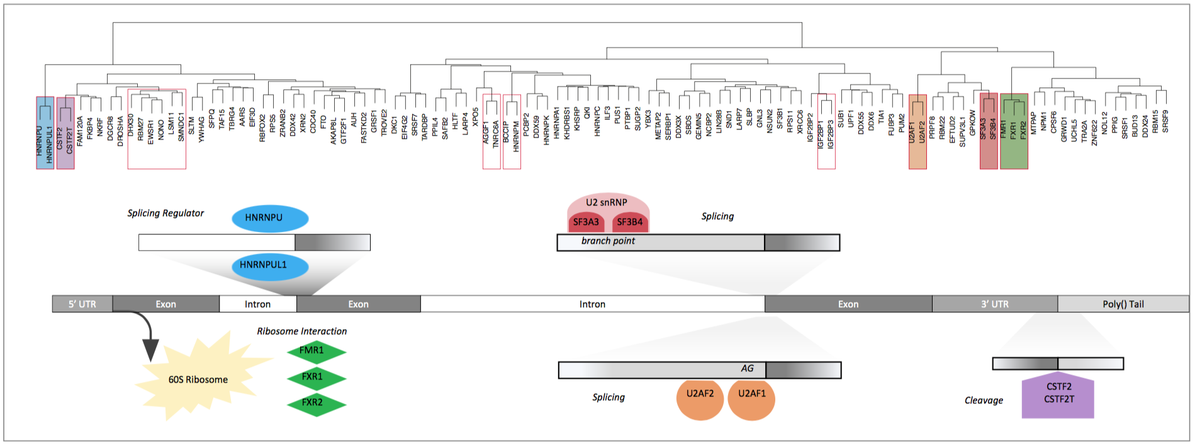
Co-binding of RBPs form biologically relevant complexes
Unique co-binding patterns of RBPs
Literature supported RBP complexes
RBP
RBP
Binding hubs are enriched for rare variants
Hub Number
(Hotness)
Rare DAF
[Zhang*, Liu* et al., Genome Biology (in review ‘18)]
Hub Number (Hotness)

Slide 16
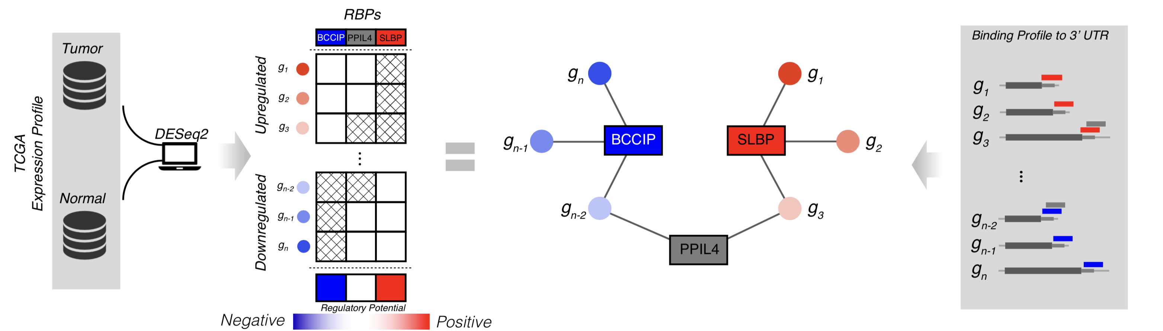
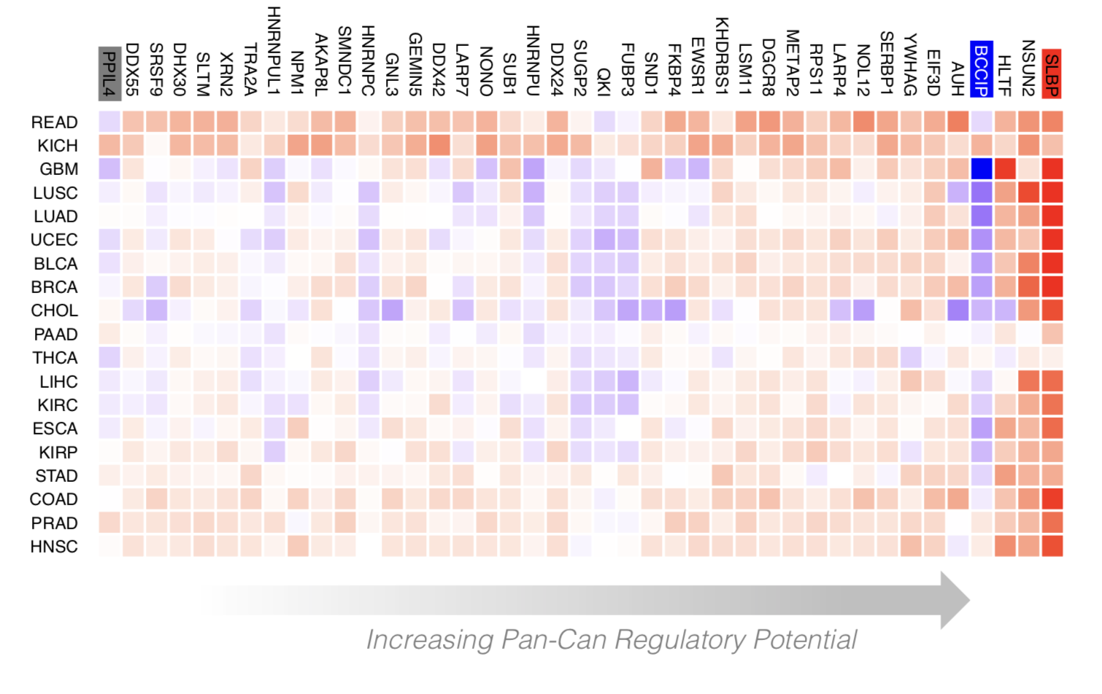
Regulatory Potential of RBPs derived from regression between gene network and expression levels
[Zhang*, Liu* et al., Genome Biology (in review ‘18)]

Slide 17
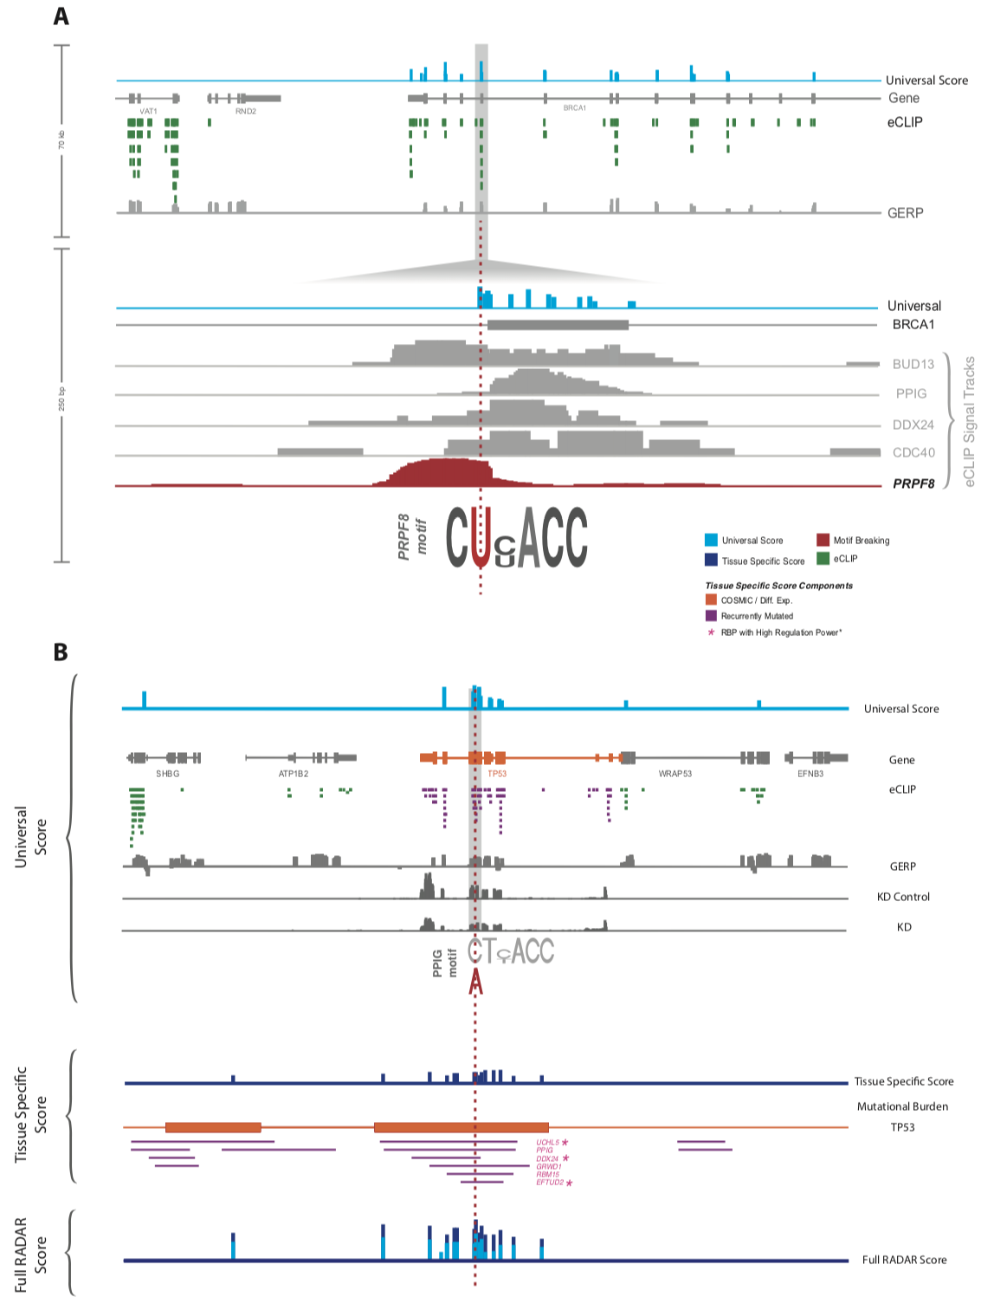
Visualization of RADAR Features and Scoring
Germline Variants are Score Using a Universal Scoring Scheme
Input Variants
eCLIP
GERP
Motif
…
[Zhang*, Liu* et al., Genome Biology (in review ‘18)]

Slide 18
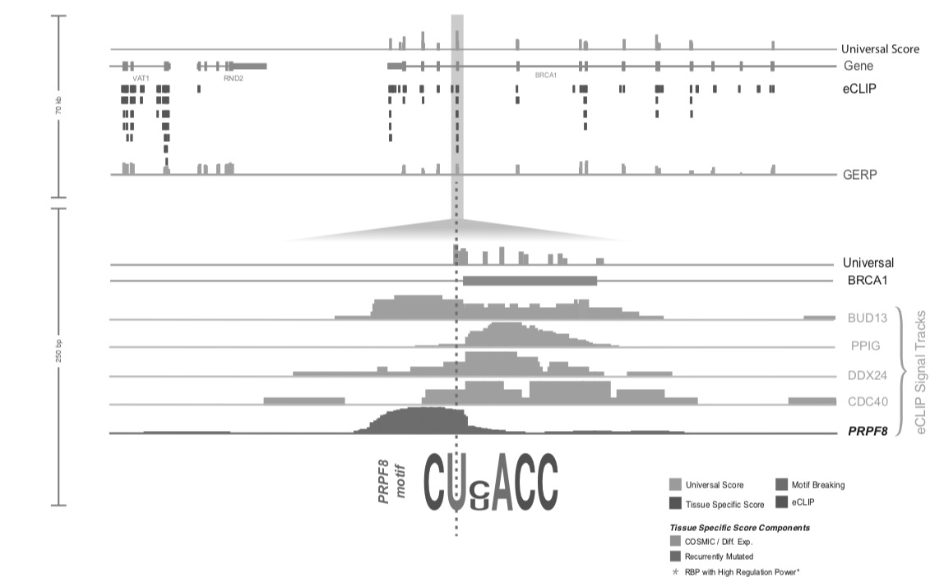
Visualization of RADAR Features and Scoring
Tissue Specific:
Variants
Expression
Regulatory Potential
Input Variants
eCLIP
GERP
Motif
…
Somatic Variant Scored with Universal + Tissue specific context score
[Zhang*, Liu* et al., Genome Biology (in review ‘18)]

Slide 19
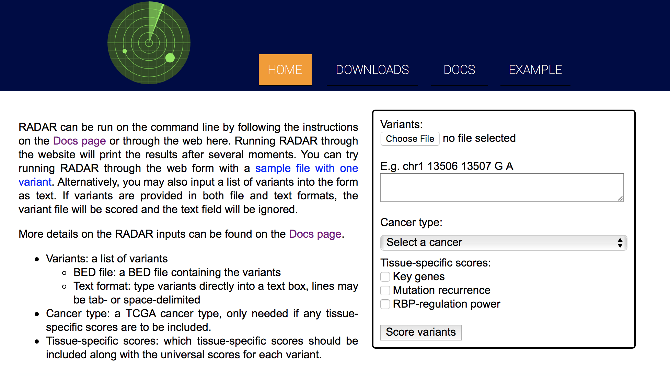

Slide 20
Evaluation of “near-coding” elements
  uORFs:
  Feature integration to find small subset of upstream mutations that potentially alter translation
  RADAR:
  prioritize variants based on post-transcriptional regulome using ENCODE eCLIP

Slide 21
Acknowledgements
github.gersteinlab.org/uORFs
P McGillivray, R Ault,
M Pawashe, R Kitchen, S Balasubramanian
RADAR.gersteinlab.org
J Zhang, J Liu, D Lee, L Lochovsky, J-J Feng, S Lou,
M Rutenberg-Schoenberg

