Slide 1

Measuring the Impact of Non-coding Mutations:
Repurposing an Additive Effects Model & Developing New Annotations
Mark Gerstein
Yale
Slides freely
downloadable from Lectures.GersteinLab.org & “tweetable” (via @MarkGerstein).
No Conflicts for this Talk. See last slide for more info.

Slide 2
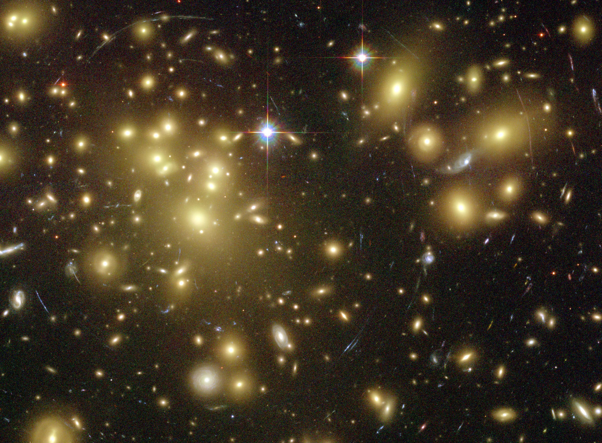
Dark Matter of the Genome
Non-coding genome is ~99% of the total bases
Not as obvious how to annotate it
or assess the impact of mutations
relative to those in coding regions
[Gravitational lensing by dark matter in Abell 1689 – HST (NASA, ESA)]

Slide 3
Measuring the Impact of Non-coding Mutations:
Repurposing an Additive Effects Model & Developing New Annotations
  Additive-Effects model to measure the Impact of non-coding v coding mutations
  Repurposing a formalism from germline genetics for missing heritability to cancer
  Using it to assess the overall Impact of passengers v drivers, non-coding vs coding, distal vs proximal non-coding
  Notable effect, particularly for non-coding passengers, in addition to known coding drivers.
  Recasting as a predictive model
  to est. number of weak drivers
New Annotations to help assess the impact non-coding variants
  RADAR Prioritization for RBP sites
    Prioritizes variants based on post-transcriptional regulome using ENCODE eCLIP
    Incorporates new annotation features related to RNA sec. struc & tissue specific effects
  uORF Prioritization
    Feature integration to find small subset of upstream mutations that potentially alter translation

Slide 4
Measuring the Impact of Non-coding Mutations:
Repurposing an Additive Effects Model & Developing New Annotations
  Additive-Effects model to measure the Impact of non-coding v coding mutations
  Repurposing a formalism from germline genetics for missing heritability to cancer
  Using it to assess the overall Impact of passengers v drivers, non-coding vs coding, distal vs proximal non-coding
  Notable effect, particularly for non-coding passengers, in addition to known coding drivers.
  Recasting as a predictive model
  to est. number of weak drivers
New Annotations to help assess the impact non-coding variants
  RADAR Prioritization for RBP sites
    Prioritizes variants based on post-transcriptional regulome using ENCODE eCLIP
    Incorporates new annotation features related to RNA sec. struc & tissue specific effects
  uORF Prioritization
    Feature integration to find small subset of upstream mutations that potentially alter translation

Slide 5
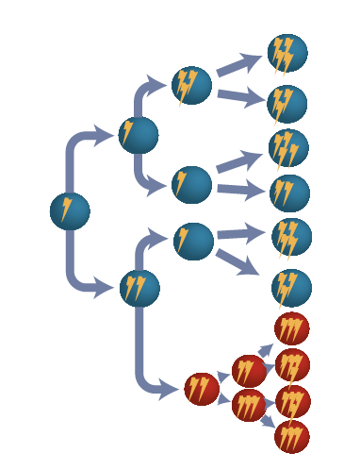
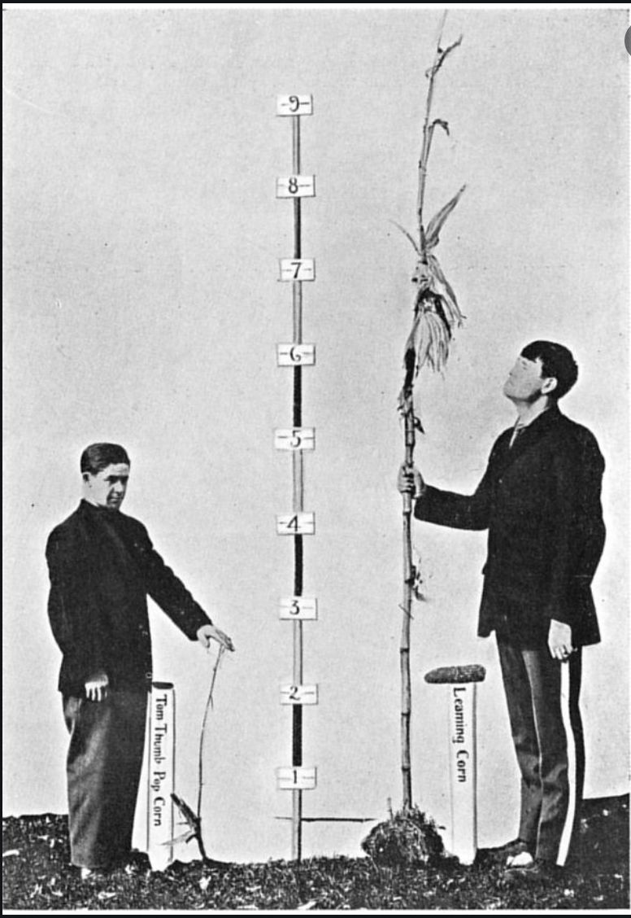
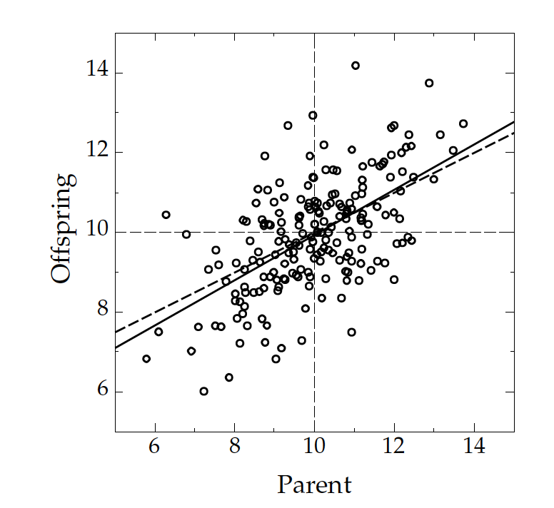
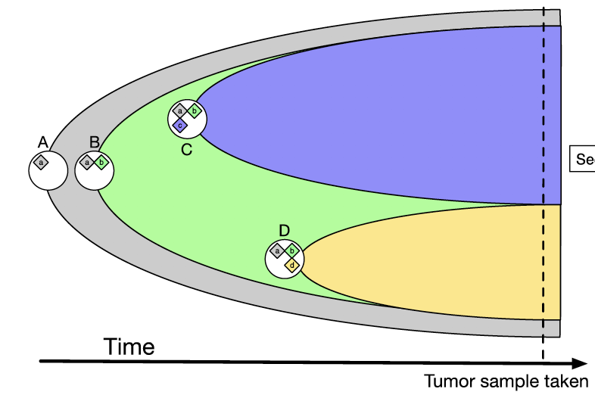




Relating Germline Missing Heritability to Cancer Studies
Population level definitions:
Parent-offspring heritability;
Twin-based heritability …
Subclonal trait in cancer: Growth rate
Organismal trait: Height
$$h^{2}$$
SNP-based polygenic & additive model:
$$Z$$
$$h^{2}=σ_{u}$$
Trait
Covariates & fixed effects
Genetic predictors & random effects
Environmental noise

Slide 6
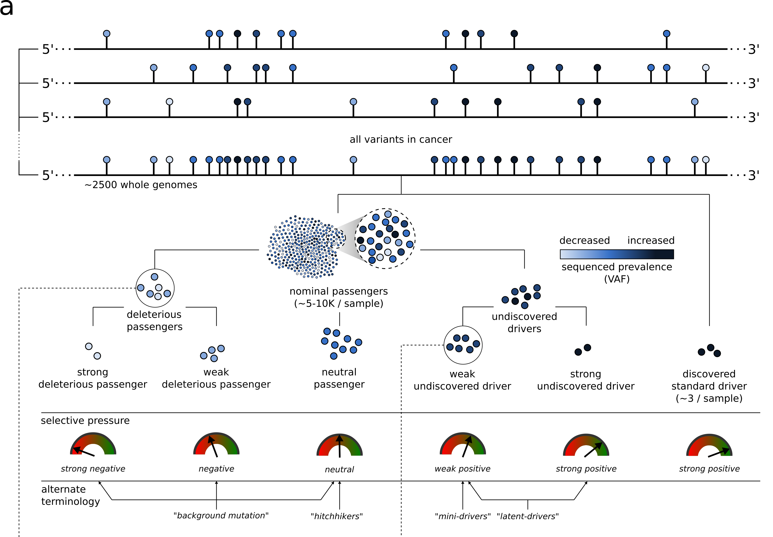
Conceptual extension of the
canonical model of drivers and passengers
[Kumar, Warrell et al. (’20, in press) Cell + biorxiv]

Slide 7
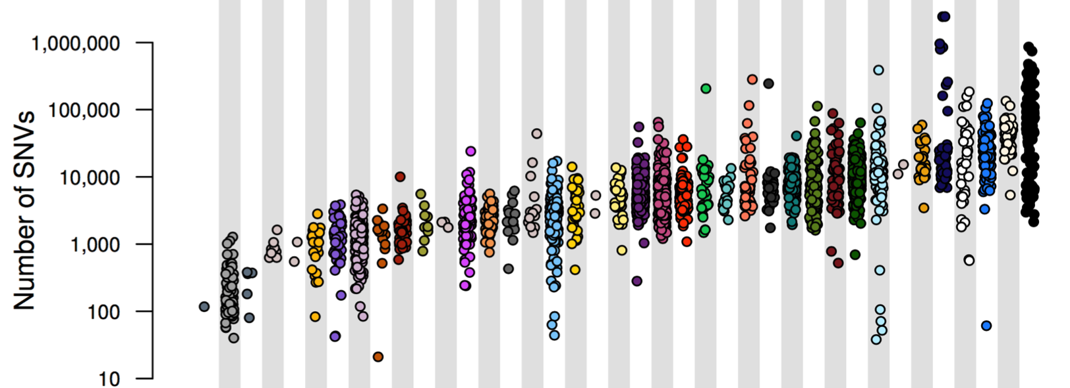
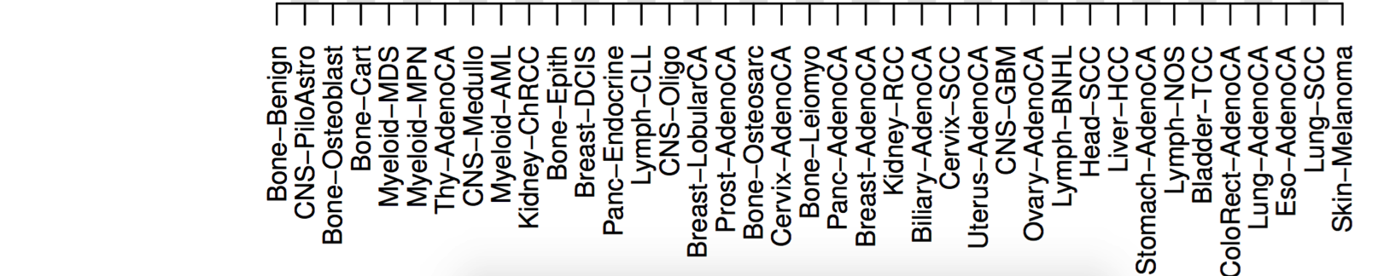
PCAWG : most comprehensive resource for
cancer whole genome analysis
Project Goals:
To understand role of non-coding regions of cancer genomes in disease progression.
Union of TCGA-ICGC efforts
Jointly analyzing ~2800 whole genome tumor/normal pairs
  > 580 researchers
  16 thematic working groups
  ~30M total somatic SNVs
Adapted from Campbell et. al., bioRxiv (’17).
Now published as Nature 578: 82–93 (2020)

Slide 8
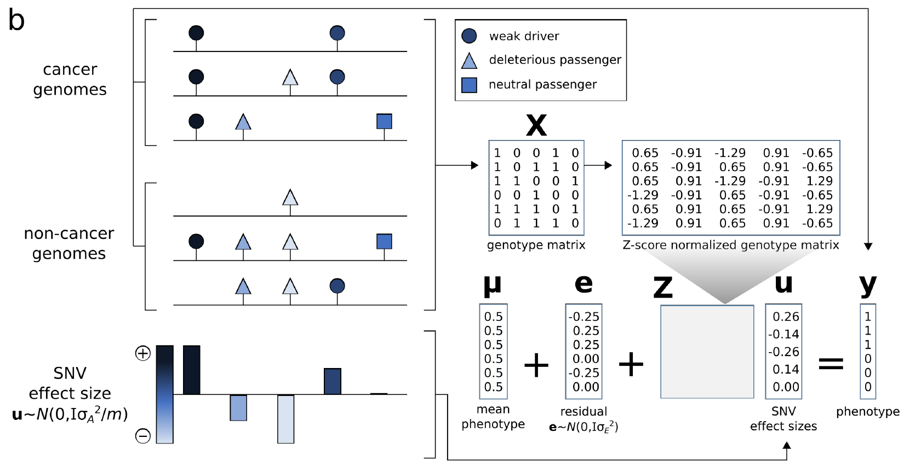
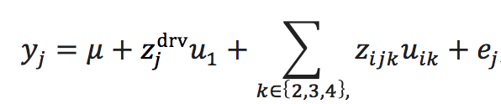

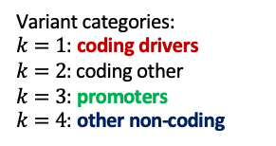

Using additive effects to compare different categories of variants
[Kumar, Warrell et al. (’20, in press) Cell + biorxiv]
$$u∼N(0,σ_{u}^{2}I)$$
Variant categories:
$k=1$: coding drivers
$k=2$: coding other
$k=3$: promoters
$k=4$: other non-coding
Model:
Parameters:

Slide 9
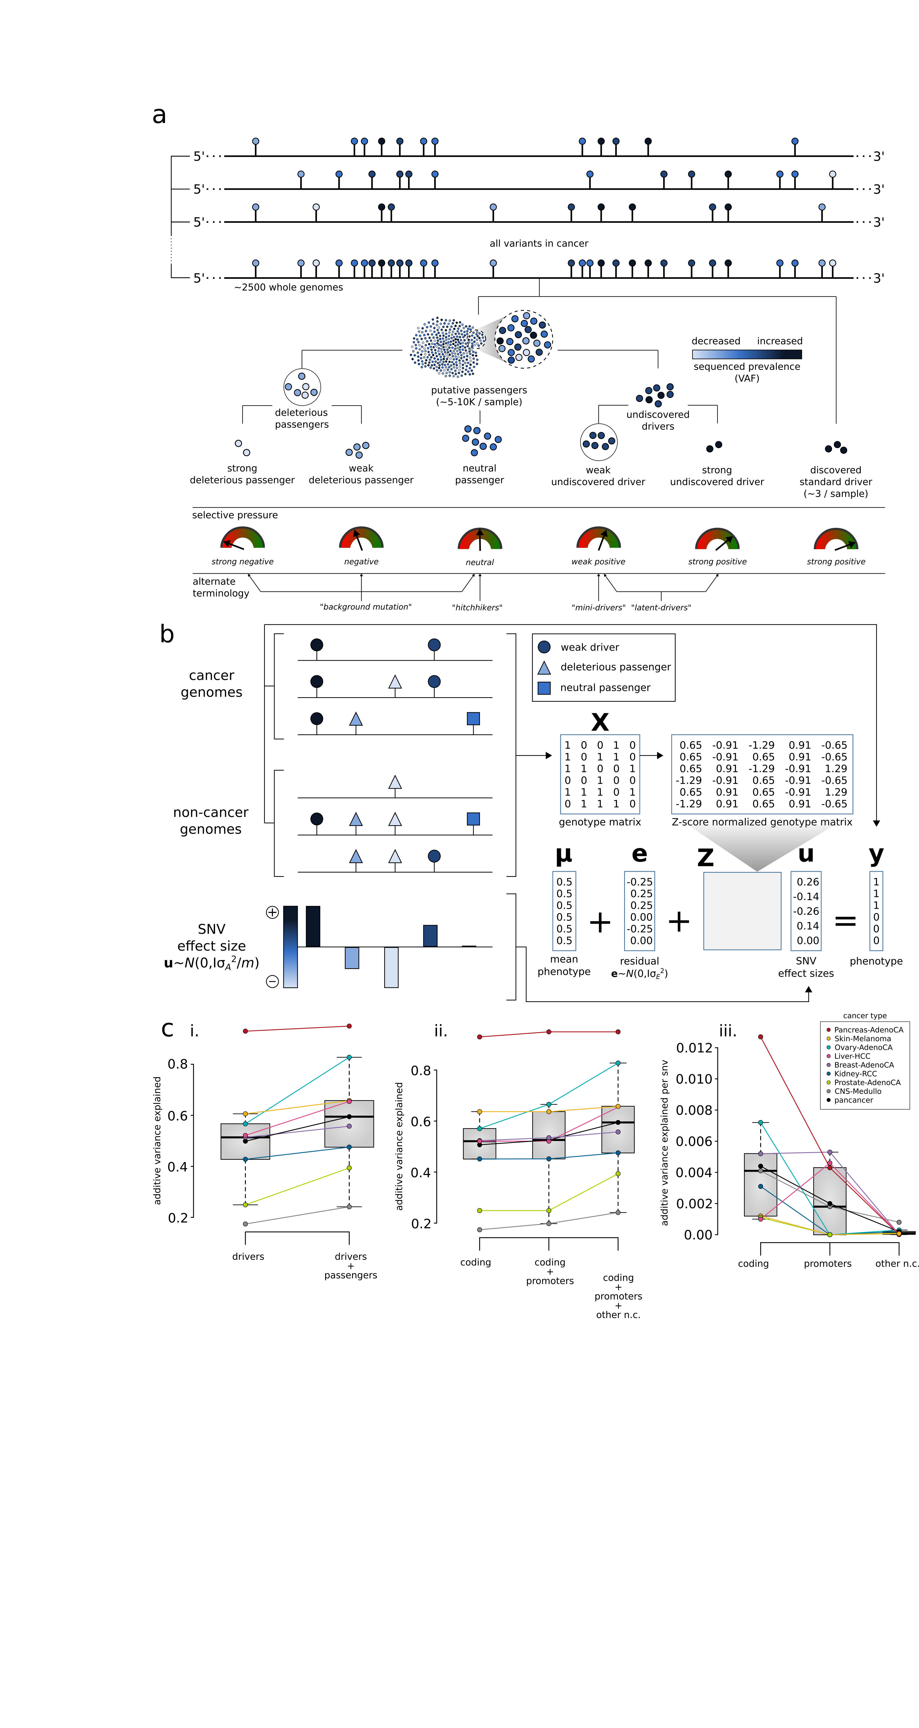
Overall additive variance increase for multiple cancer cohorts in PCAWG with the inclusion of passengers
Increase in the variance from ~50% using drivers alone to ~59% with putative passengers included, averaged across all cohorts.
[Kumar, Warrell et al. (’20, in press) Cell + biorxiv]

Slide 10
Element level additive variance for multiple cancer cohorts in PCAWG, comparing coding & non-coding
In addition to coding mutations, promoter & other non-coding mutations contributed significant amounts of extra variance
(~2% & 7%) .
[Kumar, Warrell et al. (’20, in press) Cell + biorxiv]

Slide 11



Recasting the additive effects model in a predictive context:
Best Linear Unbiased Predictor (BLUP) analysis
All SNPs
[Kumar, Warrell et al. (’20, in press) Cell + biorxiv]
95% CI
Additive variance
Cummulative
SNVs added
SNVs, ordered by descending BLUP ($\hat{u}$):
BLUP predictor:
$$\hat{u}=argmax_{u}\left(P\left(u | y,σ_{u}^{2}\right)\right)$$
…
$$=argmax_{u}\left(P\left(y | u\right)P(u|σ_{u}^{2})\right)$$
Lower bound on # weak drivers (8.4 pan-cancer average; enriched for PCAWG genes w/ FDR<0.25)

Slide 12
Measuring the Impact of Non-coding Mutations:
Repurposing the Additive Effects Model & Developing New Annotations to Assess Variants
  Additive-Effects model to quantify the Impact of non-coding v coding mutations
  Repurposing a formalism in germline genetics for missing heritability to cancer
  Using it to assess the overall Impact of passengers v drivers, non-coding vs coding, distal vs proximal non-coding
  Demonstratable effect, particularly for non-coding ones, in addition to known drivers.
  Recasting as a predictive model
  to est. number of weak drivers
New Annotations to help assess the impact non-coding variants
  RADAR Prioritization for RBP sites
    Prioritizes variants based on post-transcriptional regulome using ENCODE eCLIP
    Incorporates new features related to RNA sec. struc & tissue specific effects
  uORF Prioritization
    Feature integration to find small subset of upstream mutations that potentially alter translation

Slide 13
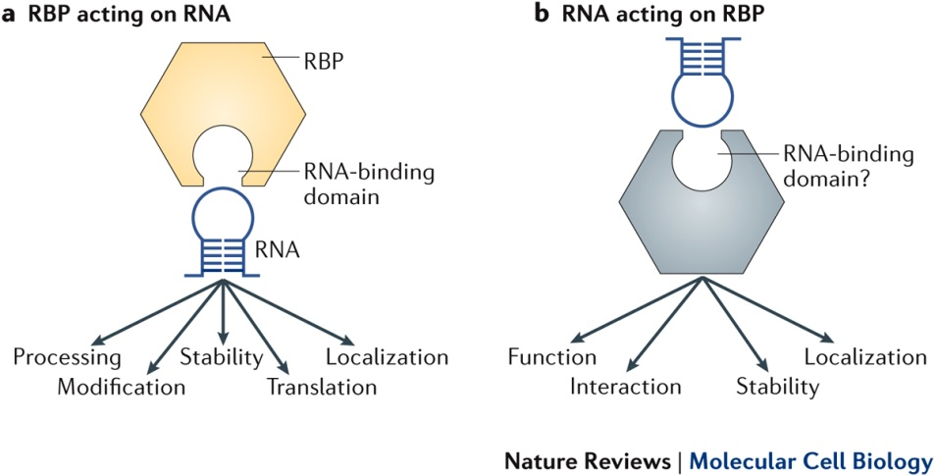
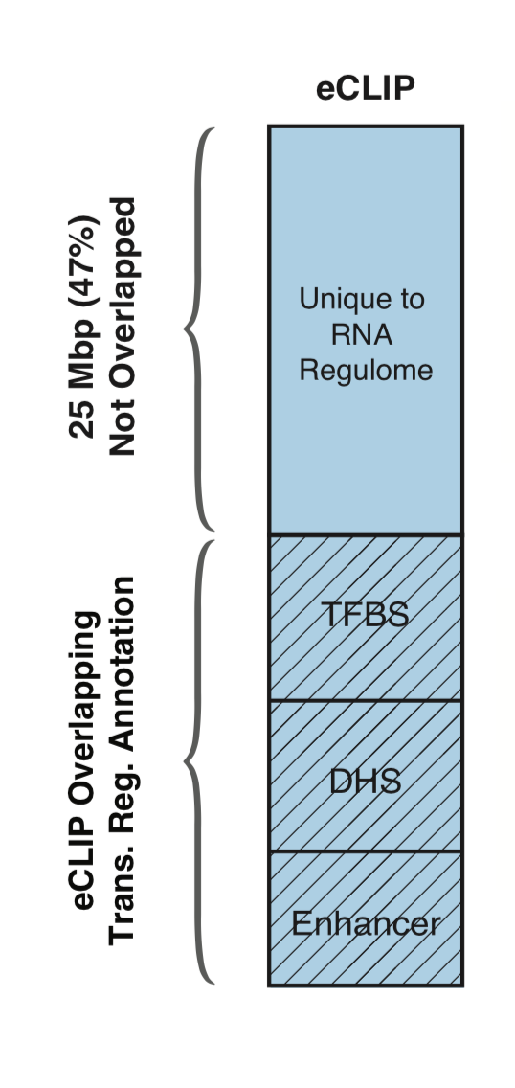
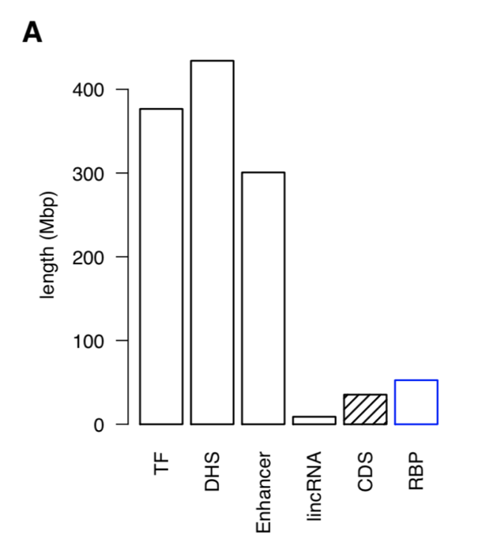
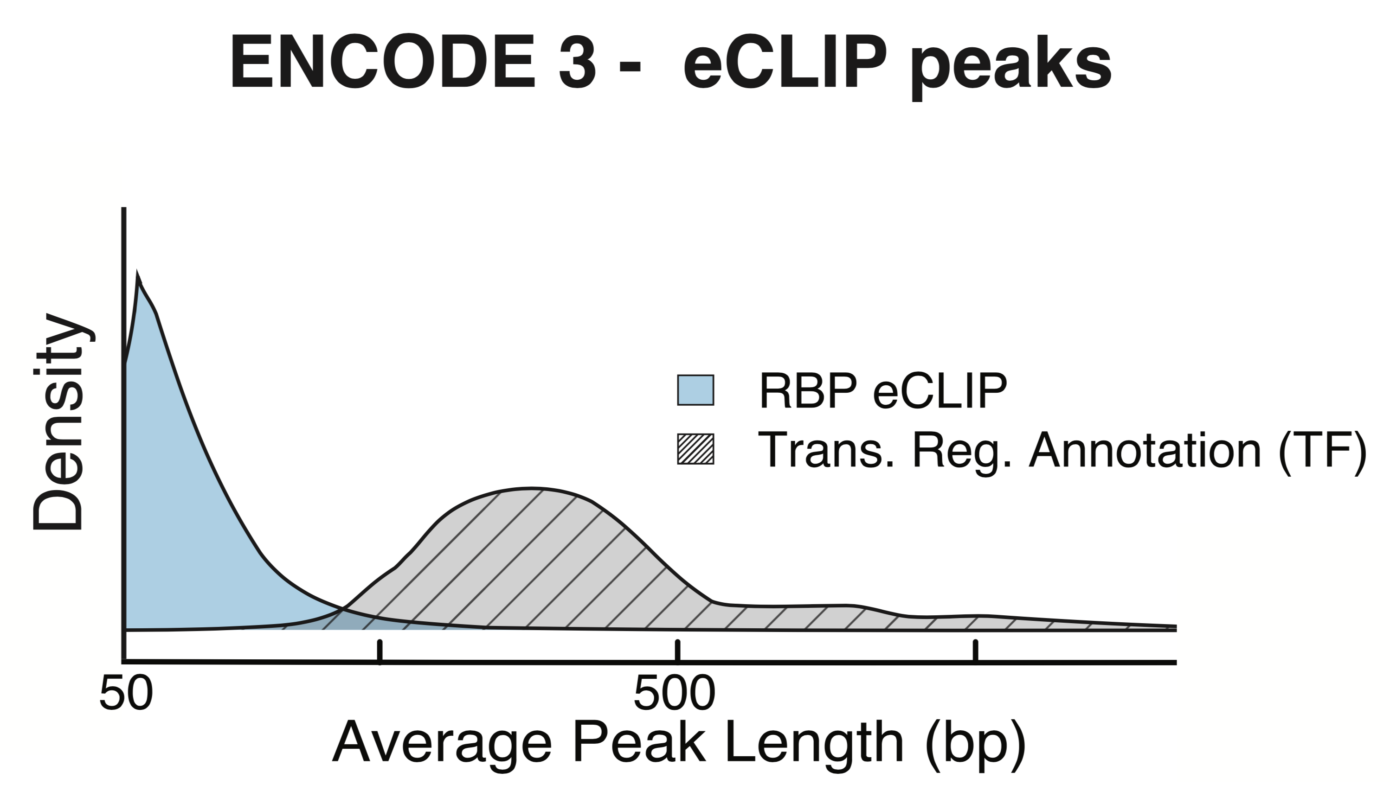
RNA Binding Proteins (RBPs)
Before ENCODE3: >150 expt.
in many different cell types
ENCODE3 did ~350 focused eCLIP expt. for >110 RBPs on HepG2 & K562
(Van Nostrand...Yeo. Nat. Meth. '16;
Van Nostrand...Graveley, Yeo
(submitted in relation to ENCODE3))
Nat Rev Mol Cell Biol. 2018 May;19(5):327-341. doi: 10.1038/nrm.2017.130. Epub 2018 Jan 17.
[Zhang*, Liu* et al., Genome Biology (in review ‘18)]

Slide 14
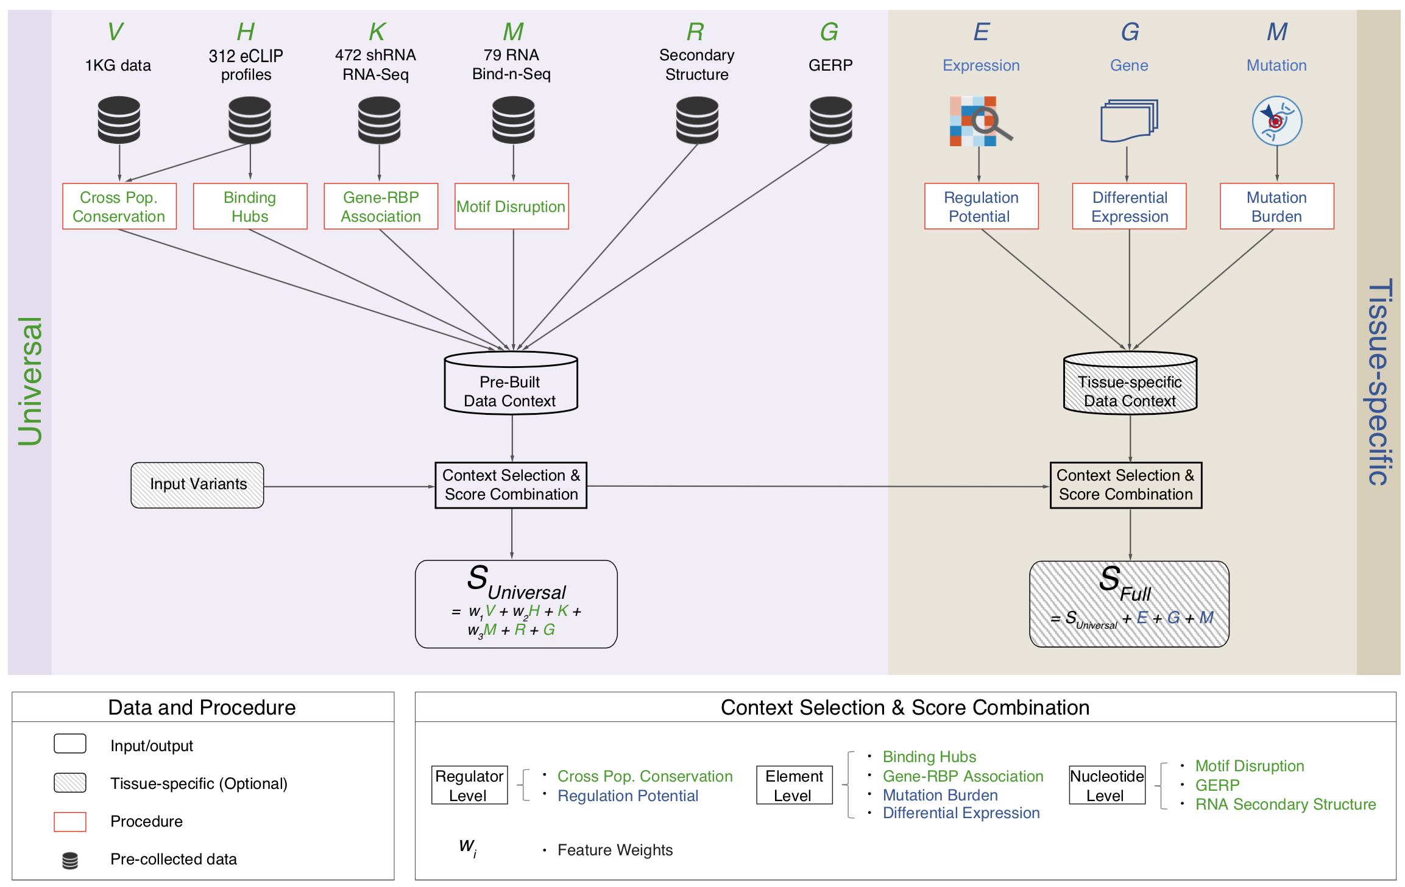
Schematic of RADAR Scoring
[Zhang*, Liu* et al., Genome Biology (in review ‘18)]

Slide 15
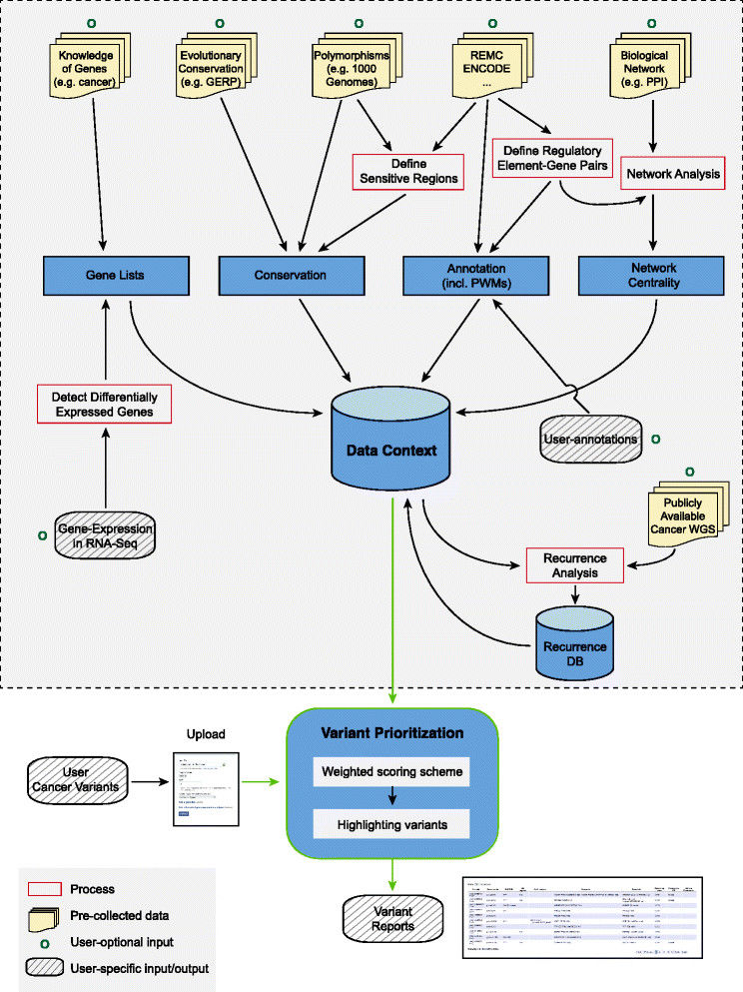
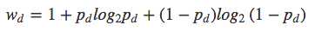
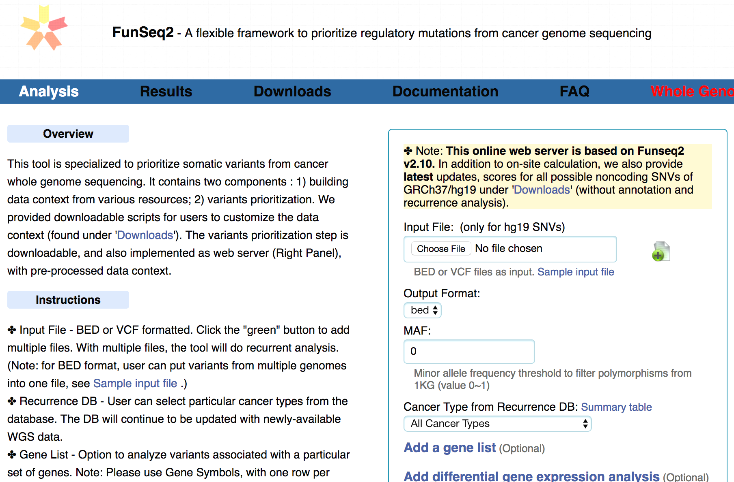
FunSeq.gersteinlab.org
HOT region
Sensitive region
Polymorphisms
Genome
Info. theory based method (ie annotation “surprisal”) for weighting consistently many genomic features
Practical web server
Submission of variants & pre-computed large data context from uniformly processing large-scale datasets
[Fu et al., GenomeBiology ('14)]

Slide 16
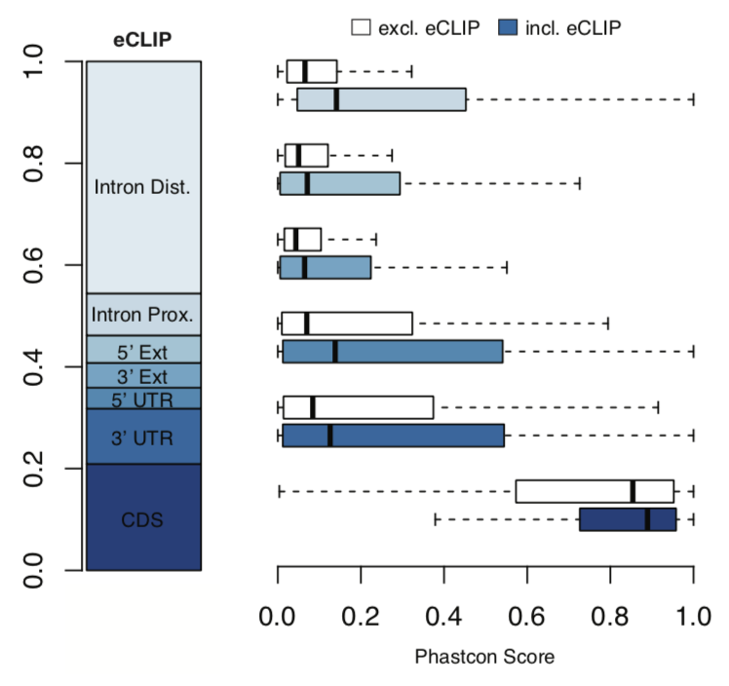
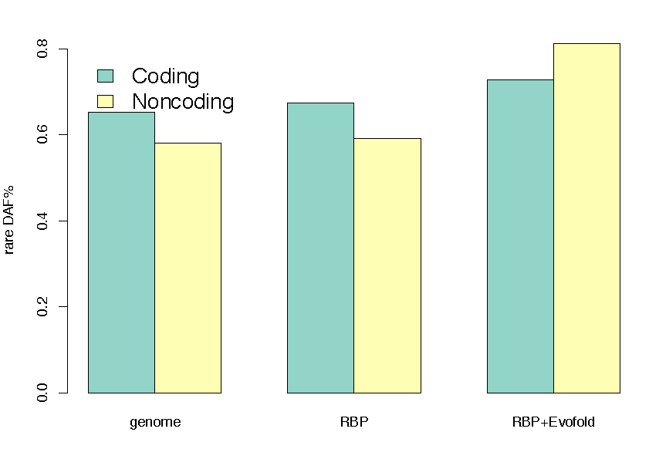
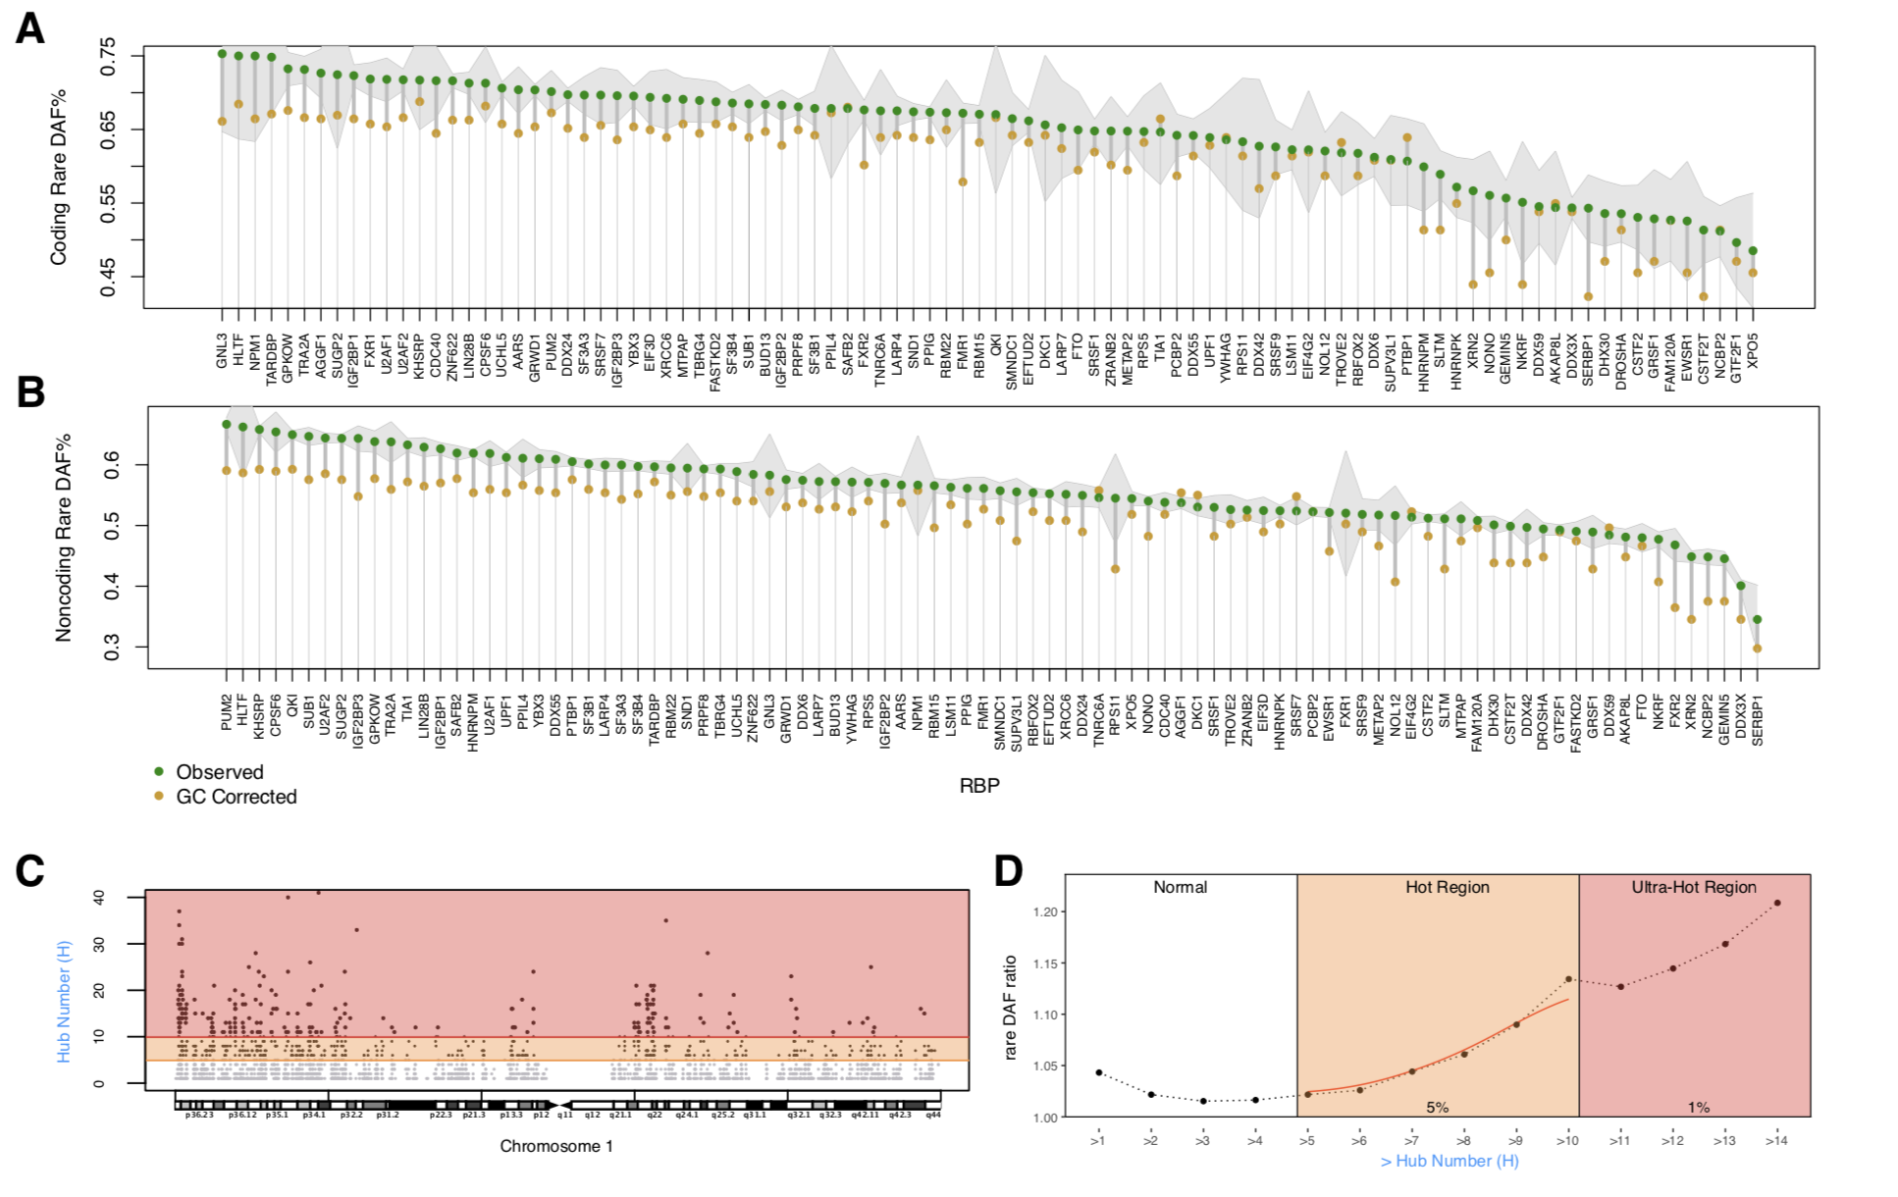
High Phastcon in RBP-overlapped annotations
RNA Structure Cons. from Evofold
Phastcon
Enriched rare DAF in eCLIP peaks
Rare DAF
[Zhang*, Liu* et al., Genome Biology (in review ‘18)]
RBP

Slide 17
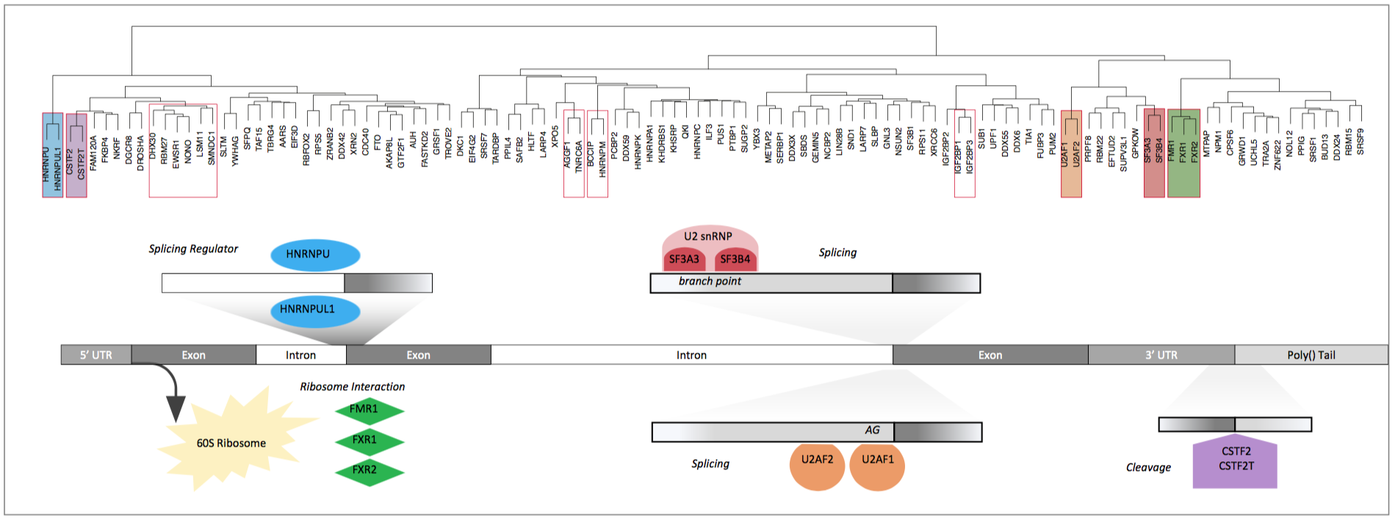
Co-binding of RBPs form biologically relevant complexes
Unique co-binding patterns of RBPs
Literature supported RBP complexes
RBP
RBP
Binding hubs are enriched for rare variants
Hub Number
(Hotness)
Rare DAF
[Zhang*, Liu* et al., Genome Biology (in review ‘18)]
Hub Number (Hotness)

Slide 18
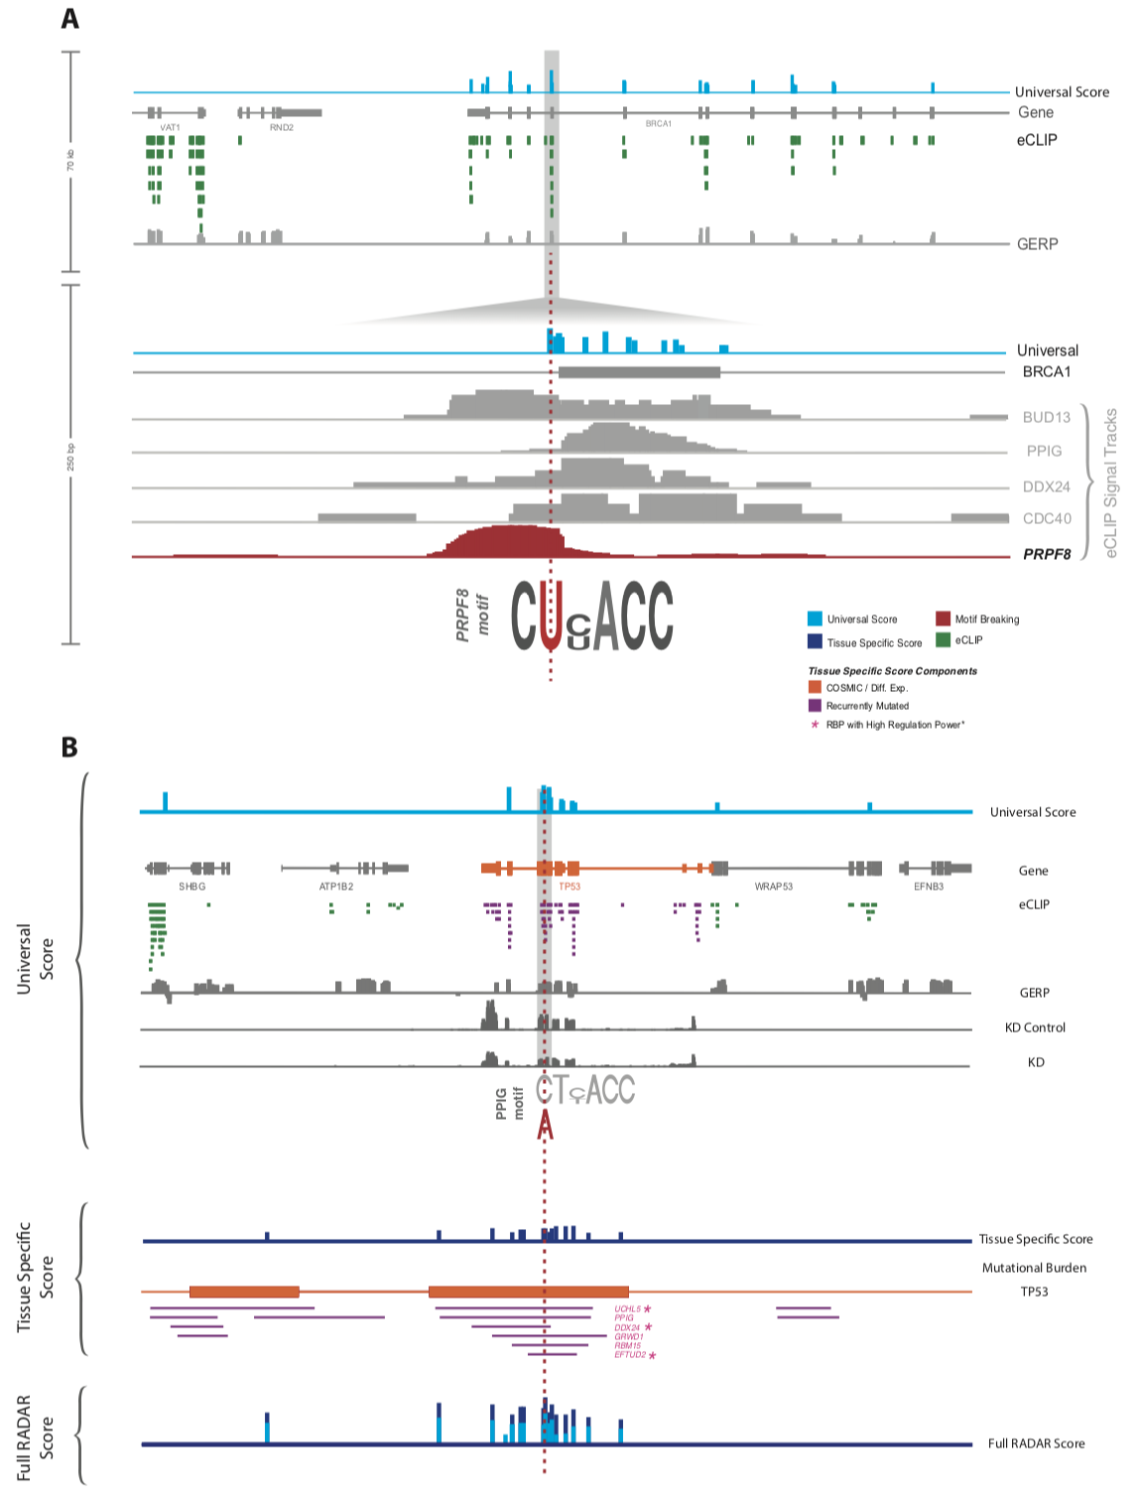
Visualization of RADAR Features and Scoring
Germline Variants are Score Using a Universal Scoring Scheme
Input Variants
eCLIP
GERP
Motif
…
[Zhang*, Liu* et al., Genome Biology (in review ‘18)]

Slide 19
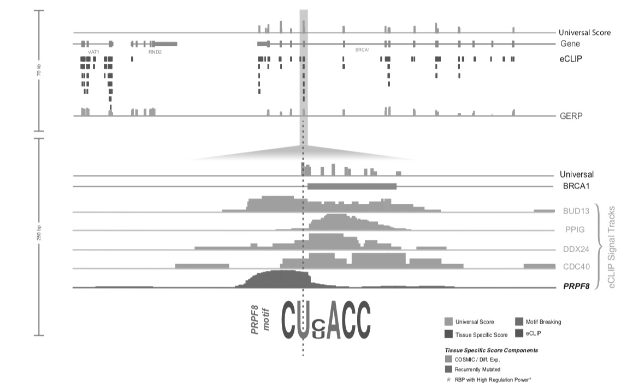
Visualization of RADAR Features and Scoring
Tissue Specific:
Variants
Expression
Regulatory Potential
Input Variants
eCLIP
GERP
Motif
…
Somatic Variant Scored with Universal + Tissue specific context score
[Zhang*, Liu* et al., Genome Biology (in review ‘18)]

Slide 20
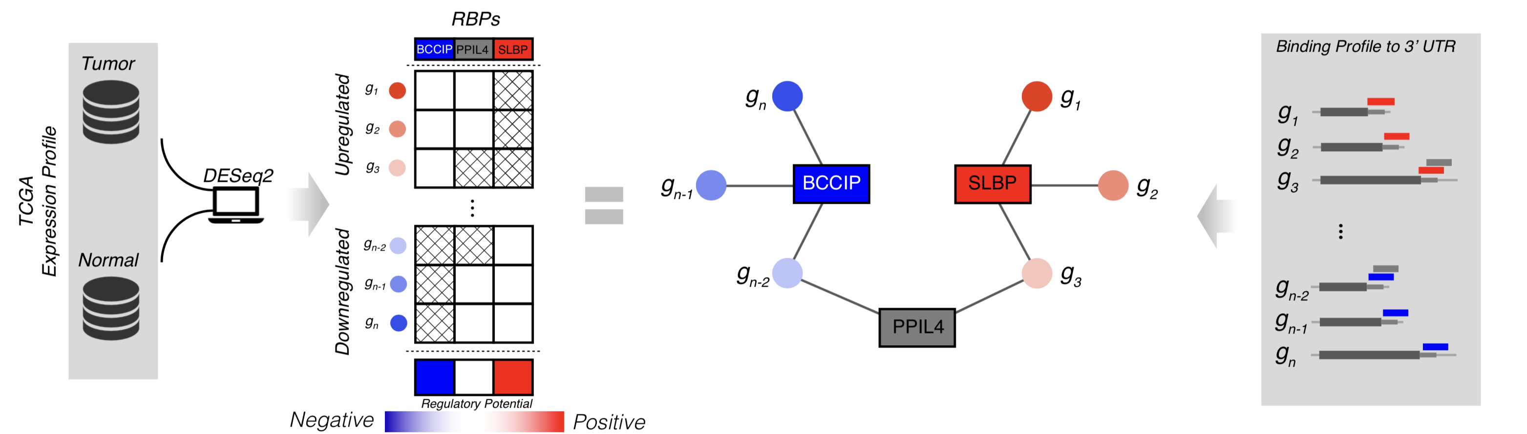
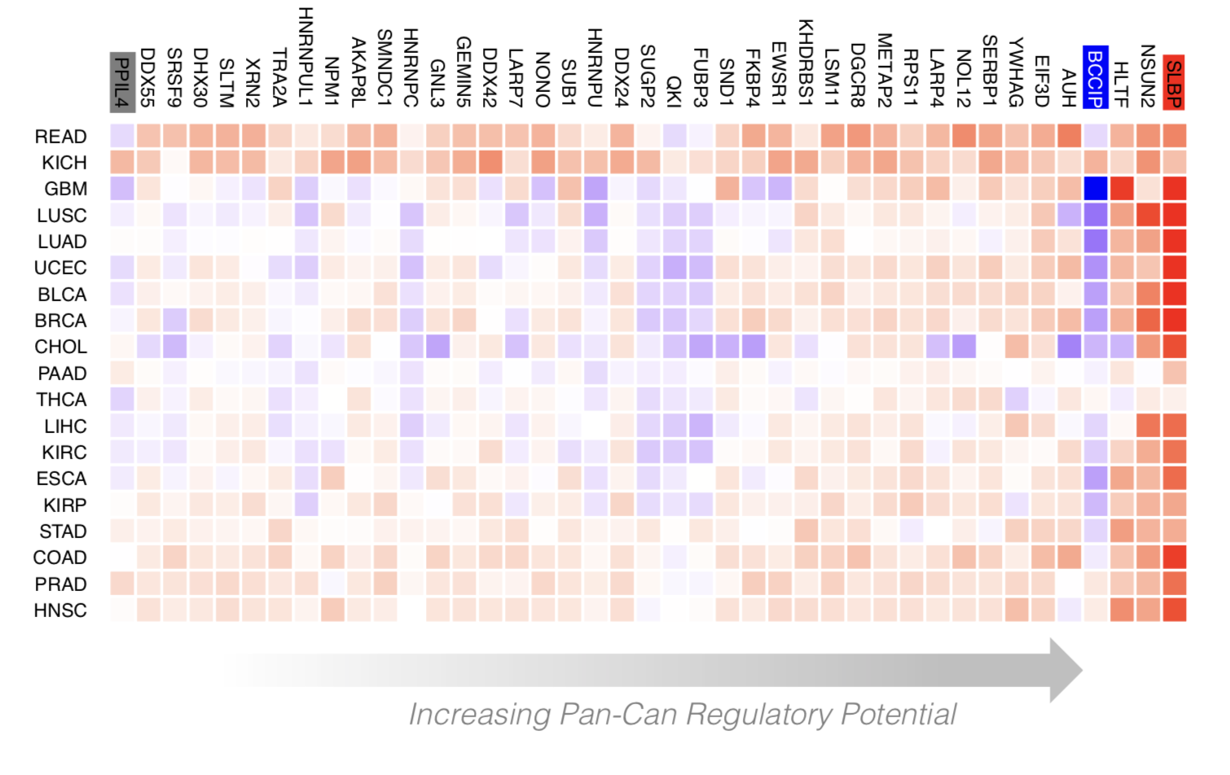
Regulatory Potential of RBPs derived from regression between gene network and expression levels
[Zhang*, Liu* et al., Genome Biology (in review ‘18)]

Slide 21
Measuring the Impact of Non-coding Mutations:
Repurposing the Additive Effects Model & Developing New Annotations to Assess Variants
  Additive-Effects model to quantify the Impact of non-coding v coding mutations
  Repurposing a formalism in germline genetics for missing heritability to cancer
  Using it to assess the overall Impact of passengers v drivers, non-coding vs coding, distal vs proximal non-coding
  Demonstratable effect, particularly for non-coding ones, in addition to known drivers.
  Recasting as a predictive model
  to est. number of weak drivers
New Annotations to help assess the impact non-coding variants
  RADAR Prioritization for RBP sites
    Prioritizes variants based on post-transcriptional regulome using ENCODE eCLIP
    Incorporates new features related to RNA sec. struc & tissue specific effects
  uORF Prioritization
    Feature integration to find small subset of upstream mutations that potentially alter translation

Slide 22
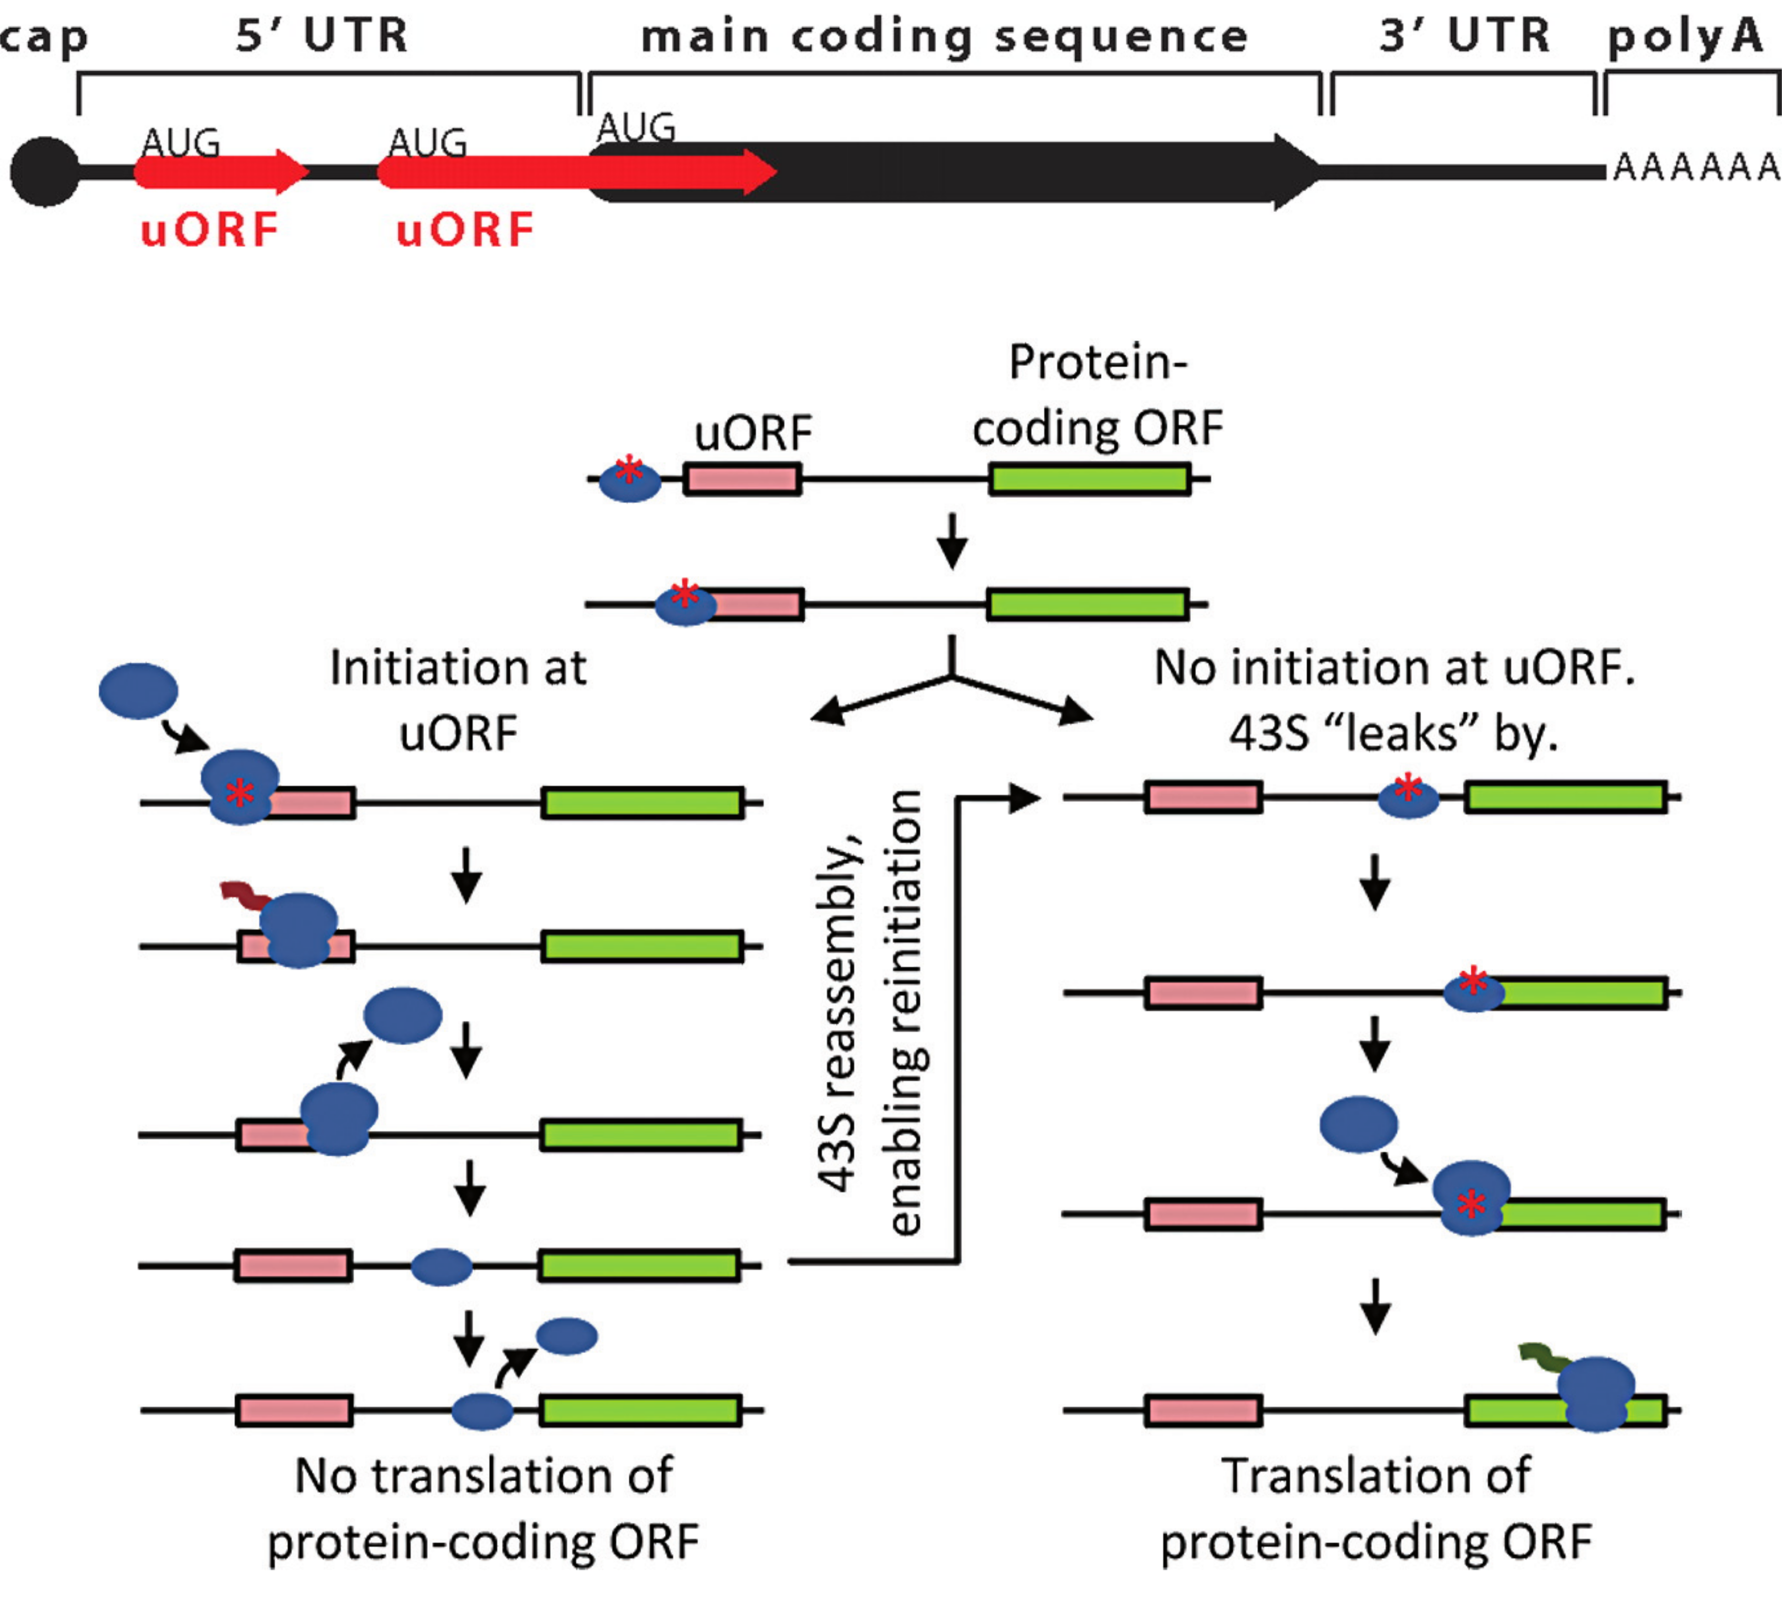
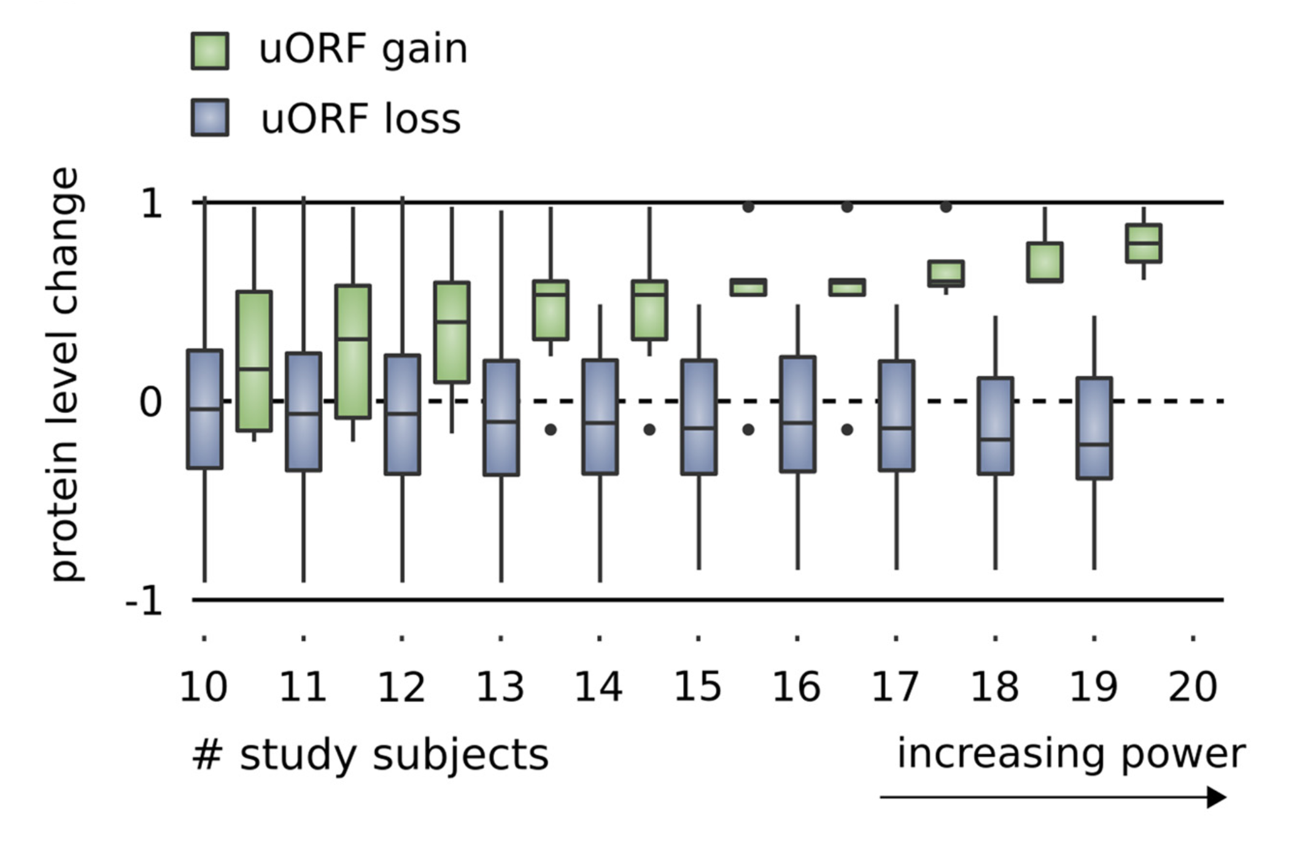
Upstream open reading frames (uORFs) regulate translation are affected by somatic mutation
uORFs regulate the translation of downstream coding regions.
This regulation may be altered by somatic mutation in cancer.
In Battle et al. 2014 data uORF gain & loss assoc. protein level change.
[Calvo et al., PNAS (‘09)]
[McGillivray et al., NAR (‘18)]
[Ferreira et al., Bioengineered (‘14)]

Slide 23
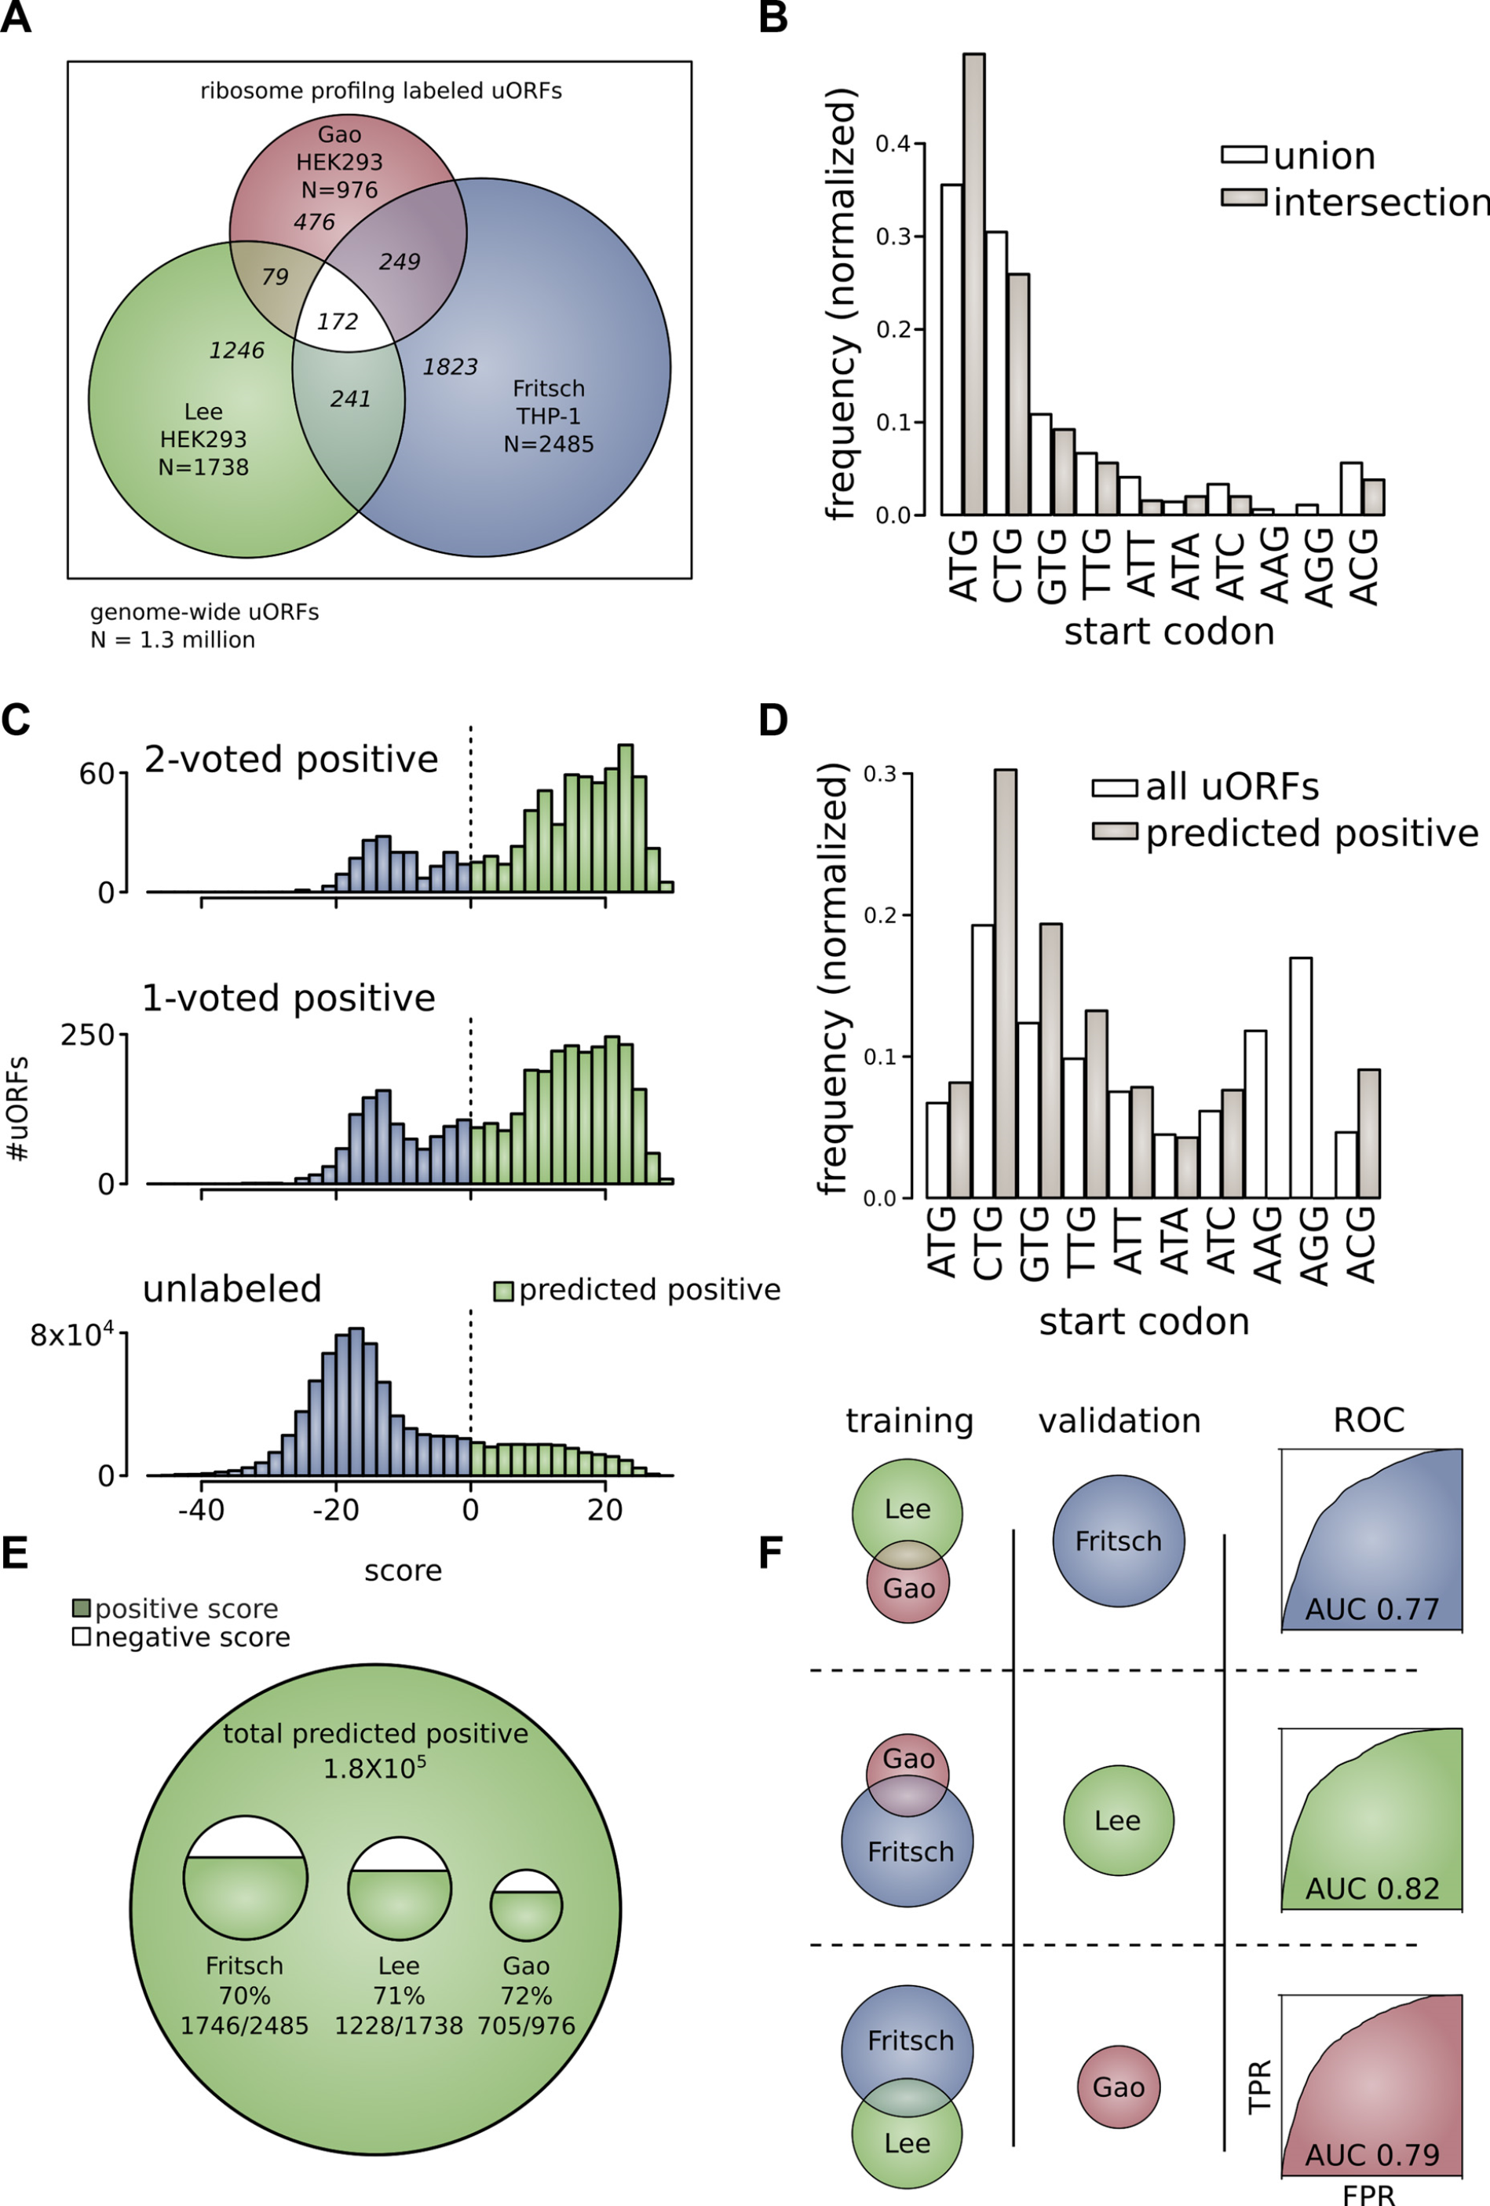
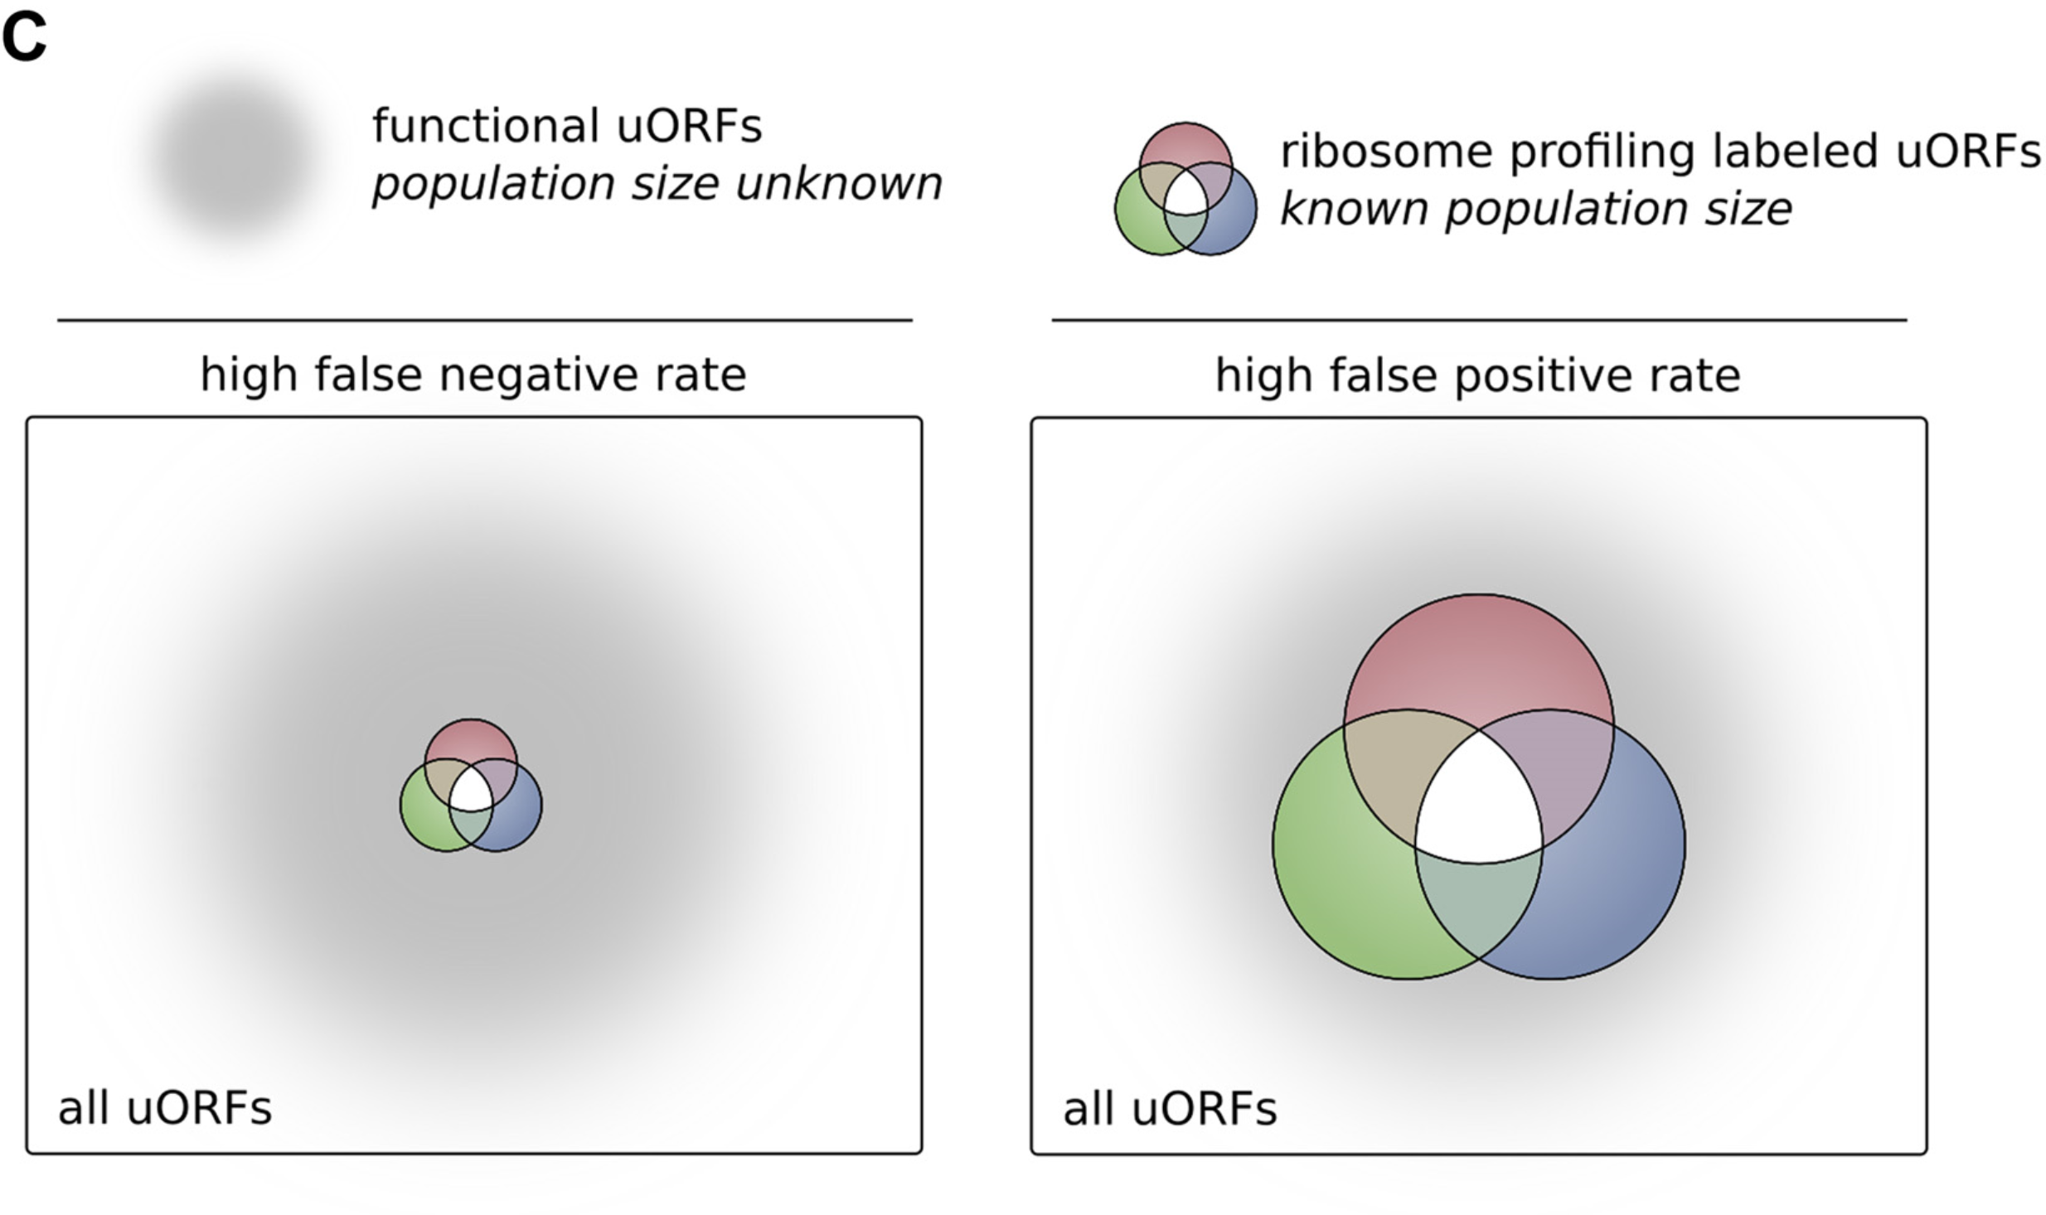
The population of functional uORFs may be significant
From a “Universe” of 1.3 M pot. uORFs
Ribosome profiling experiments have low overlap in identified uORFs.
This suggests high false-negative rate, and more functional uORFs than currently known.
[McGillivray et al., NAR (‘18)]

Slide 24
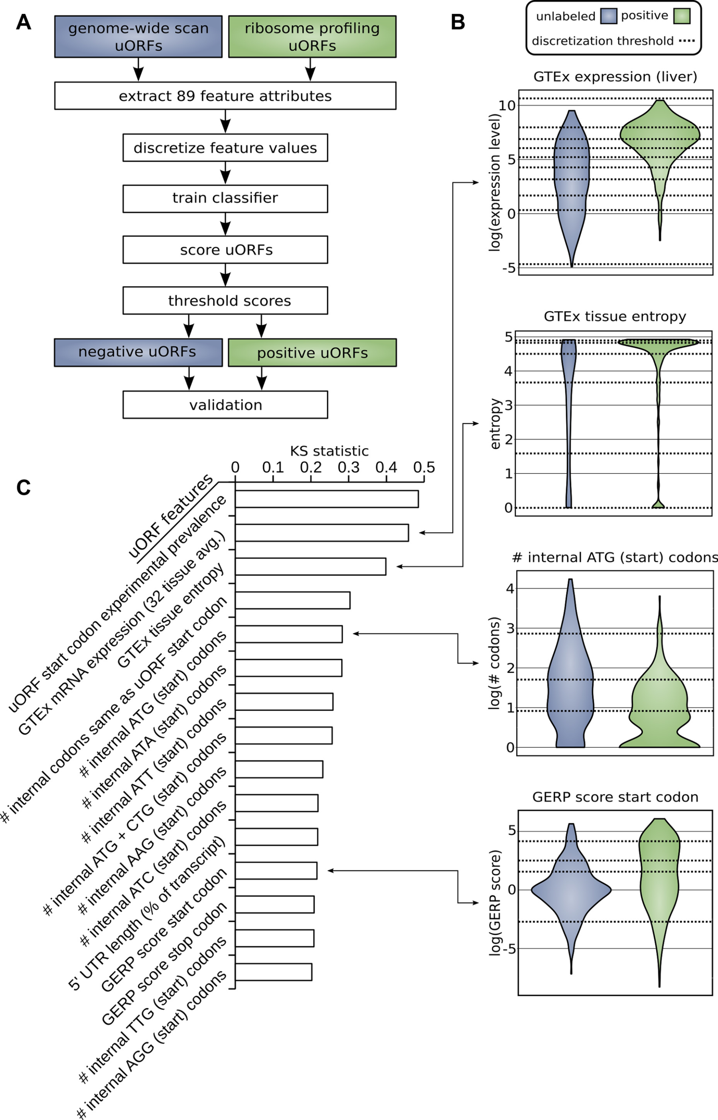
Prediction & validation of functional uORFs using 89 features
Expr.
Level
All near-cognate start codons predicted.
Cross-validation on independent ribosome profiling datasets and validation using in vivo protein levels and ribosome occupancy in humans (Battle et al. 2014).
Tissue
Dist.
Int.
ATG
Start
Conser-
vation
[McGillivray et al., NAR (‘18)]

Slide 25
A comprehensive catalog of functional uORFs
Universe of 1.3M uORFs scored via Simple Bayes algo.
180K: Large predicted positive set likely to affect translation
Calibration on gold standards, suggests getting ~70% of known
Predicted functional uORFs may be intersected with disease associated variants.
[McGillivray et al., NAR (‘18)]

Slide 26
Measuring the Impact of Non-coding Mutations:
Repurposing the Additive Effects Model & Developing New Annotations to Assess Variants
  Additive-Effects model to quantify the Impact of non-coding v coding mutations
  Repurposing a formalism in germline genetics for missing heritability to cancer
  Using it to assess the overall Impact of passengers v drivers, non-coding vs coding, distal vs proximal non-coding
  Demonstratable effect, particularly for non-coding ones, in addition to known drivers.
  Recasting as a predictive model
  to est. number of weak drivers
New Annotations to help assess the impact non-coding variants
  RADAR Prioritization for RBP sites
    Prioritizes variants based on post-transcriptional regulome using ENCODE eCLIP
    Incorporates new features related to RNA sec. struc & tissue specific effects
  uORF Prioritization
    Feature integration to find small subset of upstream mutations that potentially alter translation

Slide 27
Measuring the Impact of Non-coding Mutations:
Repurposing an Additive Effects Model & Developing New Annotations
  Additive-Effects model to measure the Impact of non-coding v coding mutations
  Repurposing a formalism from germline genetics for missing heritability to cancer
  Using it to assess the overall Impact of passengers v drivers, non-coding vs coding, distal vs proximal non-coding
  Notable effect, particularly for non-coding passengers, in addition to known coding drivers.
  Recasting as a predictive model
  to est. number of weak drivers
New Annotations to help assess the impact non-coding variants
  RADAR Prioritization for RBP sites
    Prioritizes variants based on post-transcriptional regulome using ENCODE eCLIP
    Incorporates new annotation features related to RNA sec. struc & tissue specific effects
  uORF Prioritization
    Feature integration to find small subset of upstream mutations that potentially alter translation

Slide 28

PCAWG.gersteinlab.org
S Kumar, J Warrell, S Li, P McGillivray, W Meyerson, L Salichos, A Harmanci,
A Martinez-Fundichely, C Chan, M Nielsen, L Lochovsky, Y Zhang, X Li, S Lou,
J Skou Pedersen, C H, G Getz, E Khurana
RADAR.gersteinlab.org
J Zhang, J Liu, D Lee, J-J Feng, L Lochovsky, S Lou,
M Rutenberg-Schoenberg
github.gersteinlab.org/uORFs
P McGillivray, R Ault, M Pawashe, R Kitchen, S Balasubramanian
Acknowledgments! Also, Hiring: See Jobs.gersteinlab.org

Slide 29


Slide 30
Info about this talk
No Conflicts
Unless explicitly listed here. There are no conflicts of interest relevant to the material in this talk
General PERMISSIONS
This Presentation is copyright Mark Gerstein, Yale University, 2019.
Please read permissions statement at
sites.gersteinlab.org/Permissions
Basically, feel free to use slides & images in the talk with PROPER acknowledgement (via citation to relevant papers or website link). Paper references in the talk were mostly from Papers.GersteinLab.org.
PHOTOS & IMAGES
For thoughts on the source and permissions of many of the photos and clipped images in this presentation see streams.gerstein.info . In particular, many of the images have particular EXIF tags, such as kwpotppt , that can be easily queried from flickr, viz: flickr.com/photos/mbgmbg/tags/kwpotppt

