Slide 1
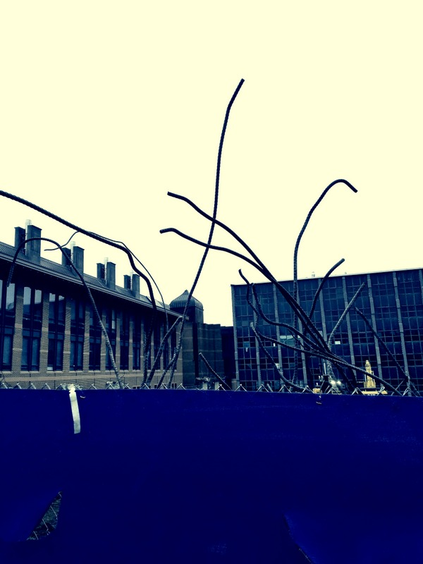
(Topics in)
Cancer Genomics:
Annotating Non-coding Variants,
Measuring Regulatory Network Rewiring, Building Background Mutation Models, Analyzing Tumor Evolution &
Evaluating the Overall Impact of Passenger Mutations
Mark Gerstein
Yale
Slides freely downloadable from Lectures.GersteinLab.org & “tweetable” (via @MarkGerstein).
No Conflicts for this Talk. See last slide for more info.

Slide 2
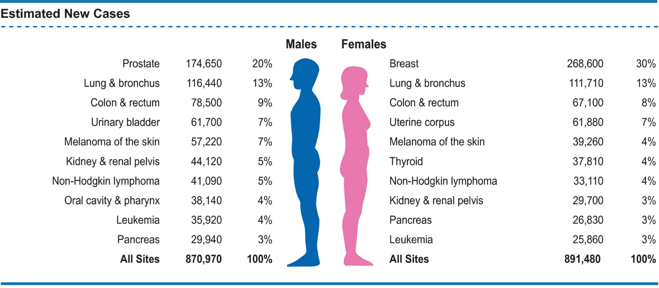

Estimated numbers of new cases of invasive cancer in the United States in 2019 by sex and cancer type
1,762,450 new cases per year
$\sim$4,800 new cases per day
Segiel et al, Cancer statistics, 2019
Notes:
No friends or relatives

Slide 3

Much Interest in Precision Oncology
Analysis of the exact somatic mutations in a individual
Highlighting key mutations
Targeting treatment
What if matching a cancer cure to our genetic code was just as easy
https://obamawhitehouse.archives.gov/blog/2016/02/25/precision-medicine-health-care-tailored-you

Slide 4

Overall Problem:
Finding Key Variants in
Personal Genomes
CAN YOU FIND THE PANDA?
  Millions of variants in a personal genome
  Thousands, in a cancer genome
  Different contexts for prioritization
  In rare disease, only a few
  high-impact variants are associated with disease
  In cancer, a few positively selected drivers amongst many passengers
  In common disease, more variants associated & each has weaker effect,
  But one wants to find key ”functional” variant amongst many in LD
Notes:
4

Slide 5
Overall Problem:
Finding Key Variants in
Personal Genomes
CAN YOU FIND THE PANDA?
  Millions of variants in a personal genome
  Thousands, in a cancer genome
  Different contexts for prioritization
  In rare disease, only a few
  high-impact variants are associated with disease
  In cancer, a few positively selected drivers amongst many passengers
  In common disease, more variants associated & each has weaker effect,
  But one wants to find key ”functional” variant amongst many in LD
  Thus: Need to find & prioritize high impact variants.
  Particularly hard for non-coding regions.
Notes:
5

Slide 6
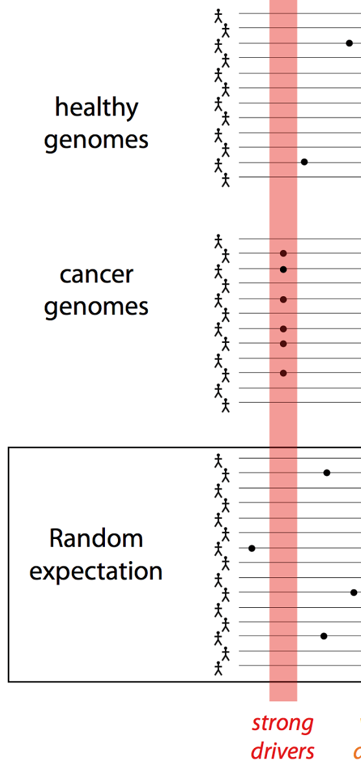
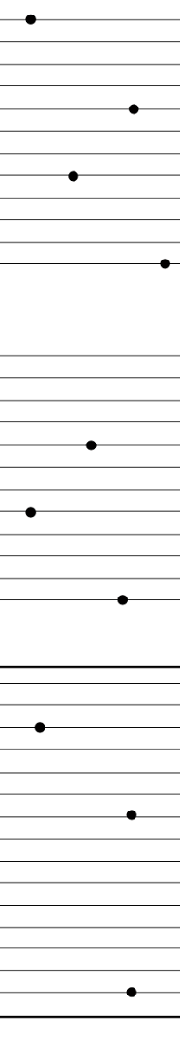
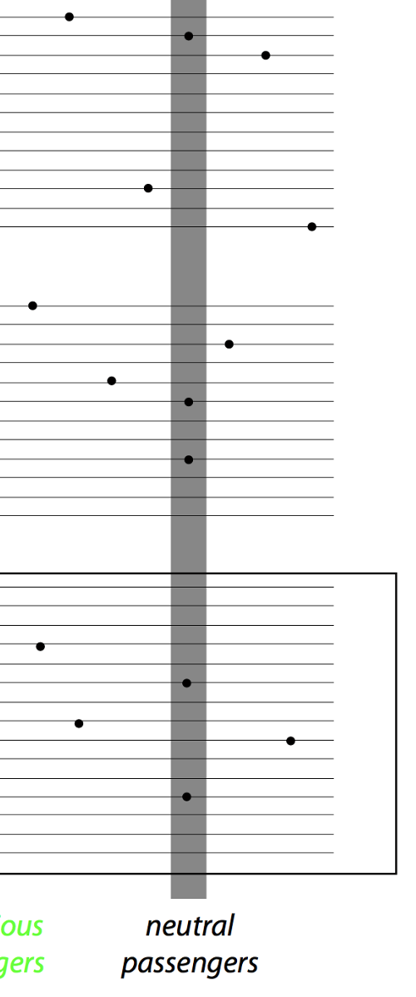
Canonical model of drivers & passengers in cancer
Drivers
  directly confer a selective growth advantage to the tumor cell.
  A typical tumor contains 2-8 drivers.
  identified through signals of positive selection.
  Existing cohorts of ~100s give enough power to identify
Passengers
  Conceptually, a passenger mutation has no direct or indirect effect on tumor progression.
  There are 1000s of passengers in a typical cancer genome.
[Vogelstein Science 2013. 339:1546]

Slide 7
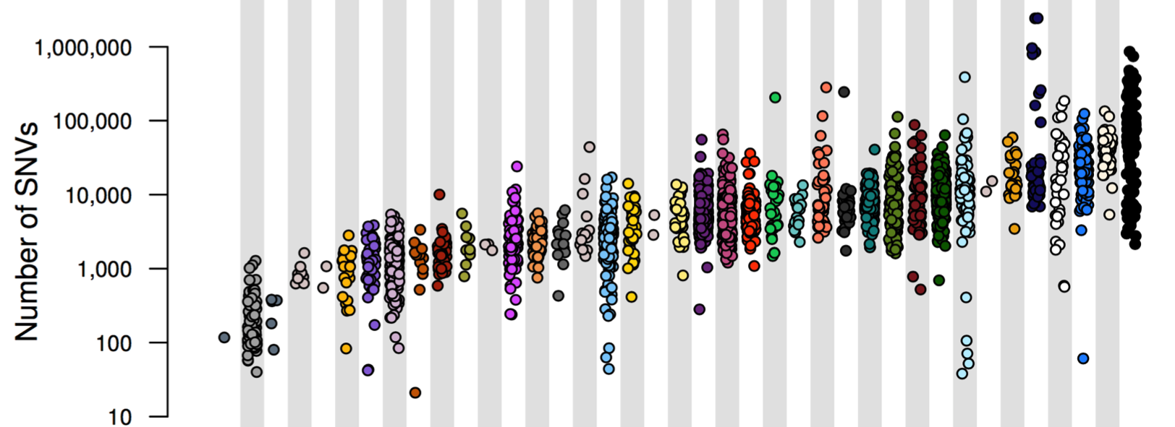
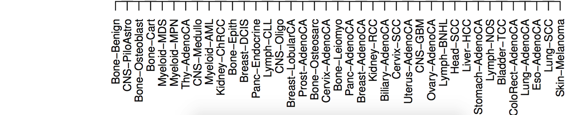
PCAWG : most comprehensive resource for
cancer whole genome analysis
Project Goals:
To understand role of non-coding regions of cancer genomes in disease progression.
Union of TCGA-ICGC efforts
Jointly analyzing ~2800 whole genome tumor/normal pairs
  > 580 researchers
  16 thematic working groups
  ~30M total somatic SNVs
Adapted from Campbell et. al., bioRxiv (’17)

Slide 8
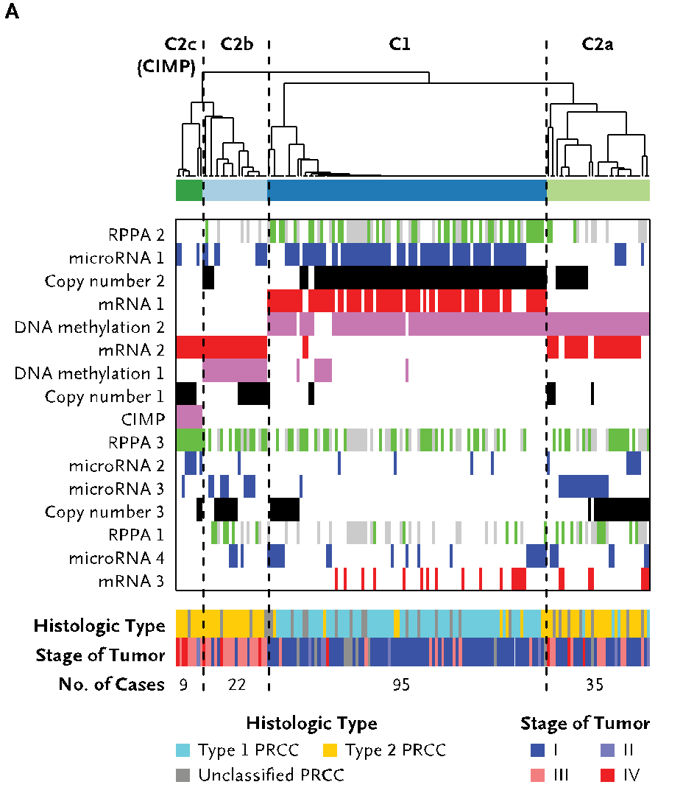
A case study: pRCC
Kidney cancer lifetime risk of 1.6% & the papillary type (pRCC) counts for ~10% of all cases
TCGA sequenced 161 exomes & classified them into subtypes
35 WGS of TN pairs
[Cancer Genome Atlas Research Network N Engl J Med. (‘16) ]

Slide 9
(Topics in) Cancer Genomics: Annotating Non-coding Variants, Measuring Regulatory Network Rewiring, Building Background Mutation Models, Analyzing Tumor Evolution & Evaluating the Overall Impact of Passenger Mutations
Intro
  PMI & Variant Prioritization; driver-passenger model
  Data source: PCAWG comprehensive WGS on >2.5K
  + focus on 35 pRCC WGS
ENCODEC Annotation
  ENCODE cancer resource,
  with TF & RBP networks
  Cell-space view of TN pairs
  FunSeq variant impact measurement integrates conservation & network centrality
Network Rewiring
  Highlights regulators that change targets greatly
  LDA approach (from text-mining) finds those that greatly change their gene communities
BMR: LARVA/MOAT
  Uses parametric beta-binomial model, explicitly modeling genomic covariates
  Non-parametric shuffles. Useful when explicit covariates not available.
  Tumor Evolution: Classification + Driver identification
  Intro: Mutational timing & tree topology classifies pRCC subtypes
  Identifying drivers from perturbations in VAF spectra from a single tumor (using many hitchhiking mutations to gain statistical support)
  Overall Impact of Putative Passengers
  Not just high & low impact dichotomy
  How the fraction of high-impact SNVs scales & relates to survival
  Differences betw. Impact of early & late passenger mutations (eg in TSGs & oncogenes)
  Differential Impact of Signatures
  Diff. burdening of TF sub-networks naturally results from mutational spectra & signatures differentially affecting binding motifs.
  High & low impact mutations assoc. w/ diff. signatures
  How it all relates to selection?
  Additive Effects Model
  To quantify aggregated effect of passengers. Demonstratable effect, particularly for non-coding ones, in addition to known drivers.
  Recasting as a predictive model
  to est. number of weak drivers

Slide 10
(Topics in) Cancer Genomics: Annotating Non-coding Variants, Measuring Regulatory Network Rewiring, Building Background Mutation Models, Analyzing Tumor Evolution & Evaluating the Overall Impact of Passenger Mutations
Intro
  PMI & Variant Prioritization; driver-passenger model
  Data source: PCAWG comprehensive WGS on >2.5K
  + focus on 35 pRCC WGS
ENCODEC Annotation
  ENCODE cancer resource,
  with TF & RBP networks
  Cell-space view of TN pairs
  FunSeq variant impact measurement integrates conservation & network centrality
Network Rewiring
  Highlights regulators that change targets greatly
  LDA approach (from text-mining) finds those that greatly change their gene communities
BMR: LARVA/MOAT
  Uses parametric beta-binomial model, explicitly modeling genomic covariates
  Non-parametric shuffles. Useful when explicit covariates not available.
  Tumor Evolution: Classification + Driver identification
  Intro: Mutational timing & tree topology classifies pRCC subtypes
  Identifying drivers from perturbations in VAF spectra from a single tumor (using many hitchhiking mutations to gain statistical support)
  Overall Impact of Putative Passengers
  Not just high & low impact dichotomy
  How the fraction of high-impact SNVs scales & relates to survival
  Differences betw. Impact of early & late passenger mutations (eg in TSGs & oncogenes)
  Differential Impact of Signatures
  Diff. burdening of TF sub-networks naturally results from mutational spectra & signatures differentially affecting binding motifs.
  High & low impact mutations assoc. w/ diff. signatures
  How it all relates to selection?
  Additive Effects Model
  To quantify aggregated effect of passengers. Demonstratable effect, particularly for non-coding ones, in addition to known drivers.
  Recasting as a predictive model
  to est. number of weak drivers

Slide 11
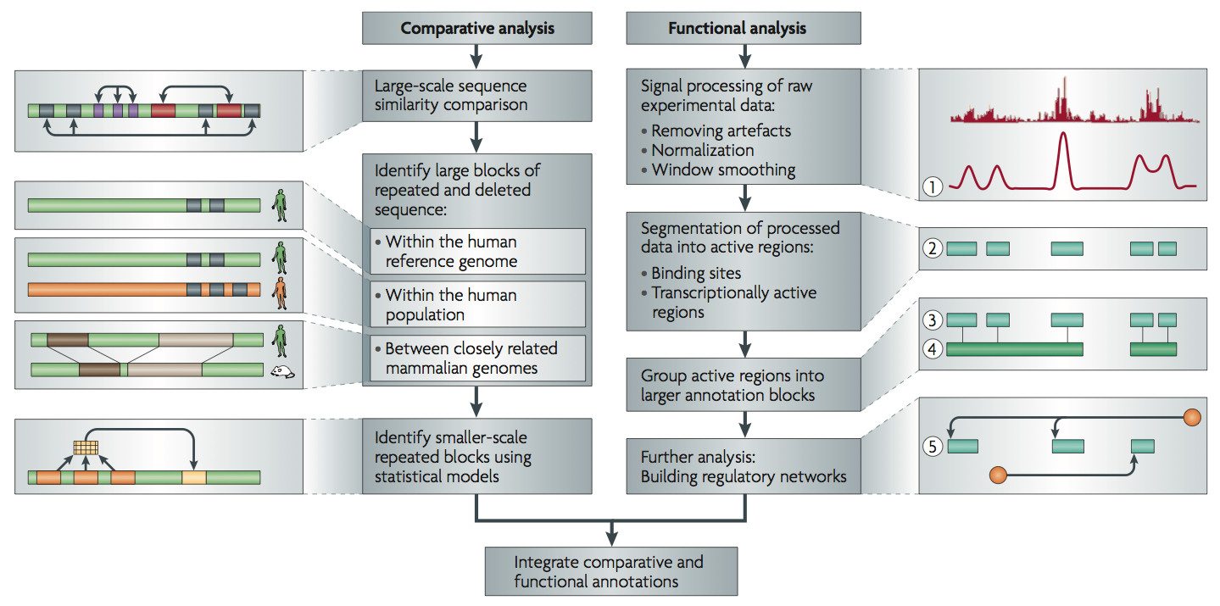
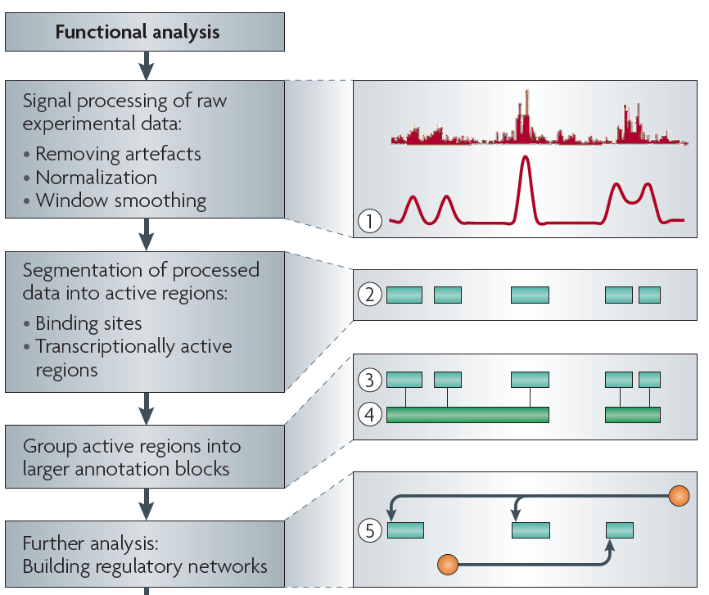
Non-coding Annotations: Overview
Features are often present on multiple ”scale” (eg elements and connected networks)
Sequence features, incl. Conservation
Functional Genomics
Chip-seq (Epigenome & seq. specific TF) and ncRNA & un-annotated transcription
[Alexander et al., Nat. Rev. Genet. (’10)]

Slide 12
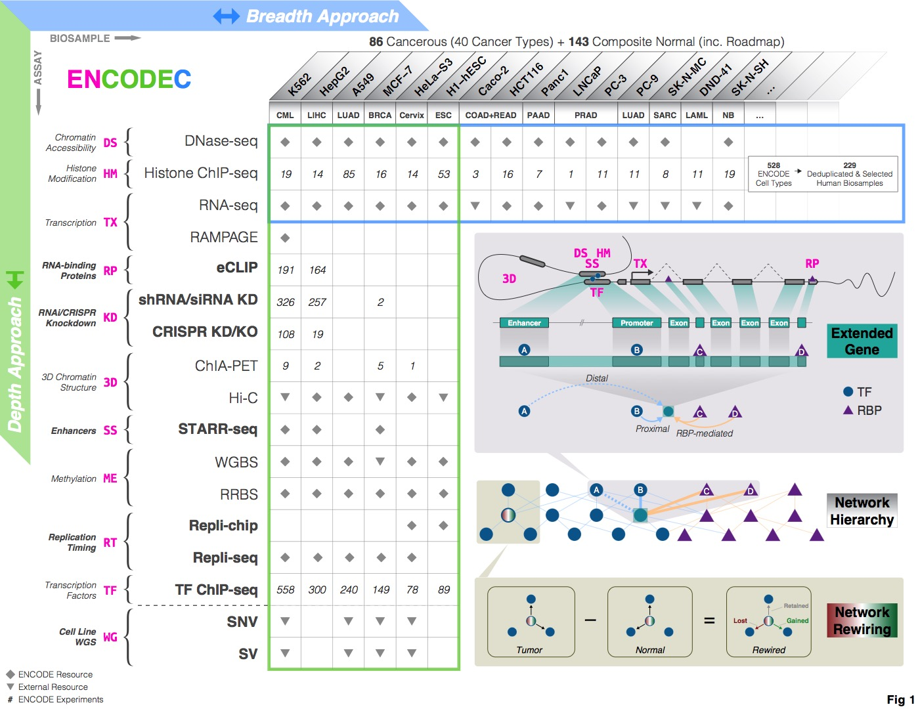
http://encodec.encodeproject.org/
[Zhang et al. (‘20), biorxiv + Nat. Comm. (in press)]

Slide 13
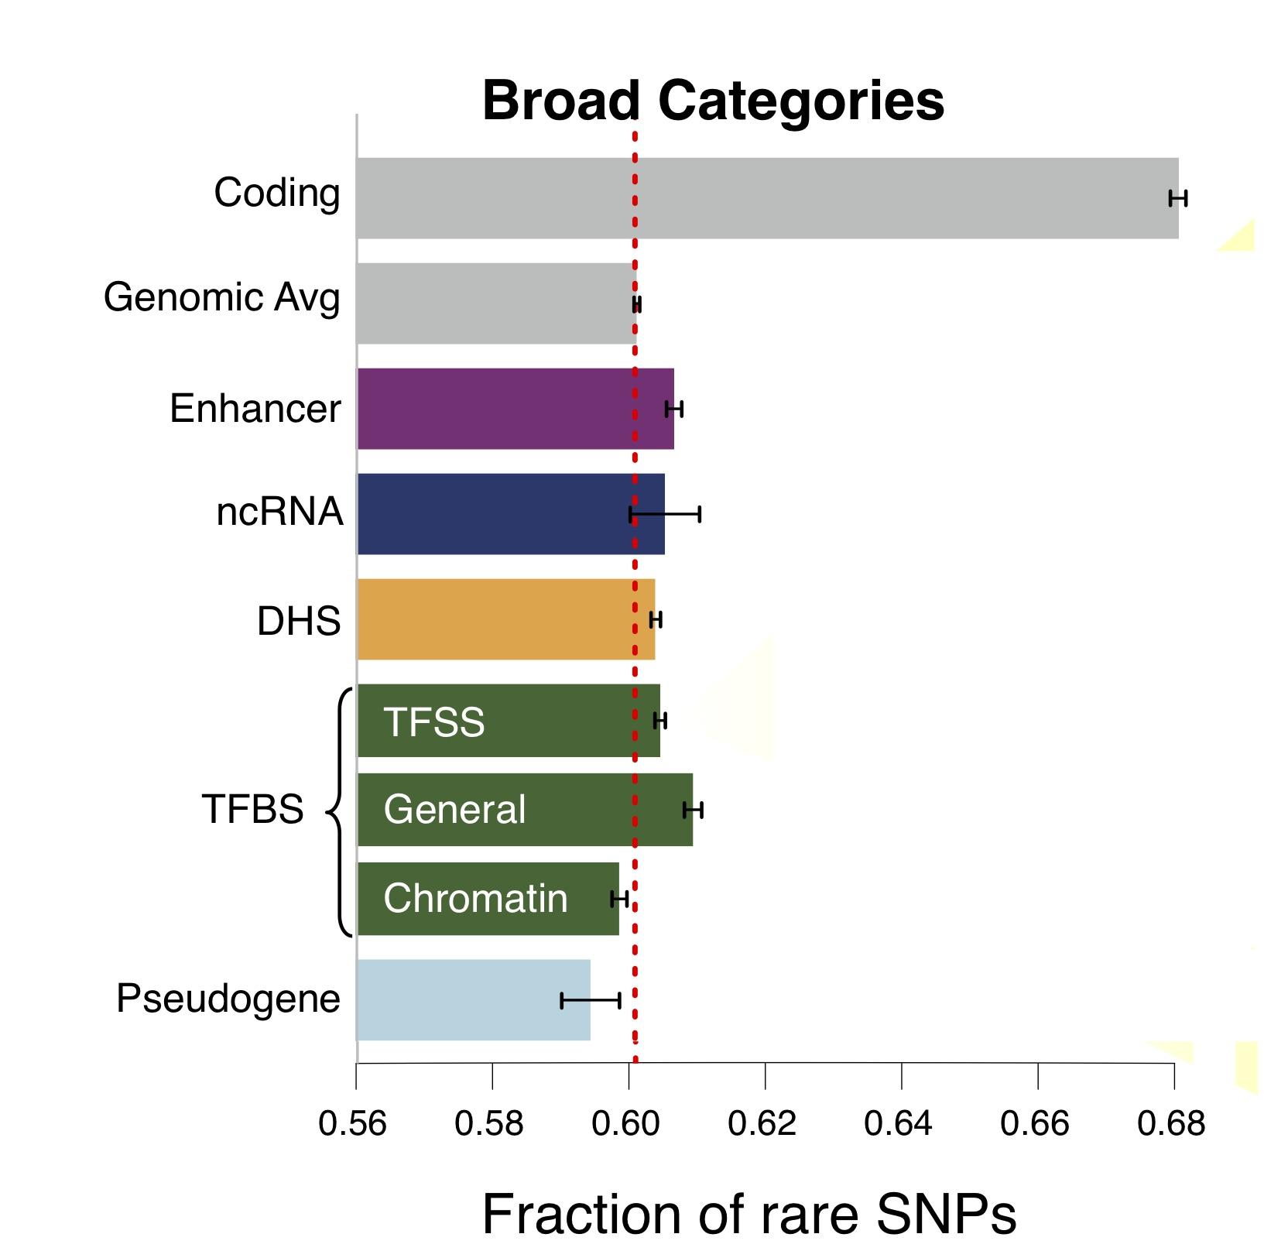
Finding "Conserved” Sites in the Human Population:
Negative selection in non-coding elements based on
Production ENCODE & 1000G Phase 1
Broad categories of regulatory regions under negative selection
Related to:
ENCODE, Nature, 2012
Ward & Kellis, Science, 2012
Mu et al, NAR, 2011
(Non-coding RNA)
(DNase I hypersensitive sites)
(TFSS: Sequence-specific TFs)
(Transcription factor binding sites)
Depletion of Common Variants
in the Human Population

Slide 14
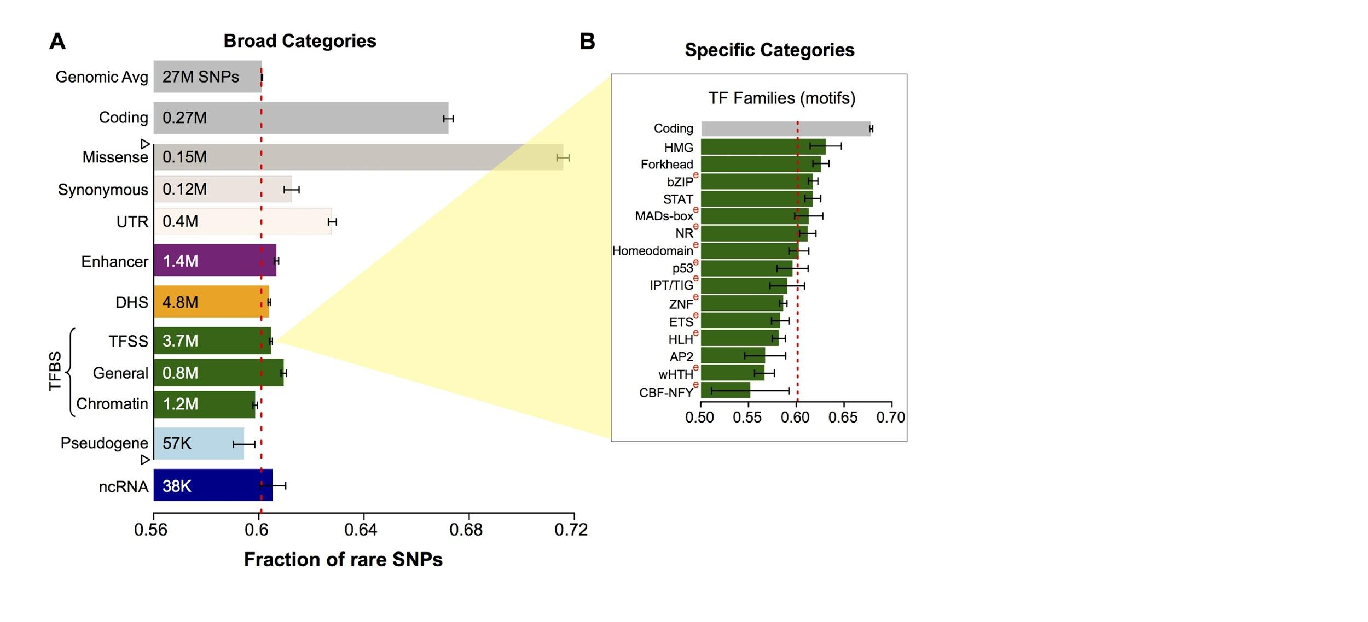
Differential selective constraints
among specific sub-categories
Sub-categorization possible because of better statistics from 1000G phase 1 v pilot
[Khurana et al., Science (‘13)]

Slide 15
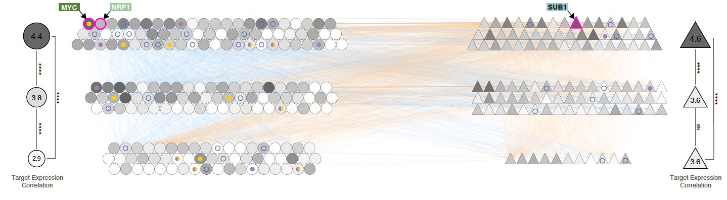
Top Layer: Master regulators, regulating others more than being regulated
Bottom Layer: follower regulators, being regulated more than regulating others
[Zhang et al. (‘20), biorxiv + Nat. Comm. (in press)]
How much power each regulator has in driving tumor-normal differential expressions
TF-RBP crosstalk
Transcription
TF
TF-RBP regulate the same gene at different levels
promoter
Exon
Intron
Exon
RBP
Post-transcription
Exon
Exon
AAAAA

Slide 16
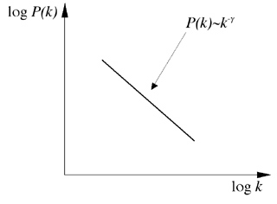
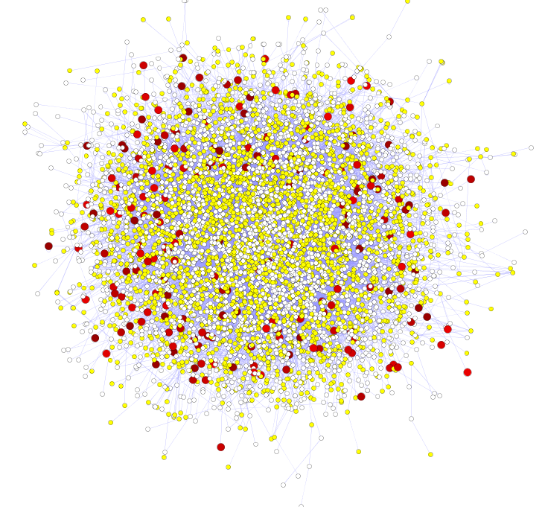
Hubs Under Constraint:
A Finding from the Network Biology Community
Power-law distribution
Hub
log(Frequency)
High likelihood of positive selection
Not under positive selection
Lower likelihood of positive selection
No data about positive selection
log(Degree)
[Nielsen et al. PLoS Biol. (2005), HPRD, Kim et al. PNAS (2007)]
More Connectivity, More Constraint: Genes & proteins that have a more central position in the network tend to evolve more slowly and are more likely to be essential.
This phenomenon is observed in
many organisms & different kinds of networks
  yeast PPI - Fraser et al ('02) Science,
  ('03) BMC Evo. Bio.
  Ecoli PPI - Butland et al ('04) Nature
  Worm/fly PPI - Hahn et al ('05) MBE
  miRNA net - Cheng et al ('09) BMC Genomics

Slide 17
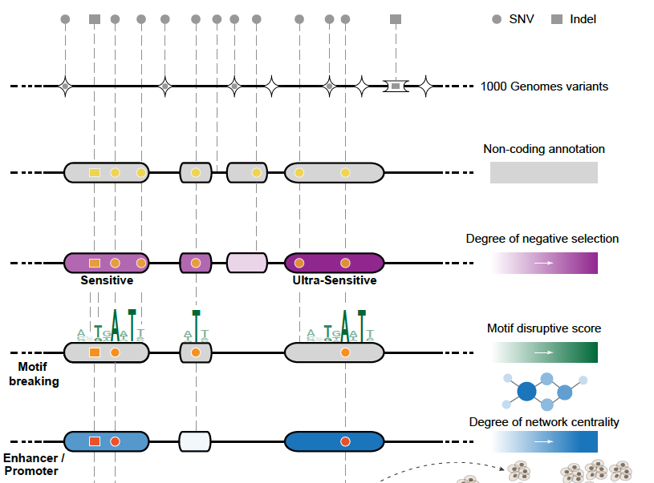
Funseq: a flexible framework to determine
functional impact & use this to prioritize variants
Annotation (tf binding sites open chromatin, ncRNAs) & Chromatin Dynamics
Conservation
(GERP, allele freq.)
Mutational impact (motif breaking, Lof)
Network (centrality position)
[Fu et al., GenomeBiology ('14), , Khurana et al., Science ('13)]

Slide 18
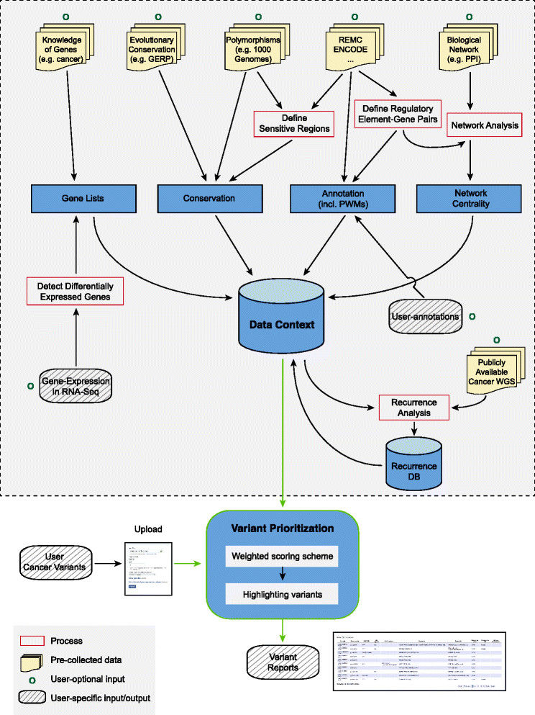
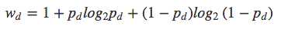
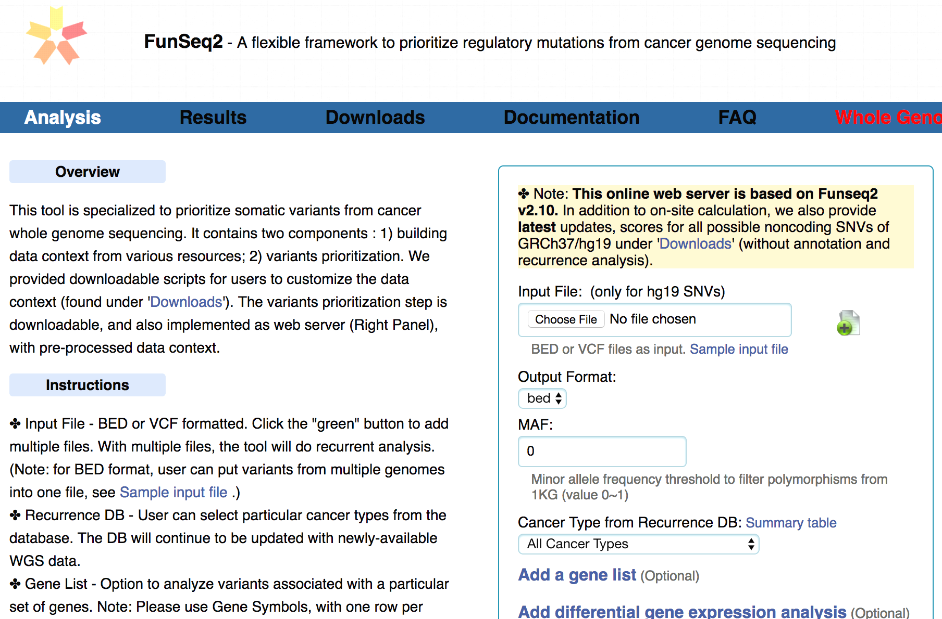
FunSeq.gersteinlab.org
HOT region
Sensitive region
Polymorphisms
Genome
Info. theory based method (ie annotation “surprisal”) for weighting consistently many genomic features
Practical web server
Submission of variants & pre-computed large data context from uniformly processing large-scale datasets
[Fu et al., GenomeBiology ('14)]

Slide 19
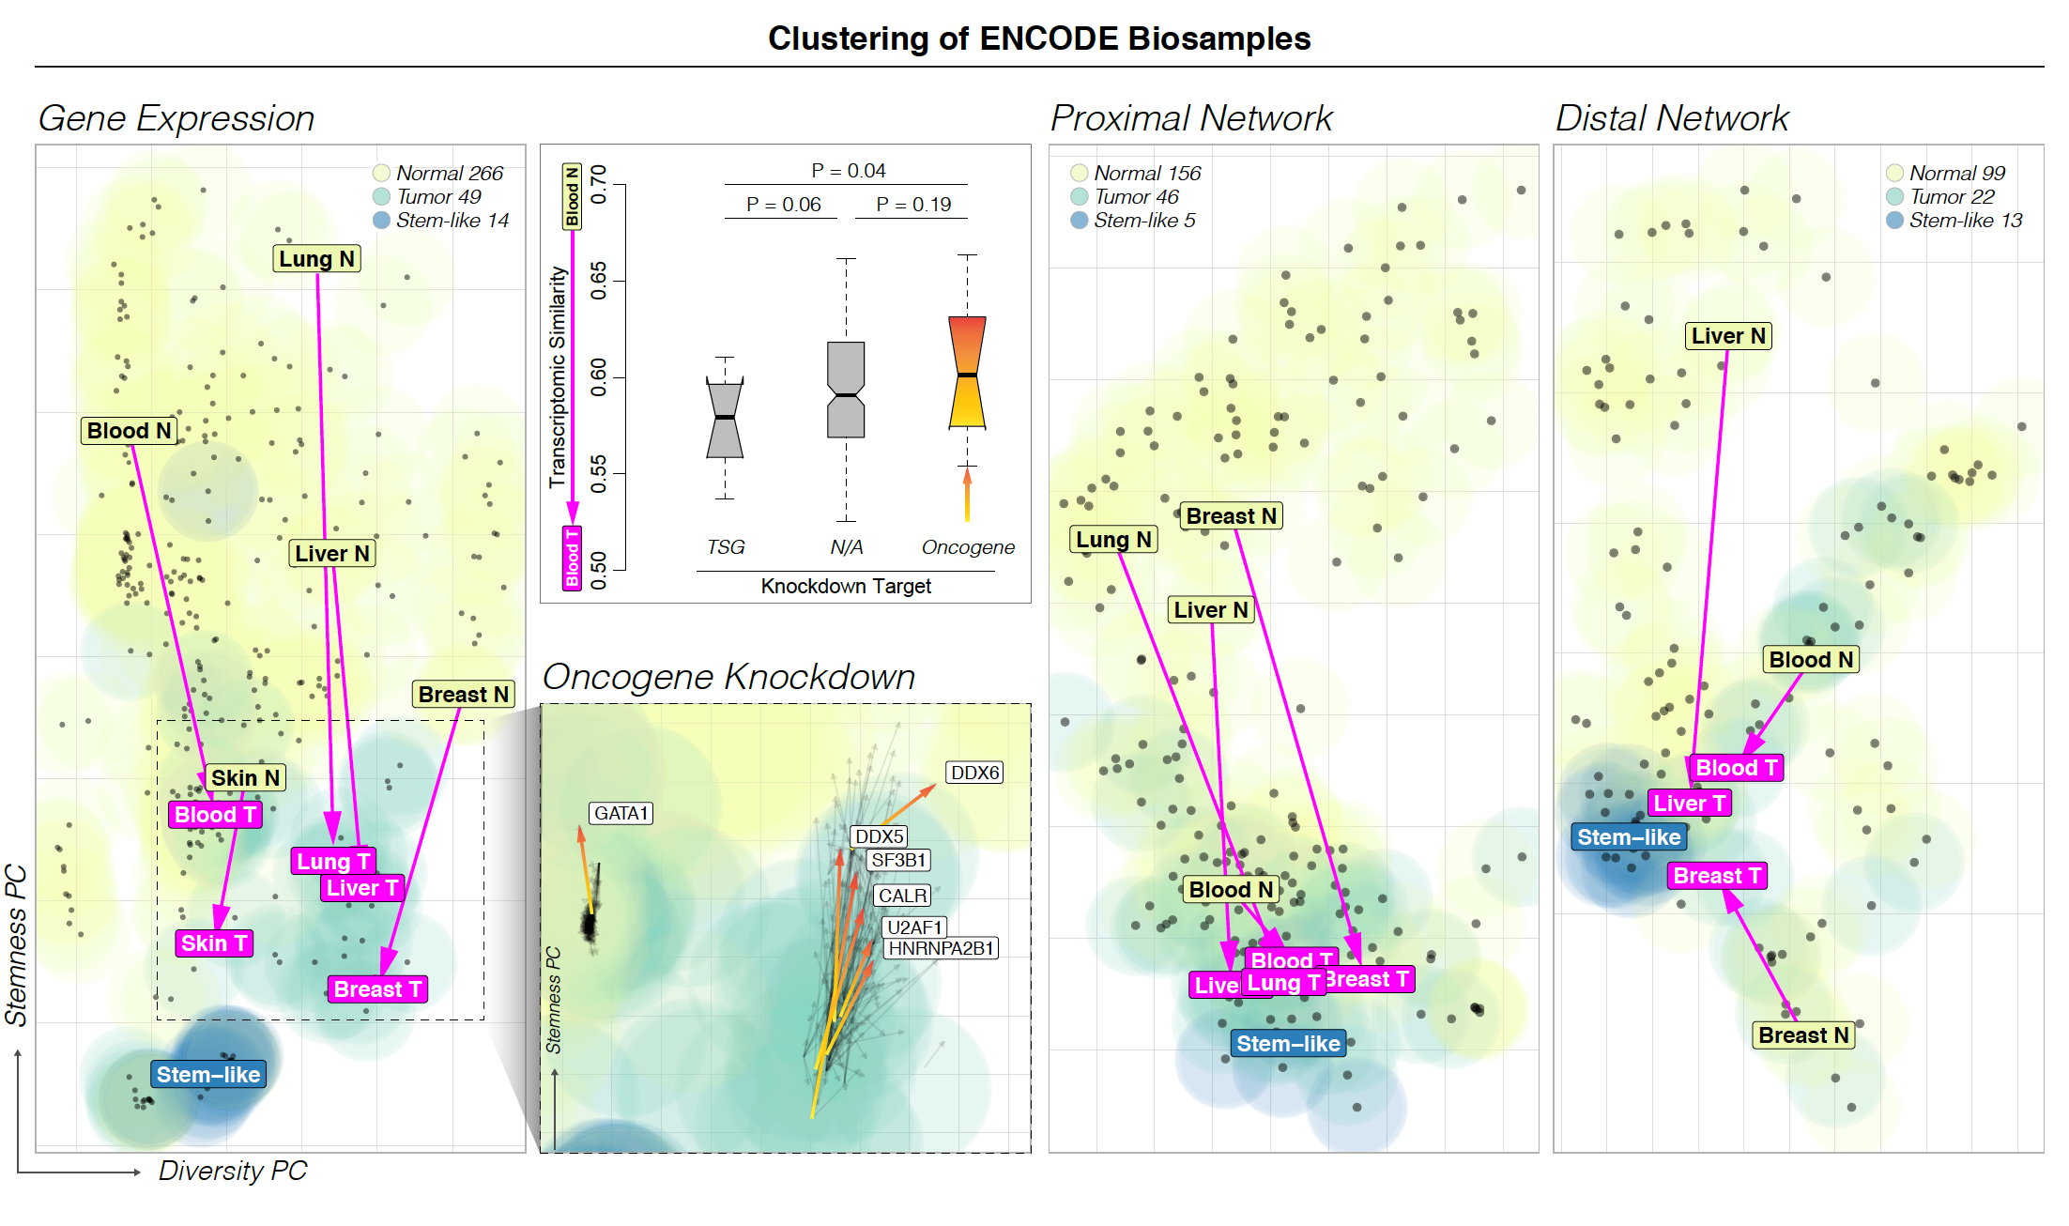
[Zhang et al. (‘20), biorxiv + Nat. Comm. (in press)]

Slide 20
(Topics in) Cancer Genomics: Annotating Non-coding Variants, Measuring Regulatory Network Rewiring, Building Background Mutation Models, Analyzing Tumor Evolution & Evaluating the Overall Impact of Passenger Mutations
Intro
  PMI & Variant Prioritization; driver-passenger model
  Data source: PCAWG comprehensive WGS on >2.5K
  + focus on 35 pRCC WGS
ENCODEC Annotation
  ENCODE cancer resource,
  with TF & RBP networks
  Cell-space view of TN pairs
  FunSeq variant impact measurement integrates conservation & network centrality
Network Rewiring
  Highlights regulators that change targets greatly
  LDA approach (from text-mining) finds those that greatly change their gene communities
BMR: LARVA/MOAT
  Uses parametric beta-binomial model, explicitly modeling genomic covariates
  Non-parametric shuffles. Useful when explicit covariates not available.
  Tumor Evolution: Classification + Driver identification
  Intro: Mutational timing & tree topology classifies pRCC subtypes
  Identifying drivers from perturbations in VAF spectra from a single tumor (using many hitchhiking mutations to gain statistical support)
  Overall Impact of Putative Passengers
  Not just high & low impact dichotomy
  How the fraction of high-impact SNVs scales & relates to survival
  Differences betw. Impact of early & late passenger mutations (eg in TSGs & oncogenes)
  Differential Impact of Signatures
  Diff. burdening of TF sub-networks naturally results from mutational spectra & signatures differentially affecting binding motifs.
  High & low impact mutations assoc. w/ diff. signatures
  How it all relates to selection?
  Additive Effects Model
  To quantify aggregated effect of passengers. Demonstratable effect, particularly for non-coding ones, in addition to known drivers.
  Recasting as a predictive model
  to est. number of weak drivers

Slide 21
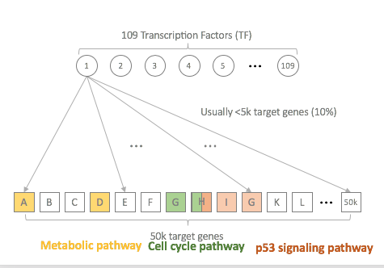
Normal network
Tumor network
1
2
3
4
1
2
3
4
A
B
C
D
E
F
A
B
C
D
E
F
Network rewiring analyses: key cancer-associated regulator identification through network comparisons
[Zhang et al. (‘20), biorxiv + Nat. Comm. (in press)]

Slide 22
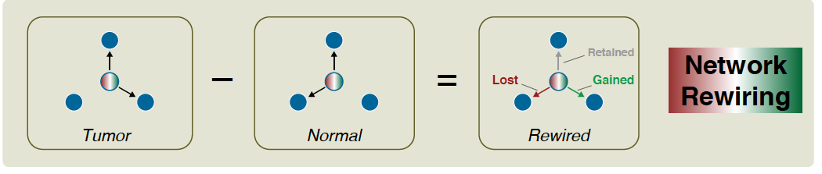
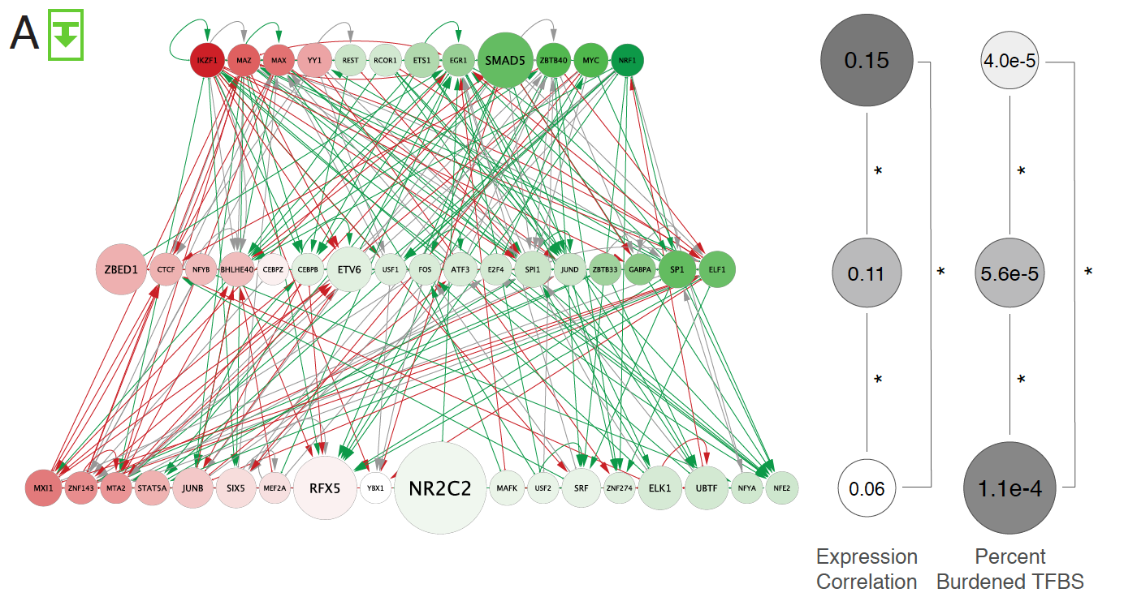
Rewired
edges in
comparison
of GM12878
to K562
109 node
TF-TF
network
(approx.
CML)
[Zhang et al. (‘20), biorxiv + Nat. Comm. (in press)]

Slide 23
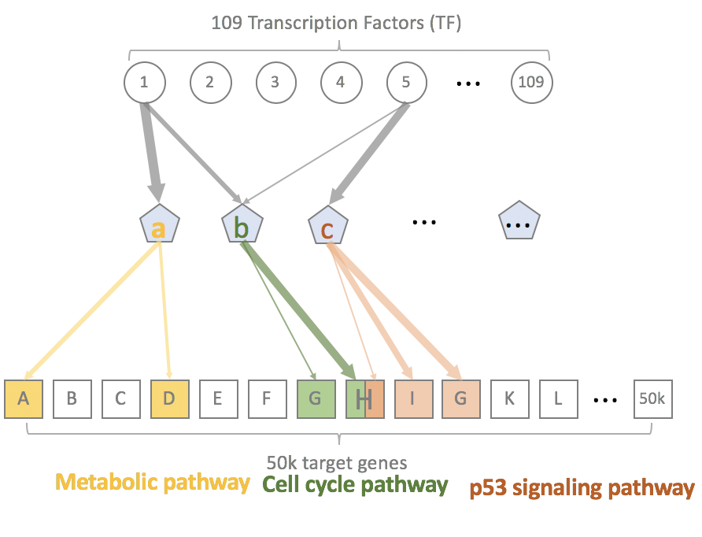
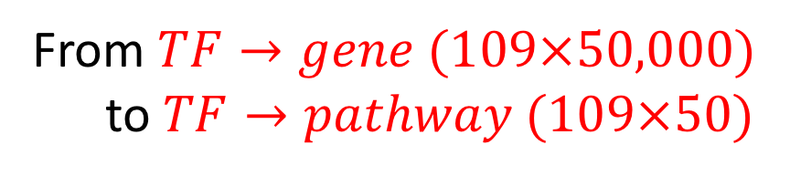
De-noising process by dimension reduction
From $TF→gene (109×50,000)$
to $TF→pathway (109×50)$
Hidden Layer
(50 biological pathways?)
Challenge: how to define appropriate pathways?
[Zhang et al. (‘20), biorxiv + Nat. Comm. (in press)]
[Zhang et al. ('19), biorxiv.org] Lectures.gersteinlab.org

Slide 24
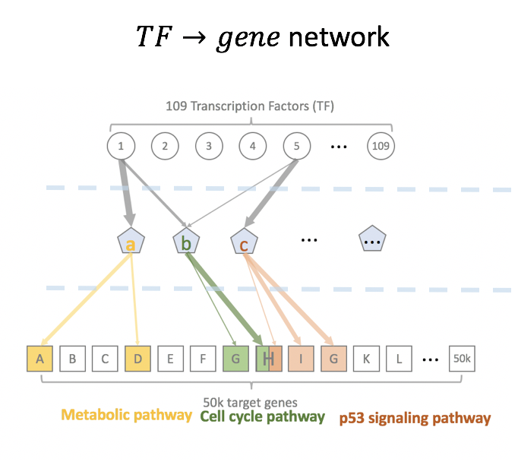
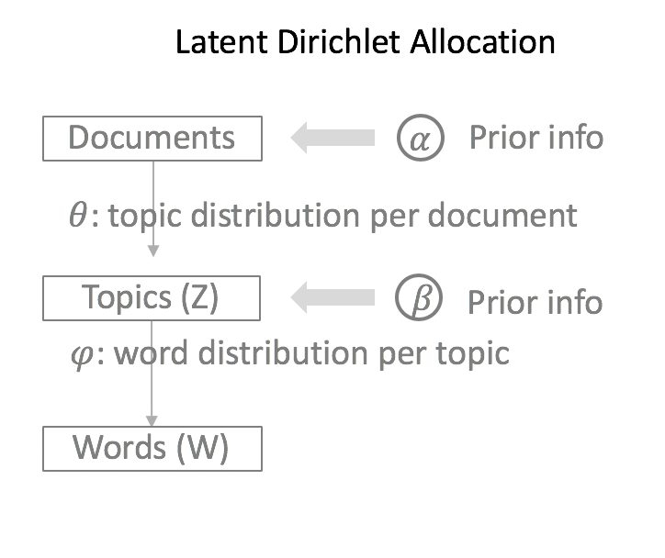
Automatic gene topic identification
based on Latent Dirichlet Allocation
[Zhang et al. ('19), biorxiv.org] Lectures.gersteinlab.org

Slide 25
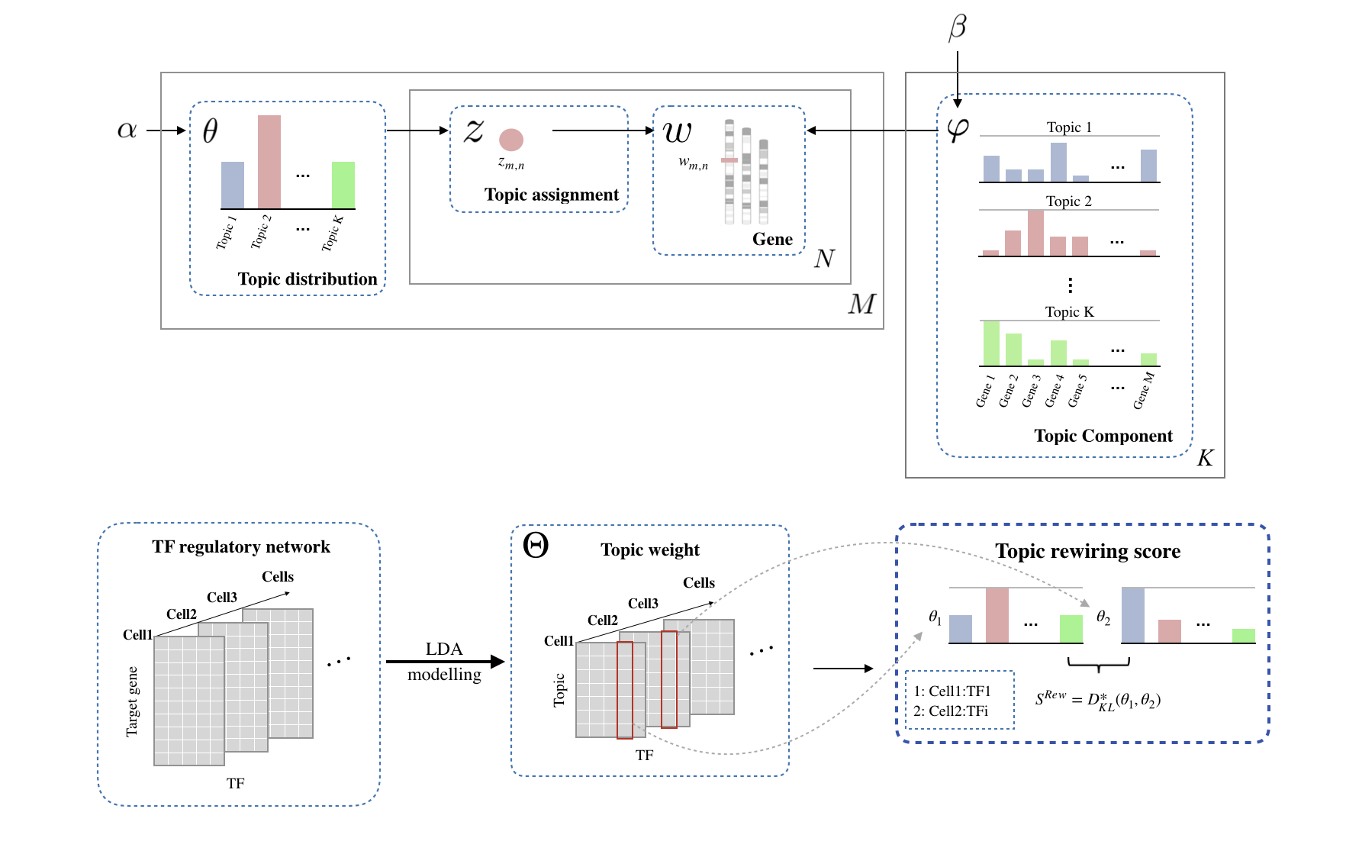

Slide 26
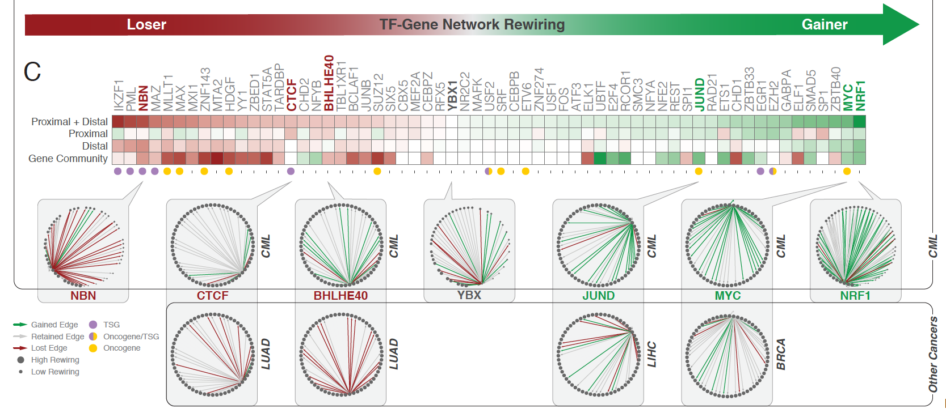
[Zhang et al. (‘20), biorxiv + Nat. Comm. (in press)]
[Zhang et al. ('19), biorxiv.org] Lectures.gersteinlab.org

Slide 27
(Topics in) Cancer Genomics: Annotating Non-coding Variants, Measuring Regulatory Network Rewiring, Building Background Mutation Models, Analyzing Tumor Evolution & Evaluating the Overall Impact of Passenger Mutations
Intro
  PMI & Variant Prioritization; driver-passenger model
  Data source: PCAWG comprehensive WGS on >2.5K
  + focus on 35 pRCC WGS
ENCODEC Annotation
  ENCODE cancer resource,
  with TF & RBP networks
  Cell-space view of TN pairs
  FunSeq variant impact measurement integrates conservation & network centrality
Network Rewiring
  Highlights regulators that change targets greatly
  LDA approach (from text-mining) finds those that greatly change their gene communities
BMR: LARVA/MOAT
  Uses parametric beta-binomial model, explicitly modeling genomic covariates
  Non-parametric shuffles. Useful when explicit covariates not available.
  Tumor Evolution: Classification + Driver identification
  Intro: Mutational timing & tree topology classifies pRCC subtypes
  Identifying drivers from perturbations in VAF spectra from a single tumor (using many hitchhiking mutations to gain statistical support)
  Overall Impact of Putative Passengers
  Not just high & low impact dichotomy
  How the fraction of high-impact SNVs scales & relates to survival
  Differences betw. Impact of early & late passenger mutations (eg in TSGs & oncogenes)
  Differential Impact of Signatures
  Diff. burdening of TF sub-networks naturally results from mutational spectra & signatures differentially affecting binding motifs.
  High & low impact mutations assoc. w/ diff. signatures
  How it all relates to selection?
  Additive Effects Model
  To quantify aggregated effect of passengers. Demonstratable effect, particularly for non-coding ones, in addition to known drivers.
  Recasting as a predictive model
  to est. number of weak drivers

Slide 28



Mutation recurrence
Cancer Type 1
Cancer Type 2
Cancer Type 3

Slide 29
Mutation recurrence
Cancer Type 1
Cancer Type 2
Cancer Type 3
Early replicated regions
Late replicated regions

Slide 30
Noncoding annotations
Cancer Type 1
Cancer Type 2
Cancer Type 3
Early replicated regions
Late replicated regions

Slide 31
Noncoding annotations
Cancer Type 1
Cancer Type 2
Cancer Type 3
Early replicated regions
Late replicated regions

Slide 32
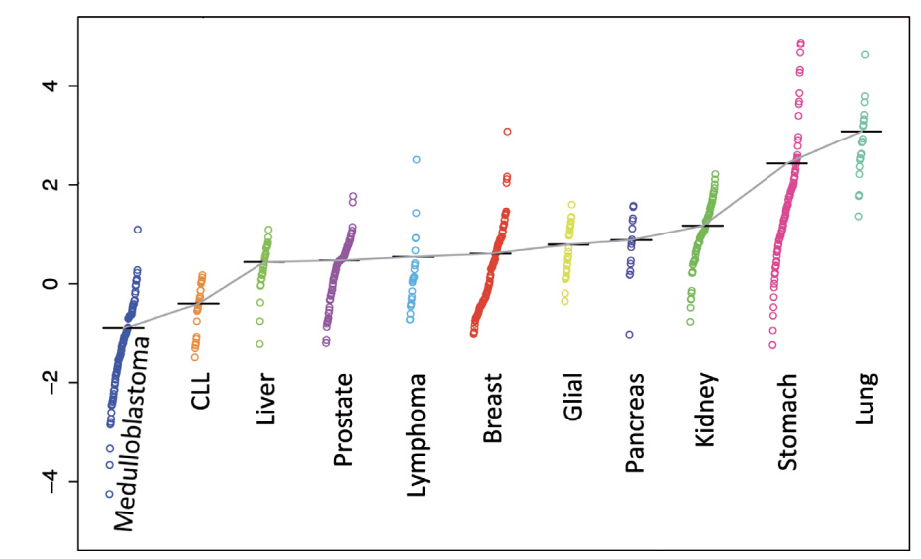
violation of the constant mutation rate assumption
mutation rate changes across tumor
within one tumor type
mutation rate changes across patients
mut. rate. per Mbp
within one tumor type
within one patient
mutation rate changes across regions
within one tumor type
within one patient
rep. timing vs. mut. rate
mutation rate changes with many covariates
inappropriate models
mut. rate. per Mbp
chromatin openness vs. mut. rate
Bad data fitting
Inaccurate burden test results
[Lochovsky et al. NAR (’15)]

Slide 33


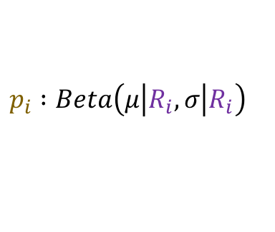
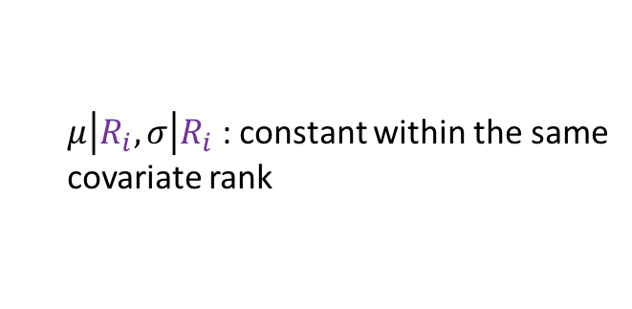

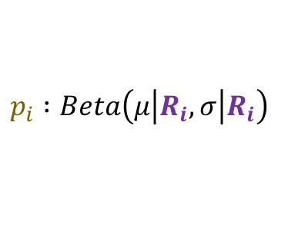

Cancer Somatic Mutation Modeling
PARAMETRIC MODELS
Suppose there are k genome elements. For element i, define:
  n_{i}: total number of nucleotides
  x_{i}: the number of mutations within the element
  p: the mutation rate
  R_{i}: the covariate rank of the element
Non-parametric model is useful when covariate data is missing for the studied annotations
  Also sidesteps issue of properly identifying and modeling every relevant covariate
  (possibly hundreds)
NON-PARAMETRIC MODELS
Model 1: Constant Background Mutation Rate (Model from Previous Work)
Assume constant background mutation rate in local regions.
Model 3a: Random Permutation of Input Annotations
Model 2a: Varying Mutation Rate
with Single Covariate Correction
Shuffle annotations within local region to assess background mutation rate.
Model 3b: Random Permutation of Input Variants
Shuffle variants within local region to assess background mutation rate.
Model 2b: Varying Mutation Rate
with Multiple Covariate Correction
[Lochovsky et al. Bioinformatics in press]
[Lochovsky et al. NAR (’15)]

Slide 34
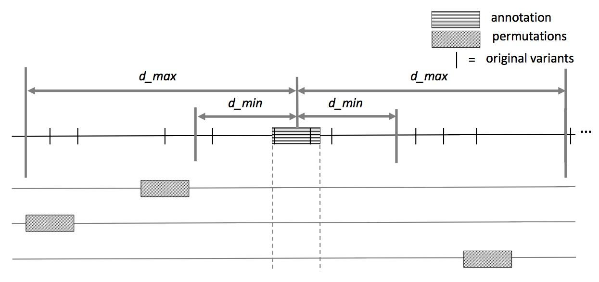
MOAT-a: Annotation-based permutation
[Lochovsky et al. Bioinformatics (‘17)]
Notes:
Formally, this method incorporates the annotation length l, the number of random bins we’re going to place in the surrounding genome, n, and two parameters that determine the boundaries of the local genome in which we place random bins, d_min and d_max. d_max has to be small enough that the background mutation rate is roughly constant, while d_min exists to ensure that, if there’s some transitionary region between the mutation rate of a and the mutation rate of the surrounding genome, that the signal from a won’t bleed into our analysis of the local genome context.

Slide 35


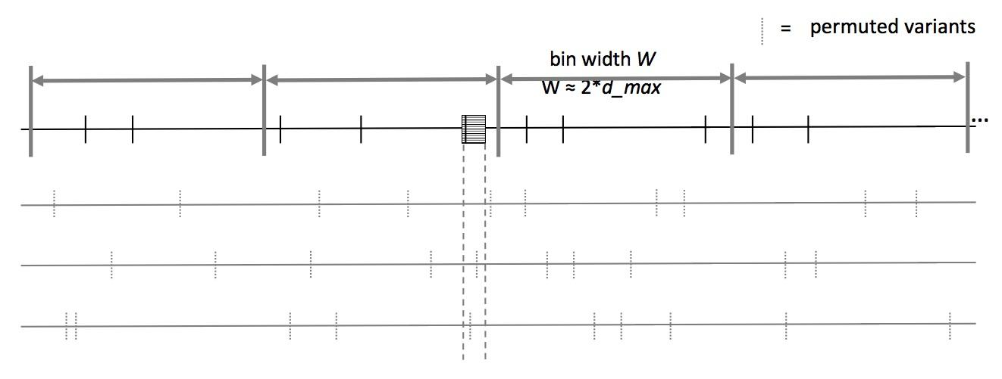
MOAT-v: Variant-based Permutation
Can preserve tri-nt context in shuffle
Similar to ”Sanger” approach in PCAWG
[Lochovsky et al. Bioinformatics (‘17)]
Notes:
The second version of MOAT operates on the idea of variant-based permutation. We place bins over the entire genome that each represent a local genome context, shuffle the variants in each bin, and track permuted variant counts for the annotation we’re studying.

Slide 36
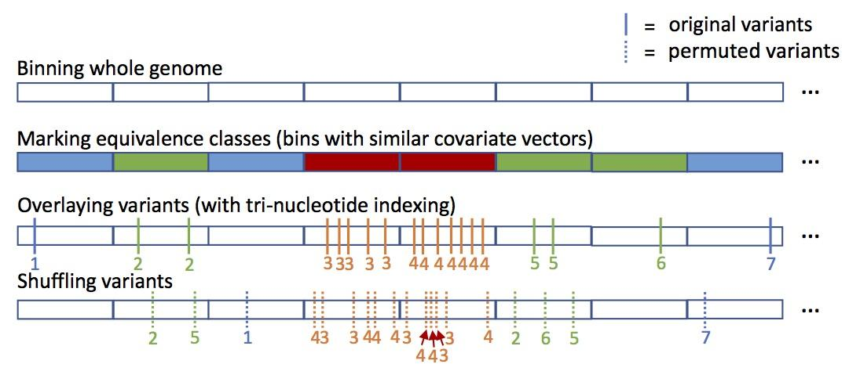
MOAT-s: a variant on MOAT-v
A somatic variant simulator
  Given a set of input variants, shuffle to new locations, taking genome structure into account
  Like “Broad” approach in PCAWG
[Lochovsky et al. Bioinformatics (‘17)]

Slide 37
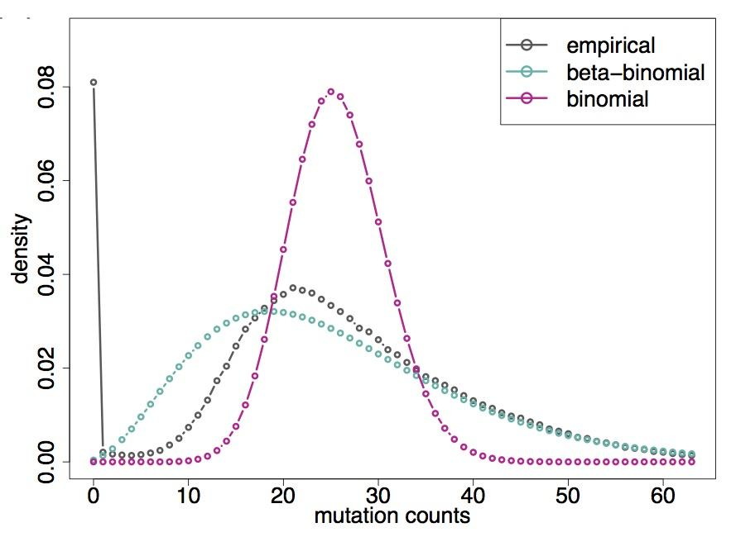
LARVA Model Comparison
Comparison of mutation count frequency implied by the binomial model (model 1) and the beta-binomial model (model 2) relative to the empirical distribution
The beta-binomial distribution is significantly better, especially for accurately modeling the over-dispersion of the empirical distribution
[Lochovsky et al. NAR (’15)]

Slide 38
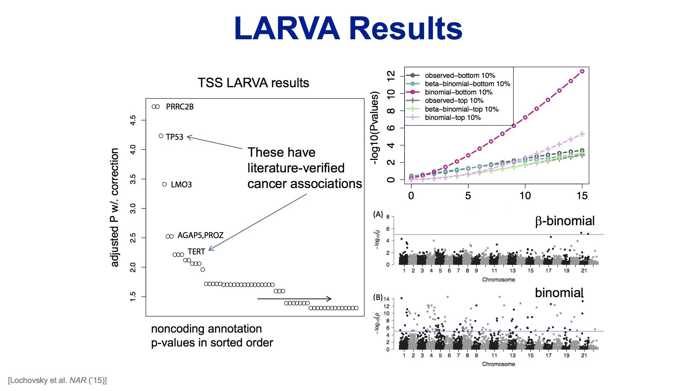

Slide 39
(Topics in) Cancer Genomics: Annotating Non-coding Variants, Measuring Regulatory Network Rewiring, Building Background Mutation Models, Analyzing Tumor Evolution & Evaluating the Overall Impact of Passenger Mutations
Intro
  PMI & Variant Prioritization; driver-passenger model
  Data source: PCAWG comprehensive WGS on >2.5K
  + focus on 35 pRCC WGS
ENCODEC Annotation
  ENCODE cancer resource,
  with TF & RBP networks
  Cell-space view of TN pairs
  FunSeq variant impact measurement integrates conservation & network centrality
Network Rewiring
  Highlights regulators that change targets greatly
  LDA approach (from text-mining) finds those that greatly change their gene communities
BMR: LARVA/MOAT
  Uses parametric beta-binomial model, explicitly modeling genomic covariates
  Non-parametric shuffles. Useful when explicit covariates not available.
  Tumor Evolution: Classification + Driver identification
  Intro: Mutational timing & tree topology classifies pRCC subtypes
  Identifying drivers from perturbations in VAF spectra from a single tumor (using many hitchhiking mutations to gain statistical support)
  Overall Impact of Putative Passengers
  Not just high & low impact dichotomy
  How the fraction of high-impact SNVs scales & relates to survival
  Differences betw. Impact of early & late passenger mutations (eg in TSGs & oncogenes)
  Differential Impact of Signatures
  Diff. burdening of TF sub-networks naturally results from mutational spectra & signatures differentially affecting binding motifs.
  High & low impact mutations assoc. w/ diff. signatures
  How it all relates to selection?
  Additive Effects Model
  To quantify aggregated effect of passengers. Demonstratable effect, particularly for non-coding ones, in addition to known drivers.
  Recasting as a predictive model
  to est. number of weak drivers

Slide 40
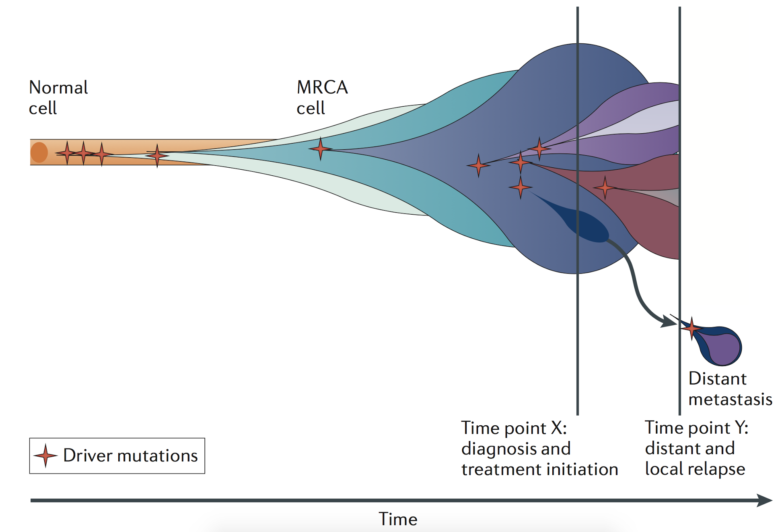
Tumor Evolution: Highlight the Ordering of Key Mutations
Yates et al, NRG (2012)

Slide 41
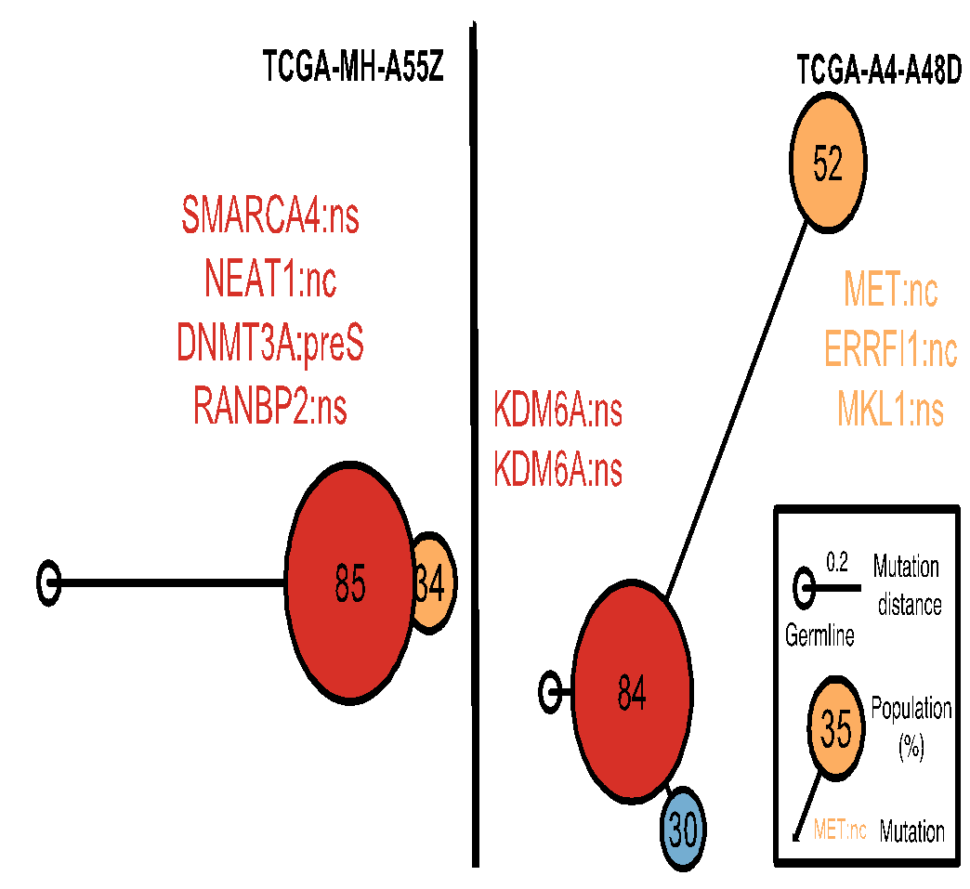
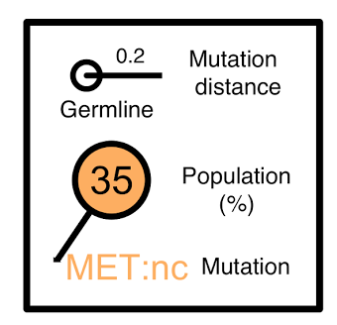

Construct evolutionary trees in pRCC
Infer mutation order and tree structure based on mutation abundance (PhyloWGS, Deshwar et al., 2015)
Some of the key mutations occur in all the clones while others are just in some parts of the tree
MET: noncoding
ERRFI1: noncoding
DNMT3A: premature stop
NEAT1: noncoding
SMARCA4: missense
KDM6A: missense
[S. Li, B. Shuch and M. Gerstein PLOS Genetics (‘17)]

Slide 42
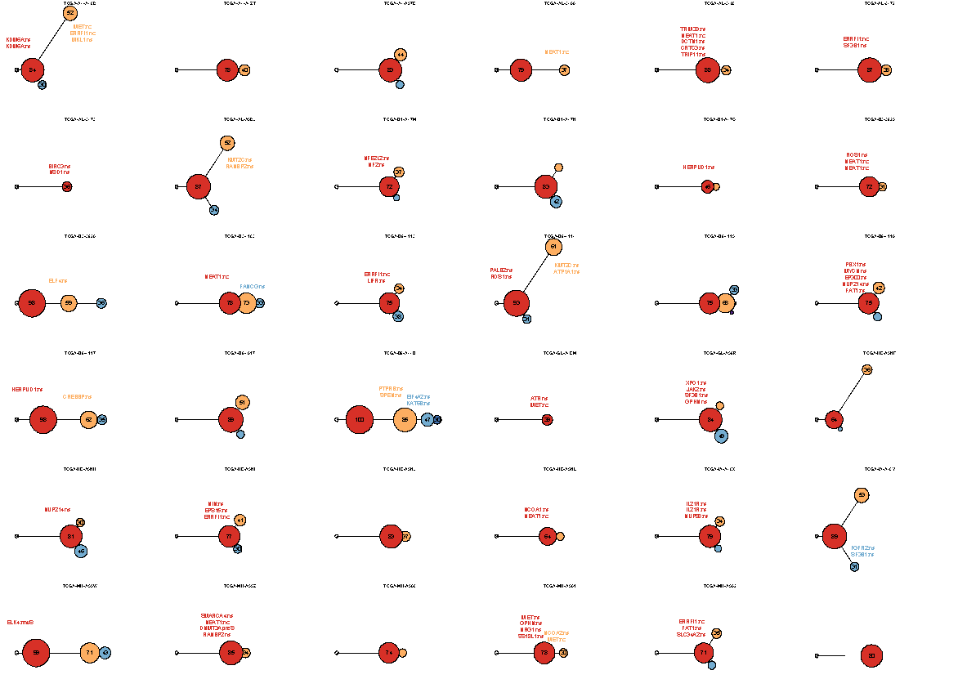
Mutation
distance
Populations
(%)
0.5
Germline
[S. Li, B. Shuch and M. Gerstein PLOS Genetics (‘17)]

Slide 43
Mutation
distance
Populations
(%)
0.5
Germline
[S. Li, B. Shuch and M. Gerstein PLOS Genetics (‘17)]

Slide 44
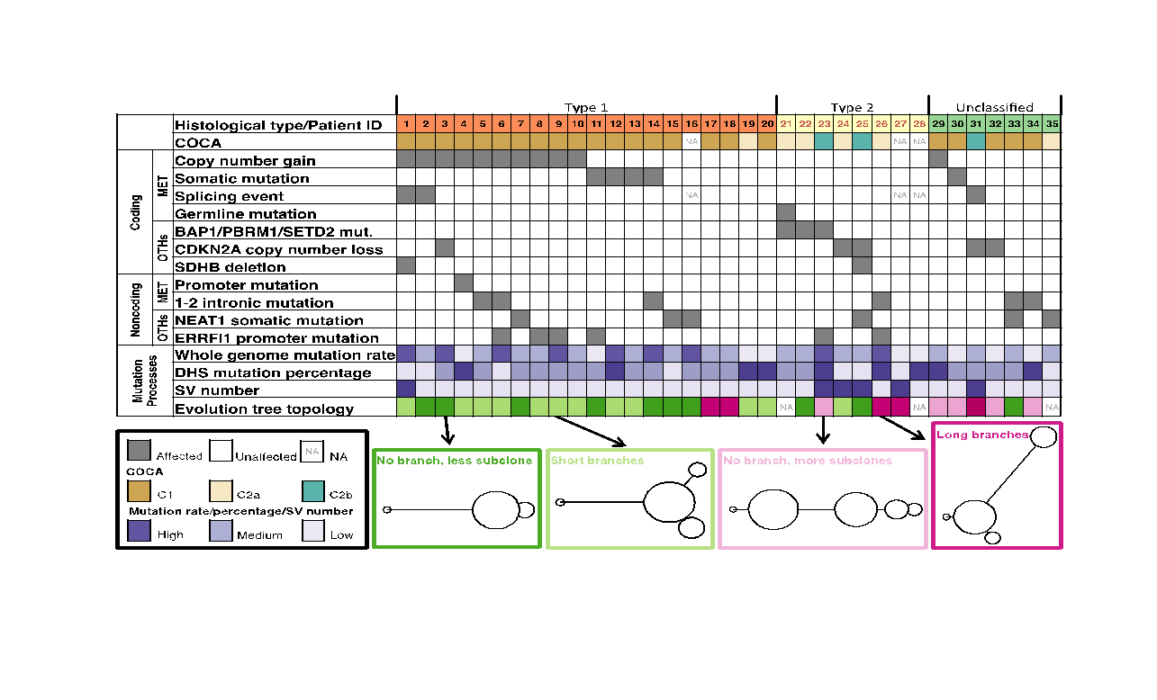
Tree topology correlates with molecular subtypes
[Li et al., PLOS Genetics (‘17)]

Slide 45
Modelling the frequency of “generational” hitchhikers in a fitness population
Mutational frequencies under neutral growth
[Salichos et al. (’20, in press) Nat. Comm.]
Hitchhiker frequencies increased due to fitness mutation
Cell growth without fitness mutation
EXTRA Cell growth WITH fitness mutation
t_{g}
Generational Time re-optimization parameter
Notes:
Emphasis : The effect on generational hitchhiker compared to passenger (non-clonal) mutations
Emphasis: re-optimizing generational time t_g as a calibration
QA: What if they are not g-H? The result stand qualitatively showing growth.

Slide 46
Modeling scalar effect k on growth rate r based on VAF perturbations to g-hitchhikers
For k=1 (neutral model)
For k=2 (fitness mutation double growth)
[Salichos et al. (’20, in press) Nat. Comm.]
δ'₁
δ’₂
Use ~150 g-hitchhikers to find growth rate r and effect k from perturbed VAFs
Final
VAF
δ₁
δ₂
Final
VAF
Generational time of mutational occurrence

Slide 47
Determining tumor growth in low coverage tumors
with known and unknown drivers
Averaged and point growth progression for a low coverage CNS oligo-tumor
Averaged and point growth progression for a low coverage thyroid adenocarcinoma tumor
[Salichos et al. (’20, in press) Nat. Comm.]

Slide 48
Application to an Ultra-Deep sequenced AML tumor
[Salichos et al. (’20, in press) Nat. Comm.]

Slide 49
(Topics in) Cancer Genomics: Annotating Non-coding Variants, Measuring Regulatory Network Rewiring, Building Background Mutation Models, Analyzing Tumor Evolution & Evaluating the Overall Impact of Passenger Mutations
Intro
  PMI & Variant Prioritization; driver-passenger model
  Data source: PCAWG comprehensive WGS on >2.5K
  + focus on 35 pRCC WGS
ENCODEC Annotation
  ENCODE cancer resource,
  with TF & RBP networks
  Cell-space view of TN pairs
  FunSeq variant impact measurement integrates conservation & network centrality
Network Rewiring
  Highlights regulators that change targets greatly
  LDA approach (from text-mining) finds those that greatly change their gene communities
BMR: LARVA/MOAT
  Uses parametric beta-binomial model, explicitly modeling genomic covariates
  Non-parametric shuffles. Useful when explicit covariates not available.
  Tumor Evolution: Classification + Driver identification
  Intro: Mutational timing & tree topology classifies pRCC subtypes
  Identifying drivers from perturbations in VAF spectra from a single tumor (using many hitchhiking mutations to gain statistical support)
  Overall Impact of Putative Passengers
  Not just high & low impact dichotomy
  How the fraction of high-impact SNVs scales & relates to survival
  Differences betw. Impact of early & late passenger mutations (eg in TSGs & oncogenes)
  Differential Impact of Signatures
  Diff. burdening of TF sub-networks naturally results from mutational spectra & signatures differentially affecting binding motifs.
  High & low impact mutations assoc. w/ diff. signatures
  How it all relates to selection?
  Additive Effects Model
  To quantify aggregated effect of passengers. Demonstratable effect, particularly for non-coding ones, in addition to known drivers.
  Recasting as a predictive model
  to est. number of weak drivers

Slide 50
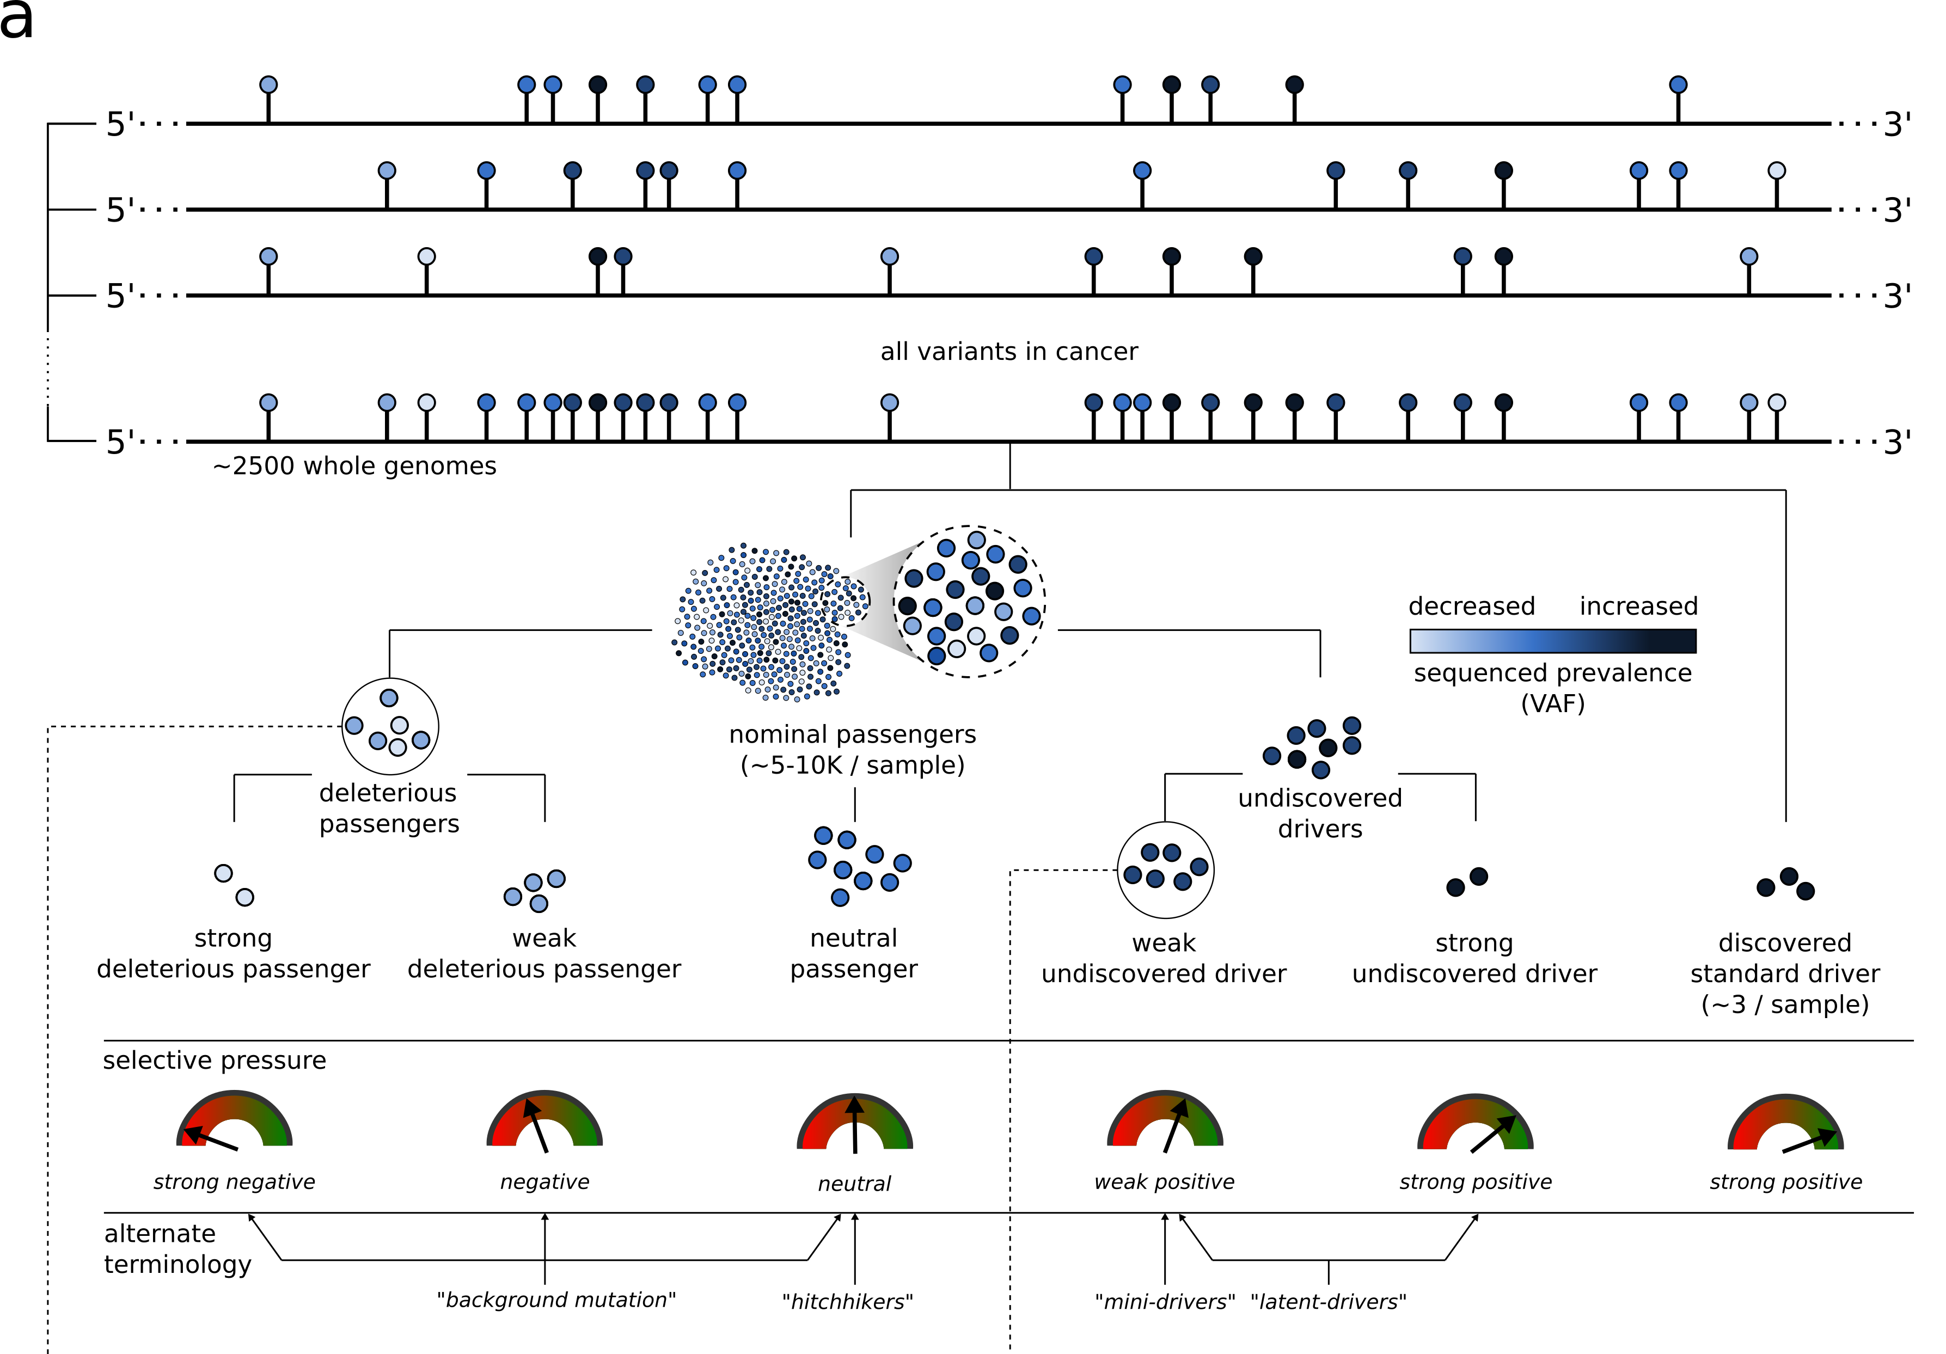
Conceptual extension of the
canonical model of drivers and passengers
[Kumar, Warrell et al. (’20, in press) Cell + biorxiv]

Slide 51
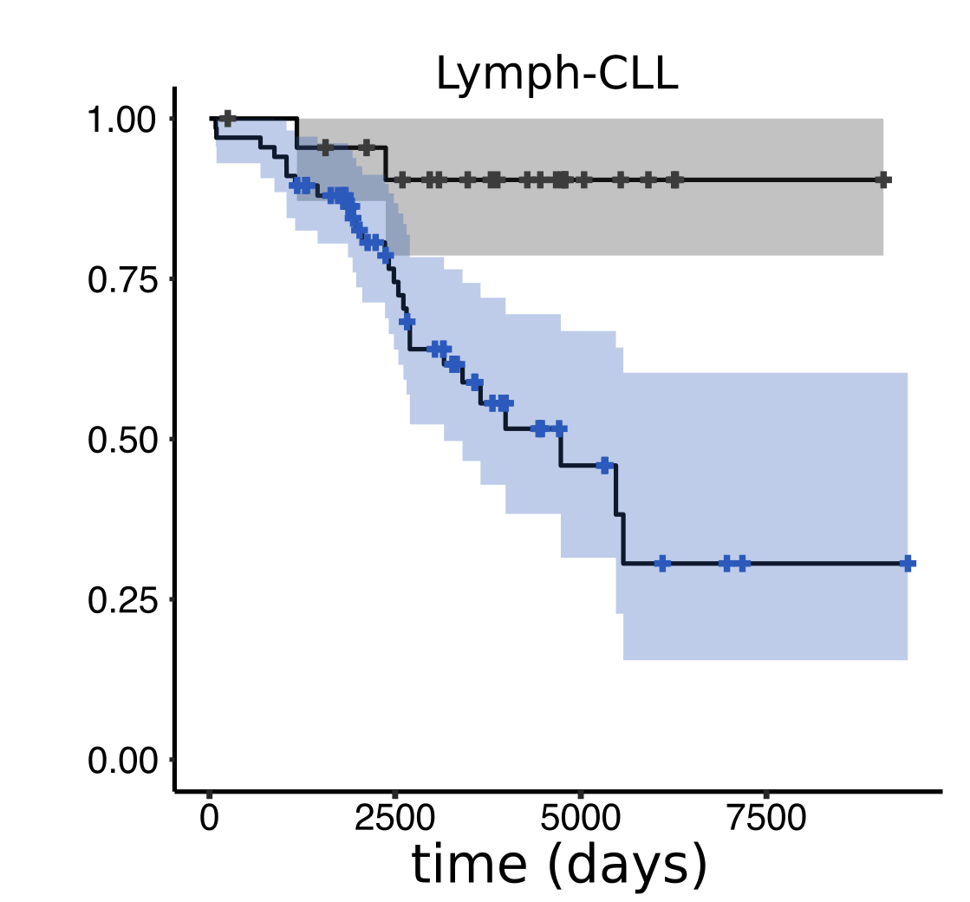
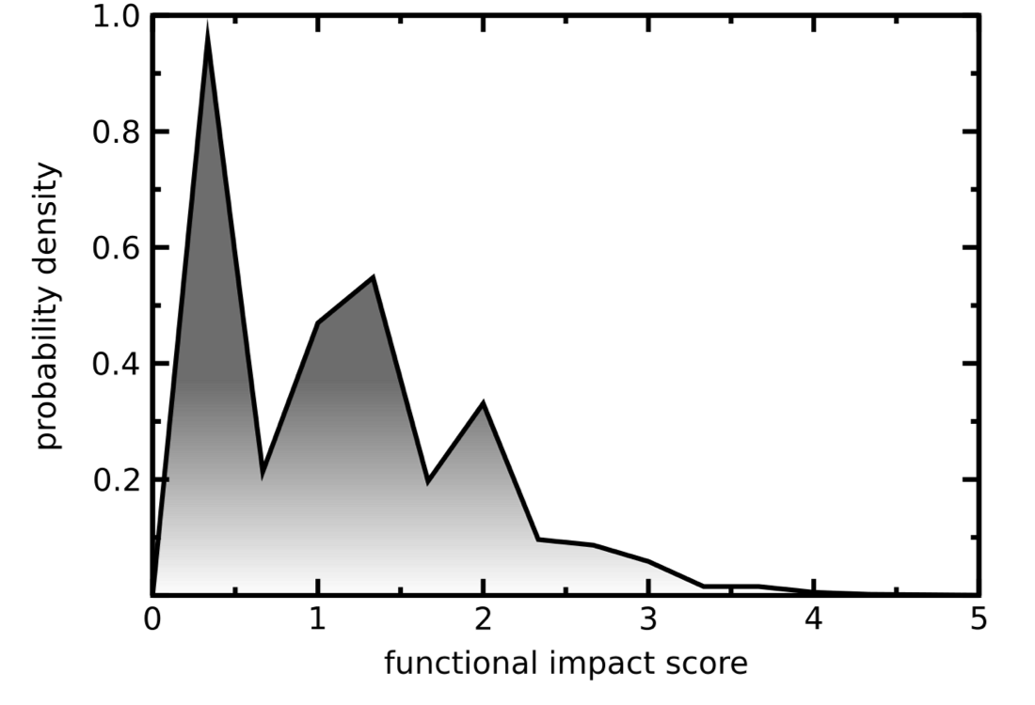
Overall functional impact distribution of
PCAWG mutations
[Kumar, Warrell et al. (’20, in press) Cell + biorxiv]
Division of PCAWG Lymph-CLL cohort based on average impact of non-driver variants (high v low)
[A result of selection?]
Funseq molecular functional impact of ~30M variants
in >2500 PCAWG samples

Slide 52
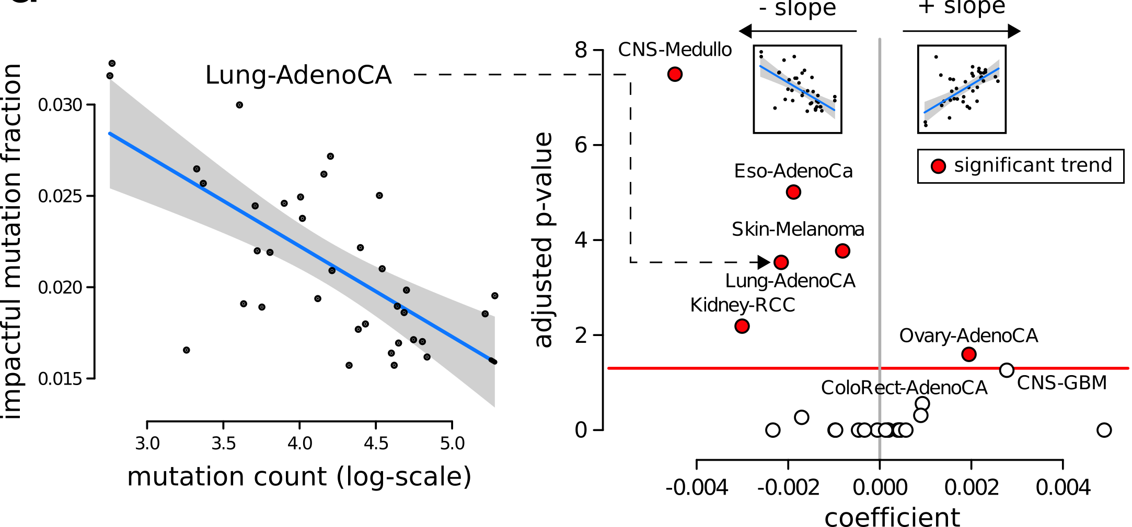
In many PCAWG cohorts, the fraction of impactful “passengers” decreases with increase in total mutation burden
(A result of selection?)
[Kumar, Warrell et al. (’20, in press) Cell + biorxiv]

Slide 53
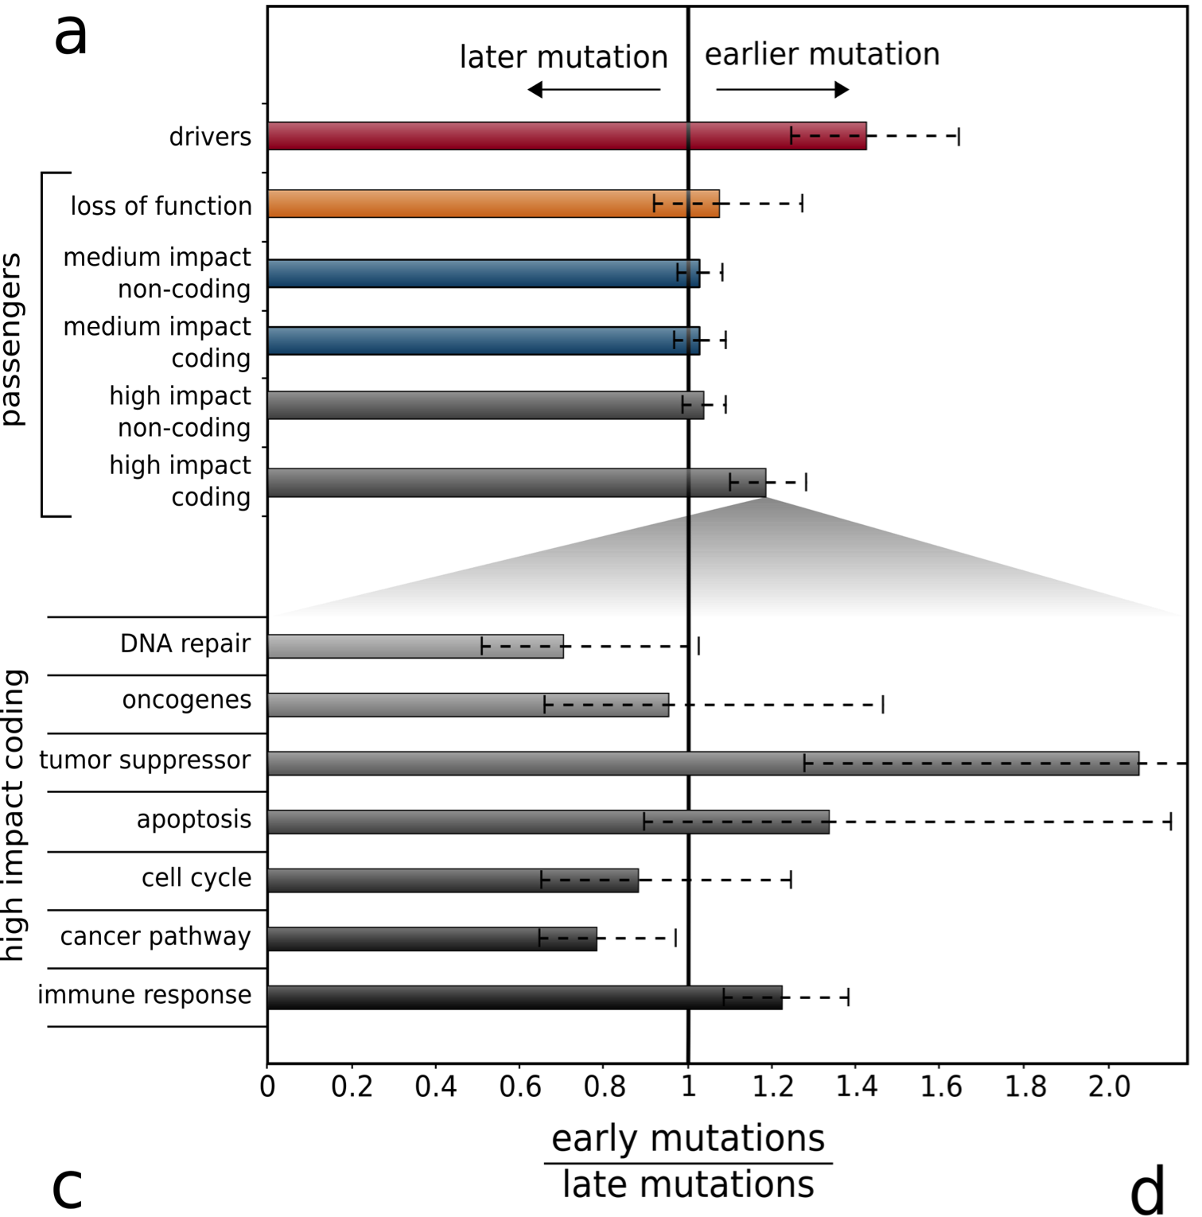
Sub-clonal architecture of mutations in PCAWG
[Kumar, Warrell et al. (’20, in press) Cell + biorxiv]
As expected, drivers are enriched in earlier subclones. Overall, no such enrichment among passengers.
High impact passengers are slightly enriched among early subclones
(weak drivers?)
Particularly, passengers in tumor suppressor (in contrast to oncogenes, which require specific mutations).

Slide 54
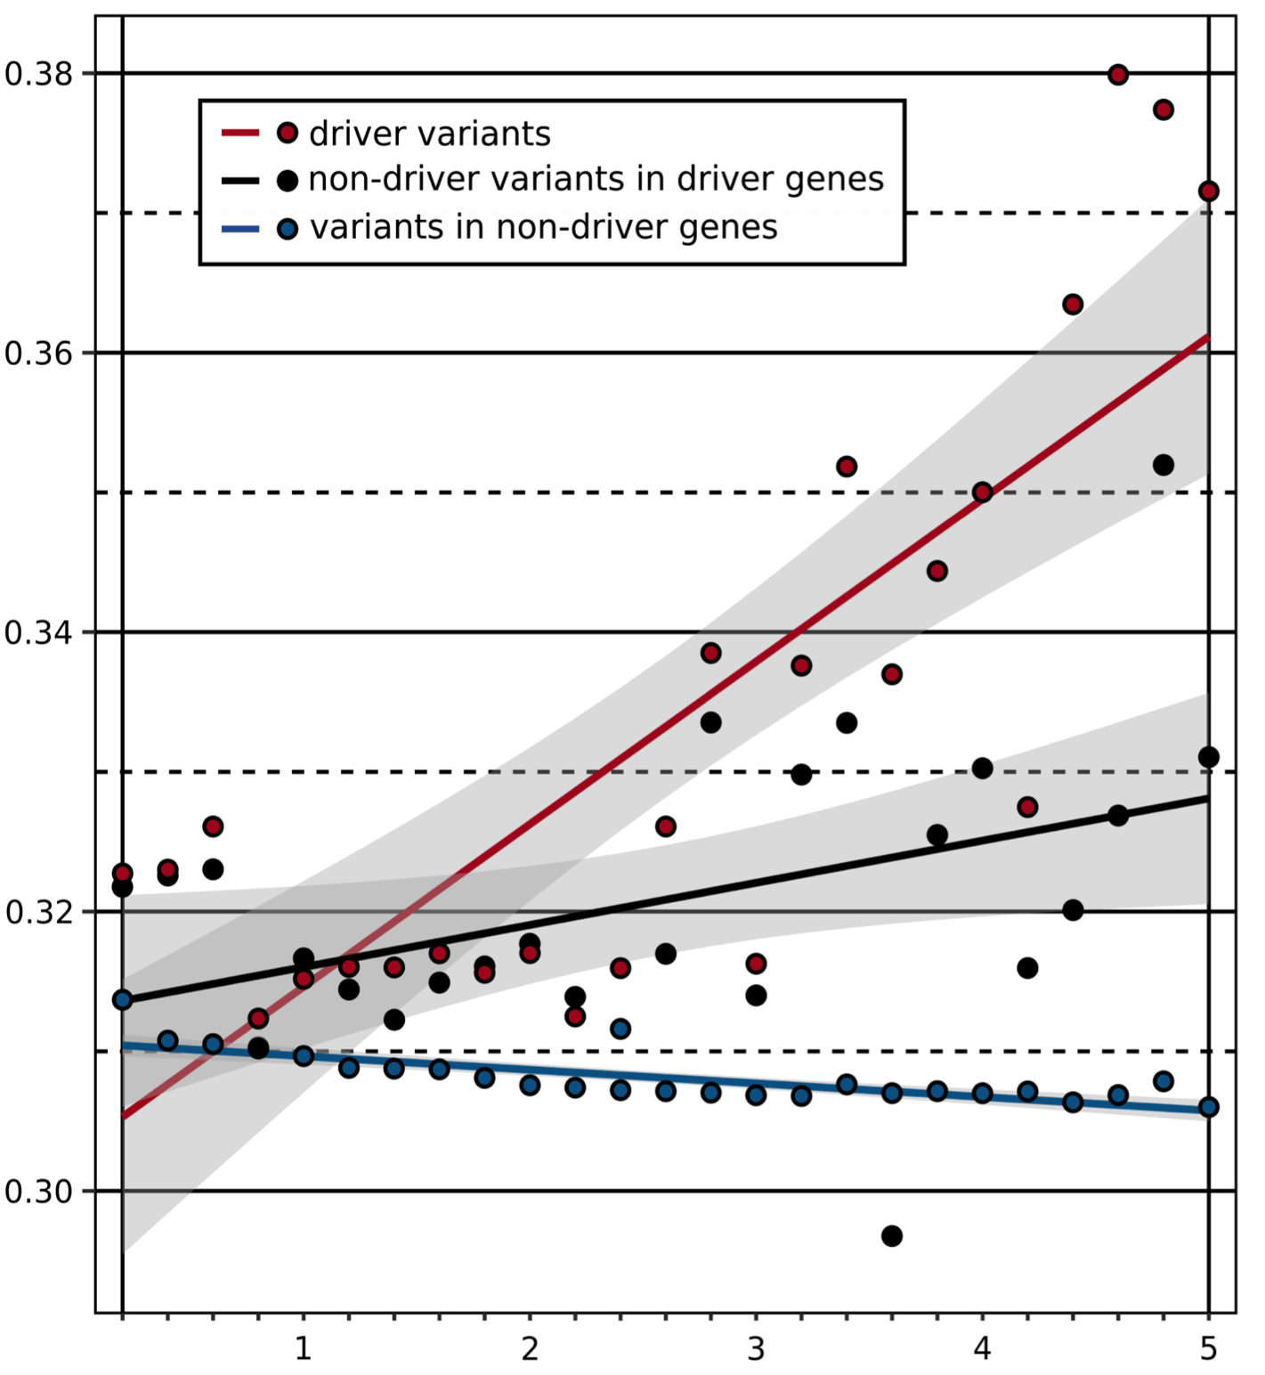
Continuous correlation of functional impact & VAF
[Kumar, Warrell et al. (’20, in press) Cell + biorxiv]
Among mutations in driver genes: higher impact mutation
Still true after removing all known driver variants from driver genes. (Latent drivers?)
Outside driver genes:
higher impact mutation
(Deleterious passengers?)
Early vs Late (mean VAF)
Functional Impact (GERP score)

Slide 55
(Topics in) Cancer Genomics: Annotating Non-coding Variants, Measuring Regulatory Network Rewiring, Building Background Mutation Models, Analyzing Tumor Evolution & Evaluating the Overall Impact of Passenger Mutations
Intro
  PMI & Variant Prioritization; driver-passenger model
  Data source: PCAWG comprehensive WGS on >2.5K
  + focus on 35 pRCC WGS
ENCODEC Annotation
  ENCODE cancer resource,
  with TF & RBP networks
  Cell-space view of TN pairs
  FunSeq variant impact measurement integrates conservation & network centrality
Network Rewiring
  Highlights regulators that change targets greatly
  LDA approach (from text-mining) finds those that greatly change their gene communities
BMR: LARVA/MOAT
  Uses parametric beta-binomial model, explicitly modeling genomic covariates
  Non-parametric shuffles. Useful when explicit covariates not available.
  Tumor Evolution: Classification + Driver identification
  Intro: Mutational timing & tree topology classifies pRCC subtypes
  Identifying drivers from perturbations in VAF spectra from a single tumor (using many hitchhiking mutations to gain statistical support)
  Overall Impact of Putative Passengers
  Not just high & low impact dichotomy
  How the fraction of high-impact SNVs scales & relates to survival
  Differences betw. Impact of early & late passenger mutations (eg in TSGs & oncogenes)
  Differential Impact of Signatures
  Diff. burdening of TF sub-networks naturally results from mutational spectra & signatures differentially affecting binding motifs.
  High & low impact mutations assoc. w/ diff. signatures
  How it all relates to selection?
  Additive Effects Model
  To quantify aggregated effect of passengers. Demonstratable effect, particularly for non-coding ones, in addition to known drivers.
  Recasting as a predictive model
  to est. number of weak drivers

Slide 56




Mutational processes carry context-specific signatures
A[C>T]G
C[C>T]G
S: Mutation signature inferred
M = S × W+ ε
M: Mutation spectrum observed
[T. Helleday, S. Eshtad & S. Nik-Zainal,
Nature Reviews Genetics (’14), L. Alexandrov et al., Nature (‘13) ]
Notes:
Mutation spectrum is further broken down to mutation signatures, which represent mutational processes

Slide 57
Kidney cancer as an example: differential burdening correlates with mutational spectrum
all mutations (N=923,782)
coding LoF: premature stops (N = 525)
[Kumar, Warrell et al. (’20, in press) Cell + biorxiv]
noncoding LoF
motif breaks in …
HDAC2 (N=675)
EWSR1 (N=514)
SP1 (N=571)
Notes:
disproportionate functional load on certain TFs in cancers can be related to an underlying mutational spectrum influencing their binding sites.
For instance in Kidney-RCC cohort, mutational spectrum of motif breaking events observed in SP1 (major contribution from C>T and C>A mutation) , HDAC2 (uniform distribution) and EWSR1 (uniform distribution) is very different.

Slide 58

Signatures and molecular impact of passengers:
ex of pRCC
[Kumar, Warrell et al. (’20, in press) Cell + biorxiv]
Underlying mutational processes are stochastic but unevenly distributed, which can potentially explain the differential burdening of various genomic elements.

Slide 59


Differential Mutational burdening of TF-subnetworks due to SNVs breaking & creating binding sites
[Kumar, Warrell et al. (’20, in press) Cell + biorxiv]
≈ç

Slide 60

Signature differences between high- and low-impact passengers
[Kumar, Warrell et al. (’20, in press) Cell + biorxiv]
Differing mutational processes could potentially explain the divergence of functional impacts among putative passengers.

Slide 61


Mutational processes and fitness
Mutational process dynamics exhibit common patterns in some cancer types
From:
Dentro, S.C., Leshchiner, I., Haase, K., Tarabichi, M., Wintersinger, J., Deshwar, A.G., Yu, K., Rubanova, Y., Macintyre, G., Vazquez-Garcia, I. and Kleinheinz, K., 2018. Portraits of genetic intra-tumour heterogeneity and subclonal selection across cancer types. bioRxiv.

Slide 62









Mutational processes and fitness
genetic inheritance
$$x$$
$$m w$$
$$x$$
$$m w$$
Do mutational processes have effects on fitness?
  Not necessarily: primarily determine mutations in next generation, rather than number of offspring
Mutational processes may have fitness effects over multiple generations
We develop a framework for cyclic and multilevel causation in evolutionary processes
Parent
Offspring
epigenetic inheritance
$$x$$
$$m w$$
Coarse-graining
$$x$$
$$m w$$
$$x$$
$$m w$$
$$x$$
$$m w$$
$$x$$
$$m w$$
$$x$$
$$m w$$
$$x$$
$$m$$
$$w$$
genotype
mutational processes
fitness
Warrell, J., and Gerstein, M. Cyclic and Multilevel Causality in Evolutionary Processes. bioRxiv (accepted in Biology and Philosophy)

Slide 63
(Topics in) Cancer Genomics: Annotating Non-coding Variants, Measuring Regulatory Network Rewiring, Building Background Mutation Models, Analyzing Tumor Evolution & Evaluating the Overall Impact of Passenger Mutations
Intro
  PMI & Variant Prioritization; driver-passenger model
  Data source: PCAWG comprehensive WGS on >2.5K
  + focus on 35 pRCC WGS
ENCODEC Annotation
  ENCODE cancer resource,
  with TF & RBP networks
  Cell-space view of TN pairs
  FunSeq variant impact measurement integrates conservation & network centrality
Network Rewiring
  Highlights regulators that change targets greatly
  LDA approach (from text-mining) finds those that greatly change their gene communities
BMR: LARVA/MOAT
  Uses parametric beta-binomial model, explicitly modeling genomic covariates
  Non-parametric shuffles. Useful when explicit covariates not available.
  Tumor Evolution: Classification + Driver identification
  Intro: Mutational timing & tree topology classifies pRCC subtypes
  Identifying drivers from perturbations in VAF spectra from a single tumor (using many hitchhiking mutations to gain statistical support)
  Overall Impact of Putative Passengers
  Not just high & low impact dichotomy
  How the fraction of high-impact SNVs scales & relates to survival
  Differences betw. Impact of early & late passenger mutations (eg in TSGs & oncogenes)
  Differential Impact of Signatures
  Diff. burdening of TF sub-networks naturally results from mutational spectra & signatures differentially affecting binding motifs.
  High & low impact mutations assoc. w/ diff. signatures
  How it all relates to selection?
  Additive Effects Model
  To quantify aggregated effect of passengers. Demonstratable effect, particularly for non-coding ones, in addition to known drivers.
  Recasting as a predictive model
  to est. number of weak drivers

Slide 64








Missing heritability and polygenicity
Population level definitions:
Parent-offspring heritability;
Twin-based heritability …
Subclonal trait in cancer: Growth rate
Organismal trait: Height
$$h^{2}$$
SNP-based polygenic & additive model:
$$Z$$
$$h^{2}=σ_{u}$$
Trait
Covariates & fixed effects
Genetic predictors & random effects
Environmental noise

Slide 65







Additive effects model to quantify cumulative effect of nominal passengers in PCAWG
Model for the effect of an individual SNP on a phenotype
Extension to model the combined effects of multiple SNPs
[Kumar, Warrell et al. (’20, in press) Cell + biorxiv]
$$y_{j}=μ+z_{ij}u_{i}+e_{j}$$
$$u∼N(0,σ_{u}^{2}I)$$

Slide 66





Using additive effects to compare different categories of variants
[Kumar, Warrell et al. (’20, in press) Cell + biorxiv]
$$u∼N(0,σ_{u}^{2}I)$$
Variant categories:
$k=1$: coding drivers
$k=2$: coding other
$k=3$: promoters
$k=4$: other non-coding
Model:
Parameters:

Slide 67

Overall additive variance increase for multiple cancer cohorts in PCAWG with the inclusion of passengers
Increase in the variance from ~50% using drivers alone to ~59% with putative passengers included, averaged across all cohorts.
[Kumar, Warrell et al. (’20, in press) Cell + biorxiv]

Slide 68
Element level additive variance for multiple cancer cohorts in PCAWG, comparing coding & non-coding
In addition to coding mutations, promoter & other non-coding mutations contributed significant amounts of extra variance
(~2% & 7%) .
[Kumar, Warrell et al. (’20, in press) Cell + biorxiv]

Slide 69



Recasting the additive effects model in a predictive context:
Best Linear Unbiased Predictor (BLUP) analysis
All SNPs
[Kumar, Warrell et al. (’20, in press) Cell + biorxiv]
95% CI
Additive variance
Cummulative
SNVs added
SNVs, ordered by descending BLUP ($\hat{u}$):
BLUP predictor:
$$\hat{u}=argmax_{u}\left(P\left(u | y,σ_{u}^{2}\right)\right)$$
…
$$=argmax_{u}\left(P\left(y | u\right)P(u|σ_{u}^{2})\right)$$
Lower bound on # weak drivers (8.4 pan-cancer average; enriched for PCAWG genes w/ FDR<0.25)

Slide 70
(Topics in) Cancer Genomics: Annotating Non-coding Variants, Measuring Regulatory Network Rewiring, Building Background Mutation Models, Analyzing Tumor Evolution & Evaluating the Overall Impact of Passenger Mutations
Intro
  PMI & Variant Prioritization; driver-passenger model
  Data source: PCAWG comprehensive WGS on >2.5K
  + focus on 35 pRCC WGS
ENCODEC Annotation
  ENCODE cancer resource,
  with TF & RBP networks
  Cell-space view of TN pairs
  FunSeq variant impact measurement integrates conservation & network centrality
Network Rewiring
  Highlights regulators that change targets greatly
  LDA approach (from text-mining) finds those that greatly change their gene communities
BMR: LARVA/MOAT
  Uses parametric beta-binomial model, explicitly modeling genomic covariates
  Non-parametric shuffles. Useful when explicit covariates not available.
  Tumor Evolution: Classification + Driver identification
  Intro: Mutational timing & tree topology classifies pRCC subtypes
  Identifying drivers from perturbations in VAF spectra from a single tumor (using many hitchhiking mutations to gain statistical support)
  Overall Impact of Putative Passengers
  Not just high & low impact dichotomy
  How the fraction of high-impact SNVs scales & relates to survival
  Differences betw. Impact of early & late passenger mutations (eg in TSGs & oncogenes)
  Differential Impact of Signatures
  Diff. burdening of TF sub-networks naturally results from mutational spectra & signatures differentially affecting binding motifs.
  High & low impact mutations assoc. w/ diff. signatures
  How it all relates to selection?
  Additive Effects Model
  To quantify aggregated effect of passengers. Demonstratable effect, particularly for non-coding ones, in addition to known drivers.
  Recasting as a predictive model
  to est. number of weak drivers

Slide 71
(Topics in) Cancer Genomics: Annotating Non-coding Variants, Measuring Regulatory Network Rewiring, Building Background Mutation Models, Analyzing Tumor Evolution & Evaluating the Overall Impact of Passenger Mutations
Intro
  PMI & Variant Prioritization; driver-passenger model
  Data source: PCAWG comprehensive WGS on >2.5K
  + focus on 35 pRCC WGS
ENCODEC Annotation
  ENCODE cancer resource,
  with TF & RBP networks
  Cell-space view of TN pairs
  FunSeq variant impact measurement integrates conservation & network centrality
Network Rewiring
  Highlights regulators that change targets greatly
  LDA approach (from text-mining) finds those that greatly change their gene communities
BMR: LARVA/MOAT
  Uses parametric beta-binomial model, explicitly modeling genomic covariates
  Non-parametric shuffles. Useful when explicit covariates not available.
  Tumor Evolution: Classification + Driver identification
  Intro: Mutational timing & tree topology classifies pRCC subtypes
  Identifying drivers from perturbations in VAF spectra from a single tumor (using many hitchhiking mutations to gain statistical support)
  Overall Impact of Putative Passengers
  Not just high & low impact dichotomy
  How the fraction of high-impact SNVs scales & relates to survival
  Differences betw. Impact of early & late passenger mutations (eg in TSGs & oncogenes)
  Differential Impact of Signatures
  Diff. burdening of TF sub-networks naturally results from mutational spectra & signatures differentially affecting binding motifs.
  High & low impact mutations assoc. w/ diff. signatures
  How it all relates to selection?
  Additive Effects Model
  To quantify aggregated effect of passengers. Demonstratable effect, particularly for non-coding ones, in addition to known drivers.
  Recasting as a predictive model
  to est. number of weak drivers

Slide 72

ENCODEC.gersteinlab.org
J Zhang, D Lee, V Dhiman, P Jiang, J Xu,
P McGillivray, H Yang…. S Liu, K White
Evotum
L Salichos , W Meyerson , J Warrell
FunSeq.gersteinlab.org
Y Fu, E Khurana, Z Liu, S Lou, J Bedford, X Mu, K Yip
E Khurana, Y Fu, H Kang, X Mu… M Rubin, C Tyler-Smith
{LARVA,MOAT}.gersteinlab.org
Lochovsky, J Zhang, Y Fu, E Khurana
PanCancer.info
S Kumar, J Warrell, W Meyerson, P McGillivary,
L Salichos, S Li, A Fundichely, E Khurana, C Chan, M Nielsen,
C Herrman, A Harmanci, L Lochovsky,Y Zhang, X Li, G Getz, J Pedersen,
pRCC
S Li, B Shuch
Acknowledgments! Also, Hiring: See Jobs.gersteinlab.org

Slide 73


Slide 74
Info about this talk
No Conflicts
Unless explicitly listed here. There are no conflicts of interest relevant to the material in this talk
General PERMISSIONS
This Presentation is copyright Mark Gerstein, Yale University, 2019.
Please read permissions statement at
sites.gersteinlab.org/Permissions
Basically, feel free to use slides & images in the talk with PROPER acknowledgement (via citation to relevant papers or website link). Paper references in the talk were mostly from Papers.GersteinLab.org.
PHOTOS & IMAGES
For thoughts on the source and permissions of many of the photos and clipped images in this presentation see streams.gerstein.info . In particular, many of the images have particular EXIF tags, such as kwpotppt , that can be easily queried from flickr, viz: flickr.com/photos/mbgmbg/tags/kwpotppt

