Slide 1
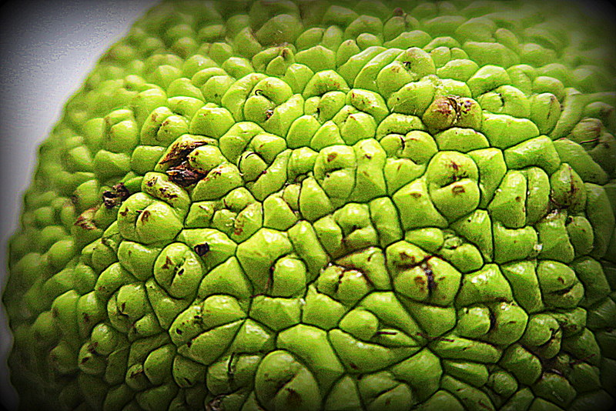
Computational analysis of variants: coding versus non-coding
Mark Gerstein, Yale
Slides freely downloadable from Lectures.GersteinLab.org & “tweetable” (via @MarkGerstein).
No Conflicts for this Talk. See last slide for more info.

Slide 2
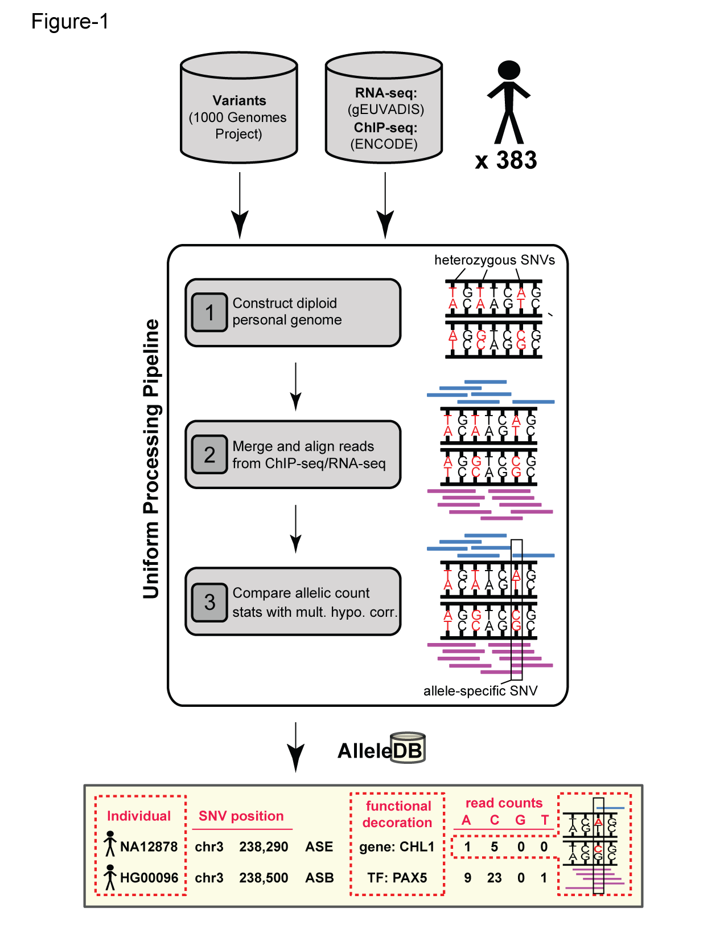
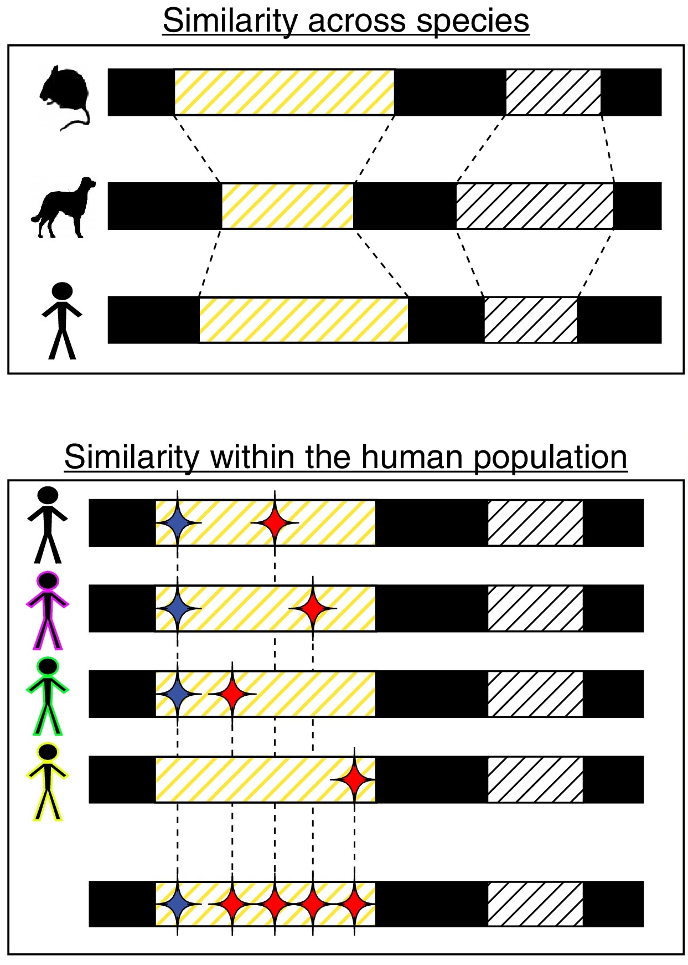


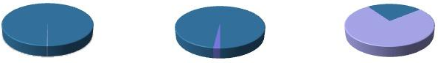
Human Genetic Variation:
the prevalence of rare variants in population studies
Population of
2,504 peoples
A Cancer Genome
A Typical Genome
Origin of Variants
Class of Variants
 | Coding | Non- coding
Germ- line | 22K | 4.1 – 5M
Somatic | ~50 | 5K
SNP | 3.5 – 4.3M
Indel | 550 – 625K
SV | 2.1 – 2.5K (20Mb)
Total | 4.1 – 5M
SNP | 84.7M
Indel | 3.6M
SV | 60K
Total | 88.3M
Prevalence of Variants
Common
Common
Passenger
Driver (~0.1%)
Rare* (1-4%)
Rare (~75%)
* Variants with allele frequency < 0.5% are considered as rare variants in 1000 genomes project.
The 1000 Genomes Project Consortium, Nature. 2015. 526:68-74
Khurana E. et al. Nat. Rev. Genet. 2016. 17:93-108
[Sethi et al. COSB (’15)]

Slide 3

Rare (as opposed to common) variant analysis particularly applicable at the moment
CMG rare-disease &
TCGA somatic variants
  Main NIH disease genomics projects
  Both focus on ”rare” variant for which GWAS is not meaningful
  For purpose of assessing impact & aggregating “burden” across a gene, somatic & germline rare can be considered similar – no notion of LD
  Differences:
  drivers under “cell-level” positive selection while
  Mendelian variants are under strong negative selection from an organismal perspective

Slide 4
Coding v Non-coding
Coding
  Easily interpretable, particularly related to structure
  Available in large quantities
  Exomes have the current potential for great scale (Scale of EXAC, >60K exomes [Lek et al. ‘16])
Non-coding
  Not as interpretable & hard to connect to genes
“Near coding”
  Bits of non-coding, close to genes & readily linked to them
  EX: Splice sites, promotors, uORF

Slide 5
Structure & genomics
Structure particularly useful for interpreting the impact of the many rare variants whose effect can not be found via GWAS
Also, integration of structure data with genomic variants, EHR & drug data will be key for realizing the goal of precision medicine.
Gerstein et al., Nat. Struct. Bio. 2000
Hauser et al., Cell 2018

Slide 6
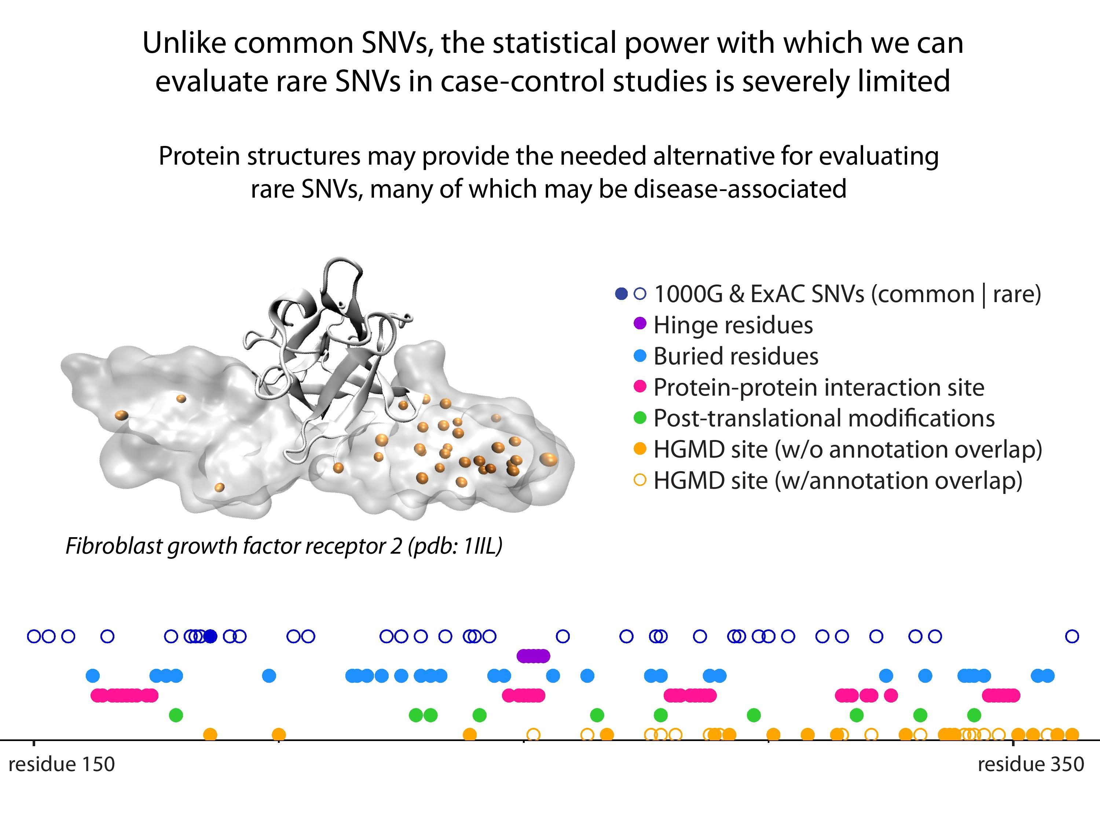
[Sethi et al. COSB (’15)]

Slide 7
Computational analysis of variants: coding versus non-coding
Intro: types of variants
  Rare v common,
  somatic v germline, coding v noncoding
Identifying cryptic allosteric sites with STRESS
  On surface & in interior bottlenecks
Frustration as a localized metric of SNV impact
  Differential profiles for oncogenes v. TSGs
ALoFT: Annotation of LoF Transcripts
Using dynamics to help identify mutation clusters (Hotcommics)
  Find dynamic sub-communities & determine aggregated mutational burden within these
RADAR Prioritization for RBP sites
  Prioritizes variants based on post-transcriptional regulome using ENCODE eCLIP
  Incorporates new features related to RNA sec. struc & tissue specific effects
uORF Prioritization
  Feature integration to find small subset of upstream mutations that potentially alter translation
GRAM to assess the molecular effect of (promotor) mutations
  Universal score + cell type specific score

Slide 8
Computational analysis of variants: coding versus non-coding
Intro: types of variants
  Rare v common,
  somatic v germline, coding v noncoding
Identifying cryptic allosteric sites with STRESS
  On surface & in interior bottlenecks
Frustration as a localized metric of SNV impact
  Differential profiles for oncogenes v. TSGs
ALoFT: Annotation of LoF Transcripts
Using dynamics to help identify mutation clusters (Hotcommics)
  Find dynamic sub-communities & determine aggregated mutational burden within these
RADAR Prioritization for RBP sites
  Prioritizes variants based on post-transcriptional regulome using ENCODE eCLIP
  Incorporates new features related to RNA sec. struc & tissue specific effects
uORF Prioritization
  Feature integration to find small subset of upstream mutations that potentially alter translation
GRAM to assess the molecular effect of (promotor) mutations
  Universal score + cell type specific score

Slide 9
Models of Protein Conformational Change
Motion Vectors from Normal Modes (ANMs)
PDB ID: 3RFU
Adapted from Fuglebakk et al, 2014
Characterizing uncharacterized variants
<= Finding Allosteric sites
<= Modeling motion

Slide 10
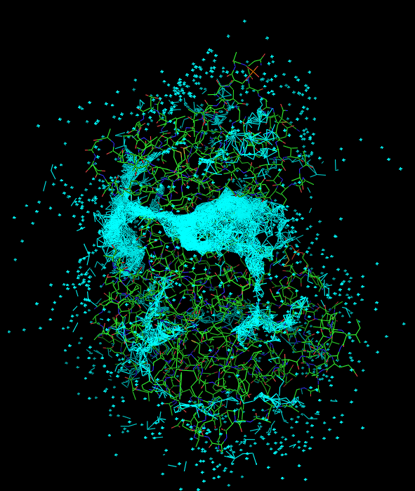
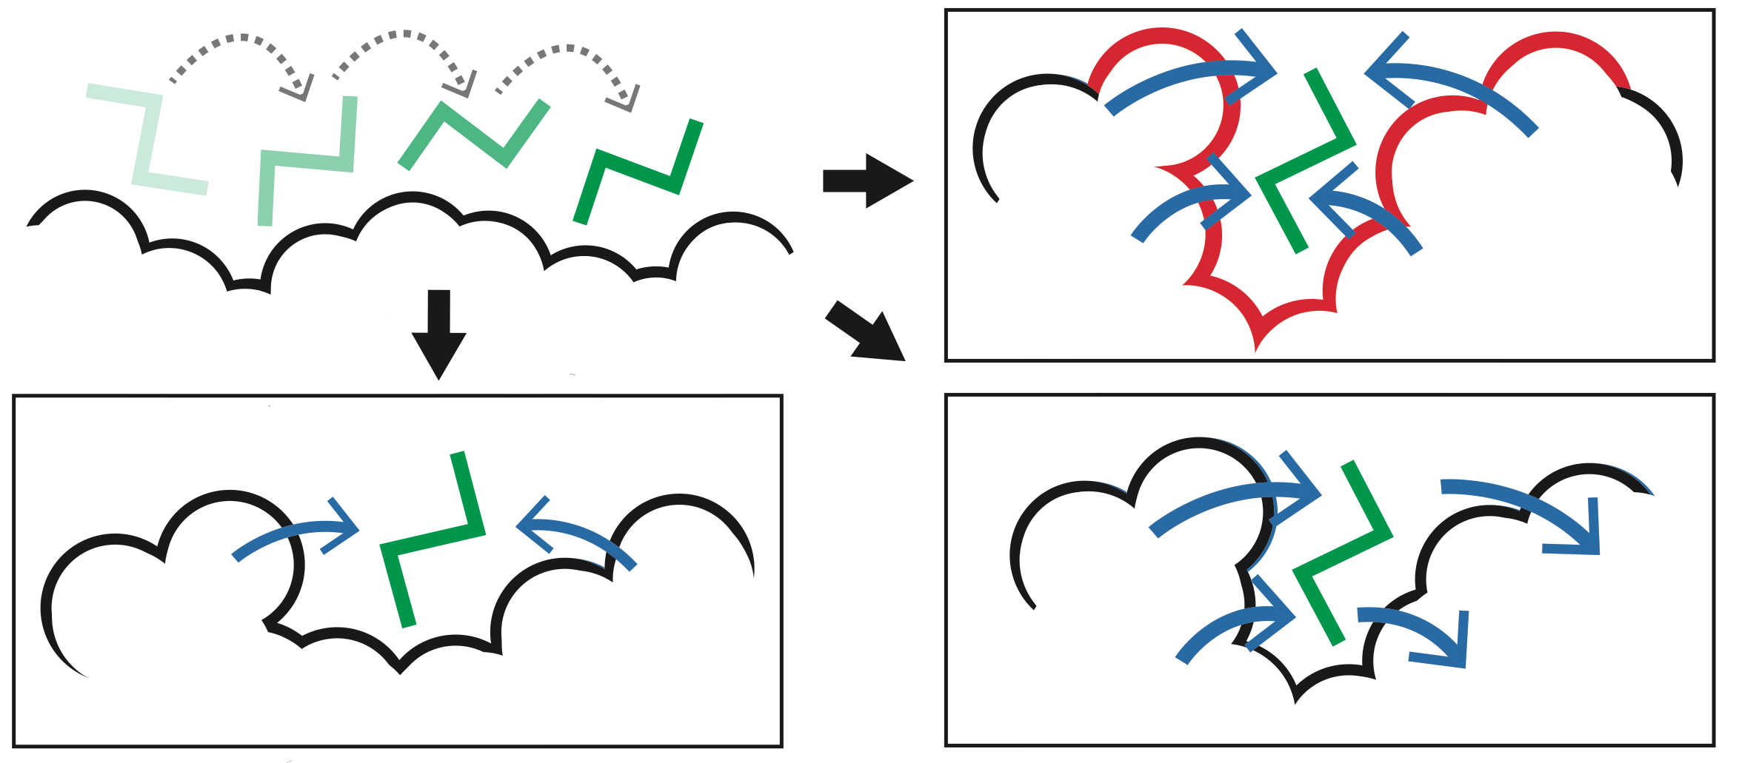
Predicting Allosterically-Important Residues at the Surface
MC simulations generate a large number of candidate sites
Score each candidate site by the degree to which it perturbs large-scale motions
Prioritize & threshold the list to identify the set of high confidence-sites
pdb 1J3H
Surface region with high
density of candidate sites
Surface region with low density of candidate sites
Adapted from Clarke*, Sethi*, et al (‘16)

Slide 11
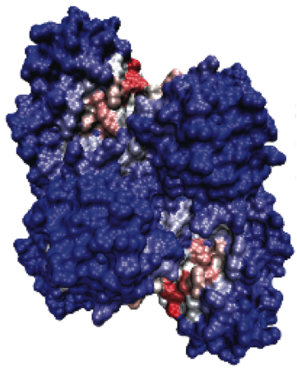
Predicting Allosterically-Important Residues at the Surface
PDB: 3PFK
Adapted from Clarke*, Sethi*, et al (‘16)

Slide 12
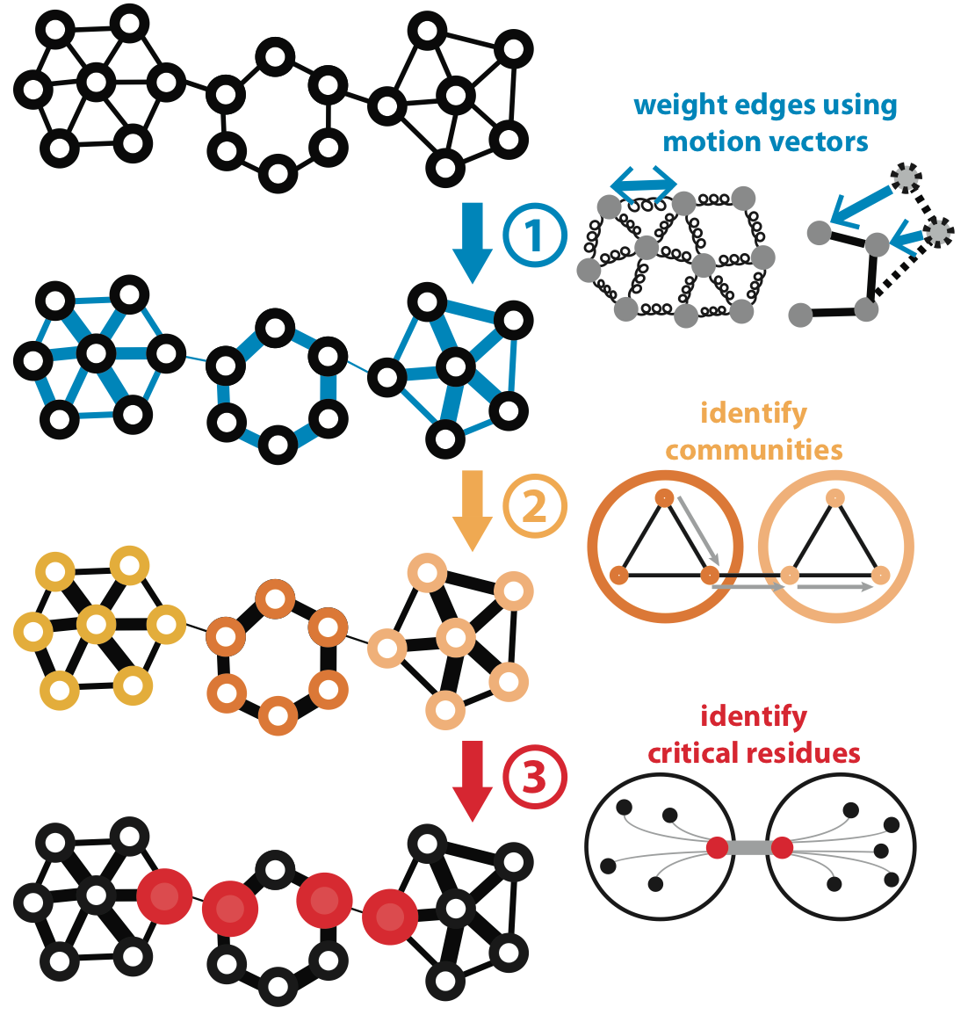
Predicting Allosterically-Important Residues within the Interior
Adapted from Clarke*, Sethi*, et al (‘16)

Slide 13
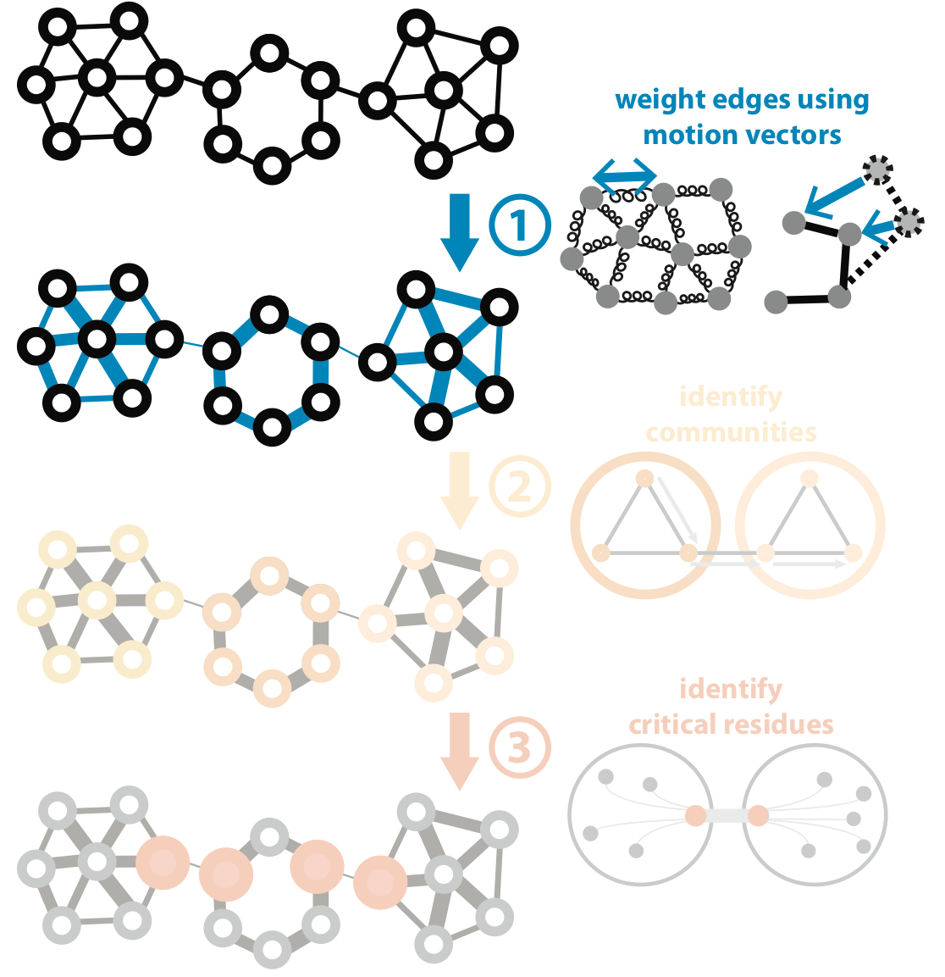
Predicting Allosterically-Important Residues within the Interior
Adapted from Clarke*, Sethi*, et al (‘16)

Slide 14
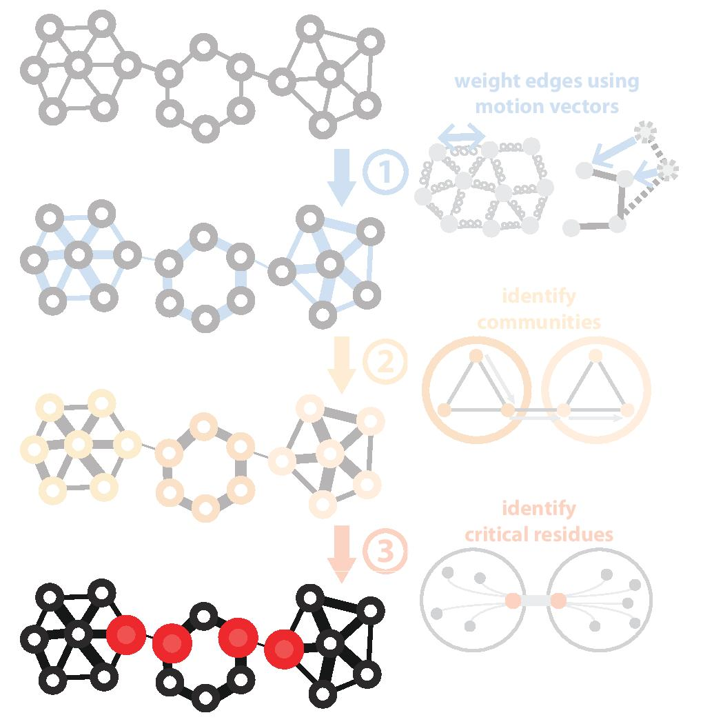
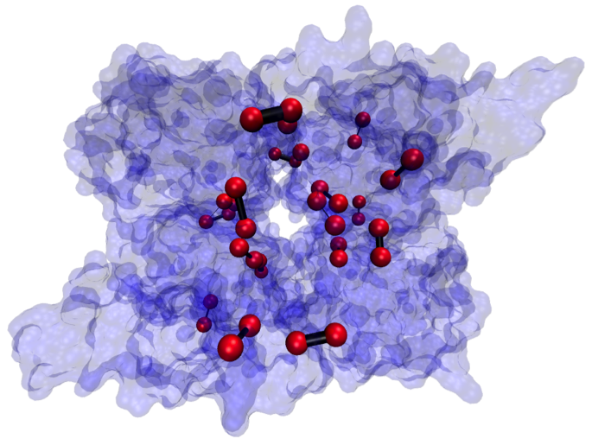
Predicting Allosterically-Important Residues within the Interior
PDB: 1XTT
Adapted from Clarke*, Sethi*, et al (‘16)

Slide 15
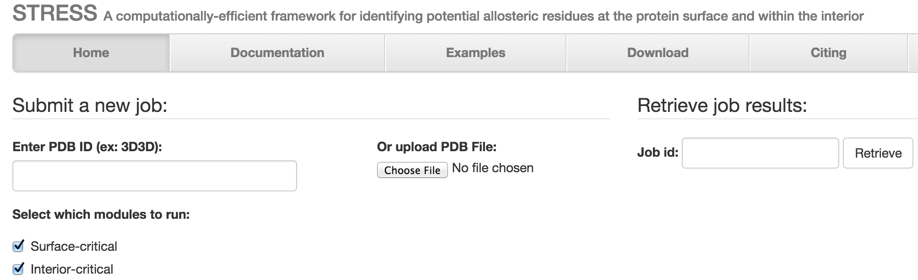
STRESS Server Architecture: Highlights
stress.molmovdb.org
A light front-end server handles incoming requests, and powerful back-end servers perform calculations.
Auto Scaling adjusts the number of back-end servers as needed.
A typical structure takes ~30 minutes on a E5-2660 v3 (2.60GHz) core.
Input & output (i.e., predicted allosteric residues) are stored in S3 buckets.
Adapted from Clarke*, Sethi*, et al (‘16)

Slide 16
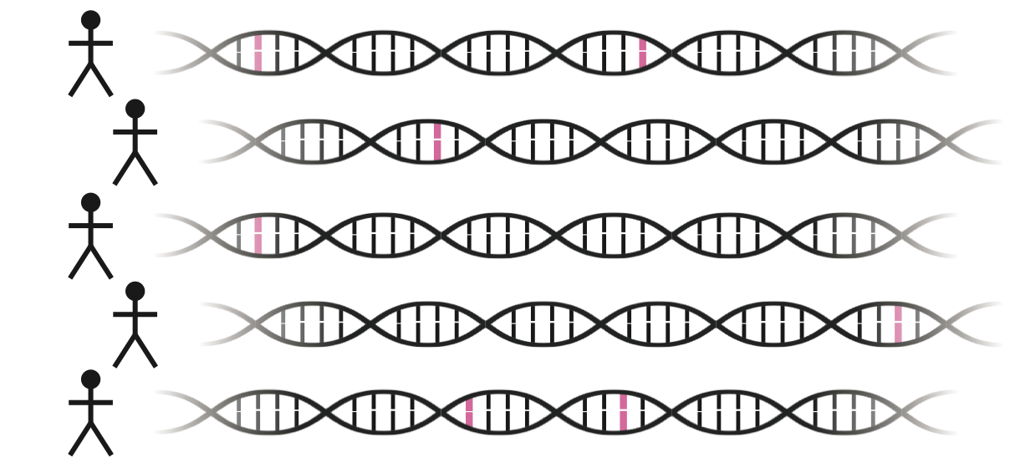
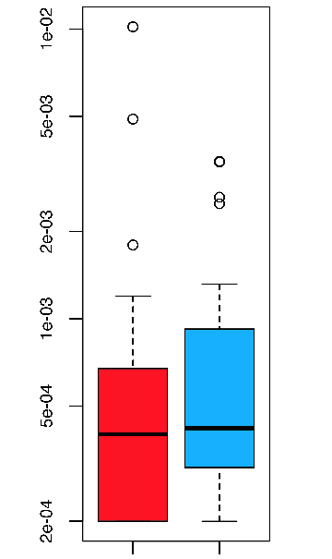
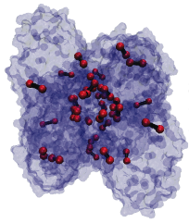
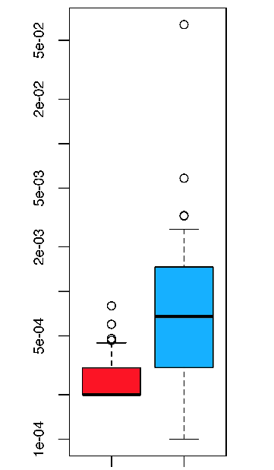
Intra-species conservation of predicted allosteric residues
1000 Genomes
Surface
Interior
Derived Allele Freq.
Derived Allele Freq.
p=0.309
p=1.80e-05
Adapted from Clarke*, Sethi*, et al (‘16)

Slide 17
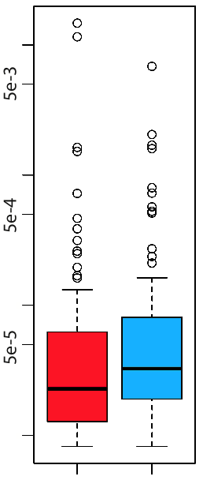
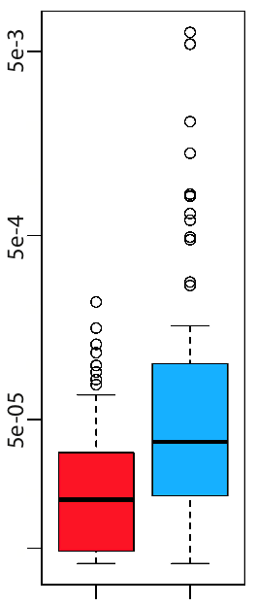
Intra-species conservation of predicted allosteric residues
ExAC
Surface
Interior
Minor Allele Freq.
Minor Allele Freq.
p=1.49e-3
p=7.98e-09
Adapted from Clarke*, Sethi*, et al (‘16)

Slide 18
[Sethi et al. COSB (’15)]

Slide 19
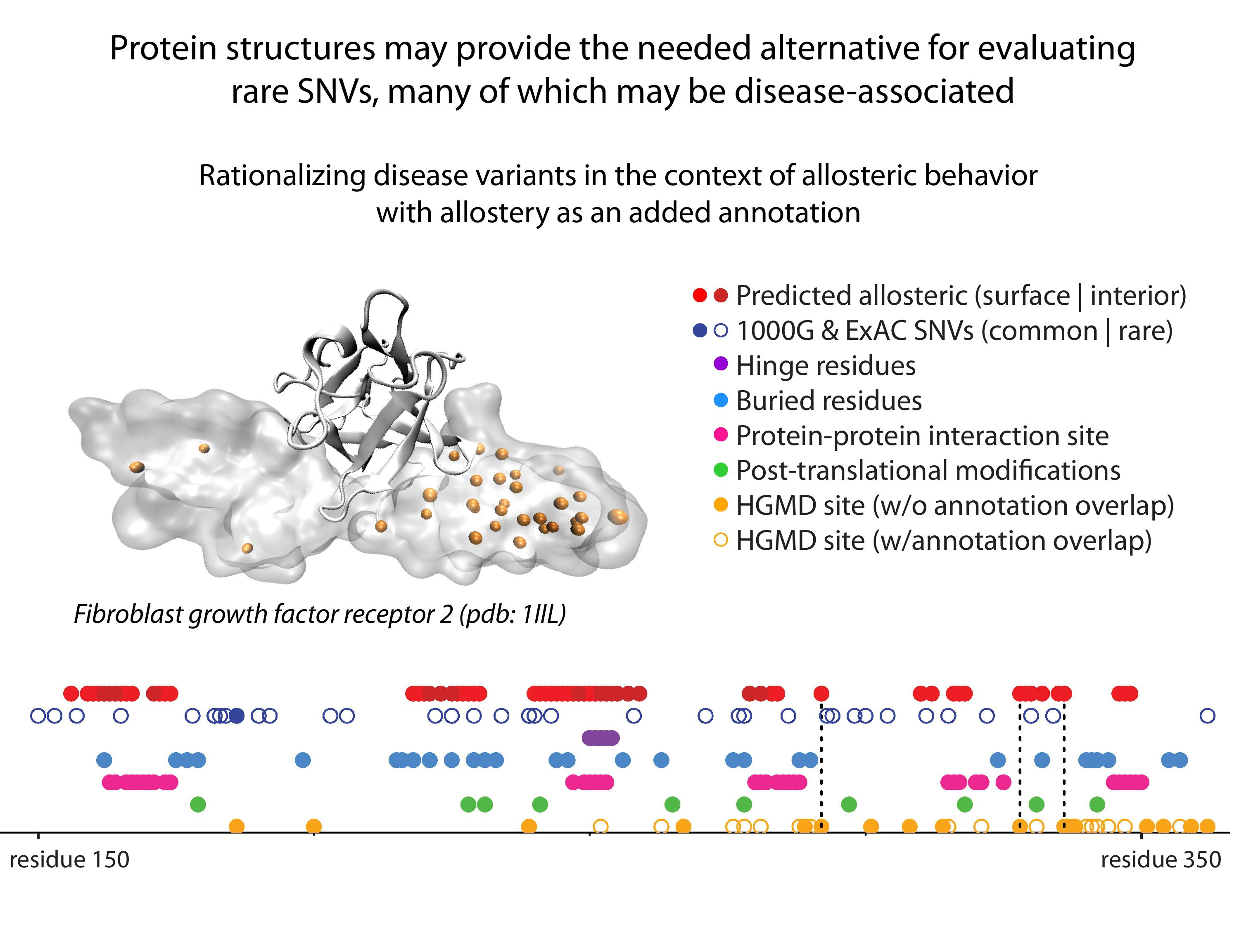
19
[Sethi et al. COSB (’15)]
Adapted from Clarke*, Sethi*, et al (in press)

Slide 20
Computational analysis of variants: coding versus non-coding
Intro: types of variants
  Rare v common,
  somatic v germline, coding v noncoding
Identifying cryptic allosteric sites with STRESS
  On surface & in interior bottlenecks
Frustration as a localized metric of SNV impact
  Differential profiles for oncogenes v. TSGs
ALoFT: Annotation of LoF Transcripts
Using dynamics to help identify mutation clusters (Hotcommics)
  Find dynamic sub-communities & determine aggregated mutational burden within these
RADAR Prioritization for RBP sites
  Prioritizes variants based on post-transcriptional regulome using ENCODE eCLIP
  Incorporates new features related to RNA sec. struc & tissue specific effects
uORF Prioritization
  Feature integration to find small subset of upstream mutations that potentially alter translation
GRAM to assess the molecular effect of (promotor) mutations
  Universal score + cell type specific score

Slide 21
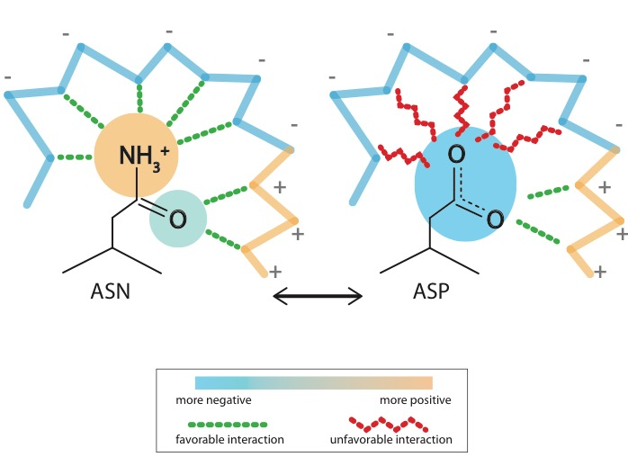
What is localized frustration?
[Ferreiro et al., PNAS (’07)]

Slide 22
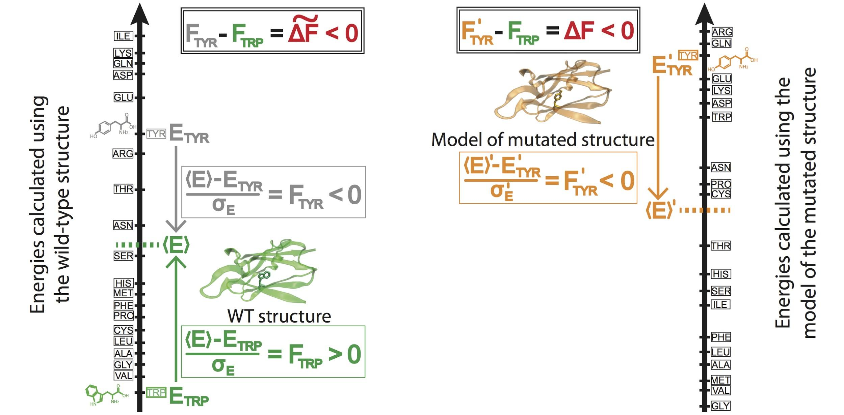
Workflow for evaluating localized frustration changes (∆F)
[Kumar et al. NAR (2016)]
Notes:
An example illustrating the case in which ∆F < 0. The ∆F associated with an SNV is negative if the SNV introduces a destabilizing effect. Shown here is the result of changing residue ID 31 in plastocyanin (pdb ID 3CVD) from the wild-type residue (Trp) to a mutated residue (Tyr). Left) The protein in its wild-type form (in green), in which the tryptophan residue at position 31 is substantially more energetically favorable relative to the mean energy ⟨E⟩ that would result from having any of the possible 20 amino acids at that position. This disparity is designated by (⟨E⟩ - E_{nat})/σ_{E} = F_{nat} > 0. Right) The entire protein structure is then modeled to generate the mutated structure after the SNV W31Y is introduced, thereby changing the relative energetic distributions for the different amino acids. The new mean and standard deviation associated with the energies of the modeled structure are designated by ⟨E⟩’ and σ_{E}’, respectively. In this case, the SNV that introduces 31Y results in an energy that is higher than the mean energy of all possible 20 amino acids at that position. This disparity is designated by (⟨E⟩’ - E_{mut})/σ_{E}’ = F_{mut} < 0. Taken together, the negative value associated with the disparity between the F_{mut} and F_{nat} values (F_{mut} - F_{nat} = ∆F < 0) indicates that the this SNV is locally unfavorable.

Slide 23
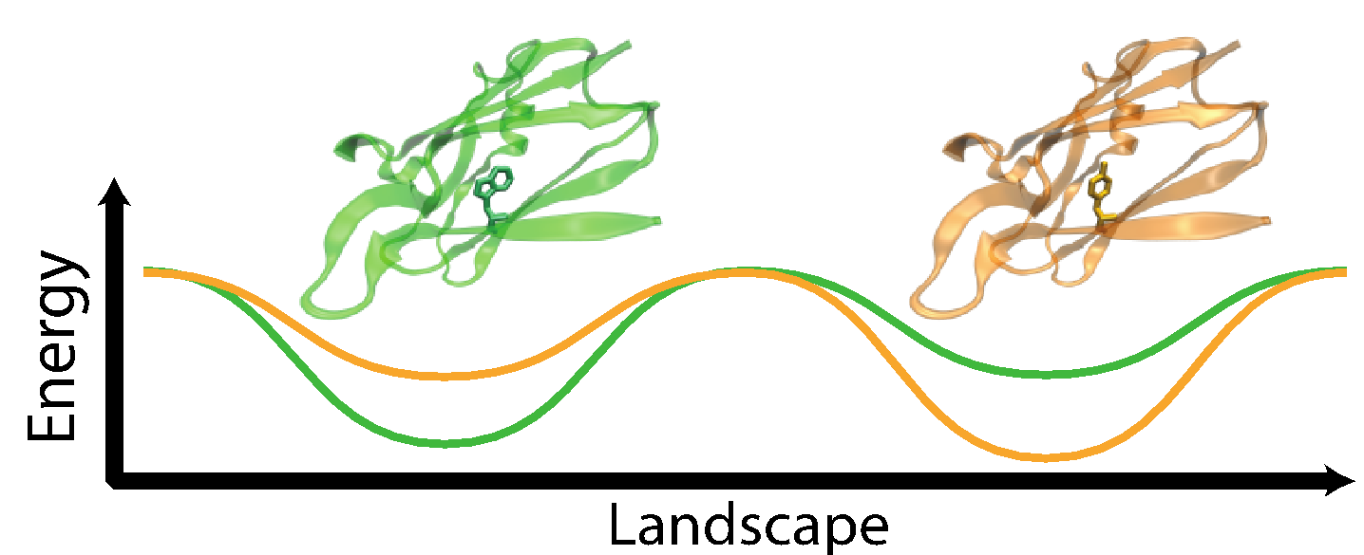
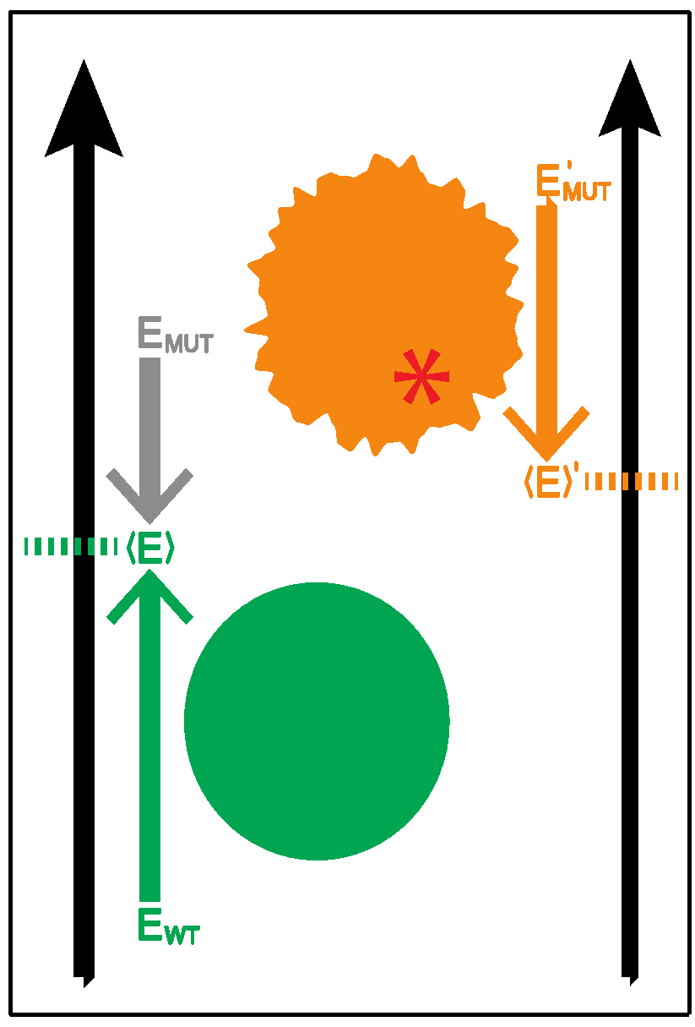
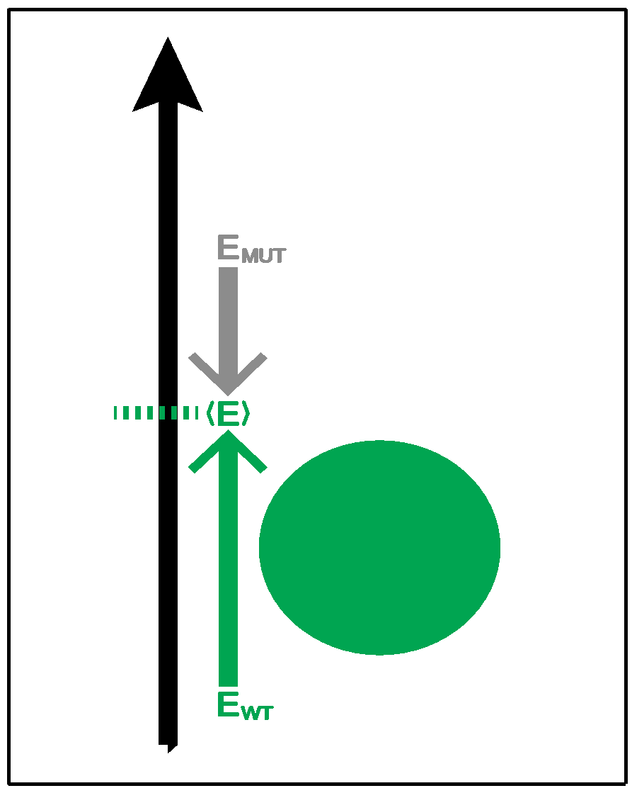
Complexity of the second order frustration calculation
MD-assisted free energy calculation (∆G)
Second order frustration calculation (∆F)
Time
First order frustration calculation (F)
Accuracy

Slide 24
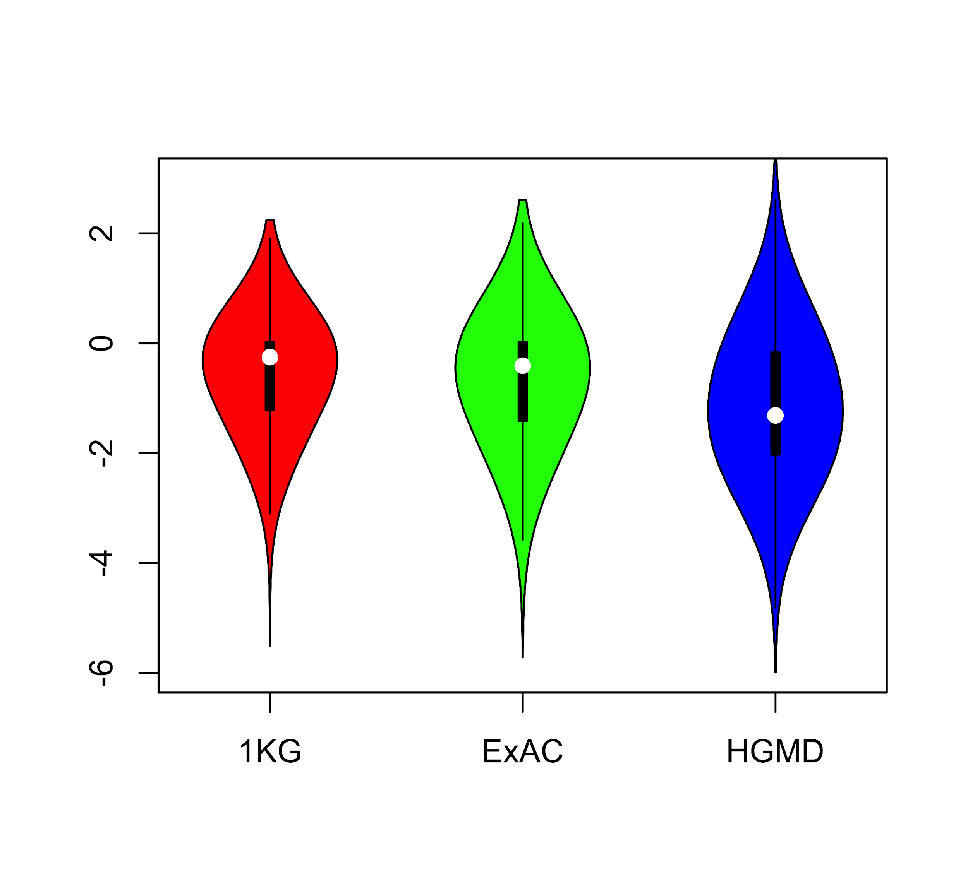
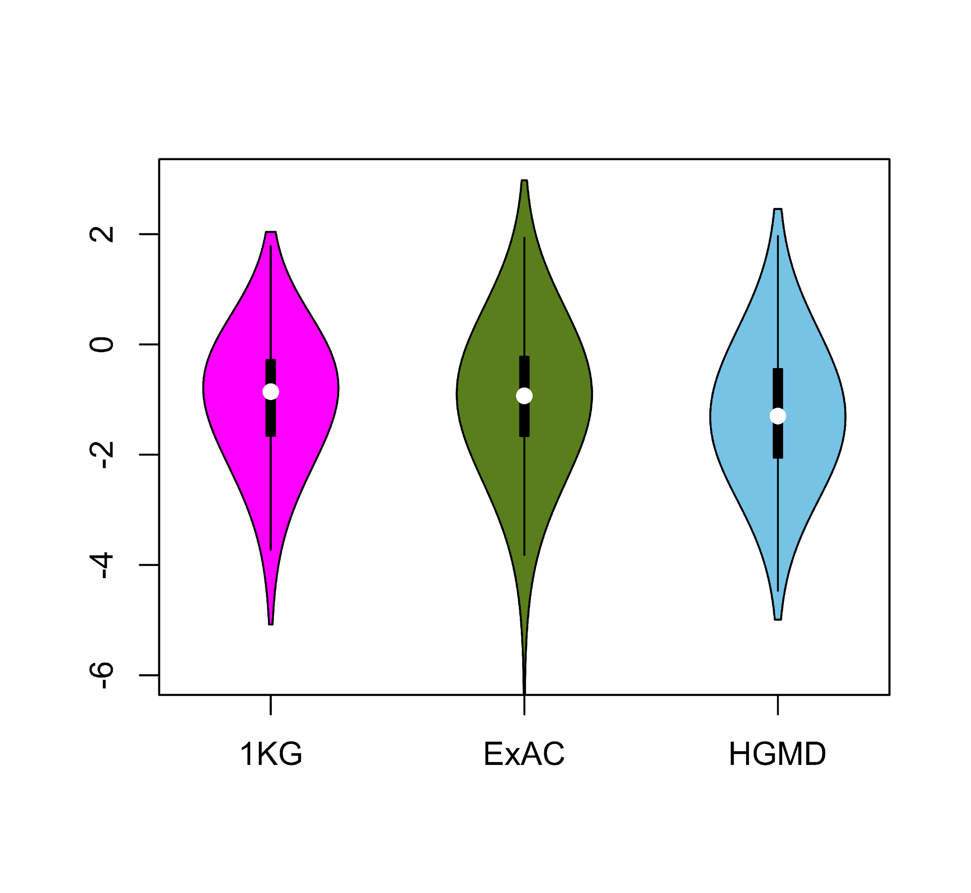
Comparing ∆F values across different SNV categories: disease v normal
Loss of frustration
Gain of frustration
Core residues
Surface residues
Normal mutations (1000G) tend to unfavorably frustrate (less frustrated) surface more than core,
but for disease mutations (HGMD)
no trend & greater changes
[Kumar et al, NAR (2016)]
Notes:
We observed that benign SNVs lead to greater disruptions within minimally frustrated surface residues compared to core residues in the native structure, and this trend is observed when using both ExAC and 1KG (Figure A & B). However, SNVs from HGMD that impact minimally frustrated core residues induce stronger perturbations than benign SNVs influencing minimally frustrated core residues (Figure C). This suggest that the mechanistic difference between benign and disease SNVs can be attributed to their impact on the local environment of core residues. Within the core, disease-associated SNVs result in more severe perturbations to local interactions relative to those introduced by benign SNVs. These local disruptions are propagated throughout the core and, in turn, drive the deleteriousness of various disease-associated SNVs.

Slide 25
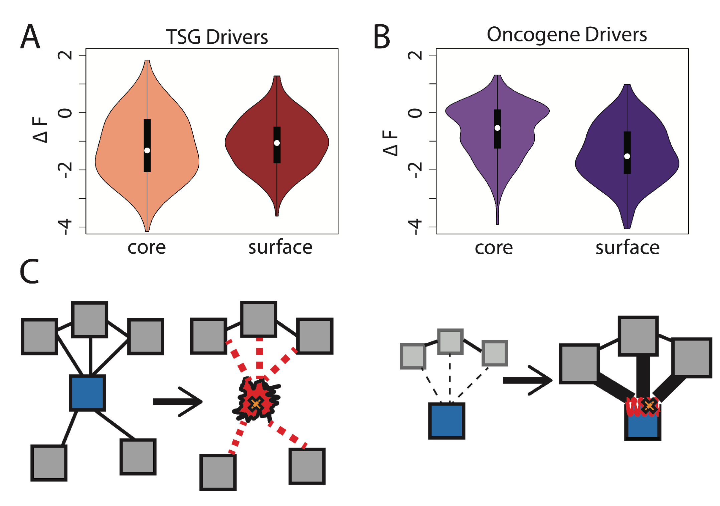
Comparison between ∆F distributions: TSGs v. oncogenes
[Kumar et al, NAR (2016)]
SNVs in TSGs change frustration more in core than the surface, whereas those associated with oncogenes manifest the opposite pattern. This is consistent with differences in LOF v GOF mechanisms.
Notes:
we observe that somatic SNVs associated with TSGs change the frustration more in core than the surface, whereas those associated with oncogenes manifest the opposite pattern. This is consistent with LOF and GOF mechanism proposed for TSG and oncogene driven cancer progression.

Slide 26
Computational analysis of variants: coding versus non-coding
Intro: types of variants
  Rare v common,
  somatic v germline, coding v noncoding
Identifying cryptic allosteric sites with STRESS
  On surface & in interior bottlenecks
Frustration as a localized metric of SNV impact
  Differential profiles for oncogenes v. TSGs
ALoFT: Annotation of LoF Transcripts
Using dynamics to help identify mutation clusters (Hotcommics)
  Find dynamic sub-communities & determine aggregated mutational burden within these
RADAR Prioritization for RBP sites
  Prioritizes variants based on post-transcriptional regulome using ENCODE eCLIP
  Incorporates new features related to RNA sec. struc & tissue specific effects
uORF Prioritization
  Feature integration to find small subset of upstream mutations that potentially alter translation
GRAM to assess the molecular effect of (promotor) mutations
  Universal score + cell type specific score

Slide 27
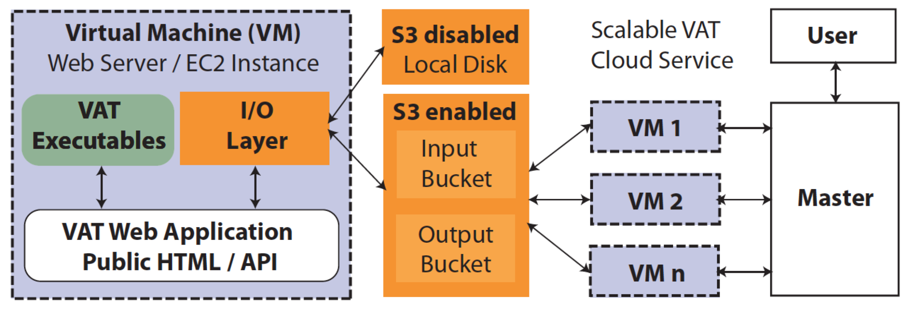
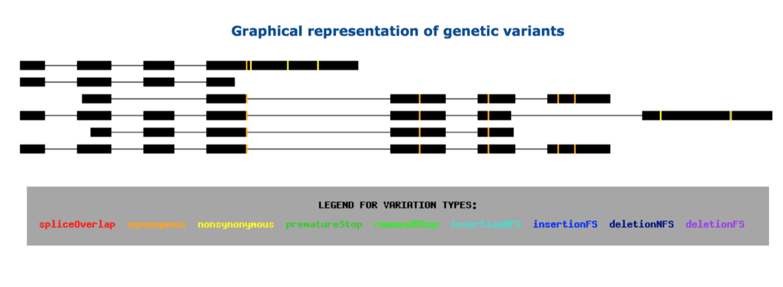
vat.gersteinlab.org
Variant Annotation Tool (VAT), developed for 1000G FIG
VCF Input
Output:
Annotated VCFs
Graphical representations of functional impact on transcripts
Access:
Webserver
AWS cloud instance
Source freely available
CLOUD APPLICATION
Habegger L.*, Balasubramanian S.*, et al. Bioinformatics, 2012
Notes:
27
Big data challenge, graphical interface is important

Slide 28
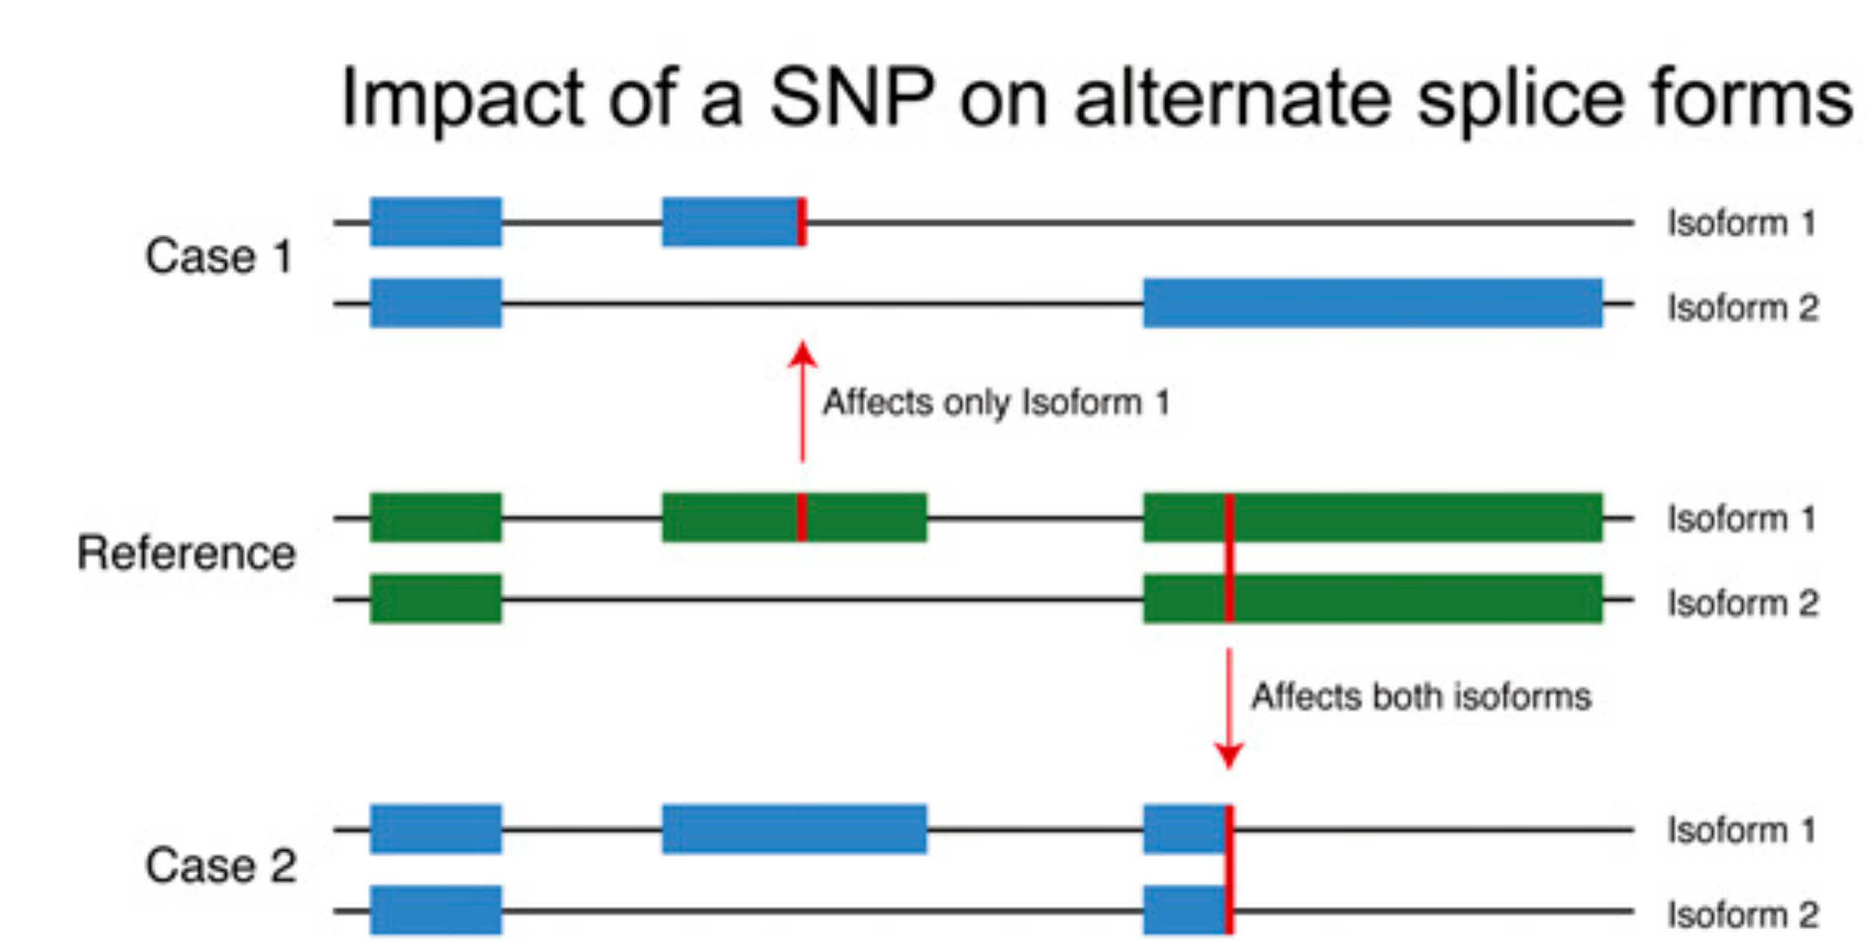
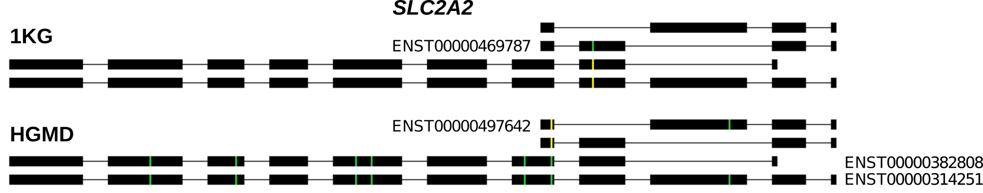
Complexities in LOF annotation
Transcript isoforms,
distance to stop,
functional domains,
protein folding,
etc.
Balasubramanian S. et al., Genes Dev., ’11
Balasubramanian S.*, Fu Y.* et al., NComms., ’17

Slide 29
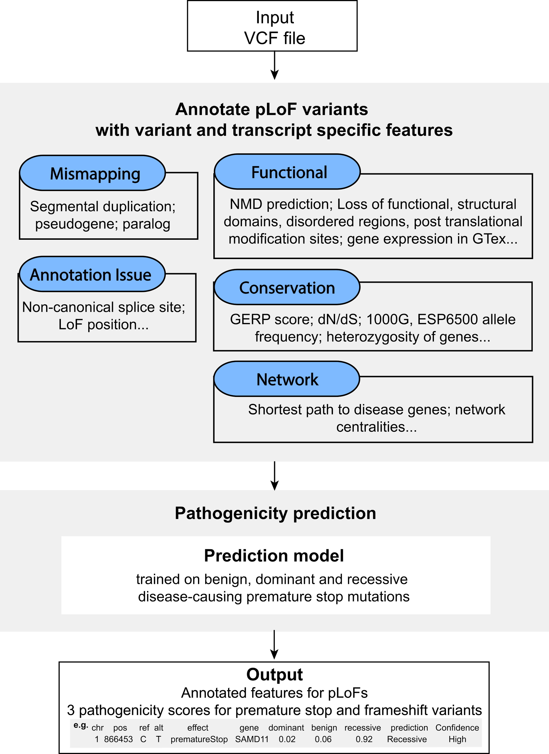
Annotation of
Loss-of-Function
Transcripts (ALoFT)
Runs on top of VAT
Output:
Impact score: benign or deleterious.
Decorated VCF.
Balasubramanian S.*, Fu Y.* et al., NComms., ’17

Slide 30
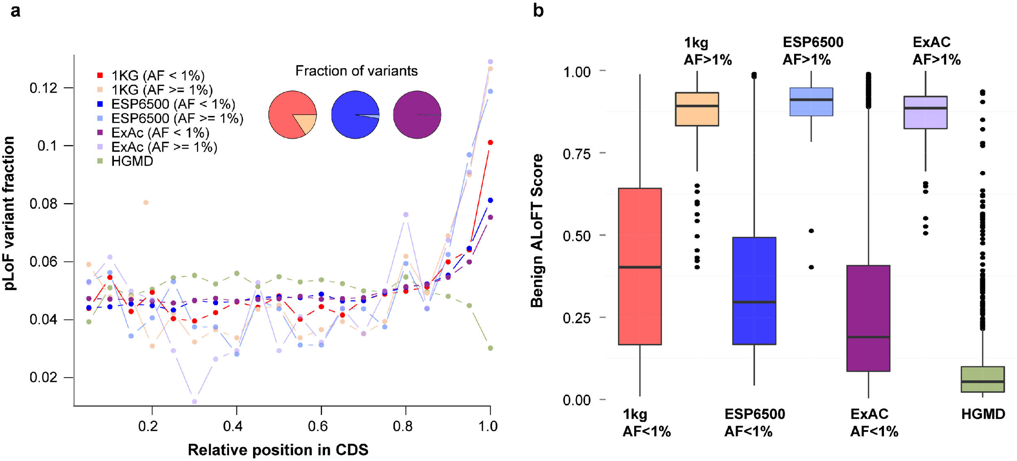
LoF distribution varies as expected by mutation set (from healthy people v from disease)
Balasubramanian S.*, Fu Y.* et al., NComms., ’17

Slide 31
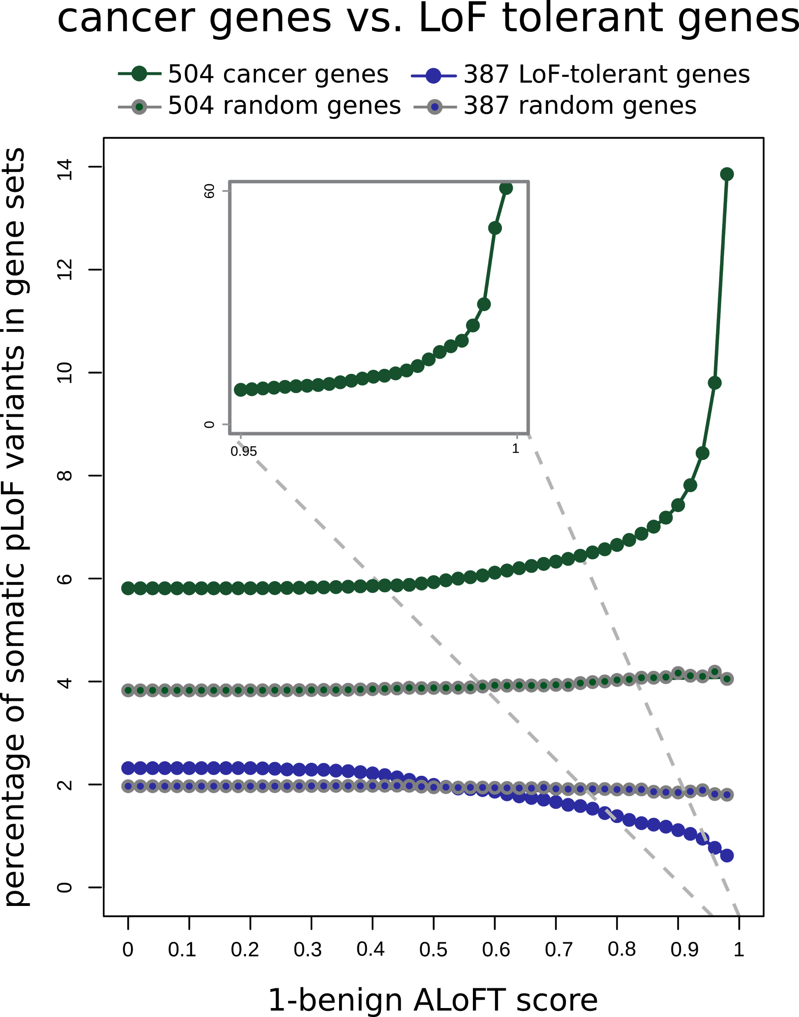
ALoFT identifies deleterious
somatic LoF variants
Cancer genes:
COSMIC consensus.
Enriched in deleterious LoFs.
LoF tolerant genes:
LoF in the 1KG cohort.
Depleted in deleterious LoFs.
Balasubramanian S.*, Fu Y.* et al., NComms., ’17

Slide 32
Computational analysis of variants: coding versus non-coding
Intro: types of variants
  Rare v common,
  somatic v germline, coding v noncoding
Identifying cryptic allosteric sites with STRESS
  On surface & in interior bottlenecks
Frustration as a localized metric of SNV impact
  Differential profiles for oncogenes v. TSGs
ALoFT: Annotation of LoF Transcripts
Using dynamics to help identify mutation clusters (Hotcommics)
  Find dynamic sub-communities & determine aggregated mutational burden within these
RADAR Prioritization for RBP sites
  Prioritizes variants based on post-transcriptional regulome using ENCODE eCLIP
  Incorporates new features related to RNA sec. struc & tissue specific effects
uORF Prioritization
  Feature integration to find small subset of upstream mutations that potentially alter translation
GRAM to assess the molecular effect of (promotor) mutations
  Universal score + cell type specific score

Slide 33
Structures have been used successfully to “aggregate” the burden of mutations
These approaches search for mutational clusters on protein structure using distance cutoff.
Permutation is performed to identify statistically significant mutational clusters on static protein structure.
Both rare germline & somatic
Sivley , et al., AJHG. (2018)

Slide 34
Protein dynamics is important for protein function
Proteins are inherently dynamic bio-molecules and sample large ensembles of conformations.
prior structure-based methods are potentially less sensitive to identify functional residues through the mutation clustering approach.
Potentially miss many critical mutational clusters
We leverage protein dynamics to identify mutation clusters
Focus on data from from TCGA pancan atlas data

Slide 35
Workflow to aggregate mutations taking into account dynamics
Our framework leverages large-scale conformational changes of a protein to identify dynamic sub-regions of proteins (or “communities”).
we mapped missense mutations
onto three-dimensional protein structures.
For each community with mapped mutations, we performed a Fisher exact test to determine whether variants fall within a given community is more frequently observed than what would be expected by chance.
[Kumar et al. (‘19). PNAS]

Slide 36
Pancancer Q-Q plot for genes with hotspot communities
Our pan-cancer analysis identifies hotspot communities present on protein structures of 434 putative driver genes.
Our workflow identifies well known driver genes as well as novel putative driver genes.
[Kumar et al. (‘19). PNAS]

Slide 37
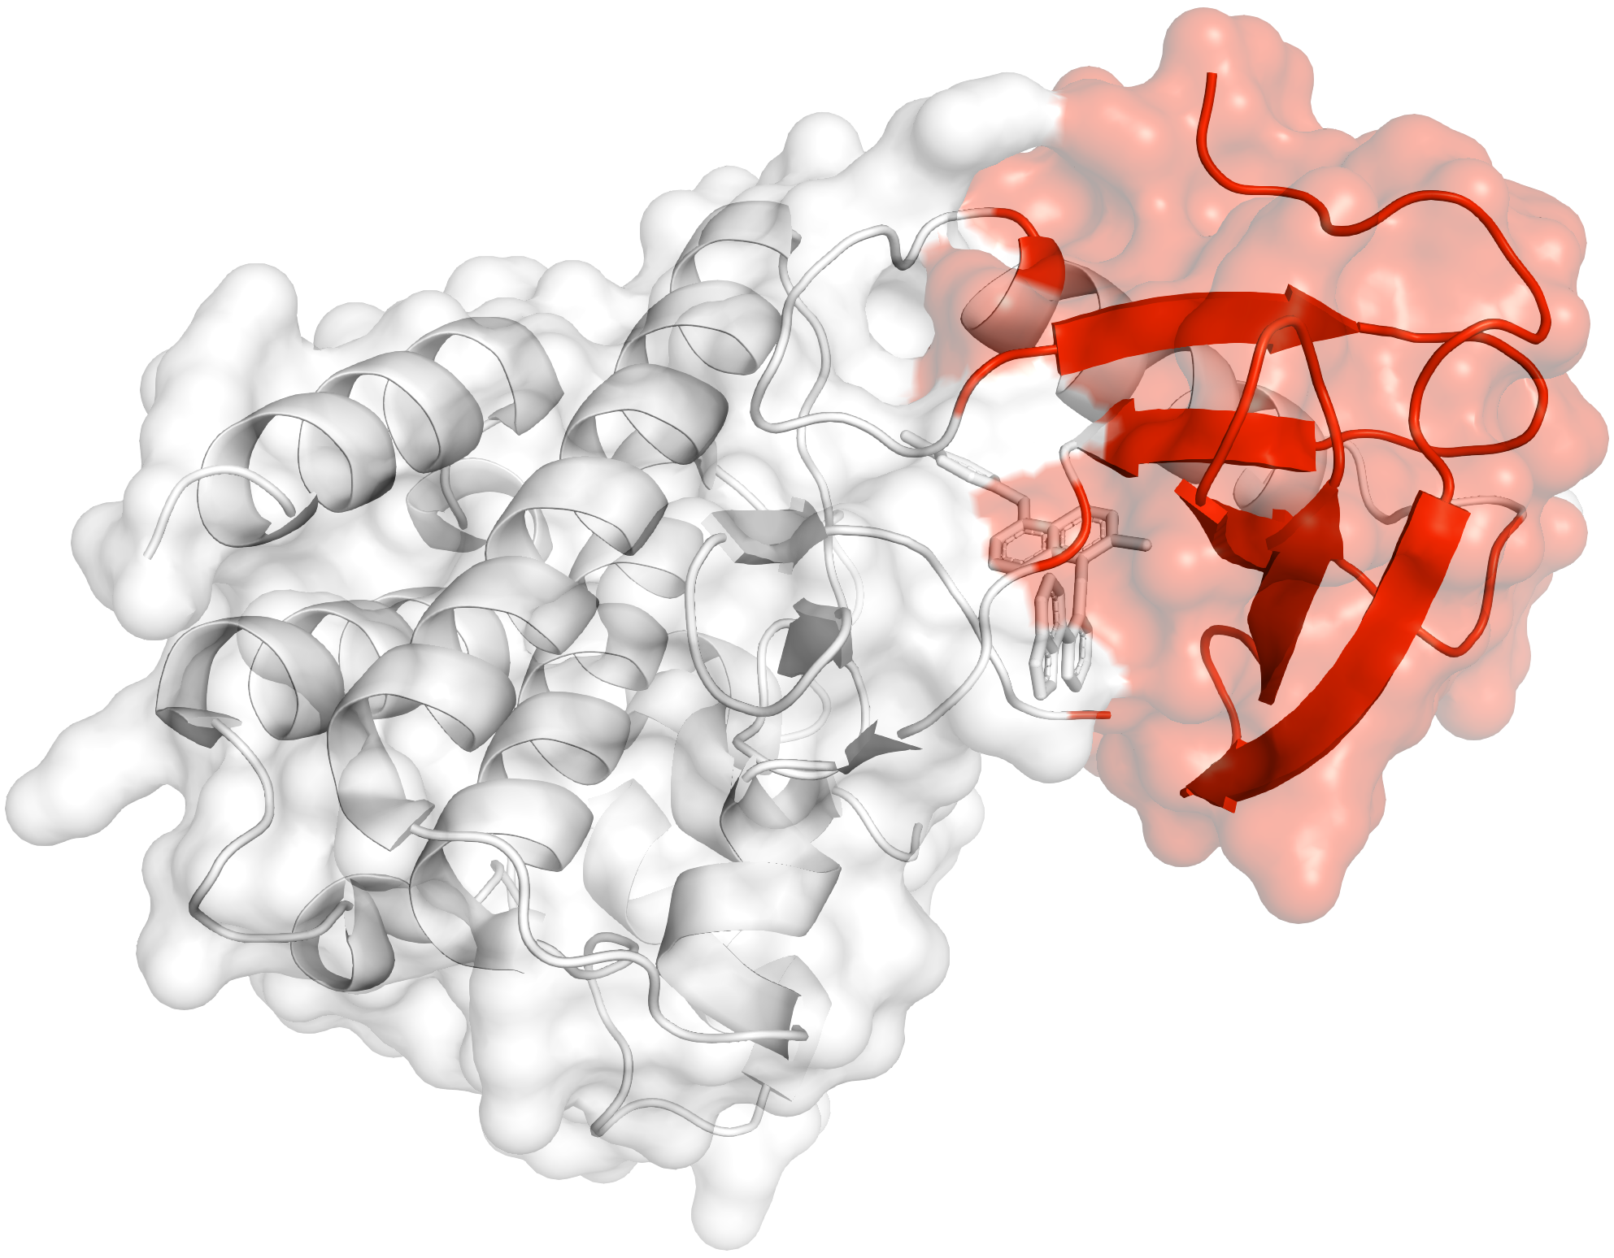
Example of oncogene with hotspot communities
BRAF: We identify one hotspot community comprising of 52 residues on the co-crystal structure of the BRafV600E kinase domain .
[Kumar et al. (‘19). PNAS]

Slide 38
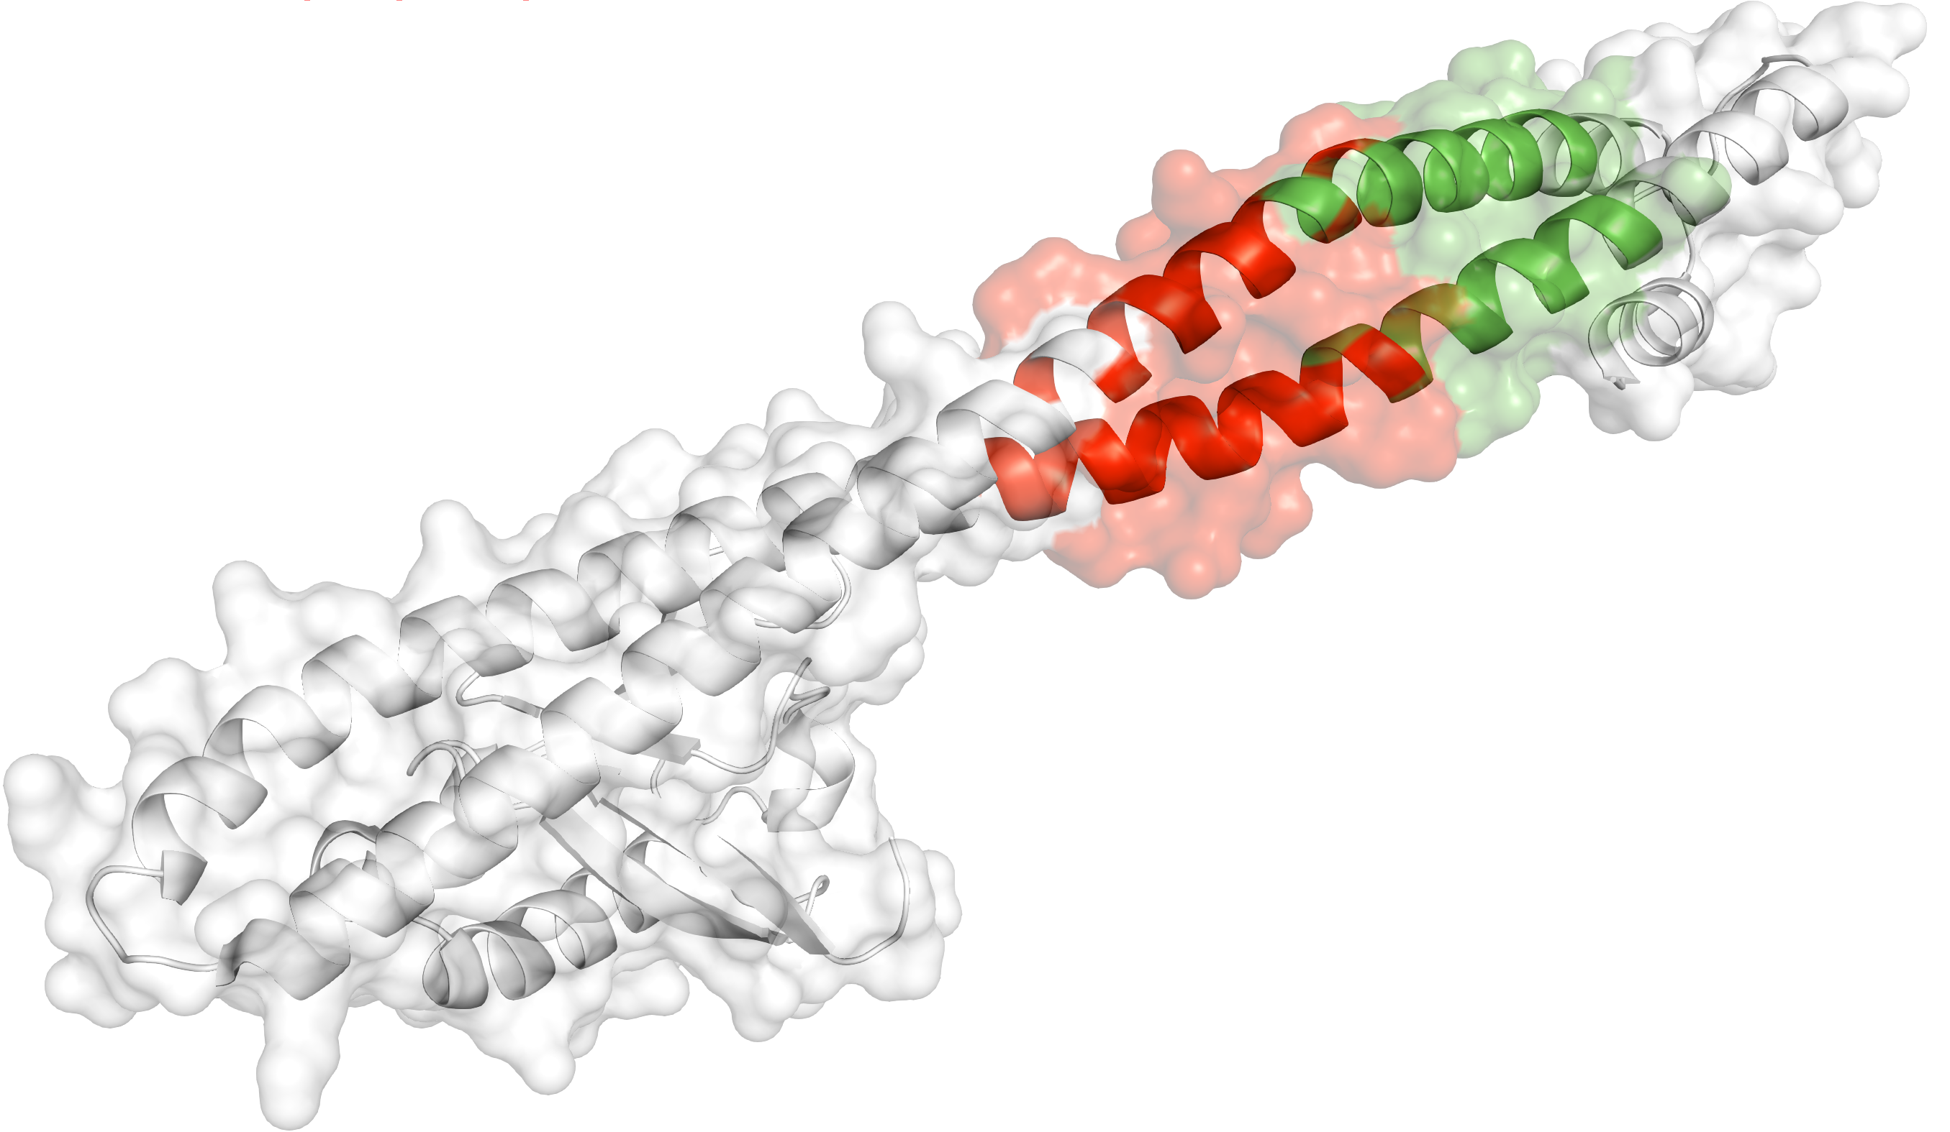
Example of TSG with hotspot communities
We identify two hotspot communities adjacent to each other on the co-crystal structure of the PIK3R1 gene.
[Kumar et al. (‘19). PNAS]

Slide 39
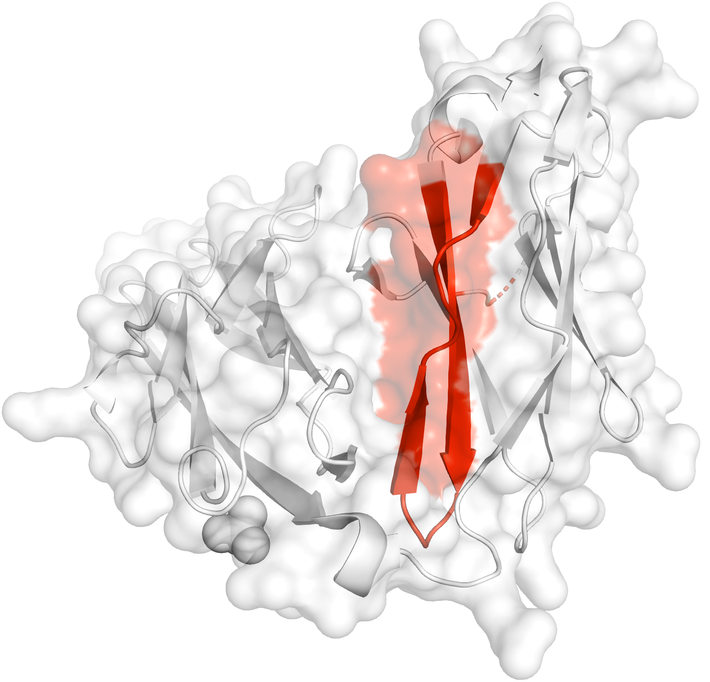
Example of novel drivers with hotspot communities
Our workflow predicts one hotspot community that comprise of 47 residues in the crystal structure of PTPRD gene.
[Kumar et al. (‘19). PNAS]

Slide 40
Computational analysis of variants: coding versus non-coding
Intro: types of variants
  Rare v common,
  somatic v germline, coding v noncoding
Identifying cryptic allosteric sites with STRESS
  On surface & in interior bottlenecks
Frustration as a localized metric of SNV impact
  Differential profiles for oncogenes v. TSGs
ALoFT: Annotation of LoF Transcripts
Using dynamics to help identify mutation clusters (Hotcommics)
  Find dynamic sub-communities & determine aggregated mutational burden within these
RADAR Prioritization for RBP sites
  Prioritizes variants based on post-transcriptional regulome using ENCODE eCLIP
  Incorporates new features related to RNA sec. struc & tissue specific effects
uORF Prioritization
  Feature integration to find small subset of upstream mutations that potentially alter translation
GRAM to assess the molecular effect of (promotor) mutations
  Universal score + cell type specific score

Slide 41
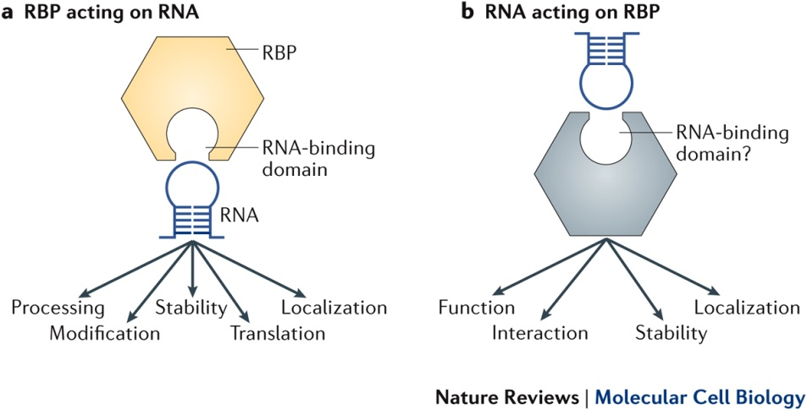
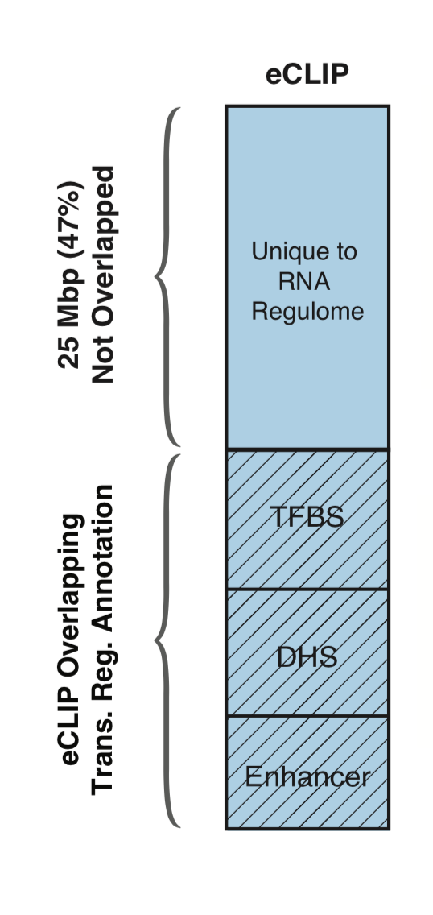
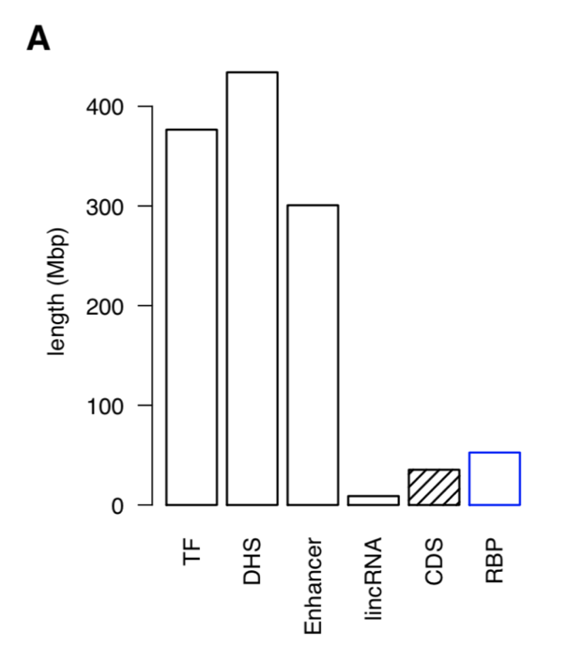
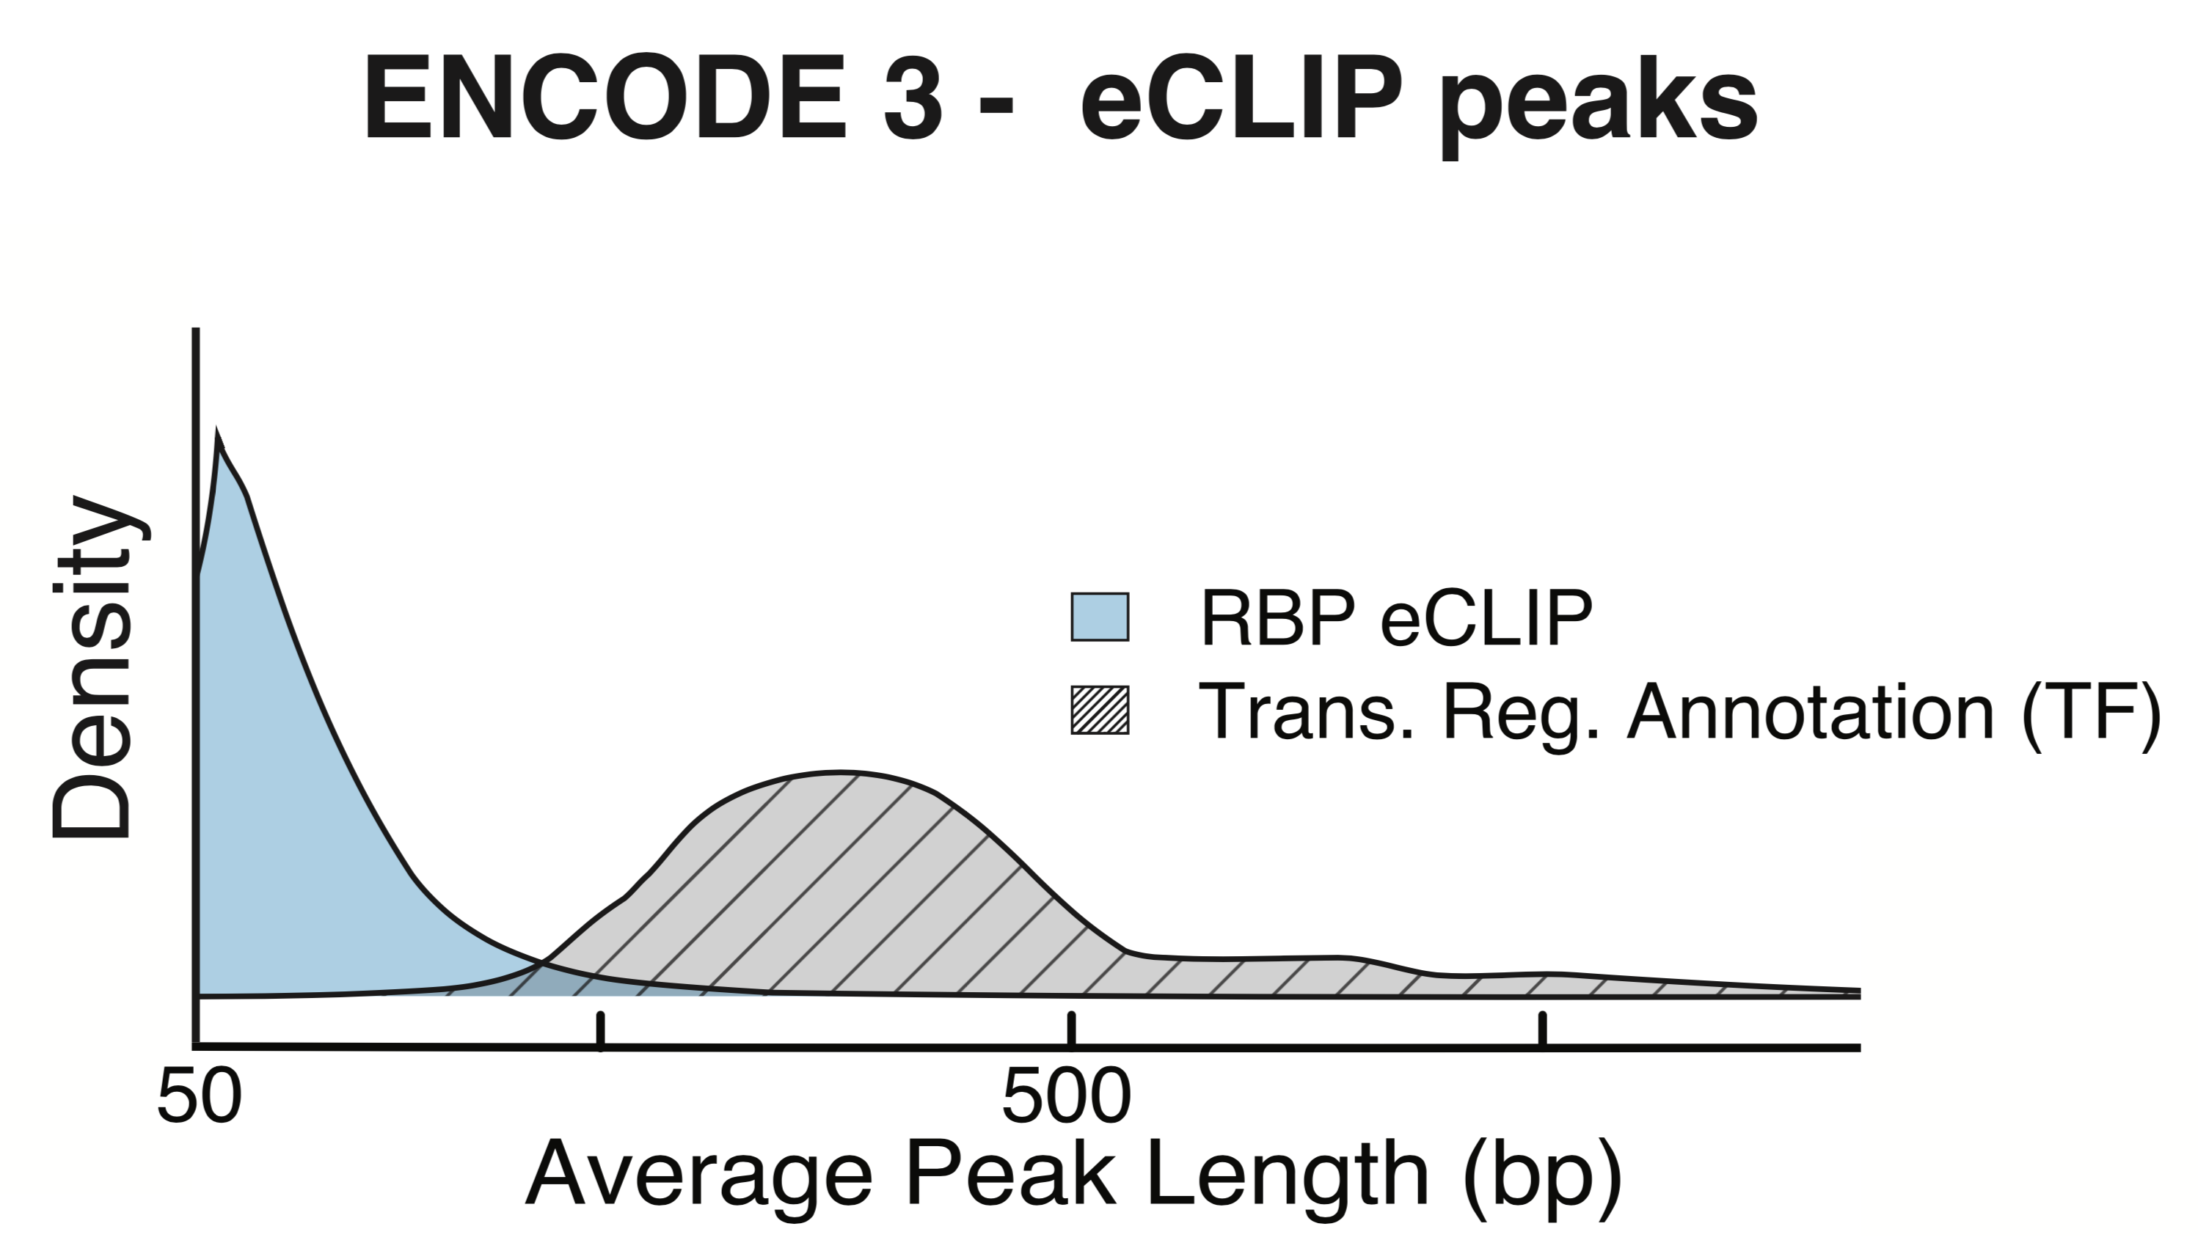
RNA Binding Proteins (RBPs)
Before ENCODE3: >150 expt.
in many different cell types
ENCODE3 did ~350 focused eCLIP expt. for >110 RBPs on HepG2 & K562
(Van Nostrand...Yeo. Nat. Meth. '16;
Van Nostrand...Graveley, Yeo
(submitted in relation to ENCODE3))
Nat Rev Mol Cell Biol. 2018 May;19(5):327-341. doi: 10.1038/nrm.2017.130. Epub 2018 Jan 17.
[Zhang*, Liu* et al., Genome Biology (in review ‘18)]

Slide 42
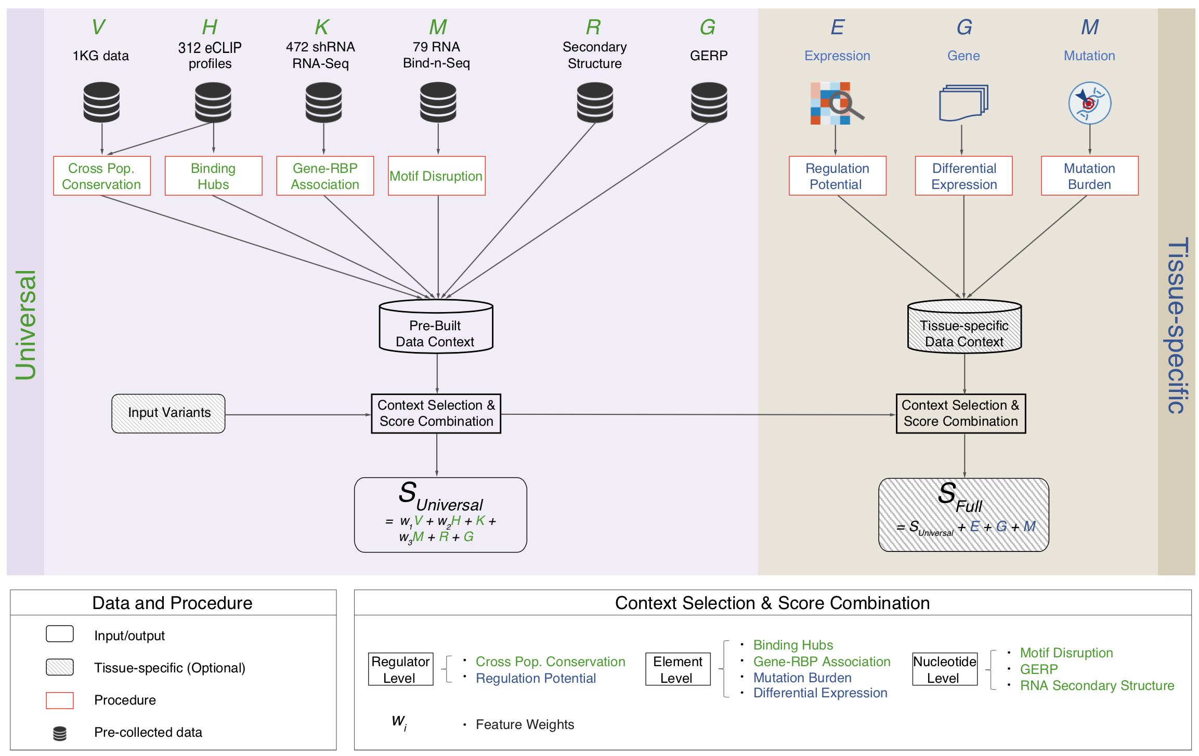
Schematic of RADAR Scoring
[Zhang*, Liu* et al., Genome Biology (in review ‘18)]

Slide 43
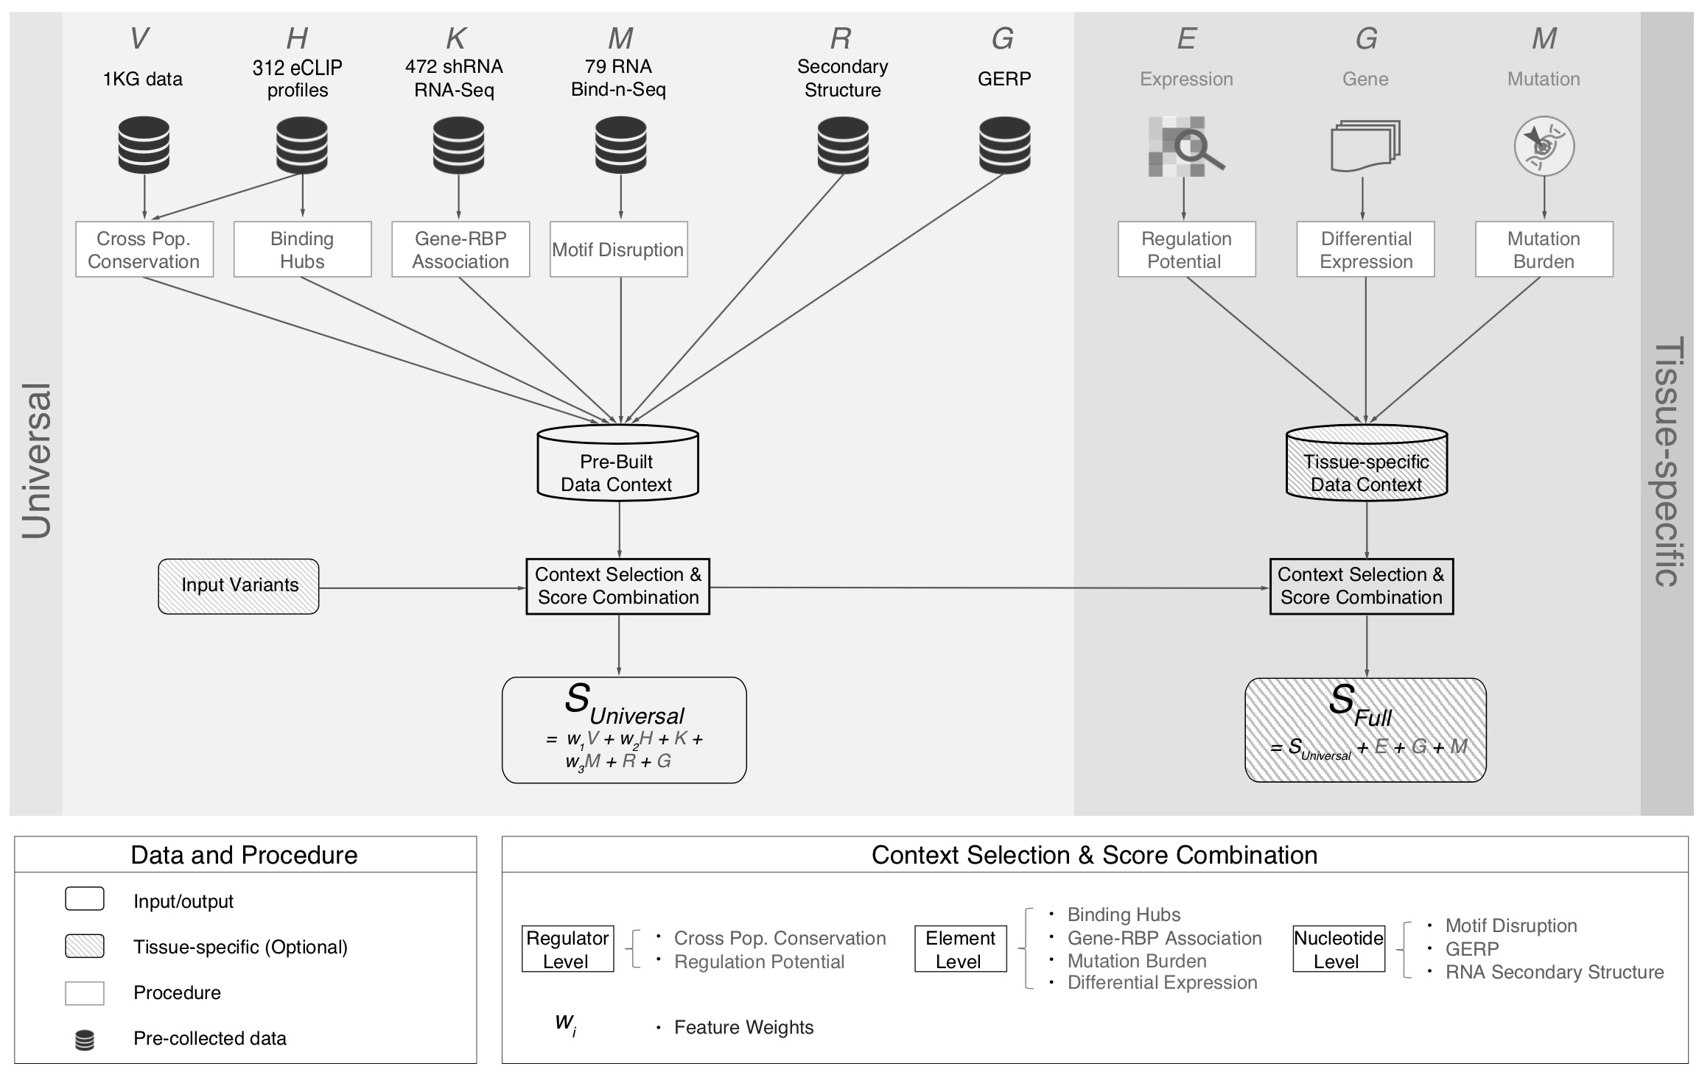
[Zhang*, Liu* et al., Genome Biology (in review ‘18)]

Slide 44
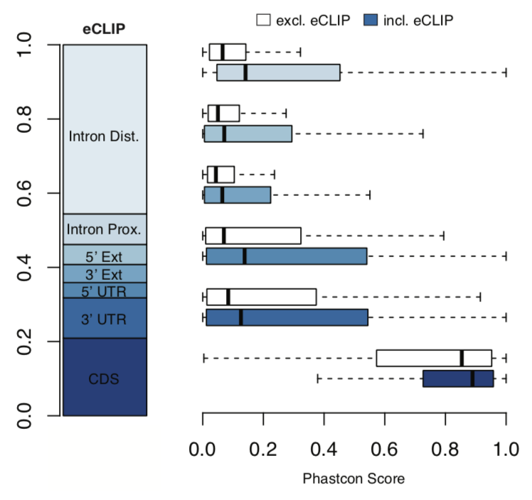
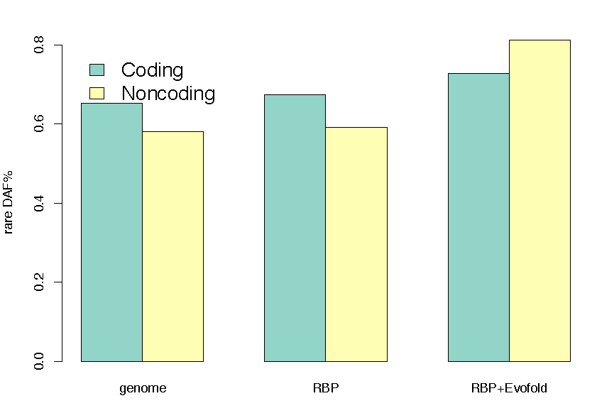
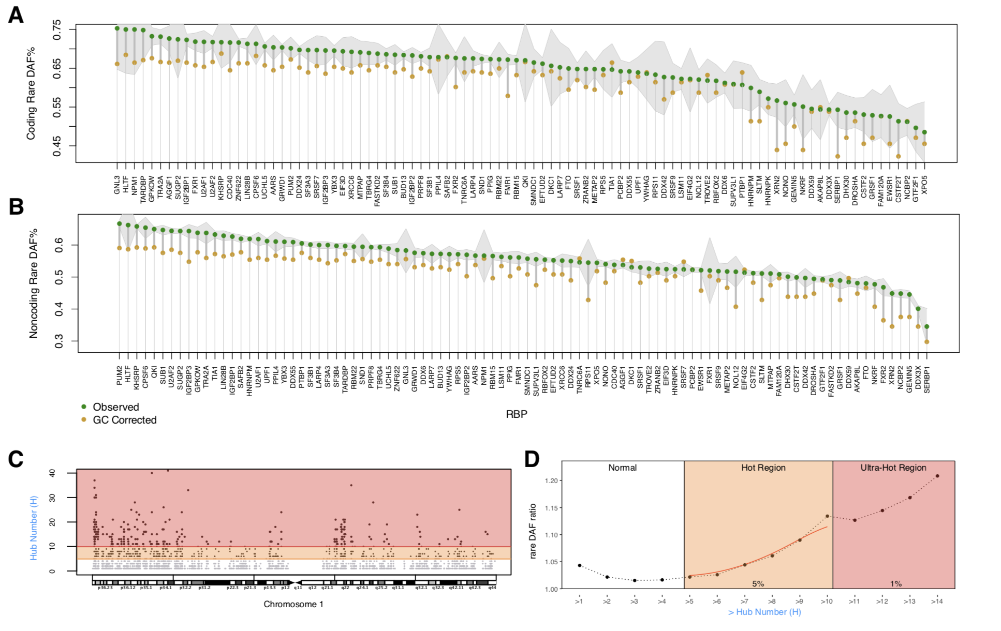
High Phastcon in RBP-overlapped annotations
RNA Structure Cons. from Evofold
Phastcon
Enriched rare DAF in eCLIP peaks
Rare DAF
[Zhang*, Liu* et al., Genome Biology (in review ‘18)]
RBP

Slide 45
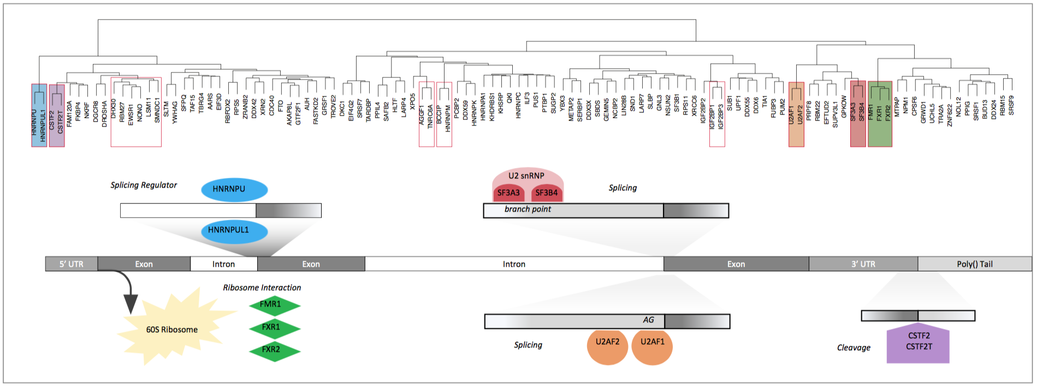
Co-binding of RBPs form biologically relevant complexes
Unique co-binding patterns of RBPs
Literature supported RBP complexes
RBP
RBP
Binding hubs are enriched for rare variants
Hub Number
(Hotness)
Rare DAF
[Zhang*, Liu* et al., Genome Biology (in review ‘18)]
Hub Number (Hotness)

Slide 46
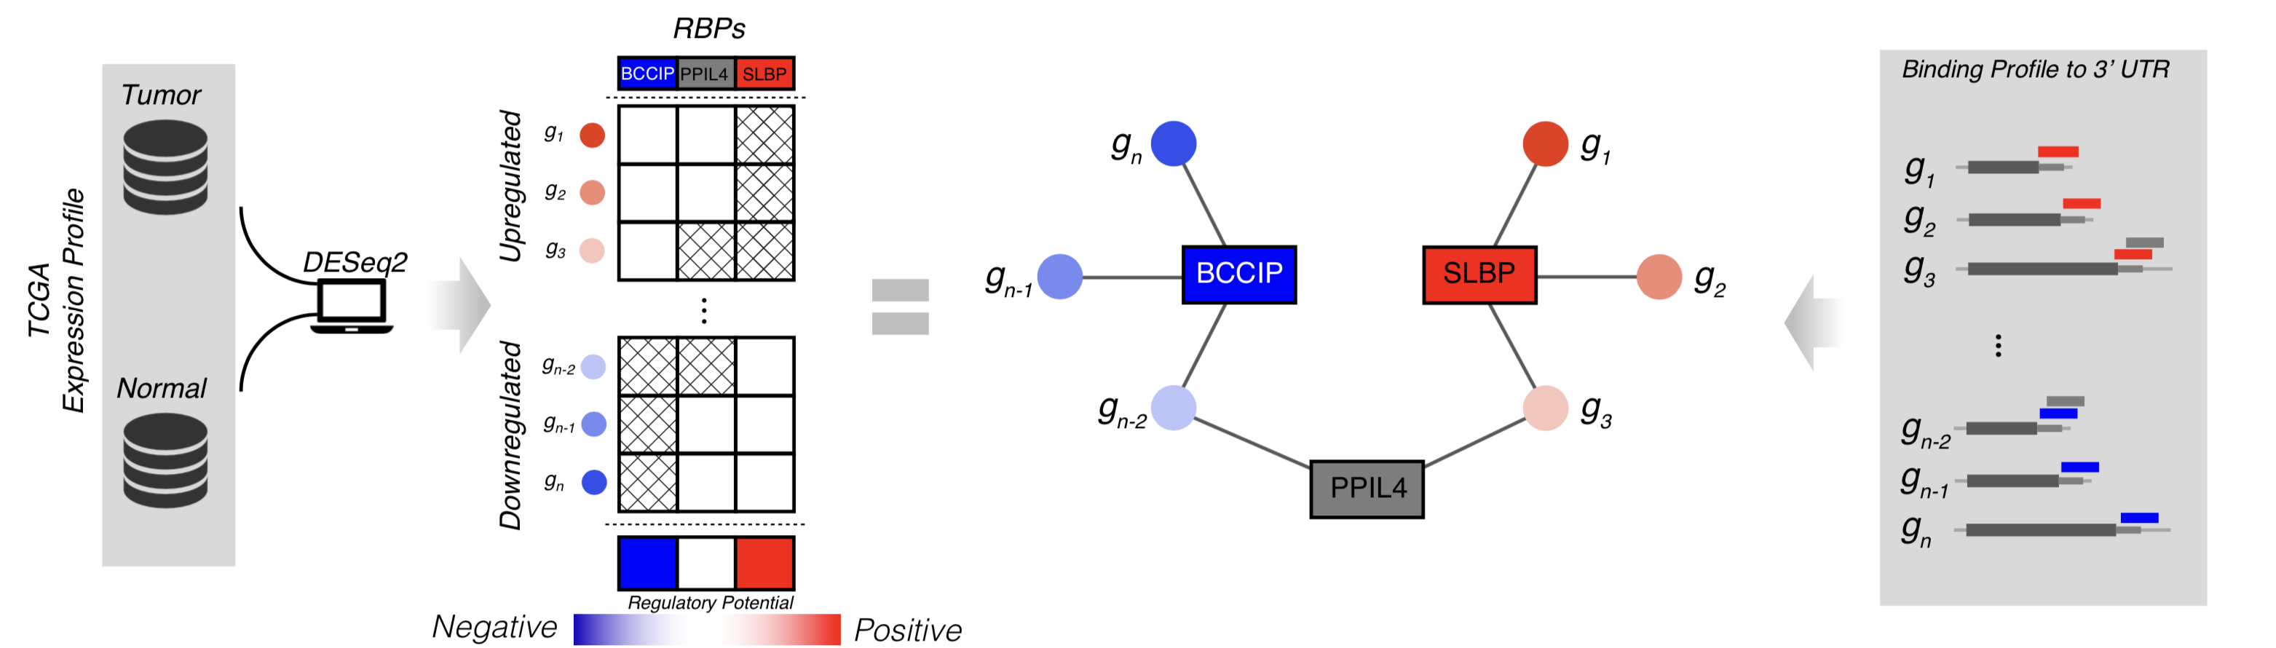
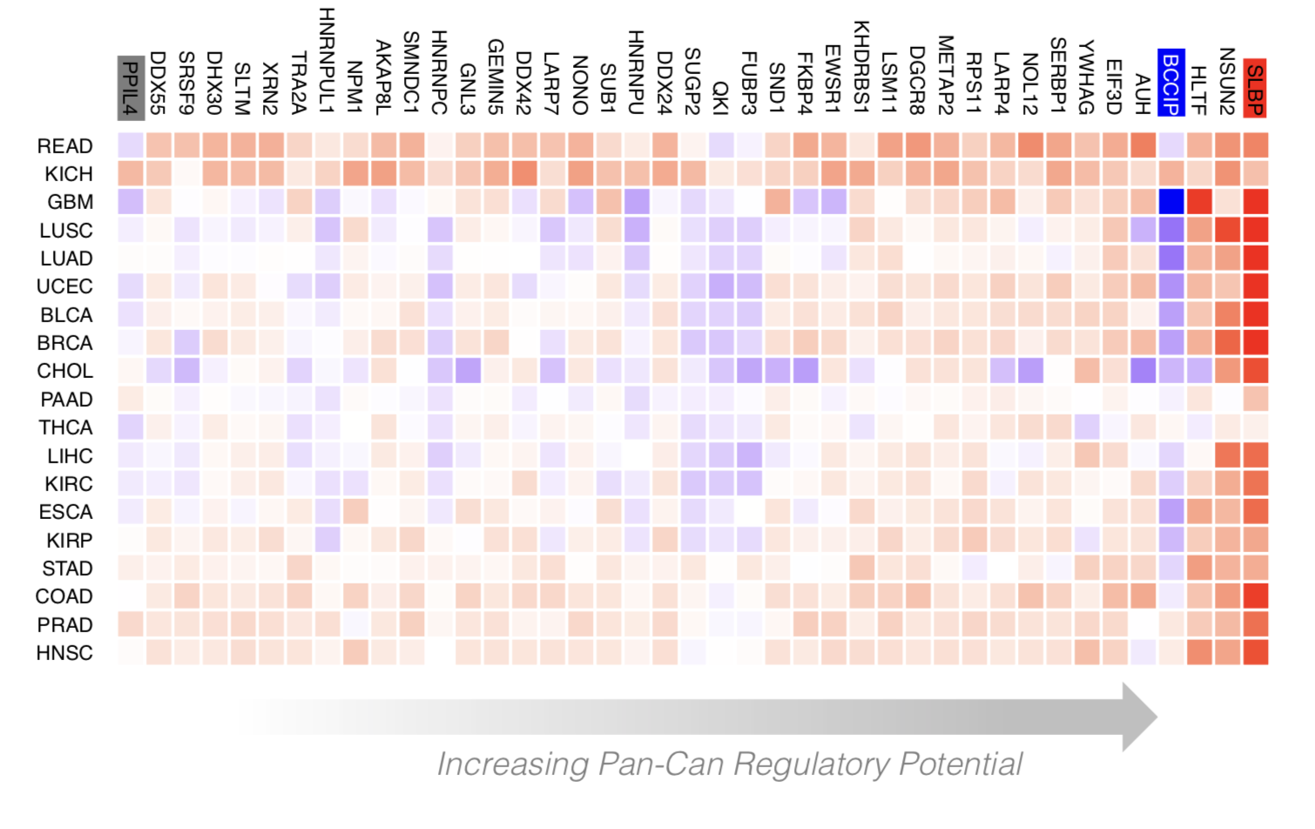
Regulatory Potential of RBPs derived from regression between gene network and expression levels
[Zhang*, Liu* et al., Genome Biology (in review ‘18)]

Slide 47

Visualization of RADAR Features and Scoring
Germline Variants are Score Using a Universal Scoring Scheme
Input Variants
eCLIP
GERP
Motif
…
[Zhang*, Liu* et al., Genome Biology (in review ‘18)]

Slide 48

Visualization of RADAR Features and Scoring
Tissue Specific:
Variants
Expression
Regulatory Potential
Input Variants
eCLIP
GERP
Motif
…
Somatic Variant Scored with Universal + Tissue specific context score
[Zhang*, Liu* et al., Genome Biology (in review ‘18)]

Slide 49
Computational analysis of variants: coding versus non-coding
Intro: types of variants
  Rare v common,
  somatic v germline, coding v noncoding
Identifying cryptic allosteric sites with STRESS
  On surface & in interior bottlenecks
Frustration as a localized metric of SNV impact
  Differential profiles for oncogenes v. TSGs
ALoFT: Annotation of LoF Transcripts
Using dynamics to help identify mutation clusters (Hotcommics)
  Find dynamic sub-communities & determine aggregated mutational burden within these
RADAR Prioritization for RBP sites
  Prioritizes variants based on post-transcriptional regulome using ENCODE eCLIP
  Incorporates new features related to RNA sec. struc & tissue specific effects
uORF Prioritization
  Feature integration to find small subset of upstream mutations that potentially alter translation
GRAM to assess the molecular effect of (promotor) mutations
  Universal score + cell type specific score

Slide 50


Upstream open reading frames (uORFs) regulate translation are affected by mutation
uORFs regulate the translation of downstream coding regions.
In Battle et al. 2014 data uORF gain & loss assoc. protein level change.
[Calvo et al., PNAS (‘09)]
[McGillivray et al., NAR (‘18)]
[Ferreira et al., Bioengineered (‘14)]

Slide 51


The population of functional uORFs may be significant
From a “Universe” of 1.3 M pot. uORFs
Ribosome profiling experiments have low overlap in identified uORFs.
This suggests high false-negative rate, and more functional uORFs than currently known.
[McGillivray et al., NAR (‘18)]

Slide 52

Prediction & validation of functional uORFs using 89 features
Expr.
Level
All near-cognate start codons predicted.
Cross-validation on independent ribosome profiling datasets and validation using in vivo protein levels and ribosome occupancy in humans (Battle et al. 2014).
Tissue
Dist.
Int.
ATG
Start
Conser-
vation
[McGillivray et al., NAR (‘18)]

Slide 53
A comprehensive catalog of functional uORFs
Universe of 1.3M uORFs scored via Simple Bayes algo.
180K: Large predicted positive set likely to affect translation
Calibration on gold standards, suggests getting ~70% of known
Predicted functional uORFs may be intersected with disease associated variants.
[McGillivray et al., NAR (‘18)]

Slide 54
Computational analysis of variants: coding versus non-coding
Intro: types of variants
  Rare v common,
  somatic v germline, coding v noncoding
Identifying cryptic allosteric sites with STRESS
  On surface & in interior bottlenecks
Frustration as a localized metric of SNV impact
  Differential profiles for oncogenes v. TSGs
ALoFT: Annotation of LoF Transcripts
Using dynamics to help identify mutation clusters (Hotcommics)
  Find dynamic sub-communities & determine aggregated mutational burden within these
RADAR Prioritization for RBP sites
  Prioritizes variants based on post-transcriptional regulome using ENCODE eCLIP
  Incorporates new features related to RNA sec. struc & tissue specific effects
uORF Prioritization
  Feature integration to find small subset of upstream mutations that potentially alter translation
GRAM to assess the molecular effect of (promotor) mutations
  Universal score + cell type specific score

Slide 55
Promotor Mutations
How do we assess their effect?
  What’s the readout? Expression?
Molecular v Organismic phenotype
Importance of specific cellular context

Slide 56

GRAM approach for assessing molecular impact
[Lou et al. (‘19). PLOS Genetics]

Slide 57


GRAM performance
[Lou et al. (‘19). PLOS Genetics]

Slide 58


GRAM Important Features
[Lou et al. (‘19). PLOS Genetics]

Slide 59

GRAM application to find molecular cause within group of eQTL variants
[Lou et al. (‘19). PLOS Genetics]

Slide 60
Computational analysis of variants: coding versus non-coding
Intro: types of variants
  Rare v common,
  somatic v germline, coding v noncoding
Identifying cryptic allosteric sites with STRESS
  On surface & in interior bottlenecks
Frustration as a localized metric of SNV impact
  Differential profiles for oncogenes v. TSGs
ALoFT: Annotation of LoF Transcripts
Using dynamics to help identify mutation clusters (Hotcommics)
  Find dynamic sub-communities & determine aggregated mutational burden within these
RADAR Prioritization for RBP sites
  Prioritizes variants based on post-transcriptional regulome using ENCODE eCLIP
  Incorporates new features related to RNA sec. struc & tissue specific effects
uORF Prioritization
  Feature integration to find small subset of upstream mutations that potentially alter translation
GRAM to assess the molecular effect of (promotor) mutations
  Universal score + cell type specific score

Slide 61
Computational analysis of variants: coding versus non-coding
Intro: types of variants
  Rare v common,
  somatic v germline, coding v noncoding
Identifying cryptic allosteric sites with STRESS
  On surface & in interior bottlenecks
Frustration as a localized metric of SNV impact
  Differential profiles for oncogenes v. TSGs
ALoFT: Annotation of LoF Transcripts
Using dynamics to help identify mutation clusters (Hotcommics)
  Find dynamic sub-communities & determine aggregated mutational burden within these
RADAR Prioritization for RBP sites
  Prioritizes variants based on post-transcriptional regulome using ENCODE eCLIP
  Incorporates new features related to RNA sec. struc & tissue specific effects
uORF Prioritization
  Feature integration to find small subset of upstream mutations that potentially alter translation
GRAM to assess the molecular effect of (promotor) mutations
  Universal score + cell type specific score

Slide 62

RADAR.gersteinlab.org
J Zhang, J Liu, D Lee, J-J Feng,
L Lochovsky, S Lou, M Rutenberg-Schoenberg
github.gersteinlab.org/uORFs
P McGillivray, R Ault, M Pawashe,
R Kitchen, S Balasubramanian
github.com/gersteinlab/Frustration
S Kumar, D Clarke
STRESS.molmovdb.org
D Clarke, A Sethi, S Li, S Kumar,
R Chang, J Chen
github.com/gersteinlab/gram
S Lou, KA Cotter, T Li, J Liang, H Mohsen, J Liu,
J Zhang, S Cohen, J Xu, H Yu, MA Rubin
github.com/gersteinlab/hotcommics
S Kumar, D Clarke
ALoFT.gersteinlab.org
S Balasubramanian, Y Fu,
M Pawashe, P McGillivray, M Jin, J Liu,
K Karczewski, D MacArthur
Acknowledgments! Also, Hiring: See Jobs.gersteinlab.org

Slide 63


Slide 64
Info about this talk
No Conflicts
Unless explicitly listed here. There are no conflicts of interest relevant to the material in this talk
General PERMISSIONS
This Presentation is copyright Mark Gerstein, Yale University, 2019.
Please read permissions statement at
sites.gersteinlab.org/Permissions
Basically, feel free to use slides & images in the talk with PROPER acknowledgement (via citation to relevant papers or website link). Paper references in the talk were mostly from Papers.GersteinLab.org.
PHOTOS & IMAGES
For thoughts on the source and permissions of many of the photos and clipped images in this presentation see streams.gerstein.info . In particular, many of the images have particular EXIF tags, such as kwpotppt , that can be easily queried from flickr, viz: flickr.com/photos/mbgmbg/tags/kwpotppt

