Slide 1

Enhancing open data sharing for functional genomics experiments: Measures to quantify genomic​ information leakage & identify file formats for privacy preservation
M Gerstein, Yale
(See last slide for more info.)
Slides freely “tweetable” (via @MarkGerstein)
& downloadable from Lectures.GersteinLab.org

Slide 2

Dilemma of Genomic Privacy
+ the 2-sided nature of functional genomics data: Analysis can be very General/Public or Individual/Private
General Dilemma of Genomic Privacy
  Risks to the individual related to
  sharing variants
  Yet benefit to medical research & society as a whole from data sharing
Functional Genomics gives General quantifications
related to overall aspects of a state– ie gene activity as a function of: Developmental stage, Evolutionary relationships, Cell-type, Disease, &c.
Above are not tied to an individual’s genotype. However, data is derived from individuals & tagged with their genotypes
  (Note, a few calculations aim to use explicitly genotype to derive general relations related to sequence variation & gene expression - eg allelic activity)

Slide 3

Data Reduction in RNA-Seq: an Overview
ATACAAGCAAGTATAAGTTCGTATGCCGTCTT
GGAGGCTGGAGTTGGGGACGTATGCGGCATAG
TACCGATCGAGTCGACTGTAAACGTAGGCATA
ATTCTGACTGGTGTCATGCTGATGTACTTAAA
Fastq sequence files
~5-10 GB
Index-building + Alignment to reference genome
BAM files
~1-2-fold reduction
Successive steps of Data Reduction
Conversion to signal track by overlapping reads
BigWig files
~25-fold reduction
Mapping to genes
Gene/Transcript expression matrix
~20-fold reduction
Quantitative information from RNA-seq signal: average signals at exon level (RPKMs)
Reads => Signal
[NAT. REV. 10: 57; PLOS CB 4:e1000158; PNAS 4:107: 5254 ]

Slide 4



Representative Functional Genomics & Genotype Datasets
Genotypes are available from the 1000 Genomes Project
mRNA sequencing for 462 individuals from gEUVADIS and ENCODE
  Publicly available quantification for protein coding genes
Functional genomics data (ChIP-Seq, RNA-Seq, Hi-C) available from ENCODE

Slide 5
Enhancing open data sharing for functional genomics experiments:
Measures to quantify genomic​ information leakage & identify file formats for privacy preservation
(Functional) Genomic Privacy
  The dilemma: The genome as fundamental, inherited info that’s very private v. need for large-scale sharing for med. research
  2-sided nature of functional genomics data presents particularly tricky privacy issues
Subtle Leakage: Signal Profiles
  Manifest appreciable leakage from large & small deletions
  Quantified by ICI and π_{GW}
  Linking attacks possible but additional complication of SV discovery in addition to genotyping
Practical solutions
  FANCY Risk assessment:
  Predicts the number of leaking variants from functional genomics data without the need for genotyping.
  pBAM file format:
  Remove obvious variants from leakage +
  Can be used with existing softwares/pipelines, giving consistent quantifications

Slide 6
Enhancing open data sharing for functional genomics experiments:
Measures to quantify genomic​ information leakage & identify file formats for privacy preservation
(Functional) Genomic Privacy
  The dilemma: The genome as fundamental, inherited info that’s very private v. need for large-scale sharing for med. research
  2-sided nature of functional genomics data presents particularly tricky privacy issues
Subtle Leakage: Signal Profiles
  Manifest appreciable leakage from large & small deletions
  Quantified by ICI and π_{GW}
  Linking attacks possible but additional complication of SV discovery in addition to genotyping
Practical solutions
  FANCY Risk assessment:
  Predicts the number of leaking variants from functional genomics data without the need for genotyping.
  pBAM file format:
  Remove obvious variants from leakage +
  Can be used with existing softwares/pipelines, giving consistent quantifications

Slide 7
Detection & Genotyping of small & large
SV deletions from signal profiles
RNA-Seq
Signal
Genomic
Coordinate
ChIP-Seq
Signals
A C G T A C G
Large Deletion
Genomic
Coordinate
Small Deletion
RNA-seq also shows large deletions
[Harmanci & Gerstein, Nat. Comm. (‘18)]

Slide 8
Example of Small Deletion Evident in Signal Profile
[Harmanci & Gerstein, Nat. Comm. (‘18)]

Slide 9
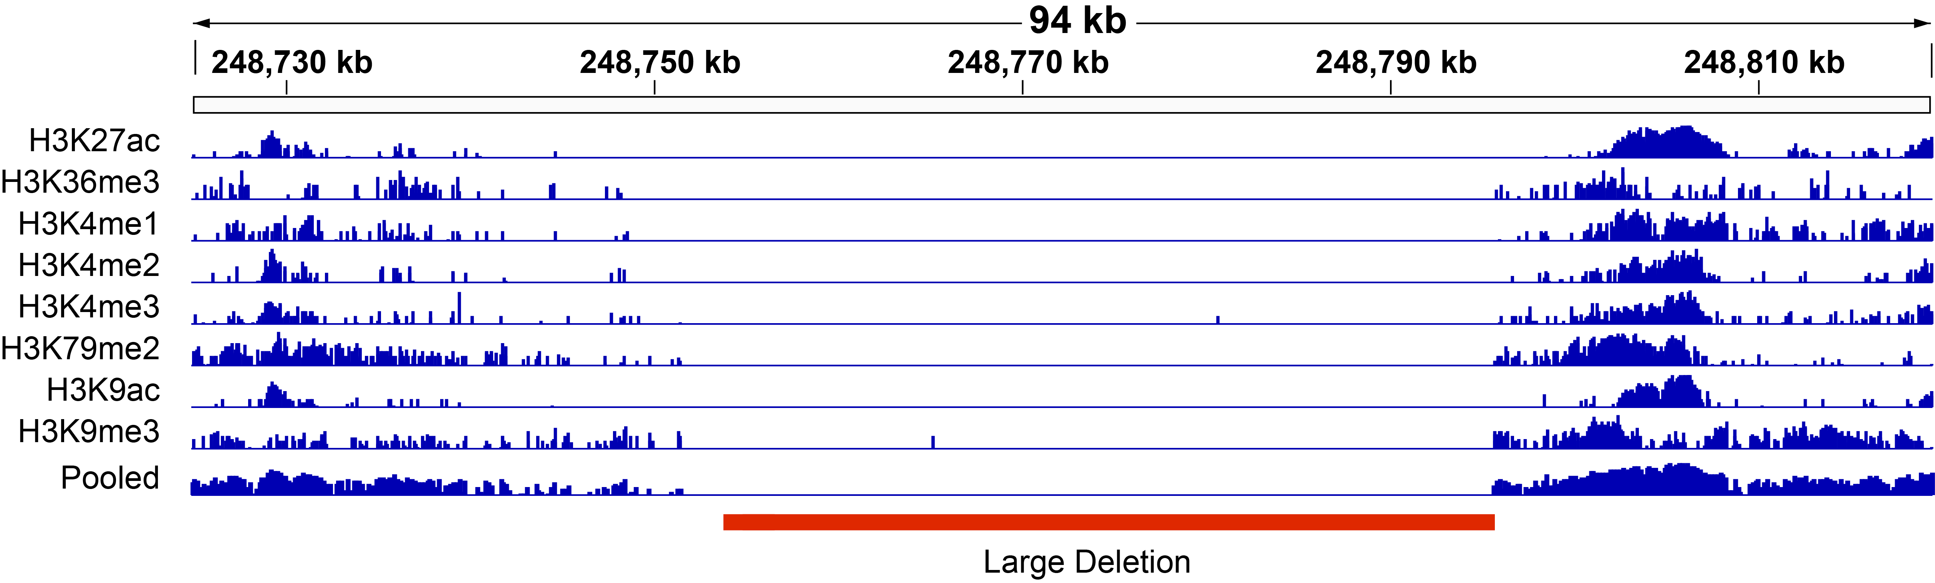
Example of Large Deletion Evident in Signal Profile
[Harmanci & Gerstein, Nat. Comm. (‘18)]

Slide 10
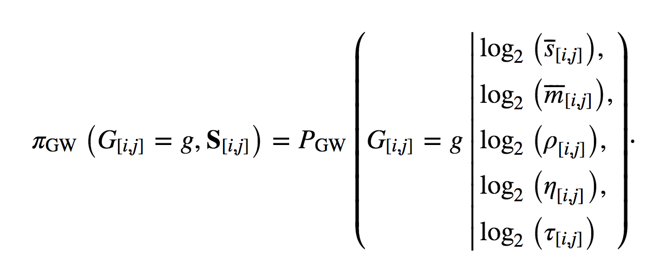
Metrics for quantifying leakage
ICI: For a given variant genotype, measures how much information it supplies for pinpointing an individual in a population. Higher weight to genotypes that have low population frequency.
π_{GW :}Predictability is defined as the conditional probability of a deletion genotype g given 5 features computed from a functional genomics signal profile (eg avg. signal, multi-mapability, signal shape, &c…)
[Harmanci & Gerstein, Nat. Comm. (‘18)]

Slide 11
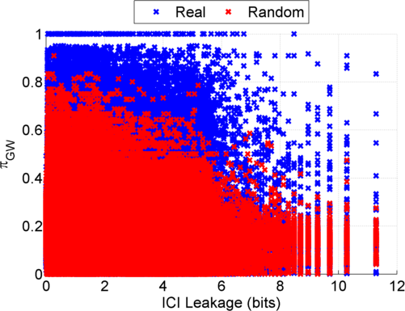
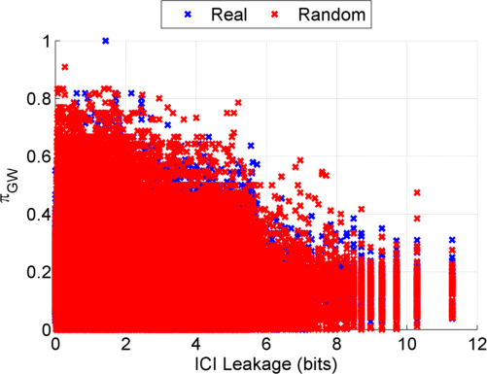
Information Leakage from SV Deletions
Before Anonymization
b) After Anonymization
Simple anonymization procedure
(filling in deletion by value at endpoints) has dramatic effect
[Harmanci & Gerstein, Nat. Comm. (‘18)]
Notes:
GEUVADIS ICI-\Pi_GW estimates:

Slide 12
Another type of Linking Attack:
Linking based on SV Genotyping
[Harmanci & Gerstein, Nat. Comm. (‘18)]

Slide 13
Another type of Linking Attack:
First Doing SV Genotyping
[Harmanci & Gerstein, Nat. Comm. (‘18)]

Slide 14
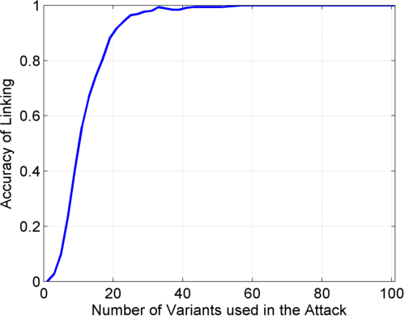
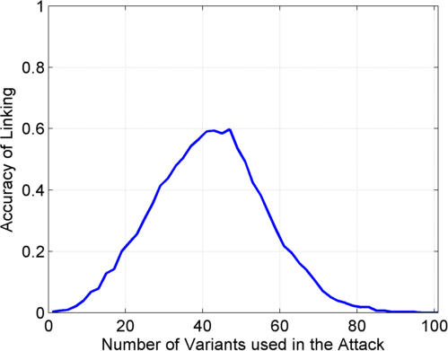
Linking Attack Based on SV Deletions in gEUVADIS Dataset
c) Genotyping
(1kG MAF>0.01)
d) Discovery + Genotyping
Sorted in Decreasing
Predictability
Sorted in Decreasing
Predictability
[Harmanci & Gerstein, Nat. Comm. (‘18)]

Slide 15
Enhancing open data sharing for functional genomics experiments:
Measures to quantify genomic​ information leakage & identify file formats for privacy preservation
(Functional) Genomic Privacy
  The dilemma: The genome as fundamental, inherited info that’s very private v. need for large-scale sharing for med. research
  2-sided nature of functional genomics data presents particularly tricky privacy issues
Subtle Leakage: Signal Profiles
  Manifest appreciable leakage from large & small deletions
  Quantified by ICI and π_{GW}
  Linking attacks possible but additional complication of SV discovery in addition to genotyping
Practical solutions
  FANCY Risk assessment:
  Predicts the number of leaking variants from functional genomics data without the need for genotyping.
  pBAM file format:
  Remove obvious variants from leakage +
  Can be used with existing softwares/pipelines, giving consistent quantifications

Slide 16
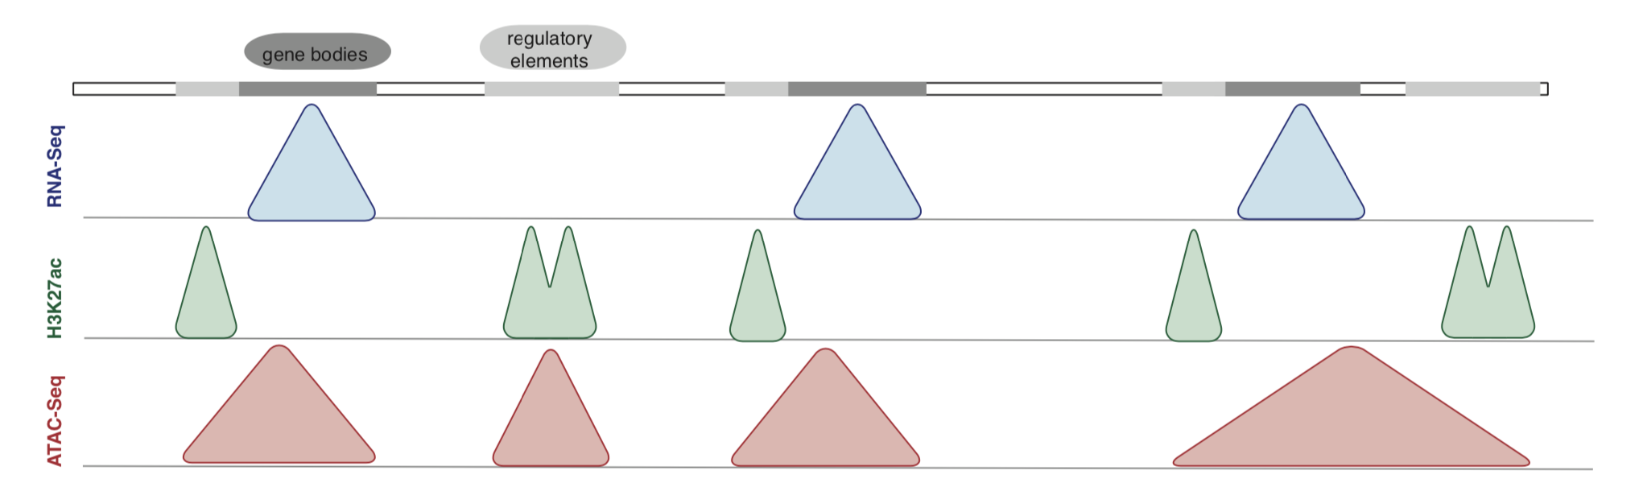
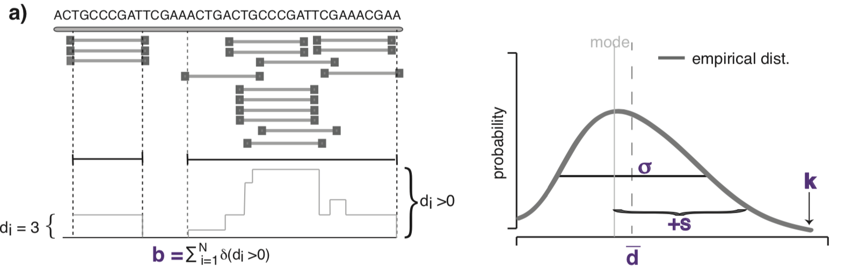
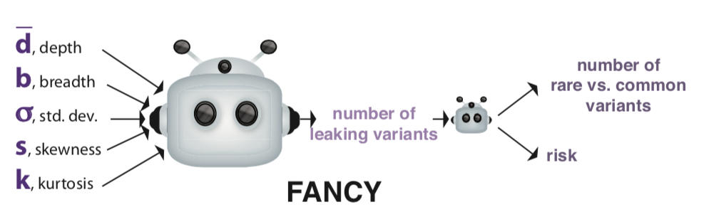
Number of leaking variants:
Can we predict without genotyping?
Genotyping is costly & requires re-parameterization for different assays
Est. number of leaking variants is important before data release
  Different assays sequence different regions.
  May not leak enough individually, but can be combined
Waterman-Lander statistics can inform us about genotyping capacity
  Hypothesis: The extended statistics from reads of functional genomics experiments
  can be used as features for a supervised regression model
    Noisy features → Gaussian Process Learning
[Gursoy et al, bioRxiv 775338]

Slide 17
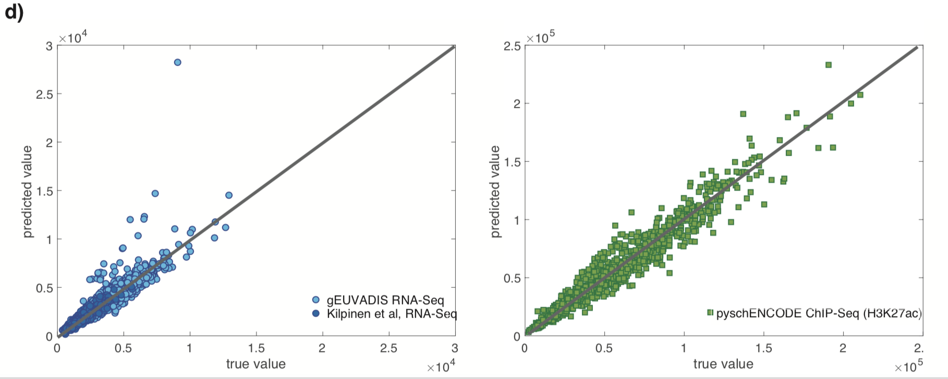
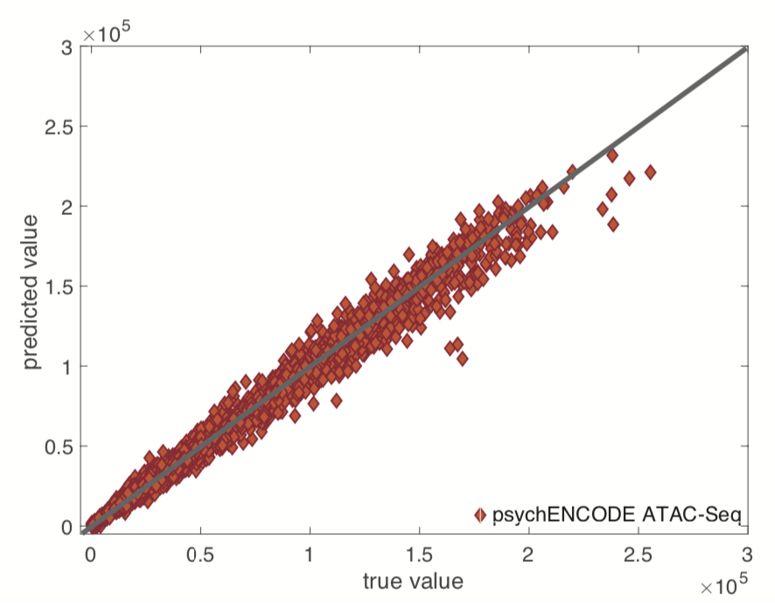
FANCY: Trained on gEUVADIS & psychENCODE and tested on an independent test dataset
TEST Results
[Gursoy et al, bioRxiv 775338]

Slide 18
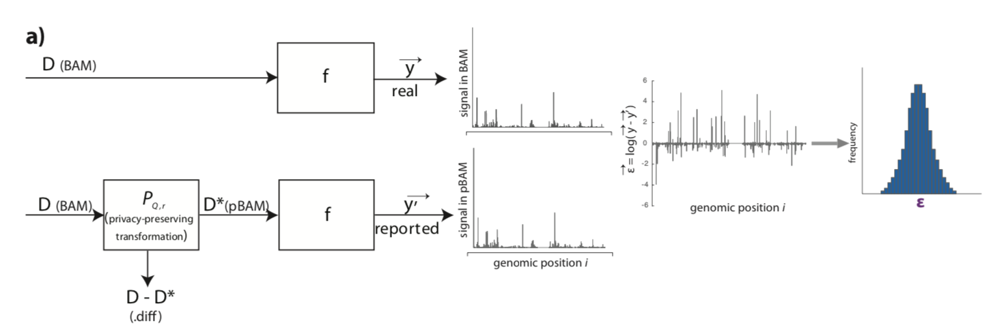
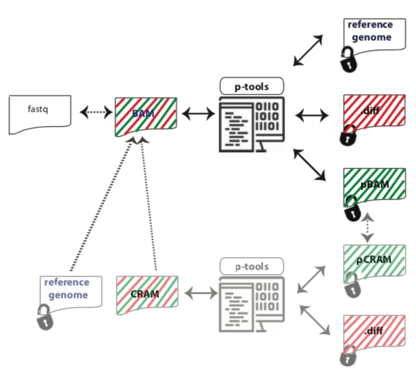
Privacy-aware Binary Alignment Mapping (pBAM)
  A manipulation of BAM
    Find leaky fields/tags
    Suppression & Generalization
  Goal:
    Accurate gene/transcript expression quantification
  Works with the pipelines / SAMtools
[Gursoy et al, BMC Med. Inform. (in press)]

Slide 19
Enhancing open data sharing for functional genomics experiments:
Measures to quantify genomic​ information leakage & identify file formats for privacy preservation
(Functional) Genomic Privacy
  The dilemma: The genome as fundamental, inherited info that’s very private v. need for large-scale sharing for med. research
  2-sided nature of functional genomics data presents particularly tricky privacy issues
Subtle Leakage: Signal Profiles
  Manifest appreciable leakage from large & small deletions
  Quantified by ICI and π_{GW}
  Linking attacks possible but additional complication of SV discovery in addition to genotyping
Practical solutions
  FANCY Risk assessment:
  Predicts the number of leaking variants from functional genomics data without the need for genotyping.
  pBAM file format:
  Remove obvious variants from leakage +
  Can be used with existing softwares/pipelines, giving consistent quantifications

Slide 20
Enhancing open data sharing for functional genomics experiments:
Measures to quantify genomic​ information leakage & identify file formats for privacy preservation
(Functional) Genomic Privacy
  The dilemma: The genome as fundamental, inherited info that’s very private v. need for large-scale sharing for med. research
  2-sided nature of functional genomics data presents particularly tricky privacy issues
Subtle Leakage: Signal Profiles
  Manifest appreciable leakage from large & small deletions
  Quantified by ICI and π_{GW}
  Linking attacks possible but additional complication of SV discovery in addition to genotyping
Practical solutions
  FANCY Risk assessment:
  Predicts the number of leaking variants from functional genomics data without the need for genotyping.
  pBAM file format:
  Remove obvious variants from leakage +
  Can be used with existing softwares/pipelines, giving consistent quantifications

Slide 21

Acknowledgements
G Gürsoy,
A Harmanci
C Brannon,
S Strattan,
O Jolanki,
F Navarro
PrivaSig.gersteinlab.org
PrivaSeq3.gersteinlab.org
github.com/gersteinlab/FANCY
Also:
JOBS.gersteinlab.org
Hiring Postdocs. See JOBS.gersteinlab.org !

Slide 22

Extra

Slide 23
Info about content in this slide pack
General PERMISSIONS
  This Presentation is copyright Mark Gerstein,
  Yale University, 2019.
  Please read permissions statement at
  www.gersteinlab.org/misc/permissions.html .
  Feel free to use slides & images in the talk with PROPER acknowledgement
  (via citation to relevant papers or link to gersteinlab.org).
  Paper references in the talk were mostly from Papers.GersteinLab.org.
PHOTOS & IMAGES. For thoughts on the source and permissions of many of the photos and clipped images in this presentation see http://streams.gerstein.info .
  In particular, many of the images have particular EXIF tags, such as kwpotppt , that can be easily queried from flickr, viz: http://www.flickr.com/photos/mbgmbg/tags/kwpotppt

