Slide 1

Personal Genomics
& Data Science:
Using population-scale functional genomics to understand neuropsychiatic disease
& interpreting the data exhaust from this activity
Mark Gerstein
Yale
Slides freely downloadable from Lectures.GersteinLab.org
& “tweetable” (via @markgerstein).
See last slide for more info.

Slide 2
Transcriptome = Gene Activity of All Genes in the Genome, usually quantified by RNA-seq
Genes (DNA)
Transcription
Regulation
RNA transcripts
Non-coding regulatory RNAs
Protein coding mRNA
Gene Expression measured by RNA-seq
Translation
Proteins
Expression of genes is quantified by transcription:
RNA-Seq measures mRNA transcript amounts
[ NATURE 459: 927; NAT. REV. GEN. 10: 57 ]

Slide 3
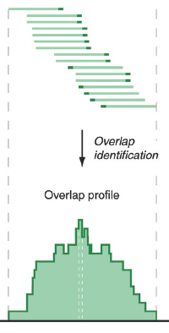
RNA-Seq Overview
ATACAAGCAAGTATAAGTTCGTATGCCGTCTT
GGAGGCTGGAGTTGGGGACGTATGCGGCATAG
TACCGATCGAGTCGACTGTAAACGTAGGCATA
ATTCTGACTGGTGTCATGCTGATGTACTTAAA
Fastq sequence files
~5-10 GB
Index-building + Alignment to reference genome
BAM files
~1-2-fold reduction
Successive steps of Data Reduction
Conversion to signal track by overlapping reads
BigWig files
~25-fold reduction
Mapping to genes
Gene/Transcript expression matrix
~20-fold reduction
Quantitative information from RNA-seq signal: average signals at exon level (RPKMs)
Reads => Signal
[NAT. REV. 10: 57; PLOS CB 4:e1000158; PNAS 4:107: 5254 ]

Slide 4

Activity Patterns
RNA Seq. gives rise to activity patterns of genes & regions in the genome

Slide 5
Some Core Science Qs Addressed by RNA-seq
Gene activity as a function of:
  Developmental stage: basic patterns of co-active genes across development
  Cell-type & Tissue: relationship to specialized functions
  Evolutionary relationships: behavior preserved across a wide range of organisms; patterns in model organisms in relation to those in humans
  Individual, across the human population
  Disease phenotypes: disruption of patterns in disease
Some overarching Qs:
Are there core patterns of gene activity ?
How do they vary across individual ?
Are they disrupted by disease?

Slide 6


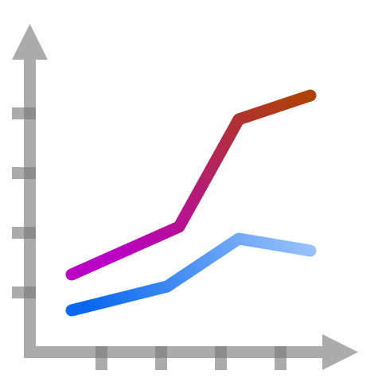



Data Exhaust
Creative use of data is key to data science!
Data exhaust = exploitable byproducts of big data collection and analysis
Data collection and analysis
metadata
data on
collaboration
data on
publication
Data exhaust
Core scientific purposes
infrastructure
[photos: wikipedia/wikimedia]

Slide 7
Using population-scale functional genomics to understand neuropsychiatic disease
& interpreting the data exhaust from this activity
[Core] PsychENCODE: Population-level analysis of functional genomics data related to neuropsychiatric disease
  Construction of an adult brain resource with 1866 individuals + dev. time-course
  Using the changing proportions of cell types (via single-cell deconvolution) to account for expression variation across a population,
  disorders & development
  Large-scale processing defines ~79K PFC
  enhancers & creates a comprehensive QTL resource (~2.5M eQTLs + cQTLs & fQTLs)
  Connecting QTLs, enhancer activity relationships & Hi-C into a
  brain regulatory network & using this to link SCZ GWAS SNPs to genes
  Embedding the reg. network in a
  deep-learning model to predict disease from genotype & transcriptome. Using this to suggest specific pathways & genes, as targets.
  [Exhaust] Other uses for the resource
    Highlighting aging related genes + consistently comparing the brain to other organs
[Exhaust] Genomic Privacy
  The Dilemma
    The genome as fundamental, inherited info that’s very private v. need for large-scale mining for med. research
    2-sided nature of RNA-seq presents tricky privacy issues
  eQTLs: Quantifying & removing variant info from expression levels with ICI & predictability. Instantiating a practical linking attack with noisy quasi-identifiers
  Signal Profiles: Manifest appreciable leakage from large & small deletions. Linking attacks possible but additional complication of SV discovery in addition to genotyping

Slide 8
Using population-scale functional genomics to understand neuropsychiatic disease
& interpreting the data exhaust from this activity
[Core] PsychENCODE: Population-level analysis of functional genomics data related to neuropsychiatric disease
  Construction of an adult brain resource with 1866 individuals + dev. time-course
  Using the changing proportions of cell types (via single-cell deconvolution) to account for expression variation across a population,
  disorders & development
  Large-scale processing defines ~79K PFC
  enhancers & creates a comprehensive QTL resource (~2.5M eQTLs + cQTLs & fQTLs)
  Connecting QTLs, enhancer activity relationships & Hi-C into a
  brain regulatory network & using this to link SCZ GWAS SNPs to genes
  Embedding the reg. network in a
  deep-learning model to predict disease from genotype & transcriptome. Using this to suggest specific pathways & genes, as targets.
  [Exhaust] Other uses for the resource
    Highlighting aging related genes + consistently comparing the brain to other organs
[Exhaust] Genomic Privacy
  The Dilemma
    The genome as fundamental, inherited info that’s very private v. need for large-scale mining for med. research
    2-sided nature of RNA-seq presents tricky privacy issues
  eQTLs: Quantifying & removing variant info from expression levels with ICI & predictability. Instantiating a practical linking attack with noisy quasi-identifiers
  Signal Profiles: Manifest appreciable leakage from large & small deletions. Linking attacks possible but additional complication of SV discovery in addition to genotyping

Slide 9
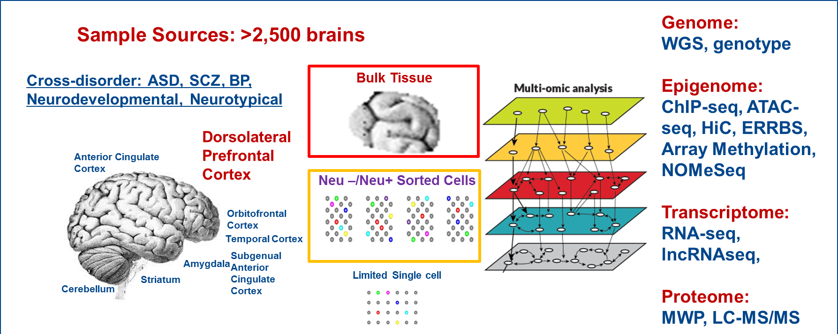


PsychENCODE
’18 rollout in Science
Single Cell
11 papers in total.
Major material in the 3 capstones:
Wang et al. (‘18), Li et al. (‘18), Gandal et al. ('18)
Notes:
Current phase is wrapping up- we have uniformly processed data across disorders and time periods on now up to >2500 frozen postmortem brains from brain banks.
Data generation has focus on mostly DLFPC with a few other brain regions also covered.
Analyses were primarily bulk tissues with some sorted NeuN+/- cells and a limited amount of ss data generation.
Multiple assays – WGS, SNP genotypes Epigenome: ChIP-seq, ATAC-seq, HiC, ERRBS, Array Methylation, NOMeSeq Transcriptome: RNA-seq, lncRNAseq, Proteome: RPPA.
The analyses have focused on identifying brain enhancers relevant and disease-specific eQTLs and epigenomic variation.
An invaluable public resource of multidimensional genomic data
They are also collaborating with GTEX, ENCODE and other related consortia to enhance the power and impact of their analyses.

Slide 10
A core issue addressed by PsychENCODE:
Using functional genomics to reveal molecular mechanisms between genotype and phenotype in brain disorders
Disease | Heritability* | Molecular Mechanisms
Schizophrenia | 81% | (C4A)
Bipolar disorder | 70% | -
Alzheimer's disease | 58 - 79% | Apolipoprotein E (APOE), Tau
Hypertension | 30% | Renin–angiotensin–aldosterone
Heart disease | 34-53% | Atherosclerosis, VCAM-1
Stroke | 32% | Reactive oxygen species (ROS), Ischemia
Type-2 diabetes | 26% | Insulin resistance
Breast Cancer | 25-56% | BRCA, PTEN
Phenotype
SCZ
BPD
AGE
…
*https://www.snpedia.com/index.php/Heritability
pathways, circuits
Cell types
Modules
Regulatory elements
Genes
Genotype
Many psychiatric conditions are highly heritable
  Schizophrenia: up to 80%
But we don’t understand basic molecular mechanisms underpinning this association
(in contrast to many other diseases such as cancer & heart disease)
Thus, interested in developing predictive models of psychiatric traits which:
  Use observations at intermediate (molecular levels) levels to inform latent structure
  Use the predictive features of these “molecular endo phenotypes” to begin to suggest actors involved in mechanism

Slide 11
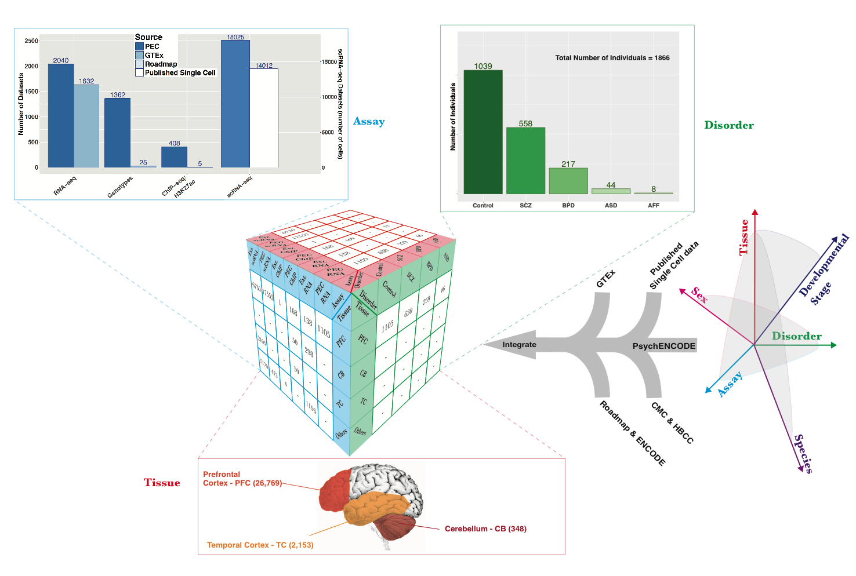
Collecting functional genomic datasets for the adult brain from PsychENCODE, other large consortia & single cell studies
1866
Individuals
~3.7K bulk RNA-seq
~32K single-cells

Slide 12
Merging & Clustering Single Cell Data Sets
Single cell signatures, from:
~14K cells
(Lake et al.,‘16 & ‘18)
~400 cells
(Darmanis et al., PNAS, ‘15)
~18K cells (PsychENCODE)
Lake et al., 2018 data
PEC adult data
[Li et al. (‘18), Science. Wang et al. (‘18). Science]

Slide 13
24 selected cell types
(Neuronal, NonNeuronal, Developmental)
1866 individuals
1866 individuals
Bulk
expression
(B)
Deconvolution
All genes
24 selected cell types
Single-cell deconvolution
Step 1:
Supervised learning to estimate cell fractions
All genes (∼20K)
≈
×
Cell fractions (W)
Single cell expression (C)
88%±4%
Individual and cross-population reconstruction accuracy via deconvolution
[Wang et al. (‘18) Science]

Slide 14
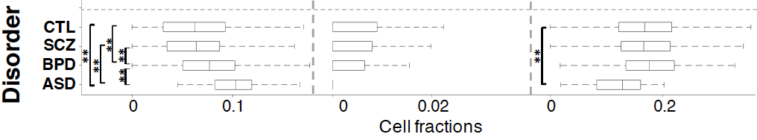
Different neuronal & glial cell fractions across disorders
Ex5
In6
Oligo
Excitatory to Inhibitory imbalance at neuronal subtype level for ASD*
* Rubenstein et al., Model of autism: increased ratio of excitation/inhibition in key neural systems, Genes Brain Behav. 2003
[Wang et al. (‘18) Science]
Notes:
* Rubenstein et al., Model of autism: increased ratio of excitation/inhibition in key neural systems, Genes Brain Behav. 2003
** Gandal et al., Shared molecular neuropathology across major psychiatric disorders parallels polygenic overlap, Science 2018

Slide 15
Developmental Capstone Data Set
60 Individuals in total
Ages from 5 PCW to 64 yrs.
16 brain regions for > 9 PCW
[Li et al. (‘18) Science]

Slide 16
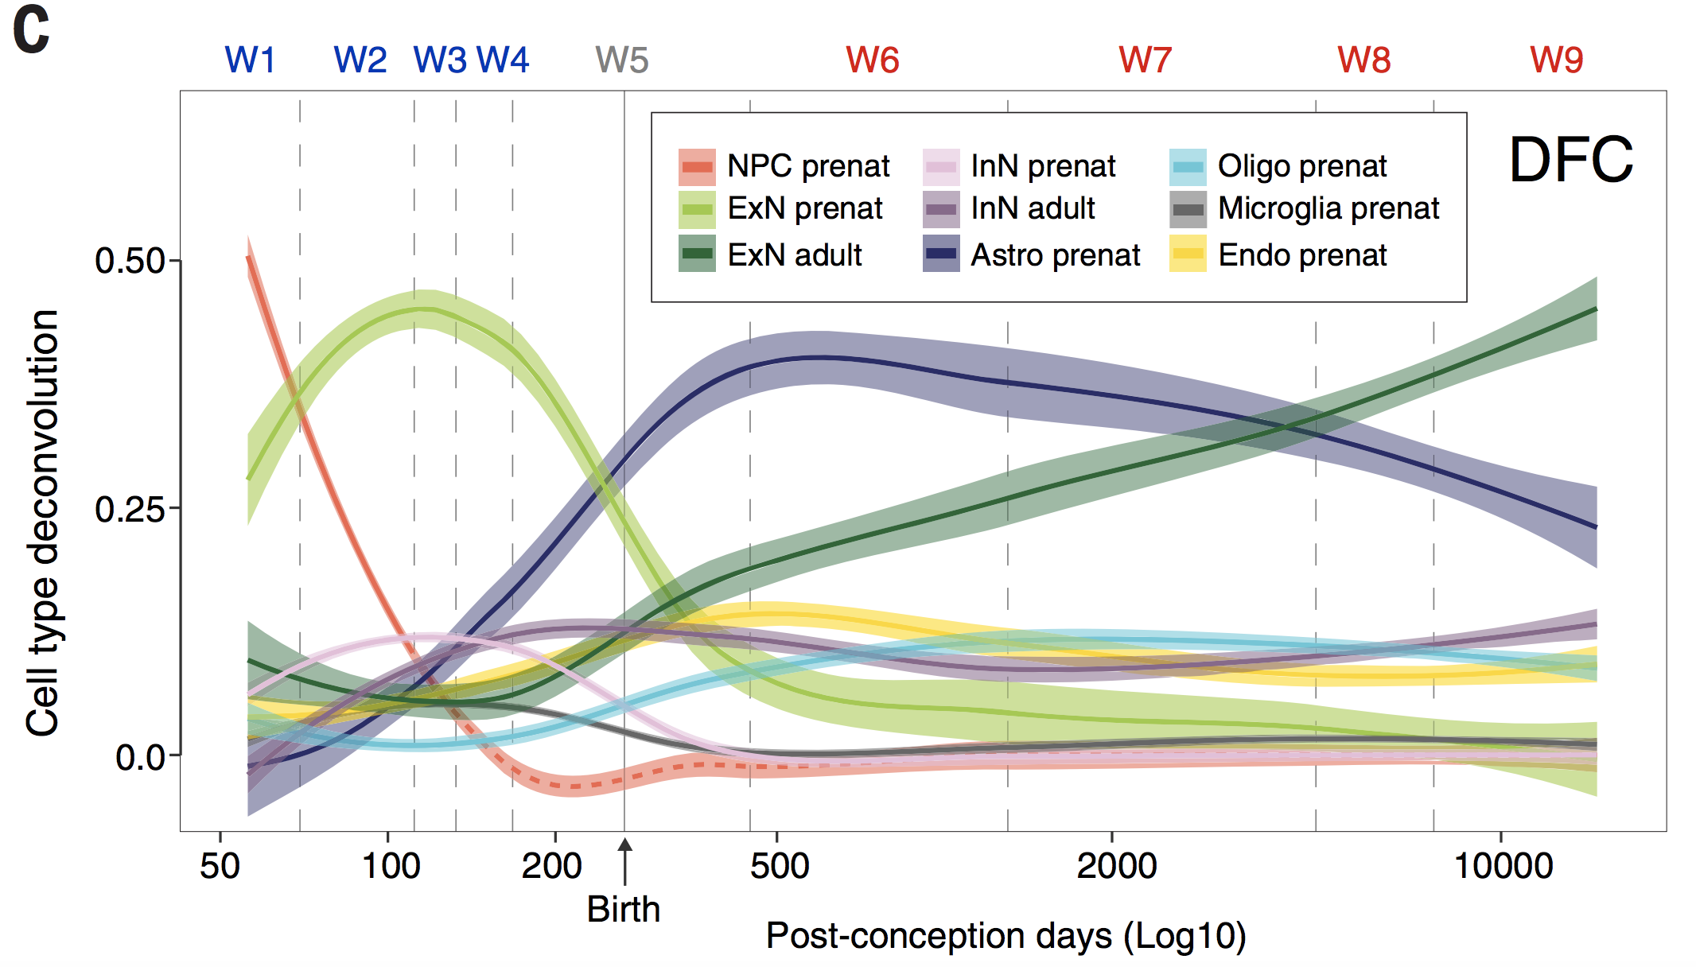
Different neuronal & glial cell fractions across ages
[Li et al. (‘18) Science]
Notes:
* Rubenstein et al., Model of autism: increased ratio of excitation/inhibition in key neural systems, Genes Brain Behav. 2003
** Gandal et al., Shared molecular neuropathology across major psychiatric disorders parallels polygenic overlap, Science 2018

Slide 17
Using population-scale functional genomics to understand neuropsychiatic disease
& interpreting the data exhaust from this activity
[Core] PsychENCODE: Population-level analysis of functional genomics data related to neuropsychiatric disease
  Construction of an adult brain resource with 1866 individuals + dev. time-course
  Using the changing proportions of cell types (via single-cell deconvolution) to account for expression variation across a population,
  disorders & development
  Large-scale processing defines ~79K PFC
  enhancers & creates a comprehensive QTL resource (~2.5M eQTLs + cQTLs & fQTLs)
  Connecting QTLs, enhancer activity relationships & Hi-C into a
  brain regulatory network & using this to link SCZ GWAS SNPs to genes
  Embedding the reg. network in a
  deep-learning model to predict disease from genotype & transcriptome. Using this to suggest specific pathways & genes, as targets.
  [Exhaust] Other uses for the resource
    Highlighting aging related genes + consistently comparing the brain to other organs
[Exhaust] Genomic Privacy
  The Dilemma
    The genome as fundamental, inherited info that’s very private v. need for large-scale mining for med. research
    2-sided nature of RNA-seq presents tricky privacy issues
  eQTLs: Quantifying & removing variant info from expression levels with ICI & predictability. Instantiating a practical linking attack with noisy quasi-identifiers
  Signal Profiles: Manifest appreciable leakage from large & small deletions. Linking attacks possible but additional complication of SV discovery in addition to genotyping

Slide 18
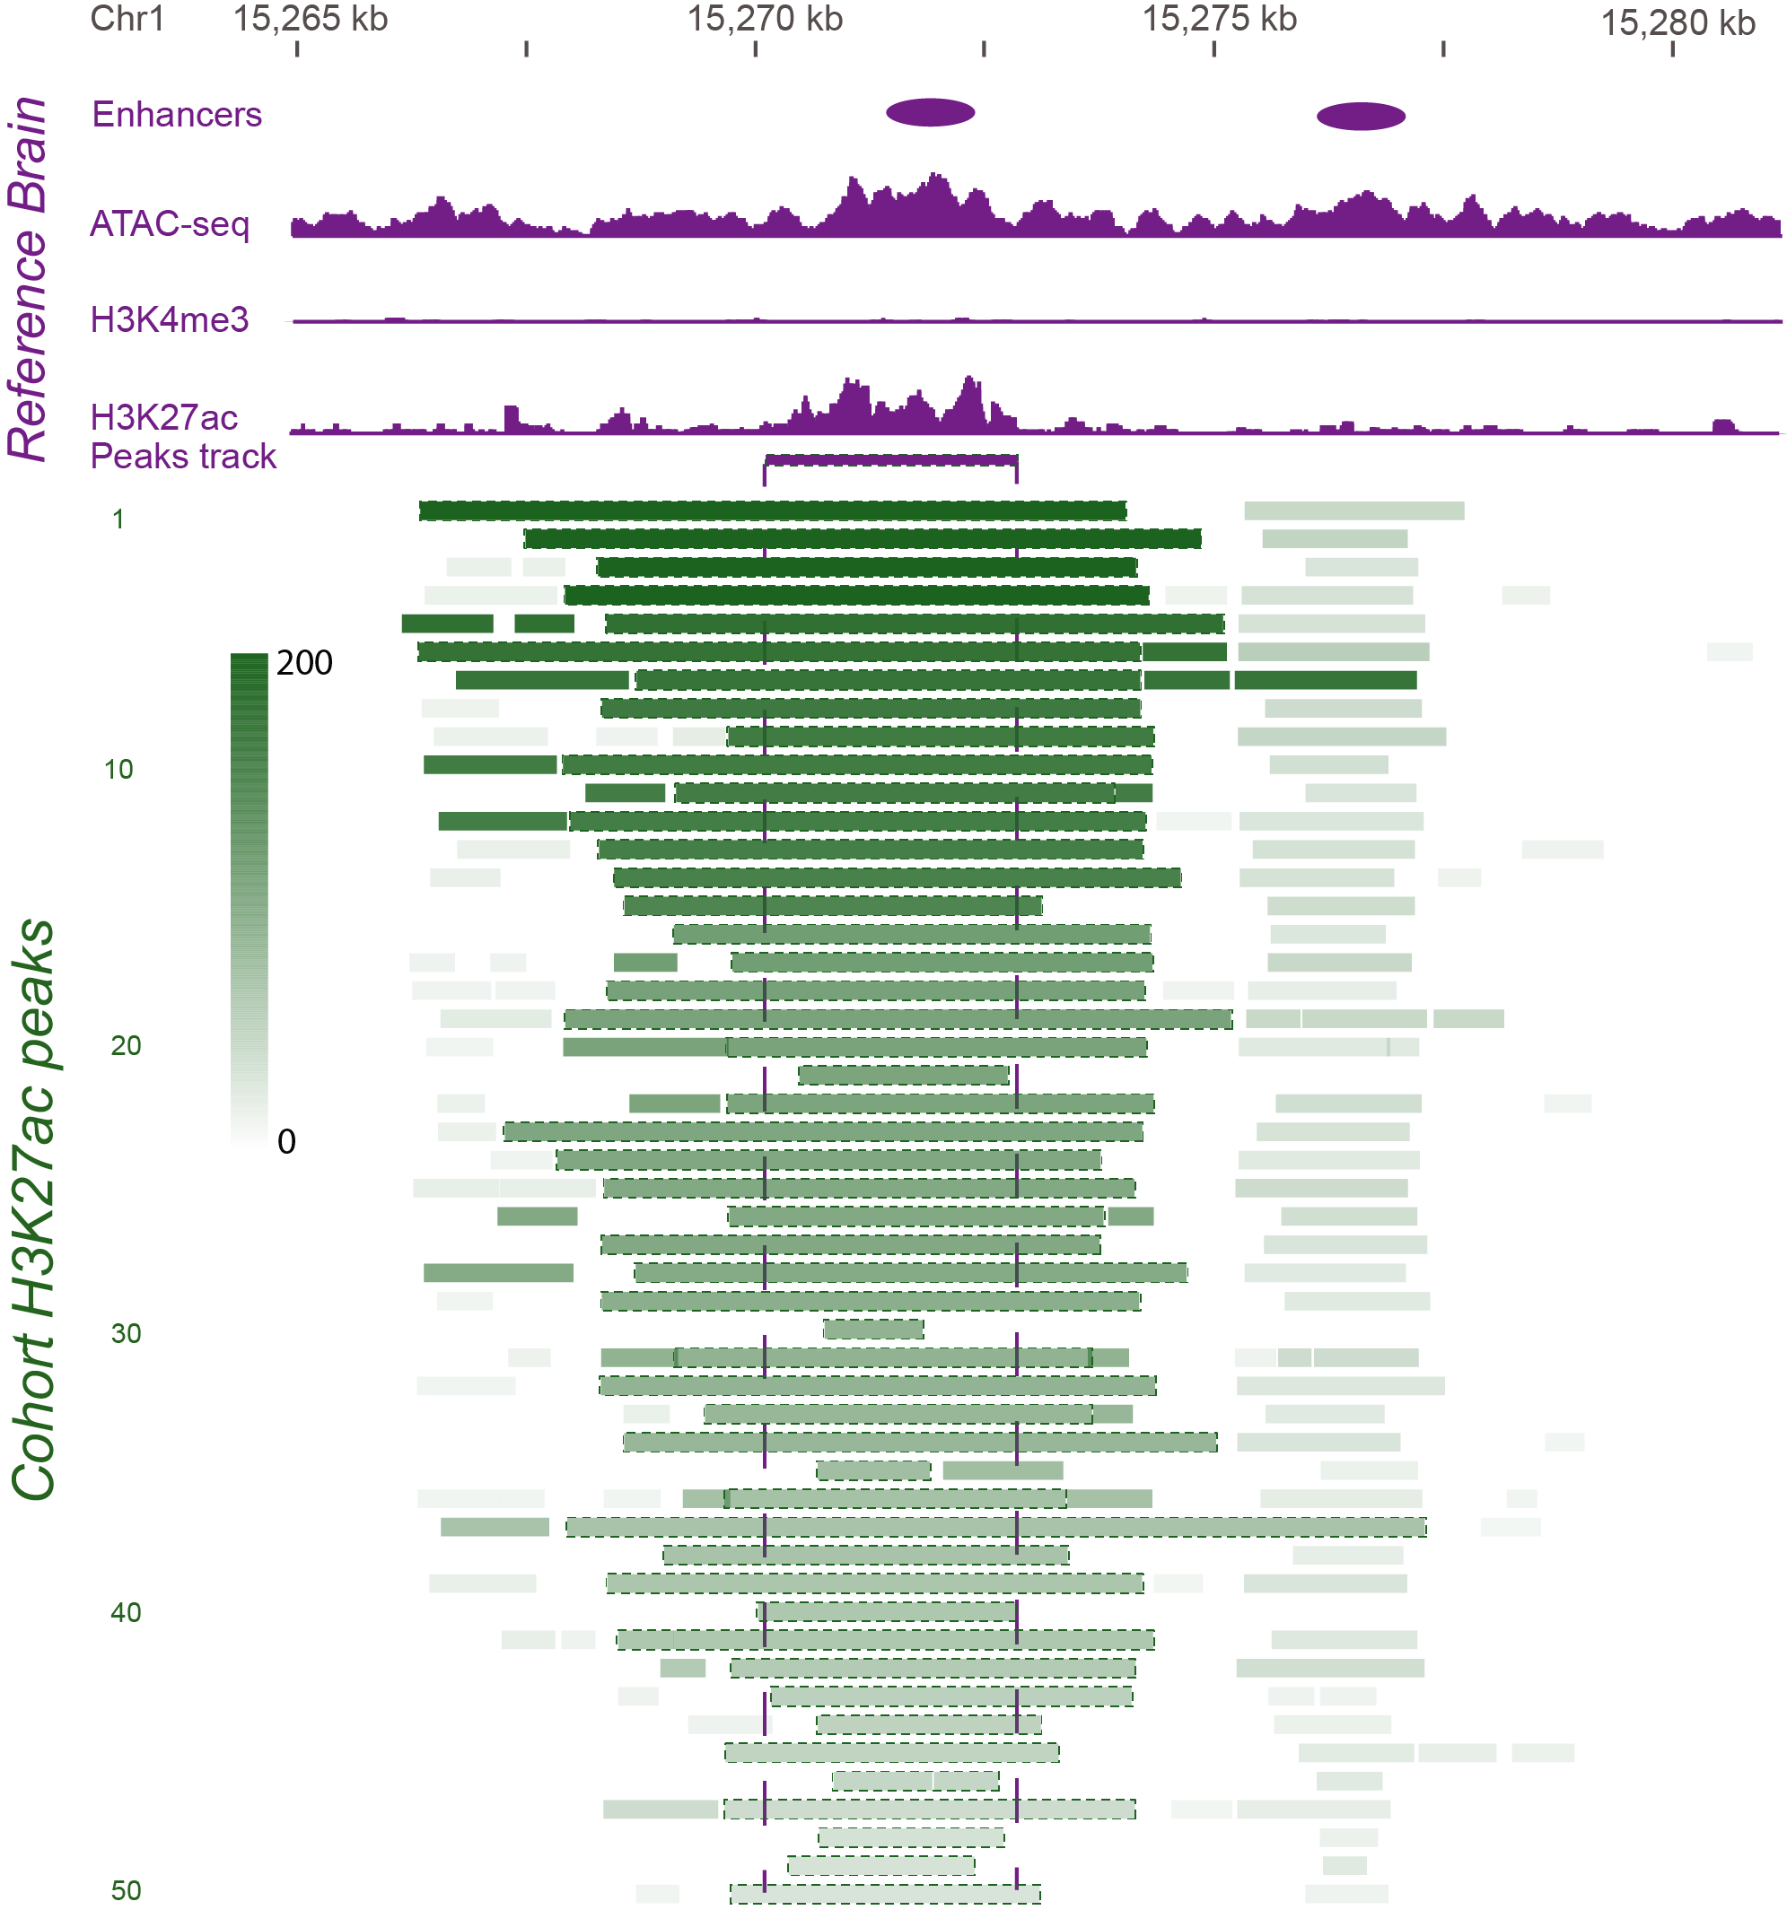
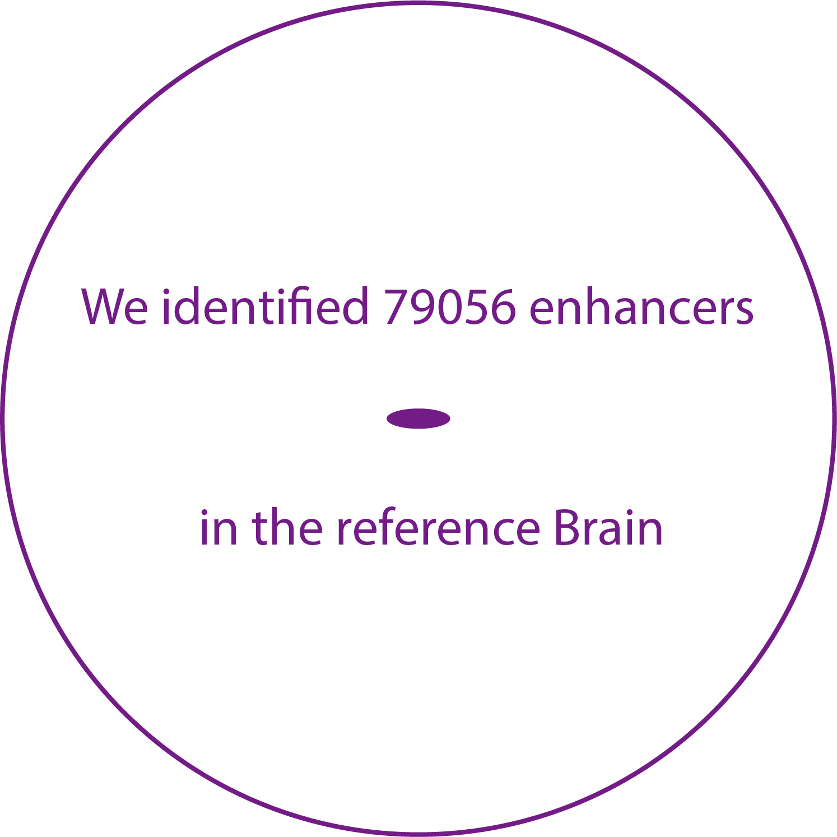
Developing a Reference Set of ~79K PFC Enhancers & Studying Their Population Variation
Characterize brain specific enhancers
Consistent with ENCODE, active enhancers are identified as open chromatin regions enriched in H3K27ac and depleted in H3K4me3
[Wang et al. (‘18) Science]

Slide 19
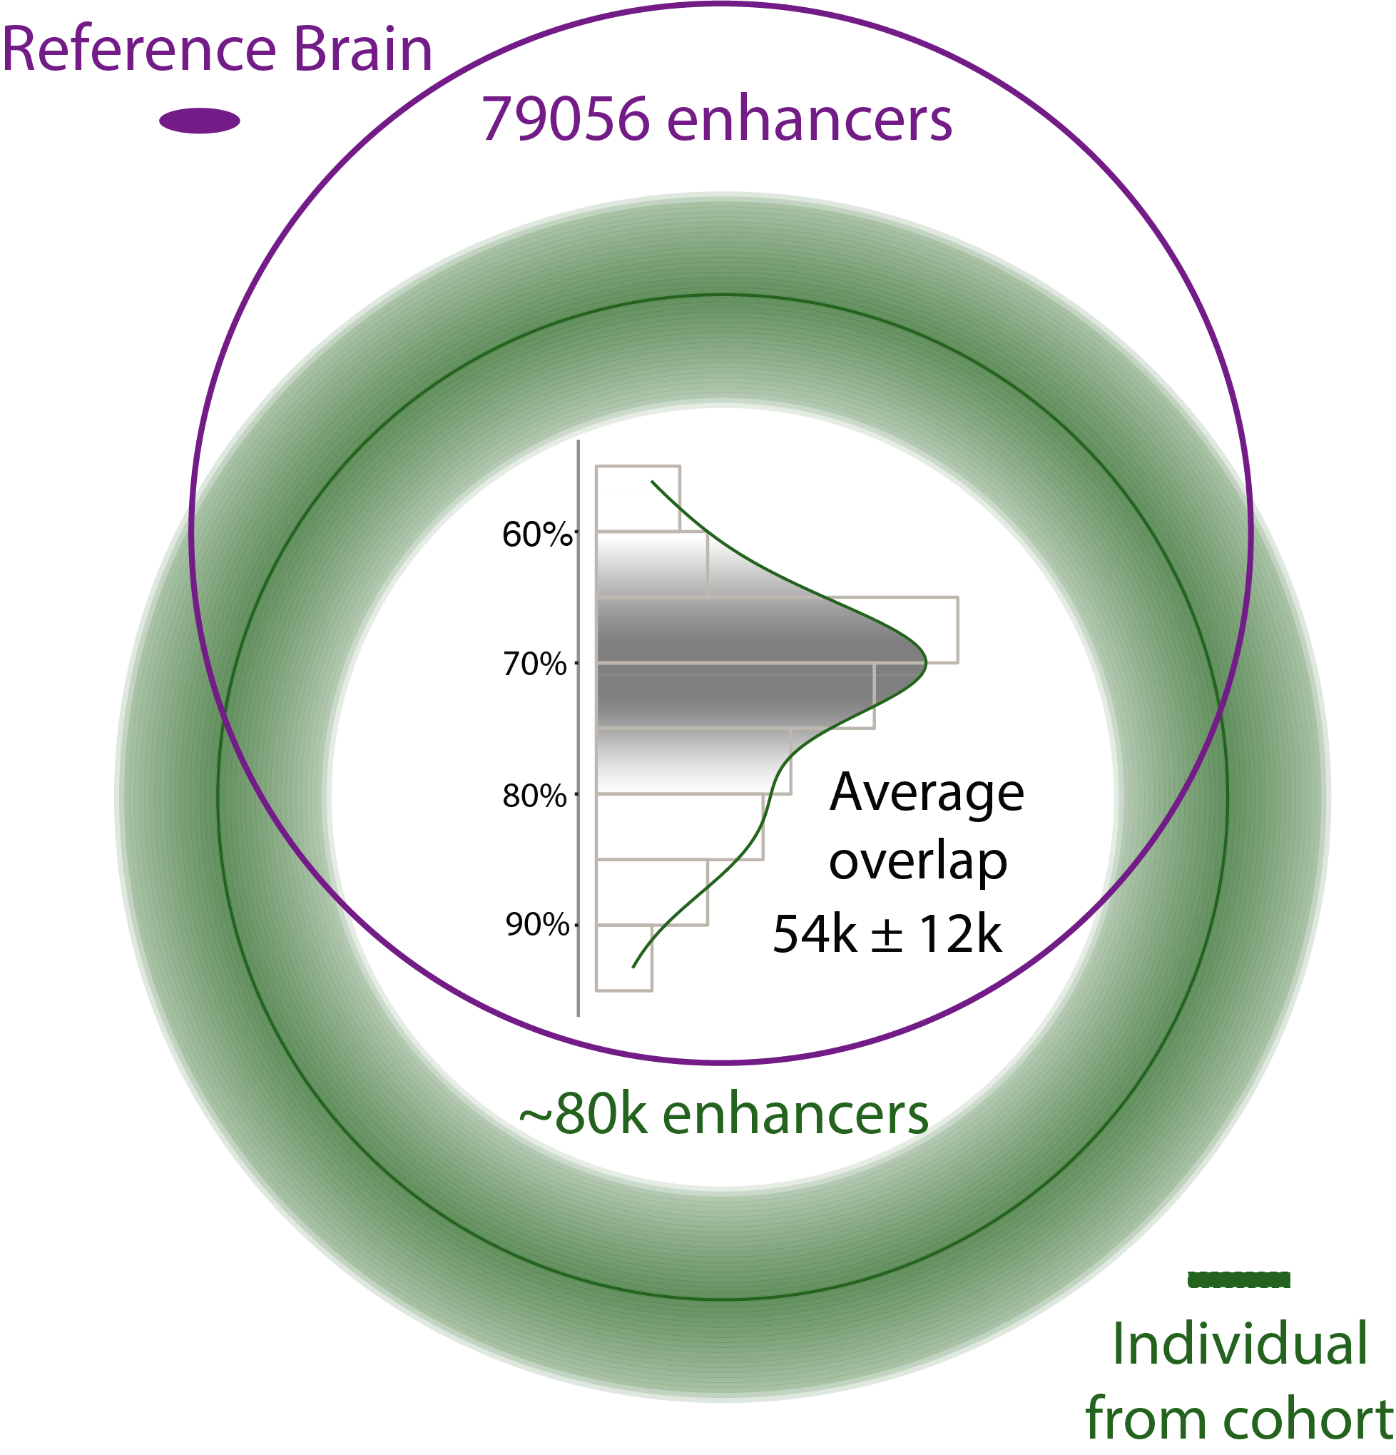
Developing a Reference Set of ~79K PFC Enhancers & Studying Their Population Variation
Characterize brain specific enhancers
[Wang et al. (‘18) Science]

Slide 20
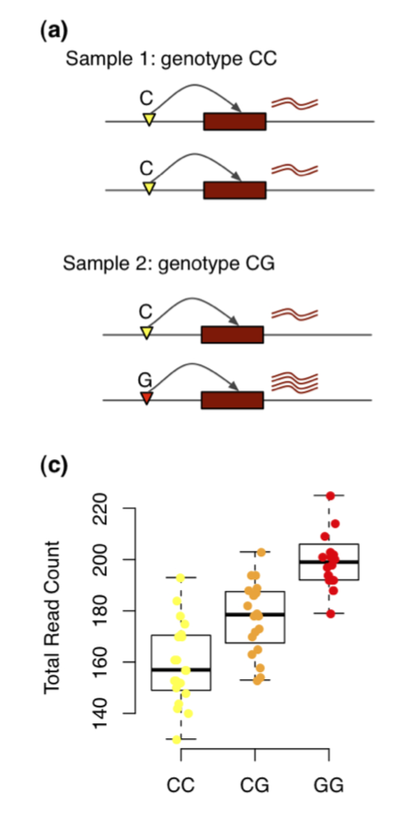
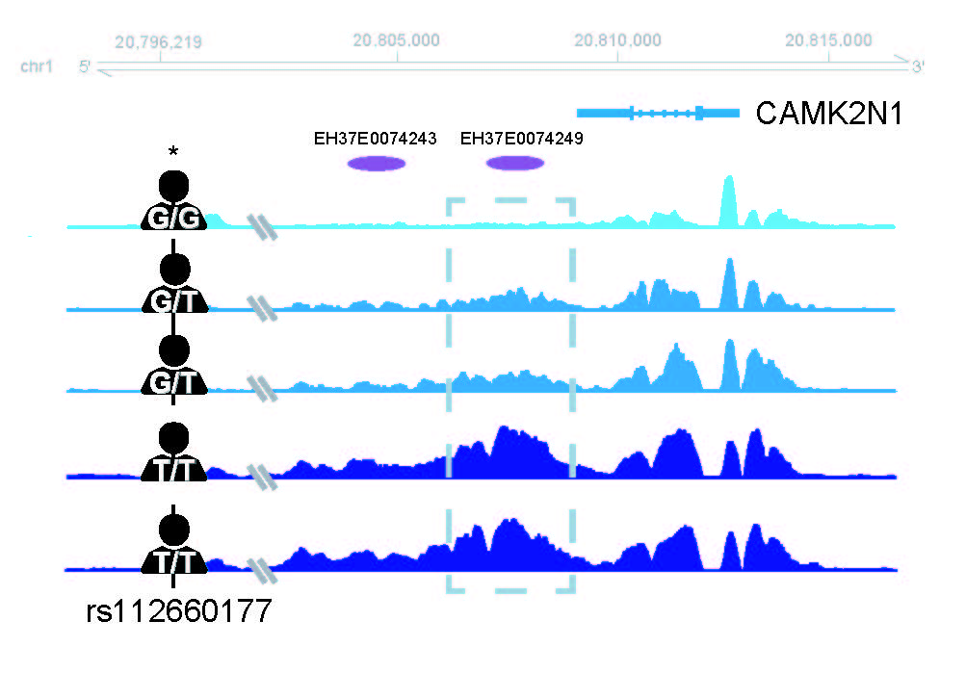
Chromatin variation in the population
Quantitaive Trait Loci (QTLs) associated with variation
Gene expression (eQTL)
Chromatin (cQTL)
Sun, Wei, and Yijuan Hu. "eQTL mapping using RNA-seq data." Statistics in biosciences 5.1 (2013): 198-219.
[Wang et al. (‘18) Science]

Slide 21
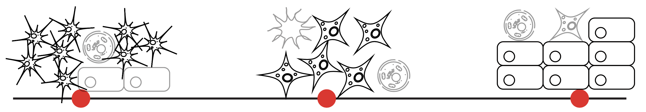
Cell fraction QTLs (fQTLs)
A→T
C→G
T→C
[Wang et al. (‘18) Science]
Notes:
Brain eQTLs
32944(75%) eGenes
2,542,908 eQTLs (3% out of 66,441,766 total pairs)
1,341,182 unique cis-eSNP (~20%) (~238K independent SNPs after linkage-disequilibrium (LD) pruning)

Slide 22
Larger brain eQTL sets than previous studies, but strong overlap with them
2,542,908 eQTLs (FDR< 0.05)
[Wang et al. (‘18) Science]
Notes:
Brain eQTLs
32944(75%) eGenes
2,542,908 eQTLs (3% out of 66,441,766 total pairs)
1,341,182 unique cis-eSNP (~20%) (~238K independent SNPs after linkage-disequilibrium (LD) pruning)

Slide 23
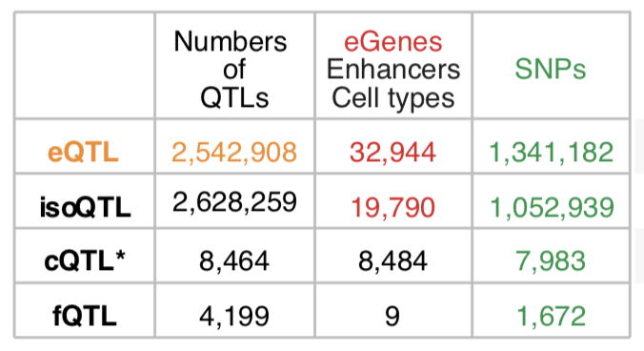
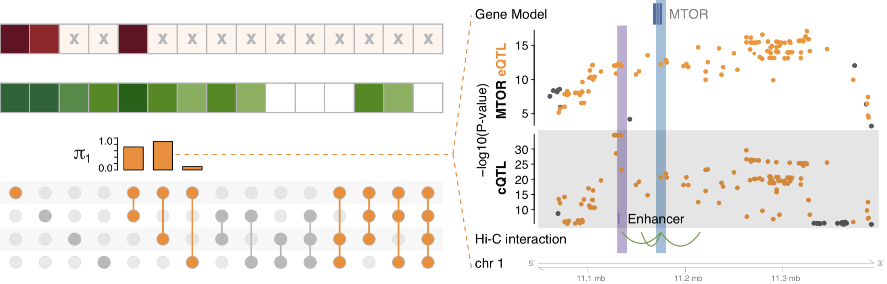
multi-QTLs from overlapping different types of QTLs: cQTL, fQTL, eQTL & isoQTL
eQTLs for mTOR mediated by cQTLs
eQTL
isoQTL
cQTL
fQTL
eQTLs and cQTLs significantly overlap
1391 SNPs (multi-QTLs)
in at least three types
among eQTLs, isoQTLs, cQTLs, fQTLs
[Wang et al. (‘18) Science]
Notes:
*top SNPs for each enhancer
To evaluate this precisely, we calculated π₁ statistics and found that the eQTL overlap with cQTLs was the most significant while that with fQTLs was lowest (0.89 vs 0.11). Moreover, eQTL-cQTL overlaps often suggested that the expression-modulating function of an eQTL derived from chromatin changes (e.g. for MTOR, Fig. 4F). Finally, 119 SNPs, which we dubbed multi-QTLs, functioned as QTLs in more than 3 different capacities (e.g. as eQTLs, cQTLs and isoQTLs).
https://www.nature.com/articles/nrn3068

Slide 24
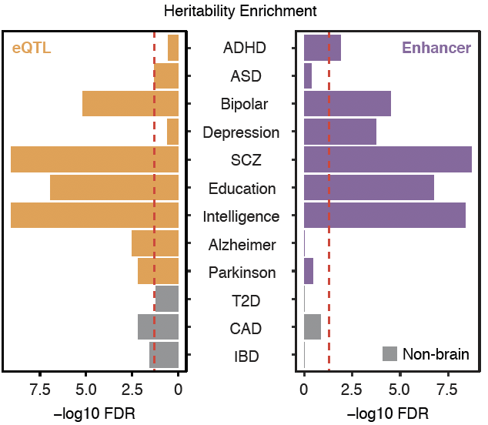
Brain eQTLs and enhancers enriched with GWAS SNPs for brain disorders
Enrichment
Wang, et al., Science, 2018
Notes:
DLPFC for psy disorders
AD/PD is not spec for DLPFC
*linkage disequilibrium score regression (LDSC, Finucane et al., 2015; https://github.com/bulik/ldsc/wiki/Partitioned-Heritability)
ADHD, attention-deficit/hyperactivity disorder; T2D, type 2 diabetes; CAD, coronary artery disease; IBD, inflammatory bowel disease.

Slide 25
Using population-scale functional genomics to understand neuropsychiatic disease
& interpreting the data exhaust from this activity
[Core] PsychENCODE: Population-level analysis of functional genomics data related to neuropsychiatric disease
  Construction of an adult brain resource with 1866 individuals + dev. time-course
  Using the changing proportions of cell types (via single-cell deconvolution) to account for expression variation across a population,
  disorders & development
  Large-scale processing defines ~79K PFC
  enhancers & creates a comprehensive QTL resource (~2.5M eQTLs + cQTLs & fQTLs)
  Connecting QTLs, enhancer activity relationships & Hi-C into a
  brain regulatory network & using this to link SCZ GWAS SNPs to genes
  Embedding the reg. network in a
  deep-learning model to predict disease from genotype & transcriptome. Using this to suggest specific pathways & genes, as targets.
  [Exhaust] Other uses for the resource
    Highlighting aging related genes + consistently comparing the brain to other organs
[Exhaust] Genomic Privacy
  The Dilemma
    The genome as fundamental, inherited info that’s very private v. need for large-scale mining for med. research
    2-sided nature of RNA-seq presents tricky privacy issues
  eQTLs: Quantifying & removing variant info from expression levels with ICI & predictability. Instantiating a practical linking attack with noisy quasi-identifiers
  Signal Profiles: Manifest appreciable leakage from large & small deletions. Linking attacks possible but additional complication of SV discovery in addition to genotyping

Slide 26
Gene regulatory network inference from Hi-C, QTLs & Activity Correlations
[Wang et al. (‘18) Science]

Slide 27
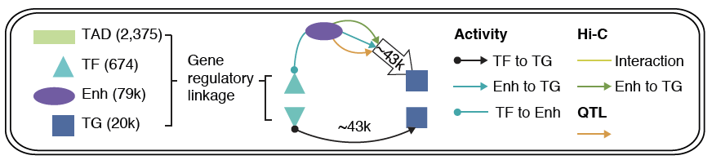
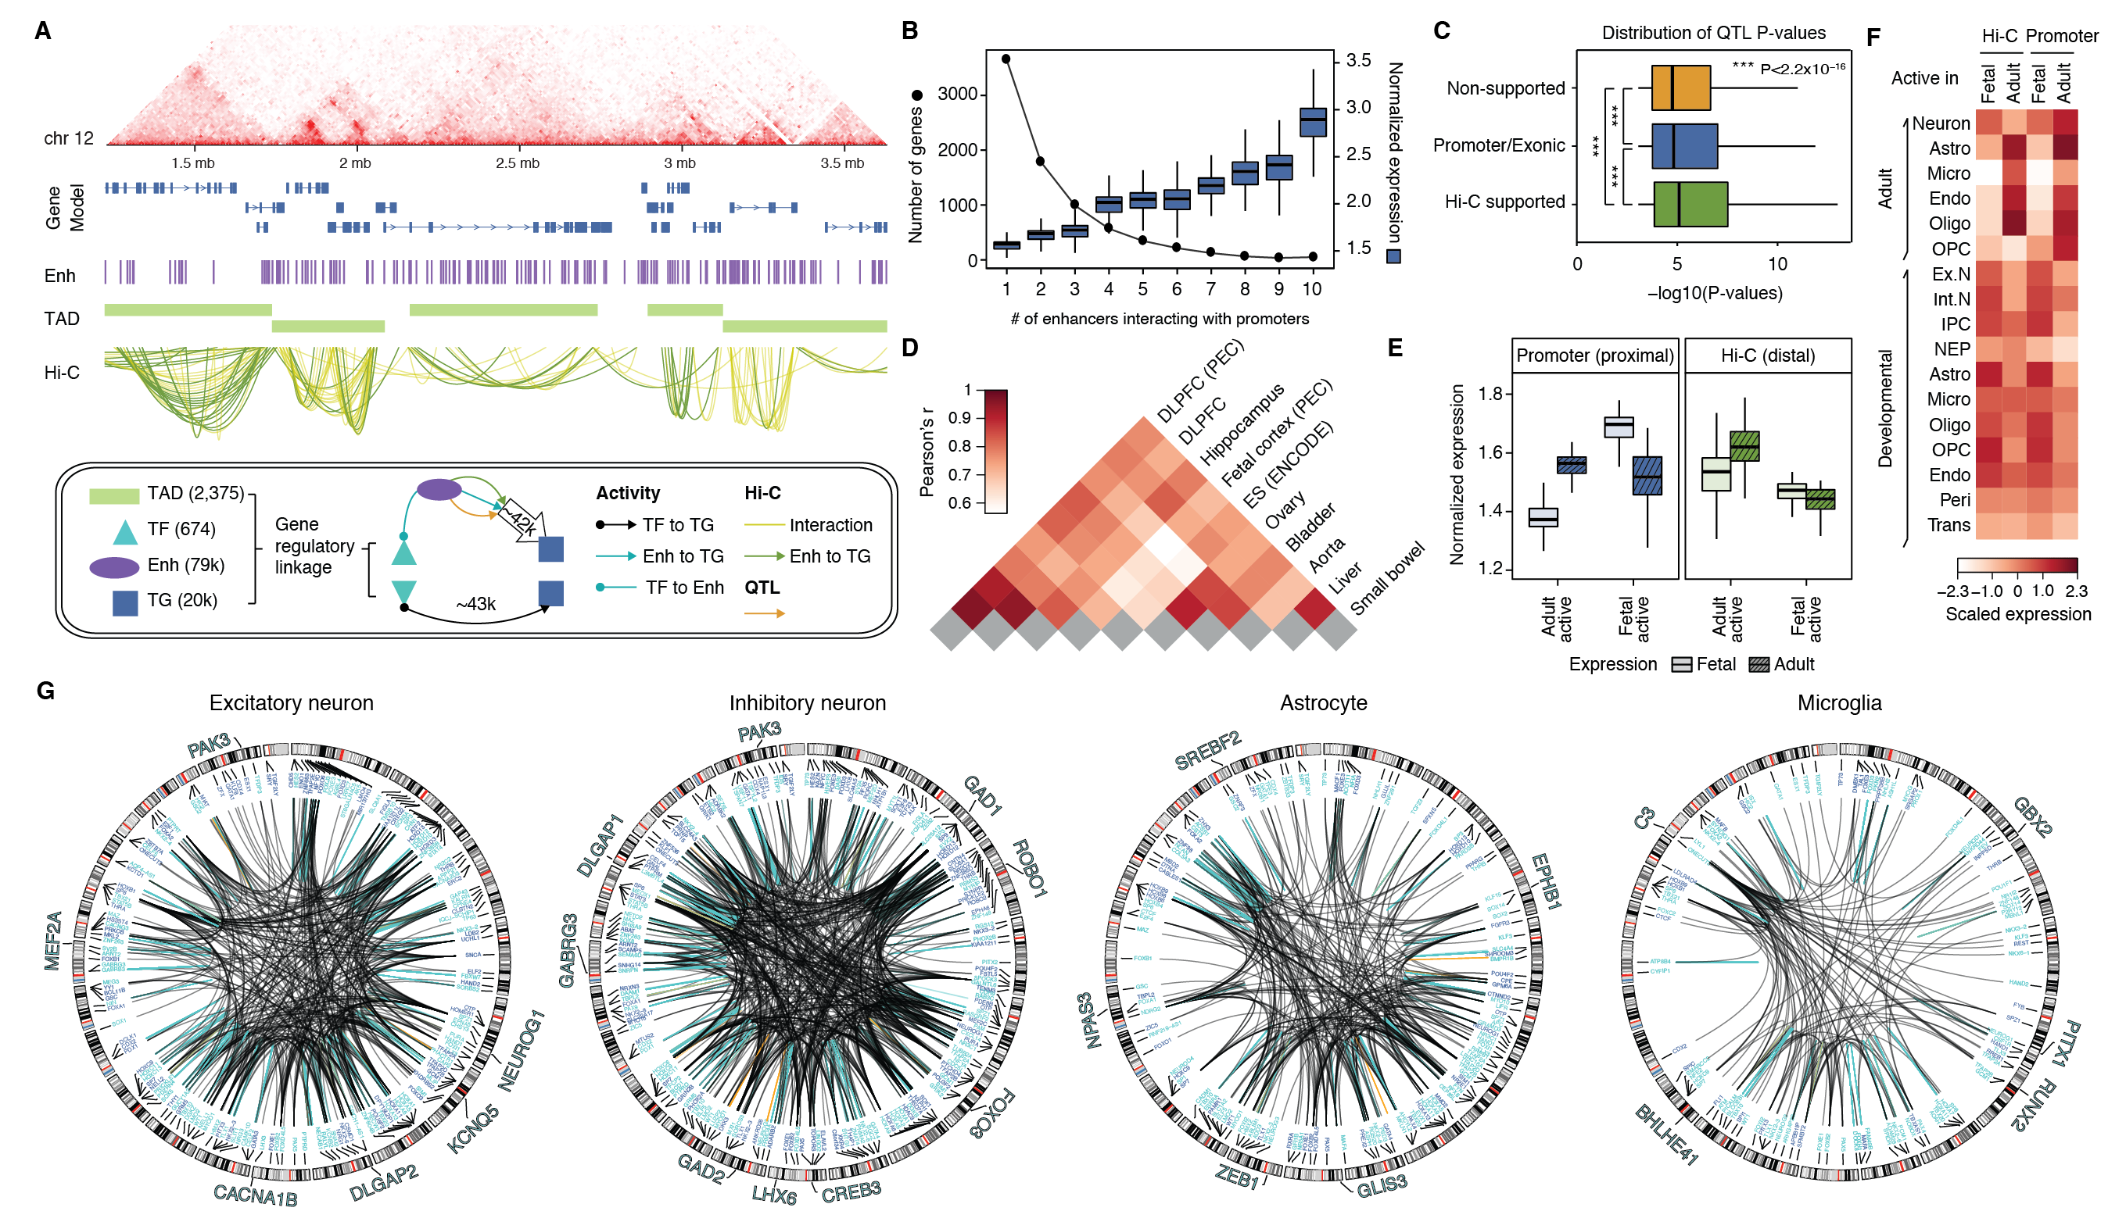
Imputed gene regulatory network for the human brain
Imputed gene regulatory network linking TFs, enhancers and genes plus QTLs
subnetworks targeting single cell marker genes
[Wang et al. (‘18) Science]

Slide 28
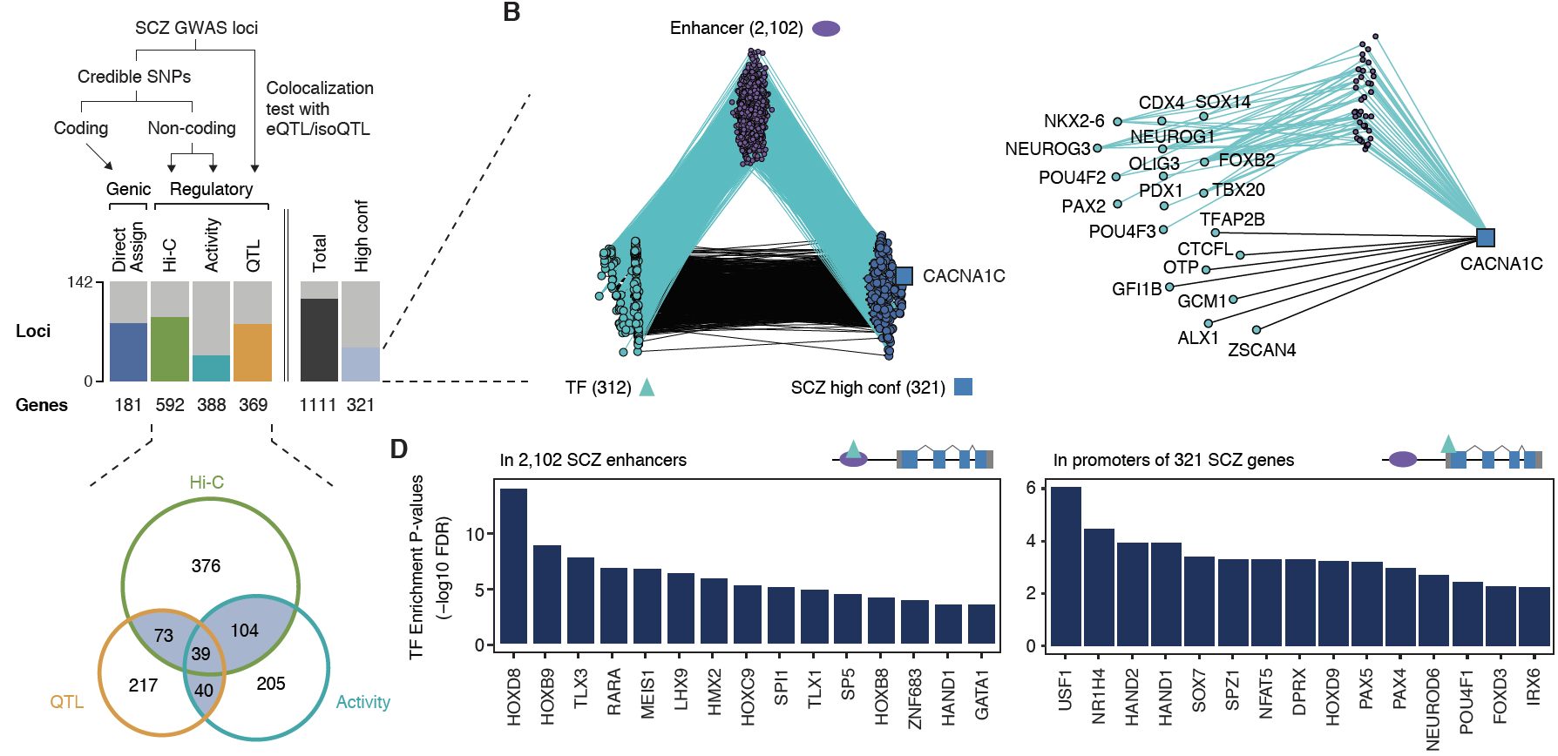
Linking GWAS SNPs to disease genes using the regulatory network
142
321
high-confident SCZ genes
Activity
[Wang et al. (‘18) Science]
Notes:
* A. F. Pardinas et al., Common schizophrenia alleles are enriched in mutation-intolerant genes and in regions under strong background selection. Nat Genet 50, 381-389 (2018)
For example, we found a set of TFs having enriched binding sites (TFBSs) on the promoters of SCZ genes, revealing potential cis-regulatory mechanisms of TFs to SCZ gene expression (Fig. 6D). Also, we found additional TFs that have enriched binding sites on the enhancers that overlap with SCZ credible SNPs (Fig. 6D), suggesting potential distal regulatory mechanisms of SCZ credible SNPs via affecting TFBSs on enhancers. In particular, these TFs include REST, a transcriptional repressor for neuronal genes \cite{16150588}, and SOX7, a TF that promotes neuronal apoptosis \cite{25847511}.

Slide 29
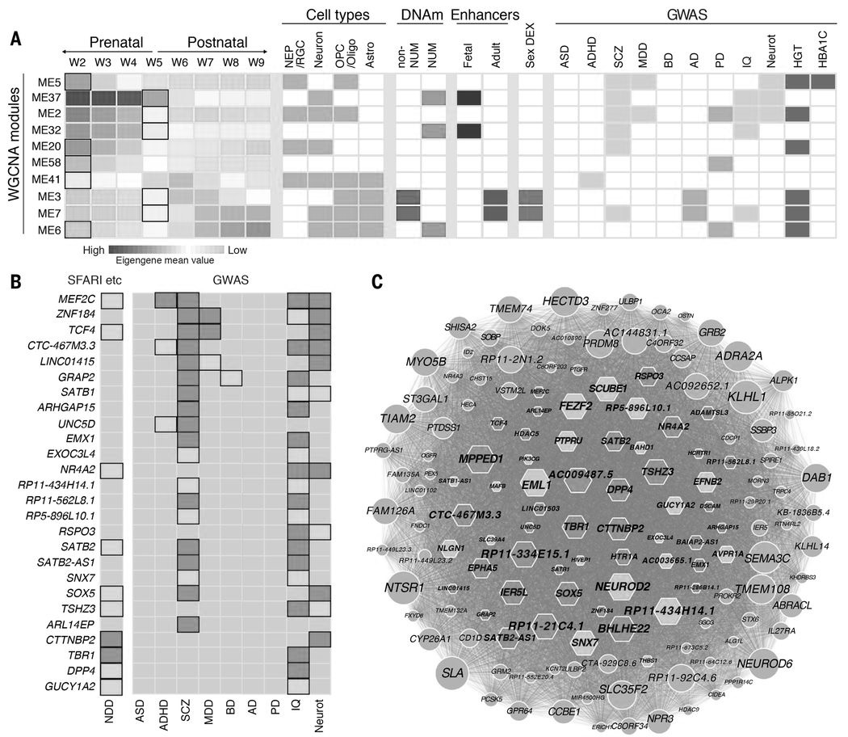
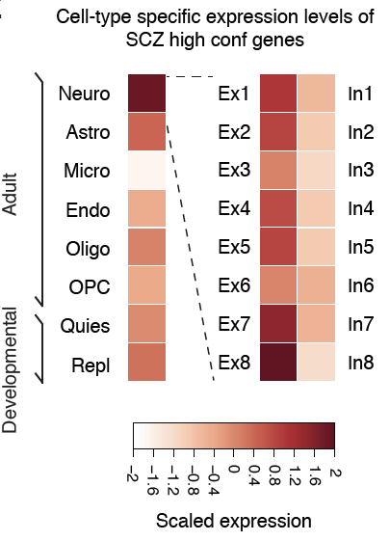
Genes associated with SCZ enriched in specific neuronal cell types & co-expression modules, active prenatally
ME37
Gene co-expression network
Mingfeng Li et al. Science 2018
Wang, et al.,
Science, 2018
Notes:
Convergence of risk for brain-based traits and disorders on discrete coexpression modules and cell types. (A) Genes associated with disease risk (right; light yellow indicates neuropsychiatric disorder or brain-based trait, and dark yellow indicates adult-onset disorder) were identified by integrating GWAS, Hi-C, and H3K27ac data and converged on 10 WGCNA modules. Many of these modules exhibited dynamic expression across time; the bold rectangles in the left panel indicate the windows with greatest rate of change. Many were also enriched for gene expression associated with distinct cell types (orange), putative active enhancers (green), and/or sites undermethylated in NeuN-positive (NUM) or NeuN-negative cells (blue, non-NUM). (B) Schematic highlighting genes in ME37 that were implicated by our study in multiple neuropsychiatric disorders (ADHD, SCZ, MDD, or BD) and neurological traits (IQ or Neurot) (list 1, light blue; list 2, dark blue), as well as neurodevelopmental disorder (NDD) risk genes, including two independent lists of high-confidence risk genes associated with ASD through de novo mutations or copy number variants [dark blue, (66)] as well as ASD risk genes identified from the SFARI dataset (light blue, http://gene.sfari.org) or for developmental delay (67). Genes implicated in only a single disorder or trait are not shown in this panel. (C) Network representation of ME37 showing connectivity between genes based on Pearson correlation. Genes linked to NDDs or neurological characteristics in our study are indicated using either dark blue–shaded or light blue–shaded hexagons, as in (B). The size of a given hexagon (or circle, indicating no association in this study) is proportional to the degree of each gene under a minimum correlation value of 0.7. (D) Enrichment for genes in ME37 or two lists of ASD risk genes among the fetal and adult cell types we identified from human NCX and multiple regions of the macaque (34) brain. For graphical representation, log₁₀P values are capped at 25. *Adult macaque cells were classified into human adult clusters using Random Forest. NEP/RGC, neural epithelial progenitor/radial glial lineage; MSN, medium spiny neurons; NasN, nascent neurons; GraN, granule neurons; PurkN, Purkinje neurons; IPC, intermediate progenitor cells; OPC, oligodendrocyte progenitor cells.

Slide 30
Using population-scale functional genomics to understand neuropsychiatic disease
& interpreting the data exhaust from this activity
[Core] PsychENCODE: Population-level analysis of functional genomics data related to neuropsychiatric disease
  Construction of an adult brain resource with 1866 individuals + dev. time-course
  Using the changing proportions of cell types (via single-cell deconvolution) to account for expression variation across a population,
  disorders & development
  Large-scale processing defines ~79K PFC
  enhancers & creates a comprehensive QTL resource (~2.5M eQTLs + cQTLs & fQTLs)
  Connecting QTLs, enhancer activity relationships & Hi-C into a
  brain regulatory network & using this to link SCZ GWAS SNPs to genes
  Embedding the reg. network in a
  deep-learning model to predict disease from genotype & transcriptome. Using this to suggest specific pathways & genes, as targets.
  [Exhaust] Other uses for the resource
    Highlighting aging related genes + consistently comparing the brain to other organs
[Exhaust] Genomic Privacy
  The Dilemma
    The genome as fundamental, inherited info that’s very private v. need for large-scale mining for med. research
    2-sided nature of RNA-seq presents tricky privacy issues
  eQTLs: Quantifying & removing variant info from expression levels with ICI & predictability. Instantiating a practical linking attack with noisy quasi-identifiers
  Signal Profiles: Manifest appreciable leakage from large & small deletions. Linking attacks possible but additional complication of SV discovery in addition to genotyping

Slide 31

Deep Structured Phenotype Network
(DSPN)
Boltzmann machine
y: phenotypes
h: hidden units (e.g., circuits)
x: intermediate phenotypes (e.g., genes, enhancers)
z: genotypes (e.g., SNPs)
W: weights
(e.g., regulatory network)
Gene
regulatory network
builds
skeleton
Energy model:
$$p\left(x,y,h|z\right)∝\exp\left(−E\left(x,y, h|z\right)\right)$$
$$E\left(x,y, h|z\right)={−z}^{T}W_{1}x{−x}^{T}W_{2}x−x^{T}W_{3}h−h^{T}W_{4}h−h^{T}W_{5}y−Bias$$
[Wang et al. (‘18) Science]

Slide 32
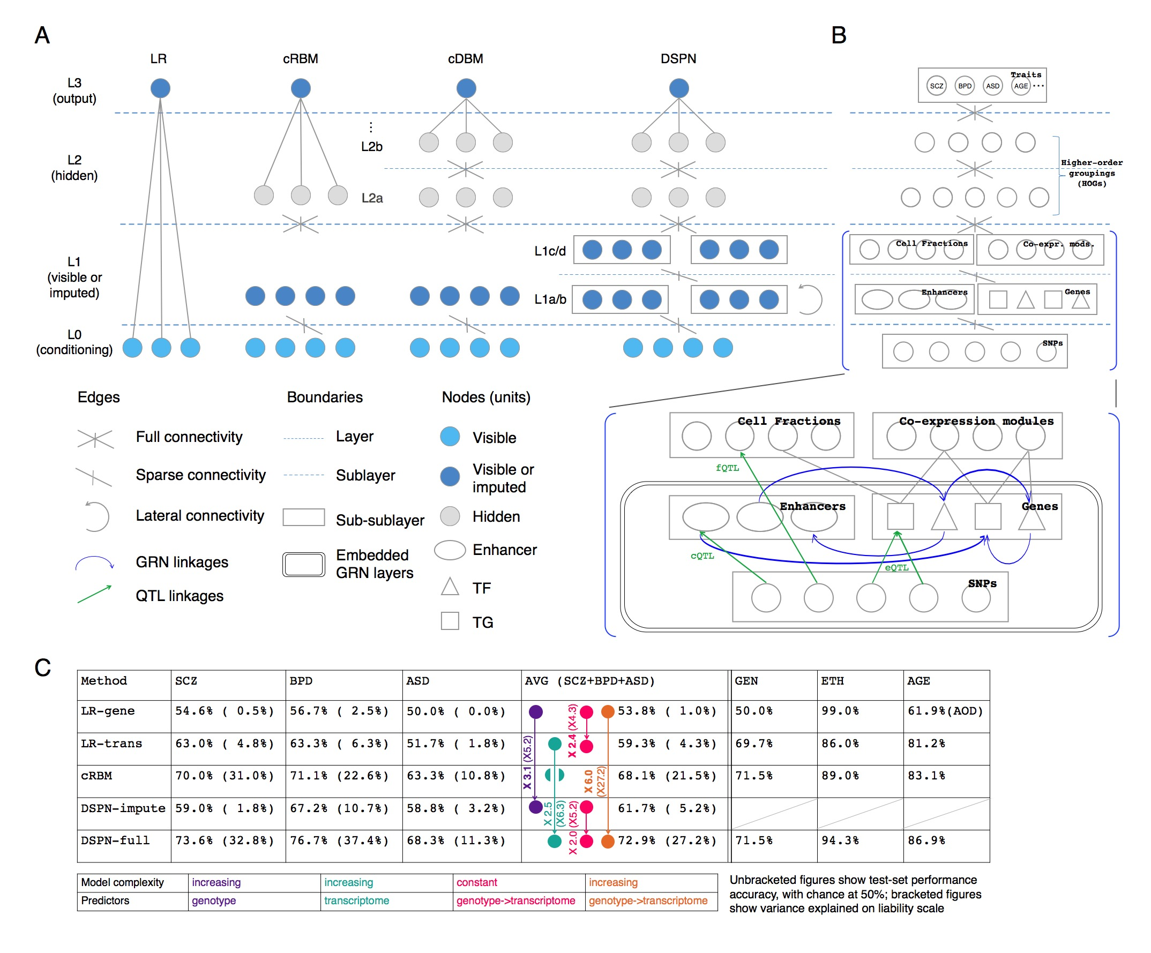
DSPN improves brain disease prediction by adding deep layers
Method | LR-genotype | LR-transcriptome | cRBM | DSPN-imputation | DSPN-full
Schizophrenia | 54.6% | 63.0% | 70.0% | 59.0% | 73.6%
Bipolar Disorder | 56.7% | 63.3% | 71.1% | 67.2% | 76.7%
Autism Spectrum Disorder | 50.0% | 51.7% | 67.2% | 62.5% | 68.3%
X 6.0
Accuracy = chance to correctly predict disease/health
[Wang et al. (‘18) Science]

Slide 33
DSPN improves brain disease prediction by adding deep layers
Method | LR-genotype | LR-transcriptome | cRBM | DSPN-imputation | DSPN-full
Schizophrenia | 54.6% | 63.0% | 70.0% | 59.0% | 73.6%
Bipolar Disorder | 56.7% | 63.3% | 71.1% | 67.2% | 76.7%
Autism Spectrum Disorder | 50.0% | 51.7% | 67.2% | 62.5% | 68.3%
X 2.5
Accuracy = chance to correctly predict disease/health
[Wang et al. (‘18) Science]

Slide 34
DSPN improves brain disease prediction by adding deep layers
Method | LR-genotype | LR-transcriptome | cRBM | DSPN-imputation | DSPN-full
Schizophrenia | 54.6% | 63.0% | 70.0% | 59.0% | 73.6%
Bipolar Disorder | 56.7% | 63.3% | 71.1% | 67.2% | 76.7%
Autism Spectrum Disorder | 50.0% | 51.7% | 67.2% | 62.5% | 68.3%
X 3.1
Accuracy = chance to correctly predict disease/health
[Wang et al. (‘18) Science]

Slide 35
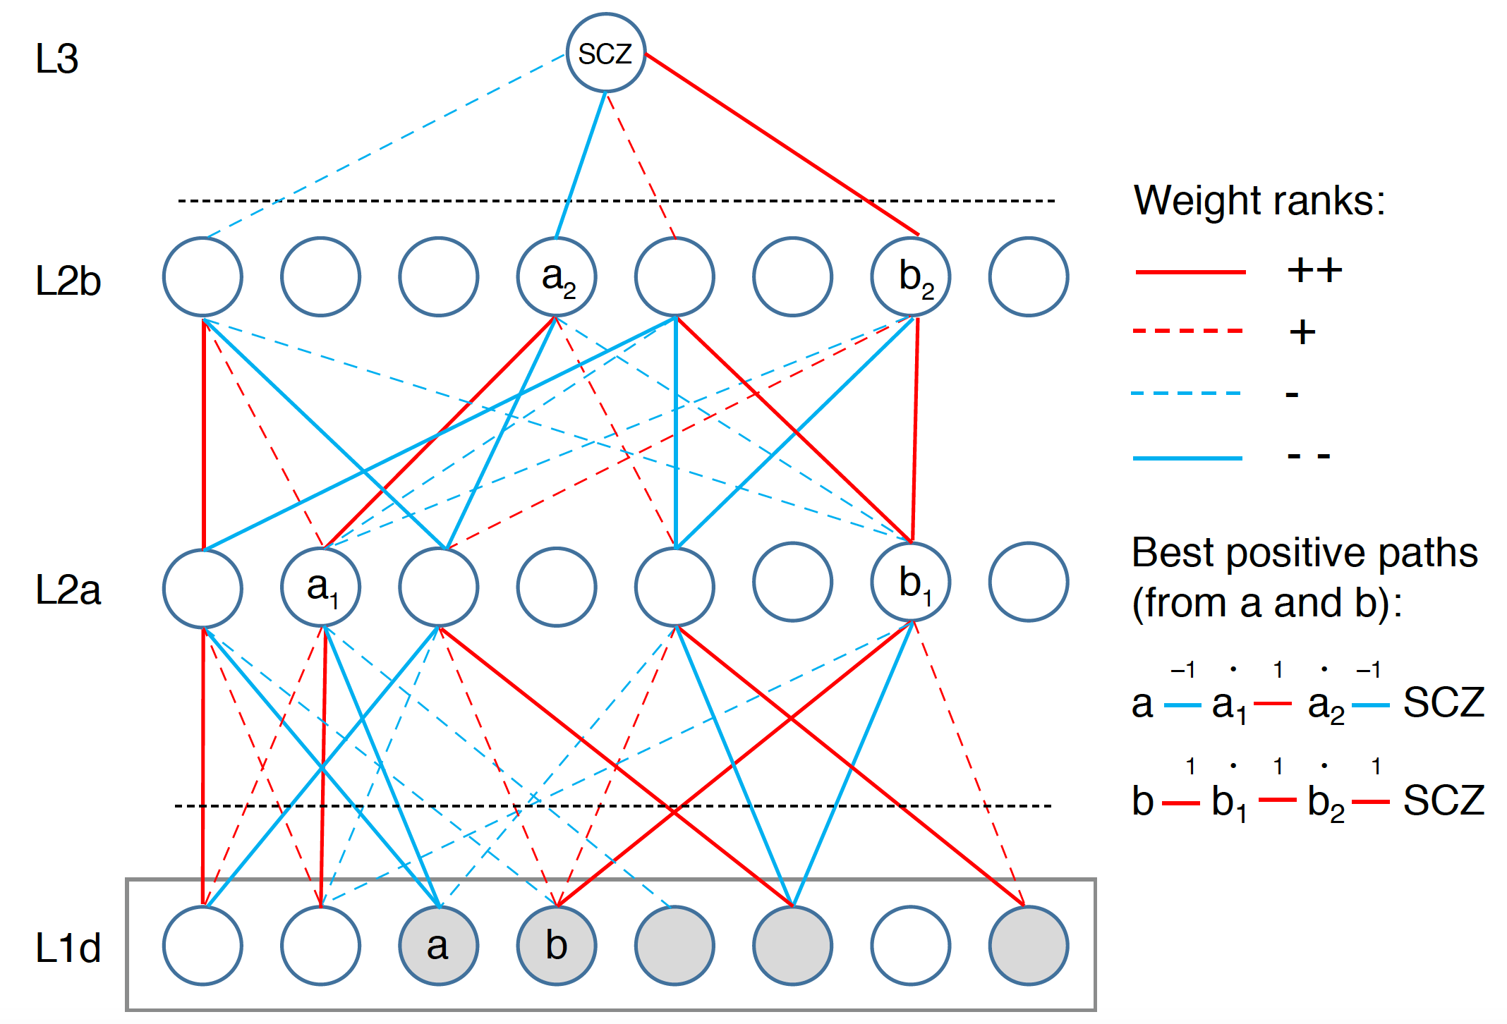
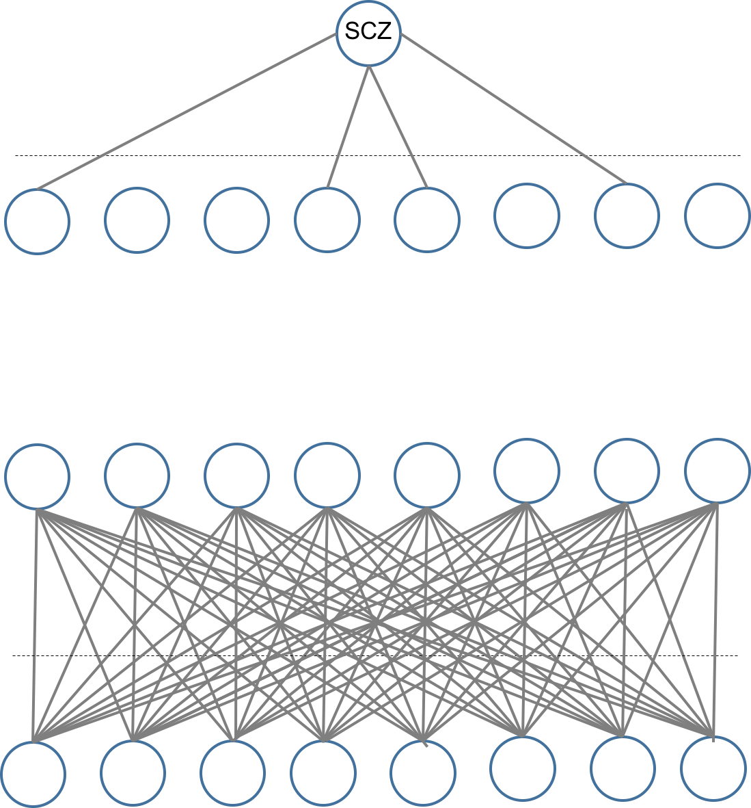
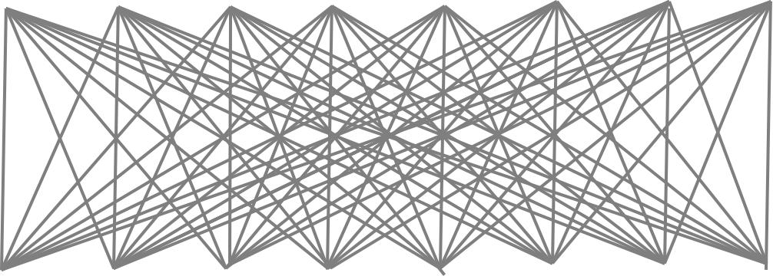
Multilevel Network Interpretation
Actual network size:
5024/400/100/1 nodes
Start with a fully connected trained network
[Wang et al. (‘18) Science]

Slide 36
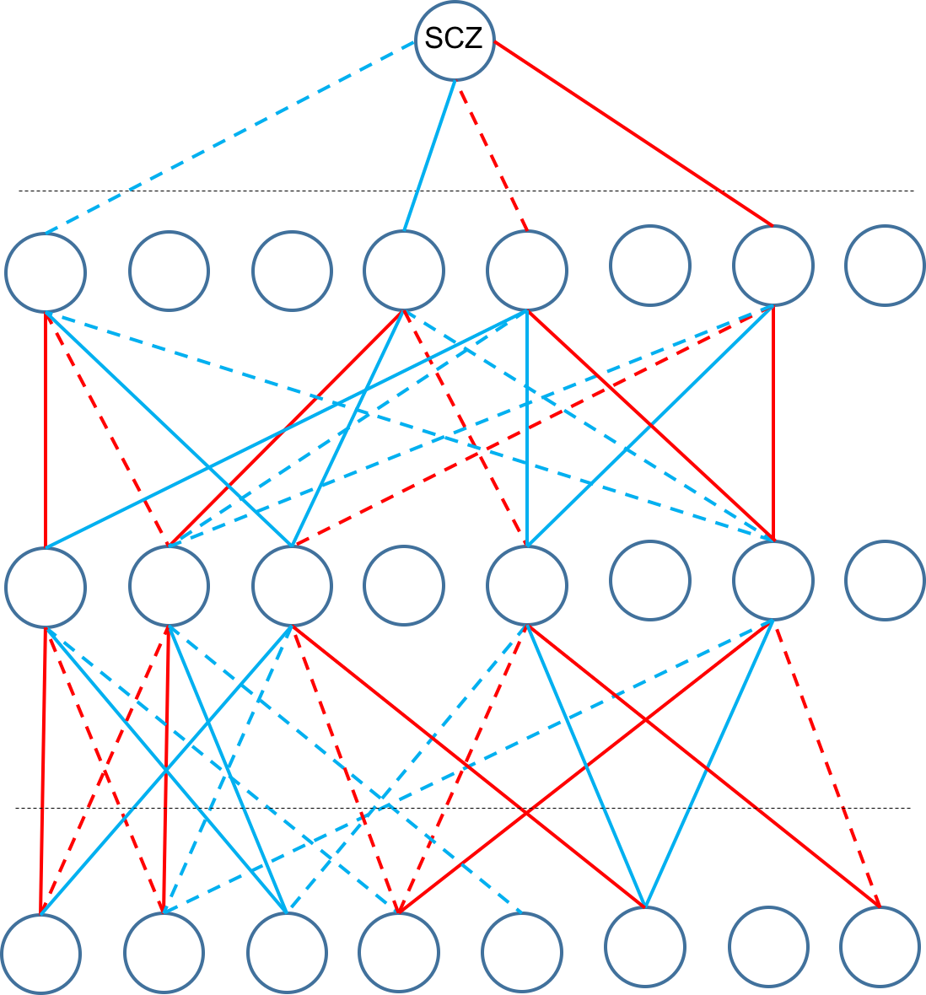
Multilevel Network Interpretation
Actual network size:
5024/400/100/1 nodes
Start with a fully connected trained network
Sparsify network using edges with largest absolute weights (+/-)
[Wang et al. (‘18) Science]

Slide 37
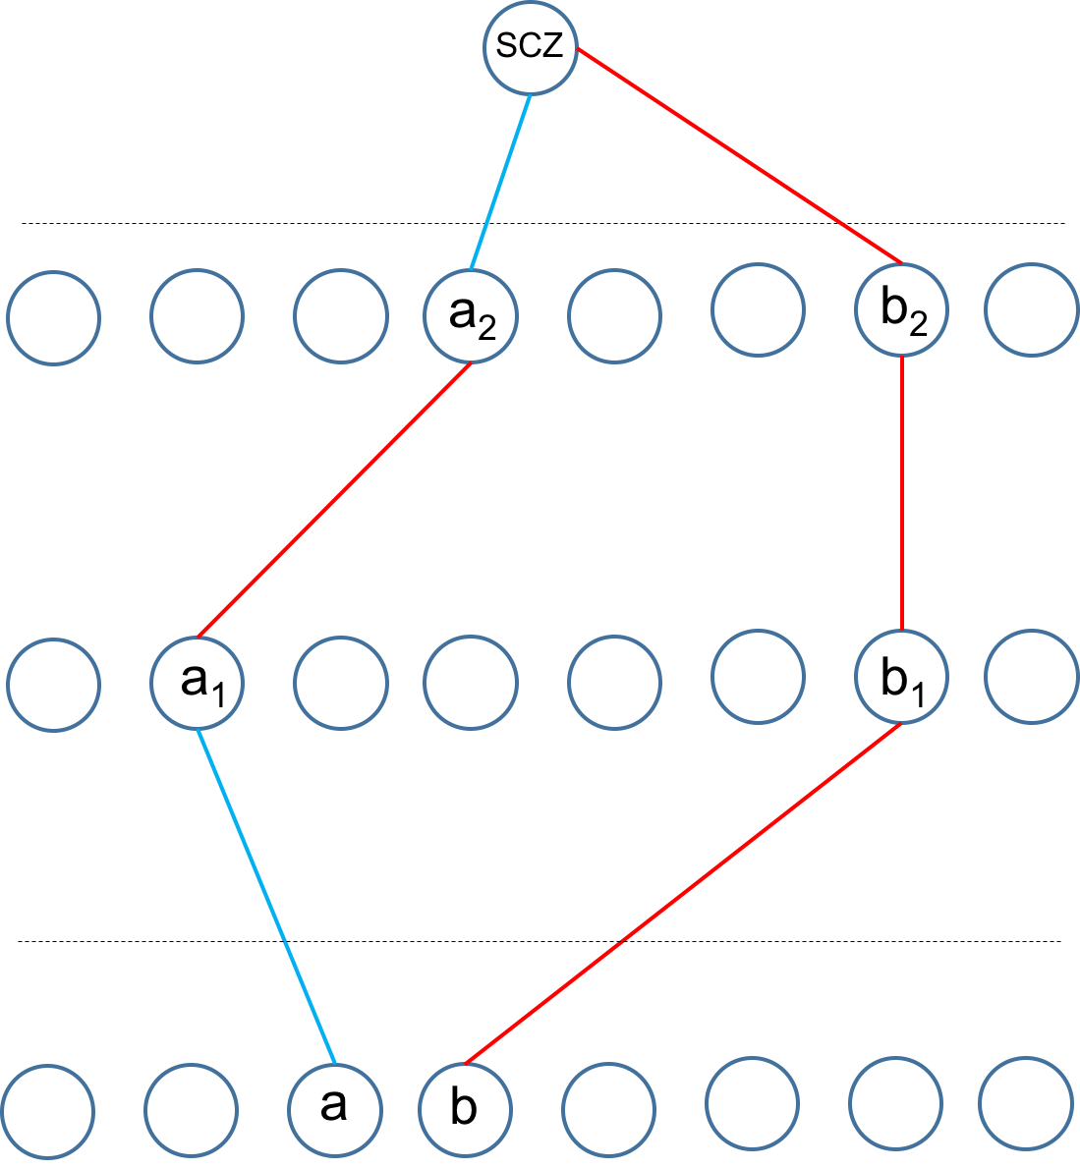
Multilevel Network Interpretation
Actual network size:
5024/400/100/1 nodes
Start with a fully connected trained network
Sparsify network using edges with largest absolute weights (+/-)
Extract ‘best positive paths’ to each prioritized module (e.g. a-a₁-a₂-SCZ) by summing weights and multiplying signs
[Wang et al. (‘18) Science]

Slide 38
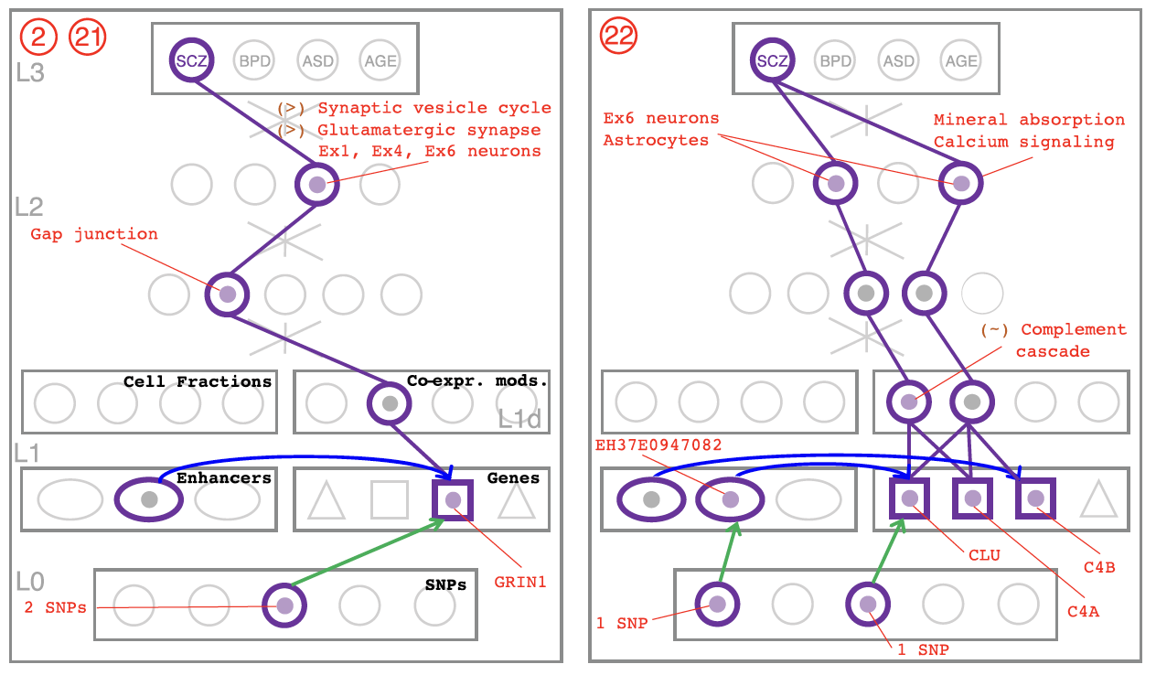
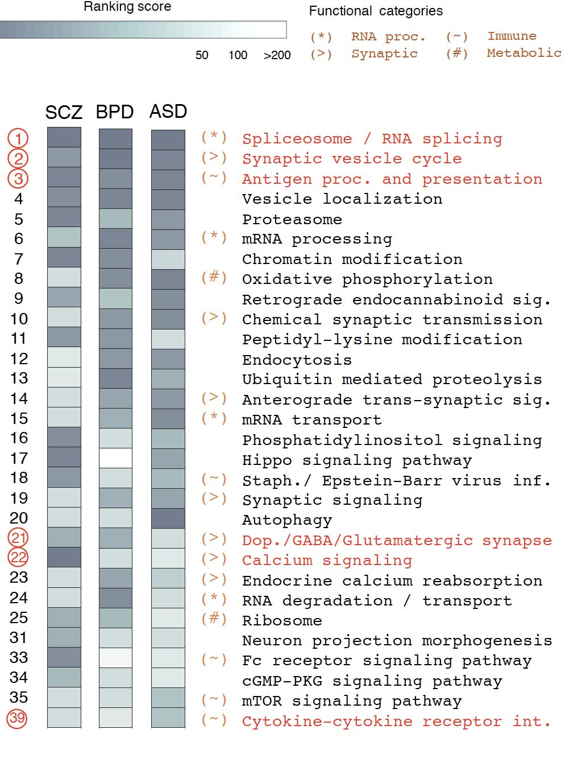
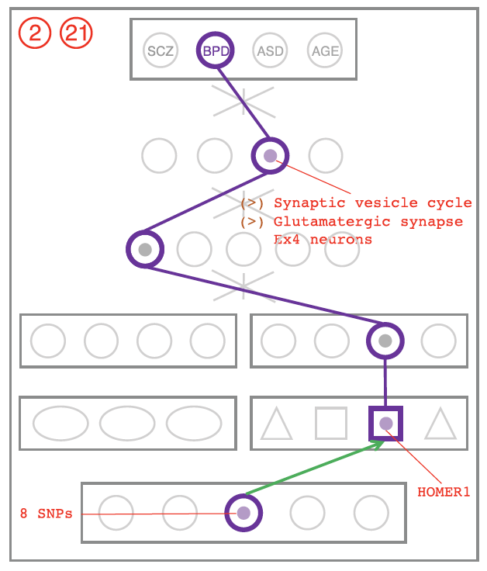
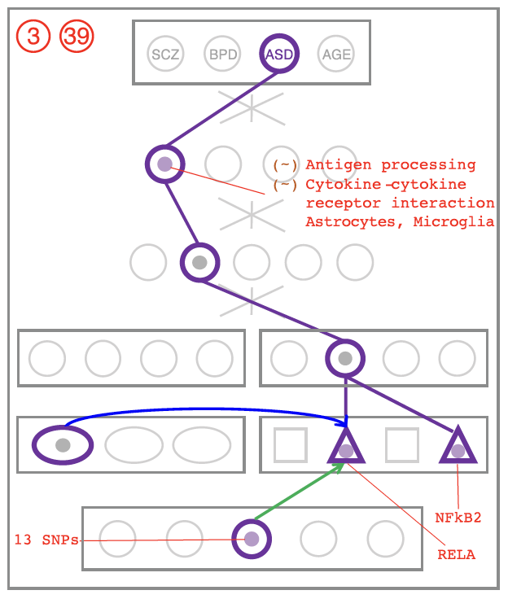
DSPN discovers enriched pathways and linkages to genetic variation
Cross-disorder MOD/HOG enrichment ranking
SCZ
BPD
ASD
[Wang et al. (‘18) Science]

Slide 39
Using population-scale functional genomics to understand neuropsychiatic disease
& interpreting the data exhaust from this activity
[Core] PsychENCODE: Population-level analysis of functional genomics data related to neuropsychiatric disease
  Construction of an adult brain resource with 1866 individuals + dev. time-course
  Using the changing proportions of cell types (via single-cell deconvolution) to account for expression variation across a population,
  disorders & development
  Large-scale processing defines ~79K PFC
  enhancers & creates a comprehensive QTL resource (~2.5M eQTLs + cQTLs & fQTLs)
  Connecting QTLs, enhancer activity relationships & Hi-C into a
  brain regulatory network & using this to link SCZ GWAS SNPs to genes
  Embedding the reg. network in a
  deep-learning model to predict disease from genotype & transcriptome. Using this to suggest specific pathways & genes, as targets.
  [Exhaust] Other uses for the resource
    Highlighting aging related genes + consistently comparing the brain to other organs
[Exhaust] Genomic Privacy
  The Dilemma
    The genome as fundamental, inherited info that’s very private v. need for large-scale mining for med. research
    2-sided nature of RNA-seq presents tricky privacy issues
  eQTLs: Quantifying & removing variant info from expression levels with ICI & predictability. Instantiating a practical linking attack with noisy quasi-identifiers
  Signal Profiles: Manifest appreciable leakage from large & small deletions. Linking attacks possible but additional complication of SV discovery in addition to genotyping

Slide 40
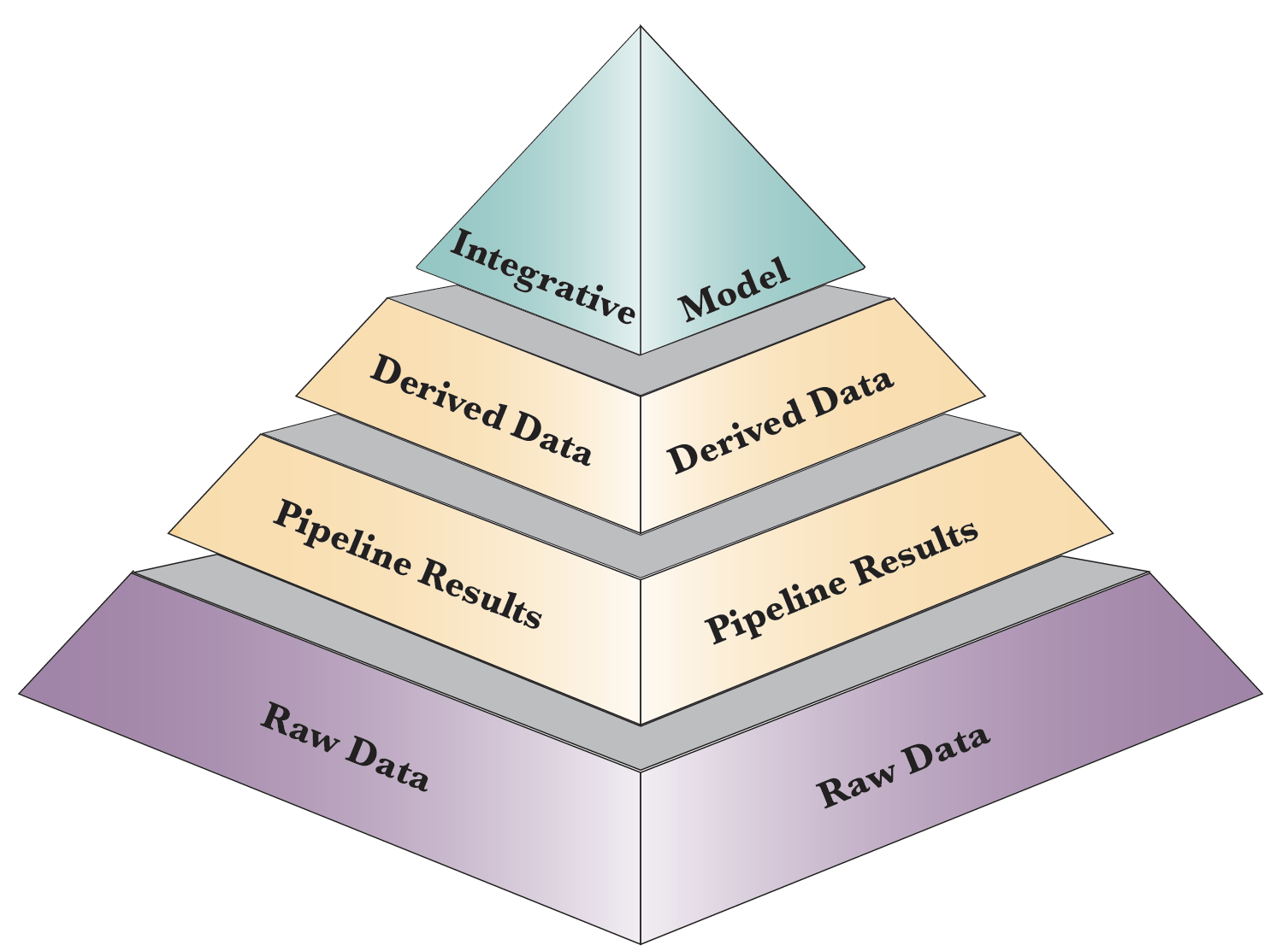
Phase 1 PsychENCODE capstone resource:
Layers of distributed information
Material in the 3 capstones:
AC - Wang et al. ('18)
DC - Li et al. ('18)
NC - Gandal et al. ('18)
Resource.psychencode.org
Development.psychencode.org

Slide 41
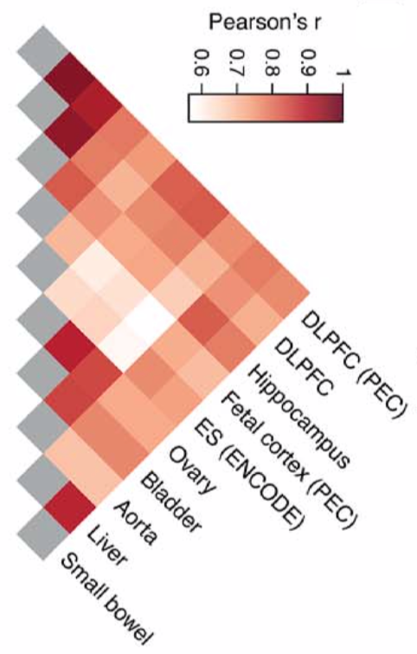
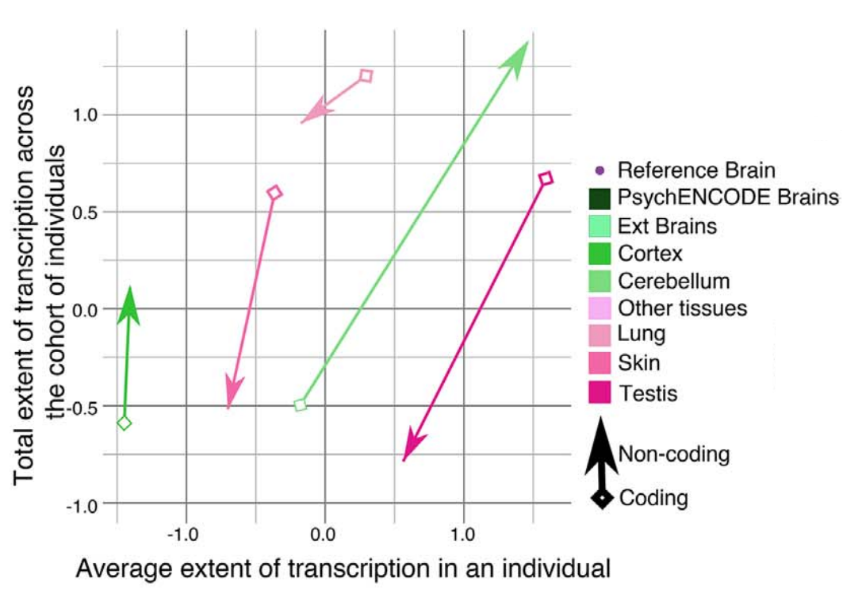
Cross tissue variation in Chromatin & Expression
Placing the
Brain in context of all other Body Tissues
Hi-C
Chromatin
Transcriptome diversity increases in the non-coding portion of the brain genome while decreases in other tissues
Expression
[Wang et al. (‘18) Science]

Slide 42
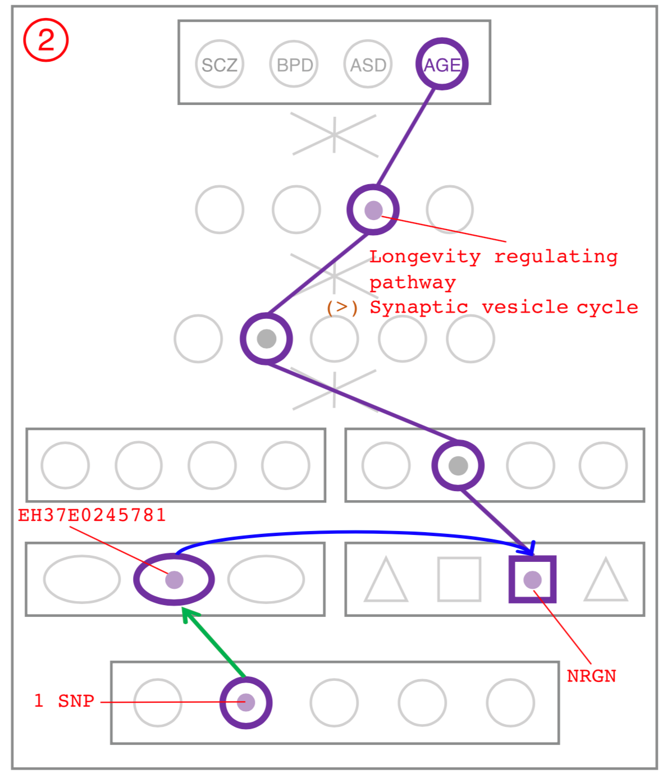
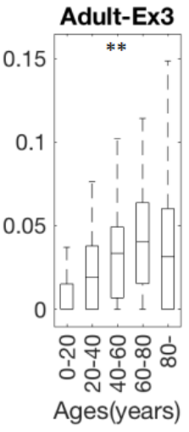
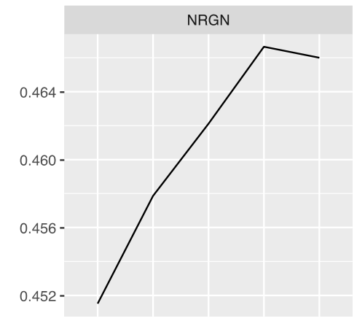

NRGN has variable expression over age and is in Synaptic vesicle cycle pathway is enriched in SCZ, BPD, ASD
NRGN
Ex3 Neuron
NGRN is a gene associated with the Synaptic vesicle pathway and NGRN expression and methylation is correlated with Age
0
2
4
0.452
0.46
0
0.05
0.1
0.15
0
20
Age (years)
40
60
0
20
40
60
80
80
Methylation
Exp.

Slide 43
Using population-scale functional genomics to understand neuropsychiatic disease
& interpreting the data exhaust from this activity
[Core] PsychENCODE: Population-level analysis of functional genomics data related to neuropsychiatric disease
  Construction of an adult brain resource with 1866 individuals + dev. time-course
  Using the changing proportions of cell types (via single-cell deconvolution) to account for expression variation across a population,
  disorders & development
  Large-scale processing defines ~79K PFC
  enhancers & creates a comprehensive QTL resource (~2.5M eQTLs + cQTLs & fQTLs)
  Connecting QTLs, enhancer activity relationships & Hi-C into a
  brain regulatory network & using this to link SCZ GWAS SNPs to genes
  Embedding the reg. network in a
  deep-learning model to predict disease from genotype & transcriptome. Using this to suggest specific pathways & genes, as targets.
  [Exhaust] Other uses for the resource
    Highlighting aging related genes + consistently comparing the brain to other organs
[Exhaust] Genomic Privacy
  The Dilemma
    The genome as fundamental, inherited info that’s very private v. need for large-scale mining for med. research
    2-sided nature of RNA-seq presents tricky privacy issues
  eQTLs: Quantifying & removing variant info from expression levels with ICI & predictability. Instantiating a practical linking attack with noisy quasi-identifiers
  Signal Profiles: Manifest appreciable leakage from large & small deletions. Linking attacks possible but additional complication of SV discovery in addition to genotyping

Slide 44

2-sided nature of functional genomics data: Analysis can be very General/Public or Individual/Private
General quantifications related to overall aspects
of a condition – ie gene activity as a function of:
  Developmental stage, Evolutionary relationships, Cell-type, Disease
Above are not tied to an individual’s genotype. However, data is derived from individuals & tagged with their genotypes
(Note, a few calculations aim to use explicitly genotype to derive general relations related to sequence variation & gene expression - eg allelic activity)

Slide 45
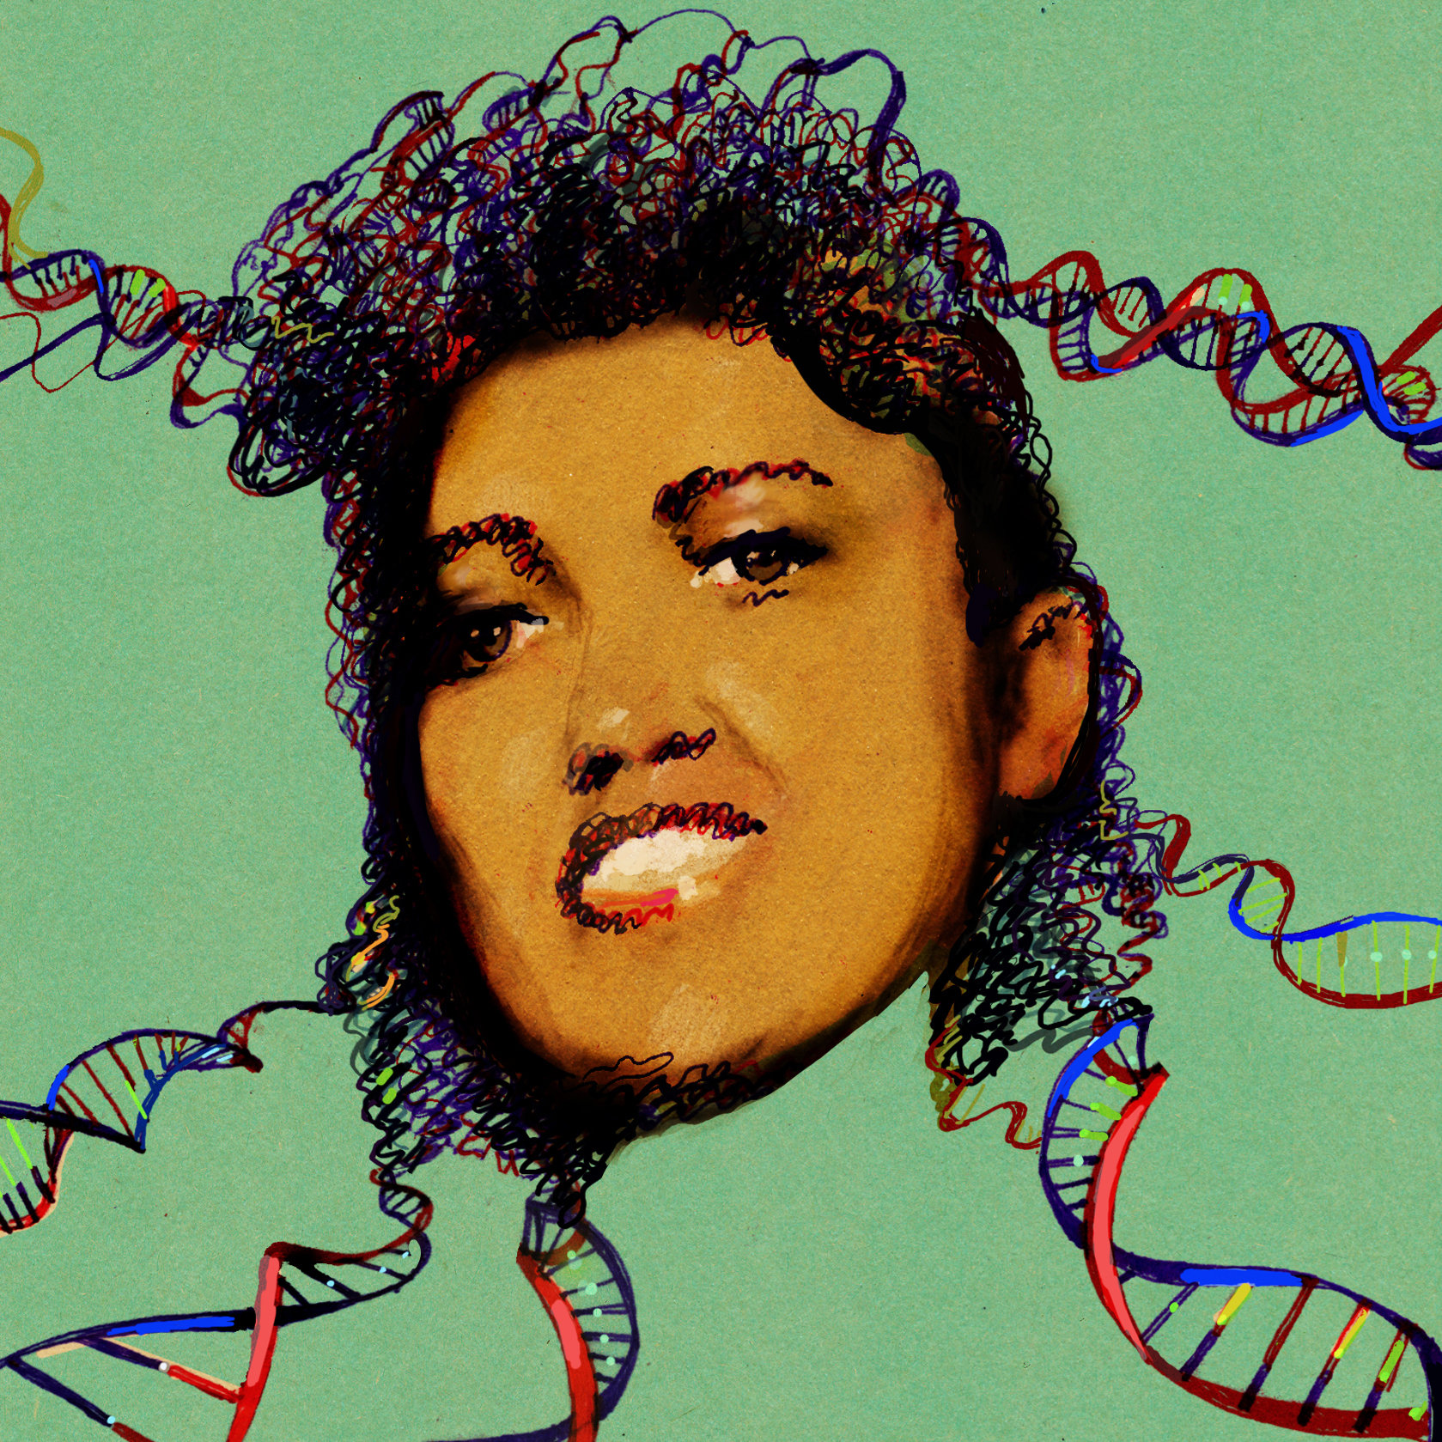
Privacy: Does Genomics has similar "Big Data" Dilemma as in the Rest of Society?
We confront privacy risks every day we access the internet (e.g., social media, e-commerce).
Sharing & "peer-production" is central to success of many new ventures, with analogous risks to genomics
  EG web search: Large-scale mining essential
Genetic Exceptionalism :
The Genome is very fundamental data, potentially very revealing about one’s identity & characteristics
Personal Genomic info. essentially meaningless currently but will it be in 20 yrs? 50 yrs?
  Genomic sequence very revealing about one’s children. Is true consent possible?
  Once put on the web it can’t be taken back
Ethically challenged history of genetics
  Ownership of the data & what consent means (Hela)
  Could your genetic data give rise to a product line?
[Seringhaus & Gerstein ('09), Hart. Courant (Jun 5); Greenbaum & Gerstein ('11), NY Times (6 Oct), D Greenbaum & M Gerstein (’08). Am J. Bioethics; D Greenbaum & M Gerstein, Hartford Courant, 10 Jul. '08 ; SF Chronicle, 2 Nov. '08; Greenbaum et al. PLOS CB (‘11) ; Greenbaum & Gerstein ('13), The Scientist; Photos from NY Times, it.wisc.edu]

Slide 46

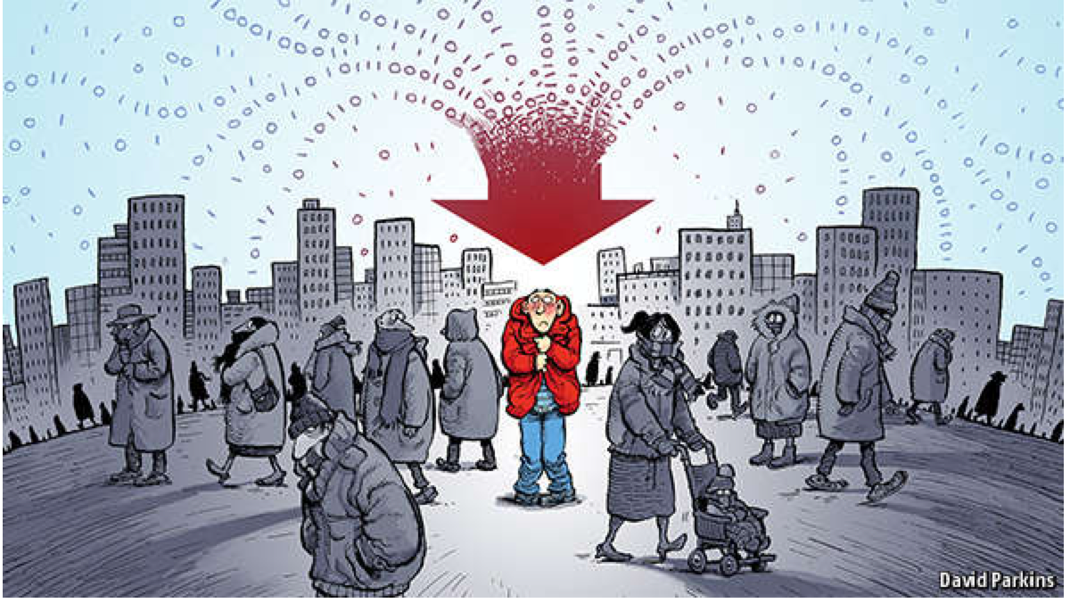
The Dilemma
The Other Side of the Coin
for Genomics: Why we should share
Sharing helps speed research
  Large-scale mining of this information is important for medical research
  Statistical power
  Privacy is cumbersome, particularly for big data
The individual (harmed?) v the collective (benefits)
  - But do sick patients care about their privacy?
How to balance risks v rewards – Quantification
[Economist, 15 Aug ‘15]
[Yale Law Roundtable (‘10). Comp. in Sci. & Eng. 12:8; D Greenbaum & M Gerstein (‘09). Am. J. Bioethics; D Greenbaum & M Gerstein (‘10). SF Chronicle, May 2, Page E-4; Greenbaum et al. PLOS CB (‘11)]

Slide 47
Current Social & Technical Solutions:
The quandary where are now
Closed Data Approach
  Consents
  “Protected” distribution via dbGAP
  Local computes on secure computer
Issues with Closed Data
  Non-uniformity of consents & paperwork
    Different, confusing int’l norms
  Computer security is burdensome
  Many schemes get “hacked” .
  Tricky aspects of high-dimensional data (leakage & ease of creating quasi-identifiers)
Open Data
  Genomic "test pilots” (ala PGP)?
    Sports stars & celebrities?
  Some public data & data donation is helpful but is this a realistic solution for an unbiased sample of ~1M
[Greenbuam et al ('04), Nat. Biotech; Greenbaum & Gerstein ('13), The Scientist; Photo: futurism.com]

Slide 48
Strawman Hybrid Social & Tech Proposed Solution?
Fundamentally, researchers have to keep genetic secrets.
  Need for an (international) legal framework
  Genetic Licensure & training for individuals
  (similar to medical license, drivers license)
Technology to make things easier
  Cloud computing & enclaves (eg solution of Genomics England)
Technological barriers shouldn't create a social incentive for “hacking”
Quantifying Leakage & allowing a small amounts of it
Careful separation & coupling of private & public data
  Lightweight, freely accessible secondary datasets coupled to underlying variants
  Selection of stub & "test pilot" datasets for benchmarking
  Develop programs on public stubs on your laptop, then move the program to the cloud for private production run
[D Greenbaum, M Gerstein (‘11). Am J Bioeth 11:39. Greenbaum & Gerstein, The Scientist ('13)]

Slide 49
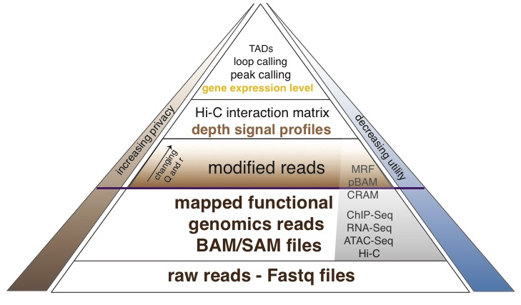
Functional genomics data comes with a great deal of sequencing;
We can quantify amount of leakage at every step of the data summarization process.
NA12878 as case study - 1000 genomes variants are used as gold standard
[Gursoy et al, Bioarvix]

Slide 50
How much information, for example, do RNA-Seq reads (or ChIP-Seq) reads contain? Does that information enough to identify individuals?
It might seem like we don’t infer much information from single ChIP-Seq and RNA-Seq experiments compared to WGS
  However putting 10 different ChIP-Seq experiments and RNA-Seq together with imputation provides a great deal of information about the individual
[Gursoy et al, Bioarvix]

Slide 51
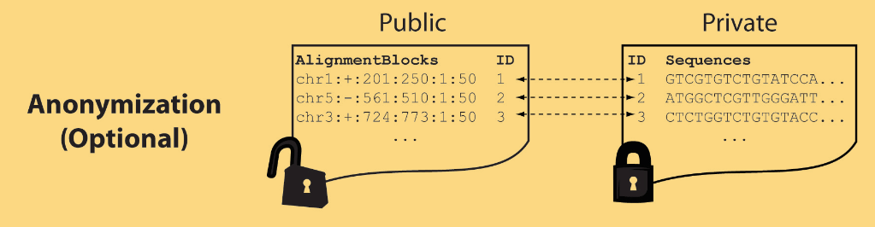
Light-weight formats to Hide Most of the Read Data (Signal Tracks)
Some lightweight format clearly separate public & private info., aiding exchange
Files become much smaller. Similar to CRAM
Distinction between formats to compute on and those to archive with – become sharper with big data
Reads
(linked via ID,
10X larger than
mapping coord.)
Mapping coordinates without variants (MRF)
[Bioinformatics 27: 281]

Slide 52
Using population-scale functional genomics to understand neuropsychiatic disease
& interpreting the data exhaust from this activity
[Core] PsychENCODE: Population-level analysis of functional genomics data related to neuropsychiatric disease
  Construction of an adult brain resource with 1866 individuals + dev. time-course
  Using the changing proportions of cell types (via single-cell deconvolution) to account for expression variation across a population,
  disorders & development
  Large-scale processing defines ~79K PFC
  enhancers & creates a comprehensive QTL resource (~2.5M eQTLs + cQTLs & fQTLs)
  Connecting QTLs, enhancer activity relationships & Hi-C into a
  brain regulatory network & using this to link SCZ GWAS SNPs to genes
  Embedding the reg. network in a
  deep-learning model to predict disease from genotype & transcriptome. Using this to suggest specific pathways & genes, as targets.
  [Exhaust] Other uses for the resource
    Highlighting aging related genes + consistently comparing the brain to other organs
[Exhaust] Genomic Privacy
  The Dilemma
    The genome as fundamental, inherited info that’s very private v. need for large-scale mining for med. research
    2-sided nature of RNA-seq presents tricky privacy issues
  eQTLs: Quantifying & removing variant info from expression levels with ICI & predictability. Instantiating a practical linking attack with noisy quasi-identifiers
  Signal Profiles: Manifest appreciable leakage from large & small deletions. Linking attacks possible but additional complication of SV discovery in addition to genotyping

Slide 53


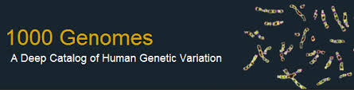
Representative Functional Genomics, Genotype, eQTL Datasets
Genotypes are available from the 1000 Genomes Project
mRNA sequencing for 462 individuals from gEUVADIS and ENCODE
  Publicly available quantification for protein coding genes
Functional genomics data (ChIP-Seq, RNA-Seq, Hi-C) available from ENCODE
Approximately 3,000 cis-eQTL (FDR<0.05)

Slide 54
Information Content and Predictability
Naive measure of information (no LD, distant correlations, pop. struc., &c)
Higher frequency: Lower ICI
Additive for multiple variants
Condition specific entropy
Higher cond. entropy: Lower predictability
Additive for multiple eQTLs
[Harmanci et al. Nat. Meth. 2016]

Slide 55
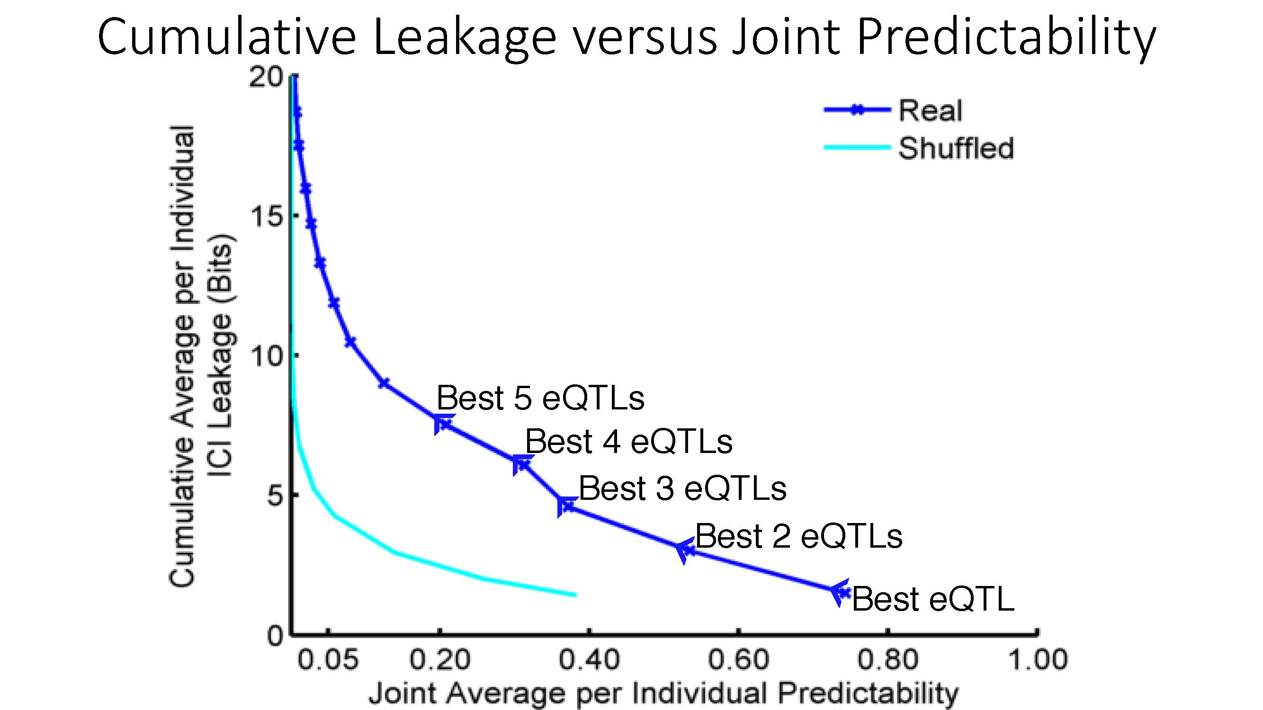
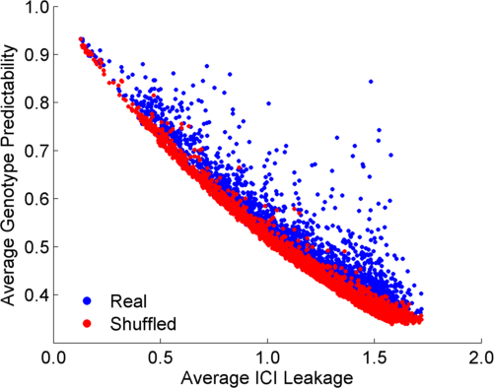
ICI Leakage versus Genotype Predictability
[Harmanciet al. Nat. Meth. (‘16]

Slide 56
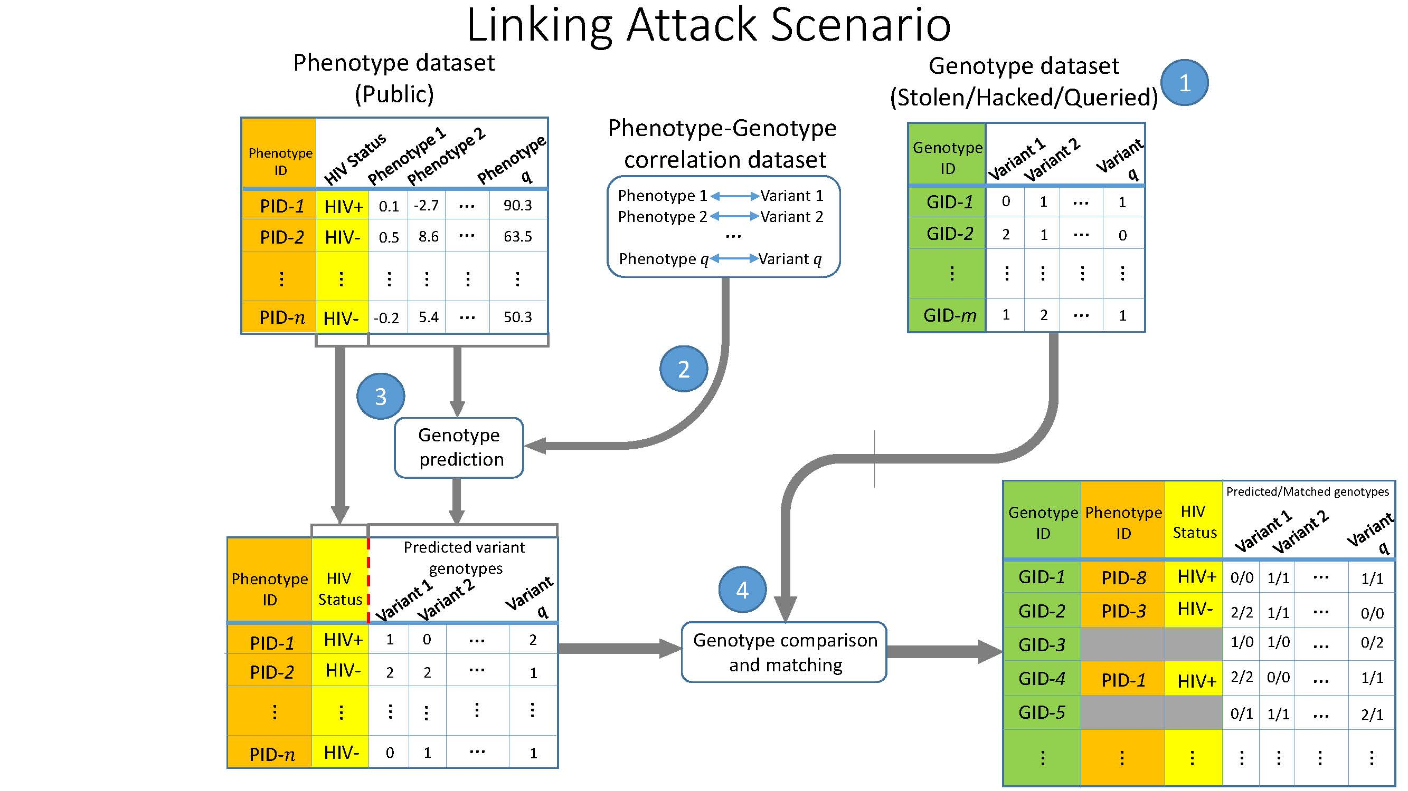
Linking Attack Scenario
[Harmanciet al. Nat. Meth. (in revision)]

Slide 57


Linking Attacks: Case of Netflix Prize
Names available for many users!
User (ID) | Movie (ID) | Date of Grade | Grade [1,2,3,4,5]
NTFLX-0 | NTFLX-19 | 10/12/2008 | 1
NTFLX-1 | NTFLX-116 | 4/23/2009 | 3
NTFLX-2 | NTFLX-92 | 5/27/2010 | 2
NTFLX-1 | NTFLX-666 | 6/6/2016 | 5
… | … | … | …
… | … | … | …
User (ID) | Movie (ID) | Date of Grade | Grade [0-10]
IMDB-0 | IMDB-173 | 4/20/2009 | 5
IMDB-1 | IMDB-18 | 10/18/2008 | 0
IMDB-2 | IMDB-341 | 5/27/2010 | -
… | … | … | …
… | … | … | …
… | … | … | …
Many users are shared
The grades of same users are correlated
A user grades one movie around the same date in two databases
Anonymized Netflix Prize Training Dataset
made available to contestants
Notes:
This figure illustrates what these datasets look like. The movie titles can be matched directly. Date of ratings and rating values are expected to be similar to each other

Slide 58
Linking Attacks: Case of Netflix Prize
Names available for many users!
User (ID) | Movie (ID) | Date of Grade | Grade [1,2,3,4,5]
NTFLX-0 | NTFLX-19 | 10/12/2008 | 1
NTFLX-1 | NTFLX-116 | 4/23/2009 | 3
NTFLX-2 | NTFLX-92 | 5/27/2010 | 2
NTFLX-1 | NTFLX-666 | 6/6/2016 | 5
… | … | … | …
… | … | … | …
User (ID) | Movie (ID) | Date of Grade | Grade [0-10]
IMDB-0 | IMDB-173 | 4/20/2009 | 5
IMDB-1 | IMDB-18 | 10/18/2008 | 0
IMDB-2 | IMDB-341 | 5/27/2010 | -
… | … | … | …
… | … | … | …
… | … | … | …
Many users are shared
The grades of same users are correlated
A user grades one movie around the same date in two databases
IMDB users are public
NetFLIX and IMdB moves are public
Notes:
As you can see, Netflx-1 user can be matched to IMDB-0 user since the date of rating is very close and the ratings are very similar. The rating in imdb is from 0 to 10. So 5 is a similar score to 3 in Netflix rating system.

Slide 59
Linking Attacks: Case of Netflix Prize
Names available for many users!
User (ID) | Movie (ID) | Date of Grade | Grade [1,2,3,4,5]
NTFLX-0 | NTFLX-19 | 10/12/2008 | 1
NTFLX-1 | NTFLX-116 | 4/23/2009 | 3
NTFLX-2 | NTFLX-92 | 5/27/2010 | 2
NTFLX-1 | NTFLX-666 | 6/6/2016 | 5
… | … | … | …
… | … | … | …
User (ID) | Movie (ID) | Date of Grade | Grade [0-10]
IMDB-0 | IMDB-173 | 4/20/2009 | 5
IMDB-1 | IMDB-18 | 10/18/2008 | 0
IMDB-2 | IMDB-341 | 5/27/2010 | -
… | … | … | …
… | … | … | …
… | … | … | …
Many users are shared
The grades of same users are correlated
A user grades one movie around the same date in two databases
Notes:
The key idea is that in imdb, the names are available for many users. Also,
Secondly, although another movie in Netflix system is not rated by this user in imdb system, namely the netflx666, the adversary can see the rating of the individual for this movie.

Slide 60
Linking Attack Scenario
[Harmanciet al. Nat. Meth. (in revision)]

Slide 61
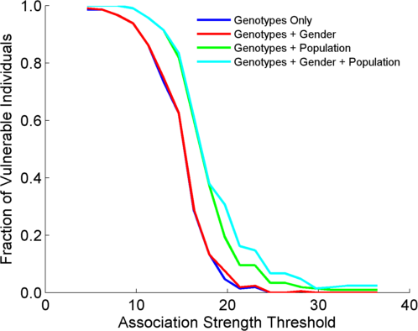
Success in Linking Attack with Extremity based Genotype Prediction
200 individuals eQTL Discovery
200 individuals in Linking Attack
High
Sensitivity
Low
Sensitivity
High Number
Of eQTLs
Low Number
Of eQTLs
[Harmanci et al. Nat. Meth. (16)]

Slide 62
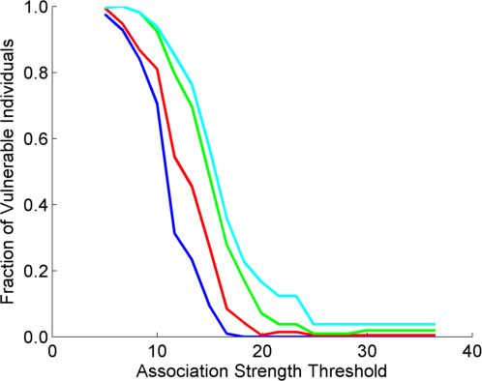
Success in Linking Attack with Extremity based Genotype Prediction
200 individuals eQTL Discovery
200 individuals in Linking Attack
200 individuals eQTL Discovery
100,200 individuals in Linking Attack
[Harmanci et al. Nat. Meth. (16)]

Slide 63
Using population-scale functional genomics to understand neuropsychiatic disease
& interpreting the data exhaust from this activity
[Core] PsychENCODE: Population-level analysis of functional genomics data related to neuropsychiatric disease
  Construction of an adult brain resource with 1866 individuals + dev. time-course
  Using the changing proportions of cell types (via single-cell deconvolution) to account for expression variation across a population,
  disorders & development
  Large-scale processing defines ~79K PFC
  enhancers & creates a comprehensive QTL resource (~2.5M eQTLs + cQTLs & fQTLs)
  Connecting QTLs, enhancer activity relationships & Hi-C into a
  brain regulatory network & using this to link SCZ GWAS SNPs to genes
  Embedding the reg. network in a
  deep-learning model to predict disease from genotype & transcriptome. Using this to suggest specific pathways & genes, as targets.
  [Exhaust] Other uses for the resource
    Highlighting aging related genes + consistently comparing the brain to other organs
[Exhaust] Genomic Privacy
  The Dilemma
    The genome as fundamental, inherited info that’s very private v. need for large-scale mining for med. research
    2-sided nature of RNA-seq presents tricky privacy issues
  eQTLs: Quantifying & removing variant info from expression levels with ICI & predictability. Instantiating a practical linking attack with noisy quasi-identifiers
  Signal Profiles: Manifest appreciable leakage from large & small deletions. Linking attacks possible but additional complication of SV discovery in addition to genotyping

Slide 64
Detection & Genotyping of small & large
SV deletions from signal profiles
RNA-Seq
Signal
Genomic
Coordinate
ChIP-Seq
Signals
A C G T A C G
Large Deletion
Genomic
Coordinate
Small Deletion
RNA-seq also shows large deletions
[Harmanci & Gerstein, Nat. Comm. (‘18)]

Slide 65
Example of Small Deletion Evident in Signal Profile
[Harmanci & Gerstein, Nat. Comm. (‘18)]

Slide 66
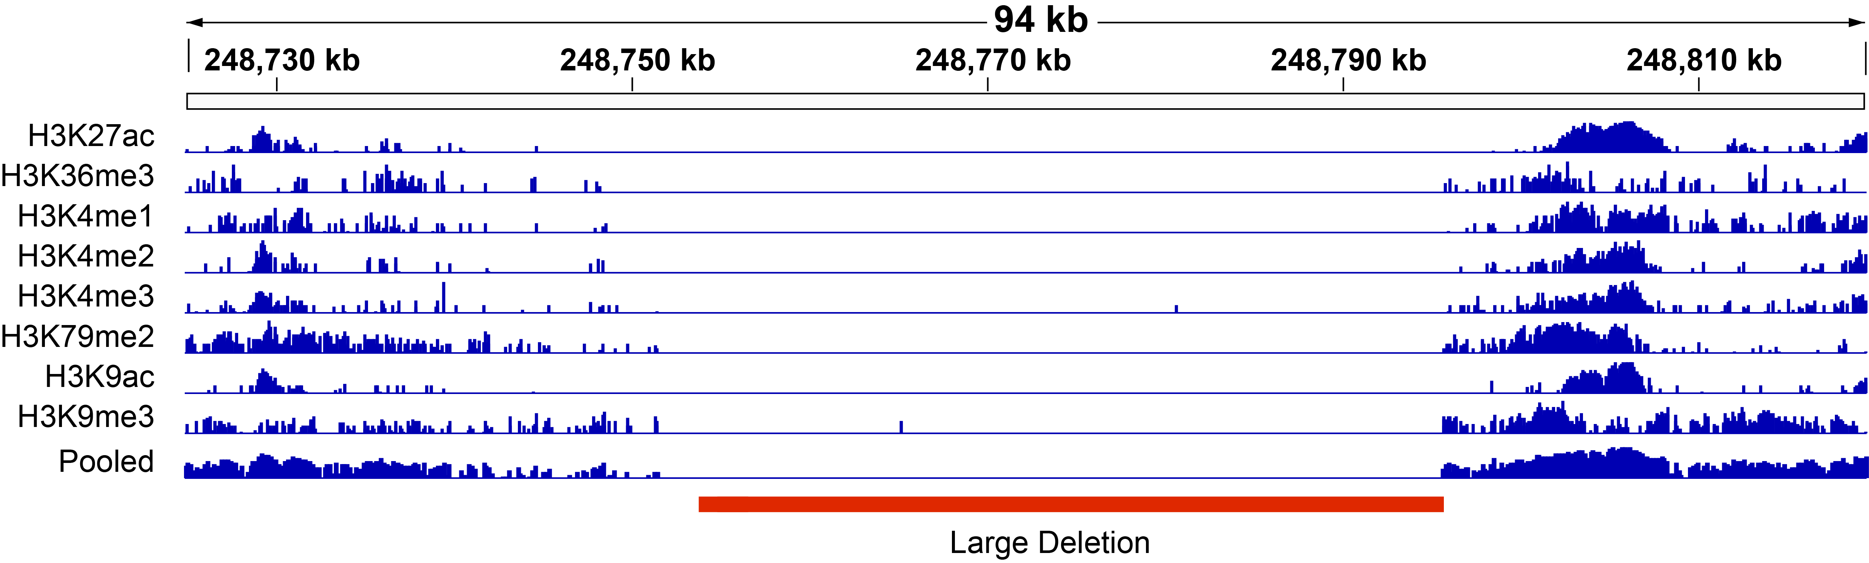
Example of Large Deletion Evident in Signal Profile
[Harmanci & Gerstein, Nat. Comm. (‘18)]

Slide 67
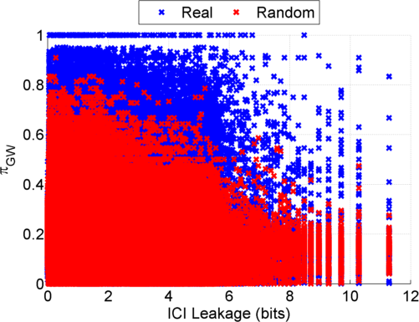
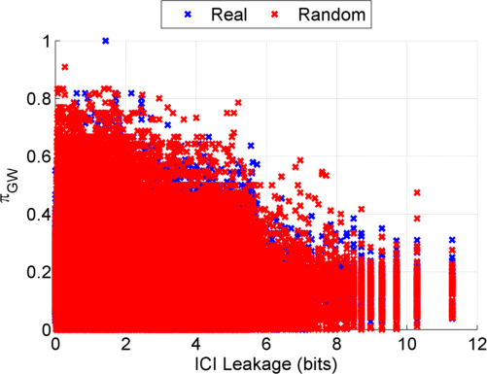
Information Leakage from SV Deletions
Before Anonymization
b) After Anonymization
Simple anonymization procedure (filling in deletion by value at endpoints) has dramatic effect
[Harmanci & Gerstein, Nat. Comm. (‘18)]
Notes:
GEUVADIS ICI-\Pi_GW estimates:

Slide 68
Another type of Linking Attack:
Linking based on SV Genotyping
[Harmanci & Gerstein, Nat. Comm. (‘18)]

Slide 69
Another type of Linking Attack:
First Doing SV Genotyping
[Harmanci & Gerstein, Nat. Comm. (‘18)]

Slide 70
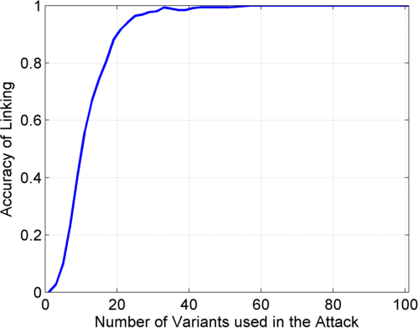

Linking Attack Based on SV Deletions in gEUVADIS Dataset
c) Genotyping
(1kG MAF>0.01)
d) Discovery + Genotyping
Sorted in Decreasing
Predictability
Sorted in Decreasing
Predictability
[Harmanci & Gerstein, Nat. Comm. (‘18)]

Slide 71
Using population-scale functional genomics to understand neuropsychiatic disease
& interpreting the data exhaust from this activity
[Core] PsychENCODE: Population-level analysis of functional genomics data related to neuropsychiatric disease
  Construction of an adult brain resource with 1866 individuals + dev. time-course
  Using the changing proportions of cell types (via single-cell deconvolution) to account for expression variation across a population,
  disorders & development
  Large-scale processing defines ~79K PFC
  enhancers & creates a comprehensive QTL resource (~2.5M eQTLs + cQTLs & fQTLs)
  Connecting QTLs, enhancer activity relationships & Hi-C into a
  brain regulatory network & using this to link SCZ GWAS SNPs to genes
  Embedding the reg. network in a
  deep-learning model to predict disease from genotype & transcriptome. Using this to suggest specific pathways & genes, as targets.
  [Exhaust] Other uses for the resource
    Highlighting aging related genes + consistently comparing the brain to other organs
[Exhaust] Genomic Privacy
  The Dilemma
    The genome as fundamental, inherited info that’s very private v. need for large-scale mining for med. research
    2-sided nature of RNA-seq presents tricky privacy issues
  eQTLs: Quantifying & removing variant info from expression levels with ICI & predictability. Instantiating a practical linking attack with noisy quasi-identifiers
  Signal Profiles: Manifest appreciable leakage from large & small deletions. Linking attacks possible but additional complication of SV discovery in addition to genotyping

Slide 72
Using population-scale functional genomics to understand neuropsychiatic disease
& interpreting the data exhaust from this activity
[Core] PsychENCODE: Population-level analysis of functional genomics data related to neuropsychiatric disease
  Construction of an adult brain resource with 1866 individuals + dev. time-course
  Using the changing proportions of cell types (via single-cell deconvolution) to account for expression variation across a population,
  disorders & development
  Large-scale processing defines ~79K PFC
  enhancers & creates a comprehensive QTL resource (~2.5M eQTLs + cQTLs & fQTLs)
  Connecting QTLs, enhancer activity relationships & Hi-C into a
  brain regulatory network & using this to link SCZ GWAS SNPs to genes
  Embedding the reg. network in a
  deep-learning model to predict disease from genotype & transcriptome. Using this to suggest specific pathways & genes, as targets.
  [Exhaust] Other uses for the resource
    Highlighting aging related genes + consistently comparing the brain to other organs
[Exhaust] Genomic Privacy
  The Dilemma
    The genome as fundamental, inherited info that’s very private v. need for large-scale mining for med. research
    2-sided nature of RNA-seq presents tricky privacy issues
  eQTLs: Quantifying & removing variant info from expression levels with ICI & predictability. Instantiating a practical linking attack with noisy quasi-identifiers
  Signal Profiles: Manifest appreciable leakage from large & small deletions. Linking attacks possible but additional complication of SV discovery in addition to genotyping

Slide 73
PsychENCODE Acknowledgment
“Adult Capstone” Team – 1 of 3 capstones
Daifeng Wang, Shuang Liu, Jonathan Warrell, Hyejung Won, Xu Shi, Fabio Navarro, Declan Clarke, Mengting Gu, Prashant Emani, Yucheng T. Yang, Min Xu, Michael Gandal, Shaoke Lou, Jing Zhang, Jonathan J. Park, Chengfei Yan, Suhn Kyong Rhie, Kasidet Manakongtreecheep, Holly Zhou, Aparna Nathan, Mette Peters, Eugenio Mattei, Dominic Fitzgerald, Tonya Brunetti, Jill Moore, Yan Jiang, Kiran Girdhar, Gabriel Hoffman, Selim Kalayci, Zeynep Hulya Gumus, Greg Crawford,
PsychENCODE Consortium,
Panos Roussos, Schahram Akbarian, Andrew E. Jaffe, Kevin White, Zhiping Weng, Nenad Sestan,
Daniel H. Geschwind, James A. Knowles
Geetha Senthil
Lora Bingaman
David Panchision
Alexander Arguello
Thomas Lehner
Dedicated to Pamela Sklar
Resource.psychencode.org
The PsychENCODE Consortium: Allison E Ashley-Koch, Duke University; Gregory E Crawford, Duke University; Melanie E Garrett, Duke University; Lingyun Song, Duke University; Alexias Safi, Duke University; Graham D Johnson, Duke University; Gregory A Wray, Duke University; Timothy E Reddy, Duke University; Fernando S Goes, Johns Hopkins University; Peter Zandi, Johns Hopkins University; Julien Bryois, Karolinska Institutet; Andrew E Jaffe, Lieber Institute for Brain Development; Amanda J Price, Lieber Institute for Brain Development; Nikolay A Ivanov, Lieber Institute for Brain Development; Leonardo Collado-Torres, Lieber Institute for Brain Development; Thomas M Hyde, Lieber Institute for Brain Development; Emily E Burke, Lieber Institute for Brain Development; Joel E Kleiman, Lieber Institute for Brain Development; Ran Tao, Lieber Institute for Brain Development; Joo Heon Shin, Lieber Institute for Brain Development; Schahram Akbarian, Icahn School of Medicine at Mount Sinai; Kiran Girdhar, Icahn School of Medicine at Mount Sinai; Yan Jiang, Icahn School of Medicine at Mount Sinai; Marija Kundakovic, Icahn School of Medicine at Mount Sinai; Leanne Brown, Icahn School of Medicine at Mount Sinai; Bibi S Kassim, Icahn School of Medicine at Mount Sinai; Royce B Park, Icahn School of Medicine at Mount Sinai; Jennifer R Wiseman, Icahn School of Medicine at Mount Sinai; Elizabeth Zharovsky, Icahn School of Medicine at Mount Sinai; Rivka Jacobov, Icahn School of Medicine at Mount Sinai; Olivia Devillers, Icahn School of Medicine at Mount Sinai; Elie Flatow, Icahn School of Medicine at Mount Sinai; Gabriel E Hoffman, Icahn School of Medicine at Mount Sinai; Barbara K Lipska, Human Brain Collection Core, National Institutes of Health, Bethesda, MD; David A Lewis, University of Pittsburgh; Vahram Haroutunian, Icahn School of Medicine at Mount Sinai and James J Peters VA Medical Center; Chang-Gyu Hahn, University of Pennsylvania; Alexander W Charney, Mount Sinai; Stella Dracheva, Mount Sinai; Alexey Kozlenkov, Mount Sinai; Judson Belmont, Icahn School of Medicine at Mount Sinai; Diane DelValle, Icahn School of Medicine at Mount Sinai; Nancy Francoeur, Icahn School of Medicine at Mount Sinai; Evi Hadjimichael, Icahn School of Medicine at Mount Sinai; Dalila Pinto, Icahn School of Medicine at Mount Sinai; Harm van Bakel, Icahn School of Medicine at Mount Sinai; Panos Roussos, Mount Sinai; John F Fullard, Mount Sinai; Jaroslav Bendl, Mount Sinai; Mads E Hauberg, Mount Sinai; Lara M Mangravite, Sage Bionetworks; Mette A Peters, Sage Bionetworks; Yooree Chae, Sage Bionetworks; Junmin Peng, St. Jude Children's Hospital; Mingming Niu, St. Jude Children's Hospital; Xusheng Wang, St. Jude Children's Hospital; Maree J Webster, Stanley Medical Research Institute; Thomas G Beach, Banner Sun Health Research Institute; Chao Chen, Central South University; Yi Jiang, Central South University; Rujia Dai, Central South University; Annie W Shieh, SUNY Upstate Medical University; Chunyu Liu, SUNY Upstate Medical University; Kay S. Grennan, SUNY Upstate Medical University; Yan Xia, SUNY Upstate Medical University/Central South University; Ramu Vadukapuram, SUNY Upstate Medical University; Yongjun Wang, Central South University; Dominic Fitzgerald, The University of Chicago; Lijun Cheng, The University of Chicago; Miguel Brown, The University of Chicago; Mimi Brown, The University of Chicago; Tonya Brunetti, The University of Chicago; Thomas Goodman, The University of Chicago; Majd Alsayed, The University of Chicago; Michael J Gandal, University of California, Los Angeles; Daniel H Geschwind, University of California, Los Angeles; Hyejung Won, University of California, Los Angeles; Damon Polioudakis, University of California, Los Angeles; Brie Wamsley, University of California, Los Angeles; Jiani Yin, University of California, Los Angeles; Tarik Hadzic, University of California, Los Angeles; Luis De La Torre Ubieta, UCLA; Vivek Swarup, University of California, Los Angeles; Stephan J Sanders, University of California, San Francisco; Matthew W State, University of California, San Francisco; Donna M Werling, University of California, San Francisco; Joon-Yong An, University of California, San Francisco; Brooke Sheppard, University of California, San Francisco; A Jeremy Willsey, University of California, San Francisco; Kevin P White, The University of Chicago; Mohana Ray, The University of Chicago; Gina Giase, SUNY Upstate Medical University; Amira Kefi, University of Illinois at Chicago; Eugenio Mattei, University of Massachusetts Medical School; Michael Purcaro, University of Massachusetts Medical School; Zhiping Weng, University of Massachusetts Medical School; Jill Moore, University of Massachusetts Medical School; Henry Pratt, University of Massachusetts Medical School; Jack Huey, University of Massachusetts Medical School; Tyler Borrman, University of Massachusetts Medical School; Patrick F Sullivan, University of North Carolina - Chapel Hill; Paola Giusti-Rodriguez, University of North Carolina - Chapel Hill; Yunjung Kim, University of North Carolina - Chapel Hill; Patrick Sullivan, University of North Carolina - Chapel Hill; Jin Szatkiewicz, University of North Carolina - Chapel Hill; Suhn Kyong Rhie, University of Southern California; Christoper Armoskus, University of Southern California; Adrian Camarena, University of Southern California; Peggy J Farnham, University of Southern California; Valeria N Spitsyna, University of Southern California; Heather Witt, University of Southern California; Shannon Schreiner, University of Southern California; Oleg V Evgrafov, SUNY Downstate Medical Center; James A Knowles, SUNY Downstate Medical Center; Mark Gerstein, Yale University; Shuang Liu, Yale University; Daifeng Wang, Stony Brook University; Fabio C. P. Navarro, Yale University; Jonathan Warrell, Yale University; Declan Clarke, Yale University; Prashant S. Emani, Yale University; Mengting Gu, Yale University; Xu Shi, Yale University; Min Xu, Yale University; Yucheng T. Yang, Yale University; Robert R. Kitchen, Yale University; Gamze Gürsoy, Yale University; Jing Zhang, Yale University; Becky C Carlyle, Yale University; Angus C Nairn, Yale University; Mingfeng Li, Yale University; Sirisha Pochareddy, Yale University; Nenad Sestan, Yale University; Mario Skarica, Yale University; Zhen Li, Yale University; Andre M.M. Sousa, Yale University; Gabriel Santpere, Yale University; Jinmyung Choi, Yale University; Ying Zhu, Yale University; Tianliuyun Gao, Yale University; Daniel J Miller, Yale University; Adriana Cherskov, Yale University; Mo Yang, Yale University; Anahita Amiri, Yale University; Gianfilippo Coppola, Yale University; Jessica Mariani, Yale University; Soraya Scuderi, Yale University; Anna Szekely, Yale University; Flora M Vaccarino, Yale University; Feinan Wu, Yale University; Sherman Weissman, Yale University; Tanmoy Roychowdhury, Mayo Clinic Rochester; Alexej Abyzov, Mayo Clinic Rochester;.

Slide 74
Developmental Capstone
M Li, G Santpere, Y Imamura Kawasawa,
OV Evgrafov, FO Gulden, S Pochareddy,
SM Sunkin, Z Li, Y Shin,
Y Zhu, AMM Sousa, DM Werling, RR Kitchen, HJ Kang, M Pletikos, J Choi, S Muchnik, X Xu, D Wang, B Lorente-Galdos, S Liu, P Giusti-Rodriguez, H Won, CA de Leeuw, AF Pardinas, BrainSpan Consortium, PsychENCODE Consortium,
PsychENCODE Developmental Subgroup,
M Hu, F Jin, Y Li, MJ Owen, MC O'Donovan, JTR Walters, D Posthuma, MA Reimers, P Levitt, DR Weinberger, TM Hyde, JE Kleinman, DH Geschwind, MJ Hawrylycz, MW State, SJ Sanders, PF Sullivan,
ES Lein, JA Knowles, N Sestan
psychencode.org

Slide 75

Acknowledgements
papers.gersteinlab.org/subject/privacy
PrivaSig.gersteinlab.org
PrivaSeq.gersteinlab.org
A Harmanci,
D Greenbaum, G Gürsoy
Hiring Postdocs. See JOBS.gersteinlab.org !

Slide 76

Extra

Slide 77
Info about content in this slide pack
General PERMISSIONS
  This Presentation is copyright Mark Gerstein,
  Yale University, 2017.
  Please read permissions statement at
  www.gersteinlab.org/misc/permissions.html .
  Feel free to use slides & images in the talk with PROPER acknowledgement
  (via citation to relevant papers or link to gersteinlab.org).
  Paper references in the talk were mostly from Papers.GersteinLab.org.
PHOTOS & IMAGES. For thoughts on the source and permissions of many of the photos and clipped images in this presentation see http://streams.gerstein.info .
  In particular, many of the images have particular EXIF tags, such as kwpotppt , that can be easily queried from flickr, viz: http://www.flickr.com/photos/mbgmbg/tags/kwpotppt

