Slide 1
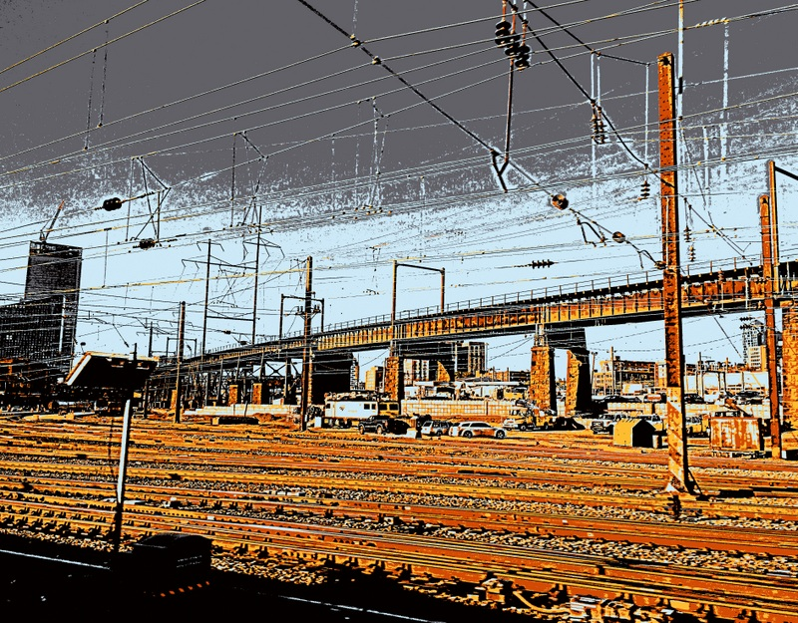

Disease Genomics: Thoughts on Genome Annotation, Prioritizing Variants, Highlighting Dysregulation & the Application of all of these to Cancer
Mark Gerstein
Yale
Slides freely downloadable from Lectures.GersteinLab.org & “tweetable” (via @MarkGerstein).
No Conflicts for this Talk. See last slide for more info.

Slide 2
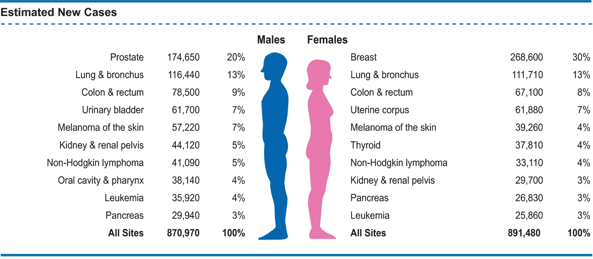

Estimated numbers of new cases of invasive cancer in the United States in 2019 by sex and cancer type
1,762,450 new cases per year
$\sim$4,800 new cases per day
Segiel et al, Cancer statistics, 2019
Notes:
No friends or relatives

Slide 3

Much Interest in Precision Oncology
Analysis of the exact somatic mutations in a individual
Highlighting key mutations
Targeting treatment
What if matching a cancer cure to our genetic code was just as easy
https://obamawhitehouse.archives.gov/blog/2016/02/25/precision-medicine-health-care-tailored-you

Slide 4

Overall Problem:
Finding Key Variants in
Personal Genomes
CAN YOU FIND THE PANDA?
  Millions of variants in a personal genome
  Thousands, in a cancer genome
  Different contexts for prioritization
  In rare disease, only a few
  high-impact variants are associated with disease
  In cancer, a few positively selected drivers amongst many passengers
  In common disease, more variants associated & each has weaker effect,
  But one wants to find key ”functional” variant amongst many in LD
Notes:
4

Slide 5
Overall Problem:
Finding Key Variants in
Personal Genomes
CAN YOU FIND THE PANDA?
  Millions of variants in a personal genome
  Thousands, in a cancer genome
  Different contexts for prioritization
  In rare disease, only a few
  high-impact variants are associated with disease
  In cancer, a few positively selected drivers amongst many passengers
  In common disease, more variants associated & each has weaker effect,
  But one wants to find key ”functional” variant amongst many in LD
  Thus: Need to find & prioritize high impact variants.
  Particularly hard for non-coding regions.
Notes:
5

Slide 6
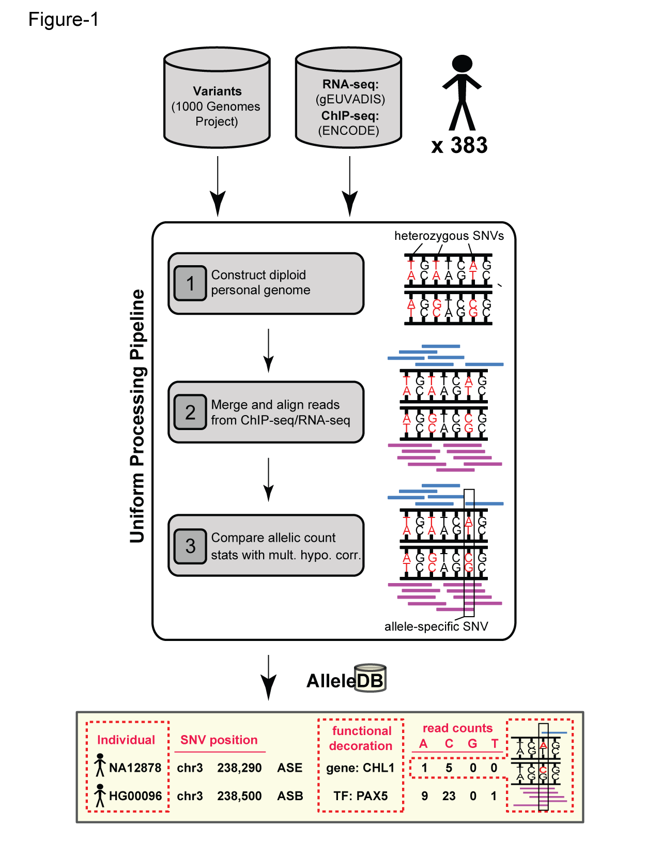


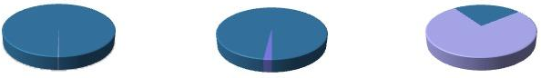
Human Genetic Variation
Population of
2,504 peoples
A Cancer Genome
A Typical Genome
Origin of Variants
Class of Variants
 | Coding | Non- coding
Germ- line | 22K | 4.1 – 5M
Somatic | ~50 | 5K
SNP | 3.5 – 4.3M
Indel | 550 – 625K
SV | 2.1 – 2.5K (20Mb)
Total | 4.1 – 5M
SNP | 84.7M
Indel | 3.6M
SV | 60K
Total | 88.3M
Prevalence of Variants
Common
Common
Passenger
Driver (~0.1%)
Rare* (1-4%)
Rare (~75%)
* Variants with allele frequency < 0.5% are considered as rare variants in 1000 genomes project.
The 1000 Genomes Project Consortium, Nature. 2015. 526:68-74
Khurana E. et al. Nat. Rev. Genet. 2016. 17:93-108

Slide 7
Disease Genomics: Thoughts on Genome Annotation, Prioritizing Variants, Highlighting Dysregulation, & the Application of all of these to Cancer
Background
  PMI & Variant Prioritization
  Types of annotations: peaks, segmentations, regulators
  Genomic covariates
  ENCODEC: ENCODE cancer annotation resource
Matched Filter Annotation
  Integrating cross-assay signal-track patterns associated with enhancers
  Trained on high throughput STARR-seq experiments
  Validation in many different contexts
FunSeq Prioritization
  Integrates evidence, with a “surprisal” based weighting scheme.
  Prioritizing variants within “sensitive sites” (human conserved)
RADAR Prioritization
  Adapts FunSeq approach to RBPs
  Prioritizes variants based on post-transcriptional regulome using ENCODE eCLIP
  Incorporates new features related to RNA sec. struc & tissue specific effects
uORF Prioritization
  Feature integration to find small subset of upstream mutations that potentially alter translation
LARVA & MOAT
  Uses parametric beta-binomial model, explicitly modeling genomic covariates
  Non-parametric shuffles. Useful when explicit covariates not available.
Network Rewiring
  Network rewiring highlights regulators that change their targets greatly.
  LDA approach specifically finds those that greatly change their gene communities
Regulatory Drivers of Differential Expression
  Highlighting regulators in terms of their power to drive differential expression.
  Relationship of this to network hierarchy & RBP-TF cross talk
  Example of MYC & SUB1

Slide 8
Disease Genomics: Thoughts on Genome Annotation, Prioritizing Variants, Highlighting Dysregulation, & the Application of all of these to Cancer
Background
  PMI & Variant Prioritization
  Types of annotations: peaks, segmentations, regulators
  Genomic covariates
  ENCODEC: ENCODE cancer annotation resource
Matched Filter Annotation
  Integrating cross-assay signal-track patterns associated with enhancers
  Trained on high throughput STARR-seq experiments
  Validation in many different contexts
FunSeq Prioritization
  Integrates evidence, with a “surprisal” based weighting scheme.
  Prioritizing variants within “sensitive sites” (human conserved)
RADAR Prioritization
  Adapts FunSeq approach to RBPs
  Prioritizes variants based on post-transcriptional regulome using ENCODE eCLIP
  Incorporates new features related to RNA sec. struc & tissue specific effects
uORF Prioritization
  Feature integration to find small subset of upstream mutations that potentially alter translation
LARVA & MOAT
  Uses parametric beta-binomial model, explicitly modeling genomic covariates
  Non-parametric shuffles. Useful when explicit covariates not available.
Network Rewiring
  Network rewiring highlights regulators that change their targets greatly.
  LDA approach specifically finds those that greatly change their gene communities
Regulatory Drivers of Differential Expression
  Highlighting regulators in terms of their power to drive differential expression.
  Relationship of this to network hierarchy & RBP-TF cross talk
  Example of MYC & SUB1

Slide 9
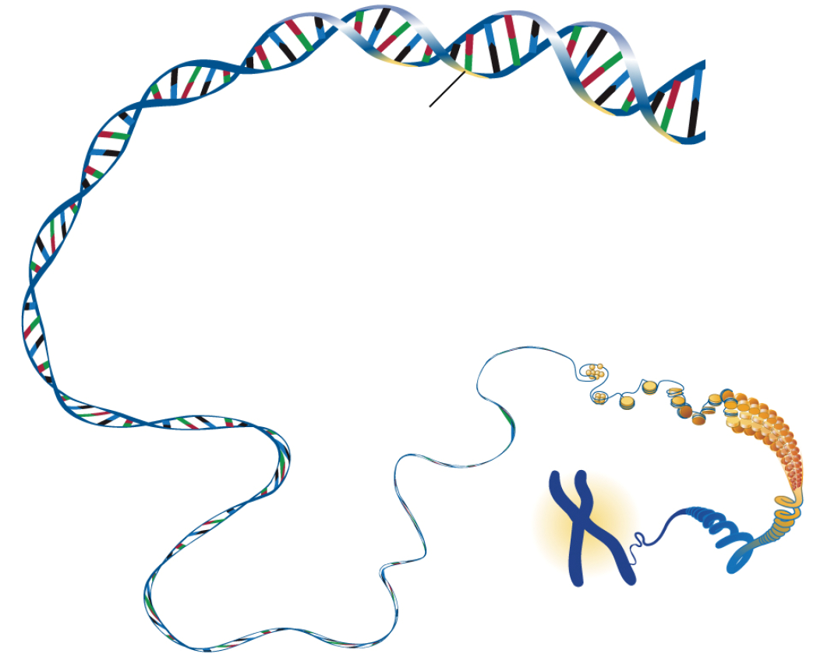
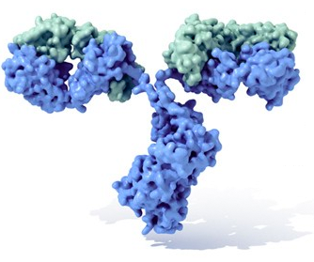





Protein Coding Regions:
Part of the genome we can “see”
< 2% of the genome
DNA
Human Genome: 3 billion base pairs
Gene
The Noncoding Regions: Dark Matter in the Genome
>98% of the genome
Host ~90% of disease risk loci
contains extensive regulatory information
Gene
$$⋮$$
$$⋮$$
$$⋮$$
$$⋮$$
$$⋮$$
$$⋮$$
$$⋮$$
G
G
G
G
G
G
G
C
C
C
C
C
C
C
T
A
T
G
G
G
T
$$⋮$$
$$⋮$$
$$⋮$$
$$⋮$$
$$⋮$$
$$⋮$$
$$⋮$$
C
C
C
C
C
C
C
Reference Genome
C
C
C
C
C
C
C
A
T
T
T
A
A
C
$$⋮$$
$$⋮$$
$$⋮$$
$$⋮$$
$$⋮$$
$$⋮$$
$$⋮$$
C
C
C
C
C
C
C
G
G
G
G
G
T
G
$$⋮$$
$$⋮$$
$$⋮$$
$$⋮$$
$$⋮$$
$$⋮$$
$$⋮$$
Image adapted from NHGRI
Greenbaum & Gerstein, Cell 15’
Notes:
what is exome
what is annotation
what is variant
gwas： ？

Slide 10
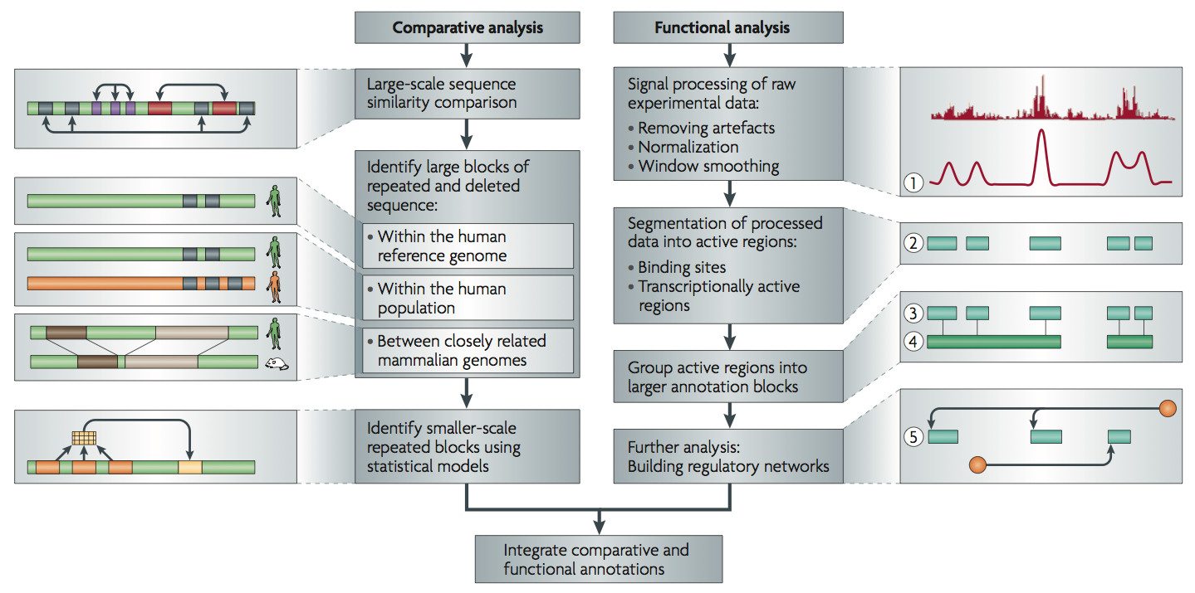
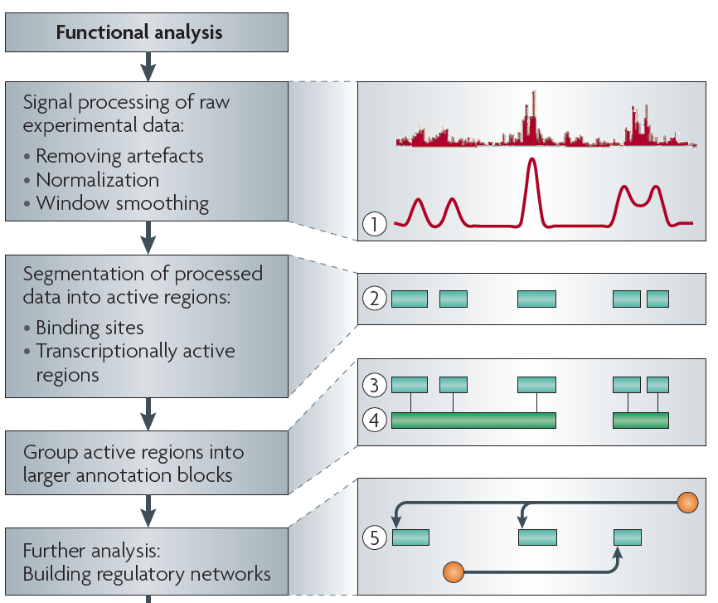
Non-coding Annotations: Overview
Features are often present on multiple ”scale” (eg elements and connected networks)
Sequence features, incl. Conservation
Functional Genomics
Chip-seq (Epigenome & seq. specific TF) and ncRNA & un-annotated transcription
[Alexander et al., Nat. Rev. Genet. (’10)]

Slide 11
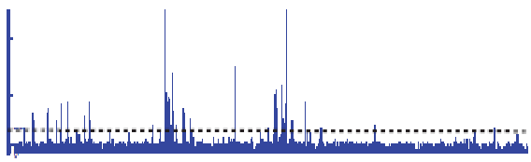

Summarizing the Signal:
"Traditional" ChipSeq Peak Calling
ChIP
Generate & threshold the signal profile to identify candidate target regions
  Simulation (PeakSeq),
  Local window based Poisson (MACS),
  Fold change statistics (SPP)
Threshold
Potential Targets
Normalized Control
Score against the control
Significantly Enriched targets
Now an update: "PeakSeq 2" => MUSIC
[Rozowsky et al. ('09) Nat Biotech]

Slide 12
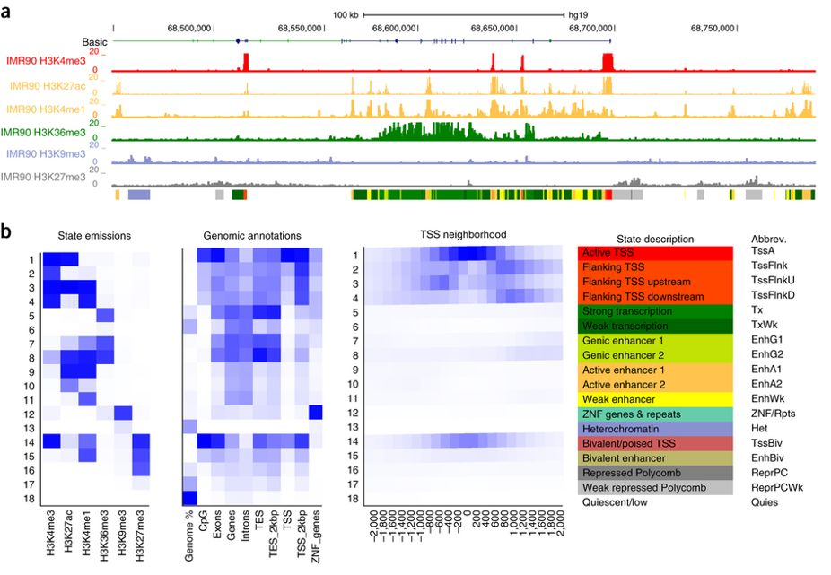
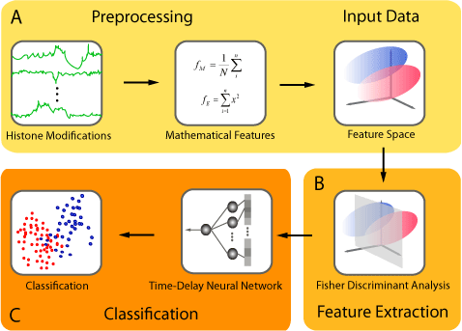
Background on computationally annotation
Peak calling:
  PeakSeq, SPP, MACS2, Hotspot …
  ENCODE Encyclopedia
Genome segmentation: partition the genome into regions (states) with distinct epigenomic profiles, then assign each state a functional label.
  ChromHMM: Multivariate Hidden Markov Model
  Segway: Dynamic Bayesian Network Model
Supervised regulatory prediction: learn predictive models from labeled dataset of regulatory elements.
  CSI-ANN: Time-Delay Neural Network
  RFECS: Random Forest
  DEEP: Ensemble SVM + Artificial Neural Network
  REPTILE: Random Forest
  gkm-SVM: Gapped k-mer
Target finding
  Ripple, TargetFinder, JEME, PreSTIGE, IM-PET
ChromHMM
J. Ernst, M. Kellis. Nat. Protoc., 2017
CSI-ANN
H.A. Firpi, D. Ucar, K. Tian. Bioinformatics, 2010

Slide 13
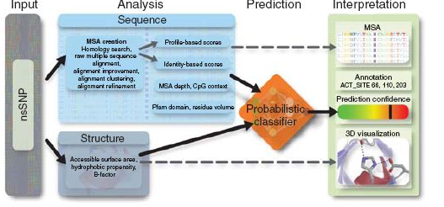
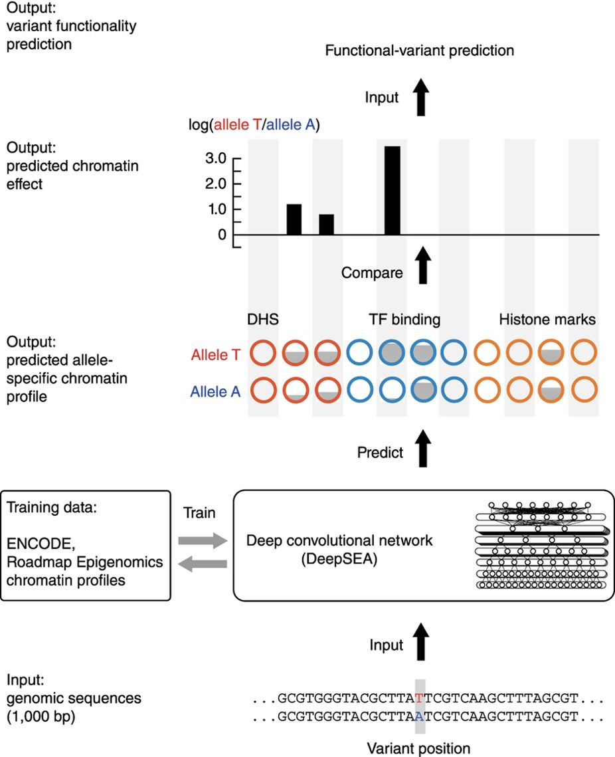
Genetic variant annotation: coding and noncoding
Tools developed specifically for coding variants:
  PolyPhen-2
  SnpEff
  SIFT
  ...
Tools developed specifically for noncoding variants:
  RegulomeDB
  HaploReg
  DeepSEA
  GWAVA
  ...
Tools for both coding and noncoding variants:
  CADD
  ANNOVAR
  VEP
  FATHMM-MKL
  ….
Polyphen-2
I.A. Adzhubei, et al. Nat. Methods, 2010
DeepSEA
J. Zhou, O.G. Troyanskaya, Nat. Methods, 2015

Slide 14
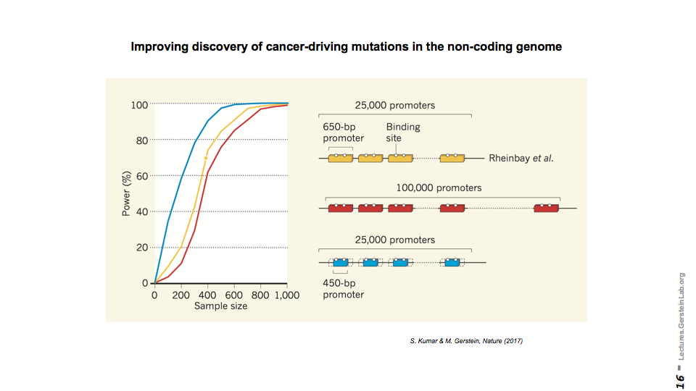
Major takeaway from annotation experience for disease studies: less is more
[Kumar & Gerstein, Nature ('17)]
Example of power issue in disease studies
Disease | Scale
rare | a few with high impact
common | many with weak effect
cancer | a few drivers

Slide 15
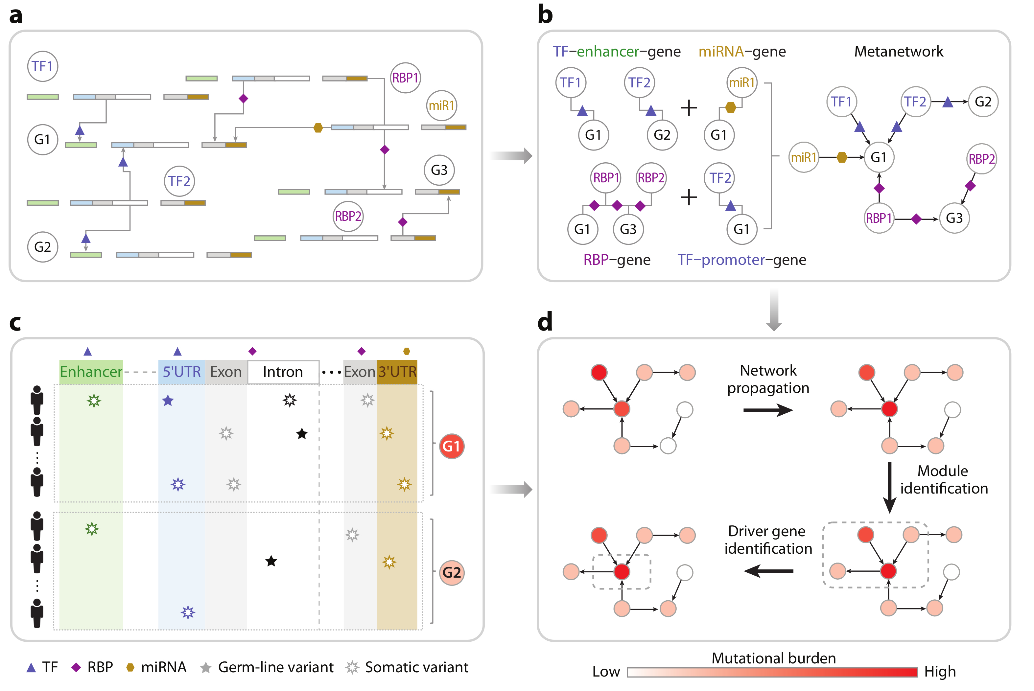
Coding and non-coding elements may synergistically contribute to cancer
[McGillivray et al., Ann. Rev. Biomedical Data Science (‘18)]

Slide 16


Major
Challenges:
Many levels of dysregulations related to disease status
A Multi-scale View of gene regulation
3
5
Regulator$↔$regulator
co-regulation network
1
4
Regulator to target gene
directional
2
Regulator co-regulation
unidirectional
Regulator$→$gene
regulatory network
Regulator
gene
gene
gene
Regulatory Element function (on/off)
Active proximal elements
Active distal elements
Inactive proximal elements
inactive distal elements
Gene expression
(high/low)
gene
gene
gene
gene
Epigenetic information
$⋯$AGCTTTACGATCCCGAAATCTGCTTTATACGATCCCGAAATC $⋯$
DNA nucleotide

Slide 17
Disease Genomics: Thoughts on Genome Annotation, Prioritizing Variants, Highlighting Dysregulation, & the Application of all of these to Cancer
Background
  PMI & Variant Prioritization
  Types of annotations: peaks, segmentations, regulators
  Genomic covariates
  ENCODEC: ENCODE cancer annotation resource
Matched Filter Annotation
  Integrating cross-assay signal-track patterns associated with enhancers
  Trained on high throughput STARR-seq experiments
  Validation in many different contexts
FunSeq Prioritization
  Integrates evidence, with a “surprisal” based weighting scheme.
  Prioritizing variants within “sensitive sites” (human conserved)
RADAR Prioritization
  Adapts FunSeq approach to RBPs
  Prioritizes variants based on post-transcriptional regulome using ENCODE eCLIP
  Incorporates new features related to RNA sec. struc & tissue specific effects
uORF Prioritization
  Feature integration to find small subset of upstream mutations that potentially alter translation
LARVA & MOAT
  Uses parametric beta-binomial model, explicitly modeling genomic covariates
  Non-parametric shuffles. Useful when explicit covariates not available.
Network Rewiring
  Network rewiring highlights regulators that change their targets greatly.
  LDA approach specifically finds those that greatly change their gene communities
Regulatory Drivers of Differential Expression
  Highlighting regulators in terms of their power to drive differential expression.
  Relationship of this to network hierarchy & RBP-TF cross talk
  Example of MYC & SUB1

Slide 18



Mutation recurrence
Cancer Type 1
Cancer Type 2
Cancer Type 3

Slide 19
Mutation recurrence
Cancer Type 1
Cancer Type 2
Cancer Type 3
Early replicated regions
Late replicated regions

Slide 20
Noncoding annotations
Cancer Type 1
Cancer Type 2
Cancer Type 3
Early replicated regions
Late replicated regions

Slide 21
Noncoding annotations
Cancer Type 1
Cancer Type 2
Cancer Type 3
Early replicated regions
Late replicated regions

Slide 22
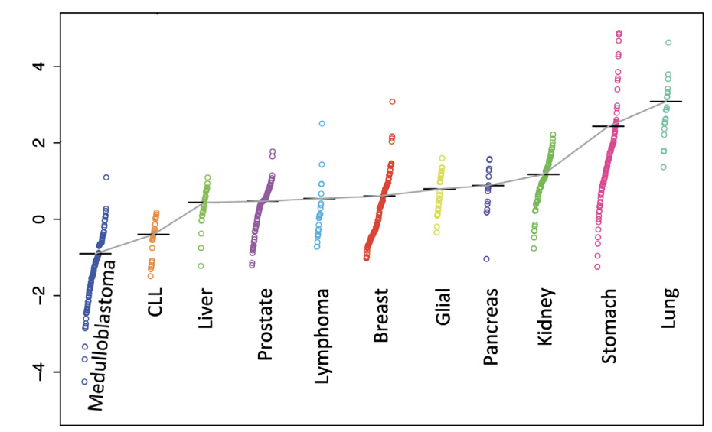
violation of the constant mutation rate assumption
mutation rate changes across tumor
within one tumor type
mutation rate changes across patients
mut. rate. per Mbp
within one tumor type
within one patient
mutation rate changes across regions
within one tumor type
within one patient
rep. timing vs. mut. rate
mutation rate changes with many covariates
inappropriate models
mut. rate. per Mbp
chromatin openness vs. mut. rate
Bad data fitting
Inaccurate burden test results
[Lochovsky et al. NAR (’15)]

Slide 23
Disease Genomics: Thoughts on Genome Annotation, Prioritizing Variants, Highlighting Dysregulation, & the Application of all of these to Cancer
Background
  PMI & Variant Prioritization
  Types of annotations: peaks, segmentations, regulators
  Genomic covariates
  ENCODEC: ENCODE cancer annotation resource
Matched Filter Annotation
  Integrating cross-assay signal-track patterns associated with enhancers
  Trained on high throughput STARR-seq experiments
  Validation in many different contexts
FunSeq Prioritization
  Integrates evidence, with a “surprisal” based weighting scheme.
  Prioritizing variants within “sensitive sites” (human conserved)
RADAR Prioritization
  Adapts FunSeq approach to RBPs
  Prioritizes variants based on post-transcriptional regulome using ENCODE eCLIP
  Incorporates new features related to RNA sec. struc & tissue specific effects
uORF Prioritization
  Feature integration to find small subset of upstream mutations that potentially alter translation
LARVA & MOAT
  Uses parametric beta-binomial model, explicitly modeling genomic covariates
  Non-parametric shuffles. Useful when explicit covariates not available.
Network Rewiring
  Network rewiring highlights regulators that change their targets greatly.
  LDA approach specifically finds those that greatly change their gene communities
Regulatory Drivers of Differential Expression
  Highlighting regulators in terms of their power to drive differential expression.
  Relationship of this to network hierarchy & RBP-TF cross talk
  Example of MYC & SUB1

Slide 24
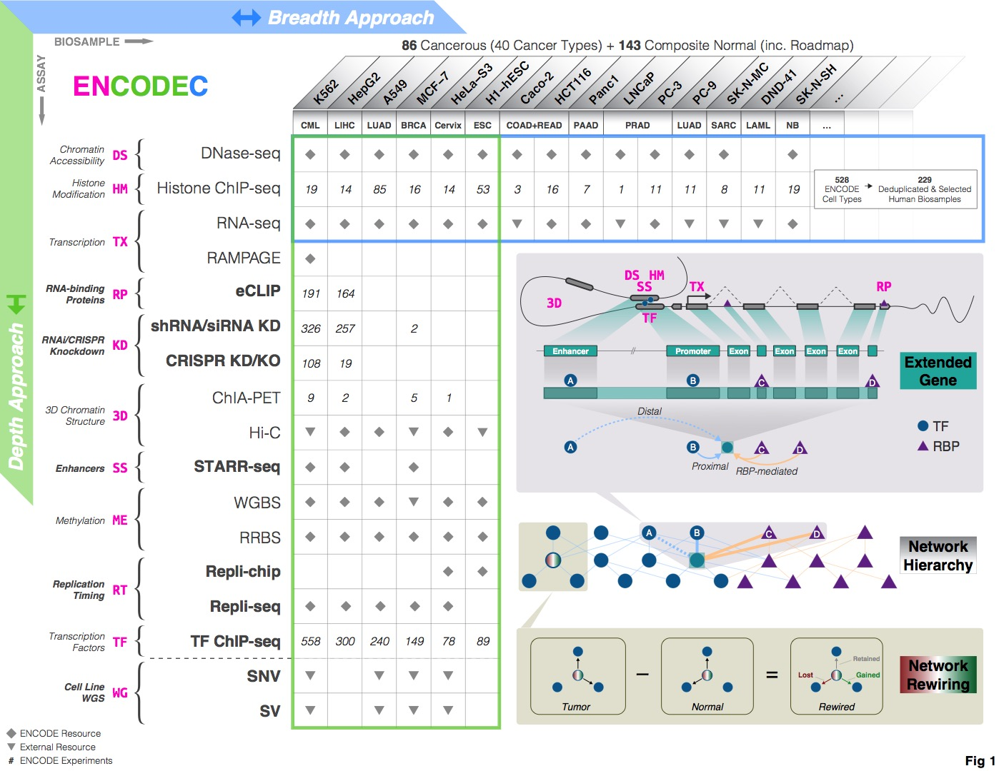
http://encodec.encodeproject.org/
[Zhang et al. ('19), biorxiv.org]

Slide 25
http://encodec.encodeproject.org/
Compact & accurate: Enhancer, promoter, TF/RBP binding
[Zhang et al. ('19), biorxiv.org]

Slide 26
http://encodec.encodeproject.org/
Compact & accurate: Enhancer, promoter, TF/RBP binding
Gene-centric: Extended Genes (proximal & distal)
[Zhang et al. ('19), biorxiv.org]

Slide 27
http://encodec.encodeproject.org/
Compact & accurate: Enhancer, promoter, TF/RBP binding
Gene-centric: Extended Genes (proximal & distal)
[Zhang et al. ('19), biorxiv.org]
Network: Regulatory networks

Slide 28
Disease Genomics: Thoughts on Genome Annotation, Prioritizing Variants, Highlighting Dysregulation, & the Application of all of these to Cancer
Background
  PMI & Variant Prioritization
  Types of annotations: peaks, segmentations, regulators
  Genomic covariates
  ENCODEC: ENCODE cancer annotation resource
Matched Filter Annotation
  Integrating cross-assay signal-track patterns associated with enhancers
  Trained on high throughput STARR-seq experiments
  Validation in many different contexts
FunSeq Prioritization
  Integrates evidence, with a “surprisal” based weighting scheme.
  Prioritizing variants within “sensitive sites” (human conserved)
RADAR Prioritization
  Adapts FunSeq approach to RBPs
  Prioritizes variants based on post-transcriptional regulome using ENCODE eCLIP
  Incorporates new features related to RNA sec. struc & tissue specific effects
uORF Prioritization
  Feature integration to find small subset of upstream mutations that potentially alter translation
LARVA & MOAT
  Uses parametric beta-binomial model, explicitly modeling genomic covariates
  Non-parametric shuffles. Useful when explicit covariates not available.
Network Rewiring
  Network rewiring highlights regulators that change their targets greatly.
  LDA approach specifically finds those that greatly change their gene communities
Regulatory Drivers of Differential Expression
  Highlighting regulators in terms of their power to drive differential expression.
  Relationship of this to network hierarchy & RBP-TF cross talk
  Example of MYC & SUB1

Slide 29
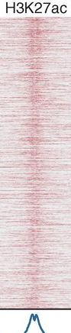
Unique shape associated histone signals flanking active enhancers identified through STARR-seq
Arnold, et al., Science
Shlyueva, et al., Nat Rev Genet
Nie, et al., PloS one

Slide 30
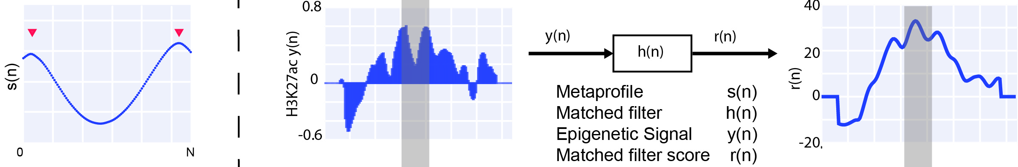
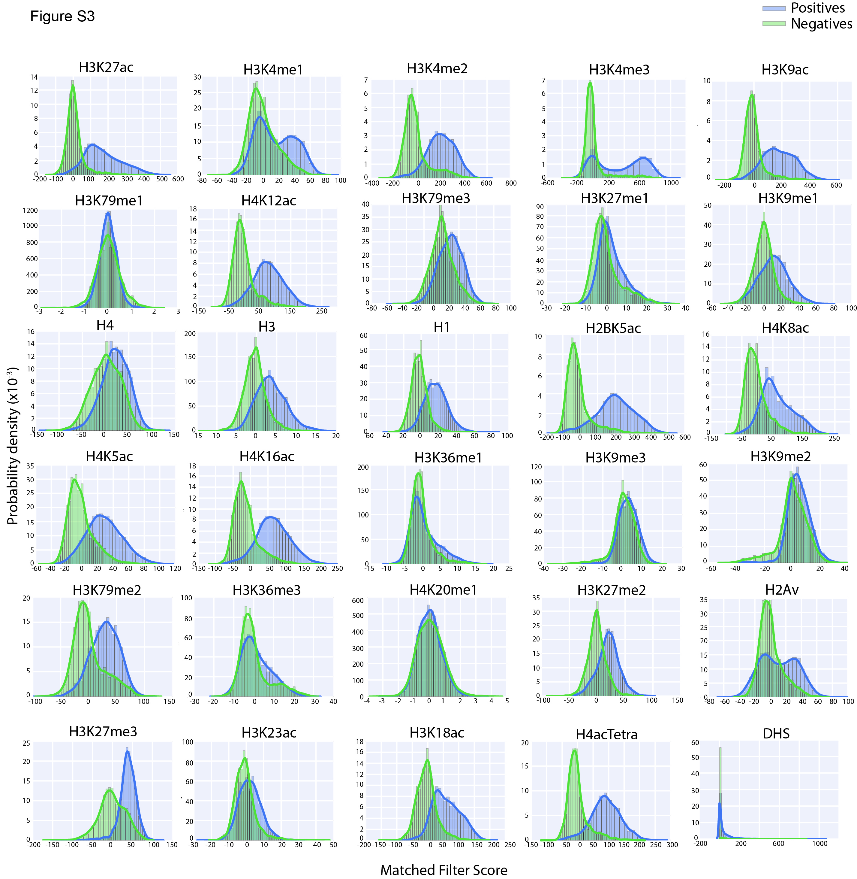
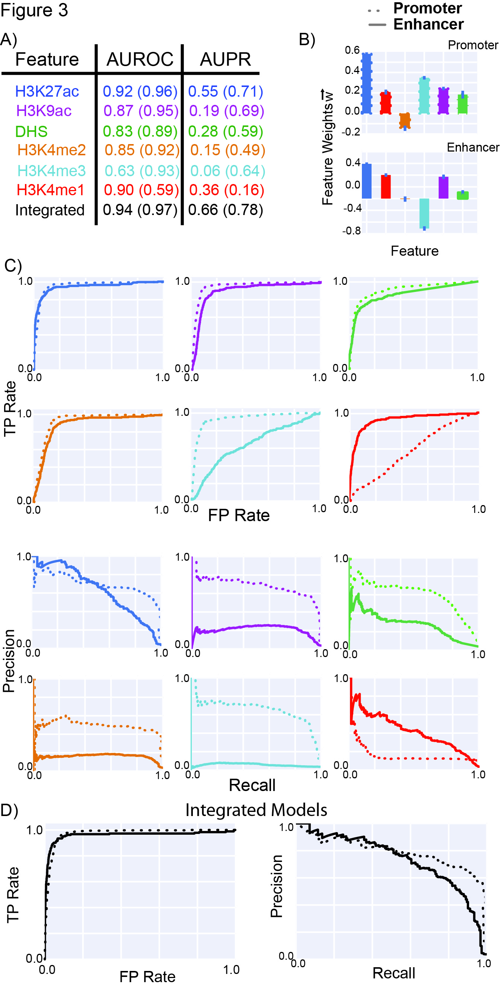
Matched Filter recognize shape patterns
Matched Filter
Score STARR-seq regulatory regions VS random negatives
Evaluate using ROC curve
H3K4me3
H3K4me1
[ biorxiv.org/content/early/2018/08/05/385237 ]

Slide 31
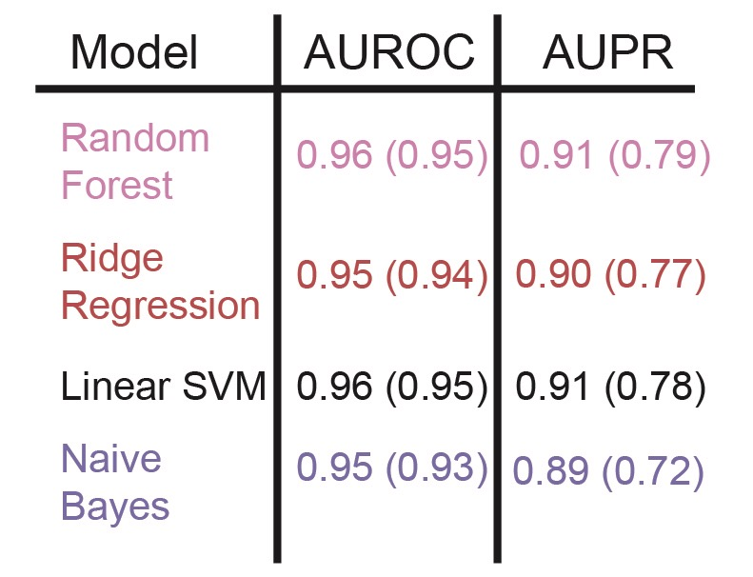
Integrate matched filter scores of multiple features
Large scale STARR-seq experiment data helps to improve the performance of integrated model
Cross validation
[ biorxiv.org/content/early/2018/08/05/385237 ]

Slide 32
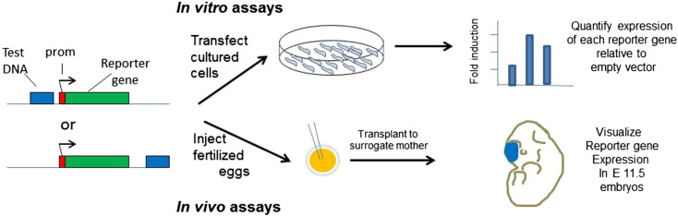
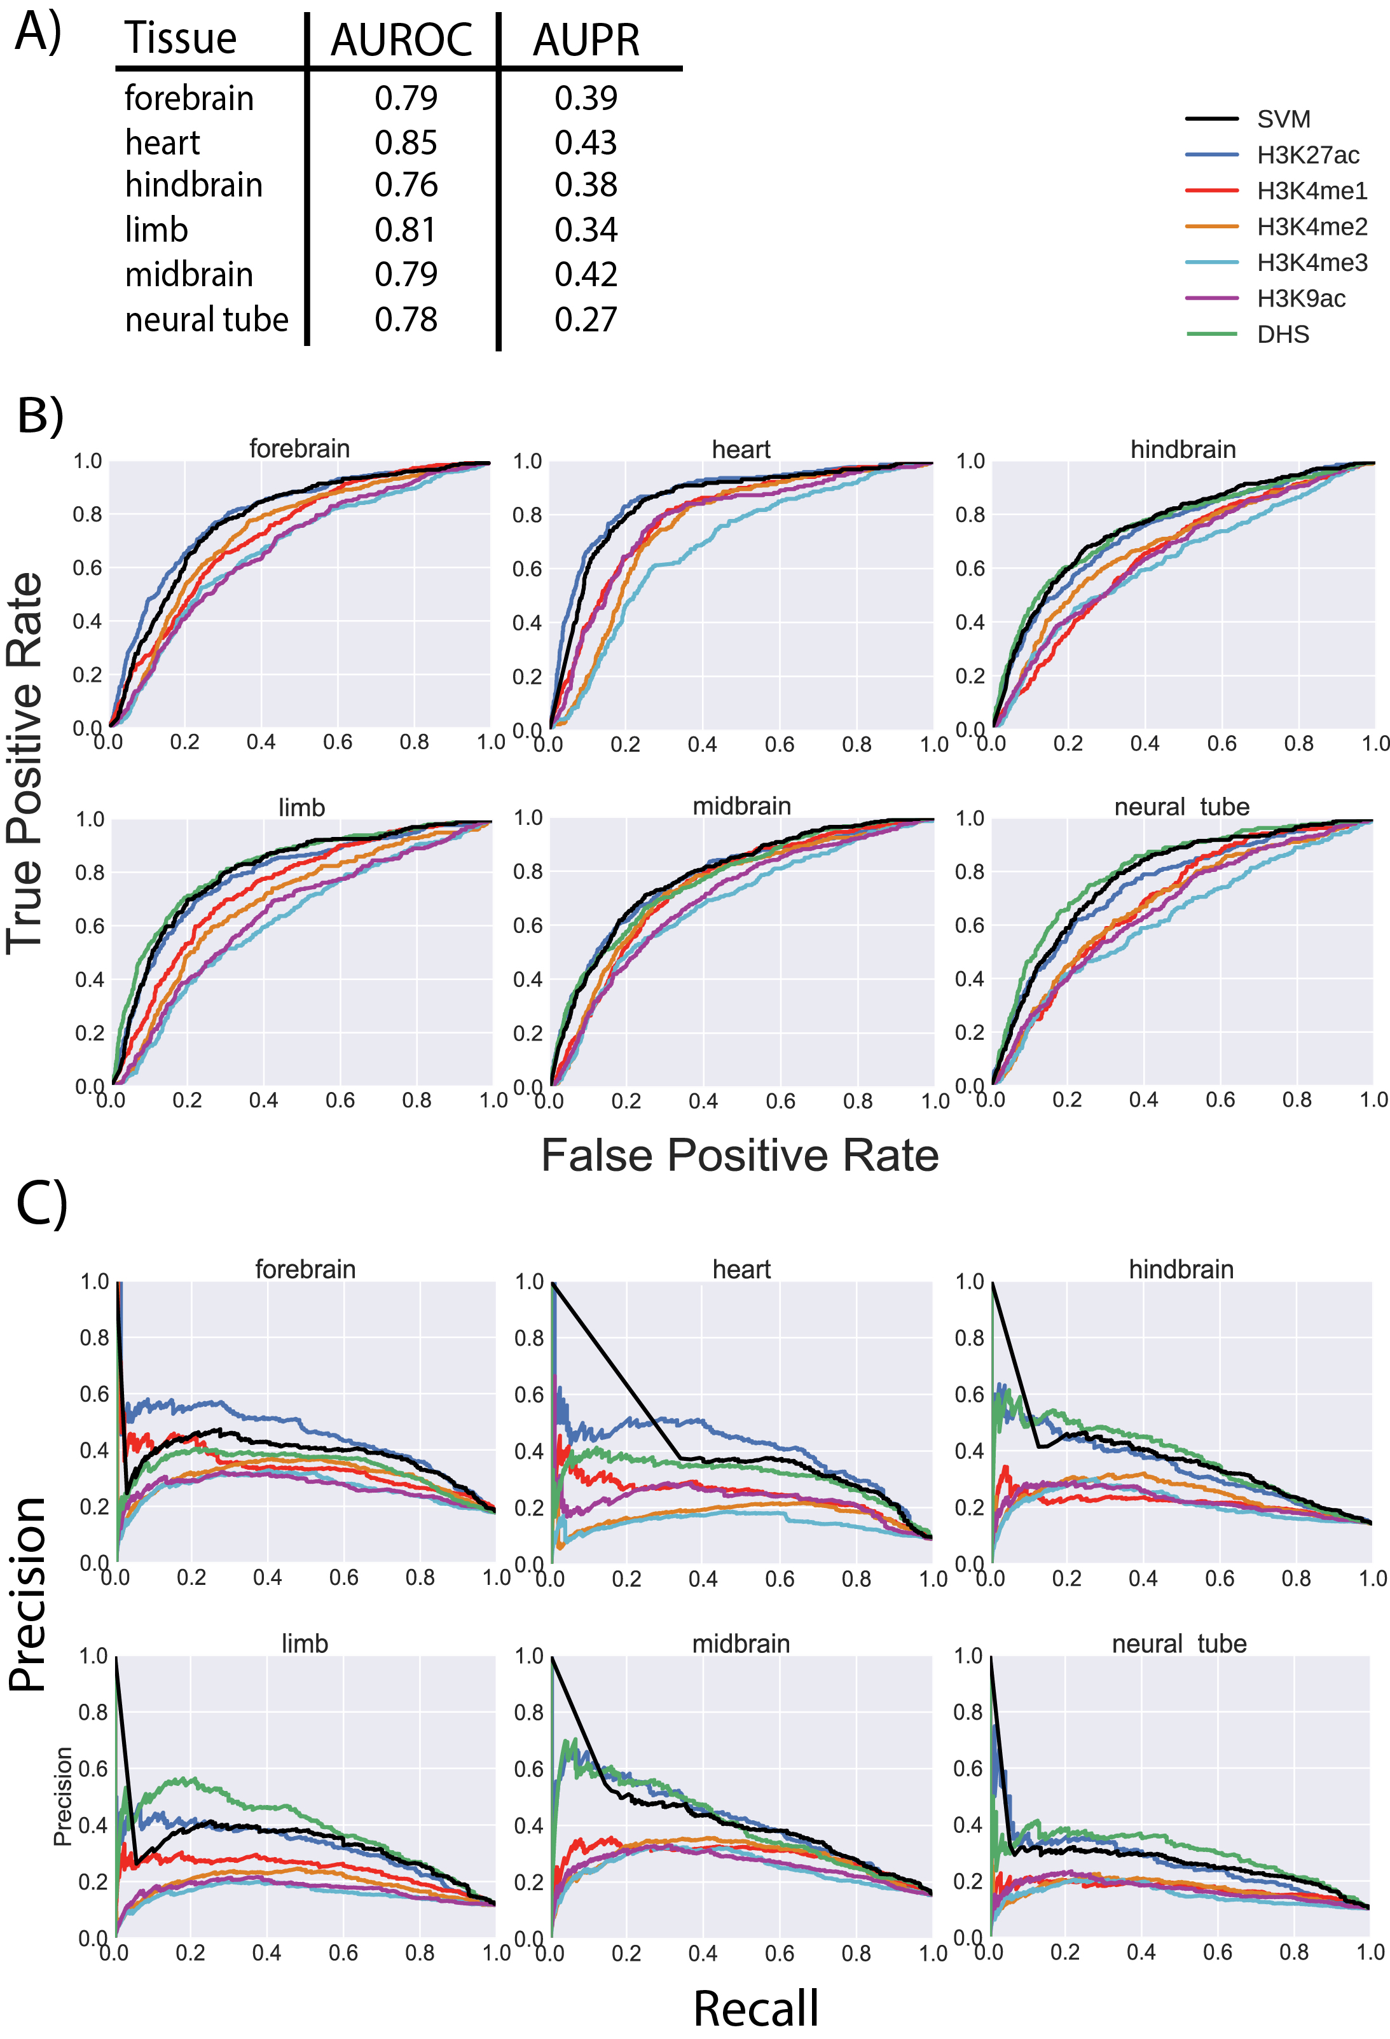
Validation with transgenic mouse enhancer assay
Inject fertilized eggs
False Positive Rate
[ biorxiv.org/content/early/2018/08/05/385237 ]

Slide 33
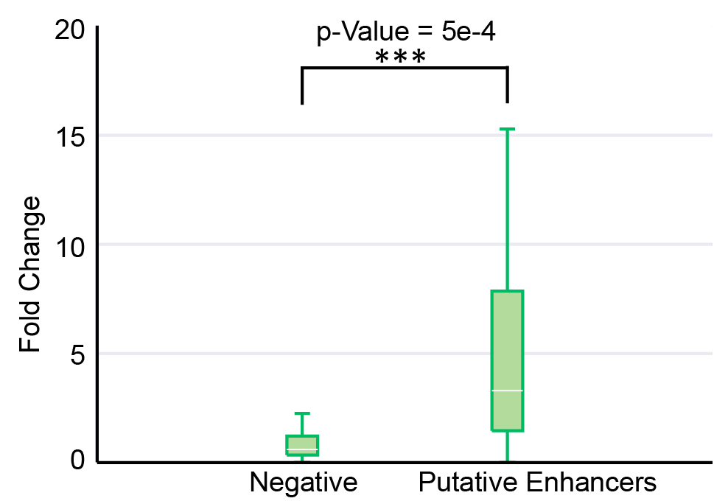
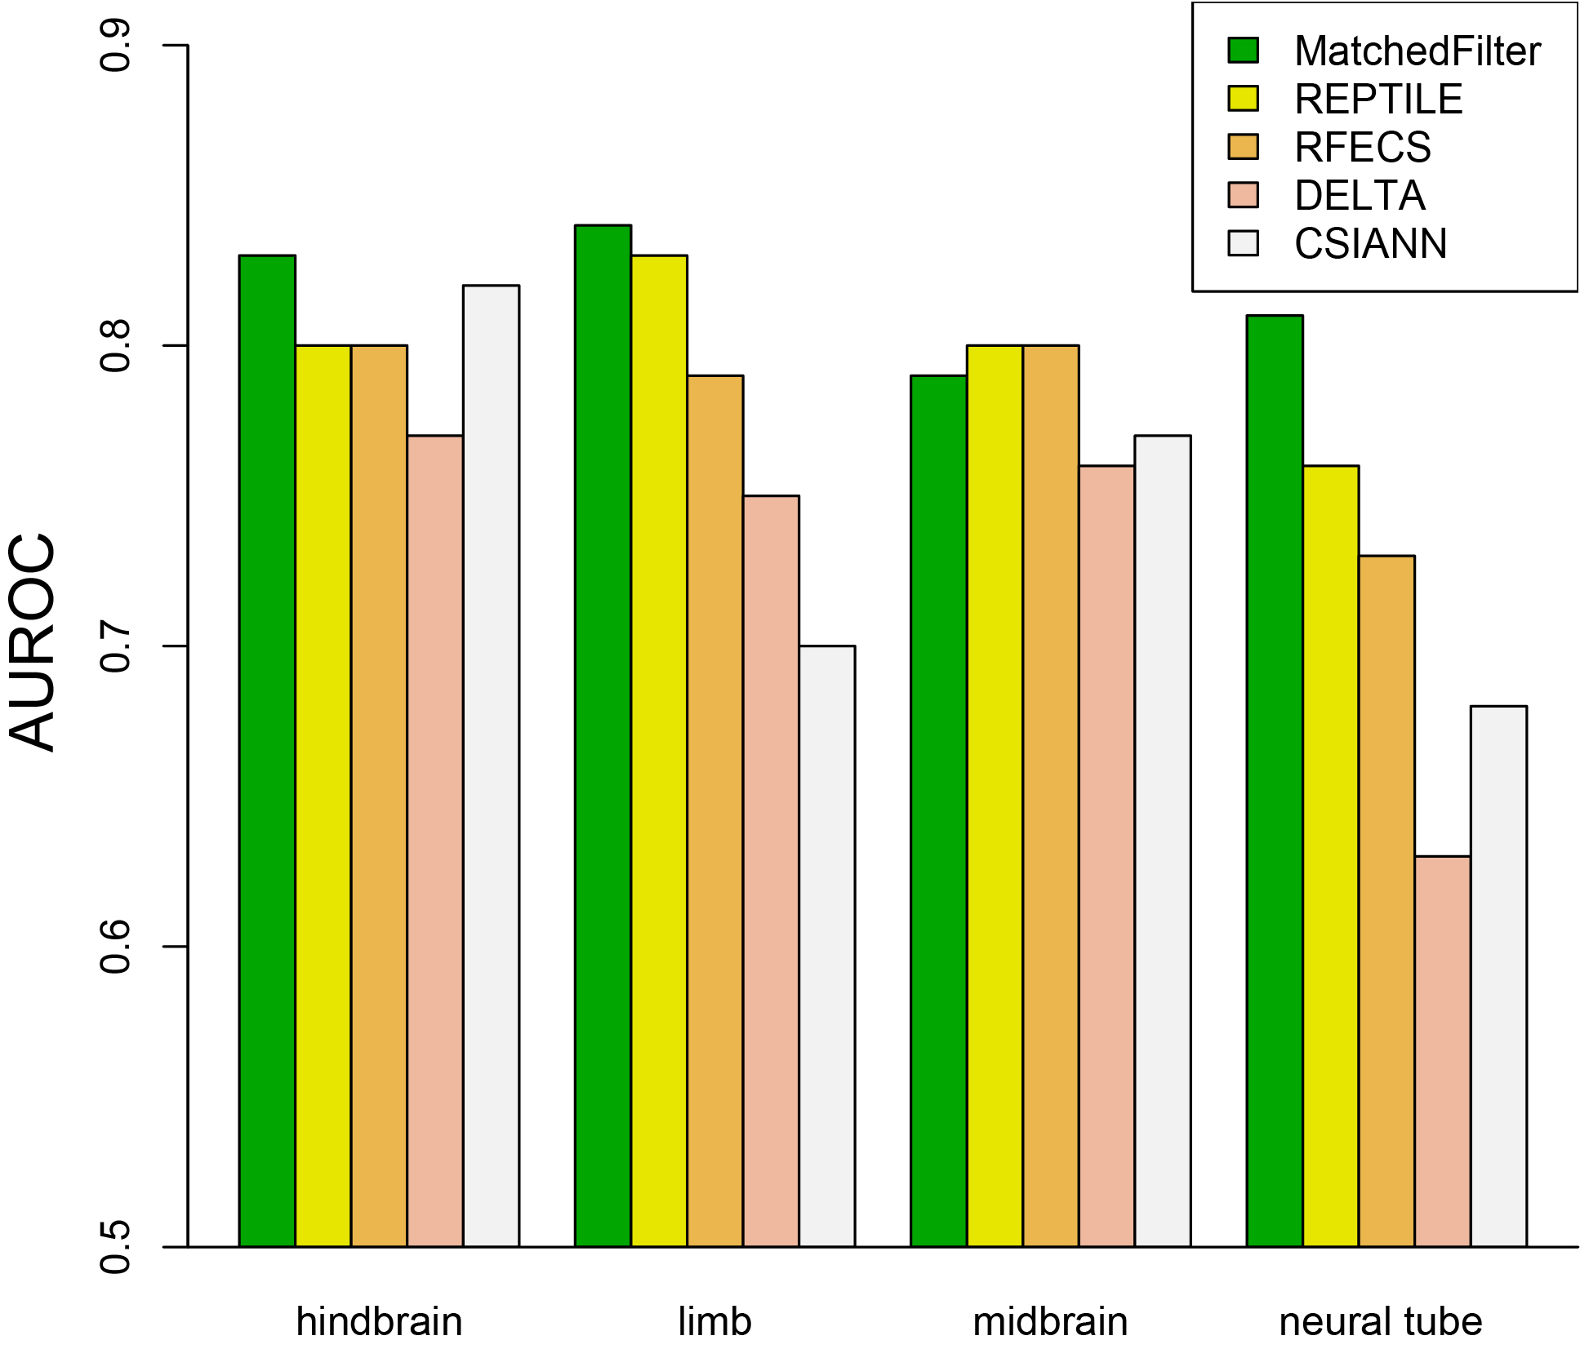
Matched-Filter can be applied across different organisms
Validation using transduction-based reporter assay (H1-hESC, HOS, A549 and TZMBL)
Compare overlap with FANTOM5 enhancers
Compare Matched-Filter performance with other state-of-the-art methods
[ biorxiv.org/content/early/2018/08/05/385237 ]

Slide 34
Constructing a high-confidence set of cell-specific enhancers
[Zhang et al. ('19), biorxiv.org]

Slide 35
Disease Genomics: Thoughts on Genome Annotation, Prioritizing Variants, Highlighting Dysregulation, & the Application of all of these to Cancer
Background
  PMI & Variant Prioritization
  Types of annotations: peaks, segmentations, regulators
  Genomic covariates
  ENCODEC: ENCODE cancer annotation resource
Matched Filter Annotation
  Integrating cross-assay signal-track patterns associated with enhancers
  Trained on high throughput STARR-seq experiments
  Validation in many different contexts
FunSeq Prioritization
  Integrates evidence, with a “surprisal” based weighting scheme.
  Prioritizing variants within “sensitive sites” (human conserved)
RADAR Prioritization
  Adapts FunSeq approach to RBPs
  Prioritizes variants based on post-transcriptional regulome using ENCODE eCLIP
  Incorporates new features related to RNA sec. struc & tissue specific effects
uORF Prioritization
  Feature integration to find small subset of upstream mutations that potentially alter translation
LARVA & MOAT
  Uses parametric beta-binomial model, explicitly modeling genomic covariates
  Non-parametric shuffles. Useful when explicit covariates not available.
Network Rewiring
  Network rewiring highlights regulators that change their targets greatly.
  LDA approach specifically finds those that greatly change their gene communities
Regulatory Drivers of Differential Expression
  Highlighting regulators in terms of their power to drive differential expression.
  Relationship of this to network hierarchy & RBP-TF cross talk
  Example of MYC & SUB1

Slide 36
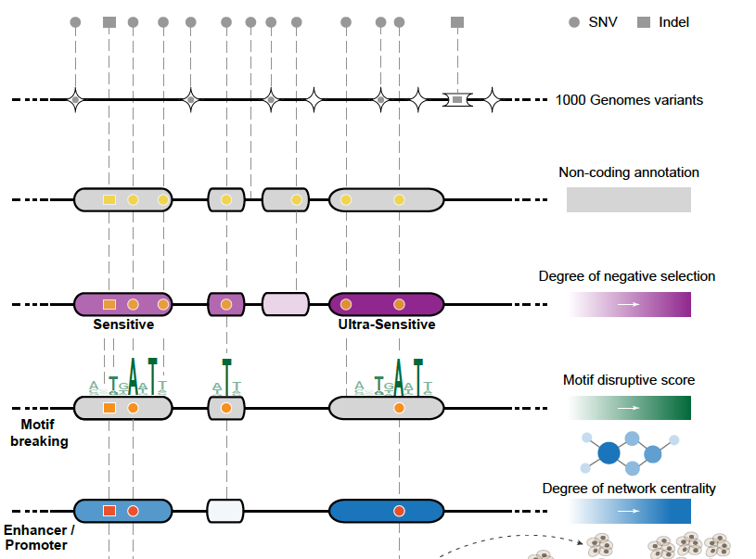
Funseq: a flexible framework to determine
functional impact & use this to prioritize variants
Annotation (tf binding sites open chromatin, ncRNAs) & Chromatin Dynamics
Conservation
(GERP, allele freq.)
Mutational impact (motif breaking, Lof)
Network (centrality position)
[Fu et al., GenomeBiology ('14), , Khurana et al., Science ('13)]

Slide 37
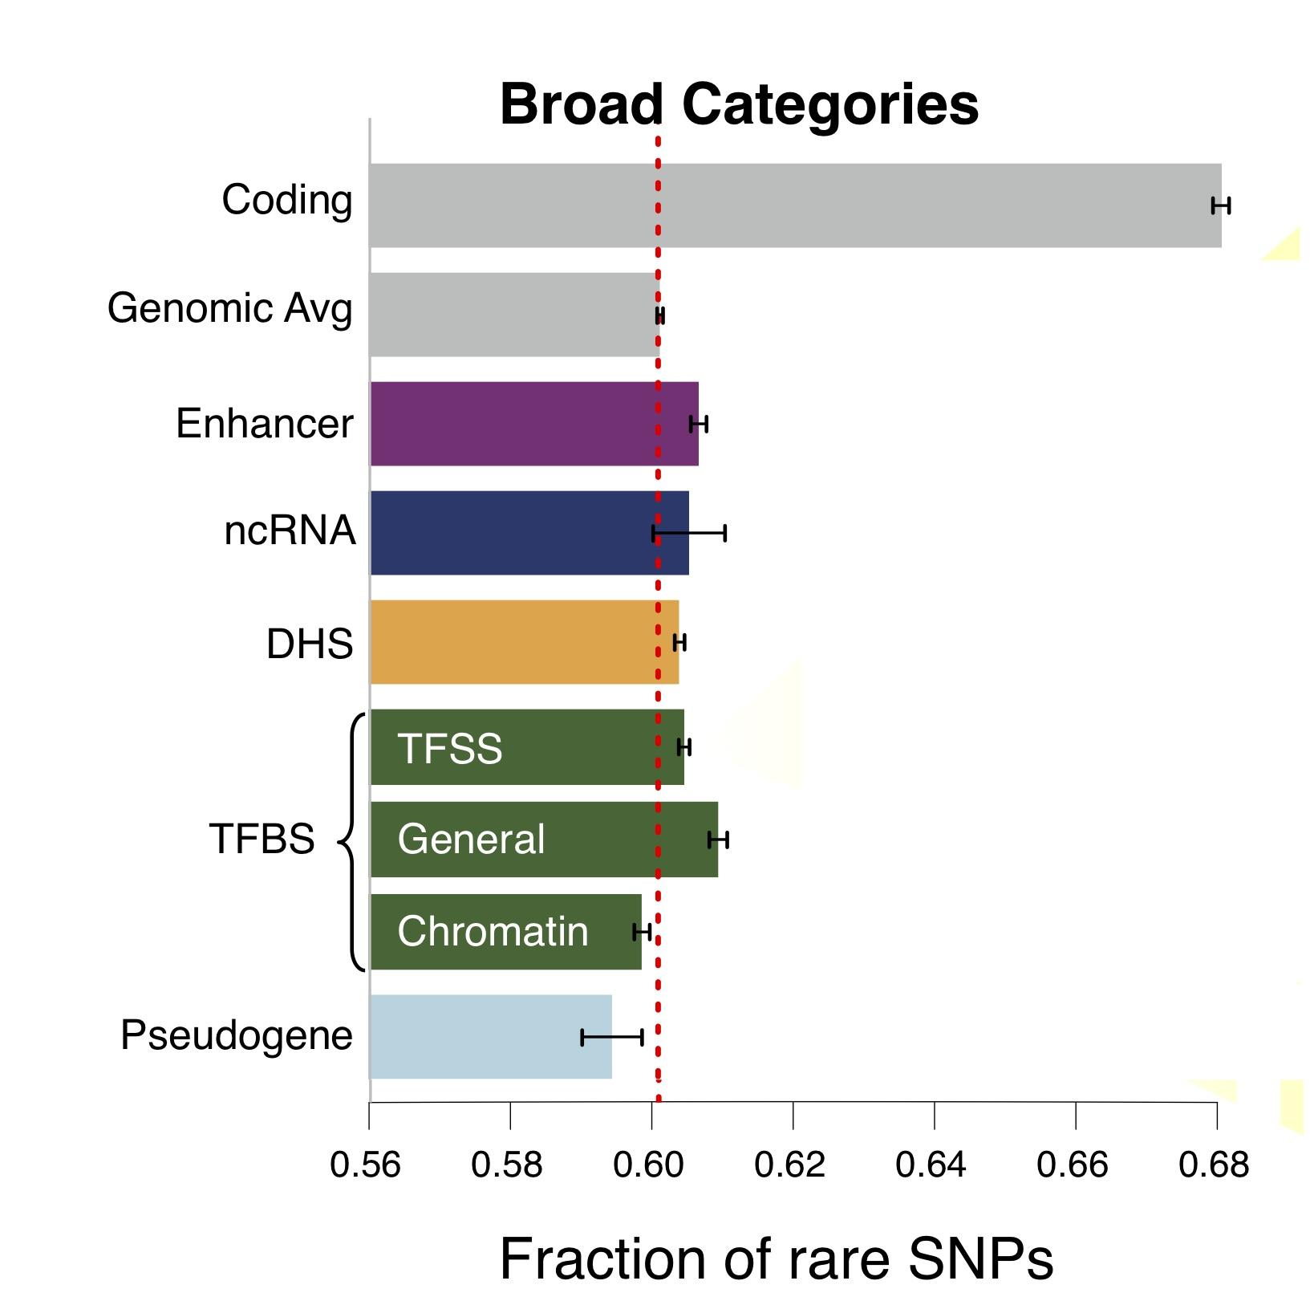
Finding "Conserved” Sites in the Human Population:
Negative selection in non-coding elements based on
Production ENCODE & 1000G Phase 1
Broad categories of regulatory regions under negative selection
Related to:
ENCODE, Nature, 2012
Ward & Kellis, Science, 2012
Mu et al, NAR, 2011
(Non-coding RNA)
(DNase I hypersensitive sites)
(TFSS: Sequence-specific TFs)
(Transcription factor binding sites)
Depletion of Common Variants
in the Human Population

Slide 38
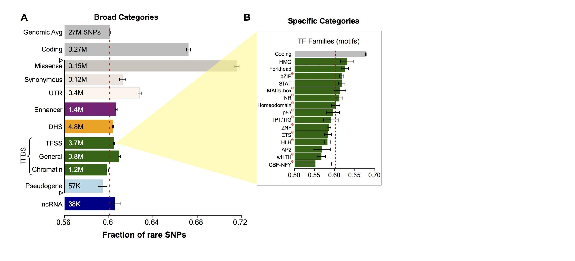
Differential selective constraints
among specific sub-categories
Sub-categorization possible because of better statistics from 1000G phase 1 v pilot
[Khurana et al., Science (‘13)]

Slide 39
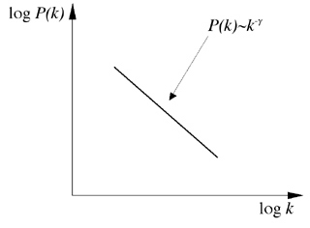
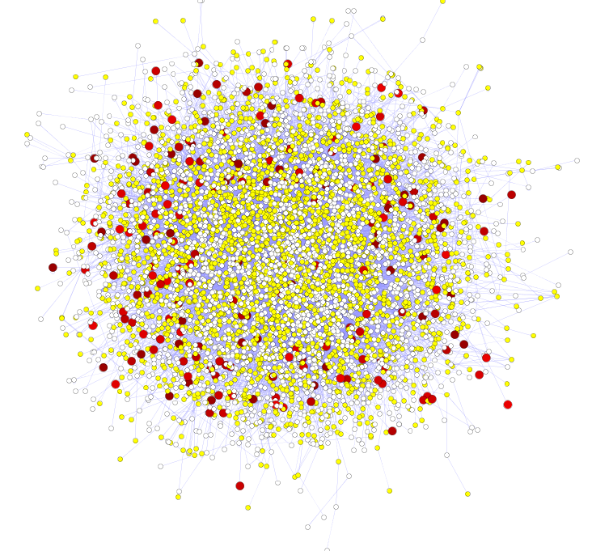
Hubs Under Constraint:
A Finding from the Network Biology Community
Power-law distribution
Hub
log(Frequency)
High likelihood of positive selection
Not under positive selection
Lower likelihood of positive selection
No data about positive selection
log(Degree)
[Nielsen et al. PLoS Biol. (2005), HPRD, Kim et al. PNAS (2007)]
More Connectivity, More Constraint: Genes & proteins that have a more central position in the network tend to evolve more slowly and are more likely to be essential.
This phenomenon is observed in
many organisms & different kinds of networks
  yeast PPI - Fraser et al ('02) Science,
  ('03) BMC Evo. Bio.
  Ecoli PPI - Butland et al ('04) Nature
  Worm/fly PPI - Hahn et al ('05) MBE
  miRNA net - Cheng et al ('09) BMC Genomics

Slide 40
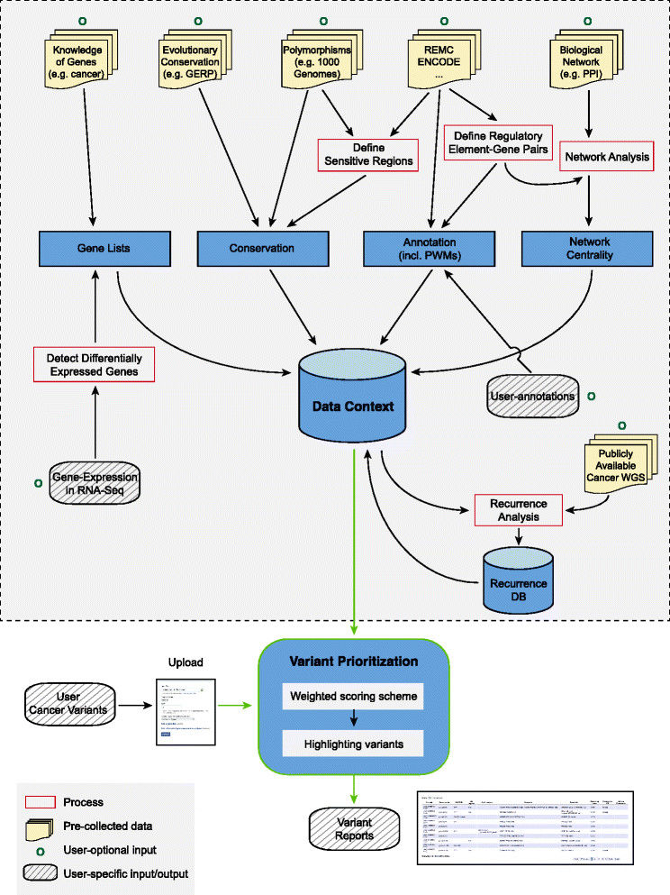
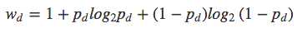
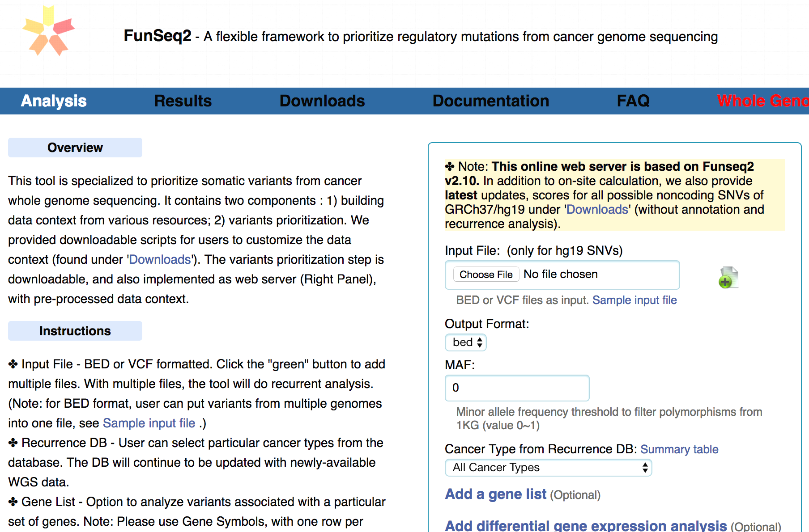
FunSeq.gersteinlab.org
HOT region
Sensitive region
Polymorphisms
Genome
Info. theory based method (ie annotation “surprisal”) for weighting consistently many genomic features
Practical web server
Submission of variants & pre-computed large data context from uniformly processing large-scale datasets
[Fu et al., GenomeBiology ('14)]

Slide 41
Disease Genomics: Thoughts on Genome Annotation, Prioritizing Variants, Highlighting Dysregulation, & the Application of all of these to Cancer
Background
  PMI & Variant Prioritization
  Types of annotations: peaks, segmentations, regulators
  Genomic covariates
  ENCODEC: ENCODE cancer annotation resource
Matched Filter Annotation
  Integrating cross-assay signal-track patterns associated with enhancers
  Trained on high throughput STARR-seq experiments
  Validation in many different contexts
FunSeq Prioritization
  Integrates evidence, with a “surprisal” based weighting scheme.
  Prioritizing variants within “sensitive sites” (human conserved)
RADAR Prioritization
  Adapts FunSeq approach to RBPs
  Prioritizes variants based on post-transcriptional regulome using ENCODE eCLIP
  Incorporates new features related to RNA sec. struc & tissue specific effects
uORF Prioritization
  Feature integration to find small subset of upstream mutations that potentially alter translation
LARVA & MOAT
  Uses parametric beta-binomial model, explicitly modeling genomic covariates
  Non-parametric shuffles. Useful when explicit covariates not available.
Network Rewiring
  Network rewiring highlights regulators that change their targets greatly.
  LDA approach specifically finds those that greatly change their gene communities
Regulatory Drivers of Differential Expression
  Highlighting regulators in terms of their power to drive differential expression.
  Relationship of this to network hierarchy & RBP-TF cross talk
  Example of MYC & SUB1

Slide 42
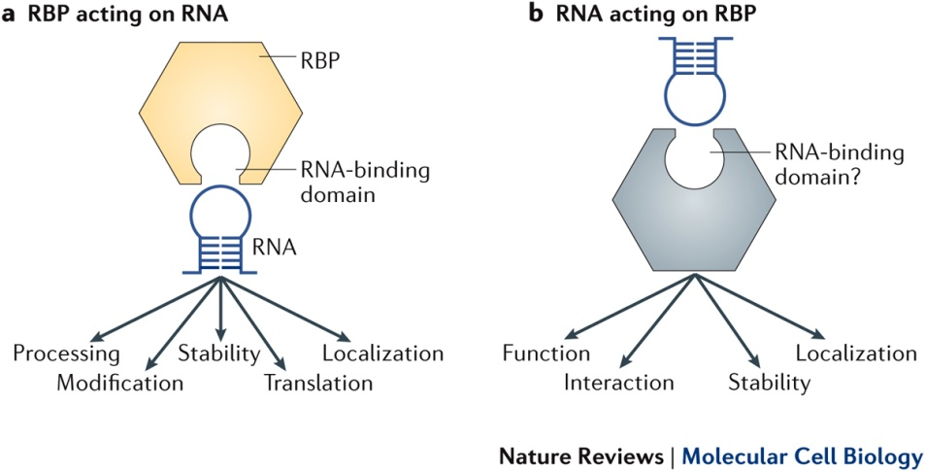
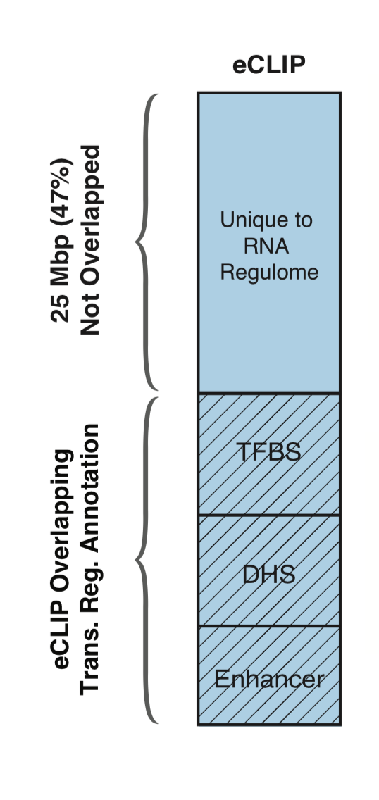
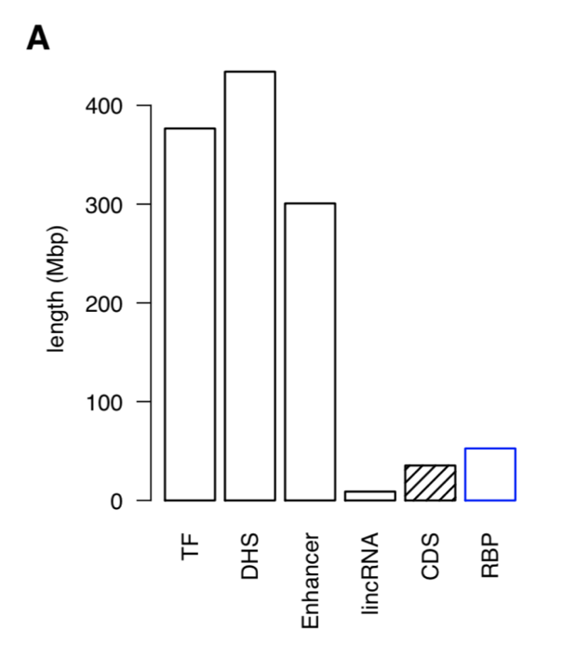
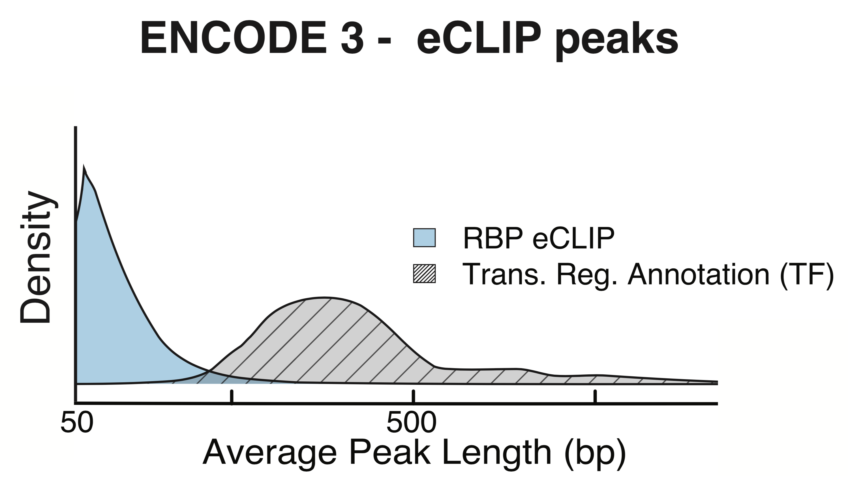
RNA Binding Proteins (RBPs)
Before ENCODE3: >150 expt.
in many different cell types
ENCODE3 did ~350 focused eCLIP expt. for >110 RBPs on HepG2 & K562
(Van Nostrand...Yeo. Nat. Meth. '16;
Van Nostrand...Graveley, Yeo
(submitted in relation to ENCODE3))
Nat Rev Mol Cell Biol. 2018 May;19(5):327-341. doi: 10.1038/nrm.2017.130. Epub 2018 Jan 17.
[Zhang*, Liu* et al., Genome Biology (in review ‘18)]

Slide 43
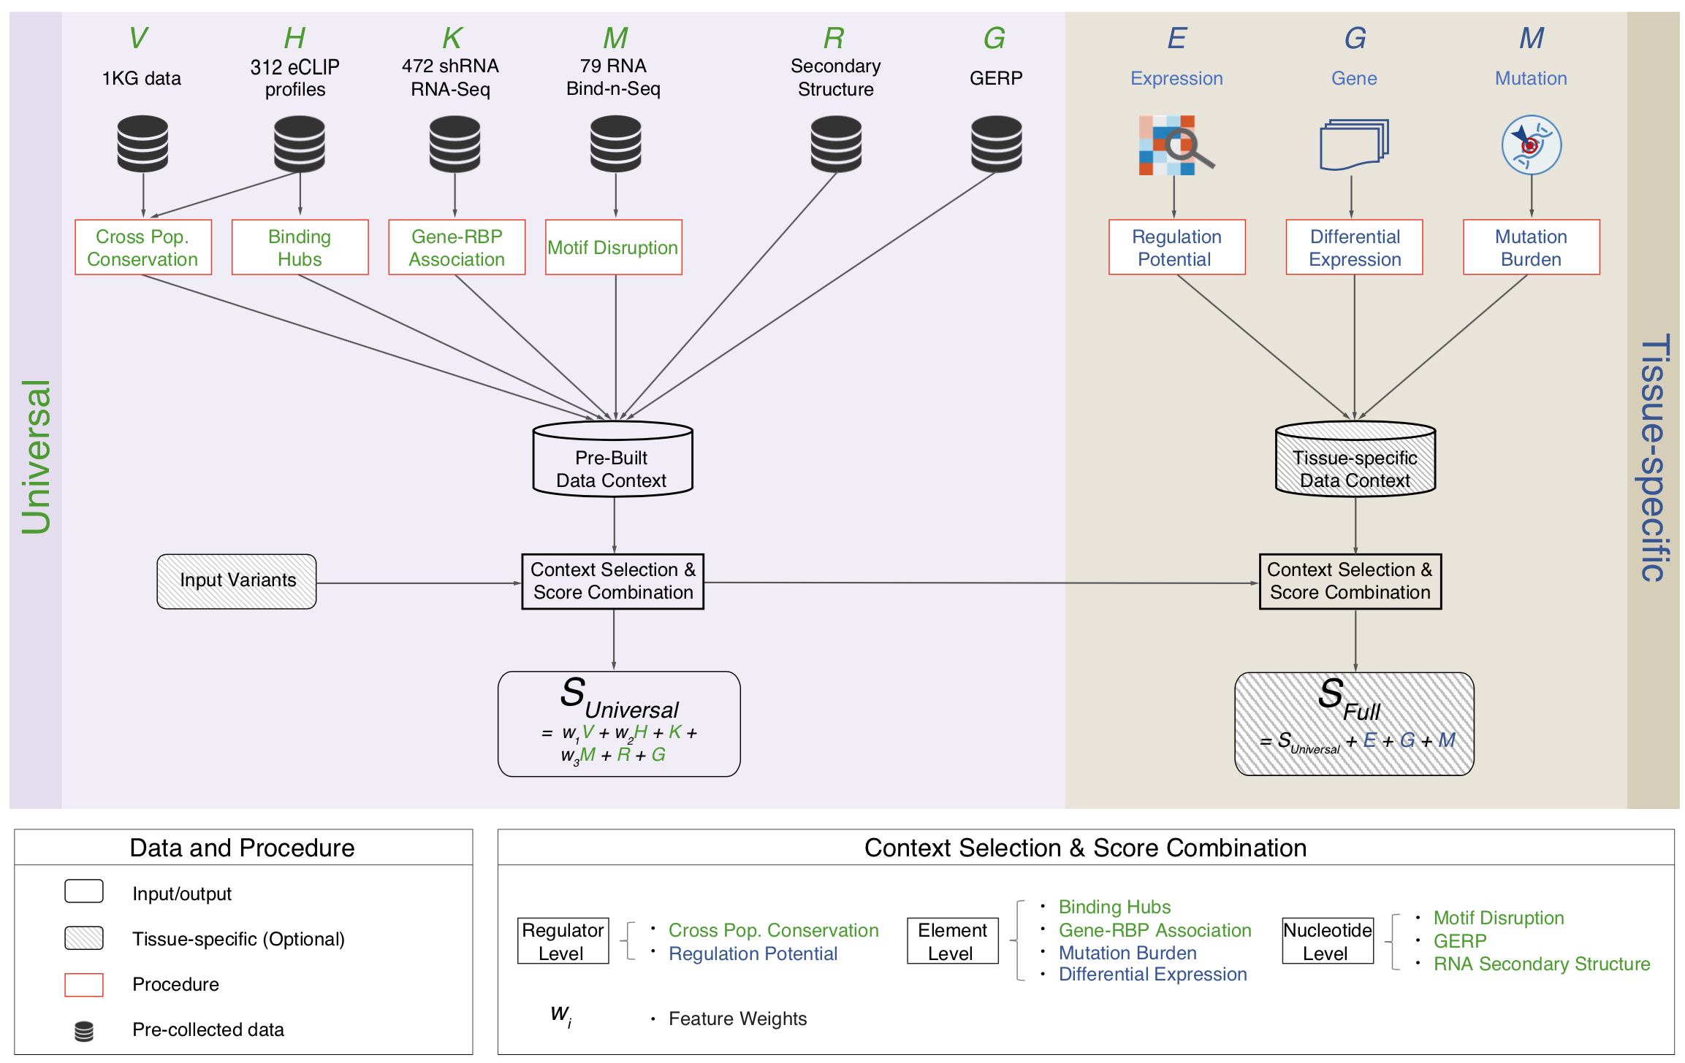
Schematic of RADAR Scoring
[Zhang*, Liu* et al., Genome Biology (in review ‘18)]

Slide 44
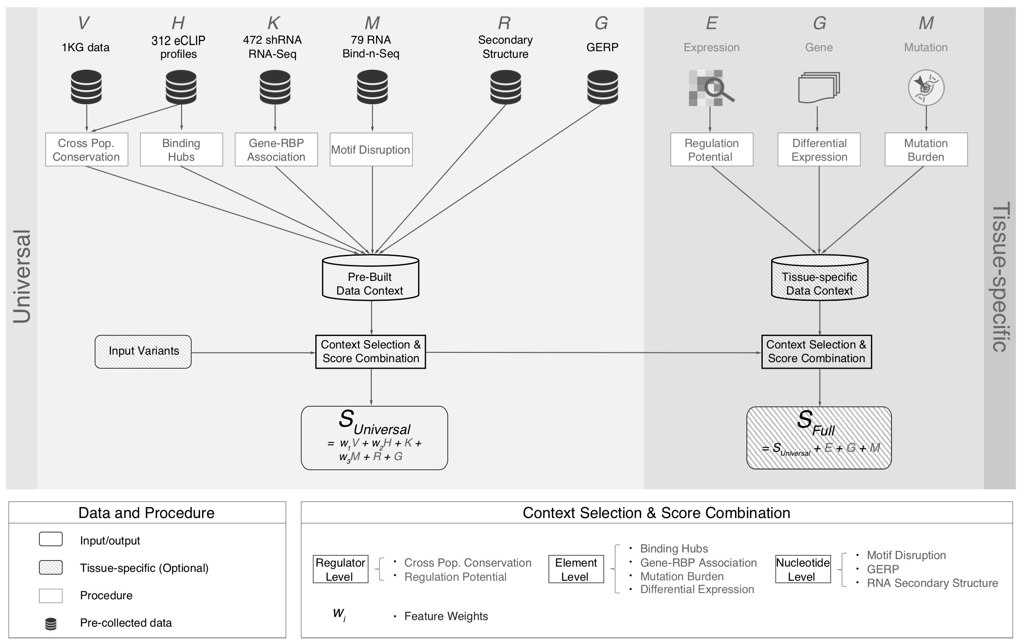
[Zhang*, Liu* et al., Genome Biology (in review ‘18)]

Slide 45
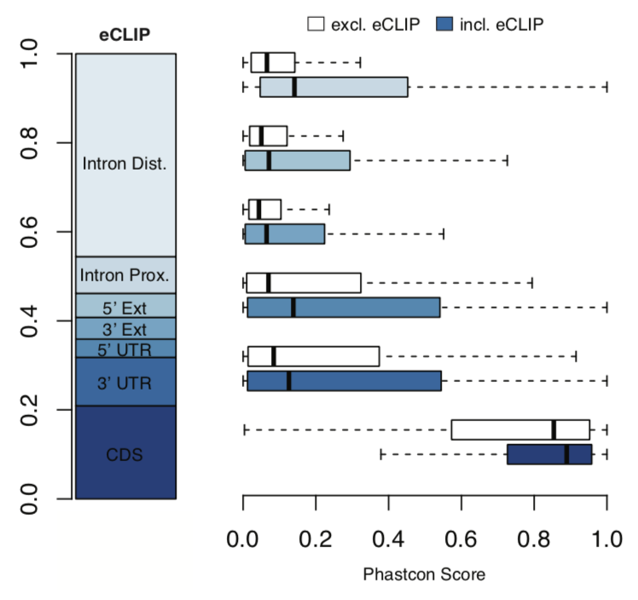
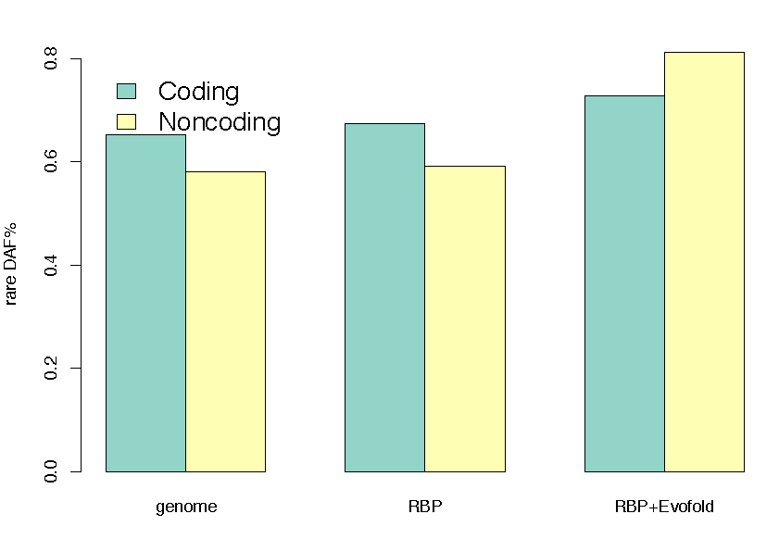
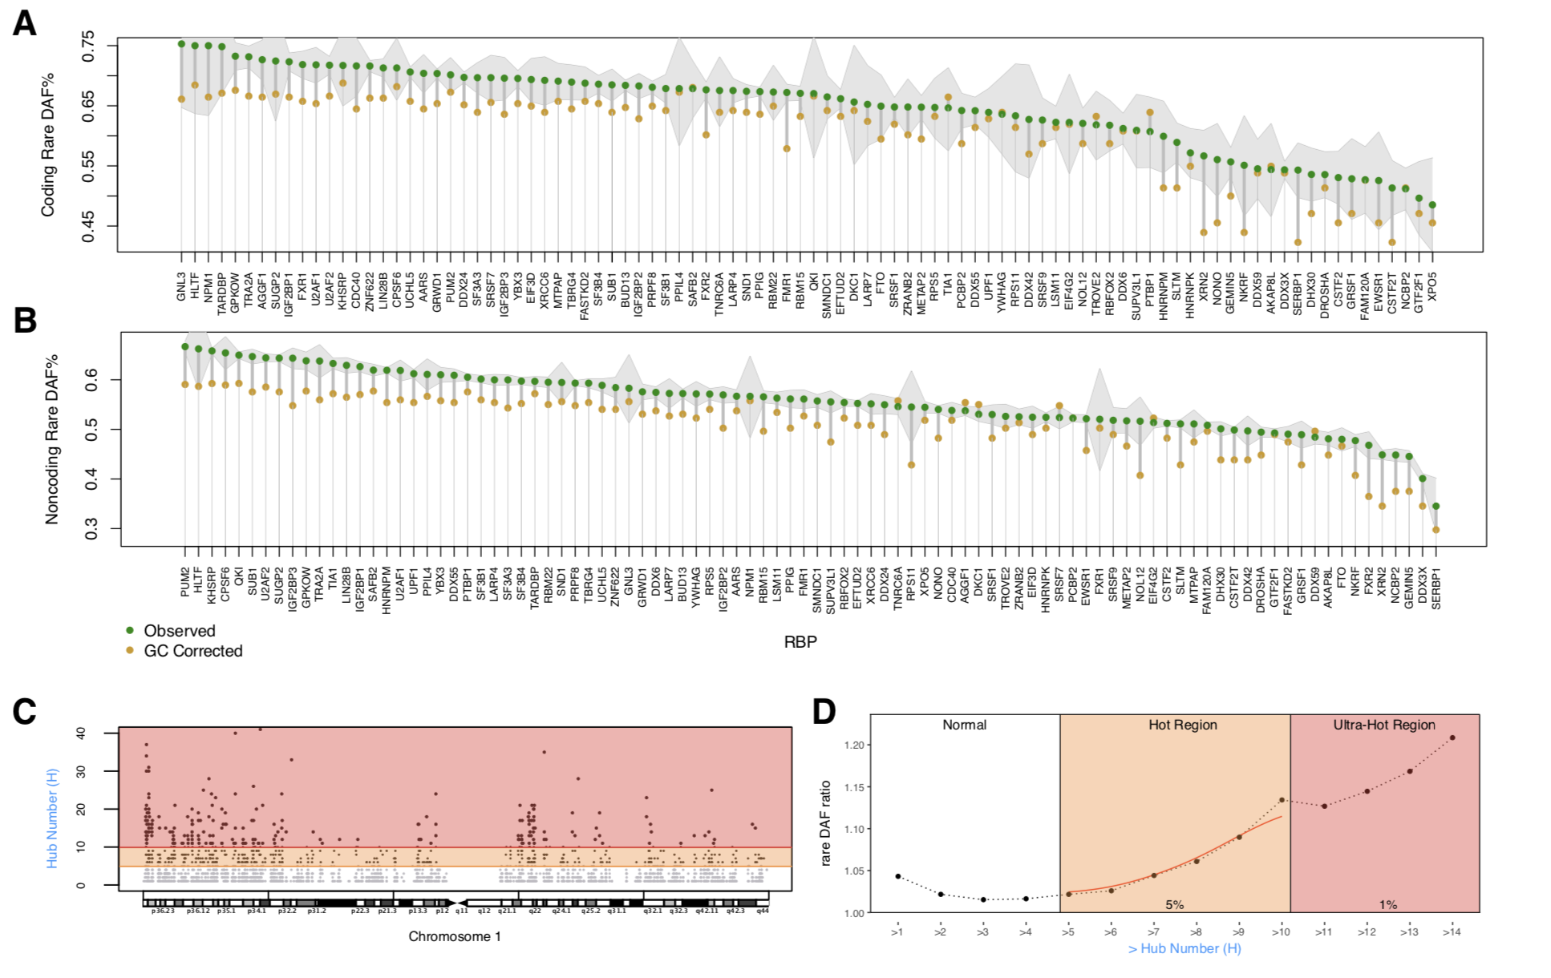
High Phastcon in RBP-overlapped annotations
RNA Structure Cons. from Evofold
Phastcon
Enriched rare DAF in eCLIP peaks
Rare DAF
[Zhang*, Liu* et al., Genome Biology (in review ‘18)]
RBP

Slide 46
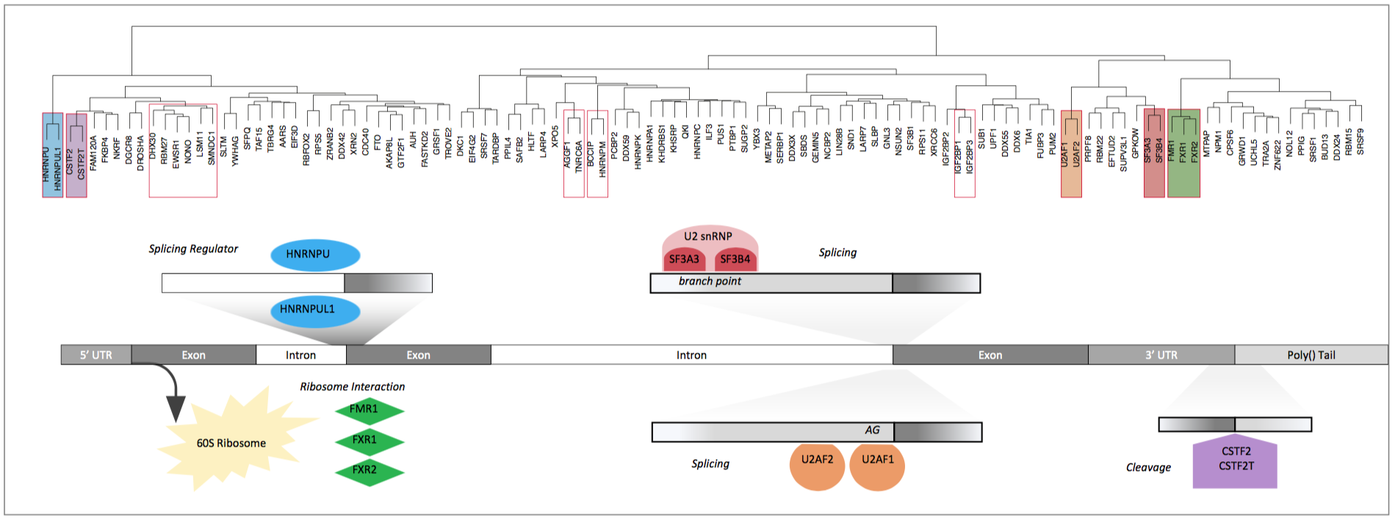
Co-binding of RBPs form biologically relevant complexes
Unique co-binding patterns of RBPs
Literature supported RBP complexes
RBP
RBP
Binding hubs are enriched for rare variants
Hub Number
(Hotness)
Rare DAF
[Zhang*, Liu* et al., Genome Biology (in review ‘18)]
Hub Number (Hotness)

Slide 47
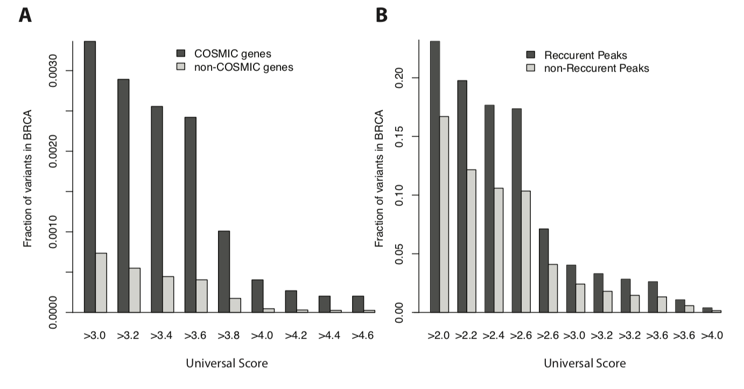
RADAR Scores enriched in COSMIC genes and recurrently mutated regions
[Zhang*, Liu* et al., Genome Biology (in review ‘18)]

Slide 48
Disease Genomics: Thoughts on Genome Annotation, Prioritizing Variants, Highlighting Dysregulation, & the Application of all of these to Cancer
Background
  PMI & Variant Prioritization
  Types of annotations: peaks, segmentations, regulators
  Genomic covariates
  ENCODEC: ENCODE cancer annotation resource
Matched Filter Annotation
  Integrating cross-assay signal-track patterns associated with enhancers
  Trained on high throughput STARR-seq experiments
  Validation in many different contexts
FunSeq Prioritization
  Integrates evidence, with a “surprisal” based weighting scheme.
  Prioritizing variants within “sensitive sites” (human conserved)
RADAR Prioritization
  Adapts FunSeq approach to RBPs
  Prioritizes variants based on post-transcriptional regulome using ENCODE eCLIP
  Incorporates new features related to RNA sec. struc & tissue specific effects
uORF Prioritization
  Feature integration to find small subset of upstream mutations that potentially alter translation
LARVA & MOAT
  Uses parametric beta-binomial model, explicitly modeling genomic covariates
  Non-parametric shuffles. Useful when explicit covariates not available.
Network Rewiring
  Network rewiring highlights regulators that change their targets greatly.
  LDA approach specifically finds those that greatly change their gene communities
Regulatory Drivers of Differential Expression
  Highlighting regulators in terms of their power to drive differential expression.
  Relationship of this to network hierarchy & RBP-TF cross talk
  Example of MYC & SUB1

Slide 49
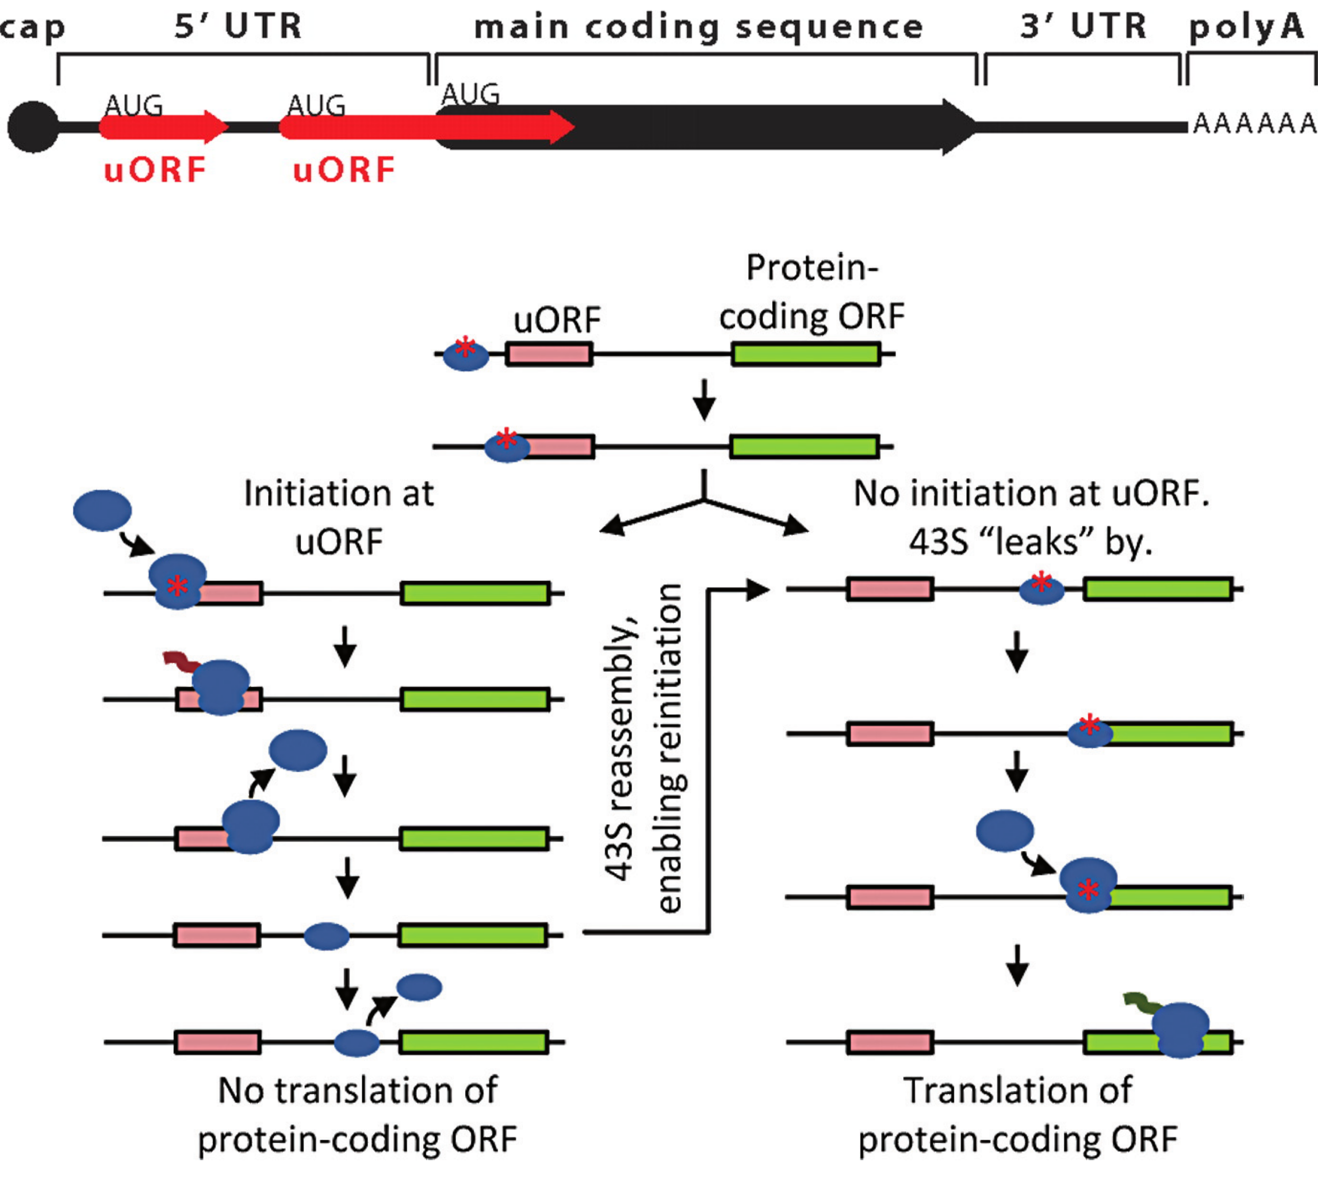
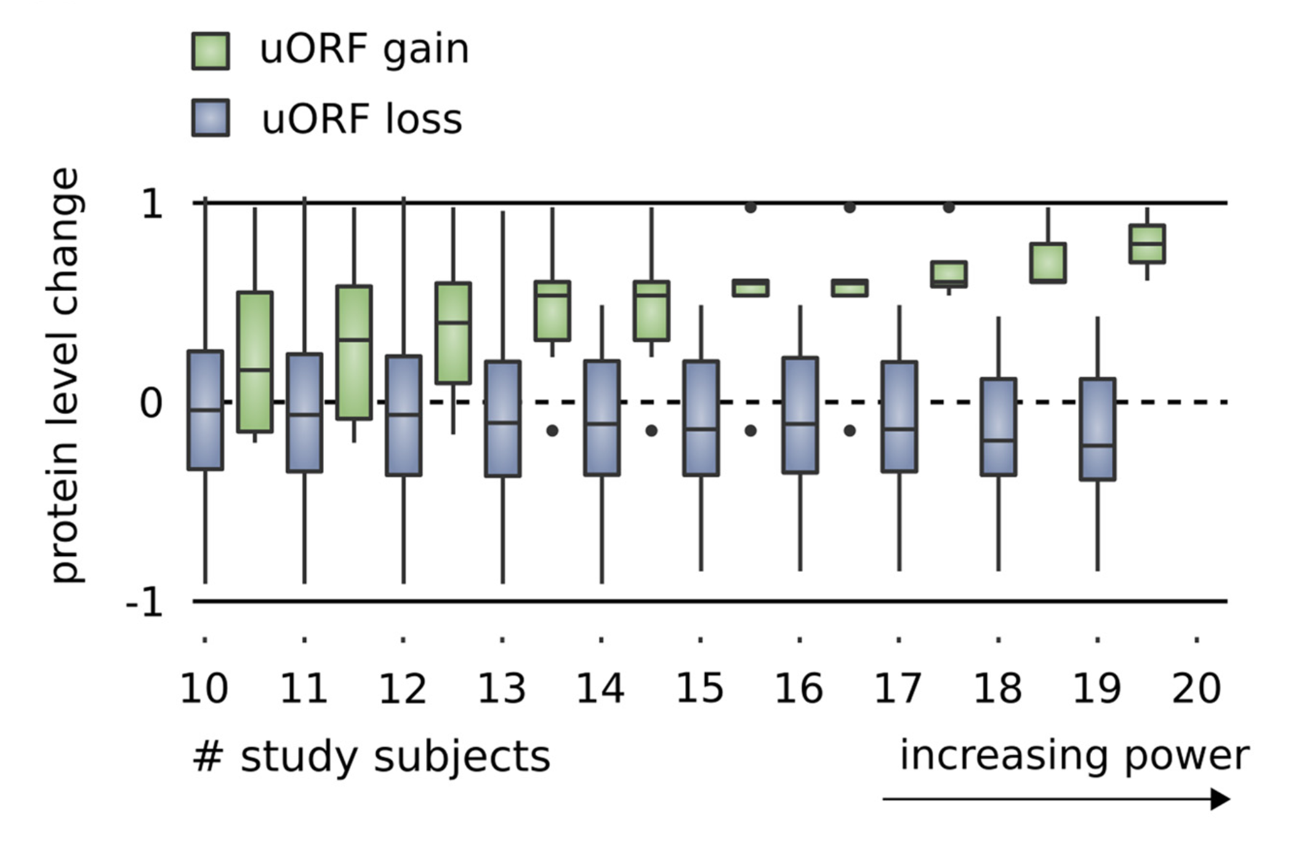
Upstream open reading frames (uORFs) regulate translation are affected by somatic mutation
uORFs regulate the translation of downstream coding regions.
This regulation may be altered by somatic mutation in cancer.
In Battle et al. 2014 data uORF gain & loss assoc. protein level change.
[Calvo et al., PNAS (‘09)]
[McGillivray et al., NAR (‘18)]
[Ferreira et al., Bioengineered (‘14)]

Slide 50
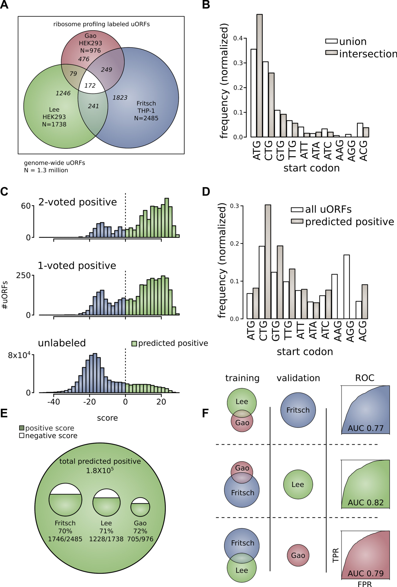
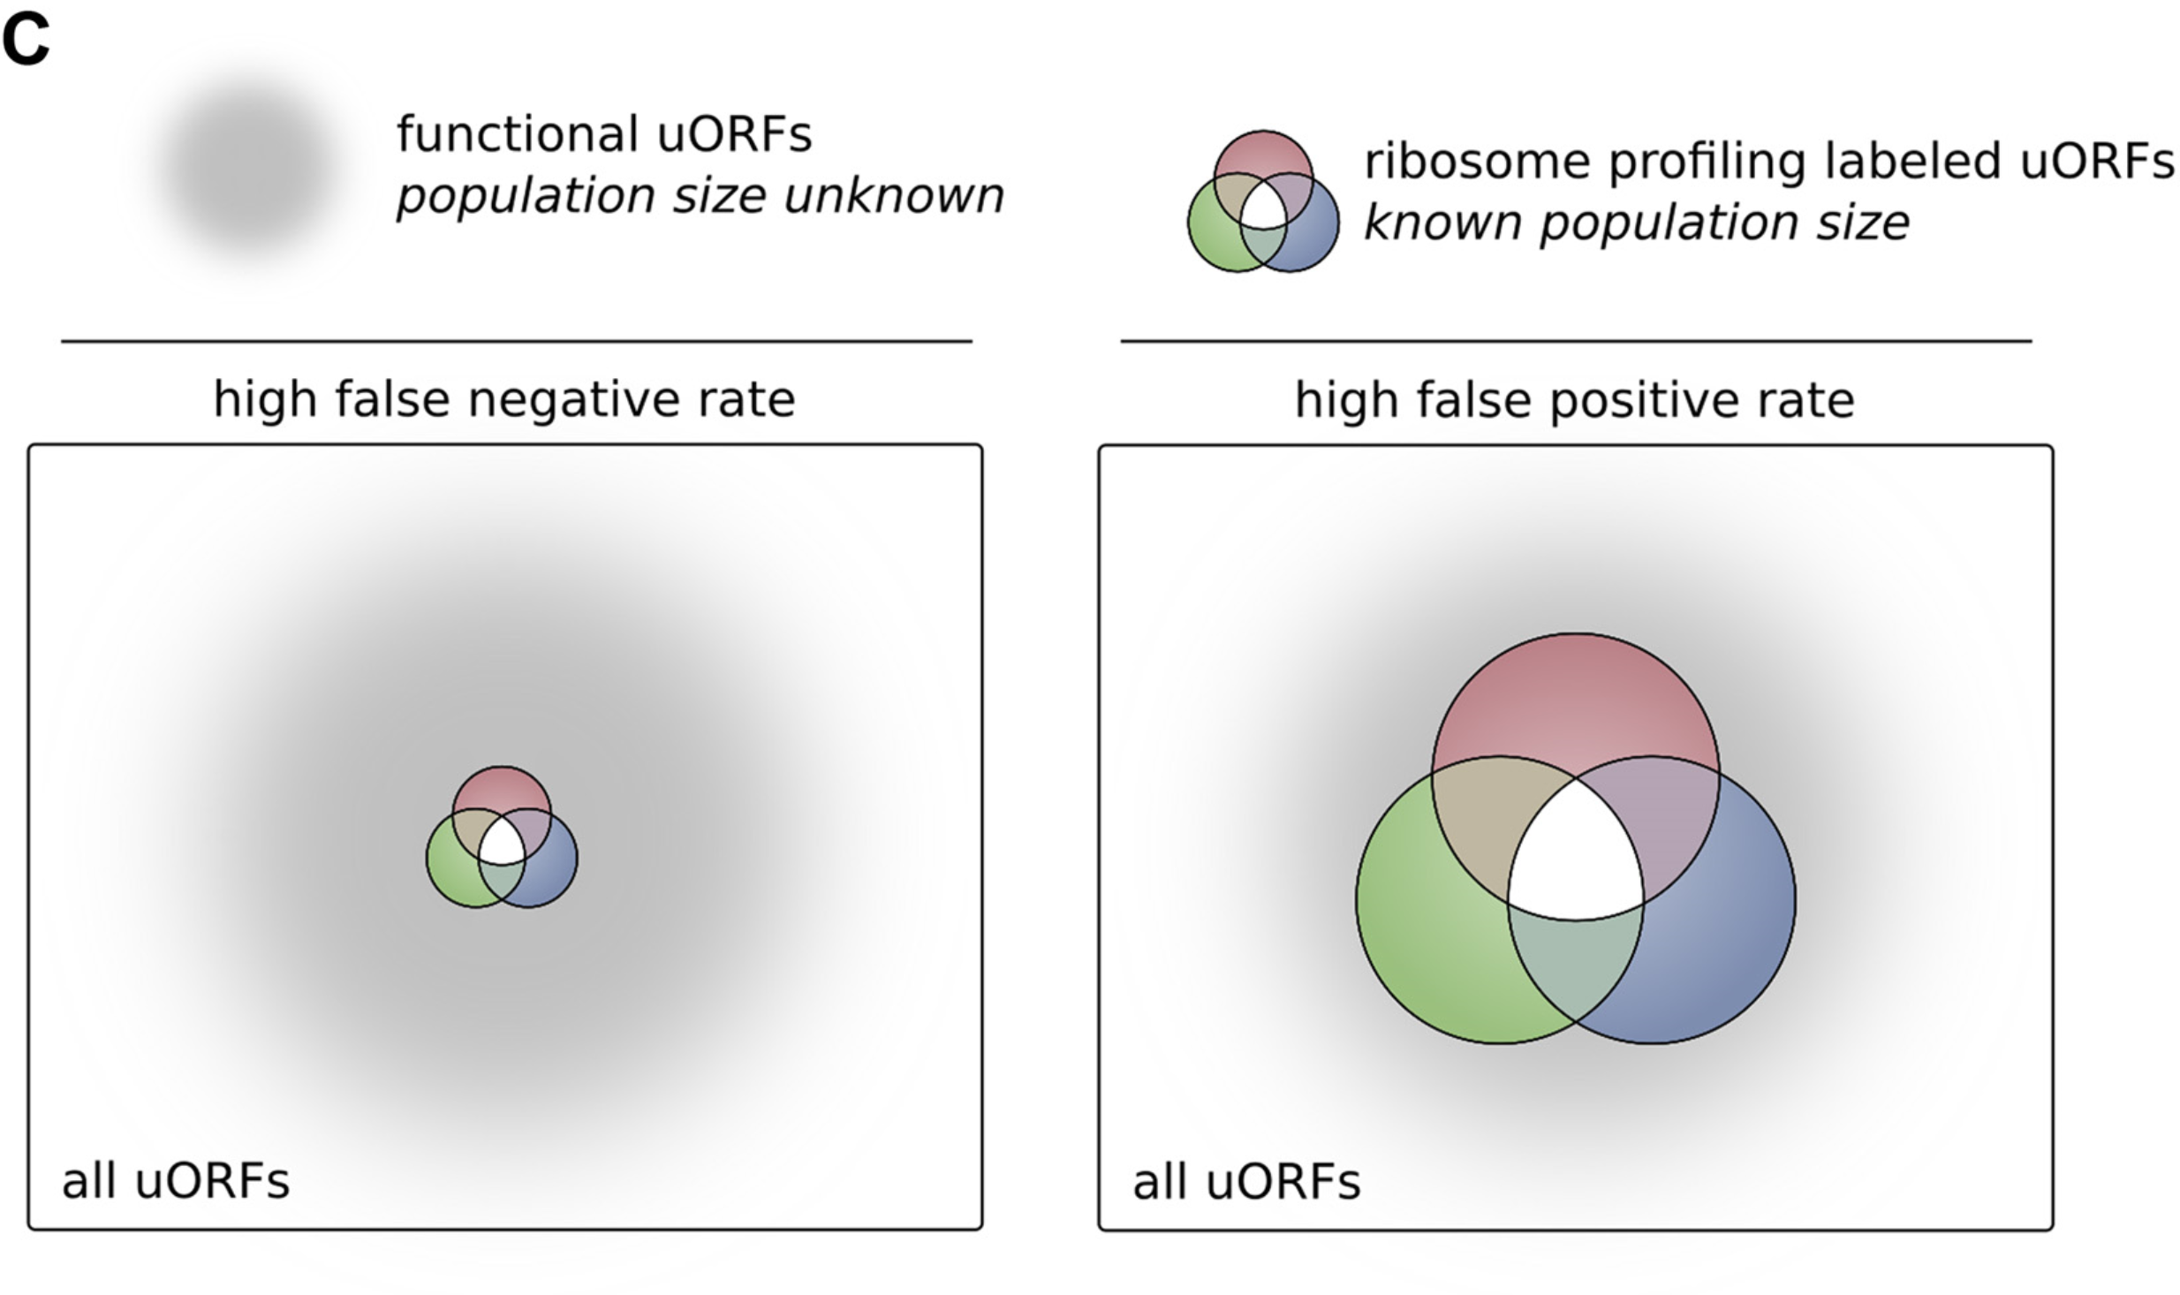
The population of functional uORFs may be significant
From a “Universe” of 1.3 M pot. uORFs
Ribosome profiling experiments have low overlap in identified uORFs.
This suggests high false-negative rate, and more functional uORFs than currently known.
[McGillivray et al., NAR (‘18)]

Slide 51
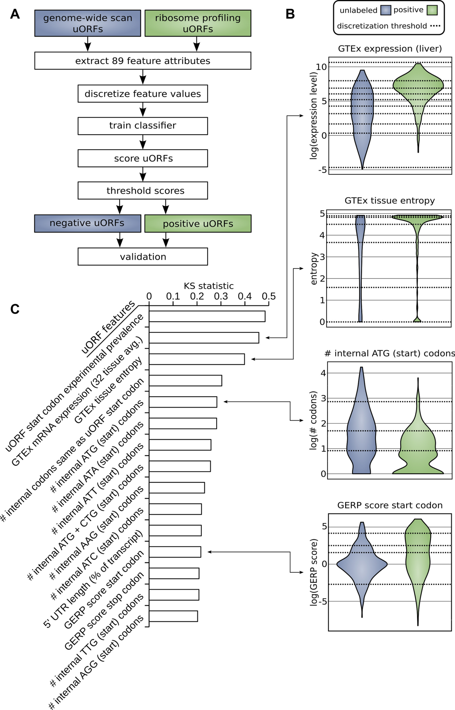
Prediction & validation of functional uORFs using 89 features
Expr.
Level
All near-cognate start codons predicted.
Cross-validation on independent ribosome profiling datasets and validation using in vivo protein levels and ribosome occupancy in humans (Battle et al. 2014).
Tissue
Dist.
Int.
ATG
Start
Conser-
vation
[McGillivray et al., NAR (‘18)]

Slide 52
A comprehensive catalog of functional uORFs
Universe of 1.3M uORFs scored via Simple Bayes algo.
180K: Large predicted positive set likely to affect translation
Calibration on gold standards, suggests getting ~70% of known
Predicted functional uORFs may be intersected with disease associated variants.
[McGillivray et al., NAR (‘18)]

Slide 53
Disease Genomics: Thoughts on Genome Annotation, Prioritizing Variants, Highlighting Dysregulation, & the Application of all of these to Cancer
Background
  PMI & Variant Prioritization
  Types of annotations: peaks, segmentations, regulators
  Genomic covariates
  ENCODEC: ENCODE cancer annotation resource
Matched Filter Annotation
  Integrating cross-assay signal-track patterns associated with enhancers
  Trained on high throughput STARR-seq experiments
  Validation in many different contexts
FunSeq Prioritization
  Integrates evidence, with a “surprisal” based weighting scheme.
  Prioritizing variants within “sensitive sites” (human conserved)
RADAR Prioritization
  Adapts FunSeq approach to RBPs
  Prioritizes variants based on post-transcriptional regulome using ENCODE eCLIP
  Incorporates new features related to RNA sec. struc & tissue specific effects
uORF Prioritization
  Feature integration to find small subset of upstream mutations that potentially alter translation
LARVA & MOAT
  Uses parametric beta-binomial model, explicitly modeling genomic covariates
  Non-parametric shuffles. Useful when explicit covariates not available.
Network Rewiring
  Network rewiring highlights regulators that change their targets greatly.
  LDA approach specifically finds those that greatly change their gene communities
Regulatory Drivers of Differential Expression
  Highlighting regulators in terms of their power to drive differential expression.
  Relationship of this to network hierarchy & RBP-TF cross talk
  Example of MYC & SUB1

Slide 54







Cancer Somatic Mutation Modeling
PARAMETRIC MODELS
Suppose there are k genome elements. For element i, define:
  n_{i}: total number of nucleotides
  x_{i}: the number of mutations within the element
  p: the mutation rate
  R_{i}: the covariate rank of the element
Non-parametric model is useful when covariate data is missing for the studied annotations
  Also sidesteps issue of properly identifying and modeling every relevant covariate
  (possibly hundreds)
NON-PARAMETRIC MODELS
Model 1: Constant Background Mutation Rate (Model from Previous Work)
Assume constant background mutation rate in local regions.
Model 3a: Random Permutation of Input Annotations
Model 2a: Varying Mutation Rate
with Single Covariate Correction
Shuffle annotations within local region to assess background mutation rate.
Model 3b: Random Permutation of Input Variants
Shuffle variants within local region to assess background mutation rate.
Model 2b: Varying Mutation Rate
with Multiple Covariate Correction
[Lochovsky et al. Bioinformatics in press]
[Lochovsky et al. NAR (’15)]

Slide 55

MOAT-a: Annotation-based permutation
[Lochovsky et al. Bioinformatics in press]
Notes:
Formally, this method incorporates the annotation length l, the number of random bins we’re going to place in the surrounding genome, n, and two parameters that determine the boundaries of the local genome in which we place random bins, d_min and d_max. d_max has to be small enough that the background mutation rate is roughly constant, while d_min exists to ensure that, if there’s some transitionary region between the mutation rate of a and the mutation rate of the surrounding genome, that the signal from a won’t bleed into our analysis of the local genome context.

Slide 56



MOAT-v: Variant-based Permutation
Can preserve tri-nt context in shuffle
[Lochovsky et al. Bioinformatics in press]
Notes:
The second version of MOAT operates on the idea of variant-based permutation. We place bins over the entire genome that each represent a local genome context, shuffle the variants in each bin, and track permuted variant counts for the annotation we’re studying.

Slide 57

MOAT-s: a variant on MOAT-v
A somatic variant simulator
  Given a set of input variants, shuffle to new locations, taking genome structure into account
[Lochovsky et al. Bioinformatics in press]

Slide 58

LARVA Model Comparison
Comparison of mutation count frequency implied by the binomial model (model 1) and the beta-binomial model (model 2) relative to the empirical distribution
The beta-binomial distribution is significantly better, especially for accurately modeling the over-dispersion of the empirical distribution
[Lochovsky et al. NAR (’15)]

Slide 59


Slide 60

MOAT: recapitulates LARVA with GPU-driven runtime scalability
Computational efficiency of MOAT’s NVIDIA™ CUDA™ version, with respect to the number of permutations, is dramatically enhanced compared to CPU version.
.
Number of permutations | Fold speedup of CUDA version
1k | 14x
10k | 100x
100k | 256x
.
.
MOAT’s high mutation burden elements recapitulate LARVA’s results & published noncoding cancer-associated elements.
[Lochovsky et al. Bioinformatics in press]

Slide 61
Disease Genomics: Thoughts on Genome Annotation, Prioritizing Variants, Highlighting Dysregulation, & the Application of all of these to Cancer
Background
  PMI & Variant Prioritization
  Types of annotations: peaks, segmentations, regulators
  Genomic covariates
  ENCODEC: ENCODE cancer annotation resource
Matched Filter Annotation
  Integrating cross-assay signal-track patterns associated with enhancers
  Trained on high throughput STARR-seq experiments
  Validation in many different contexts
FunSeq Prioritization
  Integrates evidence, with a “surprisal” based weighting scheme.
  Prioritizing variants within “sensitive sites” (human conserved)
RADAR Prioritization
  Adapts FunSeq approach to RBPs
  Prioritizes variants based on post-transcriptional regulome using ENCODE eCLIP
  Incorporates new features related to RNA sec. struc & tissue specific effects
uORF Prioritization
  Feature integration to find small subset of upstream mutations that potentially alter translation
LARVA & MOAT
  Uses parametric beta-binomial model, explicitly modeling genomic covariates
  Non-parametric shuffles. Useful when explicit covariates not available.
Network Rewiring
  Network rewiring highlights regulators that change their targets greatly.
  LDA approach specifically finds those that greatly change their gene communities
Regulatory Drivers of Differential Expression
  Highlighting regulators in terms of their power to drive differential expression.
  Relationship of this to network hierarchy & RBP-TF cross talk
  Example of MYC & SUB1

Slide 62



Network rewiring analyses: key cancer-associated regulator identification through network comparisons
Fact
TF$→gene$ regulation is important
Normal network
Tumor network
1
2
3
4
1
2
3
4
Hypothesis
Disease-associated TFs have target gain or loss events
Method
Latent Dirichlet Allocation
A
B
C
D
E
F
A
B
C
D
E
F
[Zhang et al. ('19), biorxiv.org]

Slide 63


De-noising process by dimension reduction
From $TF→gene (109×50,000)$
to $TF→pathway (109×50)$
Hidden Layer
(50 biological pathways?)
Challenge: how to define appropriate pathways?
[Zhang et al. ('19), biorxiv.org] Lectures.gersteinlab.org

Slide 64


RegLDA: automatic gene topic identification based on Latent Dirichlet Allocation
[Zhang et al. ('19), biorxiv.org] Lectures.gersteinlab.org

Slide 65



latent Dirichlet allocation
Gain/Loss Summary Statistic on Topics
[Zhang et al. ('19), biorxiv.org] Lectures.gersteinlab.org

Slide 66

[Zhang et al. ('19), biorxiv.org]

Slide 67
Disease Genomics: Thoughts on Genome Annotation, Prioritizing Variants, Highlighting Dysregulation, & the Application of all of these to Cancer
Background
  PMI & Variant Prioritization
  Types of annotations: peaks, segmentations, regulators
  Genomic covariates
  ENCODEC: ENCODE cancer annotation resource
Matched Filter Annotation
  Integrating cross-assay signal-track patterns associated with enhancers
  Trained on high throughput STARR-seq experiments
  Validation in many different contexts
FunSeq Prioritization
  Integrates evidence, with a “surprisal” based weighting scheme.
  Prioritizing variants within “sensitive sites” (human conserved)
RADAR Prioritization
  Adapts FunSeq approach to RBPs
  Prioritizes variants based on post-transcriptional regulome using ENCODE eCLIP
  Incorporates new features related to RNA sec. struc & tissue specific effects
uORF Prioritization
  Feature integration to find small subset of upstream mutations that potentially alter translation
LARVA & MOAT
  Uses parametric beta-binomial model, explicitly modeling genomic covariates
  Non-parametric shuffles. Useful when explicit covariates not available.
Network Rewiring
  Network rewiring highlights regulators that change their targets greatly.
  LDA approach specifically finds those that greatly change their gene communities
Regulatory Drivers of Differential Expression
  Highlighting regulators in terms of their power to drive differential expression.
  Relationship of this to network hierarchy & RBP-TF cross talk
  Example of MYC & SUB1

Slide 68
Disease Network：
dotted line = lost edge
Principles
Normal Network
1
2
3
4
1
2
3
4
Direct target gain/loss
A
B
C
D
E
F
A
B
C
D
E
F
Co-regulation
TF/RBP to gene
TF/RBP
gene
High expression
low expression
1
2
3
4
Target gene expression changes
A
B
C
B
C
D
E
F
[Zhang et al. ('19), biorxiv.org] Lectures.gersteinlab.org
Notes:
Idea or pattern
Too abstract…
Add sub slides
Make consistent words as in the outline

Slide 69







diff. exp.
*: down
*: up
NA
n patients
$$⋰$$
High
Target | TF1 | TF2 | TF3
 | ✔️
 | ✔️ | ✔️
 |  | ✔️
 |  | ✔️ | ✔️
 |  |  | ✔️
Low
$$x_{1}$$
$$x_{2}$$
$$x_{3}$$
$$β_{1}=2.5$$
$$β_{3}=−3.1$$
2198 ChIP-seq
459 eCLIP
differential expression
Network for Regulator 1 to k
[Zhang et al. ('19), biorxiv.org] Lectures.gersteinlab.org

Slide 70

Regulatory Potential of RBPs derived from regression between gene network and expression levels
A
B
C
[Zhang*, Liu* et al., Genome Biology (in review ‘18)]

Slide 71



Aggregated t-statistic in regression over TCGA samples
[Zhang et al. ('19), biorxiv.org]

Slide 72

Top Layer: Master regulators, regulating others more than being regulated
Bottom Layer: follower regulators, being regulated more than regulating others
How much power each regulator has in driving tumor-normal differential expressions
[Zhang et al. ('19), biorxiv.org]
TF-RBP crosstalk
Transcription
TF
TF-RBP regulate the same gene at different levels
promoter
Exon
Intron
Exon
RBP
Post-transcription
Exon
Exon
AAAAA

Slide 73














Slower mRNA decay rate in SUB1 targets
initiate transcription
stabilize mRNA
MYC KD
SUB1 KD
MYC+SUB1 KD

Slide 74
Disease Genomics: Thoughts on Genome Annotation, Prioritizing Variants, Highlighting Dysregulation, & the Application of all of these to Cancer
Background
  PMI & Variant Prioritization
  Types of annotations: peaks, segmentations, regulators
  Genomic covariates
  ENCODEC: ENCODE cancer annotation resource
Matched Filter Annotation
  Integrating cross-assay signal-track patterns associated with enhancers
  Trained on high throughput STARR-seq experiments
  Validation in many different contexts
FunSeq Prioritization
  Integrates evidence, with a “surprisal” based weighting scheme.
  Prioritizing variants within “sensitive sites” (human conserved)
RADAR Prioritization
  Adapts FunSeq approach to RBPs
  Prioritizes variants based on post-transcriptional regulome using ENCODE eCLIP
  Incorporates new features related to RNA sec. struc & tissue specific effects
uORF Prioritization
  Feature integration to find small subset of upstream mutations that potentially alter translation
LARVA & MOAT
  Uses parametric beta-binomial model, explicitly modeling genomic covariates
  Non-parametric shuffles. Useful when explicit covariates not available.
Network Rewiring
  Network rewiring highlights regulators that change their targets greatly.
  LDA approach specifically finds those that greatly change their gene communities
Regulatory Drivers of Differential Expression
  Highlighting regulators in terms of their power to drive differential expression.
  Relationship of this to network hierarchy & RBP-TF cross talk
  Example of MYC & SUB1

Slide 75
Disease Genomics: Thoughts on Genome Annotation, Prioritizing Variants, Highlighting Dysregulation, & the Application of all of these to Cancer
Background
  PMI & Variant Prioritization
  Types of annotations: peaks, segmentations, regulators
  Genomic covariates
  ENCODEC: ENCODE cancer annotation resource
Matched Filter Annotation
  Integrating cross-assay signal-track patterns associated with enhancers
  Trained on high throughput STARR-seq experiments
  Validation in many different contexts
FunSeq Prioritization
  Integrates evidence, with a “surprisal” based weighting scheme.
  Prioritizing variants within “sensitive sites” (human conserved)
RADAR Prioritization
  Adapts FunSeq approach to RBPs
  Prioritizes variants based on post-transcriptional regulome using ENCODE eCLIP
  Incorporates new features related to RNA sec. struc & tissue specific effects
uORF Prioritization
  Feature integration to find small subset of upstream mutations that potentially alter translation
LARVA & MOAT
  Uses parametric beta-binomial model, explicitly modeling genomic covariates
  Non-parametric shuffles. Useful when explicit covariates not available.
Network Rewiring
  Network rewiring highlights regulators that change their targets greatly.
  LDA approach specifically finds those that greatly change their gene communities
Regulatory Drivers of Differential Expression
  Highlighting regulators in terms of their power to drive differential expression.
  Relationship of this to network hierarchy & RBP-TF cross talk
  Example of MYC & SUB1

Slide 76


ENCODEC.gersteinlab.org
J Zhang, D Lee, V Dhiman, P Jiang, J Xu,
P McGillivray, H Yang…. S Liu, K White
github.com/gersteinlab/MatchedFilter
A Sethi, M Gu, E Gumusgoz, L Chan, KK Yan, J Rozowsky,
A Harrington, B Mannion, E Lee, Y Fukuda-Yuzawa, A Visel,
D Dickel, K Yip, R Sutton, LA Pennacchio
FunSeq.gersteinlab.org
Y Fu, E Khurana, Z Liu, S Lou, J Bedford, X Mu, K Yip
E Khurana, Y Fu, H Kang, X Mu… M Rubin, C Tyler-Smith
RADAR.gersteinlab.org
J Zhang, J Liu, D Lee, J-J Feng, L Lochovsky, S Lou,
M Rutenberg-Schoenberg
github.gersteinlab.org/uORFs
P McGillivray, R Ault, M Pawashe, R Kitchen, S Balasubramanian
{LARVA,MOAT}.gersteinlab.org
Lochovsky, J Zhang, Y Fu, E Khurana
Acknowledgments! Also, Hiring: See Jobs.gersteinlab.org

Slide 77


Slide 78
Info about this talk
No Conflicts
Unless explicitly listed here. There are no conflicts of interest relevant to the material in this talk
General PERMISSIONS
This Presentation is copyright Mark Gerstein, Yale University, 2017.
Please read permissions statement at
sites.gersteinlab.org/Permissions
Basically, feel free to use slides & images in the talk with PROPER acknowledgement (via citation to relevant papers or website link). Paper references in the talk were mostly from Papers.GersteinLab.org.
PHOTOS & IMAGES
For thoughts on the source and permissions of many of the photos and clipped images in this presentation see streams.gerstein.info . In particular, many of the images have particular EXIF tags, such as kwpotppt , that can be easily queried from flickr, viz: flickr.com/photos/mbgmbg/tags/kwpotppt

