Slide 1
Comparing RNA & Protein Abundance
M Gerstein & P Emani

Slide 2
Outline: Comparing Protein & RNA Abundance
Past Context: to work in the Center
Quantifying the moderate statistical correlation between protein & RNA
PARE server
EMpire (Current result)
Leveraging the correlation to better assign peptides to isoforms
EM algorithm better assigns dominant isoforms, with greater interpretability
uORFs (Current result)
Affect translation & relationship between protein & RNA
Feature integration to find small subset of uORFs that most alter translation
Future Direction: Protein v RNA using matched samples in the Brainspan dataset + single-cell data

Slide 3
Why relate amounts of protein & mRNA?
Gene expression - major place for regulation (easy to measure)
vs.
Concentration of protein - major determinant of activity
Expectations from simple kinetic models:
dPi
dt
= k_{s,i} [mRNA_{i} ] – k_{d,i} P_{i}
k_{s;i} [mRNA_{i} ]
At steady state: P_{i} =
k_{d,i}
where k_{s,i} and k_{d,i} are the protein synthesis and degradation rate constants
[Greenbaum et al. Bioinformatics 2002, 18, 587]
Outliers from trend interesting
Notes:
3

Slide 4
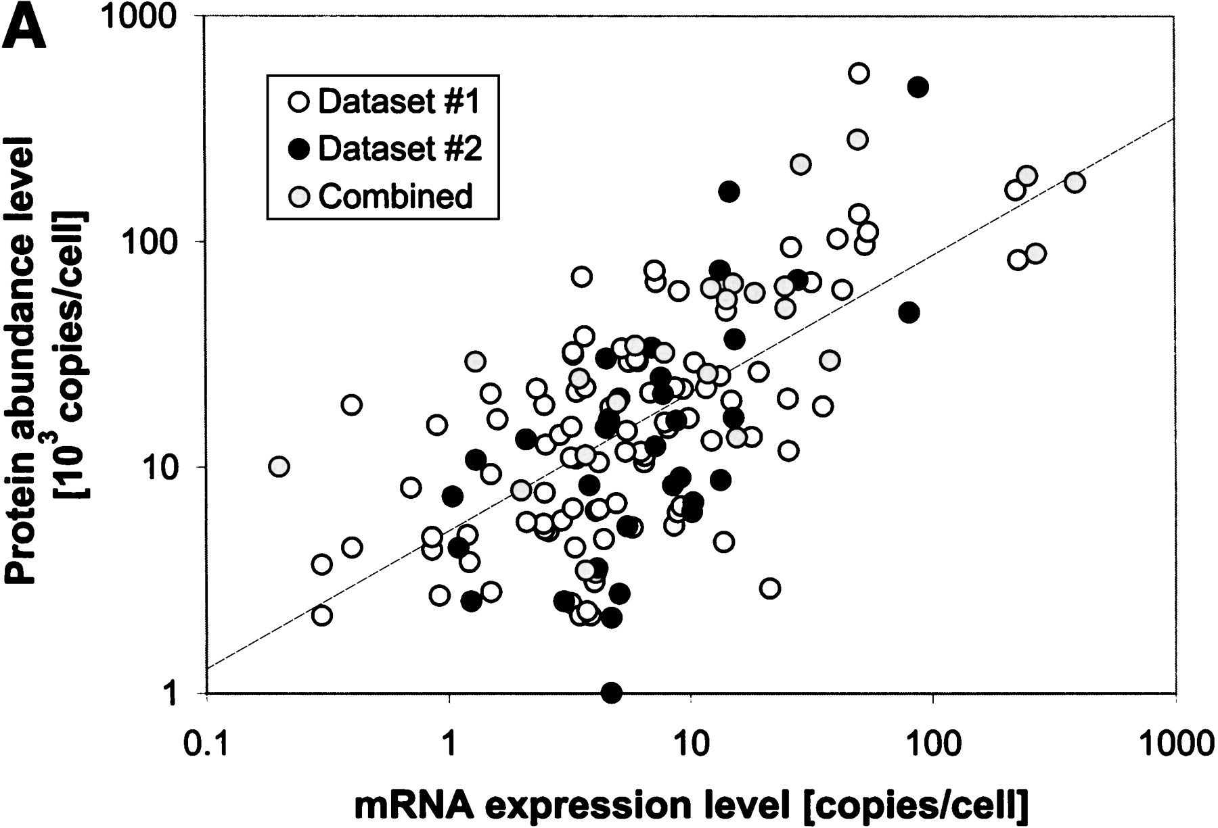
Early result on mRNA vs Protein, using 2D gels
r =0.67
[Greenbaum et al. Bioinformatics 2002, 18, 587]

Slide 5
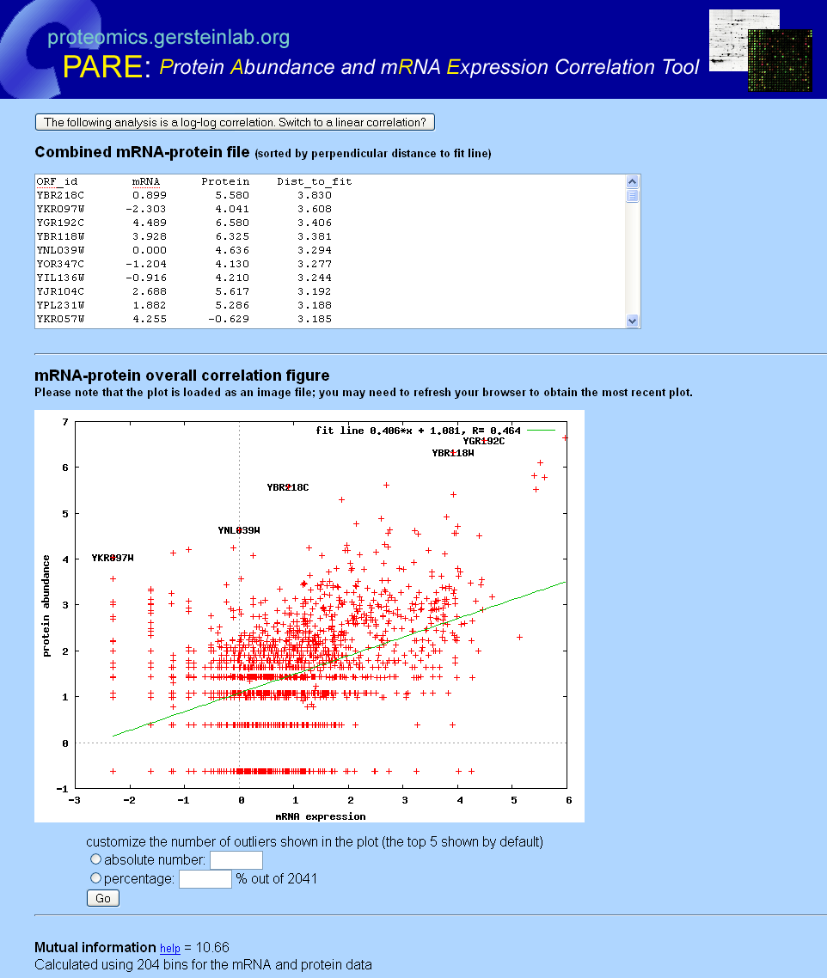
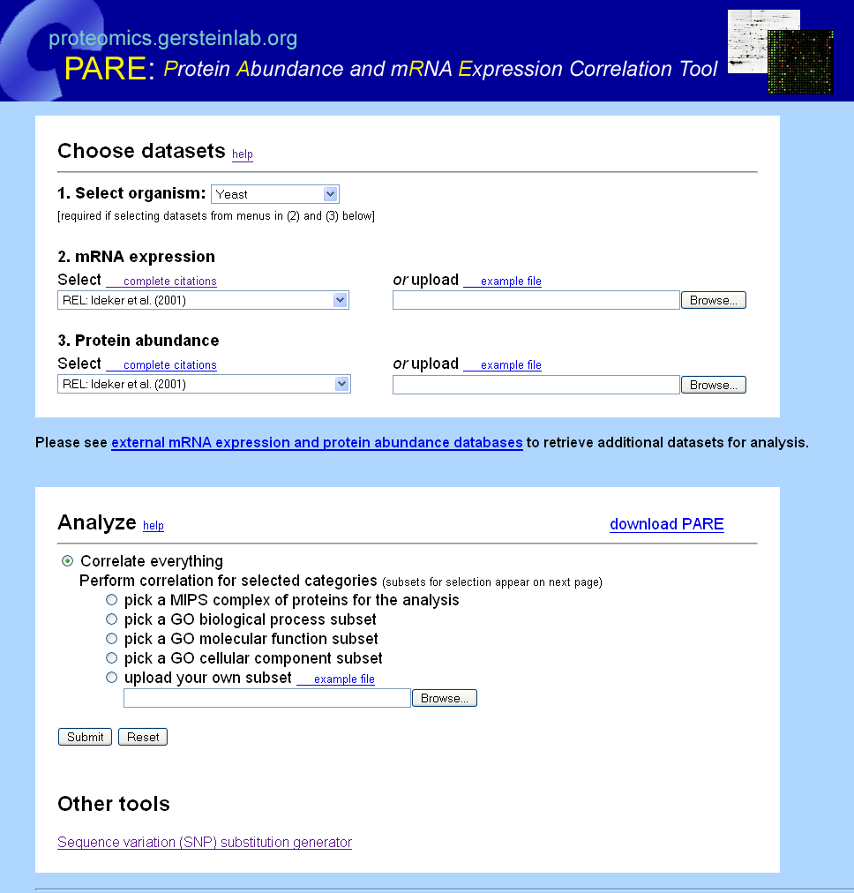
PARE
Open-source code Downloadable
Analyze all or GO subset
Log-log plot of correlation
-linear fit
-outliers labeled
Calculation of
mutual information
[Yu et al., BMC Bioinfo. '07]
Notes:
5

Slide 6
Outline: Comparing Protein & RNA Abundance
Past Context: to work in the Center
Quantifying the moderate statistical correlation between protein & RNA
PARE server
EMpire (Current result)
Leveraging the correlation to better assign peptides to isoforms
EM algorithm better assigns dominant isoforms, with greater interpretability
uORFs (Current result)
Affect translation & relationship between protein & RNA
Feature integration to find small subset of uORFs that most alter translation
Future Direction: Protein v RNA using matched samples in the Brainspan dataset + single-cell data

Slide 7
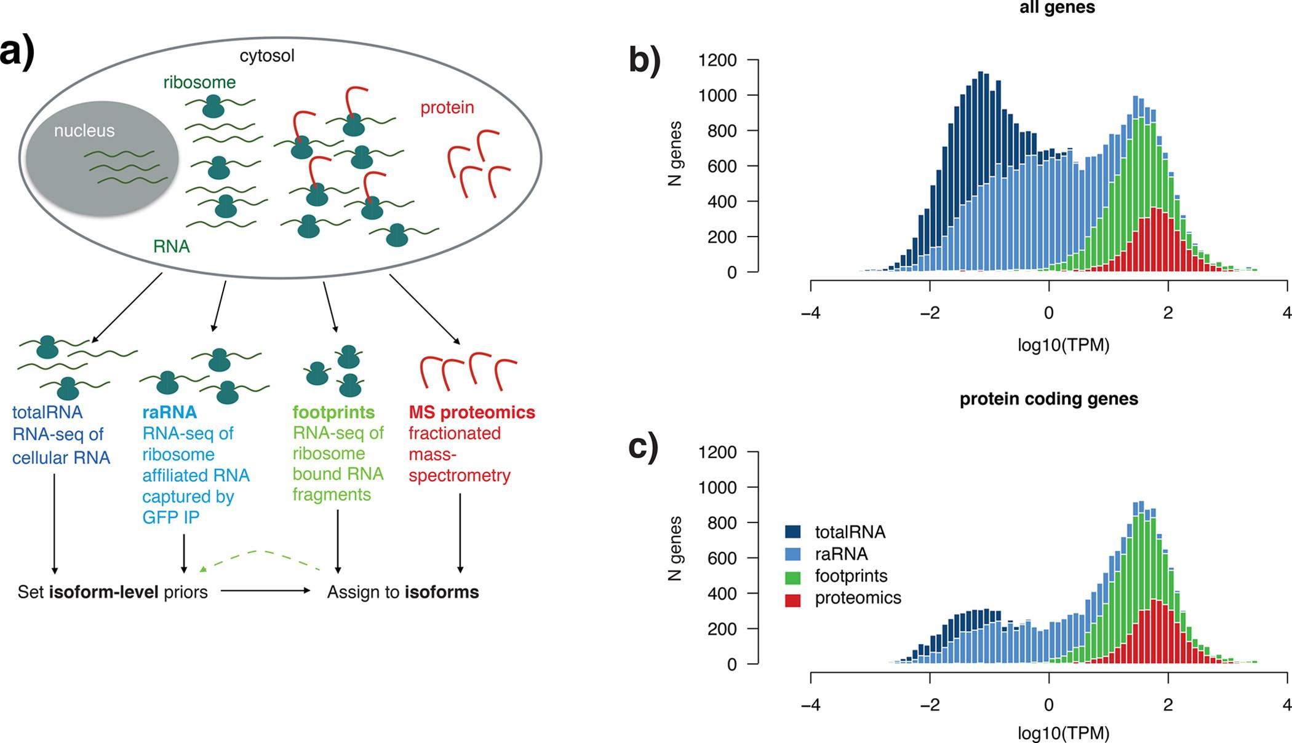
Integration of RNA-seq and Proteomic Data for Isoform Interpretation
[Carlyle, Kitchen et al. (2018) Journal of Proteome Research]

Slide 8
Challenge for Isoform-Level Interpretation of Proteomics Data
Multimapping
Different assays reflecting expression at various levels
More reads at earlier stage assay (RNA-Seq > FP > MS)
Leverage other assays for better estimation
[Carlyle, Kitchen et al. (2018) Journal of Proteome Research]

Slide 9
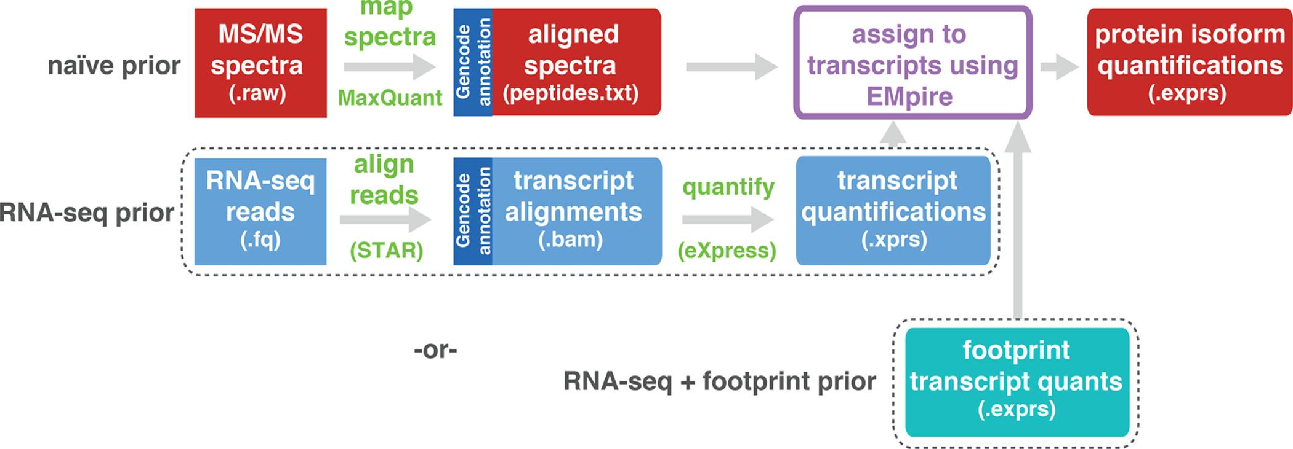
EMpire (Expectation Maximisation Propagation of Isoform abundance from RNA Expression)
[Carlyle, Kitchen et al. (2018) Journal of Proteome Research]

Slide 10
EMpire (Expectation Maximisation Propagation of Isoform abundance from RNA Expression)
[Carlyle, Kitchen et al. (2018) Journal of Proteome Research]

Slide 11
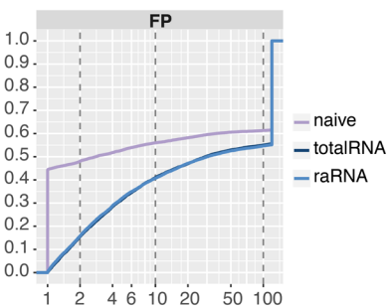
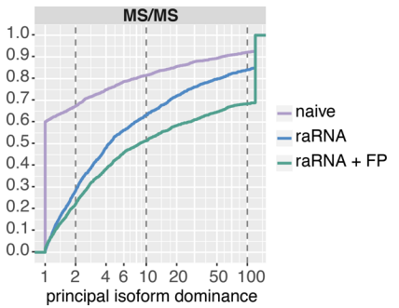
[Carlyle, Kitchen et al. (2018) Journal of Proteome Research]
Cumulative Fraction
Cumulative Fraction
Larger principal isoform dominance = Less ambiguity in major isoform identification

Slide 12
Biologically informative priors improve isoform level interpretation of MS/MS peptides, by increasing dominance of principal isoform
[Carlyle, Kitchen et al. (2018) Journal of Proteome Research]
Notes:
Figure S8 | Use of a biologically informative prior improves isoform level interpretation of ribosome footprints and
MS/MS peptides
Heatmaps show the effect of using different priors on the dominance of the principal isoform following the EM. In
each doublet row, the top row represents assignment of reads/peptides before EM, the second row represents
updated ratios after iterations of EM with a naive or biological prior. Clusters of principal isoforms (x-axes) are
indicated by dendrogram colours (top) and numeric IDs (bottom), the latter matching the cluster IDs in Figure 4.
a) The heatmap plots the principal isoform fraction for the 6,650 multi-isoform genes with at least 3 footprint
reads. Using a biological prior improved the ability to resolve the principal isoform in 3,795 genes (57.1%) and
converged on the same isoform as the naive prior in 2,747 genes (41.3%).
b) The heatmap plots the principal isoform fraction for the 1,212 multi-isoform genes with at least 2 peptides.
Using a biological prior improved the ability to resolve the principal isoform in 663 genes (54.7%) and converged
on the same isoform as the naive prior in 408 genes (33.7%).

Slide 13
Outline: Comparing Protein & RNA Abundance
Past Context: to work in the Center
Quantifying the moderate statistical correlation between protein & RNA
PARE server
EMpire (Current result)
Leveraging the correlation to better assign peptides to isoforms
EM algorithm better assigns dominant isoforms, with greater interpretability
uORFs (Current result)
Affect translation & relationship between protein & RNA
Feature integration to find small subset of uORFs that most alter translation
Future Direction: Protein v RNA using matched samples in the Brainspan dataset + single-cell data

Slide 14
Upstream open reading frames (uORFs) may shift the expected balance between mRNA & protein
[Zhang et al., Trends in Biochemical Sciences (‘19)]
uORF regulation can be affected by mutation
In Battle et al. 2014 data uORF gain & loss assoc. protein level change.
[McGillivray et al., NAR (‘18)]

Slide 15
The population of functional uORFs may be significant
Ribosome profiling experiments have low overlap in identified uORFs.
This suggests high false-negative rate, and more functional uORFs than currently known.
From a “Universe” of 1.3 M pot. uORFs
[McGillivray et al., NAR (‘18)]

Slide 16
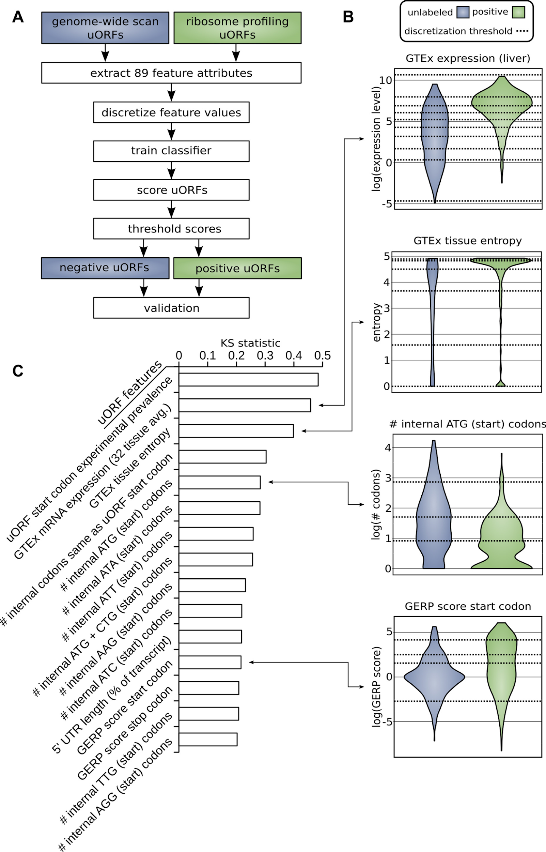
Prediction & validation of
functional uORFs using 89 features
Expr.
Level
All near-cognate start codons predicted.
Cross-validation on independent ribosome profiling datasets and validation using in vivo protein levels and ribosome occupancy in humans (Battle et al. 2014).
Tissue
Dist.
Int.
ATG
Start
Cons-
ervation
[McGillivray et al., NAR (‘18)]

Slide 17
A comprehensive catalog of functional uORFs
Universe of 1.3M uORFs scored via Simple Bayes algo.
180K: Large predicted positive set likely to affect translation
Calibration on gold standards, suggests getting ~70% of known
Predicted functional uORFs may be intersected with disease associated variants.
[McGillivray et al., NAR (‘18)]

Slide 18
Outline: Comparing Protein & RNA Abundance
Past Context: to work in the Center
Quantifying the moderate statistical correlation between protein & RNA
PARE server
EMpire (Current result)
Leveraging the correlation to better assign peptides to isoforms
EM algorithm better assigns dominant isoforms, with greater interpretability
uORFs (Current result)
Affect translation & relationship between protein & RNA
Feature integration to find small subset of uORFs that most alter translation
Future Direction: Protein v RNA using matched samples in the Brainspan dataset + single-cell data

Slide 19
Leveraging New Datasets

Slide 20
Schematic workflow

Slide 22
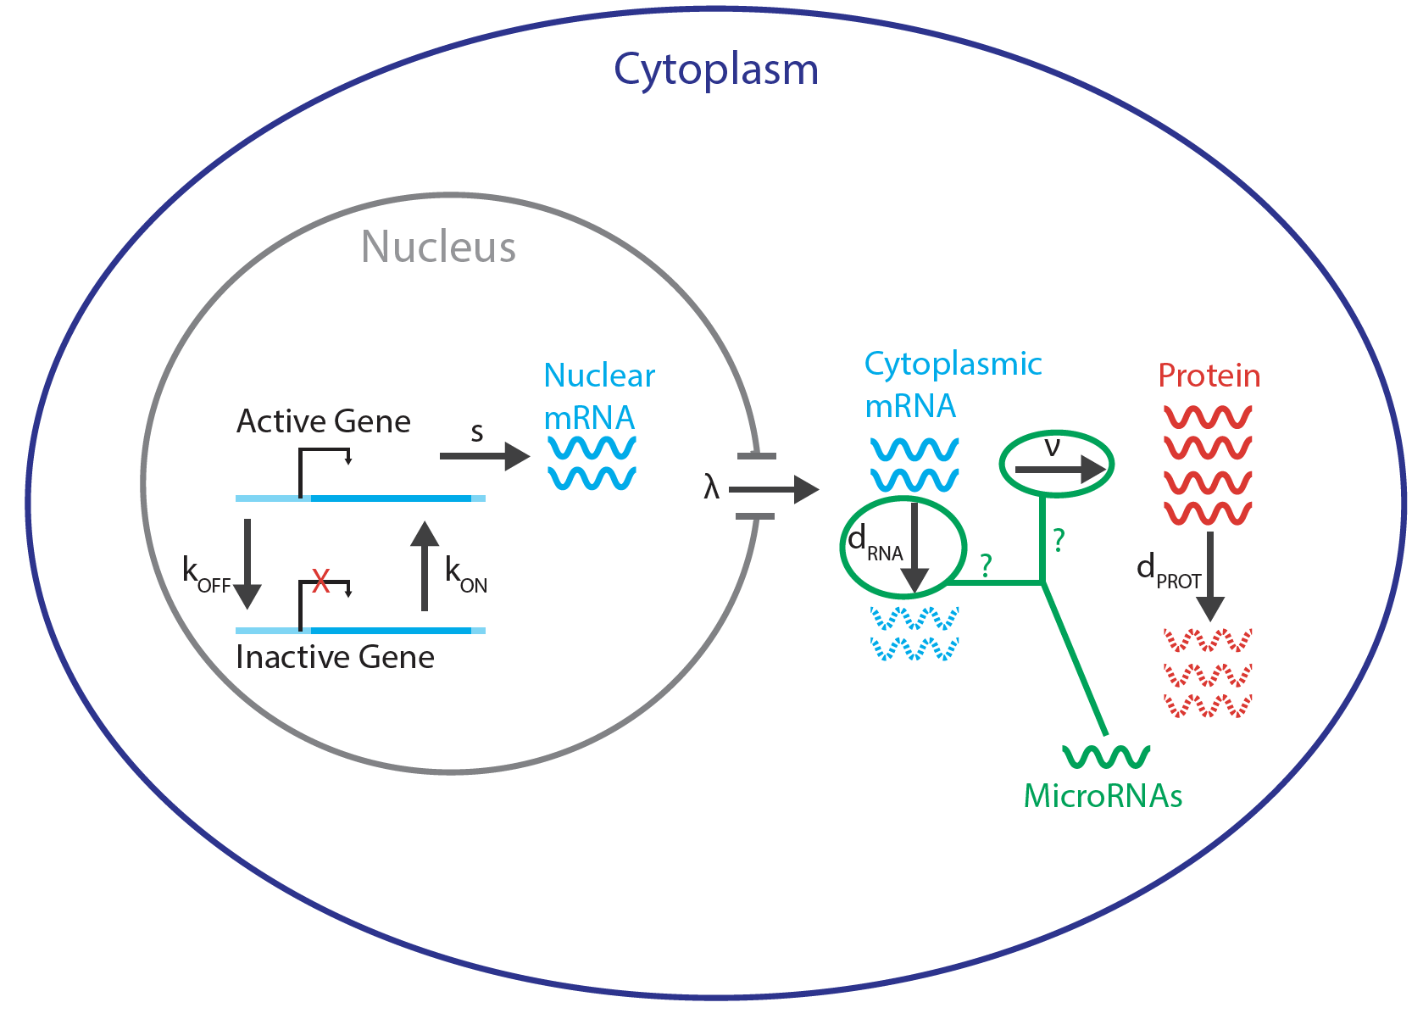
MicroRNA intervention
Sousa et al., Science 2017, 358, Pgs. 1027–1032.

Slide 23
Outline: Comparing Protein & RNA Abundance
Past Context: to work in the Center
Quantifying the moderate statistical correlation between protein & RNA
PARE server
EMpire (Current result)
Leveraging the correlation to better assign peptides to isoforms
EM algorithm better assigns dominant isoforms, with greater interpretability
uORFs (Current result)
Affect translation & relationship between protein & RNA
Feature integration to find small subset of uORFs that most alter translation
Future Direction: Protein v RNA using matched samples in the Brainspan dataset + single-cell data

Slide 24
genecensus.org/expression/translatome
D Greenbaum, R Jansen, M Gerstein
Proteomics.gersteinlab.org (PARE)
E Yu, A Burba, M Gerstein
github.com/rkitchen/EMpire
B Carlyle, R Kitchen, J Zhang, R Wilson, T Lam, J Rozowsky, K Williams, N Sestan, M Gerstein, A Nairn
github.gersteinlab.org/uORFs
P McGillivray, R Ault, M Pawashe, R Kitchen, S Balasubramanian, M Gerstein
Brainspan data
P Emani, T Galeev, N Sestan, A Nairn
Acknowledgments!

