Slide 1
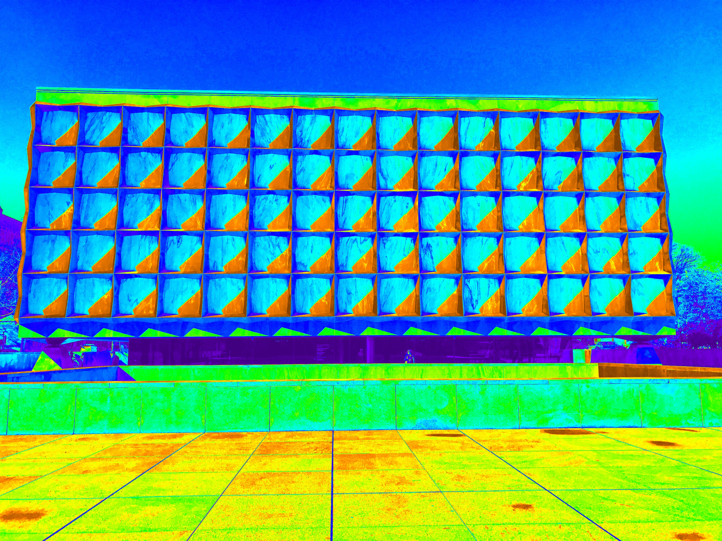
Personal Genomics & Data Science:
Using population-scale functional genomics to suggest potential neuropsychiatric drug targets & building a hybrid classifier to ascertain differential drug sensitivity
M Gerstein
Yale
(See last slide for more info.)
Slides freely downloadable
from Lectures.GersteinLab.org
& “tweetable” (via @MarkGerstein)

Slide 2

The Genomic Future

Slide 3
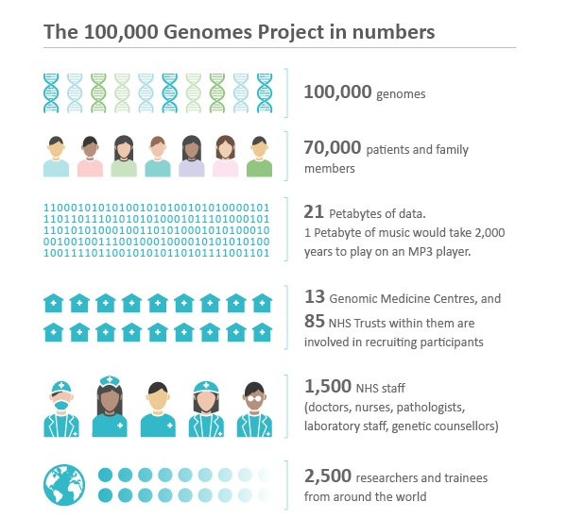


Many big projects.
Soon millions will be sequenced….
https://www.mongodb.com/press/genomics-england-uses-mongodb-to-power-the-data-science-behind-the-100000-genomes-project

Slide 4
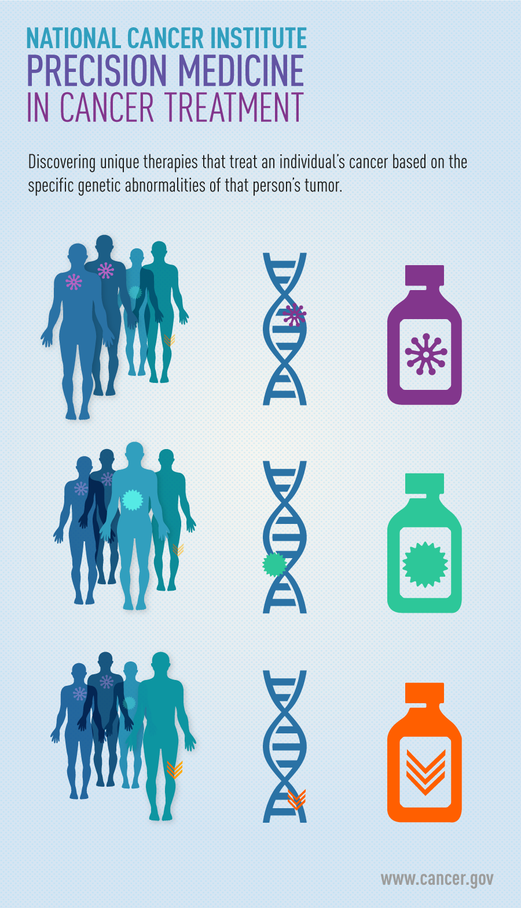
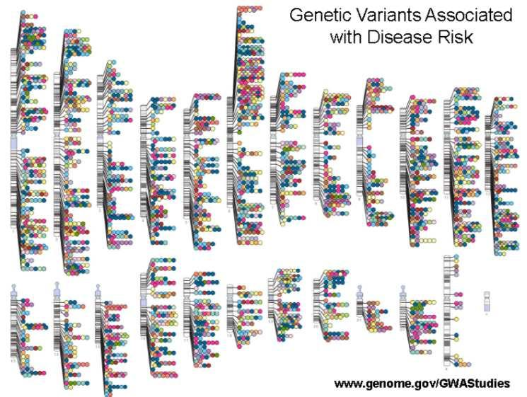
What to do with these variants in relation to disease
Personalized risk prediction
for many conditions
Precision oncology
Drug target identification
via genetic associations
Accounting for differential drug sensitivity

Slide 5
Using population-scale functional genomics to suggest potential neuropsychiatric drug targets
& building a hybrid classifier to ascertain differential drug sensitivity
PsychENCODE: Population-level analysis of
functional genomics data related to
neuropsychiatric disease
  Construction of an adult brain resource with 1866 individuals + full developmental time-course
  Using the changing proportions of cell types (via single-cell deconvolution) to account for
  expression variation across a population,
  disorders & development
  Large-scale processing defines ~79K PFC
  enhancers & creates a comprehensive QTL resource (~2.5M eQTLs + cQTLs & fQTLs)
  Connecting QTLs, enhancer activity relationships & Hi-C contacts into a brain regulatory network & using this to link SCZ GWAS SNPs to genes
  Embedding the reg. network in a
  deep-learning model to predict psychiatric disease from genotype & transcriptome. Using this to suggest specific pathways & genes, as potential drug targets.
  Other resource uses: highlighting aging related genes + consistently comparing the brain to other organs
GenoDock: Building a predictor for the sensitivity of drug binding to personal SNVs
  Hybrid classifier connecting physical modelling with statistical learning
    The modeling creates a pseudo gold-standard dataset, which is used to train the stat. classifier
  Classifier Results
    Independent validation
    on an expt. validation set
    Gives higher disruption scores to cancer driver SNVs. Also, illustrates importance of different features (eg GERP).
    Picks out certain drugs (eg imatinib) as being particularly sensitive to SNVs

Slide 6
Using population-scale functional genomics to suggest potential neuropsychiatric drug targets
& building a hybrid classifier to ascertain differential drug sensitivity
PsychENCODE: Population-level analysis of
functional genomics data related to
neuropsychiatric disease
  Construction of an adult brain resource with 1866 individuals + full developmental time-course
  Using the changing proportions of cell types (via single-cell deconvolution) to account for
  expression variation across a population,
  disorders & development
  Large-scale processing defines ~79K PFC
  enhancers & creates a comprehensive QTL resource (~2.5M eQTLs + cQTLs & fQTLs)
  Connecting QTLs, enhancer activity relationships & Hi-C contacts into a brain regulatory network & using this to link SCZ GWAS SNPs to genes
  Embedding the reg. network in a
  deep-learning model to predict psychiatric disease from genotype & transcriptome. Using this to suggest specific pathways & genes, as potential drug targets.
  Other resource uses: highlighting aging related genes + consistently comparing the brain to other organs
GenoDock: Building a predictor for the sensitivity of drug binding to personal SNVs
  Hybrid classifier connecting physical modelling with statistical learning
    The modeling creates a pseudo gold-standard dataset, which is used to train the stat. classifier
  Classifier Results
    Independent validation
    on an expt. validation set
    Gives higher disruption scores to cancer driver SNVs. Also, illustrates importance of different features (eg GERP).
    Picks out certain drugs (eg imatinib) as being particularly sensitive to SNVs

Slide 7
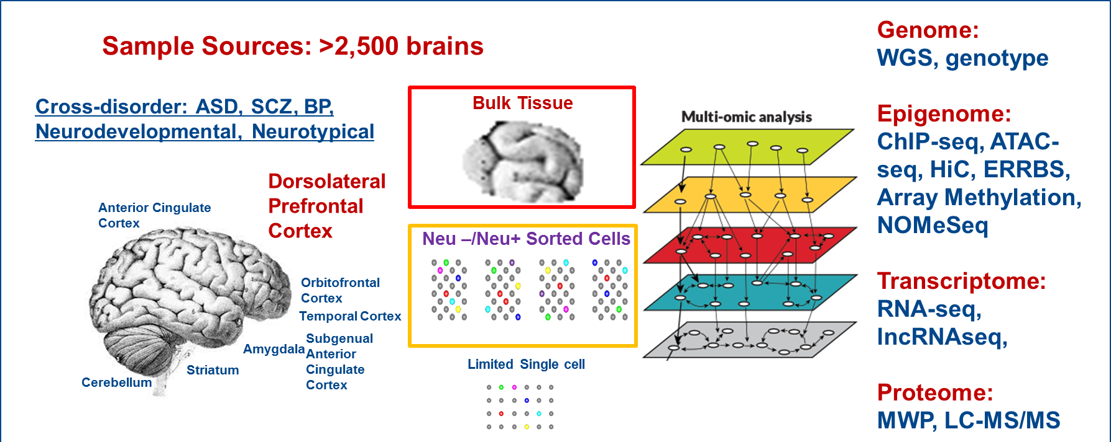


PsychENCODE
’18 rollout in Science
Single Cell
11 papers in total.
Major material in the 3 capstones:
Wang et al. (‘18), Li et al. (‘18), Gandal et al. ('18)
Notes:
Current phase is wrapping up- we have uniformly processed data across disorders and time periods on now up to >2500 frozen postmortem brains from brain banks.
Data generation has focus on mostly DLFPC with a few other brain regions also covered.
Analyses were primarily bulk tissues with some sorted NeuN+/- cells and a limited amount of ss data generation.
Multiple assays – WGS, SNP genotypes Epigenome: ChIP-seq, ATAC-seq, HiC, ERRBS, Array Methylation, NOMeSeq Transcriptome: RNA-seq, lncRNAseq, Proteome: RPPA.
The analyses have focused on identifying brain enhancers relevant and disease-specific eQTLs and epigenomic variation.
An invaluable public resource of multidimensional genomic data
They are also collaborating with GTEX, ENCODE and other related consortia to enhance the power and impact of their analyses.

Slide 8
A core issue addressed by PsychENCODE:
Using functional genomics to reveal molecular mechanisms between genotype and phenotype in brain disorders
Disease | Heritability* | Molecular Mechanisms
Schizophrenia | 81% | (C4A)
Bipolar disorder | 70% | -
Alzheimer's disease | 58 - 79% | Apolipoprotein E (APOE), Tau
Hypertension | 30% | Renin–angiotensin–aldosterone
Heart disease | 34-53% | Atherosclerosis, VCAM-1
Stroke | 32% | Reactive oxygen species (ROS), Ischemia
Type-2 diabetes | 26% | Insulin resistance
Breast Cancer | 25-56% | BRCA, PTEN
Phenotype
SCZ
BPD
AGE
…
*https://www.snpedia.com/index.php/Heritability
pathways, circuits
Cell types
Modules
Regulatory elements
Genes
Genotype
Many psychiatric conditions are highly heritable
  Schizophrenia: up to 80%
But we don’t understand basic molecular mechanisms underpinning this association
(in contrast to many other diseases such as cancer & heart disease)
Thus, interested in developing predictive models of psychiatric traits which:
  Use observations at intermediate (molecular levels) levels to inform latent structure
  Use the predictive features of these “molecular endo phenotypes” to begin to suggest actors involved in mechanism

Slide 9
Developmental Capstone Data Set
60 Individuals in total
Ages from 5 PCW to 64 yrs.
16 brain regions for > 9 PCW
[Li et al. (‘18) Science]

Slide 10
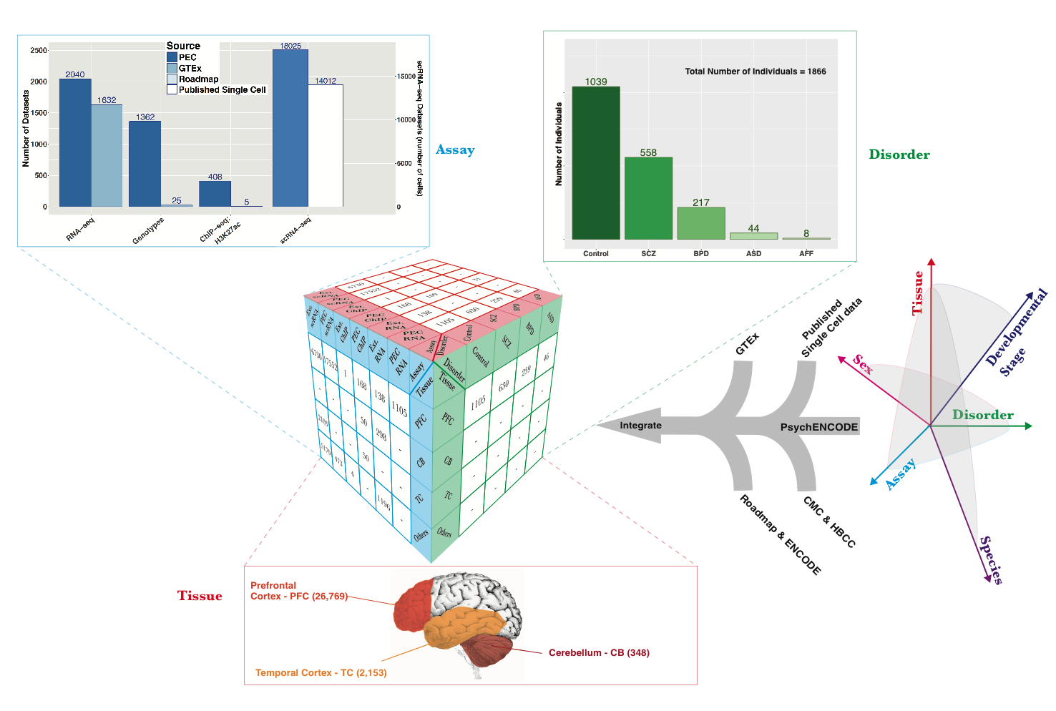
Collecting functional genomic datasets for the adult brain from PsychENCODE, other large consortia & single cell studies
1866
Individuals
~3.7K bulk RNA-seq
~32K single-cells
[Wang et al. (‘18) Science]

Slide 11
Merging & Clustering Single Cell Data Sets
Single cell signatures, from:
~14K cells
(Lake et al.,‘16 & ‘18)
~400 cells
(Darmanis et al., PNAS, ‘15)
~18K cells (PsychENCODE)
Lake et al., 2018 data
PEC adult data
[Li et al. (‘18), Science. Wang et al. (‘18). Science]

Slide 12
24 selected cell types
(Neuronal, NonNeuronal, Developmental)
1866 individuals
1866 individuals
Bulk
expression
(B)
Deconvolution
All genes
24 selected cell types
Single-cell deconvolution
Step 1:
Supervised learning to estimate cell fractions
All genes (∼20K)
≈
×
Cell fractions (W)
Single cell expression (C)
88%±4%
Individual and cross-population reconstruction accuracy via deconvolution
[Wang et al. (‘18) Science]

Slide 13
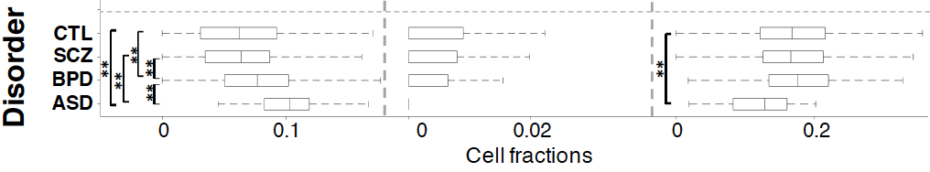
Different neuronal & glial cell fractions across disorders
Ex5
In6
Oligo
Excitatory to Inhibitory imbalance at neuronal subtype level for ASD*
* Rubenstein et al., Model of autism: increased ratio of excitation/inhibition in key neural systems, Genes Brain Behav. 2003
[Wang et al. (‘18) Science]
Notes:
* Rubenstein et al., Model of autism: increased ratio of excitation/inhibition in key neural systems, Genes Brain Behav. 2003
** Gandal et al., Shared molecular neuropathology across major psychiatric disorders parallels polygenic overlap, Science 2018

Slide 14
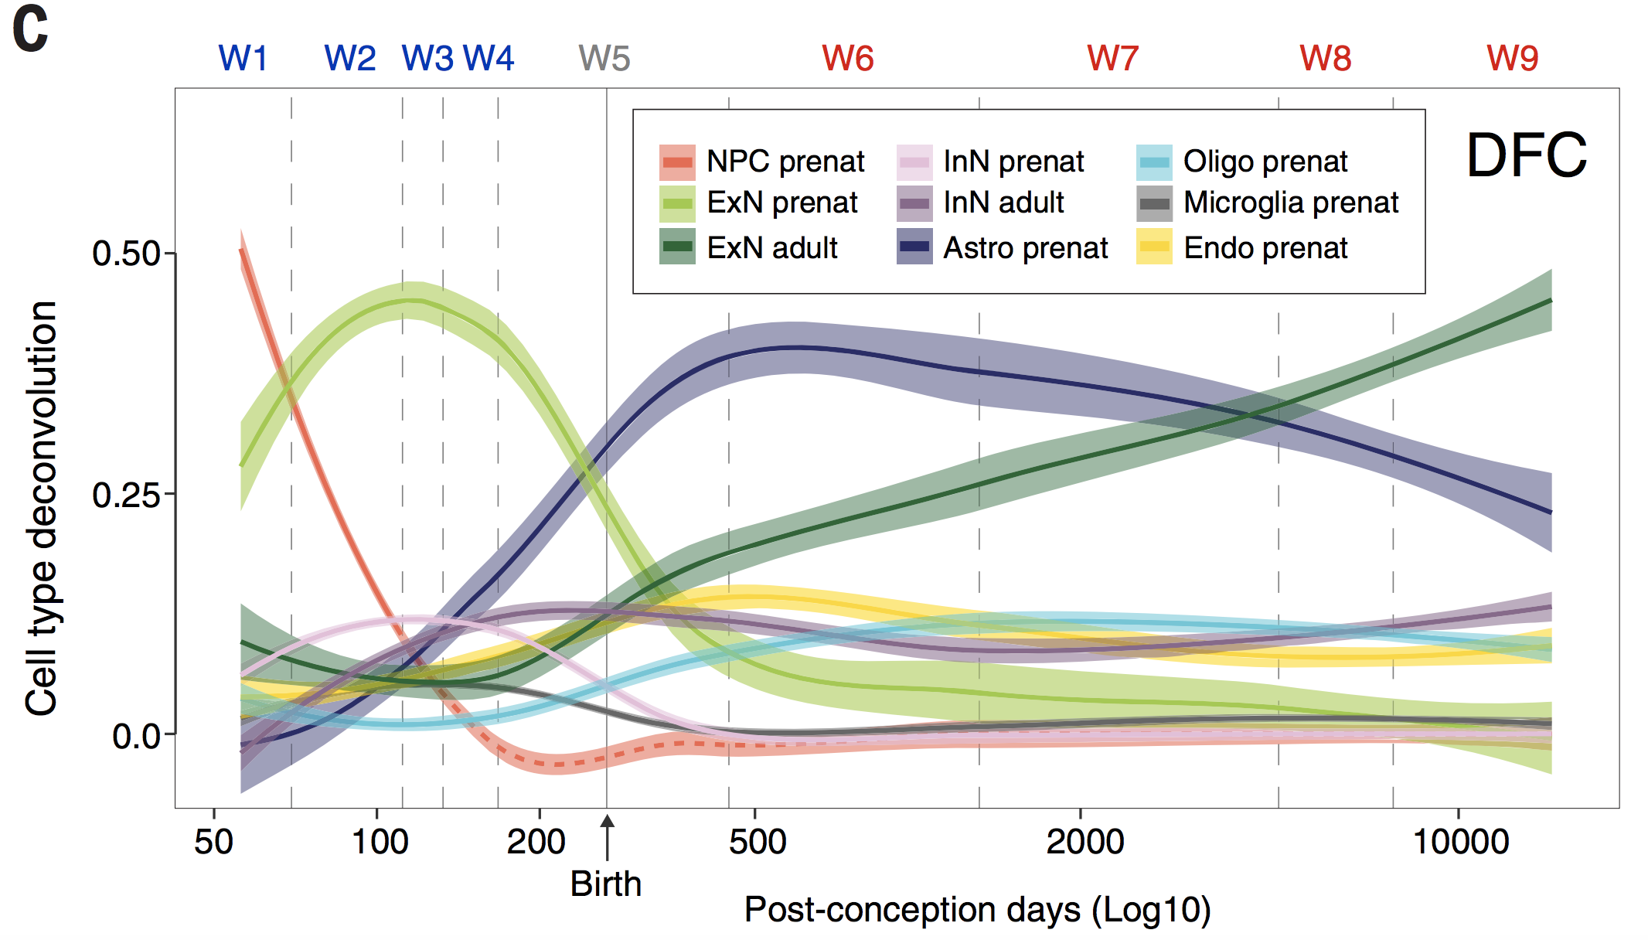
Different neuronal & glial cell fractions across ages
[Li et al. (‘18) Science]
Notes:
* Rubenstein et al., Model of autism: increased ratio of excitation/inhibition in key neural systems, Genes Brain Behav. 2003
** Gandal et al., Shared molecular neuropathology across major psychiatric disorders parallels polygenic overlap, Science 2018

Slide 15
Using population-scale functional genomics to suggest potential neuropsychiatric drug targets
& building a hybrid classifier to ascertain differential drug sensitivity
PsychENCODE: Population-level analysis of
functional genomics data related to
neuropsychiatric disease
  Construction of an adult brain resource with 1866 individuals + full developmental time-course
  Using the changing proportions of cell types (via single-cell deconvolution) to account for
  expression variation across a population,
  disorders & development
  Large-scale processing defines ~79K PFC
  enhancers & creates a comprehensive QTL resource (~2.5M eQTLs + cQTLs & fQTLs)
  Connecting QTLs, enhancer activity relationships & Hi-C contacts into a brain regulatory network & using this to link SCZ GWAS SNPs to genes
  Embedding the reg. network in a
  deep-learning model to predict psychiatric disease from genotype & transcriptome. Using this to suggest specific pathways & genes, as potential drug targets.
  Other resource uses: highlighting aging related genes + consistently comparing the brain to other organs
GenoDock: Building a predictor for the sensitivity of drug binding to personal SNVs
  Hybrid classifier connecting physical modelling with statistical learning
    The modeling creates a pseudo gold-standard dataset, which is used to train the stat. classifier
  Classifier Results
    Independent validation
    on an expt. validation set
    Gives higher disruption scores to cancer driver SNVs. Also, illustrates importance of different features (eg GERP).
    Picks out certain drugs (eg imatinib) as being particularly sensitive to SNVs

Slide 16
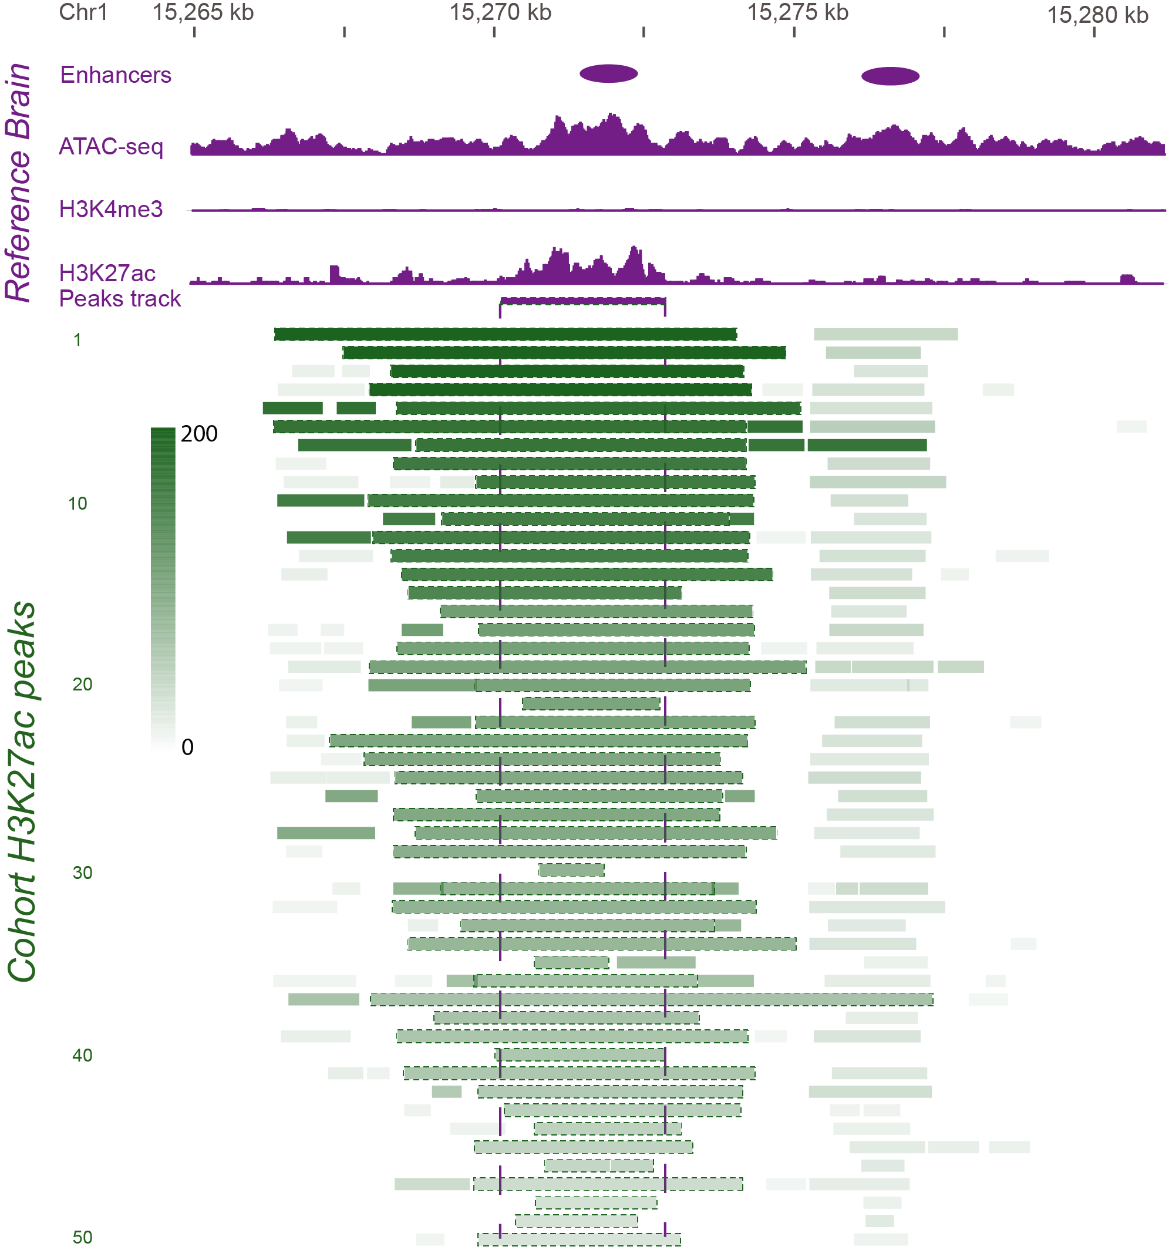
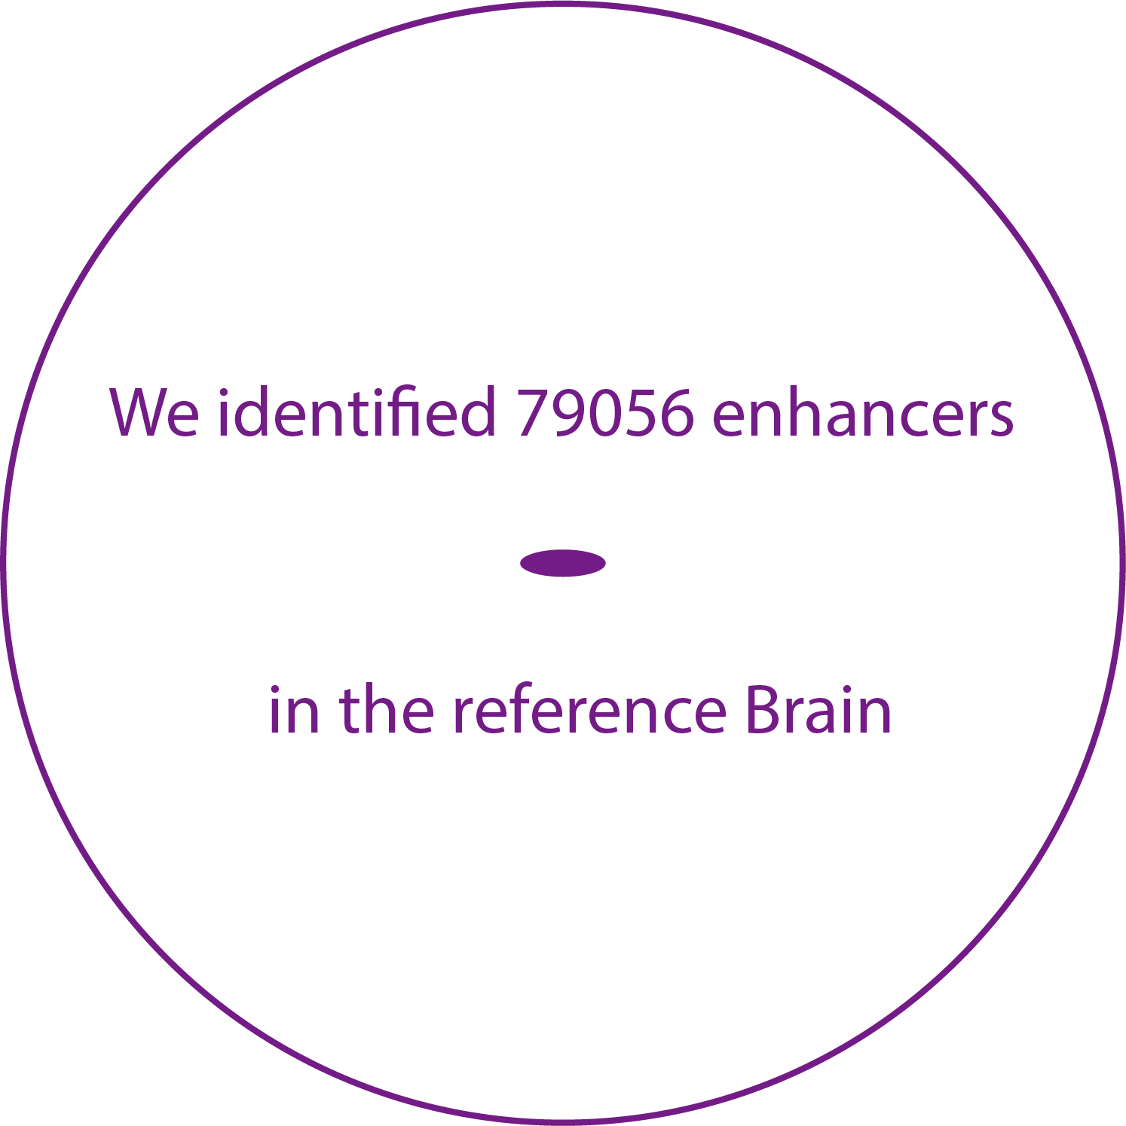
Developing a Reference Set of ~79K PFC Enhancers & Studying Their Population Variation
Characterize brain specific enhancers
Consistent with ENCODE, active enhancers are identified as open chromatin regions enriched in H3K27ac and depleted in H3K4me3
[Wang et al. (‘18) Science]

Slide 17
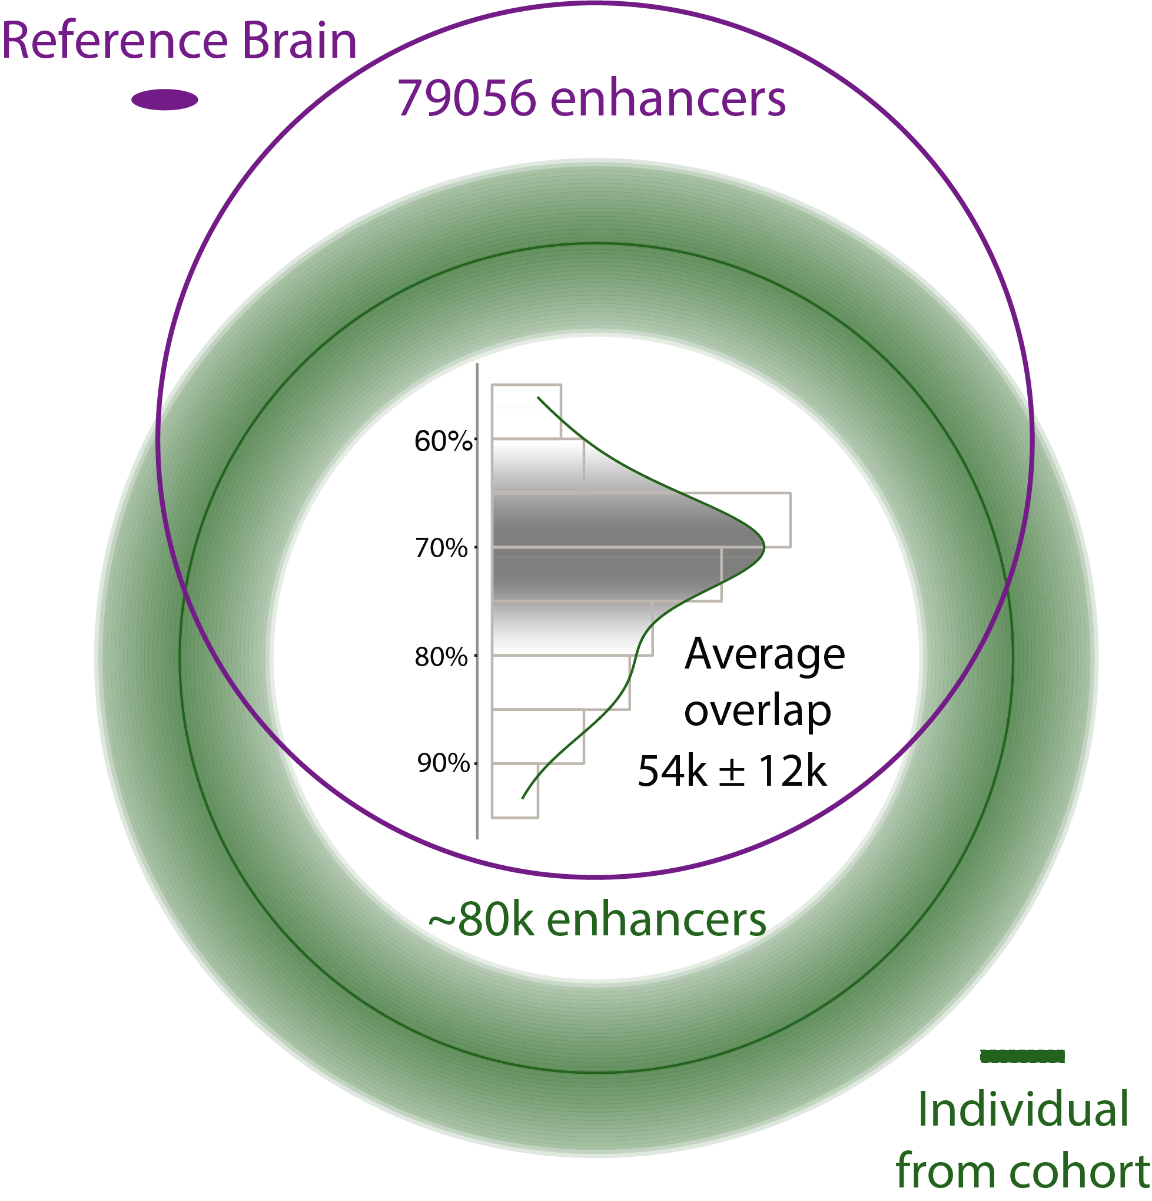
Developing a Reference Set of ~79K PFC Enhancers & Studying Their Population Variation
Characterize brain specific enhancers
[Wang et al. (‘18) Science]

Slide 18
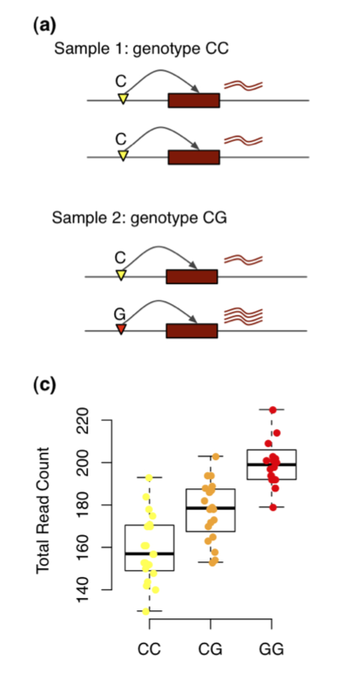
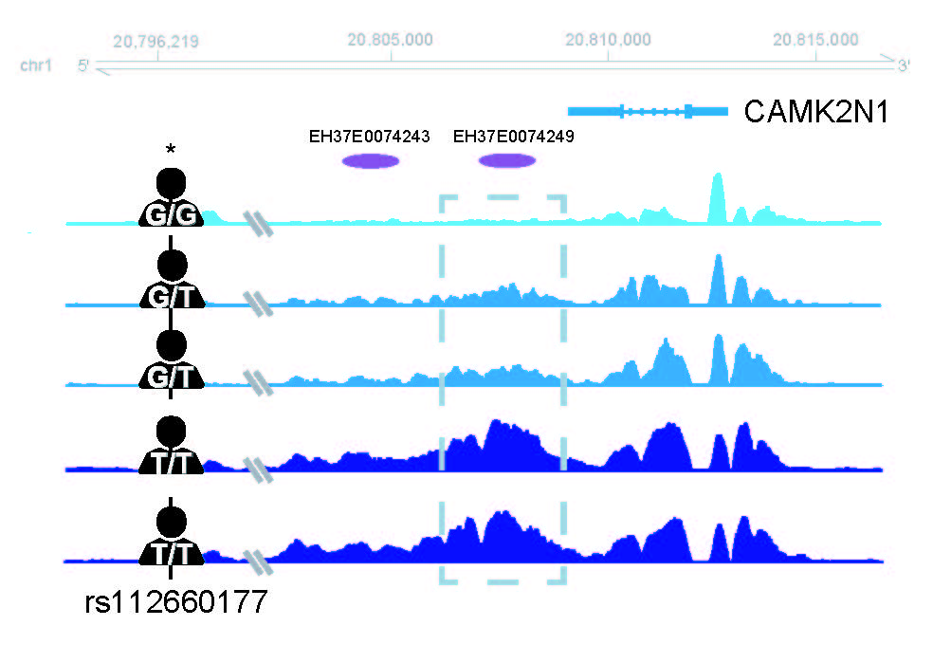
Chromatin variation in the population
Quantitaive Trait Loci (QTLs) associated with variation
Gene expression (eQTL)
Chromatin (cQTL)
Sun, Wei, and Yijuan Hu. "eQTL mapping using RNA-seq data." Statistics in biosciences 5.1 (2013): 198-219.
[Wang et al. (‘18) Science]

Slide 19
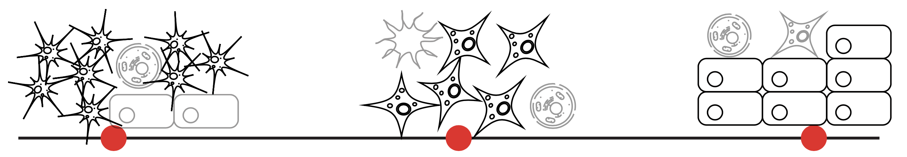
Cell fraction QTLs (fQTLs)
A→T
C→G
T→C
[Wang et al. (‘18) Science]
Notes:
Brain eQTLs
32944(75%) eGenes
2,542,908 eQTLs (3% out of 66,441,766 total pairs)
1,341,182 unique cis-eSNP (~20%) (~238K independent SNPs after linkage-disequilibrium (LD) pruning)

Slide 20
Larger brain eQTL sets than previous studies, but strong overlap with them
2,542,908 eQTLs (FDR< 0.05)
[Wang et al. (‘18) Science]
Notes:
Brain eQTLs
32944(75%) eGenes
2,542,908 eQTLs (3% out of 66,441,766 total pairs)
1,341,182 unique cis-eSNP (~20%) (~238K independent SNPs after linkage-disequilibrium (LD) pruning)

Slide 21
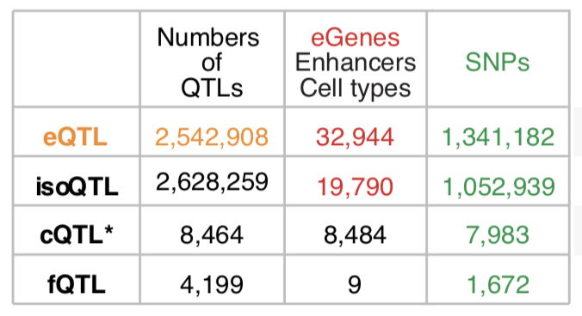
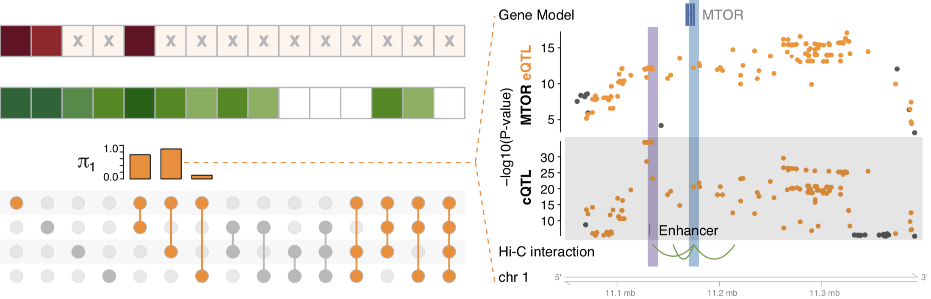
multi-QTLs from overlapping different types of QTLs: cQTL, fQTL, eQTL & isoQTL
eQTLs for mTOR mediated by cQTLs
eQTL
isoQTL
cQTL
fQTL
eQTLs and cQTLs significantly overlap
1391 SNPs (multi-QTLs)
in at least three types
among eQTLs, isoQTLs, cQTLs, fQTLs
[Wang et al. (‘18) Science]
Notes:
*top SNPs for each enhancer
To evaluate this precisely, we calculated π₁ statistics and found that the eQTL overlap with cQTLs was the most significant while that with fQTLs was lowest (0.89 vs 0.11). Moreover, eQTL-cQTL overlaps often suggested that the expression-modulating function of an eQTL derived from chromatin changes (e.g. for MTOR, Fig. 4F). Finally, 119 SNPs, which we dubbed multi-QTLs, functioned as QTLs in more than 3 different capacities (e.g. as eQTLs, cQTLs and isoQTLs).
https://www.nature.com/articles/nrn3068

Slide 22
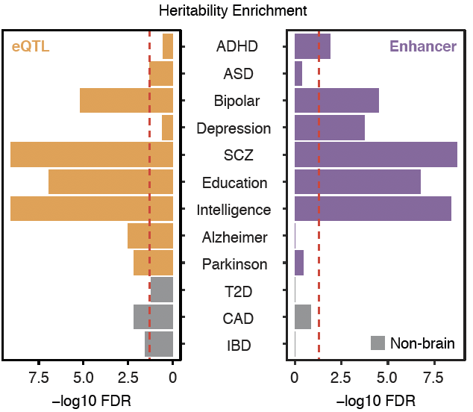
Brain eQTLs and enhancers enriched with GWAS SNPs for brain disorders
Enrichment
Wang, et al., Science, 2018
Notes:
DLPFC for psy disorders
AD/PD is not spec for DLPFC
*linkage disequilibrium score regression (LDSC, Finucane et al., 2015; https://github.com/bulik/ldsc/wiki/Partitioned-Heritability)
ADHD, attention-deficit/hyperactivity disorder; T2D, type 2 diabetes; CAD, coronary artery disease; IBD, inflammatory bowel disease.

Slide 23
Using population-scale functional genomics to suggest potential neuropsychiatric drug targets
& building a hybrid classifier to ascertain differential drug sensitivity
PsychENCODE: Population-level analysis of
functional genomics data related to
neuropsychiatric disease
  Construction of an adult brain resource with 1866 individuals + full developmental time-course
  Using the changing proportions of cell types (via single-cell deconvolution) to account for
  expression variation across a population,
  disorders & development
  Large-scale processing defines ~79K PFC
  enhancers & creates a comprehensive QTL resource (~2.5M eQTLs + cQTLs & fQTLs)
  Connecting QTLs, enhancer activity relationships & Hi-C contacts into a brain regulatory network & using this to link SCZ GWAS SNPs to genes
  Embedding the reg. network in a
  deep-learning model to predict psychiatric disease from genotype & transcriptome. Using this to suggest specific pathways & genes, as potential drug targets.
  Other resource uses: highlighting aging related genes + consistently comparing the brain to other organs
GenoDock: Building a predictor for the sensitivity of drug binding to personal SNVs
  Hybrid classifier connecting physical modelling with statistical learning
    The modeling creates a pseudo gold-standard dataset, which is used to train the stat. classifier
  Classifier Results
    Independent validation
    on an expt. validation set
    Gives higher disruption scores to cancer driver SNVs. Also, illustrates importance of different features (eg GERP).
    Picks out certain drugs (eg imatinib) as being particularly sensitive to SNVs

Slide 24
Gene regulatory network inference from Hi-C, QTLs & Activity Correlations
[Wang et al. (‘18) Science]

Slide 25
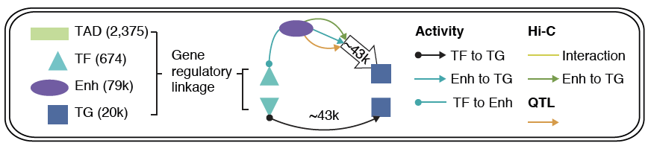
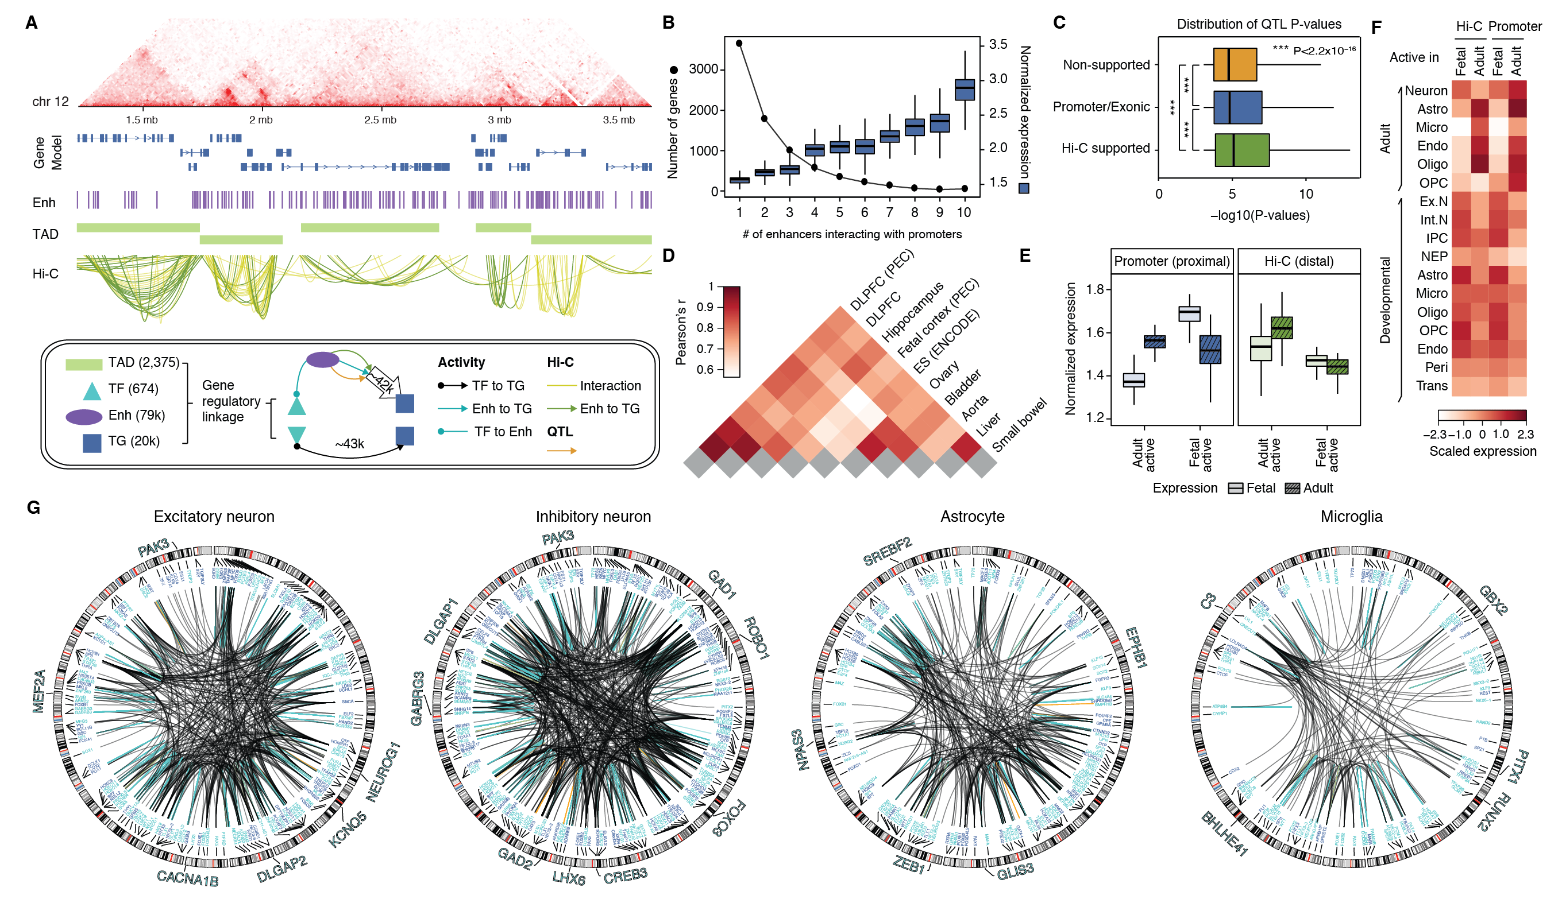
Imputed gene regulatory network for the human brain
Imputed gene regulatory network linking TFs, enhancers and genes plus QTLs
subnetworks targeting single cell marker genes
[Wang et al. (‘18) Science]

Slide 26
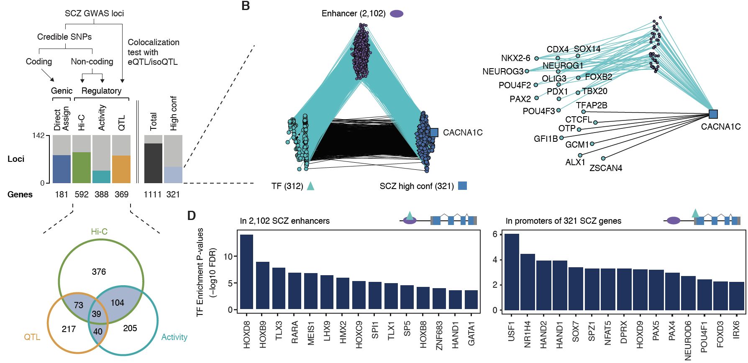
Linking GWAS SNPs to disease genes using the regulatory network
142
321
high-confident SCZ genes
Activity
[Wang et al. (‘18) Science]
Notes:
* A. F. Pardinas et al., Common schizophrenia alleles are enriched in mutation-intolerant genes and in regions under strong background selection. Nat Genet 50, 381-389 (2018)
For example, we found a set of TFs having enriched binding sites (TFBSs) on the promoters of SCZ genes, revealing potential cis-regulatory mechanisms of TFs to SCZ gene expression (Fig. 6D). Also, we found additional TFs that have enriched binding sites on the enhancers that overlap with SCZ credible SNPs (Fig. 6D), suggesting potential distal regulatory mechanisms of SCZ credible SNPs via affecting TFBSs on enhancers. In particular, these TFs include REST, a transcriptional repressor for neuronal genes \cite{16150588}, and SOX7, a TF that promotes neuronal apoptosis \cite{25847511}.

Slide 27
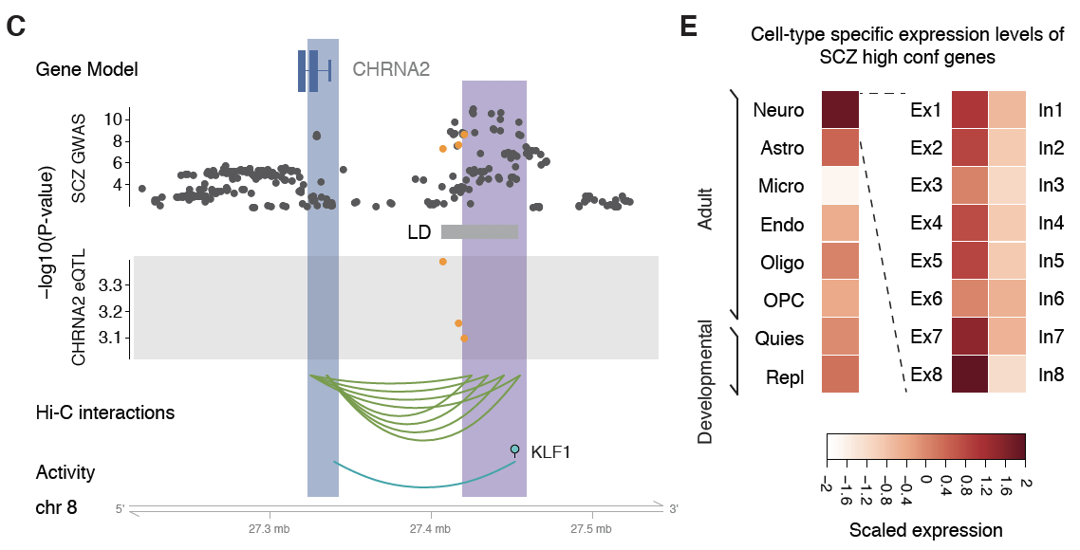
GWAS variants and single cell expression levels for SCZ genes
Wang, et al., Science, 2018
Notes:
https://www.ncbi.nlm.nih.gov/pubmed/29483656
* A. F. Pardinas et al., Common schizophrenia alleles are enriched in mutation-intolerant genes and in regions under strong background selection. Nat Genet 50, 381-389 (2018)

Slide 28
Using population-scale functional genomics to suggest potential neuropsychiatric drug targets
& building a hybrid classifier to ascertain differential drug sensitivity
PsychENCODE: Population-level analysis of
functional genomics data related to
neuropsychiatric disease
  Construction of an adult brain resource with 1866 individuals + full developmental time-course
  Using the changing proportions of cell types (via single-cell deconvolution) to account for
  expression variation across a population,
  disorders & development
  Large-scale processing defines ~79K PFC
  enhancers & creates a comprehensive QTL resource (~2.5M eQTLs + cQTLs & fQTLs)
  Connecting QTLs, enhancer activity relationships & Hi-C contacts into a brain regulatory network & using this to link SCZ GWAS SNPs to genes
  Embedding the reg. network in a
  deep-learning model to predict psychiatric disease from genotype & transcriptome. Using this to suggest specific pathways & genes, as potential drug targets.
  Other resource uses: highlighting aging related genes + consistently comparing the brain to other organs
GenoDock: Building a predictor for the sensitivity of drug binding to personal SNVs
  Hybrid classifier connecting physical modelling with statistical learning
    The modeling creates a pseudo gold-standard dataset, which is used to train the stat. classifier
  Classifier Results
    Independent validation
    on an expt. validation set
    Gives higher disruption scores to cancer driver SNVs. Also, illustrates importance of different features (eg GERP).
    Picks out certain drugs (eg imatinib) as being particularly sensitive to SNVs

Slide 29

Deep Structured Phenotype Network
(DSPN)
Boltzmann machine
y: phenotypes
h: hidden units (e.g., circuits)
x: intermediate phenotypes (e.g., genes, enhancers)
z: genotypes (e.g., SNPs)
W: weights
(e.g., regulatory network)
Gene
regulatory network
builds
skeleton
Energy model:
$$p\left(x,y,h|z\right)∝\exp\left(−E\left(x,y, h|z\right)\right)$$
$$E\left(x,y, h|z\right)={−z}^{T}W_{1}x{−x}^{T}W_{2}x−x^{T}W_{3}h−h^{T}W_{4}h−h^{T}W_{5}y−Bias$$
[Wang et al. (‘18) Science]

Slide 30
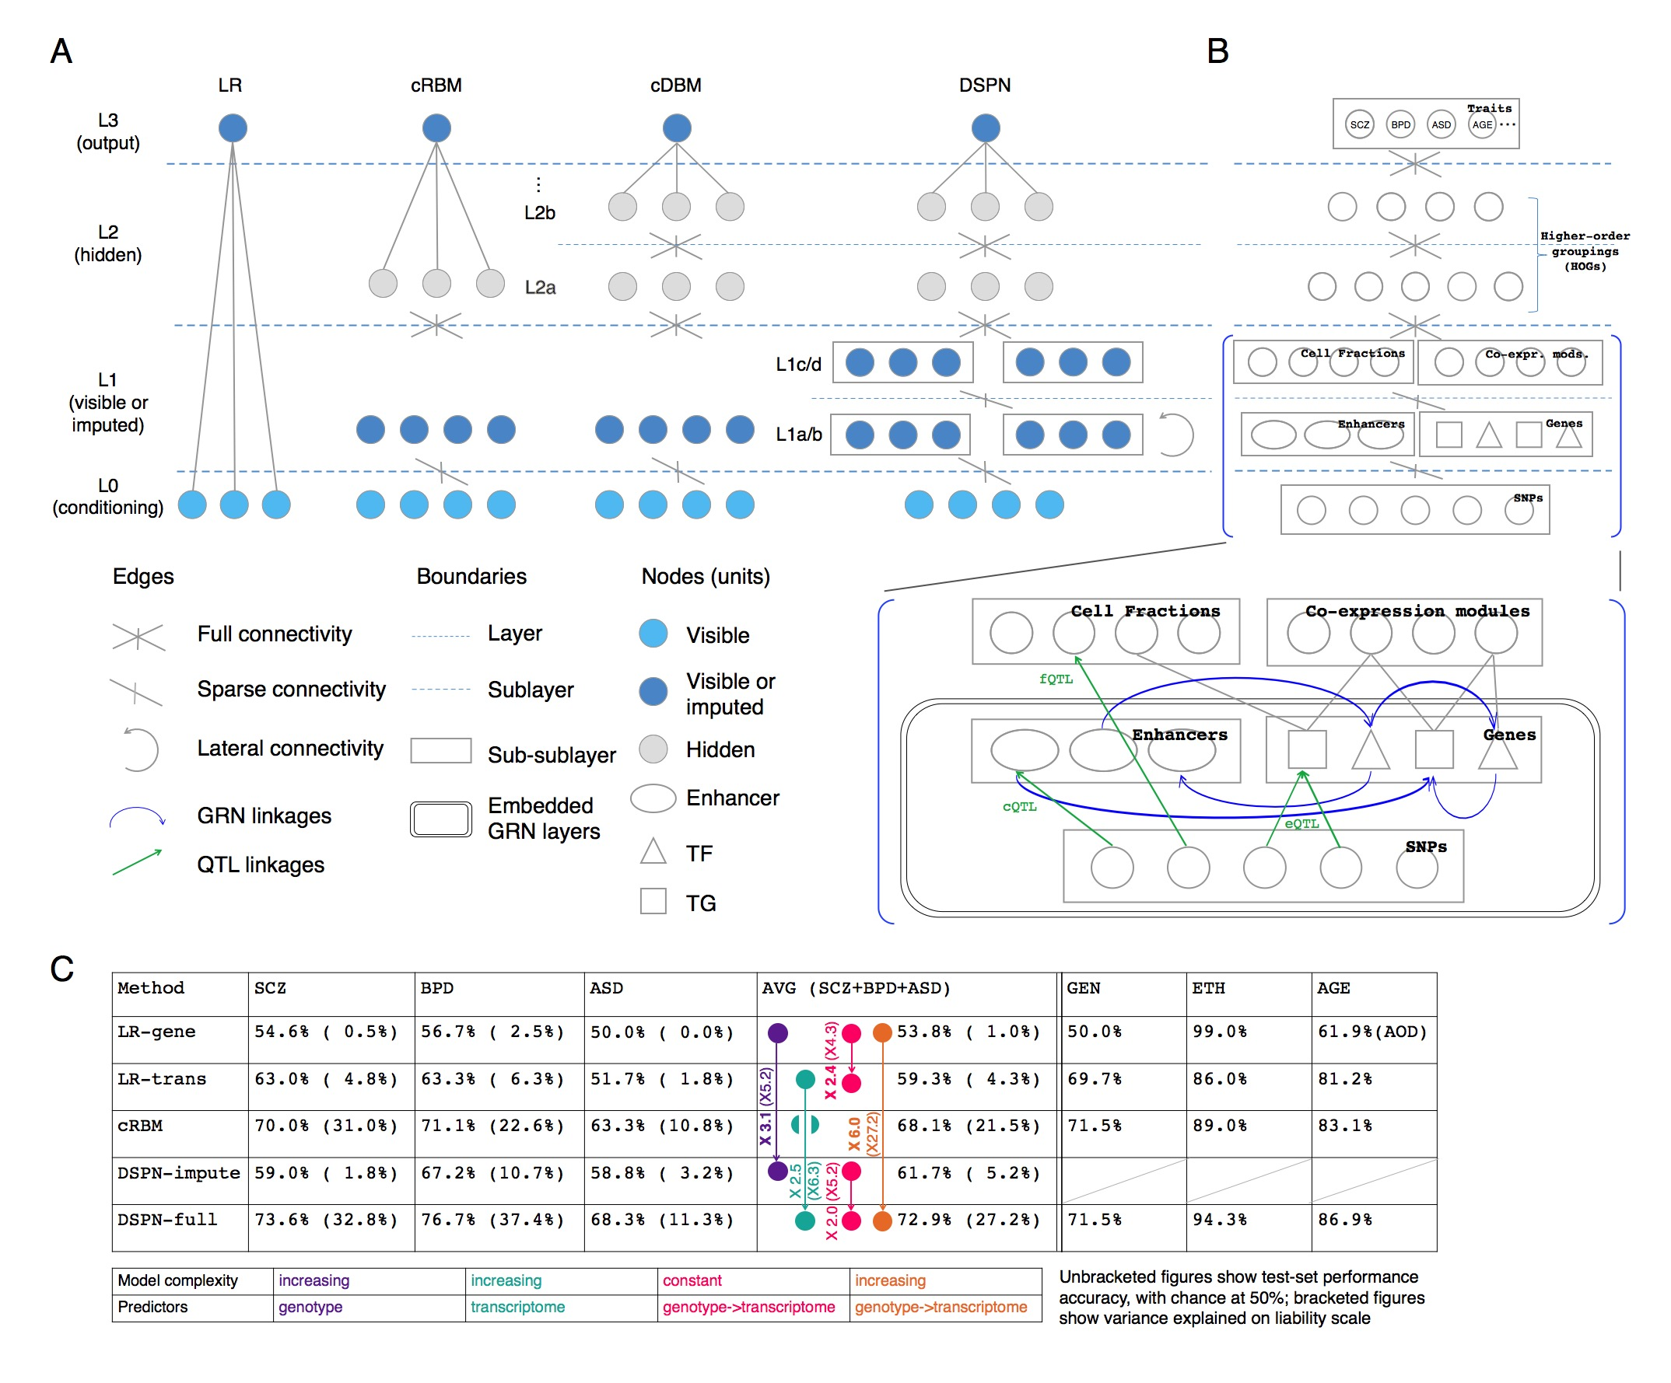
DSPN improves brain disease prediction by adding deep layers
Method | LR-genotype | LR-transcriptome | cRBM | DSPN-imputation | DSPN-full
Schizophrenia | 54.6% | 63.0% | 70.0% | 59.0% | 73.6%
Bipolar Disorder | 56.7% | 63.3% | 71.1% | 67.2% | 76.7%
Autism Spectrum Disorder | 50.0% | 51.7% | 67.2% | 62.5% | 68.3%
X 6.0
Accuracy = chance to correctly predict disease/health
[Wang et al. (‘18) Science]

Slide 31
DSPN improves brain disease prediction by adding deep layers
Method | LR-genotype | LR-transcriptome | cRBM | DSPN-imputation | DSPN-full
Schizophrenia | 54.6% | 63.0% | 70.0% | 59.0% | 73.6%
Bipolar Disorder | 56.7% | 63.3% | 71.1% | 67.2% | 76.7%
Autism Spectrum Disorder | 50.0% | 51.7% | 67.2% | 62.5% | 68.3%
X 2.5
Accuracy = chance to correctly predict disease/health
[Wang et al. (‘18) Science]

Slide 32
DSPN improves brain disease prediction by adding deep layers
Method | LR-genotype | LR-transcriptome | cRBM | DSPN-imputation | DSPN-full
Schizophrenia | 54.6% | 63.0% | 70.0% | 59.0% | 73.6%
Bipolar Disorder | 56.7% | 63.3% | 71.1% | 67.2% | 76.7%
Autism Spectrum Disorder | 50.0% | 51.7% | 67.2% | 62.5% | 68.3%
X 3.1
Accuracy = chance to correctly predict disease/health
[Wang et al. (‘18) Science]

Slide 33
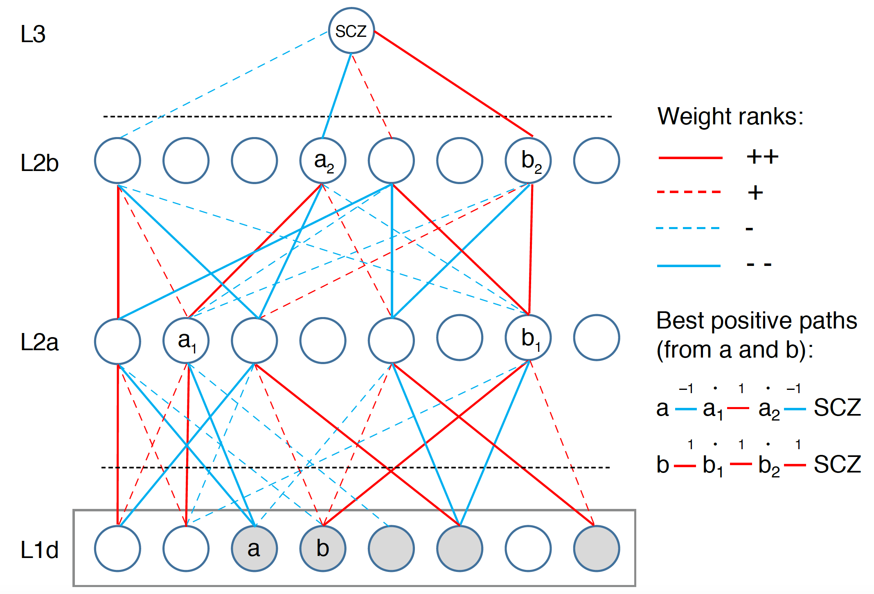
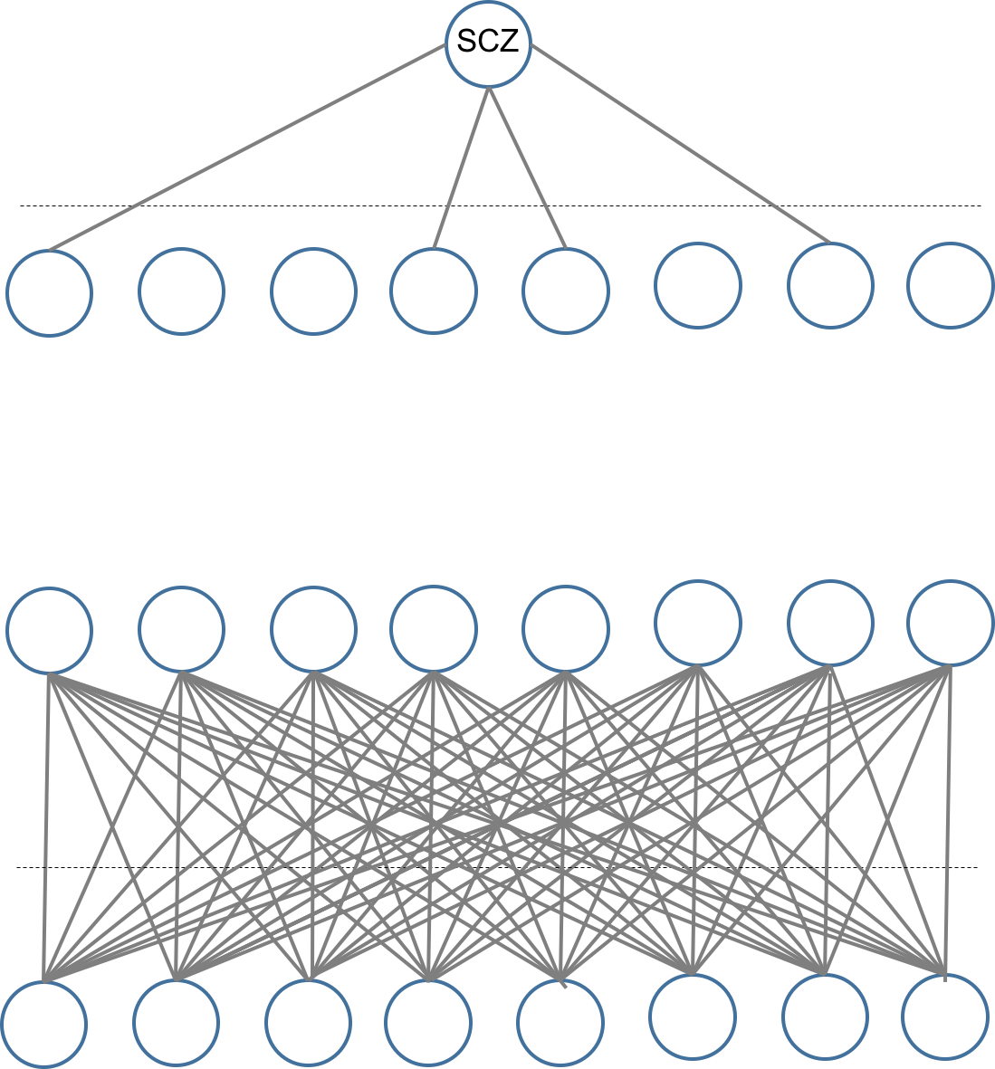
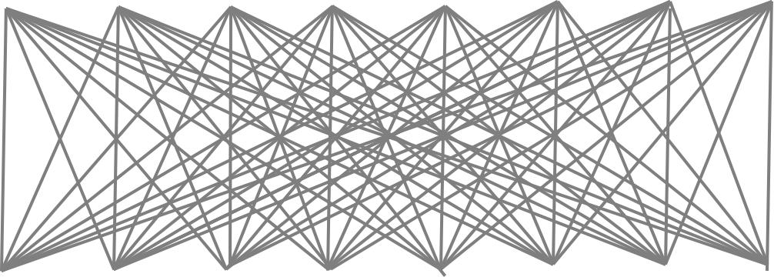
Multilevel Network Interpretation
Actual network size:
5024/400/100/1 nodes
Start with a fully connected trained network
[Wang et al. (‘18) Science]

Slide 34
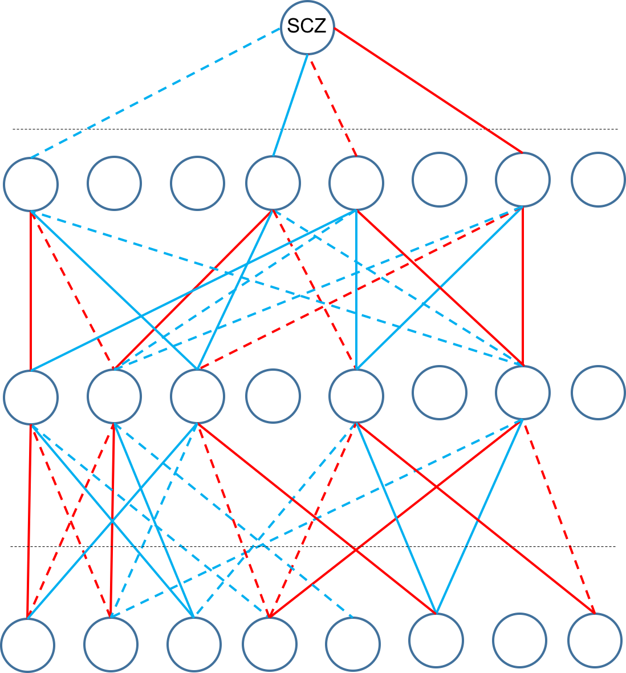
Multilevel Network Interpretation
Actual network size:
5024/400/100/1 nodes
Start with a fully connected trained network
Sparsify network using edges with largest absolute weights (+/-)
[Wang et al. (‘18) Science]

Slide 35
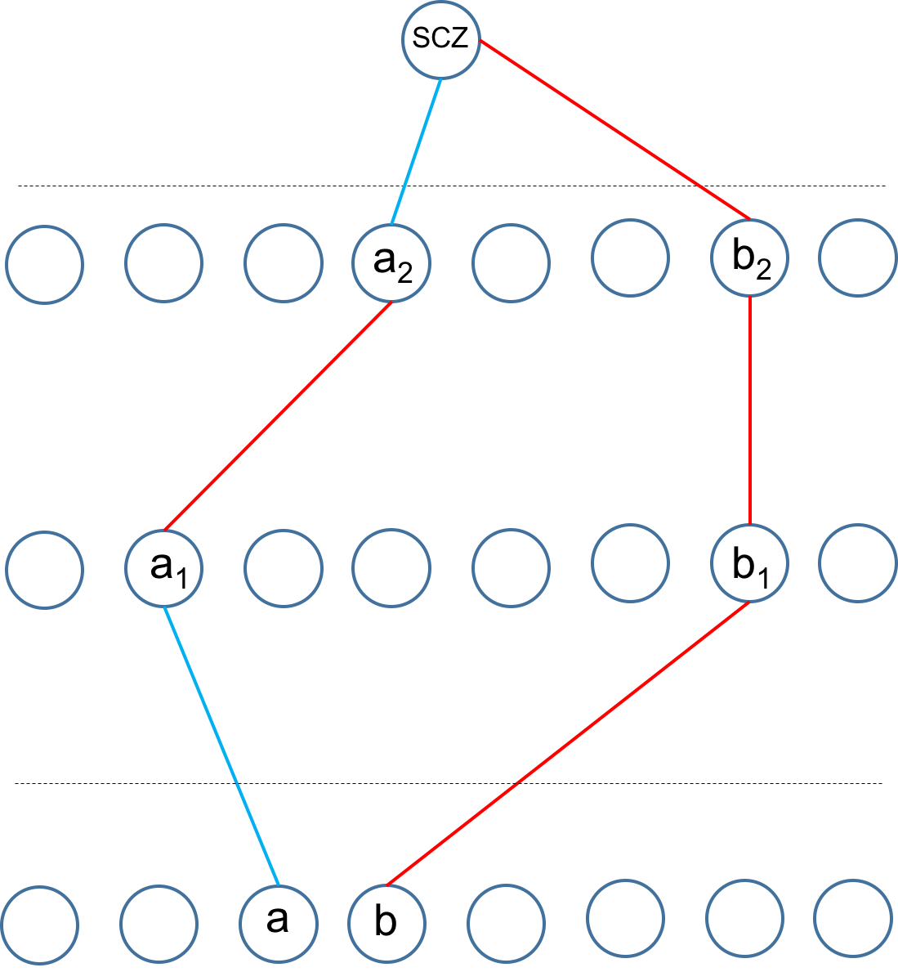
Multilevel Network Interpretation
Actual network size:
5024/400/100/1 nodes
Start with a fully connected trained network
Sparsify network using edges with largest absolute weights (+/-)
Extract ‘best positive paths’ to each prioritized module (e.g. a-a₁-a₂-SCZ) by summing weights and multiplying signs
[Wang et al. (‘18) Science]

Slide 36
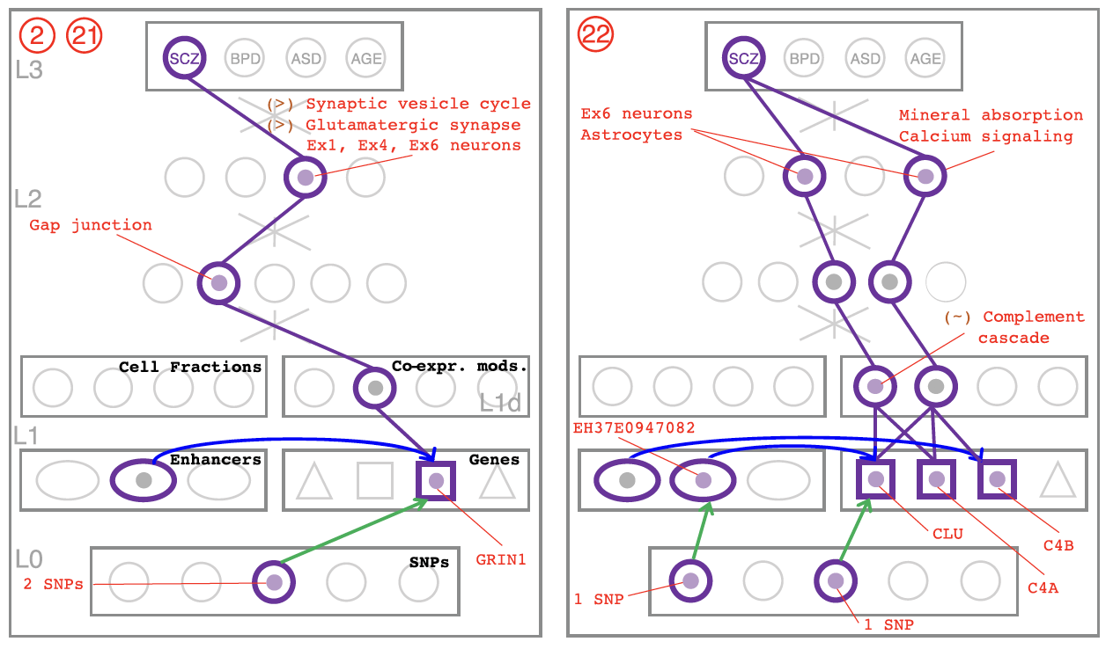
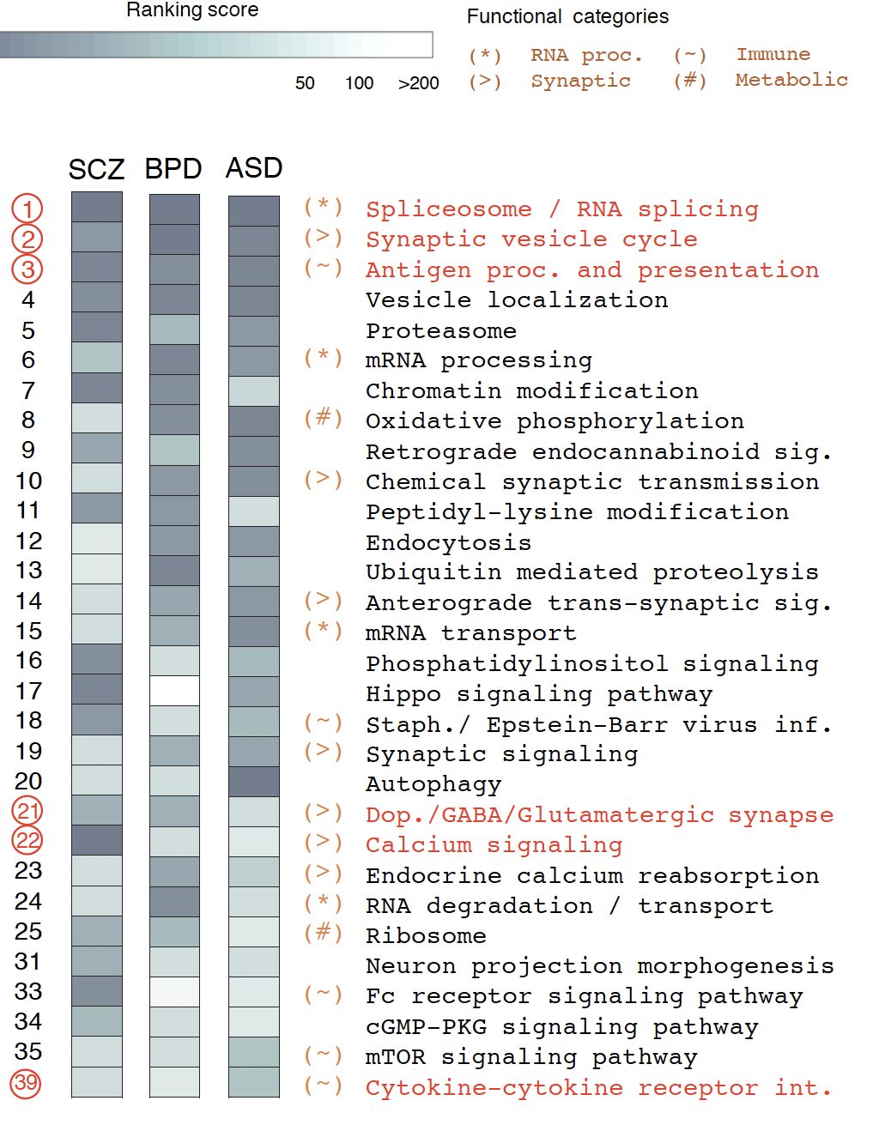
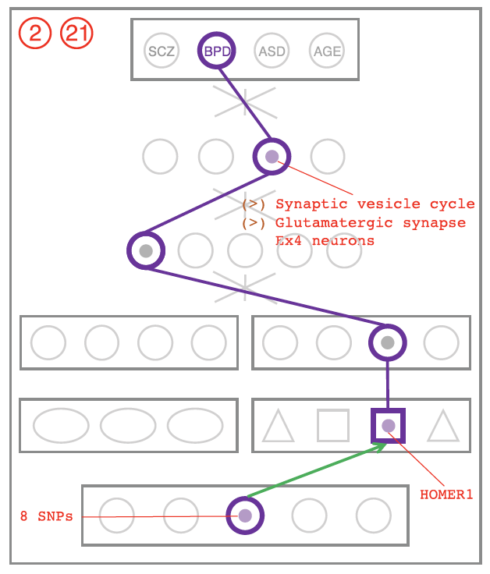
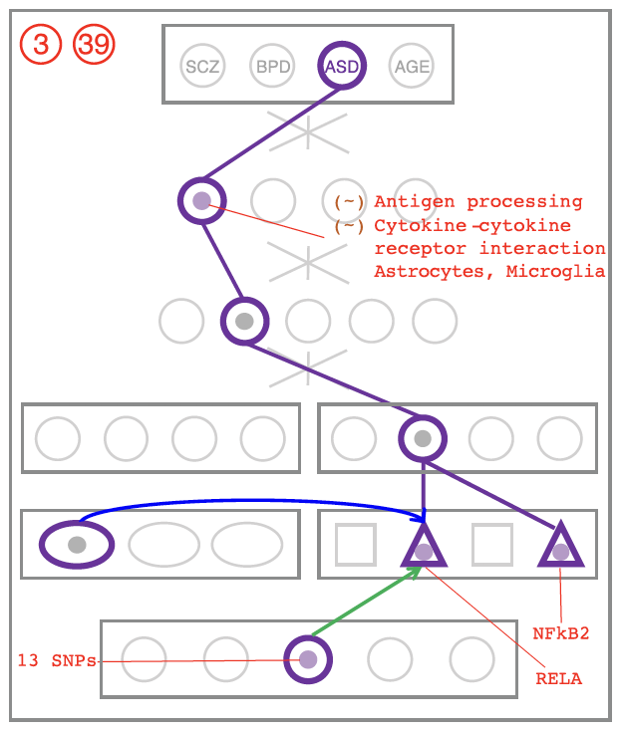
DSPN discovers enriched pathways and linkages to genetic variation
Cross-disorder MOD/HOG enrichment ranking
SCZ
BPD
ASD
[Wang et al. (‘18) Science]

Slide 37
Using population-scale functional genomics to suggest potential neuropsychiatric drug targets
& building a hybrid classifier to ascertain differential drug sensitivity
PsychENCODE: Population-level analysis of
functional genomics data related to
neuropsychiatric disease
  Construction of an adult brain resource with 1866 individuals + full developmental time-course
  Using the changing proportions of cell types (via single-cell deconvolution) to account for
  expression variation across a population,
  disorders & development
  Large-scale processing defines ~79K PFC
  enhancers & creates a comprehensive QTL resource (~2.5M eQTLs + cQTLs & fQTLs)
  Connecting QTLs, enhancer activity relationships & Hi-C contacts into a brain regulatory network & using this to link SCZ GWAS SNPs to genes
  Embedding the reg. network in a
  deep-learning model to predict psychiatric disease from genotype & transcriptome. Using this to suggest specific pathways & genes, as potential drug targets.
  Other resource uses: highlighting aging related genes + consistently comparing the brain to other organs
GenoDock: Building a predictor for the sensitivity of drug binding to personal SNVs
  Hybrid classifier connecting physical modelling with statistical learning
    The modeling creates a pseudo gold-standard dataset, which is used to train the stat. classifier
  Classifier Results
    Independent validation
    on an expt. validation set
    Gives higher disruption scores to cancer driver SNVs. Also, illustrates importance of different features (eg GERP).
    Picks out certain drugs (eg imatinib) as being particularly sensitive to SNVs

Slide 38
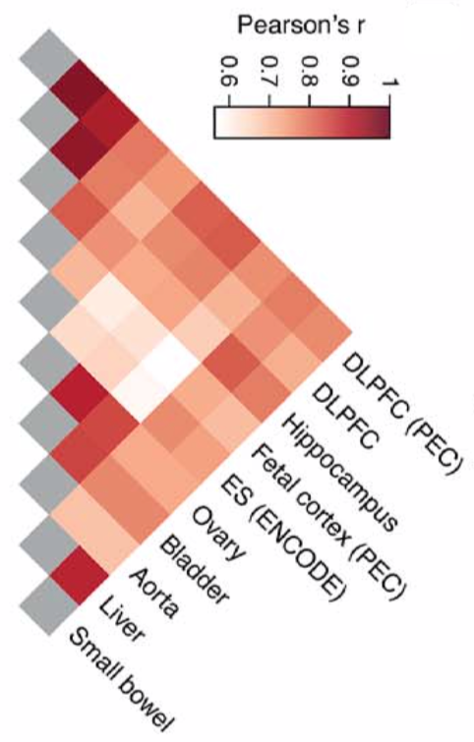
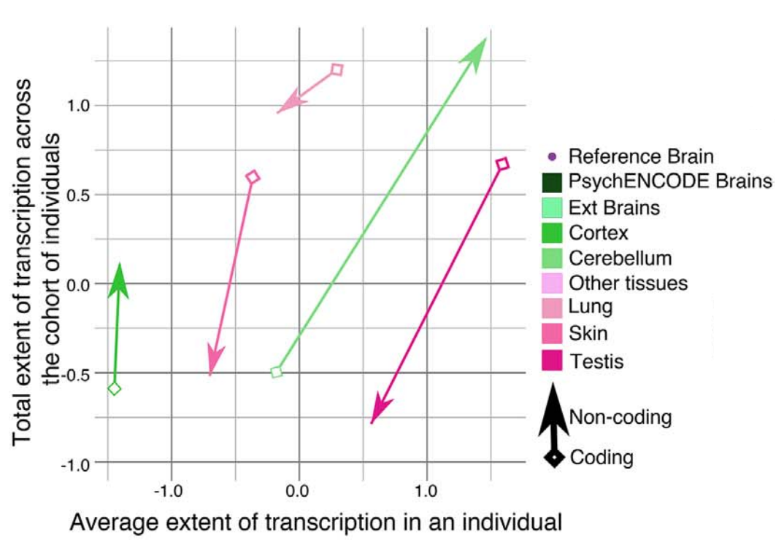
Cross tissue variation in Chromatin & Expression
Placing the
Brain in context of all other Body Tissues
Hi-C
Chromatin
Transcriptome diversity increases in the non-coding portion of the brain genome while decreases in other tissues
Expression
[Wang et al. (‘18) Science]

Slide 39
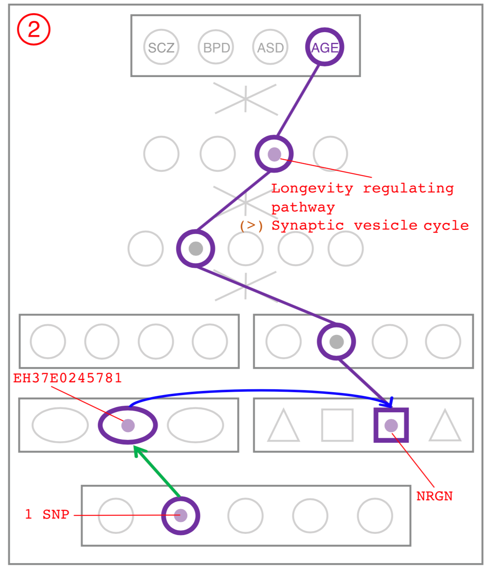
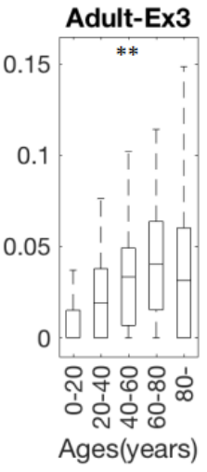
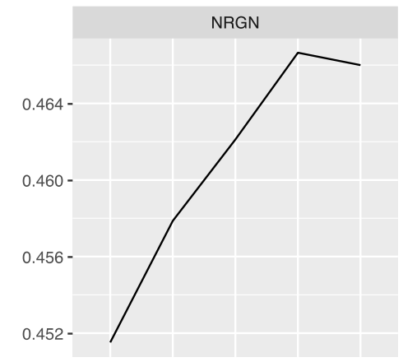

NRGN has variable expression over age and is in Synaptic vesicle cycle pathway is enriched in SCZ, BPD, ASD
NRGN
Ex3 Neuron
NGRN is a gene associated with the Synaptic vesicle pathway and NGRN expression and methylation is correlated with Age
0
2
4
0.452
0.46
0
0.05
0.1
0.15
0
20
Age (years)
40
60
0
20
40
60
80
80
Methylation
Exp.

Slide 40
Using population-scale functional genomics to suggest potential neuropsychiatric drug targets
& building a hybrid classifier to ascertain differential drug sensitivity
PsychENCODE: Population-level analysis of
functional genomics data related to
neuropsychiatric disease
  Construction of an adult brain resource with 1866 individuals + full developmental time-course
  Using the changing proportions of cell types (via single-cell deconvolution) to account for
  expression variation across a population,
  disorders & development
  Large-scale processing defines ~79K PFC
  enhancers & creates a comprehensive QTL resource (~2.5M eQTLs + cQTLs & fQTLs)
  Connecting QTLs, enhancer activity relationships & Hi-C contacts into a brain regulatory network & using this to link SCZ GWAS SNPs to genes
  Embedding the reg. network in a
  deep-learning model to predict psychiatric disease from genotype & transcriptome. Using this to suggest specific pathways & genes, as potential drug targets.
  Other resource uses: highlighting aging related genes + consistently comparing the brain to other organs
GenoDock: Building a predictor for the sensitivity of drug binding to personal SNVs
  Hybrid classifier connecting physical modelling with statistical learning
    The modeling creates a pseudo gold-standard dataset, which is used to train the stat. classifier
  Classifier Results
    Independent validation
    on an expt. validation set
    Gives higher disruption scores to cancer driver SNVs. Also, illustrates importance of different features (eg GERP).
    Picks out certain drugs (eg imatinib) as being particularly sensitive to SNVs

Slide 41
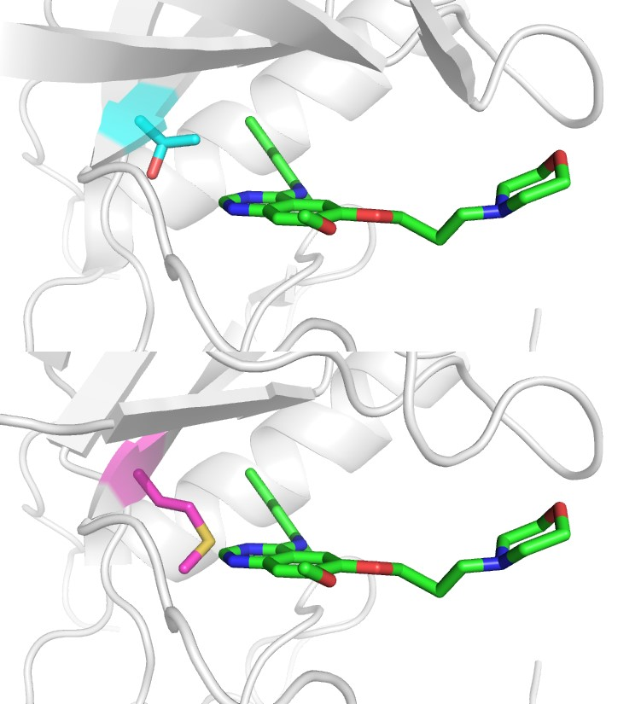


An Example of Binding Affinity Change between Protein & Drug Ligand under the Impact of Single Nucleotide Variants (SNV)
Epidermal growth factor receptor (EGFR) tyrosine kinase inhibitors (EGFR-TKIs) are used in the treatments of non-small cell lung cancer (NSCLC)
For protein-drug binding upon point mutation,
T790
if $∆$BA ≤ 0
if $∆$BA > 0
IRE
non-disruptive
SNV (ND)
disruptive
SNV (D)
WT
M790
IRE
Is there any method that could predict the effects of SNVs to drug binding (D or ND)?
MUT
human EGFR & gefitinib (IRE)
PDB: 2ity, Chain A, amino acid 790
Modeling and Visualization: Modeller & PyMol
Notes:
T: Threonine
M: Methionine

Slide 42
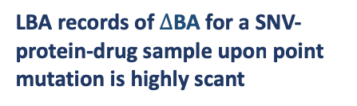
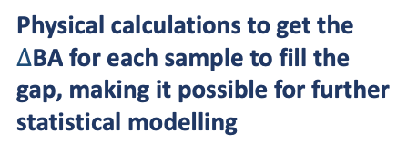


Assessment of feasibility to build a supervised-learning
classifier for binding-disruptive SNVs
~10K
SNV-structure
-drug
DATA
SNV:
Structure:
(co-crystal)
Drug:
ExAC & TCGA
PubChem Compound
RCSB PDB
Though limited SNVs could be mapped onto PDBs, this data pool keeps growing.
RF
LR
SVM
GBDT
ALGORITHM
availability of well-established machine learning classification algorithms
LBA records of $∆$BA for a SNV-protein-drug sample upon point mutation is highly scant
“real” gold-standard of $∆$BA
Ligand binding assay data
Too few for model training
GAP and SOLUTION
Physical calculations to get the $∆$BA for each sample to fill the gap, making it possible for further statistical modelling
pseudo gold-standard of $∆$BA
Ligand-binding model
Value for each sample
Notes:
EXAC: exome aggregation consortium
TCGA: the cancer genome atlas

Slide 43
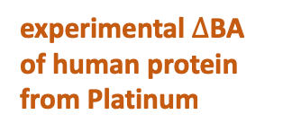


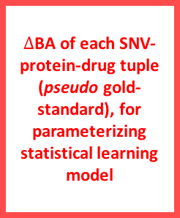
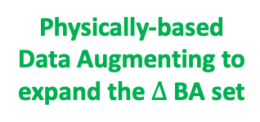
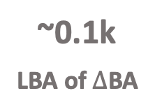
A Hot Topic in Machine Learning is “Hybrid” Model
Integrating Physical & Statistical Calculations
The Major Hurdle:
Highly Scant Ligand Binding Assay Data for $∆$BA
The Physically-based Data Augmentation Approach:
Leveraging Physical Calculations of $∆$BA to Fill the Gap
(Reichstein et al., Nature, 2019 & Xie et al., preprint, 2018)
>10M
SNV
Number of sequenced exonic SNVs
Expansion of the training dataset for under sampled domains
Data augmentation is crucial to avoid overfitting
~175K
SNV-structure
$∆$BA of each SNV-protein-drug tuple
(pseudo gold-standard), for parameterizing statistical learning model
Physically-based Data Augmenting to expand the $∆$BA set
SNVs mapped with human PDB (>2.8Å )
amount
(Kumar et al., 2016)
~10K
SNV-struc.-drug
entries in GenoDock
(Wang et al., 2019)
~10K
~0.1k
LBA of $∆$BA
experimental $∆$BA of human protein from Platinum
Docking
time
2015
2019
(Pires et al., 2015)

Slide 44
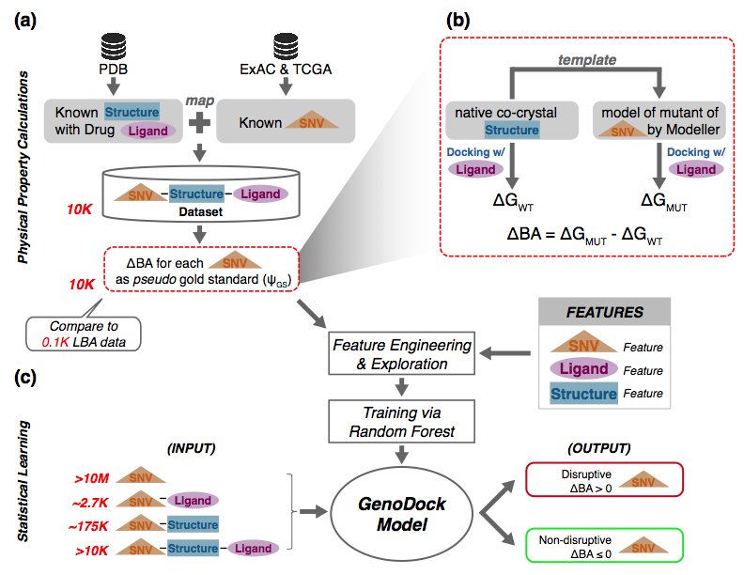
Framework for GenoDock: from Dataset Preparation to Model Construction
JW to fix
Wang et al. Structure, 2019

Slide 45
3 Feature Groups as Predictor, with 4 Application Cases Based on Info Availability
SNV Feature
Ligand Feature
Structure Feature
What are features are effective for prioritization of disruptive SNVs?
3
groups of features as predictors
Allele Frequency
SIFT
PolyPhen-2
GERP
Germline/Somatic
Molecular Weight
H-bond donor
H-bond acceptor
Rotatable Bond #
Polar Surface Area
Distance
Binding Site
Polarity Change
Volume Change
SNV + Structure + Ligand
SNV + Structure
SNV + Ligand
SNV only
Will SNV of interest disrupt protein-ligand binding
validate the “full feature” case
4
random forest model trained based on information available
then, expand the model to 3 more “feature poor” cases

Slide 46
List of Models & Datasets in the Study
Model 1: statistical model (GenoDock)
Model 2: ligand binding model (to calculate ΔBA)
KEY TAKE-AWAY
The statistical model and ligand binding model are the two models for this study;
The validation of the statistical model and the assessment of rigor of the ligand binding model are two independent process.

Slide 47
Using population-scale functional genomics to suggest potential neuropsychiatric drug targets
& building a hybrid classifier to ascertain differential drug sensitivity
PsychENCODE: Population-level analysis of
functional genomics data related to
neuropsychiatric disease
  Construction of an adult brain resource with 1866 individuals + full developmental time-course
  Using the changing proportions of cell types (via single-cell deconvolution) to account for
  expression variation across a population,
  disorders & development
  Large-scale processing defines ~79K PFC
  enhancers & creates a comprehensive QTL resource (~2.5M eQTLs + cQTLs & fQTLs)
  Connecting QTLs, enhancer activity relationships & Hi-C contacts into a brain regulatory network & using this to link SCZ GWAS SNPs to genes
  Embedding the reg. network in a
  deep-learning model to predict psychiatric disease from genotype & transcriptome. Using this to suggest specific pathways & genes, as potential drug targets.
  Other resource uses: highlighting aging related genes + consistently comparing the brain to other organs
GenoDock: Building a predictor for the sensitivity of drug binding to personal SNVs
  Hybrid classifier connecting physical modelling with statistical learning
    The modeling creates a pseudo gold-standard dataset, which is used to train the stat. classifier
  Classifier Results
    Independent validation
    on an expt. validation set
    Gives higher disruption scores to cancer driver SNVs. Also, illustrates importance of different features (eg GERP).
    Picks out certain drugs (eg imatinib) as being particularly sensitive to SNVs

Slide 48
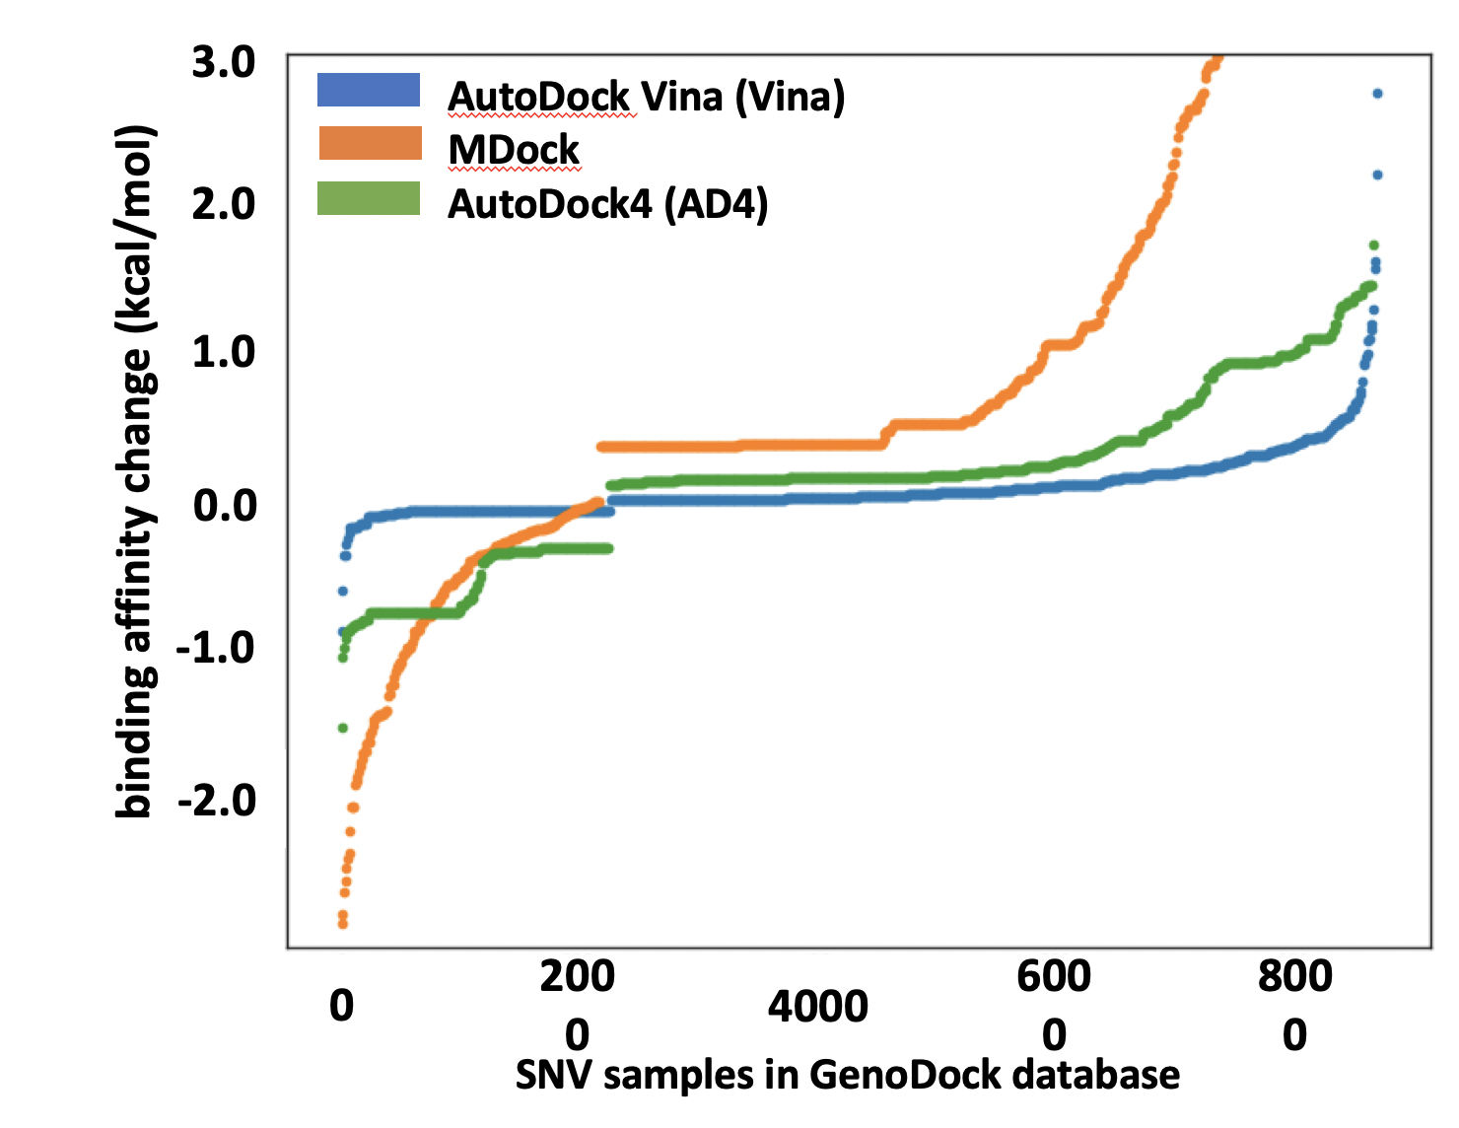
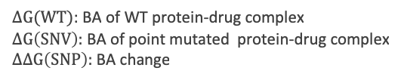
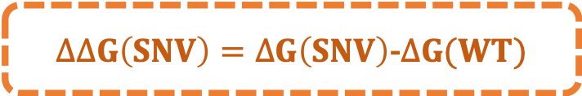
The pseudo Gold-Standard as Self-Constructed Prediction Target:
Physical Calculations for Binding Affinity Score Change (ΔBA)
ExAC: 8565 SNV-PDB native-mutant pairs
TCGA: 1718 SNV-PDB native-mutant pairs
Pearson Product-Moment Correlation (PMCC) reveals good consistency of different docking calculations
PMCC (Vina & AD4) = 0.89
PMCC (Vina & MDock) = 0.94
Dataset
$∆∆G\left(SNV\right)=∆G\left(SNV\right)$-$∆G(WT)$
Equation
$∆G(WT)$: BA of WT protein-drug complex
$∆G\left(SNV\right):$ BA of point mutated protein-drug complex
$∆∆G\left(SNP\right):$ BA change
Approach
MDock
AutoDock Vina
AutoDock 4
8000

Slide 49
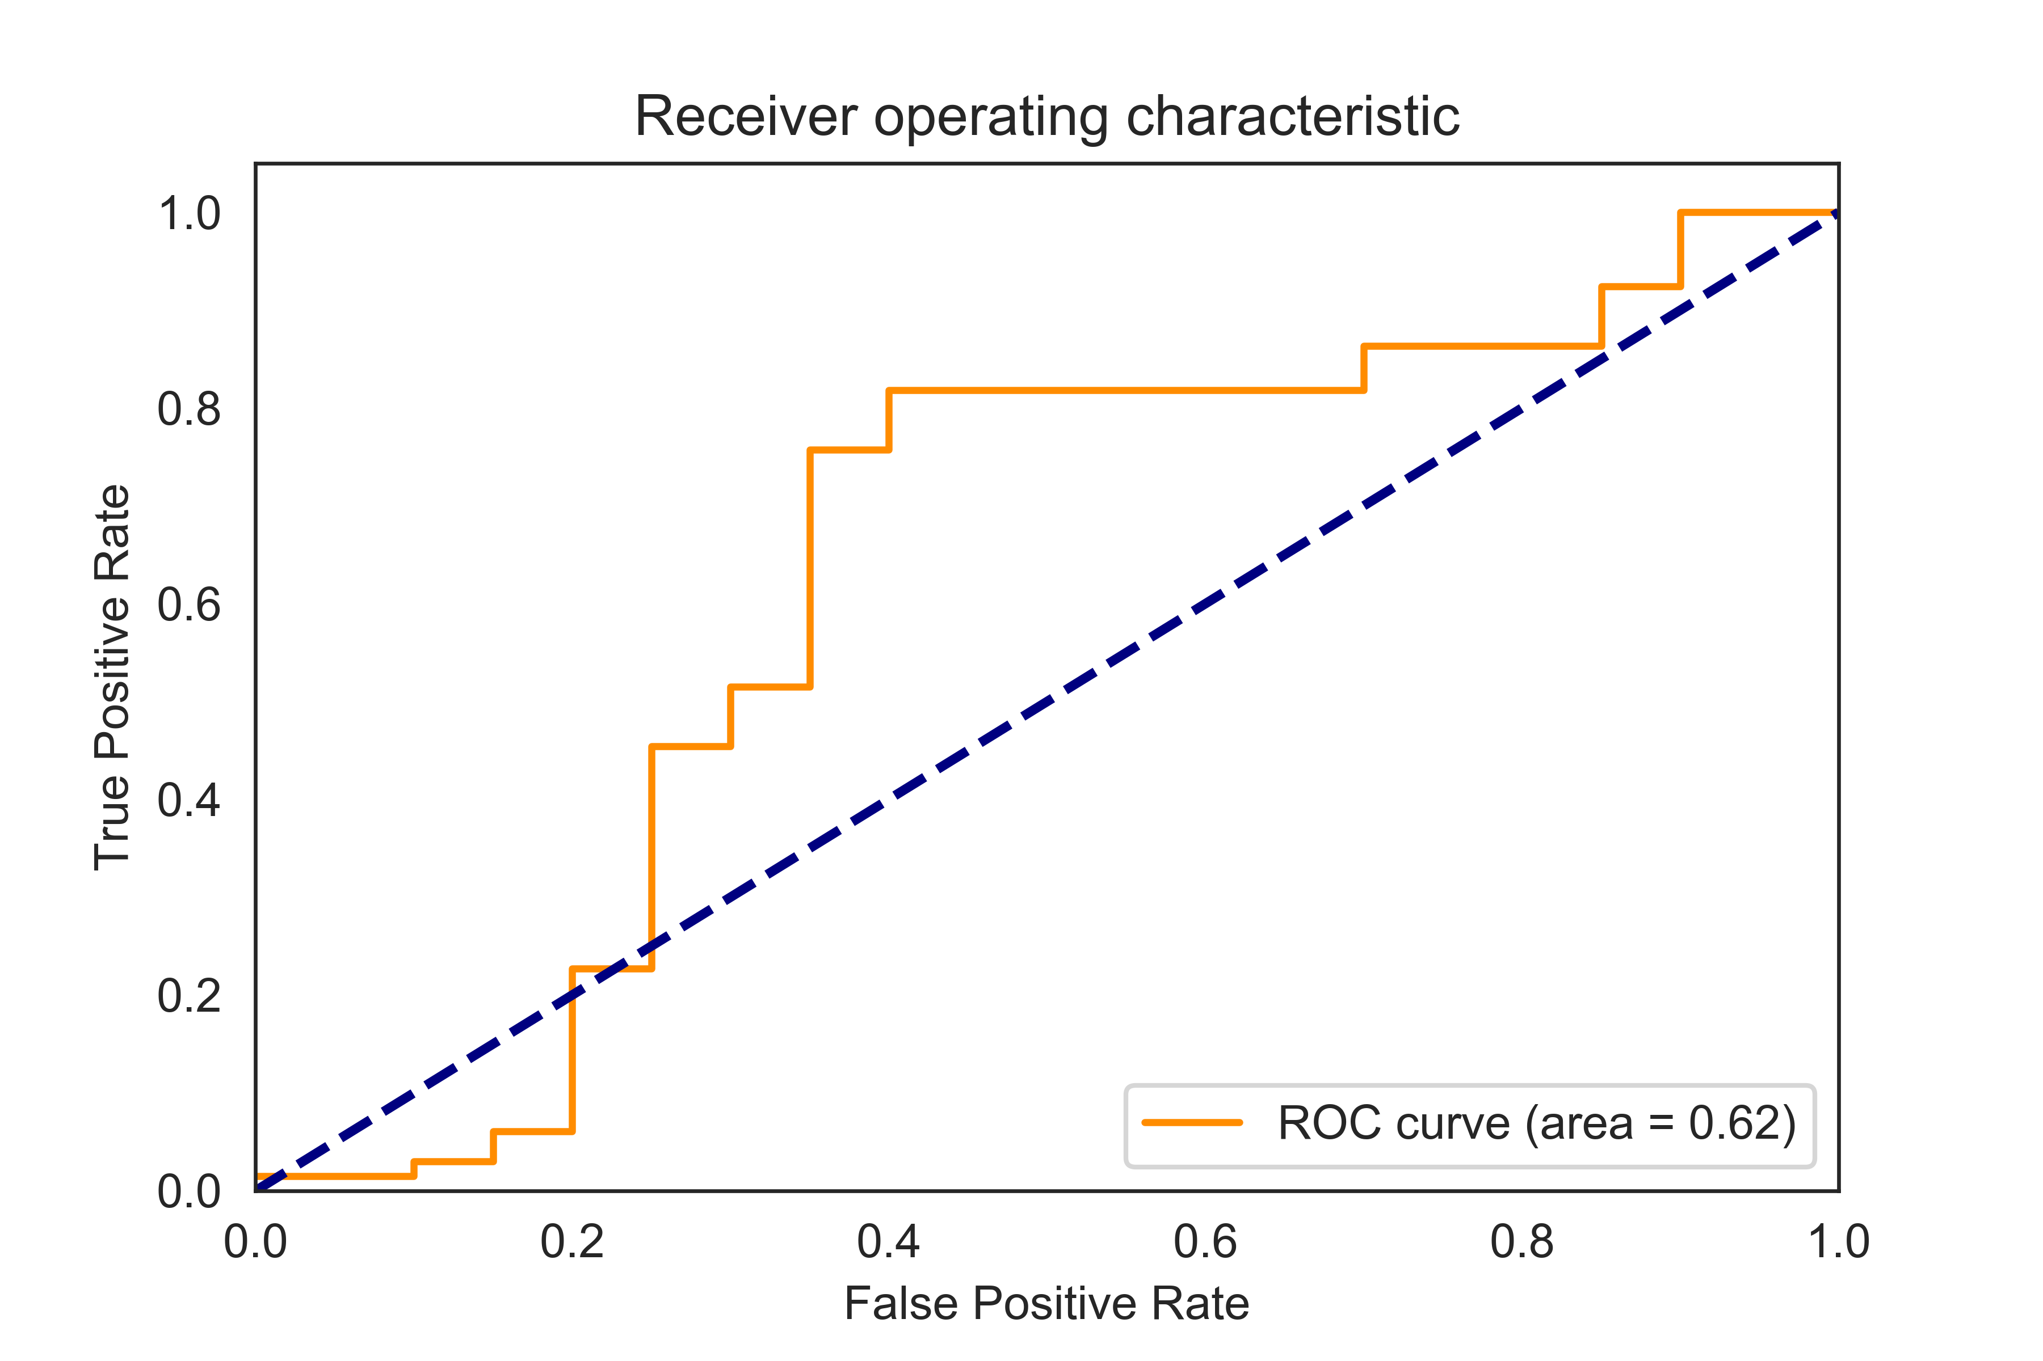
Given the pseudo Gold-Standard, the Workflow for Building the Statistical Model & its Performance in Cross-validation & Independent Testing
Training set (70%)
1. Model training
2. Evaluation
Selected model
n disruptive SNVs
GB
DT
RF
n non-disruptive SNVs
RF
LR
SVM
…
Test set (30%)
10-fold
cross-validation
Training folds
Test fold
n disruptive SNVs:
n non-disruptive SNVs:
3. Model testing
1st iteration
Statistical Model Development for GenoDock
Independent Validation
(Platinum Experiment Dataset)
2nd iteration
3rd iteration
test on experiment data auROC= 0.62
cross validation on pseudo G.S.
auROC=0.97
…
…
10th iteration
Finalized
model
Notes:
GridSearch: n feature combinations, for each combination, 10-fold to have 10 RF -> in total 10*n RFs, then pick up the best one and keep this set of para. Then test on the 30% data
RF: good with a mixture of numerical and categorical features; train each tree independently, less likely to overfit on the training data
SVM: need to scale features; -> give you “support vectors” that is points in each class closest to the boundary between classes.
GBDT: theoretically better than RF, but in our case quiet similar in predicting power; but much slower to train and harder to tune the parameter( num of tree, depth of tree, learning rate) since trees are built once at a time and the later trees are correcting previous tree; likely to overfit the data.

Slide 50
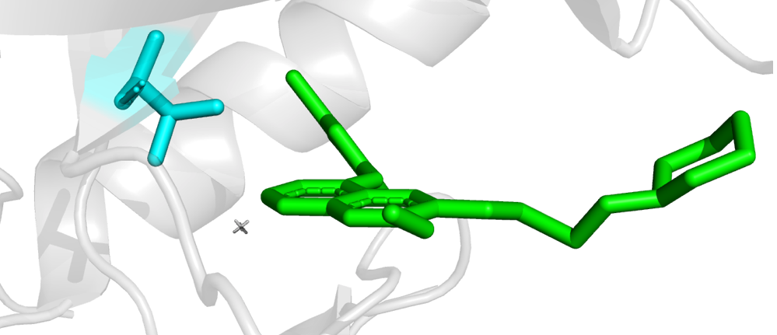
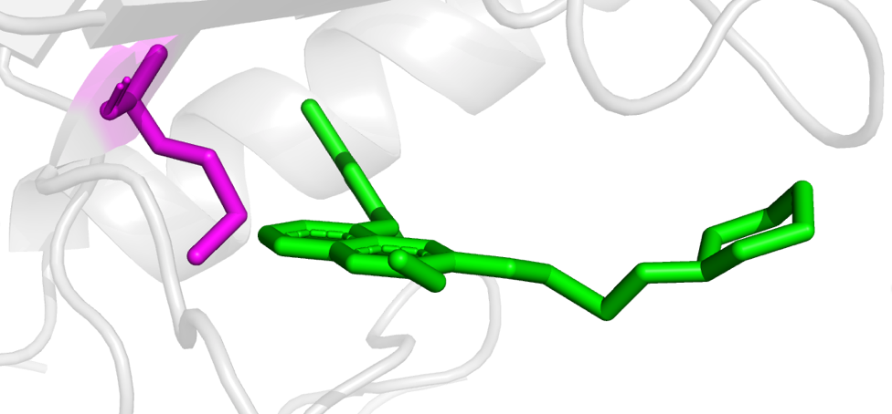




Example of the Output of the Classifier: GenoDock Helps Characterize Known & Unknown SNVs that Disrupt Protein-Ligand Binding
VISUALIZATION
DECISION FLOW
EXPLANATION
(a)
mutation close to ligand
IRE
distance from ligand < 3Å
WT
1
T790
steric hindrance
volume increased by 33.3%
3
MUT
M790
4
GERP = 5.9
PPH = 1
SIFT =0
Prob. of
$∆$BA > 0 by GenoDock: 64.0%*
high impact by SNV features
human EGFR & gefitinib (IRE)
PDB: 2ity
5
8
(b)
mutation close to ligand
R112
distance from ligand < 3Å
WT
1
ZOL
4
GERP score ≈ 4.0
high evolutionary significance
MUT
large polar surface area of ligand
H112
7
Prob. of
$∆$BA > 0 by GenoDock: 99.8%*
10
salt bridge disappeared
human FPPS & zoledronate (ZOL)
PDB: 4p0w
increased hydrophobicity
Structure Feature
SNV Feature
Ligand Feature
1-10: Feature significance rank by Gini Distance for selected features
* $∆$BA > 0 validated by docking calculations

Slide 51




Gini Distance for Relative Feature Importance in 4 Models
Wang et al. Structure, 2019
(a)
Mean Decrease Gini
(b)
SNV Only
SNV + PDB
features
features
GERP
dV
feature importance
(c)
SNV + Ligand
(d)
SNV + PDB + Ligand
features
features
DIST to
Binding
Site
ASA(polar)

Slide 52



Boxplot of Overall Ligand Binding Affinity Changes
for Different Types of SNVs in GenoDock
percentage of SNV leads to $∆$BA ≤ 0
$∆$BA in different groups of SNV that leads to $∆$BA > 0
percentage of SNV leads to $∆$BA = 0
1.0
94%
93%
91%
100%
85%
0.8
88%
87%
87%
80%
The more an SNV is considered disease-associated, the greater chance that this SNV would destabilize binding affinity of the protein and drug ligand.
77%
0.6
P-value:
3.60e-4
60%
binding affinity change (kcal/mol)
percentage
0.4
40%
0.236 kcal/mol
0.2
20%
0.117 kcal/mol
0.129 kcal/mol
0.159 kcal/mol
0.0
0%
COMMON
(ExAC)
RARE
(ExAC)
PASSENGER
(TCGA)
DRIVER
(TCGA)
Notes:
An overall comparison of common, rare, passenger, and driver SNVs in terms of binding affinity change from the GenoDock data source. SNVs with $∆BA>0$ were plotted in order to compare the extent of destabilization of ligand binding by each SNV group. The mean values for those SNVs leading to ligand-binding disruption for common, rare, passenger, and driver SNVs from the ExAC and TCGA dataset were 0.117 kcal/mol, 0.129 kcal/mol, 0.159 kcal/mol, and 0.236 kcal/mol, respectively. The difference between common and rare SNVs from the ExAC dataset was not significant; the difference between passenger and driver SNVs from TCGA was significant, with a p-value of 3.60e-4, where driver SNVs were more likely to disrupt ligand binding compared with other groups. The green-dotted and pink-dotted lines in the figure show the percentage of SNVs from each group that lead to non-positive shift of binding affinity ($∆BA<0 or ∆BA=0$; 94%, 93%, 91%, 85%, respectively), and those that do not change the binding affinity ($∆BA=0$; 88%, 87%, 87%, 77%, respectively). It is clear that cancer driver SNVs have a greater probability to result in a positive binding affinity change compared with the other three groups.
Driver: SNVs in cancer driver genes listed in Catalogue of Somatic Mutations in Cancer (COSMIC)
Rare: allel freq./2*(# of indiv.) = 1, appear once. 2 alleles per person

Slide 53


Application of GenoDock to large-scale screening of disruptive SNVs for Drug Ligand interactions
Aceta-
zolamide
(glaucoma)
7%
11%
5.0
18%
21%
4.0
density
32%
density
3.0
33%
2.0
35%
36%
1.0
51%
0.0
65%
Imatinib
(cancer)
0.00
0.25
0.50
0.75
1.00
probability of a disruptive nsSNV
probability
Notes:
We applied GenoDock (“SNV + Ligand” model
290,515 somatic
in the binding pocket in order to estimate the maximum probability

Slide 54
Using population-scale functional genomics to suggest potential neuropsychiatric drug targets
& building a hybrid classifier to ascertain differential drug sensitivity
PsychENCODE: Population-level analysis of
functional genomics data related to
neuropsychiatric disease
  Construction of an adult brain resource with 1866 individuals + full developmental time-course
  Using the changing proportions of cell types (via single-cell deconvolution) to account for
  expression variation across a population,
  disorders & development
  Large-scale processing defines ~79K PFC
  enhancers & creates a comprehensive QTL resource (~2.5M eQTLs + cQTLs & fQTLs)
  Connecting QTLs, enhancer activity relationships & Hi-C contacts into a brain regulatory network & using this to link SCZ GWAS SNPs to genes
  Embedding the reg. network in a
  deep-learning model to predict psychiatric disease from genotype & transcriptome. Using this to suggest specific pathways & genes, as potential drug targets.
  Other resource uses: highlighting aging related genes + consistently comparing the brain to other organs
GenoDock: Building a predictor for the sensitivity of drug binding to personal SNVs
  Hybrid classifier connecting physical modelling with statistical learning
    The modeling creates a pseudo gold-standard dataset, which is used to train the stat. classifier
  Classifier Results
    Independent validation
    on an expt. validation set
    Gives higher disruption scores to cancer driver SNVs. Also, illustrates importance of different features (eg GERP).
    Picks out certain drugs (eg imatinib) as being particularly sensitive to SNVs

Slide 55
Using population-scale functional genomics to suggest potential neuropsychiatric drug targets
& building a hybrid classifier to ascertain differential drug sensitivity
PsychENCODE: Population-level analysis of
functional genomics data related to
neuropsychiatric disease
  Construction of an adult brain resource with 1866 individuals + full developmental time-course
  Using the changing proportions of cell types (via single-cell deconvolution) to account for
  expression variation across a population,
  disorders & development
  Large-scale processing defines ~79K PFC
  enhancers & creates a comprehensive QTL resource (~2.5M eQTLs + cQTLs & fQTLs)
  Connecting QTLs, enhancer activity relationships & Hi-C contacts into a brain regulatory network & using this to link SCZ GWAS SNPs to genes
  Embedding the reg. network in a
  deep-learning model to predict psychiatric disease from genotype & transcriptome. Using this to suggest specific pathways & genes, as potential drug targets.
  Other resource uses: highlighting aging related genes + consistently comparing the brain to other organs
GenoDock: Building a predictor for the sensitivity of drug binding to personal SNVs
  Hybrid classifier connecting physical modelling with statistical learning
    The modeling creates a pseudo gold-standard dataset, which is used to train the stat. classifier
  Classifier Results
    Independent validation
    on an expt. validation set
    Gives higher disruption scores to cancer driver SNVs. Also, illustrates importance of different features (eg GERP).
    Picks out certain drugs (eg imatinib) as being particularly sensitive to SNVs

Slide 56
PsychENCODE Acknowledgment
“Adult Capstone” Team – 1 of 3 capstones
Daifeng Wang, Shuang Liu, Jonathan Warrell, Hyejung Won, Xu Shi, Fabio Navarro, Declan Clarke, Mengting Gu, Prashant Emani, Yucheng T. Yang, Min Xu, Michael Gandal, Shaoke Lou, Jing Zhang, Jonathan J. Park, Chengfei Yan, Suhn Kyong Rhie, Kasidet Manakongtreecheep, Holly Zhou, Aparna Nathan, Mette Peters, Eugenio Mattei, Dominic Fitzgerald, Tonya Brunetti, Jill Moore, Yan Jiang, Kiran Girdhar, Gabriel Hoffman, Selim Kalayci, Zeynep Hulya Gumus, Greg Crawford,
PsychENCODE Consortium,
Panos Roussos, Schahram Akbarian, Andrew E. Jaffe, Kevin White, Zhiping Weng, Nenad Sestan,
Daniel H. Geschwind, James A. Knowles
Geetha Senthil
Lora Bingaman
David Panchision
Alexander Arguello
Thomas Lehner
Dedicated to Pamela Sklar
Resource.psychencode.org
The PsychENCODE Consortium: Allison E Ashley-Koch, Duke University; Gregory E Crawford, Duke University; Melanie E Garrett, Duke University; Lingyun Song, Duke University; Alexias Safi, Duke University; Graham D Johnson, Duke University; Gregory A Wray, Duke University; Timothy E Reddy, Duke University; Fernando S Goes, Johns Hopkins University; Peter Zandi, Johns Hopkins University; Julien Bryois, Karolinska Institutet; Andrew E Jaffe, Lieber Institute for Brain Development; Amanda J Price, Lieber Institute for Brain Development; Nikolay A Ivanov, Lieber Institute for Brain Development; Leonardo Collado-Torres, Lieber Institute for Brain Development; Thomas M Hyde, Lieber Institute for Brain Development; Emily E Burke, Lieber Institute for Brain Development; Joel E Kleiman, Lieber Institute for Brain Development; Ran Tao, Lieber Institute for Brain Development; Joo Heon Shin, Lieber Institute for Brain Development; Schahram Akbarian, Icahn School of Medicine at Mount Sinai; Kiran Girdhar, Icahn School of Medicine at Mount Sinai; Yan Jiang, Icahn School of Medicine at Mount Sinai; Marija Kundakovic, Icahn School of Medicine at Mount Sinai; Leanne Brown, Icahn School of Medicine at Mount Sinai; Bibi S Kassim, Icahn School of Medicine at Mount Sinai; Royce B Park, Icahn School of Medicine at Mount Sinai; Jennifer R Wiseman, Icahn School of Medicine at Mount Sinai; Elizabeth Zharovsky, Icahn School of Medicine at Mount Sinai; Rivka Jacobov, Icahn School of Medicine at Mount Sinai; Olivia Devillers, Icahn School of Medicine at Mount Sinai; Elie Flatow, Icahn School of Medicine at Mount Sinai; Gabriel E Hoffman, Icahn School of Medicine at Mount Sinai; Barbara K Lipska, Human Brain Collection Core, National Institutes of Health, Bethesda, MD; David A Lewis, University of Pittsburgh; Vahram Haroutunian, Icahn School of Medicine at Mount Sinai and James J Peters VA Medical Center; Chang-Gyu Hahn, University of Pennsylvania; Alexander W Charney, Mount Sinai; Stella Dracheva, Mount Sinai; Alexey Kozlenkov, Mount Sinai; Judson Belmont, Icahn School of Medicine at Mount Sinai; Diane DelValle, Icahn School of Medicine at Mount Sinai; Nancy Francoeur, Icahn School of Medicine at Mount Sinai; Evi Hadjimichael, Icahn School of Medicine at Mount Sinai; Dalila Pinto, Icahn School of Medicine at Mount Sinai; Harm van Bakel, Icahn School of Medicine at Mount Sinai; Panos Roussos, Mount Sinai; John F Fullard, Mount Sinai; Jaroslav Bendl, Mount Sinai; Mads E Hauberg, Mount Sinai; Lara M Mangravite, Sage Bionetworks; Mette A Peters, Sage Bionetworks; Yooree Chae, Sage Bionetworks; Junmin Peng, St. Jude Children's Hospital; Mingming Niu, St. Jude Children's Hospital; Xusheng Wang, St. Jude Children's Hospital; Maree J Webster, Stanley Medical Research Institute; Thomas G Beach, Banner Sun Health Research Institute; Chao Chen, Central South University; Yi Jiang, Central South University; Rujia Dai, Central South University; Annie W Shieh, SUNY Upstate Medical University; Chunyu Liu, SUNY Upstate Medical University; Kay S. Grennan, SUNY Upstate Medical University; Yan Xia, SUNY Upstate Medical University/Central South University; Ramu Vadukapuram, SUNY Upstate Medical University; Yongjun Wang, Central South University; Dominic Fitzgerald, The University of Chicago; Lijun Cheng, The University of Chicago; Miguel Brown, The University of Chicago; Mimi Brown, The University of Chicago; Tonya Brunetti, The University of Chicago; Thomas Goodman, The University of Chicago; Majd Alsayed, The University of Chicago; Michael J Gandal, University of California, Los Angeles; Daniel H Geschwind, University of California, Los Angeles; Hyejung Won, University of California, Los Angeles; Damon Polioudakis, University of California, Los Angeles; Brie Wamsley, University of California, Los Angeles; Jiani Yin, University of California, Los Angeles; Tarik Hadzic, University of California, Los Angeles; Luis De La Torre Ubieta, UCLA; Vivek Swarup, University of California, Los Angeles; Stephan J Sanders, University of California, San Francisco; Matthew W State, University of California, San Francisco; Donna M Werling, University of California, San Francisco; Joon-Yong An, University of California, San Francisco; Brooke Sheppard, University of California, San Francisco; A Jeremy Willsey, University of California, San Francisco; Kevin P White, The University of Chicago; Mohana Ray, The University of Chicago; Gina Giase, SUNY Upstate Medical University; Amira Kefi, University of Illinois at Chicago; Eugenio Mattei, University of Massachusetts Medical School; Michael Purcaro, University of Massachusetts Medical School; Zhiping Weng, University of Massachusetts Medical School; Jill Moore, University of Massachusetts Medical School; Henry Pratt, University of Massachusetts Medical School; Jack Huey, University of Massachusetts Medical School; Tyler Borrman, University of Massachusetts Medical School; Patrick F Sullivan, University of North Carolina - Chapel Hill; Paola Giusti-Rodriguez, University of North Carolina - Chapel Hill; Yunjung Kim, University of North Carolina - Chapel Hill; Patrick Sullivan, University of North Carolina - Chapel Hill; Jin Szatkiewicz, University of North Carolina - Chapel Hill; Suhn Kyong Rhie, University of Southern California; Christoper Armoskus, University of Southern California; Adrian Camarena, University of Southern California; Peggy J Farnham, University of Southern California; Valeria N Spitsyna, University of Southern California; Heather Witt, University of Southern California; Shannon Schreiner, University of Southern California; Oleg V Evgrafov, SUNY Downstate Medical Center; James A Knowles, SUNY Downstate Medical Center; Mark Gerstein, Yale University; Shuang Liu, Yale University; Daifeng Wang, Stony Brook University; Fabio C. P. Navarro, Yale University; Jonathan Warrell, Yale University; Declan Clarke, Yale University; Prashant S. Emani, Yale University; Mengting Gu, Yale University; Xu Shi, Yale University; Min Xu, Yale University; Yucheng T. Yang, Yale University; Robert R. Kitchen, Yale University; Gamze Gürsoy, Yale University; Jing Zhang, Yale University; Becky C Carlyle, Yale University; Angus C Nairn, Yale University; Mingfeng Li, Yale University; Sirisha Pochareddy, Yale University; Nenad Sestan, Yale University; Mario Skarica, Yale University; Zhen Li, Yale University; Andre M.M. Sousa, Yale University; Gabriel Santpere, Yale University; Jinmyung Choi, Yale University; Ying Zhu, Yale University; Tianliuyun Gao, Yale University; Daniel J Miller, Yale University; Adriana Cherskov, Yale University; Mo Yang, Yale University; Anahita Amiri, Yale University; Gianfilippo Coppola, Yale University; Jessica Mariani, Yale University; Soraya Scuderi, Yale University; Anna Szekely, Yale University; Flora M Vaccarino, Yale University; Feinan Wu, Yale University; Sherman Weissman, Yale University; Tanmoy Roychowdhury, Mayo Clinic Rochester; Alexej Abyzov, Mayo Clinic Rochester;.

Slide 57
Developmental Capstone
M Li, G Santpere, Y Imamura Kawasawa,
OV Evgrafov, FO Gulden, S Pochareddy,
SM Sunkin, Z Li, Y Shin,
Y Zhu, AMM Sousa, DM Werling, RR Kitchen, HJ Kang, M Pletikos, J Choi, S Muchnik, X Xu, D Wang, B Lorente-Galdos, S Liu, P Giusti-Rodriguez, H Won, CA de Leeuw, AF Pardinas, BrainSpan Consortium,
PsychENCODE Consortium, PsychENCODE Developmental Subgroup,
M Hu, F Jin, Y Li, MJ Owen, MC O'Donovan, JTR Walters, D Posthuma, MA Reimers, P Levitt, DR Weinberger, TM Hyde, JE Kleinman, DH Geschwind, MJ Hawrylycz, MW State, SJ Sanders, PF Sullivan,
ES Lein, JA Knowles, N Sestan
psychencode.org

Slide 58

GenoDock.molmovdb.org
B Wang, C Yan,
S Lou, P Emani, B Li, M Xu, X Kong, W Meyerson, Y Yang, D Lee
See
JOBS.gersteinlab.org
Hiring Postdocs

Slide 59

Extra

Slide 60
Info about content in this slide pack
General PERMISSIONS
  This Presentation is copyright Mark Gerstein,
  Yale University, 2019.
  Please read permissions statement at
  www.gersteinlab.org/misc/permissions.html .
  Feel free to use slides & images in the talk with PROPER acknowledgement
  (via citation to relevant papers or link to gersteinlab.org).
  Paper references in the talk were mostly from Papers.GersteinLab.org.
PHOTOS & IMAGES. For thoughts on the source and permissions of many of the photos and clipped images in this presentation see http://streams.gerstein.info .
  In particular, many of the images have particular EXIF tags, such as kwpotppt , that can be easily queried from flickr, viz: http://www.flickr.com/photos/mbgmbg/tags/kwpotppt

