Slide 1


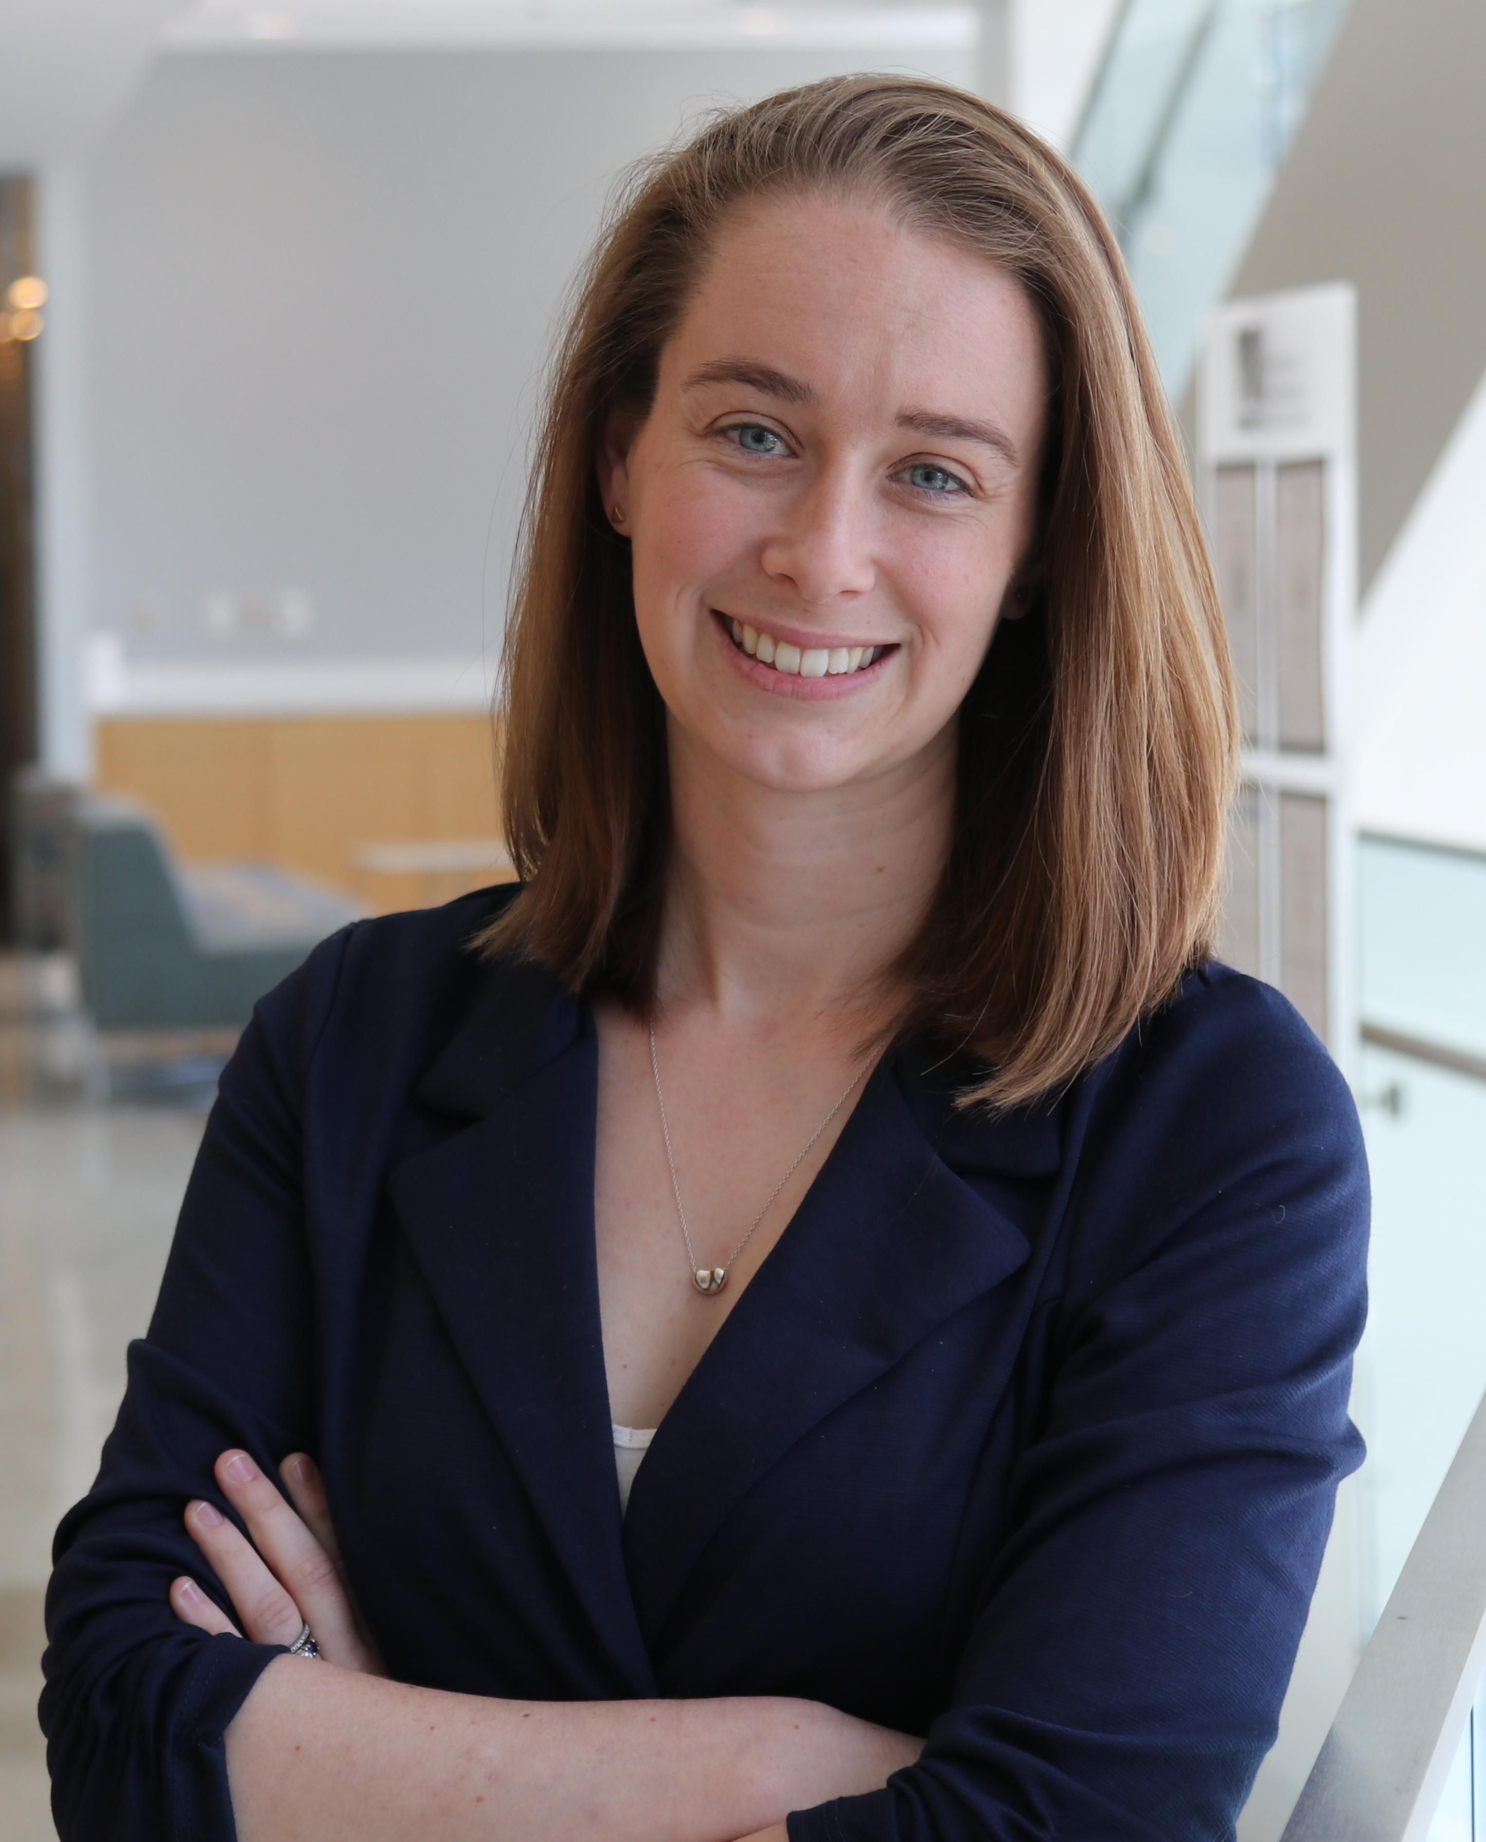
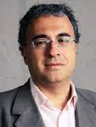

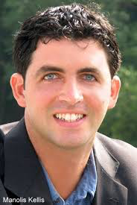
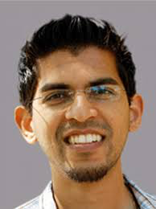
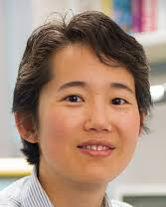

The ENCODE Data Analysis Center (DAC)
Manager
MPI
Zhiping Weng
UMMS
Mark Gerstein
Yale
Jill Moore
UMMS
Co-I
Roderic Guigo
CRG
Rafa Irizarry
Harvard
Manolis Kellis
MIT
Anshul Kundaje
Stanford
Shirley Liu
Harvard
Bill Noble
UW

Slide 2
Registry of candidate cis-Regulatory Elements (ccREs)
Collection of putative regulatory regions defined using DNase-seq and H3K4me3, H3K27ac, and CTCF ChIP-seq
V0 – Currently available at portal and SCREEN: 1.31 M ccREs in human (hg19) and 432 k in mouse (mm10)
V1 – soon to be released, featured in Encyclopedia manuscript: 1.46 M ccREs in human (hg38) and 499 k in mouse (mm10)
    300+ more experiments than V1
    Updated methodology to achieve finer resolution and classification of elements
Jill Moore, Henry Pratt, Zhiping Weng

Slide 3
Updates to the Registry of ccREs: rDHSs for Anchoring ccREs
Worked with the Stam lab to select a list of biosamples with DNase-seq data to build representative DHSs (rDHSs).
Developed a new method of calling DNase hotspots in individual samples to account for differences in sequencing depth and then compile these DNase hotspots in the list of biosamples into rDHSs.
Worked with the Stam lab to ensure that the rDHSs were congruent with the Stam lab’s consensus DHSs (cDHSs).
The final rDHSs form the collection from which ccREs are selected based on DNase, H3K4me3, H3K27ac, and CTCF signal levels.
Jill Moore, Henry Pratt, Zhiping Weng

Slide 4
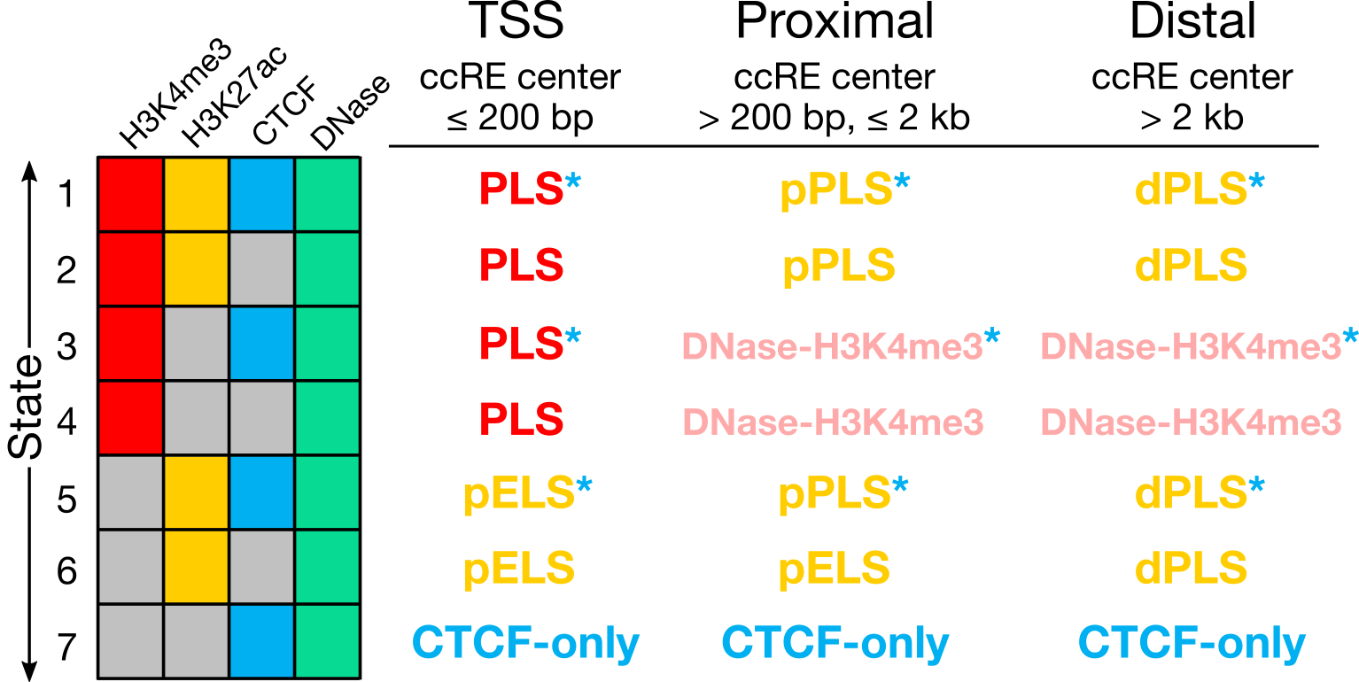
Updates to the Registry of ccREs: New classification groups
Jill Moore, Zhiping Weng
ccRE group (Wold, Hardison, Berstein, Stam, Snyder, Gerstein, Kundaje)

Slide 5
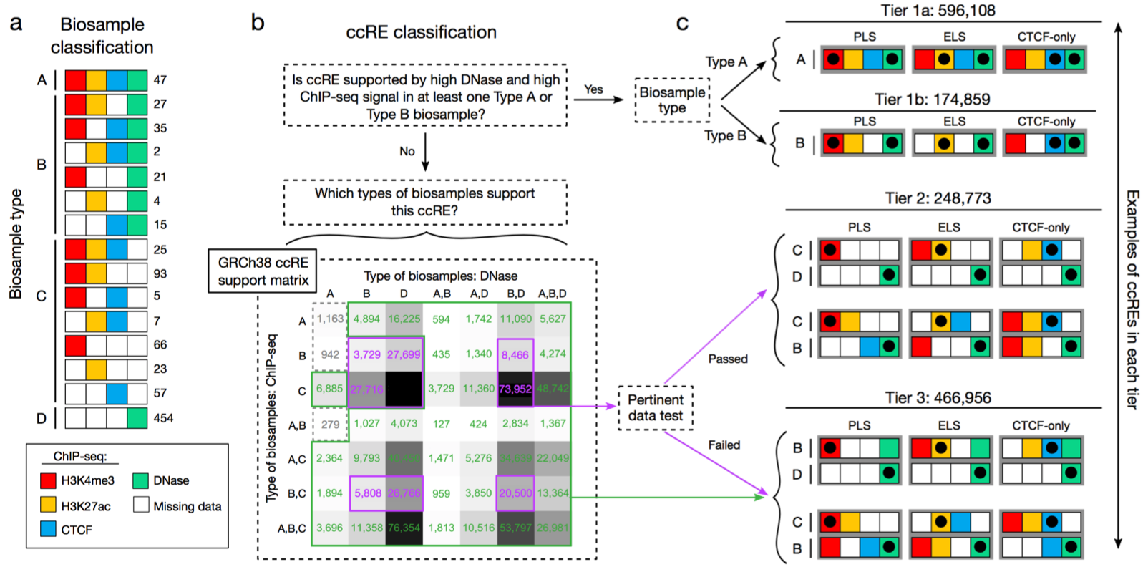
Updates to the Registry of ccREs: New tier system
Jill Moore, Zhiping Weng
ccRE group (Wold, Hardison, Berstein, Stam, Snyder, Gerstein, Kundaje)

Slide 6
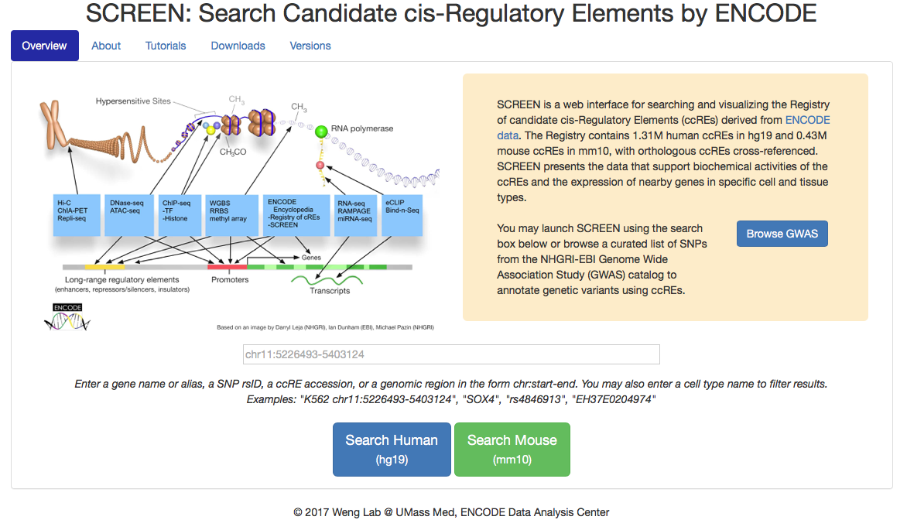

Search Candidate cis-Regulatory Elements by ENCODE (SCREEN)
Henry Pratt, Jill Moore, Zhiping Weng

Slide 7
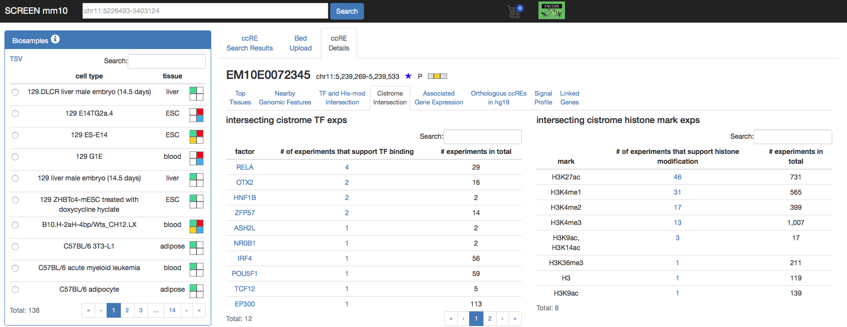
SCREEN-Cistrome Interface (MM10 and GRCh38)
Henry Pratt, Zhiping Weng, Shirley Liu

Slide 8
Cistrome DB Toolkit
http://cistrome.org/db
Which factors bind to your genomic interval of interest?
Which factors regulate your gene of interest?
Which cistromes in the Cistrome DB are similar to your cistrome of interest?
Rongbin Zheng, Cliff Meyer, Shirley Liu
Notes:
Three new functions have been made available to query chromatin profiles in the Cistrome DB.
These allow users to answer 3 questions based on data in the public domain.

Slide 9
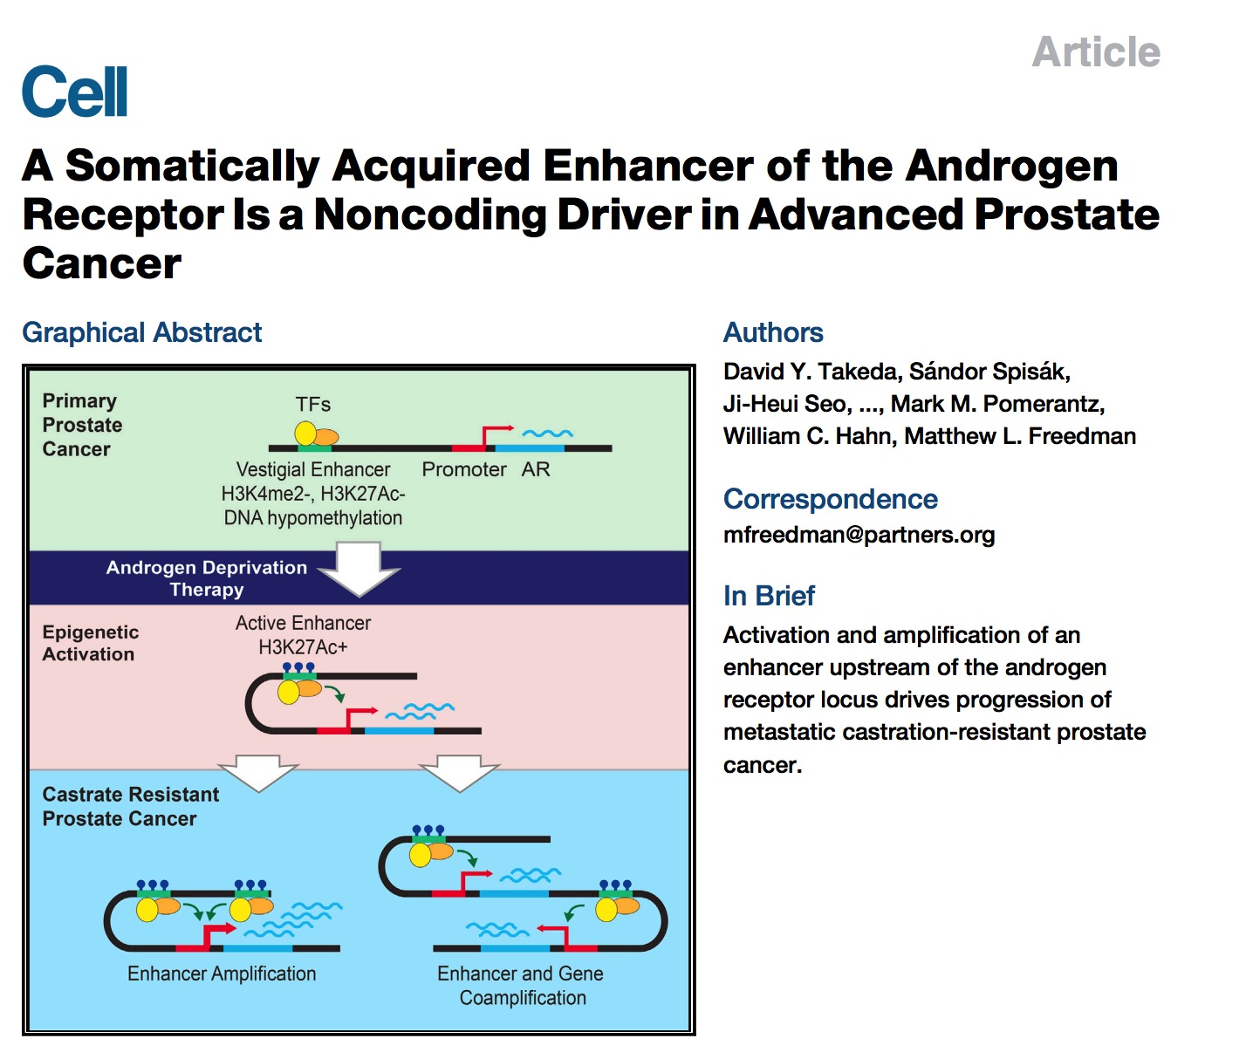
Which factors bind to your genomic interval?
Rongbin Zheng, Cliff Meyer, Shirley Liu
Notes:
Users can also query binding sites that lie within a given genomic interval of interest. For example an enhancer that has been found to regulator the androgen receptor described in a recent cell paper. To find out what TFs bind to the enhancer they can query the Cistrome DB using the Toolkit function and visualise the tracks using the WashU epigenome browser.

Slide 10
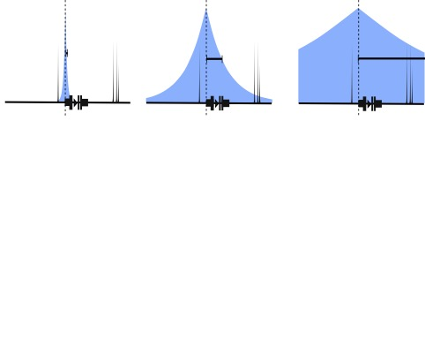
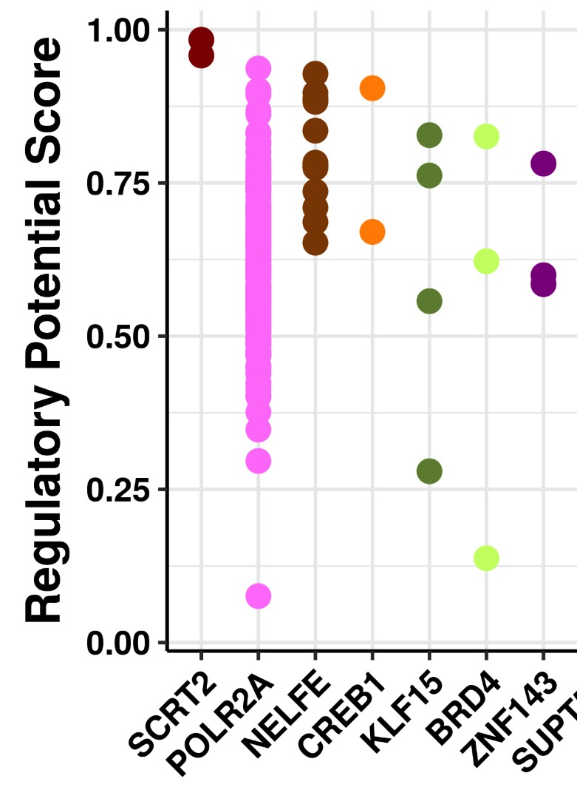
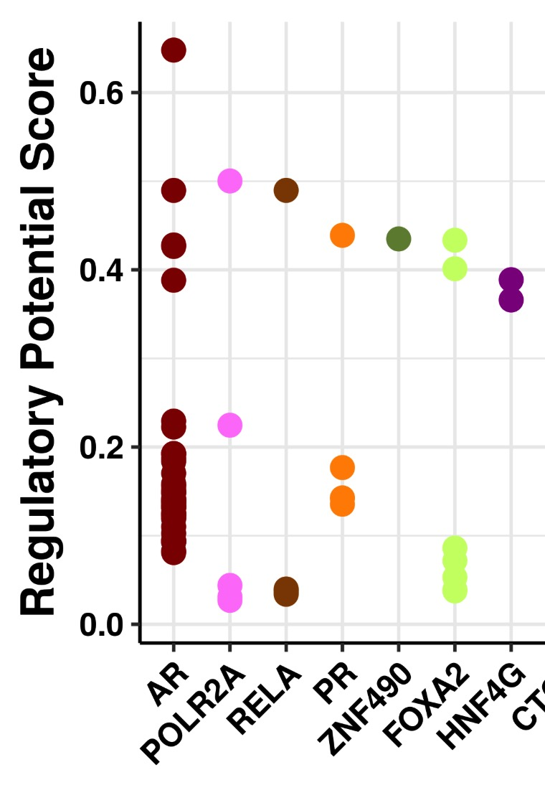
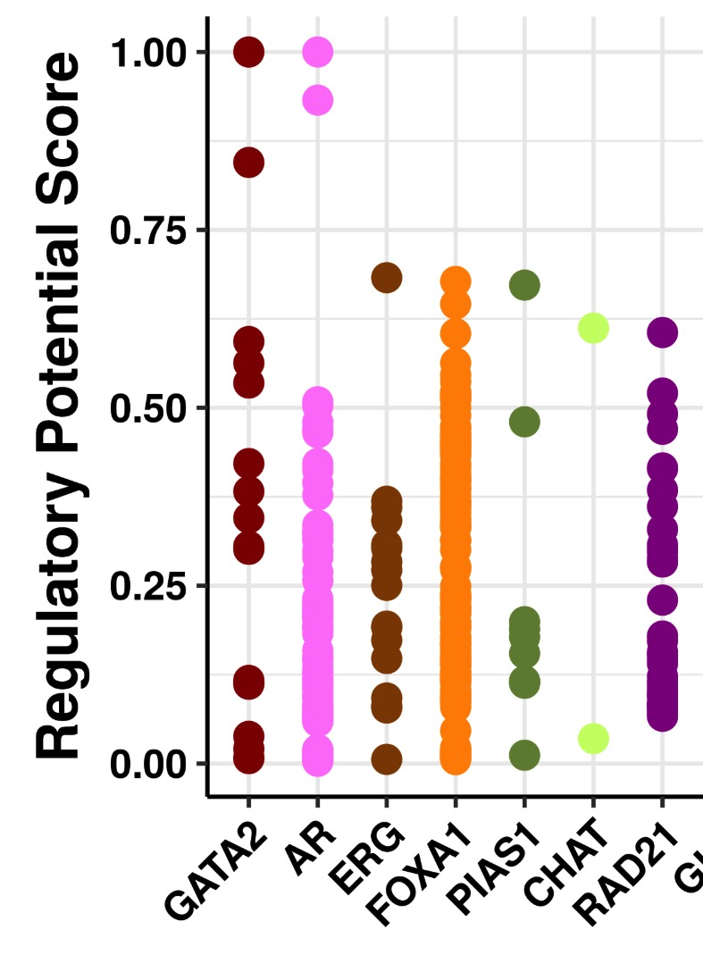
Which TFs regulates your gene?
1kb
10kb
100kb
Rongbin Zheng, Cliff Meyer, Shirley Liu
Notes:
The TFs that regulate a gene are associated with genes using a regulatory potential model which weights binding sites nearer to the TSS than sites further away.
The decay rate of the weighting function can be set to determine promoter specific factors (1kb decay rate), enhancer factors (10kb decay) and long range enhancers (100kb) decay.
The Cistrome DB Toolkit identifies specific samples with binding sites associated with the gene and provides summary figures such as those shown in this slide.

Slide 11
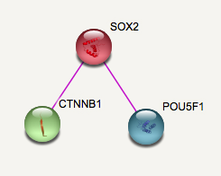
Co-regulatory TFs identified using Cistrome DB ChIP-seq data
STRING database:
Experimental evidence
Rongbin Zheng, Cliff Meyer, Shirley Liu
Notes:
The Cistrome DB can also be used to identify the transcription factors that regulate a differentially expressed gene set.
In this example the input was the sets of up- and down- regulated genes from a comparison of SOX2 KO vs wt.
The down-regulated genes were predicted to be regulated by NANOG, SOX2, OCT4 and beta-catenin. The down regulated
Genes were associated with NELFE, EOMES and FOXA1 binding.
(The color of the dots represents the log fold change of the gene in the gene expression experiment.)

Slide 12
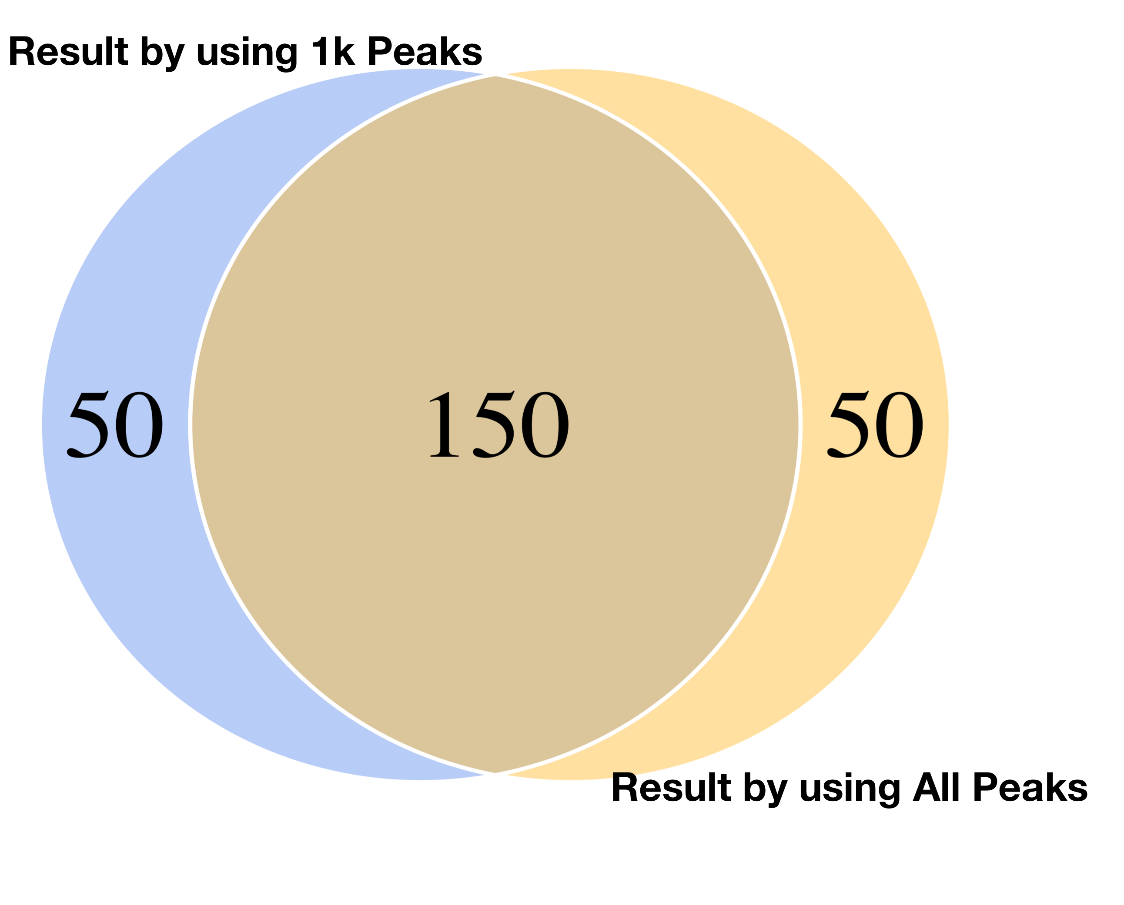
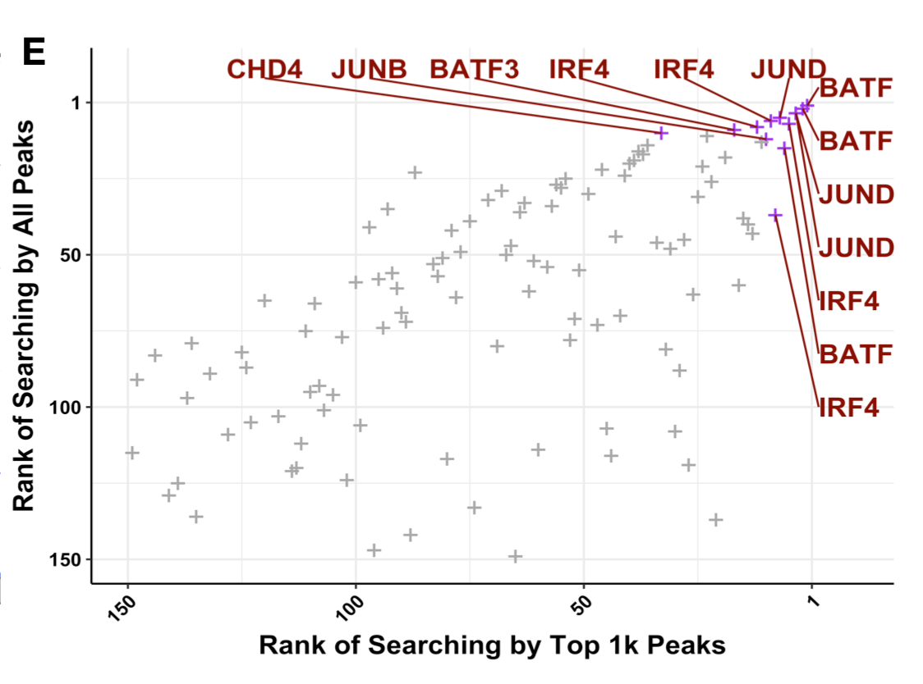
Which Cistrome DB cistromes are similar to your cistrome?
Rongbin Zheng, Cliff Meyer, Shirley Liu
Notes:
Users can also compare a cistrome of their own with those in the Cistrome DB. This is an example of a BATF cistrome which is most similar to other TFs important to T-cell activity. This analysis is based on the strongest 1k or 10k peaks and the results are robust to this peak number parameter.

Slide 13
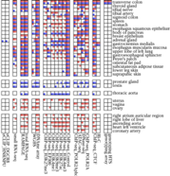

EN-TEx effort & the DAC
Involves Gerstein, Guigo & Noble labs
Cataloguing genomic elements in personal genomes with matched ENCODE datasets & the full breadth of assays on many tissues
Collect matched WGS & functional genomic data across ~20 tissues for 4 individuals.
Catalogue & compare genomic elements between individuals and tissues.
Study utility of
phased personal diploid genomes

Slide 14
Chromatin & ChIP analysis
The DAC has continued to develop methods for the large-scale analysis of ENCODE ChIP-seq data, many applied to EN-TEx

Slide 15
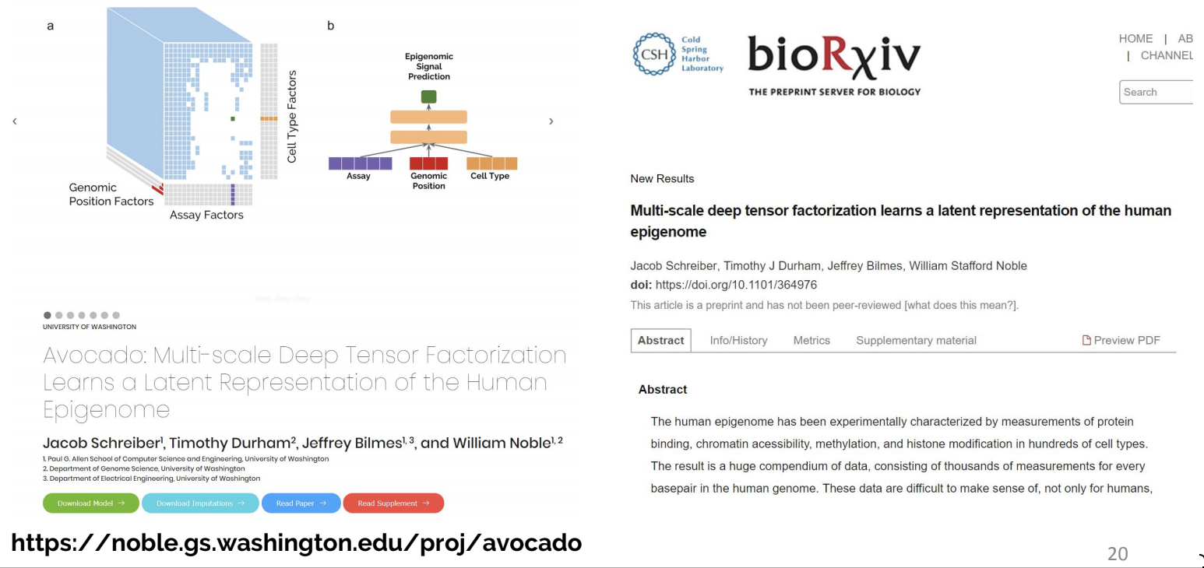
Avocado method for Imputation of Chromatin Data
Jacob Schreiber, Bill Noble
Notes:
(using bill)

Slide 16
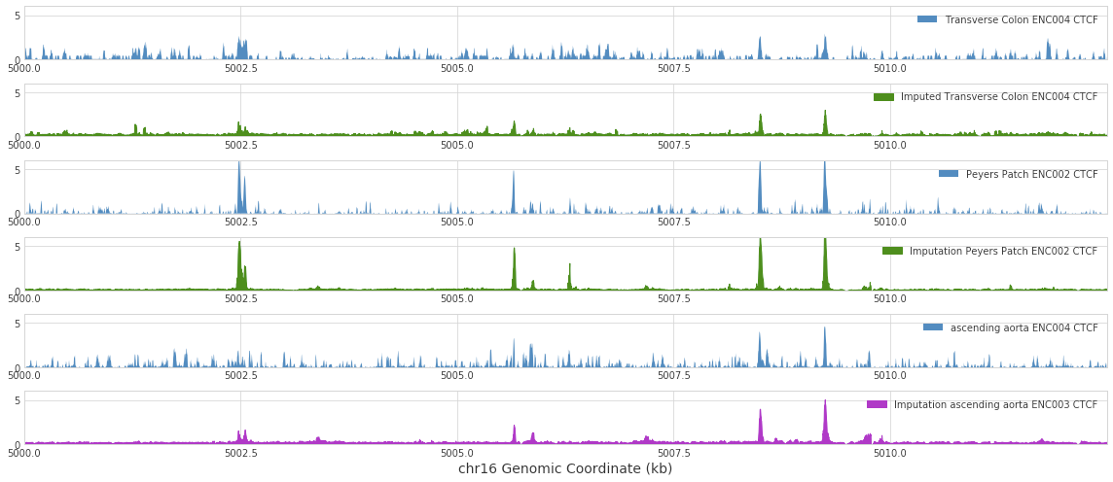
Application of Avocado to the ENTEx Dataset
910 sample imputations from Avocado (Deep learning model)
Histone modifications + CTCF + RNApol II
Training
Control vs Imputed signal
Imputation
Jacob Schreiber, Bill Noble

Slide 17
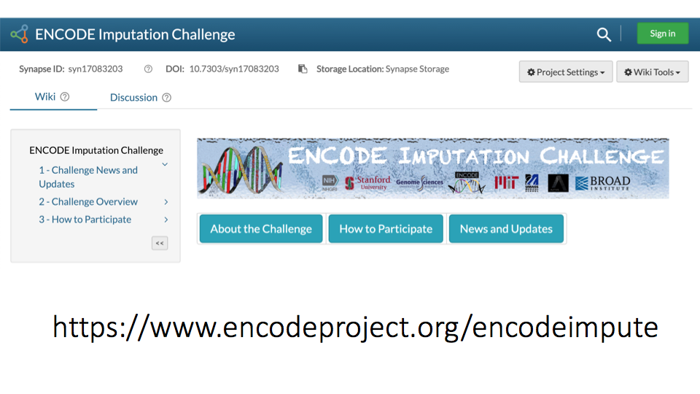
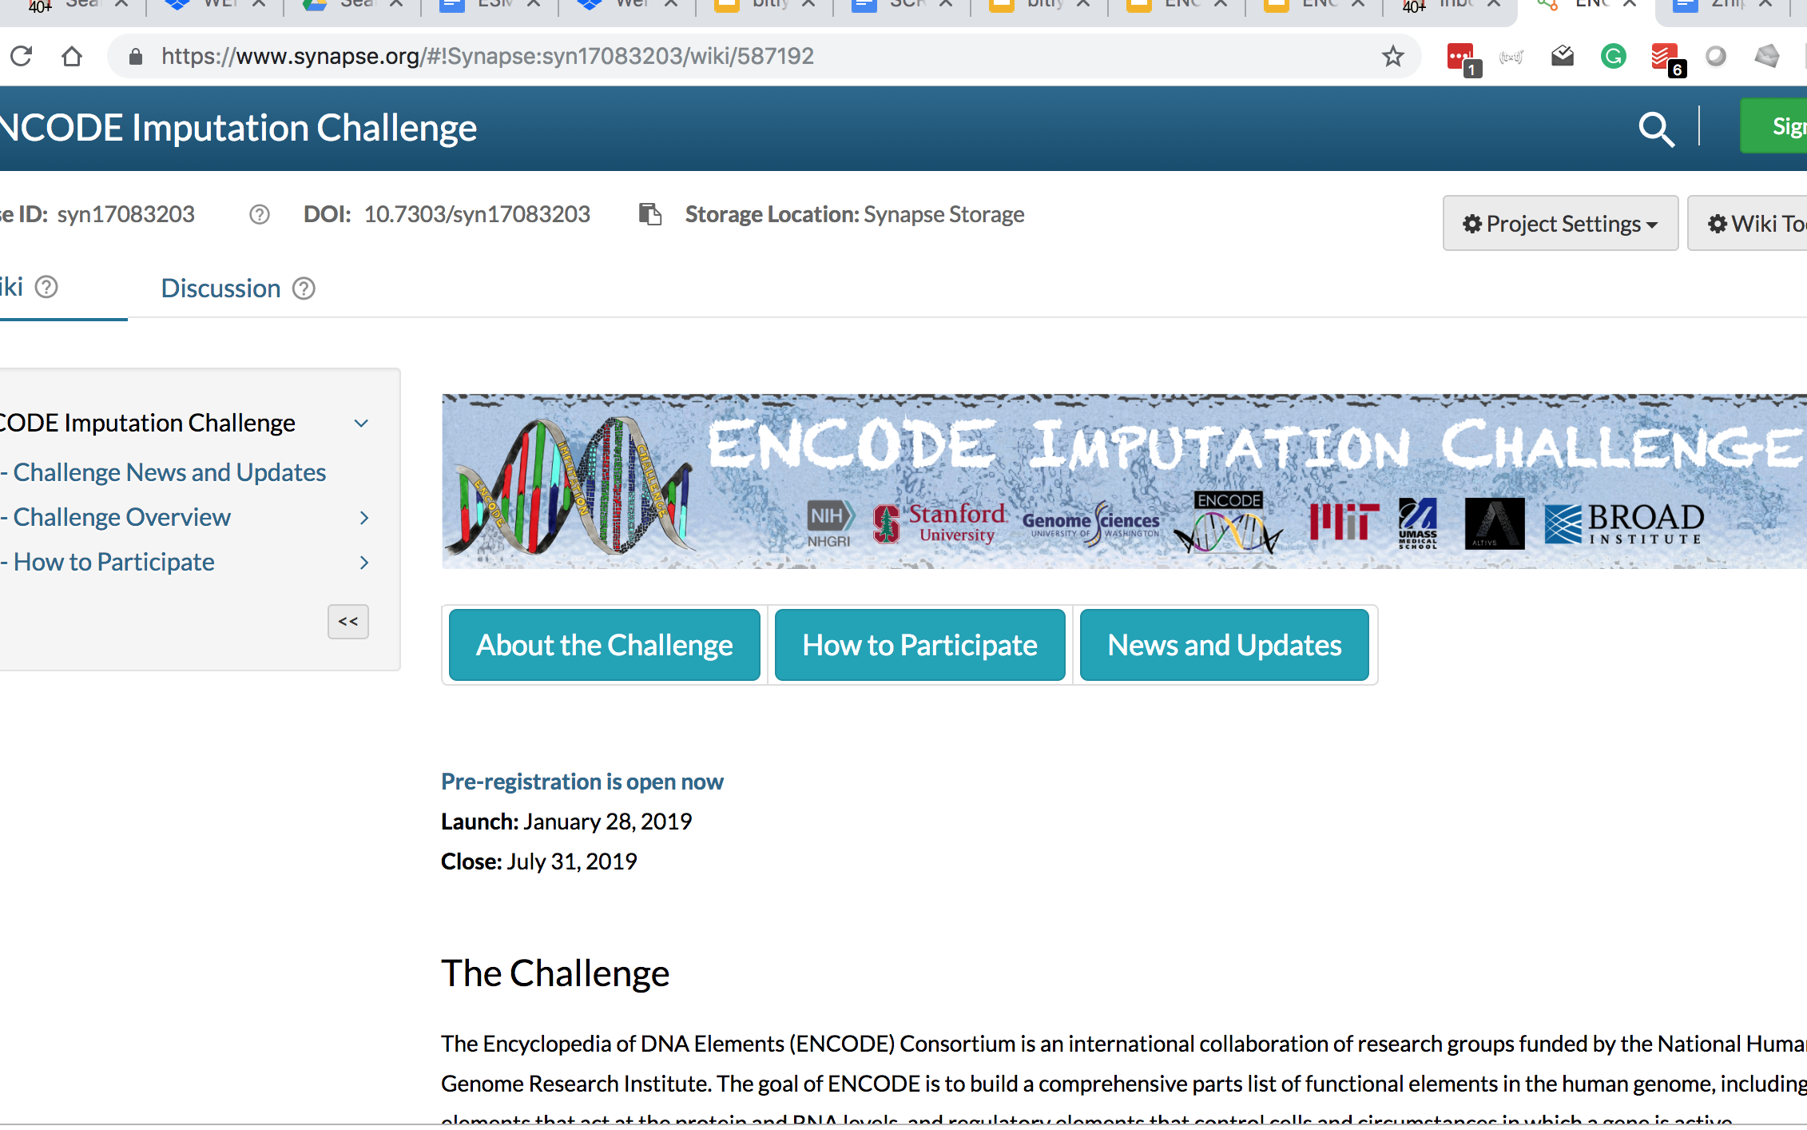
[Noble]
Jacob Schreiber, Bill Noble

Slide 18
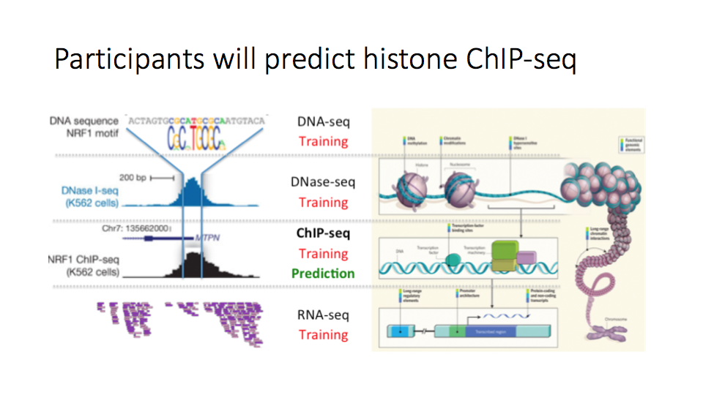
Jacob Schreiber, Bill Noble

Slide 19
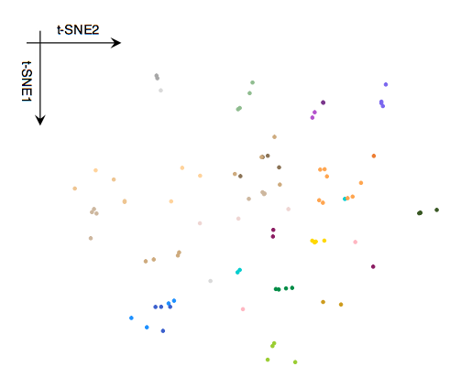
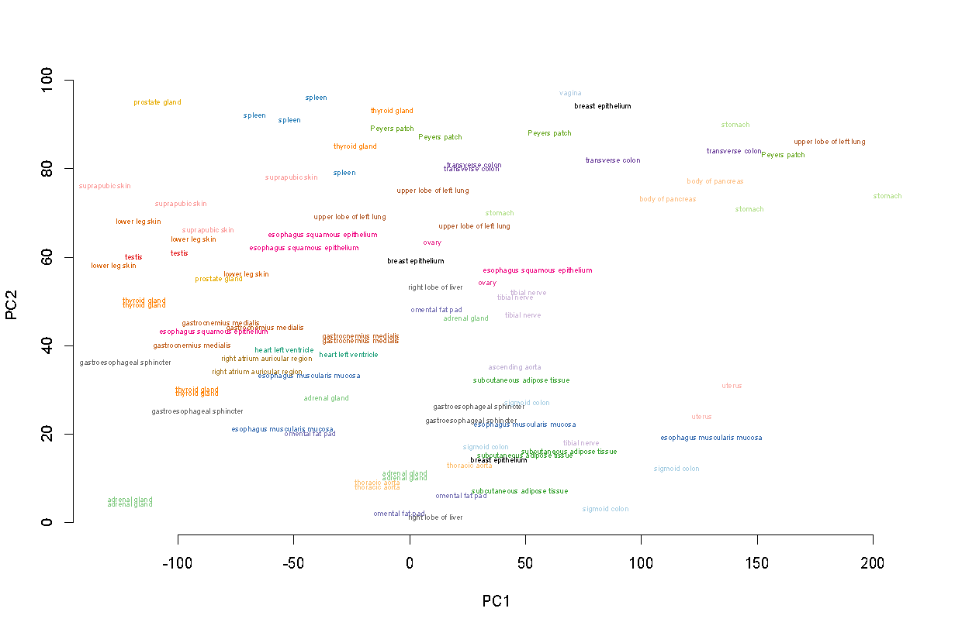
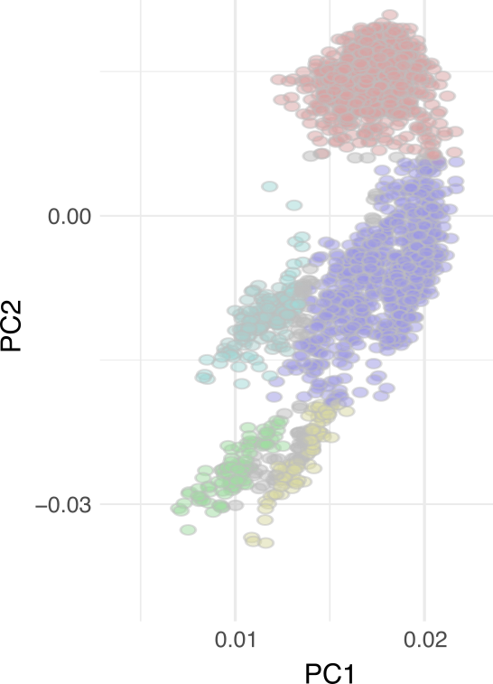
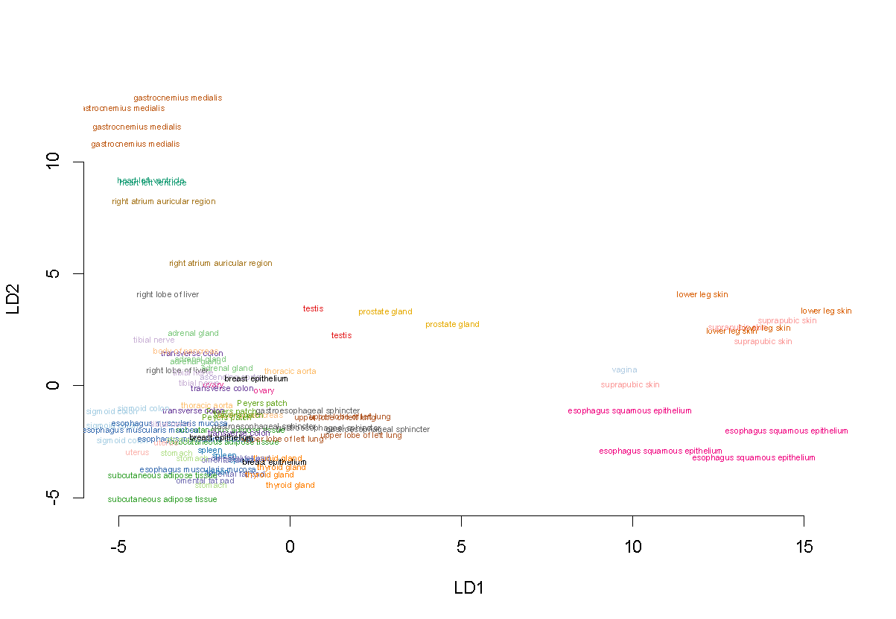
Decompose the variance
Dimensionality reduction & consistent visualization
of transcriptome & epigenetic data across cell types
Traditional PCA is fully unsupervised and operates on an individual sample. Can we make the models aware of the structure?
PCA: Principal Component Analysis
cPCA: Contrastive PCA
RCA: Reference Component Analysis
LDA: Linear Discriminant Analysis
PCA/tSNE
cPCA
RCA
LDA
Unsupervised;
no assumption on the structure
More supervised;
with assumption on the structure
tSNE
cPCA
RCA
LDA
For example in EN-TEx, Observed variance = Individual variance + tissue-specific variance + …

Slide 20
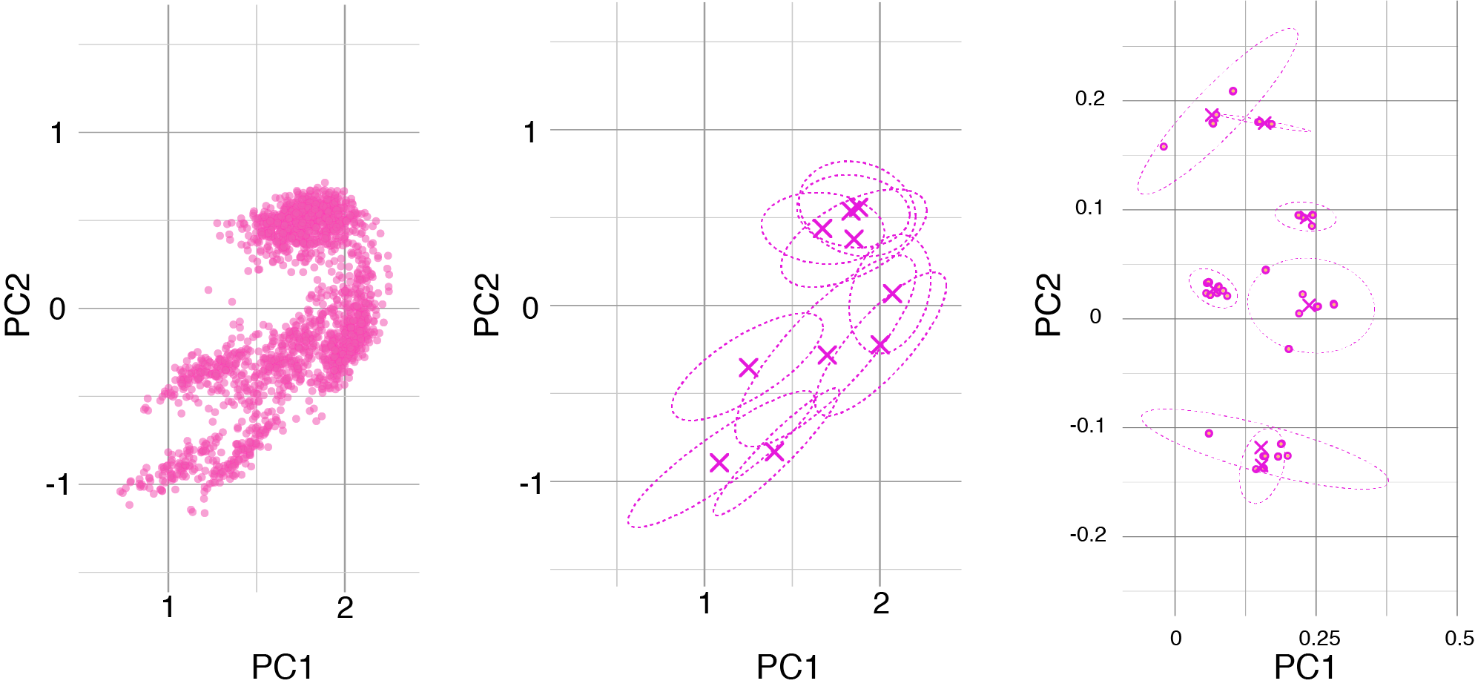
Reference Component
Analysis (RCA)
Applied to EN-TEx data, giving consistent transcriptome v epigenome comparison
Transcriptome (GTEx)
Transcriptome
Grouped by tissue
H3K27Ac
Projections
into EN-TEx space

Slide 21
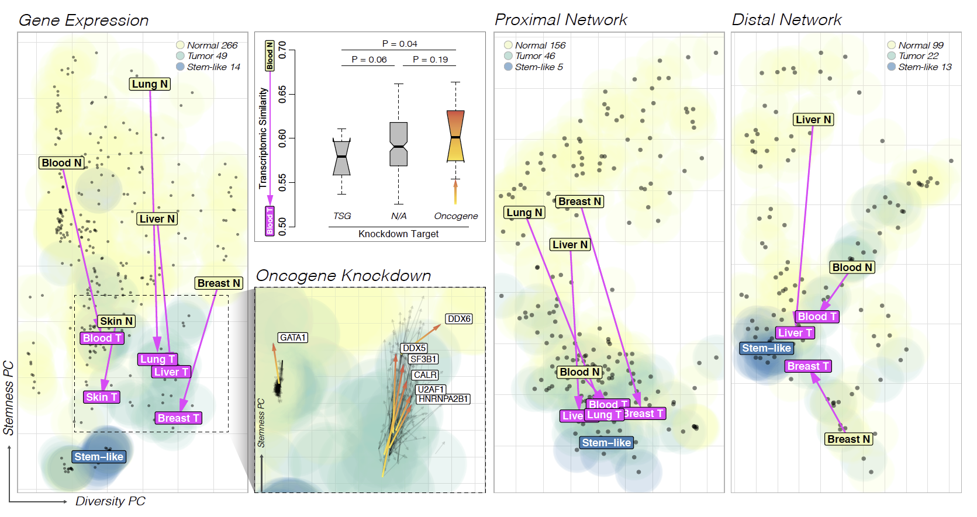
Applying RCA to many ENCODE cell types, focusing on Tumor-Normal Comparison
Gene Expression across 329 cell types
Proximal Network across 207 cell types
Distal Network across 134 cell types
[Zhang et al.]

Slide 22
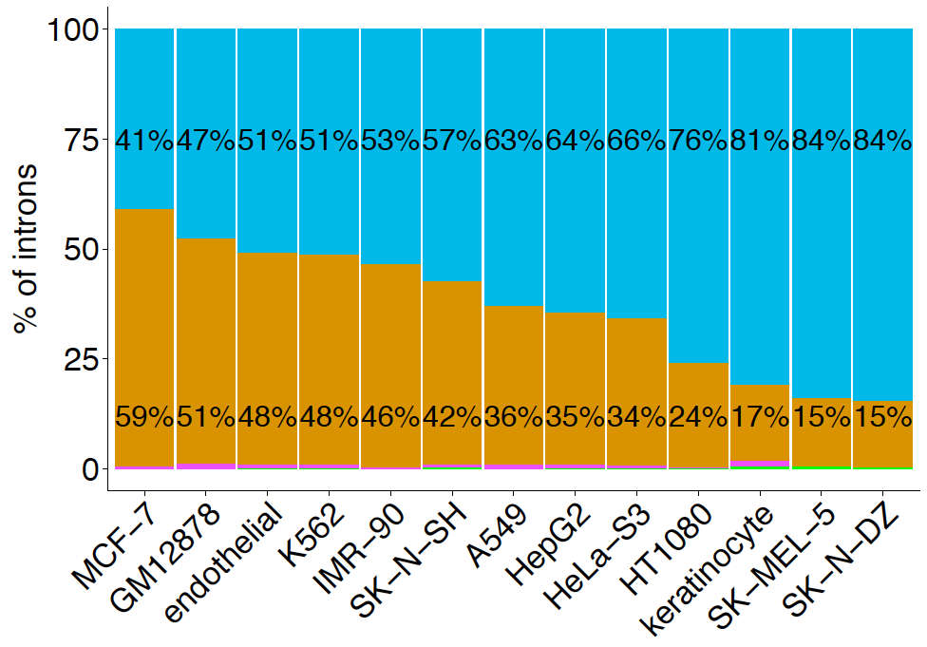
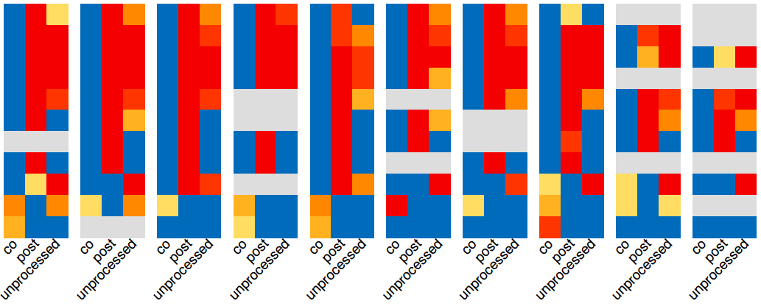
Epigenome & Transcriptome: HMs & Splicing
We observe enrichment of specific histone marks in the 3 distinct groups of introns (co-t. spliced, post-t. spliced, unprocessed)
narrow and active histone marks → post-t. spliced & unprocessed
broad and active histone marks → post-t. Spliced
broad and repressive histone marks → co-t. spliced (& unprocessed)
A549
GM12878
HeLa-S3
HepG2
IMR-90
K562
MCF-7
SK-N-SH
endoth.
keratinocyte
H3K4me1
H3K4me2
H3K4me3
H3K9ac
H3K27ac
H3K79me2
H3K36me3
H4K20me1
H2AFZ
H3K27me3
H3K9me3
Guigo
Notes:
Different chromatin marking characterize different types of introns (summarized in the box below)

Slide 23
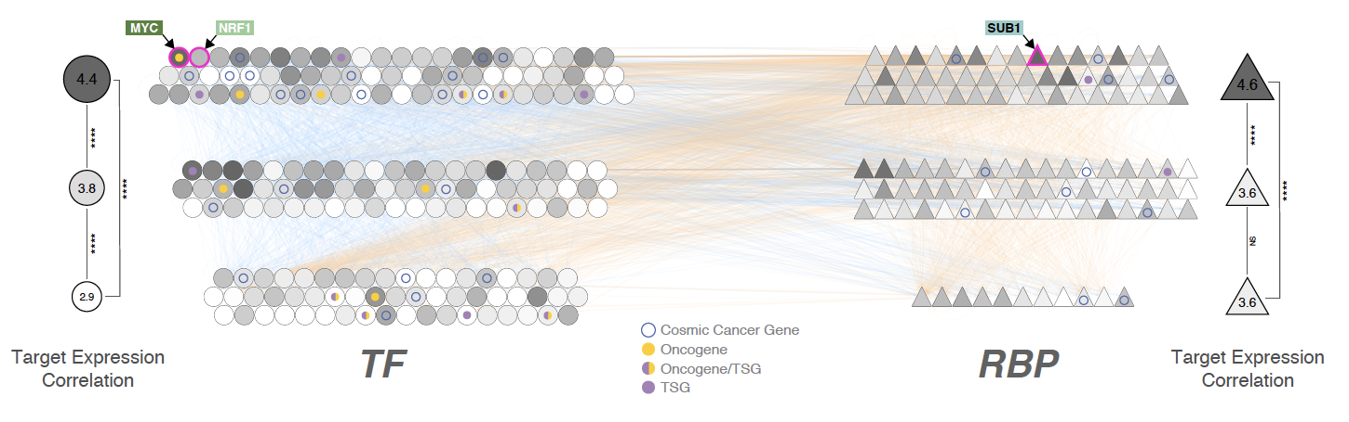
Recasting of ENCODE Annotations in terms of TF & RBP Regulatory Networks
TF to target, via promoter (or pot. enhancer); RBP to target;
& then TF <=> RBP interconnections
[Zhang et al.]

Slide 24
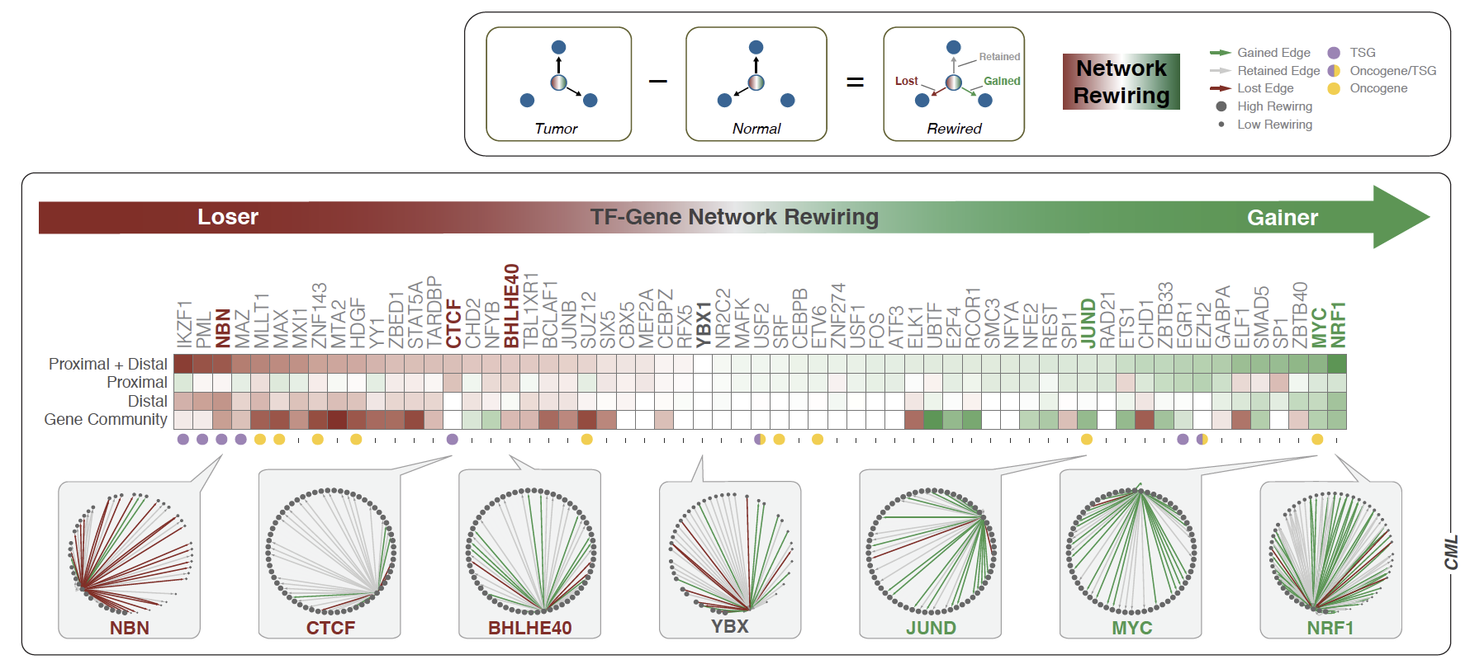
Developing Metrics for Network Change
(Rewiring Index for K562 v GM12878)
K
G
[Zhang et al.]

Slide 25
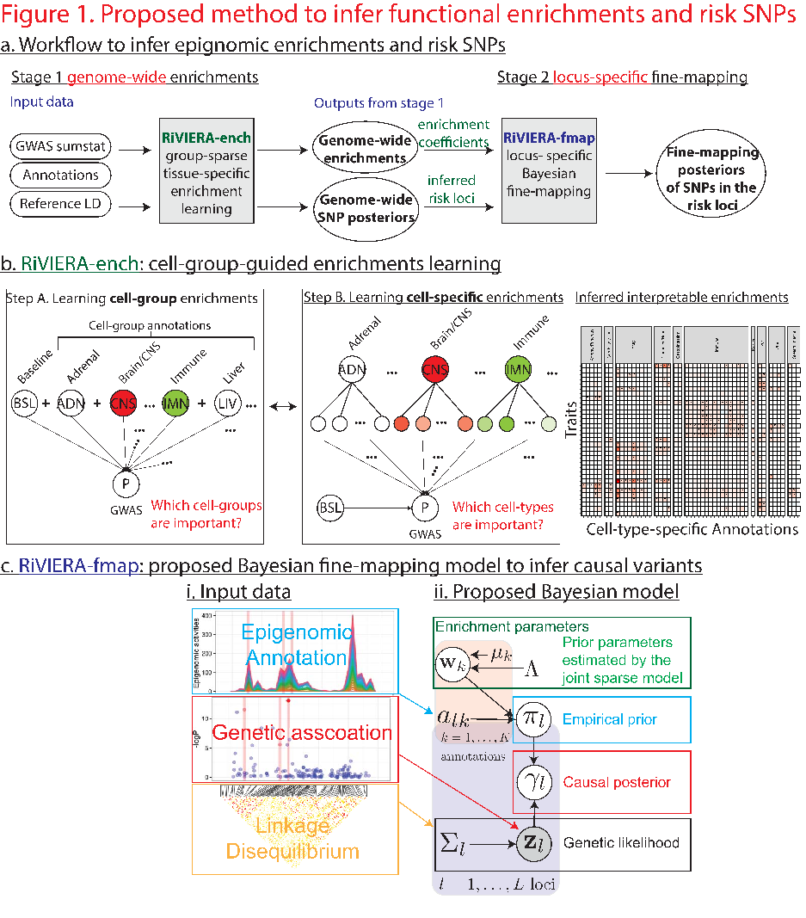
Variant Annotation
The DAC & other consortium members have developed tools
for annotating variants with
ENCODE annotations
Eg HaploReg, FunSeq, RegulomeDB
Work has continued on new tools
e.g. Riviera
Risk Variant Inference using Epigenomic Reference Annotations is for inference of driver variants from summary statistics across multiple traits using hundreds of epigenomic annotations
Kellis

Slide 26
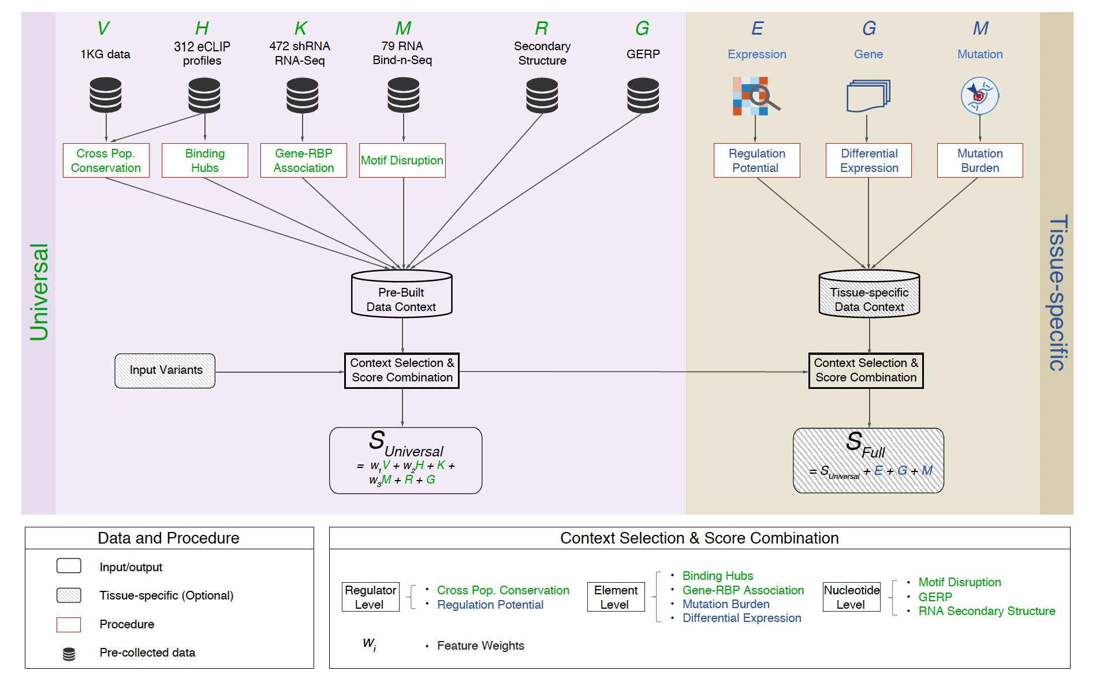
Variant Annotation #2
Another new tool:
RADAR annotates the effect of variants in relation to RBP binding sites

Slide 27
Conclusions
ENCODE DAC priorities
  Building version 1.0 of the Encyclopedia
  Building SCREEN 1.0
  Developing pipelines & QC metrics
  Participating in working groups (EN-TEx, NAWG, RNA, etc.)
  Development of Chromatin Analysis Tools & Approaches
Thanks to:
  DAC members, especially trainees
  Other ENCODE members

