Slide 1
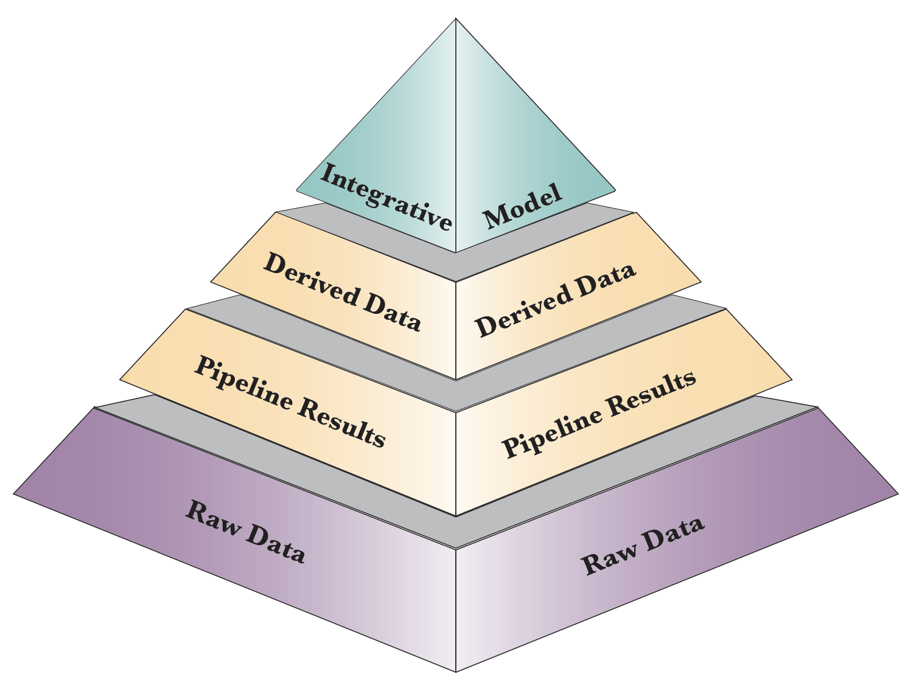
Review of the Phase 1 PsychENCODE capstone resource: Layers of distributed information
Material in the 3 capstones:
AC - Wang et al. ('18)
DC - Li et al. ('18)
NC - Gandal et al. ('18)
Resource.psychencode.org
Development.psychencode.org

Slide 2
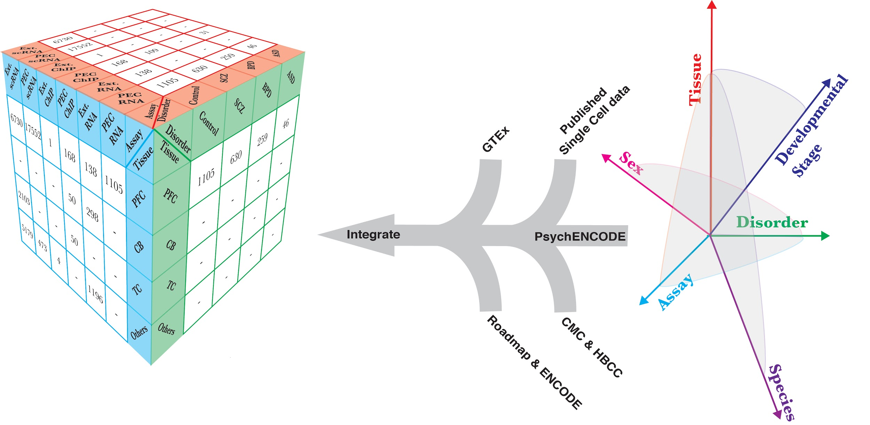
Base Data Layer
Organizing Metaphors
Future considerations
New "Axes" ?
New sets to merge (GTEx v8, HCA)?
Reference brain ?
[AC,DC]

Slide 3
Pipeline Results
ChIP-seq & Me
signal tracks & peaks
Differential H3K27ac & Me peaks
Bulk RNA-seq quantifications
Single-cell
Quantifications
Cell-type signatures & fractions
Imputed genotypes
Hi-C matrix & TADs
Future considerations
ATAC-seq pipeline? sc-ATAC?
More cell types
WGS vs. imputed genotypes
[AC,DC]

Slide 4
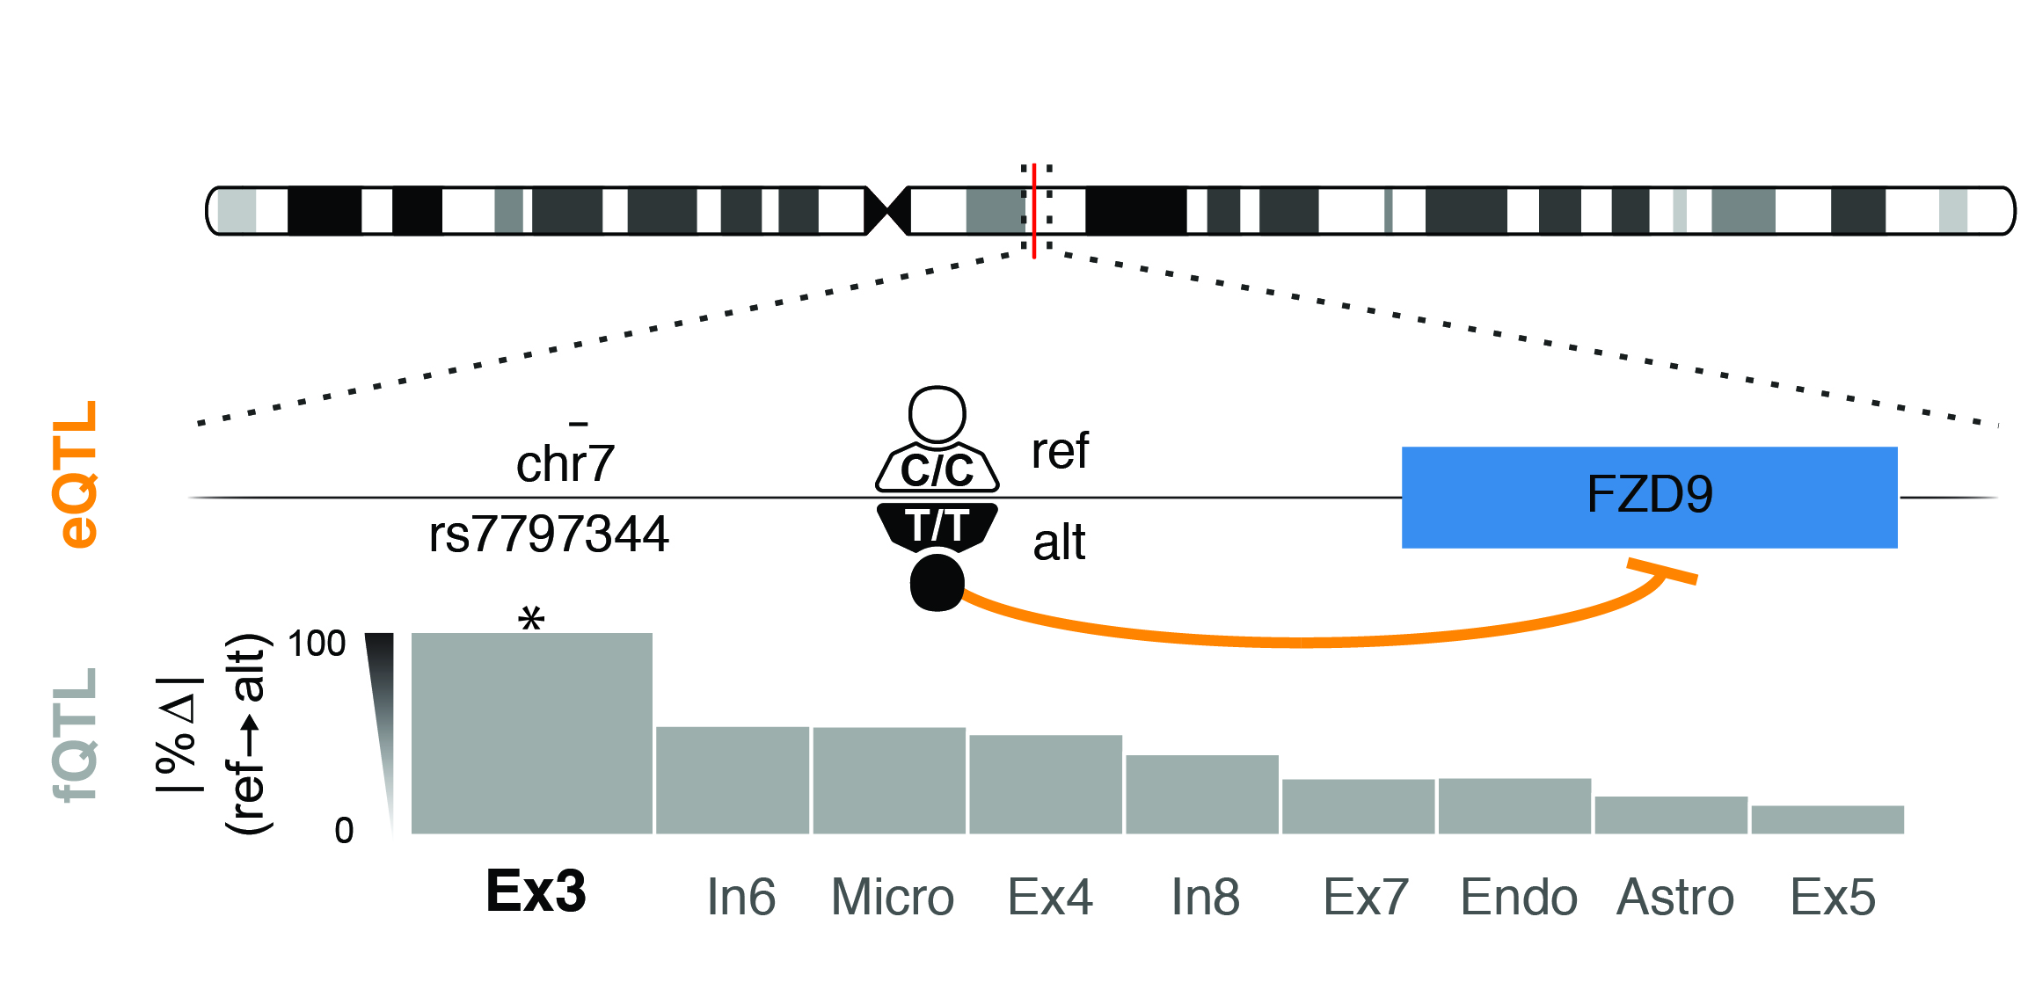
Derived Results
DEX genes & co-expr. modules
Across development, regions & conditions
Differential splicing
PFC QTLs
cis-eQTLs - ~2M (sat’d)
fQTL, cQTLs
Enhancers (init. PFC & CBC)
Future considerations
Trans QTLs? More regions?
Starr-seq enhancers?
[AC,NC]

Slide 5
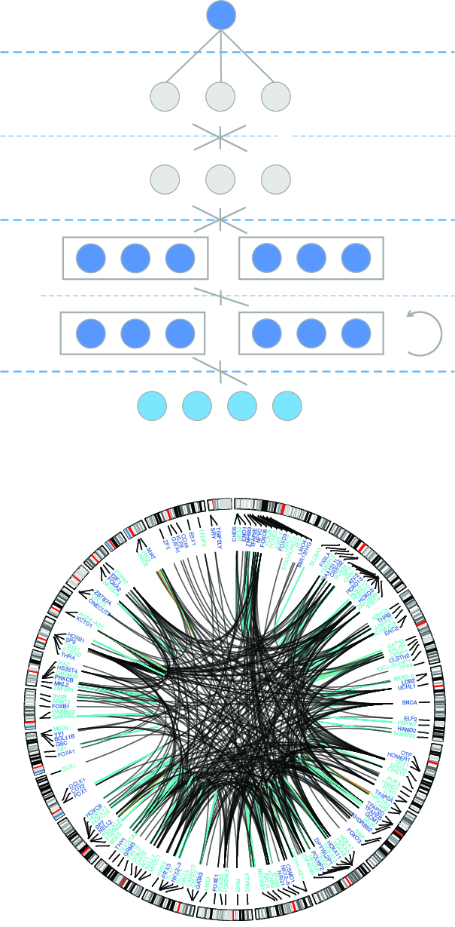
Integrative Models
Integ. Regulatory Networks
Activity+Hi-C+QTL
Double overlap high-conf. linkages (eg A+H)
Init. disease prediction model (DSPN)
Future considerations
Better networks? Single-cell?
How to distribute models ?
[AC]

